Slide 2
PS Booster Magnets Task Force
Antony Newborough on behalf of TE/MSC-NCM

Slide 3
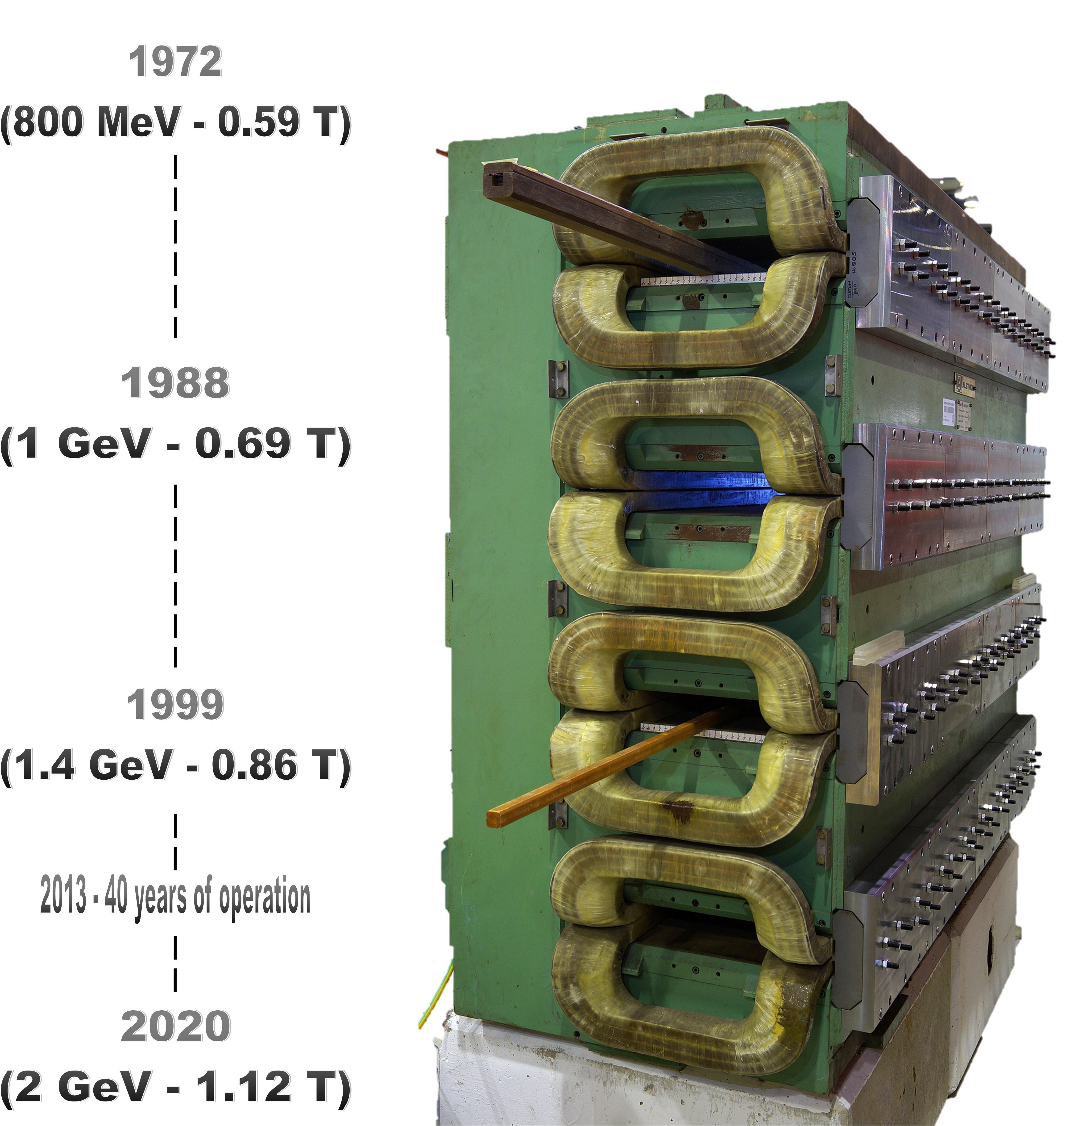
PS Booster Magnets Task Force
  Mock-up - status;
  Magnet reconstruction and estimated timeline;
  New magnet construction.
The PSB Upgrades

Slide 4
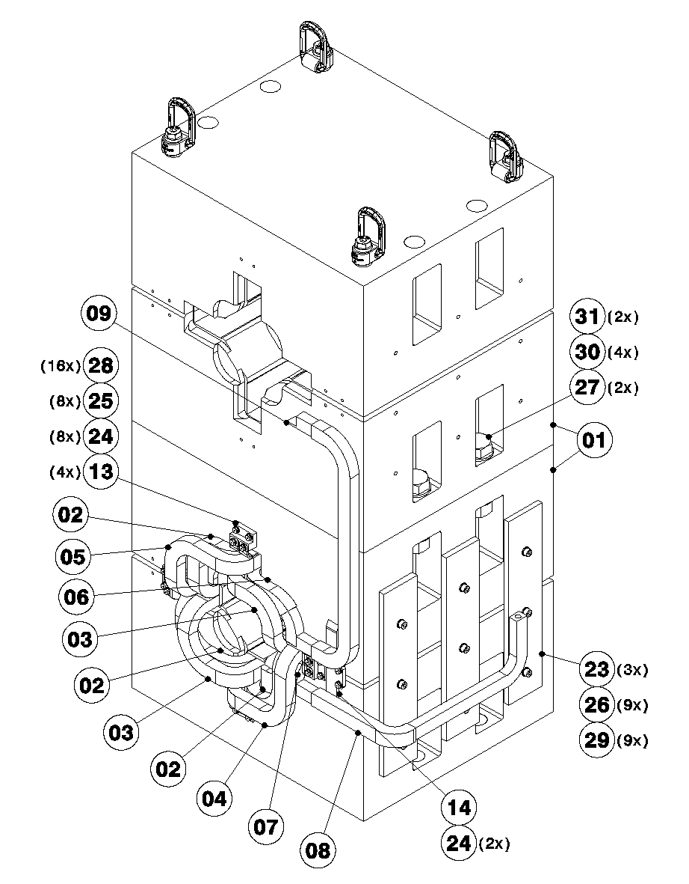
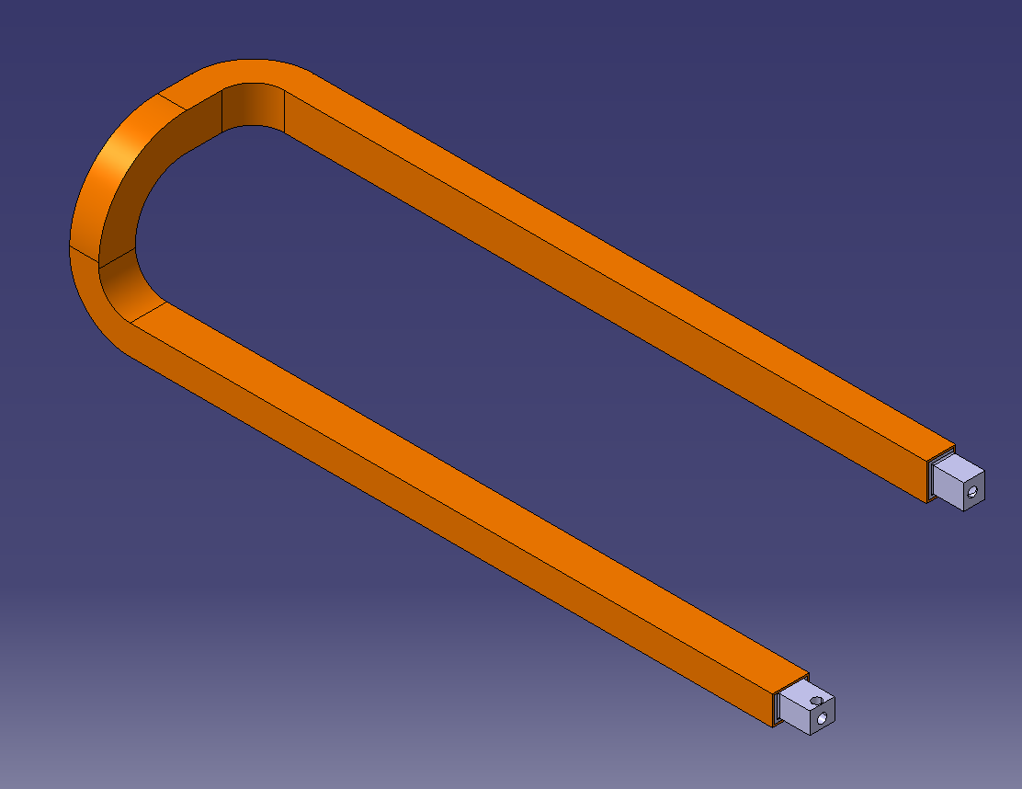
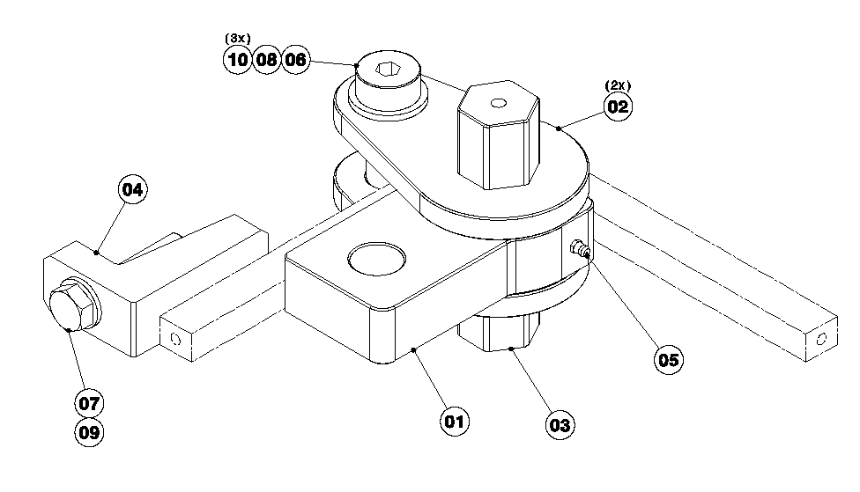
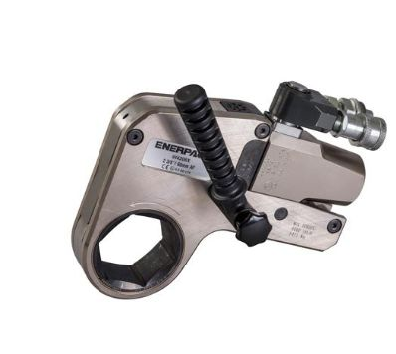
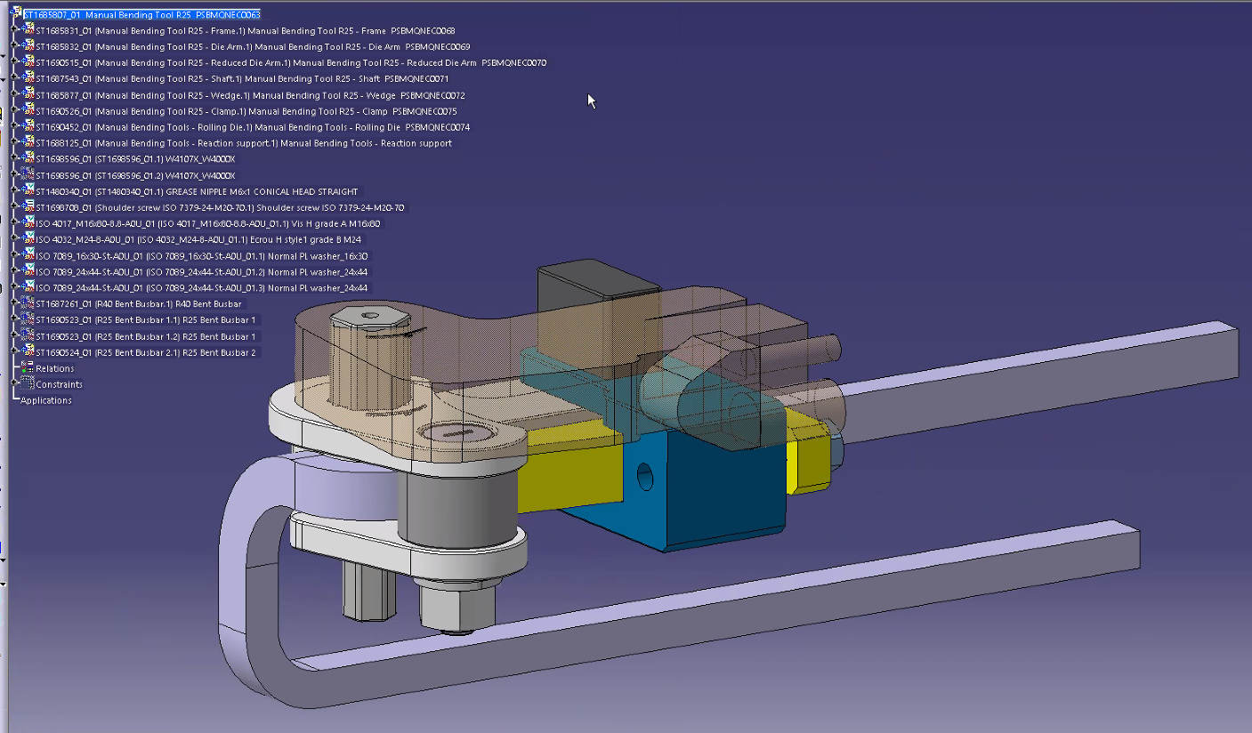
Magnet Mock-up…
  Study current method and alternative method of impregnation;
  Order of raw material for dummy trials and to refurbish at least 6 magnets;
  Perform dummy assembly;
Courtesy of I. Aguirrebeitia EN/MME

Slide 5
Magnet Mock-up status…
Task | Estimated Cost (kCHF) | Estimated Date | Comment
Design office study | 15 25 | 12/22 – 4/23 | Increase with new scope (forming tooling etc…), 160 hrs to completion
Assembly (Yoke + Coils) |  |  | Complete
Tooling |  |  | Complete
Coil forming (Bending/Machining) |  |  | On-going
Wrapping |  |  | Pending (new wrapping machine cost not yet included)
Copper for 3 QD / 3 QF
Jumper | 8.2 | May-23 | https://edh.cern.ch/Document/SupplyChain/DAI/9500342
QF/QD | 46.3 | Jul-23 | https://edh.cern.ch/Document/SupplyChain/DAI/9575519
Forming + machining | 15 | 06/23 -09/23 | Tooling design by end of April, procument by June, tbd
Insulation + Resin (3QD + 3 QF) | 20 | Jun-23 | Sample tape qualificaton underway, 0.15 mm tape has 5 week delay
Dummy ½ Yoke (2 apertures) | 16 (23.5) | May-23 | Fabrication MME - 5k Material, 16.6k Machining, 1.9k Welding
Assembly (FSU) | 30 | 09/23 – 12/23
Impregnation of Dummy with industrial partner | 10 | 09/23 – 12/23 | Contact with Tesla and Partzsch ongoing
Total | 178
We propose to already launch the complete design file ‘build to plan’ for
4 variants ~ 800 hrs, 45 kCHF (4 x models + ~60 drawings), required for both the reconstruction and potential new magnets.

Slide 6

Magnet reconstruction + potential downtime…
Task | Estimated Duration Weeks | FSU (years) | kCHF | Comment
Strip down + yoke reconditioning | 5 | 0.1 | 10 | Removal of copper, replacing broken bolts, painting etc…
Assembly | 8 | 0.3 | 30 | Copper forming, machining, wrapping, '1st' brazing, insertion and shimming
Brazing | 5 | 0.1 | 10 | 'Brazed end' x 64 + cleaning + Inspections/Testing
Prep for impregnation, impregnation/curing, cleaning | 4 | 0.1 | 10 | Final wrapping, shimming of bus bars, masking of references
Final Assembly | 2 | 0.05 | 5 | Interlock, Hydraulic, electrical alignment
Certification | 2 | 0.05 | 5 | Including transport to lab with 6 kA connverter
Total MNC |  | 0.7 | 70 | Does not include CERN supervision/setup (Initially 30 - 50%)
Materials (not including Transport, MM, Vacuum etc..) |  |  | 20 | Copper, Insulation, electrical, hydraulic etc…
Magnetic Measurements | 3 |  |  | Cost to be evaluated
Additional activitities (BI / vacuum/ survey/transport etc…) | 4 |  |  | Complexity varies with machine position, cost to be evaluated!
Potential Downtime | 33 | Total | 90 | FSU time my be reduced to 50 to 70% as we advance & outsource tasks?
Does not included infrastructure costs (VPI, oven, wrapping machine etc…) or CERN staff and that of other services (BI, Vacuum, Survey, Transport etc…)

Slide 7
News magnet construction …
Characteristics
QD length, mm | 820
QF length, mm | 450
Average length, mm | 635
QD Weight, kg | 6062
QF Weight, kg | 3327
Average weight, kg | 4694
Fixed costs
Stamping tool, CHF | 100000
Stacking tool, CHF | 50000
steel cost per kg, CHF | 2
Average # laminations | 635
Cost per lamination, CHF | 3
Units # | 50
Unit cost
Yoke
Stamping per magnet, CHF | 1905
Stamping tool per magnet (50 units), CHF | 2000
Stacking tool per magnet (50 units), CHF | 1000
Average steel cost, CHF | 9389
Assembly and Machining, CHF | 40000
Measurement, CHF | 10000
Coil
Material, CHF | 10000
Forming + Machining + Wrapping + Insertion, CHF | 30000
Brazing/impregnation/Assembly, CHF | 25000
Testing, CHF | 5000
Final Assembly
Interlock, CHF | 5000
Hydraulic, CHF | 4000
Electrical, CHF | 2000
Engineering ,Testing, Measurements and Documentation… | 50000
Total kCHF | 195

Slide 9
SPARE SLIDES

