Slide 2
PLC survey
Preliminary results

Slide 3
Context
CTTB mandates the Industrial Controls Forum and BE/ICS to review the PLC usage at CERN in order to
Identify equipment groups that use other PLCs that the recommended ones
Evaluate if the PLC recommendation needs to be reviewed or if it still fits with equipment groups needs
Get a full picture of the support expected by equipment groups
Seek collaboration opportunities between equipment groups
Understand how PLC are integrated by equipment groups within accelerator control infrastructure
Evaluate the situation regarding spare parts (stock and management)
Capture the situation regarding “legacy” PLC based solutions (hardware and software)
Anticipate forthcoming CONS requests linked to PLC

Slide 4
Overview
39 surveys completed from 22 groups
BE: ABP, CEM, EA, ICS
EN: AA, CV, EL, HE
EP: AID, DT, SME, UAI, UCM
SY: BI, EPC, RF, STI, CRG, MPE, VCS
HSE-RP
PH-ADO

Slide 5
PLC in production
Siemens | 2101
Schneider | 796
WAGO | 76
Beckhoff | 63
B&R | 13
Rockwell | 1
TOTAL | 3050

Slide 6
Use of “no-contract” PLCs
Beckhoff: (SY-RF)
Technical: “Cycle time down to 100 μs. Volume occupied by the 16 digital inputs ~5 Cm3 per input. Typical board with 12mm. Ethernet & Screen Integrated in the CPU.
Cost: “Price of material 2/3 times lower than Schneider and Siemens”
Wago: (EN-CV)
Cost: “Monitoring devices for small installations where no control cubicles are installed.” (EN-CV)
Legacy: “Legacy.”
B&R: (SY-STI)
Legacy: “Was the PLC supplied with the transport vehicles at the time of construction of the vehicles”
Rockwell:
Legacy: “It came with the Tracker Membrane Plant/Nitrogen Separator. The plan is for EN-CV to replace it with Siemens hardware at the end of Run 3, when CMS will acquire a second plant that will be also handled by EN-CV.”

Slide 7
Other controllers
National Instruments: (BE-CEM, EP-DT)
Estimate: 133 controllers in production
Technical: “The systems cover many different use cases from low sampling rate (kHz) and precision (16 bit) to high rate (several GHz) and precision (24 bit).” (BE-CEM)
Technical: “High speed signal processing with FPGA, to cope with requirements defined by Machine Protection Panel.” (EP-DT)

Slide 8
PLC applications
Q: Your applications are mainly…
Developed
Maintained
Versioned

Slide 9
UNICOS usage
Applications developed with UNICOS
Ever considered UNICOS?

Slide 10
UNICOS usage
Reasons not to use UNICOS
[BE-ABP]: “Not suitable for one-off systems for accelerator controls.“ “A long time ago SILECS seemed simpler for small scale systems that constantly needed to be modified at a test stand.”
[BE-ICS]: DSS. Detector safety system. “Not easy to adapt. I requires significant changes in the application”
[EN-AA]: “It was evaluated but judged not to be ideal for CSAM application.”
[EN-EL]: “Our PLCs are connected via a proprietary LAN to the RTU (Remote Terminal Units) installed in all main electrical substations and acting as gateway between all field devices (PLCs, IED's, I/O's) and the main EL SCADA server. No direct connection between PLC and SCADA.” “Higher hardware requirement needed for same application.” “Added complexity to systems internally used and maintained by EN-EL.” “No need of standardisation due to very restricted number of system maintainers (piquet), not necessarily comfortable with PLC based systems.”
[EP-UCM]: “It was not flexible enough for the complexity of our PLC applications at the time we tested it.”
[HS-RP]: “Cahier des charges spécifique. Fonctions non réalisées sous UNICOS.”
[SY-RF]: “Not adapted to our needs.”
[TE-MPE]: PIC and WIC are currently in evaluation to evolve into UNICOS applications.

Slide 11
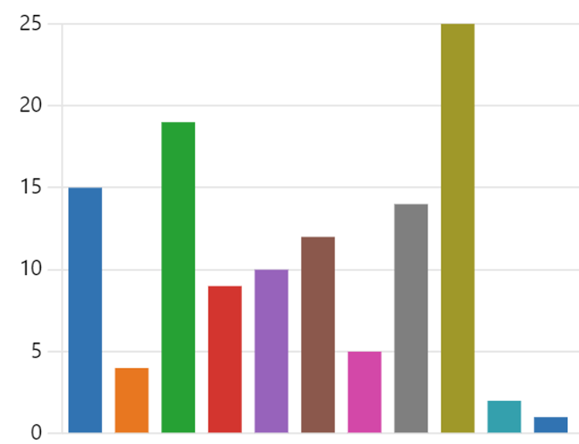
PLC support by BE-ICS
Most valued support services
Purchasing orders (offers, additional discounts, product selection...)
Asset management (inforEAM, asset codes...)
Consultancy (Architectural design, technical choice, advice, guidance...)
Diagnostics and monitoring
Obsolescence (product life, migration...)
Version control repository (versiondog)
Installation and commissioning
Training (Siemens and Schneider courses, custom trainings...)
Technical support
Documentation
I don't use BE/ICS support
15 | 4 | 19 | 9 | 10 | 12 | 5 | 14 | 25 | 2 | 1

Slide 12
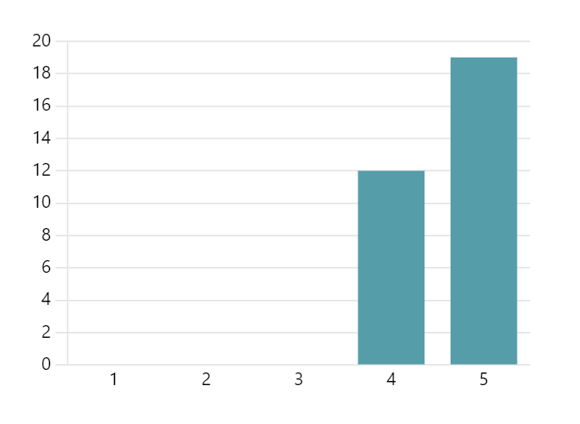
PLC support by BE-ICS
To improve
[BE-CEM]: “Support for more industrial (network) communication protocols officially supported at CERN.”
[BE-ICS] Cryo: “JIRA, too heavy and time-consuming, IMO.”
[EN-CV]: “We would like more proposals in term of plc architectures and devices: Siemens drives through PROFINET (PROFIDRIVE), sensors through bus like IO-link, IoT, industrial AI. Today, I feel BE-ICS is focused on UNICOS, coding, software but not really on devices/hardware integration/implementation.”
[EN-EL]: “Setup networking strategies. For example, identify the different types of needs within the community and cluster them in order to share information. Another example would be to bring together the different sections within CERN and provide opportunities to participate in events. For example, in a group where the controls are not the core business, it is difficult to justify the participation in events such as ICALEPCS or visits to industrial installations. If a controls-oriented budget could be managed by BE/ICS in order to give all the same opportunities would be interesting.”
[EN-HE]: “We definitely need a central support on obsolete systems, both to maintain the knowledge on how to connect to a PLC, and for the spare parts.”
[EP-DT]: "Merging JCOP and UNICOS as CMS does not allow UNICOS in the detector network"
[SY-EPC]: "Versiondog seems unreliable and limited. Diagnostics and monitoring tools for PLC hardware could be improved. "
[TE-VSC]: More initiatives from BE-ICS: workshops on new technologies, in-house trainings, etc.
Rating
Average rating 4.61 over 5

Slide 13
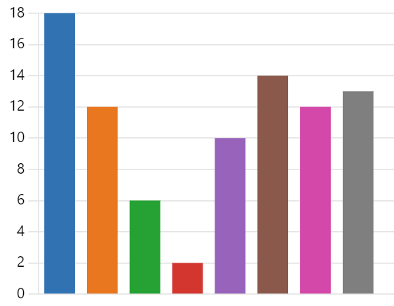

PLC support by Siemens
Most valued support services
Purchasing orders (offers, additional discounts, product selection...)
Consultancy (Architectural design, technical choice, advice, guidance...)
Obsolescence (product life, migration...)
Installation and commissioning
Training (Siemens official courses)
Technical support
Documentation (web, docs...)
I don't use Siemens support
18 | 12 | 6 | 2 | 10 | 14 | 12 | 13

Slide 14
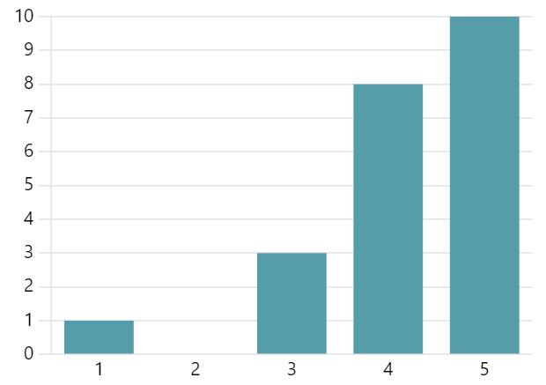
PLC support by Siemens
To improve
[BE-ICS]: “Detailed information regarding obsolescence.” “Sometimes the interaction with the support lines is slow.”
[EN-AA]: “Siemens Support is very vertical on a particular product or component, things become more complicated for integration of multiple hardware and software components. Delivery delays are unacceptable.”
[EP-DT]: “Delivery delays.” “More documentation and possible CERN wide standardized solutions for smallest Siemens PLCs even if they can not handle UNICOS“
[EP-UCM]: “Sometimes, the web server becomes sluggish."
[SY-EPC]: "The training catalogue available at CERN is always the same. Most of the experts have already followed the offered courses. Siemens could organize trainings or seminars on more specific technologies and features."
[TE-VSC]: “For very specific support requests I tend to use the Siemens forums rather than directly contact Siemens support. The one time I used it (regarding the possible implementation of TSPP on S7-1200) it was not very helpful.”
Rating
Average rating 4.18 over 5

Slide 15
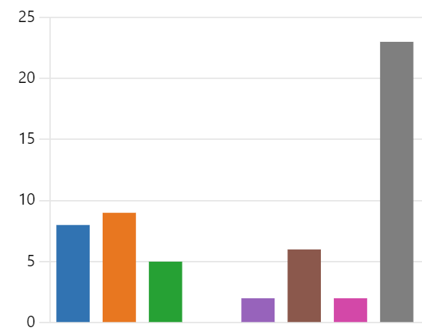
PLC support by Schneider
Most valued support services
Purchasing orders (offers, additional discounts, product selection...)
Consultancy (Architectural design, technical choice, advice, guidance...)
Obsolescence (product life, migration...)
Installation and commissioning
Training (Schneider official courses)
Technical support
Documentation (web, docs...)
I don't use Schneider support
8 | 9 | 5 | 0 | 2 | 6 | 2 | 23

Slide 16
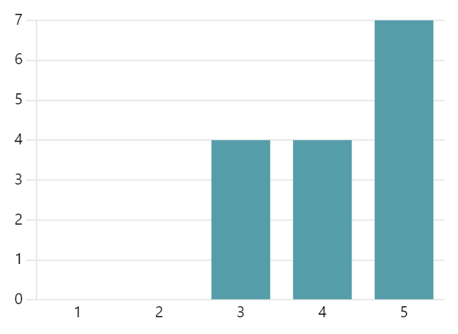
PLC support by Schneider
Rating
To improve
[BE-ICS]: “Post-mortem analysis reactivity.”
Average rating 4.20 over 5

Slide 17
Asset management system
Q: What asset management system do you use?
replies
weighted to number of PLCs

Slide 18

PLC central spare parts
MAYBE
[BE-ABP]: “To reduce need to keep local spares.”
[BE-ICS]: “It is very difficult to maintain up to date information of the assets installed. It would be more adequate to have visibility on all the spare parts available at CERN.”
[EN-AA]: “At least for non-critical components”
[EN-CV]: “We have already a spare parts service managed by CV.” “If compatible with EN/CV activities.”
[EN-EL]: “There was an attempt by EN/ICE to build a central spare part service around 10 years ago, but it never materialized.” “The idea is interesting from the commercial point of view (cost reduction of stock).”
[EP-DT]: “BE-ICS is already providing support for GCS application, having PLC spare parts handled by BE-ICS could simplify and speed up interventions in case of PLC crash.”
[SY-BI]: “Not necessary to have the stock in our section, if we can make sure to have access at some spare easily, may be.”
[SY-EPC]: “BE-ICS could propose to the equipment groups a central spare parts repository with a limited list of recommended references, easily accessible by the stand-by service of the group with a digital access system. BE-ICS should ensure the constant availability of spares.”
[TE-CRG]: “Would be nice to mutualize the spares to avoid to many spare parts that stay on a storage and are never used.”
[TE-VSC]: “The idea in itself is good, but it has been tried before and didn't work particularly well. Perhaps it could work if done in a different format. In case of urgent needs the grassroots method (i.e. contacting the members of the GUAPI or Industrial Controls Forum e-group to check if someone might have a specific spare) has worked relatively well.”
NO
[BE-ICS]: “Solution already tried with the Emergency central spart, it has never been used. Heavy to maintain.”
[EP-DT]: “Perhaps for non critical systems. In any case for critical system we'll keep the spare parts per system and not by brand”
[HSE-RP]: “We have ours.”
[SY-RF]: “we have a stock of spare parts that we manage ourselves”
[SY-STI]: “No thank you. Even a long interruption of the hotcell operation will not affect the accelerator complex.“
[TE-CRG]: “Our spares are used by testing system (production mirrors).”

Slide 19

PLC central standby service
MAYBE
[BE-ABP]: “If they could change hardware parts (PSU, CPU, module) in case no experts in the local area. But such faults are very rare (<1 per year).”
[BE-CEM]: “For mission critical systems it makes sense to have a trained SBS service.”
[BE-ICS]: “A basic support together with central spare parts service would be feasible. In general, it is very difficult to have a good knowledge of all installations.”
[EN-AA]: “Could be a solution for Stand-by resources limitation.” “It would require a lot of training to get the piquet to understand the overall system.”
[BE-ABP]: “we have Installations in high voltage platforms that have restricted access.”
[EP-DT]: “BE-ICS piquet? For overall CERN systems it make sense.”
[EP-UCM]: “It really depends on the practical implementation.”
[TE-MPE]: “We have around 1-2 failure/system a year, which is not enough to justify on-call service.”
NO
[BE-EA]: “We can manage the keep the installations in service (except major fault occurs) until the next day, so the stand-by service is not crucial. However, for future installations might be interested to explore the topic more.”
[EN-CV]: “In CV we have already stand-by service.”
[EP-AID]: “Standby service for our PLC systems is assured internally. In case of serious issues we rely on the 'normal' support of BE-ICS.”
[EP-DT]: “We do have CO2 piquet in place and support agreement with BE-ICS which works well since many years. No need of change.”
[TE-CRG]: “No needed, would require an intervention also from our section.”
[SY-RF]: “The downtime rate of our systems is extremely low. The best effort system is sufficient.”
[TE-VSC]: “TE-VSC has its own standby service.”

Slide 20
Siemens or Schneider limitations
replies
[BE-EA]: “Price.”
[BE-ICS]: “Reliability of Schneider PLCs.”
[EN-AA]: “For safety systems actual Siemens solution is driven by a manufacturer economical response and not by the most adequate technical solution. Should be interesting to go back on our needs and to see what the market offer.” “Cost.”
[EN-EL]: “The usage of other brands should be considered, even if I understand that introducing other brands may add complexity to standardisation.”
[EP-DT]: “Delivery delays.”
[SY-RF]: “We prefer to continue using Beckhoff because it better meets our needs.”
[TE-MPE]: “The reaction time (speed) of Siemens PLCs could be a limitation for some application and we have already done a study with a B&R reAction technology PLC which is very promising. However, recent choices make the high speed offered by B&R not needed anymore.”
[EP-UCM]: “No, except for the very limited availability of some Siemens modules. We are experimenting on replacing S7-1200 small-scale systems with alternatives such as Arduino Portenta Machine Control boards, but the IDE is really far from satisfactory yet.”
weighted to number of PLCs

Slide 22
Other frameworks
Object libraries, generation tools
[BE-ABP]: SILECS + FESA
[BE-CEM]: RADE
[BE-ICS]: Cause-effect Matrix. Unity Developers edition tools
[EN-AA]: Object libraries modelling safety functions
[EP-UAI]: JCOP
[SY-EPC]: PoWPLC framework, being replaced by a UNICOS-CPC sub-package under development in EPC.
[TE-CRG]: GitCI
[TE-VSC]: TE-VSC-ICM Vacuum Framework

