Slide 1
CTTB 2022 Fieldbuses Survey Results
Rodrigo Ferreira, Eva Gousiou, Jean-Charles Tournier, Slawosz Uznanski
Industrial Controls Forum – May 11th 2023

Slide 2
Context
CTTB mandates the Electronic and Industrial Controls forums to review the fieldbuses strategy
Purpose
    Update of the recommendation for the use of fieldbuses at CERN (1996)
    Consider new user requirements and fieldbus technology evolution
Scope
    All types of fieldbuses used / planned to be used within ATS
      RadTol and not RadTol, commercial and custom, recommended and others
Objectives
    Review of fieldbus requirements within ATS as identified by the Fieldbus Working Group in 2013 (EDMS 1262875)
    Identification of technical solution(s)
    Update recommendation for the use of fieldbuses at CERN

Slide 3
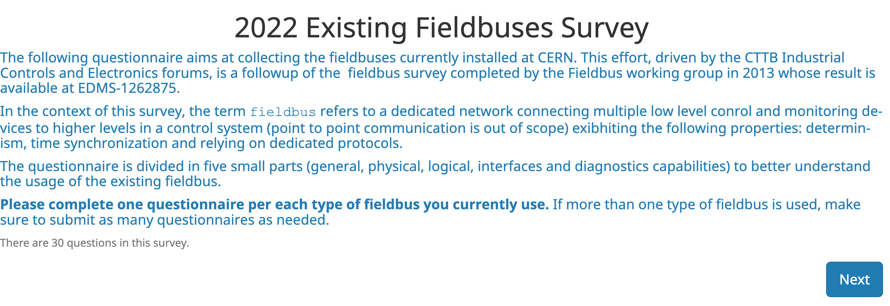
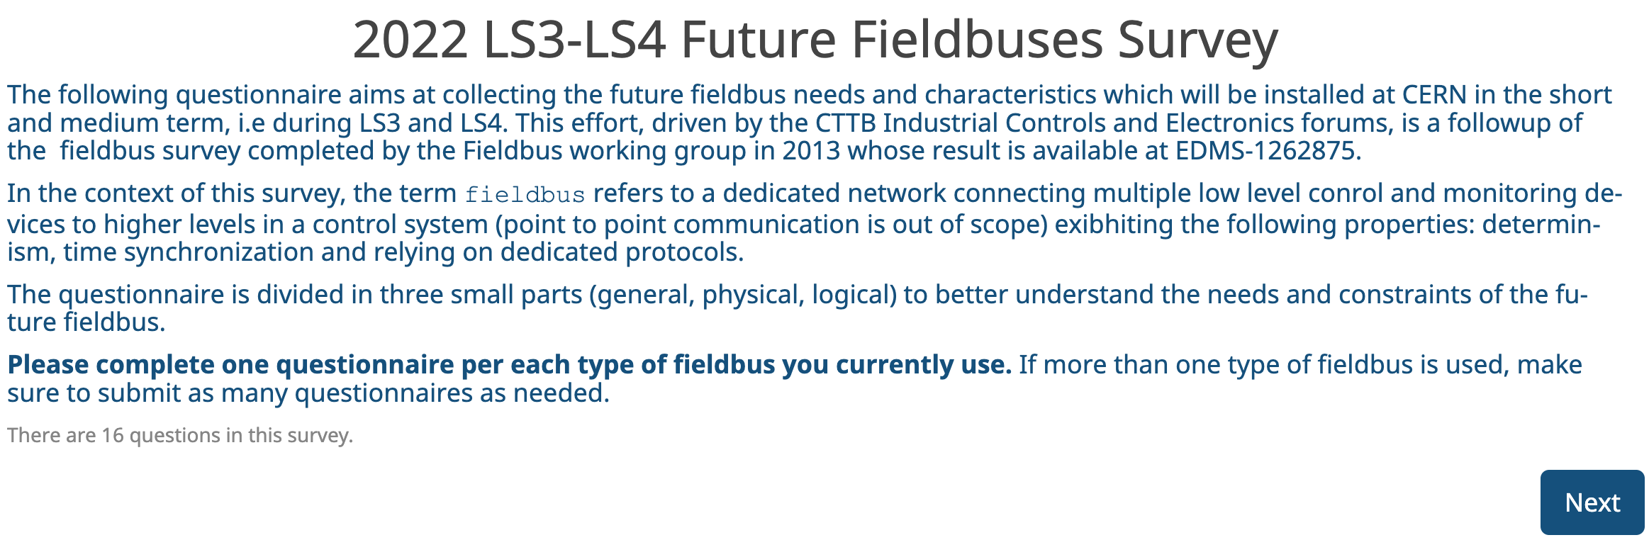
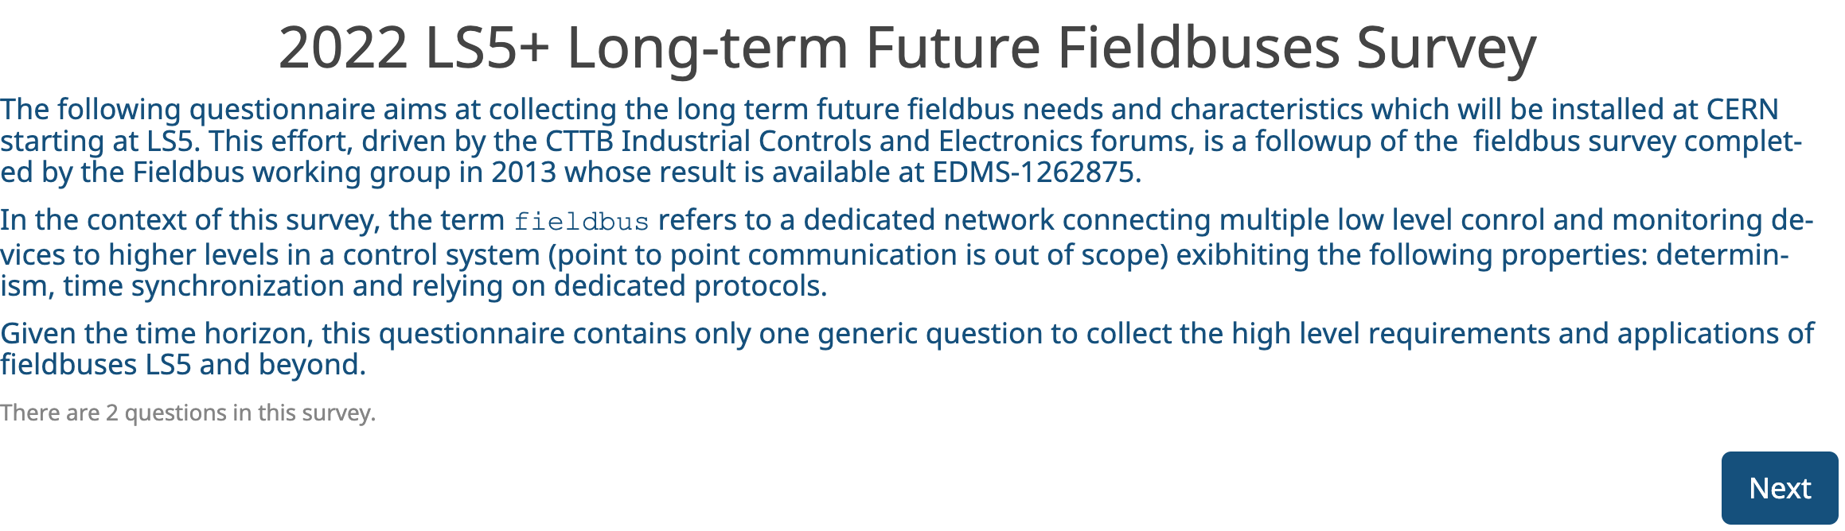
Fieldbuses Review Approach
Three surveys
  Identify the current installations
  Identify the short-term needs and evolutions
  Identify the long-term requirements
Audience
  All groups within ATS
  Groups identified during the previous survey
  Inputs from the CTTB and user forums
Fieldbuses (and protocols) considered
  Dedicated network
  Connecting low-level control and monitoring devices
  Deterministic
  Dedicated or specific communication protocols
  Point-to-point, broadcast only and TN not considered

Slide 4
Timeline
July 2022
  CTTB mandates the Electronic and Industrial Controls forums to review the fieldbuses strategy
  Survey creation
August – October 2022
  Survey announced at CTTB
  Survey sent to all identified groups
November 2022 – February 2023
  Survey results collection and analysis
May 2023
  Recommendations discussion

Slide 5
Survey Results

Slide 6
Overview
11 Groups participating
    BE
      BE-CEM, BE-ICS
    EN
      EN/EL
    SY
      SY-ABT, SY-BI, SY-EPC, SY-RF
    TE
      TE-CRG, TE-MPE, TE-MSC, TE-VSC
~30 surveys completed in total
  Mostly on the current installations
  Few on LS3-LS4 requirements
  Very few on LS5+ requirements
Notes:
Surveys:
* 17 for current
* 8 for LS3-LS4
* 5 for LS5+

Slide 7
Survey Results
Existing Fieldbuses

Slide 8
17 Fieldbuses Identified
Industrial
  A/S Interface
  CAN
  EtherCAT
  EtherNet/IP
  FIPIO
  IEC-61850
  MIL-STD-1533
  MODBUS
  PROFIBUS
  PROFINET
  PROFIsafe
  Serial RS232/422/485
  3G/4G Network
Custom
  Ethernet UDP/IP
  FGCether
  White Rabbit
  WorldFIP

Slide 9
Number of Users per Fieldbus
Number of times a fieldbus has been mentioned
Raw numbers to be taken with a grain of salt
  But gives an overview of the fieldbus usage

Slide 10
Number of Users per Fieldbus
Number of times a fieldbus has been mentioned
Raw numbers to be taken with a grain of salt
  But gives an overview of the fieldbus usage
Few fieldbuses mentioned at least 3 times

Slide 11
Number of Users per Fieldbus
Number of times a fieldbus has been mentioned
Raw numbers to be taken with a grain of salt
  But gives an overview of the fieldbus usage
Few fieldbuses mentioned at least 3 times
Many fieldbuses mentioned once

Slide 12
Number of Nodes per Fieldbus
Number of nodes given as order of magnitude
Watch out for the log scale

Slide 13
Number of Nodes per Fieldbus
Number of nodes given as order of magnitude
Watch out for the log scale
Ten fieldbuses have 100 nodes or more

Slide 14
Number of Nodes per Fieldbus
Number of nodes given as order of magnitude
Watch out for the log scale
Ten fieldbuses have 100 nodes or more
Only 3 fieldbuses have 20 or less nodes

Slide 15
Fieldbuses Support
Central Support vs. Equipment Owner
Industrial
  A/S Interface
  CAN
  EtherCAT
  EtherNet/IP
  FIPIO
  IEC-61850
  MIL-STD-1533
  MODBUS
  PROFIBUS
  PROFINET
  PROFIsafe
  Serial RS232/422/485
  3G/4G Network
Custom
  Ethernet UDP/IP
  FGCether
  White Rabbit
  WorldFIP

Slide 16
Centrally Supported Fieldbuses
Fieldbuses with most nodes are mostly centrally supported

Slide 17
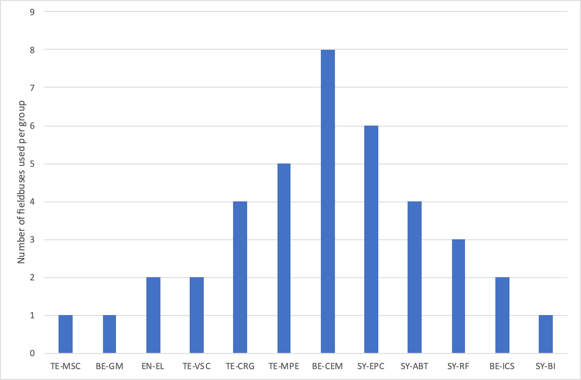
Number of Fieldbuses per Group
Most of the groups have two or more fieldbuses
  Historical reasons, vendors choices, easiest solutions
BE-CEM
  RadMon, OASIS/WRTD, BIDs
TE-MPE
  QPS, SMP, WIC, PIC
BE-ICS
  LHC Experiments, External Conditions
Notes:
WRTD whiterabbit trigger distribution (part of OASIS) – WRTD is the new technologoy for OASIS
BID -> beam intercepting devices (collimators, etc.)

Slide 18
Evolution since 2013 Survey
2013 Survey
1 - CAMAC
2 - IEEE-488 (GPIB)
7 - CAN
12 - PROFIBUS
3 - INSUM
8- FIPIO
13 - PROFINET
4 - JBus
9 - IEC-61850
14 - RS232, RS485
10 - MIL-STD-1533
15 - RS422
5 - Siemens MPI
11 - MODBUS
16 - WorldFIP
6 - Standard Ethernet
16 fielbuses

Slide 19
Evolution since 2013 Survey
2013 Survey
2022 Survey
1 - CAMAC
17 - AS-Interface
18 - EtherCAT
2 - IEEE-488 (GPIB)
7 - CAN
12 - PROFIBUS
19 - EtherNet/IP
3 - INSUM
8- FIPIO
13 - PROFINET
20 - FGC_Ether
4 - JBus
9 - IEC-61850
14 - RS232, RS485
21 - PROFIsafe
10 - MIL-STD-1533
15 - RS422
22 - TCP or UDP over Ethernet
5 - Siemens MPI
11 - MODBUS
16 - WorldFIP
23 - TCP or UDP over 3G/4G
6 - Standard Ethernet
24 - WhiteRabbit
16 fielbuses
17 fielbuses

Slide 20
Fieldbuses Recommended in 2013
2013 Survey
2022 Survey
1 - CAMAC
17 - AS-Interface
18 - EtherCAT
2 - IEEE-488 (GPIB)
7 - CAN
12 - PROFIBUS
19 - EtherNet/IP
3 - INSUM
8- FIPIO
13 - PROFINET
20 - FGC_Ether
4 - JBus
9 - IEC-61850
14 - RS232, RS485
21 - PROFIsafe*
10 - MIL-STD-1533
15 - RS422
22 - TCP or UDP over Ethernet
5 - Siemens MPI
11 - MODBUS
16 - WorldFIP*
23 - TCP or UDP over 3G/4G
6 - Standard Ethernet
24 - WhiteRabbit
16 fielbuses
17 fielbuses

Slide 21
Fieldbuses Recommended in 1996
2013 Survey
2022 Survey
1 - CAMAC
17 - AS-Interface
18 - EtherCAT
2 - IEEE-488 (GPIB)
7 - CAN
12 - PROFIBUS
19 - EtherNet/IP
3 - INSUM
8- FIPIO
13 - PROFINET
20 - FGC_Ether
4 - JBus
9 - IEC-61850
14 - RS232, RS485
21 - PROFIsafe
10 - MIL-STD-1533
15 - RS422
22 - TCP or UDP over Ethernet
5 - Siemens MPI
11 - MODBUS
16 - WorldFIP
23 - TCP or UDP over 3G/4G
6 - Standard Ethernet
24 - WhiteRabbit
16 fielbuses
17 fielbuses
“Recommendations for the use of fieldbuses at CERN in the LHC era”, Baribaud et al., Fieldbus Working Group, 1996, http://cdsweb.cern.ch/record/311229

Slide 22
Survey Results
LS3-LS4

Slide 23
LS3-LS4 needs - Industrial Fieldbuses
PROFIBUS replacement by PROFINET
  TE-VSC, SY-EPC, TE-ABT
PROFIBUS still needs to be supported though
Decommissioning of serial protocols
  SY-ABT
Industrial Ethernet with Custom electronics
  WorldFIP - PROFINET translator supported by DI/OT

Slide 24
LS3-LS4 needs - Custom Electronics
Radiation Tolerant
Possible increase of WorldFIP installations
  WorldFIP supported by DI/OT (GM and WIC)
  Considered for BLM and BPM by BE-BI
No need for higher bandwidth for rad-tol fieldbus
  2.5 Mbps seem sufficient for HL-LHC
expected
Notes:
BE/BI:
BLM beam loss monitor
BPM beam position monitor
For white rabbit:
Renovation of the timing systems
Unification over WR of the two following
BST (beam synchronous over WR)
GMT (General Machine Timing)
SMP (Safe Machine Parameter)
WRTD (TriggerDistribution)
Sambuca (for collimeter)
Need for protocols over WR (different applications use different protocols)

Slide 25
LS3-LS4 needs - Custom Electronics
Nanosecond level synchronization
Increasing number of WhiteRabbit applications
  General Machine Timing (GMT), potentially Beam Synchronous Timing (BST), Safe Machine Parameters (SMP), WR Trigger Distribution (WRTD), potentially RF Crab Cavities.
  A CERN-wide WR network under deployment (mainly for GMT/BSToWR)
  WR supported by DI/OT
Need for data transfers protocols over WhiteRabbit
  Raw Ethernet or UDP layer
  Efforts for standardization
expected
Notes:
BE/BI:
BLM beam loss monitor
BPM beam position monitor
For white rabbit:
Renovation of the timing systems
Unification over WR of the two following
BST (beam synchronous over WR)
GMT (General Machine Timing)
SMP (Safe Machine Parameter)
WRTD (TriggerDistribution)
Sambuca (for collimeter)
Need for protocols over WR (different applications use different protocols)

Slide 26
LS3-LS4 needs - Custom Electronics
Microsecond level synchronization
Currently
  FGC-ether: since Run2; Raw Ethernet + 50Hz
  QPS: since Run3; UDP + PTP
  Different implementations: off-the-shelf switches & some custom developments
  No centrally supported solution
LS3-LS4
  Requests for centralised support: FGC4, QPS-extensions
  Possible solution with off-the-shelf switches & one WR connection for PTP
  Formalization & Resources to be discussed
expected
Notes:
BE/BI:
BLM beam loss monitor
BPM beam position monitor
For white rabbit:
Renovation of the timing systems
Unification over WR of the two following
BST (beam synchronous over WR)
GMT (General Machine Timing)
SMP (Safe Machine Parameter)
WRTD (TriggerDistribution)
Sambuca (for collimeter)
Need for protocols over WR (different applications use different protocols)

Slide 27
Survey Results
LS5+

Slide 28
Long-term needs (LS5+)
Maintain support centrally supported fieldbuses
  WorldFIP, PROFIBUS, PROFINET, MODBUS
  Possibly more but not explicitly mentioned in the survey, e.g. CAN
Strong request to consider wireless fieldbuses (TE-VSC, TE-CRG, BE-CEM, SY-ABT)
  Harsh environment (EMC, etc.)
  Integration of IoT devices
Be ready for the increased amount of data and security (SY-ABT)
  Higher bandwidth, data compression, encryption
  Integration of IoT devices
  Easier integration of PLCs in the Control System (SY-ABT)
    SoftPLC on FEC as PLC emulator

Slide 29
Recommendations
Proposal to the IC forum

Slide 30
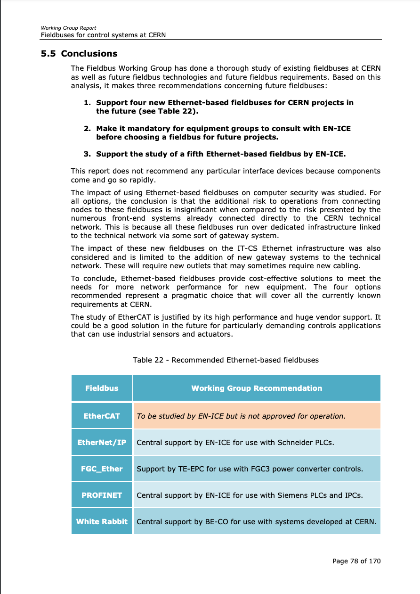
Industrial Controls Fieldbuses
Maintain the support of currently centrally supported fieldbuses
  CAN, EtherNet/IP, FIPIO, MODBUS, PROFI(BUS/NET/ Safe), White Rabbit, WorldFIP
Foster ethernet based fielbuses
    Migrate from serial to ethernet based fieldbuses whenever possible for existing installations
    Ethernet based fieldbuses should be favored for new installations
Explore wireless fieldbuses
    Mandate a group to evaluate and validate existing solutions
    e.g. PROFINET over IEEE 802.11
Update the 2013 list of recommended fieldbuses
    Add explicitly PROFIsafe to the list for safety system
    Add explicitly WorldFIP
    What about FGC_Ether? To be addressed by the Custom Electronic Forum?
    EtherCAT status study?

Slide 31
Conclusion

Slide 32
Summary
Custom Electronics
  WorldFIP is the clear option for radiation tolerant environment
  WhiteRabbit is the clear option for nanosecond synchronization
  Request for a centrally supported microsecond synchronization solution
Industrial Controls
  Trend to move away from “old” fieldbuses, e.g. serial, PROFIBUS
  Clear request to explore wireless solutions
General
  Fieldbuses with most nodes are centrally supported
  Large variety of fieldbuses are currently in use despite the previous standardization efforts
  Many fieldbuses are used by only one group but have many nodes
  Interviews would have been more effective than online surveys (but more time-consuming)

Slide 33
Next Steps
Update recommendations (WG and Forums)
    Recommendations to be endorsed/amended by the forums
Plan and share (CTTB)
    Estimate of resources for the implementation of the recommendations
    Establish accountability mechanisms
    Communicate to the different stakeholders

Slide 35
IEC Standards
IEC 61158
  Industrial communication networks - Fieldbus specification, c.f. CERN Library link
  “Conceptually, a fieldbus is a digital, serial, multidrop, data bus for communication with industrial control and instrumentation devices such as – but not limited to – transducers, actuators and controllers. “
  “The IEC 61158 series specifies a number of fieldbus protocol types. Each protocol type is designed to permit multiple measurement and control devices to communicate on a shared medium. Devices communicate directly only with other devices of the same protocol type. “
  Specifies each layer of the OSI model
  Latest release dates from 2019 and lists up to 26 different types of protocols
IEC 61784
  Industrial communication networks – Profiles, c.f. CERN Library link
  Concrete implementation of IEC-61158
  Defines ControlNet, Ethernet/IP, DeviceNet, PROFIBUS DP/PA, PROFINET, WorldFIP, INTERBUS, CC-Link, Hart, SERCOS, etc.
  Access to the 2007 from the CERN library, but latest release from 2019

Slide 36
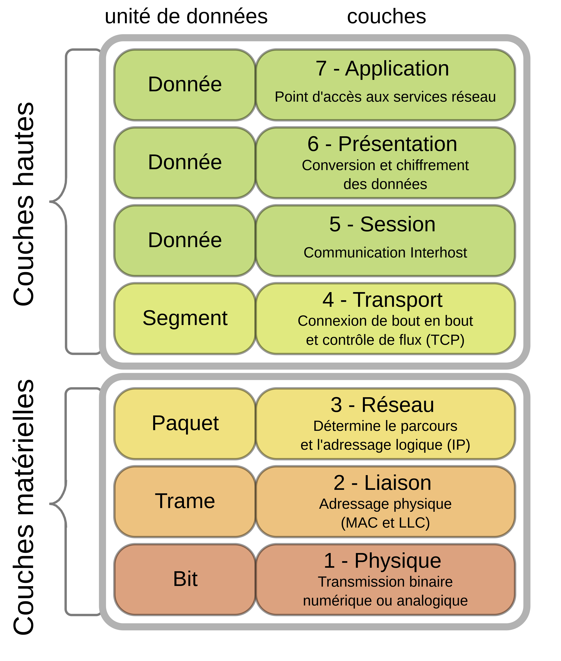
OSI Model
https://fr.wikipedia.org/wiki/Mod%C3%A8le_OSI

Slide 37
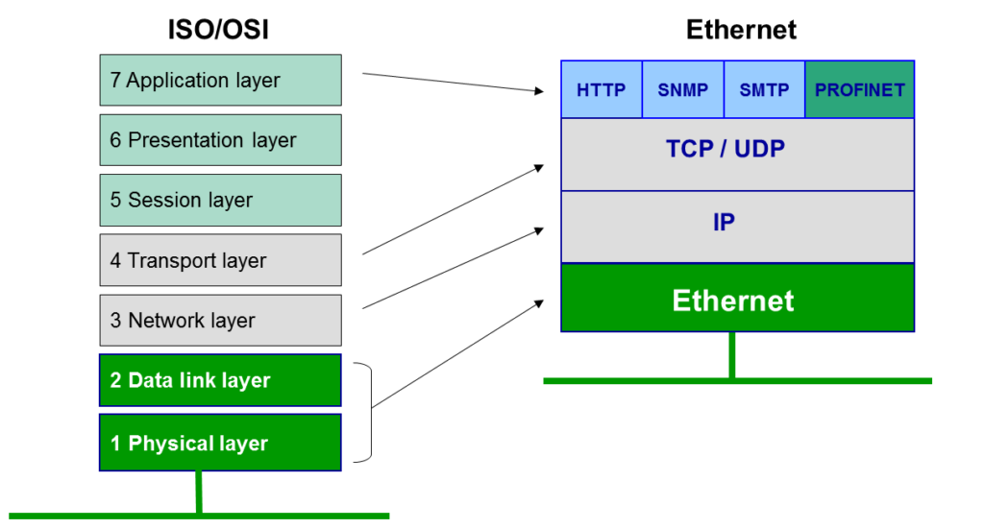
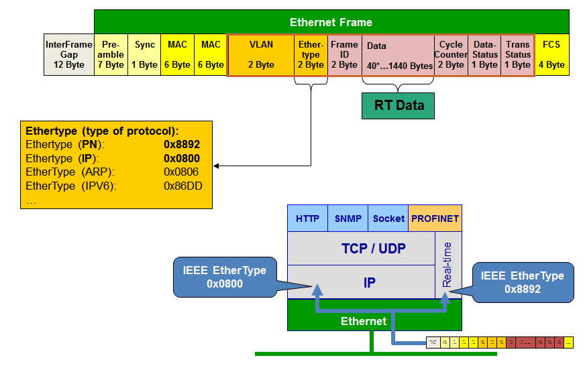
PROFINET
https://profinetuniversity.com/industrial-automation-ethernet/network-reference-model/

