Slide 1
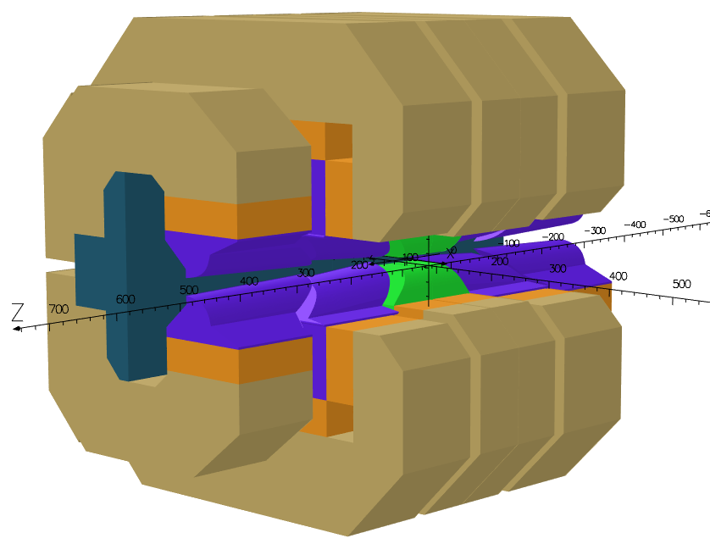
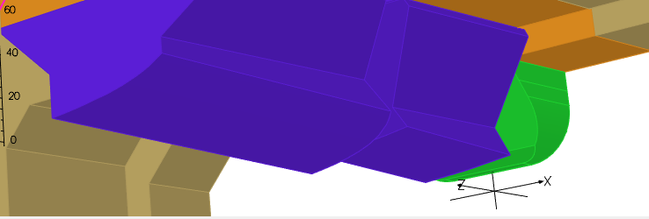
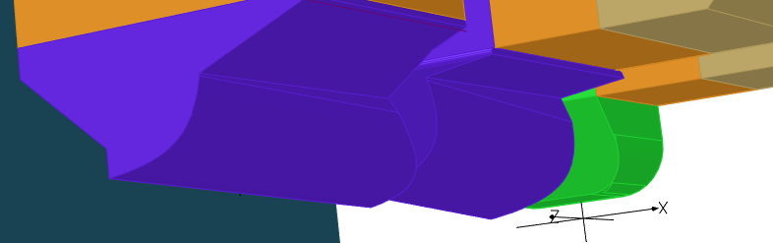
VADER: Present design
The magnetic design is close to the final phase
Minor changes in the philosophy, major changes in the poles (90% of the design time)
The permanent magnet volume is increased around 30%,reaching the demanded field peak of 2.3T with a magnet gap of 19mm (17+2mm)
CLIC poles
VADER poles

Slide 2
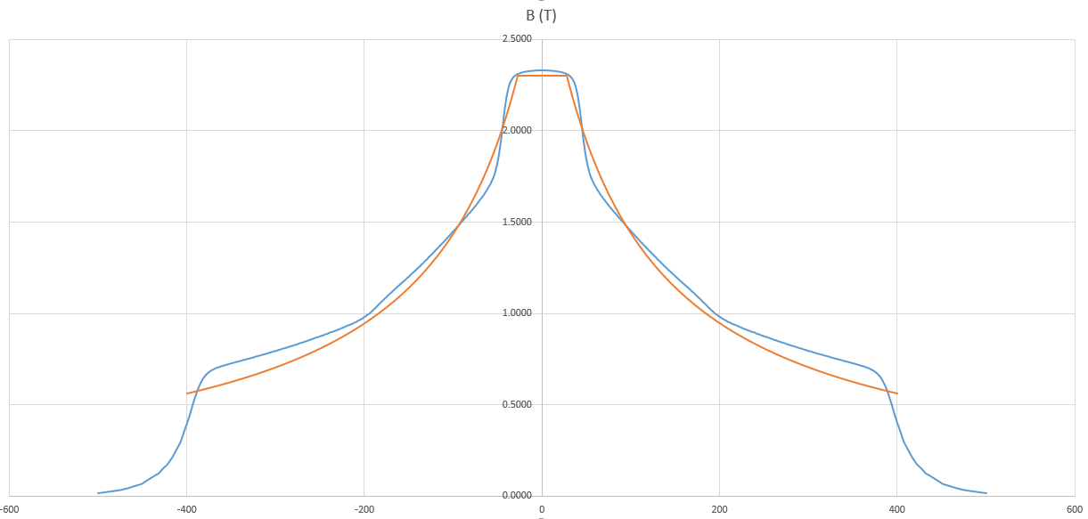
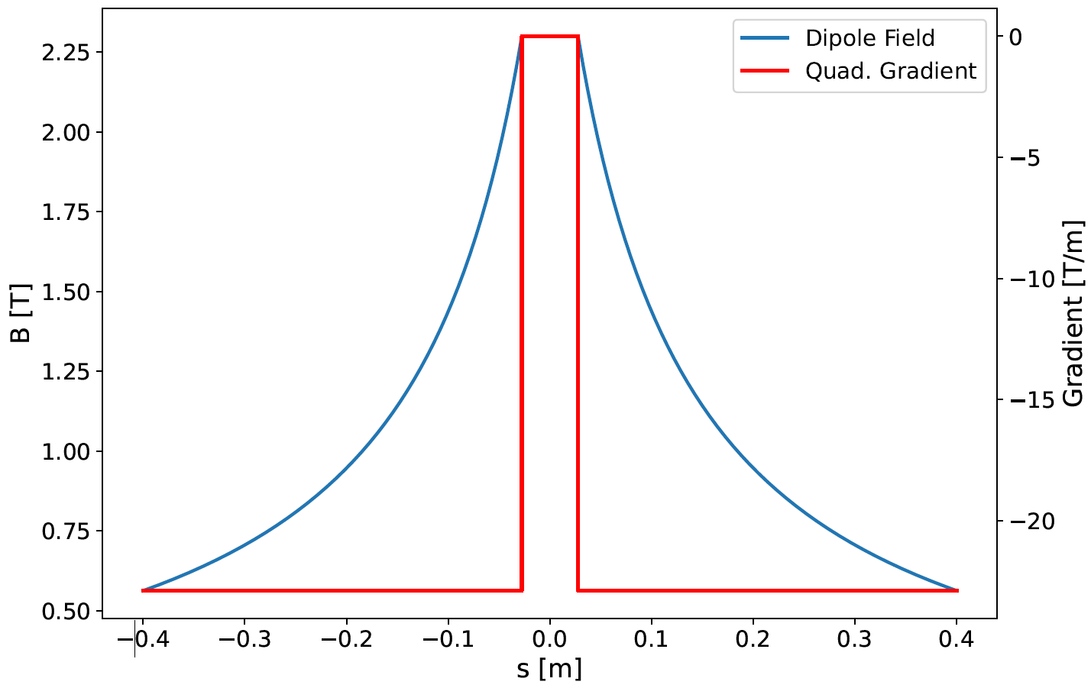
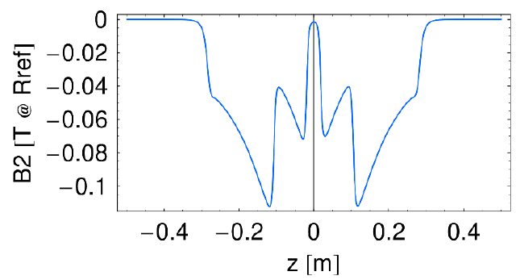
VADER: Field profiles
Important to take into account for the final optimization:
Longitudinal gradient (not final)
  Magnetic length? Real vs Optimal
  Field decays outside the magnet
  count for the integral
Transverse gradient
  It is impossible to have constant
  transverse gradient with a variable gap

Slide 3
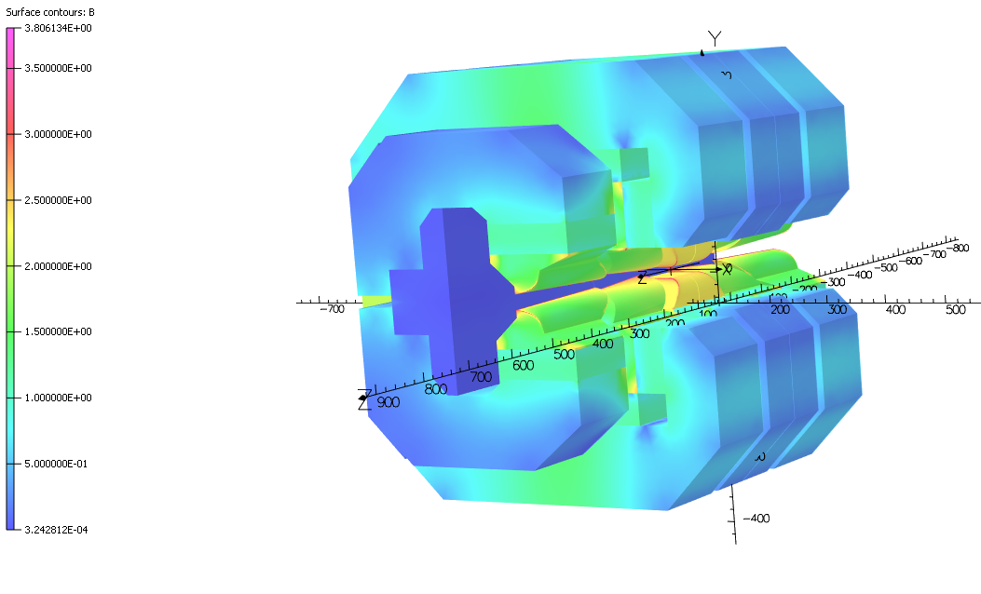
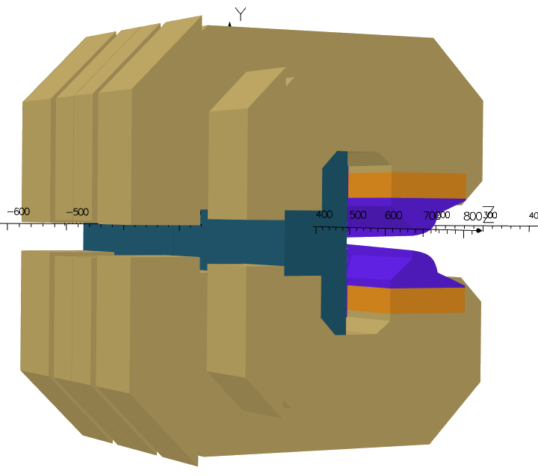
VADER: Field Trimming
New field trimming design implemented:
Yoke completely split in two parts supported by an aluminium block
Sliding parts perform the regulation
Higher/better regulation than the CLIC prototype

Slide 4
VADER: Conclusions
The field quality is still very good. Comparable to the CLIC prototype
  This is just an example, they change with every iteration with the poles:
Very close to the final magnetic design
Objective of this meeting: check and verify that the decisions taken are correct so we can proceed and finalise the design

Slide 5
Off-Topic: CLIC prototype update
We received the material to produce the new poles in January 23
Took samples and sent them to perform a magnetic characterization
  Two samples of each Armco block: EDM and machined ones to decide which machining type gives better magnetic properties
Simulating now the recently received Armco experimental magnetic properties

