Slide 1
Connecting and Integration of the Instrumentation in the DCM
Y. Leclercq, F. Crisci for WP3
HL-LHC Magnet Circuit Instrumentation Day 2023

Slide 2
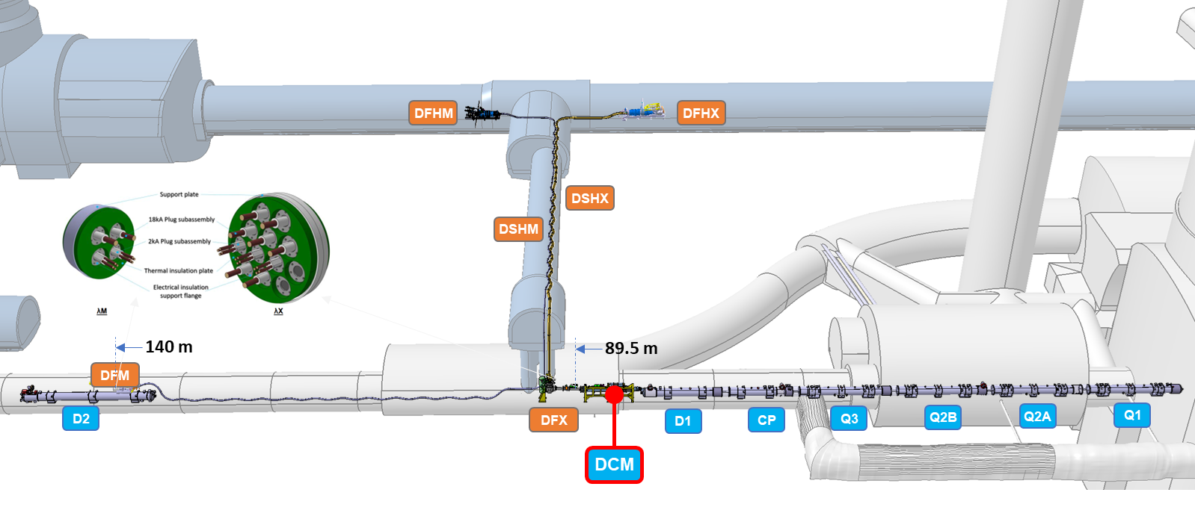
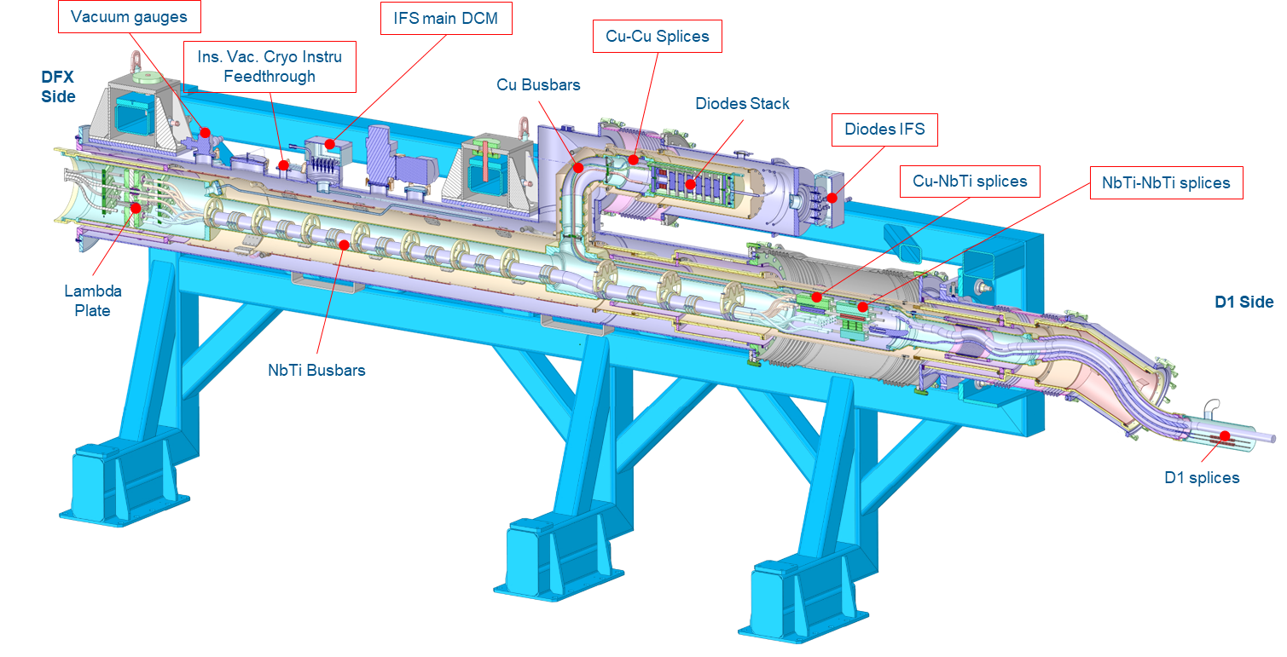
DCM overview
DCM part of IT chain of magnets cryostats
  Common cryogenic volume
  Common insulation vacuum volume
  Electrical continuity of conductors
Functions
  Integrate and provide operating conditions for:
    Cold diodes
    Lambda plates
  Route SC busbars
  Present instrumentation feedthroughs and interfaces
  Interface with WP6a
Key features wrt instrumentation
  Two IFS flanges
    Cold diodes
    Main DCM)
  Two groups of splices
    Diodes interconnect (x5)
    DCM-D1 interconnect (x24)

Slide 3
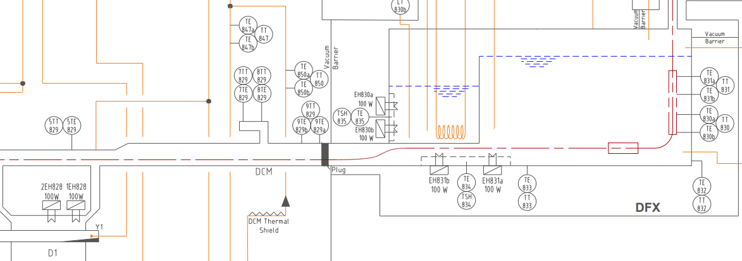
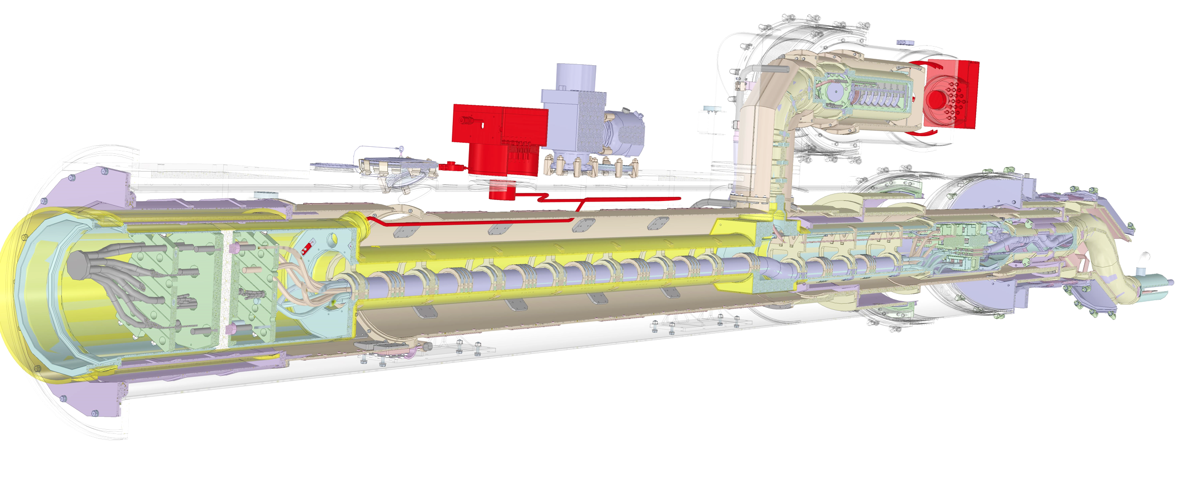
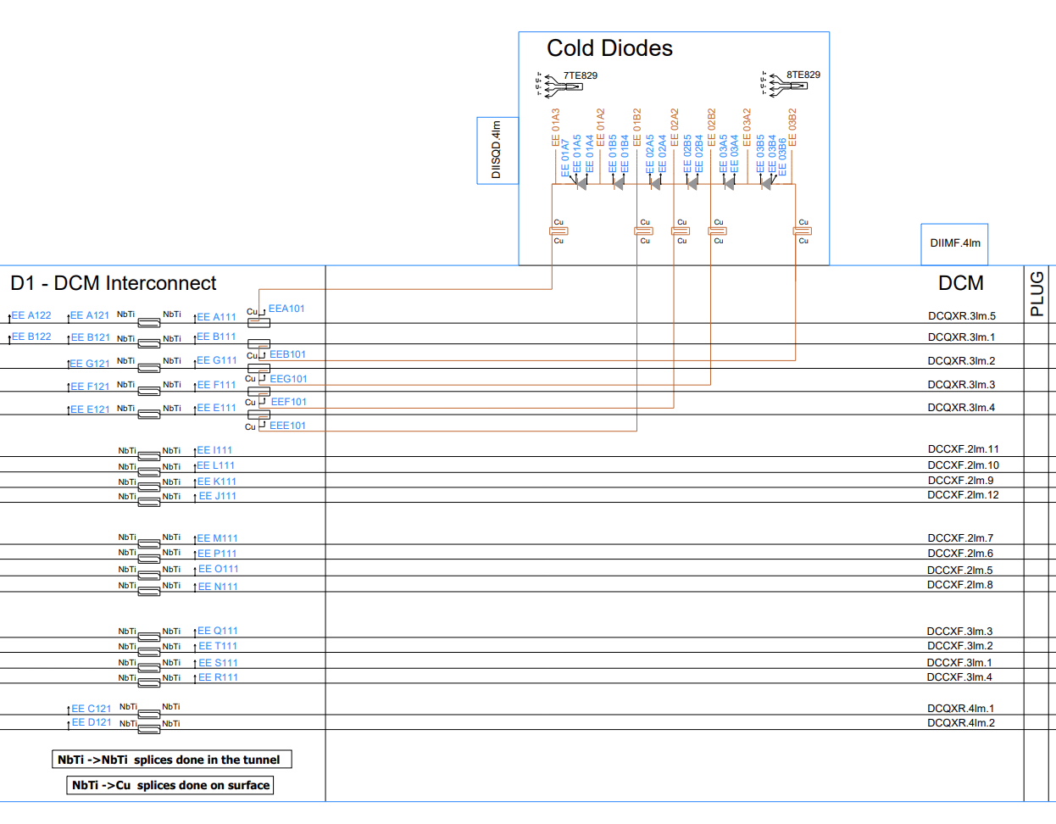
Instrumentation scheme for the DCM
Electrical V-taps : LHCLSDIX0001
  DCM main IFS : 31 V-taps
  Diodes IFS : 14 V-taps + 7 I-taps
Cryogenic : LHCLSQRG0041
  DCM main IFS
    0 TT for Tunnel version
    2 TT for String version
  Diodes IFS : 4 TT
  Insulation vacuum : 2 TT
No vacuum gauges installed on DCM
P&ID
IFS “DCM Main”
IFS “Diodes”
Short Cernox sensor immersed in SFHE close to Lambda Plate

Slide 4
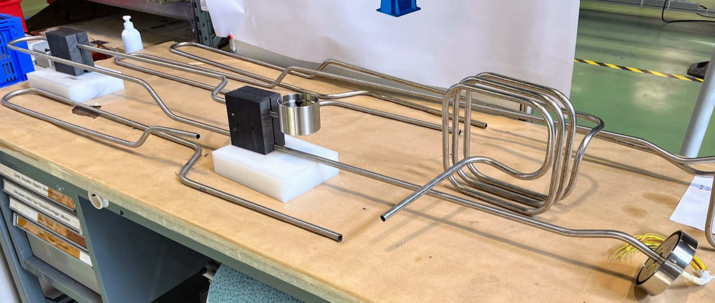
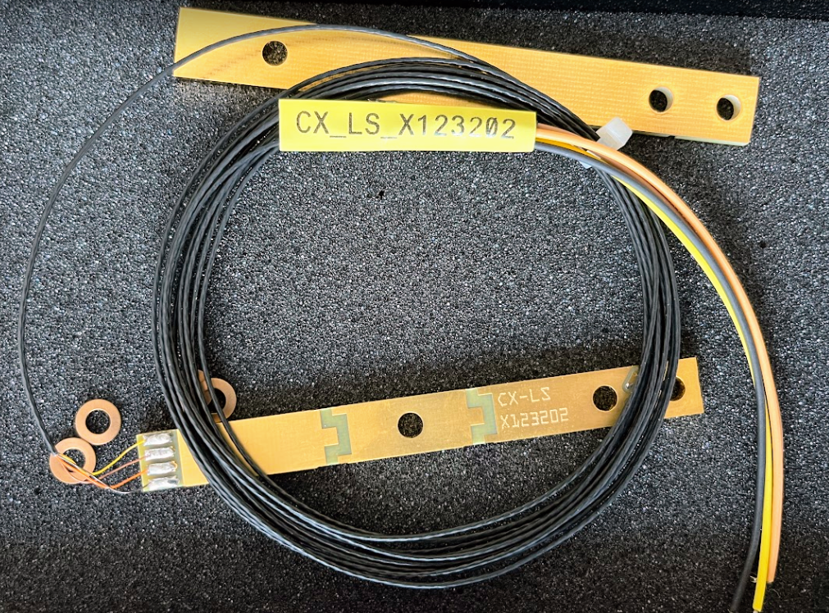
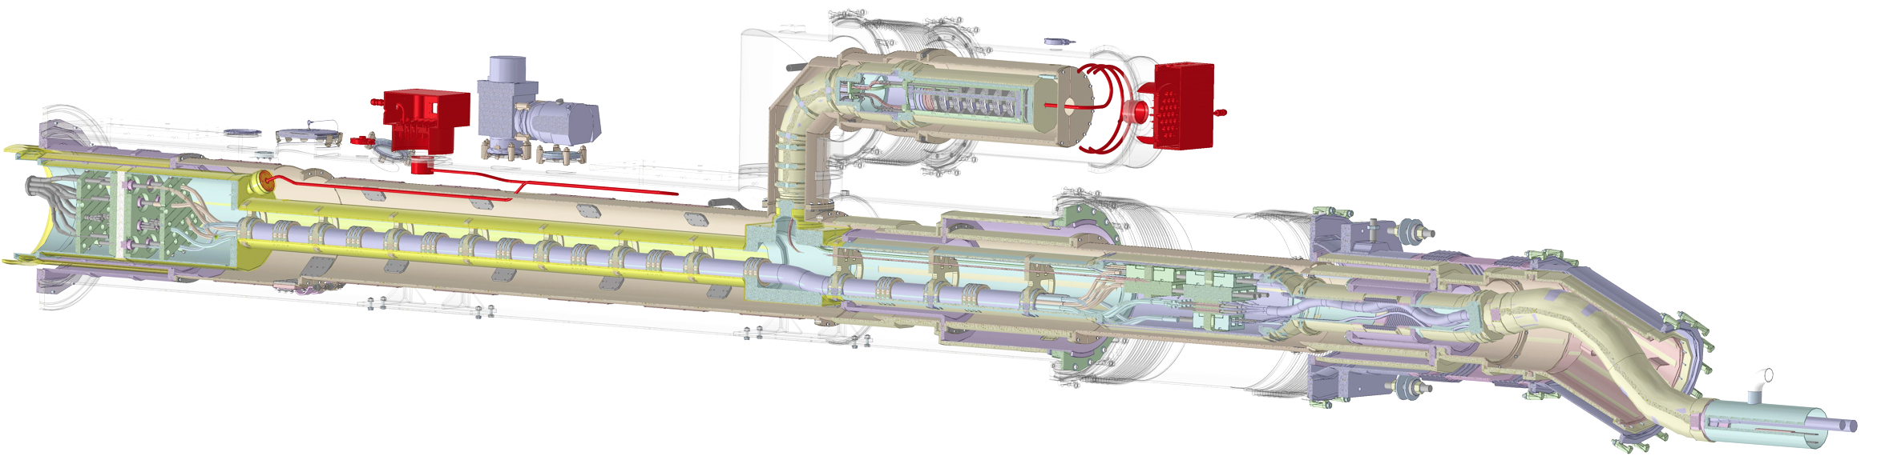
Wires connection, routing and testing
Wires types : same wires as for magnets & WP6a
Routing :
  From IFS flange to Helium vessel :
    Wires bundle in fibre glass sleeves
    Capillaries pre-assembled, cold shocked and QC tested before installation
  Inside helium vessel : fibre glass sleeves along busbars
  Insulation vacuum : usual routing technique with cryogenic tape
 | Type | AWG | Conductor | Layout | Insulation | OD
TT in helium | Axon - HT3007 | AWG30 | Copper | 4-in-1 | Polyimide | 1.70 mm
TT in vacuum | Habia - B/Mang 0.12 N4 |  | Manganin | 4-in-1 | Polyamide | 1.00 mm
V-taps | Axon - HH2619 | AWG26 | Copper | Single | Polyimide | 0.95 mm
I-taps | Axon – HH2019 | AWG20 | Copper | Single | Polyimide | 1.50 mm
DCM IFS capillaries in production in SMI2
1
DCM - CERNOX equipped with Habia cable
3
1
2

Slide 5
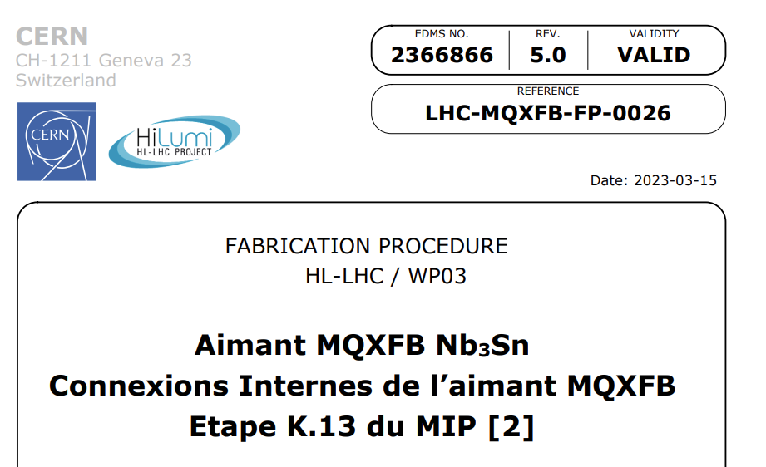
Wires connection, routing and testing
HV test sequence
Wires connection
  TT-sensors
    Inside He vessel: connected at installation
    Insulation vacuum: pre-wired, connection to MIL8
  V-taps
    Installed during soldering operation
    Follow same procedures as for magnets EDMS 236866
Testing :
  EDMS 2747011 in work with MCF
  HV tests at RT in air from 10 kV down to 1.5 kV
  Electrical Design Criteria document not released yet

Slide 6
Documentation
  V-taps layout LHCLSDIX0001
  Cryogenic instrumentation : LHCLSQRG0041
  Electrical design criteria EDMS 2747011
  IFS flanges : EDMS 2896437 & 2896449

