Slide 1

Precision Measurements
and Tevatron Legacy
M.V. Chizhov
Sofia University and JINR

Slide 2
Standard Model (SM)
SU(3)_{C}
SU(2)_{L}
U(1)_{Y}

Slide 3
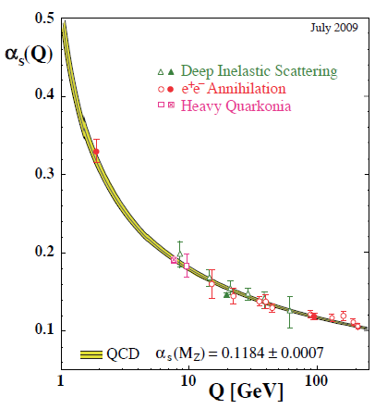
Gauge group of the SM
Spontaneous Symmetry Breaking
I.Khriplovich’68
…contains one more independent
parameter: the Higgs mass

Slide 4
α

Slide 5
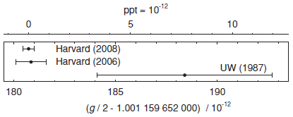

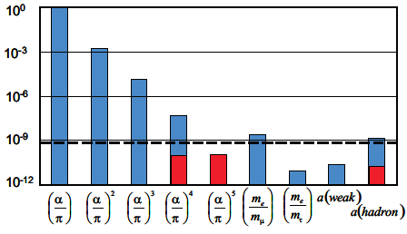
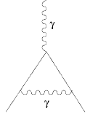
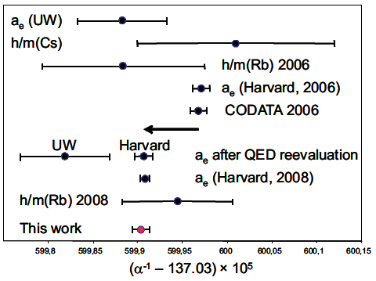
The electron anomalous magnetic moment
and the fine-structure constant measurements
D. Hanneke, S. Fogwell and G. Gabrielse, Phys. Rev. Lett. 100 (2008) 120801;
D. Hanneke, S. Fogwell Hoogerheide and G. Gabrielse, Phys. Rev. A 83 (2011) 052122
R. Bouchendira, P. Clade, S. Guellati-Khelifa, F. Nez and F. Biraben, Phys. Rev. Lett. 106 (2011) 080801
Notes:
the astonishing precision!

Slide 6
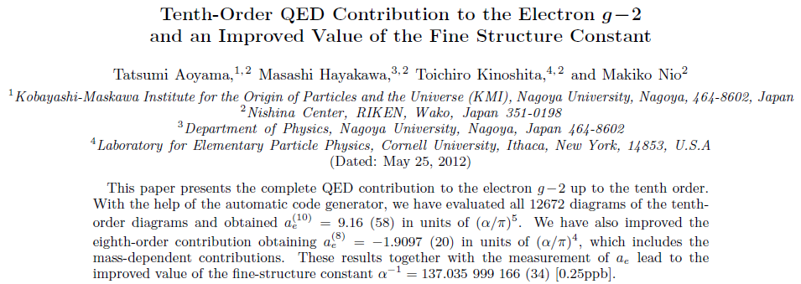
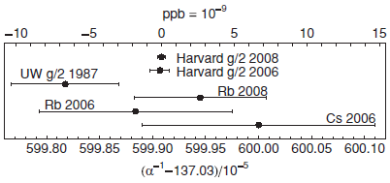
Fine-structure constant determination
arXiv:1205.5368v1 [hep-ph] 24 May 2012
Rb10

Slide 7
G_{F}

Slide 8
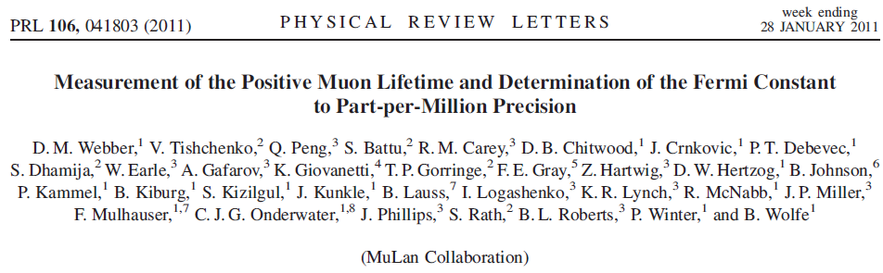
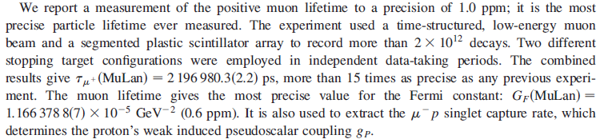
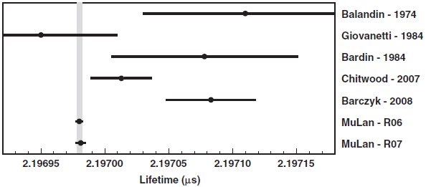
PDG
MuLan
FAST
1 ppm

Slide 9
Fermi constant determination
Theoretical uncertainty in the determination of G_{F} is less than 0.3 ppm
R. K. Behrends, R. J. Finkelstein, & A. Sirlin, Phys. Rev. 101 (1955) 866;
T. Kinoshita & A. Sirlin, Phys. Rev. 113 (1959) 1652
T. van Ritbergen & R.G. Stuart, Phys. Rev. Lett. 82 (1999) 488
A. Pak & A. Czarnecki, Phys. Rev. Lett. 100 (2008) 241807

Slide 10
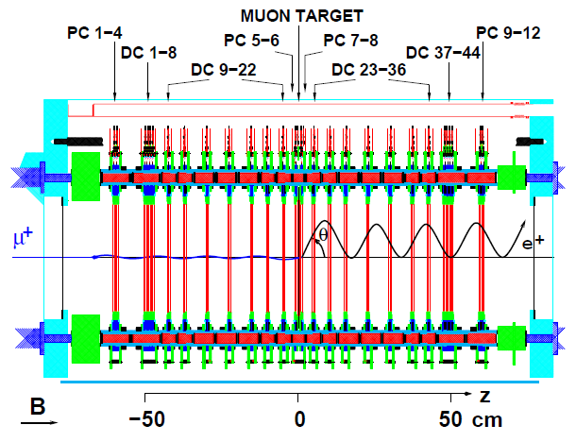
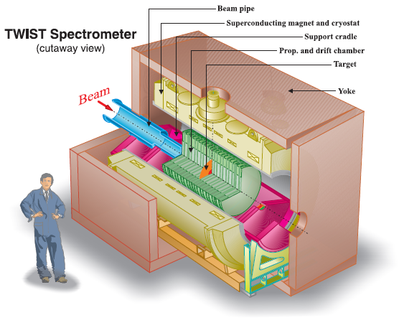
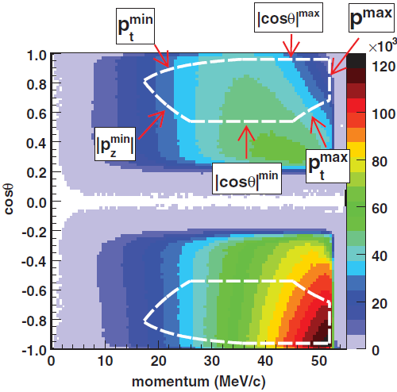
TWIST
TRIUMF Weak Interaction Symmetry Test
L. Michel, Proc. Phys. Soc. A63, 514 (1950).

Slide 11

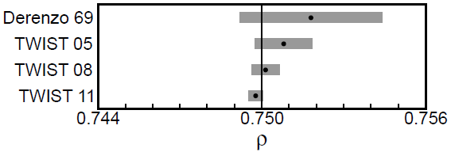
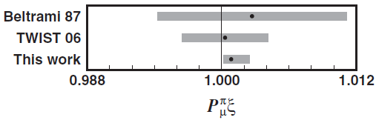
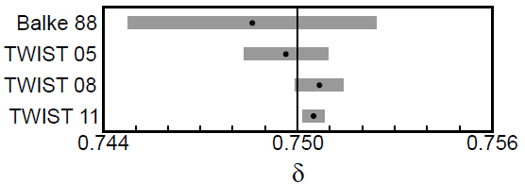
TWIST final results
Phys. Rev. D 85 (2012) 092013
Phys. Rev. D 84 (2011) 032005
C. A. Gagliardi, R. E. Tribble, and N. J. Williams
Phys. Rev. D 84 (2011) 032005
M.V. Chizhov, Mod. Phys. Lett. A9 (1994) 2979

Slide 12
Choosing the third constant
For scales above a few hundred MeV extra uncertainty due to the low
energy hadronic contribution to vacuum polarization is introduced.

Slide 13
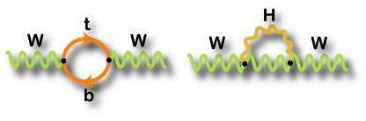
Electroweak Quantum corrections
(M_{W}, m_{t} and M_{H})
All coupling constants are functions of a scale (by the way, definition of the mass is also scale dependent). Therefore, different definitions of the sin² θ_{W}, which are equivalent in the Born (tree) approximation, depend on the renormalization prescription. There are a number of popular schemes leading to values which differ by small factors depending on m_{t} and M_{H}.
M. Awramik, M. Czakon, A. Freitas, and G. Weiglein, Phys. Rev. D 69 (2004) 053006
dependence?

Slide 14
What about Appelquist−Carazzone decoupling theorem?
T. Appelquist & J. Carazzone, Phys. Rev. D 11 (1975) 2856
In QED and QCD the vacuum polarization contribution of a heavy fermion pair is suppressed by inverse powers of the fermion mass. At low energies, the information on the heavy fermions is then lost. This ‘decoupling’ of the heavy fields happens in theories with only vector couplings and an exact gauge symmetry, where the effects generated by the heavy particles can always be reabsorbed into a redefinition of the low-energy parameters.
The SM involves, however, a broken chiral gauge symmetry. Therefore, the electroweak quantum corrections offer the possibility to be sensitive to heavy particles, which cannot be kinematically accessed, through their virtual loop effect. The vacuum polarization contributions induced by a heavy top generate corrections to the W± and Z propagators, which increase quadratically with the top mass [M. Veltman, Nucl. Phys. B 123 (1977) 89]. Therefore, a heavy top does not decouple. For instance, with m_{t} = 173 GeV, the leading quadratic correction to amounts to a sizeable 3% effect. The quadratic mass contribution originates in the strong breaking of weak isospin generated by the top and bottom quark masses, i.e., the effect is actually proportional to .
Owing to an accidental SO(3)_{C} symmetry of the scalar sector (the so-called custodial symmetry), the virtual production of Higgs particles does not generate any quadratic dependence on the Higgs mass at one loop [M. Veltman]. The dependence on M_{H} is only logarithmic. The numerical size of the corresponding correction to varies from a 0.1% to a 1% effect for M_{H} in the range from 100 to 1000 GeV.

Slide 15
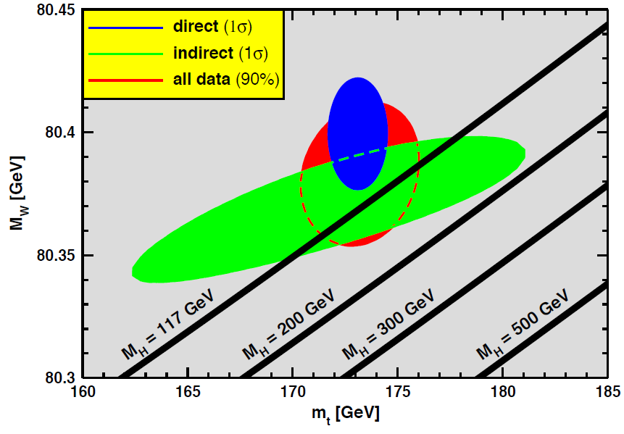
SM prediction versus data (PDG)

Slide 16
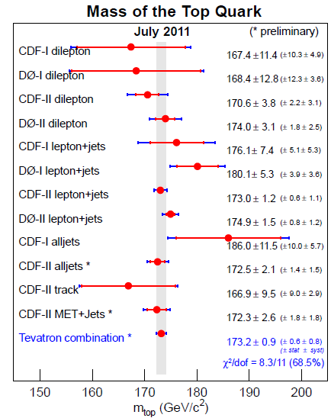
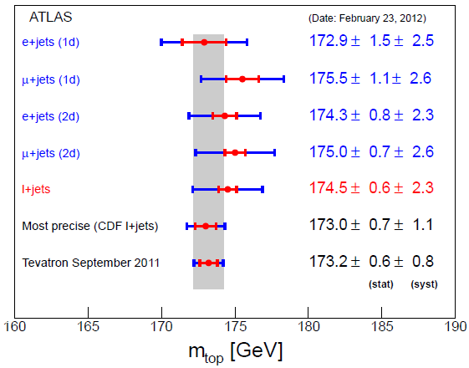
Tevatron: m_{t} = 173.18 ± 0.94 GeV
arXiv:1107.5255
ATLAS 1.04 fb⁻¹ !
arXiv:1203.5755
172.85 ± 0.71 ± 0.84
CDF 8.7 fb⁻¹ !
Conf Note 10761

Slide 17
SM prediction versus data & new m_{t}

Slide 18
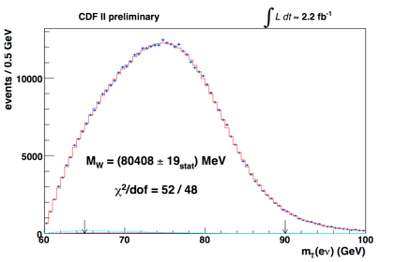
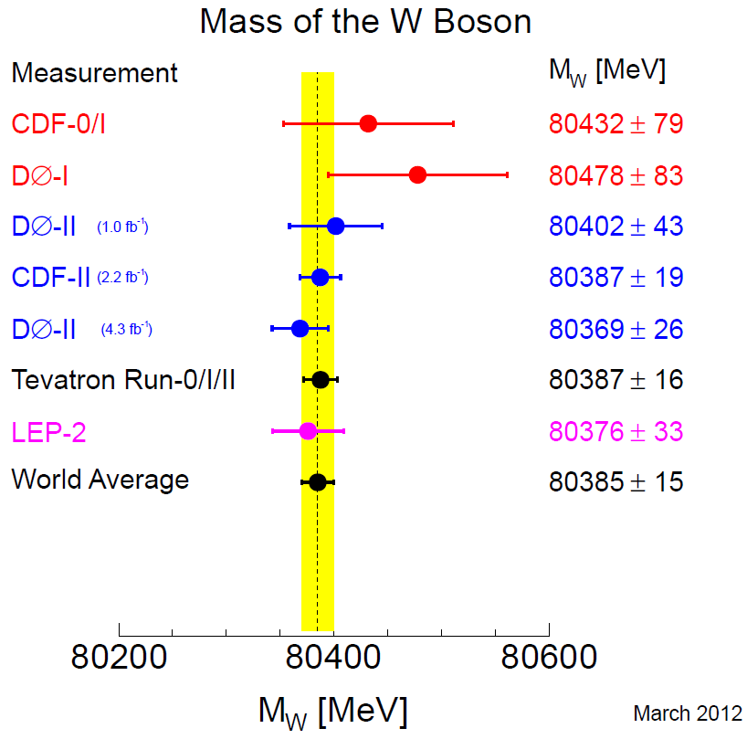
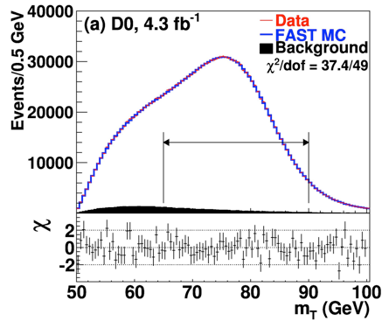
Tevatron: M_{W} = 80.387 ± 0.016 GeV
arXiv:1204.0042

Slide 19
SM prediction vs new Tevatron data
Higgs?

Slide 20
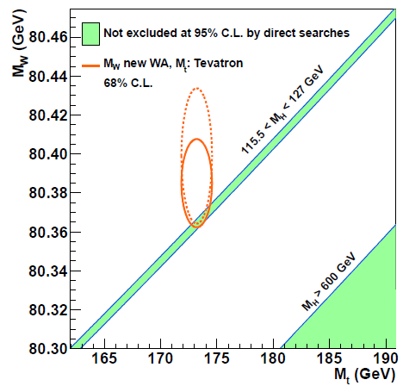
SM, Tevatron and LHC

Slide 21
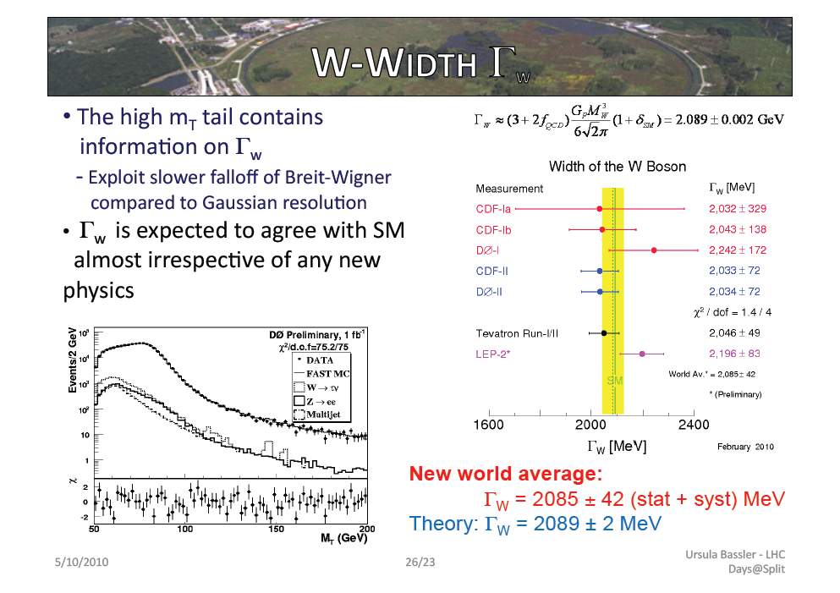

Slide 22
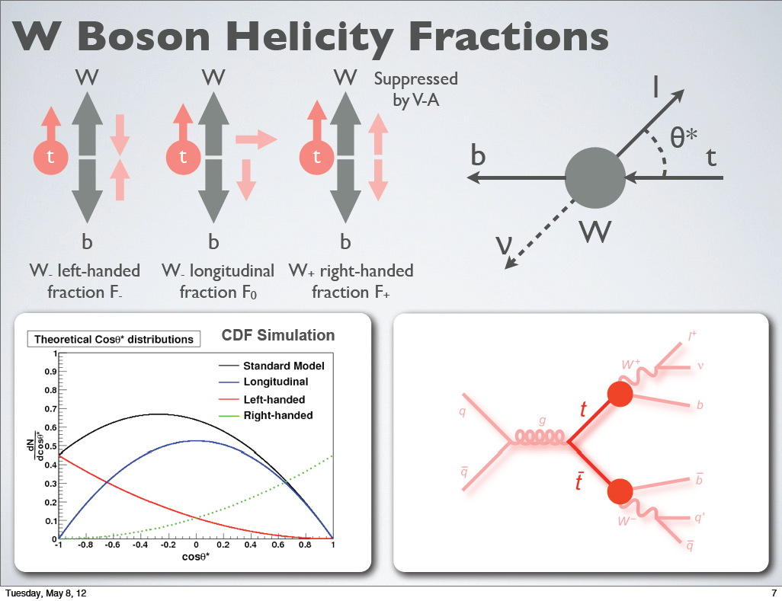
Victor E. Bazterra

Slide 23
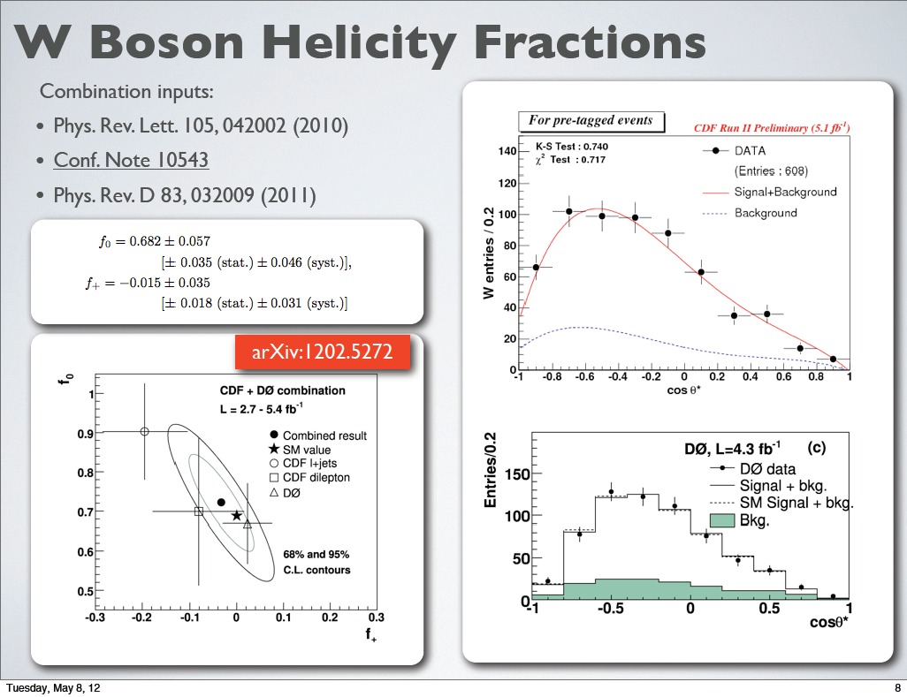
Victor E. Bazterra

Slide 24
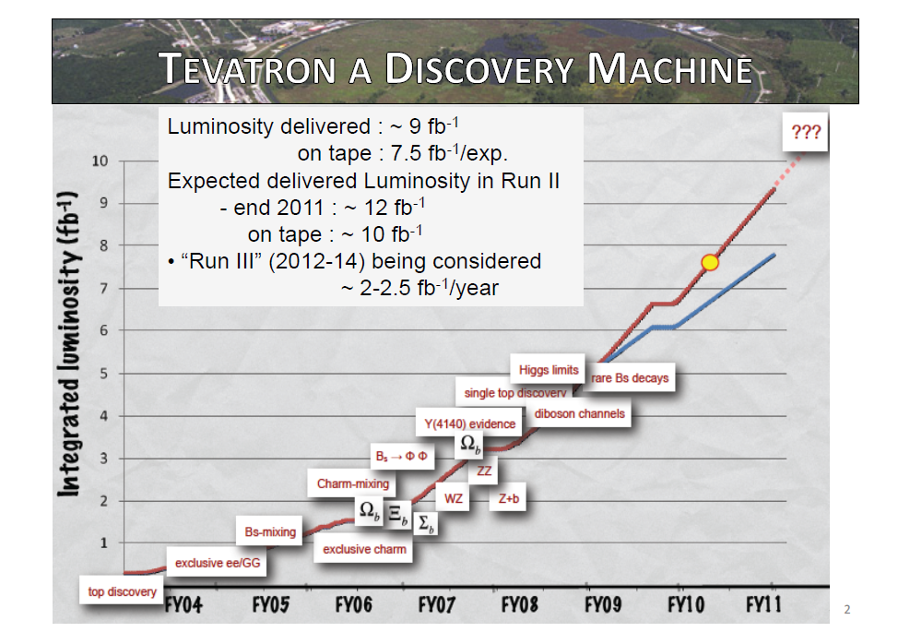
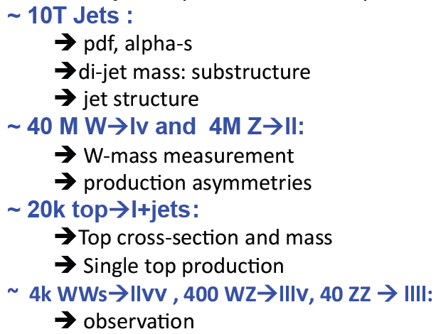
L_{peak}=4.3 x 10³² cm⁻² s⁻¹

Slide 25
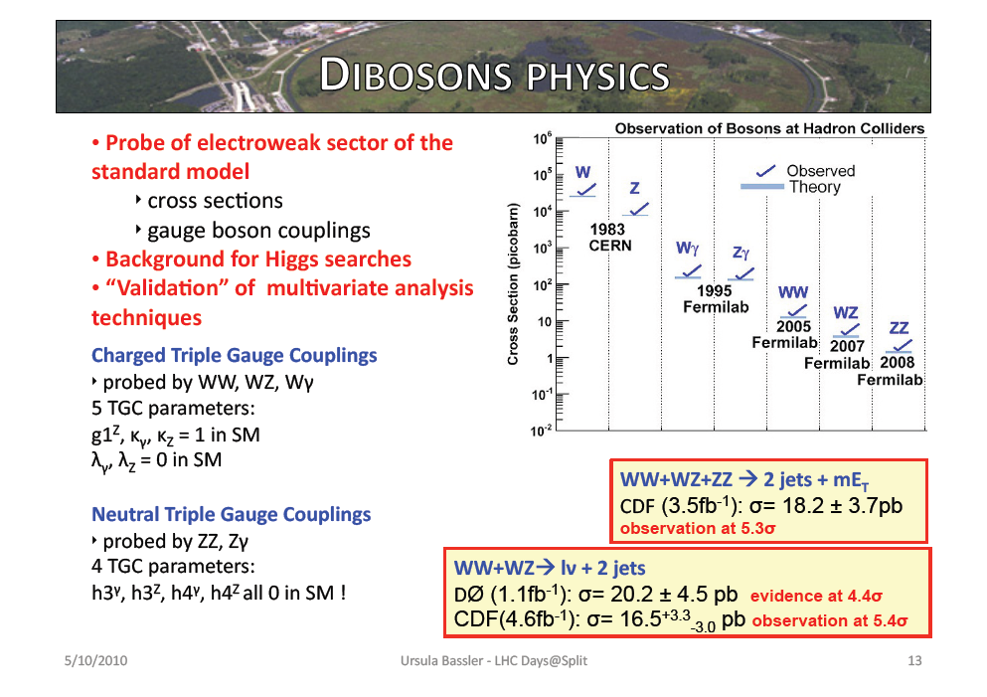

Slide 26
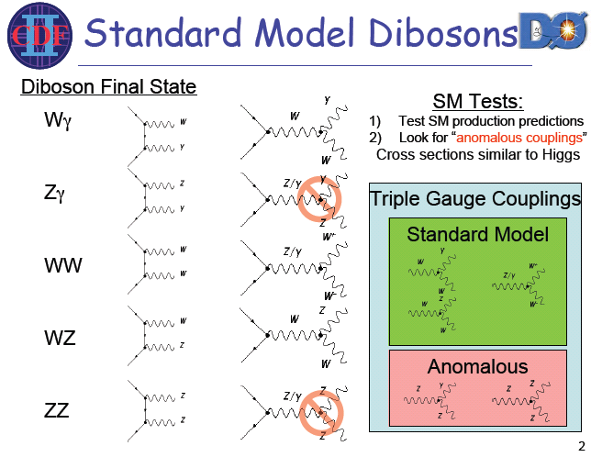

Slide 27
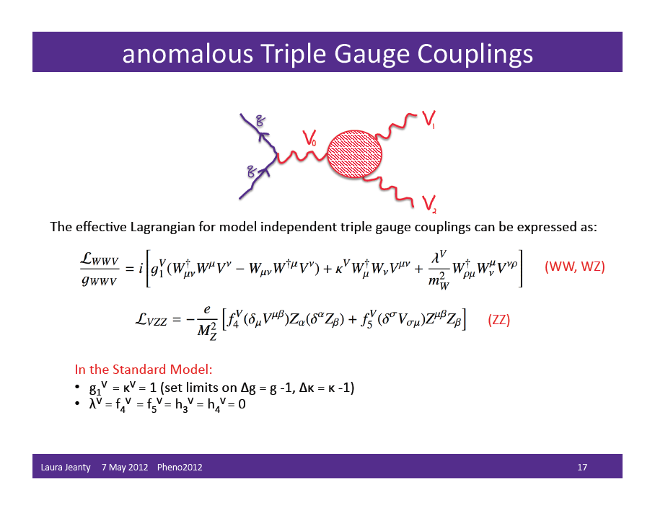

Slide 28
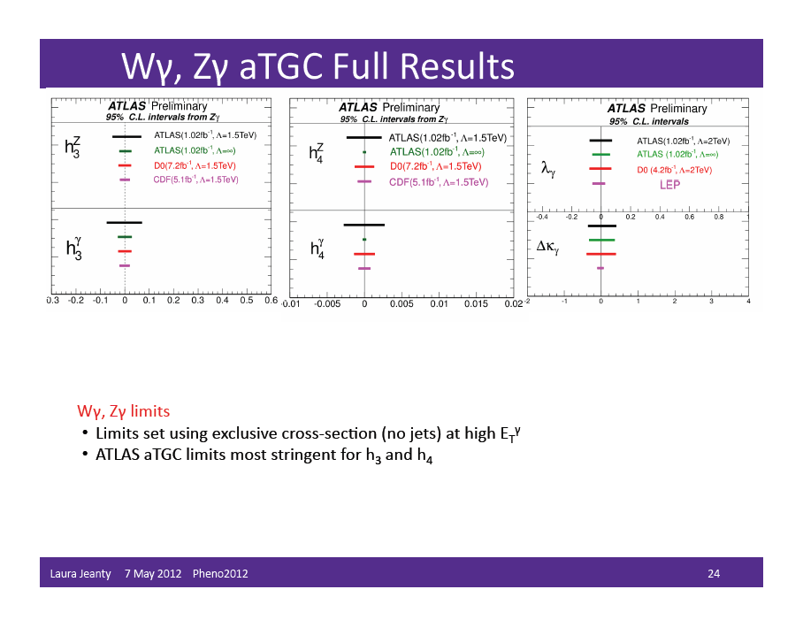

Slide 29
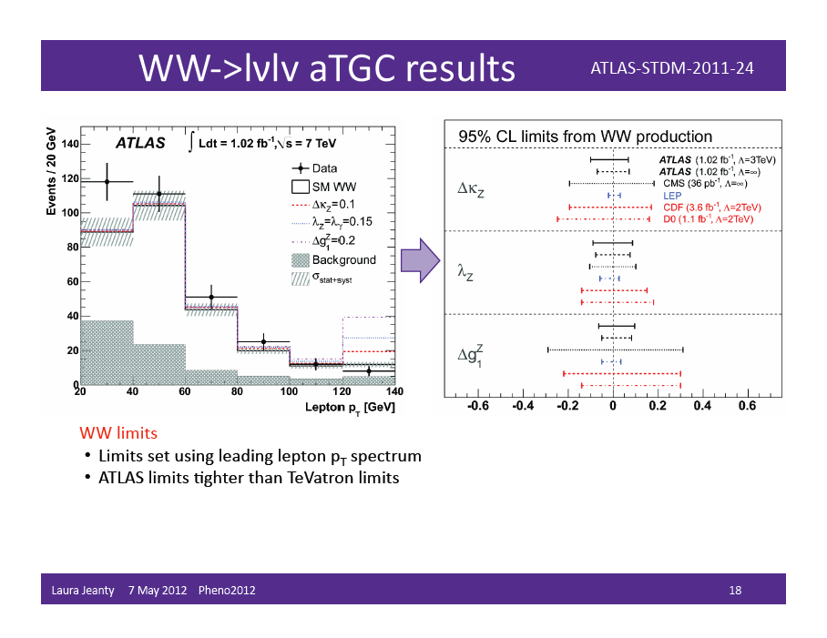

Slide 30
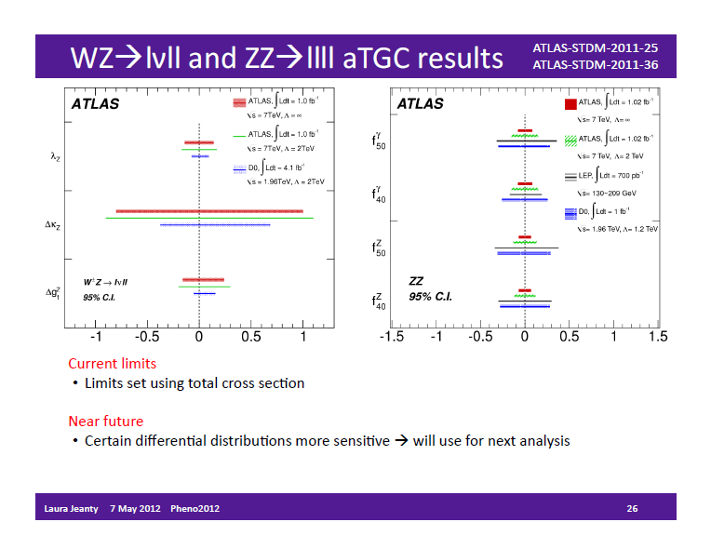

Slide 31
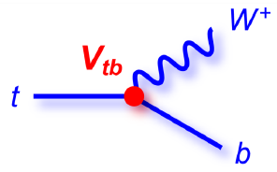
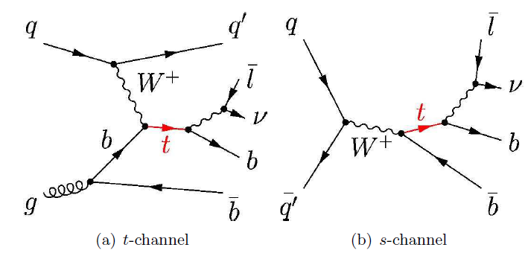
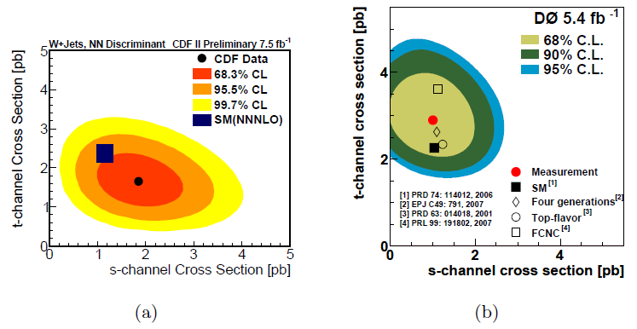
Single Top Production

Slide 32
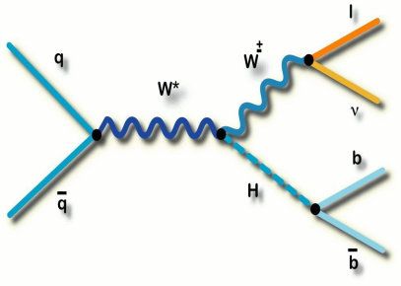
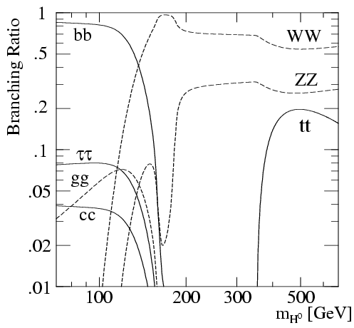
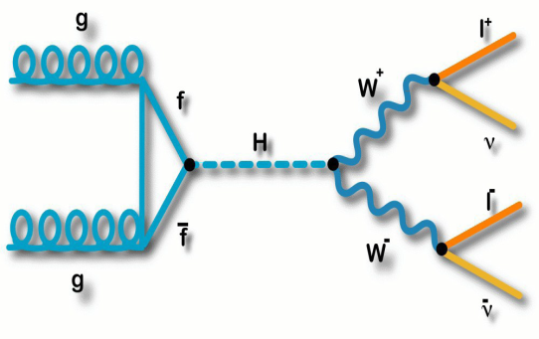
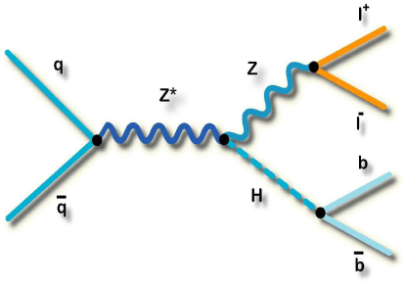
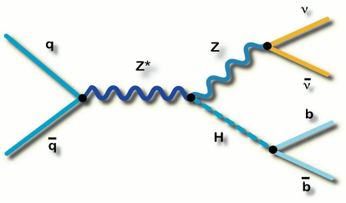
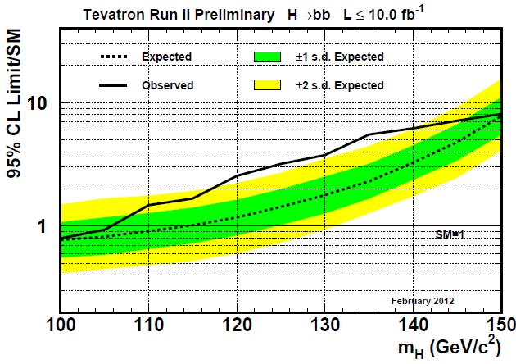
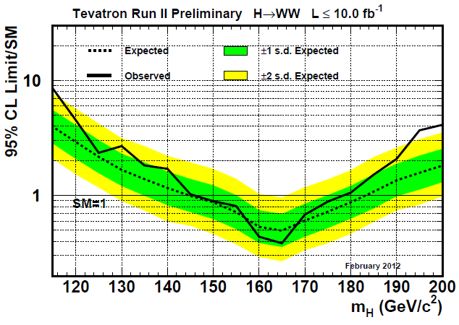
Higgs Search at the Tevatron
My guess
(unpublished):
M_{H} ~ υ/2
≈ 123 GeV

Slide 33
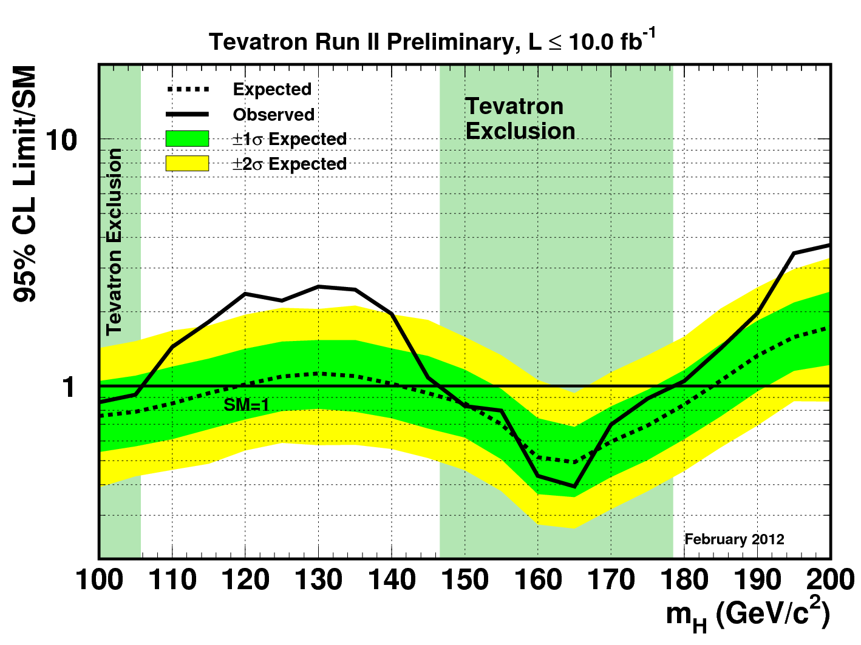
Tevatron Exclusion

Slide 34
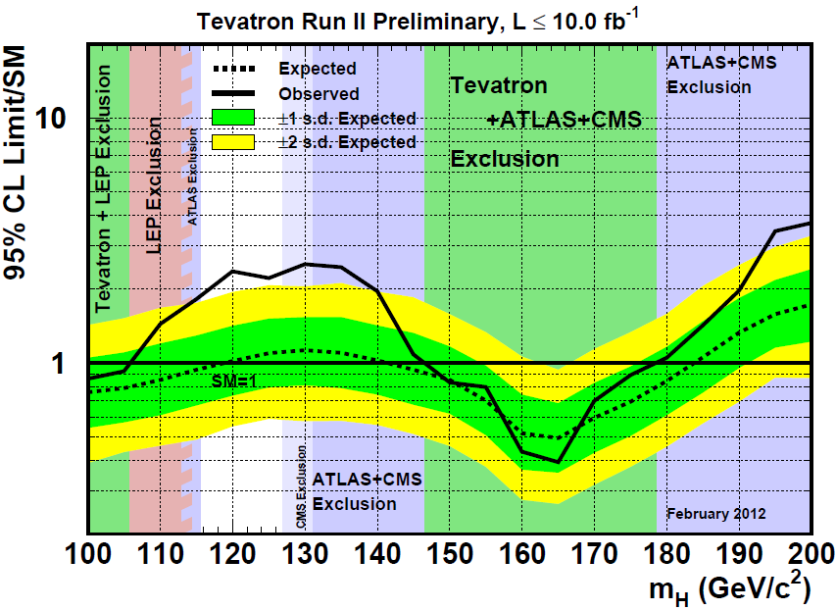
Tevatron Exclusion with LHC results

Slide 35

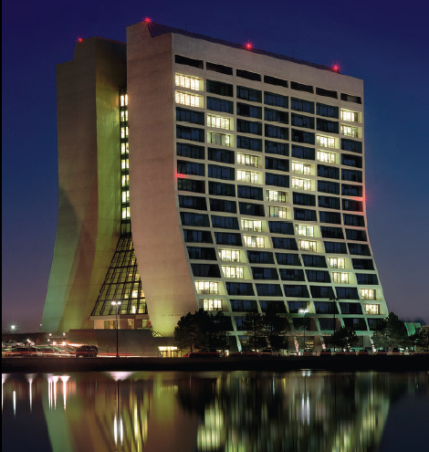
Project X
The Tevatron is shutting down, and a new project is on the horizon: Project X.

Slide 36
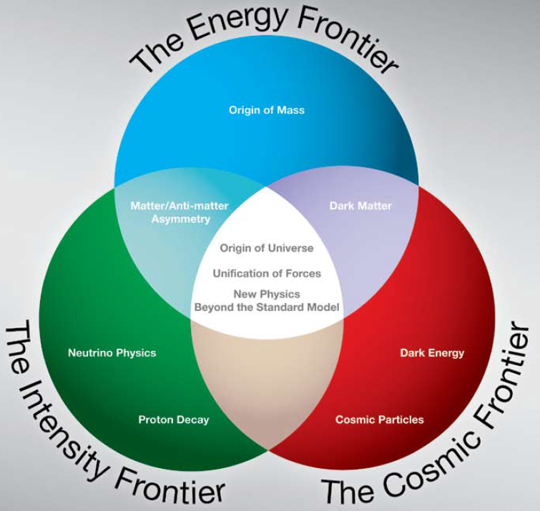
Neutrino Physics
Project X will open a path to discovery in neutrino science
and in precision experiments with charged leptons and quarks.

Slide 37


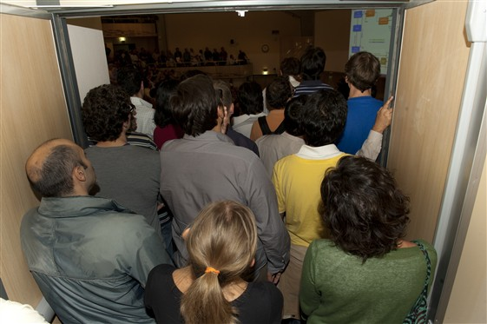




CERN
23.11.2011
υ_{ν} >c

Slide 38
Mixing matrices
Cabibbo-Kobayashi-Maskawa
Wolfenstein parameterization
Pontecorvo-Maki-Nakagawa-Sakata
P. F. Harrison, D. H. Perkins and W. G. Scott, Phys. Lett. B 530 (2002) 167

Slide 39
Oscillations
The two necessary conditions for neutrino oscillations:
U_{PMNS} is non-identity matrix:
the flavour states are different from the mass states
m₁ ≠ m₂ ≠ m₃:
non-degeneracy of the mass states
Oscillations!

Slide 40


First indications of non-zero U_{e3}
ν_{μ} → ν_{e}
Appearance!
T2K
MINOS
Phys.Rev.Lett. 107 (2011) 041801
arXiv:1106.2822 [hep-ex]
Phys.Rev.Lett. 107 (2011) 181802
arXiv:1108.0015 [hep-ex]

Slide 41


U_{e3} = sin θ₁₃ e^{-iδ}

Slide 42


Slide 43


Slide 44



Double Chooz
anti-­ν_{e} disappearance
sin² 2θ₁₃ < 0.15 at 90% C.L.
Eur. Phys. J. C 27, 331 (2003)
Phys.Rev.Lett. 108 (2012) 131801
e-Print: arXiv:1112.6353 [hep-ex]
NEUTRINO 2012 (June 4, 2012)
sin² 2θ₁₃ = 0.109 ± 0.030(stat) ± 0.025(syst)
sin² 2θ₁₃ = 0 is excluded at the 99.9% C.L.
(3.1σ)
sin² 2θ₁₃ = 0.086 ± 0.041(stat) ± 0.030(syst)
sin² 2θ₁₃ = 0 is excluded at the 94.6% C.L.

Slide 45


Slide 46


Slide 47


Daya Bay R=Far/Near
Phys.Rev.Lett.108 (2012) 171803
e-Print: arXiv: 1203.1669 [hep-ex]
NEUTRINO 2012 (June 4, 2012)
R = 0.940 ± 0.011(stat) ± 0.004(syst)
R = 0.944 ± 0.007(stat) ± 0.003(syst)

Slide 48


Daya Bay sin² 2θ₁₃ fit
Phys.Rev.Lett.108 (2012) 171803
e-Print: arXiv: 1203.1669 [hep-ex]
NEUTRINO 2012 (June 4, 2012)
sin² 2θ₁₃ = 0.092 ± 0.016(stat) ± 0.005(syst)
sin² 2θ₁₃ = 0 is excluded at 5.2 σ
sin² 2θ₁₃ = 0.089 ± 0.010(stat) ± 0.005(syst)
sin² 2θ₁₃ = 0 is excluded at 8 σ !!!
Installation of final pair antineutrino detectors this year.

Slide 49





RENO
arXiv:1003.1391v1

Slide 50



RENO
Phys.Rev.Lett.108 (2012) 191802
e-Print: arXiv: 1204.0626 [hep-ex]
R = 0.920 ± 0.009(stat) ± 0.014(syst)
No new RENO results
on NEUTRINO 2012
sin² 2θ₁₃ = 0.113 ± 0.013(stat) ± 0.019(syst)

Slide 51

Mixing angles
G.L. Fogli, E. Lisi, A. Marrone,
D. Montanino, A. Palazzo, A.M. Rotunno
arXiv:1205.5254 [hep-ph] 25 May 2012
after Neutrino 2012 (beginning of June)
sin²θ₁₂ sin²θ₁₃ sin²θ₂₃
5.4% 10% 13%

Slide 52


MEG μ⁺ → e ⁺ γ
Phys. Rev. Lett. 107 (2011) 171801; arXiv:1107.5547v4 [hep-ex]
.
BR(μ⁺ → e⁺ γ) < 2.4 × 10⁻¹²

Slide 53


L. Calibbi, A. Faccia, A. Masiero, and S. K. Vempati,
Phys. Rev. D74 (2006) 116002, arXiv:hep-ph/0605139.

Slide 54


IceCube Collaboration
Nature 484 (2012) 351; arXiv:1204.4219 [astro-ph.HE]
GRBs (γ-ray bursts) have been proposed
as possible candidate sources for very
high energy (10¹⁸ eV) cosmic rays.
An upper limit on the flux of energetic ν’s
associated with GRBs is at least a factor
of 3.7 below the predictions!

Slide 55
Thank you for
your attention!

Slide 56
Backup slides

Slide 57

Running coupling “constants”
The Standard Model is based on the gauge group
SU(3)_{C} x SU(2)_{W} x SU(1)_{Y} with the corresponding
coupling constants g₃, g₂ = g and g’.
All further evaluations will be done in one-loop leading
order radiative correction approximation.

Slide 58

α₁ , α₂ , α₃
1/α₁
1/α₂
1/α₃

Slide 59

Evolution of the mixing angle
m_{s}
m_{c}
m_{b}
M_{W}

Slide 60


Electroweak coupling constants
Instead of g and g’, PYTHIA is using α_{em} and sin²θ_{W} .
“The coupling structure within the electroweak sector is usually
(re)expressed in terms of gauge boson masses, α_{em} and sin²θ_{W}…
Having done that, α_{em} is allowed to run [Kle89], and is evaluated at the s scale. … Currently sin²θ_{W} is not allowed to run.”
sin²θ_{W} is fixed. It is nonsense in TeV region!!!
PDG plot
μ [TeV]

Slide 61

Fine structure constant α_{em} evolution
W±
t
Was not included in PYTHIA
α_{em}⁻¹
PYTHIA8
(MS)
ZFITTER (thanks to A. Arbuzov)
PYTHIA6
(on-shell)
2m_{W}
2m_{t}
μ [GeV]

Slide 62

Evolution of SU(2)_{W} weak coupling constant α₂
The PYTHIA result versus my calculations
with properly running coupling constant
1/α₂
running α₂
PYTHIA
μ [GeV]

Slide 63

Z’_{SSM} total width
The PYTHIA result versus my calculations
with properly running coupling constants
PYTHIA
Relative width Γ/ M_{Z’}
M_{Z’} [GeV]

