Slide 1


Hot QCD Matter
Peter Jacobs
Lawrence Berkeley National Laboratory/CERN
Lecture 1: Tools
Lecture 2: Initial conditions: partonic structure and global observables
Lecture 3: Collective flow and hydrodynamics
Lecture 4: Jets and other hard probes

Slide 2
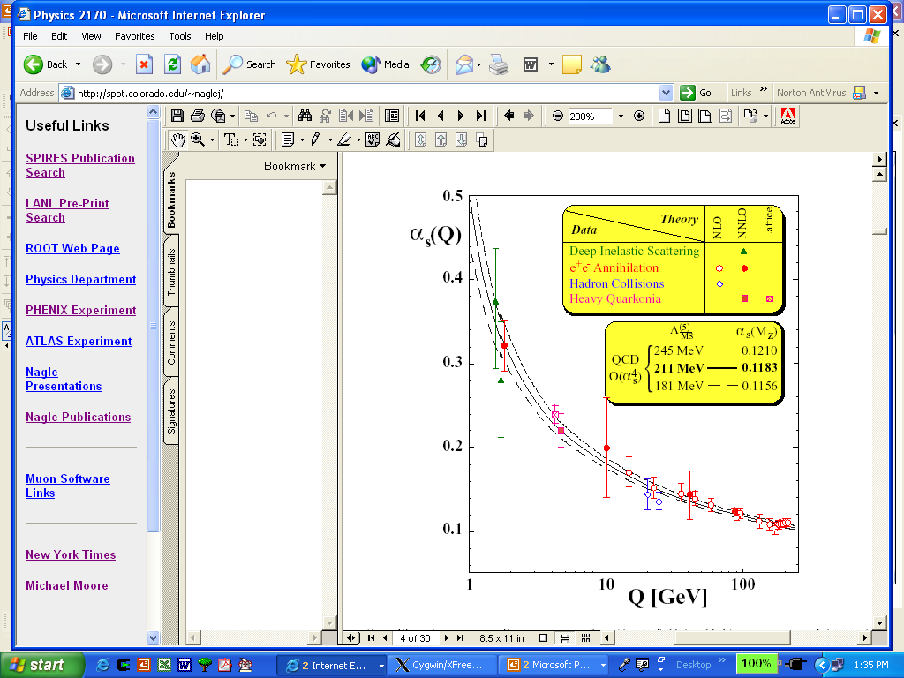
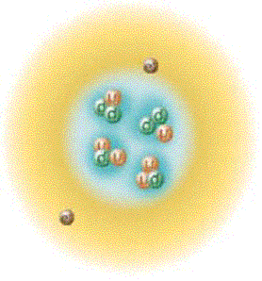
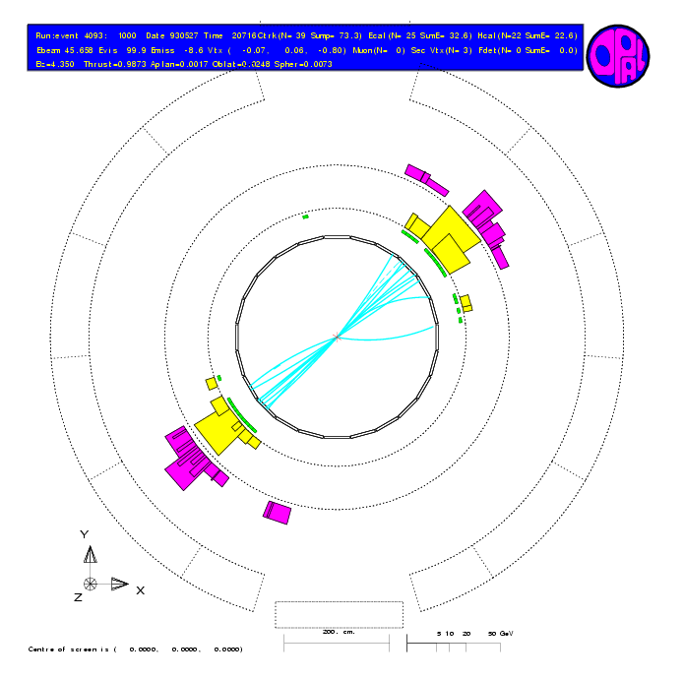
QCD: running of α_{S}
Asymptotic Freedom
Confinement
0.2 fm
0.02 fm
0.002 fm
Low momentum
High momentum

Slide 3
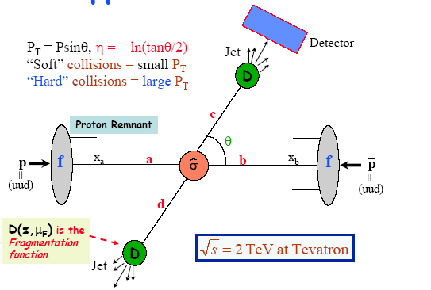
Perturbative QCD factorization in hadronic collisions
Hard process scale Q²>>Λ²_{QCD}
pQCD factorization:
  parton distribution fn f_{a/A}
  + partonic cross section σ
  + fragmentation fn D_{h/c}

Slide 4
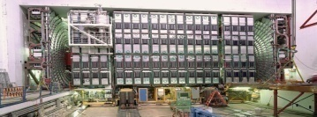
What really happens to produce a jet…
Final State Radiation
(FSR)
Detector
{π,K,p,n,…}
Initial State Radiation
(ISR)
Hadronization
Jet
p
Beam
Remnants
=
(uud)
Beam
Remnants
p
=
(uud)

Slide 5
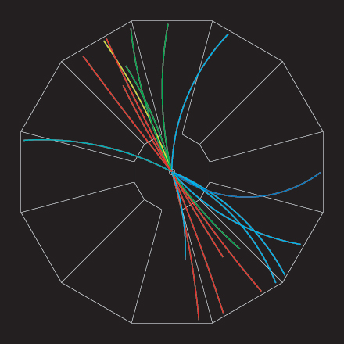
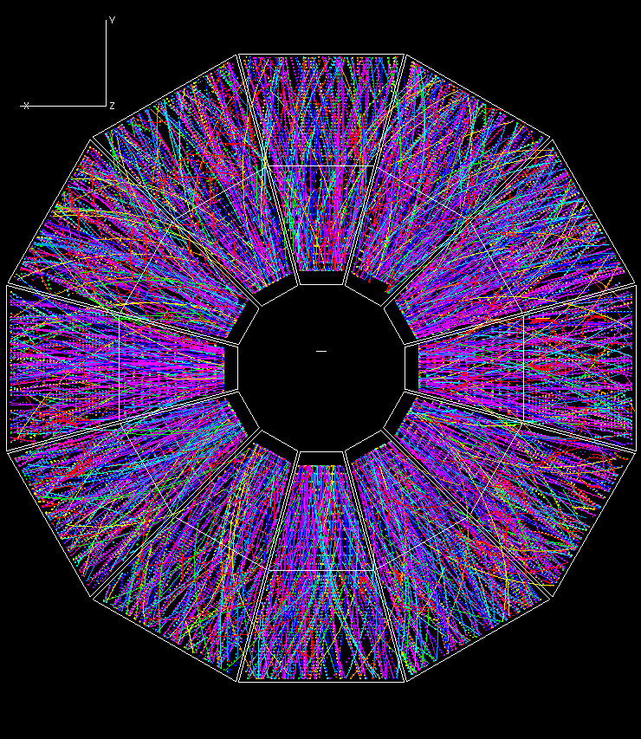
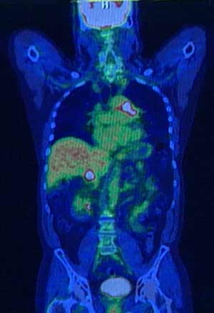
Jets in heavy ion collisions
Controlled “beams” with well-calibrated intensity
Final-state interactions with colored matter are calculable using controlled approximations
→ tomographic probe of the Quark-Gluon Plasma

Slide 6
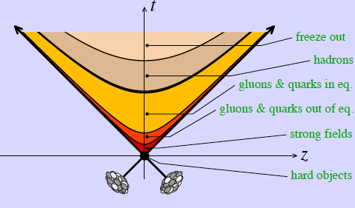
Jet
Jet

Slide 7
Jet quenching
Radiative energy loss in QCD (multiple soft scattering):
Plasma transport coefficient:
Total medium-induced energy loss:

Slide 8
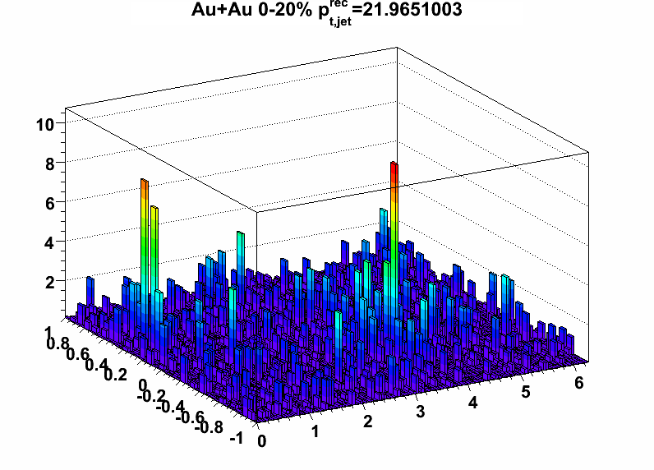
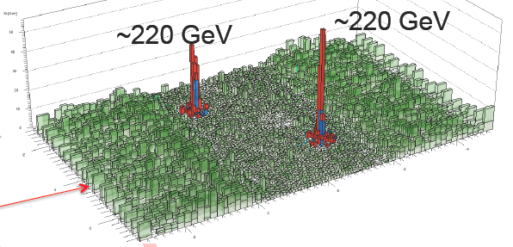
Jets in real heavy ion collisions
RHIC/Star
LHC/CMS

Slide 9
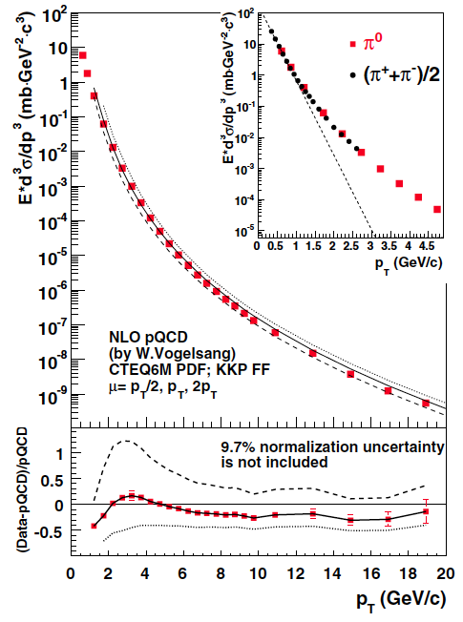
Leading hadron as a jet surrogate
PHENIX Phys Rev D76, 051106
π⁰
p+p
√s=200 GeV
Energy loss ⇒ softening of fragmentation ⇒ suppression of leading hadron yield
Binary collision scaling
p+p reference

Slide 10
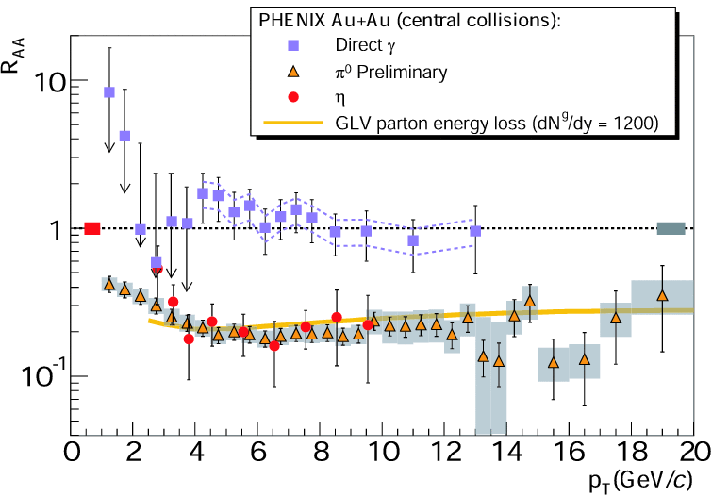
Jet quenching I: leading hadrons are suppressed, photons are not
Jet quenching
Photons (color-neutral)
Jet fragments (color-charged)

Slide 11
Jet quenching at the LHC: ALICE
Phys. Lett. B 696 (2011)
p+p reference at 2.76 TeV: interpolated
peripheral
central
p_{T}
p_{T}

Slide 12
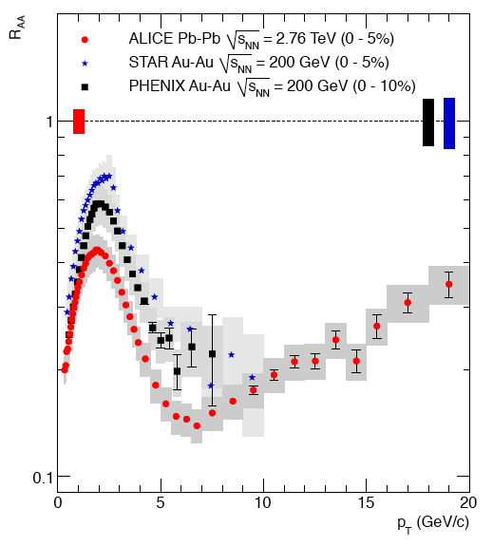
Jet quenching: RHIC vs LHC
RHIC/LHC charged hadrons
RHIC π⁰, η, direct γ
RHIC/LHC: Qualitatively similar, quantitatively different
Where comparable, LHC quenching is larger
  ➔higher color charge density

Slide 13
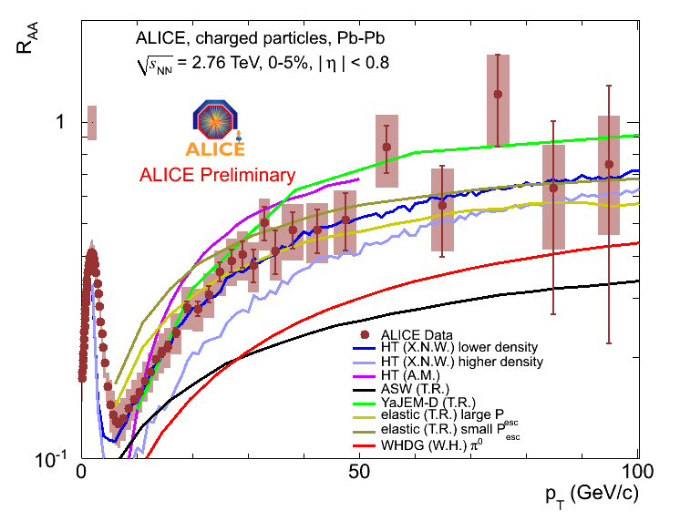
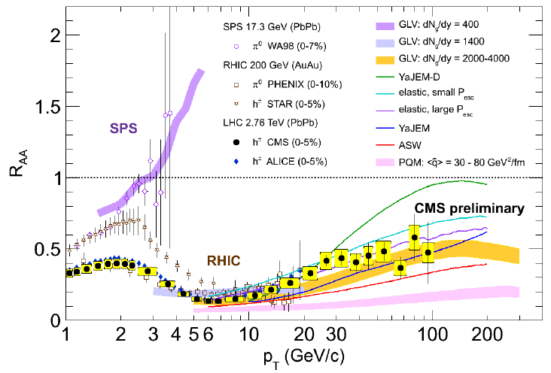
LHC jet quenching: comparison to pQCD-based models
Main variation amongst models:
  implementations of radiative and elastic energy loss
Models calibrated at RHIC, scaled to LHC via multiplicity growth
Key prediction: p_{T}-dependence of R_{AA} ( ΔE ~ log (E) ) - OK
Qualitatively: pQCD-based energy loss picture consistent with measurements
We can now refine the details towards a quantitative description

Slide 14
Calculation of quenching parameter qhat: pQCD vs AdS/CFT
Weakly coupled medium: perturbative QCD (Baier et al.):
Proportional to N_{C}² ~ entropy density
Strong coupling: N=4 SYM AdS/CFT (Liu, Rajagopal and Wiedemann):
NOT proportional to N_{C}² ~ entropy density
Roughly

Slide 15
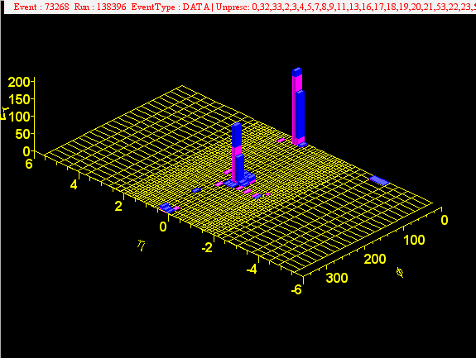
Full jet reconstruction
Jet quenching is a partonic process: can we study it at the partonic level?
Jet reconstruction: capture the entire spray of hadrons to reconstruct the kinematics of the parent quark or gluon

Slide 16
Jet measurements in practice: experiment and theory
Fermilab Run II jet physics
hep-ex/0005012
colinear safety:
  finite seed threshold misses jet on left?
infrared safety:
  one or two jets?
Algorithmic requirements:
same jets at parton/particle/detector levels
independence of algorithmic details (ordering of seeds etc)

Slide 17
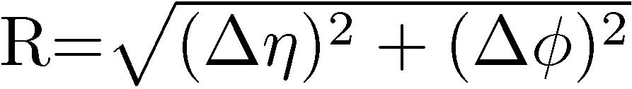
Modern jet reconstruction algorithms
Cone algorithms
  Mid Point Cone (merging + splitting)
  SISCone (seedless, infr-red safe)
Sequential recombination algorithms
    k_{T}
    anti-k_{T}
    Cambridge/ Aachen
Algorithms differ in recombination metric:
  ➔different ordering of recombination
  ➔different event background sensitivities
Jet
Fragmentation
Hard scatter
K_{T} jet
Cone jet
Modern implementation: FastJet (M. Cacciari, G. Salam, G. Soyez JHEP 0804:005 (2008))

Slide 18
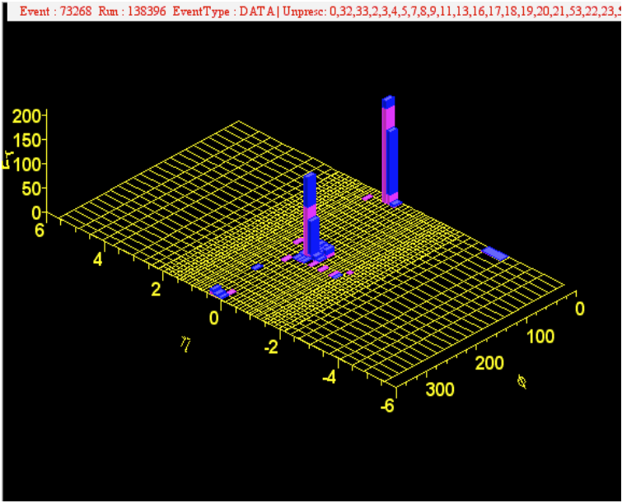
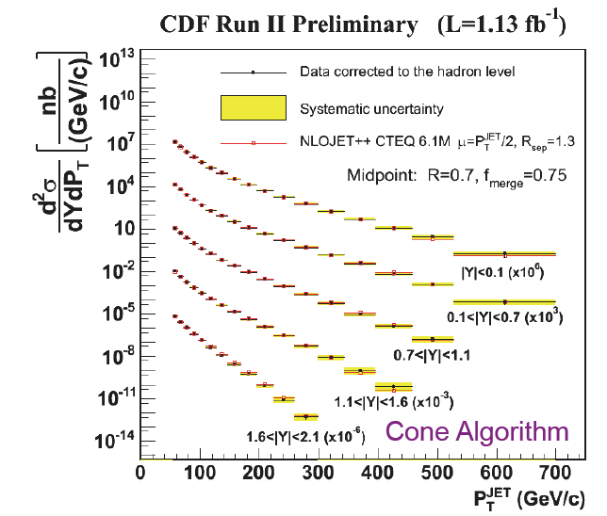
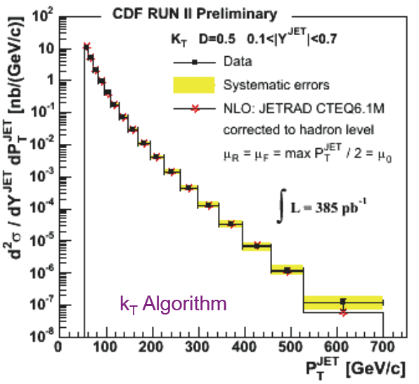
Jet production at collider energies
Good agreement with NLO pQCD

Slide 19
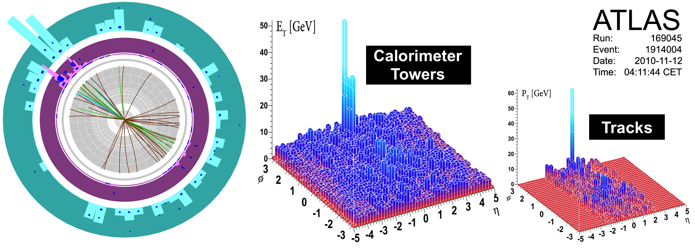
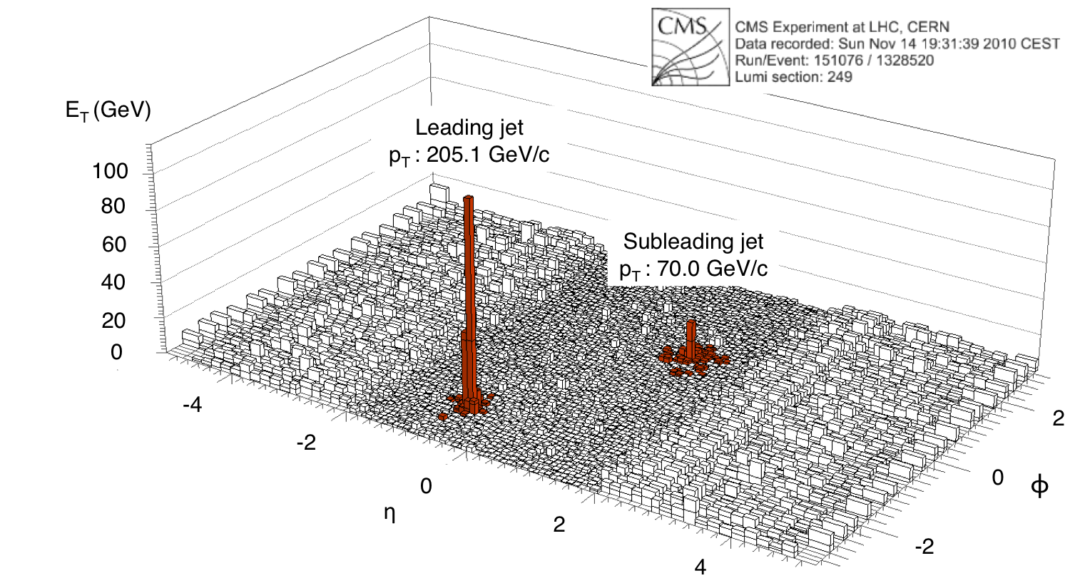
Jets in LHC Heavy Ion Collisions

Slide 20
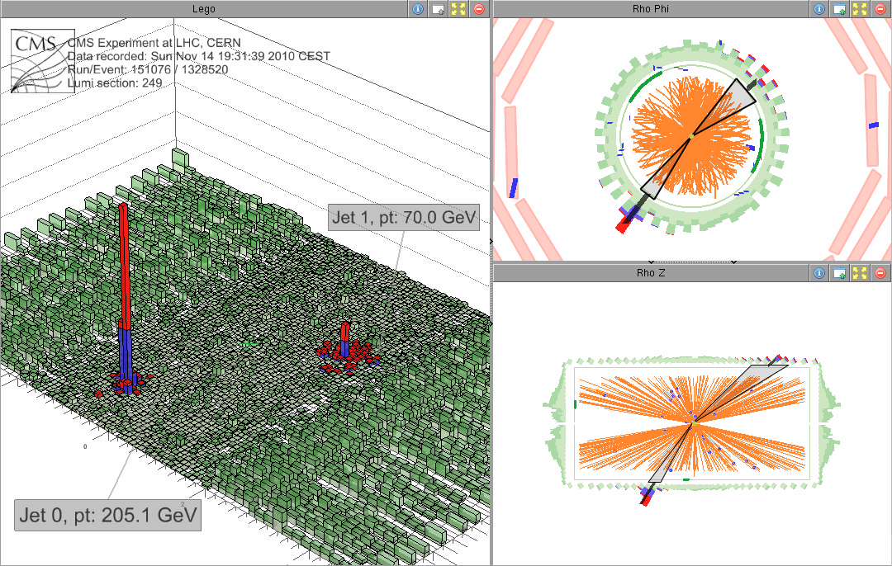

Slide 21
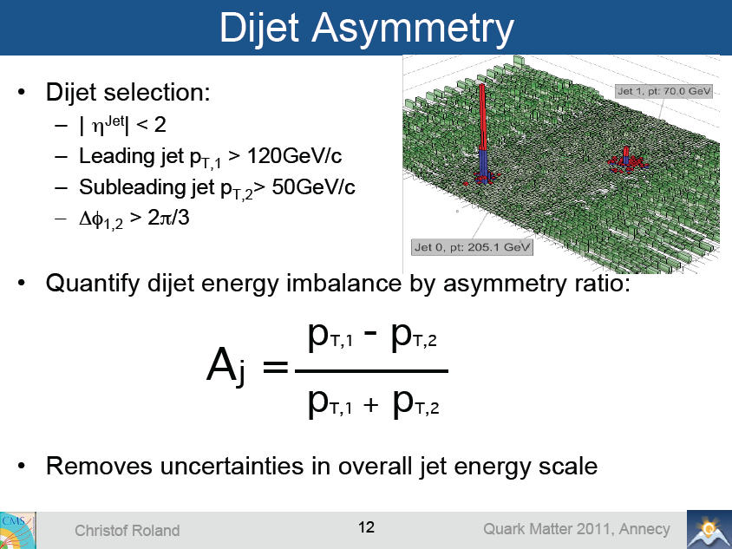

Slide 22
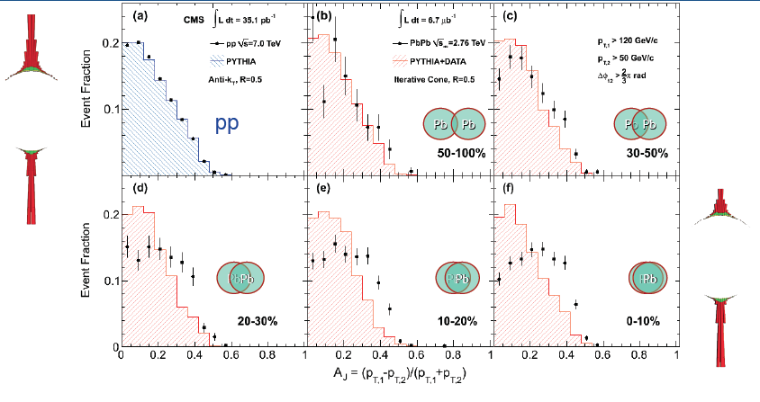
LHC Pb+Pb: Dijet energy imbalance
Large energy asymmetry in central collisions (seen by both CMS and ATLAS)
Is this jet quenching?

Slide 23
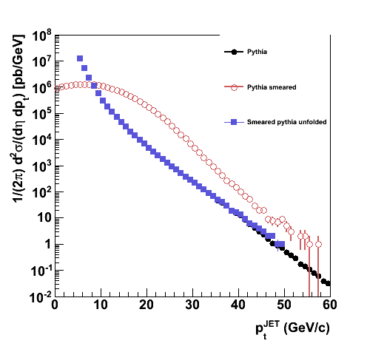
Jet measurements over large background
Background fluctuations distort measured inclusive cross section
Pythia
Pythia smeared
Pythia unfolded
unfolding
Warning: this is a large effect even for high energy jets at the LHC
But not corrected by ATLAS or CMS
  Instead, each makes ad hoc cuts to suppress magnitude of fluctuations and uses MC to estimate residual effects
Jet quenching = unknown modification of fragmentation; correct procedure?

Slide 24
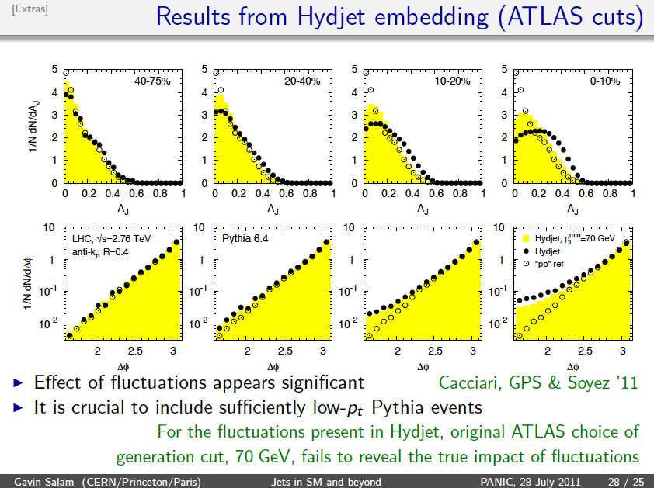
Test: PYTHIA+Fluctuations (no quenching)
Salam, Cacciari and Soyez ‘11
Looks like “jet quenching”, but unfortunately it isn’t

Slide 25
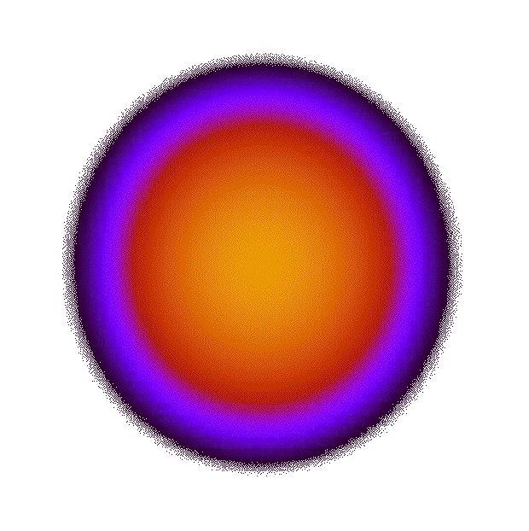
CMS: γ-Jet Correlations
Jet
θ
)
Ein
Ein-ΔΕ
γ
Correlate Isolated Photons with Jets
  Photons do not interact with the medium
    Tag initial parton energy and direction
  γ-Jet channel selects predominantly quark jets

Slide 26
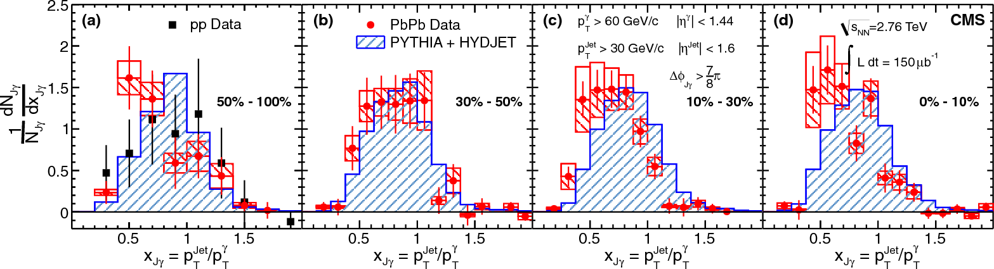
CMS: γ-Jet Momentum Balance
Submitted to PLB, arXiv:1205.0206
p_{T}^{γ} > 60 GeV/c |η| < 1.44
p_{T}^{Jet}> 30 GeV/c |η| < 1.6
Peripheral collisions: no quenching expected
MC (blue) and Data (red) distributions should match
but they don’t: issues with MC, residual fluctuations, biased jet reconstruction,…?
Momentum ratio shifts/decreases with centrality
  jets shifting below the 30 GeV p_{T} threshold not included
C. Roland, Hard Probes ‘12

Slide 27
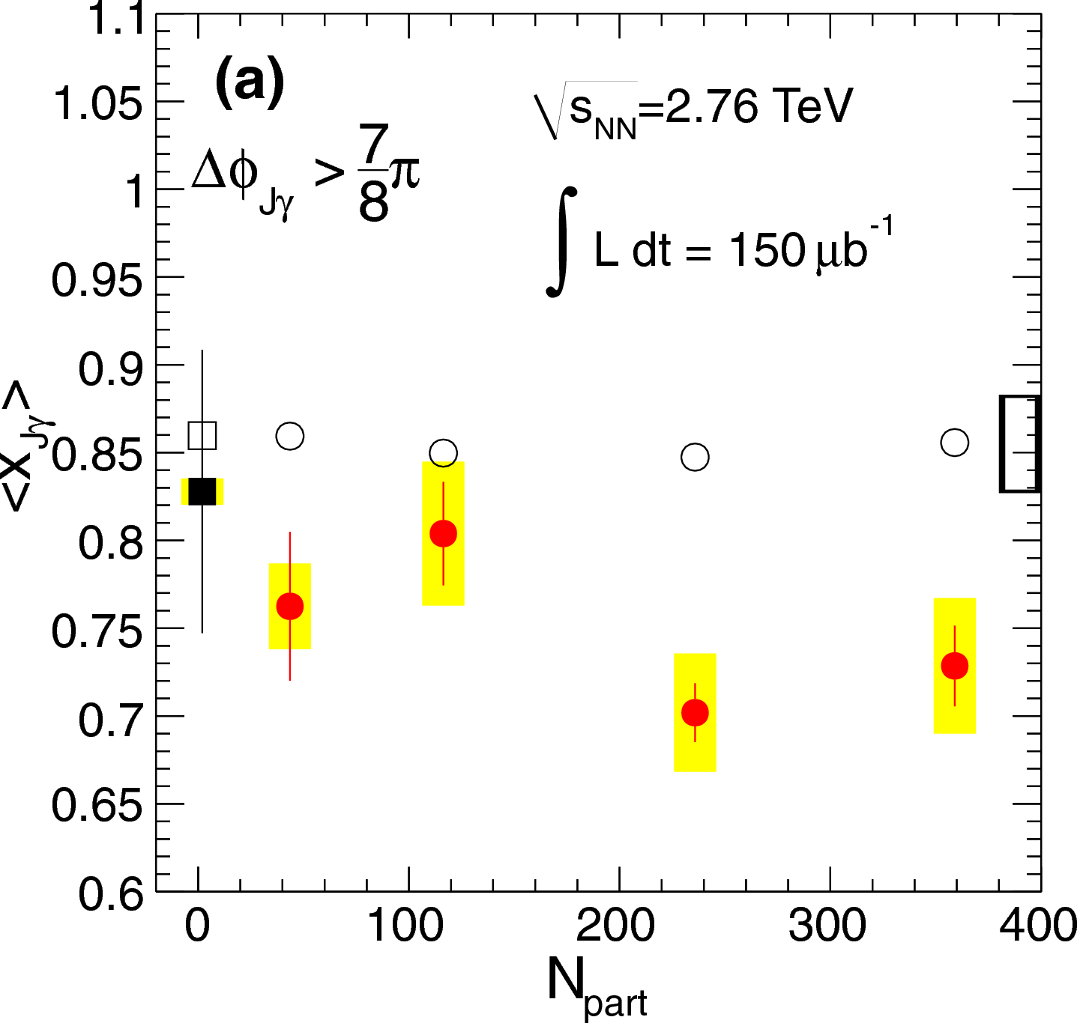
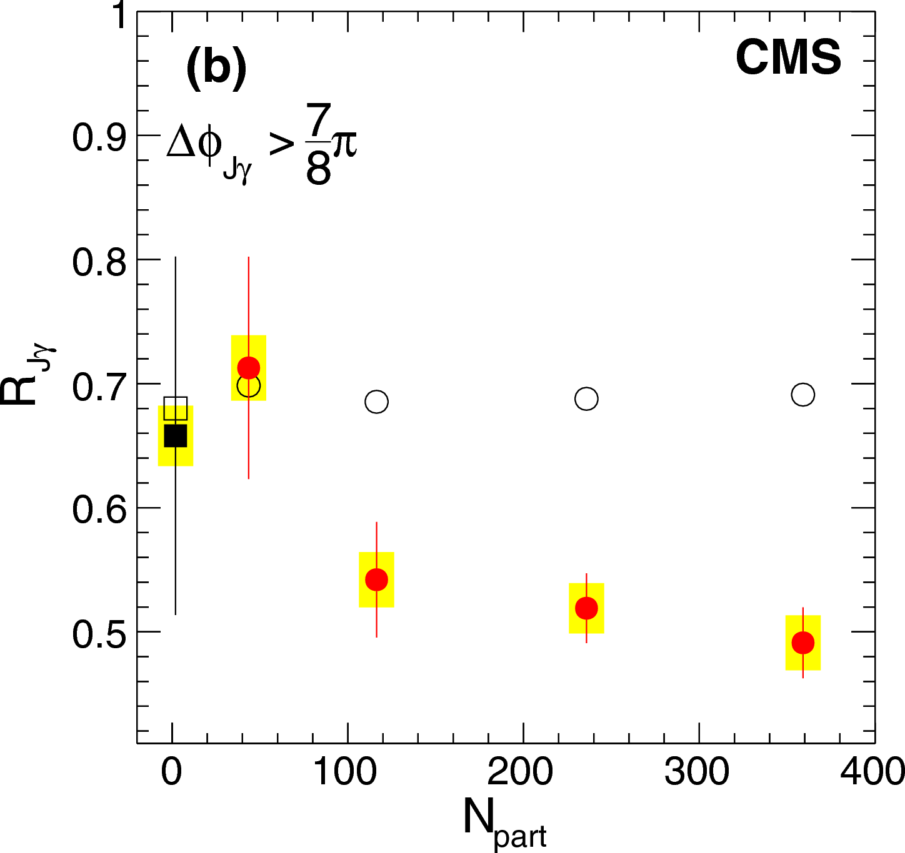
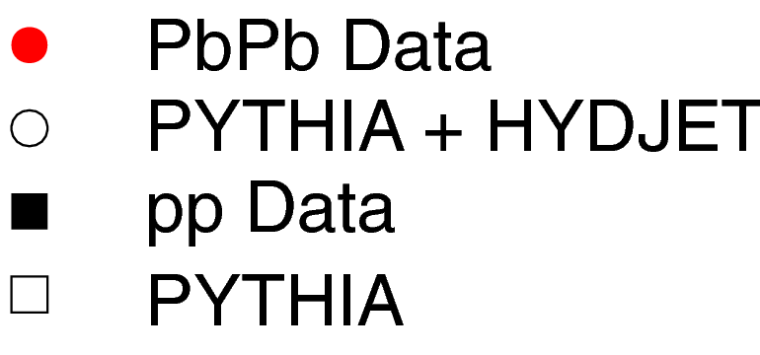
CMS: γ-Jet Momentum Balance vs. Centrality
Mean x_{Jγ}
γ-Fraction without jet: R_{Jγ}
CMS
pmj: no clear evidence of jet quenching…???
CMS speaker‘s comments:
Significant deviation of〈x_{Jγ}〉in PbPb compared to PYTHIA + HYDJET
The centrality dependence is mostly visible in R_{Jγ}
  jet p_{T} shifting below the 30 GeV threshold
Yue Shi Lai, Parallel VB, Thursday 16:30

Slide 28
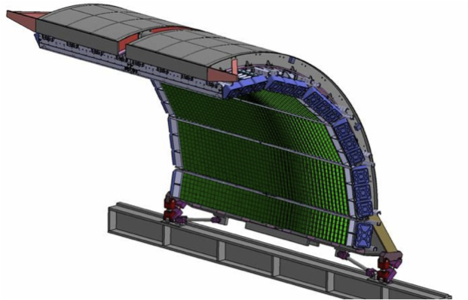
ALICE jet measurements
EMCal: Pb-scintillator sampling calorimeter which covers:
|η|<0.7, 80°<φ<180°
11520 towers with each covers
ΔηxΔφ~0.014x0.014
Tracking:|η|<0.9, 0<φ<360°
TPC: gas detector
ITS: silicon detector
Charged
constituents
Neutral
constituents
Jet

Slide 29
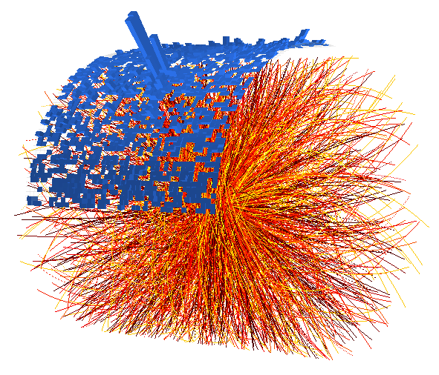
ALICE jet measurement strategy
Measure almost all jet constituents explicitly
  Efficient charged particle tracking over wide p_{T} range
  Highly granular EM calorimetry
pp collisions: well controlled systematics
  Jet Energy Scale uncertainty ~4% at p_{T}=100 GeV/c
    ~20% cross section uncertainty

Slide 30
pp at √s = 2.76 TeV: inclusive jet cross section
Talk: R. Ma
Agreement within uncertainties with NLO pQCD, PYTHIA8

Slide 31
pp at √s = 2.76 TeV: ratio of jet cross-sections R=0.2/R=0.4
Probe of jet structure
Talk: R. Ma
Soyez ‘12: direct calculation of ratio is effectively NNLO
Reasonable agreement with NLO+hadronization
ALICE Jets in heavy ions: coming soon, with very different systematics…

Slide 32
Recall the summary of Lecture 1: scorecard
Red=progress
Blue=interesting ideas
Black=still thinking
What is the nature of QCD Matter at finite temperature?
  What is its phase structure?
  What is its equation of state?
  What are its effective degrees of freedom?
    Is it a (trivial) gas of non-interacting quarks and gluons, or a fluid of interacting quasi-particles?
  What are its symmetries?
  Is it correctly described by Lattice QCD or does it require new approaches, and why?
What are the dynamics of QCD matter at finite temperature?
  What is the order of the (de-)confinement transition?
  How is chiral symmetry restored at high T, and how?
  Is there a QCD critical point?
  What are its transport properties?
Can QCD matter be related to other physical systems?
Can we study hot QCD matter experimentally?

Slide 33
Backup

Slide 34
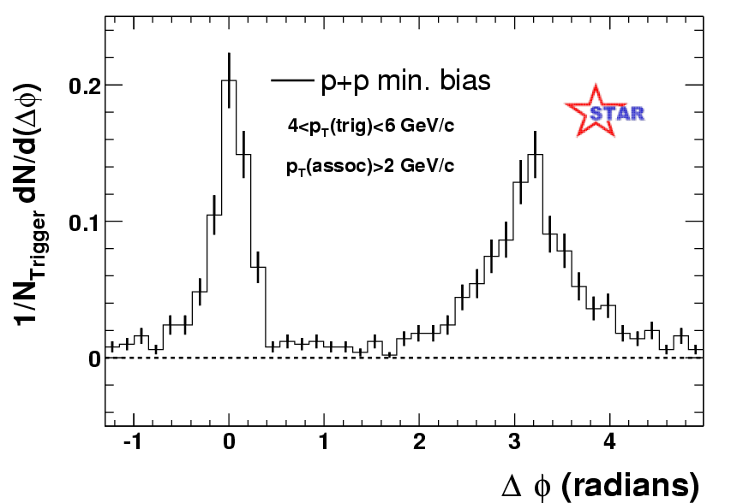
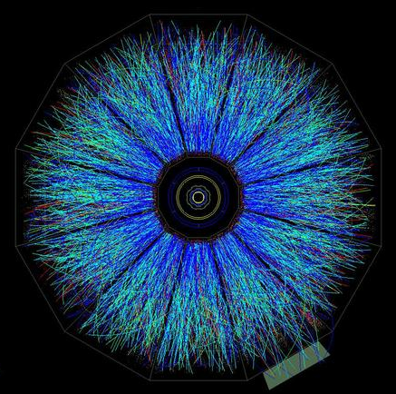
Di-hadron correlations as a jet surrogate
trigger
STAR, Phys Rev Lett 90, 082302
trigger

Slide 35
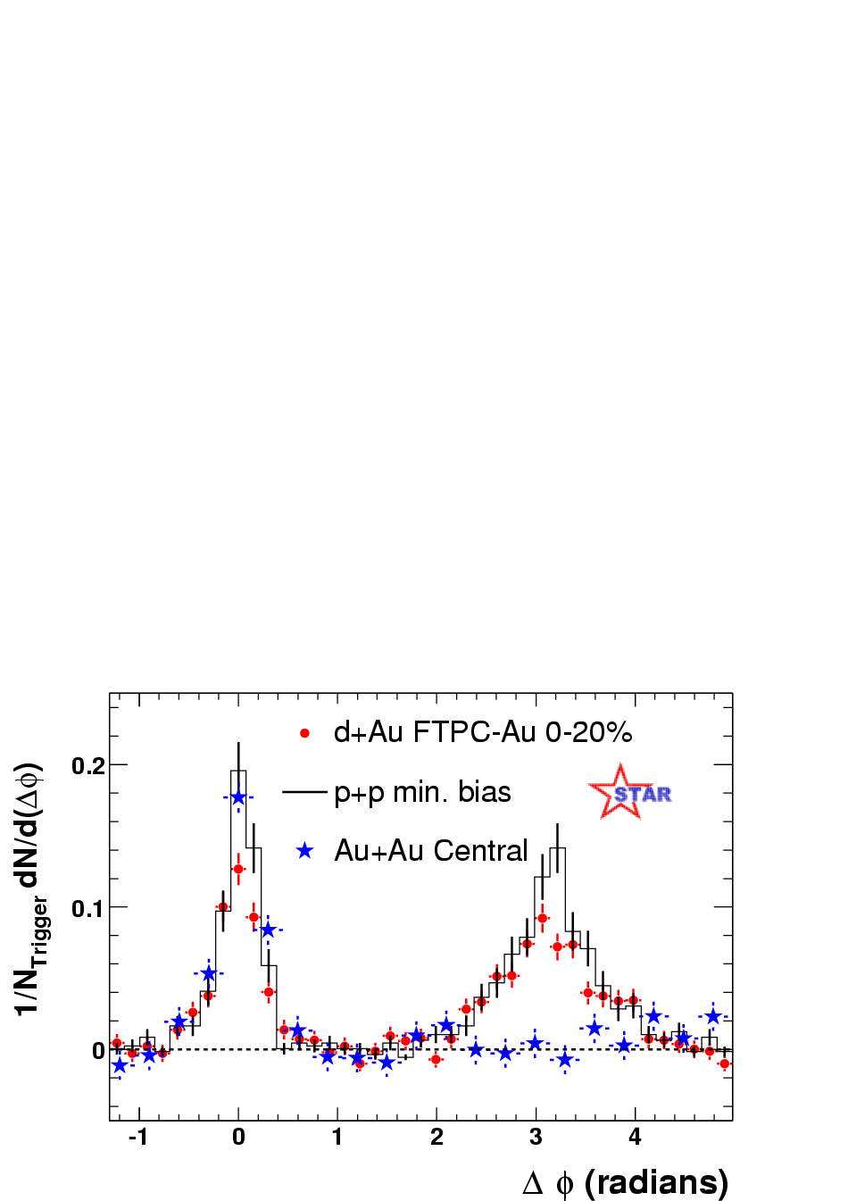
Jet quenching II: di-hadrons
Azimuthal separation of high pT hadron pairs
trigger
Jet quenching
X
recoil
STAR, Phys Rev Lett 91, 072304
Recoiling jet is strongly altered by medium
Clear evidence for presence of very high density matter

Slide 36
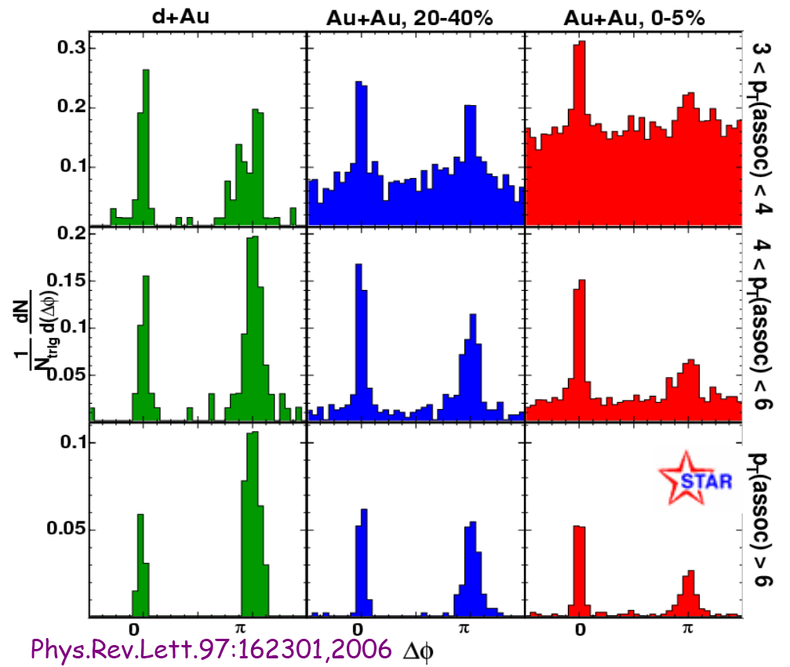
Di-hadron correlations at high-pt
Reaperance of the away side peak at high-assoc.-pT:
similar suppression as inclusive spectra
no angular broadening
Central collisions
Differential measurement of jets
w/o interaction
High-pT

Slide 37
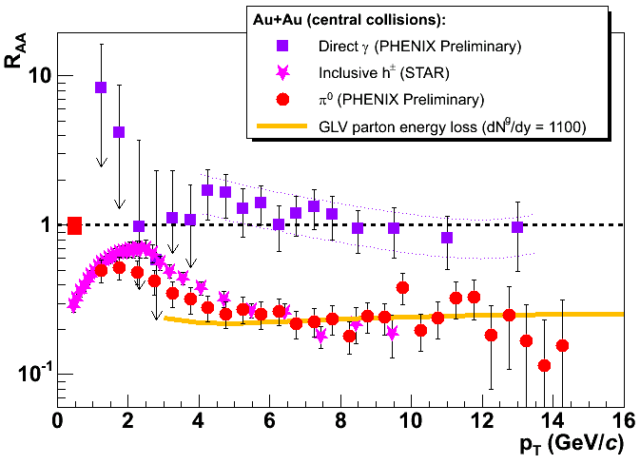
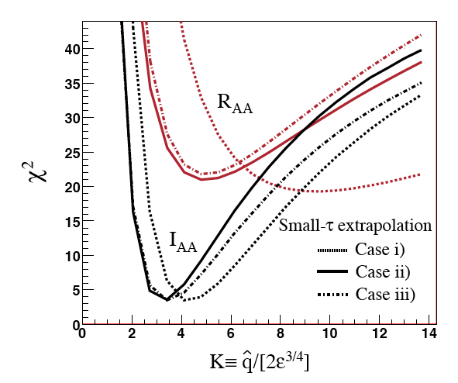
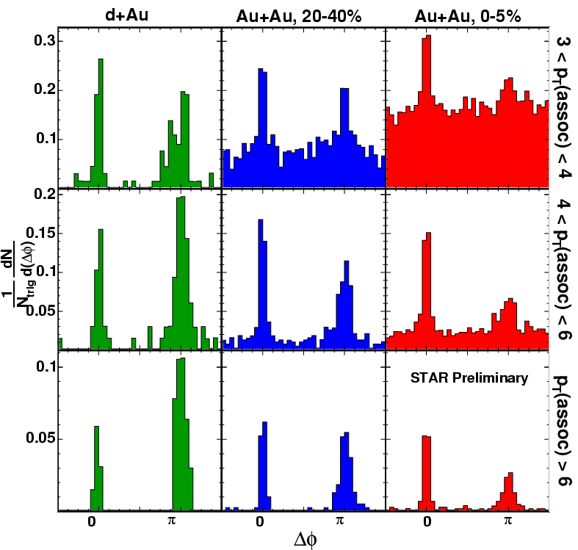
QCD analysis of jet quenching
Model calculation: ASW quenching weights, detailed geometry
Simultaneous fit to data.
Conditional yield
Armesto et al.
0907.0667 [hep-ph]
Δφ
~Self-consistent fit of independent observables
Data have good precision: limitation is accuracy of the theory

Slide 38
Inclusive jet cross sections at √s=200 GeV
M. Ploskon QM09
Consistent results from different algorithms
Background correction ~ factor 2 uncertainty in xsection

Slide 39
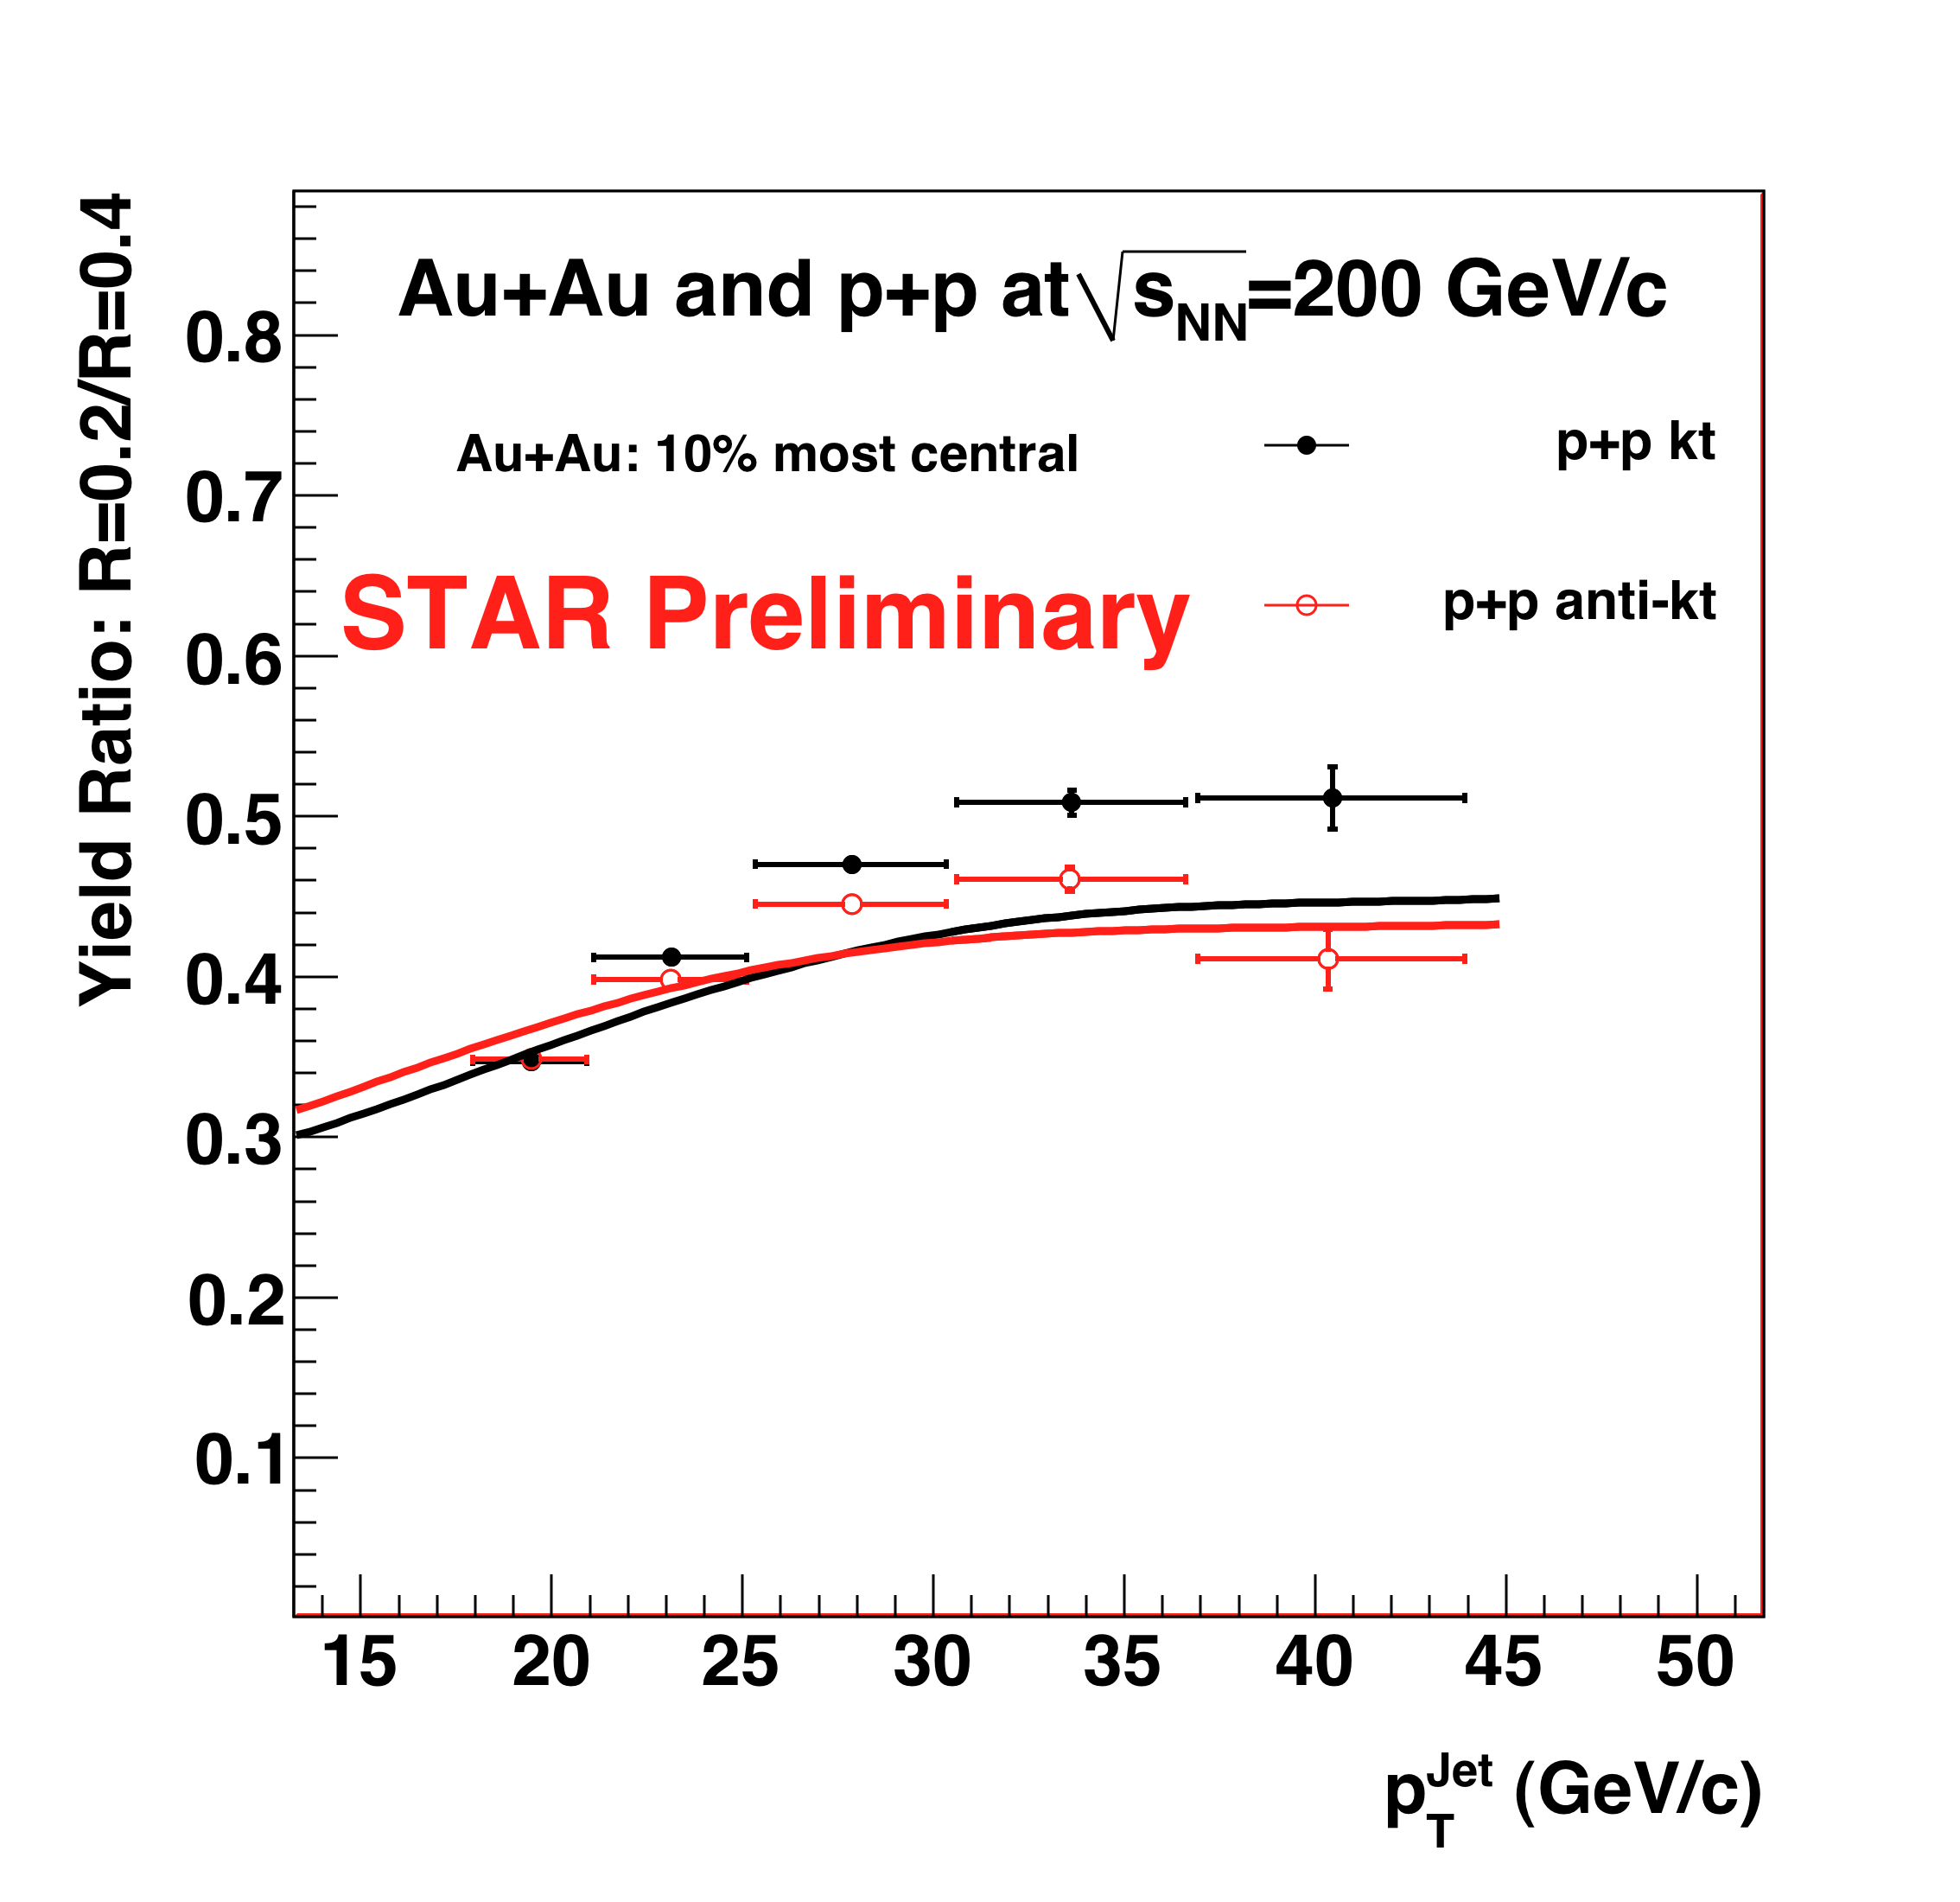
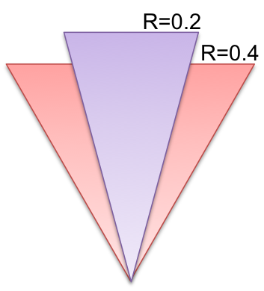
Inclusive cross-section ratio: p+p R=0.2/R=0.4
compare within same dataset: systematically better controlled than R_{AA}
Solid lines:
Pythia – particle level
Narrowing of the jet structure with increasing jet energy

Slide 40
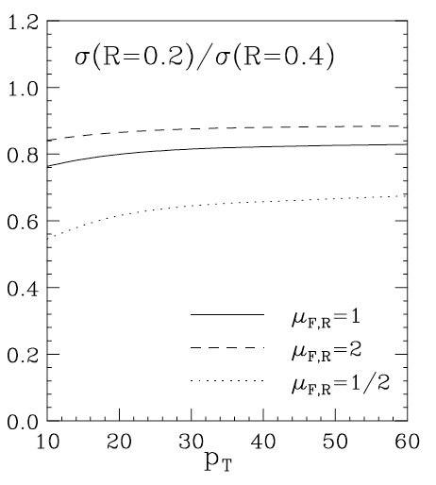
Inclusive cross-section ratio in p+p: compare to NLO pQCD
NLO pQCD calculation
W. Vogelsang – priv. comm. 2009
Solid lines:
Pythia – particle level
Narrowing of structure with increasing energy
NLO: narrower jet profile
  ➔hadronization effects?

Slide 41
Jet hadronization
pQCD factorization:
  parton distribution fn f_{a/A}
  + partonic cross section σ
  + fragmentation fn D_{h/c}

Slide 42
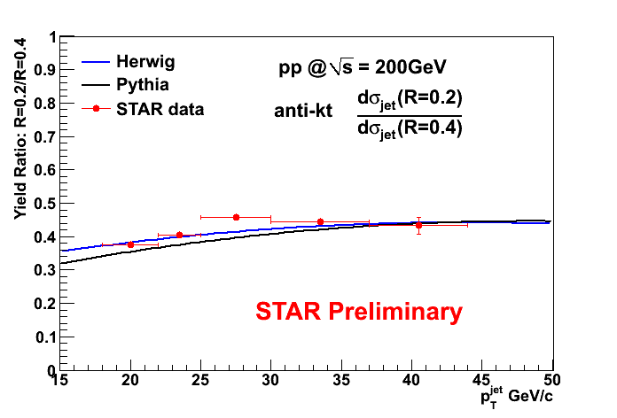
Hadronization effects: HERWIG vs. PYTHIA
Different hadronization models generate closely similar ratios

Slide 43
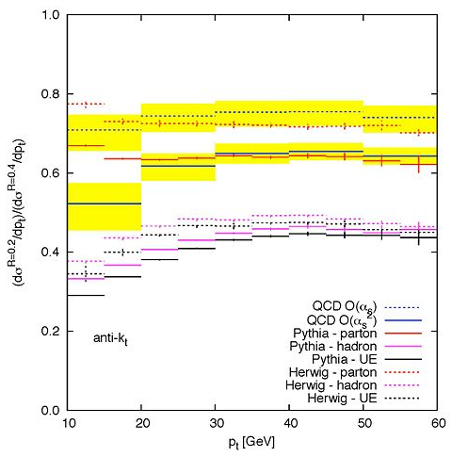
σ(R=0.2)/σ(R=0.4) : NNLO calculation
G. Soyez, private communication
p+p
√s=200 GeV
QCD NLO
QCD NNLO
PYTHIA parton level
PYTHIA hadron level
HERWIG hadron level
|η|<0.6
Broadening due to combined effects of higher order corrections and hadronization

Slide 44
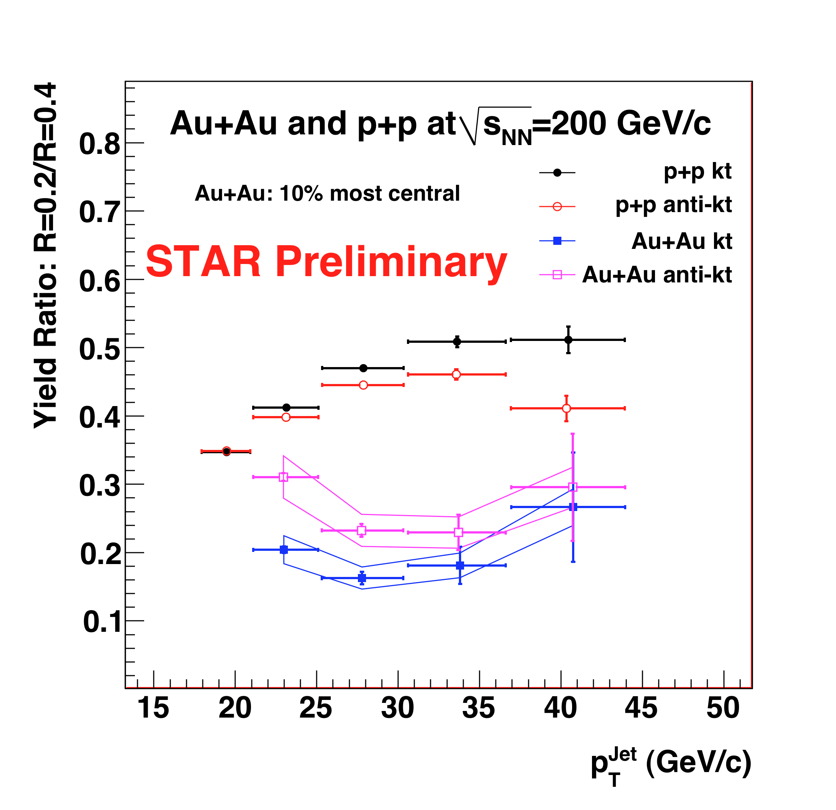
Incl. cross-section ratio: Au+Au R=0.2/R=0.4
Main result of this analysis
Marked suppression of ratio relative to p+p
  ➔medium-induced jet broadening

Slide 45
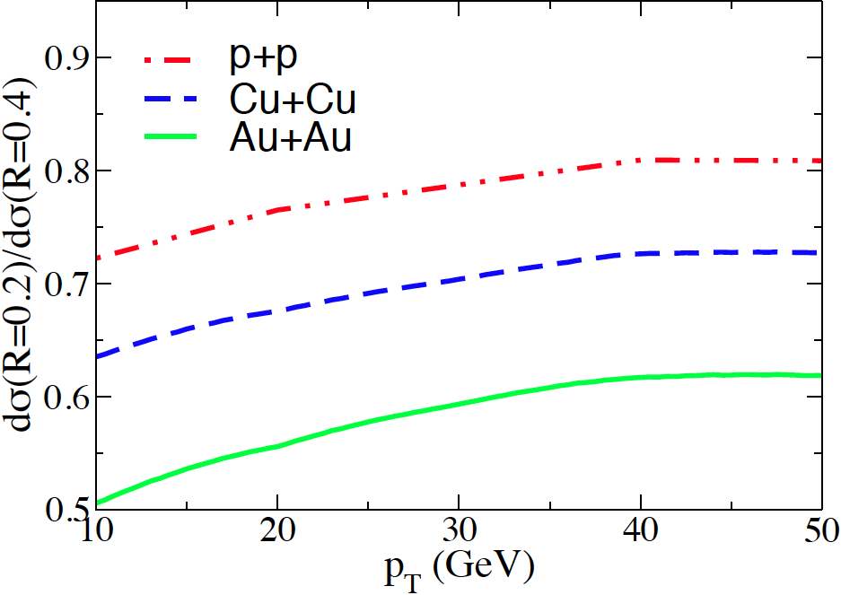
Incl. cross-section ratio Au+Au: compare to NLO
NLO with jet quenching (GLV)
B.-W. Zhang and I. Vitev
Phys. Rev. Lett. 104, 132001 (2010)
Stronger broadening in measurement than NLO
…work in progress for both experiment and theory…

