Slide 1
Public Events Committee
26 July 2022

Slide 2
Schedule for 2023
Date | Name | Format | Theme | Audience | Location
Jan - Apr 23 | Shows scientifiques | Shows | Science | General public + children | Globe
Sept - Dec 23 | Shows scientifiques | Shows | Science | General public + children | Globe
08-Feb | La Forza Nascosta | Theater + music | Science - Women | General public | Globe
02-Mar-23 | Bruno Mansoulié | Conference | Science | General public | Globe
11-Mar-23 | Devoxx4kids (recurrent) | Workshops | Scince - IT | Children + teenagers | Globe
23 mars 2023 | Mad Maths | Theater | Science - Mathematics | General public + Children | Globe
May |  |  |  |  | Globe
June |  |  |  |  | Globe
First week of October | Opening of SG |  |  |  | SG
14-Oct-22 | Partage ta science (recurrent) | Colloquium | Science | General public + teens | Globe
October | Dark Matter Day (recurrent) |  |  |  | Globe
6-10 November | CineGlobe evening (recurrent) |  |  |  | SG if possible
16 November | Sparks! (recurrent) |  |  |  | SG if possible
Notes:
Add the Scientific Conference to mark the anniversary of neutro and WZ

Slide 3
Already approved but not scheduled
De temps en temps
  “Le temps étant un élément central de ces deux disciplines, en plus d’explications présentées par l’altiste du quatuor, un support musical est employé par le quatuor pour illustrer des concepts comme le rubato, le rythme, le musique répétitive etc”
  🡪 Postponed to early next year
Aurélie Jean (FR) – Author of «Les algorithmes font-ils la loi ?»
  Computational scientist. Ph.D. in digital science, former researcher at MIT and Penn State
  One of the 40 most influential women in France
  Entrepreneur, Founder of In Silico Veritas
  🡪 Wait for a comms hook

Slide 4
Already approved need to be scheduled soon
Hugo Duminil-Copin (FR) – 2022 Fields Medalist
  Professor of Mathematics, UNIGE. He studies phase transitions - abrupt changes in the properties of matter, such as the transition from the gaseous state to the liquid state of water - using probability theory.
  🡪 Shall we follow-up for May/June or leave for next year?
Jean-Marc Jancovici (via GFC)
  partner of a consultancy specialized in low carbon transition, president of a NGO active in the same field, professor, and author of books and columnist.
  🡪 Frédérick to follow-up for SG next year
David Townsend Instead he is suggesting Avi Loeb (John Grace distinguished lecture)
  former chair of the Harvard Astronmy department, Director, Institute for Theory and Computation (ITC), Founding Director, Black Hole Initiative (BHI), Chair, Breakthrough Starshot Advisory Committee and Chair, Board on Physics and Astronomy, National Academies
  Now he thinks we might have glimpsed evidence of an alien civilization… https://www.smithsonianmag.com/science-nature/wonder-avi-loeb-180978579/
  🡪 Pascale to follow-up

Slide 5
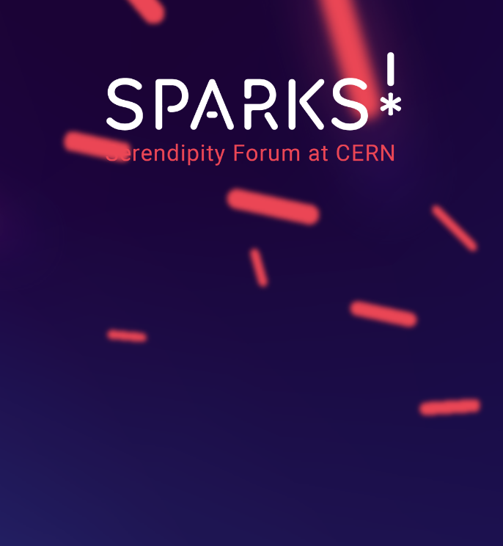
3rd edition Sparks – Quantum (TBC)
Dates: 16 Nov 2023 (TBC) and March/April 2024 / Theme: Quantum (TBC) / Comms hooks: CERN Quantum Technology Initiative (CERN QTI)
Description/Format
2023 - 16 Nov - Public talk/panel record as video and as one PODCAST
2024 - March/April
8 short talks with Q&A and artistic intervention (large event)
Forum and panel - March/April
Forum (optional - forum could be split into two mornings)
Panel (instead of a wrap-up session of the forum) - (a small size event)
Duration: 2 hours
Audience: Interested General public / Language: EN / Gender: all
Cost: externally funded
Link: https://sparks.cern/

Slide 6
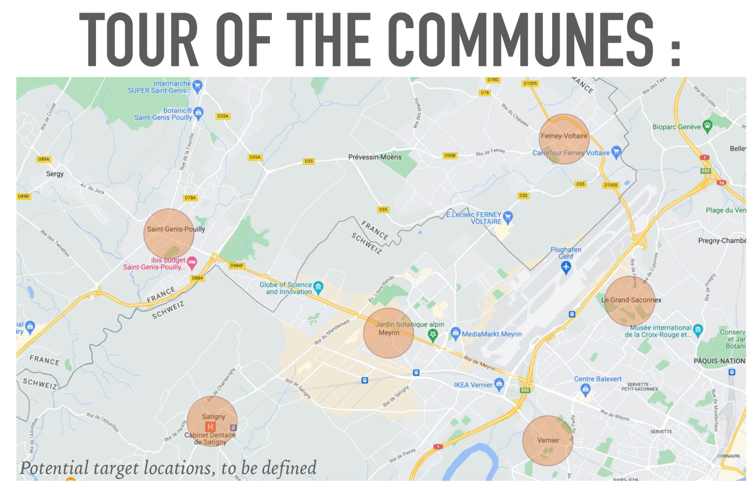
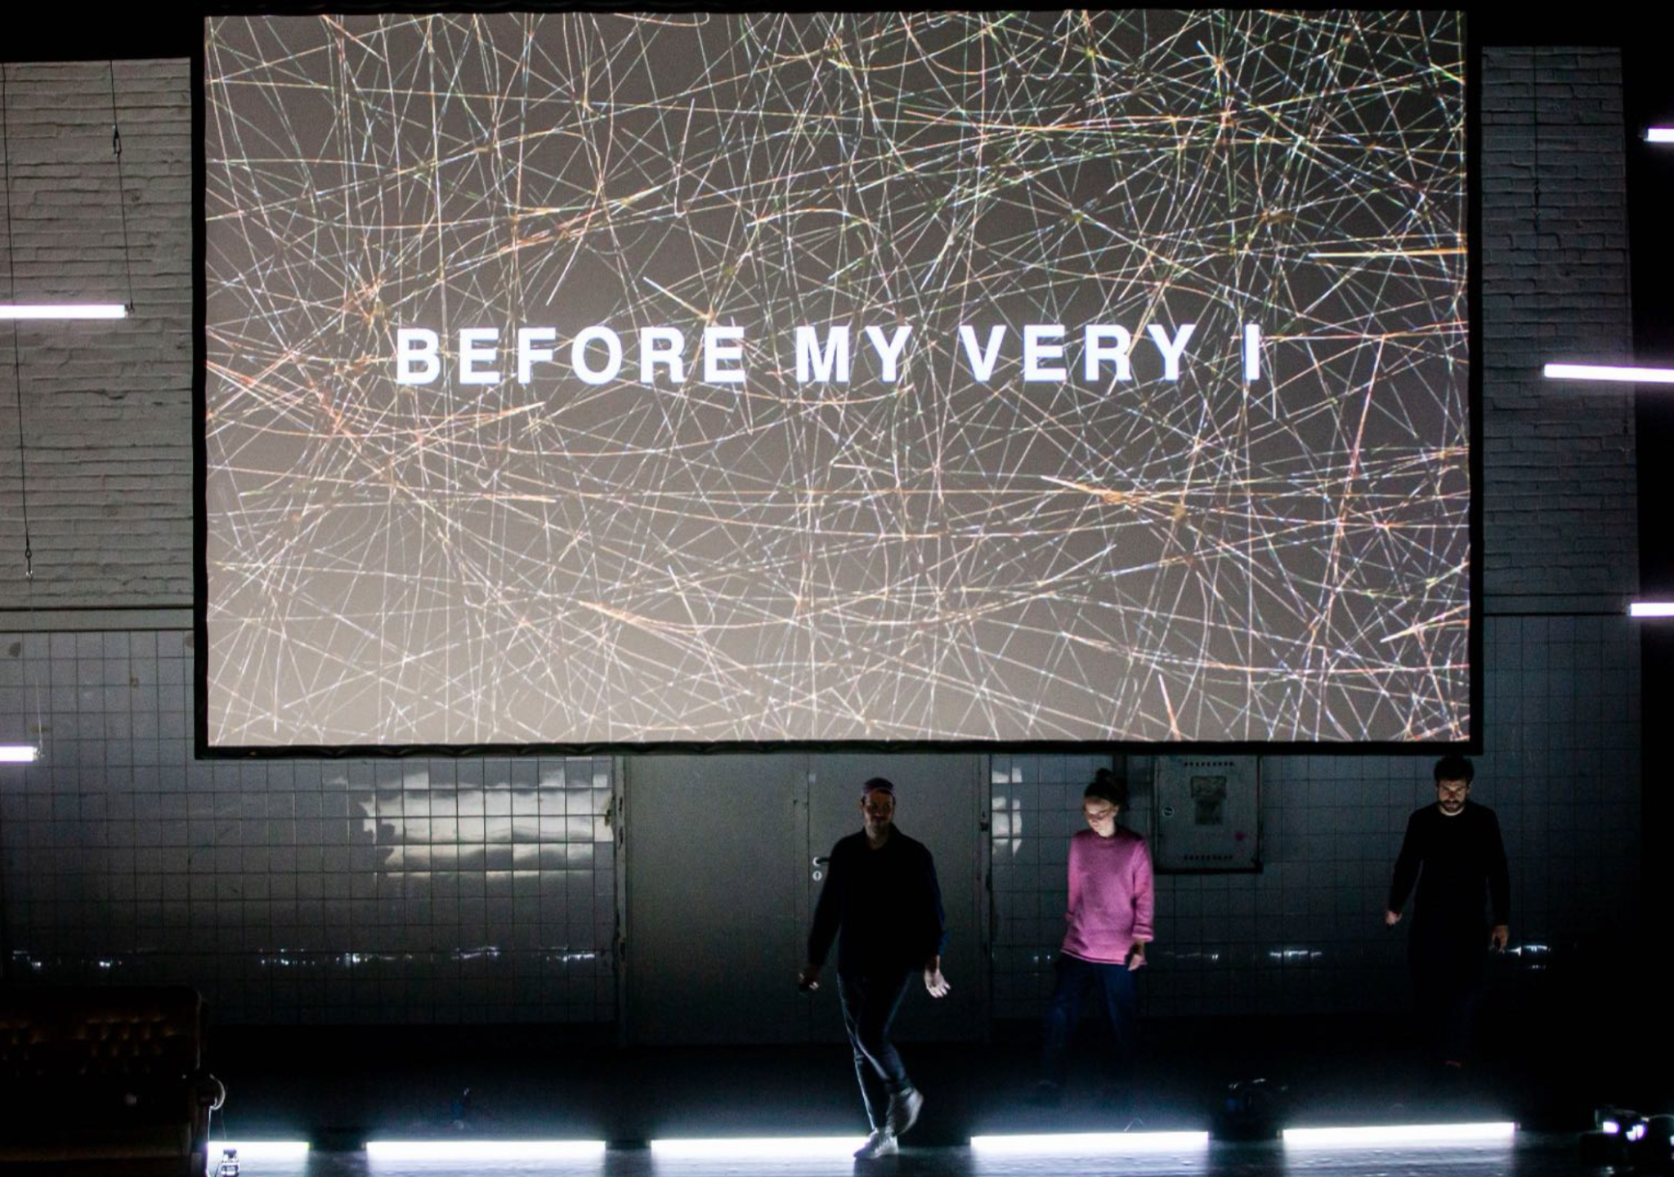
Cineglobe Film Festival
“Made to measure”
Dates: 3rd or during the week 6-10 if on Science Gateway / Theme: data privacy / Comms hook: 28 of January is data privacy day
Description: CineGlobe this year will be present among few of the communities around CERN
The closing gala event in end of the year at the Science Gateway/Globe with a co-production between CineGlobe and Laokoon, whose filmmakers produced The Cleaners and Made to Measure and have been awarded with numerous prizes. This live performance will mix cinema, theater and internet data through of a scientific experiment based on data, actors, recorded, and the audience itself. The performance will compose of 3 steps:
DATA SCIENTIST PRESENTS TASTES, PREDOMINANT TRAITS, CORRELATIONS. AUDIENCE VOTES ON CHARACTERISTICS, LIKE JOB, GENDER, AGE, ETC.
AUDIENCE IS PROVIDED WITH FOUR ACTORS THAT PRESENT VIGNETTES FROM THE DATA. THEY VOTE ON THE CHARACTER THEY BELIEVE IS CLOSEST TO THE REAL PERSON.
THE REAL PERSON AND THE ACTOR MEET ON STAGE AND CONDUCT AN INTERVIEW REVEALING WHAT IS REAL AND WHAT IS NOT.
Format: film, theater and interaction / Duration: 2 hours
Audience: General public / Language: EN / Gender: all
Cost: externally funded
Link to proposal: https://cernbox.cern.ch/remote.php/dav/public-files/ZkrkDssPSRsHfSL/2023/PROPOSALS/CineGlobe2023-ProjetDétaillé.v2.pdf

Slide 7
Dark Matter Day
2017 – Don’t be afraid of the dark!
- Katherine Leney, ATLAS Researcher
- Wessel Valkenburg, Research Fello at the Theory Department
2018 – A la recherche de la matière cachée de l’univers
- Marco Cirelli, CNRS Researcher at Sorbonne University
2019 – La matière noire : du côté de l’infinement petit et de l’infiniment grand
- Cécile Renault, Research Director, CNRS
- Sabine Crépé-Renaudin, Research Director, CNRS
2021 – Vera
- Dance performance on the life of Vera Rubin
- Talk – Searching for the heaviest and lightest particles in the universe by Nicholas Rodd (CERN TH)
- Suggestion - see next slide…

Slide 8
New Proposals

Slide 9
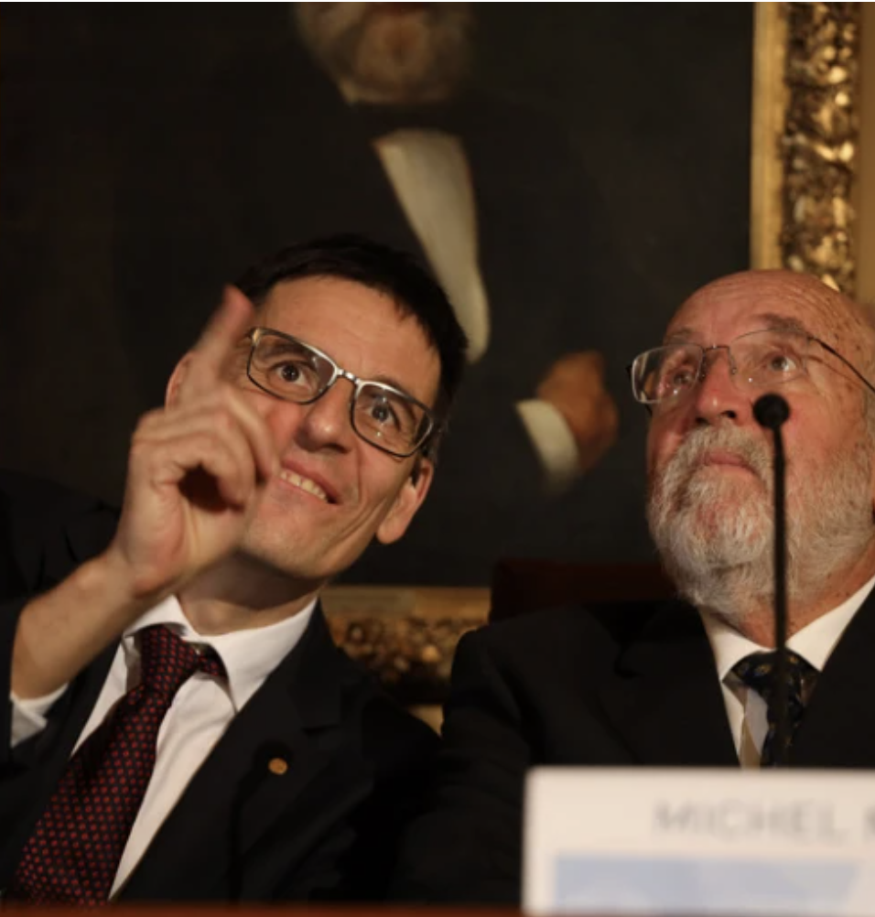
Talk - by Michel Mayor and discussion with Catherine Deglioni from ATLAS, moderated by Paola Catapano
Dates/Comms hooks: He is currently booked to give a library talk at the main auditorium on 19 June 2023. Should we offer to host it at the Globe OR try to postpone it for around the 31 October for Dark Matter Day and hopefully host it at SG. Alternatively, we can leave it for next year
Proposed by: Paola Catapano and Marilena Streit-Bianchi
Description: Book “ Advances in Cosmology - Science, philosophy and art” for event on 19 June with Paola and Marilena - https://acrobat.adobe.com/link/track?uri=urn%3Aaaid%3Ascds%3AUS%3Af71fb7ab-fc23-38c4-b492-754310334240&viewer%21megaVerb=group-discover
Speaker: Michel Mayor - Together with Didier Queloz in 1995, he discovered 51 Pegasi b, the first extrasolar planet orbiting a sun-like star, 51 Pegasi.^{[5]} For this achievement, they were awarded the 2019 Nobel Prize in Physics "for the discovery of an exoplanet orbiting a solar-type star"^{[6]} resulting in "contributions to our understanding of the evolution of the universe and Earth’s place in the cosmos”
Format: talk / Duration: 90 ming / Audience: interested general public / Gender: all / Language: FR
Costs: none

Slide 10
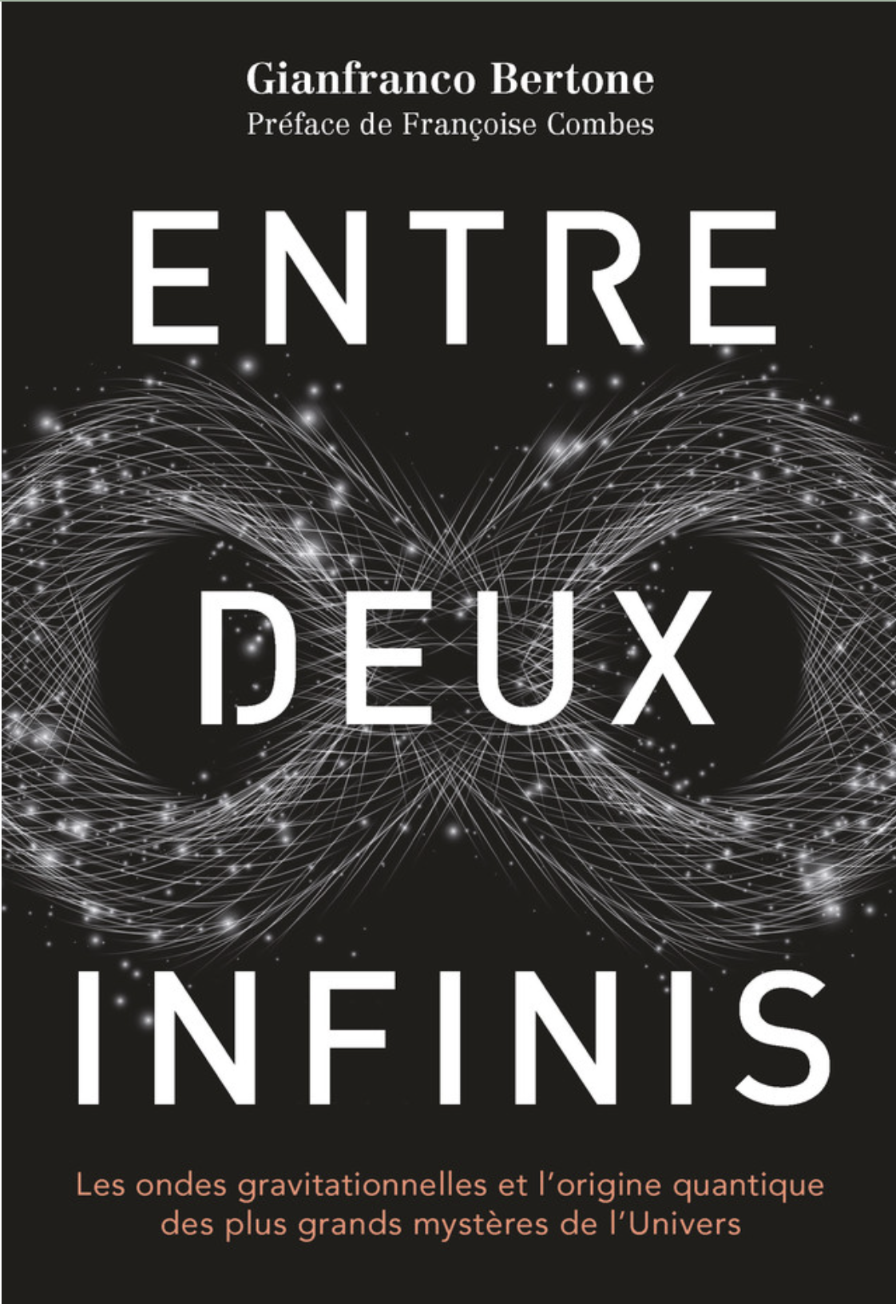
Talk (book) – “Entre deux infinis” by Gianfranco Bertone
Dates: 31 May, 1 and 2 June / Theme: Gravitation waves / Comms hook: ?
Proposed by: EPFL
Description: Dans ce livre, Gianfranco Bertone expose l’extraordinaire potentiel de l’« astronomie multimessager », une nouvelle discipline fondée sur l’observation de la lumière émise par les objets célestes combinée à l’analyse d’autres « messages » provenant de l’espace, comme les ondes gravitationnelles, les neutrinos et les rayons cosmiques. Il nous entraîne dans une aventure scientifique passionnante, entre l’infiniment grand de l’Univers et l’infiniment petit des particules élémentaires.
Speaker: Professor of Theoretical Astroparticle Physics at the Center of Excellence in Gravitation and Astroparticle Physics of the U. of Amsterdam, GRAPPA (Gravitation, AstroParticle Physics Amsterdam), where he leads a research team investigating topics at the interface between particle physics and cosmology. Founding director of the European Consortium for Astroparticle Physics (EuCAPT).
Format: talk / Duration: 90 min / Audience: General interested public / Gender: M / Language: FR
Cost: none
About the book: https://www.epflpress.org/produit/1418/9782889155088/entre-deux-infinis and abuot the Speaker: https://www.youtube.com/watch?v=1dh2UL7R9II

Slide 11
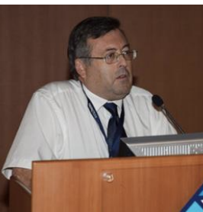
Talk - Visibilité des montagnes lointaines, figure de la Terre & dimensions atomiques by Philippe Lebrun
Dates: xx / Comms hooks: xx / Theme: science / Comms hook: ?
Proposed by: self
Description: Deux effets distincts limitent la visibilité des montagnes lointaines : la rotondité de la Terre, connue depuis l’Antiquité et le Moyen-Age, qui fait disparaître les coques des navires derrière l’horizon marin et limite la portée des phares (Aristote, Strabon, Pline l’Ancien, Cléomède, Johannes de Sacrobosco), et la combinaison de l’absorption et de la diffusion de la lumière par l’atmosphère, observée dès le 18ème siècle (Bouguer, Lambert) et expliquée au 19ème siècle en liaison avec le développement de l’hypothèse atomique et moléculaire (Maxwell, Rayleigh). Après ces rappels historiques, nous illustrerons ces effets à l’aide d’exemples – certains spectaculaires – dans les Alpes, et montrerons comment la distance maximale de visibilité limitée par la diffusion atmosphérique permet d’estimer la dimension des atomes et molécules, question qui a longtemps constitué la pierre d’achoppement de la théorie atomique.
Speaker: Spécialisé dans le domaine des aimants supraconducteurs et de la cryogénie, il a dirigé le département « Technologies des accélérateurs » pendant la construction du Grand Collisionneur de Hadrons (LHC).
Format: Talk / Duration: 90 min / Audience: Interested local audience / Gender: M / Language: FR
Costs: none
Link to proposal: https://cernbox.cern.ch/remote.php/dav/public-files/ZkrkDssPSRsHfSL/2023/PROPOSALS/Philippe Lebrun/RESUME Visibilité des montagnes lointaines.pdf

Slide 12
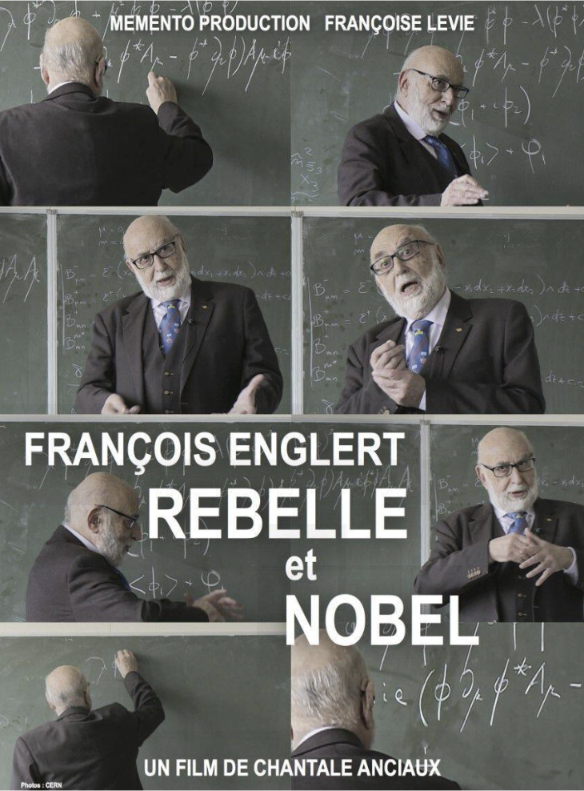
Film – “Master Nobel et Rebelle”
Englert documentary
Dates: Comms hooks: Now or Maybe for 70th anniversary along with other documentaries about CERN / Theme: biography, Higgs /
Proposed by: James/Loraine
Description: The film addresses the life of Englert, the Belgian theoretical physicist and Nobel prize laureate who, along with Robert Brout and, independently, Peter Higgs, theorised the Brout-Englert-Higgs mechanism in 1964.
Format: / Duration: 60 min
Audience: General public / Language: FR or EN / Gender: M
Cost: none
https://home.web.cern.ch/events/projection-du-film-master-nobel-et-rebelle
https://vimeo.com/645716759/f902f6c71b

Slide 13
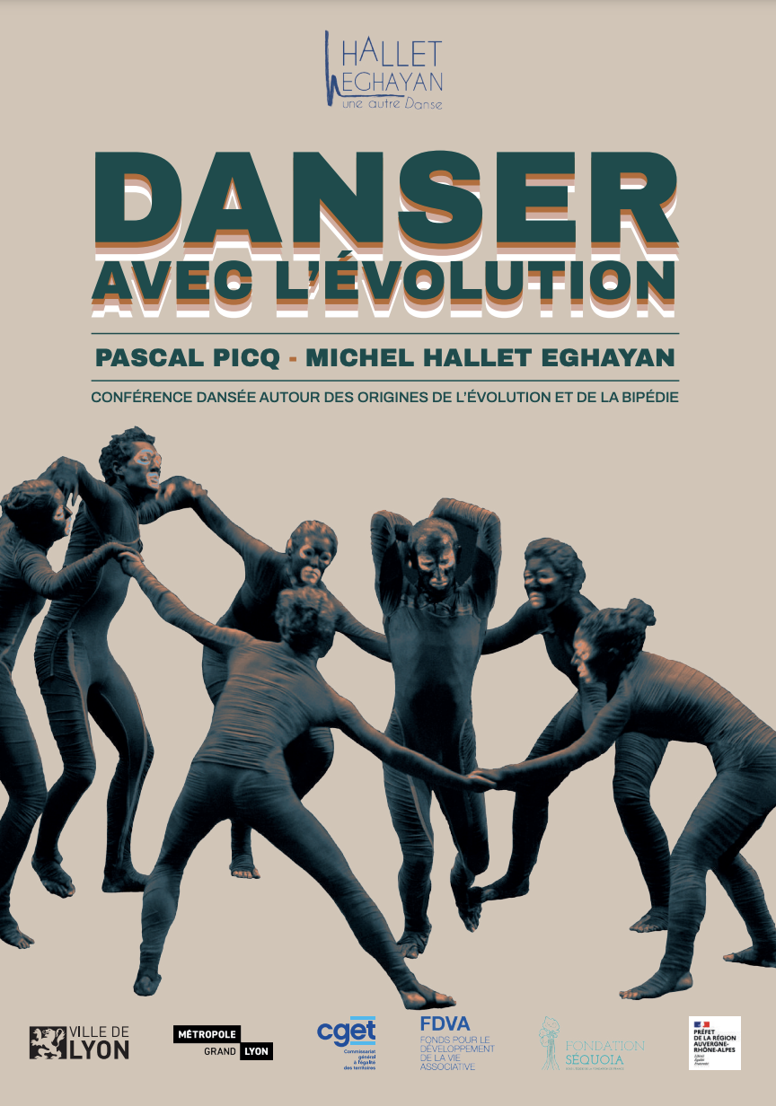
Dance avec l’evolution
Hallet Eghayan and Pascal Picq
Proposed by: self
Dates: for 70 anniversary to discuss where we are and what is important to continue addressing for our survival / Theme: evolution / Comms Hook: maybe in link to the temp exhibition of the musee the natural history in the second part of 2024 ? - the narrative can fit into the 70 anniversary
Description: CONFÉRENCE DANSÉE AUTOUR DES ORIGINES DE L’ÉVOLUTION ET DE LA BIPÉDIE with anthropologist PASCAL PICQ and choreographer MICHEL HALLET EGHAYAN. En complément et en parallèle à la création Which side story ?, Pascal Picq et Michel Hallet Eghayan ont créé cette nouvelle forme de spectacle liant l’explicite scientifique à l’implicite artistique : “Danser avec l’évolution”. Ces deux œuvres constituent le premier volet du projet “Arborescence”, mettant en scène le paléoanthropologue aux côtés des danseurs de la Compagnie.
Format: Dance and talk, can be on stage or around the space / Duration: 60 min / Audience: general public / Gender: all / Language: FR
Costs: 7-10K for 1 or 2 performances + travel and accomodations
https://cernbox.cern.ch/pdf-viewer/public/ZkrkDssPSRsHfSL/2023/PROPOSALS/Hallet%20Eghayan/Danser%20avec%20l%27e%CC%81volution%20-%20Dossier%20V6_compressed.pdf
Notes:
Narrative events
History of Big Bang - documentaries
History of Earth - Oct - event natural history museum
Future of collaborations - Nov
Sparks!
History of Universe
History of Earth with their science

Slide 14
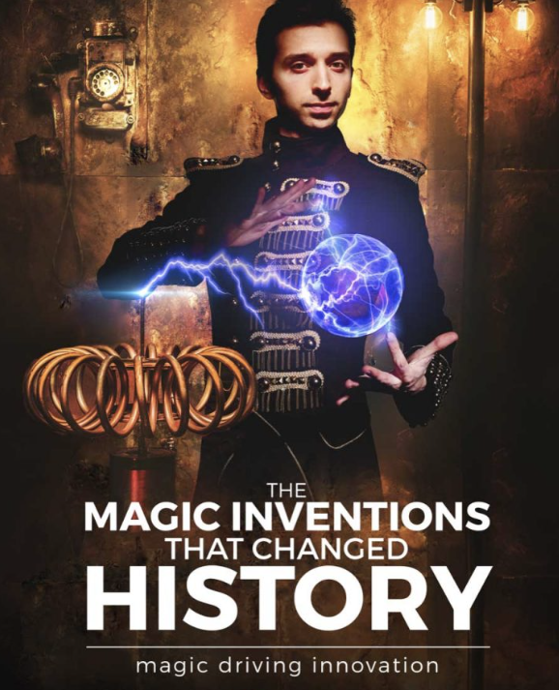
Magic and Science Academy (Cambridge) –
THE MAGIC INVENTIONS THAT CHANGED HISTORY
Dates: for the 70th anniversary / Theme: scientific discoveries / Comms Hook:
Proposed by: Francois Briard
Description: From mechanical tools to chemical reactions and from electrical devices to flying and disappearing objects! Embark on an enchanting journey exploring the spell binding inventions that changed history and transformed life, as if by magic! While the purpose of magistery was always to produce mystery and awe, some of the most history changing tools, devices and practices were invented by magical scientists that kept them secret to captivate their audiences! And as expectations and capabilites were evolving, they kept innovating, producing technologies that at the time seemed as if they were magical!
Format: / Duration:
Audience: general public / Gender: M / Language: EN
Costs: to be investigated
https://www.magicacademy.co.uk/shows/

Slide 15
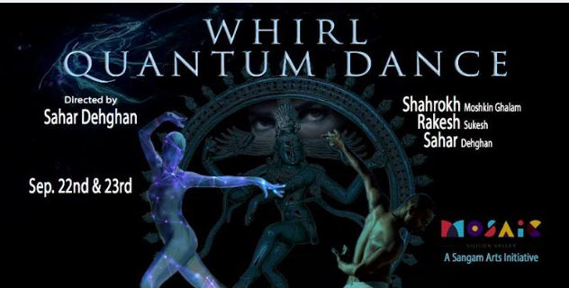
Sahar Dehghan - WHIRL Quantum Dance
Dates: xx / Theme: Quantum/ Comms hooks: to go with Sparks! Quantum theme
Proposed by: James
Description: Hindu cosmology, Particle Physics, Astrophysics and Persian arts come together for a show exploring how we are all part of the same whole. Sahar Dehghan spent time observing at CERN to get inspiration for this project, collaborating with nuclear physicist Andrea Latina.
Through dance and digital arts, the poetry of Rumi, Omar Khayyam, and many more, not to mention the particles we all share, Whirl Quantum Dance portrays the nature of our deepest connections
Format: Dance/ Duration: 60 min
Audience: General public / Language: / Gender: F
Cost: ?

Slide 16
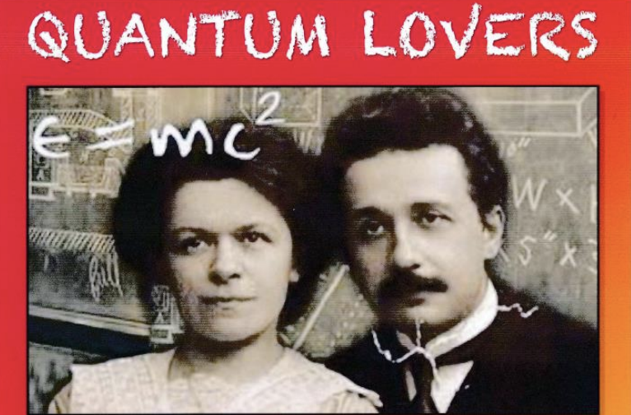
Theater - Quantum Lovers
Dates: next yea for SG / Theme: / Comms Hook: Quantum initiative / Sparks theme
Proposed by: James Gillies
Description: in Two Acts by Hasan Padamsee (Cornell University). inspired by Einstein in Love by Dennis Overbye, NY Times Writer Einstein in Berlin by Thomas Levenson. QUANTUM LOVERS is about the turbulent love affair and tragic break-up between Albert Einstein and his first wife, Mileva Maric, a bittersweet tale that took place in the tumultuous times of World War I
Format: / Duration: xx / Audience: general public / Gender: all / Language: EN
Costs: To be investigate go ahead to talk to GAOS (Geneva Amateur
Link to proposal:
https://cernbox.cern.ch/remote.php/dav/public-files/ZkrkDssPSRsHfSL/2023/PROPOSALS/Quantum Lovers/QuantumLovers Musical Book CERN Book2.pdf

Slide 17
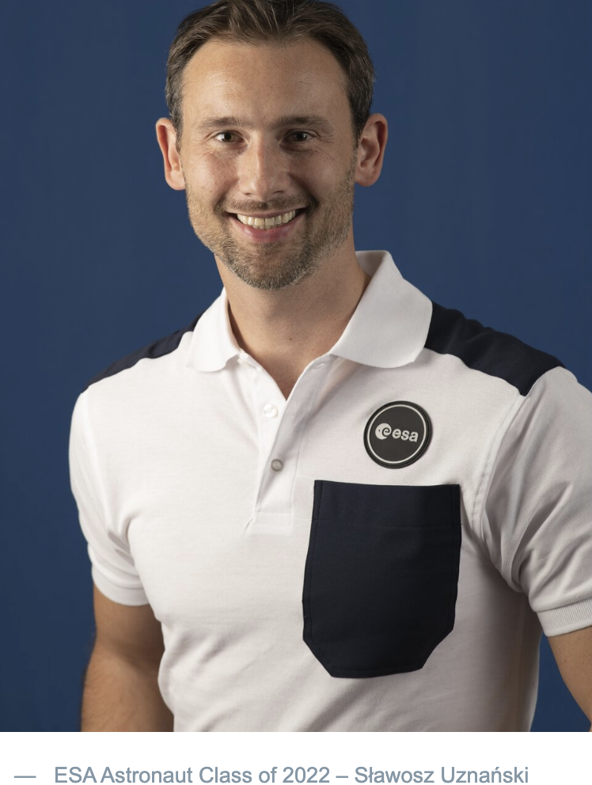
Talk - ESA astronauts
Slawosz Uznanski (CERN) with others
Dates: next year at SG / Comms hook: Space week in October linked to KT technology to aerospace / Theme:
Proposed by: Paola/Loraine
Description: a talk by Slawosz Uznanski with other astronauts such as Paolo Nespoli or French Sophie Adenot. Link to technologies that CERN might have contribute to the field
Format: Talk / Duration: 90 min / Audience: general pubilc / Gender: xx / Language: EN or FR
Costs:
Link: https://www.esa.int/Science_Exploration/Human_and_Robotic_Exploration/Astronauts/Slawosz_Uznanski

Slide 18

Theater - Binome
Dates: next year SG/ Theme: at our choice / Comms Hook:
Proposed by: self
Description: an original and innovative project imagined in 2010 by Thibault Rossigneux, director of thefrench theatre company « les sens des mots ». It is the result of a collaboration between contemporary playwrights and scientists, following a very strict protocole. After a short and unique meeting with a scientist, the author has six weeks to write a 30 minutes-play for 3 characters. The result is sensitive, often funny and offers us an unusual sight towards Science and scientists. A binôme performance lasts a bit more than one hour and includes videos, the directed reading of the play and exchanges between the audience, the artistic team and the scientist. It is divided into the following four steps :
  Video extracts of the single encounter between scientist & playwright (12min.)
  Stage reading of the play by the collective of actors/directors les sens des mots (30min.)
  Video extracts of the scientist’s reaction after he / she has just read the play (3min.)
  An exchange between the audience, the artistic collective and the scientist (if present) (20 to 30min.) Format: / Duration: 90 min
Audience: general / Gender: all / Language: FR/ EN
Costs: 25 000 € H.T, comprenant les tournages, la commande en écriture, la résidence et 3 representations
Videos: https://www.lessensdesmots.eu/la-collection-binome
Link to proposal: https://cernbox.cern.ch/remote.php/dav/public-files/ZkrkDssPSRsHfSL/2023/PROPOSALS/BINOME/binôme_international_eng.pdf

Slide 19

Theater - Farm Hall
Dates: next year SG / Theme: scientific discovery / Comms hooks:
Proposed by: James
Description: This captivating world premiere dramatises the true story recorded inside the bugged walls of Farm Hall between July 1945 and January 1946. Stephen Unwin, former Artistic Director of English Touring Theatre and the Rose Theatre Kingston, returns to JST to direct Katherine Moar’s debut play
Format: Theater / Duration: 90 min / Audience: General interested public / Language: EN
Cost: will we be able to charge the audience for tickets?
https://www.jermynstreettheatre.co.uk/show/farm-hall/

Slide 20
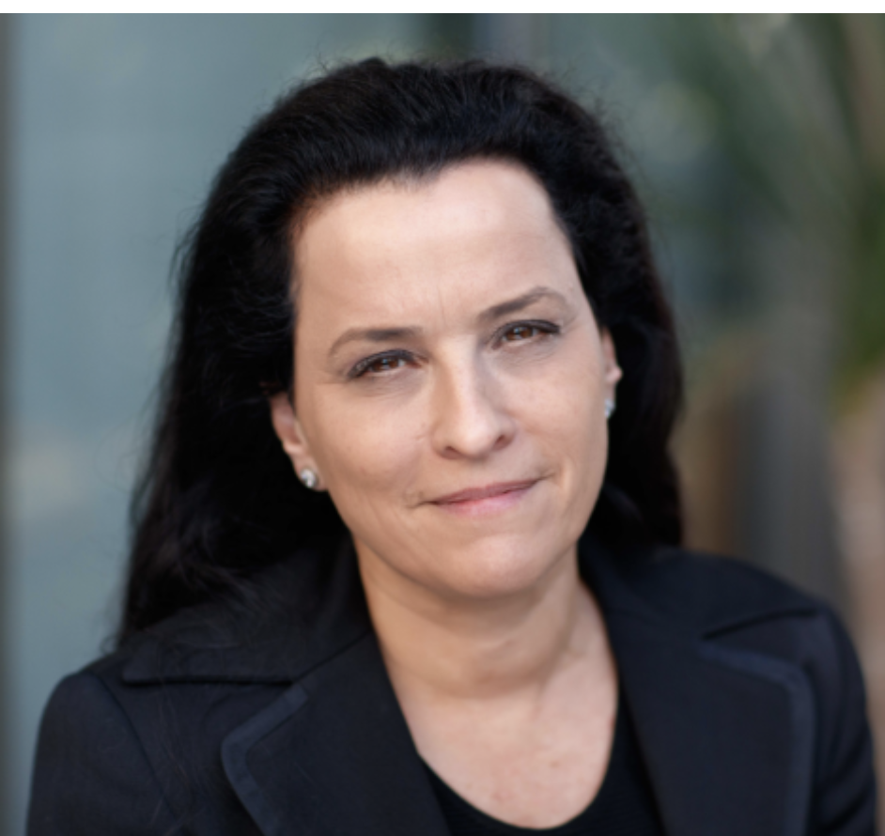
Theater - THE OH MY GOD PARTICLE SHOW
Dates: / Theme / Comms Hook:
Proposed by: self
Description: wrote the play from the point of view of BEATRICE PORTINARI (the love interest of Dante Aleghieri) as if she came through the space-time continuum to find Dante in the present time researching the sequel to Dante's Inferno at the Large Hadron Collider - I am interestedd in how the universe responds, and how what we are looking for may be looking for us, and what is love/energy, etc - I used the Dante's Inferno story from Beatrice's point of view (as we never heard from her!) so it could be a romantic comedy of sorts and it has Beatrice discovering that perhaps she could be a poet/scientist, use her creativity/imagination, etc.
Format: / Duration: / Audience: / Gender: F / Language: EN
Costs:
https://www.global-ambassadors.org/people/dahlia-wilde/
» For your information, I was considering to add this proposal to our list of public events however I just notice that this person is claiming that “ She received The Large Hadron Collider Creative Fellowship from CERN, Geneva for her new particle physics play THE OH MY GOD PARTICLE SHOW ”

Slide 21
Any other business
Webcasted event vs recording
  AV support from IT team necessary – lack of resources outside worksing hours
  Return on investment – up to CHF 96/h after 20h00
  Impact on attendance – people prefer the comfort of their home
  No possibility to interact with the Globe – a recording made available afterwards would allow the same
  Low n° of viewers
Interpretation?
  Very costly: CHF 2500 per event
  Low use: maximum 10 headsets used at each event

Slide 22
Globe public events in recent years

Slide 23
Globe public events in recent years

Slide 24
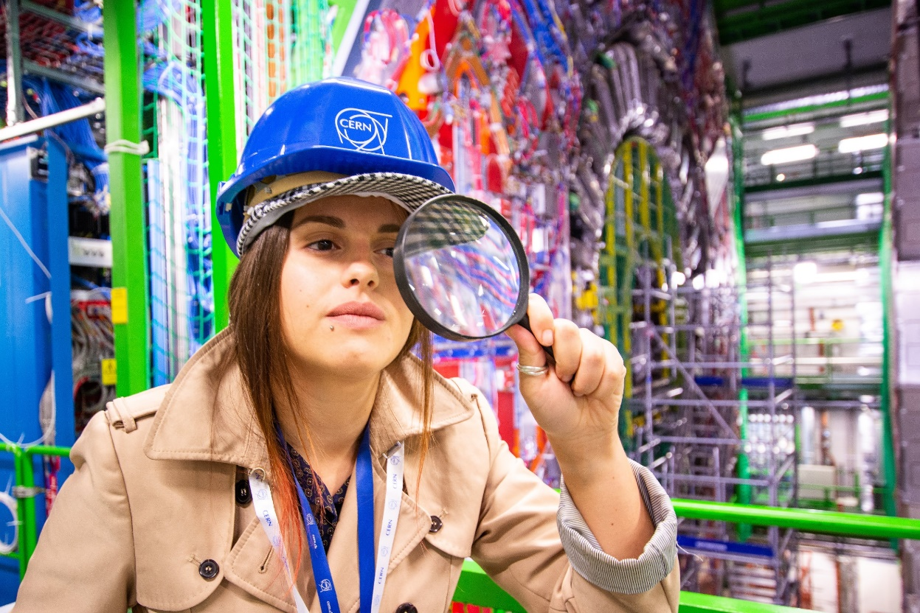
Summer Science Shows 2022
28 science shows for summer visitors
5 shows per week, in English and French
3 different shows:
  Fun with physics
  Seeing the invisible - Test by TSP
  Seize the data - Test by TSP

