Slide 1
CERN Public Events Programming
Strategy Proposal
Updated by Claudia Marcelloni
05-04-23
Notes:
Public programing - coding
Cultural ?

Slide 2
In the operations phase of Science Gateway
IR-ECO remit
Content for exhibitions, education labs, online (setting the theme and direction; developing, delivering)
Programming and curation of events
Defining and delivering content for volunteer training
Evaluation
Communications
Fundraising
IR Sector
SGW Operations Group
IR-ECO
SGW Operations remit
Facility operations
Visitor and event operations
Technical support
Development and implementation of the business model
Marketing and Fundraising
Reporting and monitoring
Financial management of the SGW budget

Slide 3
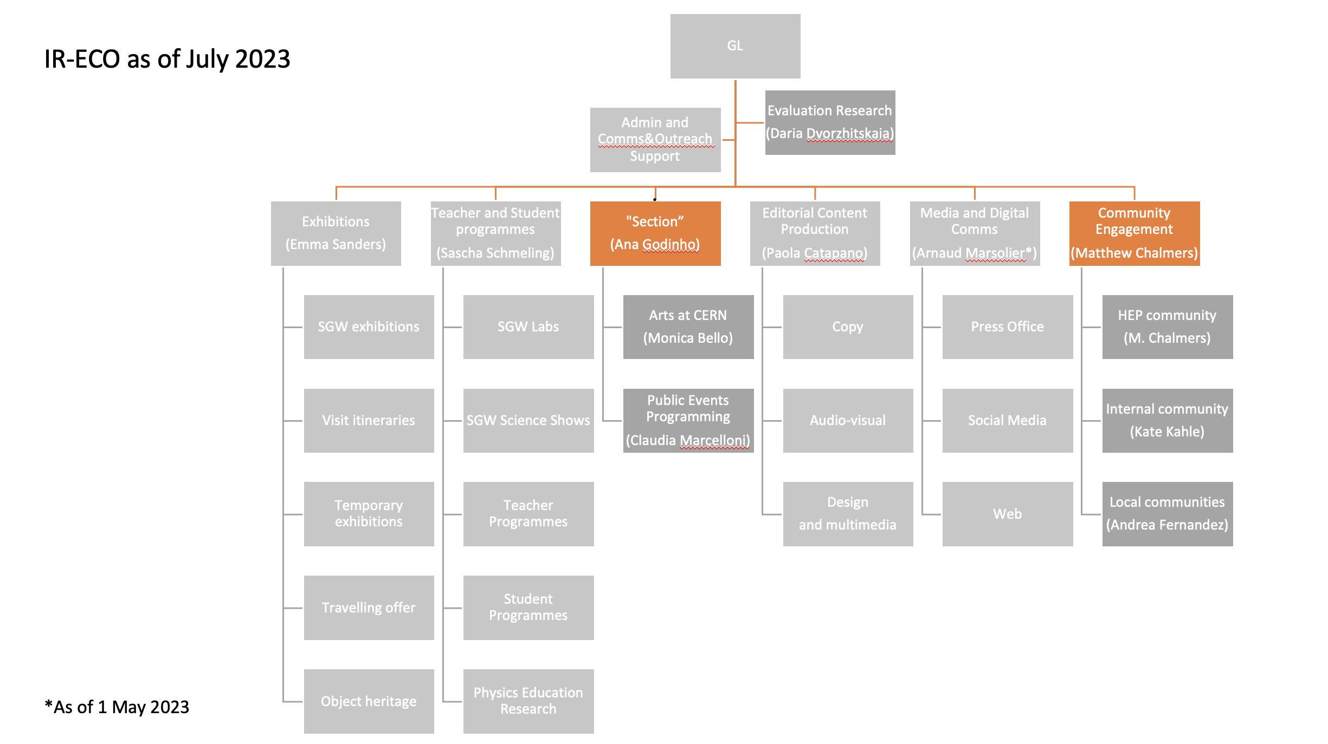

Slide 4
Public Events Committee
Committee name changes - from Globe Public Events Committee to Public Events Committee. We will develop the Terms of References for this committee but for now:
The committee will continue giving input on all the proposals for the Public Events programming, in order to guarantee the presence of the internal diversity of the scientific programmes
Frequence of the committee meetings: 3 times/year. For example definition of thematic programming for Sep 2025
In a long term, we will also create an advisory board for the THEMATIC PROGRAMMING SECTION, composed of external members who can help with the integration of our programming to the cultural landscape of the area, as well as with fundraising

Slide 5
Goal of Public Events Programming
Building on the Vision, Mission and Goals of SG, the public events programme should empower our visitors to engage with CERN and science through authentic and inspirational experiences.
The public events programme aims to create intellectually engaging content and experiences in the format of an event that:
Engages a diverse audience in making sense of the science that shapes their lives.
Establishes CERN as a key voice/forum to convey the importance and relevance of fundamental science in creating knowledge, bringing peoples and nations together through peaceful collaboration and driving innovation collectively.
Build ties across CERN Member States and beyond, encouraging co-creation with other museums, science centres, cultural centres and education networks.

Slide 6
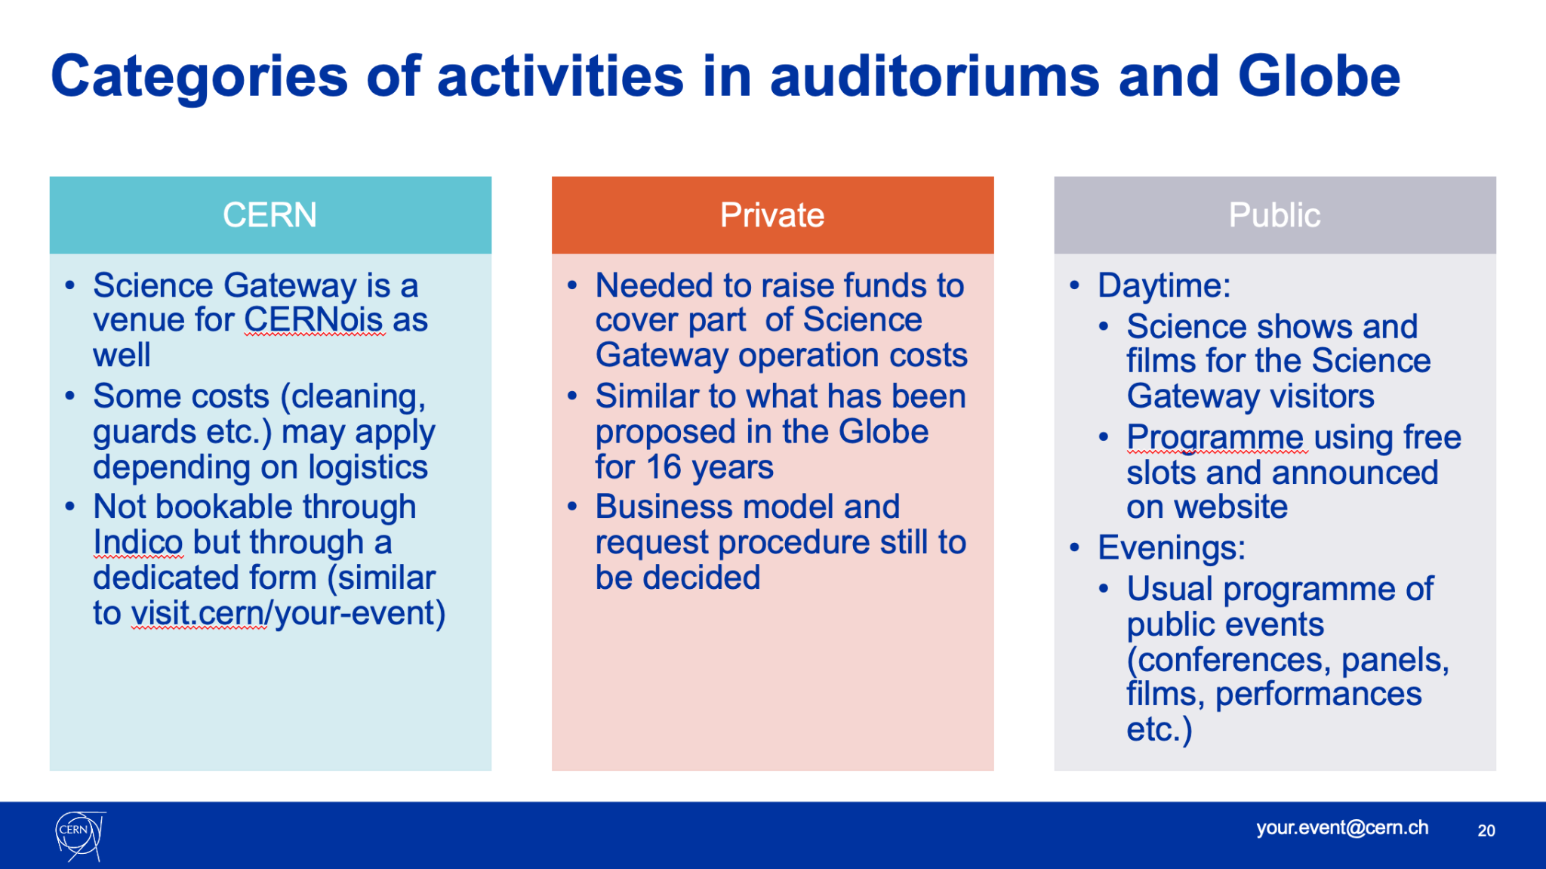
Notes:
Taken from Loraine’s presentation about events for Science Gateway in April 2021. The events and operations at the SG Business Unit still responsible for the other two pillars: Private and CERNois requests to Science Gateway

Slide 7
Public Events Programming
Suggestion on how to visualize the public events offer into 5 PILLARS:
Visitor Experience
Programme
(science shows, lab workshops, exhibitions)
Recurring Programme
(E.g. Dark Matter Day, Cineglobe)
Spontaneous Proposals
Thematic Programme
Local Events
Outside CERN
Color represents degree of involvement of Public Events Programming

Slide 8
Recurrent Events
Internal
Sparks!
Alumni - Collisions (every three years, next 9-11 February 2023)
NEW! Arts at CERN event
With/by partners
Dark Matter Day
CineGlobe Film Festival
Educational
Partage ta science
Devoxx4kids (not every year and format will be reconsidered in the future)
Les journées Codez la science (not every year, depends on resources and partners’ availability

Slide 9
Thematic programming
Cultural season (September - June)
Following the practice of most of large facilities, cultural centers and museums, we shall have a cultural season running from Sept through June the following year, with none or minimum activities during the holiday months of December, July and August.
Theme
Define the theme more than one year in advance, in order to allow time for content development, partnerships, fundraising, and communication efforts towards a combined campaign; (themes already considered for Sparks)
Partnerships
The thematic programming shall build strong ties with partners such as International Geneva, other museums, science centres, cultural centres and education networks - for which we are developing a Landscape analysis of potential cultural partners
and also across CERN Member States and beyond, encouraging co-creation with research labs, universities and institutes, government agencies, linked to CERN.

Slide 10
Types of possible activities under a thematic programme
Different formats will appeal for different audiences and communities
Talks from or linked to CERN
  By CERN scientists
  By outside people on specific CERN topics
Talks from renowned guests on broader subjects
  Scientific or cultural figures
  Artists
Performances and multidisciplinary events
  Arts at CERN
  Dance,
  Film,
  Music, etc

Slide 11
Timeline of strategy
Sep 2023 - June 2024
  Develop Terms of References for this committee
  Keep the recurrent programme + spontaneous proposals going
  Inauguration of Science Gateway - October 2023
  Use either Quantum (Sparks! theme) in 2023 or the 70th anniversary in 2024 to guide “a light version of the thematic programming”
  Developing thematic programming - Landscape analysis of partners and Fundraising campaign
Sep 2024 - June 2025
  Establish advisory board and secure funds for thematic programming
  Keep the spontaneous proposals + recurrent programme going
  CERN 70th Anniversary
  Use the theme of 70 anniversary to guide a “light version of the thematic programming”in 2024, and for Sparks in 2025
  Curating and finalize fundraising for full public events programming season 2025 - 2026
Sep 2025 - June 2026
  Keep the spontaneous proposals + recurrent programme going
  Launch of the thematic programming

Slide 12
END

