Slide 1
Celebrating Ioannis Carreer
Saclay, Oct 5th 2023

Slide 2
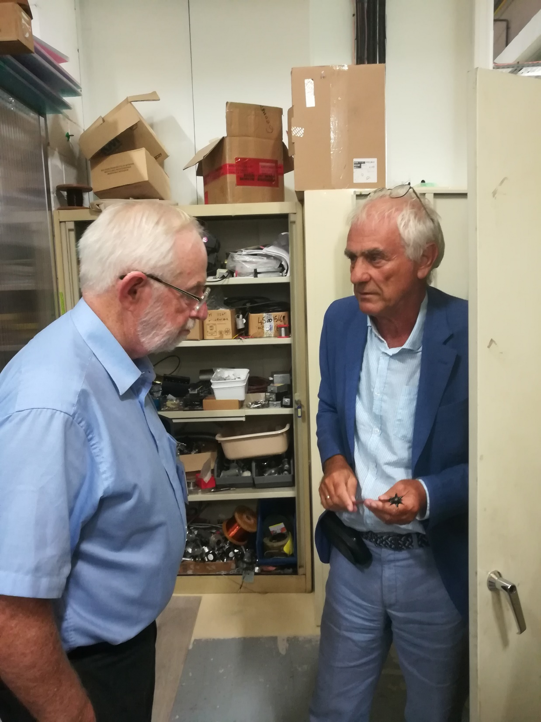
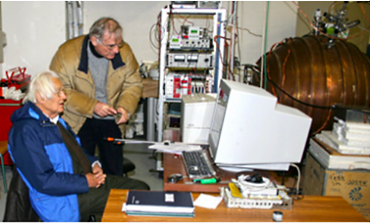
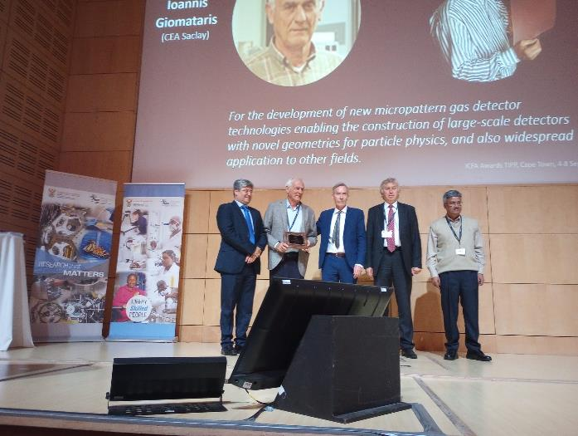
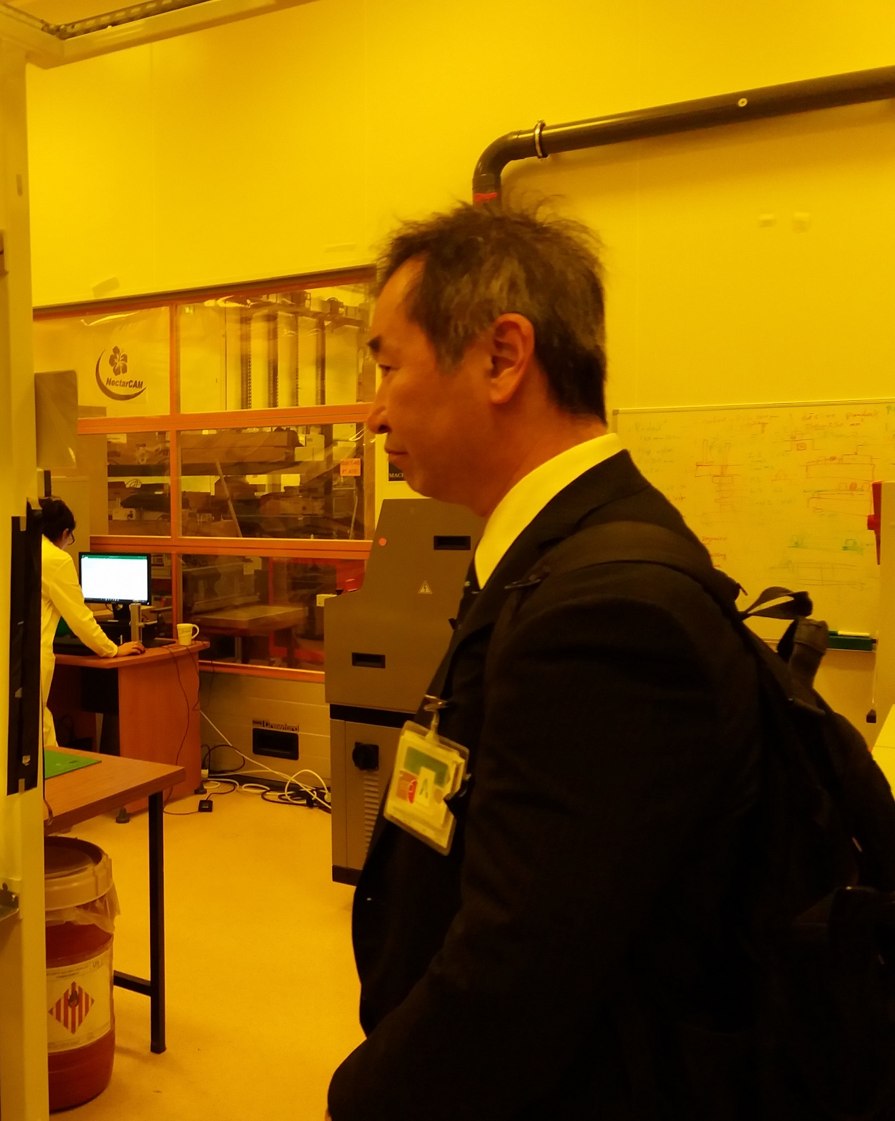
Art McDonald
Georges Charpak
ICFA award 2023
ceremony
Takaaki Kajita

Slide 3
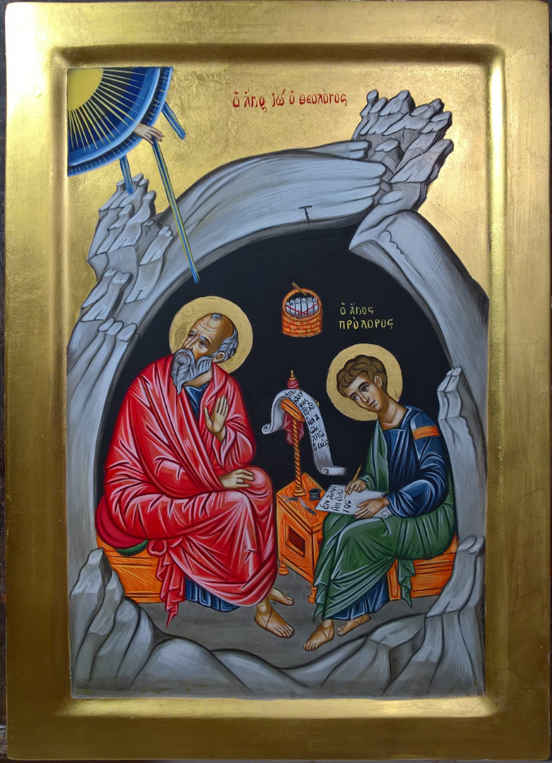

Slide 4


MERCI
IOANNIS

