Slide 1
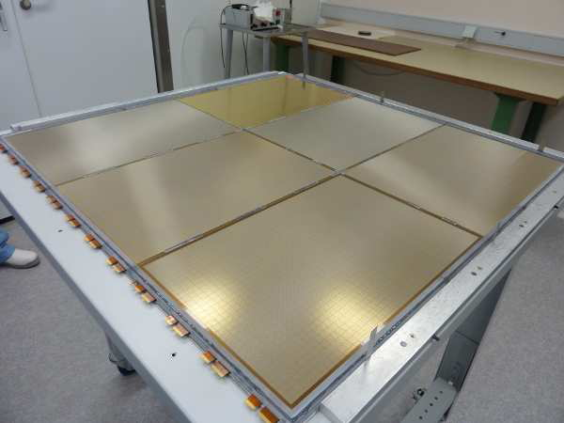
Micromegas detectors
MPGD situation at the end of the nineties
Initial Micromegas and evolutions
Introduction of resistive layers
Micromegas today

Slide 2
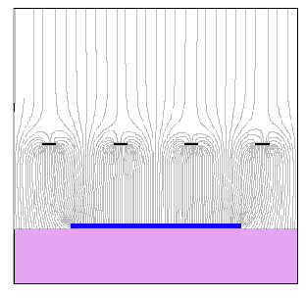
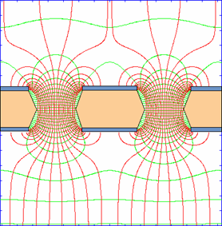
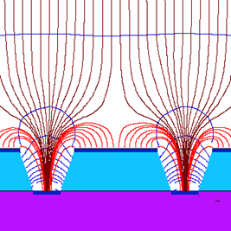
End of nineties , 3 main MPGD structures emerged !
Mesh with spacers
Holes
Wells
It is interesting to observe that in these 3 options the amplification gaps are precisely defined by industrial materials, not by photolithography:
-Polyimide 50um +/-0.1um
-Photo-imageable coverlay spacer 128um +/-2um

Slide 3
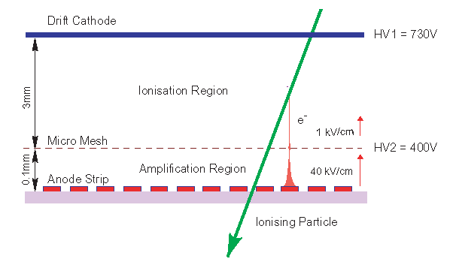
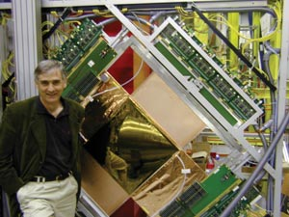
1997→Micromegas (Yannis)

Slide 4
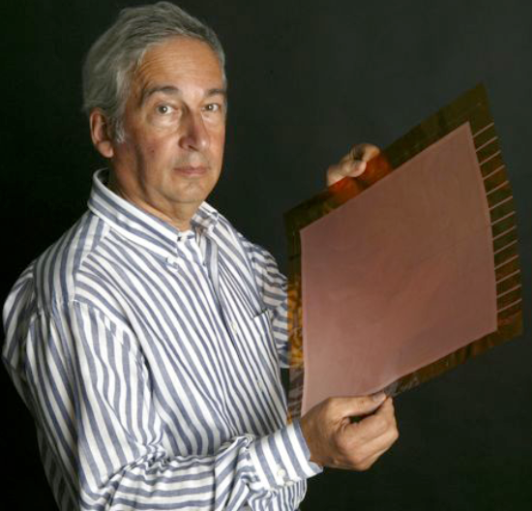
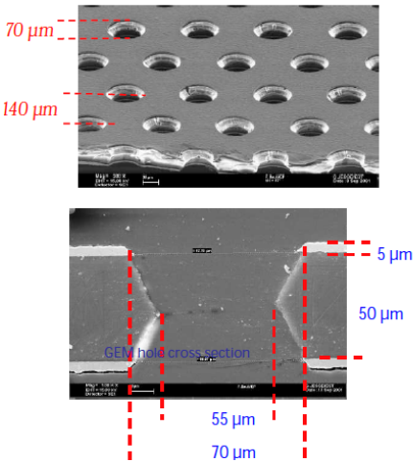
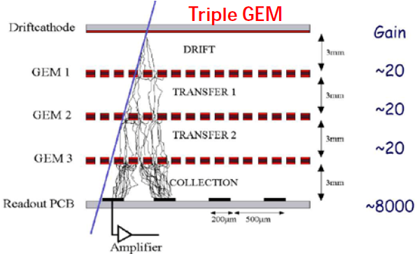
1998→GEM foil and then triple GEM detector (Fabio Sauli)
Spark problem solved by stacking 3 GEMs:
The size of the detector do not affect the performance.
A GEM is only made with
Photolithographic processes.
Industrial by nature.
The technology was spread rapidly.

Slide 5
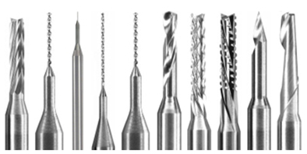
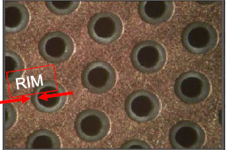
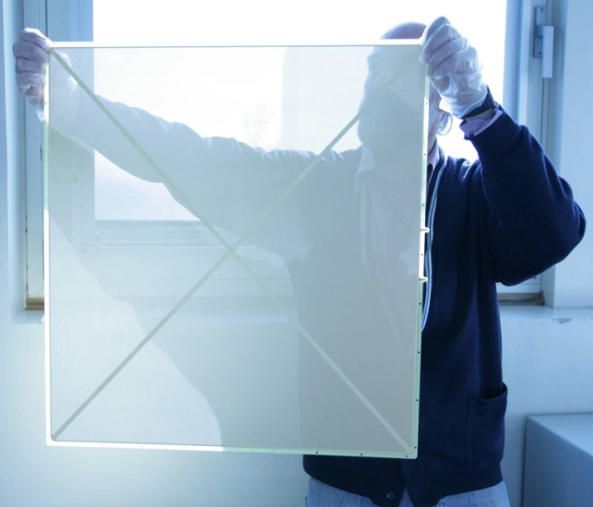
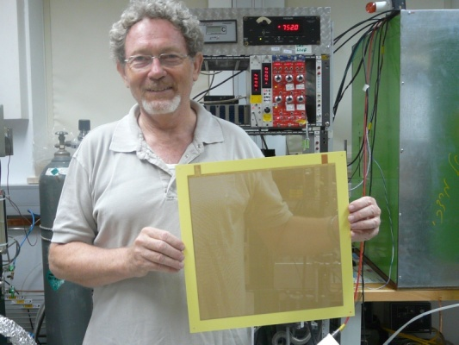
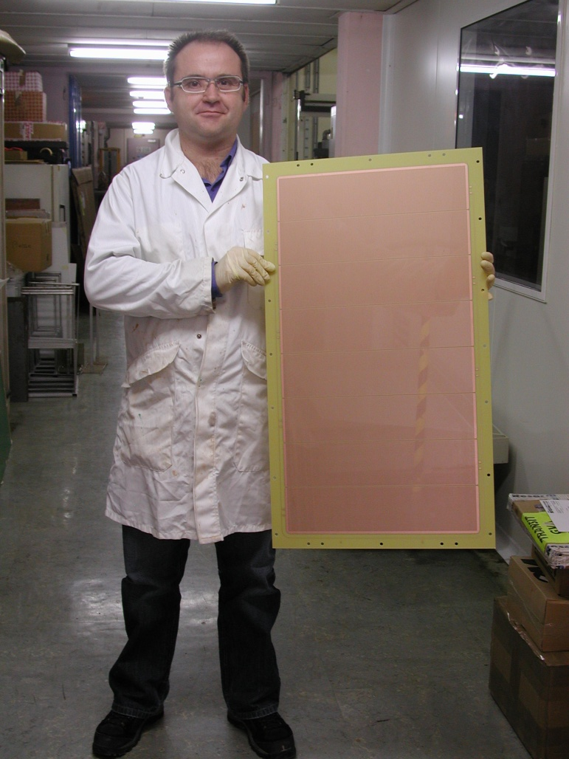
1998→first LEM or THGEM
(Pio Picchi and his team)
Mechanical Drilling : FR4, PMMA etc..
More recently:
Multi electrode THGEM
Sand blasting on glass
Photo imaged glass
PCB
Eltos (IT)
Hold by
Fulvio Tessarotto
Print electronics (IS)
Hold by
Amos Breskin
CERN
Hold by
Serge Ferry

Slide 6

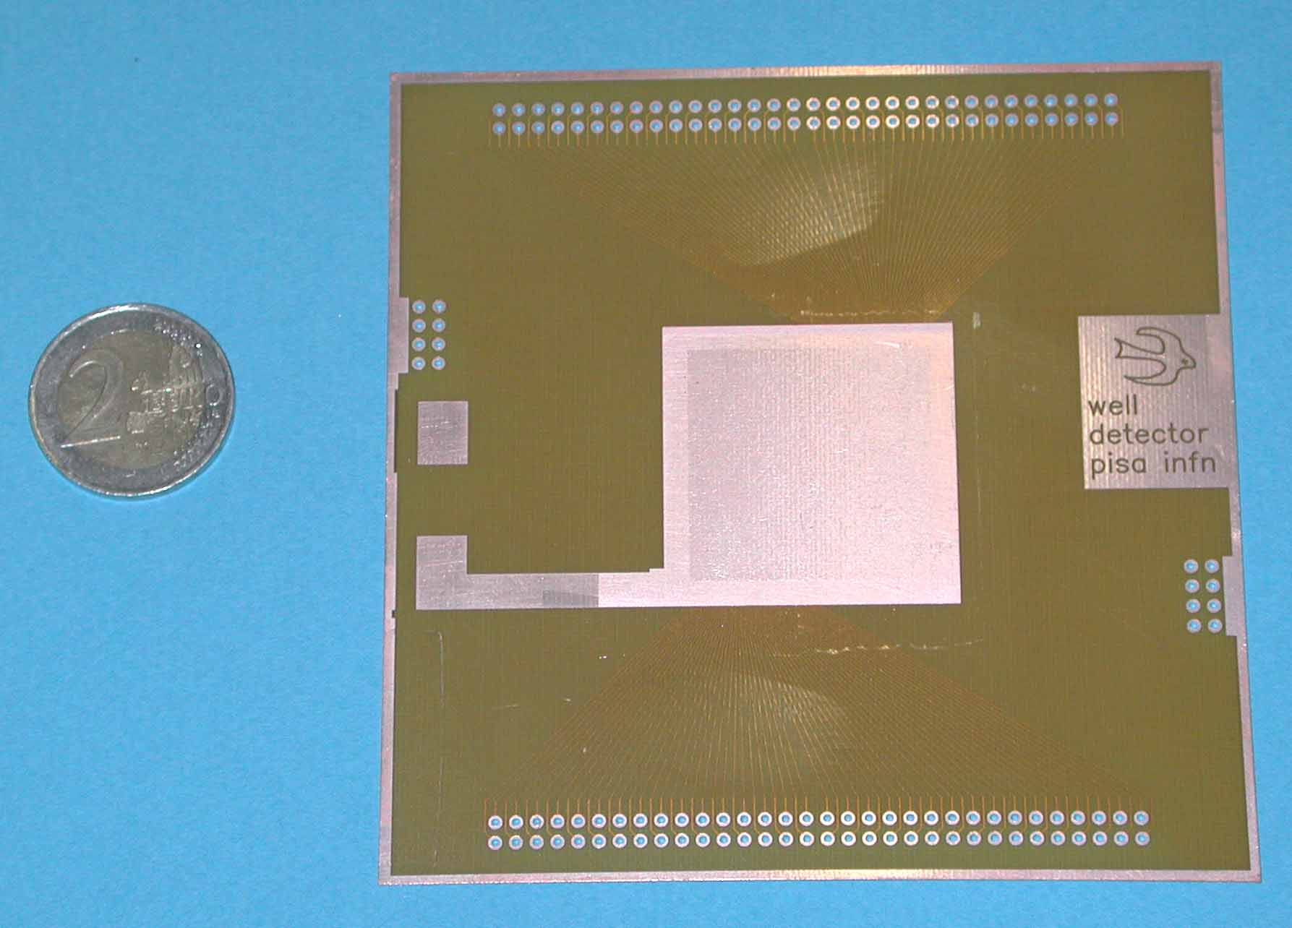
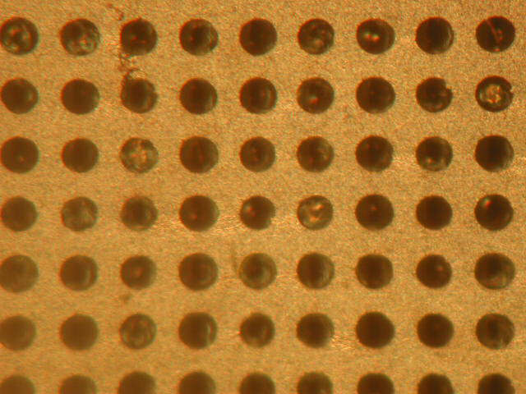
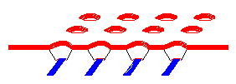
1999→Micro-Well (Ronaldo Bellazzini)
Anode strips
Cathode
Close-up view
Square pattern used
in the early days
Anode strips
-3 x 3 cm Micro-well detector
-Produced with GEM processes
-Really simple but abandoned for a while
due to the difficulty to mitigate sparks
R/O lines
Anode
cathode
6

Slide 7
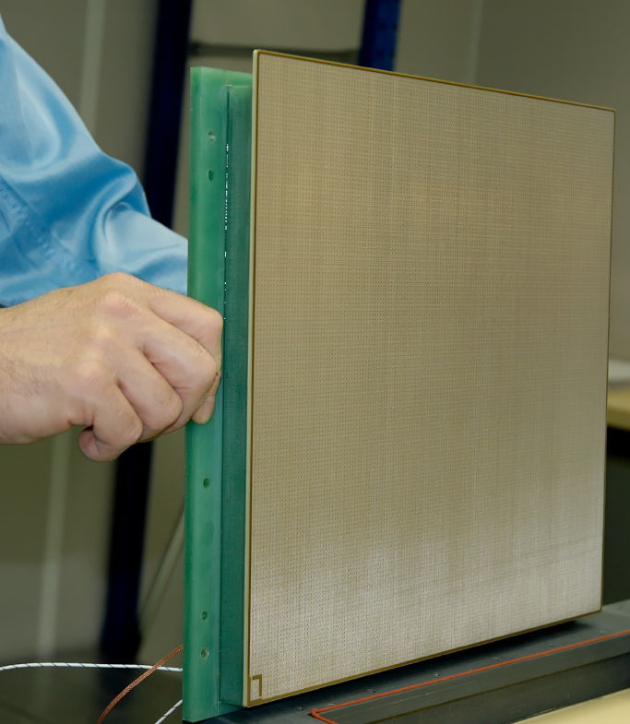
But let’s come back to MM

Slide 8
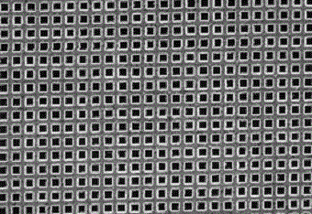
1997 First Micromegas (Yannis)
-Ni electroformed mesh stretched on a frame.
-Spacers done with fishing wires.
-Spark protection done with added discrete components.
-The size of the detector have an impact on the spark current.
-The Ni mesh is fragile.
-The production steps are mainly relying on manual artisanal skills .
-Challenge to produce a 30cm x30cm detector
PCB with R/O structure
8

Slide 9
2000 First Evolution (Yannis)
→ Photo imaged pillars
-Still fragile Ni Electroformed mesh stretched on a frame.
-Spacers deposited on the PCB by photo lithographical processes.
-Still production steps relying to much on manual artisanal skills .
-Structure used initially for Compass.
-30cm x 30cm challenging
PCB with R/O structure

Slide 10
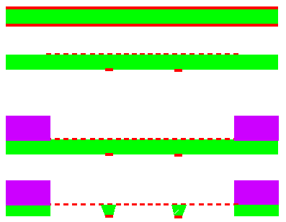
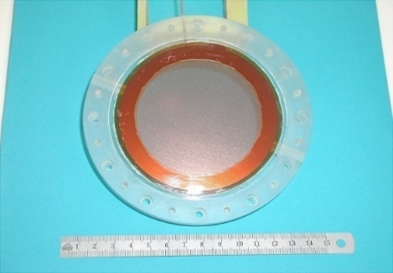
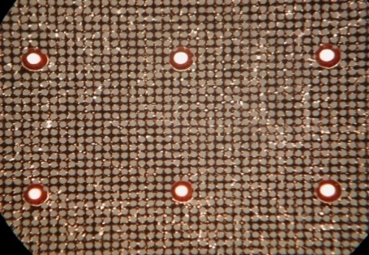
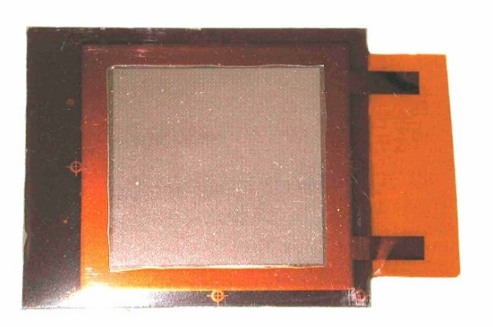
2001 Second evolution (CERN)
→ Dots on mesh
-Copper Mesh done by photolithography
-Spacers are attached to the mesh and done by photolithography.
-This structure is still fragile due to the thin copper mesh .
-Structure used for KABES and CAST
-30cm x30cm challenging
CAST
KABES

Slide 11
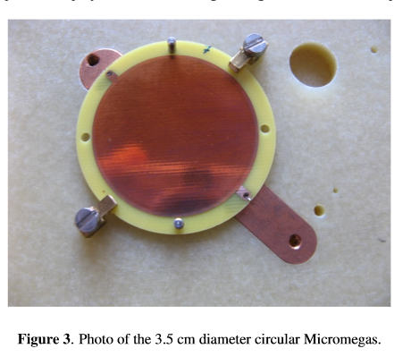
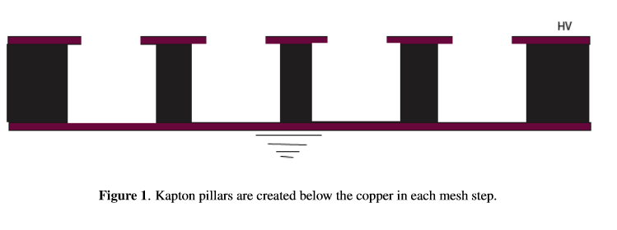
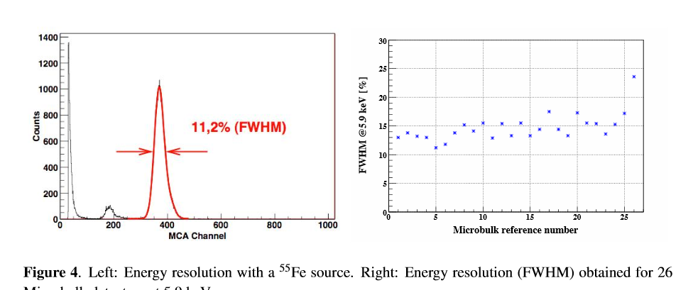
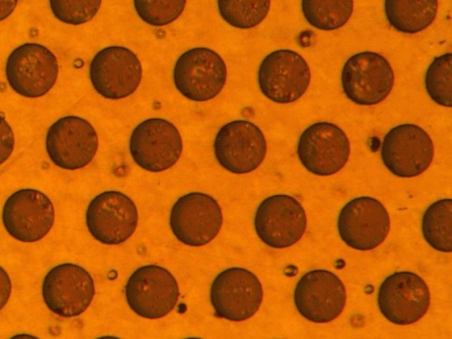
Right after with similar process →Micro bulk
Yannis and CERN
S Andriamonje et all 2010 JINST 5 P02001
Same material as GEM (kapton + Cu)
Holes created etching copper and kapton (like a GEM)
Amplification in the small holes (field ~ uniform)
Best energy resolution among MPGD

Slide 12
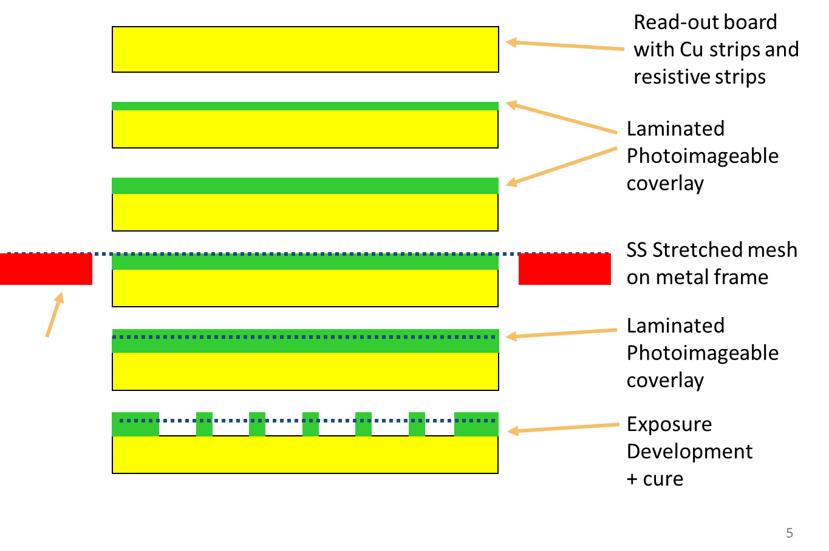
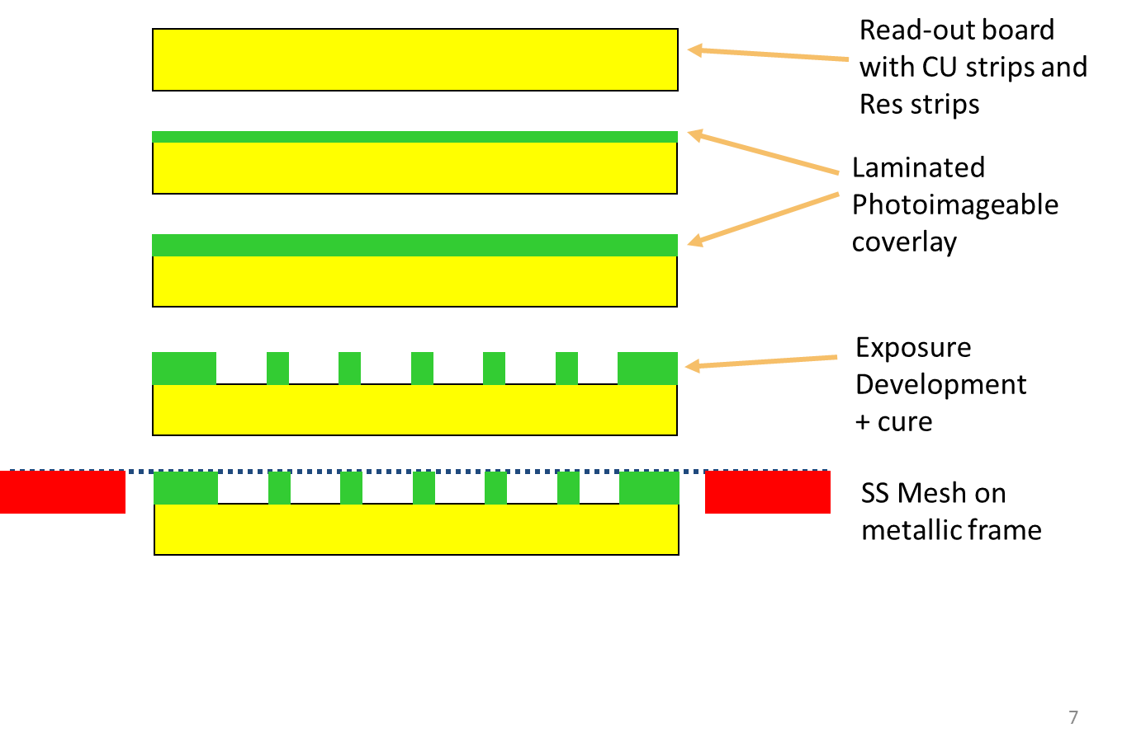
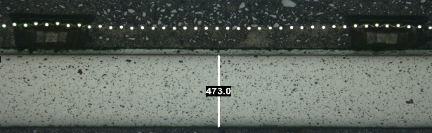
2004 Third evolution (Yannis and CERN)
→ use of stainless-steel woven mesh
BULK Micromegas
Floating mesh Micromegas
Robust mesh
Repeatable industrial processes.
Possibility to make large detectors of 2m x 1m
The technology spread was then rapid.

Slide 13
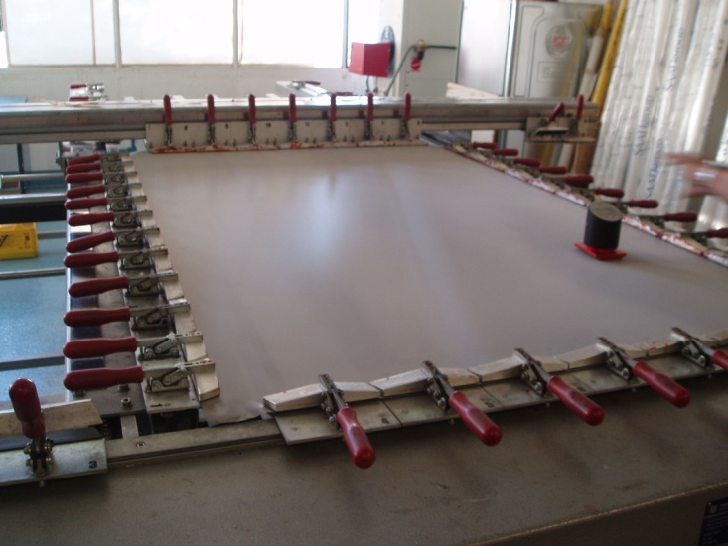
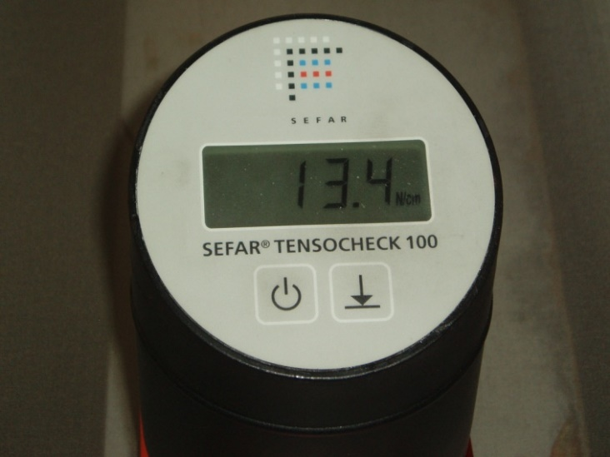
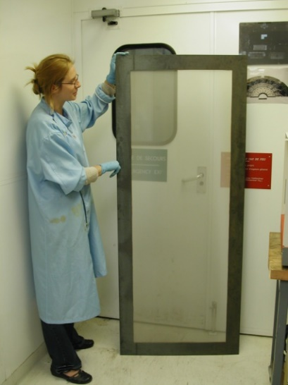
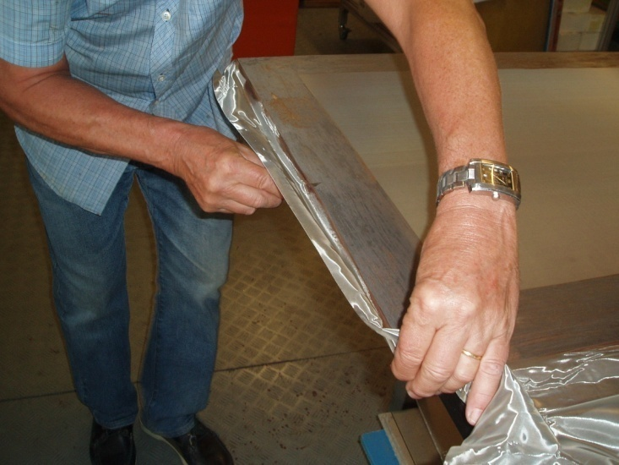
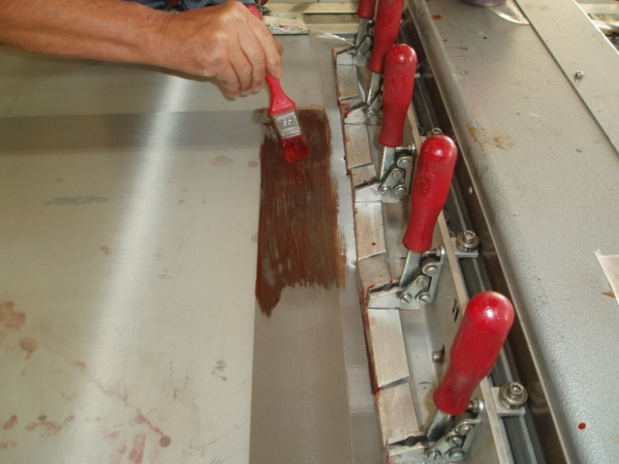
Mesh stretching
Mesh stretching 1m x 2m
control : from 10Ncm to 15Ncm
Extra mesh cut
Glue deposit

Slide 14
Hot roll lamination details
Hot roll
PCB
Rubber
Mesh
Stretched
On Frame
Coverlay
Hot roll
Coverlay roll

Slide 15
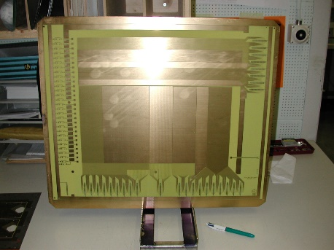
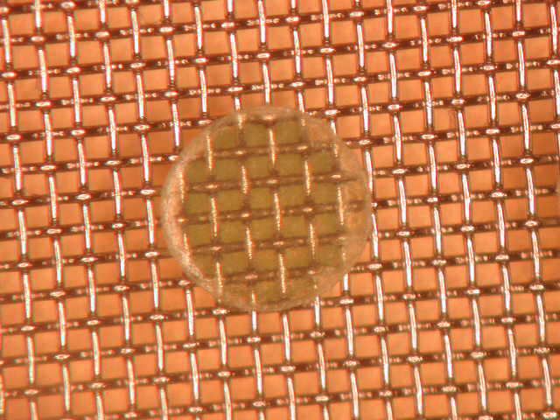
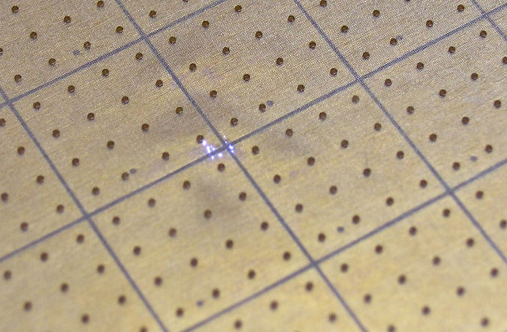
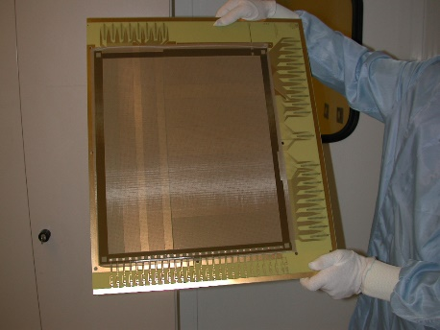
Read-out board
400um pillar
Mesh stretched on frame
Coverlay lamination
Pillar matrix
on 1cm x 1cm pads
Detector developed / cured / tested

Slide 16
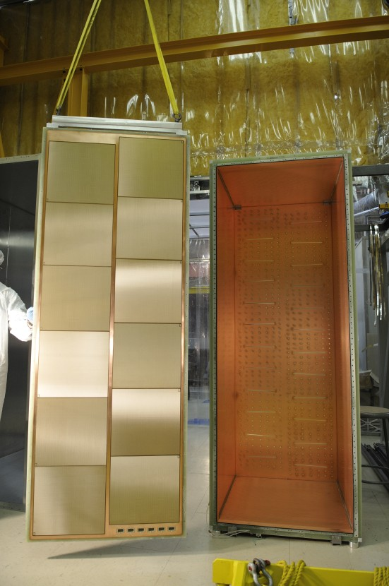
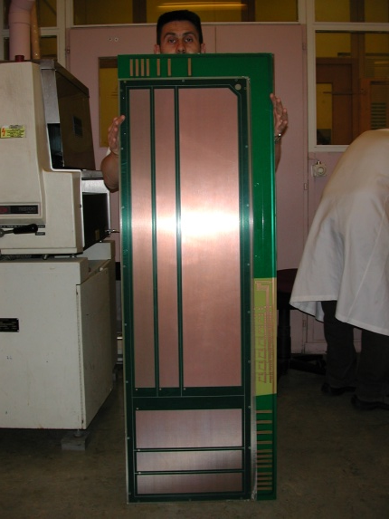
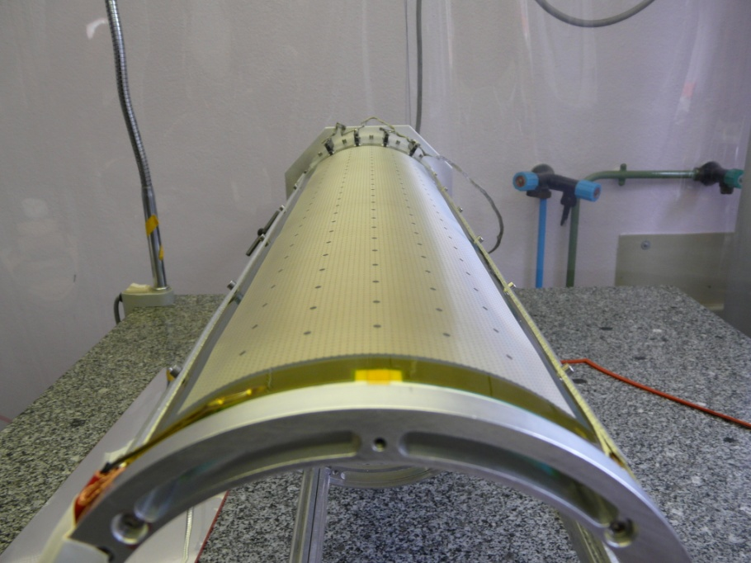
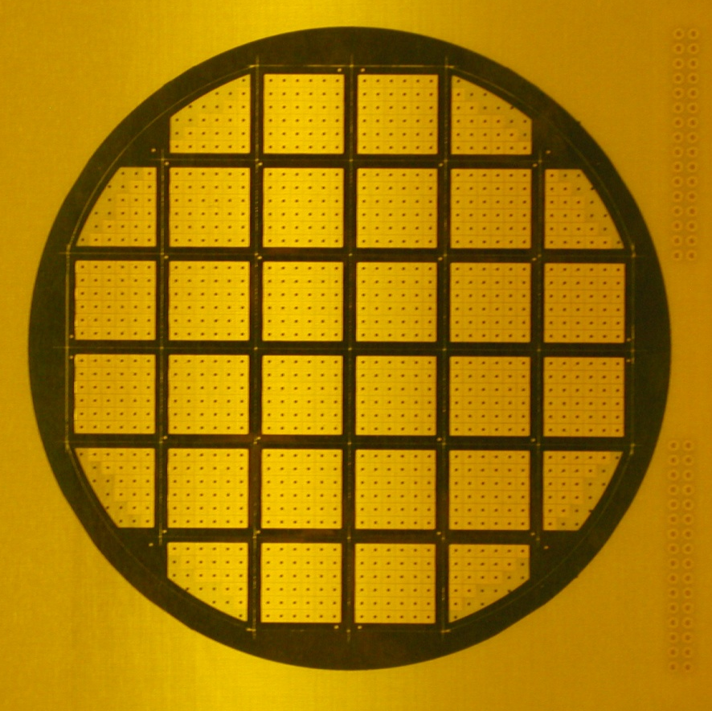
BULK Micromegas detectors
T2K TPC
Alain Delbart
ILC DHCAL ,
Max Chefdeville
1m x 1m plane
With 6 detectors
Early ATLAS NSW R&D
Joerg Wotschack
1.5m x 0.5m plane
Single panel
33 sectors , 12cm diameter
Damien Neyret
2.5mm dead space for sectorizing
1mm hole for HV connection
CLAS 12
Cylindrical Micromegas bulk
Stefan Aune

Slide 17
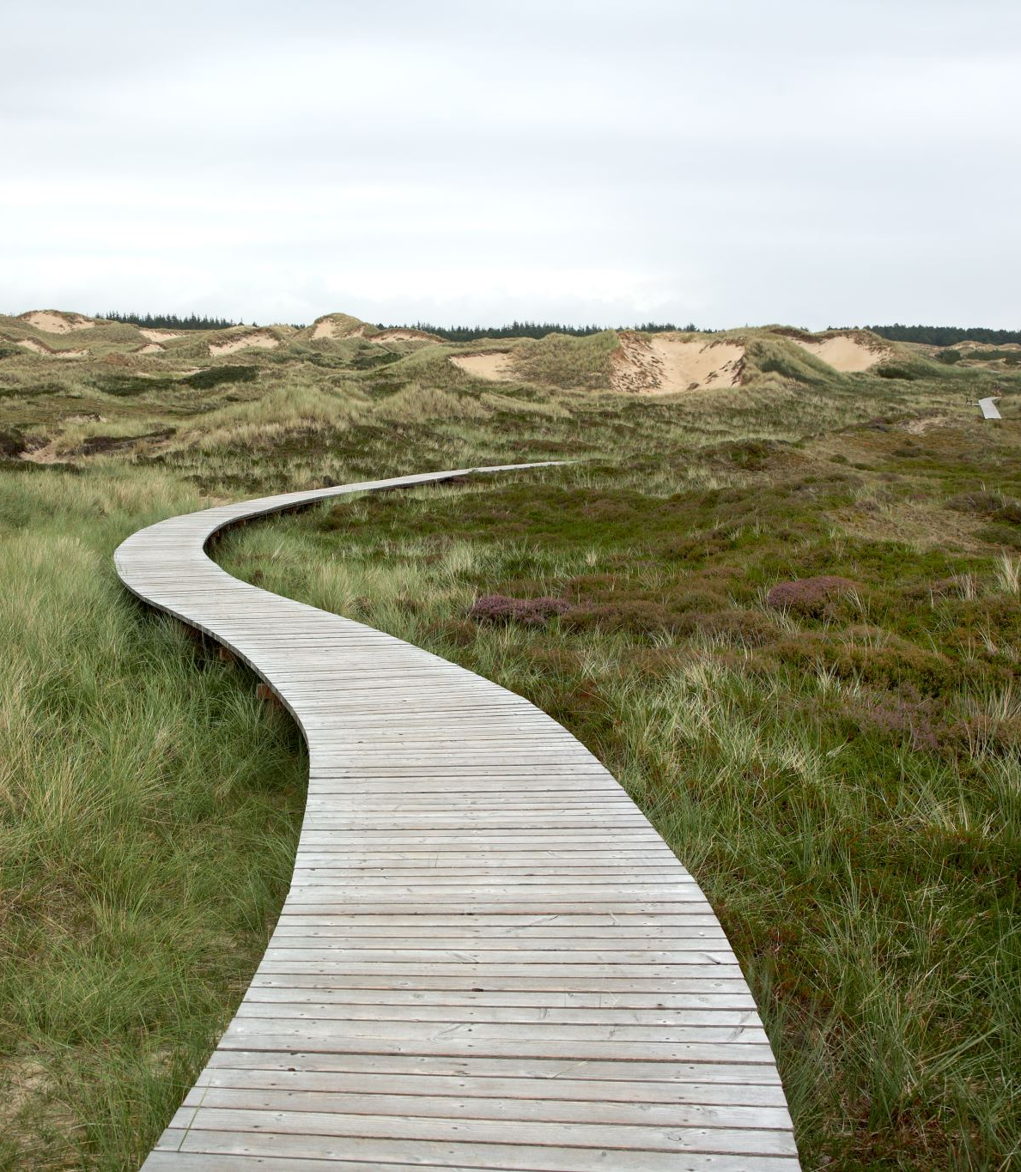
Resistive layer introduction.
  A long path, I think not yet fully explored !

Slide 18
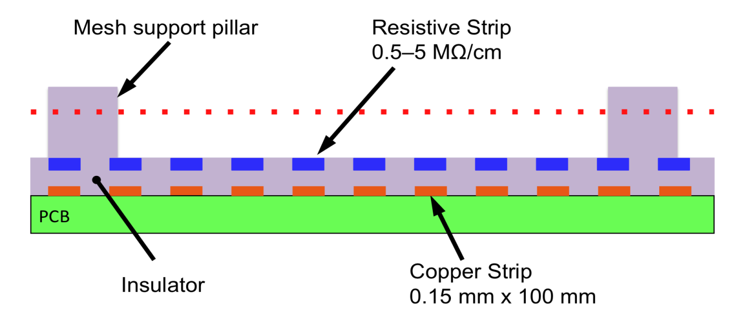
The first person who came to our workshop asking for resistive layers was again Yannis. The idea at that time was to dilute carbon powder in epoxy resin and cover read-out strips.
In 2012 during the early phase of ATLAS NSW R&D it became clear that the resistive layers are crucial.
With LHC background the single amplification stage detectors were continuously sparking, they were not damaged but simply constantly stopped due to the spark rate.
In close collaboration with Joerg Wotschack we dive in resistive layers.
It took us 12 iterations to find the right structure.
Screen printed resistive strips (ATLAS NSW)

Slide 19
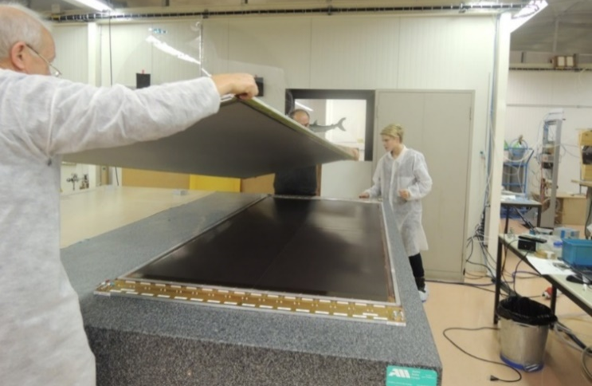
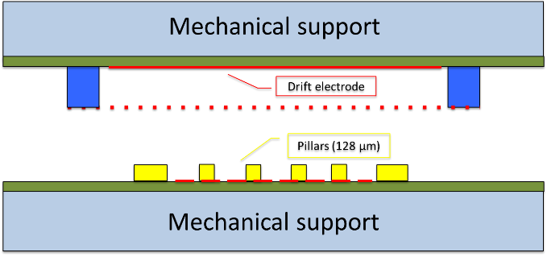
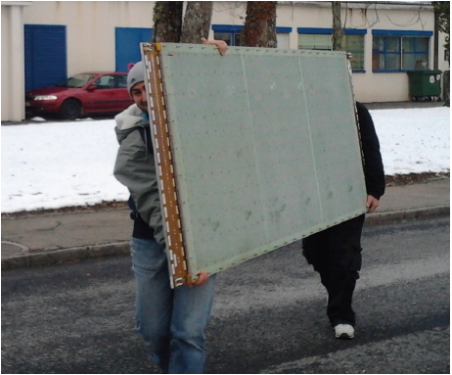
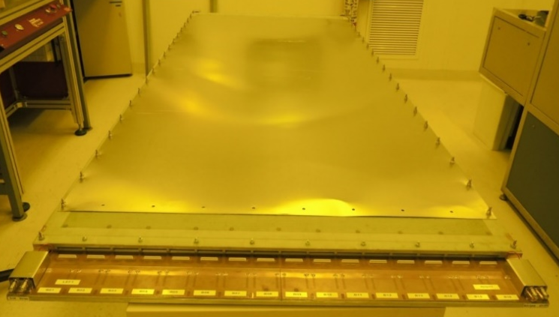
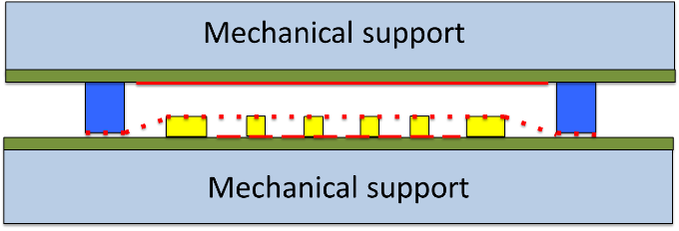
ATLAS NSW prototype 1m x 2m → Floating mesh
Open
Open
cathode
anode
Closed
Closed

Slide 20


Atlas NSW
Joerg Wotschack
Close to 2000 Micromegas detectors produced with modules sizes up to 2m x 0.5m
PCBs with pillars built at ELTOS (IT) and ELVIA (FR)
Meshes stretched and glued on frame in Thessaloniki
Honey-comb panels construction and detector Assembly :
-Dubna
-INFN Frascati
-CEA Saclay (Fabien Jeanneau’s gang)
-LMU Munich
MPT participated to the R&D and was also involved in the mass production with industry
-Specification
-Companies selection
-Technology transfer

Slide 21
Right after we did a Survey on existing resistive layers to take a direction for the future
Polymer paste 10Kohms to 100K/Square Too low values (but strips can artificially increase the value)
RuO Thick film paste 10K to 100M/square Perfect range , but the substrate must be ceramic
Resistive ceramics or glass Limitation on resistive values and size
Resistive Kapton Limitation on resistive values
Dissipative films Too high values
DLC: Diamond Like Carbon Perfect range 100K to 1T→ chosen direction

Slide 22

First benefit coming from resistive layers : Spark protection
  Spark energy : ½ CV2
    600 uJ in a 10cm x 10cm GEM.
    30 uJ with a classical MM 10cm x10cm.
    0.06 uJ with a 10M resistive layer.
  Below 10M/square.
    We can still create some visible compounds.
    There is still enough energy to slightly
    deteriorate dielectrics.
  Above 10M/square
    No visible compounds.
    The structure is never damage.
    But low Humidity and High cleanliness are mandatory !
No structural defect
No process above 100deg
No effect on metals or Polymers
Massive structural effects
Metal melting
Kapton evaporation
Processes happening above 1000 deg
But thanks to Triple GEM structure
this is not happening

Slide 23


second benefit : Resistive spreading
spice simulation Virginia university collaboration
Resistive layer model
Pulse amplitude and time shift with a 1MOhms/SQR layer
GND
GND
1600 cells
0.125mm x 0.125mm

Slide 24

Resistive spreading
Initial pulse
VS
Pulse evolution in position, time , width and amplitude
V7
50ns later
V13
150ns later
GND
GND
DLC
50um PI
R/O pick up structure
Approximative spreading diameter
-3mm for 1M
-1.25mm for 10M
-0.25mm for 100M
-less than 0.1mm for 1G

Slide 25


Third benefit : The FE protections are useless
Classical MM
C4 is defining the Spark current
C4 is in the range of 300pF
Resistive MM
C3 is defining the Spark current
and C3 is less than 1pF

Slide 26
2013-2023→MM with resistive layers
Medium-rate detectors 100kHz/cm2
Side evacuation of the charges
High-rate detectors 10Mhz/cm2
Charge evacuation inside active area
2013
2015
Screen printed resistive strips (ATLAS NSW)
2 layers with screen printed pads
or
or
2015
2020
1 full DLC or resistive kapton layer
2 DLC layers without patterns
Joerg Wotschack CERN
Alain Delbart Saclay
Paul Colas Saclay
Damien Neyret Saclay
Max Chefdeville Lapp Annecy
Renaud Gaglionne Lapp Annecy
Mauro Iodice INFN Roma

Slide 27



2016→PicoSec precise timing with Micromegas
PICOSEC: Charged particle timing at sub-25 picosecond precision with a Micromegas based detector
J. Bortfeldt et. al. (RD51-PICOSEC collaboration), NIM A (903), 2018, https://doi.org/10.1016/j.nima.2018.04.033
Cherenkov radiator
(3 mm MgF2)
Photocathode
(3 nm Cr + 18 nm CsI)
Ion tail
Drift gap
(Pre-amplification)
Micromegas
(Amplification)
Electron peak
Gas mixture: 80% Ne + 10% C2H6 + 10% CF4
(COMPASS gas)
Signal with two distinct components:
Electron peak: fast (≈0.5 ns)
Ion tail: slow (≈100 ns)
Schematic not drawn to scale
X. Wang et al., Study of DLC photocathode for PICOSEC detector, RD51 collaboration meeting, October 2018

Slide 28



PicoSec detector modules
Single pad (2016)
Pads ⌀1 cm
Multi pad (2017)
Pads ⬡ 1 cm
10x10 module (2022)
Pads □ 1 cm

Slide 29

Conclusion
Yannis have triggered nearly all the major MM improvements
There is now a solution for nearly all applications: large size, shape, protection , rate , space resolution, mass production , time resolution etc.
Yannis could you help us to face our last problem :
Improving the robustness of photocathode layers for precise timing detectors

Slide 30
Third benefit : The FE protections are useless
-HV
mesh
Cu Strip 0.1mm x 10cm
+Vs
MM with classical
discrete components
protection
(In green)
Gas volume
C3
C1
C4
R2
R1
PCB
C2
-Vs
GND
C1 : capacity mesh to GND many nF
C2 : strip capacity to GND in the range of 20 pF
C3 : strip capacity to mesh in the range of 10pf
C4 : spark protection capacitor in the range of 300pF → 10 x (C2//C3)
R1 : polarization resistor 1M
R2 : peak spark current limitation 20 Ohms to protect the external diodes

Slide 31
Third benefit : The FE protections are useless
-HV
mesh
Cu Strip 0.1mm x 10cm
+Vs
MM with classical
discrete components
protection
(In green)
Gas volume
C3
C1
C4
R2
R1
PCB
C2
-Vs
GND
C1 : capacity mesh to GND many nF
C2 : strip capacity to GND in the range of 20 pF
C3 : strip capacity to mesh in the range of 10pf
C4 : spark protection capacitor in the range of 300pF → 10 x (C2//C3)
R1 : polarization resistor 1M
R2 : peak spark current limitation 20 Ohms to protect the external diodes
The spark current is defined by C4 serial to R2 through outer diodes.
This spark current do not flow through the amplifier.
Without external diodes the inner diodes would have been damaged.
Without C4 , C1 defines a so large current that the outer diodes would have been damaged, melting also the mesh.

Slide 32
Third benefit : The FE protections are useless
-HV
mesh
Gas volume
Resistive strip or layer
C4
Cu Strip 0.1mm x 10cm
MM with
Resistive protection
Kapton
+Vs
C3
C1
R1
-Vs
PCB
C2
GND
C1 : capacity mesh to GND many nF
C2 : strip capacity to GND in the range of 20 pF
C3 : local capacity res layer to mesh below the pF
C4 : local capacity res layer to strip below the pF
R1 : embedded resistor part of the resistive strip or layer

Slide 33
Third benefit : The FE protections are useless
-HV
mesh
Gas volume
Resistive strip or layer
C4
Cu Strip 0.1mm x 10cm
MM with
Resistive protection
Kapton
+Vs
C3
C1
R1
-Vs
PCB
C2
GND
C1 : capacity mesh to GND many nF
C2 : strip capacity to GND in the range of 20 pF
C3 : local capacity res layer to mesh below the pF
C4 : local capacity res layer to strip below the pF
R1 : embedded resistor part of the resistive strip or layer
The peak spark current flowing in the amplifier is defined by C3 and the amplifier internal diodes.
Approximately 1000 time less the previous scheme.
External diodes are not necessary.

