Slide 1
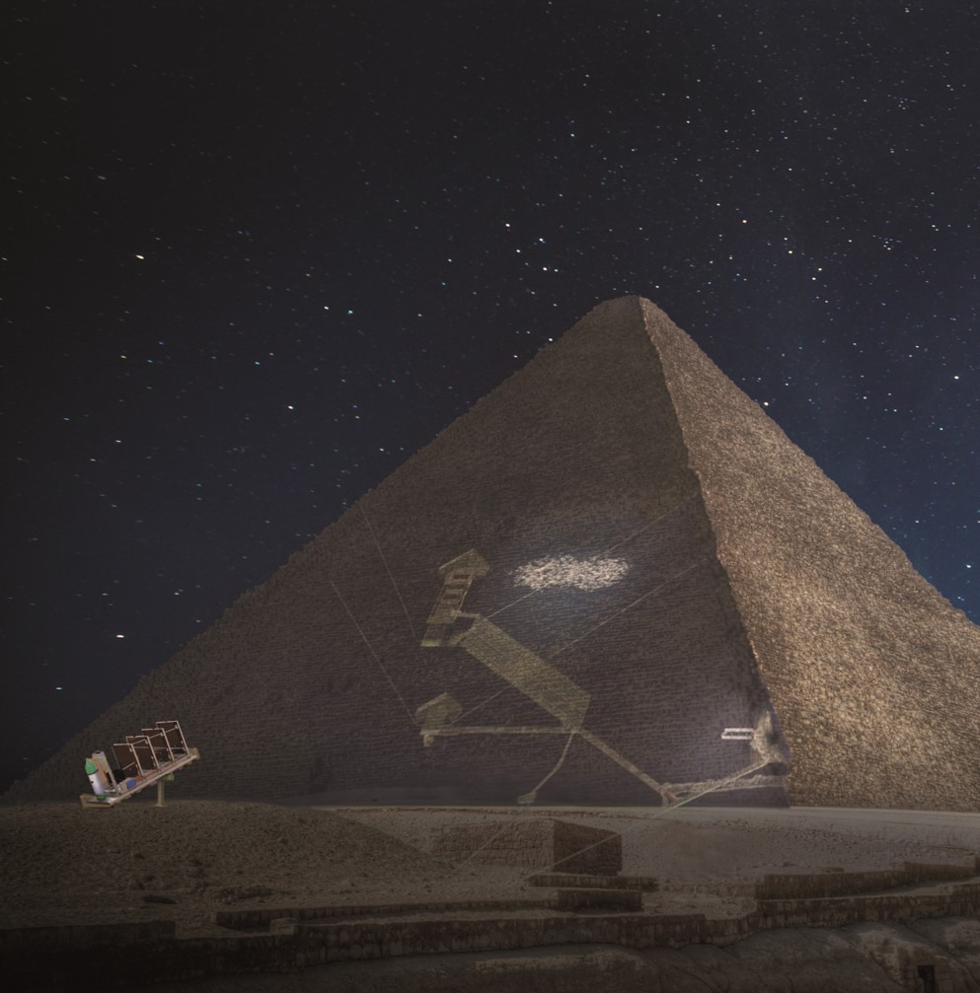
Muon tomography using Micromegas technology
David Attié
Celebrating Ioannis, October 5th, 2023

Slide 2
Preambule
1
My contribution to Resistive Micromegas

Slide 3
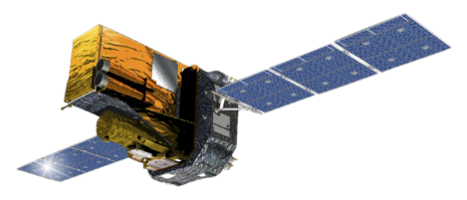
My contribution to Resistive Micromegas
  After a PhD in Space γ-ray Astrophysics (INTEGRAL/SPI)
    HPGe detectors
  Courtesy visit in Astrophysics Department in December 2005 → Eric Delagnes → Paul Colas
X
2006
2007
2008
2009
2010
2011
2012
2013
2014
X

Slide 4
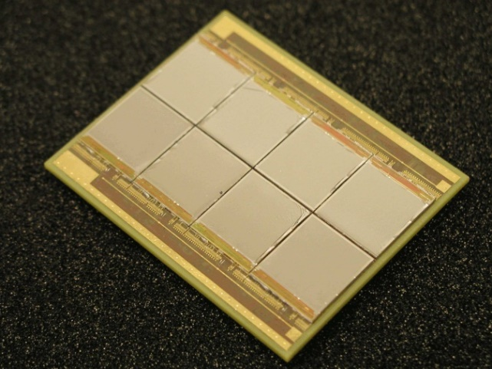
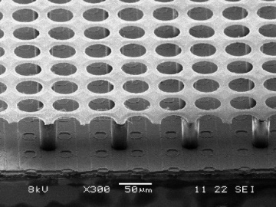
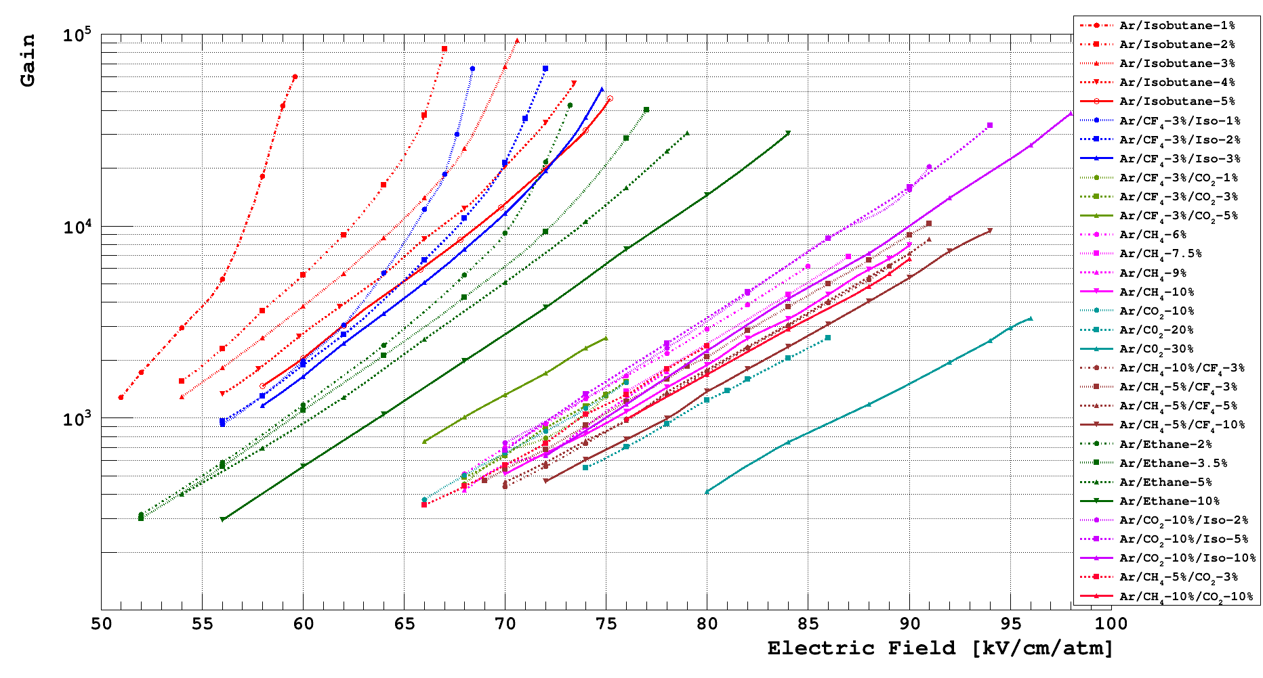
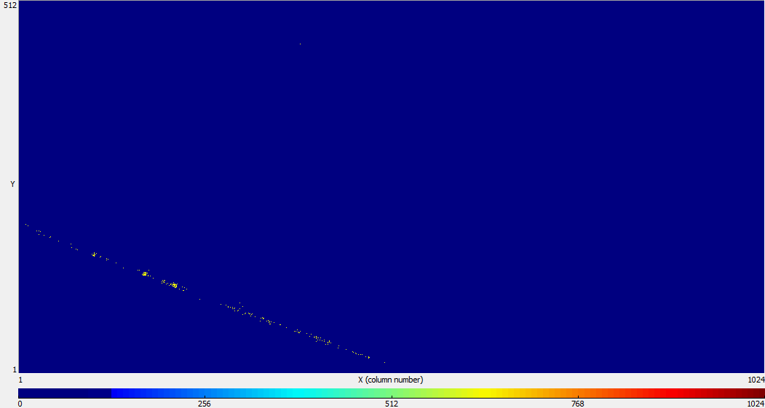
My contribution to Resistive Micromegas
  Postdoc position on digital TPC:
    Gas detector novice
    Systematic study of gas mixtures
    First small digital TPC using TimePix + Micromegas
X
X
  Permanent position at CEA:
    First large digital TPC (TimePix/Ingrid)
X
2006
2007
2008
2009
2010
2011
2012
2013
2014
X
X
X

Slide 5
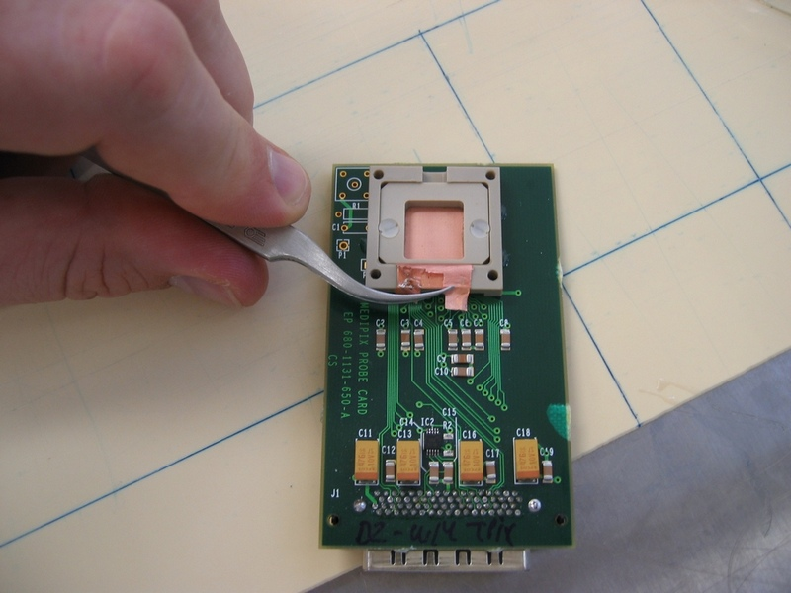
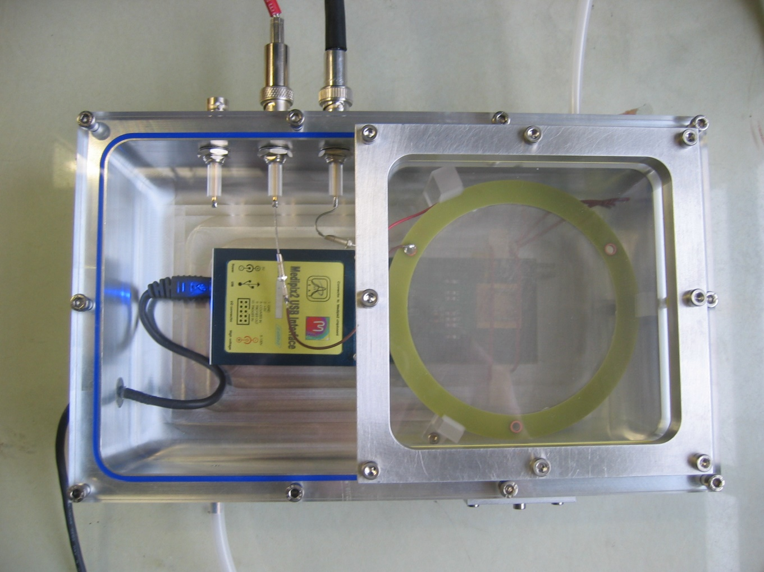
My contribution to Resistive Micromegas
  My first close interaction with Ioannis!
    Micromegas copper grid on TimePix without resitive layer for spark protection
    My first gas box
    But need to borrow a CAEN power supply to Ioannis lab for the first test
X
2006
2007
2008
2009
2010
2011
2012
2013
2014
X
  Conclusion:
  So we must find an « Ioannis’ proof » solution to improve people trust
  in Micromegas detector!
  → Resitive detectors?!

Slide 6
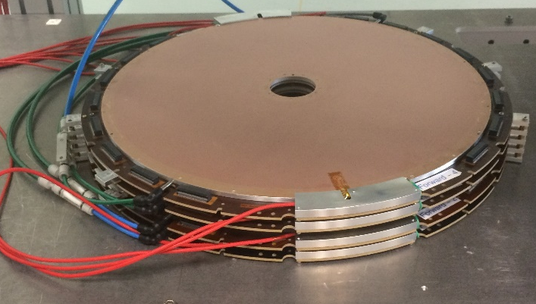
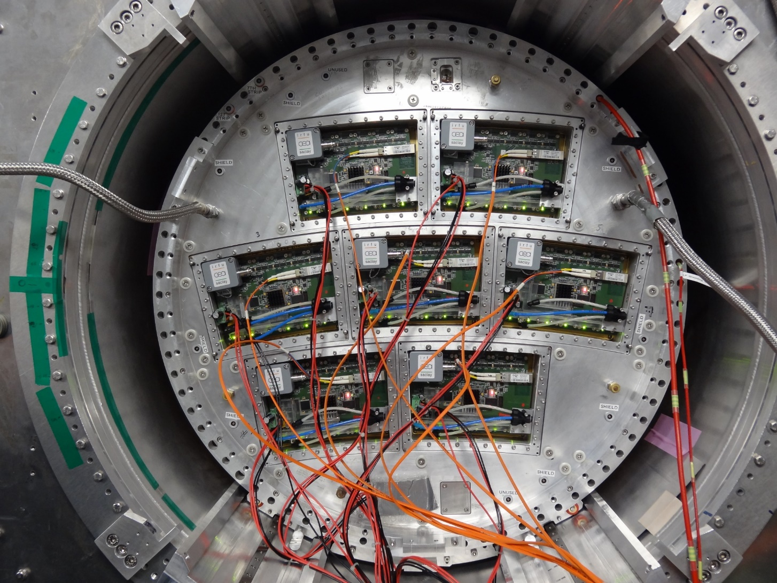
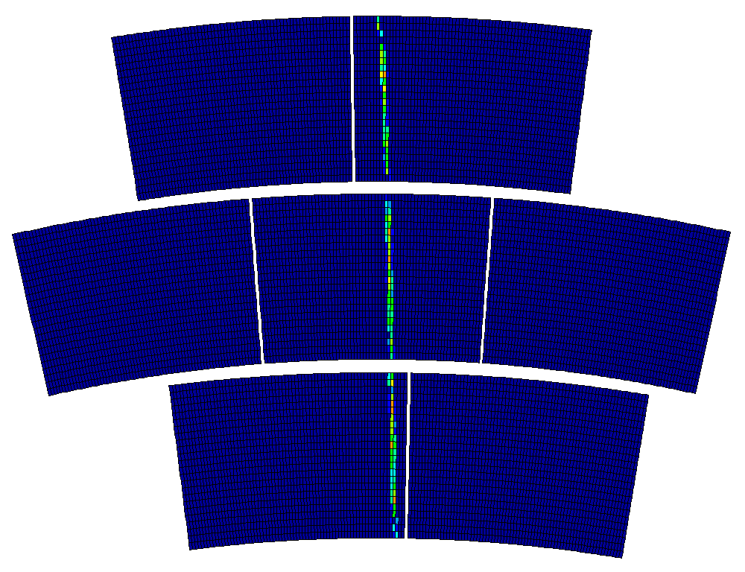
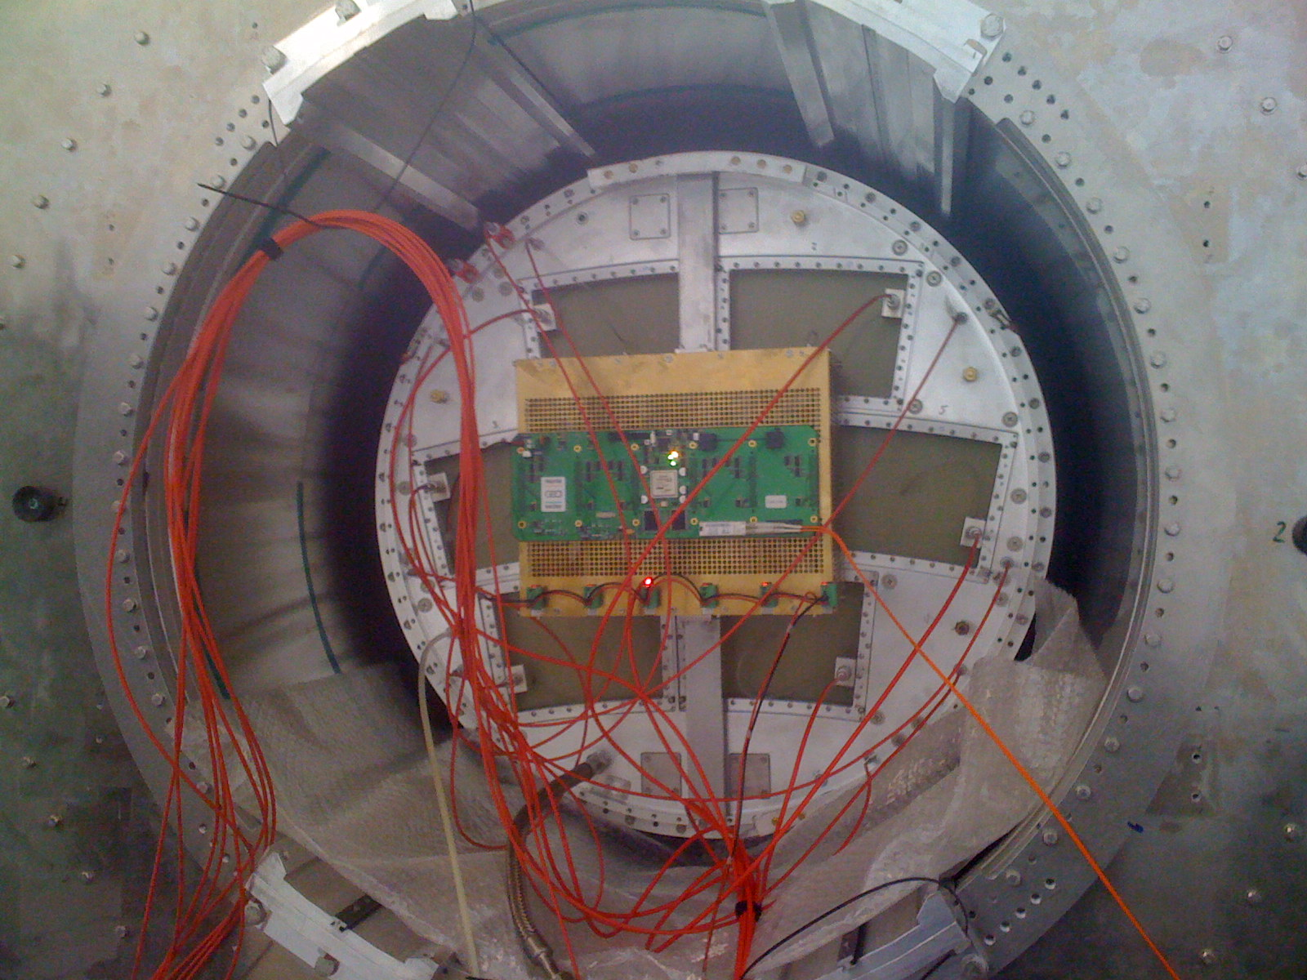
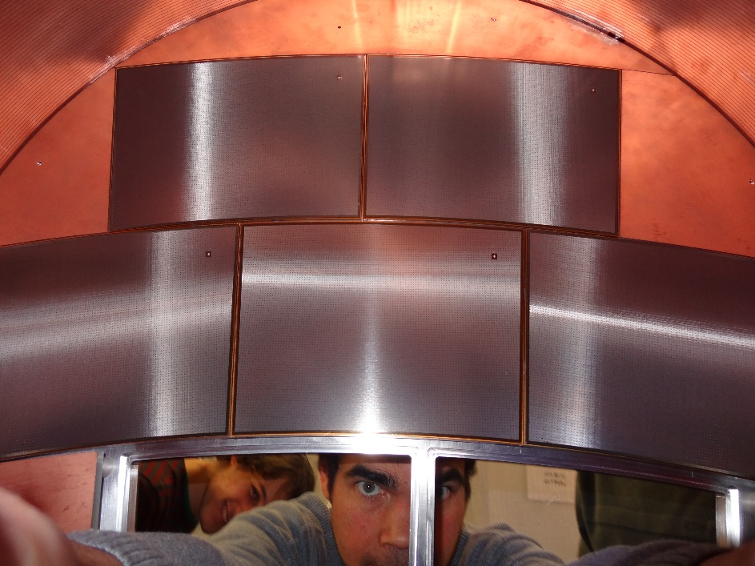
My contribution to Resistive Micromegas
  Resistive Micromegas solution for ILC-TPC
    Tests of several resistive coating with one module
    Beam tests in a large prototype TPC
  MAMMA collaboration
  HARPO
  Clas 12
  T2K
  PiggyBack…
X
    Unprotected integrated electronics with 7 modules
X
2006
2007
2008
2009
2010
2011
2012
2013
2014
X
X

Slide 7
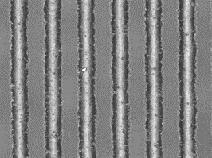
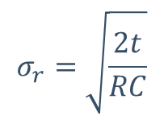
Micromegas Technology
Standard Model of Particle Physics
  First introduced by Dixit et al. NIM A518(2004)721 to improve spatial resolution
  Use material properties (resistivity) and geometry (insulator thickness) to spread charge over several pads
    Resistive ink
    Carbon Loaded Kapton (CLK)
    Diamond Like Carbon (DLC)
  Choice of resistivity: from 100 kΩ/□ to 10 MΩ/□
  Specific Pad Response Function (PRF) needed
  Advantages for resistive readout:
Micromegas mesh
Resistive foil
Insulated layer
 | Resistive Anode
Properties | Strips | Plane
Charge dispersion | × | ×
Spark protection | × | ×
Multiplexing readout | ×
2D readout | ×
Readout segmentation | Strips | Strips/Pixels
left
middle
right
Pads
PCB
Anode with strips
Plane anode
$$σ_{r}=\sqrt{\frac{2t}{RC}}$$
t≈ shaping time
RC from resistive layer

Slide 8
Muon Tomography
2
Imaging from muon flux

Slide 9
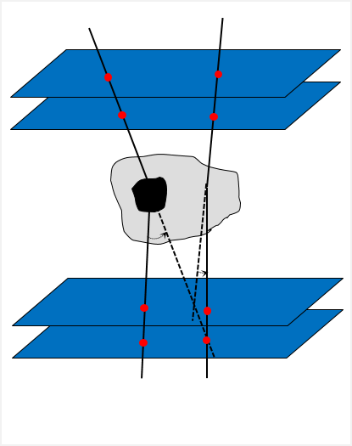
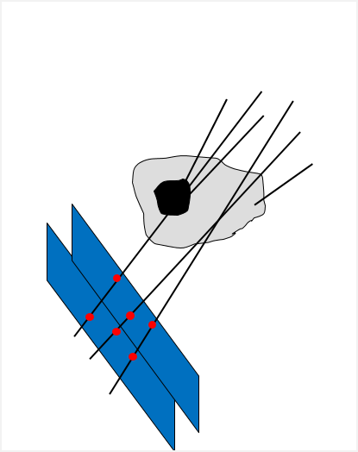
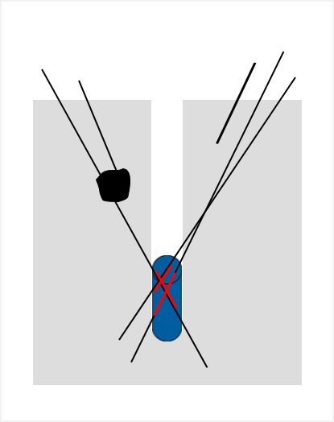
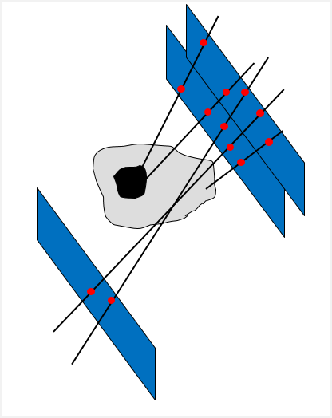
Muon tomography – Principle
  Enable a non-invasive but penetrating imaging of density contrast using natural charged particles
  Muon tomography can be done using one of the three methods:
    Deviation
(M-Cube)
    Transmission
(WatTo, Scanpyramids, G2G3, INB72, EDF, D3DT)
    Absorption
(IZEN)
Transmission
Transmission
Absorption
~10-100 m
~1 m
~10-100 m
~1 m
Deviation

Slide 10
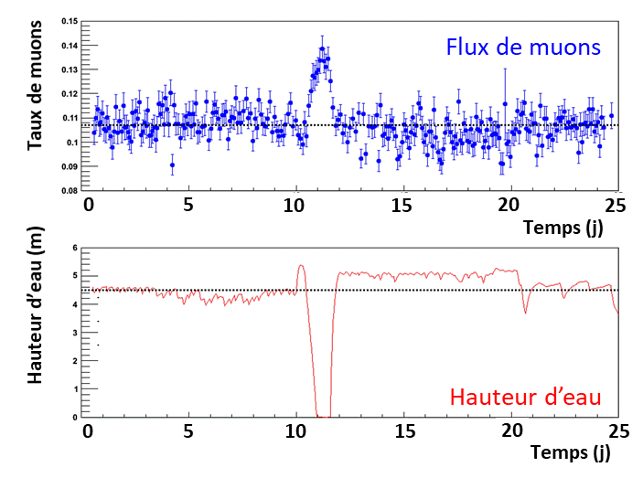
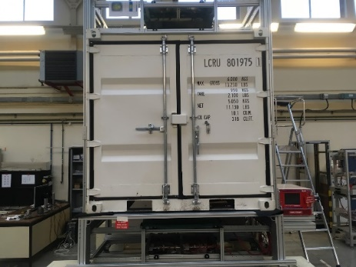
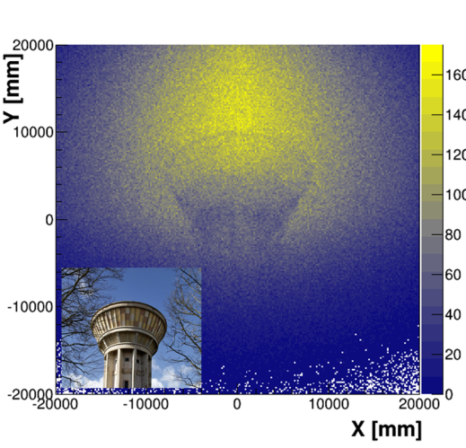
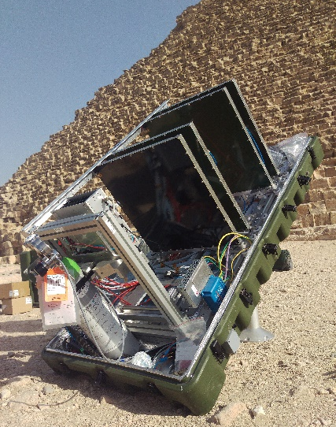
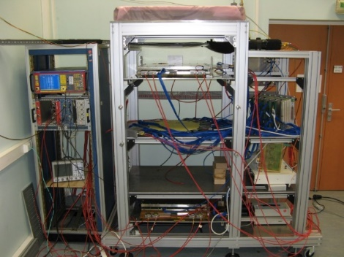
Muon tomography – Timeline
  Started with the R&D of resistive multiplexed Micromegas
  Used for hodoscope in cosmic test bench
    Reduce channel number
  M-Cube :
  U detected in less than 4 minutes
    Large area with accurate tracking
2012
2013
2014
2015
2016
2017
X
X
X
X
X
  Cosmic bench for Clas12 detectors validation
  M-Cube:
  demonstrator for homeland security
  WatTo (Water Tower)
  ScanPyramids
1st muography HD online

Slide 11

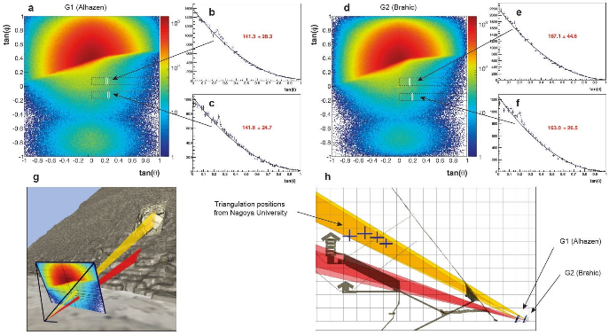


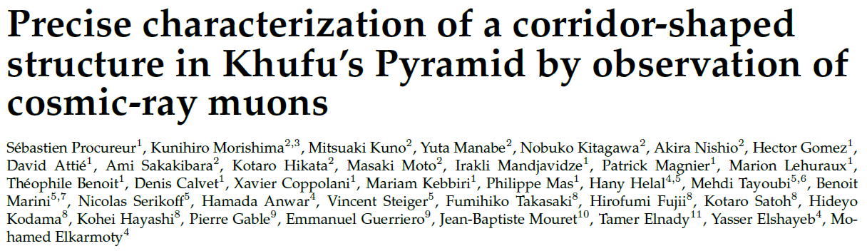

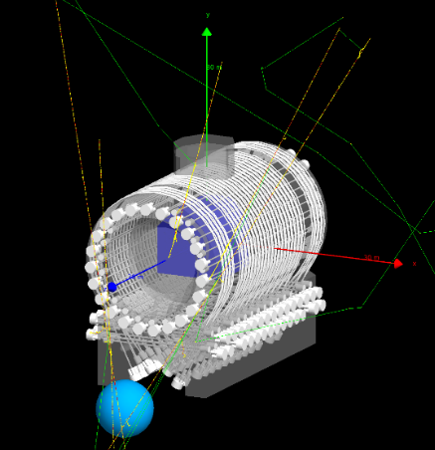
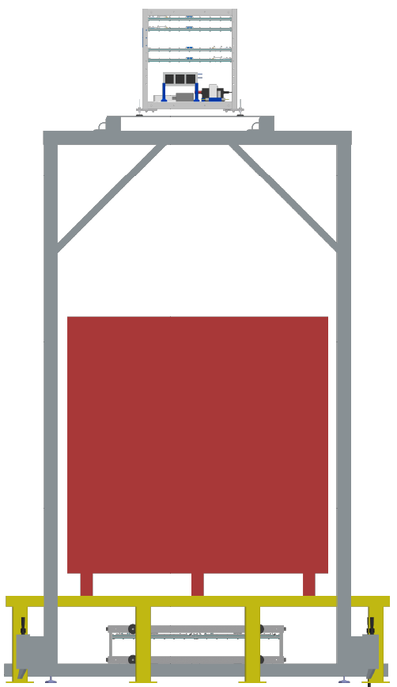
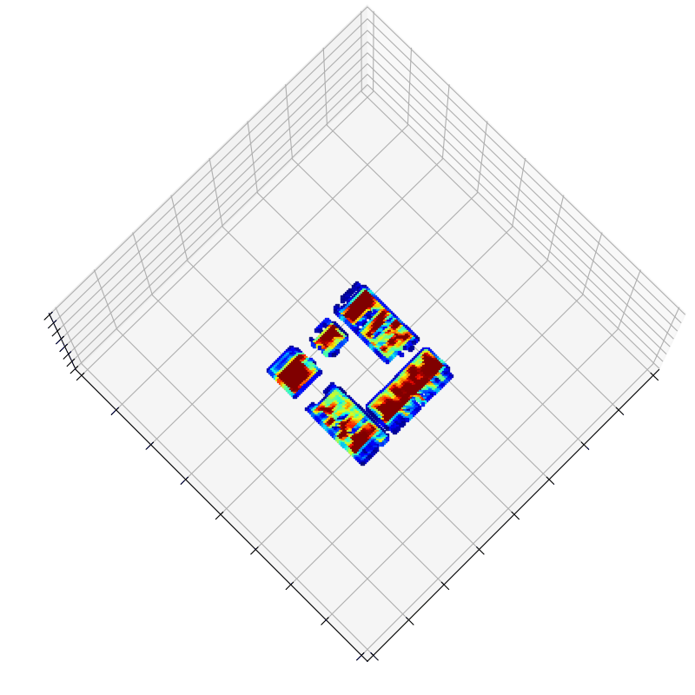
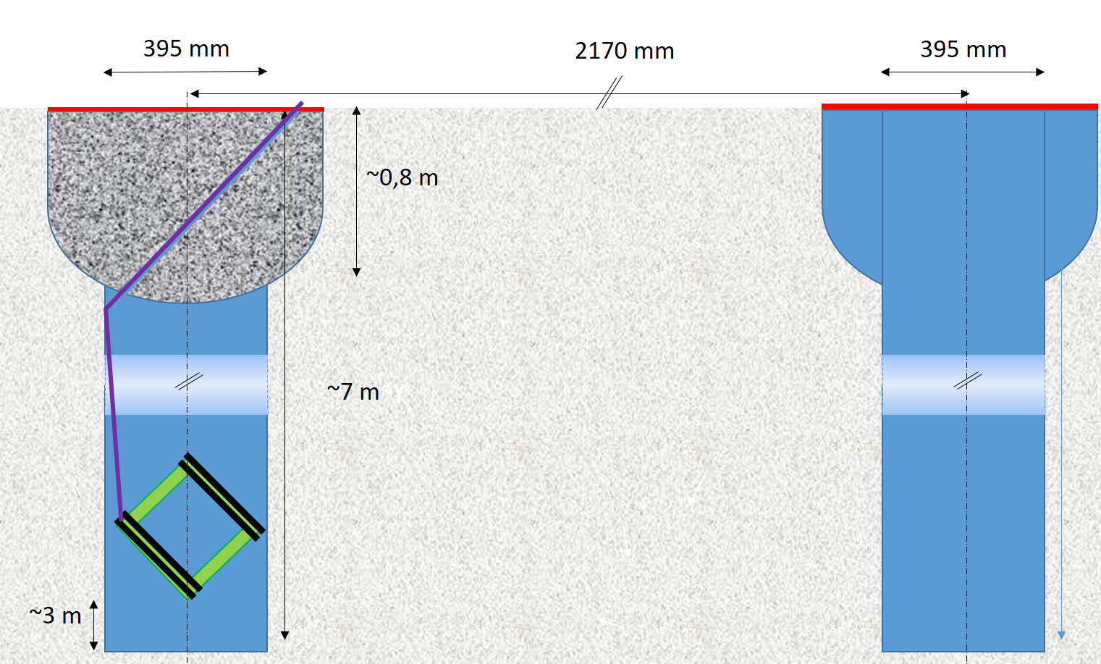
Muon tomography – Timeline
Industrialization
  Common lab
2017
2018
2019
2020
2021
2022
X
X
X
X
X
X
X
X
  Maison de l’Imagerie Muonique Ouverte aux applications Sociétales et Académiques
INB72
  G3 nuclear reactor (NR)
  G2G3
IZEN
Nuclear dismantling projects
1st muography of a military NR

Slide 12
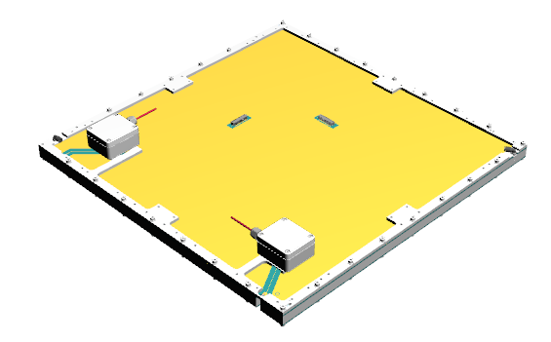
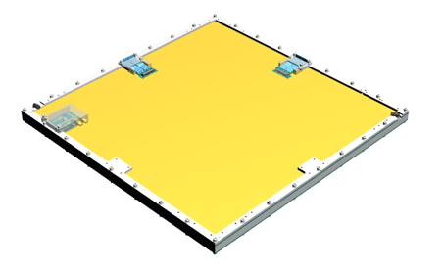
MultiGen detector – Basic element of a telescope
  MultiGen detector
    Resistive strip bulk Micromegas
    2D readout (X & Y) genetic multiplexing
    PCB size: 546×546 mm²
    Active area: 500×500 mm²
    Can be used in mosaic
(X₁,Y₁,Z₁ )
MultiGen v2
MultiGen v3-v4
  Evolution since 2014: from prototype to serial
  Since 2021 working on replacement of Pyralux by Vacrel
X
MultiGen Version | Multiplexing Family | Strip number | Strip pitch (μm) | Year | Produced Detector | Improvement
v1 | 17* | 1024 | 488 | 2014 | 7 | (*) one family incomplete: 13 strips missing
v2 | 17 | 1037 | 482 | 2015 | 42 | Complete families; grounding plane added
v3 | 17 | 1037 | 482 | 2017 | 50 | Connectors moved to sides; HV filters on PCB
v4 | 12 | 732 | 683 | 2019 | 52 | Number of family reduced to 12; resistivity increased
INB72 | 5 | 305 | 560 | 2022 | 8 | Smaller detector (200×200 mm²) for specific application

Slide 13
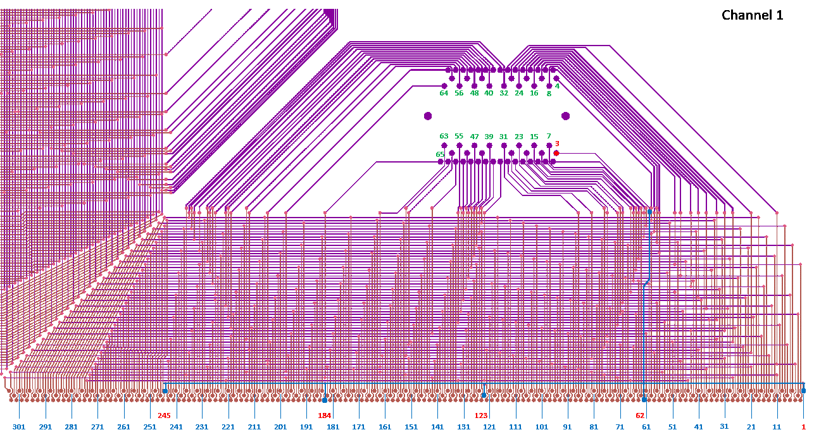
MultiGen detector – Illustration with 5 families
INB72 detector
5 multiplexing families
305 (5x61) strips
Pitch: 560 µm

Slide 14
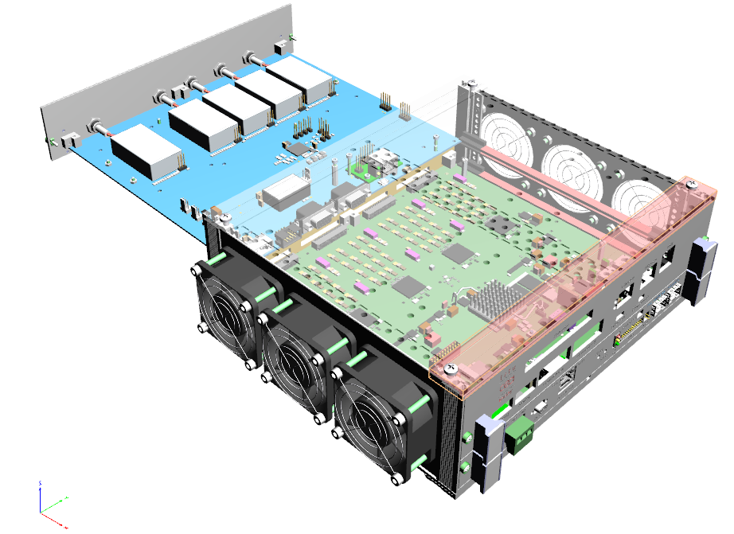
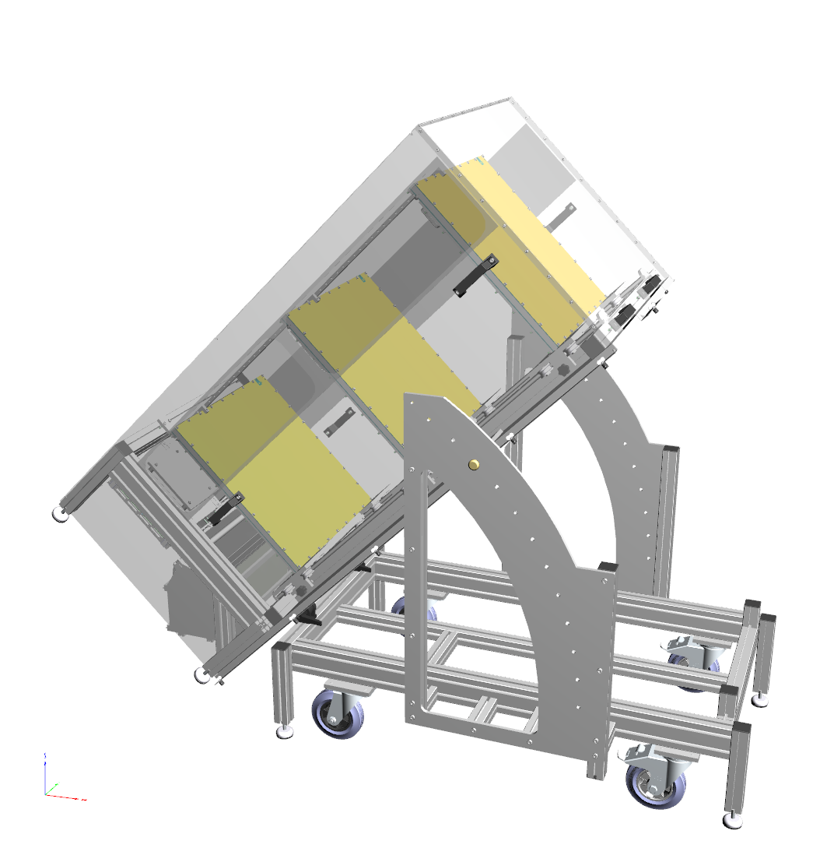
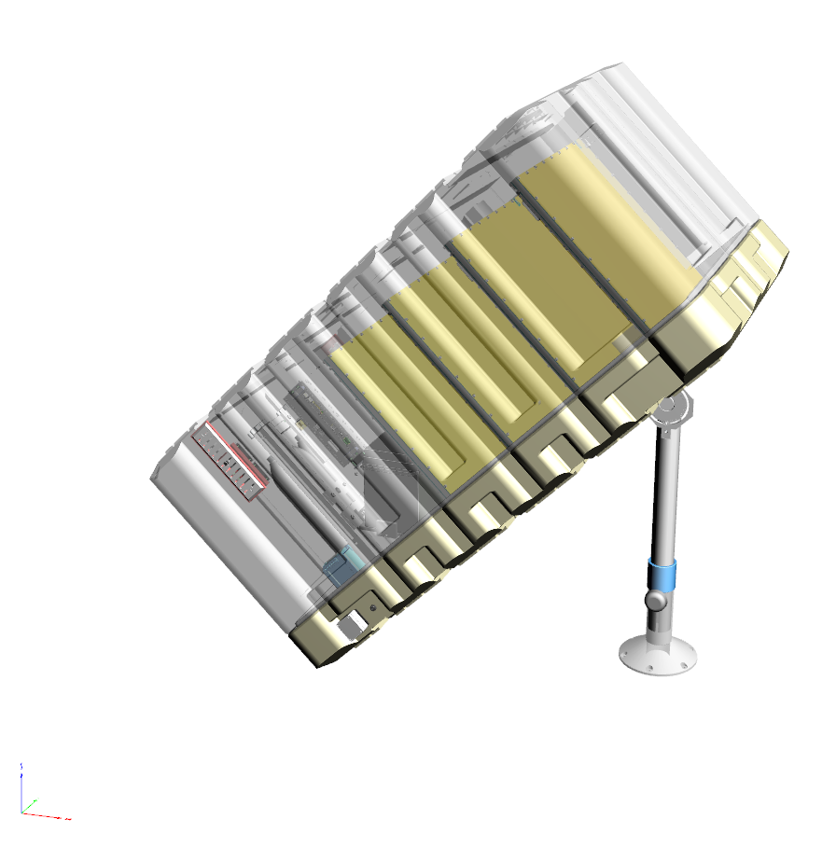
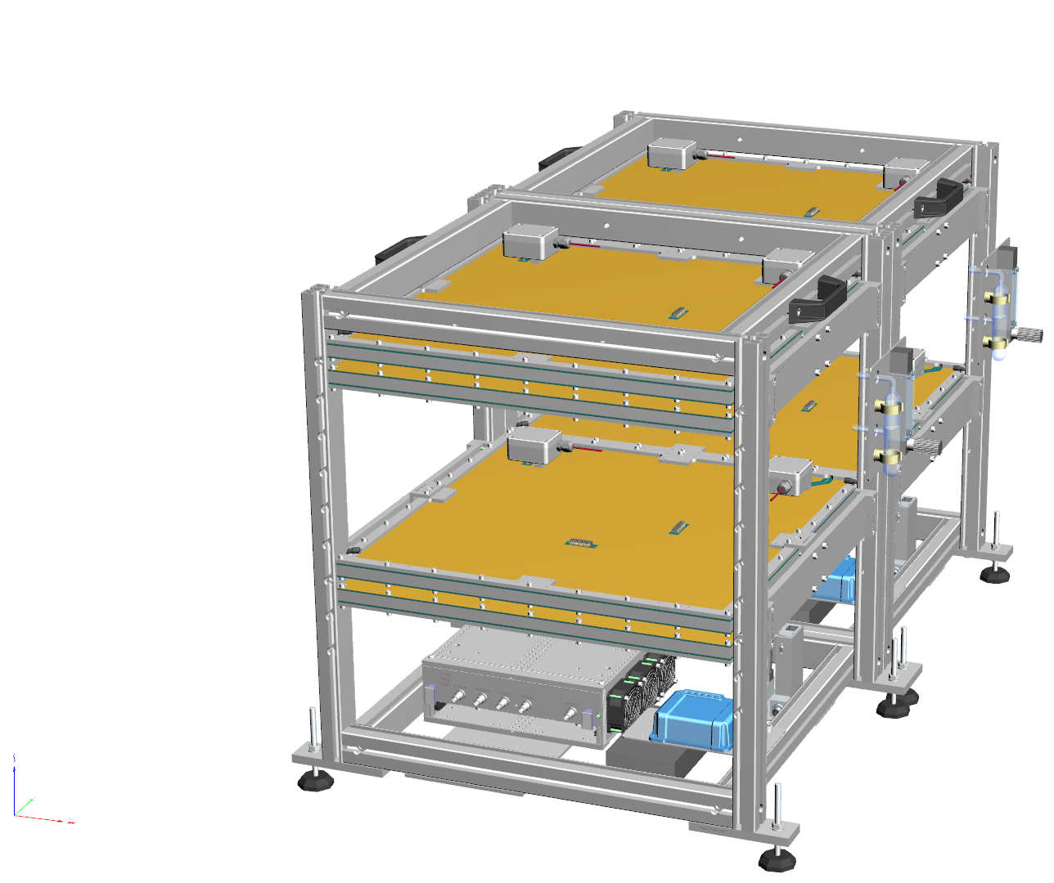
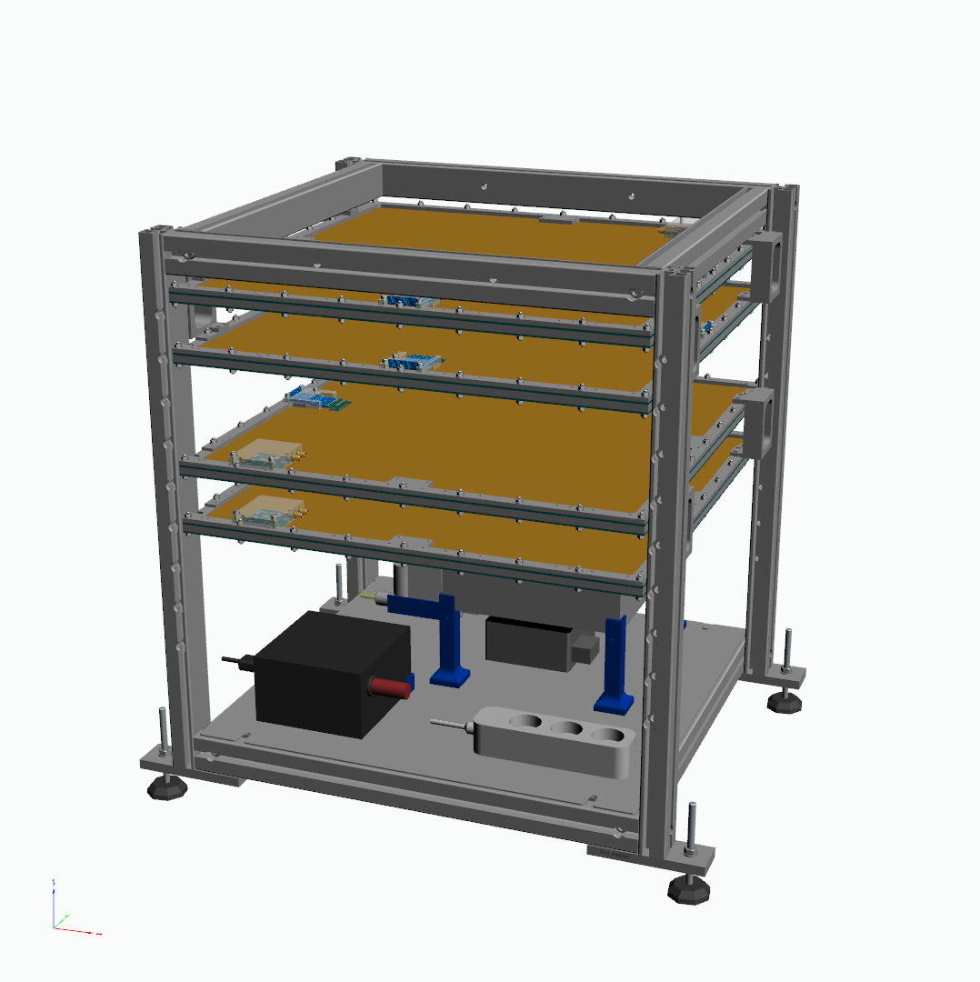
Telescopes based on MultiGen
  Evolution of the CEA/Irfu telescope: towards compactness and transportability
  CEA/Irfu’s electronis cards
    Front-End Unit (FEU) card developed for Clas12
    High Voltage Power Supply (HVPS) card dedicated to muon
DC-DC
6U Rack
    2015: WatTo, ~200 kg
    2016: ScanPyramids (outside), ~130 kg
    2018: ScanPyramids (inside) cube, ~45 kg
    2019: G2G3, EDF, …, optimized cube, ~45 kg
HVPS
FEU
8 ASICs Dream
2015
2016
2018
2019-today

Slide 15
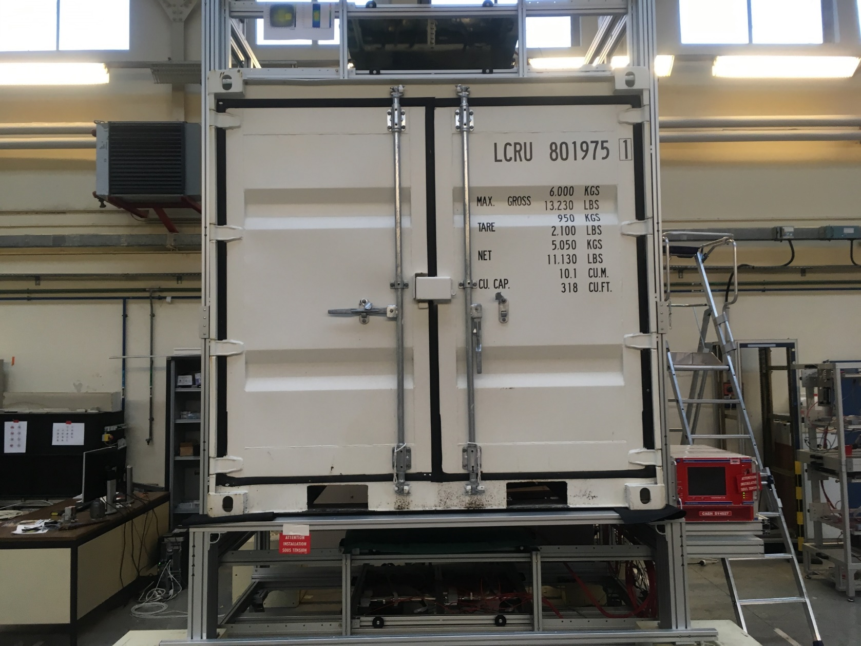
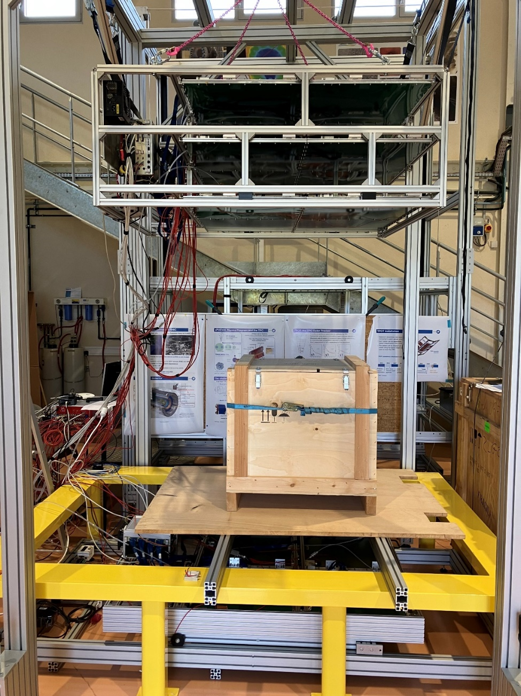
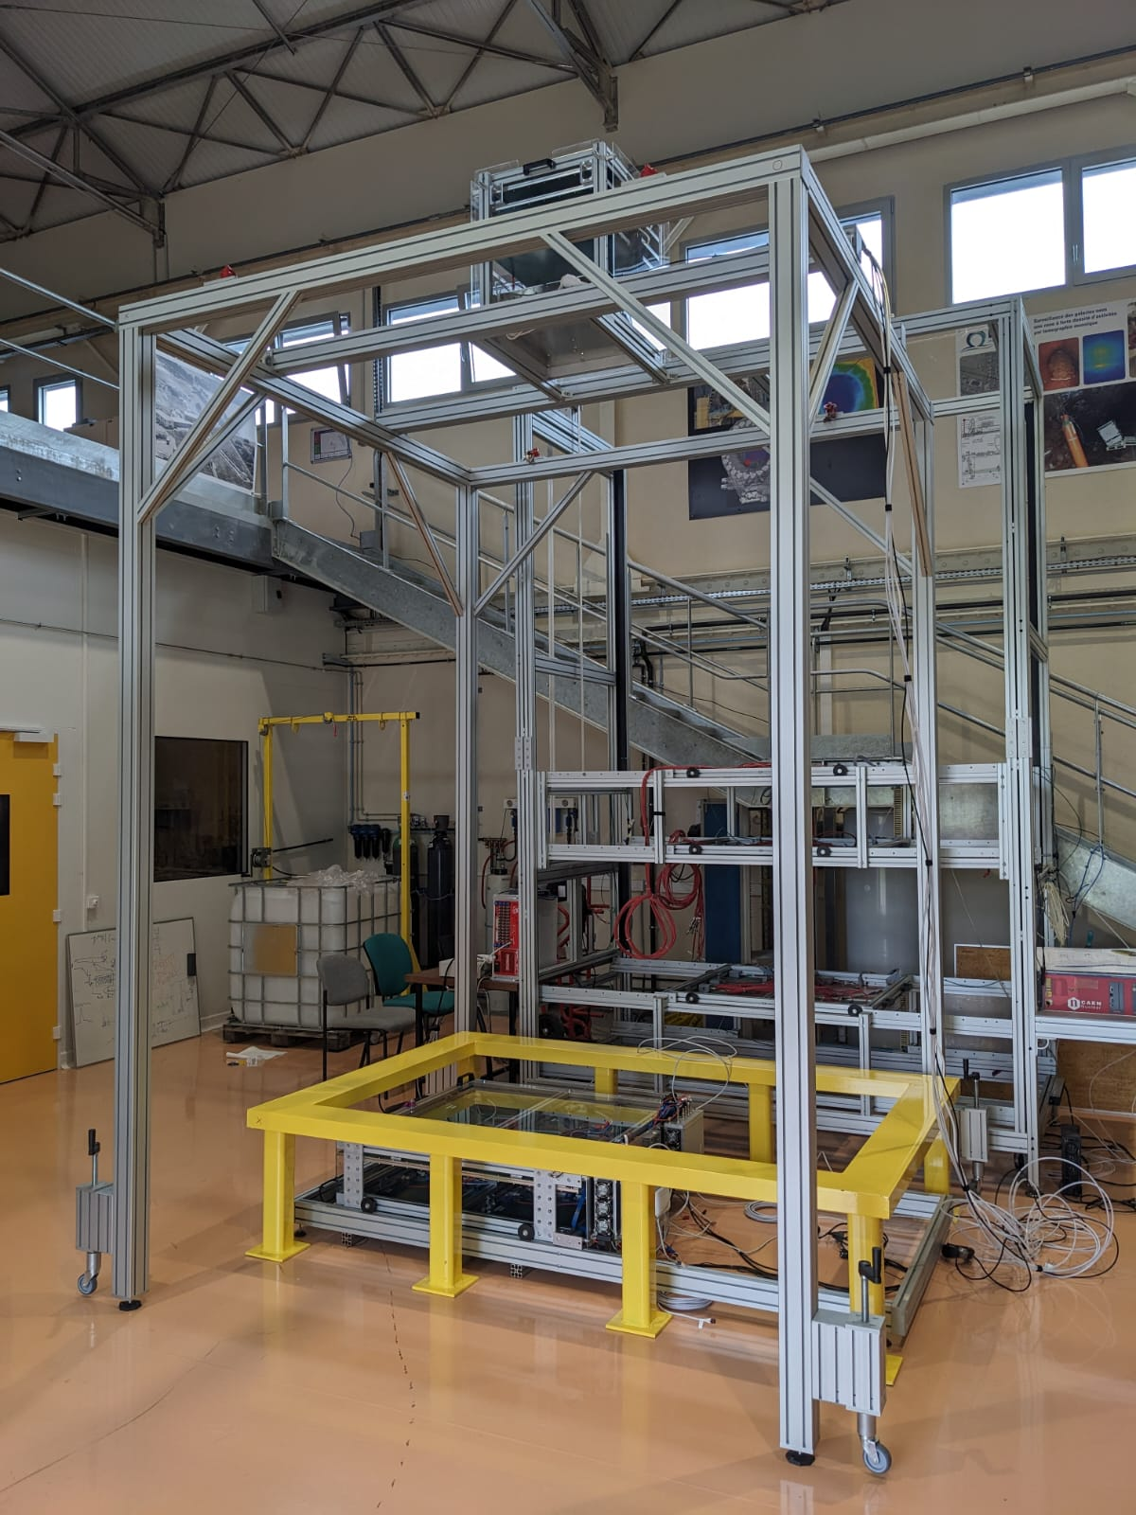
Benches of Muon Tomography
  Benches built for specific applications
    M-Cube: smuggled "Special nuclear material" (SNM)
    ENTRANCE: EfficieNT Risk-bAsed iNspection of freight Crossing bordErs without disrupting business
    IZEN: waste package inspection
2014-2017
2020-2023

Slide 16
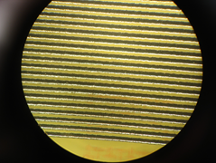
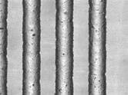
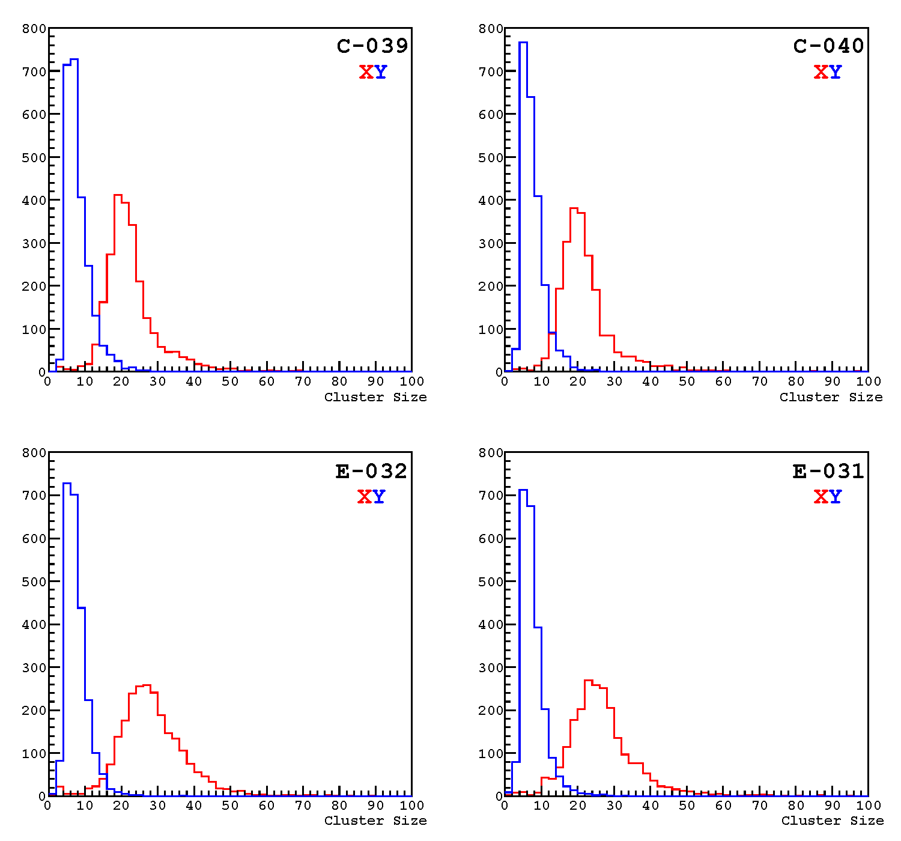
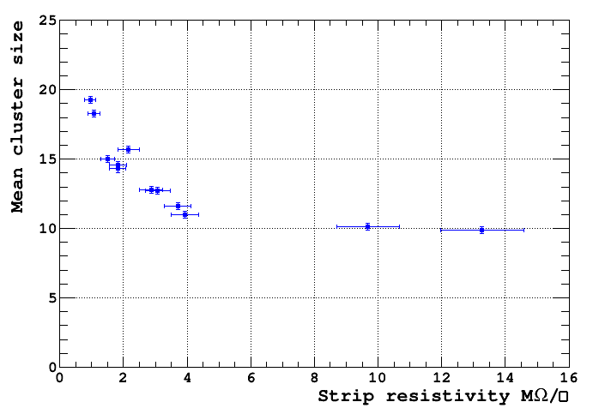
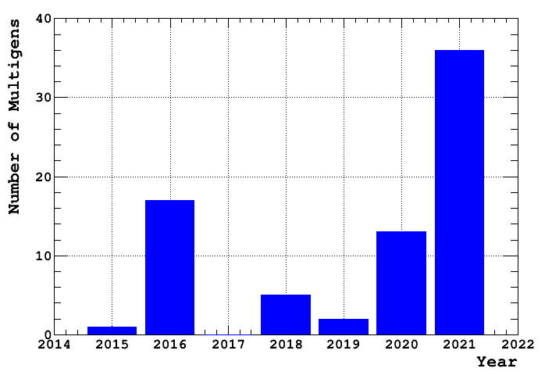
Resistive strip and detector production
  Resistive strip with high resistivity strip requested
    R&D made over two years
    CEA/Irfu the only producer by screen printing left
    Target resistivity between 1&5 MΩ/□
  Detector manufacturing transfer to Elvia-PCB
    Started in 2014
    Succeed after many years until obsolescence of Pyralux → Vacrel

Slide 17
Conclusions
  Micromegas detectors made a late start in the very active field of muon tomography thanks to
    Resistive strip readout
    2D multiplexing technique
    Amplitude feedback to compensate for environmental changes (P, T)
    PCB factory production (more than 150 detectors produced since 2015)
    Gas tightness, recirculation and filtration
  Over a decade, the competition has been caught up, or even surpassed
    First online HD muography (WatTo)
    First nuclear reactor tomography with muons
    ScanPyramids mission results (Big Void, North Face Corridor)
  Muon tomography telescope based on Micromegas technology is a success
    The first telescope will be sale by Iris-Instruments this year
    Probably helped by the research process to make them “Ioannis’ proof” put in place

Slide 18
Thank you!

Slide 20
Muon particle
1
What is it?

Slide 21
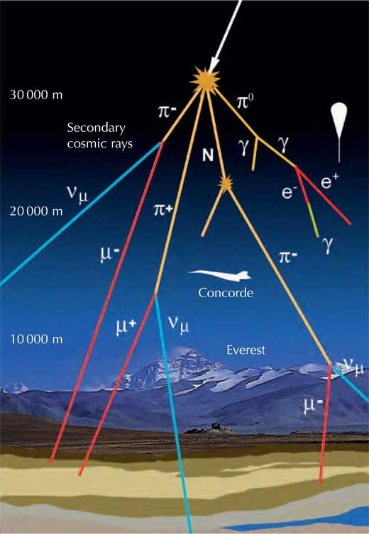
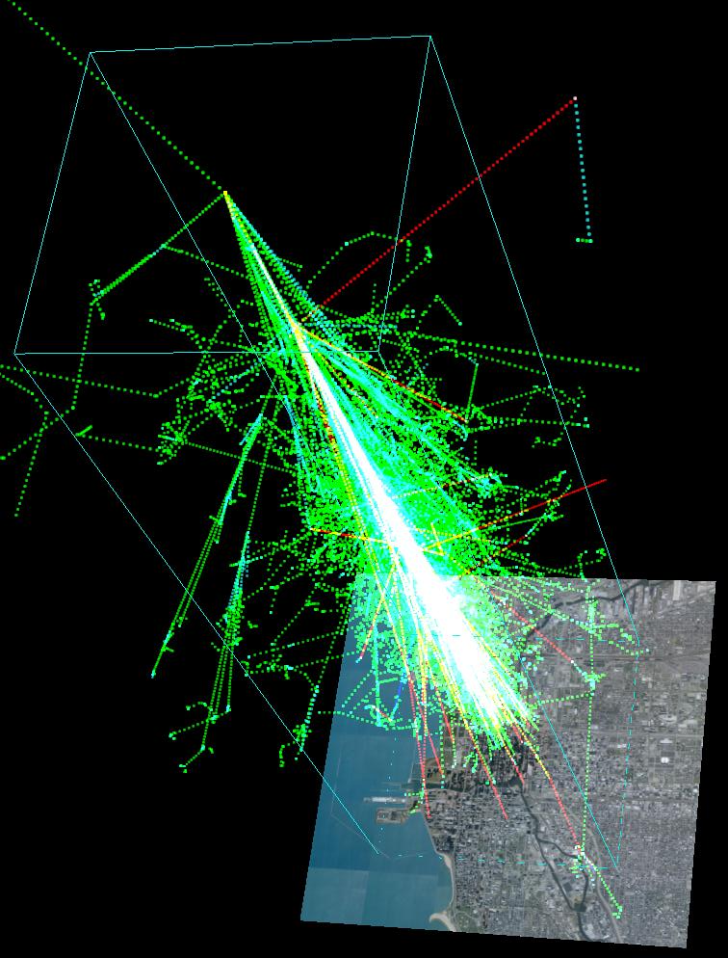
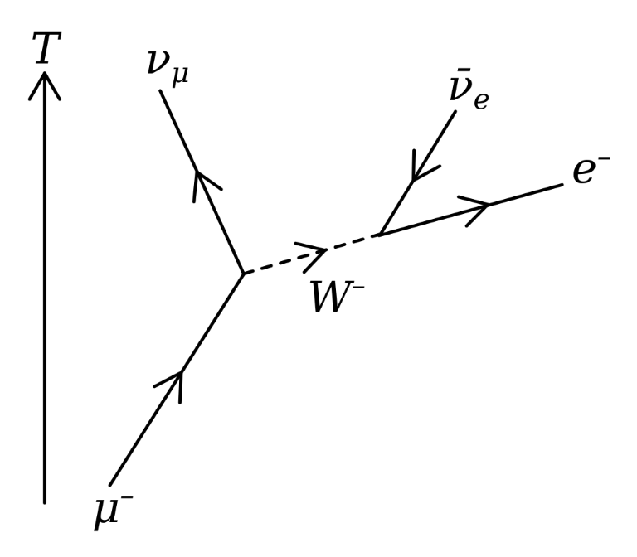
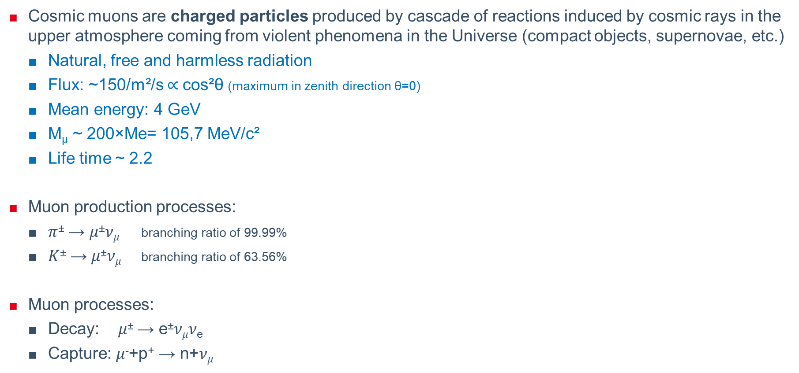
Cosmic-rays muons
  Cosmic muons are charged particles produced by cascade of reactions induced by cosmic rays in the upper atmosphere coming from violent phenomena in the Universe (compact objects, supernovae, etc.)
    Natural, free and harmless radiation
    Flux: ~150/m²/s $∝$cos²θ (maximum in zenith direction θ=0)
    Mean energy: 4 GeV
    M_{µ} ~ 200×Me= 105,7 MeV/c²
    Life time ~ 2.2
  Muon production processes:
    𝜋± → 𝜇±𝜈_{𝜇} branching ratio of 99.99%
    𝐾± → 𝜇±𝜈_{𝜇} branching ratio of 63.56%
  Muon processes:
    Decay: 𝜇± → e±𝜈_{𝜇}𝜈_{e}
    Capture: 𝜇⁻+p⁺ → n+𝜈_{𝜇}
Simulated air shower created by 1 TeV proton

Slide 22



Muon interation with matter
  Muon trajectories are straights in mean
  Muons interact with matter and can be
    Absorbed/stopped (decay)
    Scattered
  Interaction processes with matter
    Energy loss given by Bethe-Bloch ionization stopping power
    Standard deviation of the scattering angle describe by Molière theory
      Radiation length is given with good approximation by:
$$−\frac{dE}{ds}=ρq^{2}\frac{N_{A}e^{4}}{4πε_{0}^{2}m_{e}c^{2}}\frac{Z}{A}\frac{1}{β^{2}}\left(\frac{1}{2}\ln{\frac{2m_{e}c^{2}β^{2}γ^{2}W_{max}}{I^{2}}}−β^{2}−\frac{δ}{2}\right)$$
$$σ_{θ}= \frac{19.2MeV}{βpc}\sqrt{\frac{ρs}{X_{0}}}\left(1+0.038\ln{\frac{ρs}{X_{0}}}\right)$$
p~4 GeV
Material | Thickness | θ (°) | P_{absorption}
Air | 100 m | 0.094 | 0.78%
Lead | 10 cm | 1.01 | 2.9%
Water | 1 m | 0.35 | 4.2%
Ground | 100 m |  | 99%
$$X_{0}=716.4gcm^{−2}\frac{A}{Z\left(Z+1\right)\ln{\frac{287}{\sqrt{Z}}}}$$

