Slide 1
Yannis and the TPC for Future Colliders
Paul Colas
History of fruitful interactions with Yannis and others in 27 years of quest for the best tracking for future e+e- colliders.

Slide 2
Prequel
In 1992 at Garmisch-Partenkirchen, the decision was made to start designing a detector for capturing e+e- collisions at 500 GeV.
As far as tracking is concerned, mainly two solutions were advocated : a TPC, by Ron Settles and a silicon tracker, by Paul Groβe-Wiesmann.
The TPC was building on the successful application in ALEPH and DELPHI at LEP, and the silicon tracker was an extrapolation of the emerging vertex detectors in LEP experiments
In the following years I estimated the impact of multiple scattering in a silicon tracker and concluded that, unless enormous progress in silicon thinning and cooling, a silicon tracker would be limited to 5 measuring points per track, because of multiple scattering.

Slide 3
Encounter with Micromegas
In 1995 Michel Spiro (head of Particle Physics) advised me to consider the newly born Micromegas concept as a tracker, and to contact Yannis, newly appointed at DAPNIA (ex-Irfu)
I started thinking on Micromegas planes to make a tracker, but was hampered by the necessary frames and the readout electronics, which were ruining the matter budget of such a tracker.
Then came the idea of using Micromegas for reading out a TPC, instead of a wire chamber. Then the matter was only on the endplate, and 3D points could be measured with this 2D readout combined with a drift time measurement. I presented this idea in 1996

Slide 4
HELLAZ
Yannis worked on a TPC before Micromegas : The HELLAZ project, for solar neutrino detection, a 20 bar He TPC.
I came to one or two meetings, but realized immediately that this was not suitable for the linear collider : high pressure requires a thick field cage.
However this project introduced some of the ideas that we pursued later : TPCs for low-energy rare events, single electron detection,…

Slide 5
Drift velocity measurements
[NIM A 478 (2002) 215]
With a method invented by Yannis, we measured the drift velocity of electrons in various gases, on a very wide range of fields, with Vincent Lepeltier and Fabien Jeanneau in 2001-2002

Slide 6
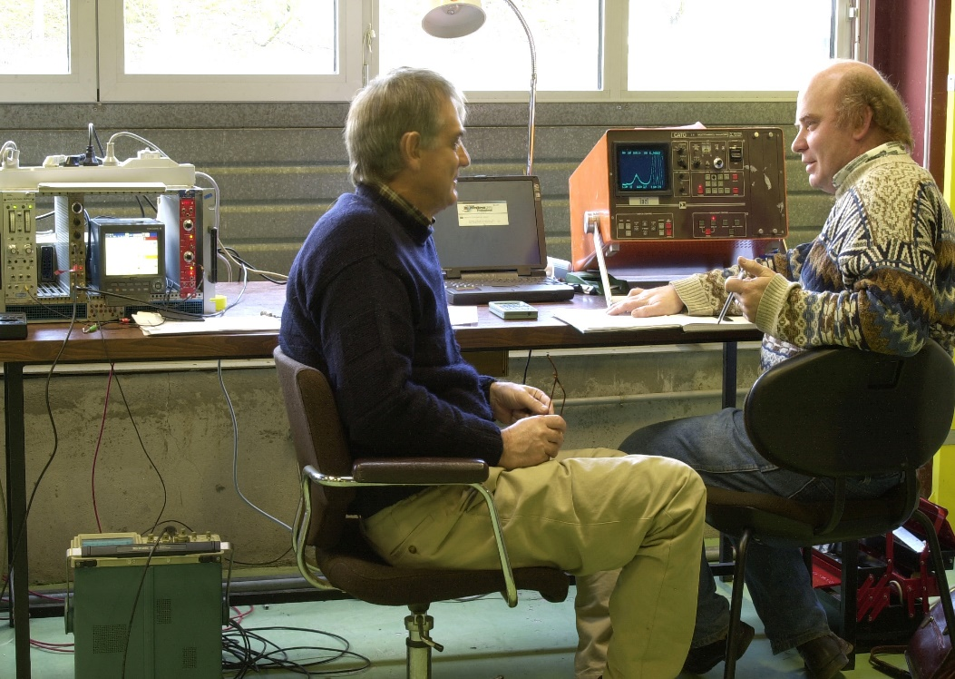
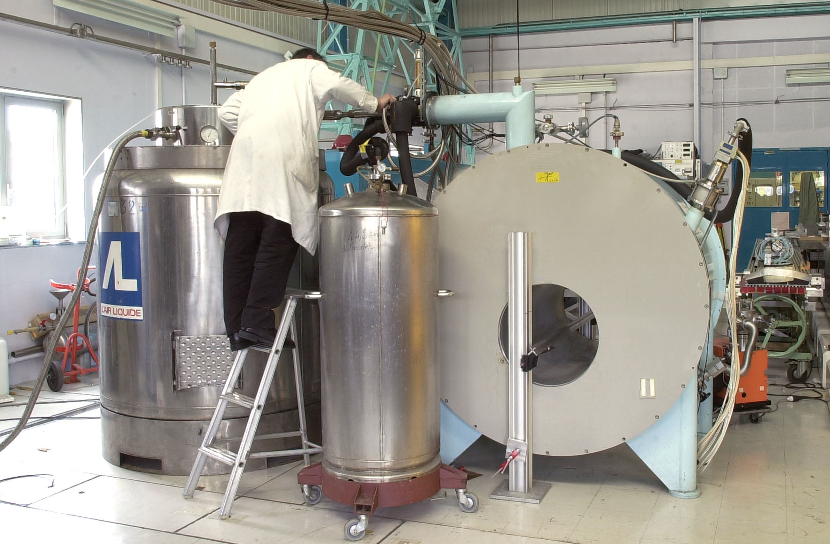
Tests of Micromegas in a magnet
At the begining we were not sure that Micromegas would work in a magnetic field. Using a Nickel mesh stretched on a frame, we saw that concentrical waves formed on the mesh.
Since then, we use only non-magnetic materials for the mesh : copper and stainless steel.

Slide 7
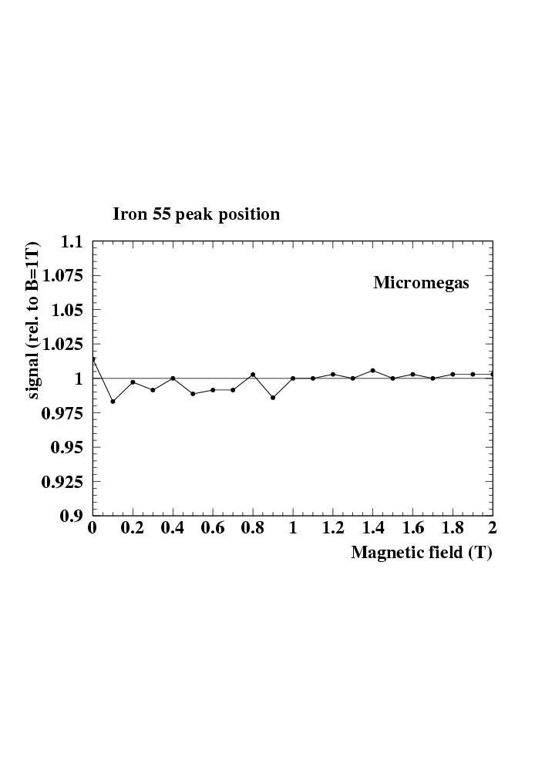
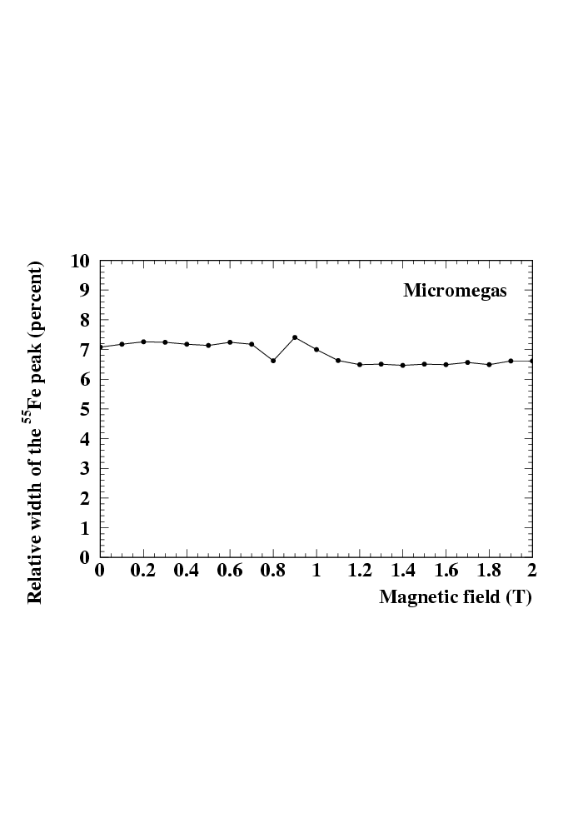
We checked that the position and width of the 55Fe peak was not altered by the magnetic field

Slide 8
Study of ion back-flow
In a TPC, ions back-flowing in the drift space will build up a space charge which, in turn, will distort the trajectory of the drifting electrons.
With Yannis and Vincent Lepeltier, we studied the ion backflow and understood how it is governed by the field ratio between the amplification field and the drift field.
We carried out measurements of Ion back-flow in a magnetic field

Slide 9
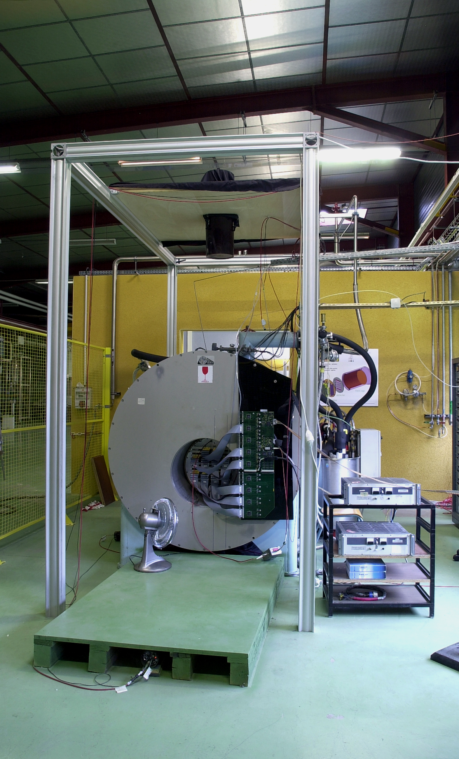
Berkeley-Orsay-Saclay prototype
Recuperating electronics from the STAR TPC, we built a prototype TPC (Field cage from Robert Cizeron) with Vincent Lepeltier and Mike Ronan, fitted in a 2 Tesla RMN magnet at Saclay, and tested it in cosmics. We took data in 2002 and 2003 at Bdg 192(Jean-Pierre Robert)

Slide 10
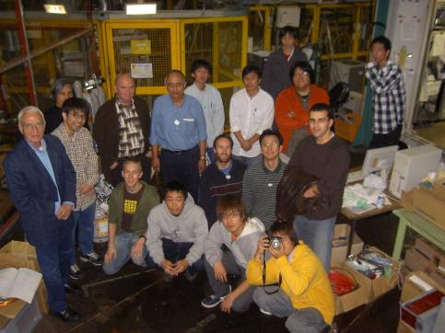
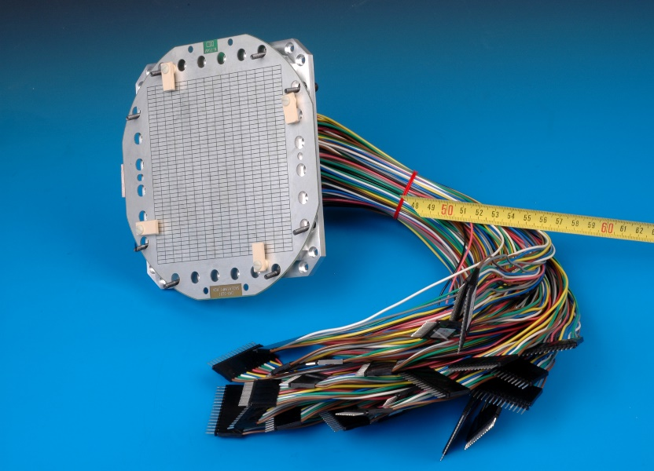
Tests in Japan
Ron Settles
Takeshi Matsuda
Keisuke Fujii

Slide 11
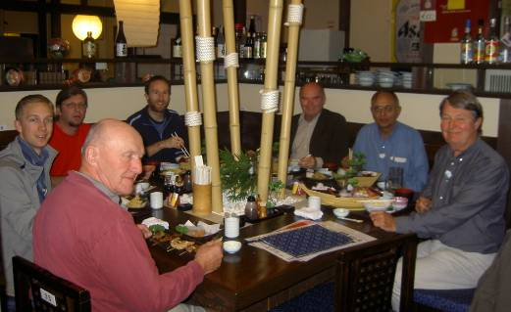
Tests in Japan
Arnaud Giganon
Madhu Dixit
Dan Burke
Vincent Lepeltier

Slide 12
Bulk Micromegas (2004-2005)
With Rui de Oliveira from CERN, we started to make ‘bulk Micromegas’ detectors, and tested them extensively with Arnaud Giganon.
This all-in-one process was used to make subsequent large-scale productions of Micromegas modules : ILC TPC prototypes, T2K, Atlas/NSW,…

Slide 13
T2K gas
Ar:CF4:isobutane (95:3:2) mixture was optimized for TPCs in September 2005, and immediately adopted by T2K.
Ar is a cheap ‘carrier’ gas giving close to 100 e-/cm of ionisation
Ioannis suggested to use CF4 (based on a paper by Christophorou et al.). With my student Dan Burke, we tested this gas, measured the gain, and performed Magboltz simulations to estimate the omega.tau, which governs the diffusion suppression in a high magnetic field.
At 4T, ω.τ ~ 15, allowing an excellent spatial resolution (30 µm with 2mm pads)
2% isobutane is considered as a safe value for the mixture not to be explosive. It is required for quenching the avalanches and stabilizing the gas.

Slide 14
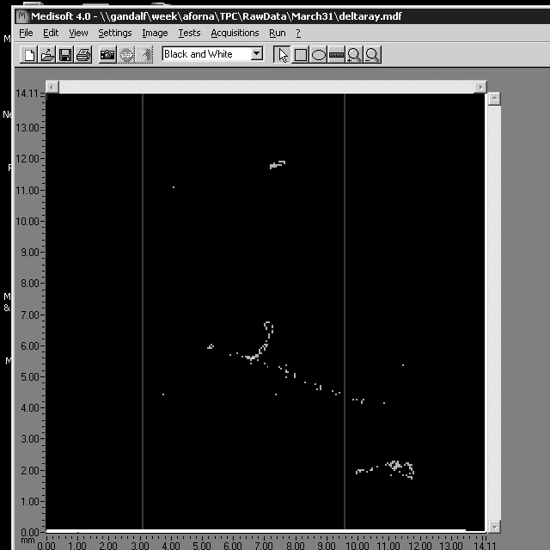
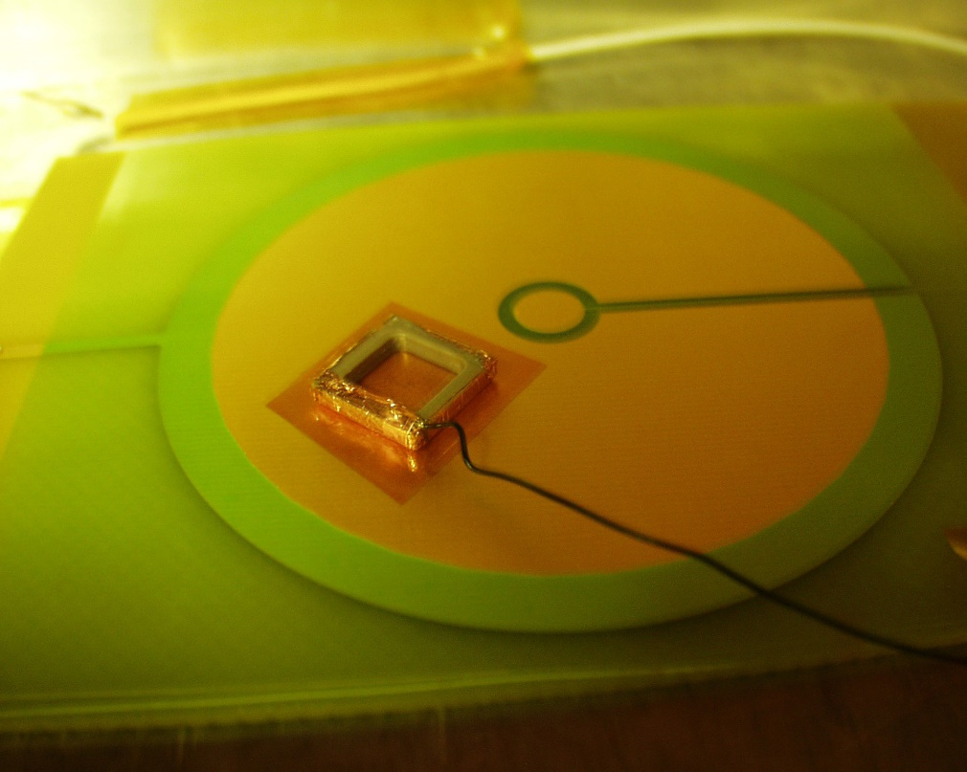
Medipix and Timepix
Nikhef colleagues (Harry van der Graaf, Jan Timmermans, Jan Visschers) attempted to use the Medipix chip to amplify the electron signal from a GEM. At the end of 2003 we proposed to help by adding a Micromegas on top of a chip.
Arnaud Giganon glued a copper mesh on a frame, and we could see tracks early 2004, first proof of single electron detection

Slide 15
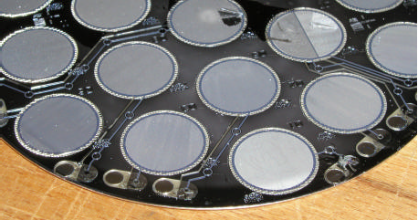
Ingrid and GridPix
By post-processing on silicon wafers, with Twente and Nikhef colleagues, we were able to deposit 0.8 µm Al meshes. The ‘Integrated Grid’ InGrid was born.

Slide 16
Ingrid and GridPix
By post-processing on silicon wafers, with Twente and Nikhef colleagues, we were able to deposit 0.8 µm Al meshes. The ‘Integrated Grid’ InGrid was born.

Slide 17
Timepix
By adding a clock distributed in all the pixels, we changed the ‘grey level’ for photon counting into a time measurement on all pixels, changing the imaging chip into a TPC (digital) readout.
We could fund this, from the chip design (Xavier Lloppart) to the wafer production, and tests (David Attié) within an EU project, EUDET, from 2006 on.
In the following years, we carried out many studies using TimePix : Octopuce, an 8-chip module, study of avalanche fluctuations (Michael Lupberger), many studies on Micromegas (Max Chefdeville), and improved the protection against sparks with a 15 µm resistive layer…

Slide 18
Mélanges à base d’Argon
David Attié, Michal Was
iC₄H₁₀
Gaz froids: CO₂, CH₄
C₂H₆

Slide 19
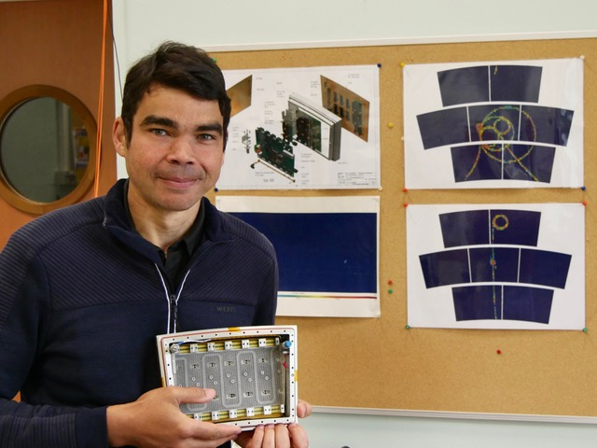
EUDET Prototype and DESY beam tests
Since 2008, we had on average 1 beam test per year with our large prototype, with up to 7 modules, and one module was used to take cosmic data in Saclay (Boris Tuchming).
For this, we developped resistive-anode bulk Micromegas, now used in T2K, to suppress sparks and to improve the resolution.
Drawings and mechanical conception were done by Marc Riallot.

