Slide 1



Radiation Field in GIF ++
Nicola Ferrara, Bari University

Slide 2
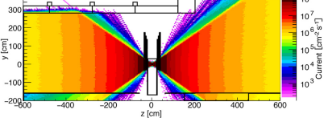
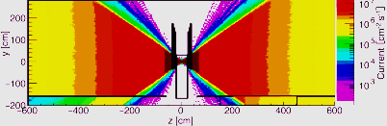
Geant4 GIF++ code simulation :
Pfeiffer Dorothea Software developed in GEANT4-10.0 to simulate GIF++ radiation background [ref]
PLOT ..
PLOT ..
Just 1 month, in the framework of the new DRD1 «collaboration», I started to upgrade the project.
Main steps:
Transition from GEANT4-10.0 to GEANT4-10.7
New bunker geometry
[ref] https://gif-irrad.web.cern.ch/documents/1-s2.0-S0168900217306113-main.pdf

Slide 3
Transition from GEANT4-10.0 to GEANT4-10.7 (1)
Open GIF++ project ()
GEANT4 version: geant4-10-07-patch-03 [MT]
Issue: in class GIF++UserScoreWriter,
the typedef MeshScoreMap becomes defined in G4VScoringMesh
Solutions: Geant4 upgrades to G4VScoringMesh::MeshScoreMap

Slide 4
Changes
Transition from GEANT4-10.0 to GEANT4-10.7 (2)
MeshScoreMap fSMap = fScoringMesh->GetScoreMap();
G4VScoringMesh::MeshScoreMap fSMap = fScoringMesh->GetScoreMap();
std::map<G4int, G4double*> * score = msMapItr->second->GetMap();
std::map<G4int, G4StatDouble *> &score = *(msMapItr->second->GetMap());
std::map<G4int, G4double*>::iterator value = score->find(idx);
std::map<G4int, G4StatDouble *>::iterator value = score.find(idx);

Slide 5
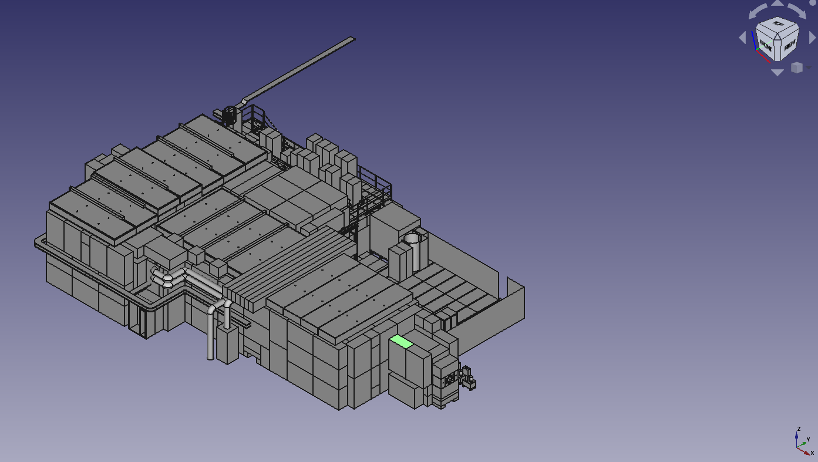
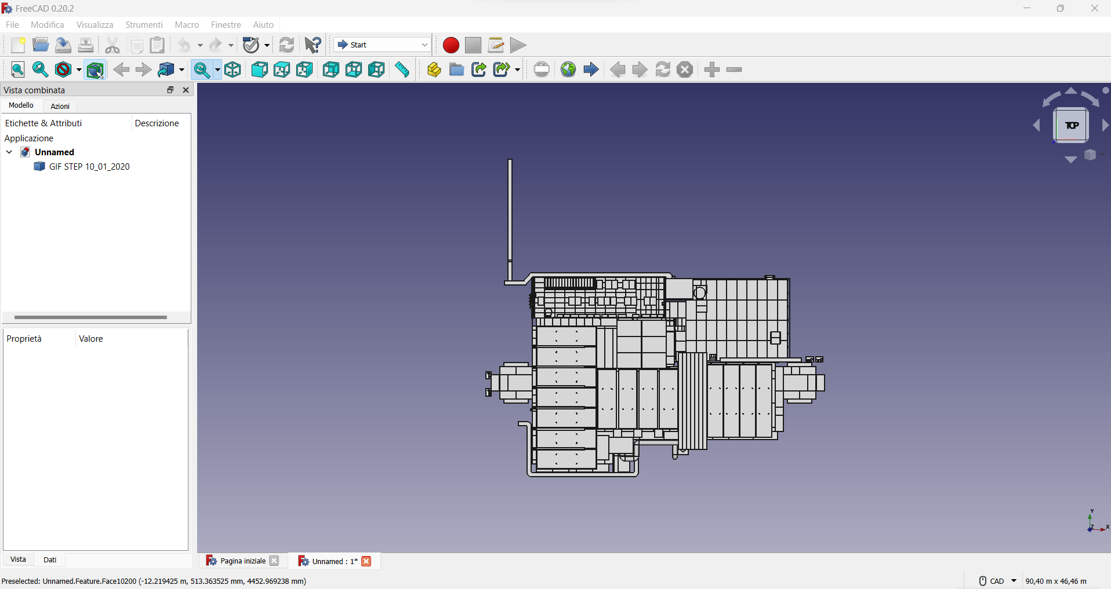
2. GIF++ geometry UPDATE
Open with FreeCAD the STEP file with the description of the new bunker geometry

Slide 6
Transition from STEP file to GDML
FreeCAD automatically does *:
Tessellate object with separate volumes
Set GDML material for every volume
Gives as Outcome a set of tessellated GDML volumes
GDML volumes imported in GEANT4 software…. it crashes opening!
*https://github.com/KeithSloan/GDML/wiki/Step2Tessellate

Slide 7
Next step:
Two options in order to solve this issue:
Try to tessellate with https://github.com/christopherpoole/CADMesh every sub-volumes setting a scale for the mesh.
Build geometry from zero with basic geometric parts assembled togheter, with less details with not relevance for simulation( as suggested by Dorothea).

