Slide 1
Environmental Friendly Gas Mixtures for Gaseous Tracking and Timing Detectors
Dario Stocco
Project Presentation: RD51 Collaboration
22nd May 2023

Slide 2

Collaboration

Slide 3
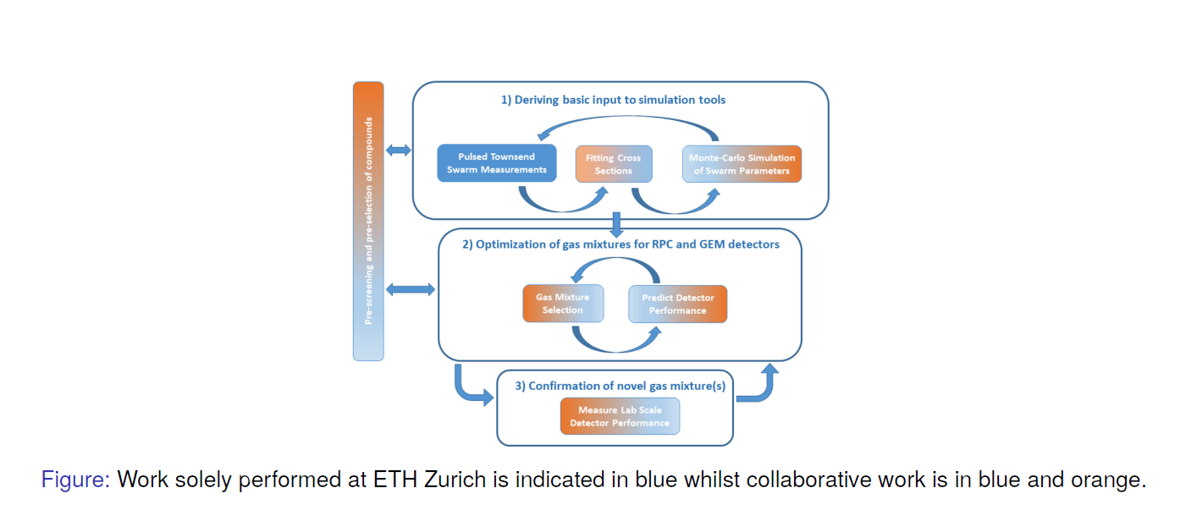
Project Overview

Slide 4
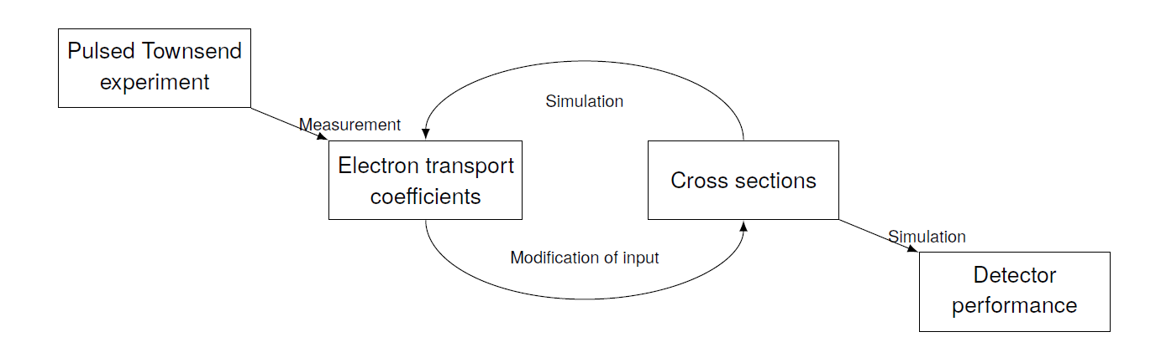
Objective 1: Electron-Molecule Cross-Section Determination
Research Goal
Determine a complete and self-consistent set of cross section for several promising candidate gases in gaseous tracking and timing detectors.
+
Extended collaboration
Electron Scattering experiment

Slide 5
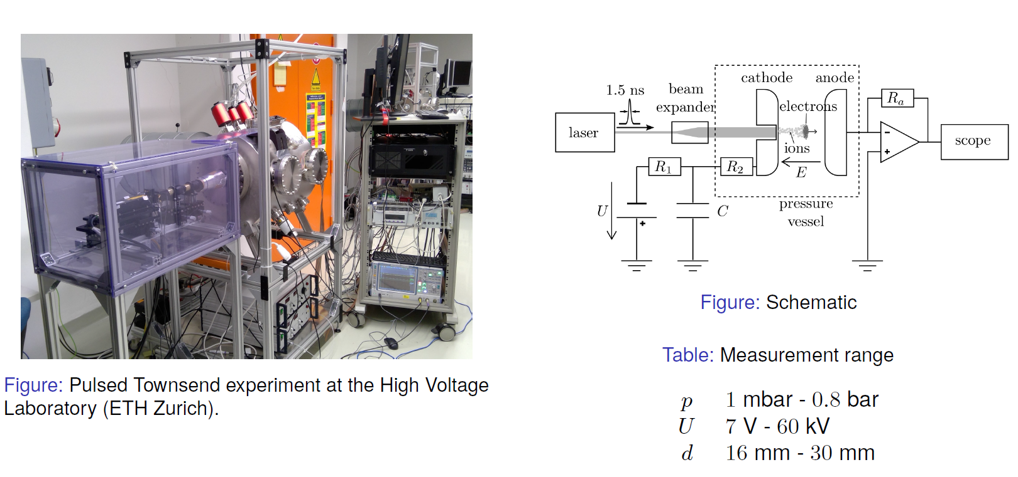
Pulsed Townsend (PT) Experiment

Slide 6
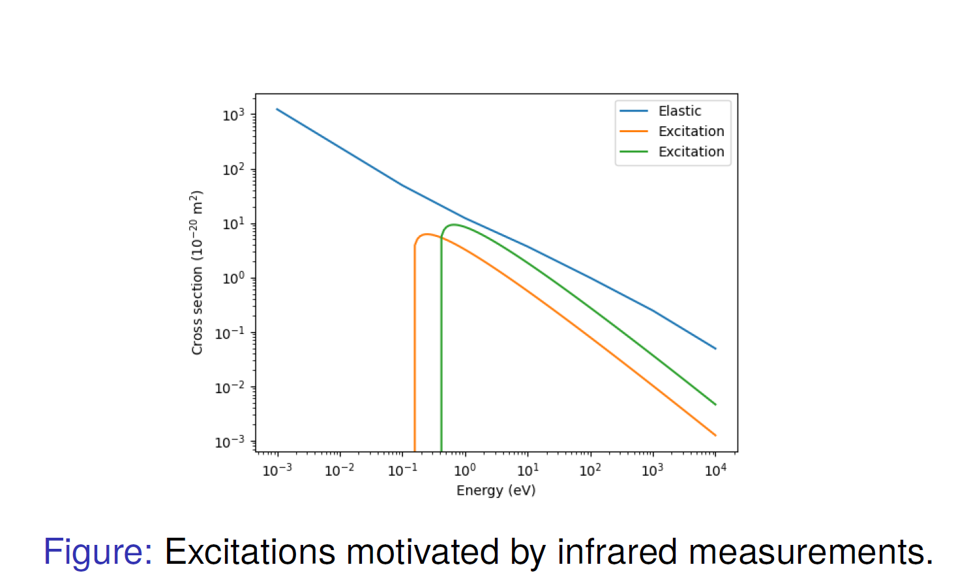
Preliminary Results HFO1234ze
Elastic line motivated by water vapour
Vibrational excitations
0.144eV (C-F)
0.386 eV (C-H)

Slide 7
Project Status & Outlook
2023
2023
2024 -
PT measurements and determination of an improved R134a cross-section set.
PT & electron scattering measurements and determination of a consistent HFO1234ze cross-section set.
Start cross-section determination of other promising gases

Slide 8
Objective 2: Detector Simulation
Research Goal
Simulate and predict the performance of gaseous detectors using various environmentally-friendly gas mixtures. Identify optimal mixtures and validate them through lab-scale experiments.
Systematic parameter-space scan
Garfield++
Proposed
Alternative
Mixture
Novel cross-sections
Gas mixture selection
Detector performance
Quantify performance

Slide 9
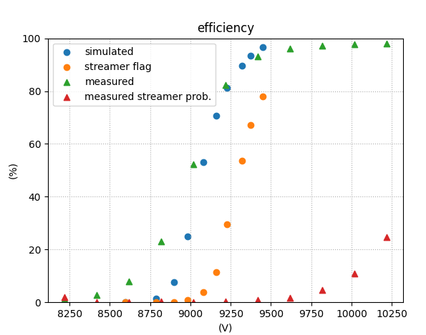
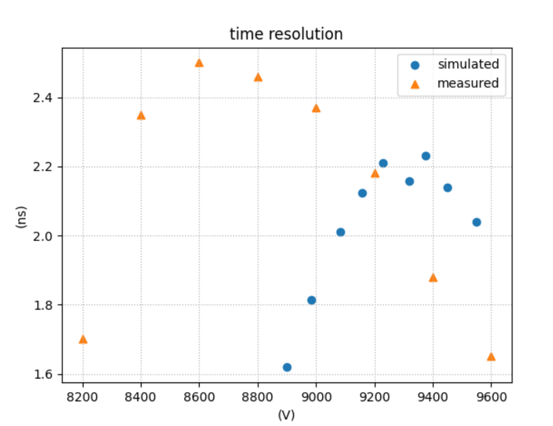


Start with: Resistive Plate Chamber
Garfield++ for determination of efficiency curves and time resolutions
Prediction of streamer probability
  No reliable tool available?
  Monte Carlo simulation of space charge effects, deexcitation + photoionization effects
  $→$ extend 2d model from Lippmann and Riegler from 2003

Slide 10
Project Status & Outlook
2023
2023
2024 -
Optimization of standard gas mixture (R134a) by adding CO2
G. Rigoletti et al. (2023)
Optimization of partial replacement of R134a with HFO1234ze
R. Guida et al. (2016)
Start optimization of various gas mixtures using novel cross-sections
Extend to other types of gaseous detectors
Improving the streamer probability prediction

Slide 11
Conclusion
Cross section determination of R134a and HFO1234ze ongoing
  Promising initial results using electron scattering experiments
Optimization of gas mixtures for given gas content
  Optimization approaches in development
  CO2 in standard gas mixtures
  Partial replacement of R134a with HFO1234ze
Improving streamer probability prediction, to help optimize gas mixtures
  Investigations of already available data, i.e. time shift between precursor to fast increasing signal

Slide 12
Contact Information
Dario Stocco
PhD Student
stoccod@ethz.ch
ETH Zürich
High Voltage Laboratory
ETL H 29
Physikstrasse 3
8092 Zürich, Switzerland
https://hvl.ee.ethz.ch

Slide 13
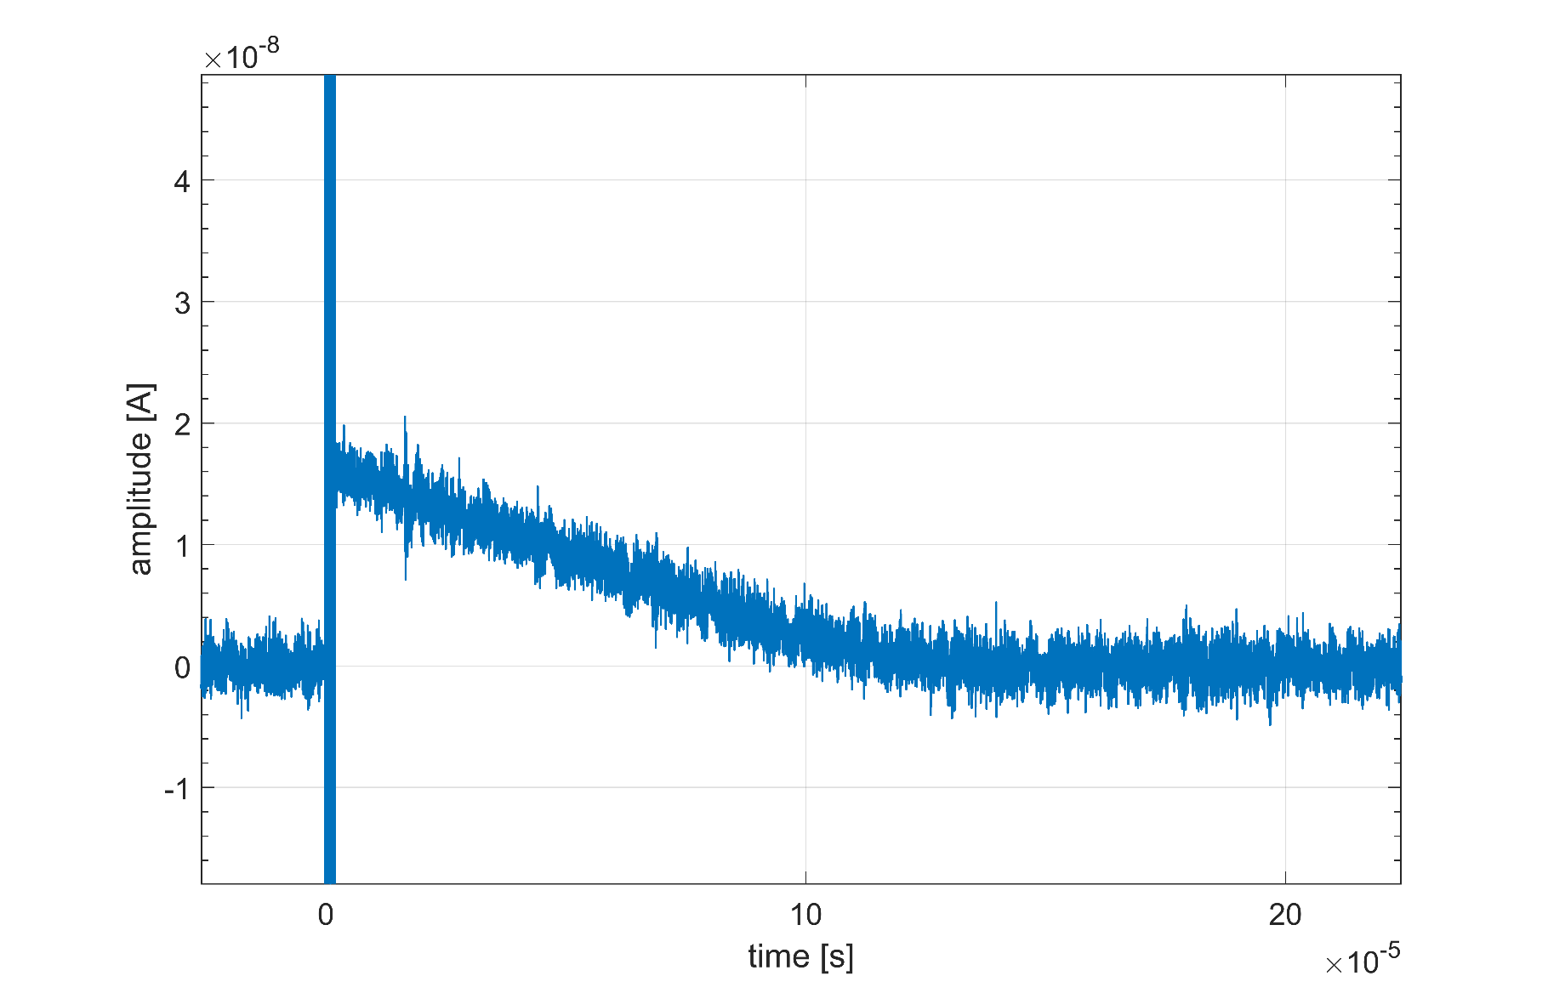
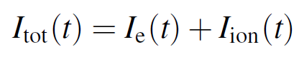
PT – Ion Signal
Electron time scale
Ion time scale

