Slide 1
R&D of Low-Material-Budget(LMB) Electrode for STCF inner tracker
Zhou Lin , Tian Xiangqi , He Siqi
Notes:
Good morning everyone, I am Zhou Lin from USTC, my presentation is about the R&D work of low mass electrode for STCF inner tracker

Slide 2
Outline
Introduction
R&D of LMB drift electrode
R&D of LMB V-strip readout electrode
Summary
Notes:
There are 4 parts in my presentation, including the introduction, the R&D work of low mass drift electrode, the R&D work of low mass V-strip readout electrode, and the summary.

Slide 3
Introduction
Notes:
Let’s start the introduction part first.

Slide 4
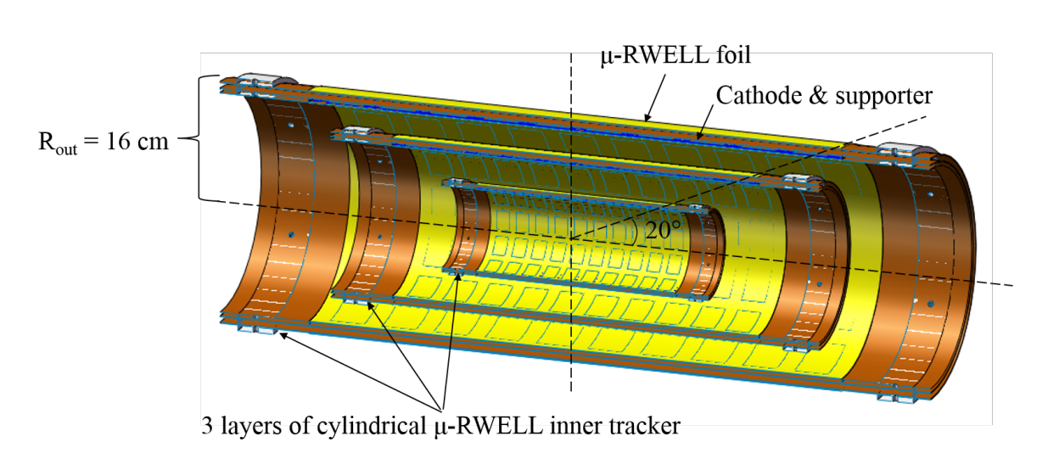
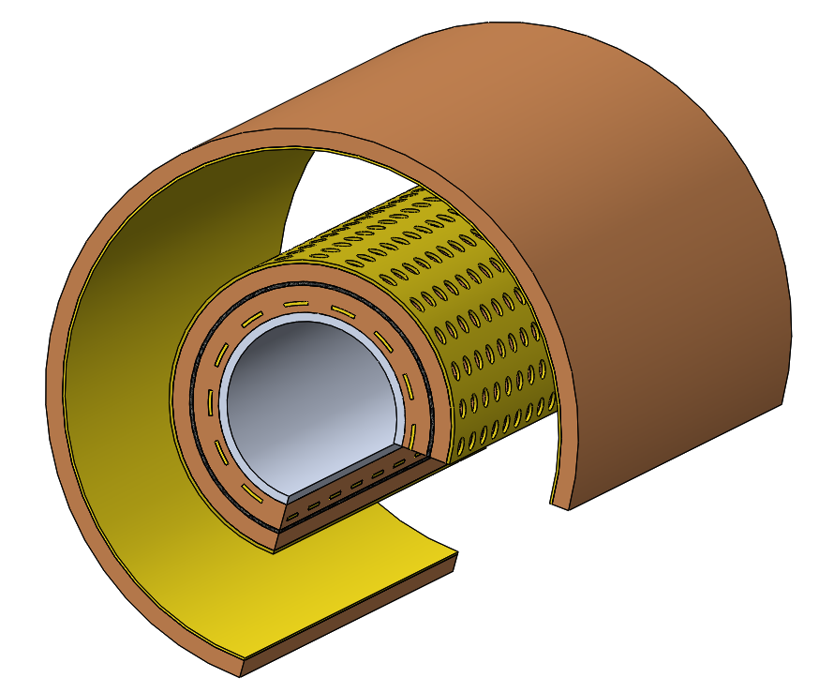
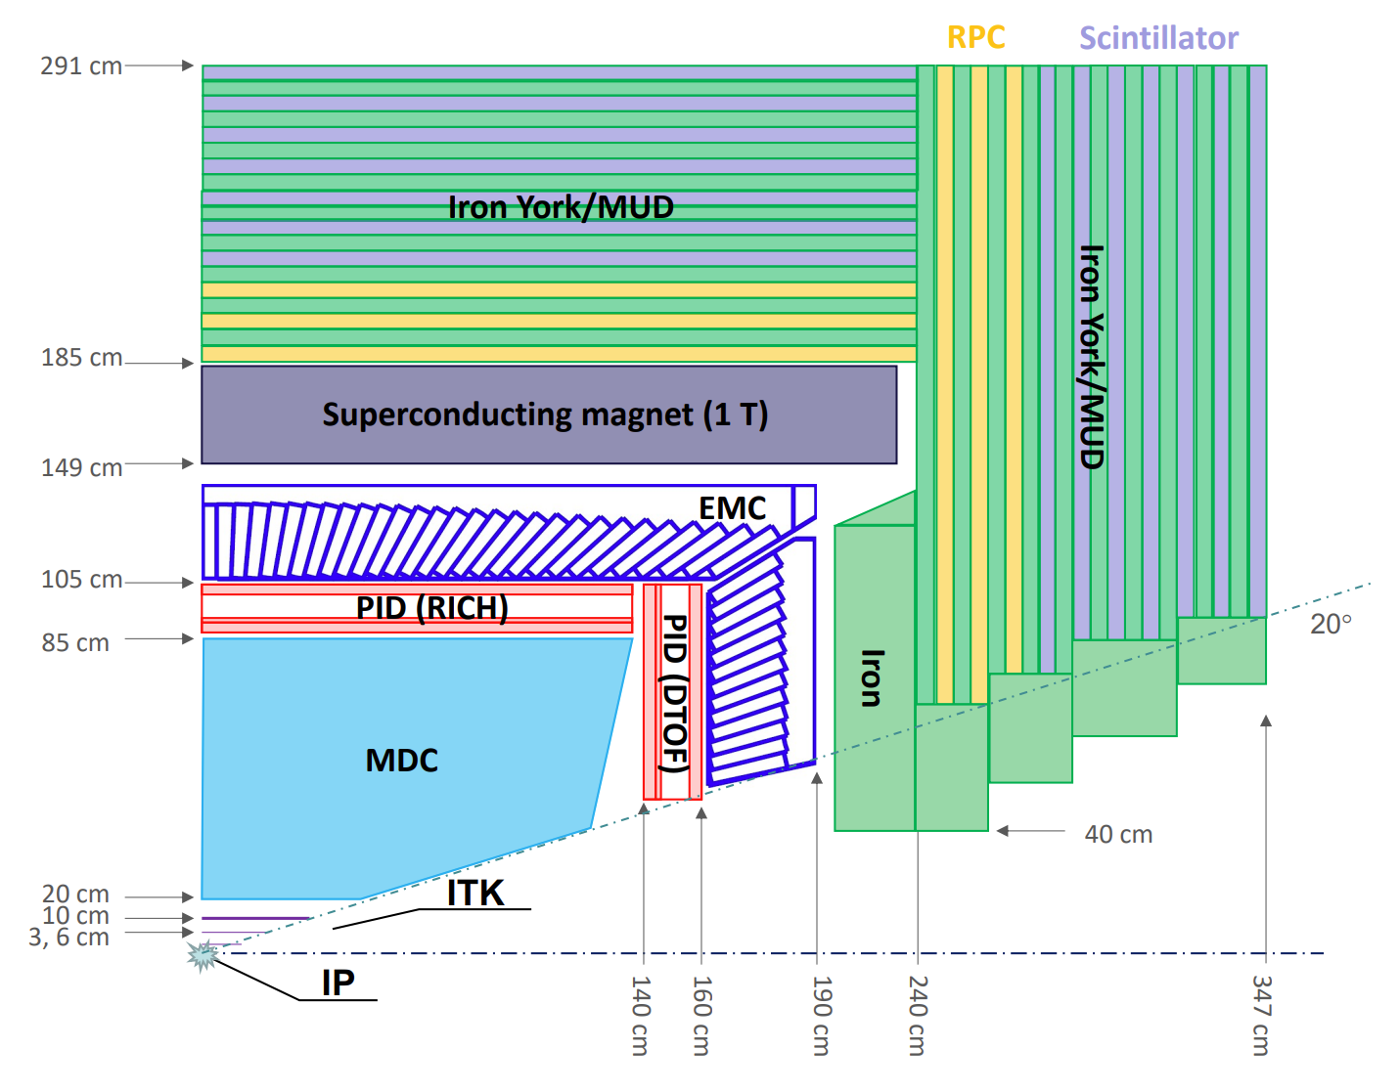
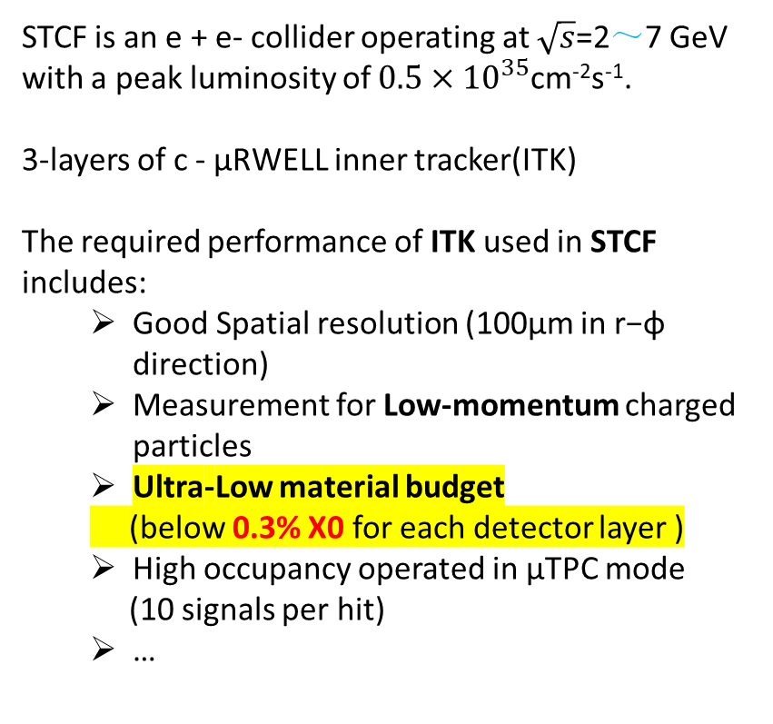
Motivation
STCF is an e + e- collider operating at $\sqrt{s}$=2～7 GeV with a peak luminosity of $0.5×{10}^{35}$cm⁻²s⁻¹.
3-layers of c - μRWELL inner tracker(ITK)
The required performance of ITK used in STCF includes:
  Good Spatial resolution (100μm in r−ϕ direction)
  Measurement for Low-momentum charged particles
  Ultra-Low material budget
  (below 0.3% X0 for each detector layer )
  High occupancy operated in μTPC mode
  (10 signals per hit)
  …
Notes:
The low material budget electrode was developed for Super tau charm factory c-μRWELL inner tracker. The STCF is an electron-positron collision experiment in the 2-7GeV energy region,
with a collision brightness of 0.5*E35.
Its inner tracker system is expected to include three layers of c-μRWELL detectors,
requiring the detector to have a position resolution of 100 microns in the R-φ direction and a counting rate capability of no less than ~30kHz/cm2.
In particular, the mass of each detector layer is required not to exceed 0.3%X0.

Slide 5
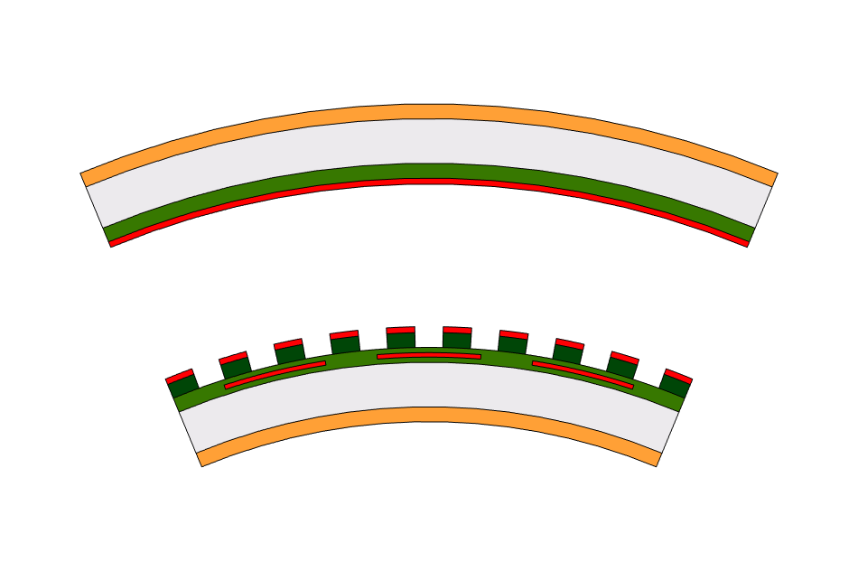
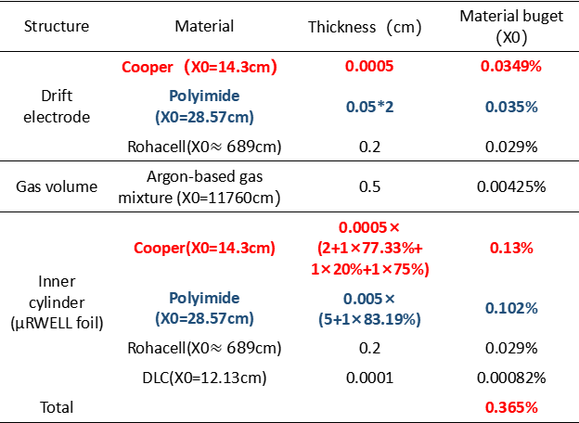
Material budget of μRWELL detector
Structure | Material | Thickness（cm） | Material buget（X0）
Drift electrode | Cooper（X0=14.3cm） | 0.0005 | 0.0349%
 | Polyimide (X0=28.57cm) | 0.05*2 | 0.035%
 | Rohacell(X0$≈689$cm) | 0.2 | 0.029%
Gas volume | Argon-based gas mixture (X0=11760cm） | 0.5 | 0.00425%
Inner cylinder (μRWELL foil) | Cooper(X0=14.3cm) | 0.0005× (2+1×77.33%+ 1×20%+1×75%) | 0.13%
 | Polyimide (X0=28.57cm) | 0.005× (5+1×83.19%) | 0.102%
 | Rohacell(X0$≈689$cm) | 0.2 | 0.029%
 | DLC(X0=12.13cm) | 0.0001 | 0.00082%
Total |  |  | 0.365%
Drift electrode
μRWELL/X readout
V readout electrode
PMI foam
Kapton
Outer layers needs thicker support structure
Main contribution is copper and polyimide
!
Research on low-material electrodes is urgently needed
Notes:
In the existing μRWELL detector structure, the metal electrode is made of 5μm copper, so the material budget of the existing μRWELL detection metal is here .
If the Rohacell with 2mm thickness is used, the material budget of the foam is 0.029%. When producing the innermost c-μRWELL detector, 2mm Rohacell provides sufficient mechanical strength.
When producing the outer layers of c-μRWELL detectors,we need thicker Rohacell to ensure that the detector has a good enough mechanical strength, which will increase material budget of the detector.
Therefore, the development of low material budget electrode is a key technical problem in the development of c-μRWELL detector.

Slide 6
R&D of LMB drift electrode
Notes:
Here we go to the R&D work of the low mass drift electrode

Slide 7
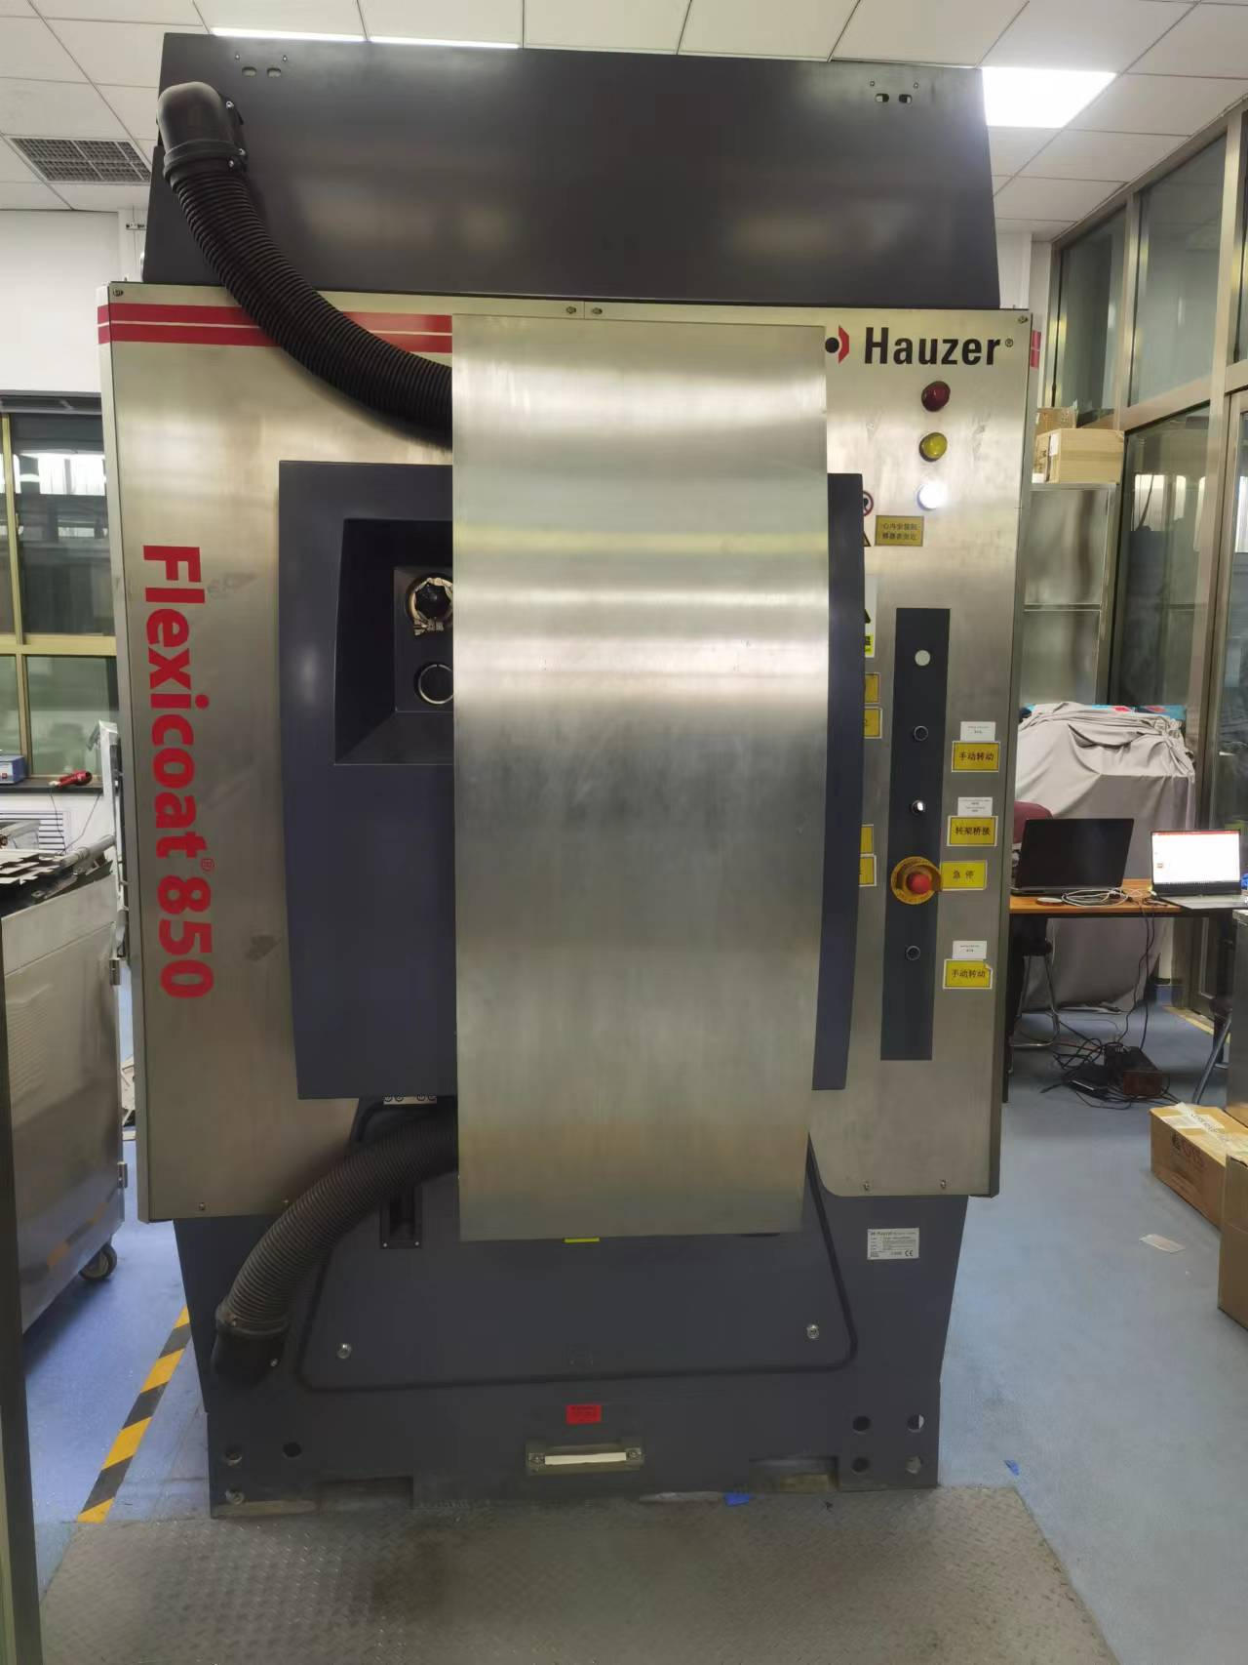
Solution of LMB drift electrode
① Thinner Kapton foils（12.5μm、25μm ）
② Coat ～100nm conductive layer instead of 5μm Cu
Coating process:
Vacuum control 5E-4 mbar
Coating Device
Hauzer 850
Pure Cr 1min 3kW
The transition layer of copper and polyimide
Cr + Cu 30s codeposition layer
Pure Cu 20min 0.5kW conductive layer
Cu + Cr 30s codeposition layer
The transition layer of copper and DLC
Pure Cr 1min 3kW
Cr + DLC 1min
DLC 1hour 4kW
Notes:
In order to produce low material drift electrode, we chose a thinner (12.5μm or 25μm) Kapton as the substrate, and then used magnetron sputtering to deposit a layer of ~100nm conductive layer on the Kapton to replace the original 5μm thick Cu electrode.
The production process of this conductive layer is shown below on the right part. Since the main component of the conductive layer is Cu, and the pure Cu with a thickness of ~100nm is easy to be oxidized in the air, it is necessary to coat a layer of DLC on the copper to protect it from oxidation,
and the thickness of this layer of DLC is about ~200nm. Considering that the adhesion , we need to use Cr as a transition layer to enhance their adhesion.

Slide 8
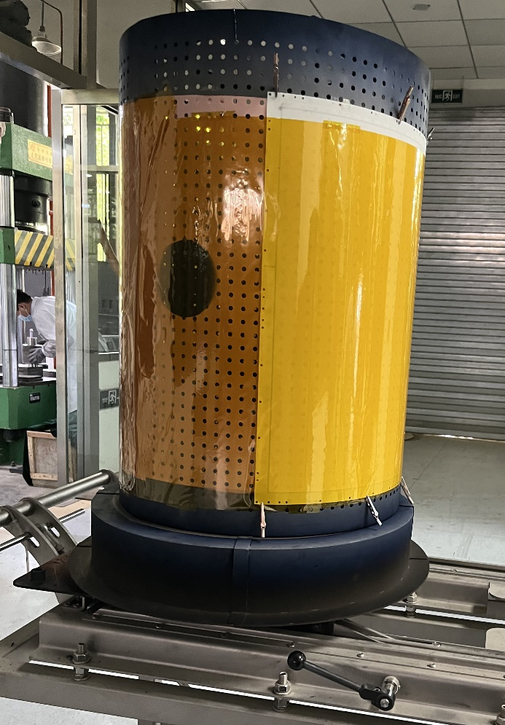
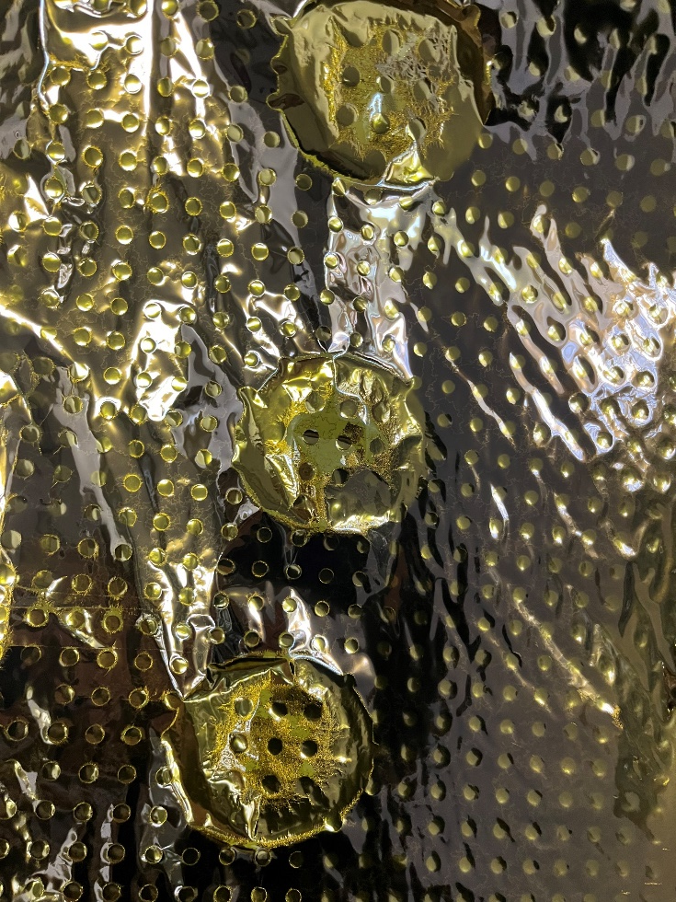
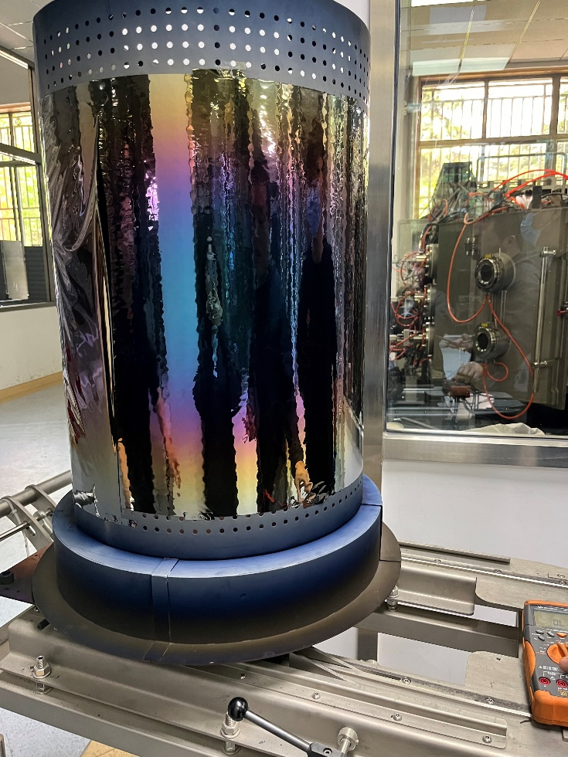
Optimization for 25μm & 12.5μm Kapton
PSE: Plasma Source Etching
optimization
Without PSE and base plate
With PSE and base plate
Notes:
We tried productions with APICAL at 50μm, Kapton at 25μm, and Kapton at 12.5μm.
For 50μm APICAL, it can be directly fixed on the Drum to obtain a good quality conductive coating.
For Kapton of 25μm and 12.5μm, the same coating process will cause severe deformation of Kapton film and will easily fall off, as shown in the figure on the left part.
To solve this problem, we inserted a layer of base plate between Kapton substrate and Drum to prevent polyimide deformation.
At the same time, we used PSE for surface activation before film deposition. Finally, we successfully produced high-quality conductive film on Kapton 25μm and 12.5μm. As shown in the picture on the right part.

Slide 9
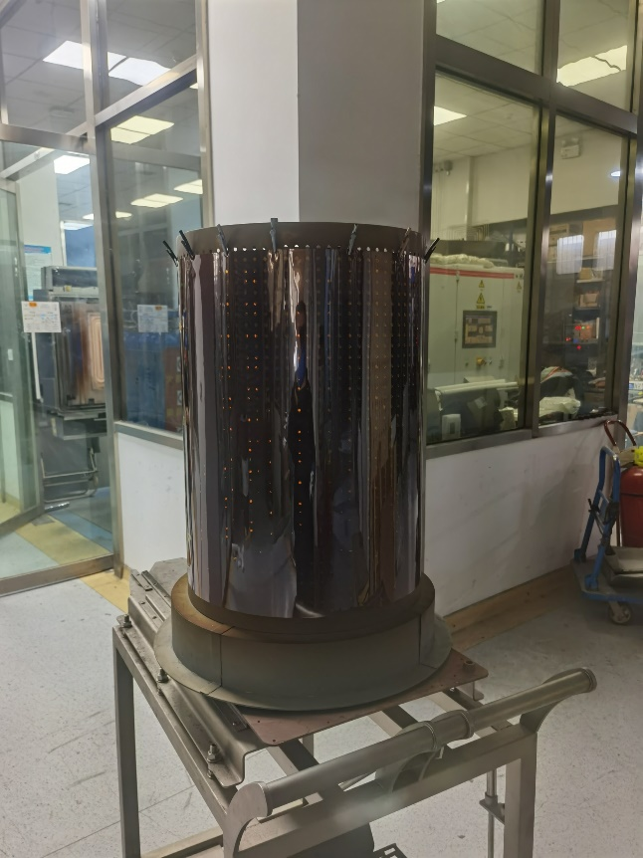
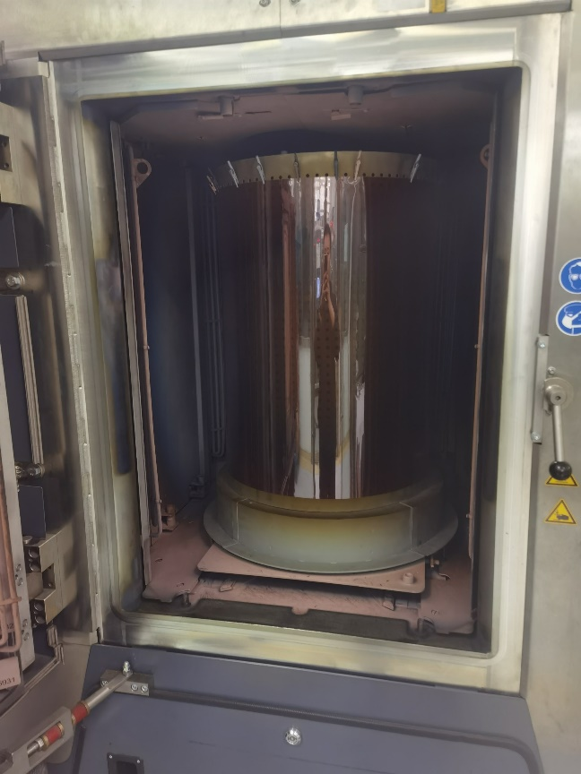
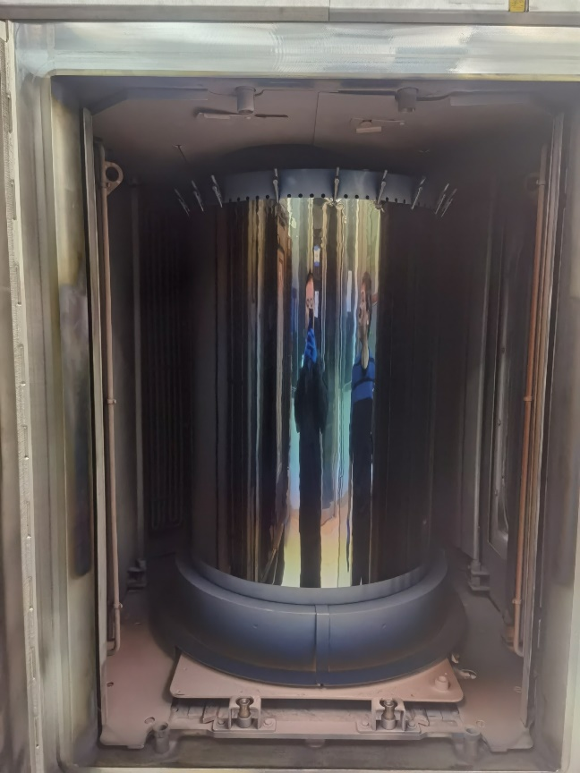
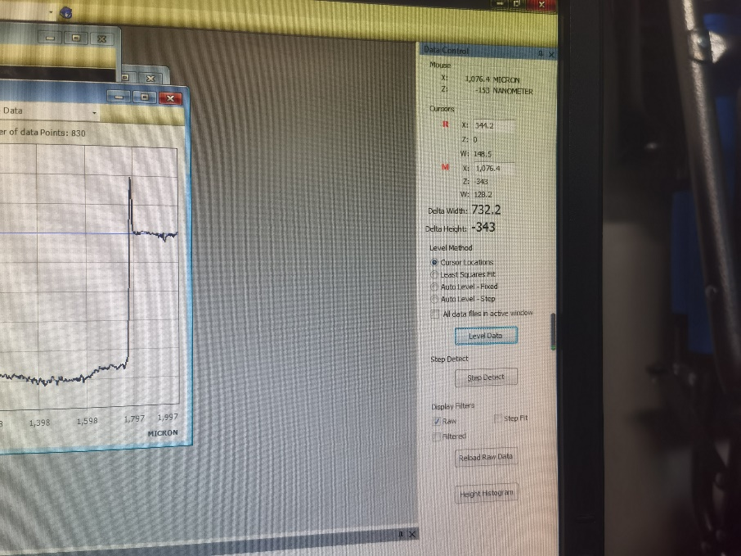

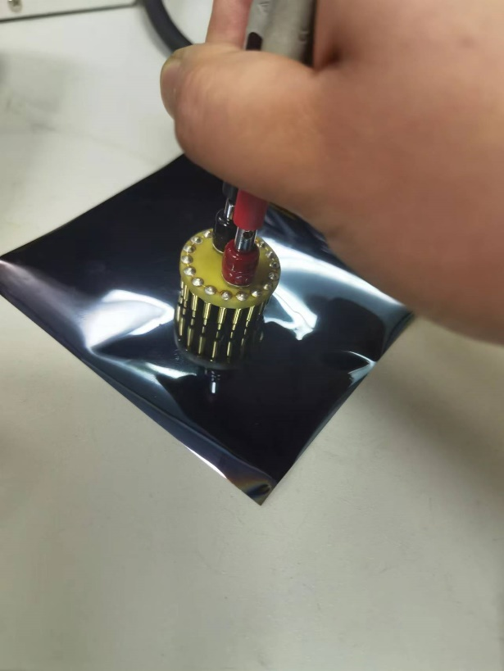
Test of the LMB drift electrode sample
Target sputtering rate :
～1.5m×0.6m
Cr | 5.25nm/min
Cu | 15.5nm/min
DLC | ～3.1nm/min
Surface resistance test：0.5Ω/□
～ 22Ω
Integral thickness scale
（on Si）：～350nm
Notes:
Before producing the LMB drift electrode, we first calibrated the sputtering rate of the target with Si plates, as shown in the upper left figure. The sputtering rate is shown here.
We prepared the LMB drift electrode substrate on a Kapton with a size of 1.5m×0.6m, and tested its end resistance and surface resistance.
As shown in the figure below, the resistance between the two points about 61cm on the film is about 22Ω, while the surface resistivity of the conductive layer is 0.5Ω/□.

Slide 10

Structure of LMB drift electrode
187nm
18.6nm
15.5nm
10.3nm
105nm
10.3nm
15.5nm
Kapton
Kapton
Cr
Cr & Cu Co-Deposition Layer
copper
DLC
Cr & C Co-Deposition Layer
Notes:
The layered structure of our low material budget electrode is shown here. From bottom to top are Kapton substrate, chromium layer, chromium copper co-doped layer, copper layer, copper chromium co-doped layer, chromium layer, chromium carbon co-doped layer, DLC, and the thickness of each layer is shown in the figure. The thickness of the copper layer is 105nm, and the thickness of the DLC is 187nm.

Slide 11
Comparison of the material budget of metal
Low Material budget Conductive Electrode
 | X0（mm） | Thickness（nm） | MB（%X0）
C | 188.4 | 193.3 | 0.0001026
Cu | 14.3 | 115.3 | 0.000862
Cr | 20.7 | 41.3 | 0.0001995
Total MB |  |  | 0.0011641
APICAL
 | X0（mm） | Thickness（nm） | MB（%X0）
Cu | 14.3 | 5000 | 0.0349
Cr | 20.7 | 10 | 0.000048
Total MB |  |  | 0.034948
The material budget has been reduced to 3.33% of APICAL
Notes:
Based on the thickness of the various elements on the previous page, we calculated the material budget of the conductive layer we made.
Without considering the Polyimide substrate, the metal on the existing APICAL substrate is Cr layer at 10nm and copper layer at 5nm.
The material budget of the conductive layer produced by us 1/30 of the existing APICAL substrate.

Slide 12
R&D of LMB V-strip readout electrode
Notes:
Now we go to the R&D work of LMB readout electrode on V direction.

Slide 13
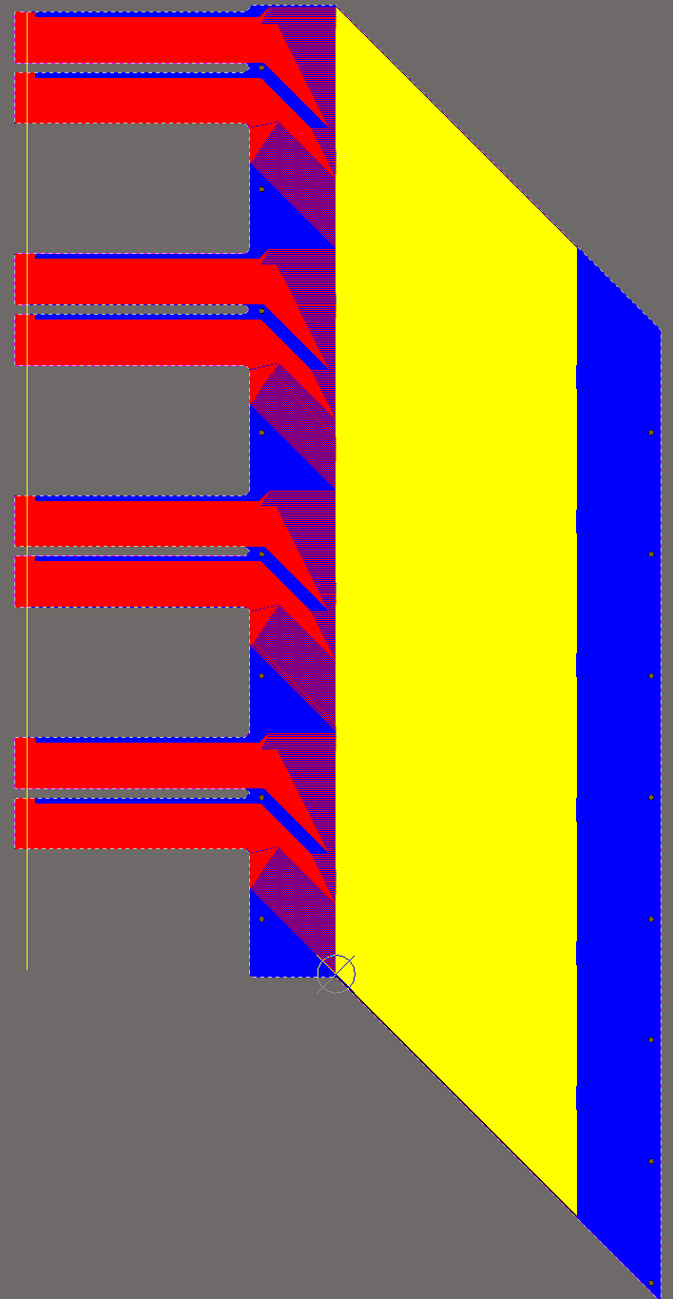
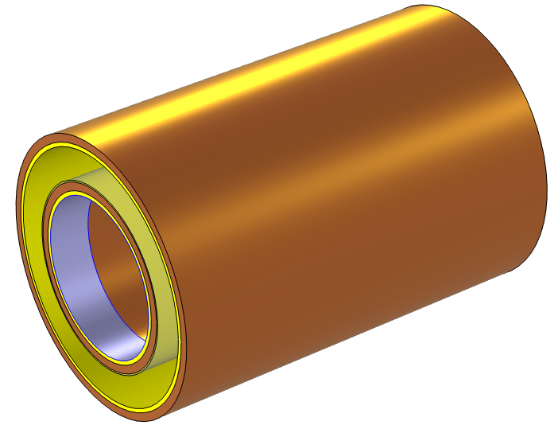
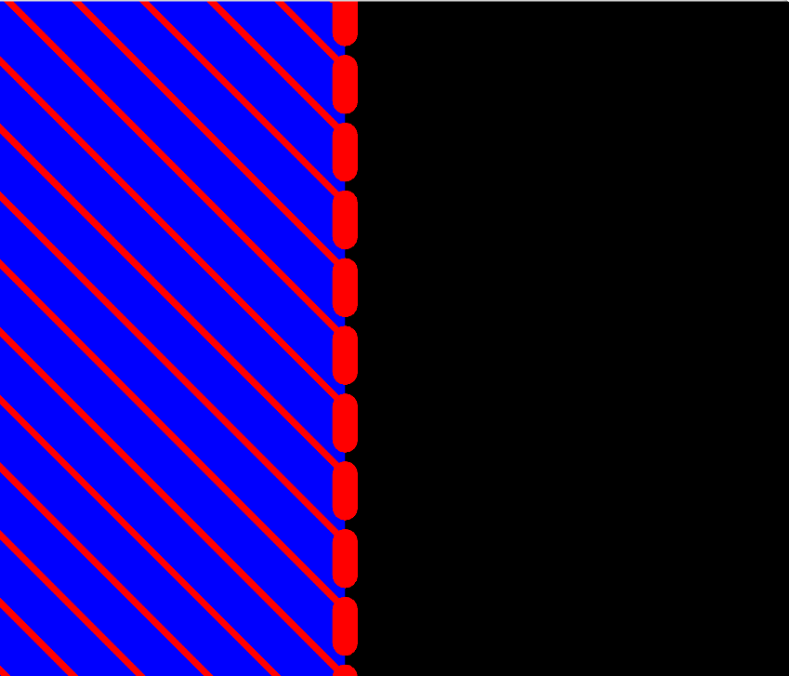
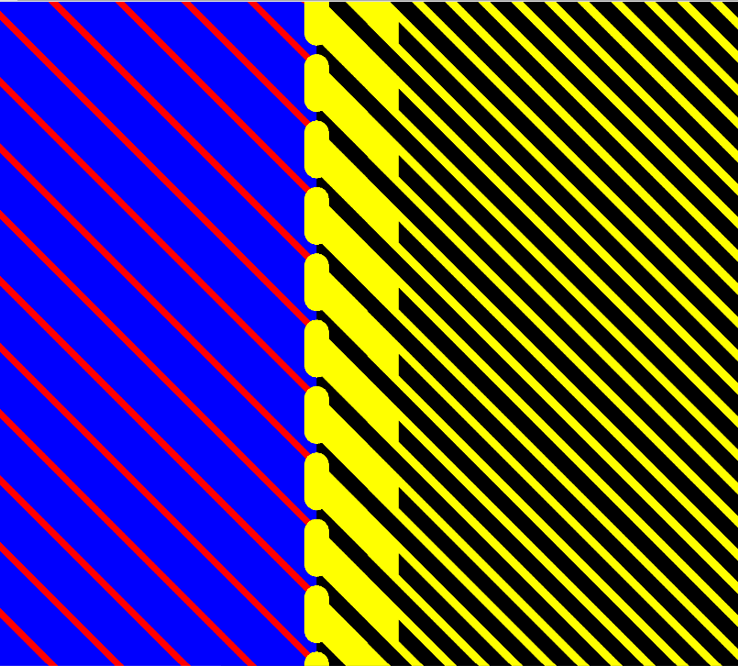
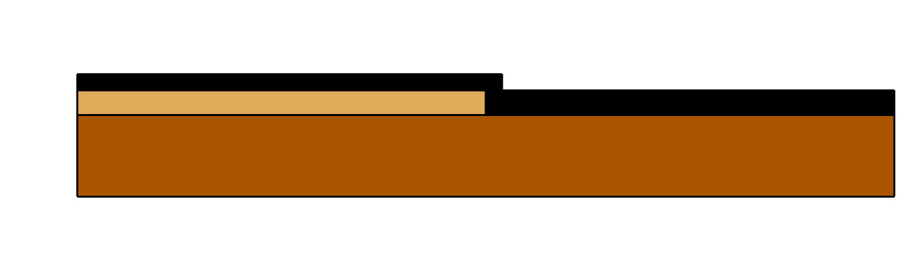
Solution of LMB V-strip readout electrode
External metal electrode
Low material budget electrode
Lift-off method is chosen for LMB strip production
The adhesion between the conductive layer and the PCB metal(Cu/Au) needs to be considered
Notes:
Because the readout strip and ground plane on the readout electrode have a specific configuration, it is not possible to directly plate a low material budget conductive layer on the whole surface like the drift.
Due to the special composition and structure of our conductive layer, the standard PCB etching process cannot be used to make the line.
In order to solve this problem, we first use the standard PCB process to make the line on the readout electrode that is outside the effective zone of the detector, and then use the Lift-Off method to make a low material budget readout strip and ground plane on the effective zone.
Since these readout strips and ground planes need to be electrically connected to the PCB line outside the effective area, it is necessary to check the adhesion between this conductive film and the metal on the PCB, which is mainly made by Cu and Au.

Slide 14
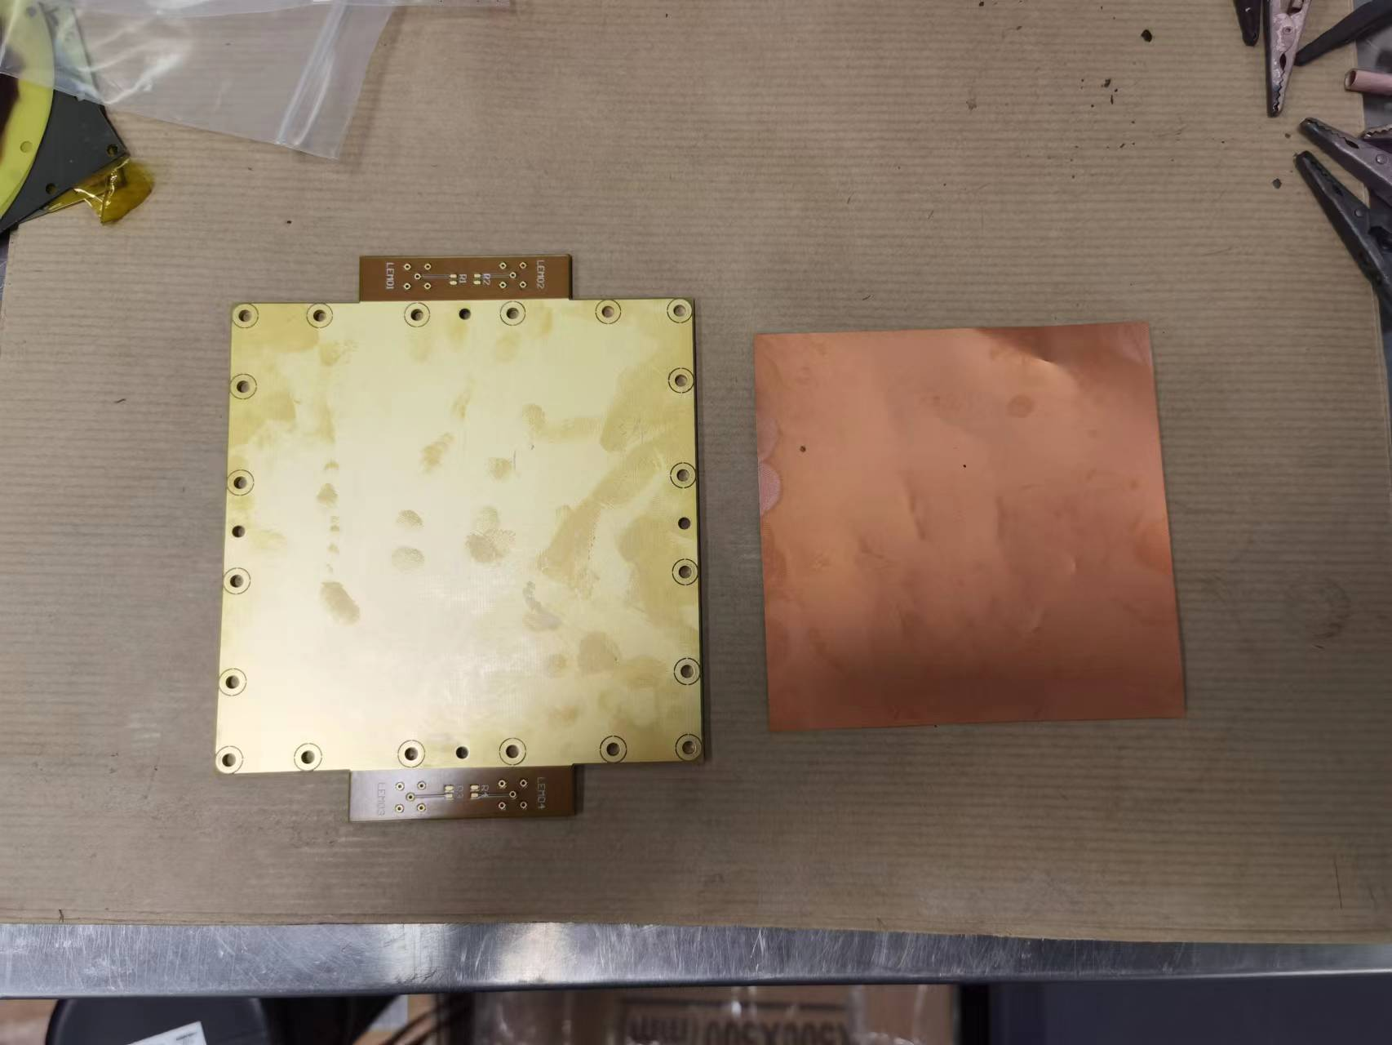
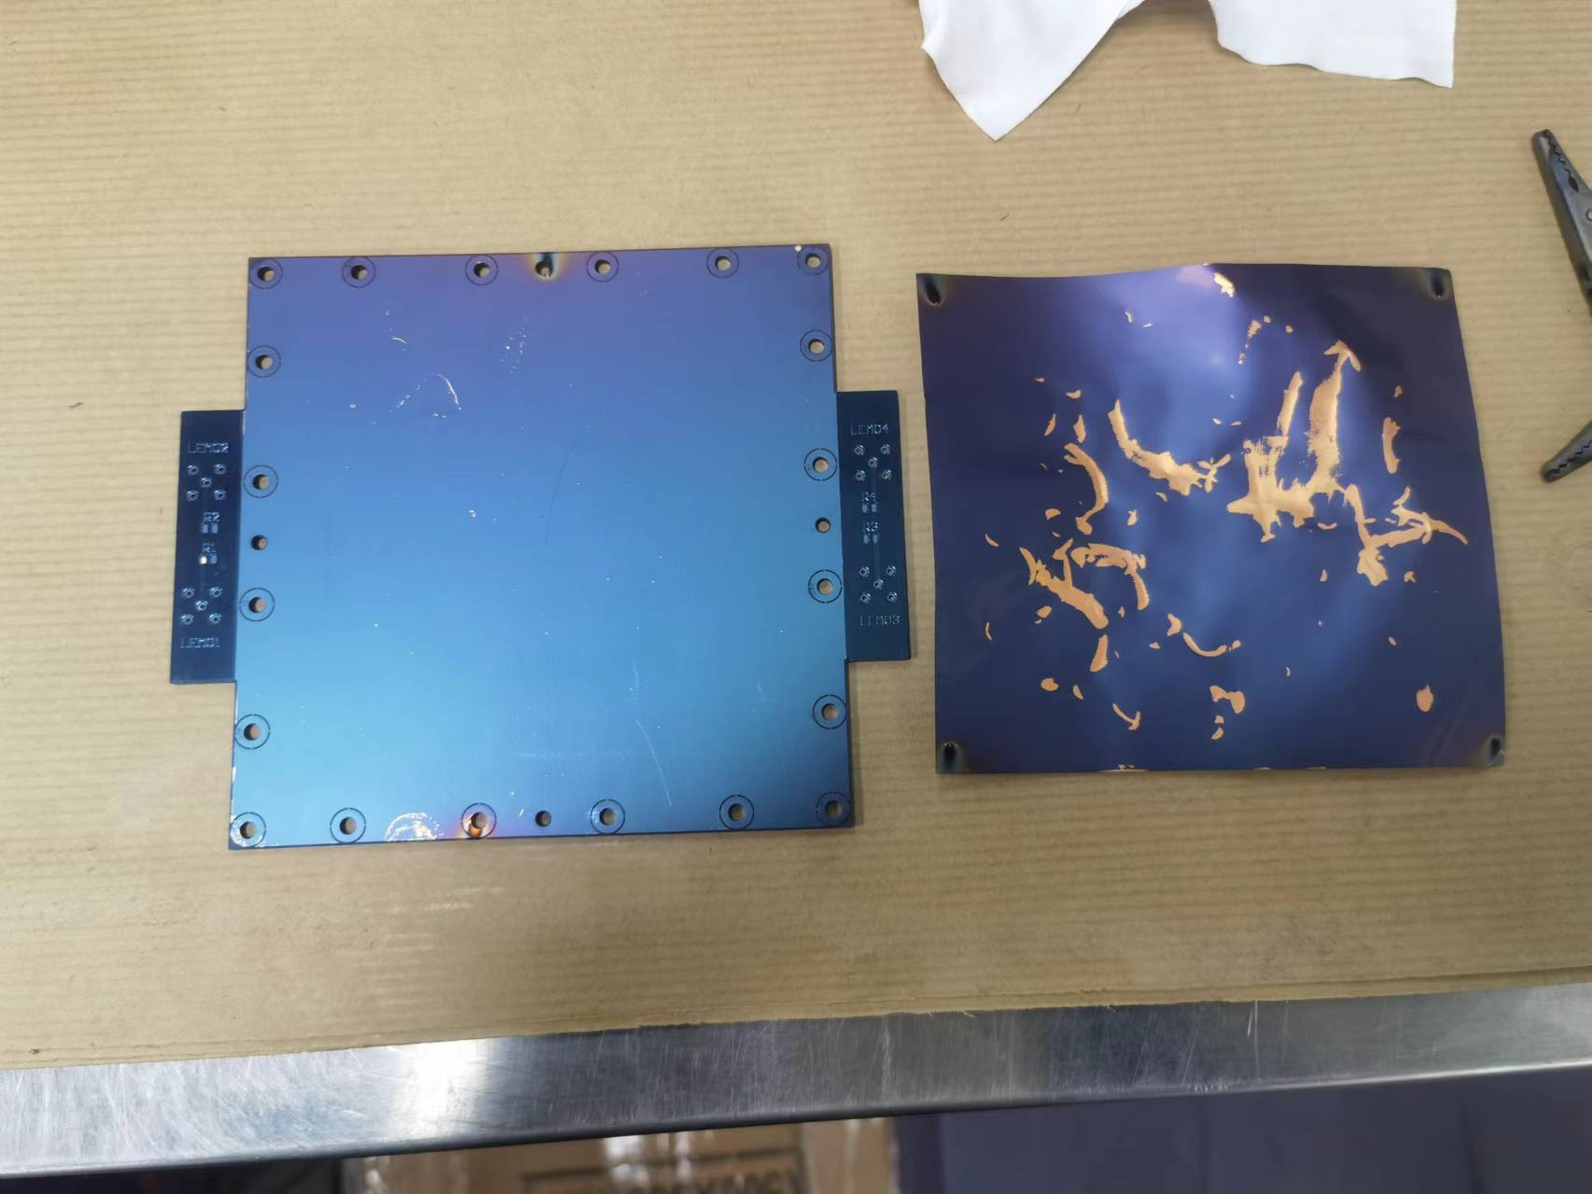
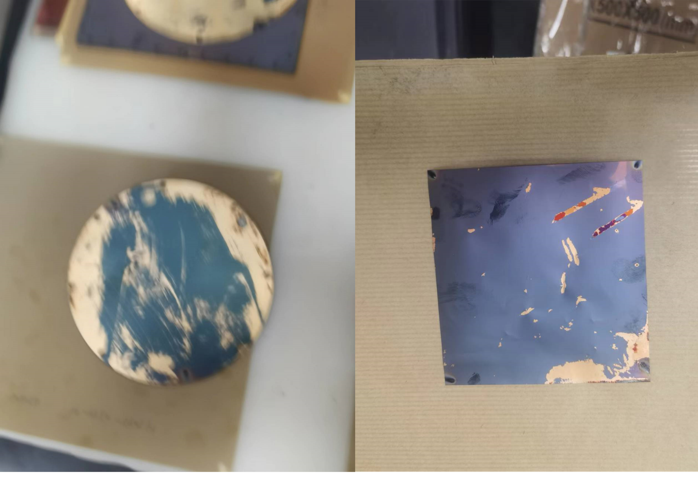
Adhesion testing
Au
Cu
NO PSE
PSE
Au
Cu
Au
Cu
PSE: Plasma Source Etching
Notes:
As shown in the figure, we have respectively tested on the gold surface and the copper surface, and the results show that
when PSE is not used, the adhesion of these two metals with low material budget conductive film is not good.
After adding PSE, the gold and low material budget conductive film can be perfectly combined, the one with copper behaved better but there are still occur deformation, which means copper is oxidized in the air.

Slide 15
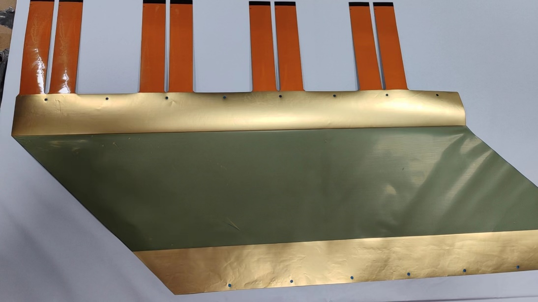
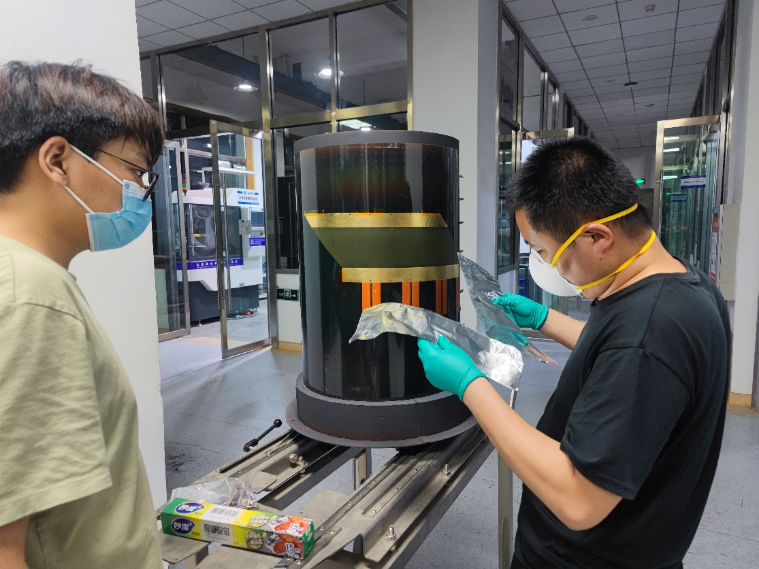
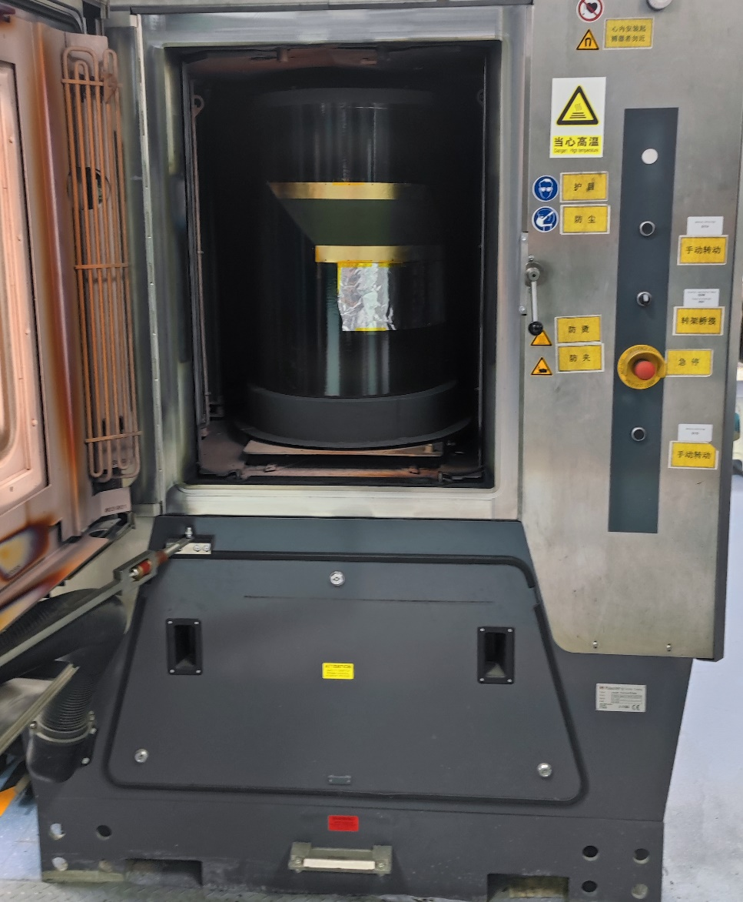
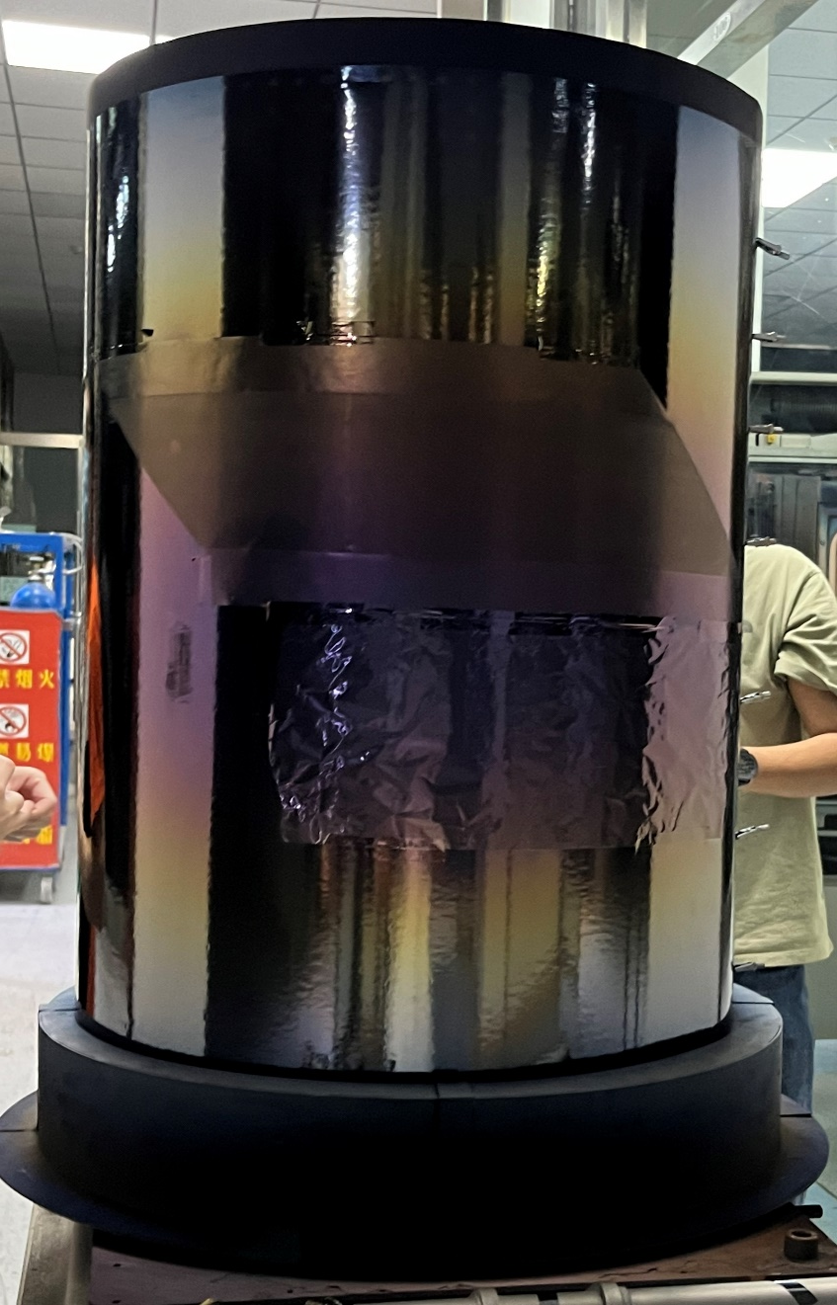
LMB Coating on V readout electrode
Vacuum control 5E-4 mbar
PSE
Pure Cr 1min 3kW
The transition layer of copper and polyimide
Cr + Cu 30s co-deposition layer
Pure Cu 20min 0.5kW conductive layer
Cu + Cr 30s co-deposition layer
The transition layer of copper and DLC
Pure Cr 1min 3kW
Cr + DLC 1min
DLC 1hour 4kW
Notes:
In order to ensure that the conductive film has the best adhesion with the PCB peripheral lines,
we gold-plated the PCB peripheral lines of the readout electrode, and then we use Photoresist to develop the graphics of the readout strip and the ground plane as a Mask on the PCB,
and then deposited a low material budget conductive film on the readout electrode.

Slide 16
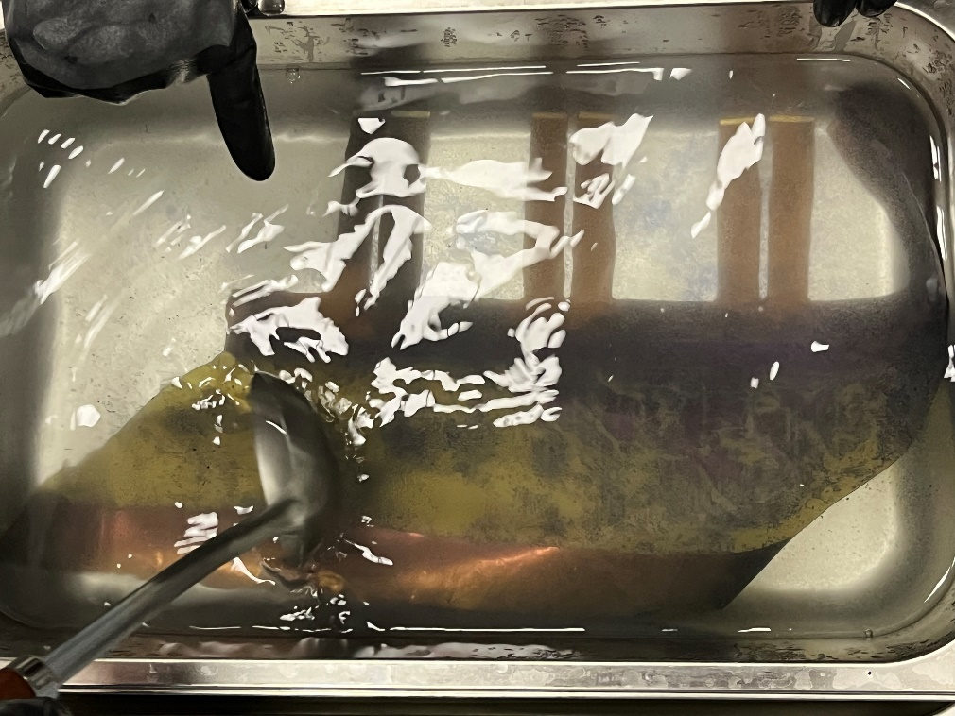
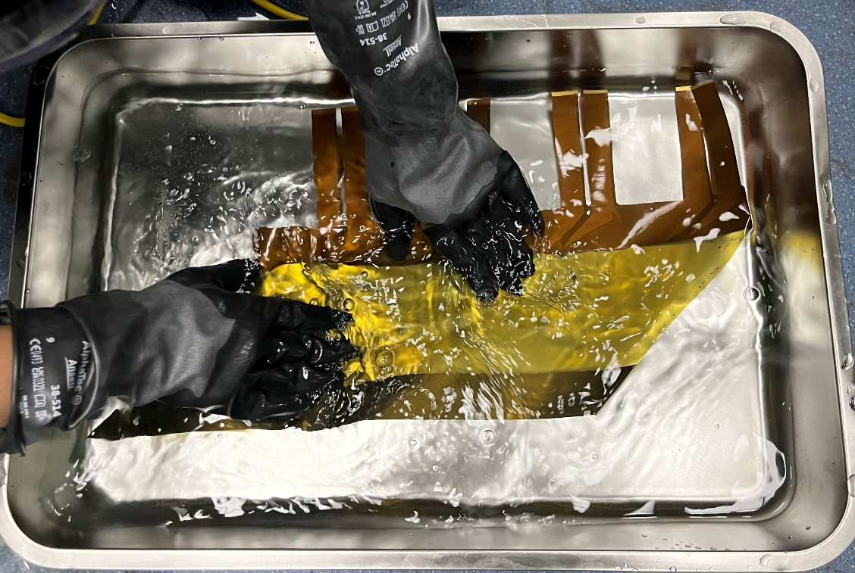
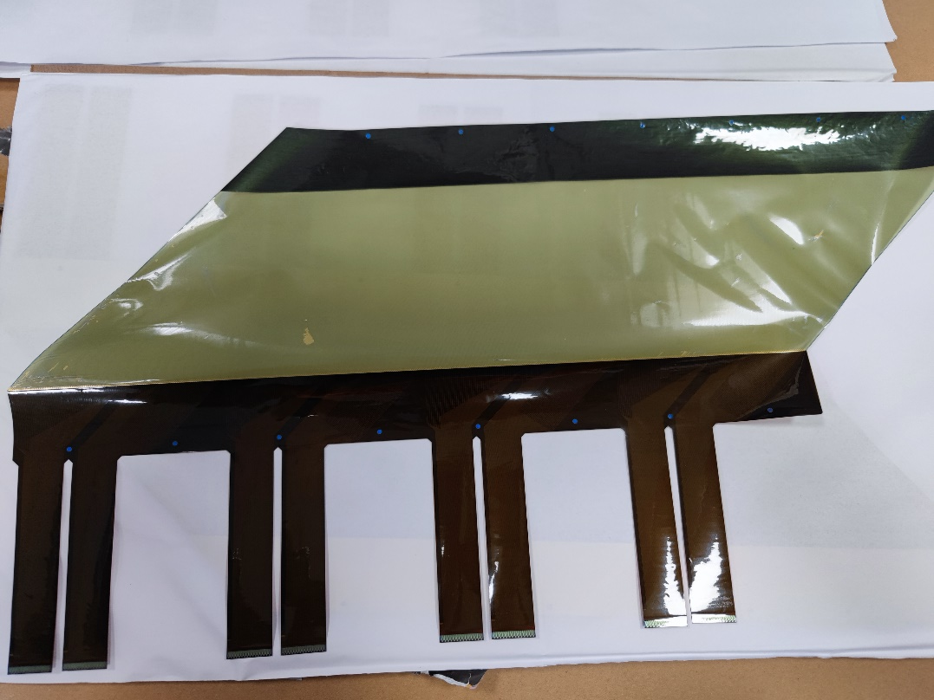
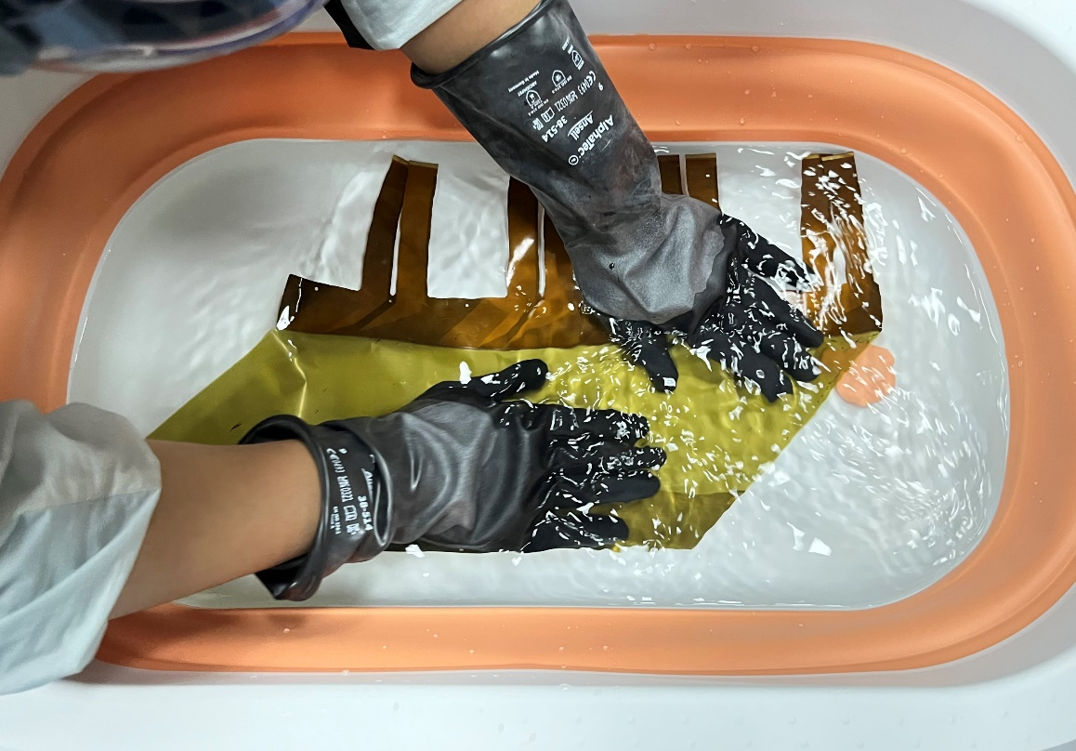
Lift-off process
20 min; 45-55℃
First water rinse
drying
Second water rinse
Notes:
After the low material budget conductive film was deposited, we used a special film removal solution to remove the Photoresist Mask. After the removal, we cleaned the film twice with water, and then dried the film.

Slide 17
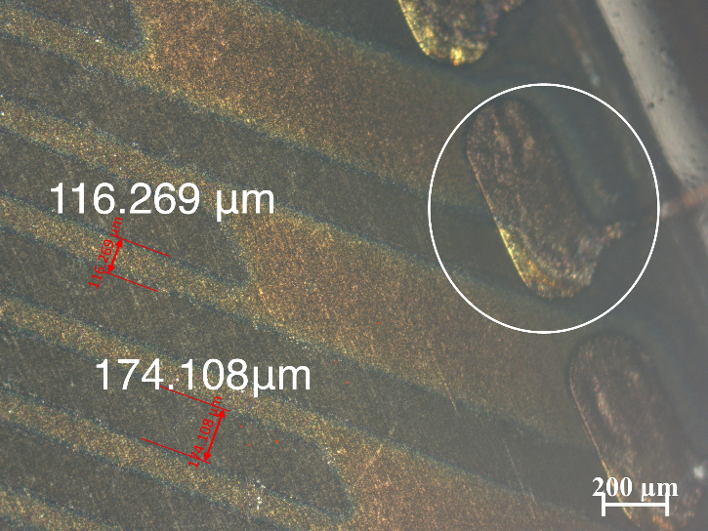
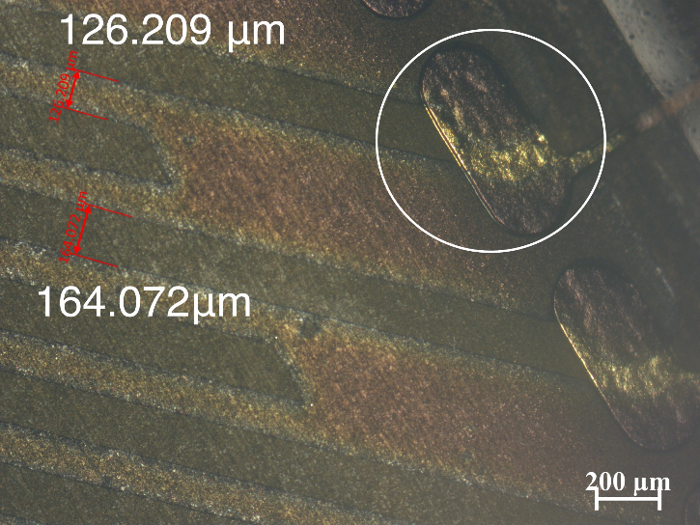
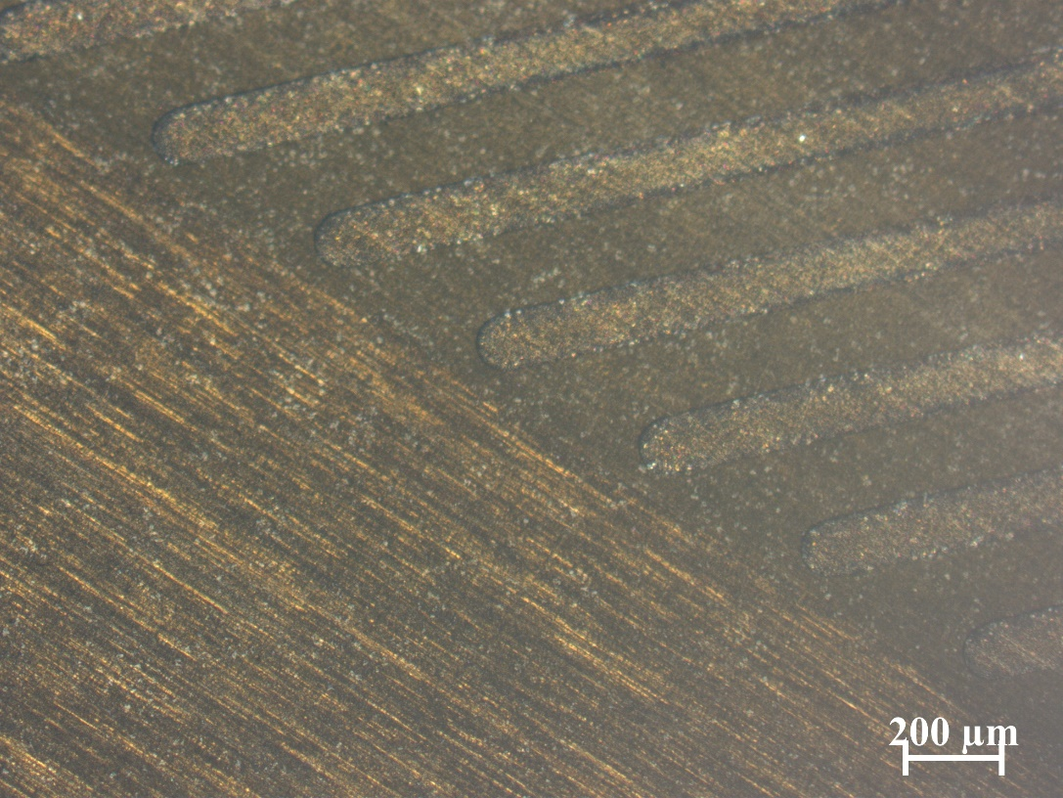
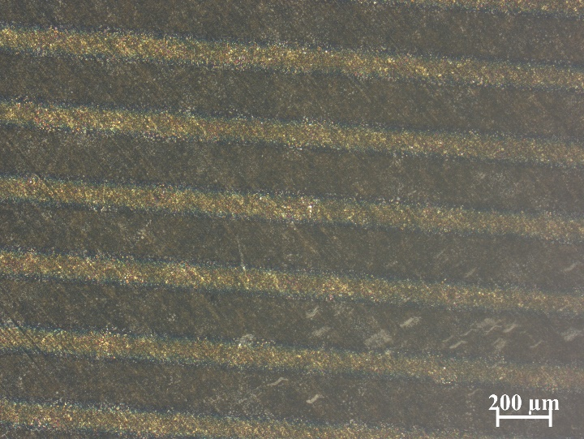
Production of LMB V-strip readout electrode
Observed under the microscope:
Good quality of the coated strips
Good connection to the external metal
Significantly mis-alignment of the pattern
Notes:
We used a microscope to examine the graphics on the PCB of the readout electrode, as shown in the figure.
The shape of these bars is relatively complete, and the width and relative position of the bars are quite accurate, and the connection with the external line is also better.
But the existing problems are also significant, the first is that some of the PCB readout bar overall has a significant offset, as shown in this figure, the readout bar overall offset is too large to the adjacent lines are connected together.
There were also cases where the readout strips broke, and where multiple strips were joined together by a large piece of metal

Slide 18
Summary
Notes:
OK，now I want to summary this R&D work.

Slide 19
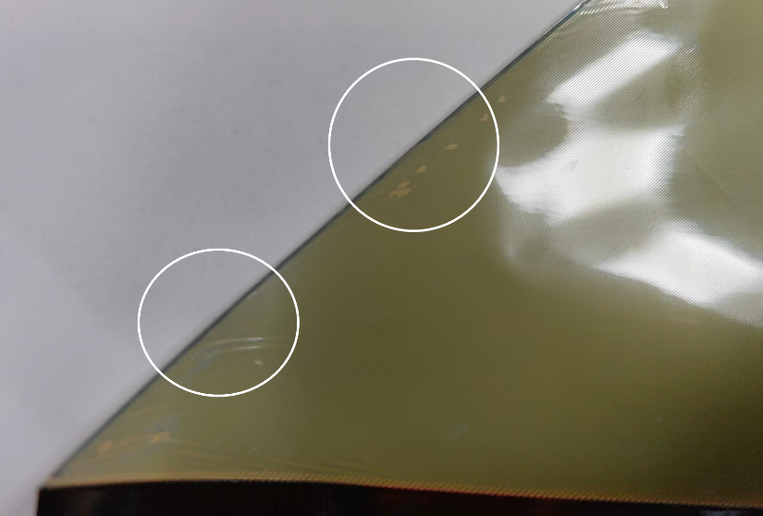
Summary and Outlook
Achievements:
Large size (～1.5m×0.6m) of LMB electrodes on Kaptons(12.5um/25um/50um) with very low resistivity are successfully prepared
Precise strip patterns have been achieved with Lift-off method
Problems and possible solution:
Pattern mis-alignment occurred in some samples；We will carefully check the deformation of flexible PCB and make a precise alignment for the pattern.
Broken strips found. We will check the mask after the pattern made, to make sure there is no any defects on the mask.
Future plans:
We can improve the conductivity of LMB electrode by doping silver in future
Thanks
Notes:
We successfully prepared low-material budget conductive electrodes on polyimide substrates of three thicknesses, and the sample size reached 1.5m×0.6m.
And by using the lift-off process, we have prepared high-quality low material budget readout electrodes with specific pattern structures.
But we also found some problems, the first is the deformation of Flexible PCB will cause the strip alignment problem;
In addition, there are still defects on the Photoresist Mask, which will lead the broken and connected strips in some places. Both of these problems need to be solved by improving the production process of Photoresist Mask.
Finally, if we need to further improve the conductivity of the low-material budget electrode, we can consider incorporating silver into the coating to achieve this. Thanks for your attention!

