Slide 1

Introduction to the DRD1 Work Packages
Piotr Gasik
(on behalf of DRD1 WG2 conveners and WP coordinators)
RD51 Collaboration Meeting
19 June 2023

Slide 2
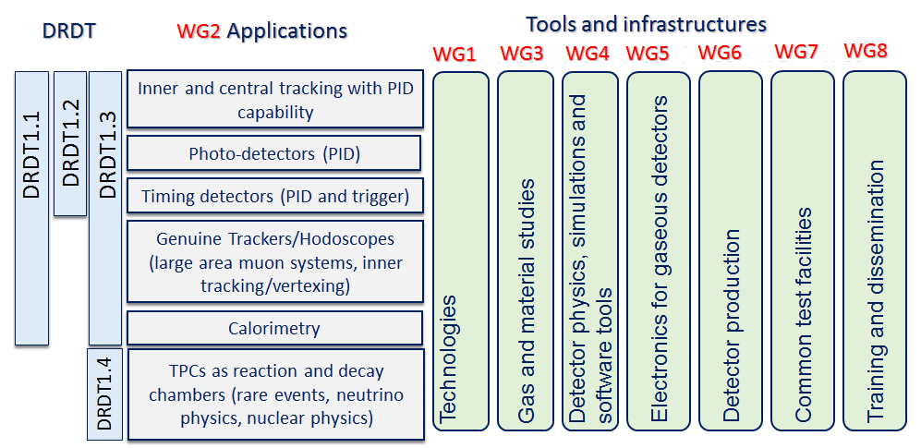
DRD1 structure
Structure in Working Groups, forum for scientific discussions, coordinated by conveners:
  aligned with the scientific program of the ECFA roadmap through the applications related to future facilities challenges, outlined by R&D Themes (DRDTs*), but also to the GSRs* (General Recommendation Strategies)
* See backup for details

Slide 3
Digression
Where, in the DRD1 scheme, current RD51 WG2 (Detector Physics and Performance)?
Shared between WG1/WG2/WG3/WG4 topics ?

Slide 4
Work Packages
Strategic R&D (according to the ECFA Detector R&D Roadmap) is organized in Work Packages
  group activities of the Institutes with shared research interests around Applications with a focus on a specific task(s) devoted to a specific DRDT challenge, typically related to specific Detector Technologies and to the development of specific tool or infrastructure
Application
⇽ defined by ECFA R&D Roadmap
Tasks
focusing on challenges related to performance (precise timing, high rates performances, longevity …)
⇽ connection to ECFA DRDTs
Technological areas:
MPGD, RPC, Wire, LDC, TPC, …
R&D on Sensors, Electronics, Software Tools, Gas Properties studies;
Development of infrastructure and production techniques
Training
Work Package

Slide 5
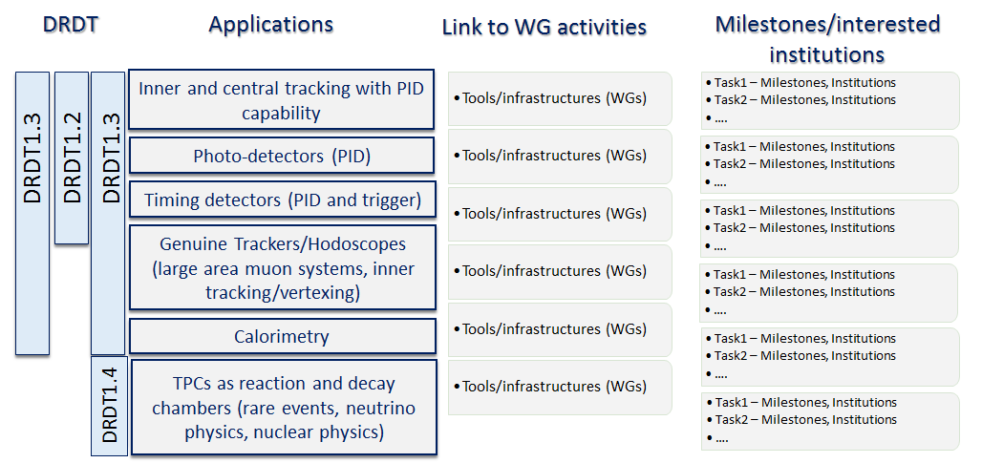
Work Packages

Slide 6
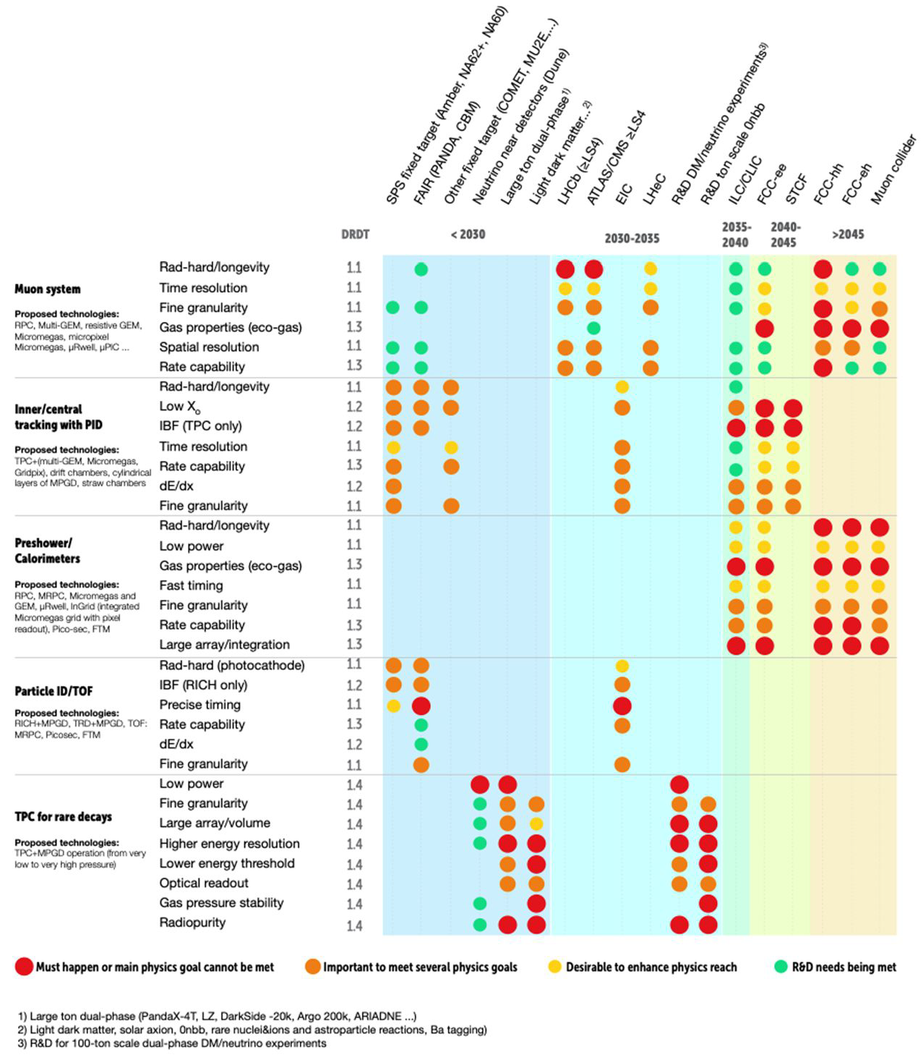
WP1: Genuine trackers/hodoscopes
(large area muon systems, tracking/vertexing)
Challenges/tasks
extend state-of-the-art rate capability and longevity by minimum one order of magnitude or more in the highest eta region (up to an order of MHz/cm²)
enable detectors reliably and efficiently working with suitable low GWP mixtures
reaching the two objectives above can be favored in 3 ways:
  low noise electronics integrated in a highly stable and noise immune Faraday cage
  new detector geometries increasing the signal collection yield
  use of innovative resistive material for suppressing discharges on the electrodes.
Time resolution O(20ps) for timing applications and of 200-300 ps to identify the BC in a very high rate collider, to help in cutting the pile up and to boost the ability to measure particle velocity
large series industrializes production

Slide 7
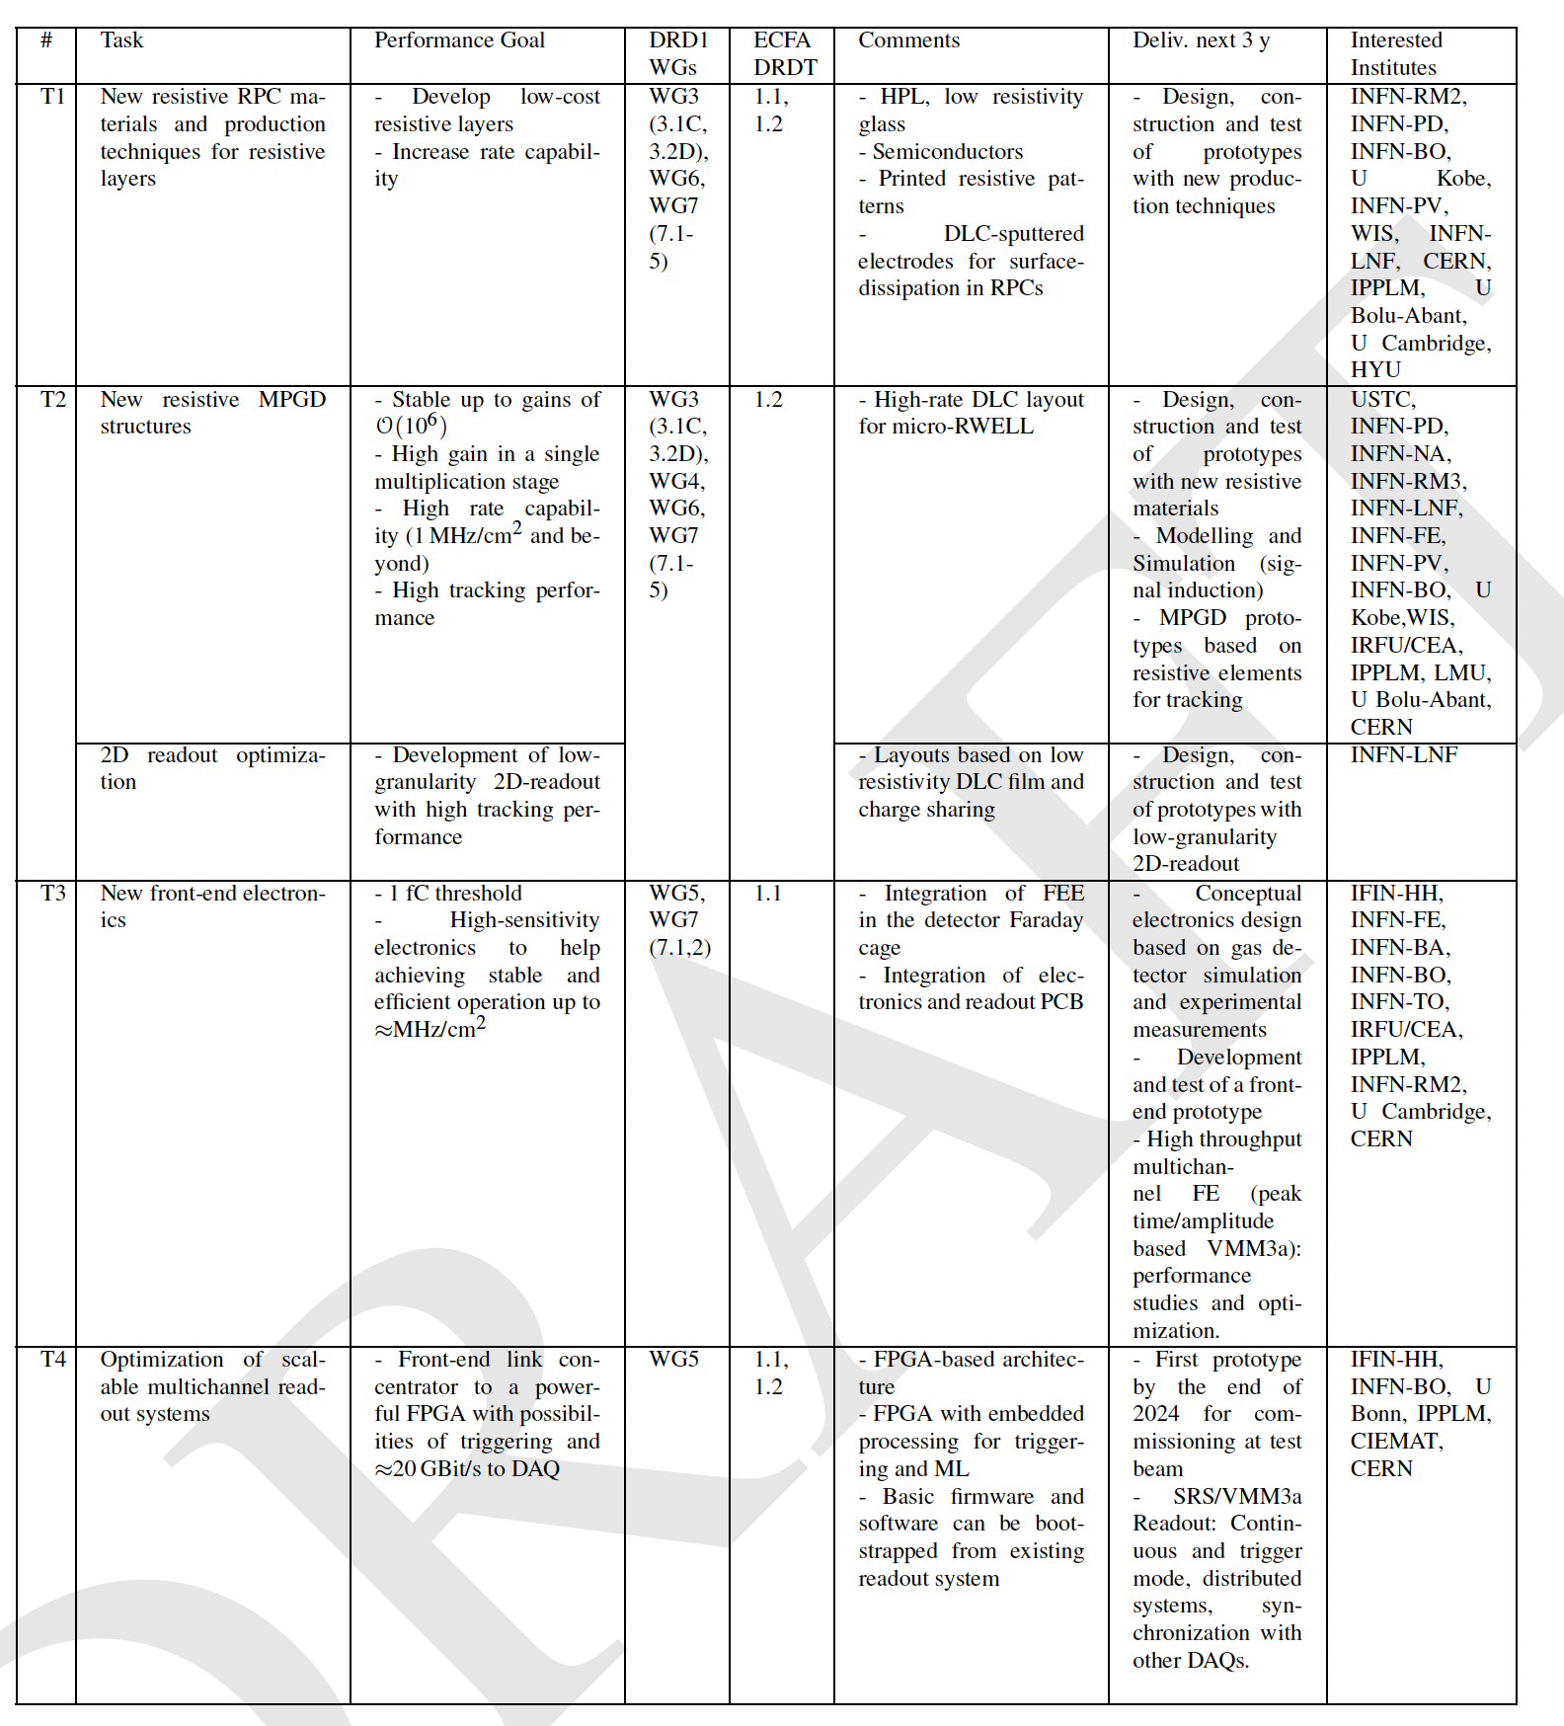
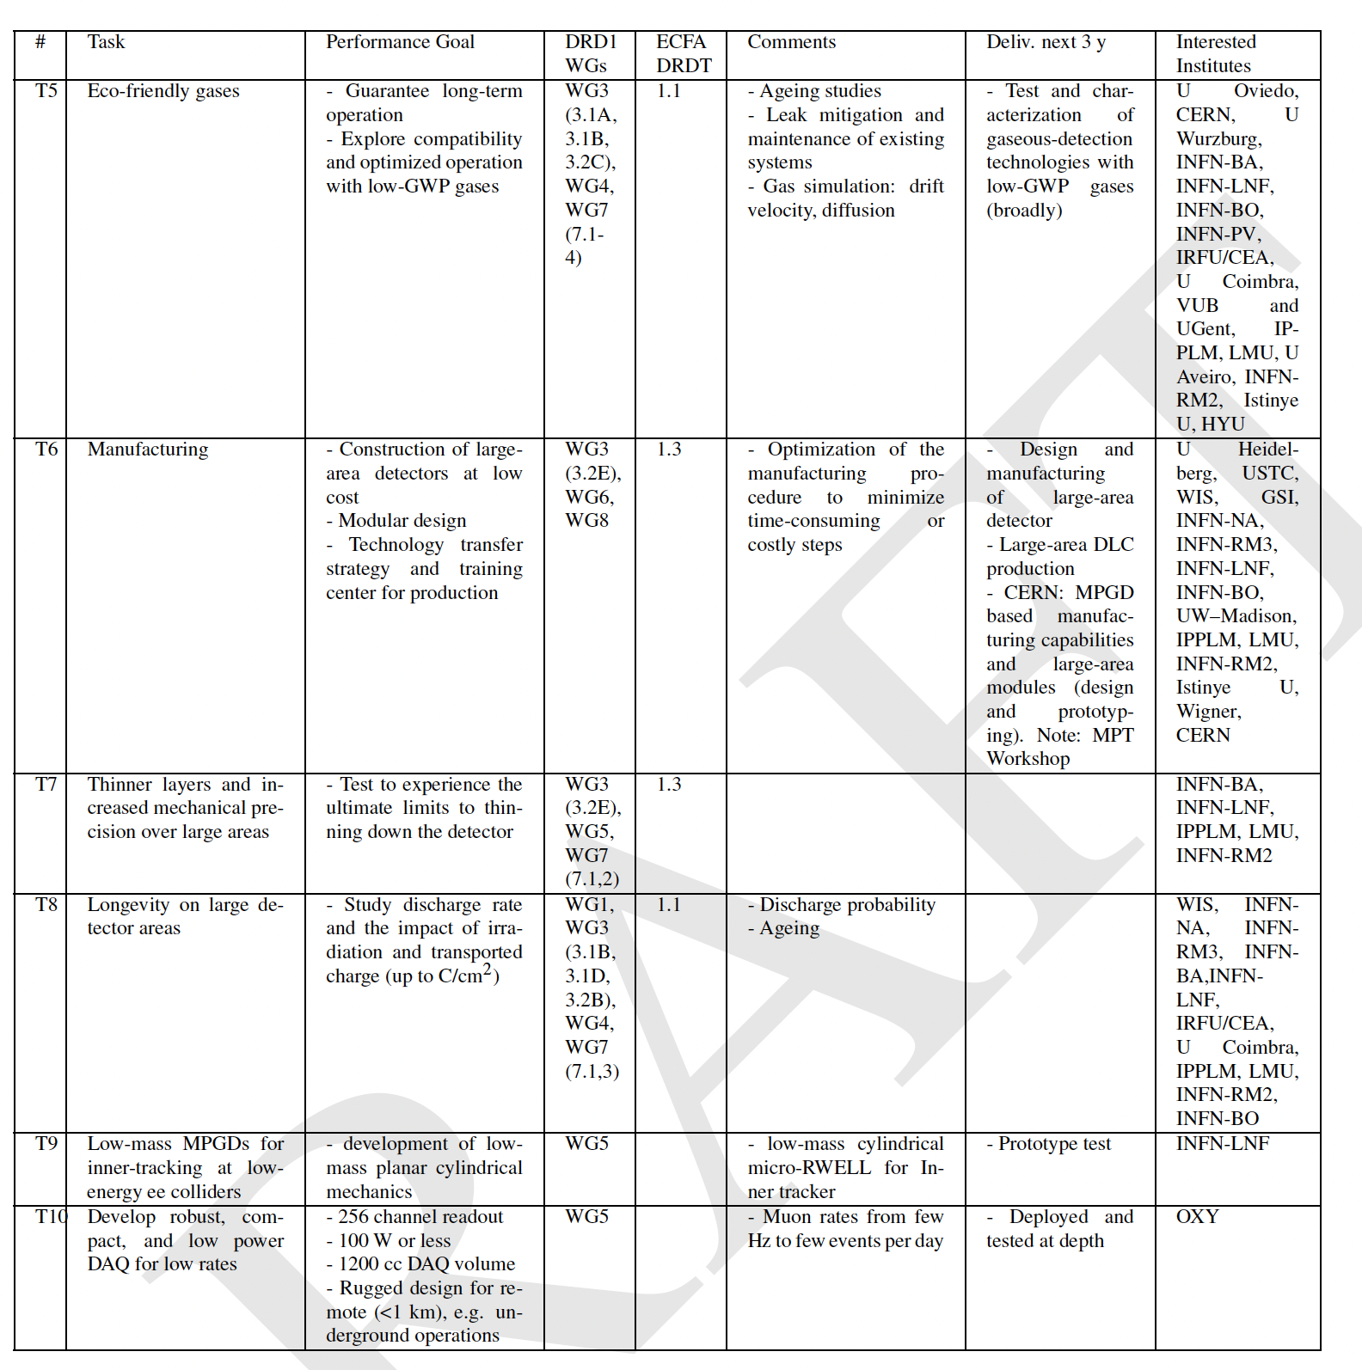
WP1: Genuine trackers/hodoscopes
(large area muon systems, tracking/vertexing)
WG1 (Technologies) – related

Slide 8
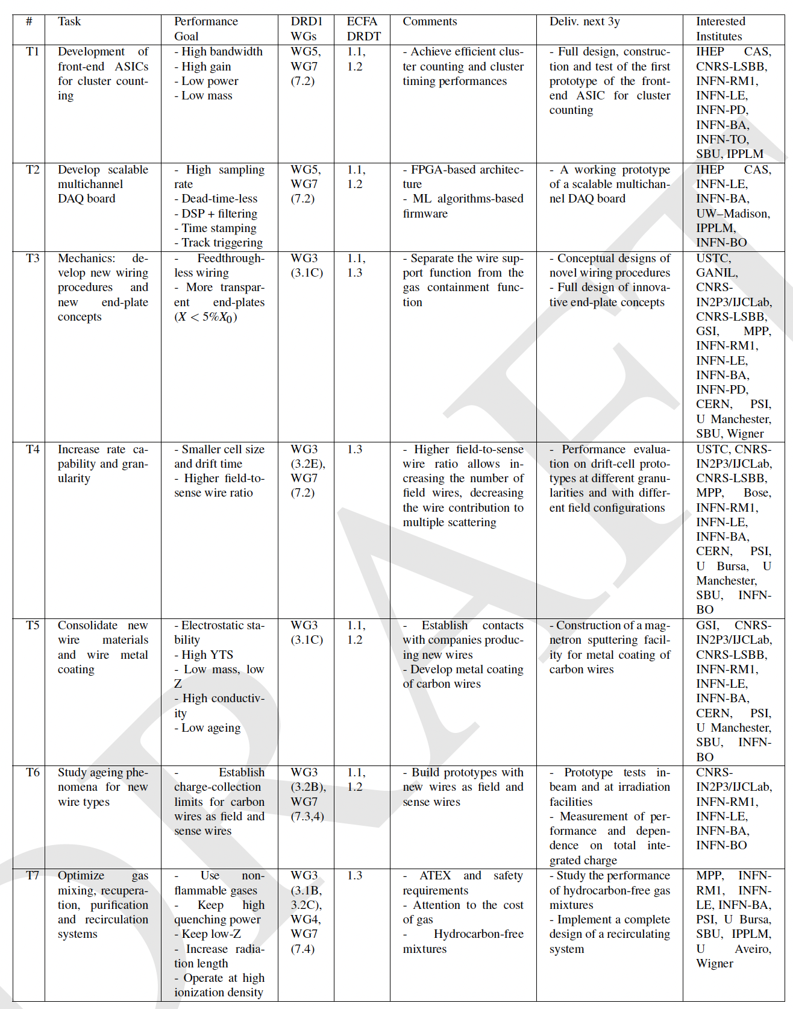
WP2: Inner and central tracking with PID
(drift chambers)
Challenges/tasks
Mechanics: new wiring procedures, new wire materials
High gas gains ∼5×10⁵, required for the application of the cluster counting techniques, high granularities (small cell size, order of 1 cm), long wires (order of 4-5 m) and electrostatic stability demand studies on new light materials with high YTS for wires.
Electronics: on-line, real time data processing algorithms
Waveform digitizers, signal processing for cluster counting exploiting new data processing algorithms
Hydrocarbon-free gas mixtures / recirculating gas systems
Safety requirements (ATEX) on flammable gases and ever-increasing costs of noble gas

Slide 9
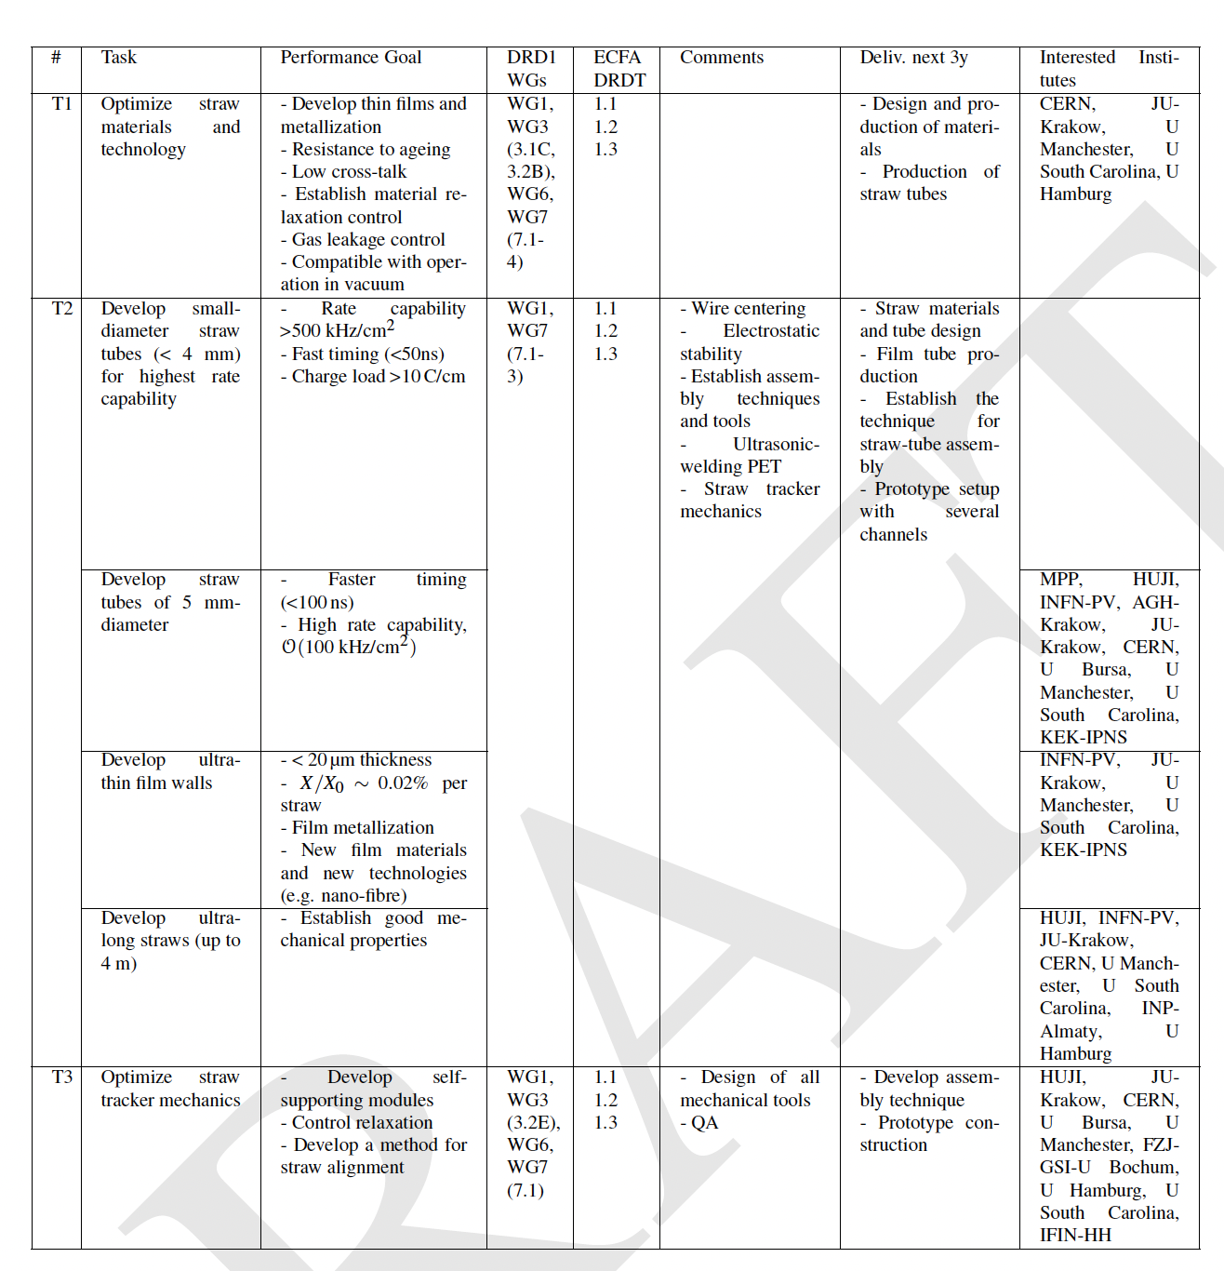
WP3: Inner and central tracking with PID
(STRAW chambers)
Challenges/tasks
Mechanics: thinner, smaller diameter, longer straw tubes / mechanical stability
6+6 μm mylar + 3 μm glue wound-type or 25 μm seamless (resistive) type, few mm diameter, several m length /self-supporting structures
Material studies
Creep under tension (tension relaxation), gas leakage (operation under vacuum or overpressure)
Electronics
Leading and trailing time resolution for 4D measurements and for dE/dx with time over threshold

Slide 10
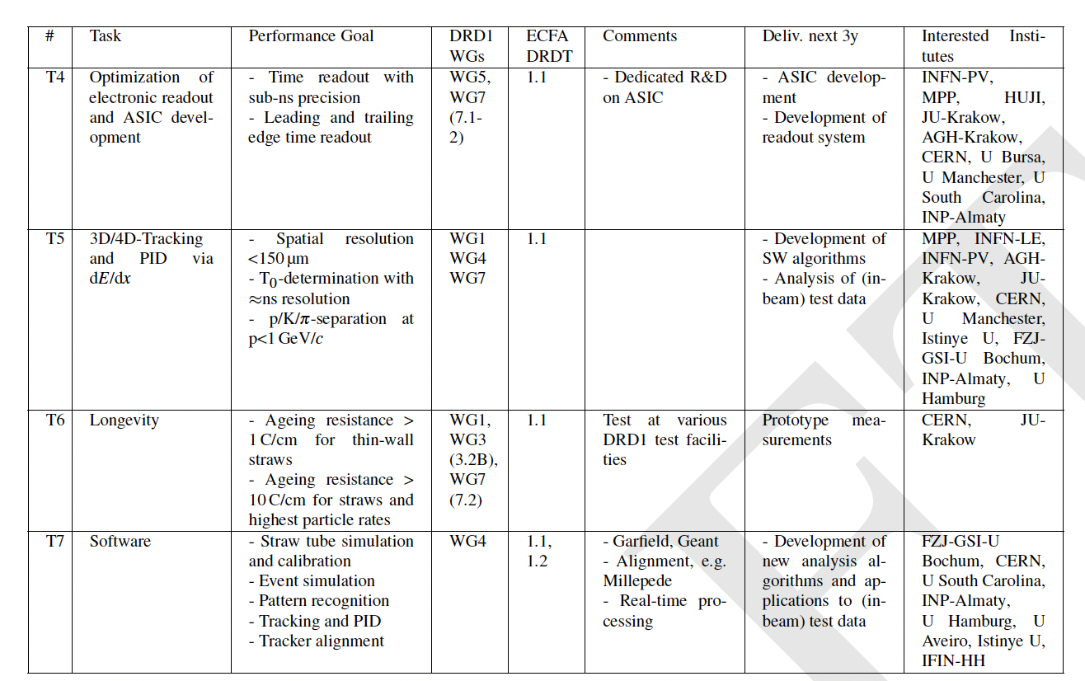
WP3: Inner and central tracking with PID
(STRAW chambers)
Challenges/tasks
Mechanics: thinner, smaller diameter, longer straw tubes / mechanical stability
6+6 μm mylar + 3 μm glue wound-type or 25 μm seamless (resistive) type, few mm diameter, several m length /self-supporting structures
Material studies
Creep under tension (tension relaxation), gas leakage (operation under vacuum or overpressure)
Electronics
Leading and trailing time resolution for 4D measurements and for dE/dx with time over threshold

Slide 11
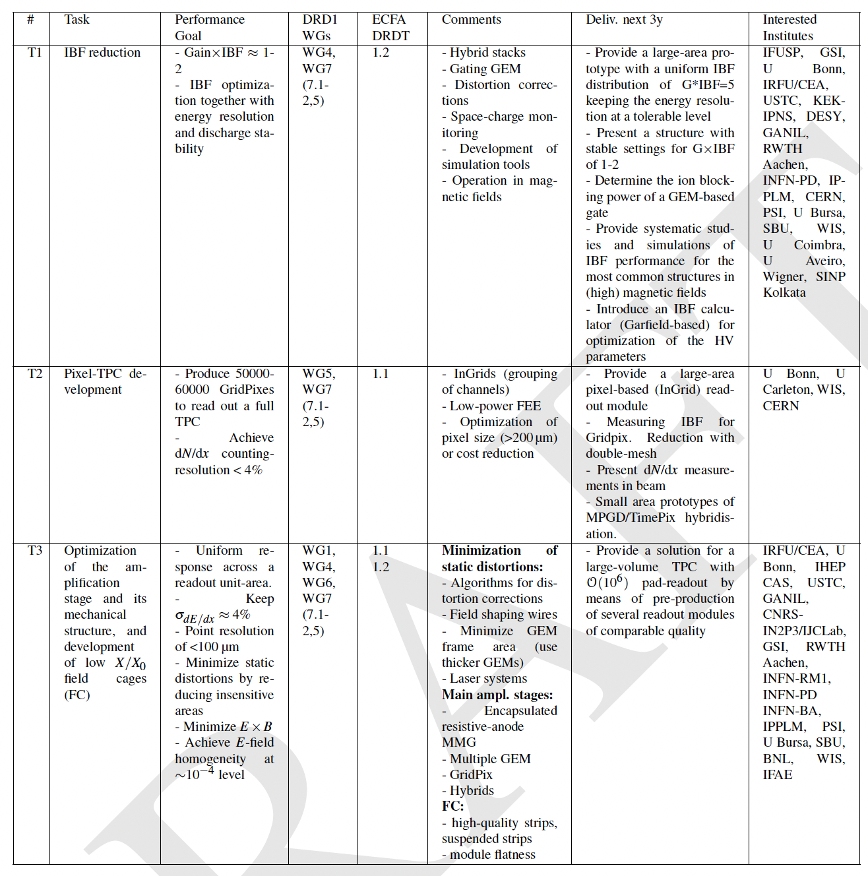
WP4: Inner and central tracking with PID
(Large volume TRACKING TPCs)
Challenges/tasks
High rate,
Low mass,
Granularity,
dE/dx & cluster counting
Ion backflow suppression,
Gas mixture optimization and Eco gas mixtures

Slide 12
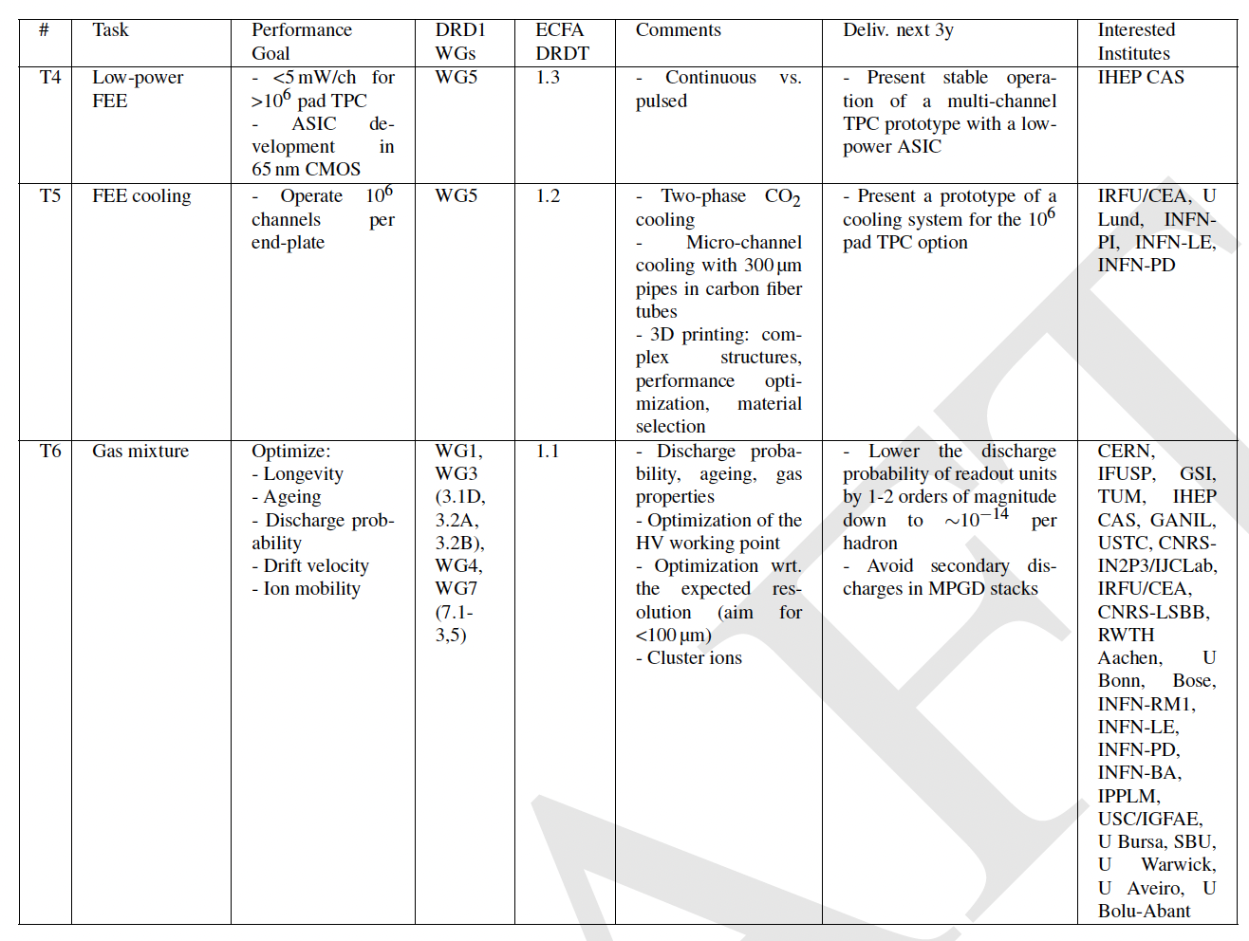
WP4: Inner and central tracking with PID
(Large volume TRACKING TPCs)
Challenges/tasks
High rate,
Low mass,
Granularity,
dE/dx & cluster counting
Ion backflow suppression,
Gas mixture optimization and Eco gas mixtures

Slide 13
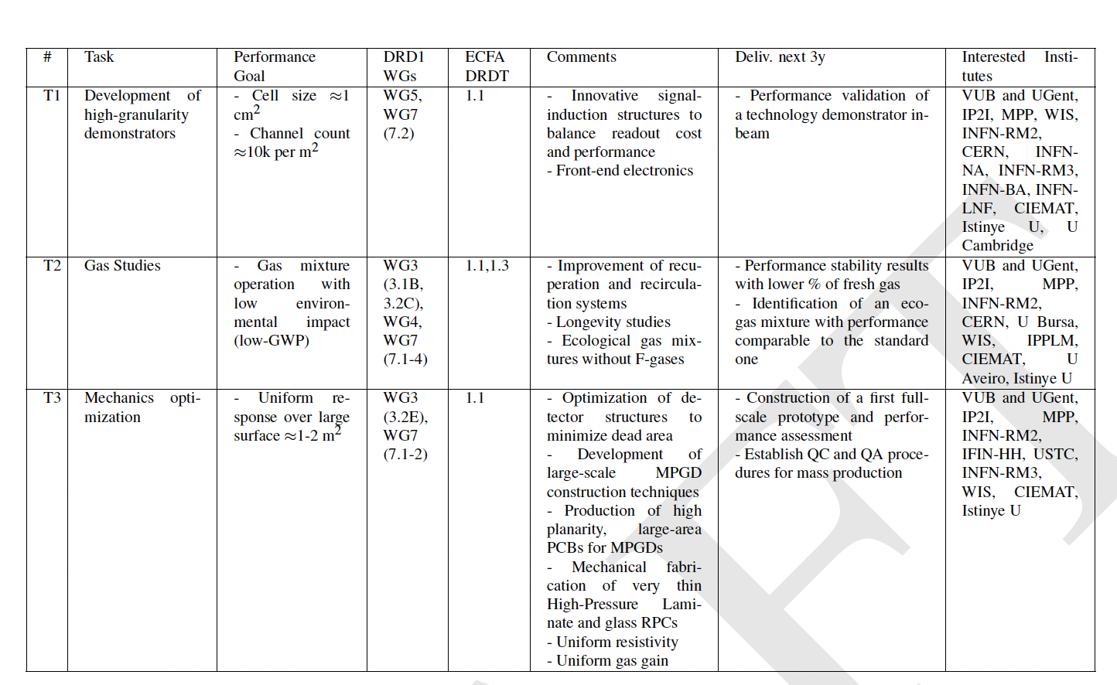
WP5: Calorimetry
Challenges to develop large detector area
Uniformity of the response and dynamic energy range
Rate capability (x resistive material detector): 1 kHz/cm²
Time resolution O(100ps)
Not necessarily for large-area:
Eco-gas mixture
Stable performance (gas gain, time resolution, etc)
High radiation hardness
Technologies:
RPC, Micromegas, GEM, RWELL/RPWELL, micro-RWELL, gridPix, PICOSEC, FTM.

Slide 14
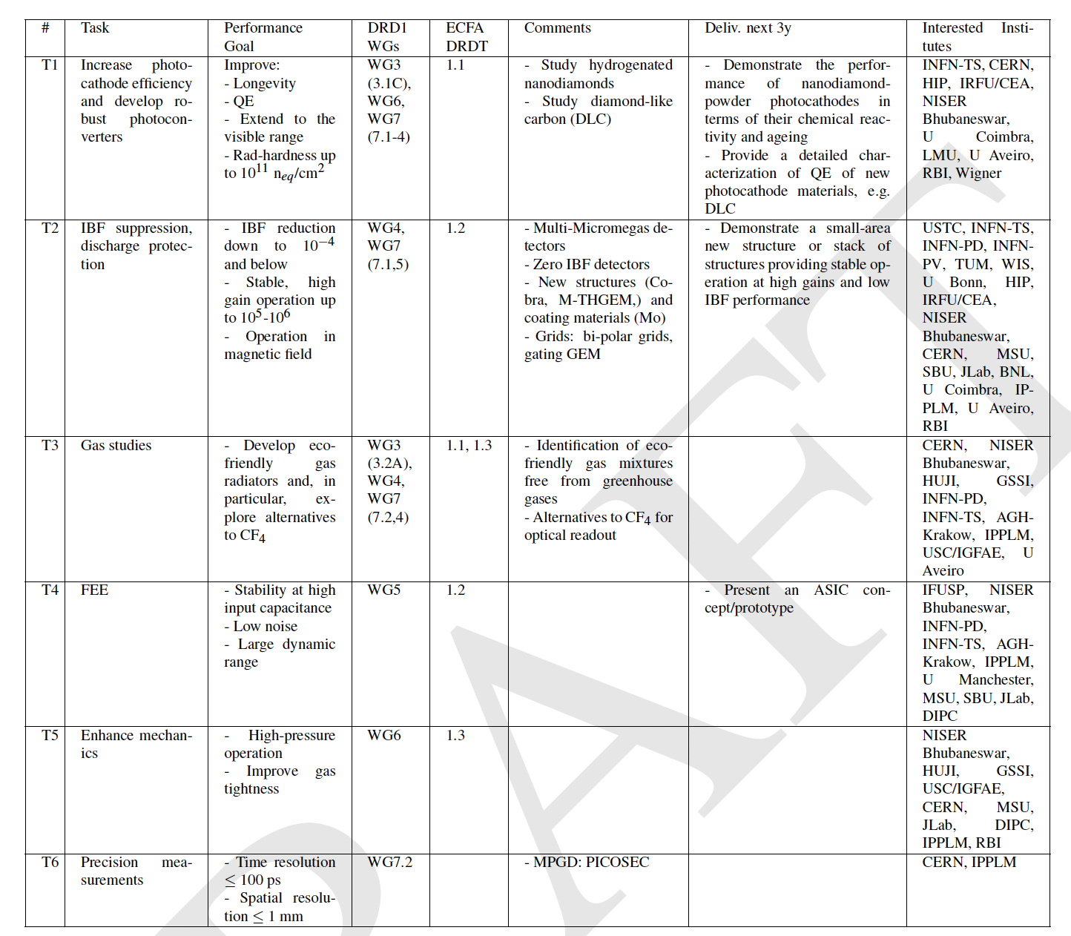
WP6: Photo-detectors
(PID)
Challenges/tasks
Preserve the photocathode efficiency by IBF and more robust photoconverters
Very low noise, large dynamic range of the FEE
Separate the TR radiation and the ionization process

Slide 15
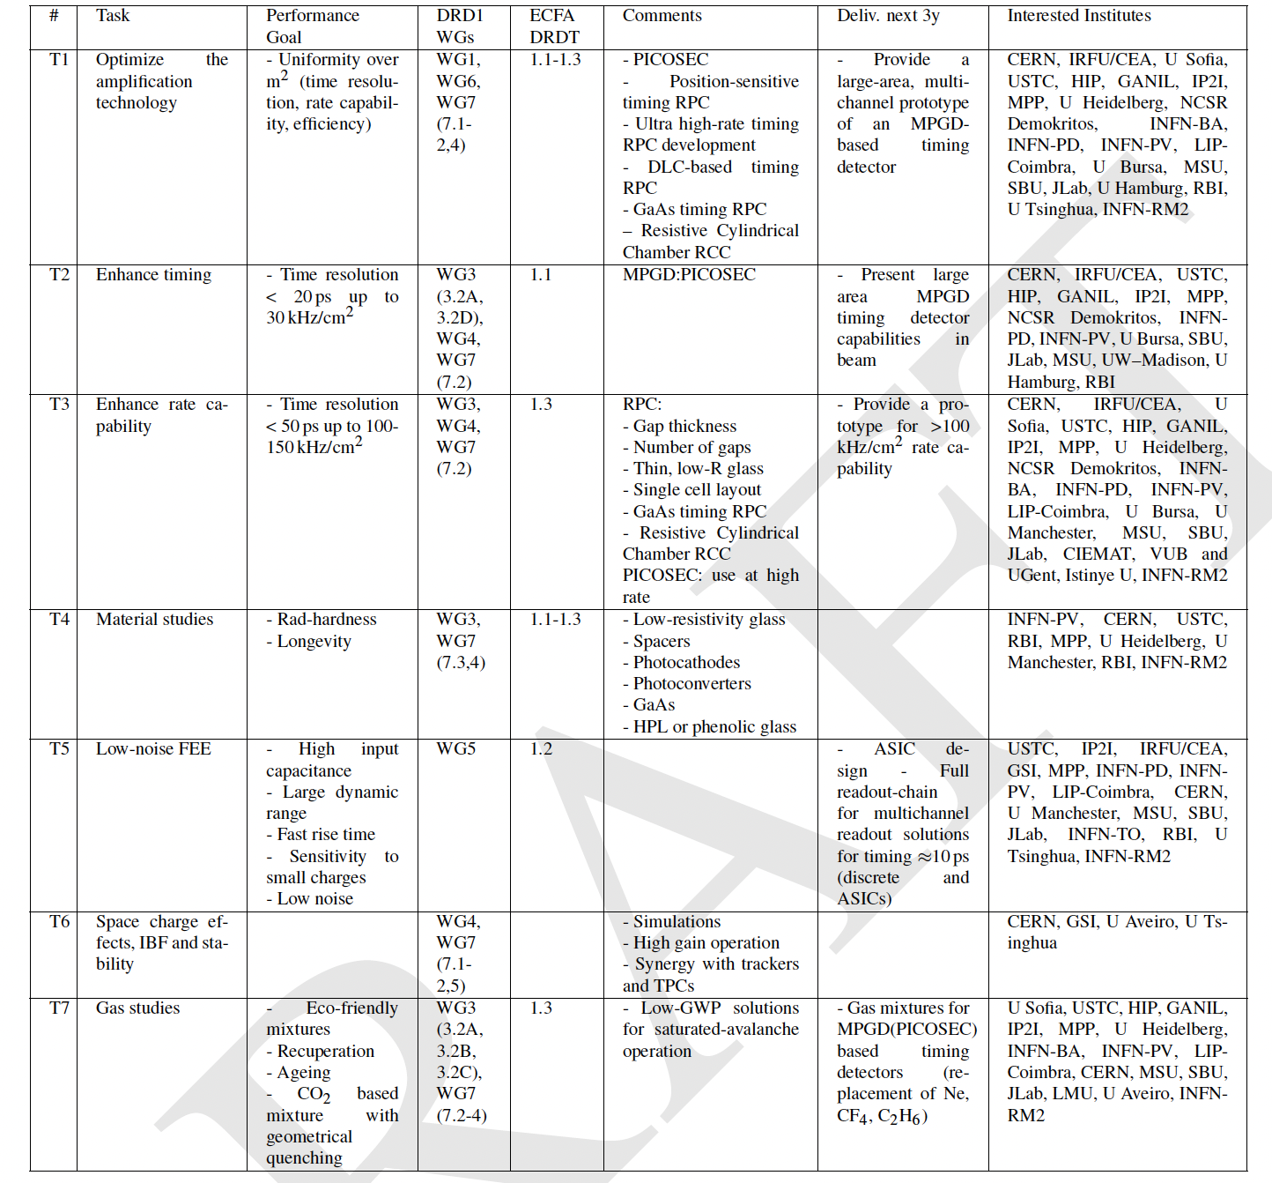
WP7: Timing detectors
(PID and trigger)
Challenges/tasks
Uniform rate capability, time resolution, and efficiency over large detector area
New material for high rate (low res., rad.hard.): uniform gas distribution, spacer material, spacer geometry, thinner structures: mechanical stability and uniformity
Eco-gas mixture, Gas recuperation systems
Electronics: Low noise, fast rise time, sensitive to small charge

Slide 16
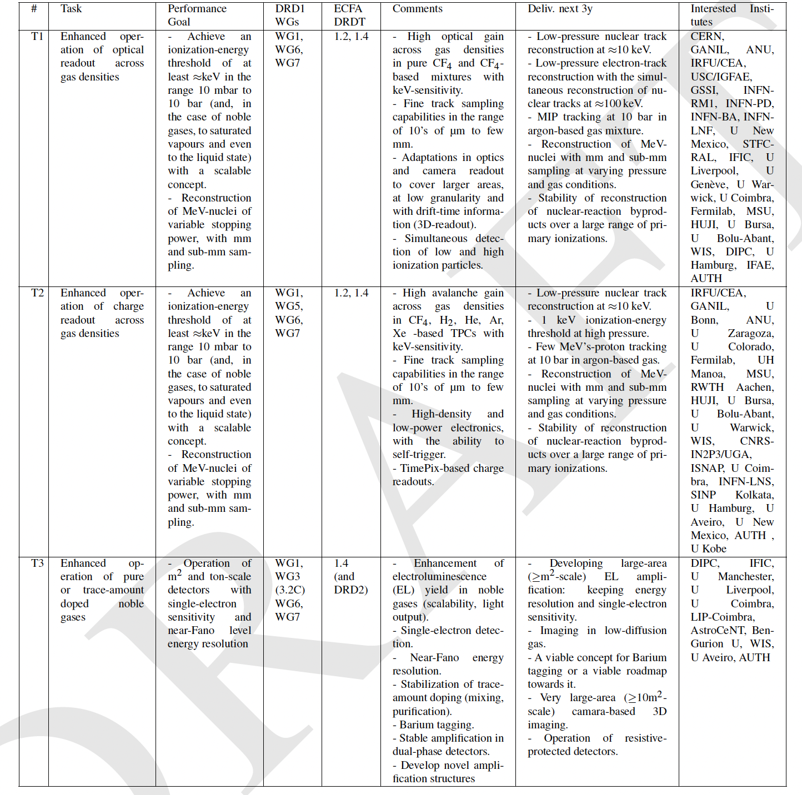
WP8: TPCs as reaction and decay chambers
(RARE EVENTS, NEUTRINO PHYSICS, NUCLEAR PHYSICS)
Challenges/tasks
Reconstruct low-energy nuclear tracks (down to 10 keV energy-scale) with high granularity and close to the thermal diffusion limit.
Low energy threshold (keV or less) far from atmospheric pressure (10mbar-20bar).
Achieving high and uniform amplification in nearly pure or weakly-doped noble gases
Increasing optical throughput (primary and secondary)
Developing more suitably scintillating and/or eco-friendly gas mixtures as well as recuperation systems;
Enhancing the radiopurity of the amplification structure and of the TPC as a whole

Slide 17
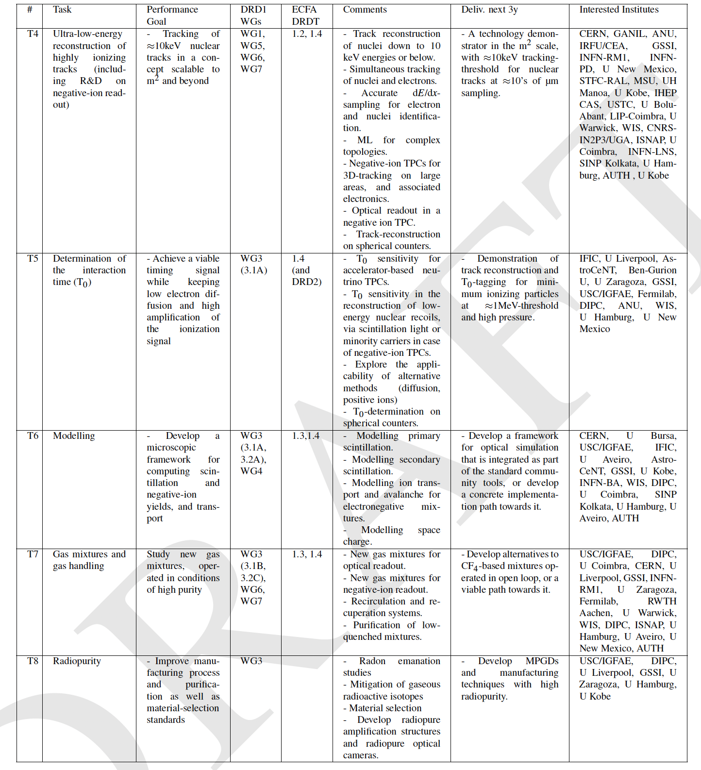
WP8: TPCs as reaction and decay chambers
(RARE EVENTS, NEUTRINO PHYSICS, NUCLEAR PHYSICS)
Challenges/tasks
Reconstruct low-energy nuclear tracks (down to 10 keV energy-scale) with high granularity and close to the thermal diffusion limit.
Low energy threshold (keV or less) far from atmospheric pressure (10mbar-20bar).
Achieving high and uniform amplification in nearly pure or weakly-doped noble gases
Increasing optical throughput (primary and secondary)
Developing more suitably scintillating and/or eco-friendly gas mixtures as well as recuperation systems;
Enhancing the radiopurity of the amplification structure and of the TPC as a whole

Slide 18
(WP9: Beyond HEP)
No WP9 in the first proposal
Community feedback: clear need of Beuyond HEP WP definition
To be discussed on Thursday
We can identify different tasks:
  muography and large area applications;
  dosimetry/beam monitoring and medical imaging applications (PET, CT, X-ray, SPECT, Gamma cameras, or X-ray fluorescence imaging);
  fast/thermal neutron imaging (MPGD-based readout with solid converter for tomography and nuclear waste monitoring;
  X-ray polarimetry and space applications;

Slide 19
Next steps
WP Coordinators will contact ALL institutes which shared their interest in given WP topics in the survey and/or community feedback
Institutes can still be added/removed from the individual WP and their tasks
  It is not required to be involved in a WP to be a member of DRD1
  It is required to be a member of DRD1 to contribute to a WP
”Extended WP tables” will be created together with institutes which declare their contribution to specific WPs
  “WP projects” with well defined tasks will cluster institutes interested in common goals;
  Final DRD1-proposal WP tables (following current scheme) will be a compilation of such “WP projects”
  The institutes intrtested to contribute to a given WP need to provide FTE and non-FTE resources in the extended WP tables
  We differentiate between “existing” and “requested” resources.
  WP can help in acquiring strategic funding, however, it is not mandatory for an institute to apply for extra funding. One can contribute with the exiting resources only
WP can be created at any time in the future

Slide 20
BACKUP SLIDES

Slide 21
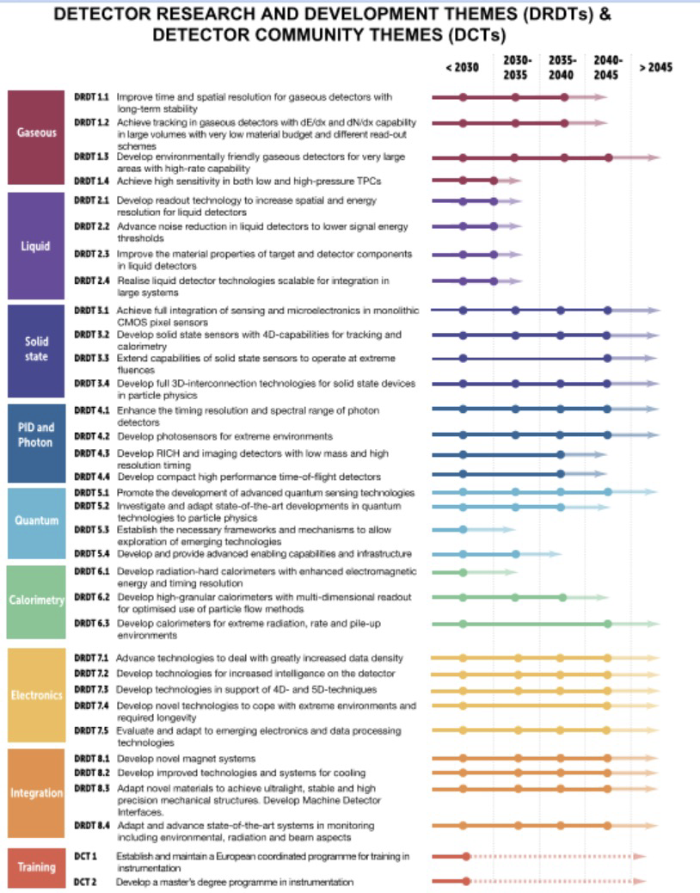
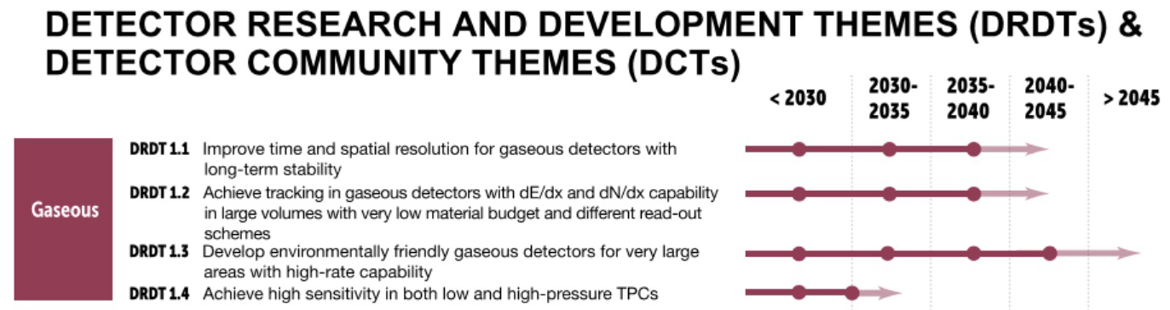
DRD Themes

Slide 22
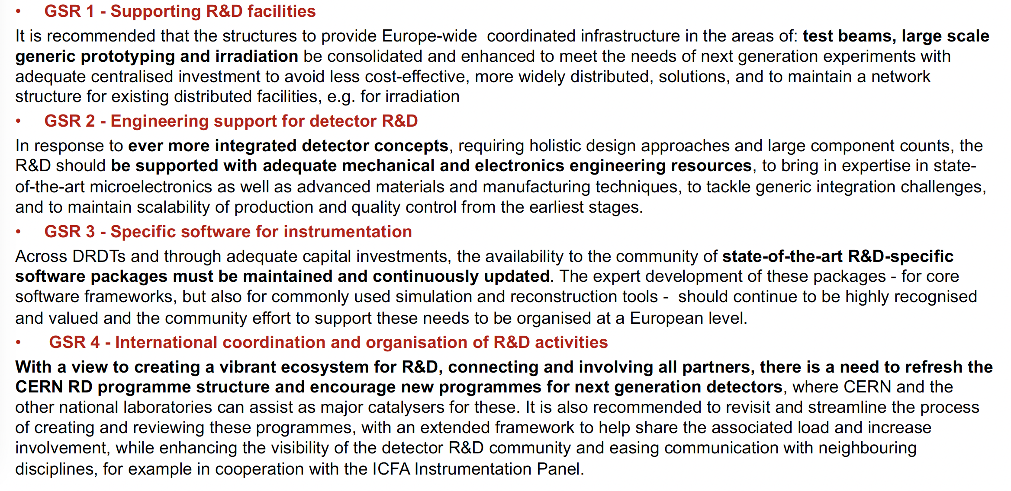
General Strategic Recommendations

Slide 23
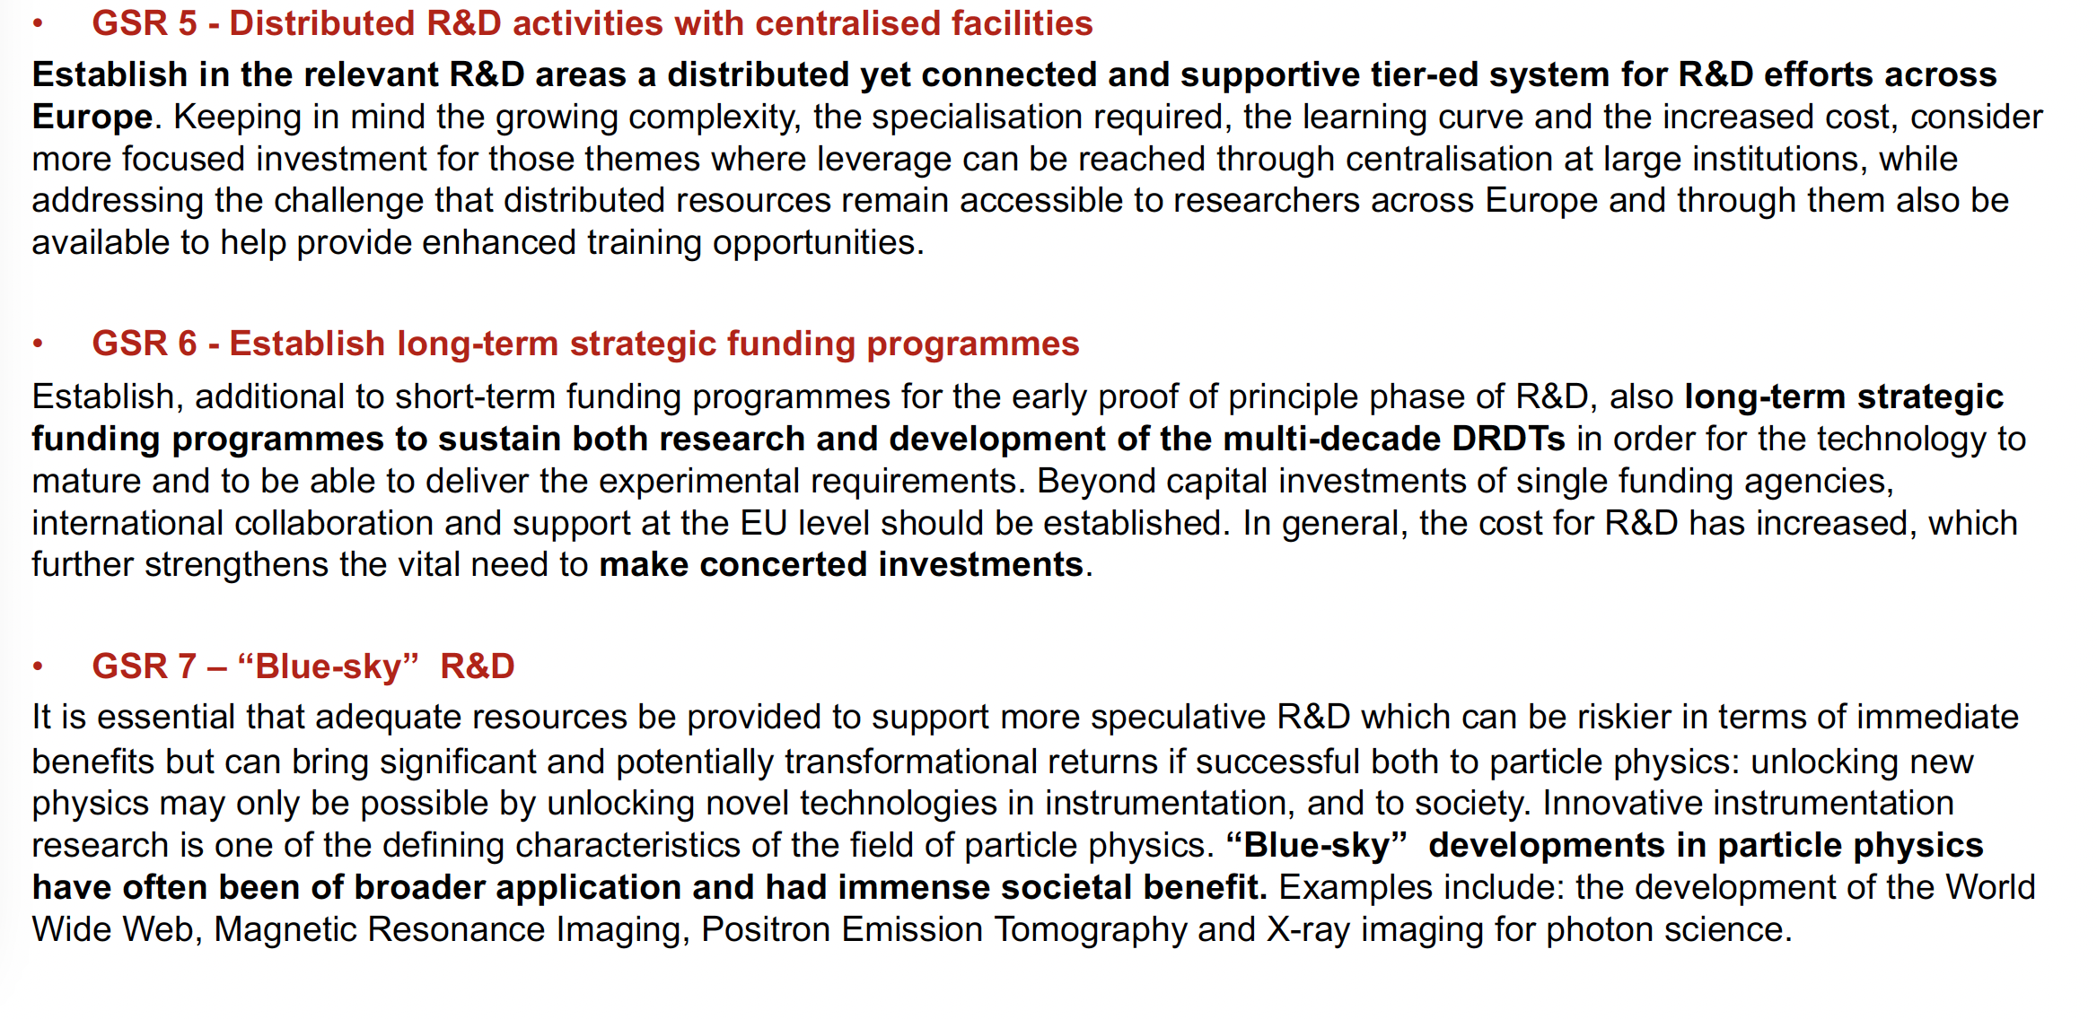
General Strategic Recommendations

Slide 24
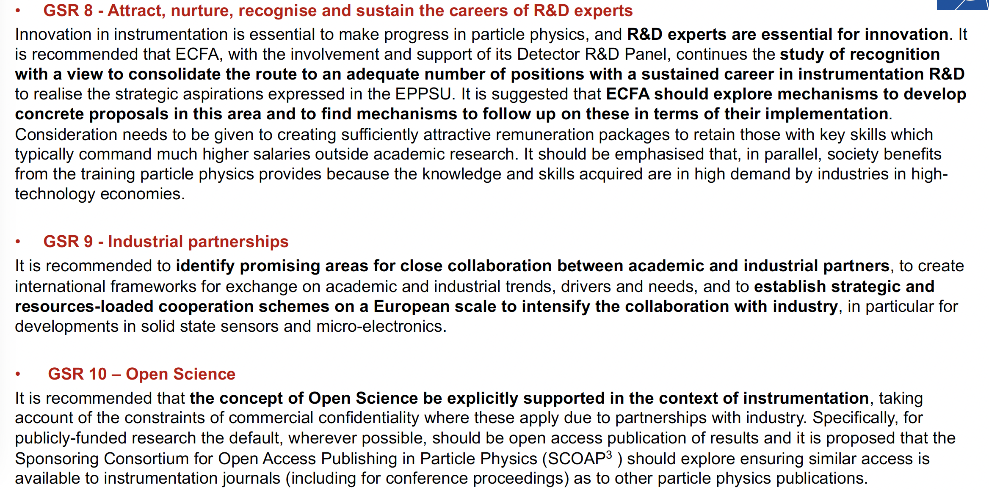
General Strategic Recommendations

