Slide 1
DRD1 WG4
Detector Physics Modelling and Simulation
An introduction to the discussion
(also for who did not have the time to read the proposal)

Slide 2
Outline of the contribution (4.4)
10 pages – 321 lines – 1 Figure – 1 Table
4.4.1 Introduction (0.5p)
4.4.2 State-of-the-Art (2p)
  Understanding of Detector Physics inside Wire Chambers (WC), TPC, RPC, MPGD and the state of the art of their simulations
  Generally well understood for WC, TPC …
  Not full understanding (or sometimes poor understanding) of “High-Energy” and “High Rate” phenomena in RPC and MPGDs
    E.g. avalanche-to-streamer transition in RPC
    E.g. Discharge formation and propation in MPGD
  Known blind spots: electroluminescence, (negative) ion drift, new gas cross-sections …
  Not all physics that is rather well understood is implemented in simulation tools in the public domain
4.4.3 Needs of the Community (7p)
  What we understood from the survey…
    2/3 interested in contributing to the understanding of gaseous detector physics
    1/3 willing to contribute to software development
  2 tasks dedicated to the improvement of the CORE Simulation
  9 tasks we envision within WG4 (and should find a home in Applications)

Slide 3
Tasks associated to WG4
”Core” Software Tool development (2 Tasks)
 | Ref. | Description | Deliverable
4.1.X GARFIELD Modernization | 4.1.1 | Review Core code for Multi-Threading and Heterogeneous Computing (CPU – GPU), optimized C++ code for modern CPUs, … | Core Code
 | 4.1.2 | Add Community Tools (Validation, Automatic Pull-Request Tests, Builds, …) | Software Tools
 | 4.1.3 | Review & Accelerate G++ integrated neBEM | Core Code
4.2.X GARFIELD Framework Improvement | 4.2.1 | Recommended Set of Ion Mobilities | New SW release
 | 4.2.2 | Secure long-term solution for Magboltz | New SW release
 | 4.2.3 | Miscellaneous: better Event Displays, Improve Documentation, Provide Examples | New SW release
We would like / need to collaborate with CERN IT department for Core Code and for the deployment of modern software tools. We would need people willing to push these developments forward and can follow PhD students (partly) working on these topics …

Slide 4
Tasks associated to WG4
Application specific Software Development (Part I)
 | Ref. | Description | Deliverable
4.3.X Simulation of Large Avalanches / Space Charge Effects | 4.3.a.1 | Implementation of Space-Charge | SW
 | 4.3.a.2 | Implementation of E-Field update (on the fly) | SW
 | 4.3.a.3 | Clustering of particles for Large Avalanches | SW
 | 4.3.b.1 | Simulate Discharges using code 4.3.a | SW
4.4.X Simulation of Resistive GDs | 4.4.a.1 | Signals: Time-dependent weighting fields (neBEM) | SW
 | 4.4.b.1 | Rate-Capability simulation (Equiv. Network) | SW
 | 4.4.b.2 | Framework for large-size detectors (cells) | SW
 | 4.4.c.1 | Model / Sim Dark Count Rate and Ageing | SW
Very important Software development required and once in place several (most) applications will benefit. Community will be allowed to simulate / compare / study effects that could not be studied before … Still funding & manpower should be driven inside App WPs

Slide 5
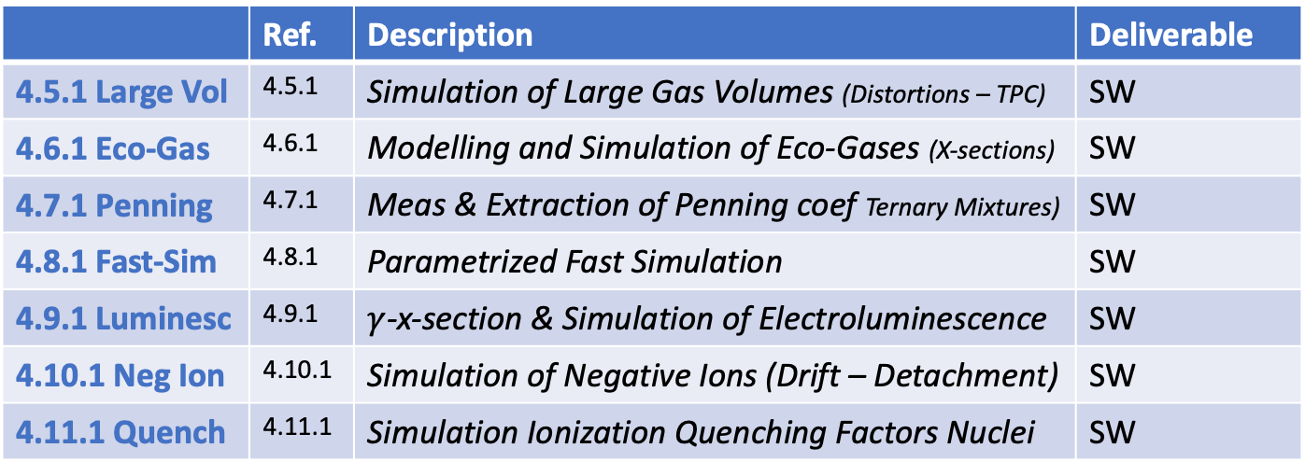
Tasks associated to WG4
Application specific Software Development (Part II)
 | Ref. | Description | Deliverable
4.5.1 Large Vol | 4.5.1 | Simulation of Large Gas Volumes (Distortions – TPC) | SW
4.6.1 Eco-Gas | 4.6.1 | Modelling and Simulation of Eco-Gases (X-sections) | SW
4.7.1 Penning | 4.7.1 | Meas & Extraction of Penning coef Ternary Mixtures) | SW
4.8.1 Fast-Sim | 4.8.1 | Parametrized Fast Simulation | SW
4.9.1 Luminesc | 4.9.1 | $γ$-x-section & Simulation of Electroluminescence | SW
4.10.1 Neg Ion | 4.10.1 | Simulation of Negative Ions (Drift – Detachment) | SW
4.11.1 Quench | 4.11.1 | Simulation Ionization Quenching Factors Nuclei | SW
Here these tasks fit naturally into the various Work Packages for the Applications. Funding and (Wo)manpower to work on these tasks should be included in the WP proposals. WG4 acting as a platform for exchange of expertise and help

Slide 6
Let’s have some discussion

