Slide 1
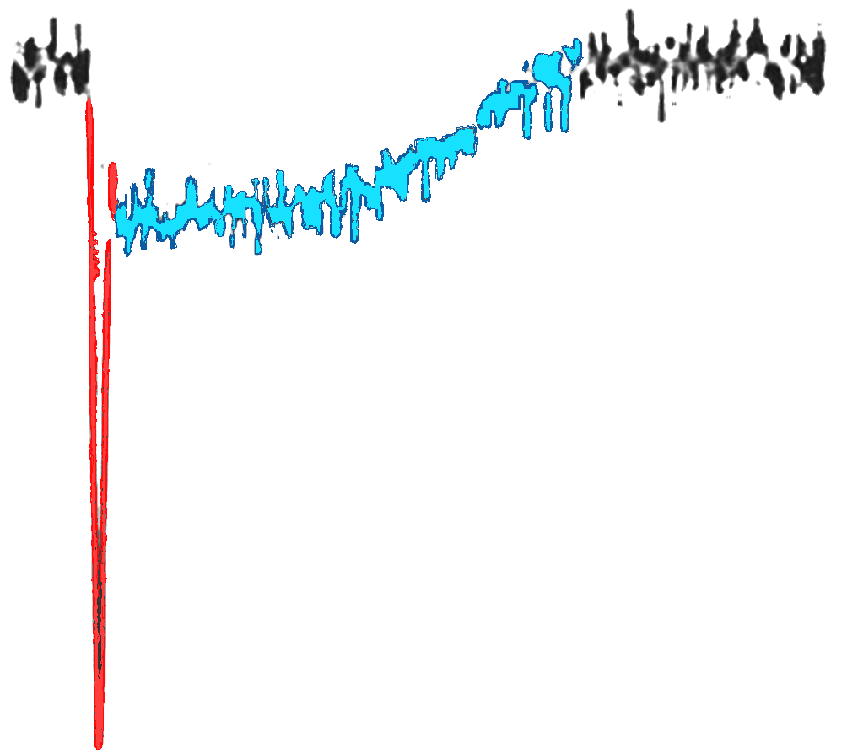

Monday, 19th June 2023
Preliminary Results on PICOSEC – MM using 7-pad resistive prototypes
Alexandra Kallitsopoulou
CEA, IRFU, Université Paris – Saclay
on behalf of PICOSEC Micromegas Collaboration
RD51 Collaboration Meeting 19-21 June 2023
PICOSEC
Micromegas
Thomas Papaevangelou
Notes:
Saisir les champs « Titre », « P. Nom » et « Date.
Laisser ou retirer le bandeau.

Slide 2
Outline
The PICOSEC Micromegas Technology
April 2023 TestBeam Setup & Measurements
7-pad resistive prototypes tested
7-pad resistive prototypes comparison

Slide 3
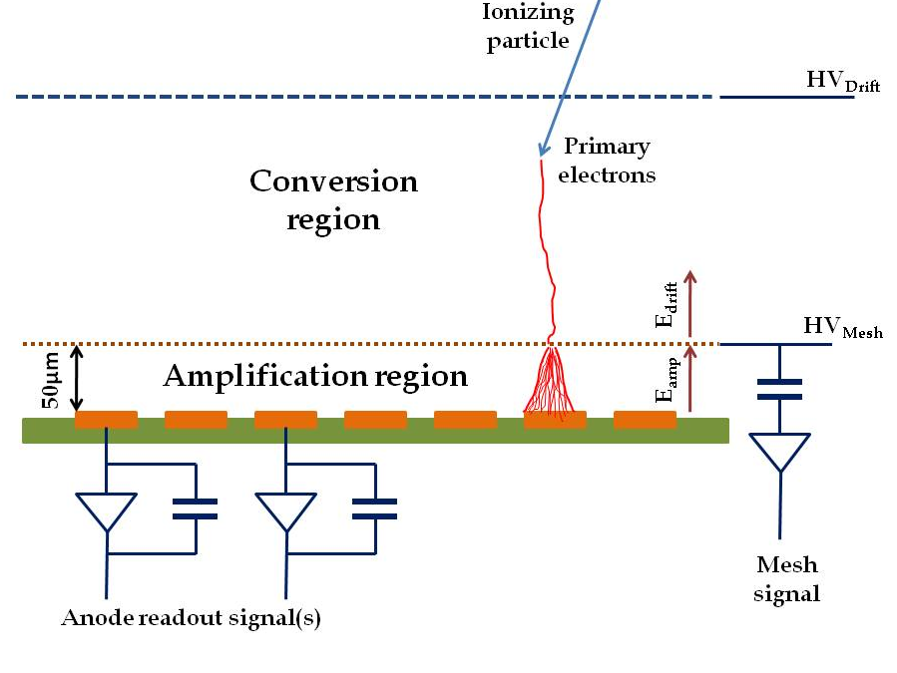
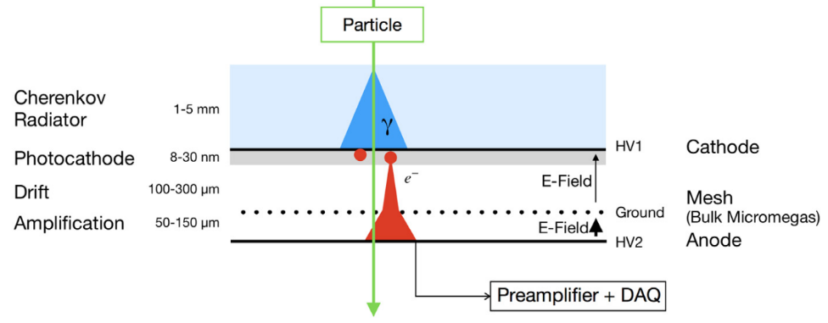
The PICOSEC Micromegas Technologie
Limitations of the Micromegas Timing Potential
  Stochastic nature of ionization
  Randomness of last ionization
  Time jitter of a few ns
The PICOSEC Concept
  Timing with tens of picosecond precision
Modifications in MM Geometry
  Smaller Drift Gap (up to 200μm)
  Elimination of the stochastic nature of ionization
  Higher applied Drift Voltage Pre-avalanche
Y. Giomataris, P. Rebourgeard, J.P. Robert and G. Charpak, “Micromegas: A high-granularity position sensitive gaseous detector for high particle-flux environments”, Nuc. Instrum. Meth. A 376 (1996) 29
Additional Components in MM geometry
  Cherenkov radiator +
  Photocathode (CsI, B4C, Diamond, DLC)
  Prompt photoelectrons
J.Bortfeldt, et al., “PICOSEC: Charged particle timing at sub-25 picosecond precision with a Micromegas based detector”, https://doi.org/10.1016/j.nima.2018.04.033
Notes:
No matter of the wide range of applications that Micromegas detector can be used, when it comes for timing in a picosecond level, it has its limitations.
Those arise from the stochastic nature of ionization. By saying this we mean that when incident radiation enters the active volume of the detector there is a probability of causing an ionization somewhere.
And of course this has a concequence also on the random last ionization. This results to a timing resolution of the order of ns.
In order to achieve the goal of picosecond timing, we apply some modifications in the geometry. Firstly, we reduce the drift gap from 3mm to 200μm, in order to minimize the direct ionization of the incident radiation.
This of course allows us to apply even higher electric field. But somehow we need to ionize the gas.
For this the detector is coupled with a Cherenkov radiator and a photocathode to create prompt photoelectrons in the active volume of the detector. So with this geometry we are able to create pre avalanches early in the drift gap.

Slide 4
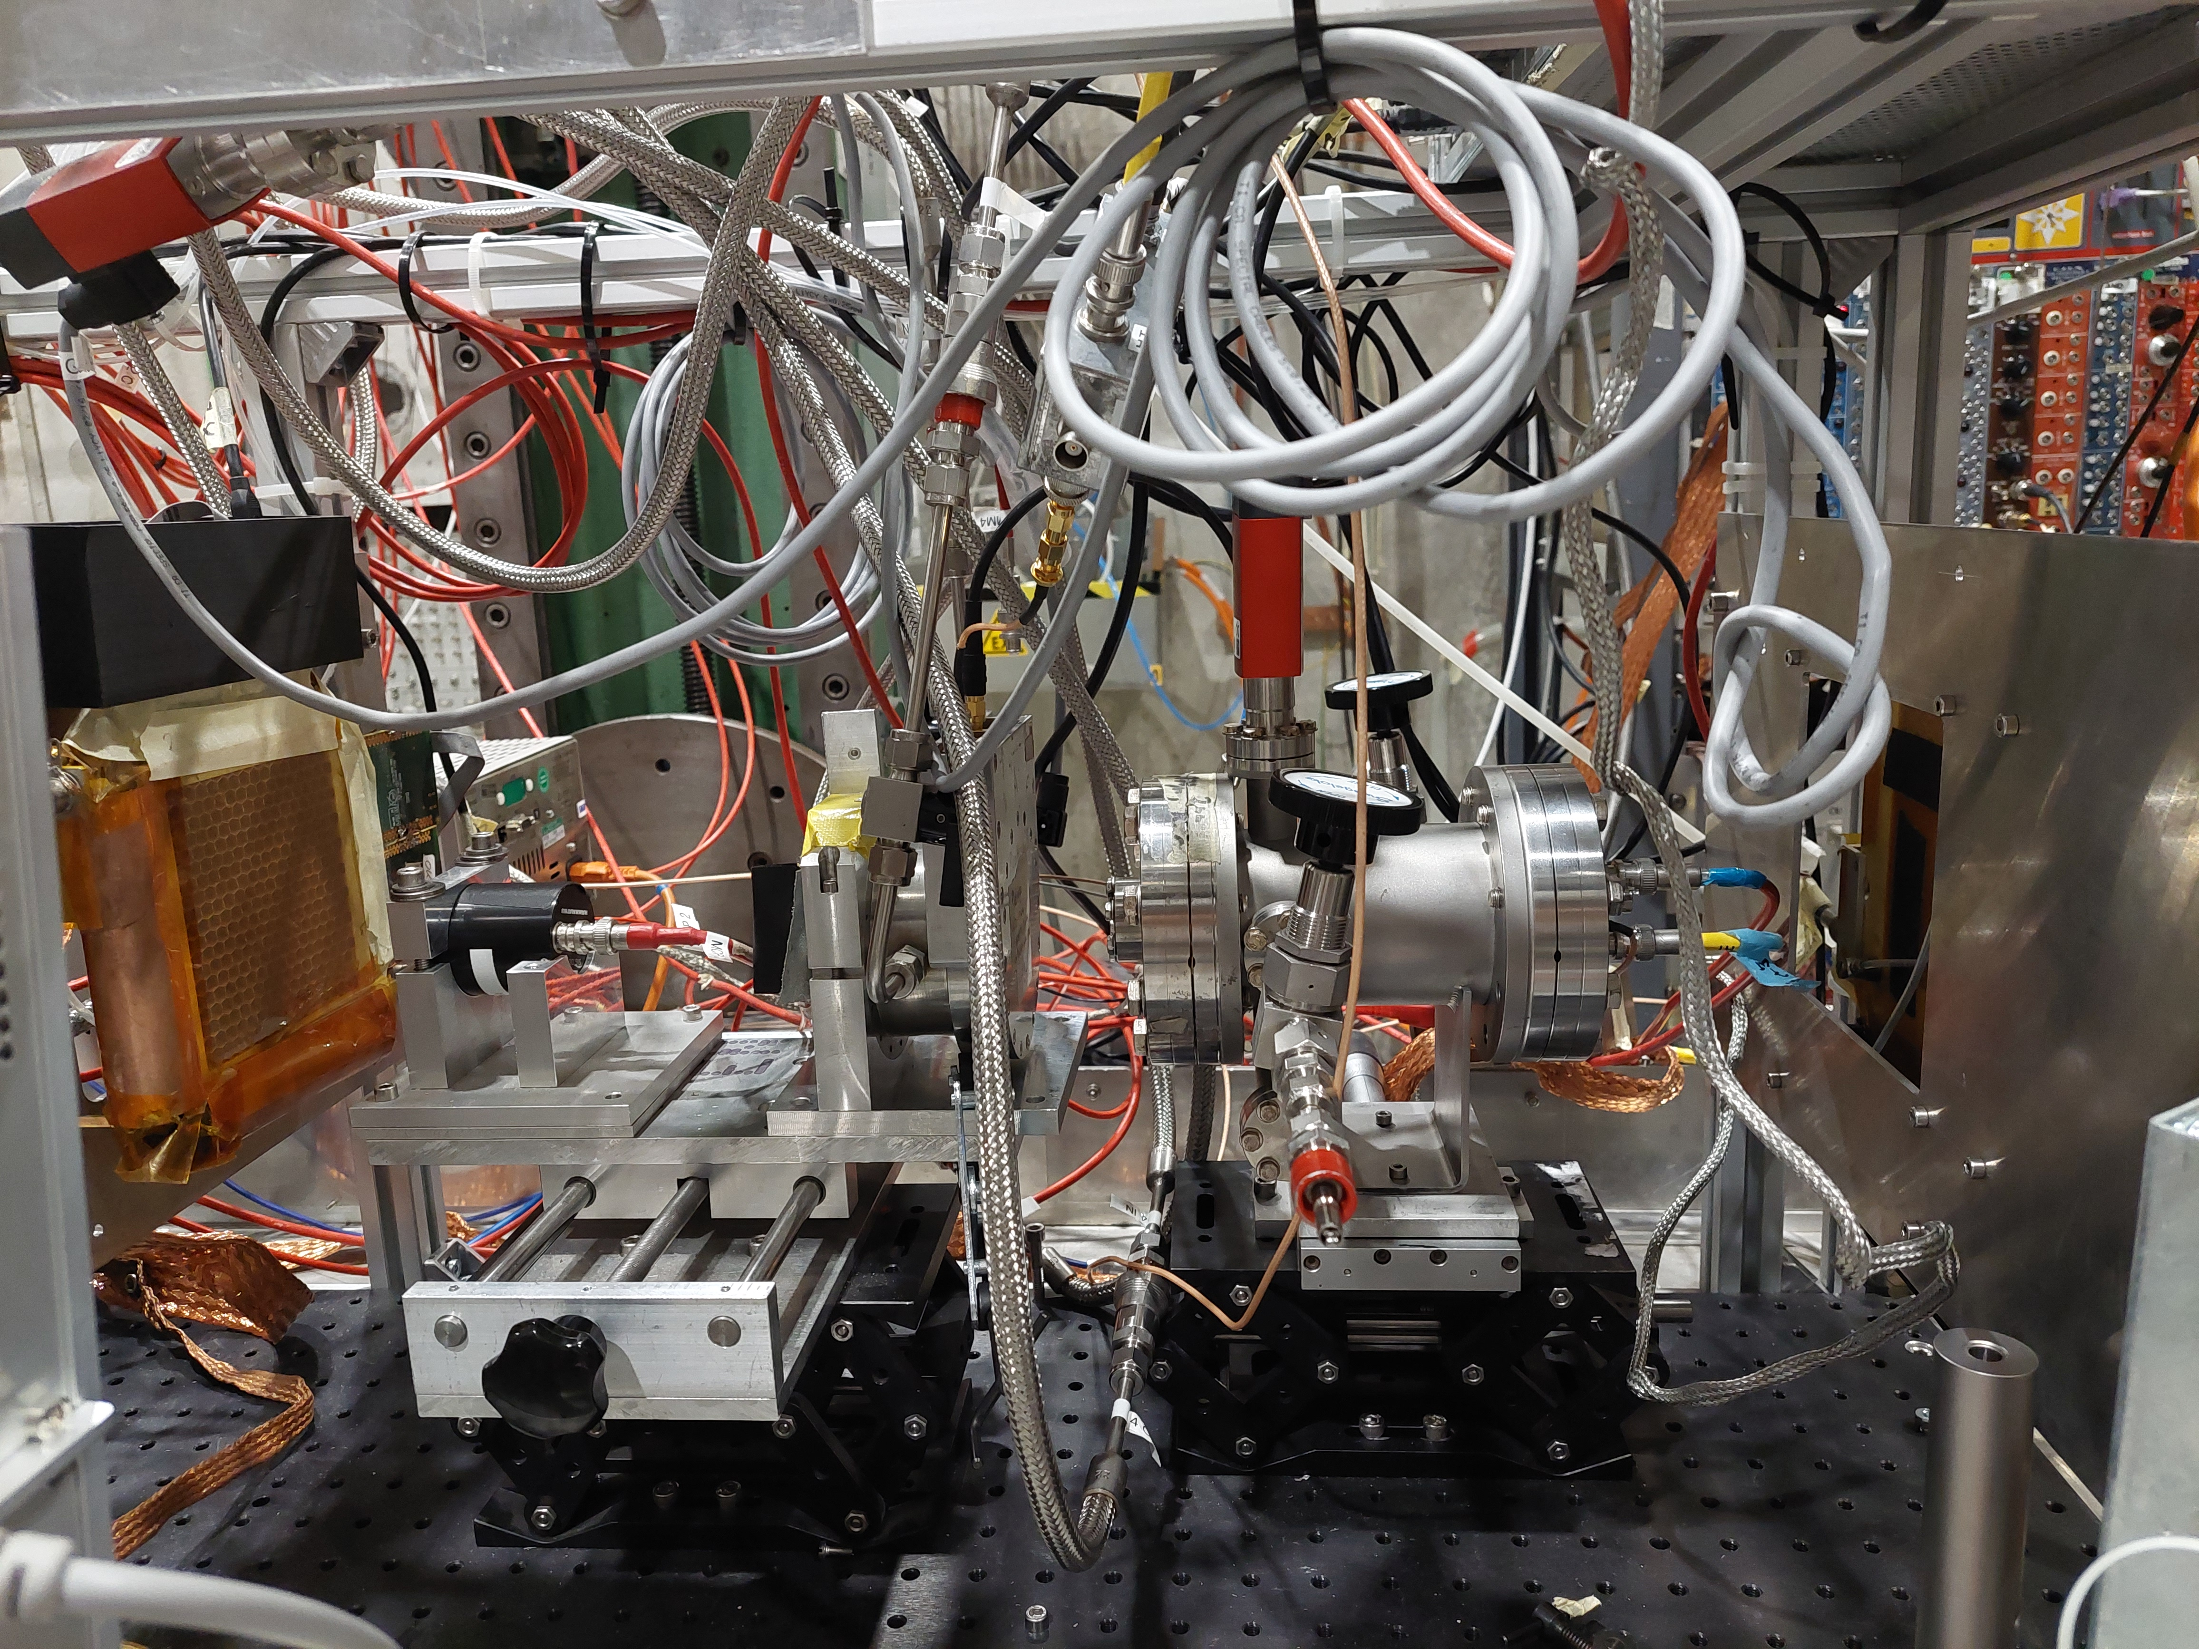
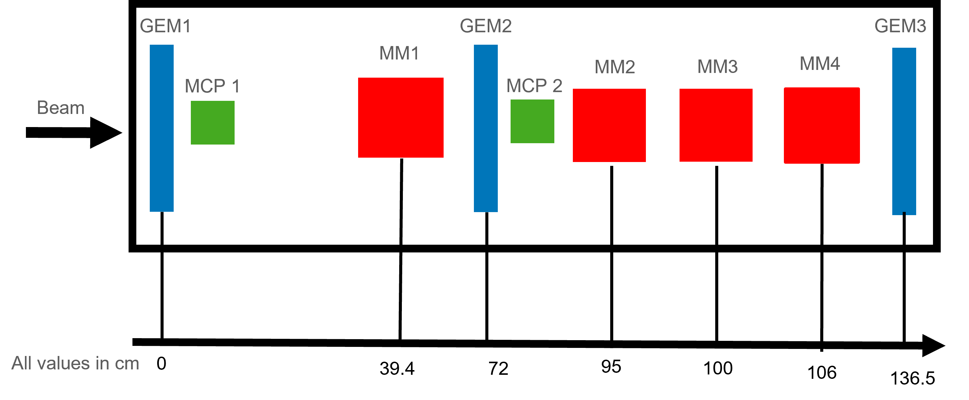
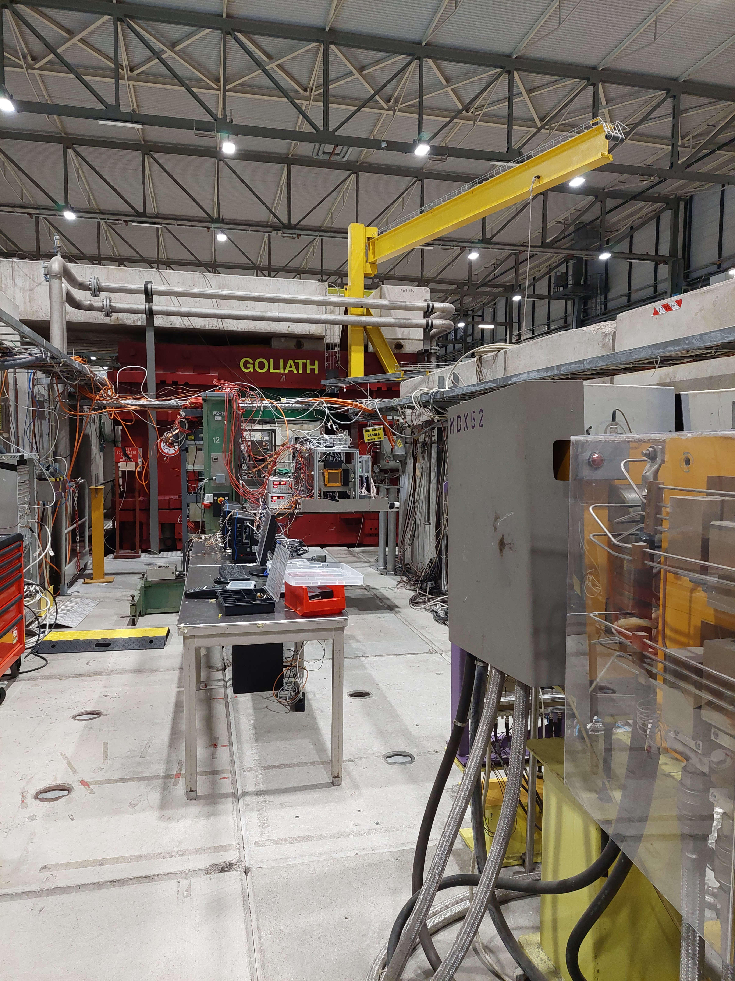
April 2023 TestBeam Telescope
Particle Beams @ CERN SPS H4 Beamline
  Muons 80-150GeV
  Scalability ( robustness and efficiency)
  Photocathode studies ( robustness and efficiency)
  Gas Mixture studies *
  Radiation Hardness studies **
The Setup
  Use GEMs for tracking
  Use MCP PMTs as timing reference devices
  and for triggering
  Electronics: CIVIDEC preamp. /
  Customade electronics + LeCroy scopes
Crystals & Photocathodes :
  MgF2 crystal +
  Metallic (Cr, Al)
  Metallic substrate(Cr) + CsI
  Metallic substrate(Cr) +B4C
Gas : 80% Ne – 10% CF₄-10%C₂H₆
*/** See “PICOSEC Micromegas” presentation on Wednesday by Florian Brunbauer https://indico.cern.ch/event/1273825/contributions/5409283/

Slide 5
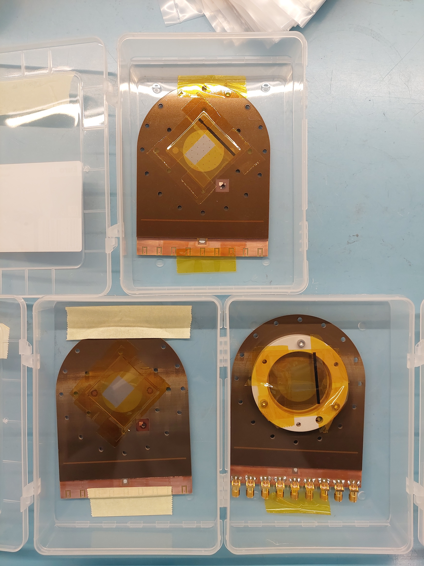
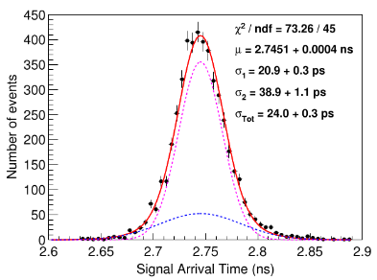
7-pad resistive Detectors Under Test
Multi-Pad Prototypes
  Hexagonal pads ø 1cm
  MgF2 crystal
  CsI photocathode
Measurements of interest focus on Timing properties & Robust Prototypes
  Different resistivity values (10 MΩ, 200kΩ)
  Different resistivity layer architectures (resistive & capacitive sharing)
  Voltage scans → Stable operation voltage at a high rate
  Timing runs on individual pads
  Long scan for uniformity map on amplitude and timing
  Signal Sharing
  Tilted detector relative to beam direction in 45 and 35 degrees
  Effectively spatial resolution studies
7-ch (∅ 2.6 cm)
11 p.e.
Timing Resolution → RMS of Signal Arrival Time Distribution
100-ch (◻ 1.0 cm)
J.Borteldt, et al. “PICOSEC: Charged particle timing at sub-25 picosecond precision with a Micromegas based detector”, Nuc. Instrum. Meth. A (2021)https://doi.org/10.1016/j.nima.2018.04.033
Notes:
To visualize somehow this detector technology, we present here several prototypes that we have tested.
At the beginning for proof of concept we started with small single pad prototypes, of 1cm diameter, and then we moved to larger ones with segmented anodes. From 7 to 19 and now to 100 channels.
The most common crystal we use is MgF2 with CsI photocathode material. But now there are several other options that they are being tested, like for example metallic ones ore B4C, DLC
The gas mixture that is was proven to be suitable for our operation was the COMPASS Gas, consisting of 80%Ne-10%CF4-10%C2H6
All the prototypes are being tested both in laser beams here at CEA and in particle beams @ CERN

Slide 6
7pad-resistive sharing

Slide 7
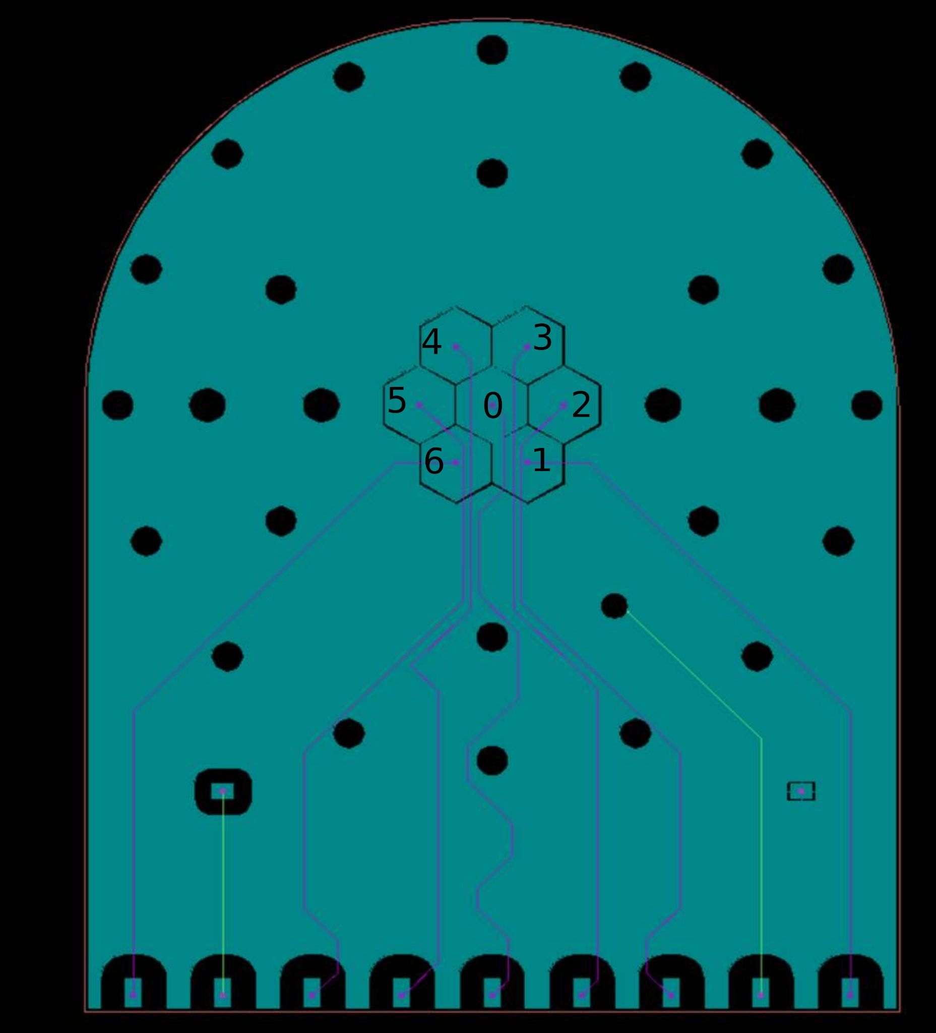
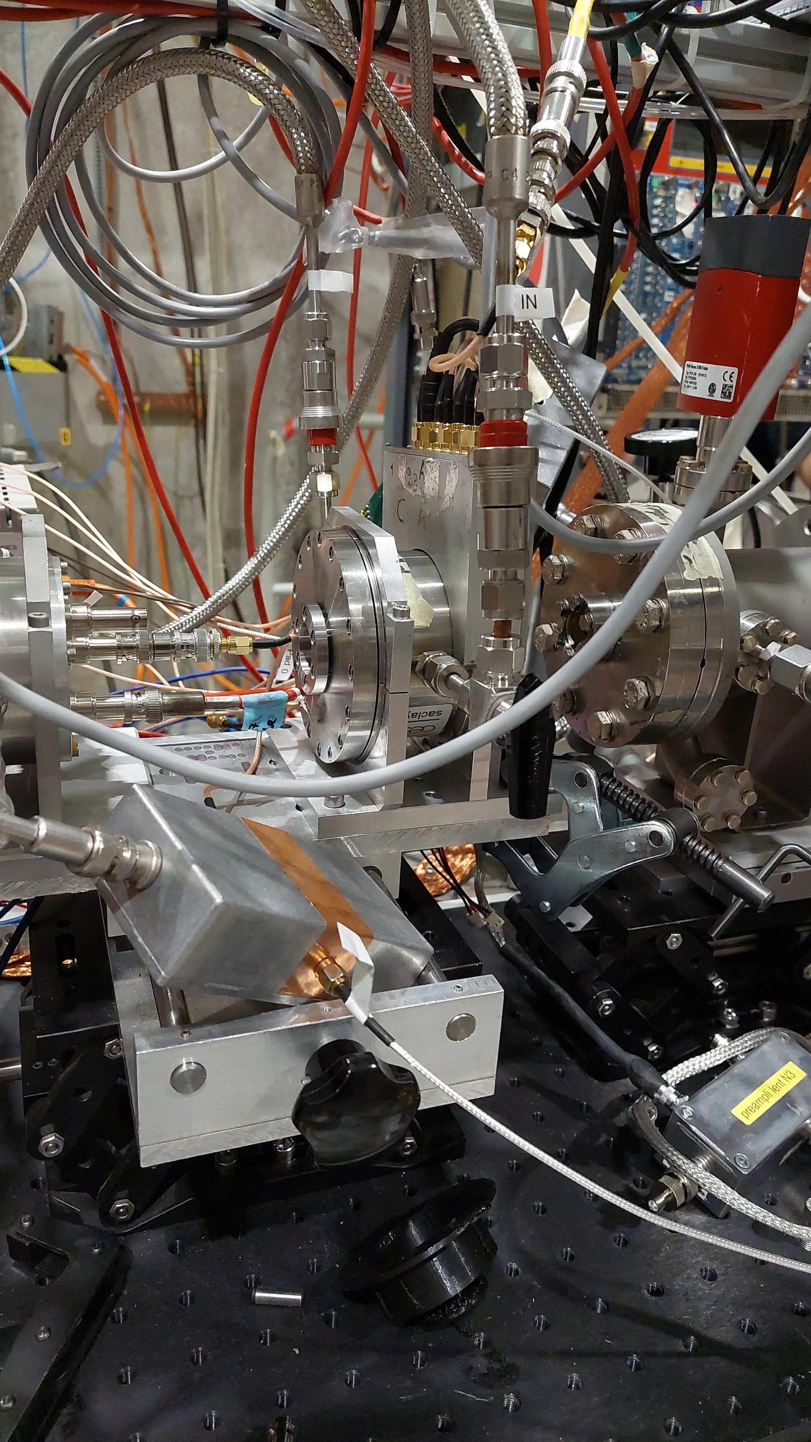
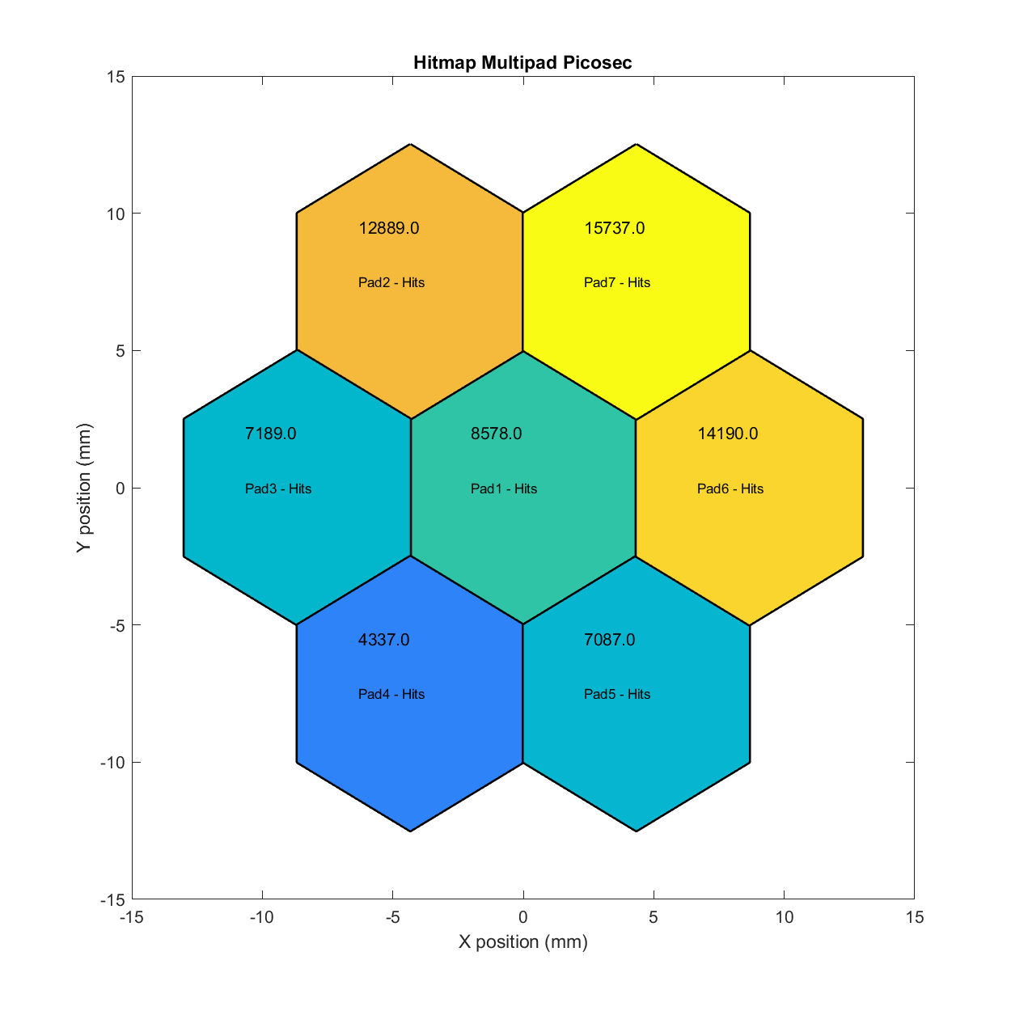
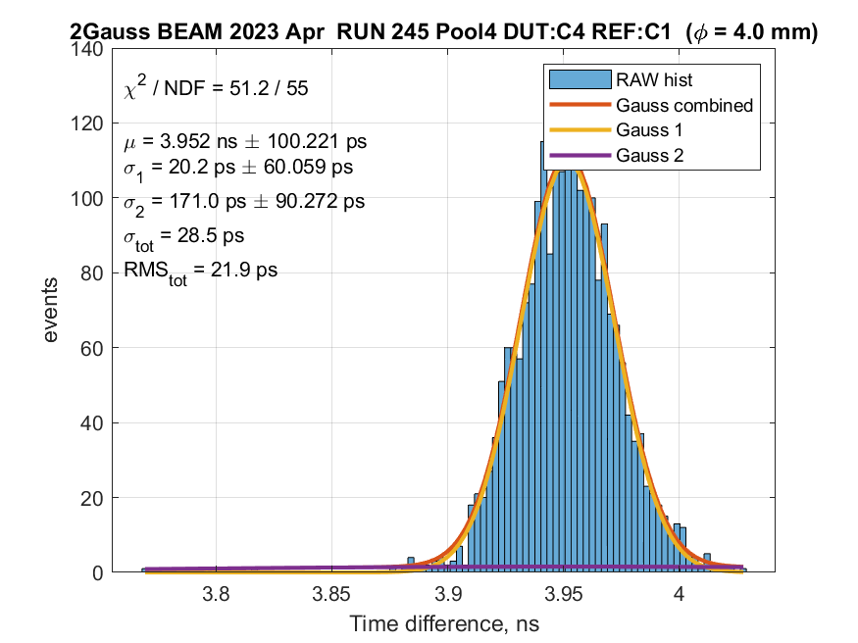
7-pad 10MΩ - CsI photocathode - 10ch Preamp card
Uniformity of response
  Timing Runs with MCP-PMT (trigger) centered on each pad center
  Voltage scan on the central pad to determine the operational voltage
Operation Voltage | Timing Resolution
500/290 | ~31ps
510/290 | ~27ps
530/275 | ~25ps
550/275 | ~21ps
ANALYSIS IN PROGRESS
Free Running Hitmap
Timing Resolution →
20ps on the central
pad @ C550/A275V
RD51 Collaboration Meeting - 19-21 June 2023

Slide 8
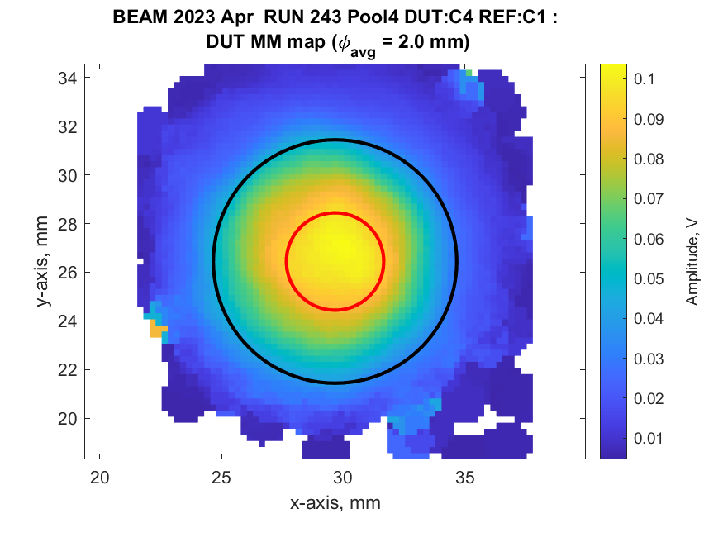
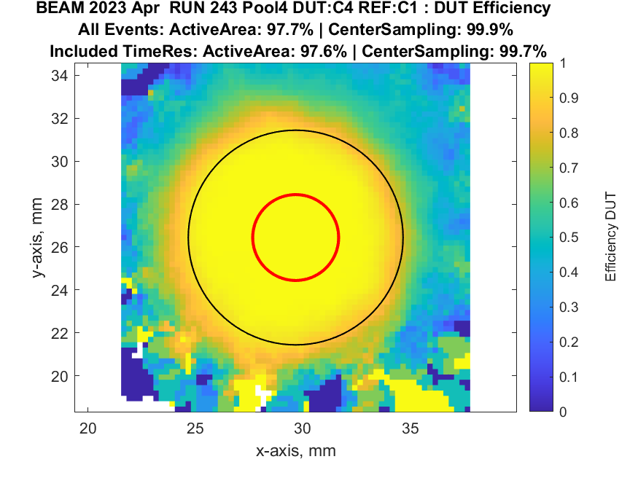
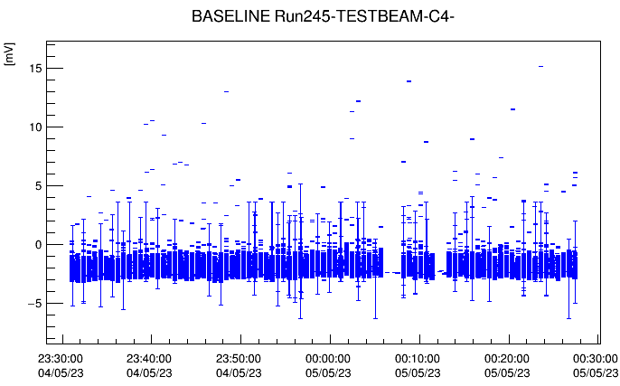
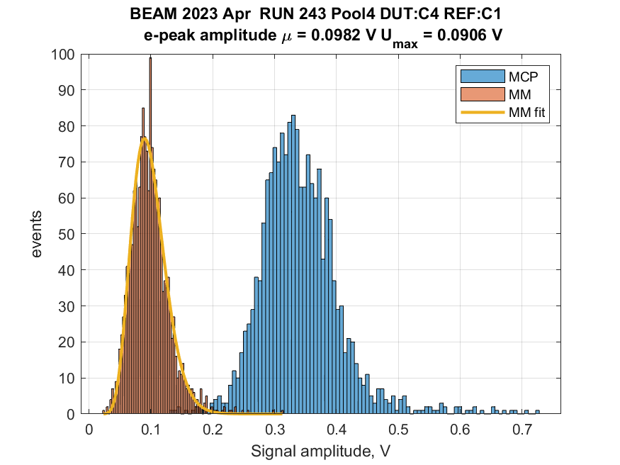
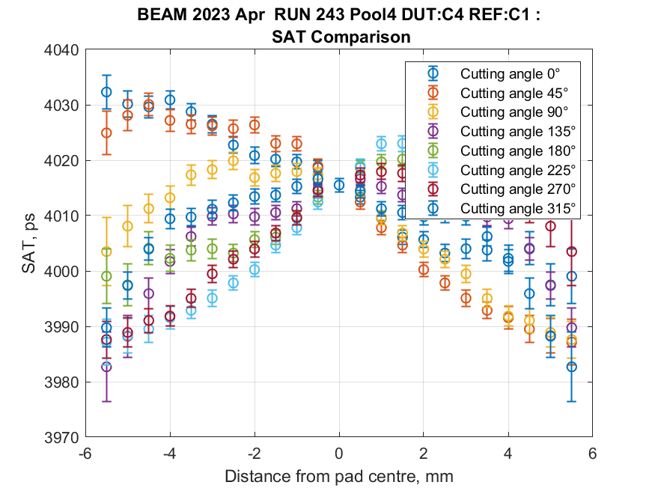
7-pad 10MΩ - CsI photocathode – 10ch ampl card
  Observation plots
    Smooth operation of the detector
  Detector Alignment with MCP – PMT
  Efficiency map
ANALYSIS IN PROGRESS
Signal Amplitude Detector vs. Reference
RD51 Collaboration Meeting - 19-21 June 2023

Slide 9
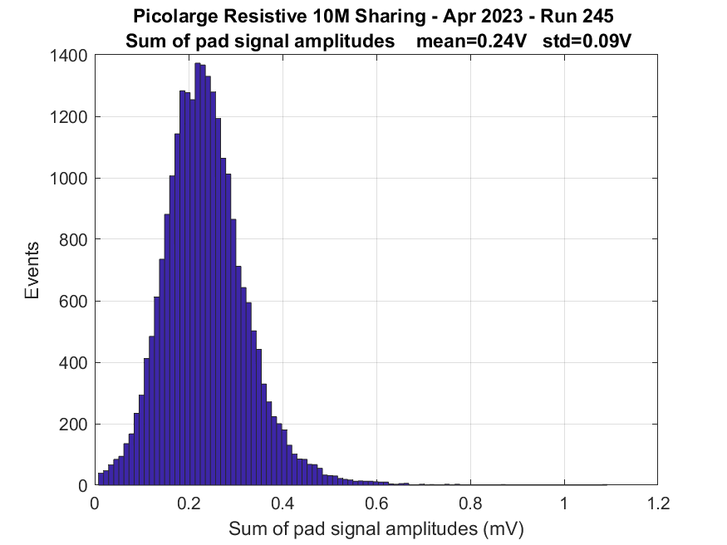
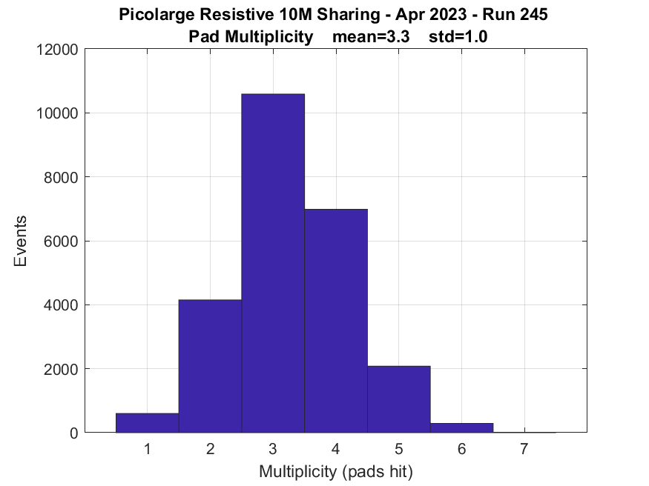
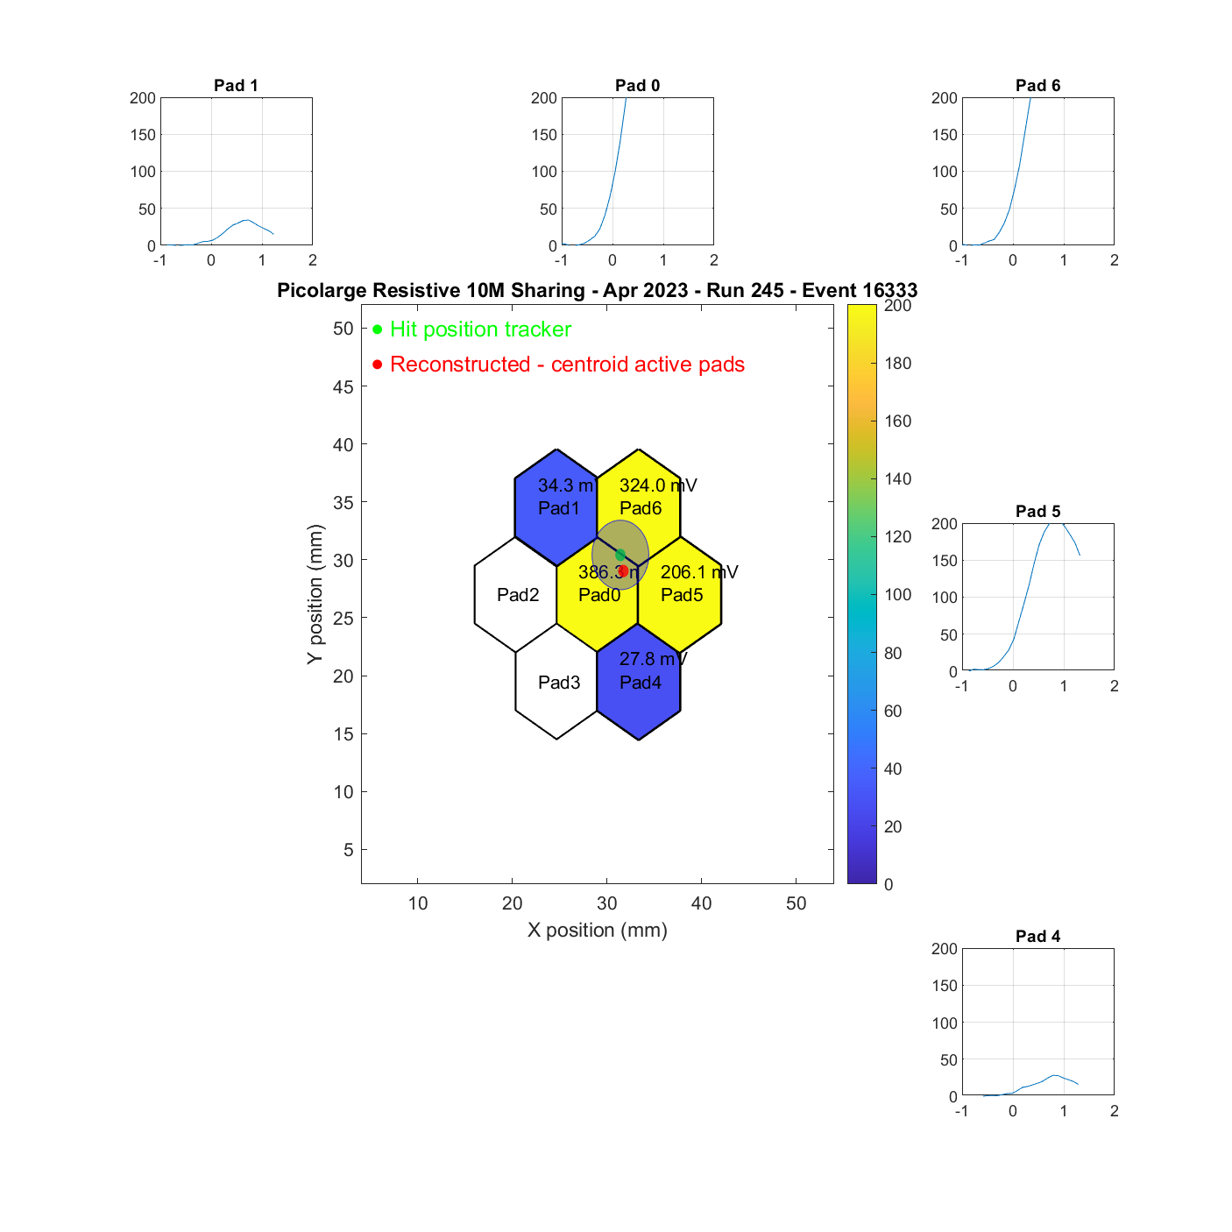
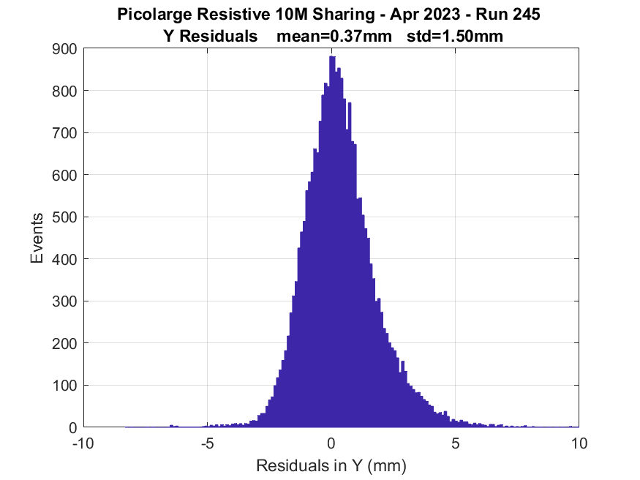
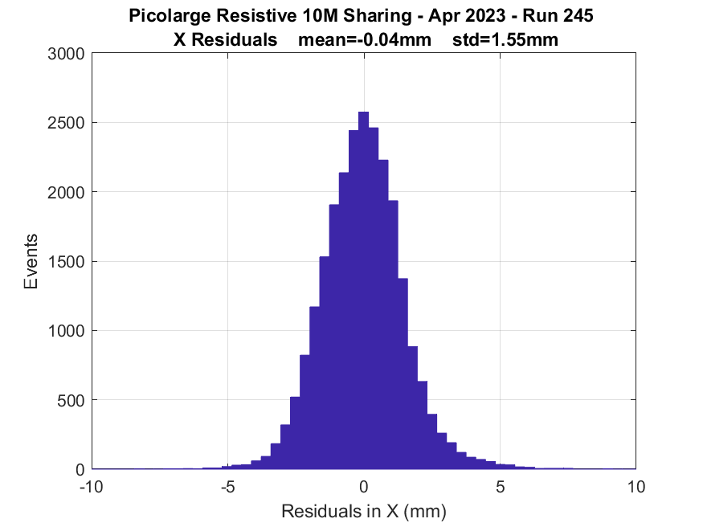
7-pad 10MΩ CsI photocathode, signal sharing
  Being centered on the central pad with MPC-PMT
    Record all pad signals in the meantime to observe signal spreading
Mean active pads = 3
ANALYSIS IN PROGRESS
σy = 1.55mm
σx = 1.5mm
RD51 Collaboration Meeting - 19-21 June 2023

Slide 10
7pad-capacitive sharing

Slide 11
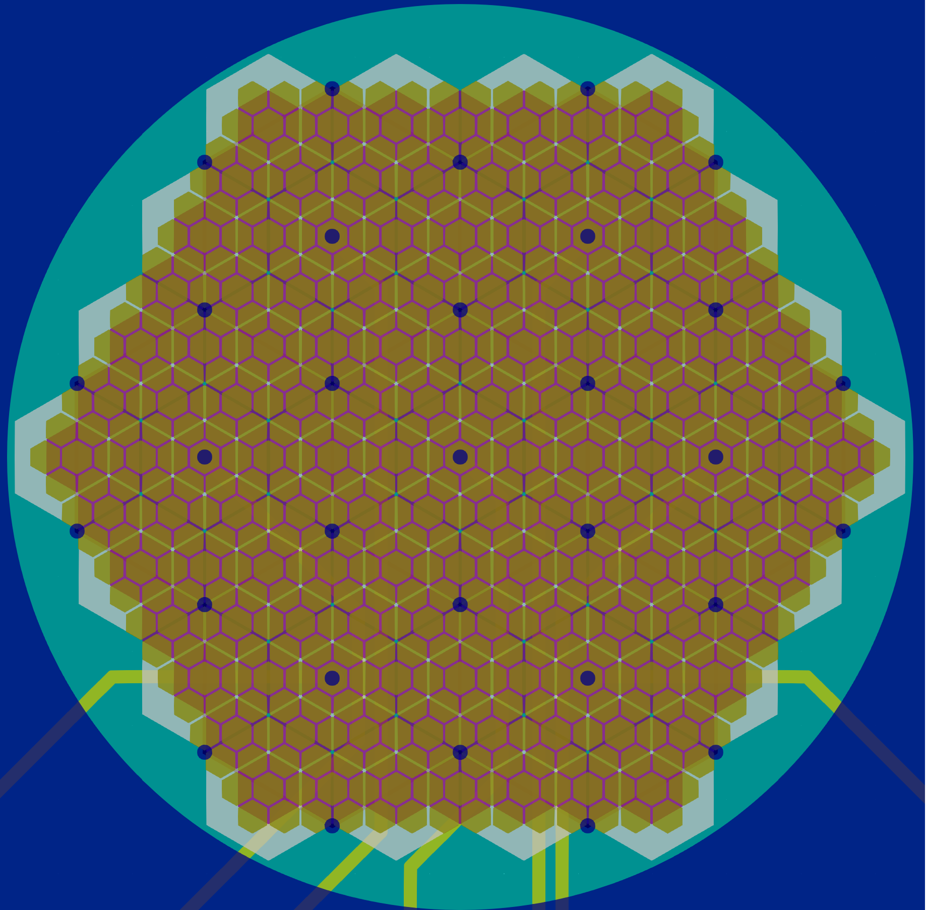
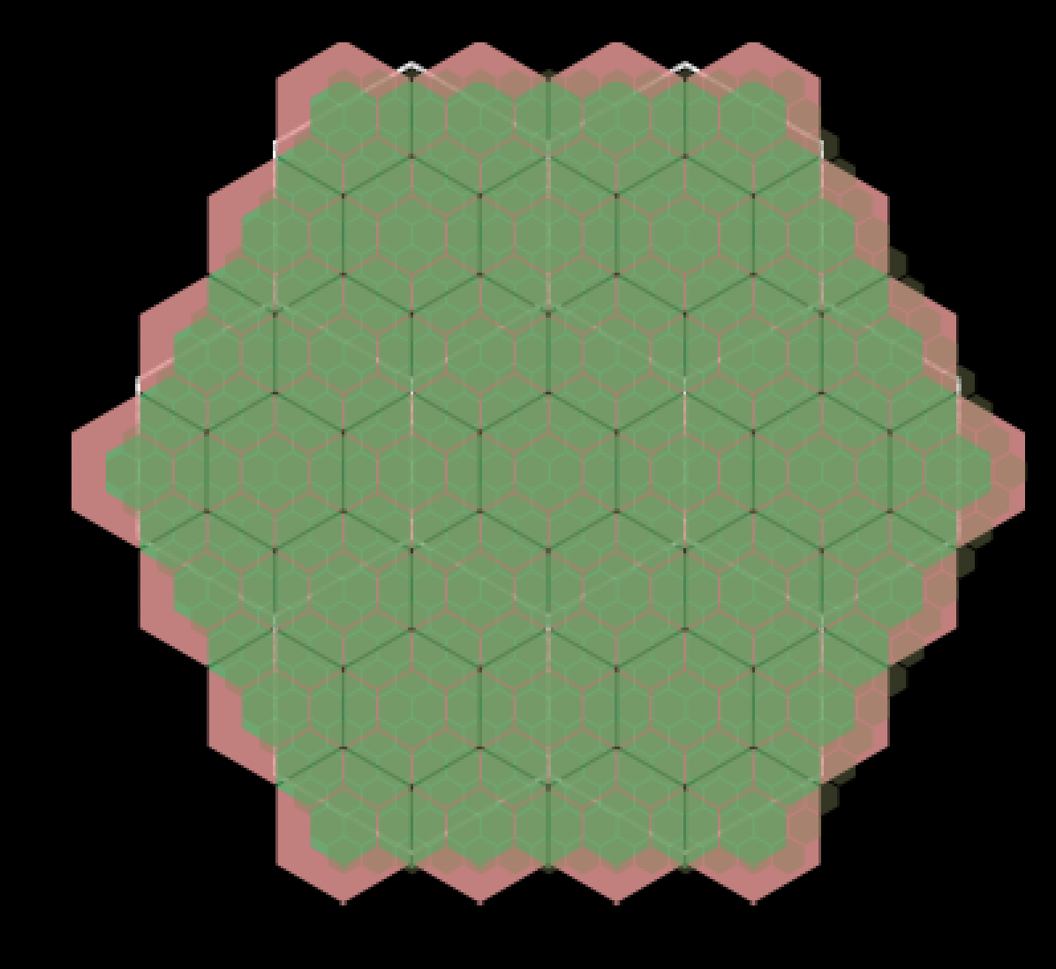
7-pad 10MΩ CsI photocathode, capacitive sharing
RD51 Collaboration Meeting - 19-21 June 2023

Slide 12
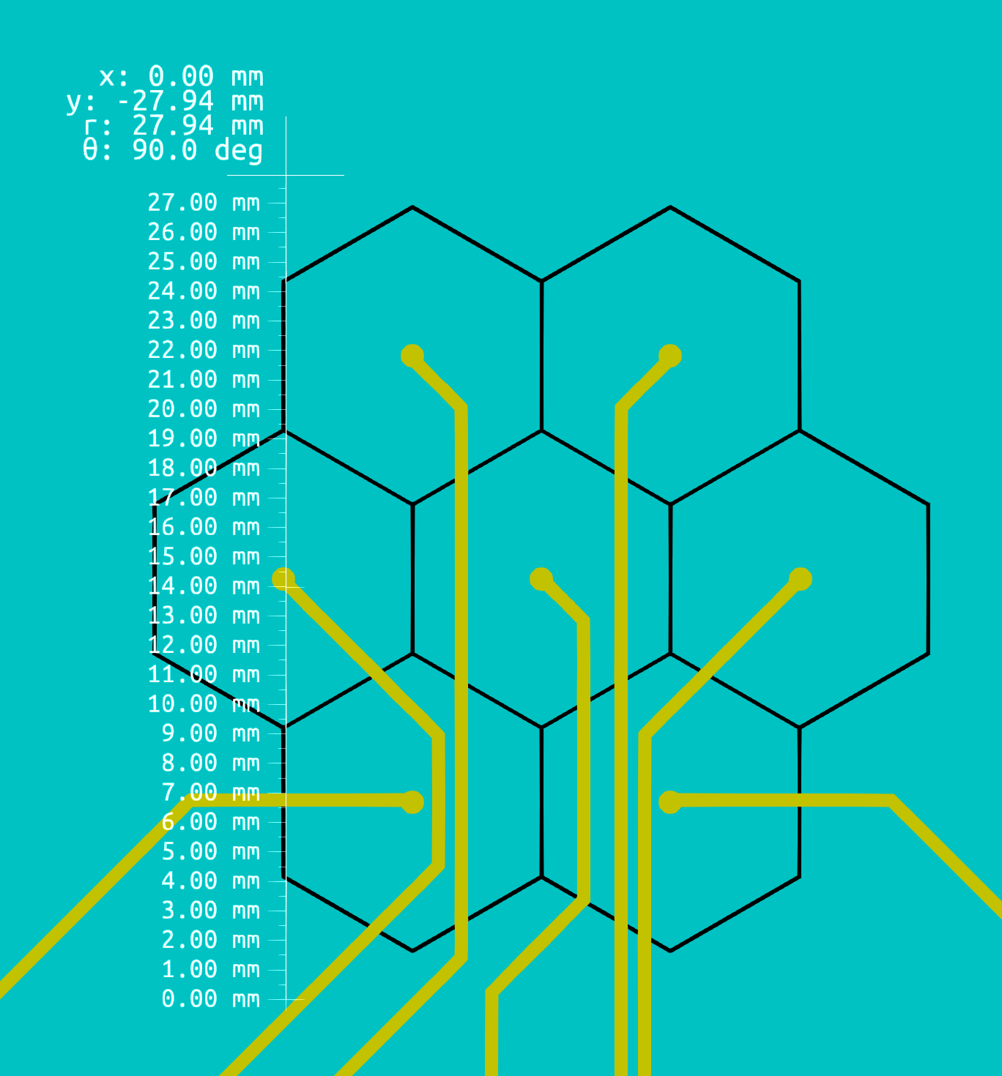
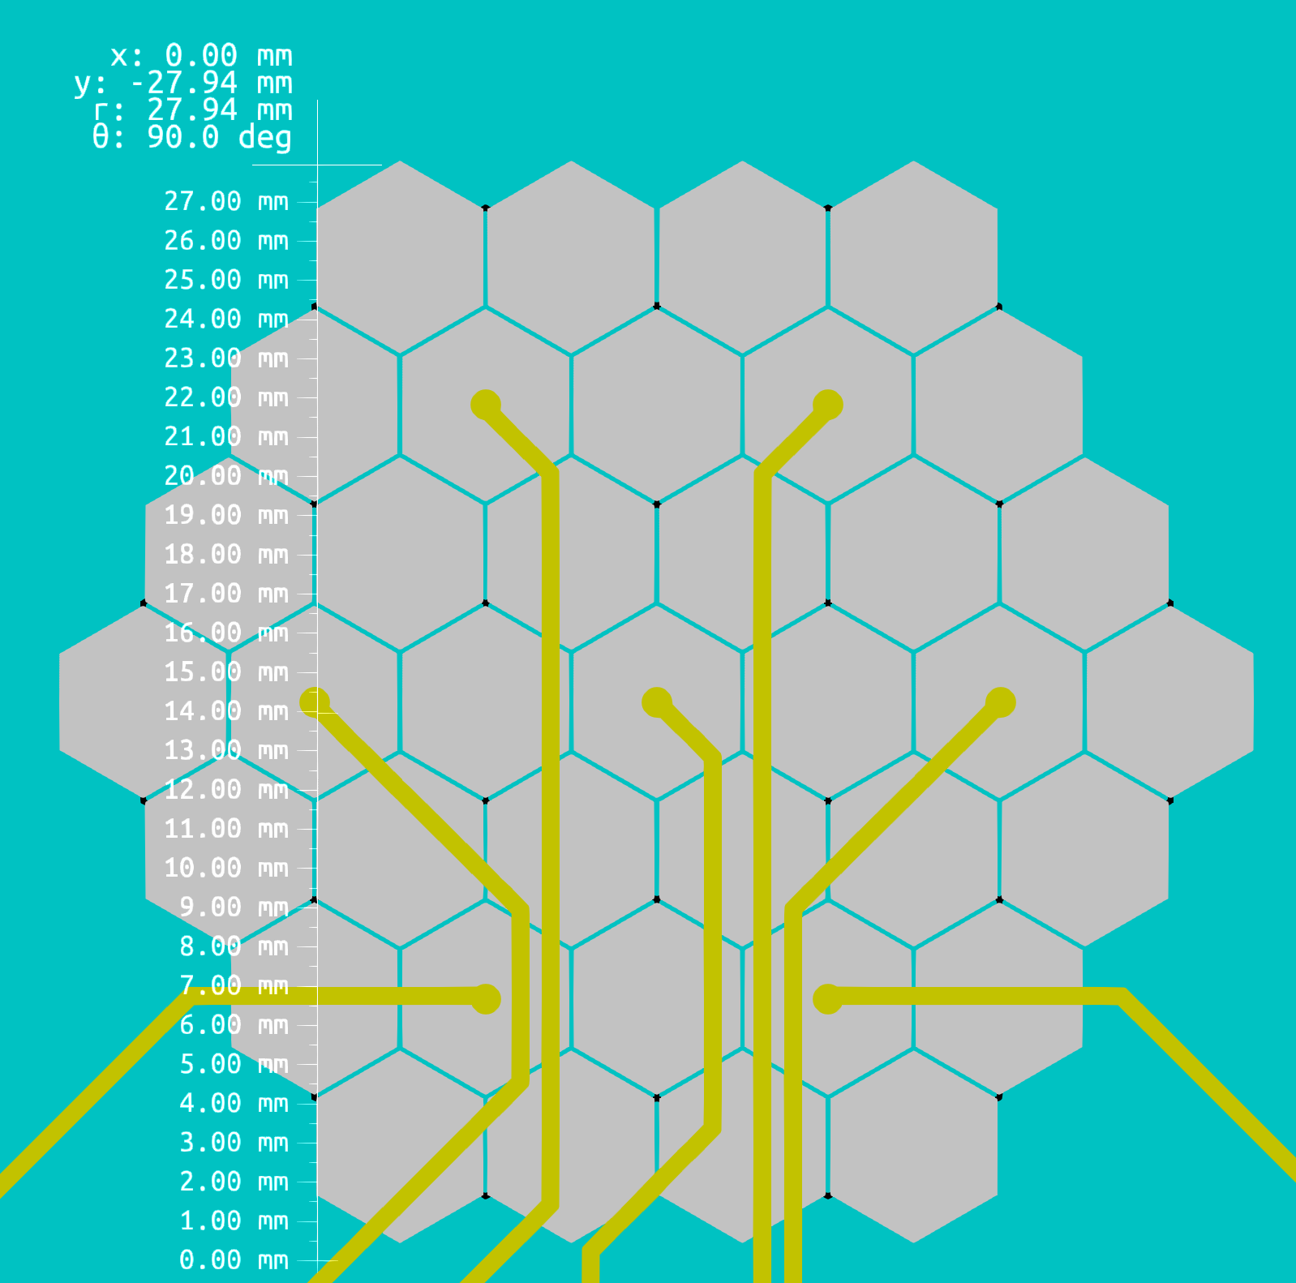
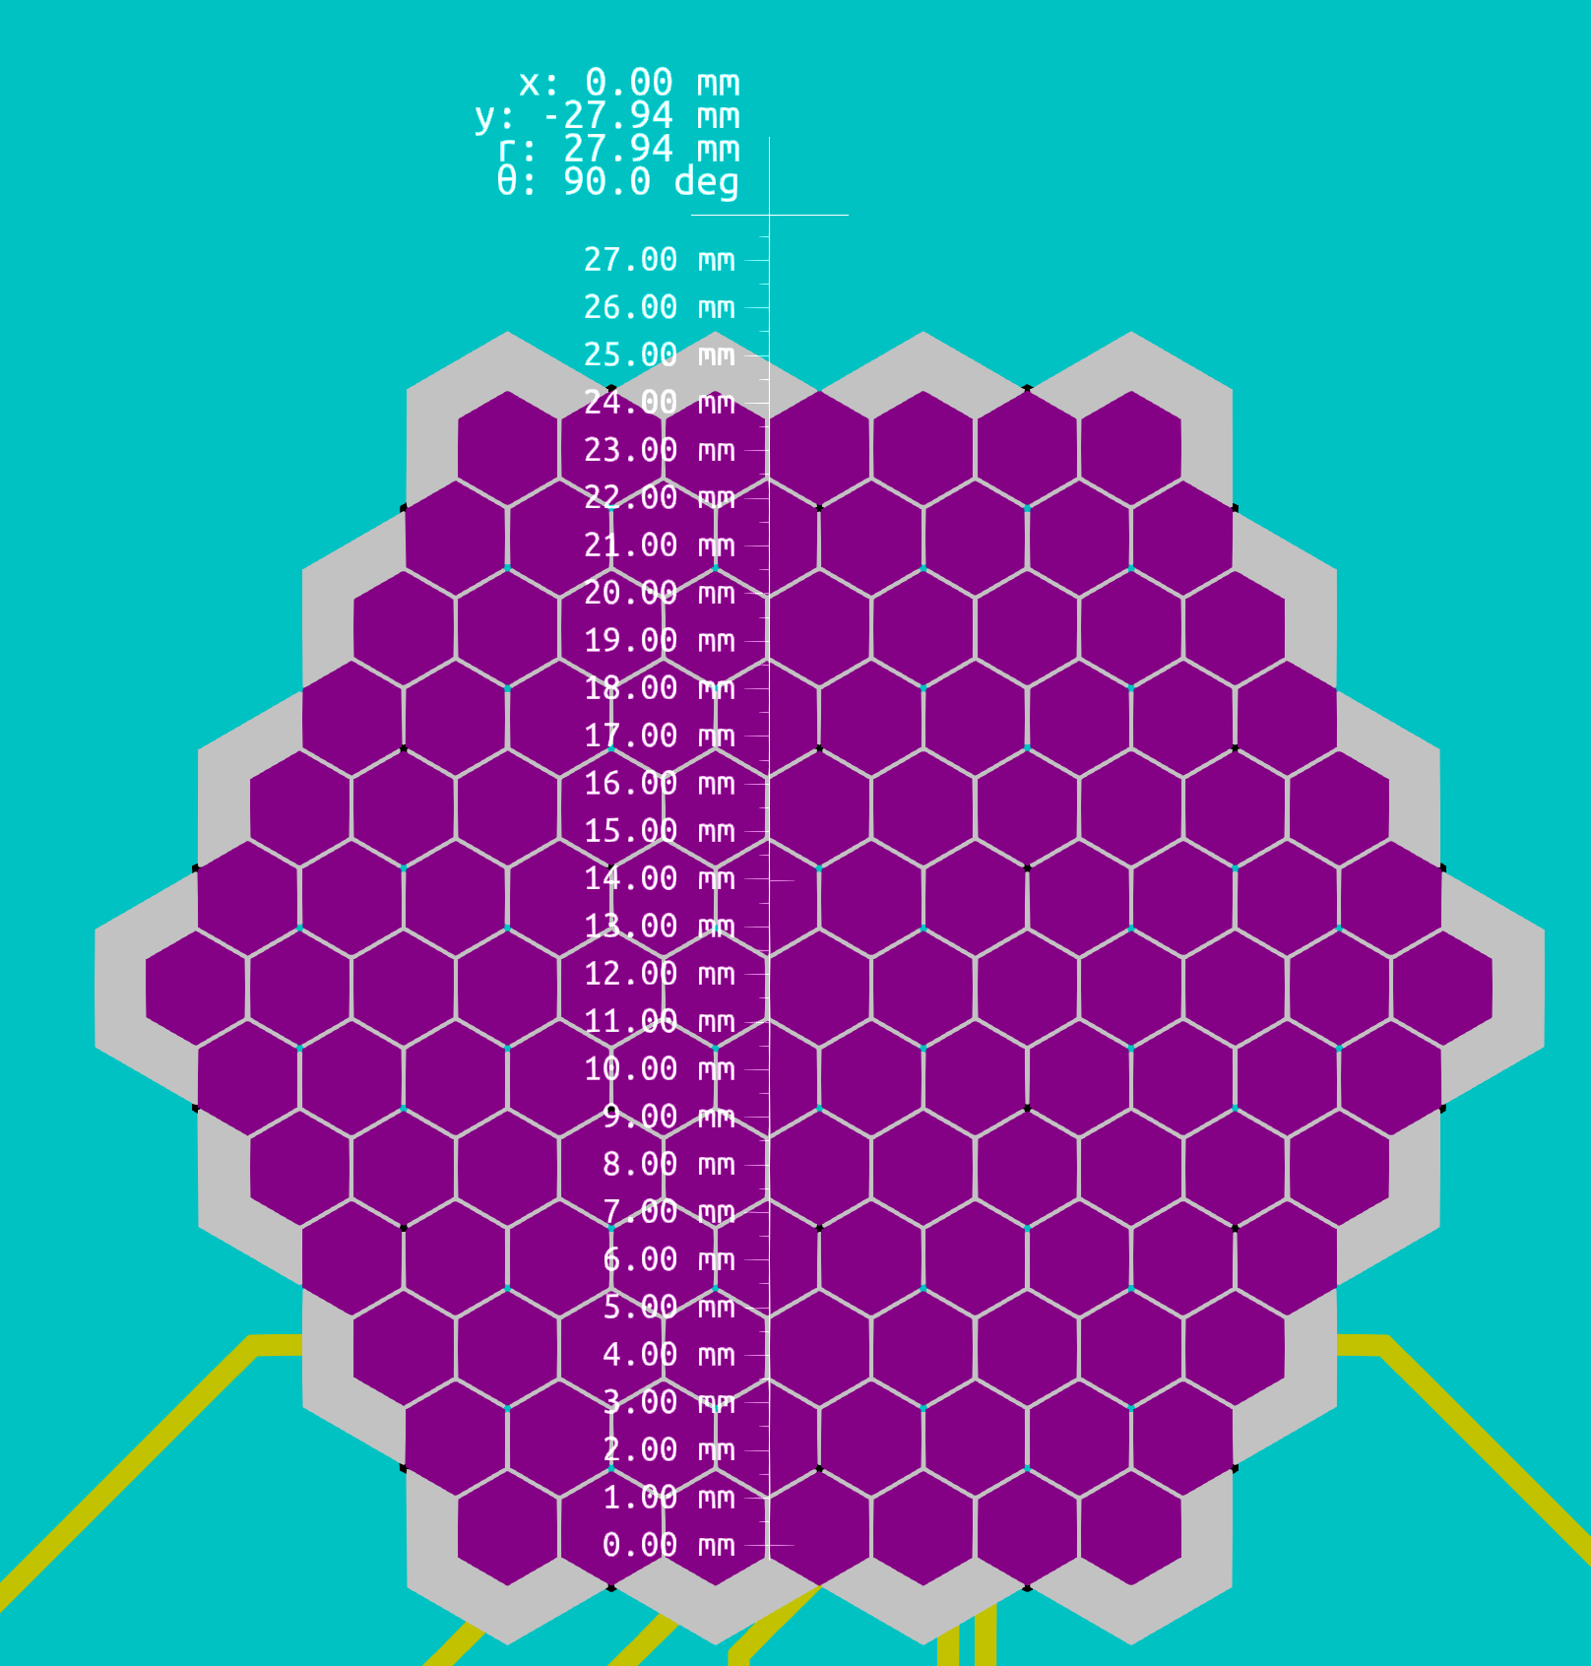
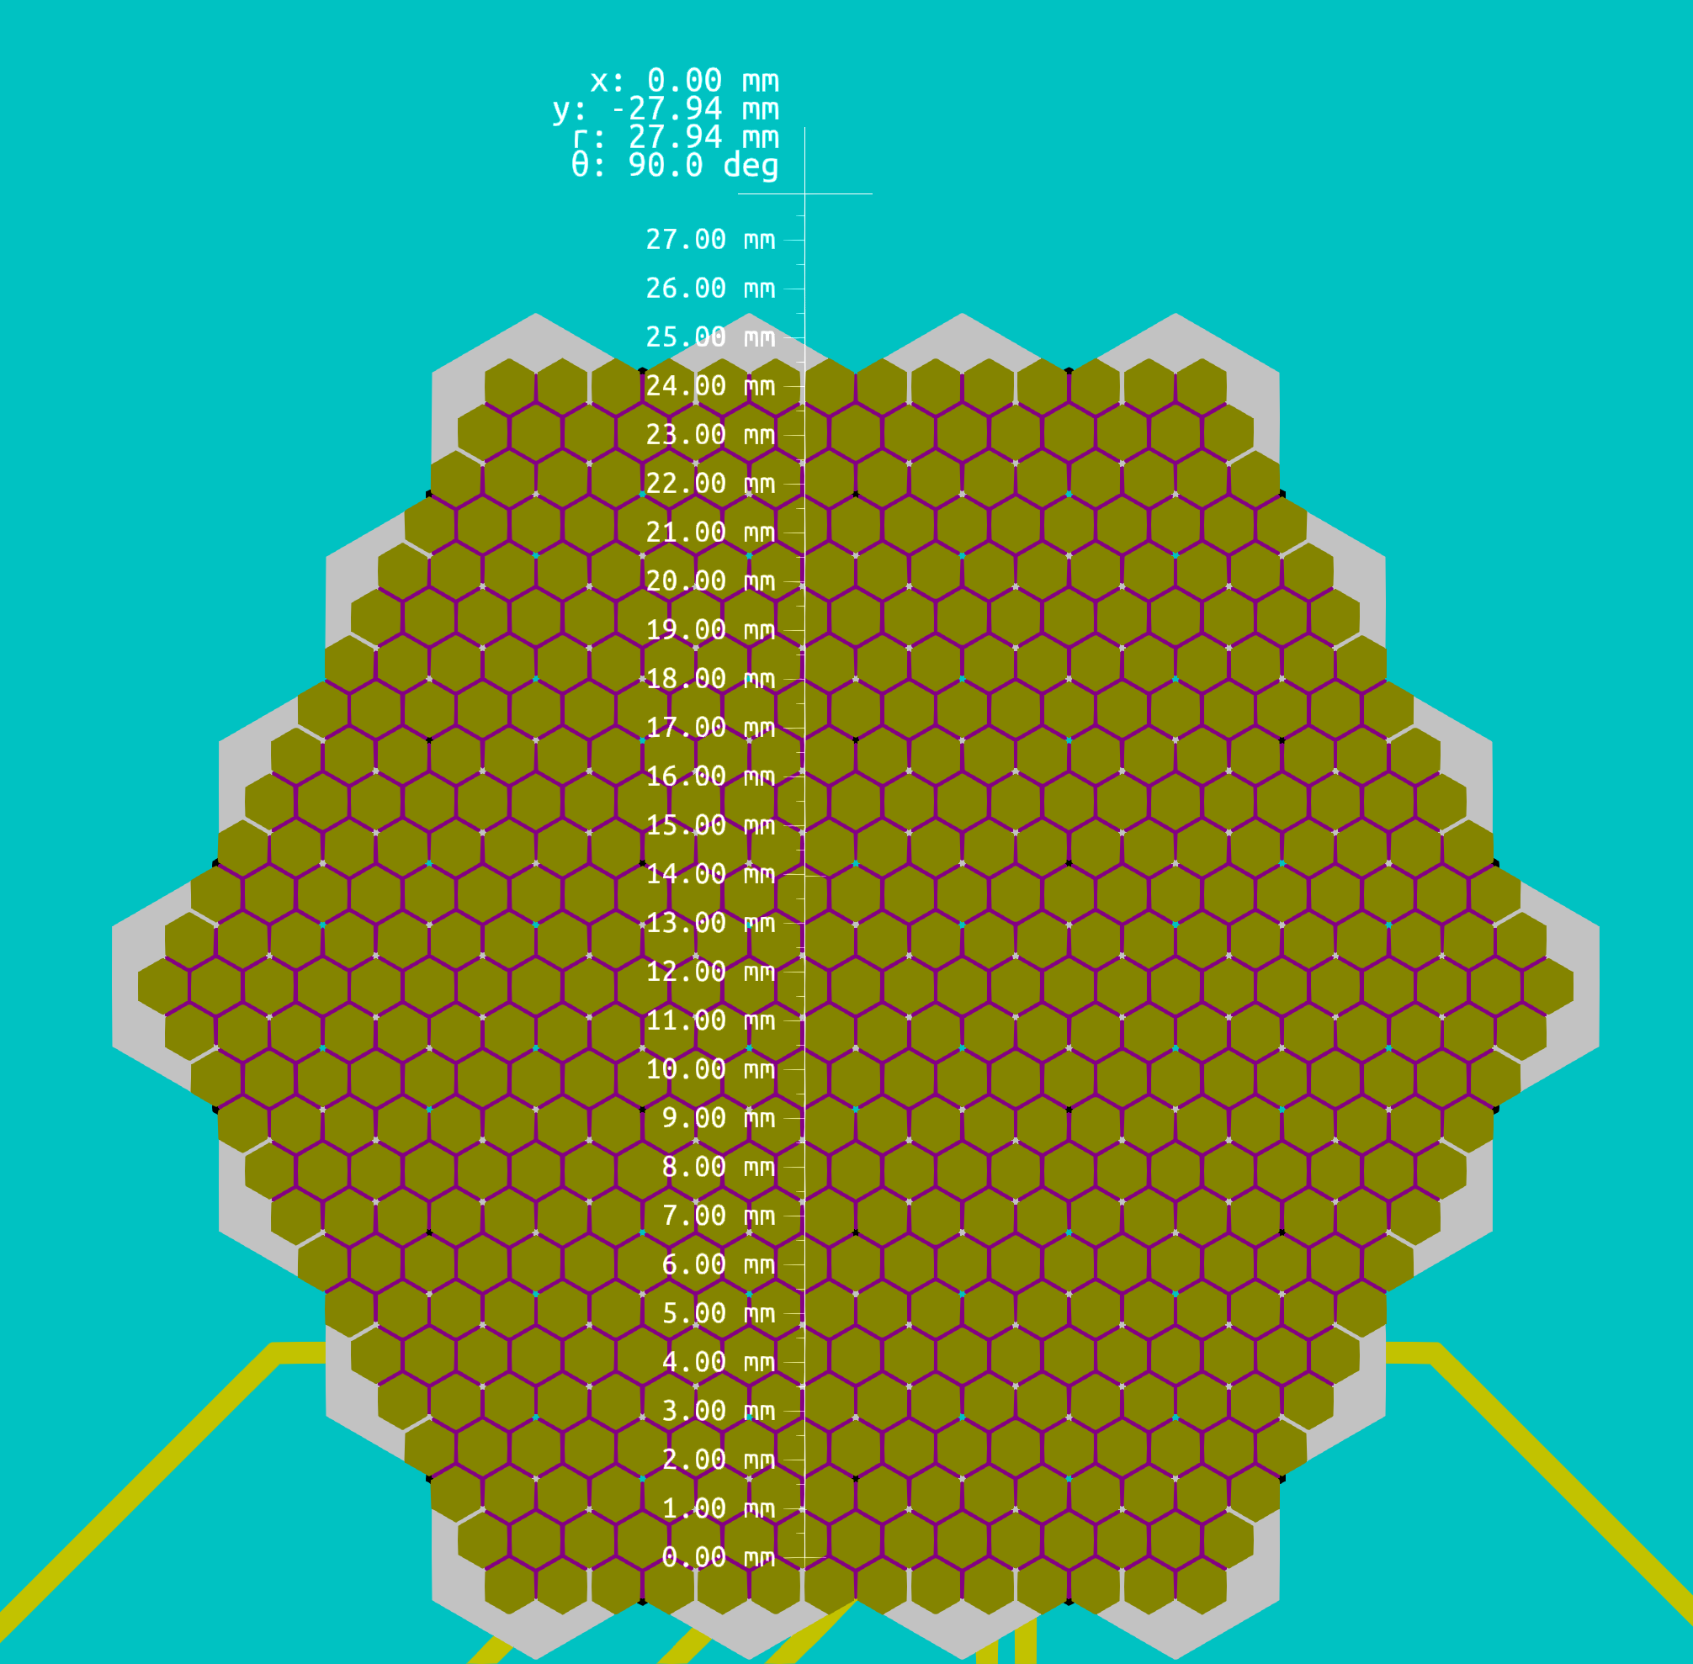
7-pad 10M CsI photocathode, capacitive sharing
Hexagon size : 10mm
Cerenkov cone 3mm radius
3rd layer of capacitive sharing
Hexagon size: 5mm
2rd layer of capacitive sharing
Hexagon size: 2.5mm
1st layer of capacitive sharing
Hexagon size: 1.25mm
RD51 Collaboration Meeting - 19-21 June 2023

Slide 13
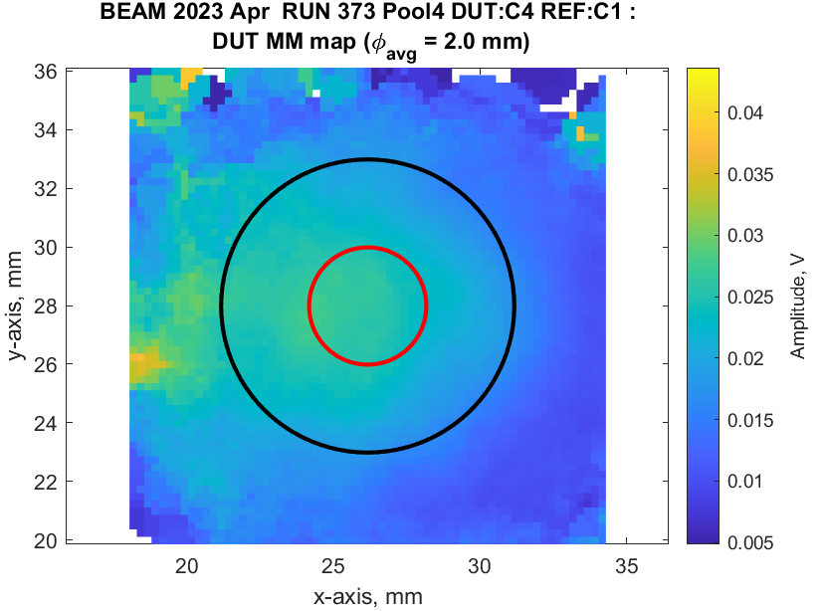
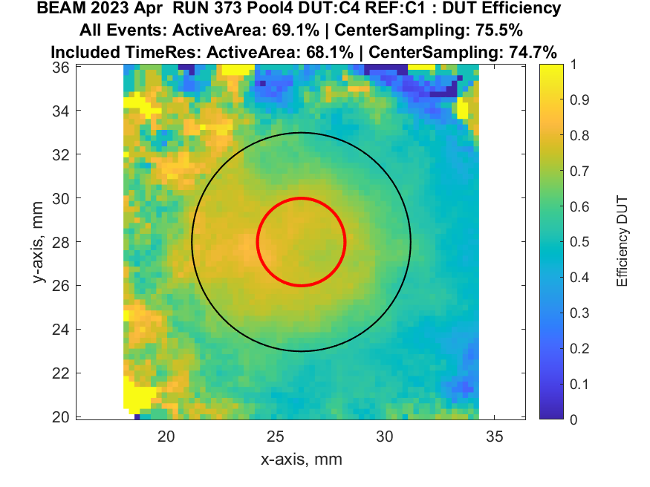
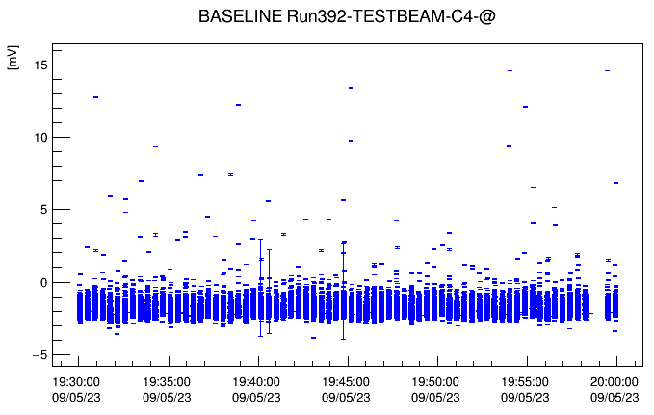
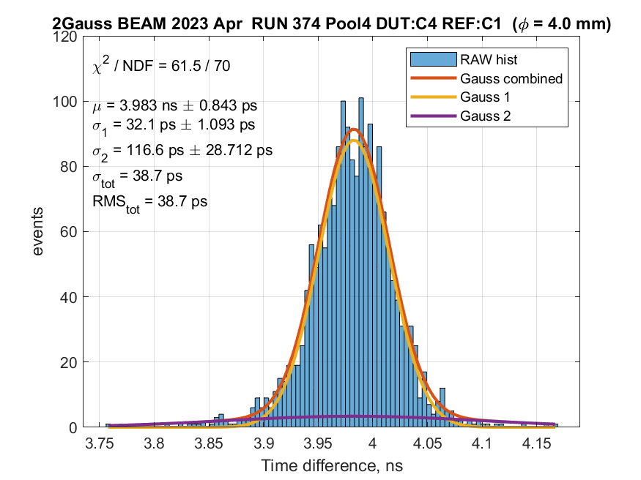
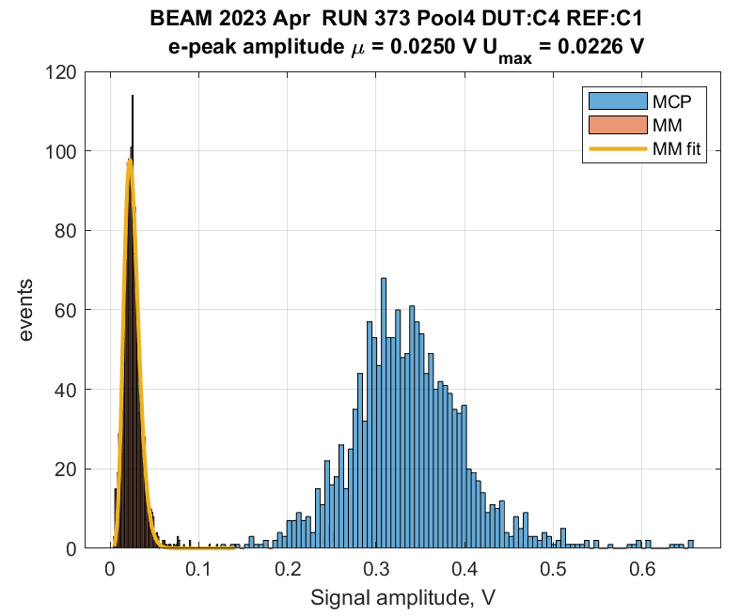
7-pad10MΩ CsI photocathode - capacitive sharing
  Detector Alignment with MCP – PMT
  Efficiency map
  Observation plots
    Smooth operation of the detector
ANALYSIS IN PROGRESS
Very low amplitudes
Timing Resolution → 33ps on the central
pad @ C550/A275V
Signal Amplitude Detector vs. Reference

Slide 14
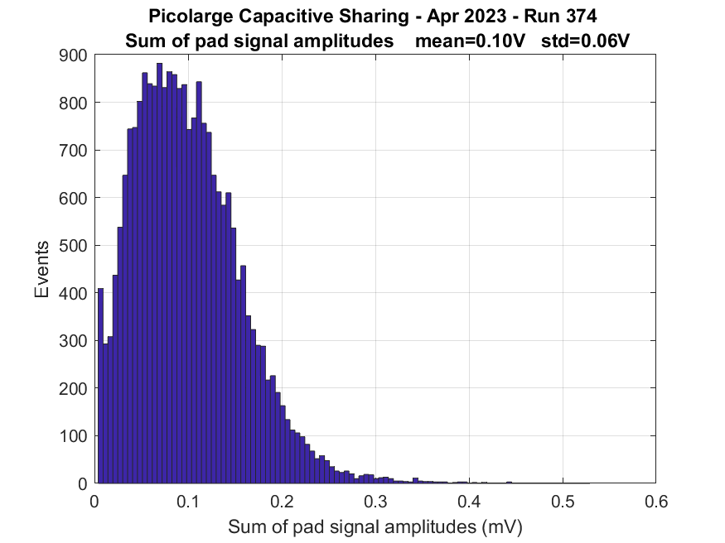
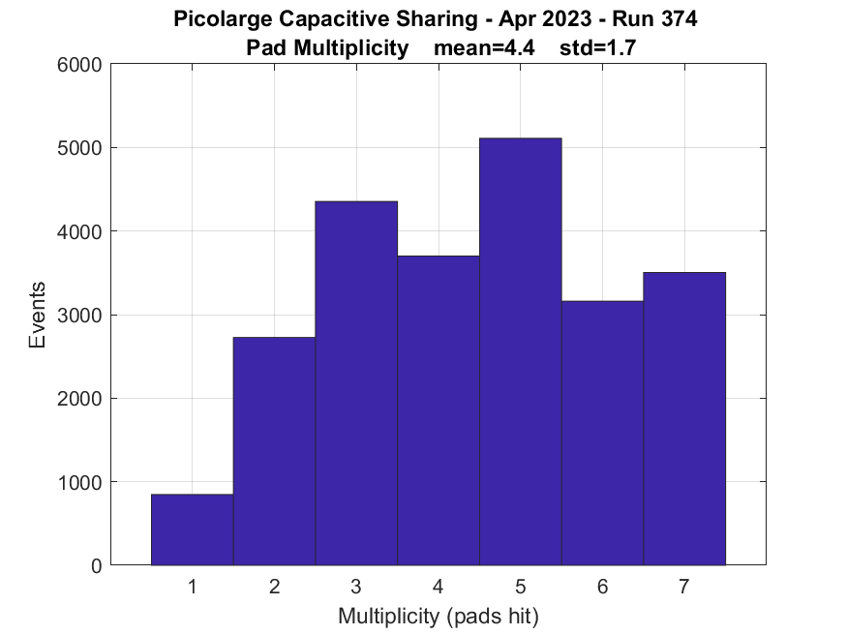
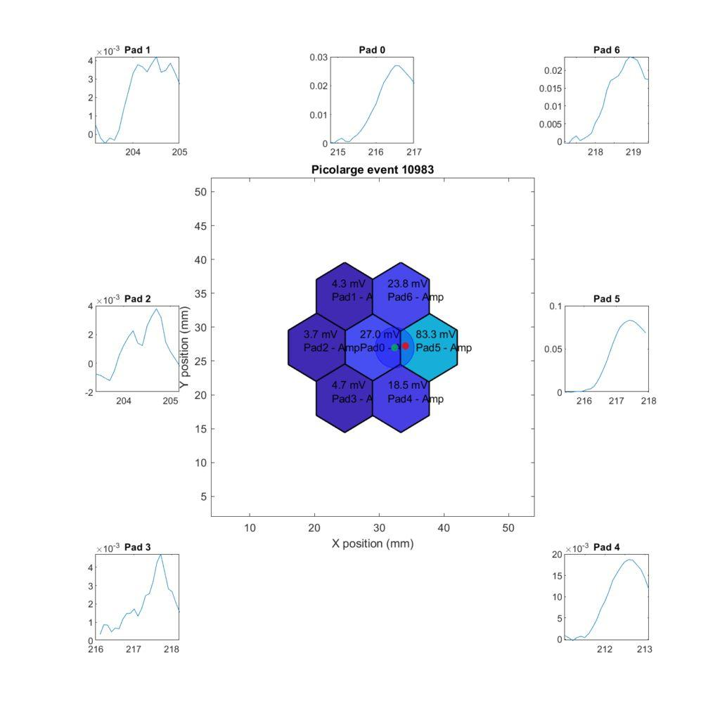
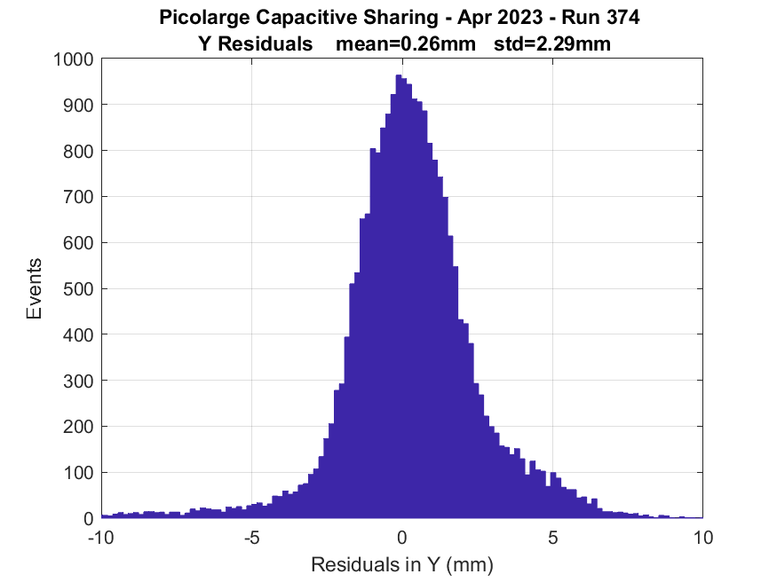
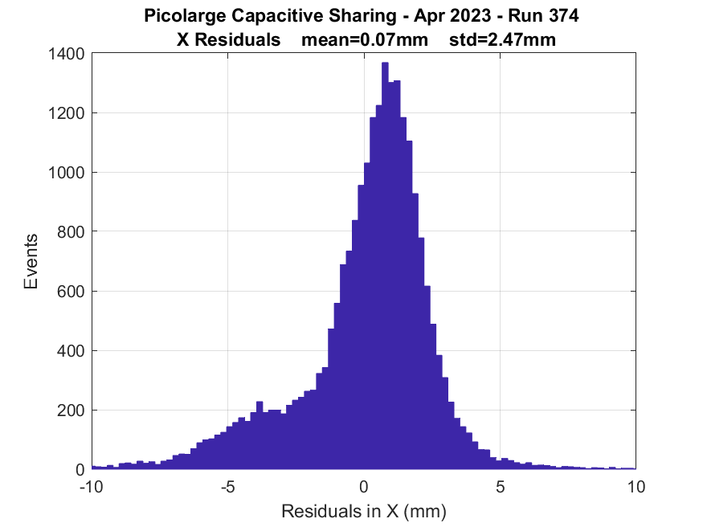
7-pad 10MΩ CsI photocathode - capacitive sharing
  Being centered on the central pad with MPC-PMT
    Record all pad signals in the meantime to observe signal spreading
Mean active pads =5
ANALYSIS IN PROGRESS
σy = 2.29mm
σx =2.47mm
RD51 Collaboration Meeting - 19-21 June 2023

Slide 15
7pad-resistive sharing 200kΩ

Slide 16
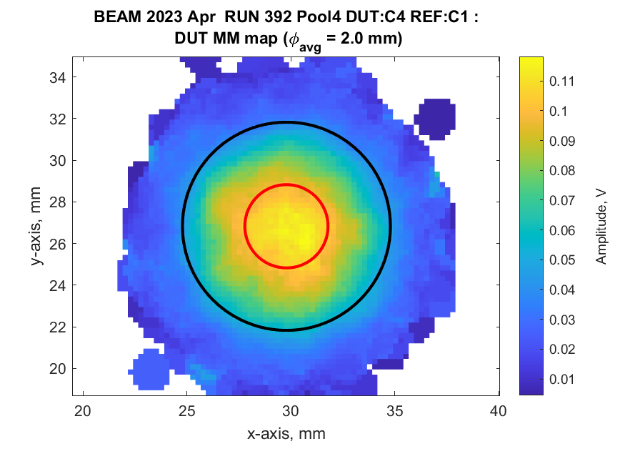
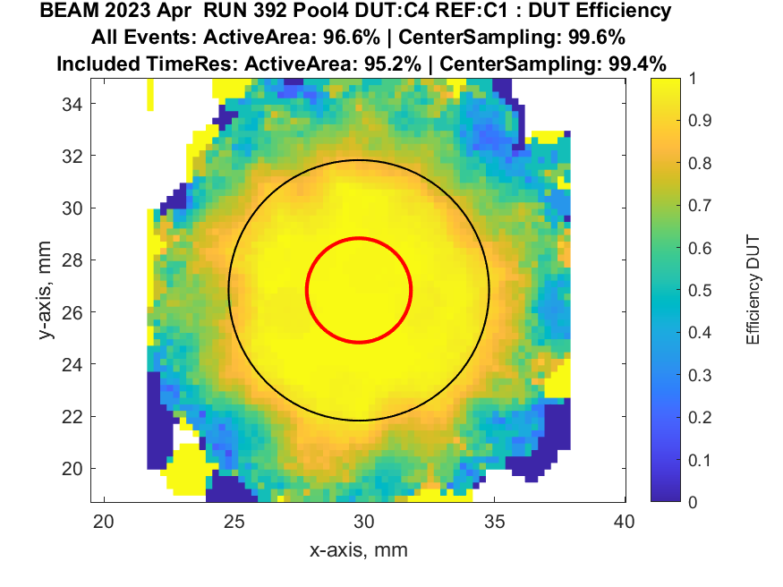
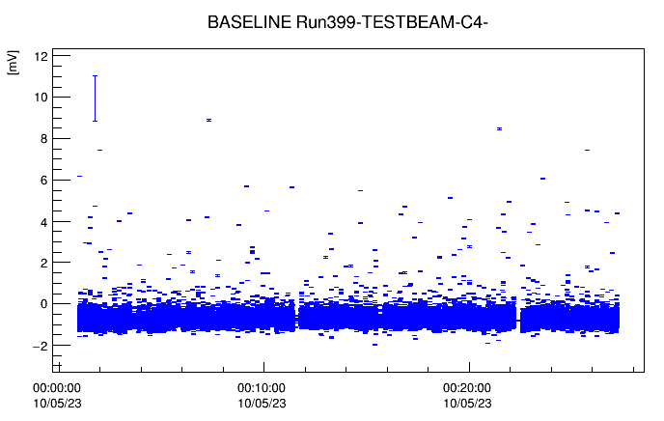
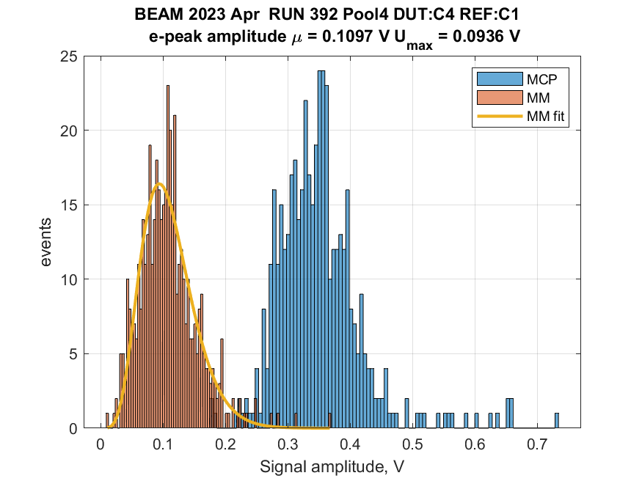
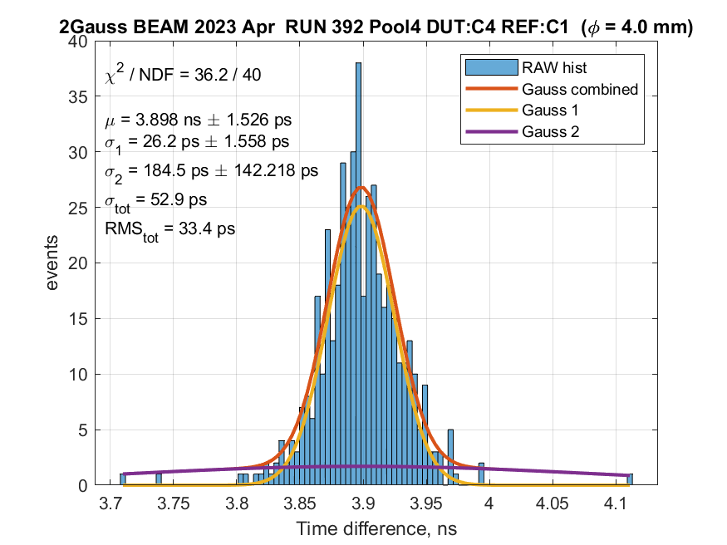
7-pad 200kΩ CsI photocathode - resistive sharing
  Detector Alignment with MCP – PMT
  Efficiency map
  Observation plots
    Smooth operation of the detector
ANALYSIS IN PROGRESS
Timing Resolution → 27ps on the central
pad @ C550/A275V
Signal Amplitude Detector vs. Reference

Slide 17
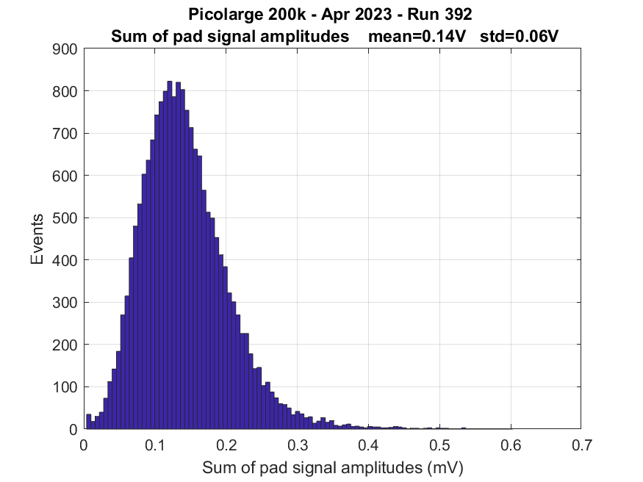
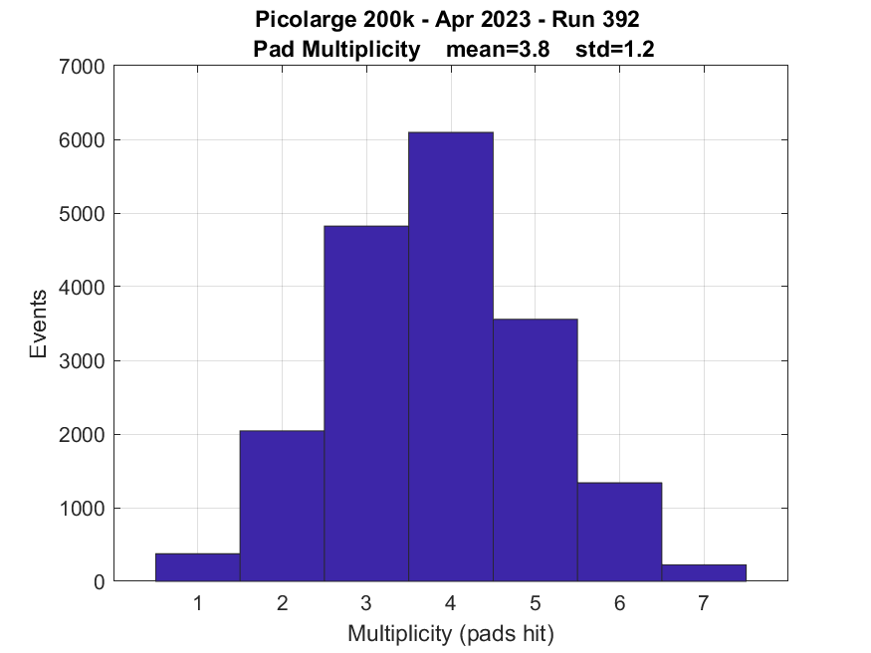
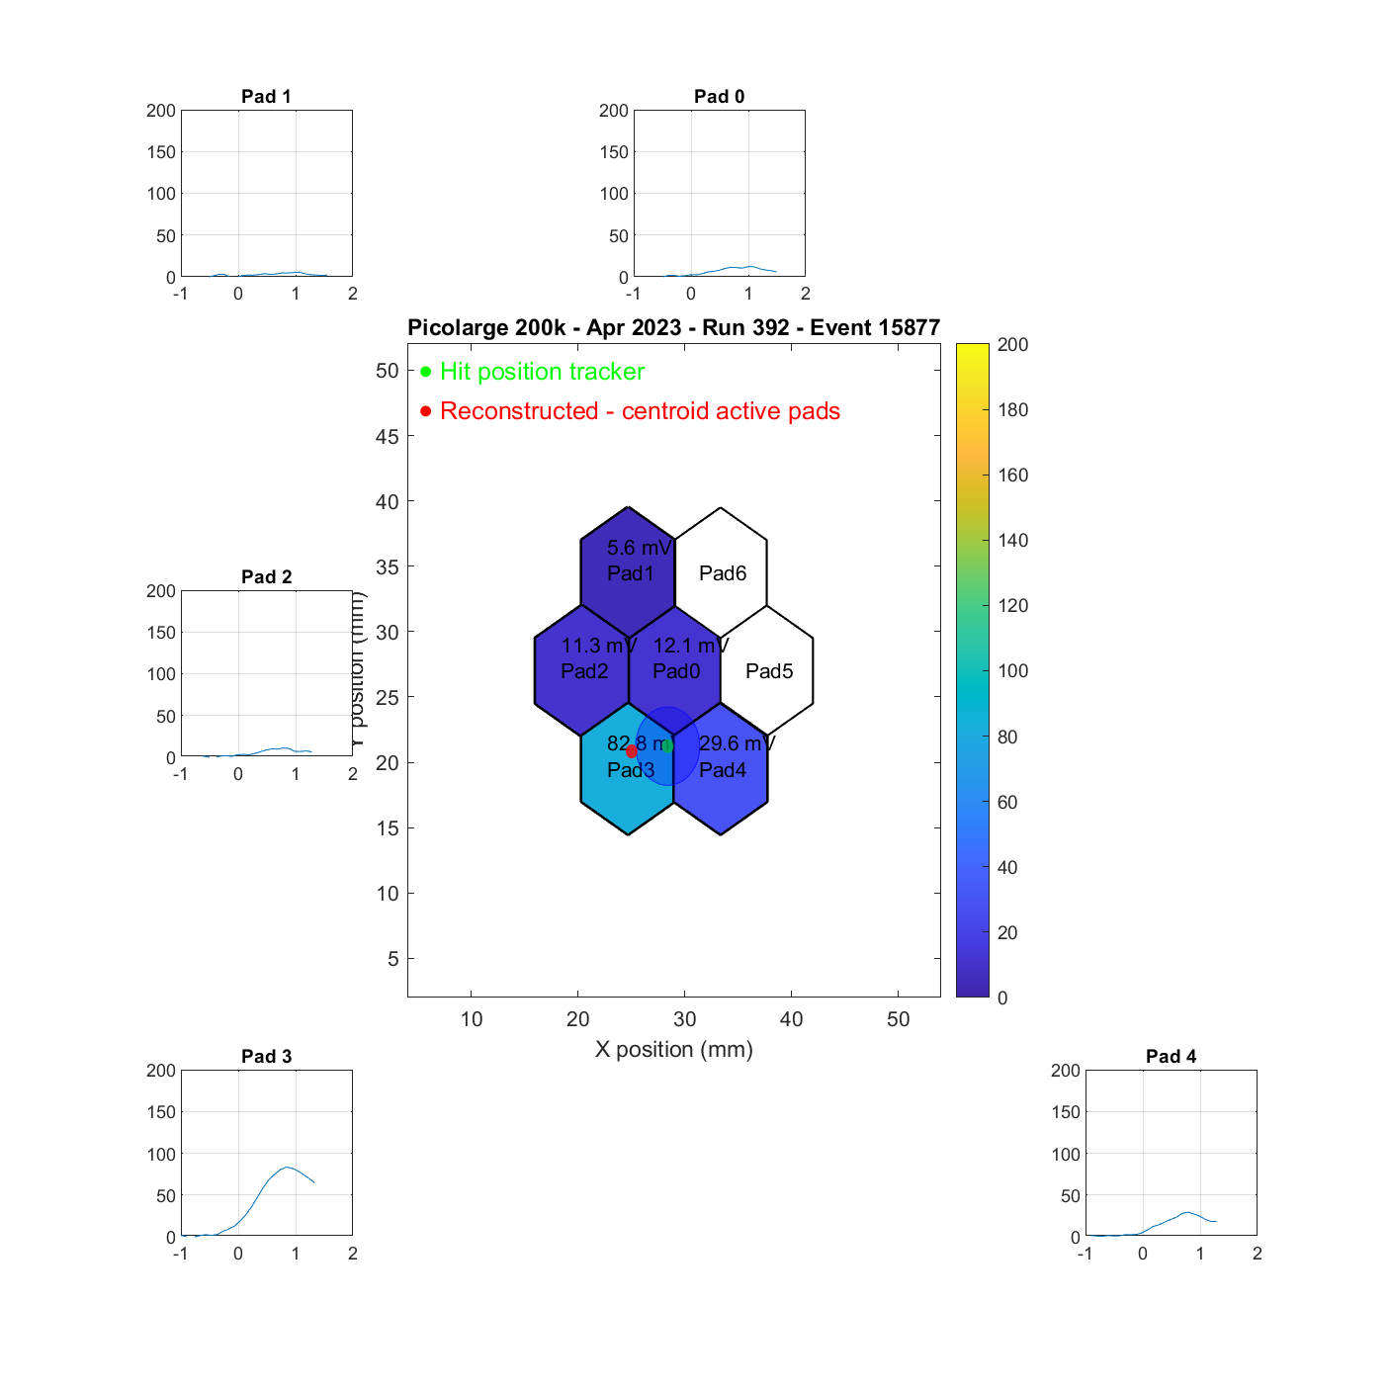
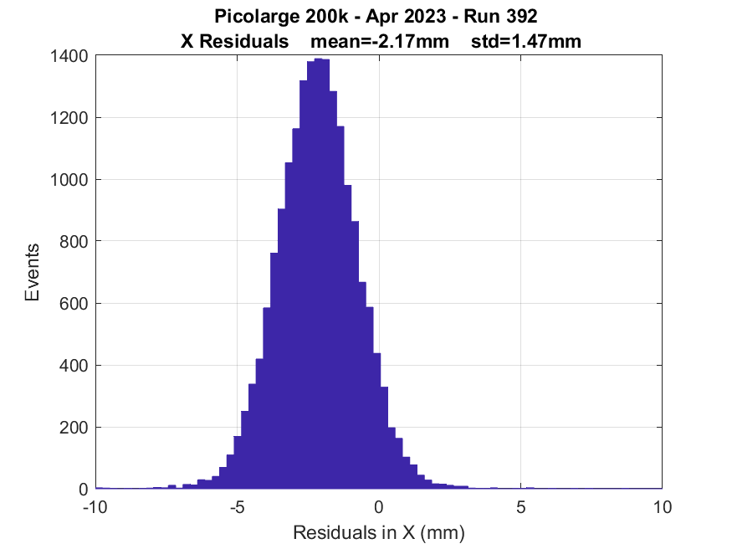
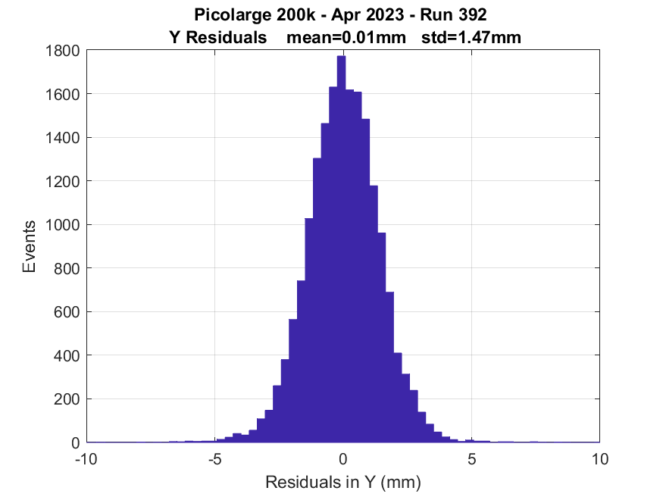
7-pad 200kΩ CsI photocathode - resistive sharing
  Being centered on the central pad with MPC-PMT
    Record all pad signals in the meantime to observe signal spreading
Mean active pads =4
ANALYSIS IN PROGRESS
σx = 1.47mm
σy = 1.47mm
RD51 Collaboration Meeting - 19-21 June 2023

Slide 18
Picolarge
Prototype Comparison
RD51 Collaboration Meeting - 19-21 June 2023

Slide 19
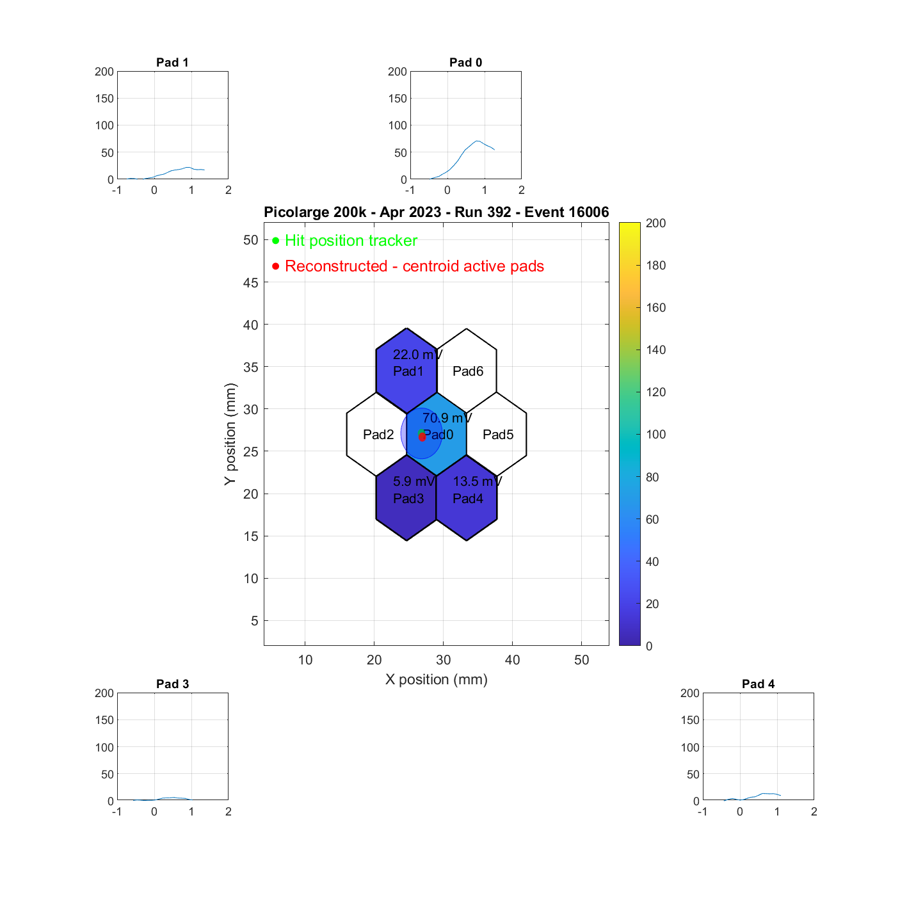
Prototype Comparison
7-pad 10MΩ - resistive sharing - 275/550
σx = 1.5mm
σy = 1.55mm
Mean active pads = 3
RMS→ 20ps
central region
7-pad 200kΩ - resistive sharing - 275/550
σx = 1.47mm
σy = 1.47mm
Mean active pads =4
ANALYSIS IN PROGRESS
RMS→ 27ps
central region
7-pad 10MΩ - capacitive sharing - 275/570
σy = 2.29mm
σx =2.47mm
Mean active pads =5
RMS→ 33ps
central region

Slide 20
Picolarge
7-pad resistive sharing
Tilted detector

Slide 21
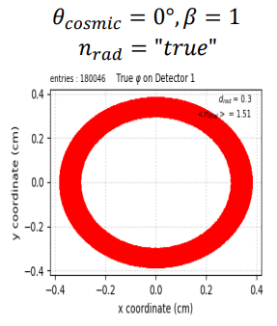










7-pad 10M CsI photocathode, aligned with central pad - tilted
Based on Simulation Studies
0 degree tilt
45 degrees tilt
Study the effect of angle on signal sharing

Slide 22






7-pad 10MΩ CsI photocathode - tilted
ANALYSIS IN PROGRESS

Slide 23

In the end it’s all a matter of timing
Thank you!

