Slide 1


A Compact, Low Rate Acquisition System for Muography
Jean-Luc Gauvreau, Daniel Snowden-Ifft
Occidental College
in Collaboration with RD51

Slide 2
Collaboration
Occidental College: Daniel Snowden-Ifft, Jean-Luc Gauvreau
CERN: Hans Muller, Dorothea Pfeiffer, Alexandru Rusu, Rui De Oliveira and Eraldo Oliveri.

Slide 3
Motivation
The goal is to develop a compact, low power muon detector and acquisition system for borehole applications, where the muon flux is very low.
This talk will focus on the electronics developments over the last 2 years.

Slide 4
Initial Setup
It was suggested by Dinesh Loomba (University of New Mexico) that we contact Rui to order a standard triple GEM muon detector.
We already had experience with TPCs using discrete preamps and shapers.

Slide 5
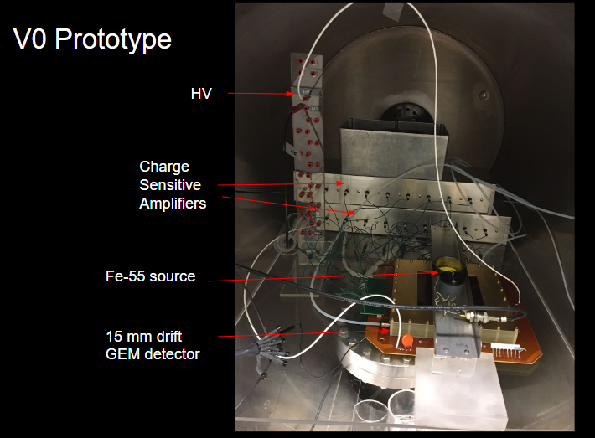
V0 muon detector
16 channels Cremat electronics
Shaping time: 50 ns
Grouped signals

Slide 6
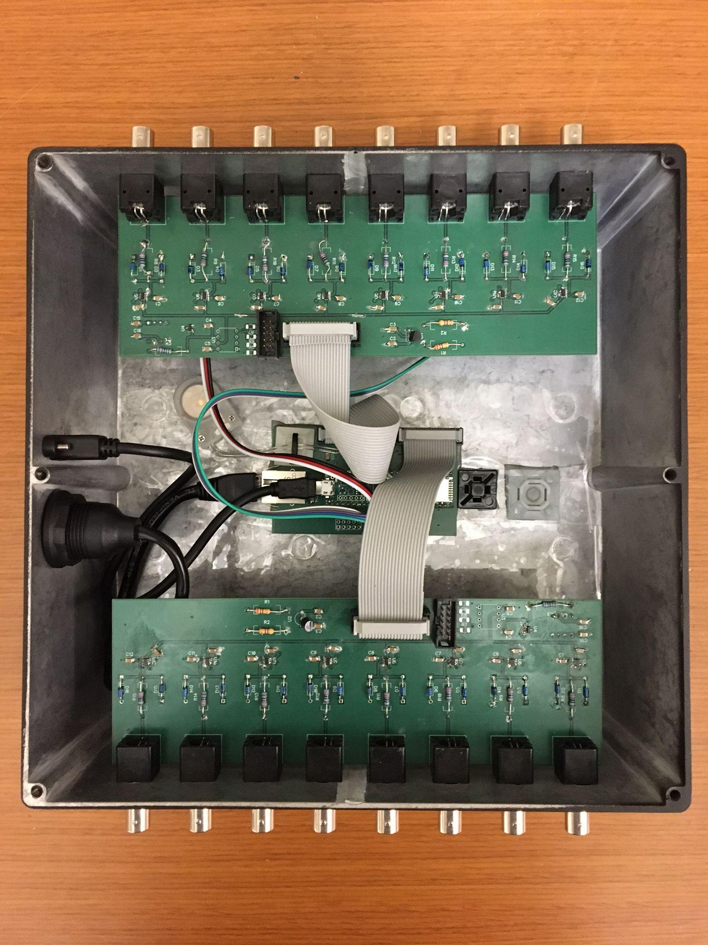
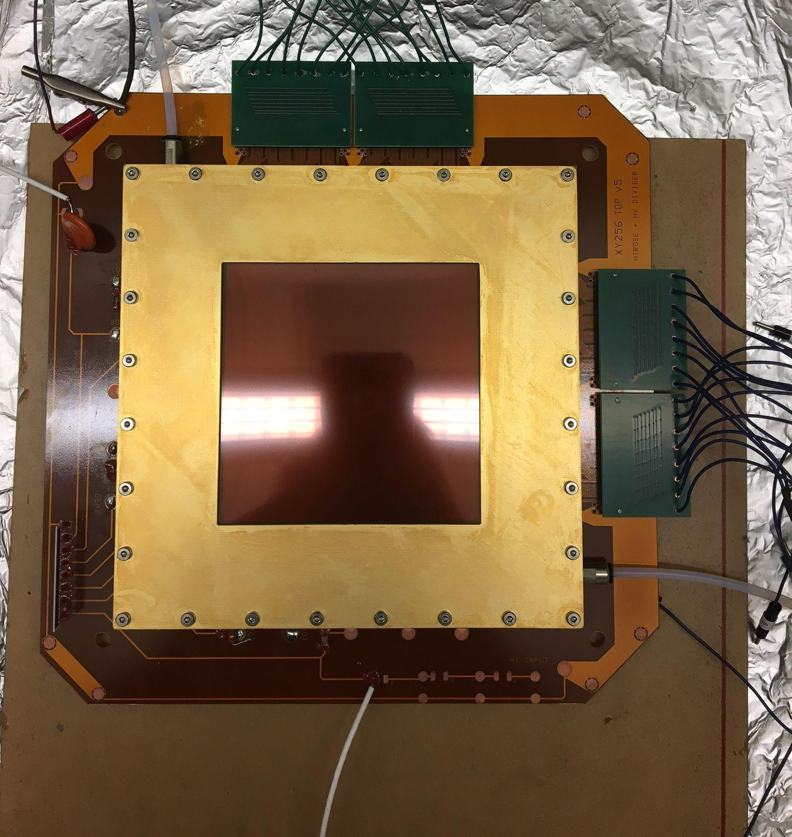
The standard muon detector V0 electronics with discrete preamplifiers/shapers and comparator logic.
:
To preamps and shapers
Grouping boards
8ch + 8ch
8ch + 8ch comparators sampled every
20 ns.
To preamps and shapers

Slide 7
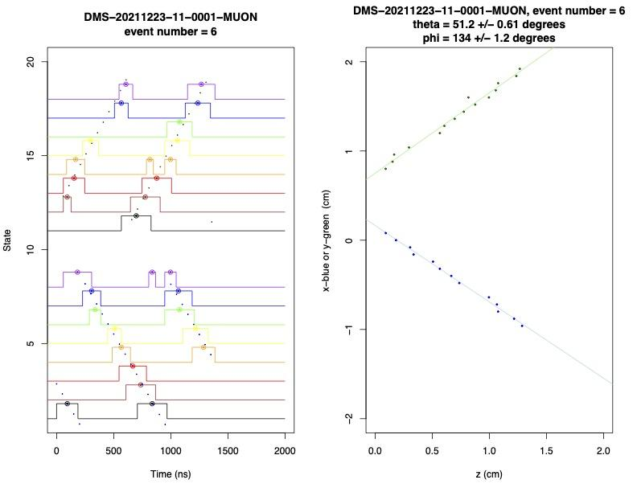
Proof of principle muon detection
The V0 ACQ consisted of
16 comparators
Teensy CPU + 16 I/O
Sampling at 50Mhz
Grouped signals
We see muons!
Measured the muon angles!
V0 works but:
Noisy
Bulky
Power hungry
Grouping was an issue
Analysis by Dan Snowden-Ifft

Slide 8
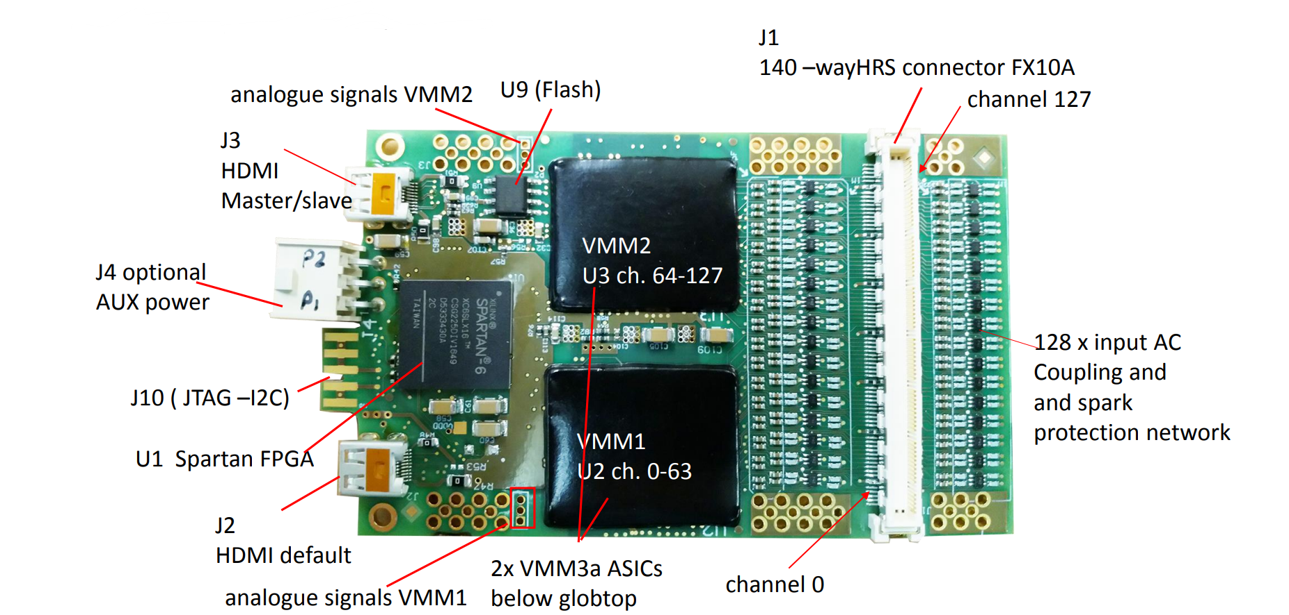
VMM Hybrid Board
Gianluigi De Geronimo (BNL) designed the VMM3a chip
Hans and Alex strongly encouraged us to borrow a VMM board as opposed to develop our own.
Sven Vahsen from U. of Hawaii graciously agreed to lend us such a VMM hybrid board.
Notes:
Alexandru Rusu, SRS Technology
Hans Muller
Sven Vahsen

Slide 9
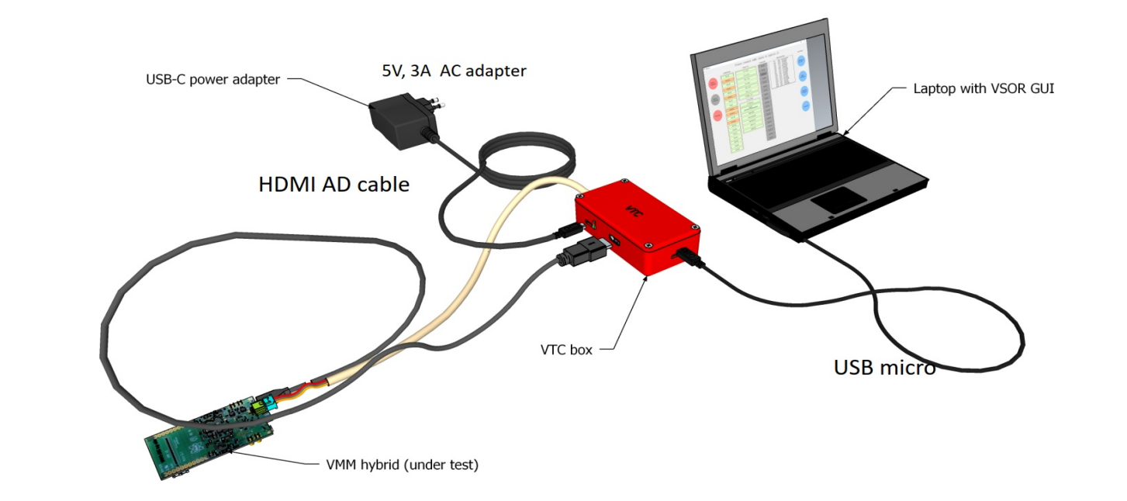
The VTC Box
The crate based SRS acquisition system is too bulky for our application.
The VTC box was designed by Hans Muller
to diagnose and calibrate the VMM hybrid board.
It uses a Pyboard microprocessor to communicate with the VMM hybrid and with the gui.
The VTC box also provides power to the VMM board.

Slide 10
The VTC box as an Acquisition System
The VTC was proposed by Hans Muller and Dorothea Pfeiffer as a possible compact acquisition system for a single VMM board using i2c communication.
The gui, the pyboard software and the VMM firmware were modified by Doro to enable data acquisition. The initial rate was 220 hits/sec.
Several iterations took place to debug and to improve the capabilities and performance of this new ACQ.
With the Spartan 6 version, the FIFO was increased to 8191 hits and each vmm3a chip can be configured independently for threshold, gain, masking, ...
The data rate was improved by increasing the i2c clock frequency and by eliminating the USB communication.
Finally, we were successful at Oxy in duplicating the VTC box with Hans’ help.

Slide 11
VTC vs SRS as Acquisition System
VTC
Max rate ~ 1.8khits/sec
SRS
Max rate ~ 18Mhits/sec
Hit
VMM3a
FIFO
PyBoard
PC
Hit
VMM3a
FIFO
FEC
PC
400kHz I2C
444MHz LVDS

Slide 12
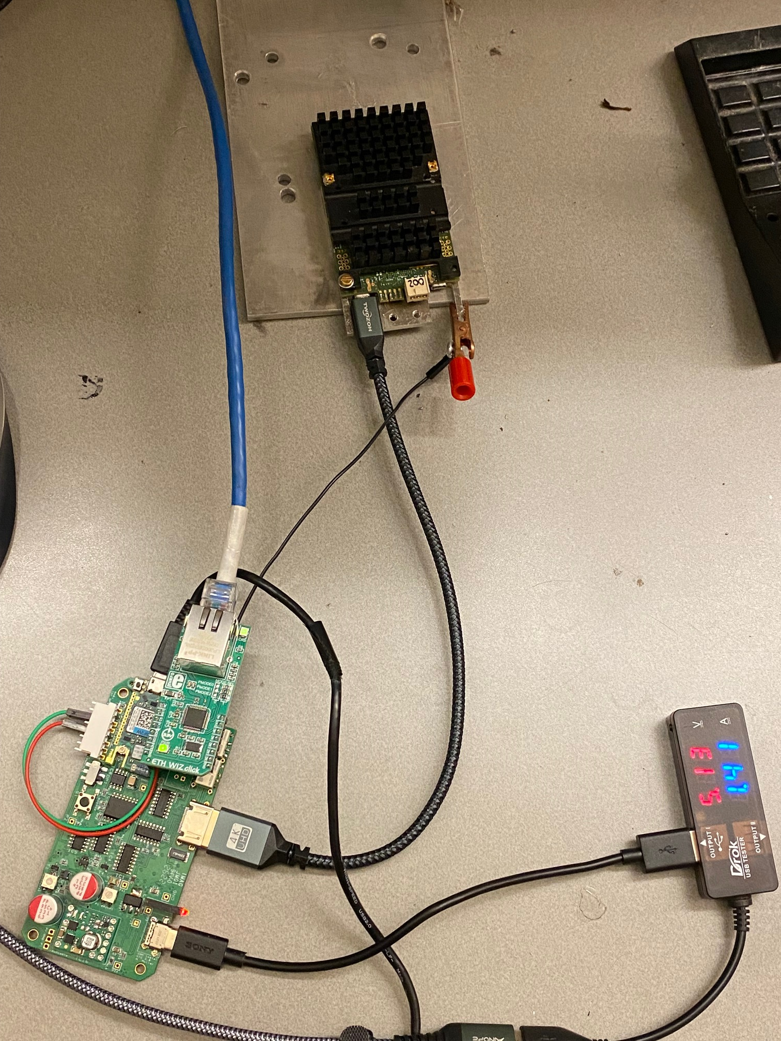
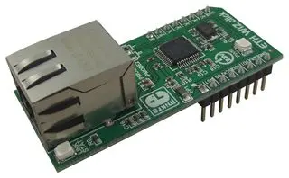
Ethernet
An ethernet card Wiznet W5500 was just successfully tested with the VTC.
All data transfer will soon be performed by ethernet instead of USB.
Ethernet client/server software is being developed by Doro.
Fiber optics and media converters will be used for distance > 100 m.
Ethernet card
VMM board
VTC board

Slide 13
Data Rates
Max data rate achieved:
220 hits/sec with 100kHz i2c clock and usb
1800 hits/sec with 1MHz i2c clock and ethernet
Typical hit rate:
Fe-55 calibration: 300 hits/sec
Surface cosmic muons ~ 1 muon/sec , ~ 100 hits/sec (including noise)
500 m underground: expected 1 muon/hour, ~ 100 hits/sec ?

Slide 14
Power usage
Total VTC + VMM power usage: 5V x 1.5A = 7.5 Watts
VMM alone power usage: 3.75 Watts/128 channels ~ 30 mW/channel
Heat evacuation with a fan or with conduction is necessary.

Slide 15
Gas and Sensors
The detector operates with Ar/CO₂ in a ratio of 70/30
The gas output of the detector is instrumented to detect:
  H₂O (GY-SHT31-D)
  O₂ (SEN0322)
  CO₂ (ExplorIR®-W 60% CO2 Sensor)
  Temperature (GY-SHT31-D)
  Pressure (SparkFun Qwiic MicroPressure Sensor)

Slide 16
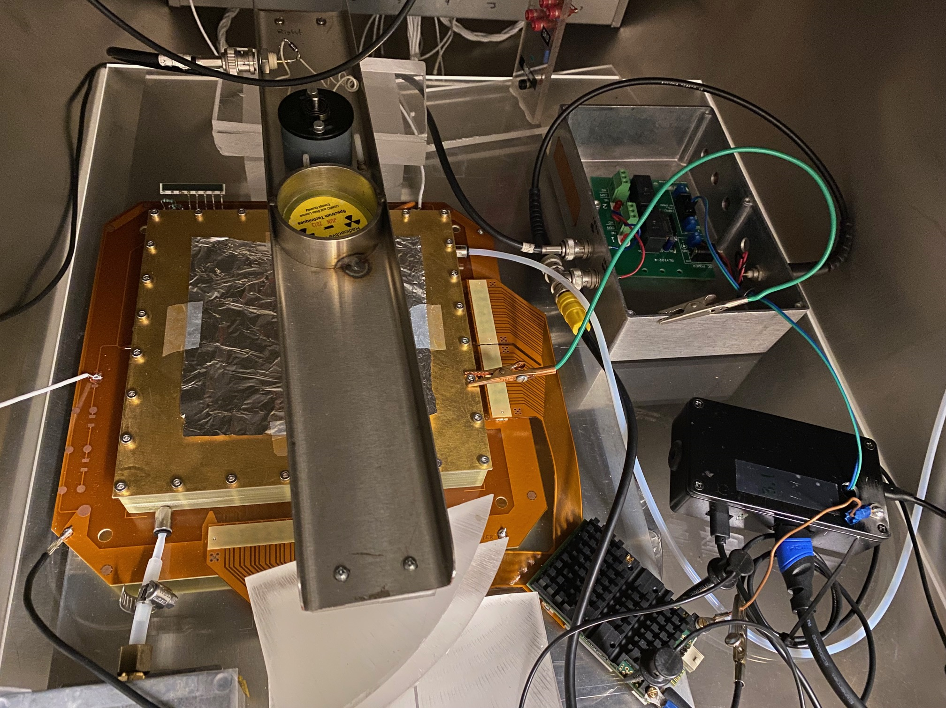
VMM, VTC box and Standard Detector
Relay for Fe-55 Shutter
Fe-55 source
+ shutter
HV
15 mm drift GEM detector
VTC box
Flex ribbon/
concentrator
VMM board

Slide 17
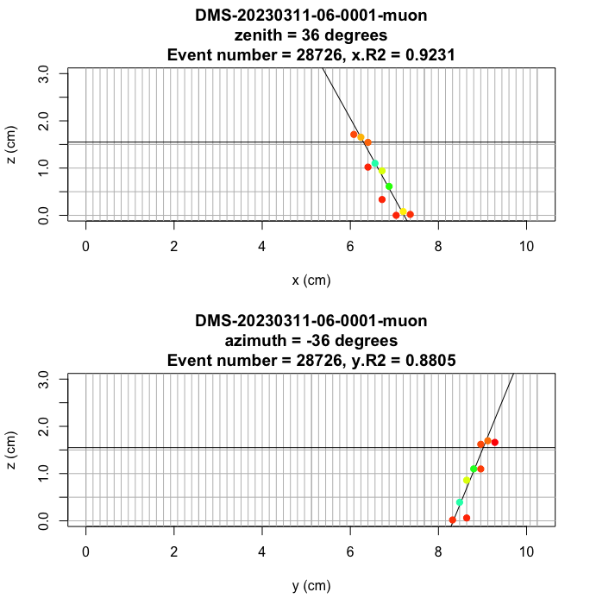
Reconstructed muon track
Analysis by Dan Snowden-Ifft

Slide 18
Next Steps
New Spartan 7 VMM were just received
  VMM upgrade
  New firmware has 32 kHit buffer, so better suited to cope with short bursts
New compact CERN detector is about to be shipped
  Integrate VMM, VTC, detector together in a tight space
  Minimize noise
  Evacuate heat

Slide 19
Future Developments
μ-roc
Alex (concept, hardware, production)
Hans (concept, hardware)
Doro (firmware and software)
Compact
Should handle the same hit rate as a SRS system
Pyboard → SoC + FPGA
Fast data transfer using LVDS
Provides power for 2 VMM hybrids
Provides ACQ for 2 VMM hybrids
Optical fiber based time synchronization between multiple VMM boards.

Slide 20
Thanks
We would like to acknowledge all the help given by:
The RD51 Collaboration and in particular
Hans Muller, Doro Pfeiffer, Rui De Oliveira, Eraldo Oliveri, Alexandru Rusu and Sven Vahsen.

