Slide 1
DRD1-WG6
Proposal
G. Charles (IJCLab), Wires
A. Delbart (Irfu Saclay), TPC
R. De Oliveira (Cern), MPGD
G. Iaselli (INFN), RPC/MRPC
F. Jeanneau (Irfu Saclay), MPGD
I. Laktineh (IP2I), RPC/MRPC

Slide 2
Mandate and objectives
Mandate
  Production aspects of gaseous detectors covering all essential construction elements
  Development of production techniques and innovative solutions
  Transfer to industry
Objectives
  1: Development and maintenance of common production facilities and equipment
  2: Quality control and large volume productions
  3: Collaboration with industrial partners
  4: Establishment and support of a forum for sharing experi- ences, knowledge, and best practices

Slide 3
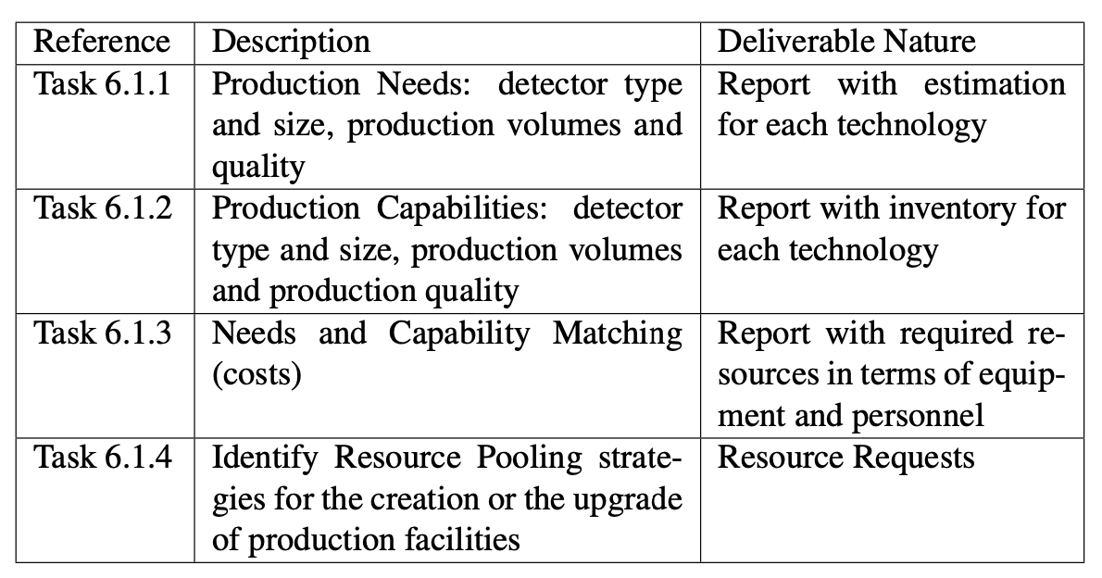
Task 1
Production facilities and equipment

Slide 4
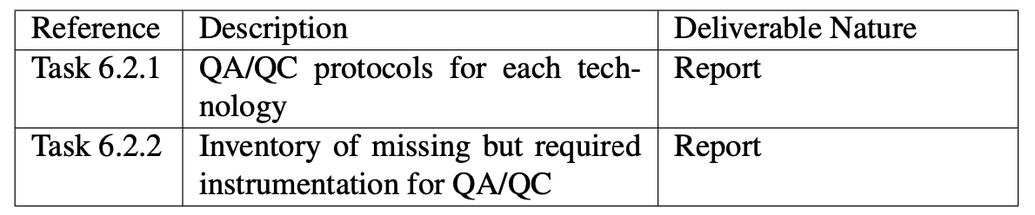
Task2
QC and production

Slide 5
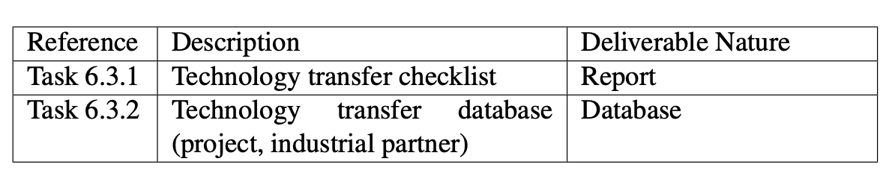
Task3
Collaboration with industrial partners

Slide 6
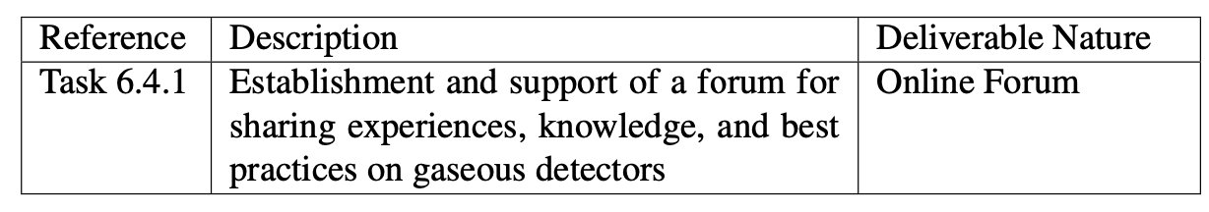
Task4
Collaborative forum

