Slide 1

EP-DT
Detector Technologies
3rd International Conference on
Detector Stability and Aging Phenomena
in Gaseous Detectors
CERN, November 6th-10th, 2023

Slide 2
topics
The conference will continue the initiative started in 1986 with the first workshop held at LBL (Berkeley) and in 2001 at DESY (Hamburg).
Conference topics will include:
Detector stability and performance
Aging phenomena
Radiation hardness
Material outgassing
Novel materials
Electrodes
Photocathodes
Plasma chemistry
Environmentally friendly gases
Gas and material analysis, characterisation, instruments
Discharge damage and mitigation
Test facilities
Front End Electronics for detector stability and aging mitigation

Slide 3
Local Organizing Committee and International Program Committee
Local Organizing Committee
Florian Brunbauer, CERN, Switzerland
Anna Colaleo, Università and INFN Bari, Italy
Roberto Guida, CERN, Switzerland
Beatrice Mandelli, CERN, Switzerland
Eraldo Oliveri, CERN, Switzerland
Leszek Ropelewski, CERN, Switzerland
Maksym Titov, CEA Saclay, France
International Program Committee
Mar Capeans, CERN, Switzerland
Paulo Fonte, LIP Coimbra, Portugal
Chilo Garabatos, GSI, Germany
Piotr Gasik, GSI, Germany
Marcus Hohlmann, Florida Institute of Technology, USA
Paolo Iengo, Universita e INFN sezione di Napoli, Italy
Fabien Jeanneau, Université Paris-Saclay, France
Carsten Niebuhr, Deutsches Elektronen-Synchrotron, Germany
Atsuhiko Ochi, Kobe University, Japan
Gabriella Pugliese, Politecnico di Bari and INFN, Italy
Anatoly Romaniouk, Innsbruck University, Austria
Burkhard Schmidt, CERN, Switzerland
Shoji Uno, KEK, Japan
Peter Wiens, Forschungszentrum Juelich GmbH, Germany

Slide 4
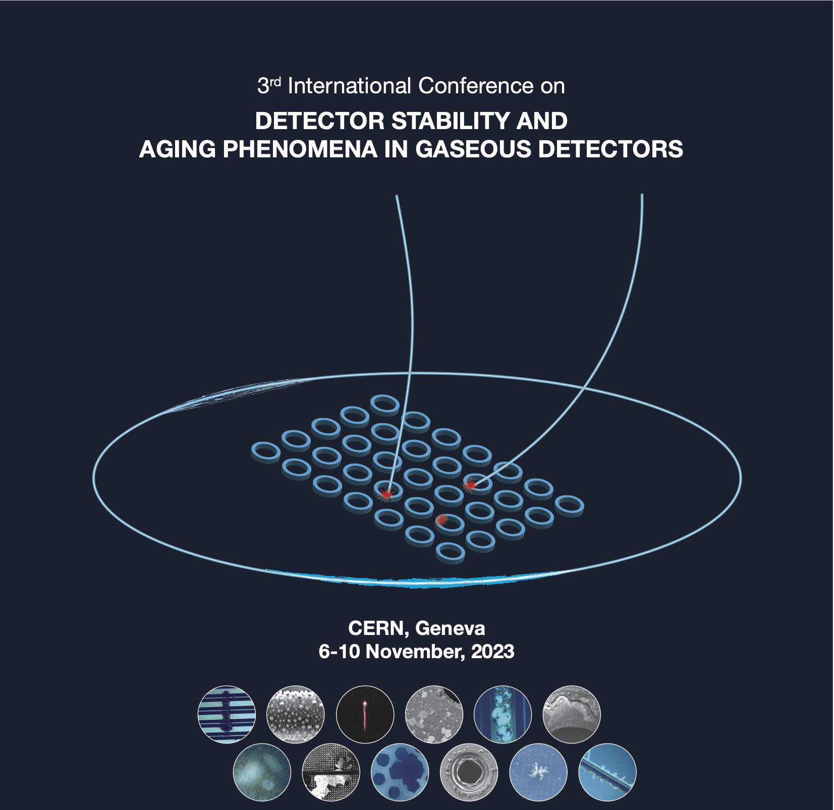
Info/Organization
Indico link: https://indico.cern.ch/event/agade23/ (AGADE: AGeing phenomena And DEtector stability in gaseous detectors)

Slide 5
Info/Organization
Conference proceedings
The conference proceedings will be published in NIMA proceeding journal.
Abstract submission
The abstract submission to the conference is now open at the conference indico page: https://indico.cern.ch/event/1237829/ .
The deadline for abstract submission is August 1st, 2023.
We would like to invite the community to submit abstracts for oral presentations as well for posters that will be displayed during a dedicated session.
Registration
The registration will be opened from June 1st to October 1st, 2023.
Please follow the instructions on the indico web page on how to register and pay the fee.
Few fellowships will be available for young scientists to cover allowance and the fee. Please submit a motivation letter in the registration indico page to support your request.
Additional information about accommodation and accessibility at CERN are available at dedicated sessions of the indico page.
Accommodation
A block of rooms has been retained at the CERN hostel from November 5th to 11th, 2023. This block is valid until October 5th, 2023. After this date, all unreserved rooms will be returned to the hostel.
Please use this hostel booking form

Slide 6
Info/Organization
Conference venue
CERN main auditorium
Conference fee
200 CHF
Conference dinner
Dinner will take place at a local Geneva restaurant (Cave Valaisanne Chalet Suisse) on Thursday 9th November 7:30 pm.
Two menus are available:
Menu Valaisan (Fondue au Fromage/Cheese fondue)
Menu Chalet (Fondue Bourguignonne/Meat fondue)
Accommodation
A block of rooms has been retained at the CERN hostel from November 5th to 11th, 2023. This block is valid until October 5th, 2023. After this date, all unreserved rooms will be returned to the hostel.
Please use this hostel booking form

Slide 7
Info/Organization
In case of questions/doubts, please contact:
Conference secretariat: SecretariatDetectorAgeing.Stability2023@cern.ch
Local organizing committee: DetectorAgeing.Stability2023@cern.ch
Do not hesitate to contact us for any question/doubt
Please spread as much as possible the info about this event. Thanks a lot!

