Slide 2
PS Booster Magnets Task Force
Antony Newborough on behalf of TE/MSC-NCM

Slide 3
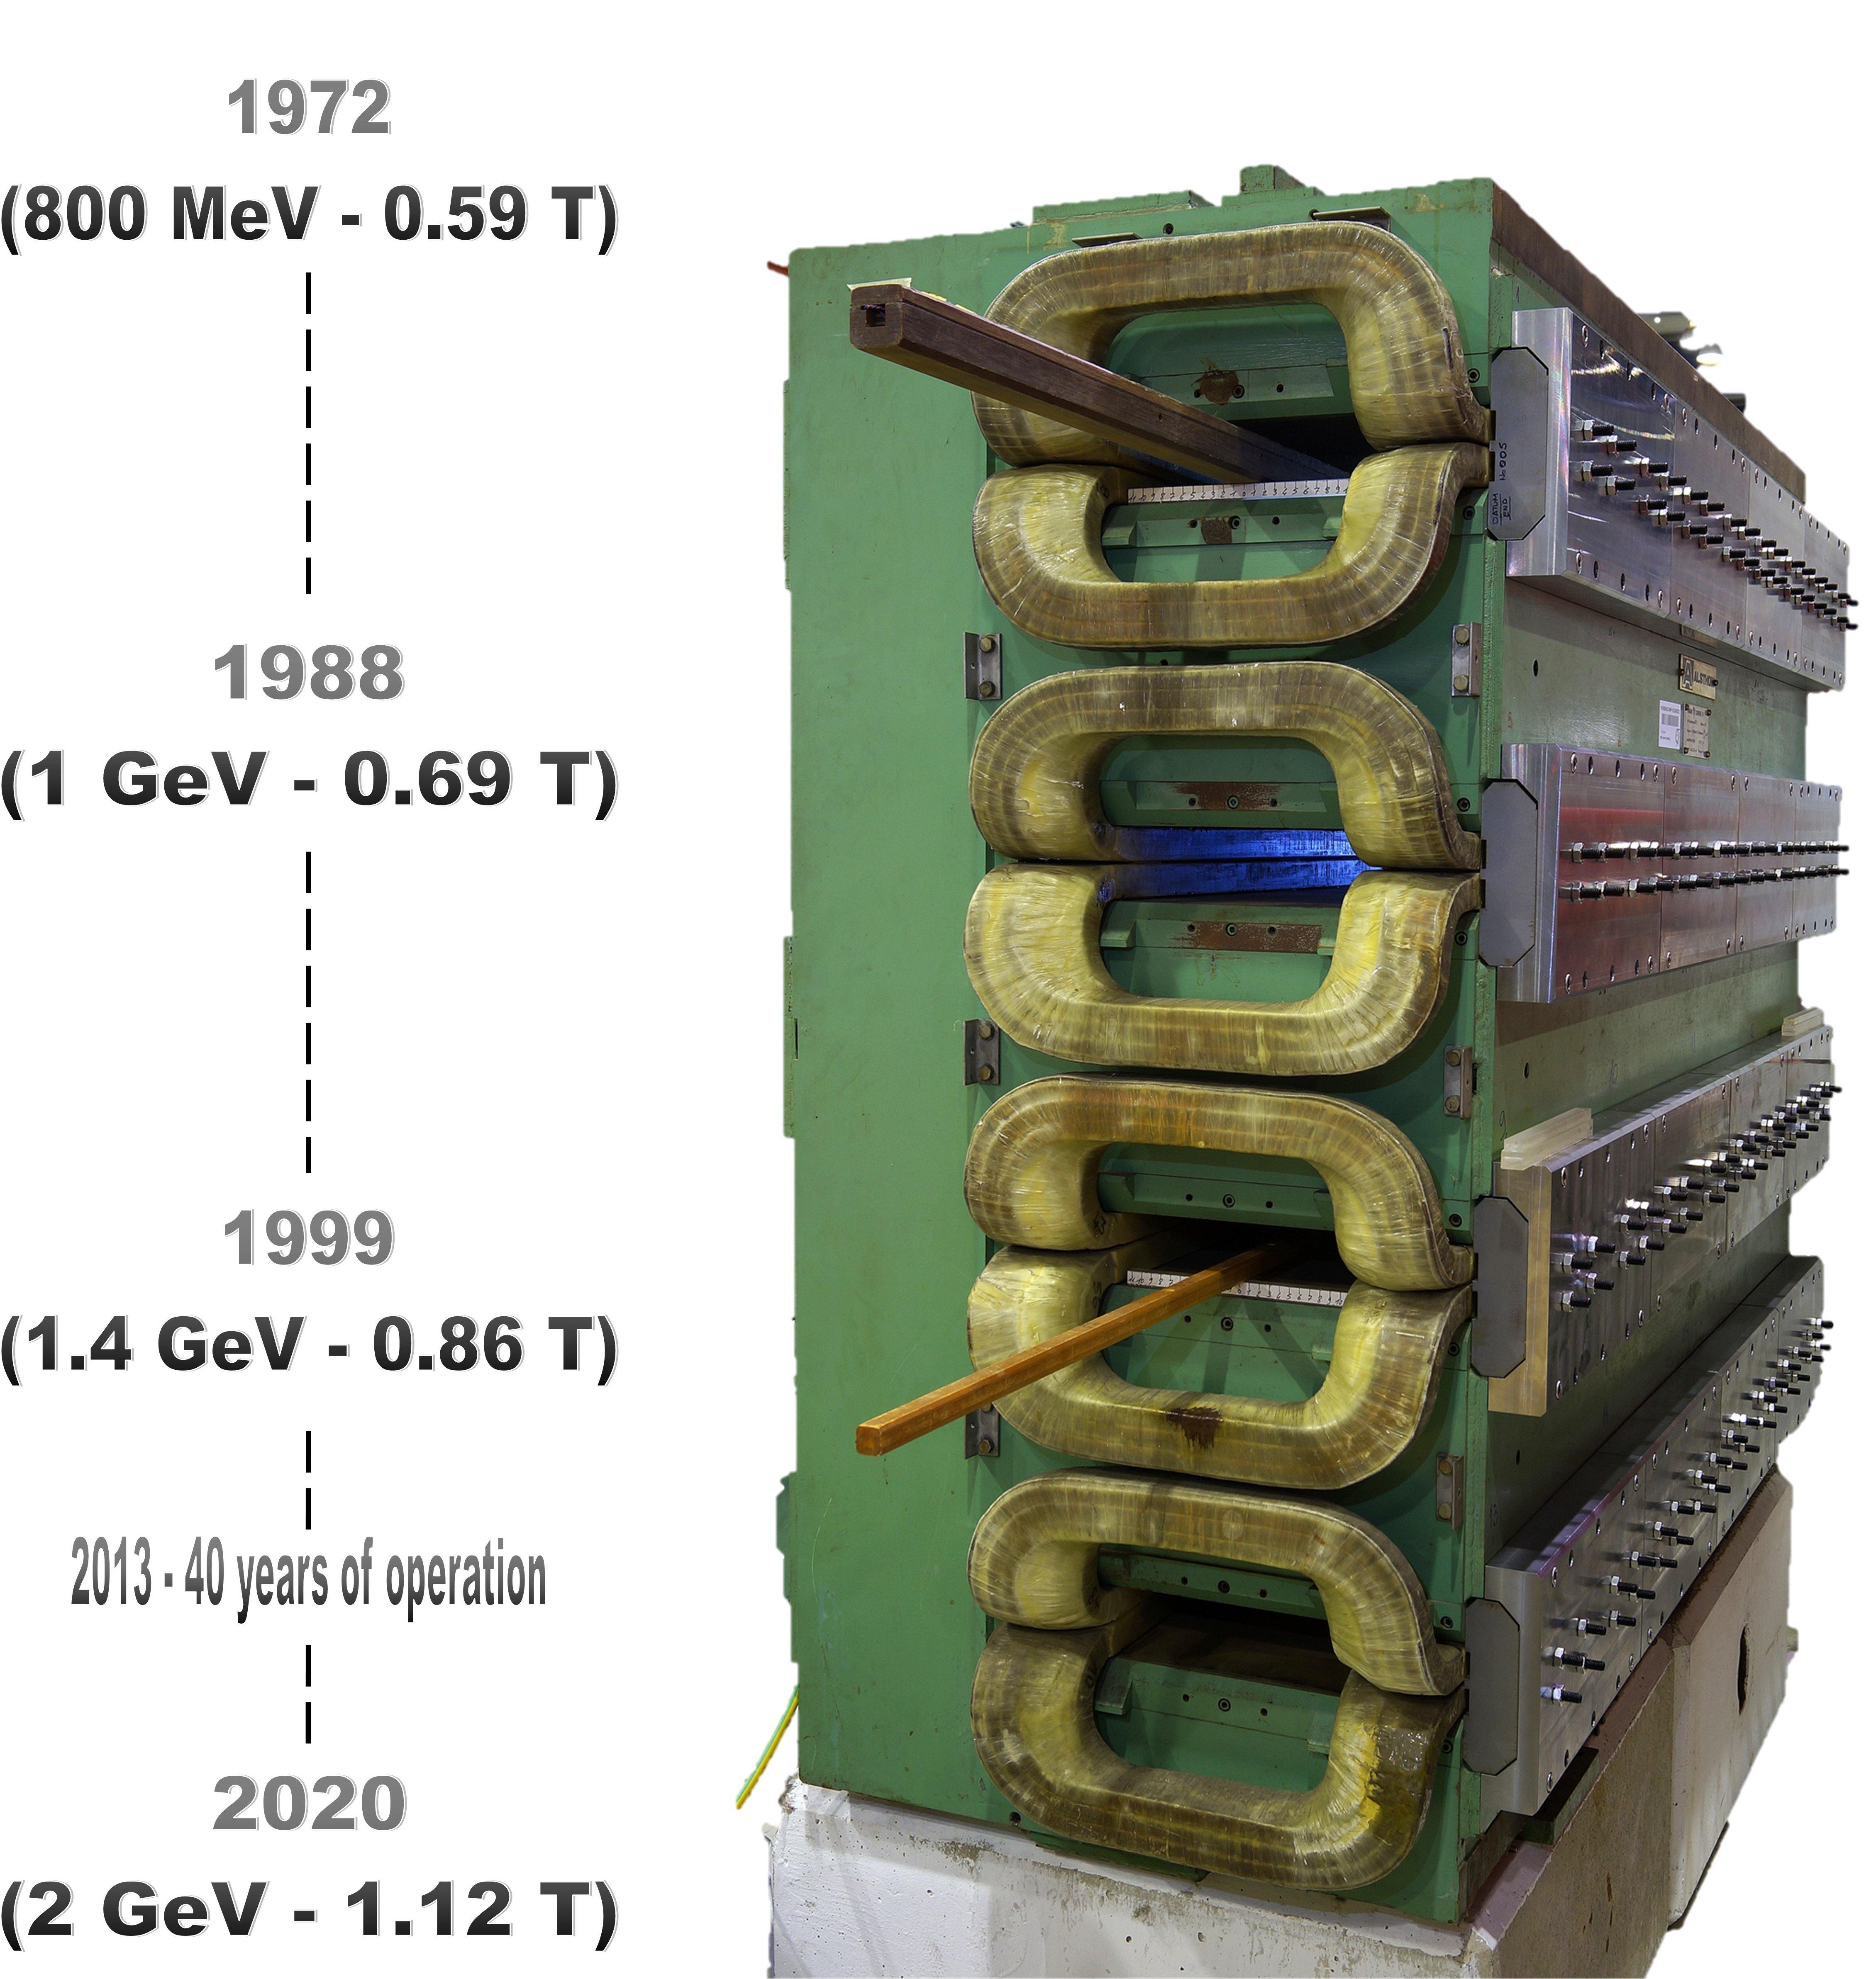
PS Booster Magnets Task Force
Introduction:
  PSB Main Quadrupole Magnets
    Inventory
    Non-conformities
    QFO11
    Repair, mitigation and reconstruction
    Leak monitoring
    Summary of Ralf’s questions
    Degraded mode operation
The PSB Upgrades

Slide 4
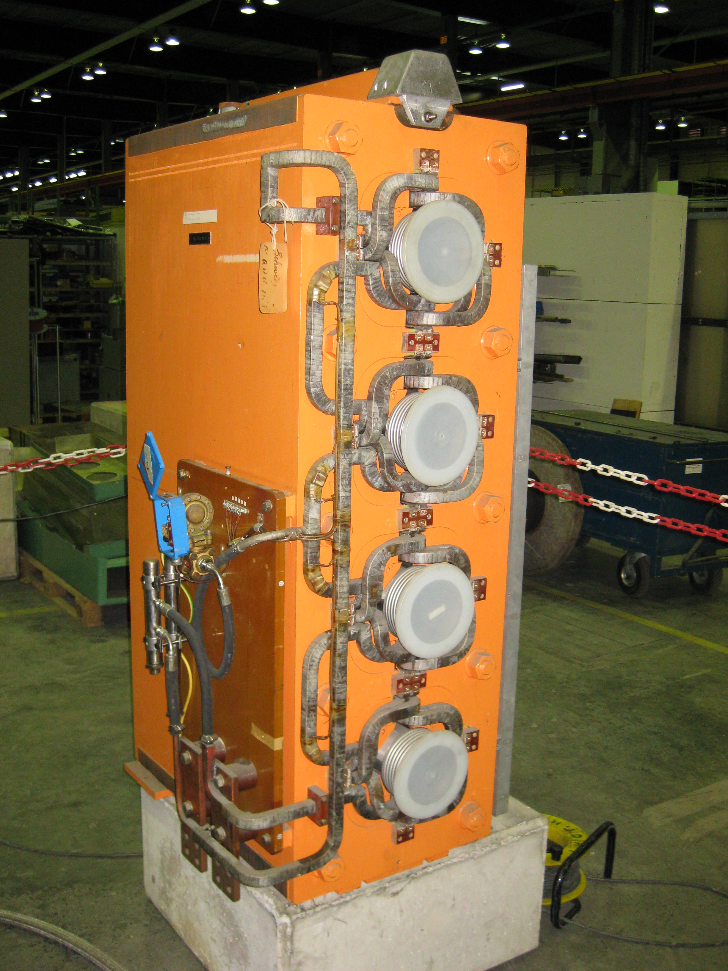
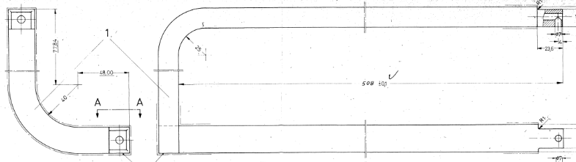
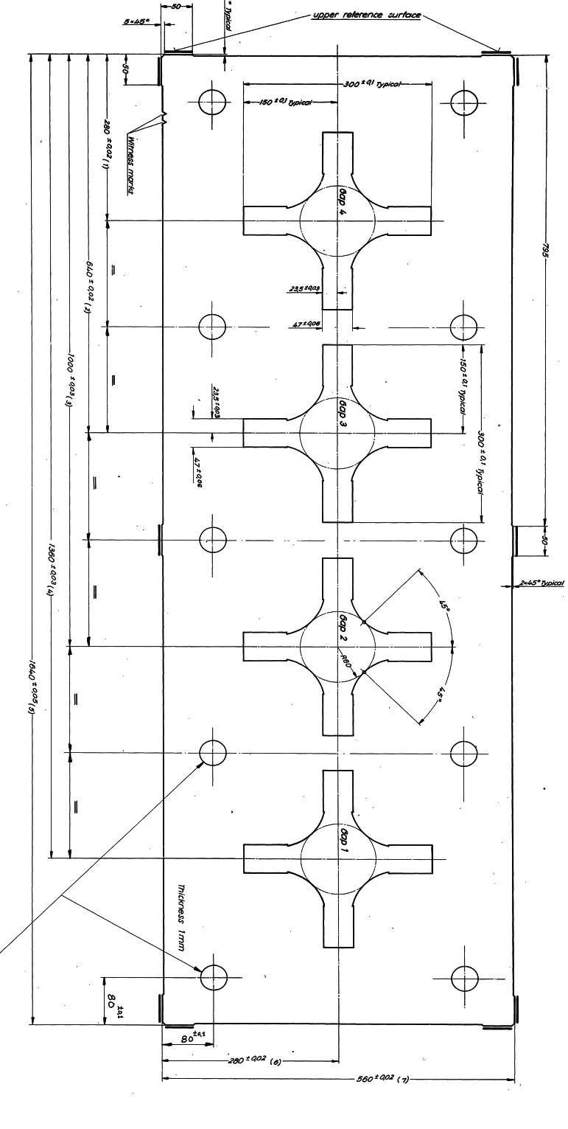
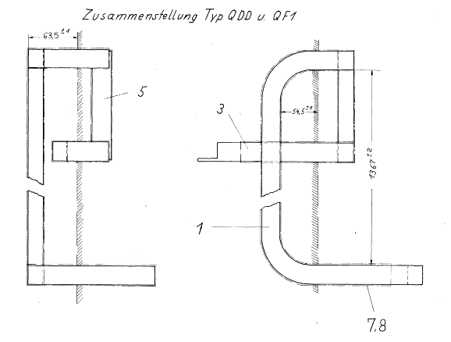
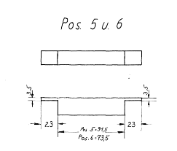
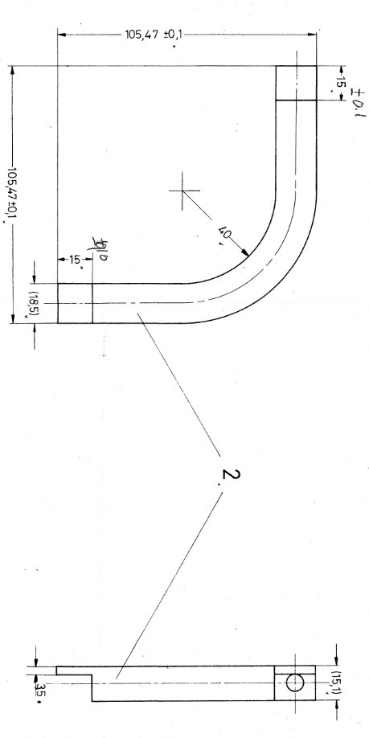
PSB quadrupole magnet ageing
REMINDER: Until 2021 the only PSB quadrupole exchange was due to a vacuum leak!
A Unique Construction!
Single lamination (no means to open the magnet)
Coil built-up turn by turn (~76 brazed connections per magnet, ~3650 in operation)**
Mica/glass fiber insulation tape with the whole magnet resin impregnated (true VPI method which CERN is not equipped)
ZERO LEAKS UNTIL 2021 AND SIX SINCE!
** Additional undocumented brazed joints are being discovered
Design Code | Old Code | Installed | Spare | Comment
PXMQNEC4WP | QFO LEFT | 16 | 2* | Removed from the ring during the YETS 21/22 #17 repaired (only where it leaked!) and certified (recertification is on-going ~1 week) #30 repaired (only where it leaked!) and certified but has since had additional sample cut and requires additional repair (ongoing ~ 2 weeks)
PXMQNED4WP | QFO RIGHT | 16 | 1* | NC Removed from the ring during the YETS 22/23, sample extracted
PXMQNFA4WP | QDE left | 8 | 1* | NC Removed from the ring during the YETS 22/23, sample extracted
PXMQNFJ4WP | QDE right | 8 | 1* | NC Removed from the ring during the YETS 22/23, sample extracted
 |  | 48 | 5
PSB Quadrupole status
*Non-conformity reports:
https://edms.cern.ch/document/2603476 (QFO161 - June 21)
https://edms.cern.ch/document/2664838 (QFO91 - Nov 21)
https://edms.cern.ch/document/2779972 (QDE5 - Sept 22)
https://edms.cern.ch/document/2812055 (QFO142 - Dec 22)
https://edms.cern.ch/document/2812056 (QDE11 - Dec 22)
https://edms.cern.ch/document/2884501 (QFO11 - April 23)

Slide 5
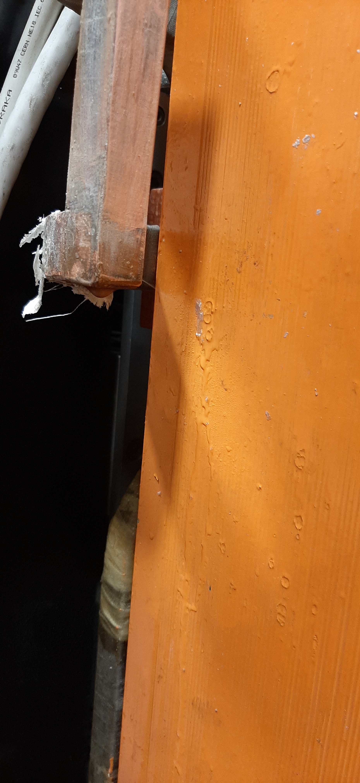
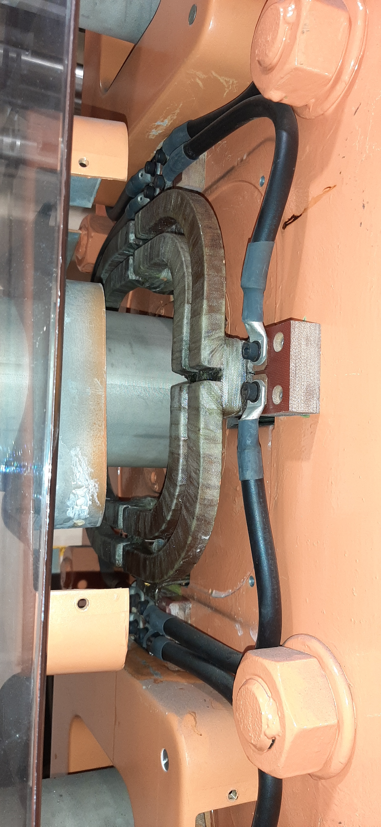
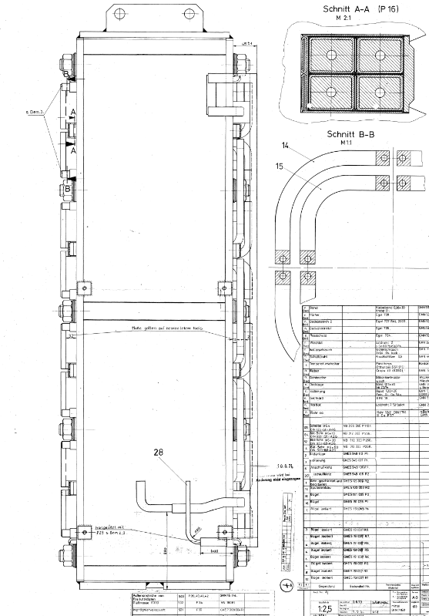
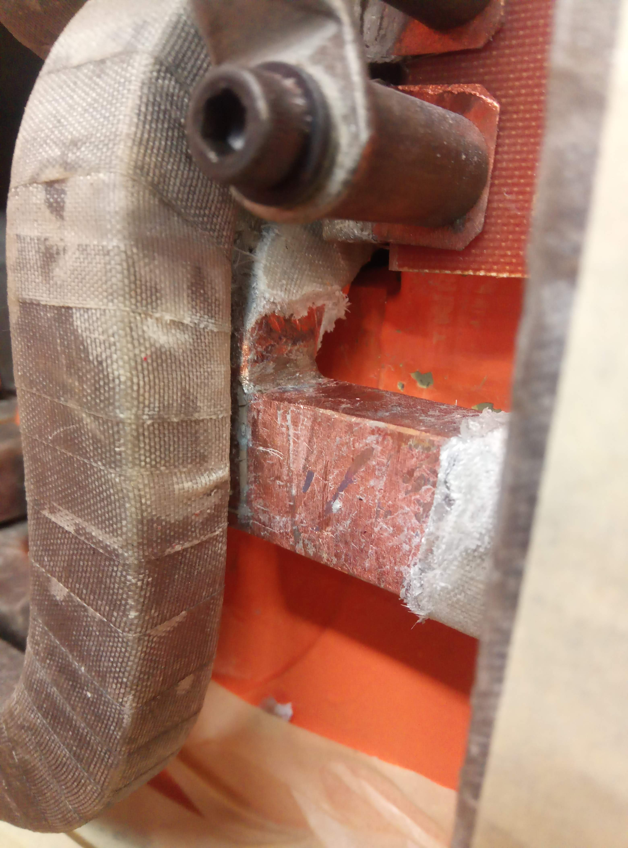
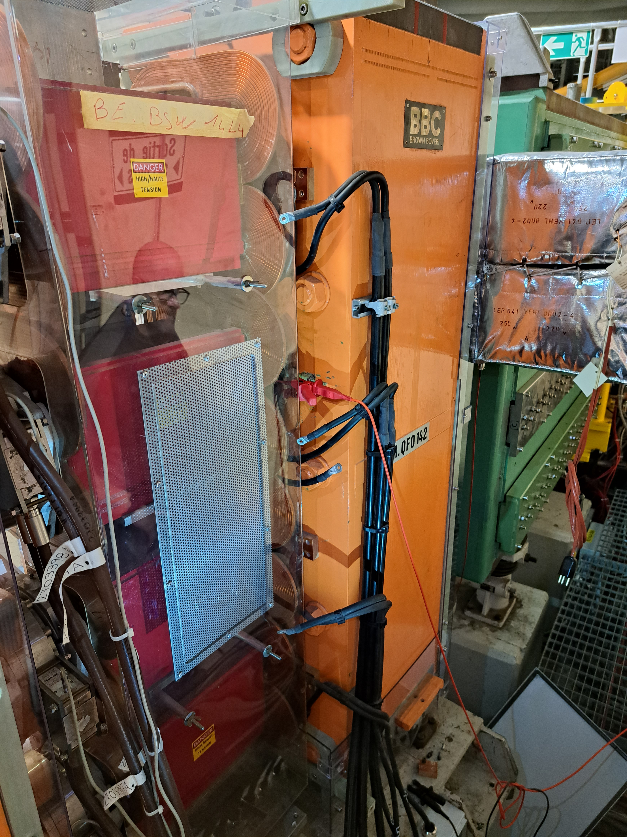
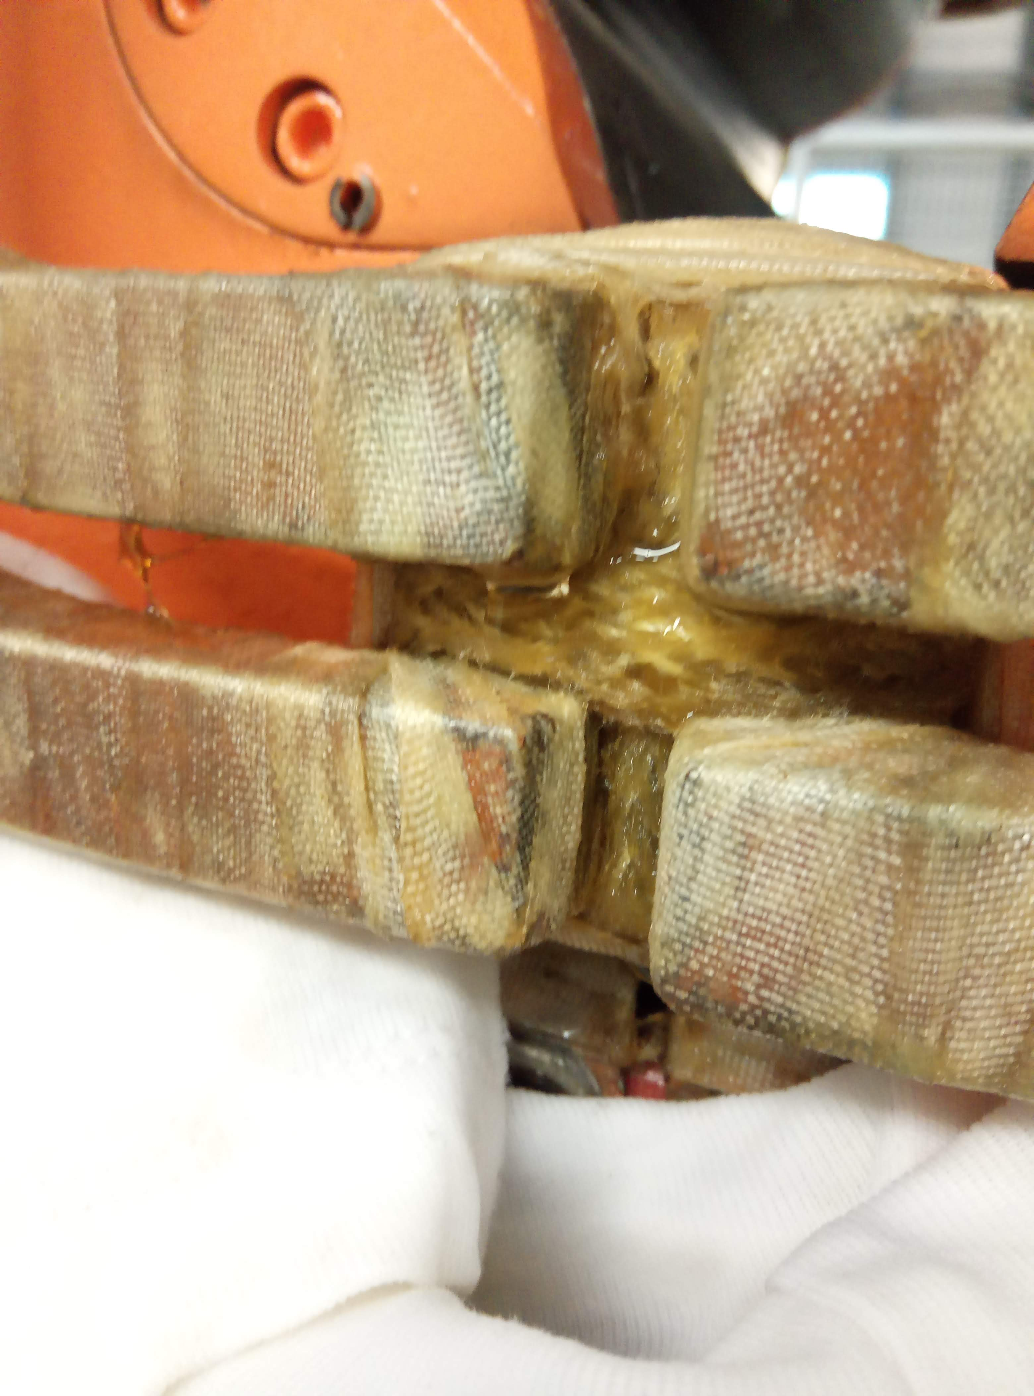
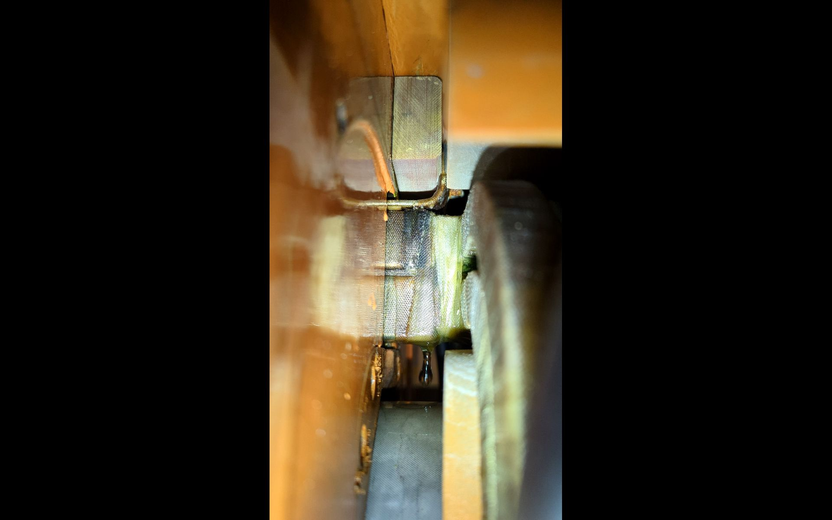
PSB quadrupole - Brazing NC Location
09/22
QDE5
“brazed end” R3
06/21
QFO161
“busbar”
11/22
QFO142
“brazed end” R3
12/22
QDE11
“Aperture link” R2-R3
11/21
QFO91
“brazed end” R2
04/23
QFO11
“brazed end” R2

Slide 6
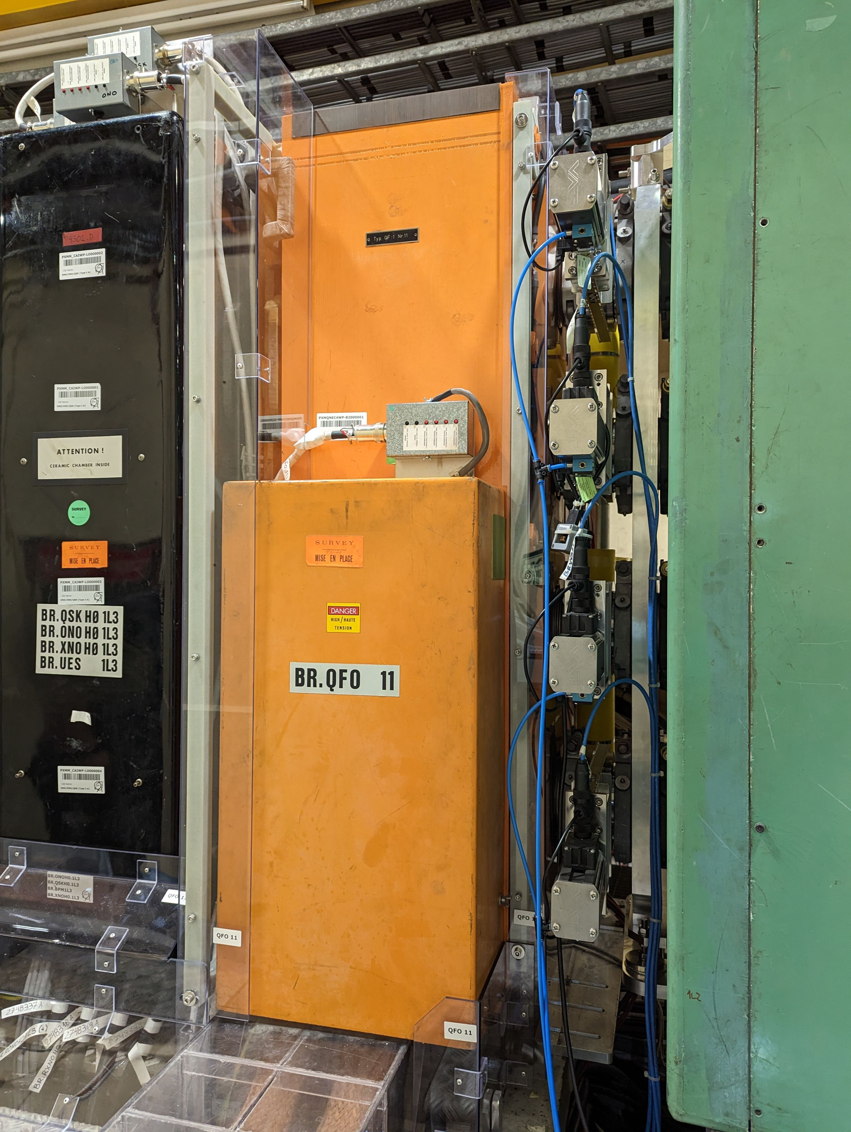
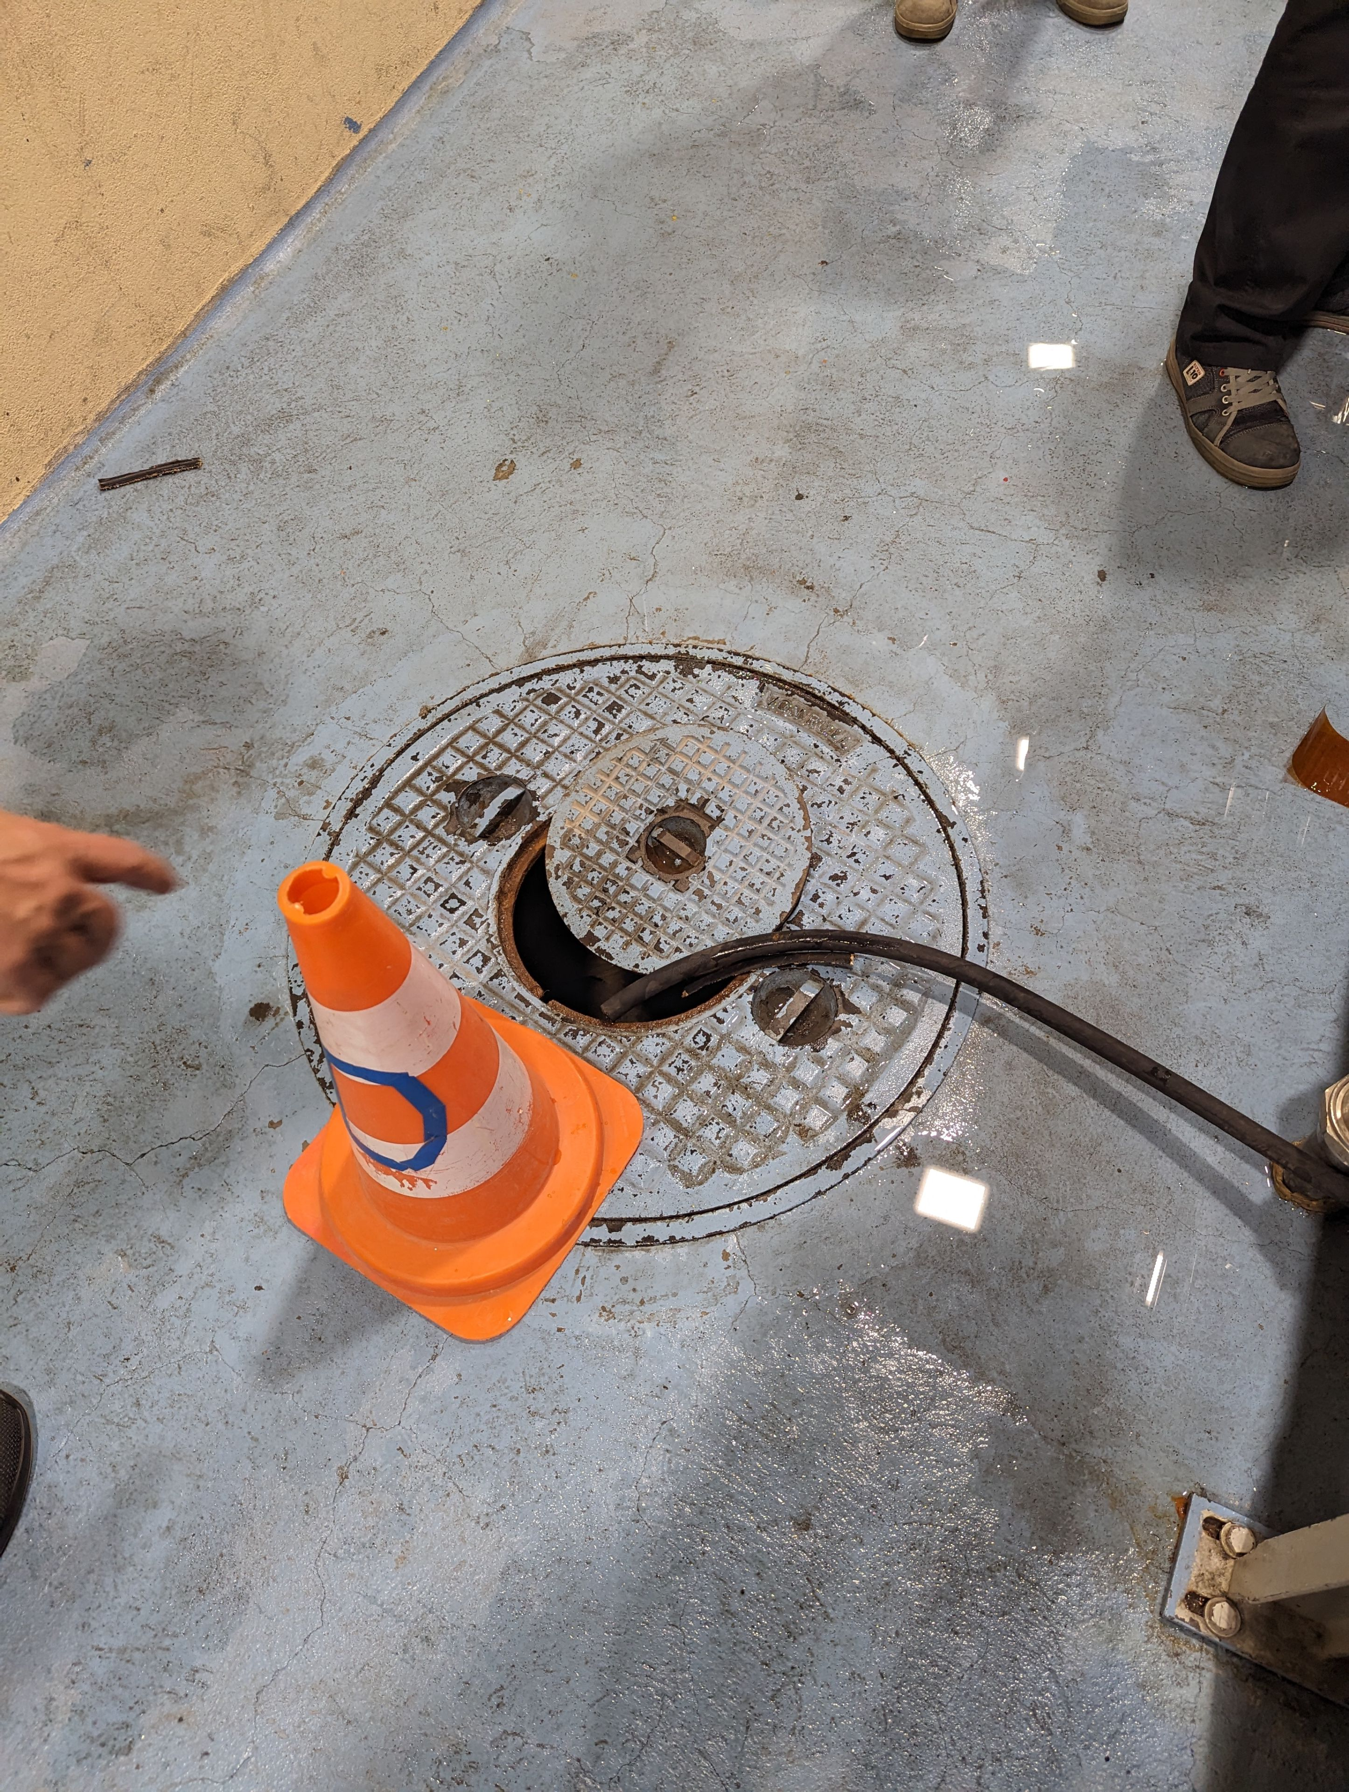
BR.QFO11, 19th April 23 https://edms.cern.ch/document/2884501
Leak identified during an inspection in the shadow of a planned access;
Extremely limited access due to the protection cover (systematically modified on magnets removed from the machine to be dismountable), no in-situ repair possible;
Water has been diverted to the drain and regular inspection will be made to monitor the situation (1hr per week as agreed in the FOM).

Slide 7
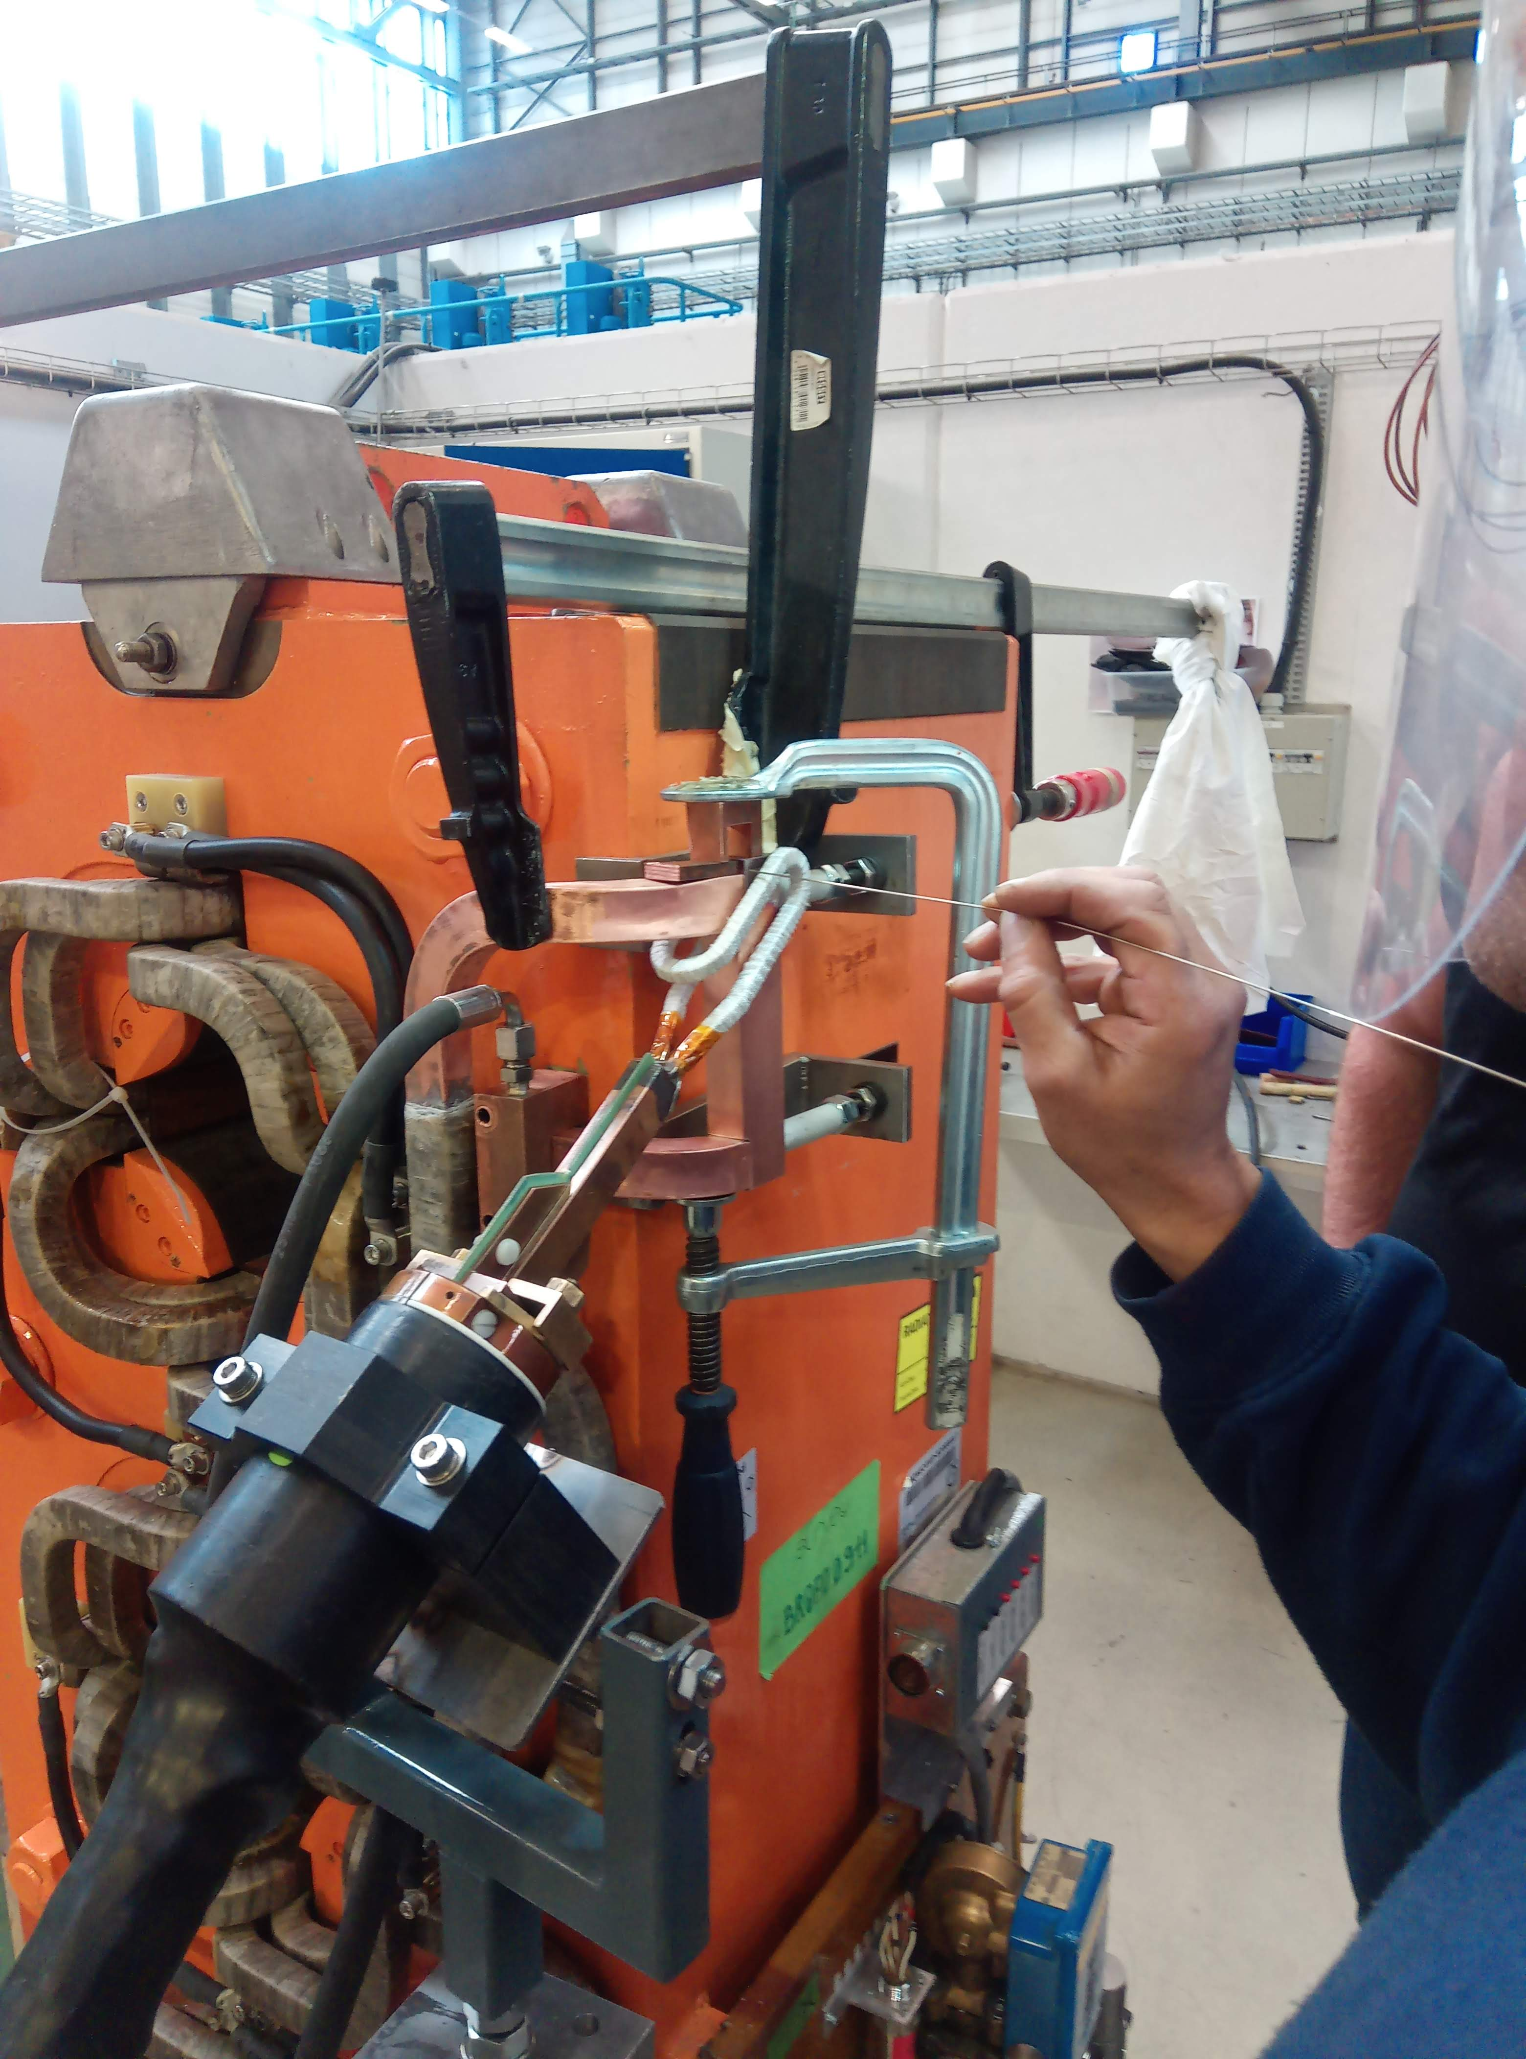
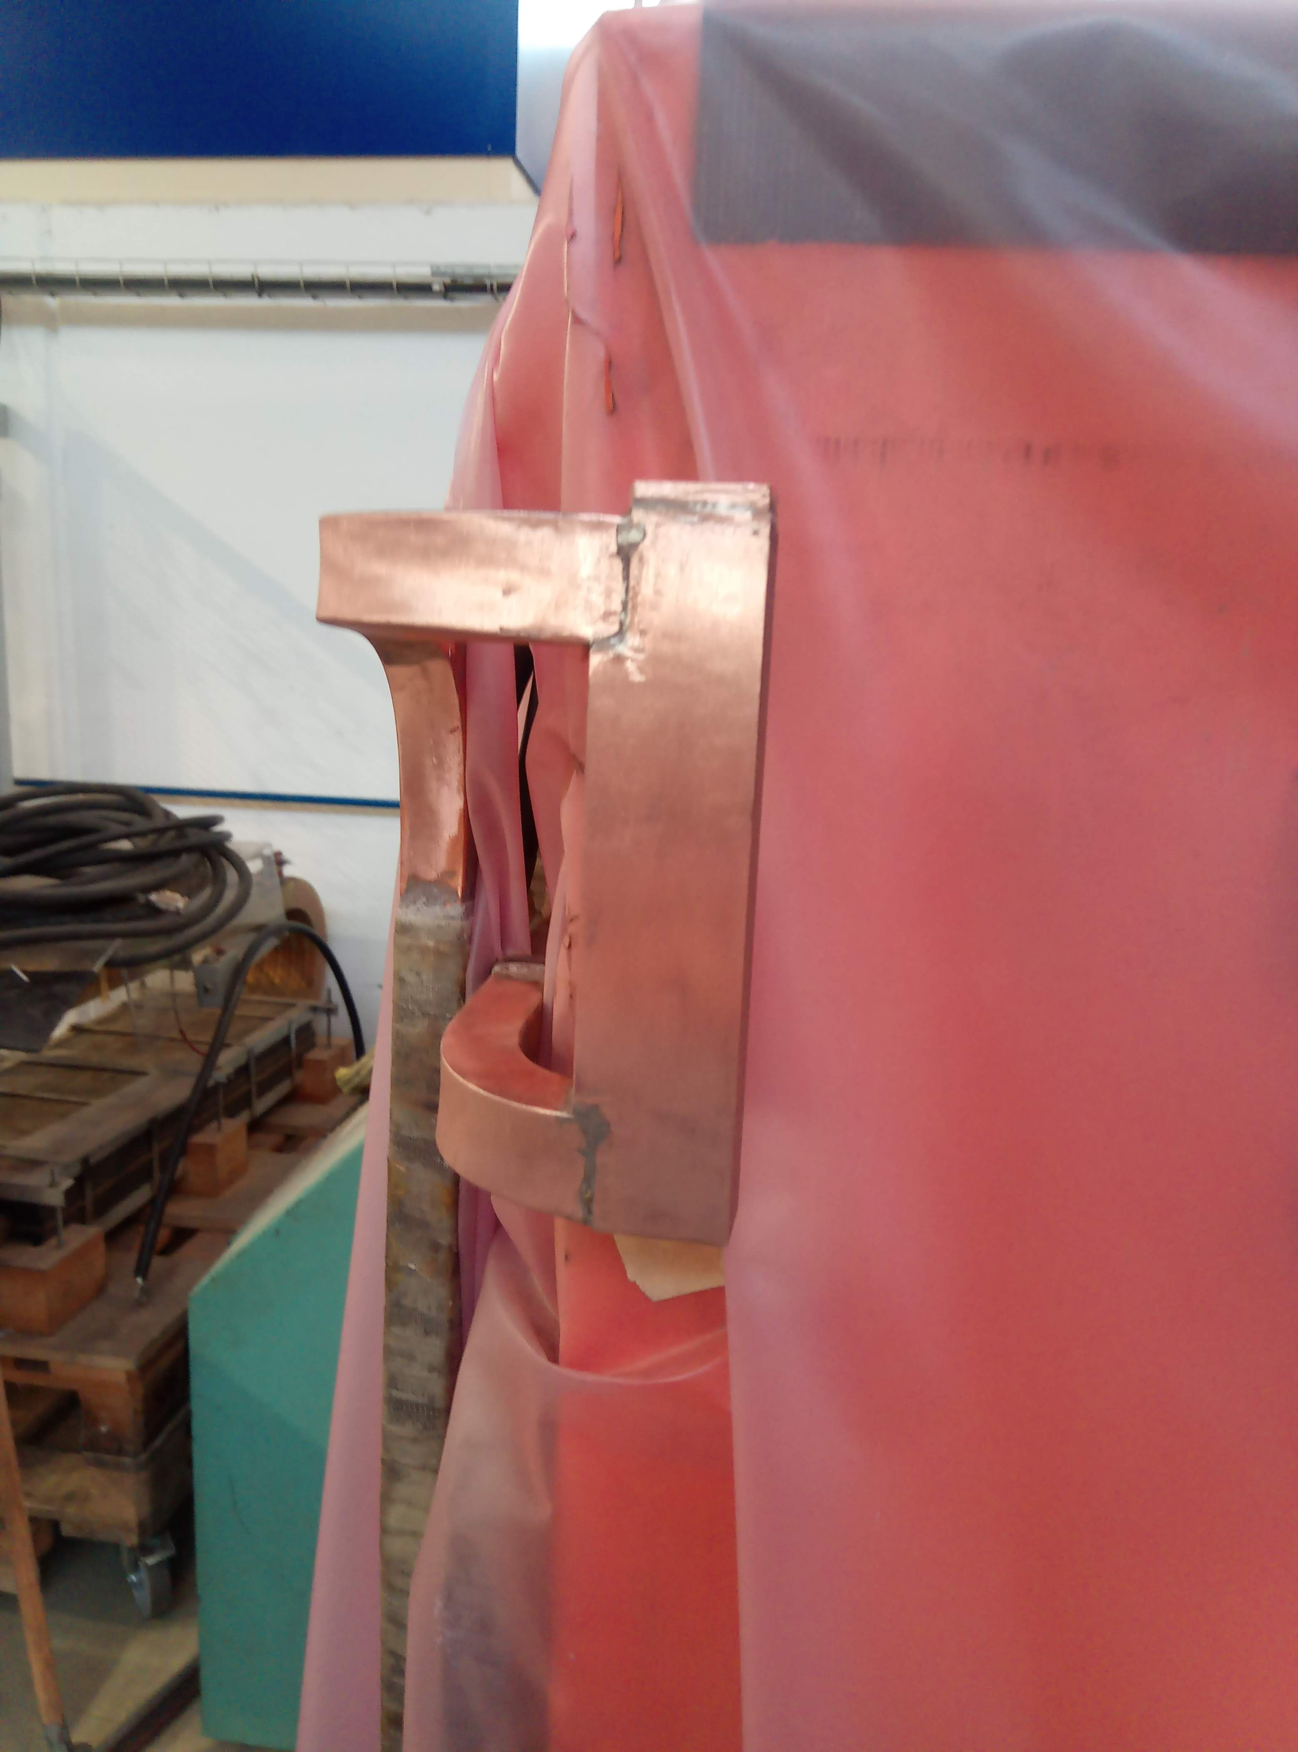
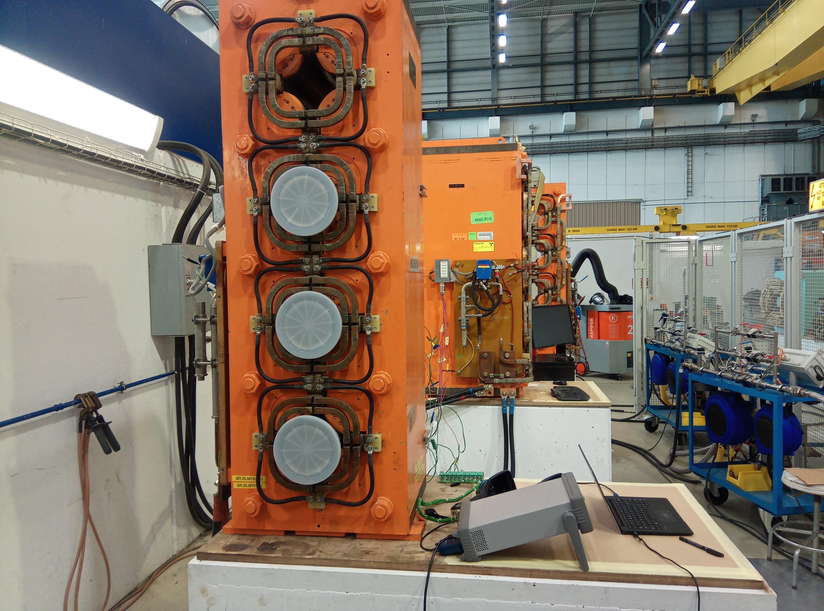
BR.QFO11, 19th April 23 https://edms.cern.ch/document/2884501
Both spare magnets are being repaired/certified, availability in ~1-2 weeks;
Repaired where it leaks!
  Possibility of ultrasonic inspections on the remaining brazed junctions before potentially installing the other magnets? Will it be conclusive enough?
Exchange would take ~ 4-5 days including the exchange of the vacuum chambers.

Slide 8
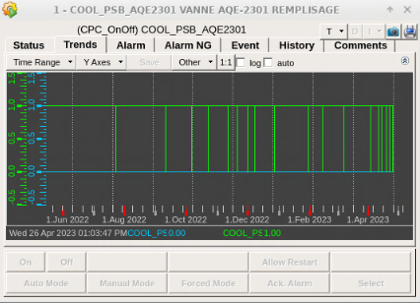
Remote monitoring?
The current leak on QFO11 is below the actual alarm threshold ~60/180 l/day.
Since 11.04 filling is now taking place every 3 to 4 days but seems stable.
EN/CV will now report each time a fill takes place to help evaluate an increase or additional leaks.
Curtesy of EN/EL

Slide 9
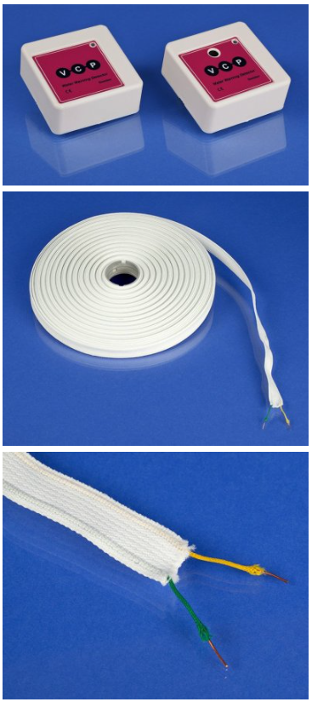
Remote monitoring?
Water detection systems could also be installed to monitor existing (diverted) leaks or to detect new leaks.
The installation of a trail system using the WIC (warm magnet interlock system) to monitor the leaking QFO11 magnet is being discussed.
Eventually installing something to monitor each period or magnet could imagined to avoid down time.
http://www.ventilationcontrolproducts.net/water-detection-wwd-wdt

Slide 10
Questions from Ralf 26/04/23
  Precise location of the leak and the magnet position in the ring, Presented
  Was/is in such a situation an in-situ repair possible, NO
    Was not possible for the following reasons
    It would have been possible if … e.g. different location of the leak and/or different magnet position in view of space to neighboring elements or …
      If an in situ repair would be possible, we would have the following principle options/techniques available/to develop
  The water captured and directed away from sensitive locations towards the floor
    Compared to spring 2022 the same ‘bricolage’ or …. YES
    As we will have to do this again and maybe for longer periods, could we imagine an improved ‘bricolage’’ To be studied
  The magnet is type xyz family (FO or DFO, R or L), Presented
  A spare (or 2?) are in principle available but need to be repaired and certified in the workshop, ONGOING
    Can we do some additional and (partial) meaningful examination of the accessible Cu parts before tunnel installation? Presented
    Can we do something, before tunnel installation, on the accessible parts of the magnets to have -in case of- easier access for ‘repair/patching’ in case of? To be studied
    Can we do something, before tunnel installation, on the accessible parts of the magnets to have -in case of- easier installation of ‘water collector’ in case of? To be studied
    Could we imagine any monitoring device to detect water leaks w/o regular patrolling the PSB? Presented
  The installation of the spare magnet
    will take how many days or better how many hours? Presented
    Would shift work or extended or shifted working hours be possible / useful to reduce the machine downtime? To be studied
  What are the (first) steps foreseen for the leaking magnet following the removal from the tunnel? Preliminary tests

Slide 11
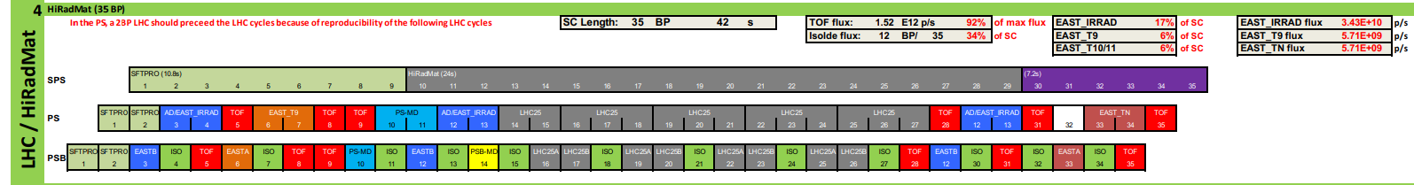
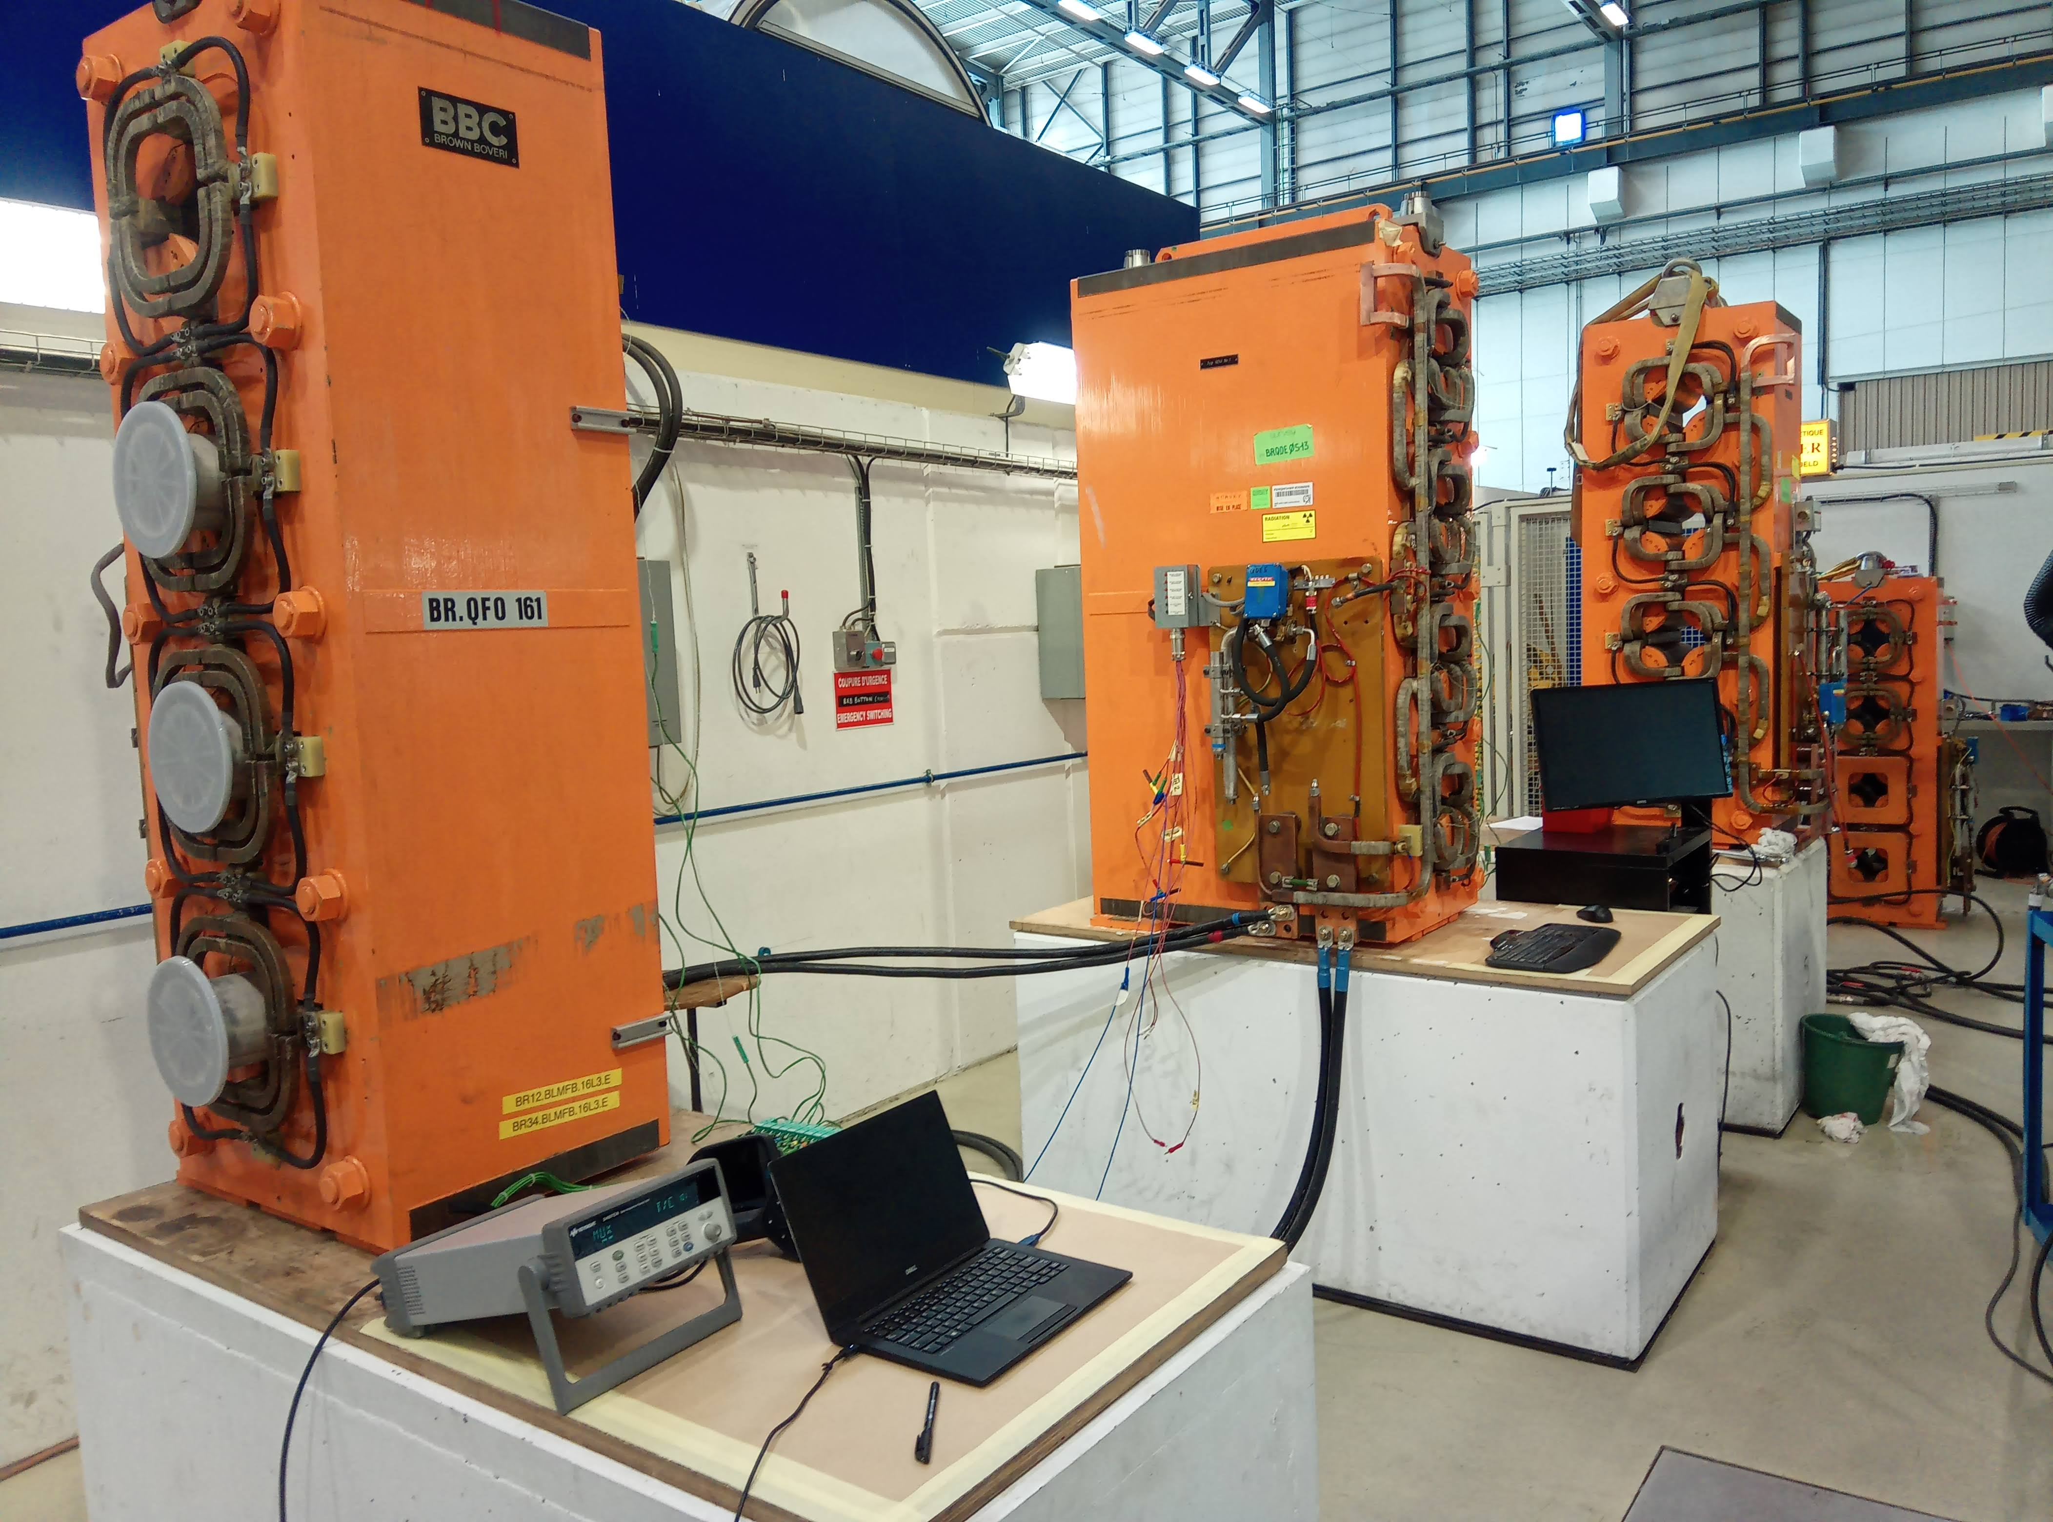
Degraded operation?
Test are being performed to determine the rms current limits in case we need to run without water.
~1/3 of super-cycle may be possible over a limited period of time.
~1/5 in continuous operation
This may only be possible if the decision is taken before an electrical failure occurs!

Slide 13
SPARE SLIDES

Slide 14
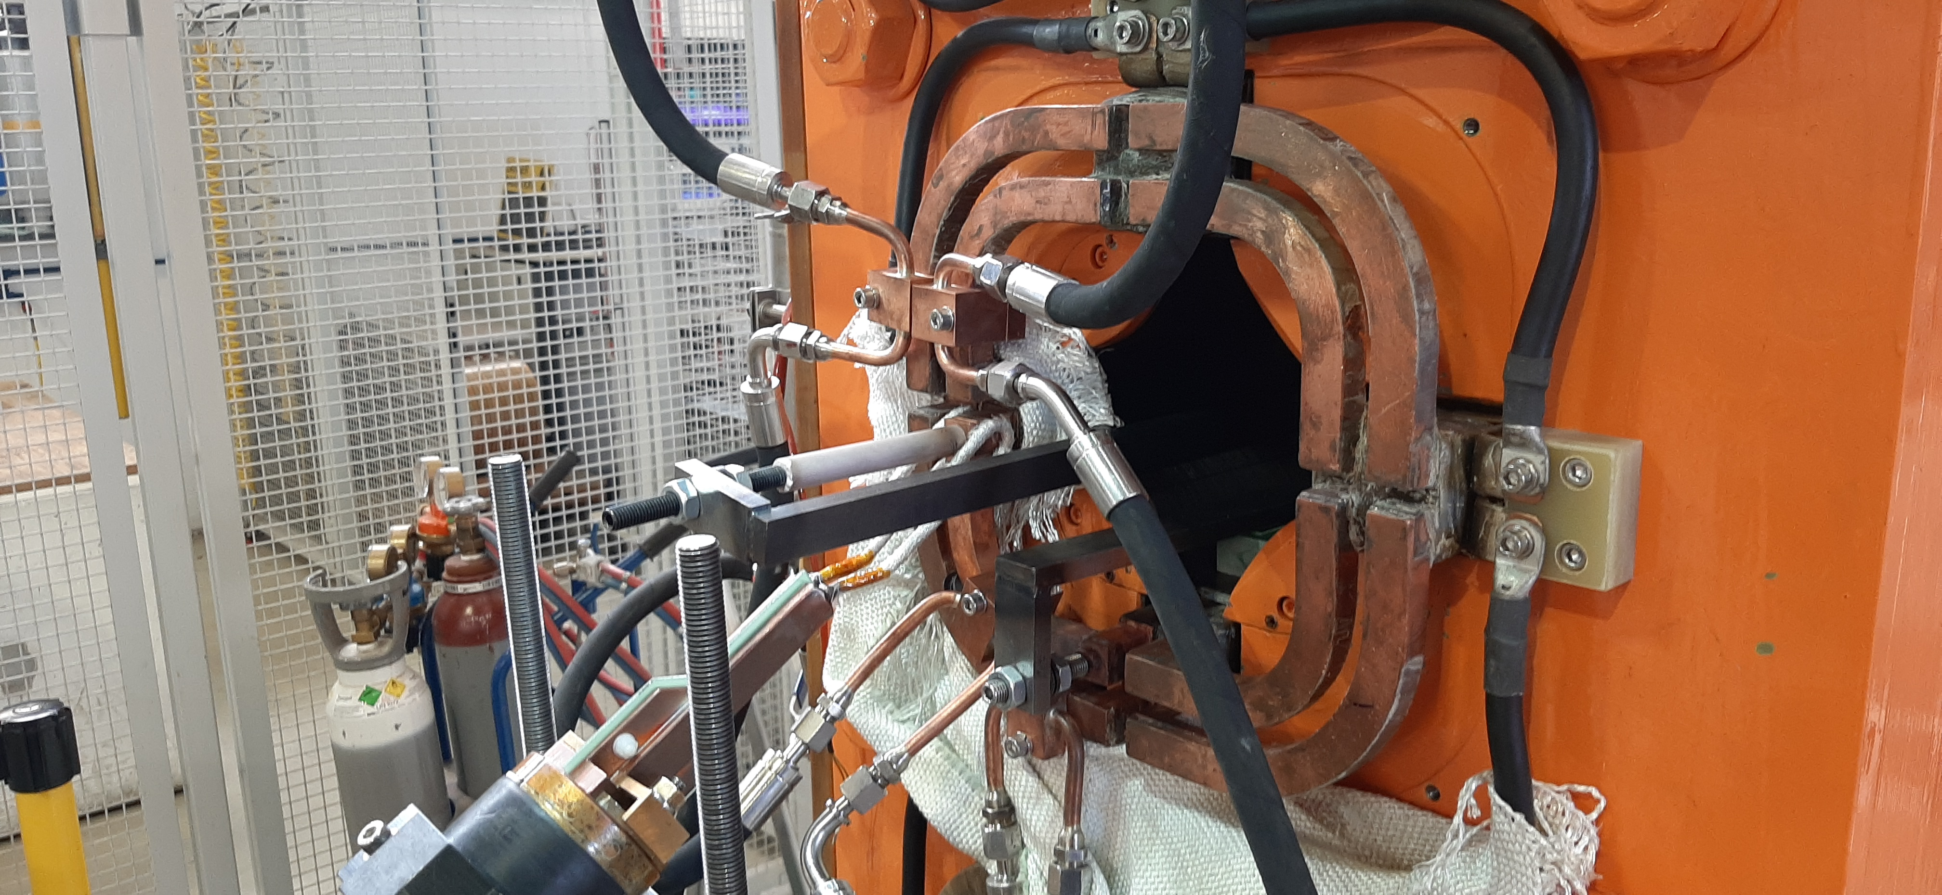
Brazing repair
Water cooling to avoid damaging insulation
Induction brazing head
Induction Brazing repair of the PSB QFO91 Quadrupole in TE workshop summer 22.

Slide 15

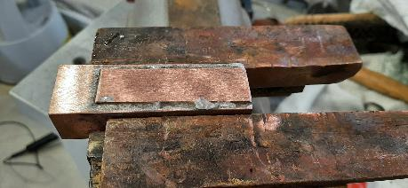
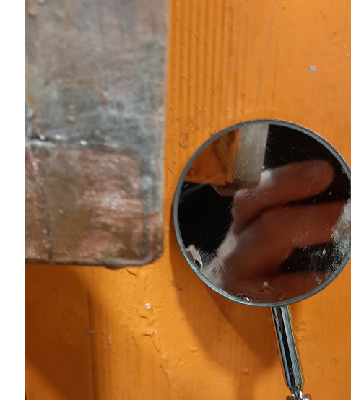
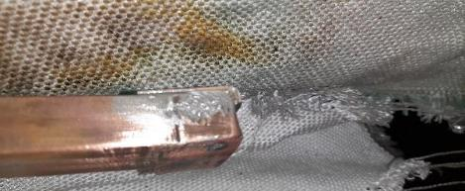
Brazing patching QFO161
Leak discovered during the run (06/21), an in-situ repair was made using ‘soft’ solder, finally the magnet was exchanged during the following YETS.

Slide 16
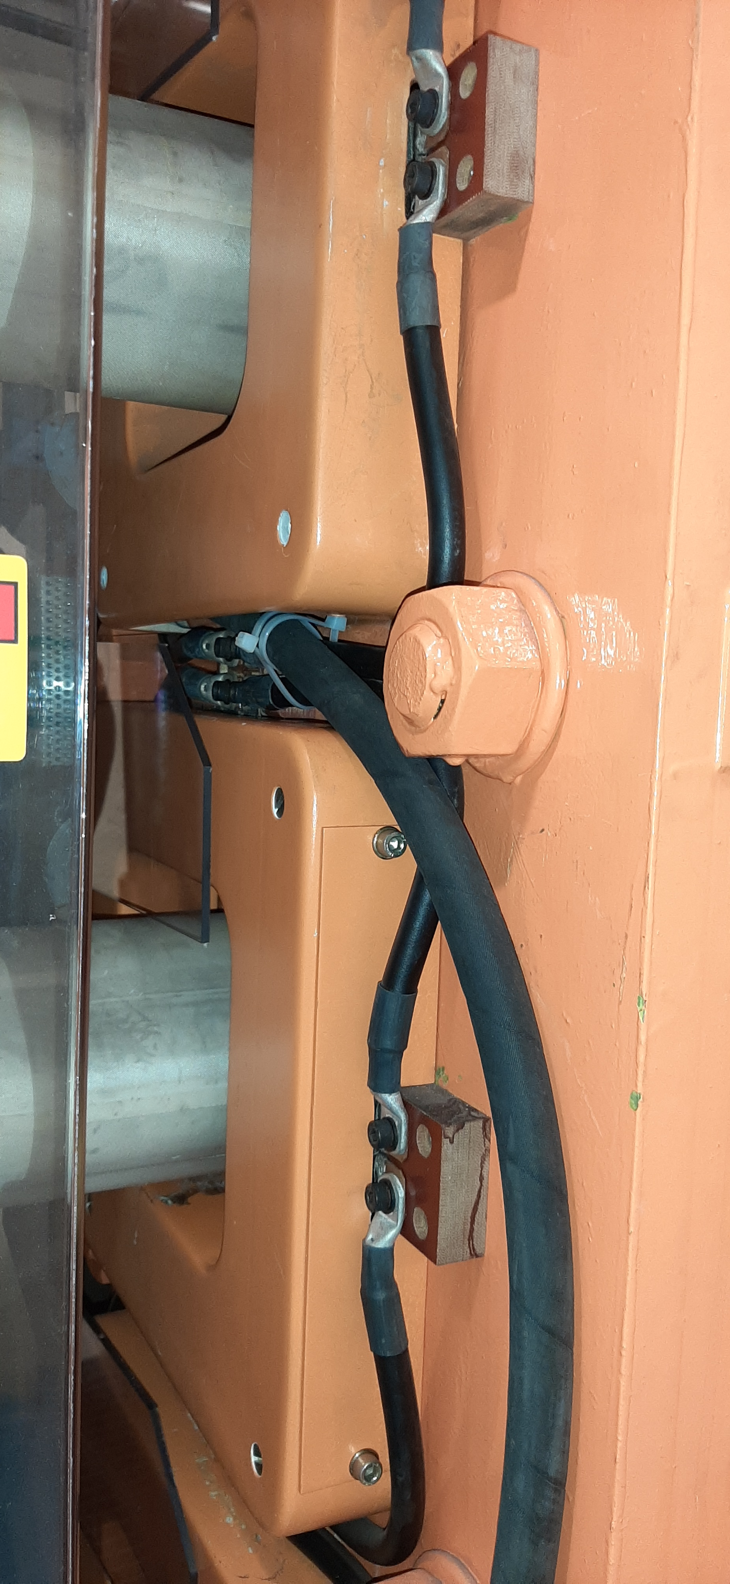
Brazing failure mitigation…
BR.QDE 5, Oct 22
Diversion of the leak to the booster tunnel floor until the magnet could be exchange in the YETS 22/23

Slide 17
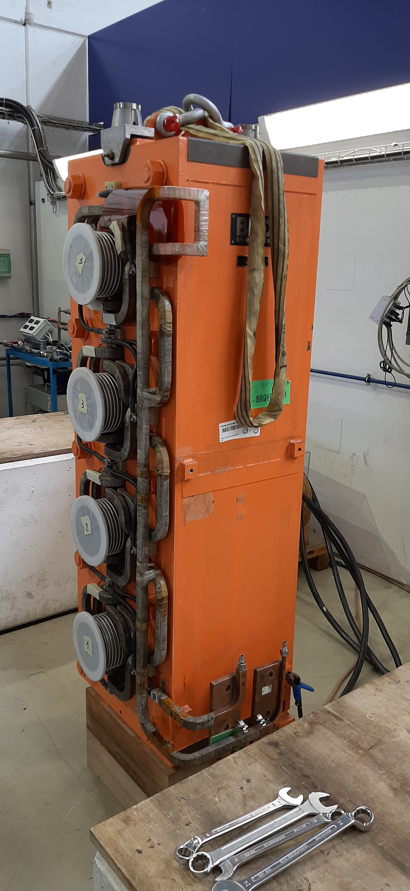
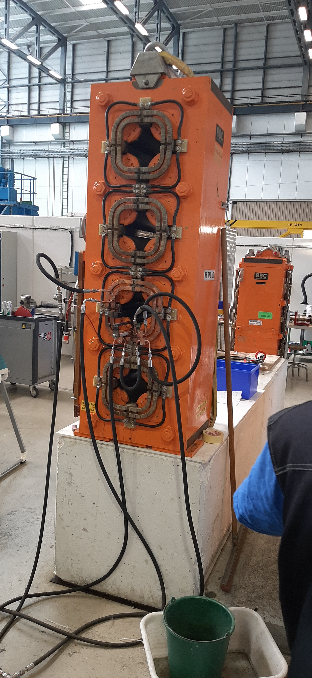
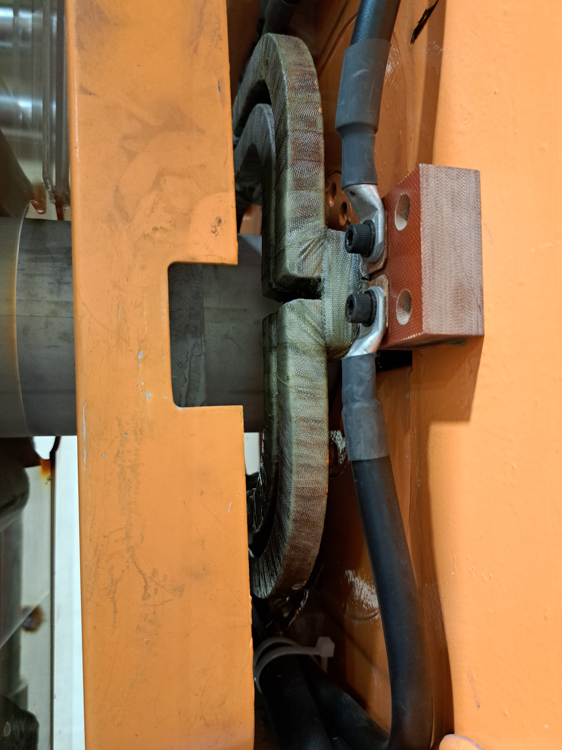
    Evolution of the faults over the past 2 years
BR.QFO161 PXMQNEC4WP-B2000030 – 06/21
BR.QFO91 PXMQNEC4WP-B2000017 – 11/21
https://edms.cern.ch/document/2603476
Leaking brazed joint temporarily repaired in the machine with a soft brazing.
Removed from the machine in YETS 21/22.
Hard brazing replaced in the NCM workshop
Weak insulation to ground ~ 50 MΩ requiring further repair!
Vacuum bag impregnation to be studied.
https://edms.cern.ch/document/2664838
Leaking brazed joint discovered during the High Voltage test during the YETS 21/22.
Removed from the machine in YETS 21/22.
Repair has been completed and the magnet is now operational
BR.QDE5 PXMQNFJ4WP-B2000005 – 09/22
https://edms.cern.ch/document/2779972/1
Leak brazed joint similar to BR.QFO91
Operation has continued diverting the water to the tunnel floor
Magnet exchange planned during YETS22/23

Slide 18
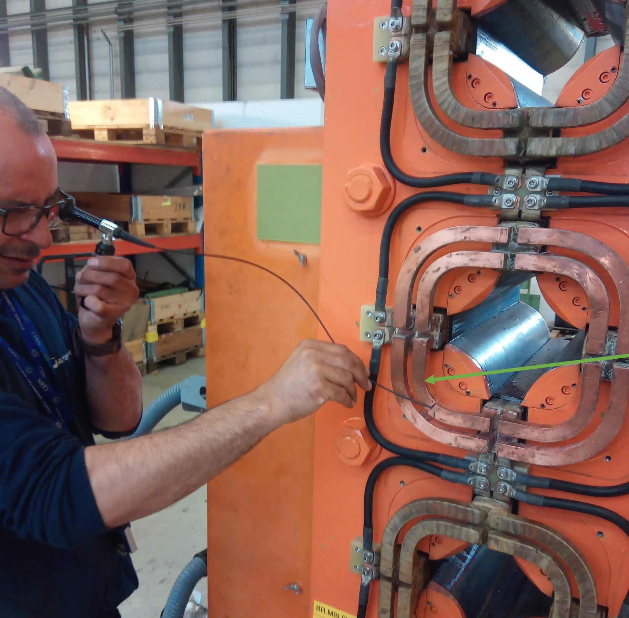
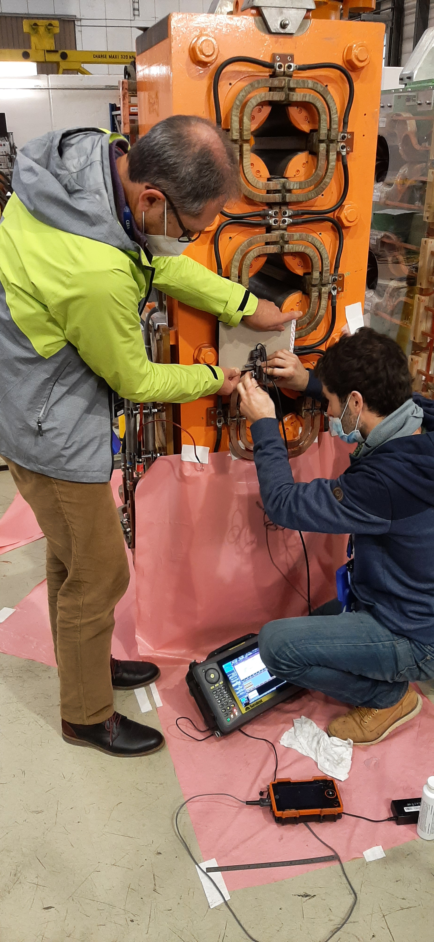
Brazing Analysis
January 22
  Ultrasonic inspection with MME. Voids in the brazed joints ‘visible’ but inconclusive as to the origin.
  Endoscope inspection MSC, nothing conclusive

Slide 19
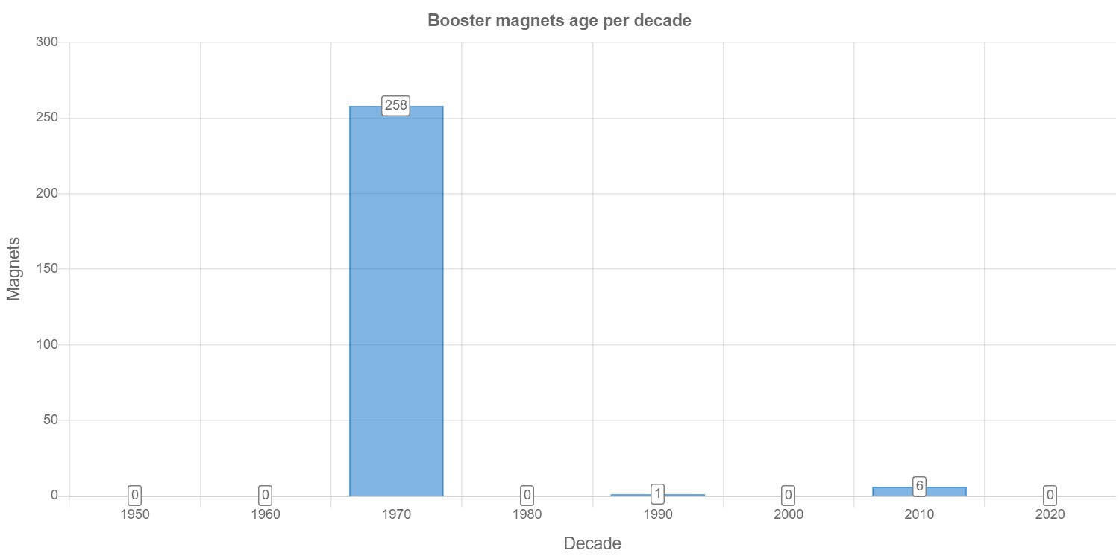
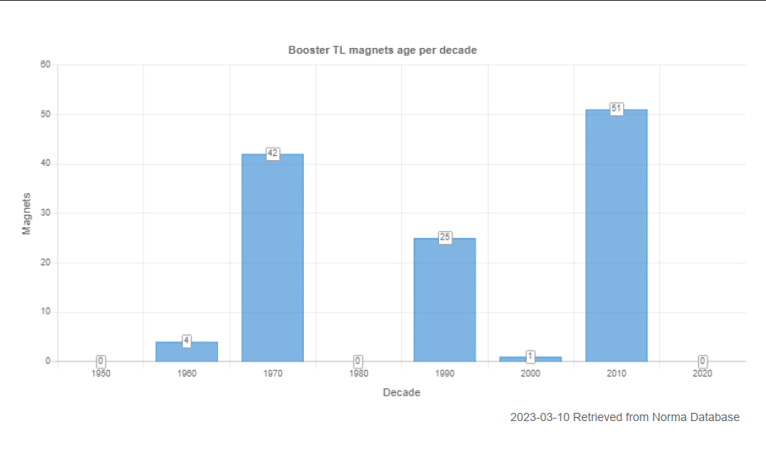
Magnet ageing PSB
PSB Ring Magnet Production by Decade
The ring magnets are predominantly original, the vast majority have never been removed from the machine.
192/260* of the magnet units are water cooled.
* 580/770 when considering multipoles e.g. combined Oct, Sex and Quads etc…
450 – 550 million cycles
26.4 millions with POPS-B
(~20 million @ 2 GeV)
+200 million up to 2040?
(Estimations from EPC & OP)
1950
1960
1970
1980
1990
2000
2010
2020
PSB TL Magnet Production by Decade
From the L4 > PSB > PS & ISOLDE many of the magnets have been exchanged during various upgrades. The majority of the remaining original magnets are air-cooled.
51/123 magnets are water cooled.

