Slide 1

Towards DRD1 Collaboration: scientific organization and the timeline
dr
Anna Colaleo (University and INFN Bari), Leszek Ropelewski (CERN)
On behalf of DRD1 coordinators and Working Group conveners
Community meeting 23/6/2023

Slide 2
DRD1 proposal implementation timeline
March- 5 May: draft document preparation including a preliminary definition of Work Package
15 May: Start the community consultation. 1st Draft shared with Institute Contacts.
15 May - 1 June: Proposal Team works on the draft document within working groups, implementing the feedback from the community and preparation of the preliminary version of the Executive Summary with WP tables.
1 June: End of the community feedback about the first draft
16 June: Approval of the document for the community-wide discussion and release to the 2nd draft whole community.
22-23 June: DRD1 Community workshop - wide discussions during the community workshop
June- July: - Definition of the required resources for the outlined programme need ( split into personel effort (FTEs) and material plus services (non-FTE) costs. – institute’s inputs; executive summary
End-July: Submission of the proposal

Slide 3
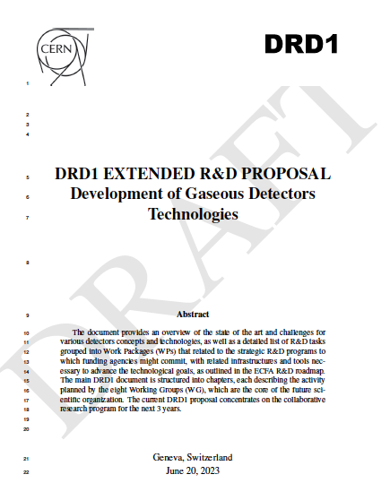
DRD1 Proposal
DRD1 document in the making
Structure of the document:
Executive summary
Scientific organization of DRD1 Collaboration
Research topics and Work plan
  8 sections: one per Working Group
  WorkPackages described in 4.2
Collaboration organization
Resource and infrastructures

Slide 4
List of editors
Organization and collaborative aspects: A. Colaleo, E. Oliveri, L. Ropelewski, M. Titov
Research topics and Work plan
Paragraph 4.1 WG1 - Technologies: P.Colas, F. Resnati, P. Wintz, I. Deppner, M. Tytgat, L. Moleri
Paragraph 4.2 WG2 - Applications: F. Garcia, P. Gasik, F. Grancagnolo, D. Gonzalez Diaz, G. Aielli, G. Pugliese, R. Farinelli, I. Laktineh
Paragraph 4.3 WG3 - Gas and material studies: B. Mandelli, G. Morello, F. Renga, K. Dehmelt, S. Roth,
D. Piccolo, A. Pastore, B. A. Gonzalez
Paragraph 4.4 WG4 - Detector physics, simulations, and software tools: M.Abbrescia, M. Borysova,
P. Fonte, O. Sahin, P. Verwilligen, R. Veenhof
Paragraph 4.5 WG5 - Electronics for gaseous detectors H. Muller, J. Kaminski, M. Gouzevitch, R. Cardarelli, Sorin Martoiu, Marco Bregant, Michael Lupberger
Paragraph 4.6 WG6 - Detector production: R. De Oliveira, F. Jeanneau, A. Delbart, G. Iaselli,
I. Laktineh, G. Charles
Paragraph 4.7 WG7: Common test facilities: Y. Tsipolitis, E. Oliveri, R. Guida, G. Iaselli,
A. Ferretti
Paragraph 4.8 WG8:Training and dissemination: F. Brunbauer, M. Iodice, E. Baracchini, B. Liberti,
A. Paoloni

Slide 5
List of editors
Editors of latest draft: Riccardo Farinelli, Esther Ferrer Ribas, Piotr Gasik, Diego Gonzalez Diaz, Michael Lupberger, Eraldo Oliveri, Alessandro Paoloni, Fulvio Tessarotto, Piet Verwilligen
Internal reviewers of the document:
Andy White, Paul Colas, Emilio Radicioni, Giuseppe Iaselli, Amos Breskin, Jianbei Liu, Supratik Mukhopadhyay, Atsuhiko Ochi
Many thanks to all editors for the extraordinary effort!
Many thanks to the institute contact persons for providing
prompt feedback!

Slide 6
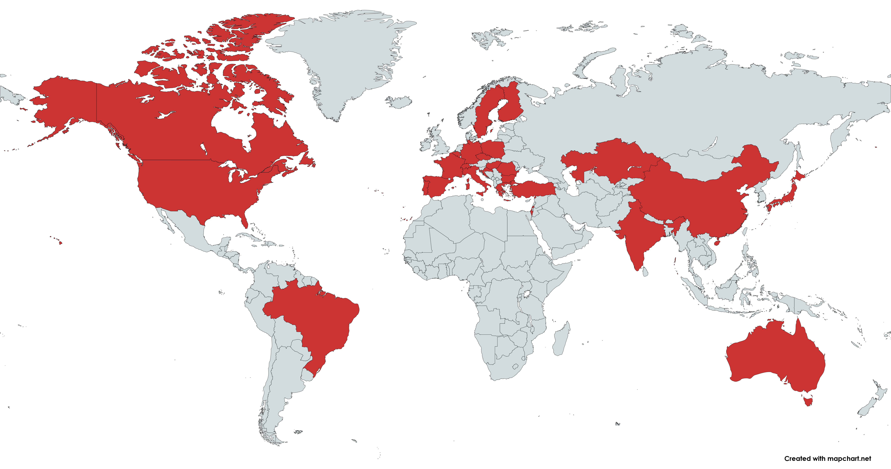
DRD1 Proposal: country maps
108 institutions in 4 continents expressed interest to join the DRD1 Collaboration

Slide 7
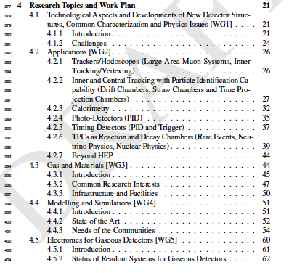
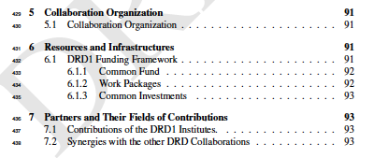
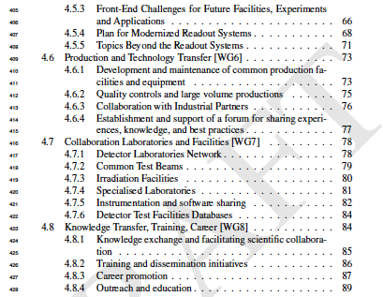
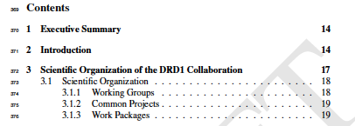
DRD1 Proposal
Research topics and Work plan
Collaboration organization
Resource and infrastructures
Executive summary
Scientific organization of DRD1 Collaboration

Slide 8
Scientific organization of DRD1: the pillars
The DRD1 Collaboration aims to promote the development, diffusion, and applications of gaseous detectors, following the General Strategic Recommendations* (GSR) outlined in the ECFA Detector R&D Roadmap Document.
The following pillars form the foundation of this Collaboration:
Community-Driven Collaboration: The Collaboration is driven by the community, providing a vital forum for exchanging ideas and establishing synergies to minimize duplicated efforts.
Recognition and Support for Young R&D Experts: The Collaboration will promote proper recognition and support for the careers of instrumentation R&D experts. This support will be facilitated through the member institutes and their interface with the scientific community and institutions.
Dynamic and Open R&D Environment: The Collaboration will strive to create and maintain an up-to-date, dynamic, and open R&D environment. This environment will support the development of necessary tools such as simulation and electronics, as well as the infrastructure required to undertake R&D on novel detectors and to validate their performances against the demanding specifications of future facilities and applications.
* See backup for details

Slide 9
Scientific organization of DRD1: the pillars
The DRD1 Collaboration aims to promote the development, diffusion, and applications of gaseous detectors, following the General Strategic Recommendations* (GSR) outlined in the ECFA Detector R&D Roadmap Document.
The following pillars form the foundation of this Collaboration:
Global Network and Access to Facilities: Leveraging its worldwide international network, the DRD1 Collaboration will facilitate access to testing facilities and advanced engineering support, available at DRD1 research laboratories and institutes.
Support for "Blue-Sky" R&D: The Collaboration will actively support "Blue-sky” R&D, which can lead to breakthroughs driven by technology. Common resources will be allocated, leveraging the aforementioned R&D environment.
Efficient Resource Pooling: The Collaboration aims for the most efficient pooling of resources through joint projects that will undergo international review. It will promote and support research plans that attract long-term funding, enabling the community to effectively address future technical challenges. These efforts will also help to build strong relationships between institutes and industrial partners.
Increasing Research Potential: By adding critical mass to the needs of individual institutes, the Collaboration aims to reduce research costs and enhance potential and results.

Slide 10
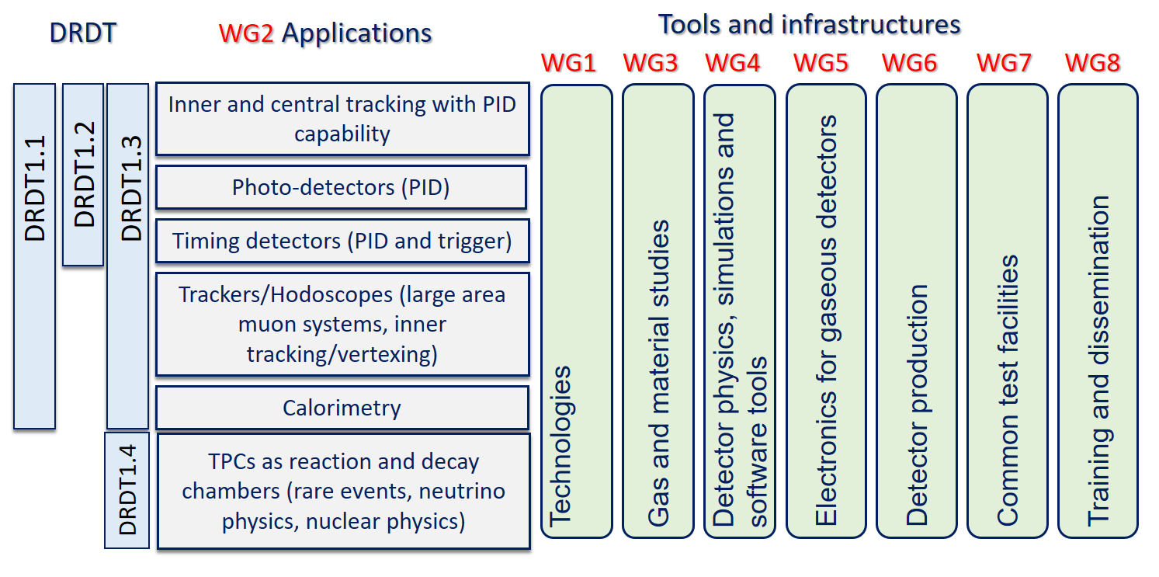
Structure in Working Groups, forum for scientific discussions, coordinated by conveners:
  aligned with the scientific program of the ECFA roadmap through the applications related to future facilities challenges, outlined by R&D Themes (DRDTs*), but also to the GSRs
DRD1 Scientific organization: Working groups
* See backup for details
Note: Applications Beyond HEP recently added

Slide 11

DRD1 scientific organization: Working groups
Working Groups are the core of the scientific collaboration
supporting the development of novel technologies and the consolidation of existing ones.
facilitating the exchange of ideas and foster synergies between institutes
playing a crucial role in identifying, guiding, and supporting strategic detector R&D directions, facilitating the establishment of joint projects between institutes
serving as a knowledge and technology hub for developing gaseous detector technologies:
  Technological Aspects and Developments of New Detector Structures, Common Characterization and Physics Issue
  Applications
  Gas and material studies, and link to the novel technologies
  Detector Physics, Modelling and Simulation frameworks
  Electronics for gaseous detectors
  Production and Technology Transfer
  Common Test Facilities and Infrastructures
  Training and dissemination
WG will be recognized as a scientific reference for the community.

Slide 12
Funding schema
Organization of the collaboration activities
Following the indication of ECFA Detector Panel (*) two areas of Detector R&D :
”Blue-sky” R&D (competitive, short-term responsive grants, nationally organised)
Strategic R&D via DRD Collaborations (long-term strategic R&D lines) (address the high-priority items defined in the Roadmap via the DRDTs)
Two types of DRD1 joint projects will be implemented:
Common projects
For low-TRL (blue sky) R&D, or other short term generic projects
Funding method:
Metabolism of each group
EU, National projects
DRD1 common fund
Work Packages
Strategic R&D targeting the priority programmes outlined in the updated European Strategy for Particle Physics.
Funding method:
Each institute asks its funding agency and controls the funds
* See backup for details

Slide 13
Common projects
Common Projects (CP) support low TRL (blue-sky) R&D considered of interest by the collaboration, or generic projects (not related to experiments) that are vital for the community and require special backing:
  Technology R&D projects towards developments of novel techniques, improvements of existing technologies, characterization methods and dedicated tools;
  Development and optimization for novel applications;
  Improvement of the technology transfer to industry.
This is a well-defined path (RD51 experience)
DRD1 Common Fund (details will be clearly defined in the MoU) supports CP with matching resources from participating Institutes.
a minimum number of participating Institutes to encourage collaborative effort between groups.
limited in time
limited funding support from the collaboration (example 20-30k/y)
➔ large number of groups in DRD1 ensures strong R&D
Reviewed by the DRD1 Collaboration

Slide 14
Strategic R&Ds (according to ECFA Detector R&D Roadmap) organized in Work Packages
  group activities of the Institutes with shared research interests around Applications with a focus on a specific task(s) devoted to a specific DRDT challenge, typically related to specific Detector Technologies and to the development of specific tool or infrastructure
Strategic R&D = Work Package
Application
⇽ defined by ECFA R&D Roadmap
Tasks
focusing on challenges related to performance (precise timing, high rates performances, longevity …)
⇽ connection to ECFA DRDTs
Technological areas:
MPGD, RPC, Wire, LDC, TPC, …
R&D on Sensors, Electronics, Software Tools, Gas Properties studies;
Development of infrastructure and production techniques
Training
Work Package

Slide 15
Work Packages
WPs are organized and coordinated internally by participating Institutes:
It is required to be a member of DRD1 to contribute to a WP
  should pursue implementation of the milestones and deliverables and execute the workplan outlined in the approved scientific proposal
  funds are fully controlled and operated by participating Institutes.
    The formal agreement between participating Institutes, DRD1 management, and the host lab (CERN) is being sorted out by CERN management
Work Packages take full advantage and contribute to the DRD1 scientific program, R&D environment, infrastructure, and R&D tools (electronics, software).
WP can be created at any time in the future
The strategic R&D will be in the focus of the DRDC* reviews.
* See backup for details

Slide 16
Work Packages
WPs are organized and coordinated internally by participating Institutes:
It is required to be a member of DRD1 to contribute to a WP
  should pursue implementation of the milestones and deliverables and execute the workplan outlined in the approved scientific proposal
  funds are fully controlled and operated by participating Institutes.
    A formal agreement between participating Institutes, DRD1 management, and the host lab (CERN) is being sorted out by CERN management
Work Packages take full advantage and contribute to the DRD1 scientific program, R&D environment, infrastructure, and R&D tools (electronics, software).
WP can be created at any time in the future
The strategic R&D will be in the focus of the DRDC* reviews.
Note: It is not required to be involved in a WP to be a member of DRD1

Slide 17
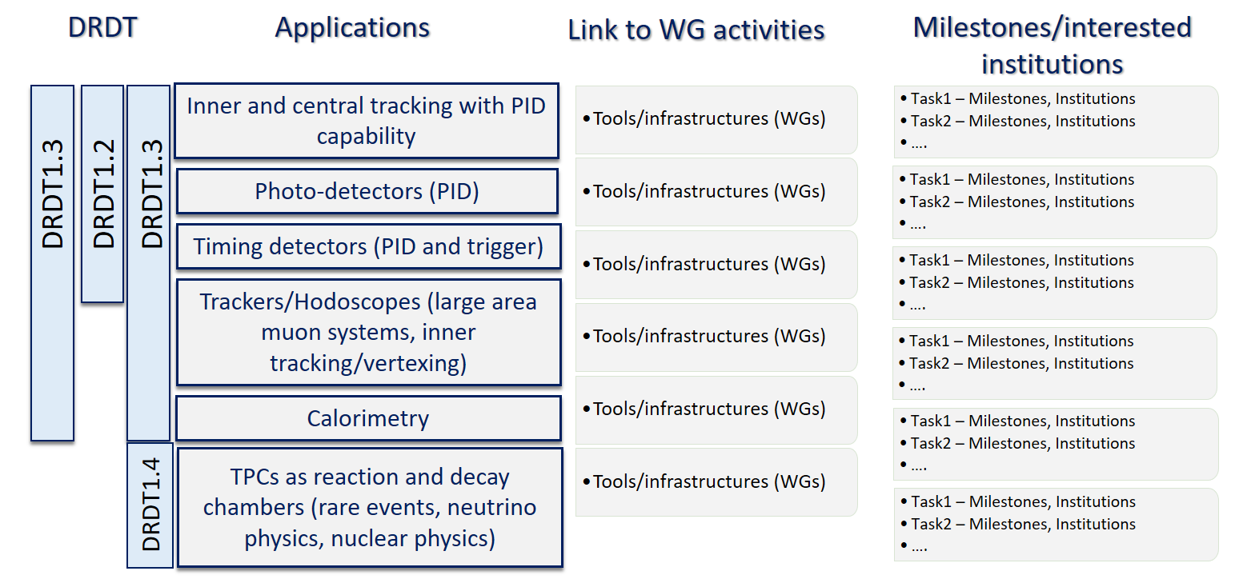
DRD1 Work Packages
For each Work-package associate to a specific application, the preliminaly list of tasks is being prepared according to the feedback received by the community

Slide 18
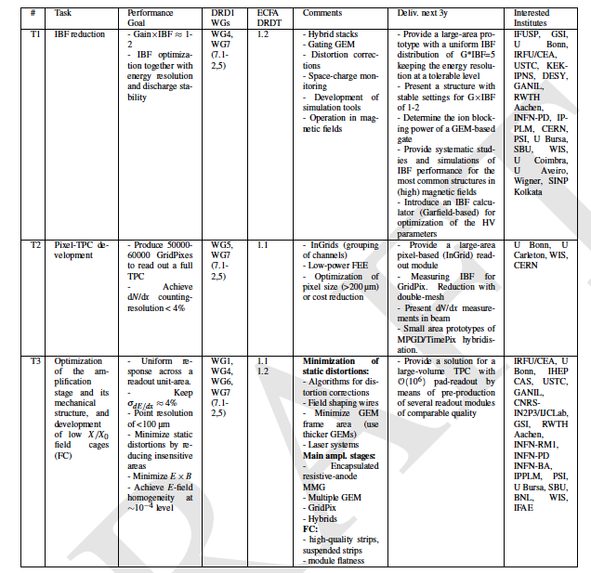
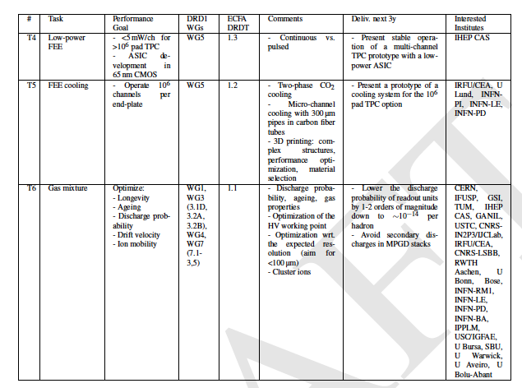
Challenges for the TPC at colliders
Example for Work Package: Inner and central tracking
• Good dE/dx resolution, partly driven by a good gain uniformity;
• very low (gain x Ion Back Flow) to drastically reduce space charge distortions;
• high readout granularity to cope with the particle multiplicity;
• electronics with low power dissipation to meet the increased density of readout channels.
• large area coverage at reduced low cost, relying on lightweight mechanical structures based on composite materials.
First draft
Area of application: future electron colliders (ILC, FCC-ee, CEPC). Timeline: 2035-2040, most of the R&D goals should be reached by 2030 to allow for timely construction.

Slide 19
DRD1 proposal implementation timeline: next steps
March- 5 May: draft document preparation including a preliminary definition of WP
15 May: Start the community consultation. Draft shared with Institute Contacts.
15 May - 1 June: Proposal Team works on the draft document within working groups, implementing the feedback from the community and preparation of the preliminary version of the Executive Summary with WP tables.
1 June: End of the community feedback about the first draft
16 June: Approval of the document for the community-wide discussion and release to the whole community.
22-23 June: DRD1 Community workshop - wide discussions during the community workshop
June- July: - Definition of the required resources for the outlined programme need ( split into personel effort (FTEs) and material plus services (non-FTE) costs. – institute’s inputs; executive summary
End-July: Submission of the proposal

Slide 20
WP definition: next step
WP Coordinators will contact ALL institutes which shared their interest in given WP topics in the survey and/or community feedback
Institutes can still be added/removed from the individual WP and their tasks
”Extended WP tables” will be created together with institutes which declare their contribution to specific WPs
  “WP projects” with well defined tasks will cluster institutes interested in common goals;
  Final DRD1-proposal WP tables will be a compilation of such “WP projects”
  The institutes interested to contribute to a given WP need to provide FTE and non-FTE resources in the extended WP tables
  We differentiate between “existing” and “requested” resources.
  WP can help in acquiring strategic funding, however, it is not mandatory for an institute to apply for extra funding. One can contribute with the exiting resources only

Slide 21


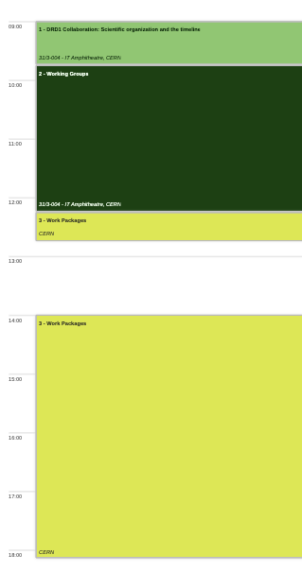
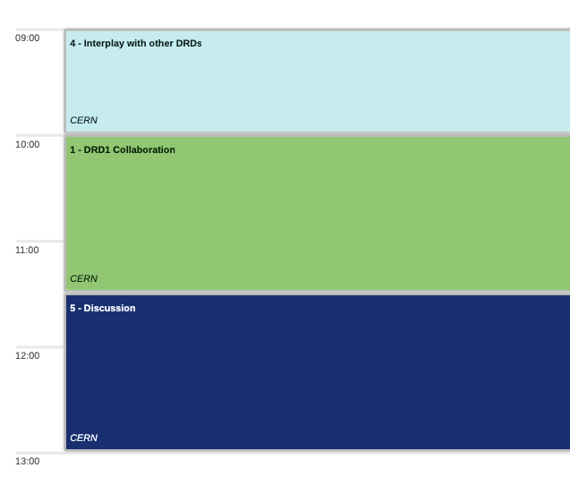
Community meeting agenda

Slide 22
BACKUP

Slide 23
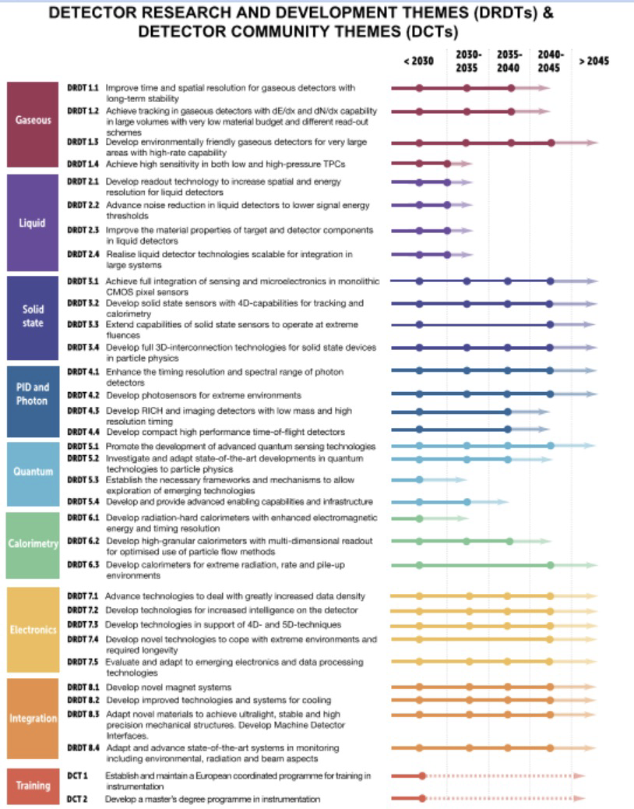
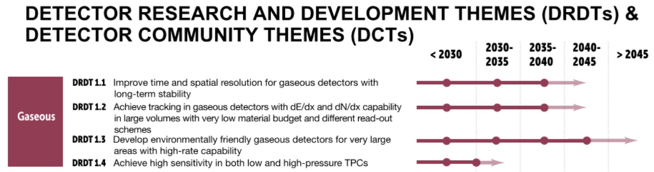
DRD Themes

Slide 24
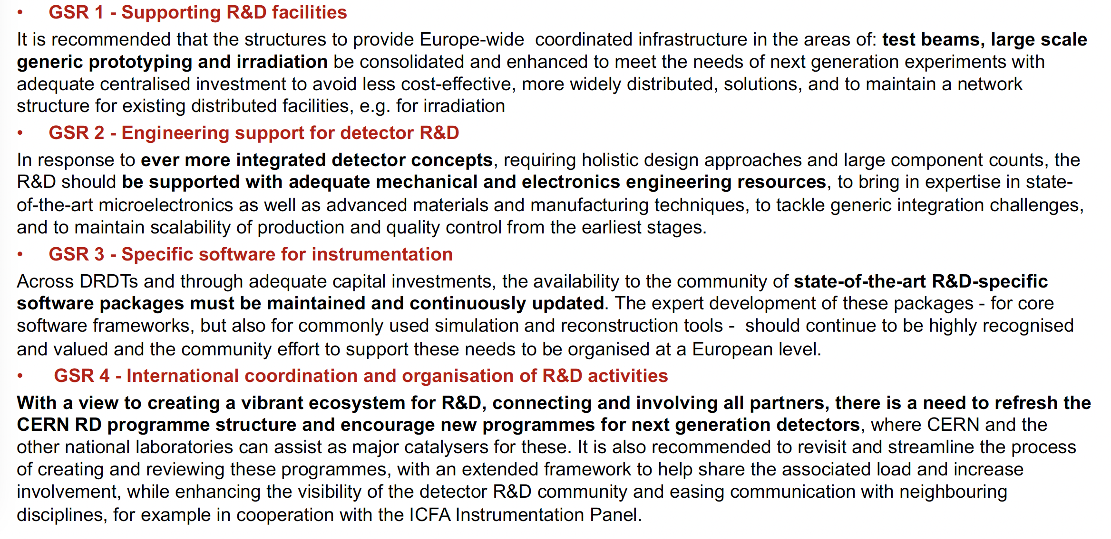
General Strategic recommendations

Slide 25
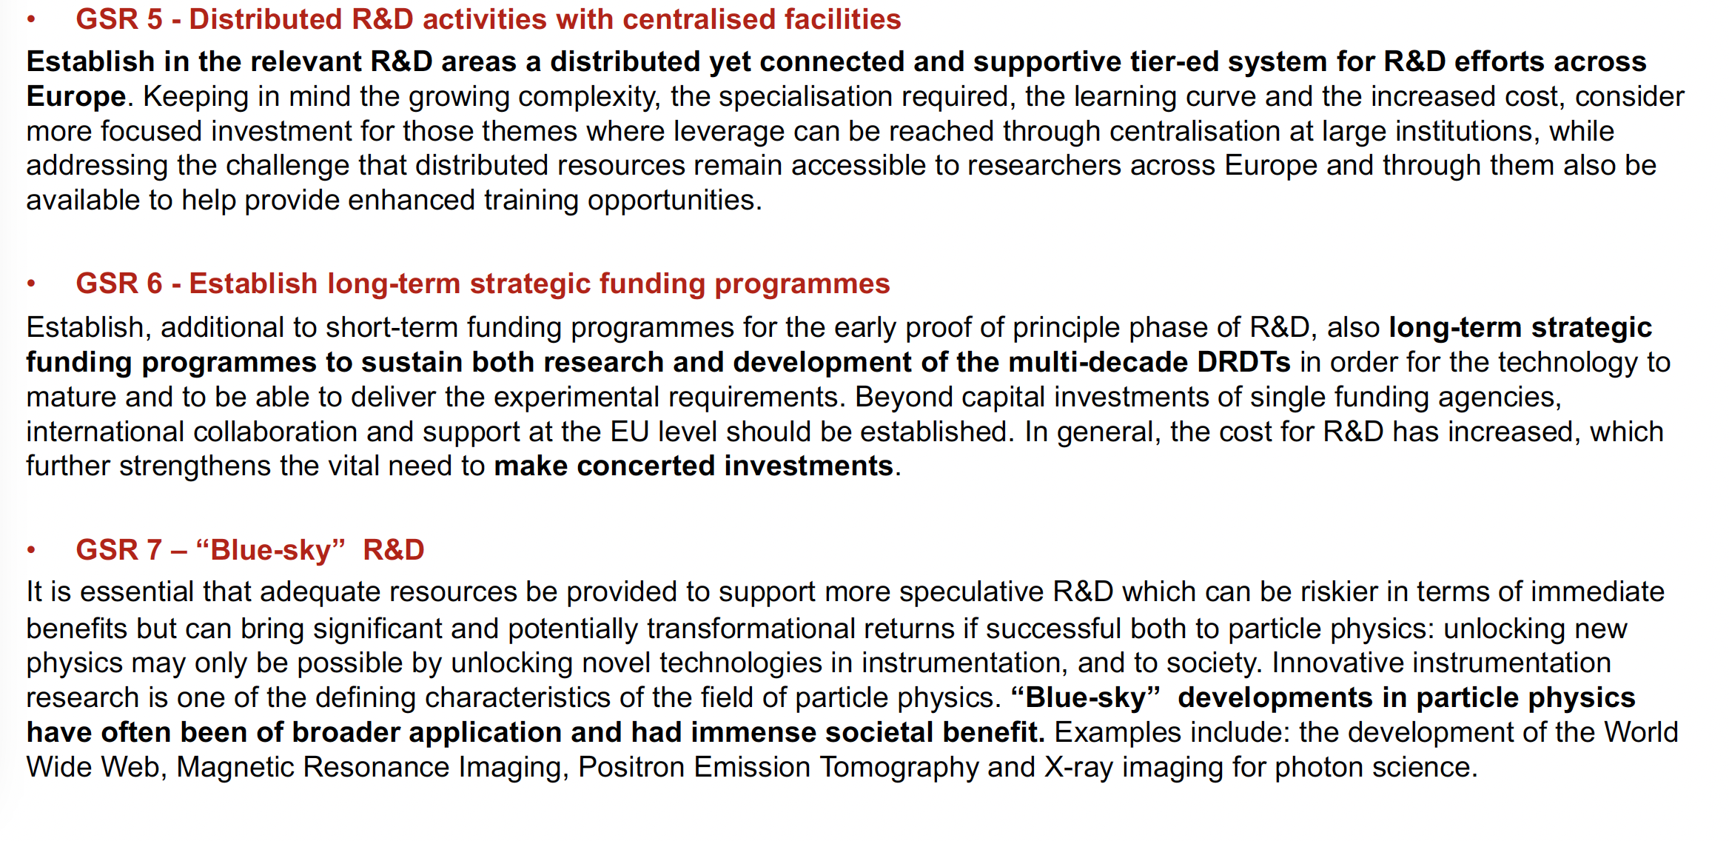
General Strategic recommendations

Slide 26
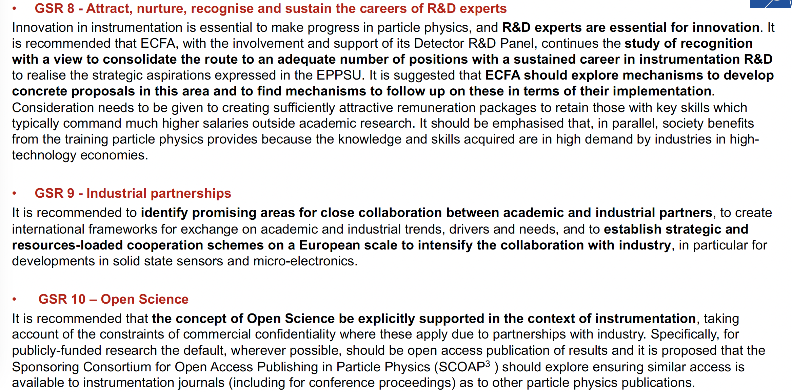
General Strategic recommendations

Slide 27
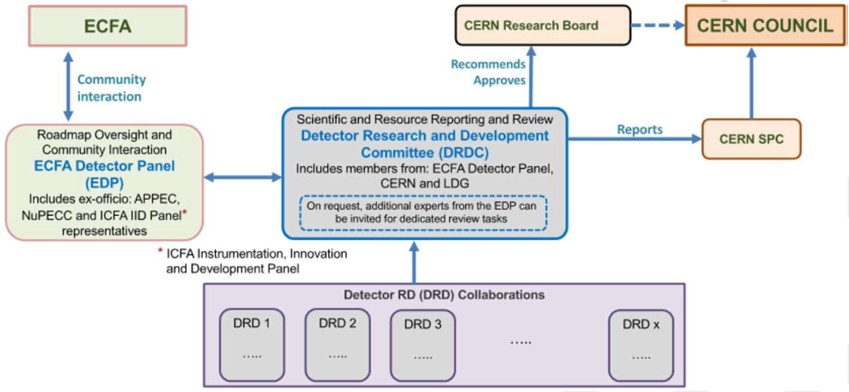


ECFA DETECTOR R&D ROADMAP IMPLEMENTATION PLAN
Requested by the CERN Council ECFA Roadmap Coordination Group worked out a proposal to organize long-term R&D effort into: new established Detector R&D Collaboration anchored at CERN
G. Pellegrini DRD3
Three areas of Detector R&D:
1.Strategic R&D (long term strategic R&D (address the high priority items defined in the Roadmap via the DRDTs)
2.Experiment specific R&D (with very well
defined detector specifications) (funded
outside of DRD programme, via experiments)
3. ”Blue-sky” R&D (competitive, short term responsive grants, nationally organised)
7 DRDs
https://cds.cern.ch/record/2838406?ln=en
DRD9 is taken care of by a new ECFA Training Panel
DRD8 felt their area is too experiment specific to be the topic of a "Strategic R&D" bid.

Slide 28
Beyond HEP
No Beyond WP in the first draft
Community feedback: clear need of Beyond HEP WP definition
Preliminary list of tasks identified:
  muongraphy and large area applications;
  dosimetry/beam monitoring and medical imaging applications (PET, CT, X-ray, SPECT, Gamma cameras, or X-ray fluorescence imaging);
  fast/thermal neutron imaging (MPGD-based readout with solid converter for tomography and nuclear waste monitoring;
  X-ray polarimetry and space applications;

