Slide 1
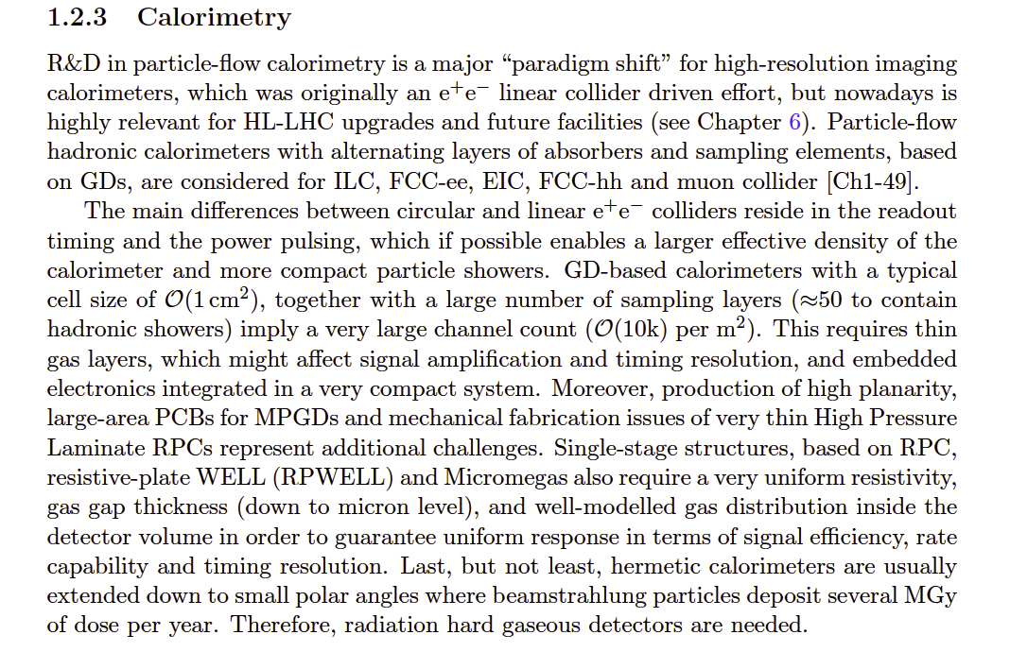
WP5: Gaseous detectors for calorimeters
Two key points were mentioned in the ECFA report on gaseous-detector calorimeters:
Large area, thin and high rate detectors.
Homogeneity : efficiency, resistivity (rate and cluster size)
Timing and High-Rate GD

Slide 2
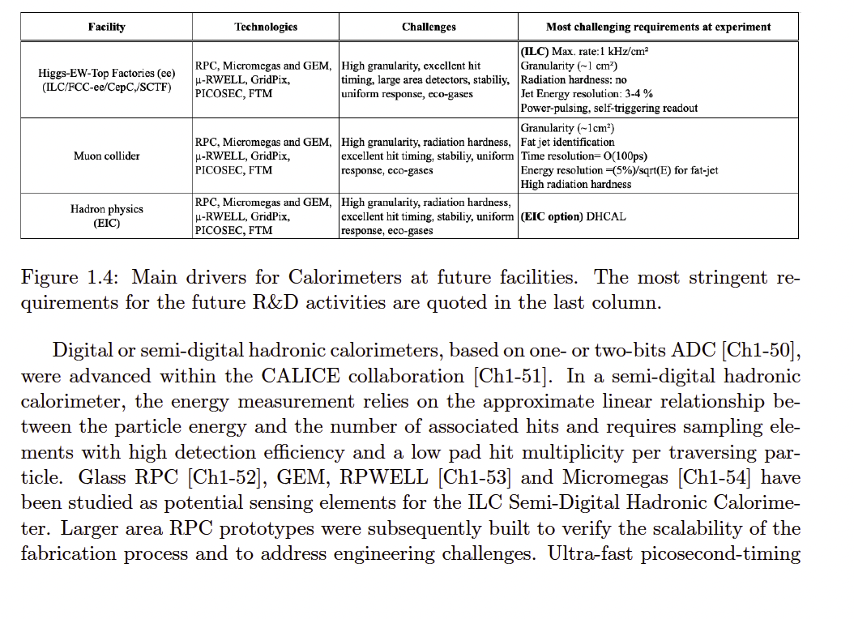
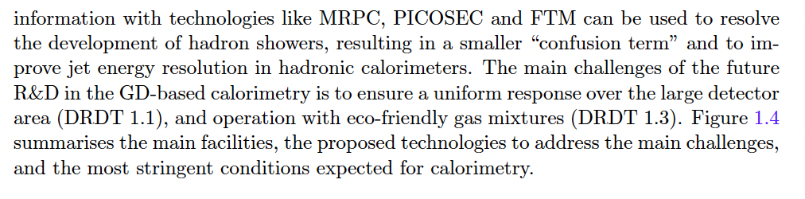

Slide 3
The related activities on calorimetry in DRD1 are dedicated to the active media while the system aspects and readout electronics belong to DRD6
Gaseous Detectors for calorimetry: (M)RPC, MicroMegas, RPWELL, µRWELL
Task1: Large area detectors
- Construction of large GD (.5 x .5, 1 X 1 m2 and then 2x1 m2)
with precise timing and using low resistive materials and snew methods to increase the homogeneity
and reduce the dead zones
Task2: Homogeneity study
Sub task2.1: resistivity map (after using adequate coating methods) in case of (M)RPC
Local cluster size measurement is the essential parameter to monitor
Subtask2.2: gas circulation study to ensure homogeneity of the gas renewal with possible
use of radioactive sources to validate in addition to efficiency
Sub task2.3: efficiency mapping as function of threshold, HV ..etc
Sub task2.4: timing mapping as function of threshold and HV.. Etc
Remarks:
-7 groups have shown interest to join this WP
-Electronics developed for (Calorimetry) in DRD6 will be used but until this is ready we propose to use the one developed for LHC (like petiroc for iRPC) or others. We will try to have the same electronics in future for the different technologies.
-Deliverables and milestones will be based on the tasks. For instance
D1: Characterization study of medium and large GD for future calorimeters

