Slide 1
DRD1
DRD6
I. Laktineh

Slide 2
Gaseous detectors-based calorimeters have many advantages
Low cost
High spatial resolution. Granularity is essentially determined by the pickup pad size.
Excellent time resolution for some
Rad. Hard for some
RPC-based SDHCAL prototype experience showed that GD-based calorimeters could do as well if not better than others
Disadvantages
-Gas related problems: leaks, cost..etc
However, the progress made on sealing GD but most importantly the big efforts of CERN gas group in recycling and recovering the gases, these issues may soon be part of the past

Slide 3
There are two activities within DRD1 that are connected to calorimetry of DRD6 with two proposals
T-SDHCAL based on MRPC
IP2I Lyon, CIEMAT; VUB, OMEGA, U Cordoba, Yonsei Cancer Center, GWNU, SJTU, U Tunis El Manar
SDHCAL using MPGD
INFN & U Bari, Weizman Inst.
N.B There is another proposal that may use GRPC-based picosecond concept. They are part of DRD6 but probably we have to invite them to be part of DRD1 as well.

Slide 4
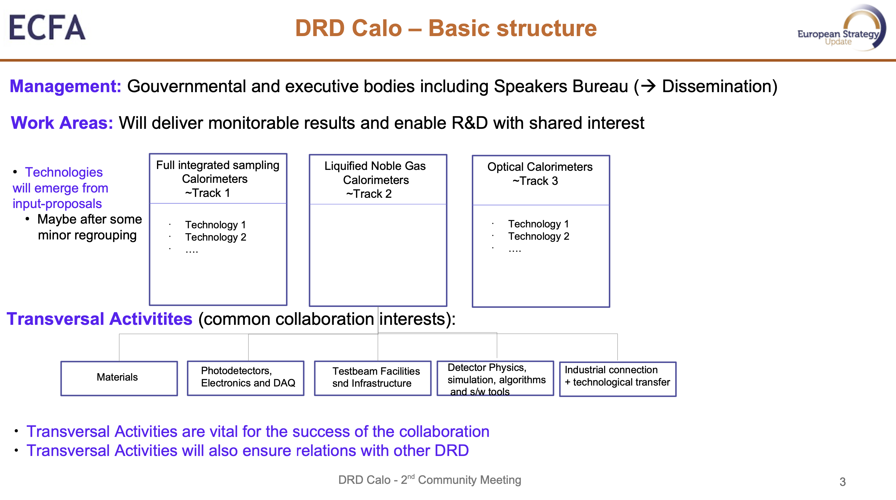
The GD-based proposals proposals are part of Track1.

Slide 5
Reminder: The related activities on calorimetry in DRD1 are dedicated to the active media while the system aspects and readout electronics belong to DRD6
The groups involved in GD-based calorimeters will work hand in hand to show the advantages of such calorimeters.
We invite other groups either to join us or to propose other GD-based technologies for calorimeters.

