Slide 1
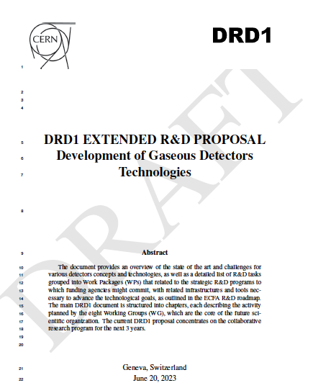
DRD1 proposal
Eraldo Oliveri, Esther Ferrer Ribas
23/06/2023
DRD1 Community Meeting

Slide 2
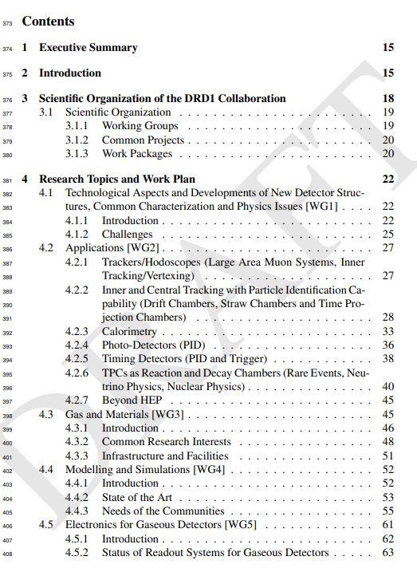
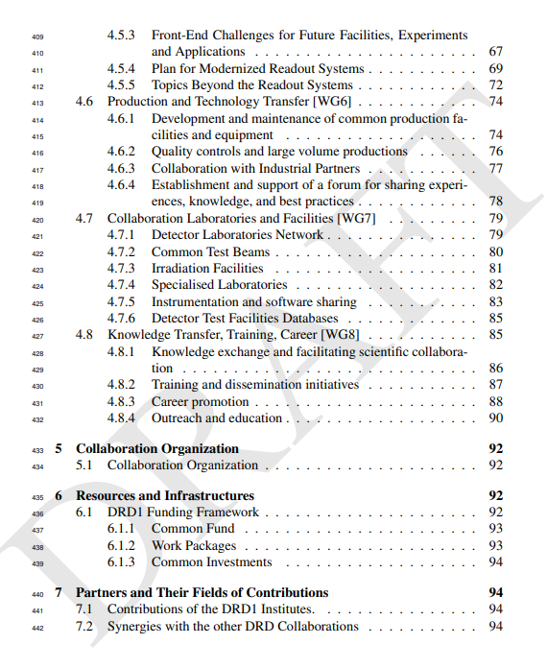

Slide 3
Different gaseous detectors communities together: state of the art and future challanges
Huge Work
Great achievement
Reference document for the future

Slide 4
Editors
Thanks!
Organization and collaborative aspects: A. Colaleo, E. Oliveri, L. Ropelewski, M. Titov
Research topics and Work plan
WG1 - Technologies: P.Colas, F. Resnati, P. Wintz, I. Deppner, M. Tytgat, L. Moleri
WG2 - Applications: F. Garcia, P. Gasik, F. Grancagnolo, D. Gonzalez Diaz, G. Aielli, G. Pugliese, R. Farinelli, I. Laktineh
WG3 - Gas and material studies: B. Mandelli, G. Morello, F. Renga, K. Dehmelt, S. Roth, D. Piccolo, A. Pastore, B. A. Gonzalez
WG4 - Detector physics, simulations, and software tools: M.Abbrescia, M. Borysova, P. Fonte, O. Sahin, P. Verwilligen, R. Veenhof
WG5 - Electronics for gaseous detectors H. Muller, J. Kaminski, M. Gouzevitch, R. Cardarelli, Sorin Martoiu, Marco Bregant, Michael Lupberger
WG6 - Detector production: R. De Oliveira, F. Jeanneau, A. Delbart, G. Iaselli, I. Laktineh, G. Charles
WG7 - Common test facilities: Y. Tsipolitis, E. Oliveri, R. Guida, G. Iaselli, A. Ferretti
WG8 - Training and dissemination: F. Brunbauer, M. Iodice, E. Baracchini, B. Liberti, A. Paoloni
Editors of latest draft: Riccardo Farinelli, Esther Ferrer Ribas, Piotr Gasik, Diego Gonzalez Diaz, Michael Lupberger, Eraldo Oliveri, Alessandro Paoloni, Fulvio Tessarotto, Piet Verwilligen
Internal reviewers of the document: Andy White, Paul Colas, Emilio Radicioni, Giuseppe Iaselli, Amos Breskin, Jianbei Liu, Supratik Mukhopadhyay, Atsuhiko Ochi
+ Institutes contact persons

