Slide 1
WG2 Applications
(on behalf of WG2 conveners)
DRD1 Community Meeting
22 June 2023

Slide 2
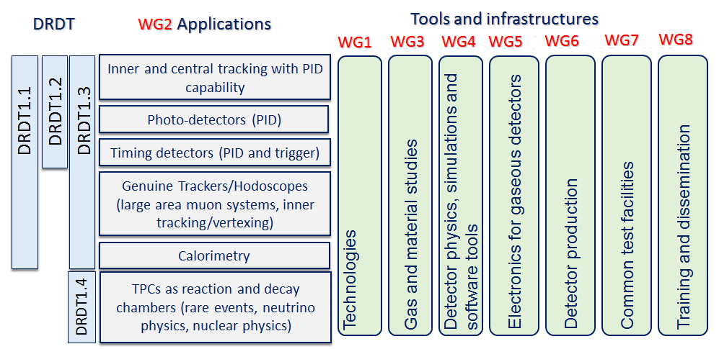
DRD1 structure
Structure in Working Groups, forum for scientific discussions, coordinated by conveners:
  aligned with the scientific program of the ECFA roadmap through the applications related to future facilities challenges, outlined by R&D Themes (DRDTs*), but also to the GSRs* (General Recommendation Strategies)
* See backup for details

Slide 3
Work Packages
Strategic R&D (according to the ECFA Detector R&D Roadmap) is organized in Work Packages
  group activities of the Institutes with shared research interests around Applications with a focus on a specific task(s) devoted to a specific DRDT challenge, typically related to specific Detector Technologies and to the development of specific tool or infrastructure
Application
⇽ defined by ECFA R&D Roadmap
Tasks
focusing on challenges related to performance (precise timing, high rates performances, longevity …)
⇽ connection to ECFA DRDTs
Technological areas:
MPGD, RPC, Wire, LDC, TPC, …
R&D on Sensors, Electronics, Software Tools, Gas Properties studies;
Development of infrastructure and production techniques
Training
Work Package

Slide 4
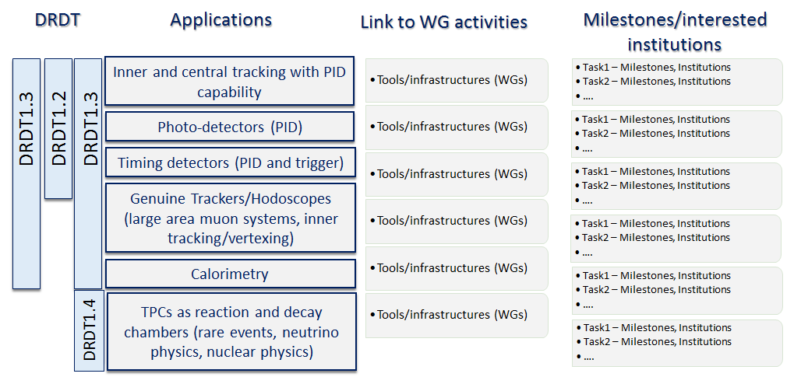
Work Packages

Slide 5
Work Packages
WP2: Drift Chambers, WP3: Straw Chambers, WP4: (Large Volume) Tracking TPCs
WP6
WP7
WP1
WP5
WP8

Slide 6
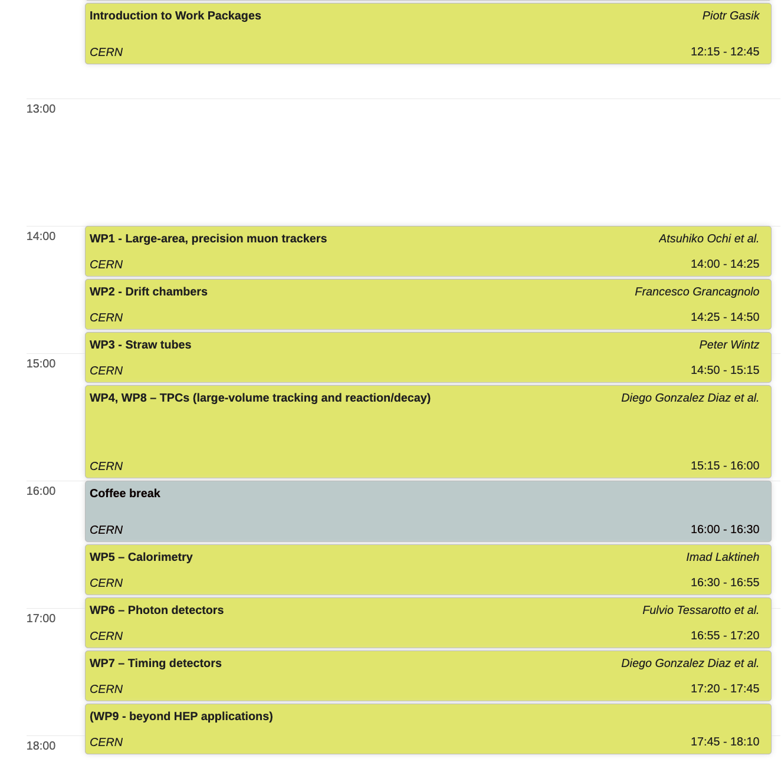
Disclaimer
The WP in the DRD1 proposal draft shall be also considered as a draft.
Open for discussion and modificaiton (see next steps)
If possible, we would keep the current division and approx. number of WPs for the final proposal
Note, WPs can be added in the future (see next steps)
General discussion on WPs today before lunch
Discussion on specific WPs today after lunch

Slide 7
Chapter 4.2 (Applications [WG2]) content
Main R&D challenges for each application
Work Package tables

Slide 8
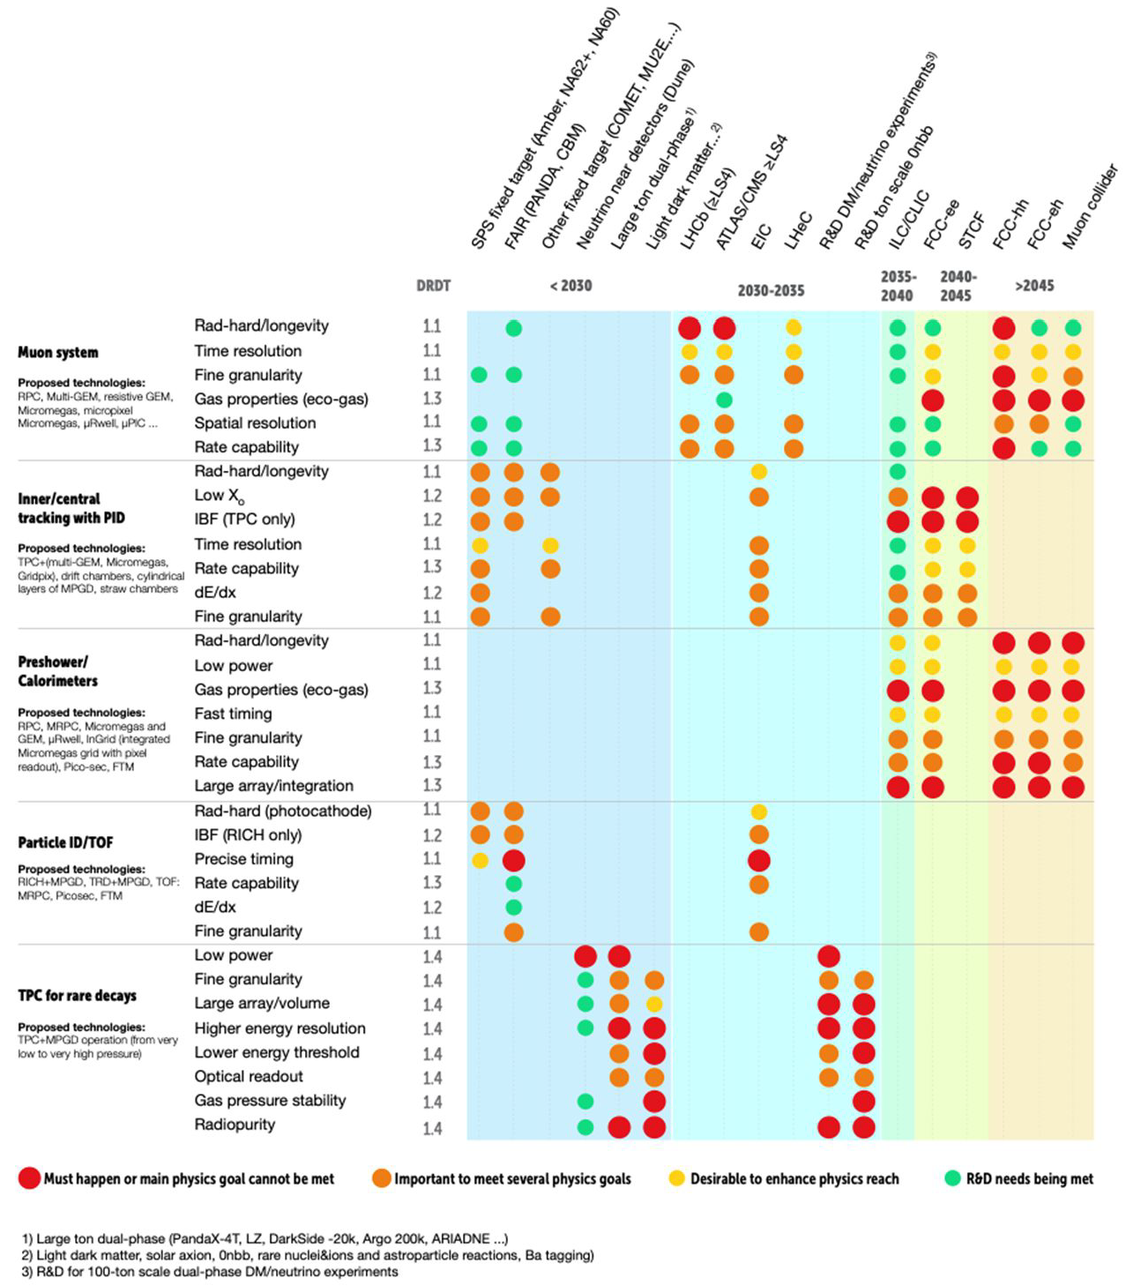
WP1: Genuine trackers/hodoscopes
(large area muon systems, tracking/vertexing)
Challenges/tasks
extend state-of-the-art rate capability and longevity by minimum one order of magnitude or more in the highest eta region (up to an order of MHz/cm²)
enable detectors reliably and efficiently working with suitable low GWP mixtures
reaching the two objectives above can be favored in 3 ways:
  low noise electronics integrated in a highly stable and noise immune Faraday cage
  new detector geometries increasing the signal collection yield
  use of innovative resistive material for suppressing discharges on the electrodes.
Time resolution O(20ps) for timing applications and of 200-300 ps to identify the BC in a very high rate collider, to help in cutting the pile up and to boost the ability to measure particle velocity
large series industrializes production
From the last meeting

Slide 9
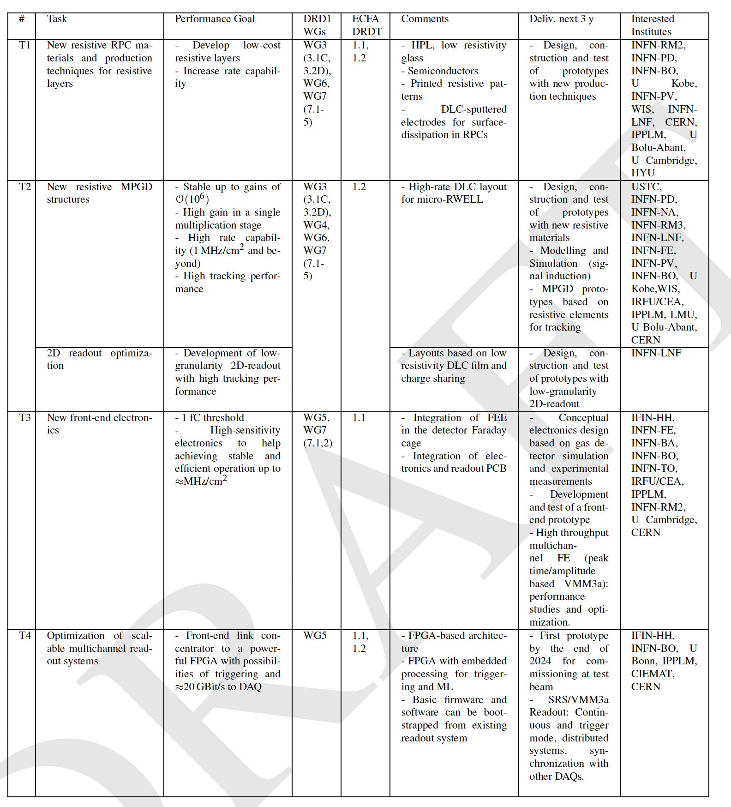
WP1: Genuine trackers/hodoscopes
(large area muon systems, tracking/vertexing)
Task
Performance goal
Include input from
- Challenges defined in ECFA Roadmap
- Survey + 1st DRD1 Community Meeting
- Conveners
- Community Feedback

Slide 10
WP1: Genuine trackers/hodoscopes
(large area muon systems, tracking/vertexing)
Task
Performance goal
DRD1 WGs
- Link to DRD1 WGs activities
ECFA DRDT
- Connection to ECFA DRDTs

Slide 11
WP1: Genuine trackers/hodoscopes
(large area muon systems, tracking/vertexing)
Task
Performance goal
DRD1 WGs
ECFA DRDT
Comments
Deliverables next 3 years
- proposal, partially based on the ECFA Roadmap
- input from the conveners and community
- timeline (deliv. until 2027) not always considered
- to be re-visited (see next steps)

Slide 12
WP1: Genuine trackers/hodoscopes
(large area muon systems, tracking/vertexing)
Task
Performance goal
DRD1 WGs
ECFA DRDT
Comments
Deliverables next 3 years
Interested institutes
- Input from the survey, conveners,
institute contact persons. Continuously updated
- base for planning next steps

Slide 13
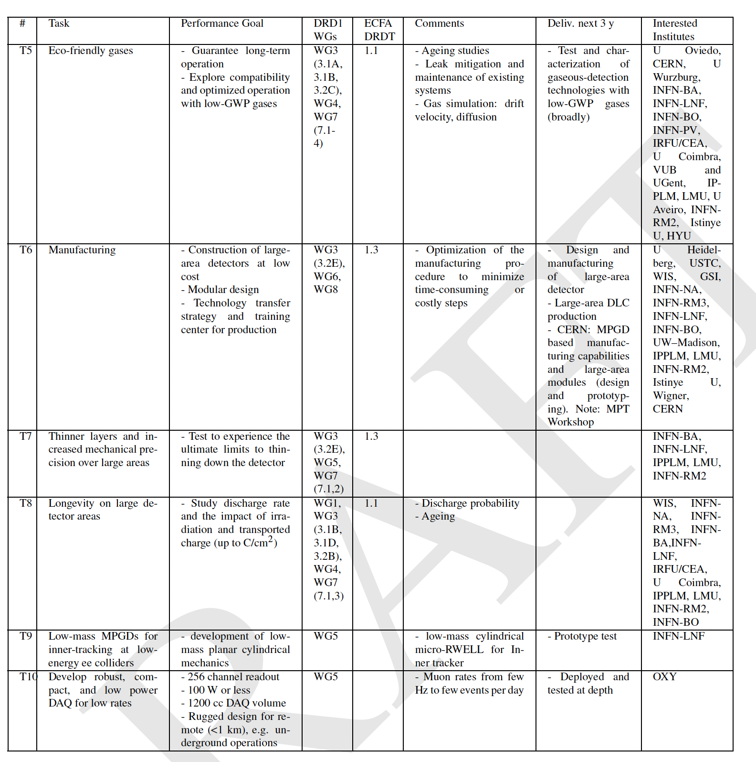
WP1: Genuine trackers/hodoscopes
(large area muon systems, tracking/vertexing)

Slide 14
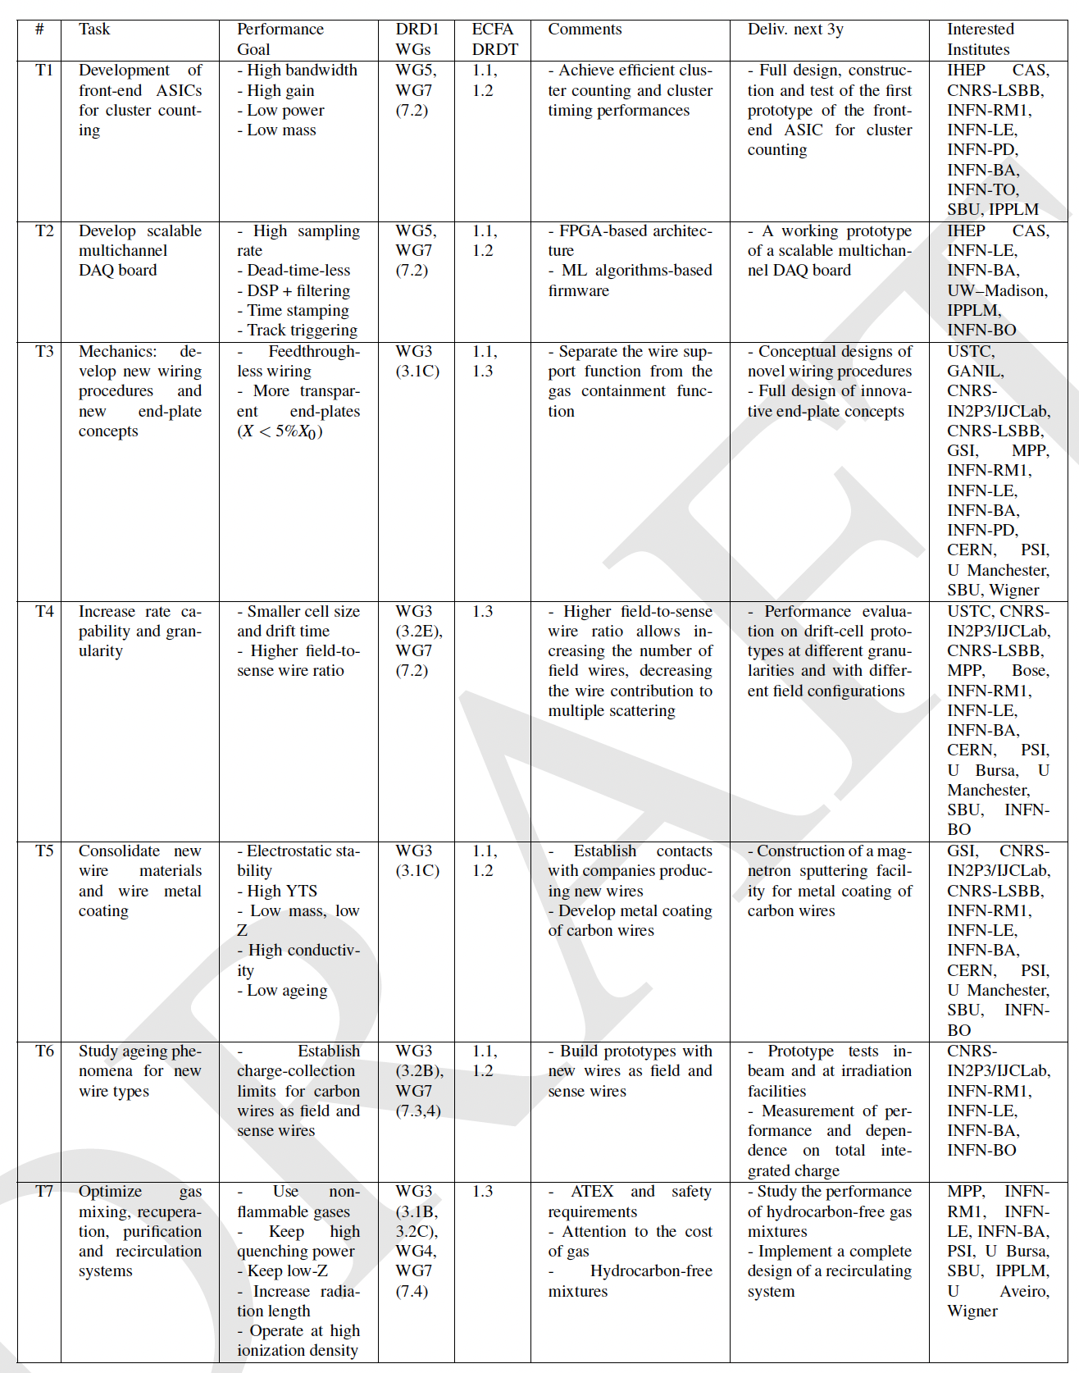
WP2: Inner and central tracking with PID
(drift chambers)
Challenges/tasks
Mechanics: new wiring procedures, new wire materials
High gas gains ∼5×10⁵, required for the application of the cluster counting techniques, high granularities (small cell size, order of 1 cm), long wires (order of 4-5 m) and electrostatic stability demand studies on new light materials with high YTS for wires.
Electronics: on-line, real time data processing algorithms
Waveform digitizers, signal processing for cluster counting exploiting new data processing algorithms
Hydrocarbon-free gas mixtures / recirculating gas systems
Safety requirements (ATEX) on flammable gases and ever-increasing costs of noble gas

Slide 15
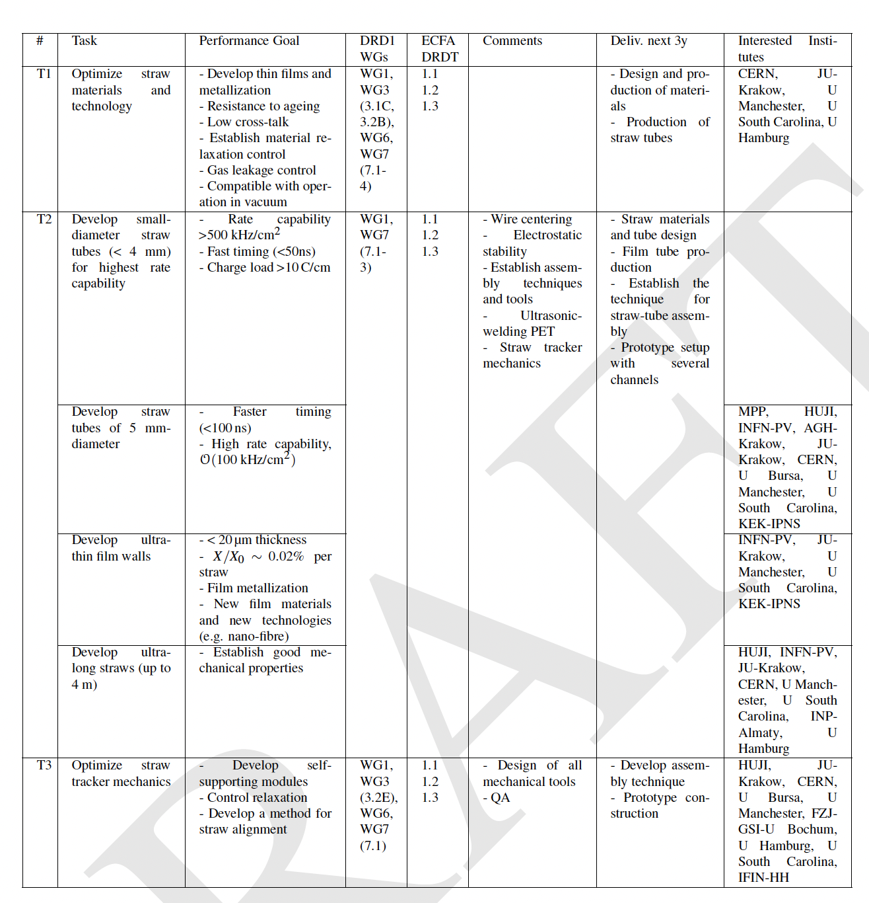
WP3: Inner and central tracking with PID
(STRAW chambers)
Challenges/tasks
Mechanics: thinner, smaller diameter, longer straw tubes / mechanical stability
6+6 μm mylar + 3 μm glue wound-type or 25 μm seamless (resistive) type, few mm diameter, several m length /self-supporting structures
Material studies
Creep under tension (tension relaxation), gas leakage (operation under vacuum or overpressure)
Electronics
Leading and trailing time resolution for 4D measurements and for dE/dx with time over threshold

Slide 16
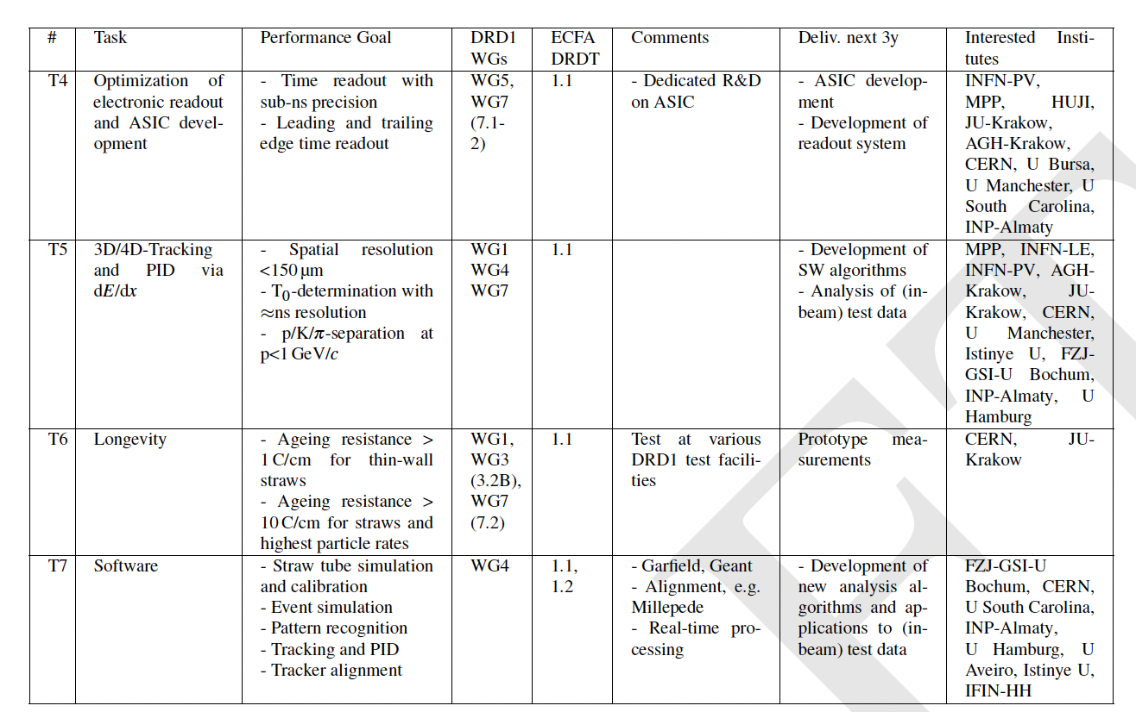
WP3: Inner and central tracking with PID
(STRAW chambers)
Challenges/tasks
Mechanics: thinner, smaller diameter, longer straw tubes / mechanical stability
6+6 μm mylar + 3 μm glue wound-type or 25 μm seamless (resistive) type, few mm diameter, several m length /self-supporting structures
Material studies
Creep under tension (tension relaxation), gas leakage (operation under vacuum or overpressure)
Electronics
Leading and trailing time resolution for 4D measurements and for dE/dx with time over threshold

Slide 17
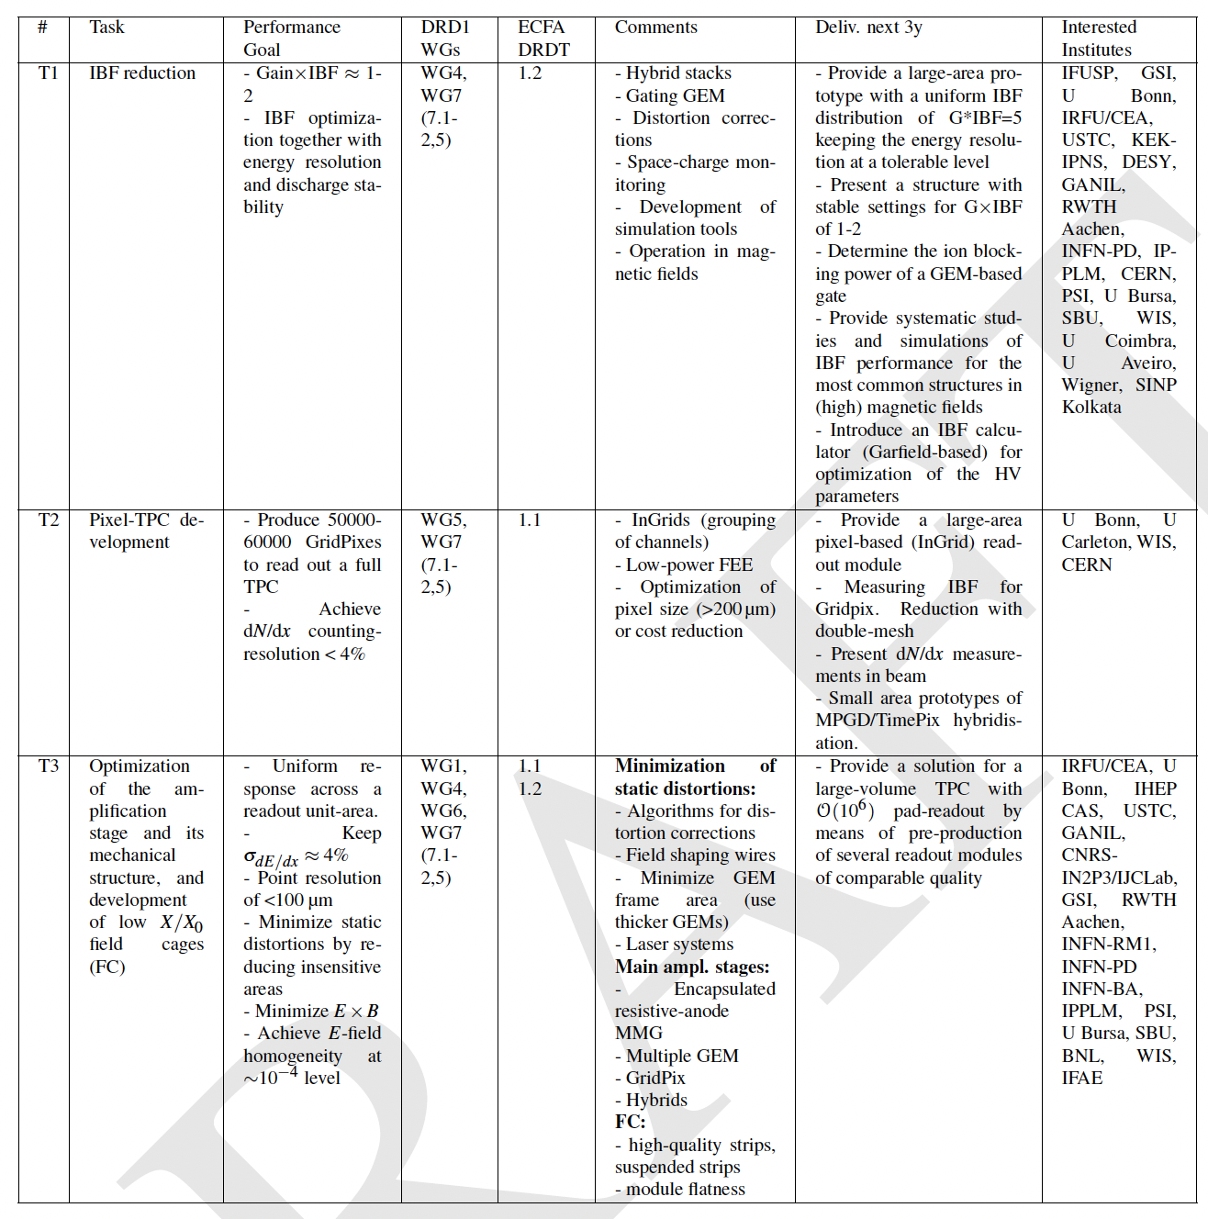
WP4: Inner and central tracking with PID
(Large volume TRACKING TPCs)
Challenges/tasks
High rate,
Low mass,
Granularity,
dE/dx & cluster counting
Ion backflow suppression,
Gas mixture optimization and Eco gas mixtures

Slide 18
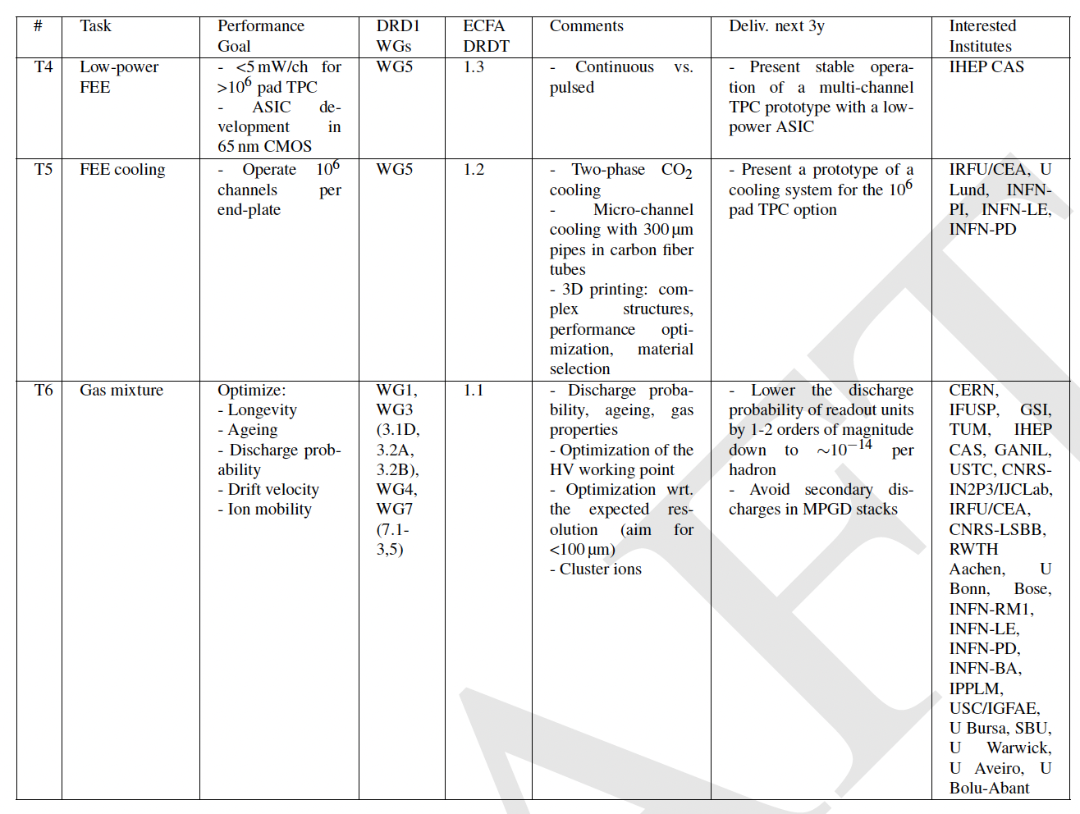
WP4: Inner and central tracking with PID
(Large volume TRACKING TPCs)
Challenges/tasks
High rate,
Low mass,
Granularity,
dE/dx & cluster counting
Ion backflow suppression,
Gas mixture optimization and Eco gas mixtures

Slide 19
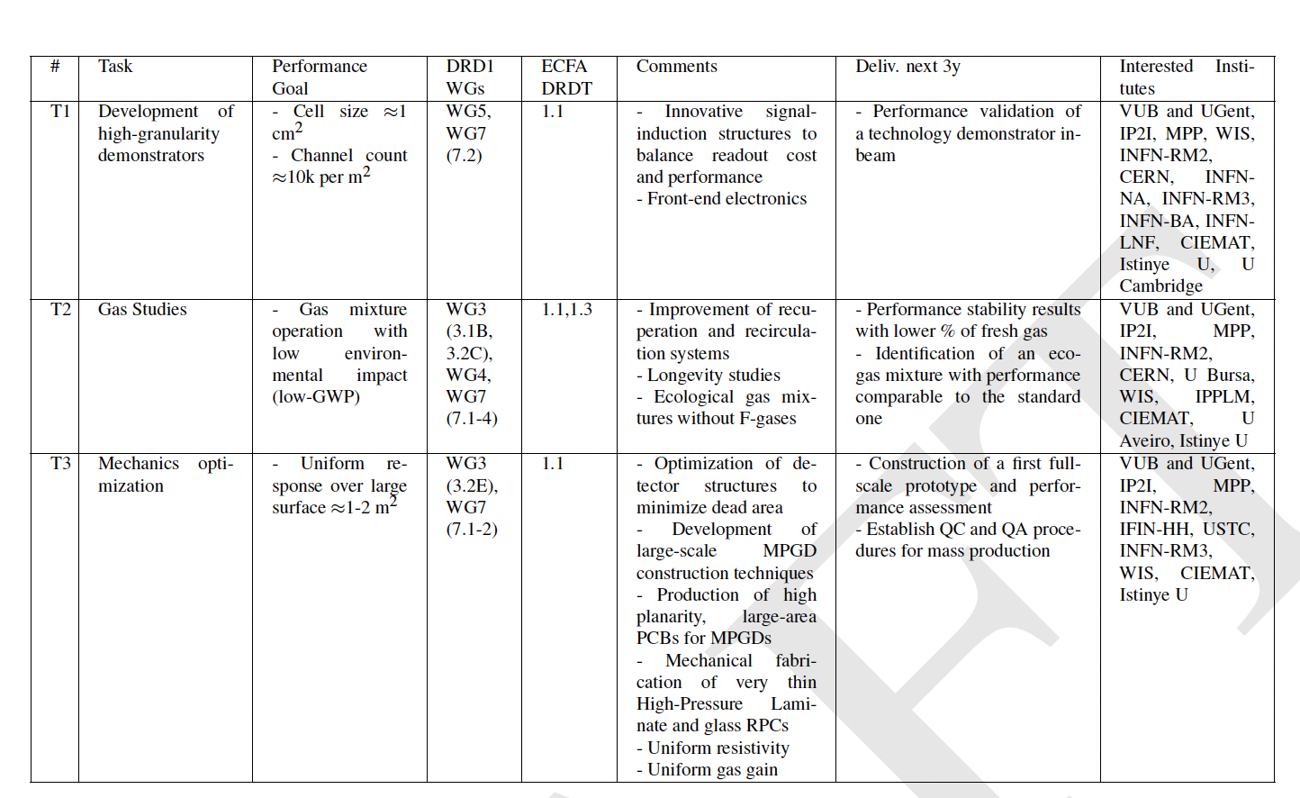
WP5: Calorimetry
Challenges to develop large detector area
Uniformity of the response and dynamic energy range
Rate capability (x resistive material detector): 1 kHz/cm²
Time resolution O(100ps)
Not necessarily for large-area:
Eco-gas mixture
Stable performance (gas gain, time resolution, etc)
High radiation hardness

Slide 20
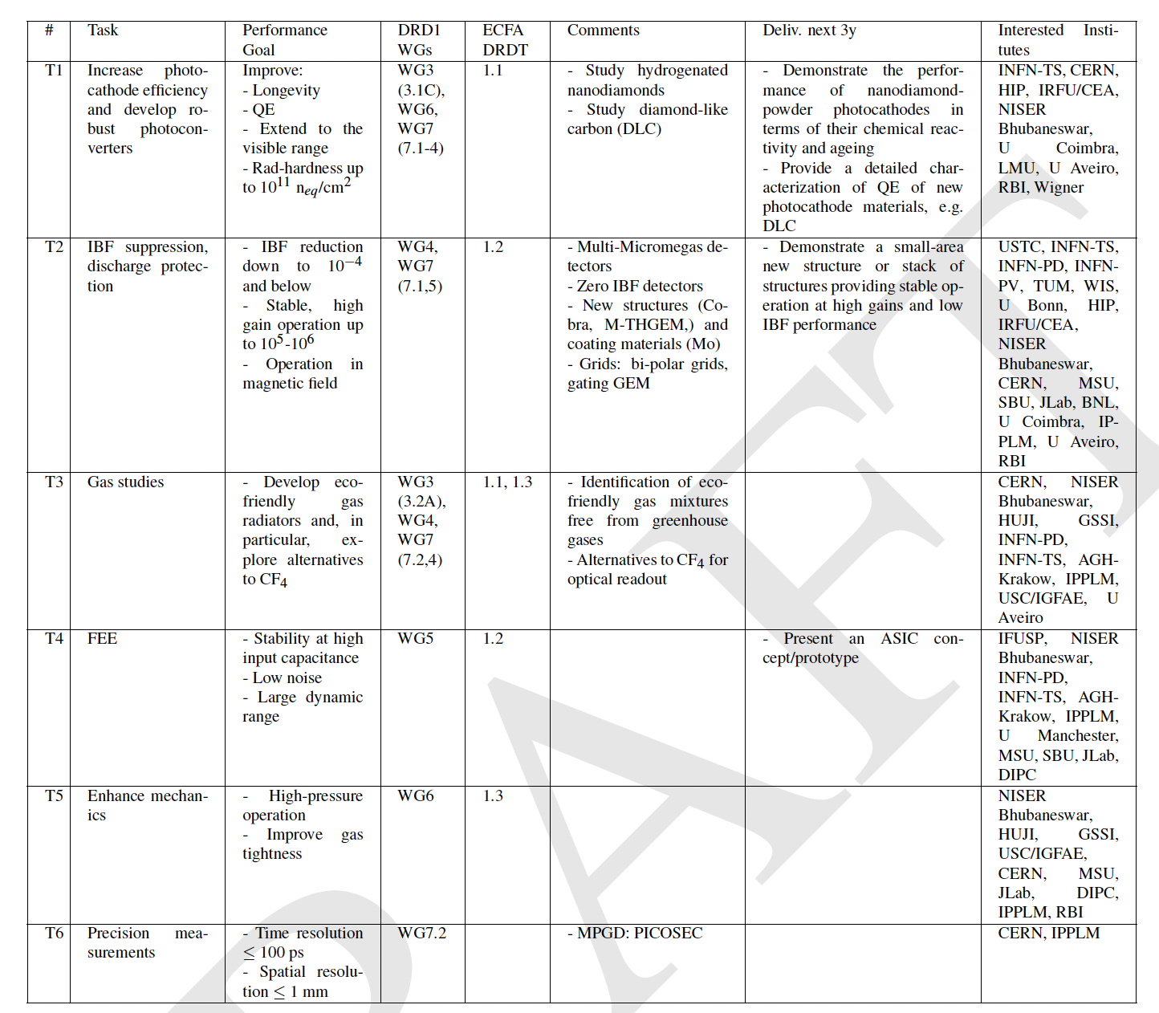
WP6: Photo-detectors
(PID)
Challenges/tasks
Preserve the photocathode efficiency by IBF and more robust photoconverters
Very low noise, large dynamic range of the FEE
Separate the TR radiation and the ionization process

Slide 21
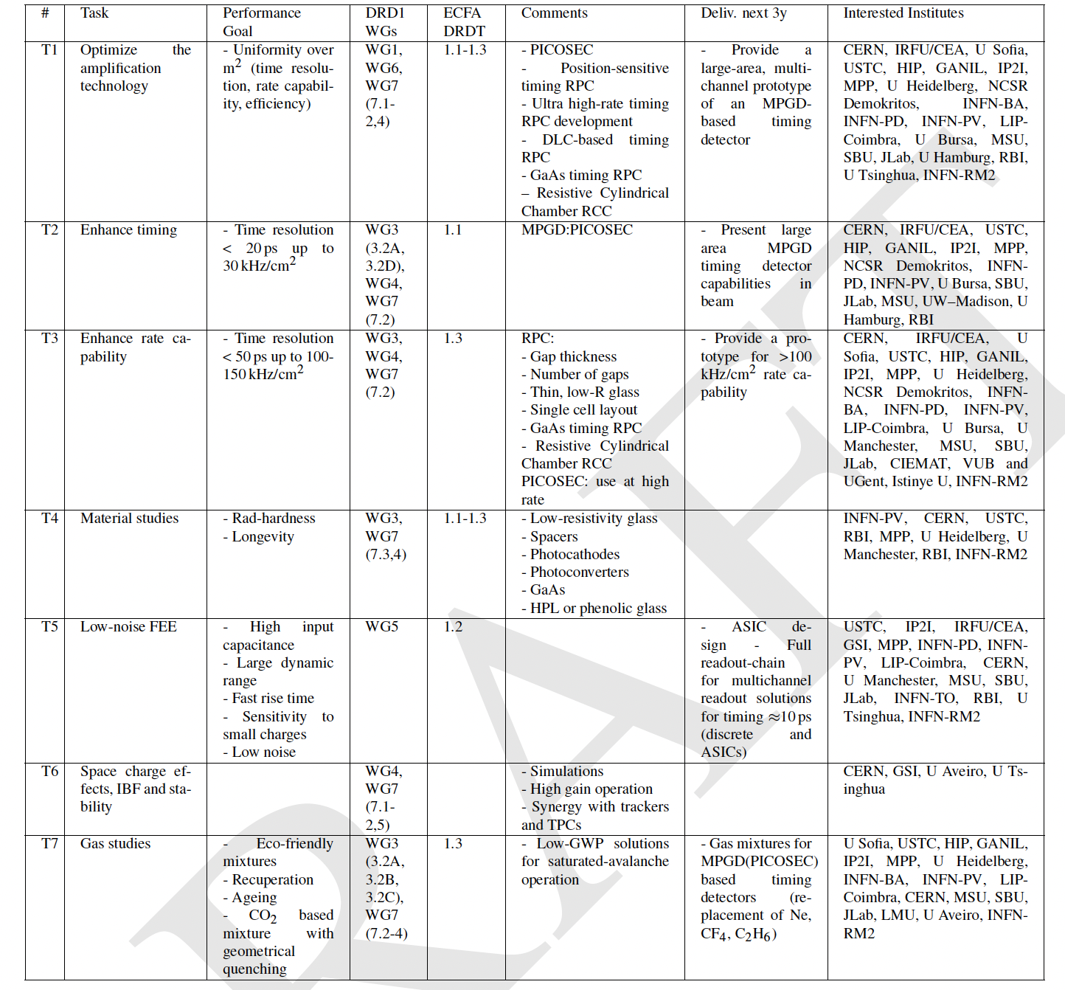
WP7: Timing detectors
(PID and trigger)
Challenges/tasks
Uniform rate capability, time resolution, and efficiency over large detector area
New material for high rate (low res., rad.hard.): uniform gas distribution, spacer material, spacer geometry, thinner structures: mechanical stability and uniformity
Eco-gas mixture, Gas recuperation systems
Electronics: Low noise, fast rise time, sensitive to small charge

Slide 22
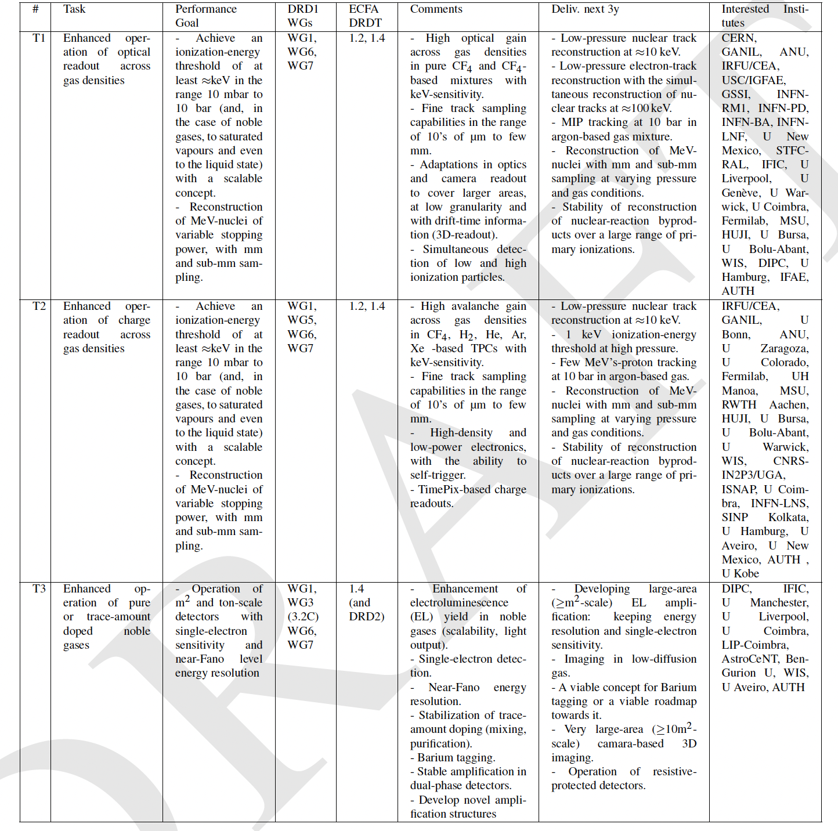
WP8: TPCs as reaction and decay chambers
(RARE EVENTS, NEUTRINO PHYSICS, NUCLEAR PHYSICS)
Challenges/tasks
Reconstruct low-energy nuclear tracks (down to 10 keV energy-scale) with high granularity and close to the thermal diffusion limit.
Low energy threshold (keV or less) far from atmospheric pressure (10mbar-20bar).
Achieving high and uniform amplification in nearly pure or weakly-doped noble gases
Increasing optical throughput (primary and secondary)
Developing more suitably scintillating and/or eco-friendly gas mixtures as well as recuperation systems;
Enhancing the radiopurity of the amplification structure and of the TPC as a whole

Slide 23
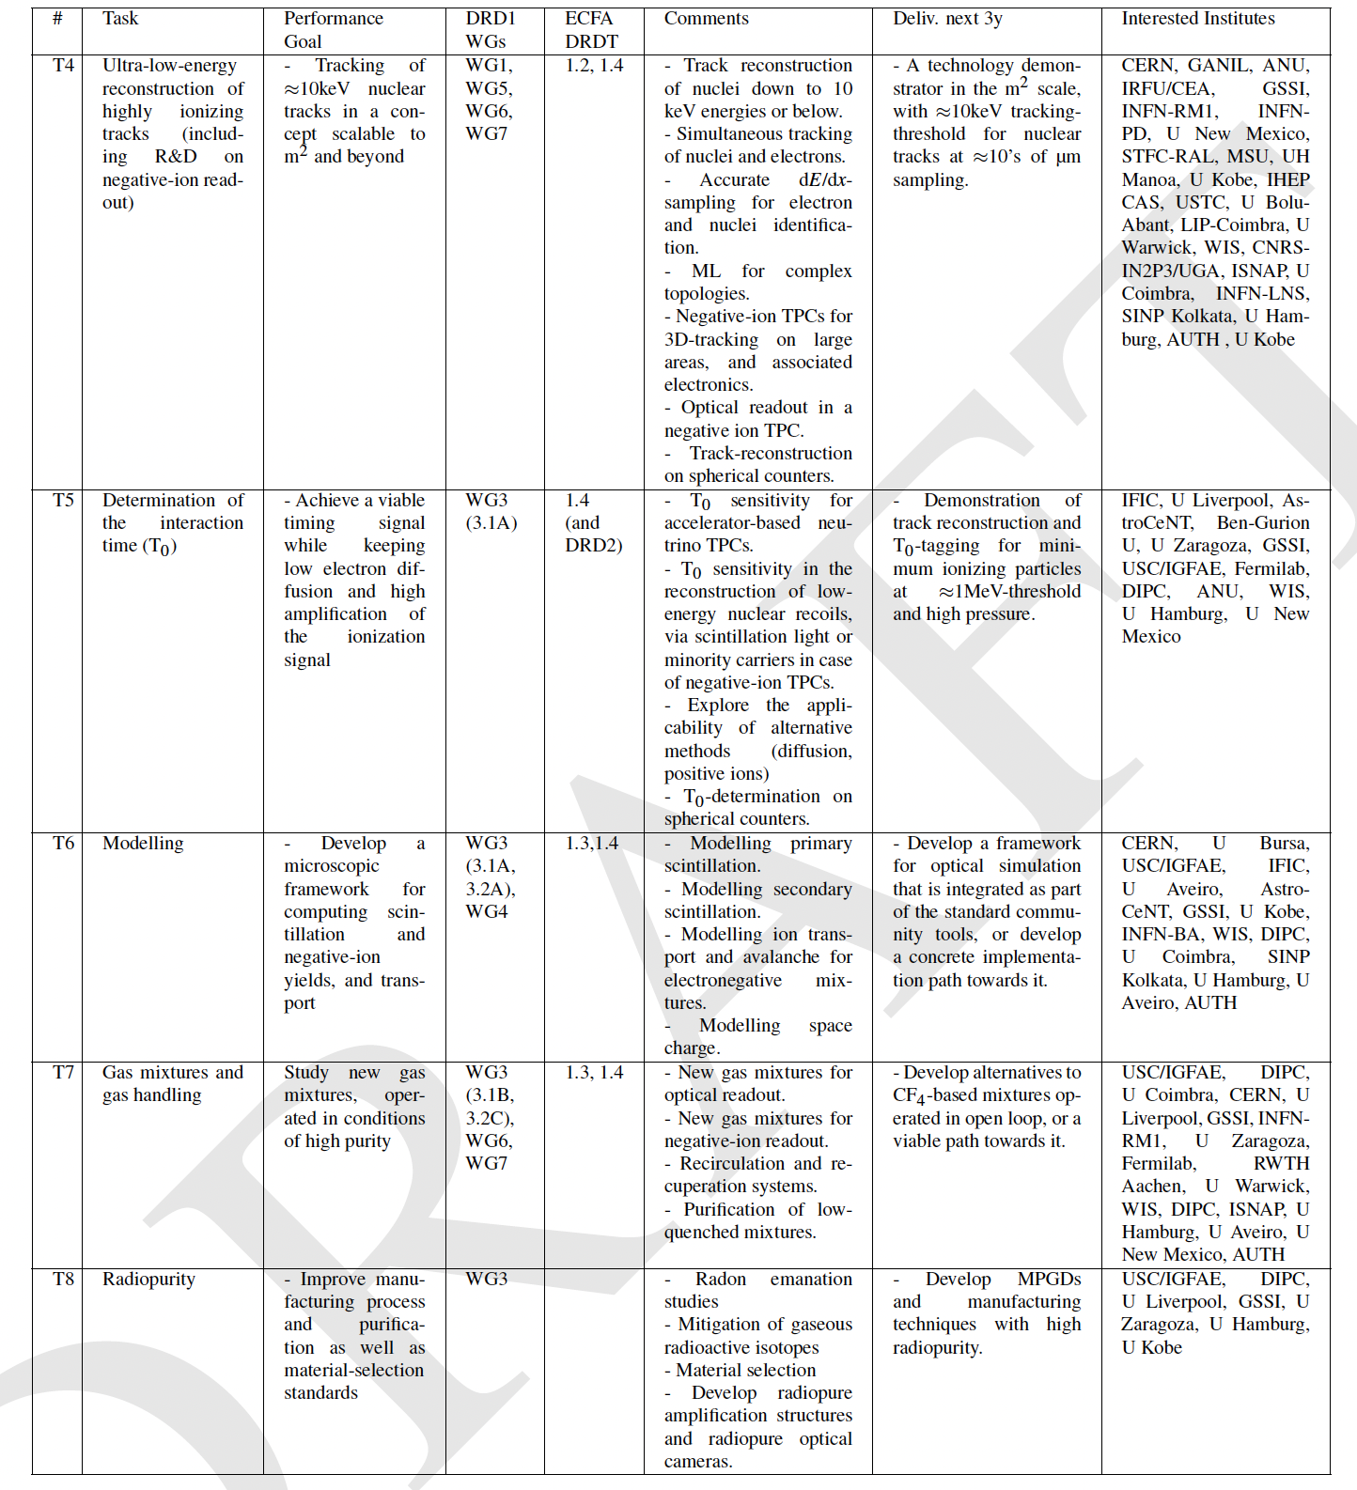
WP8: TPCs as reaction and decay chambers
(RARE EVENTS, NEUTRINO PHYSICS, NUCLEAR PHYSICS)
Challenges/tasks
Reconstruct low-energy nuclear tracks (down to 10 keV energy-scale) with high granularity and close to the thermal diffusion limit.
Low energy threshold (keV or less) far from atmospheric pressure (10mbar-20bar).
Achieving high and uniform amplification in nearly pure or weakly-doped noble gases
Increasing optical throughput (primary and secondary)
Developing more suitably scintillating and/or eco-friendly gas mixtures as well as recuperation systems;
Enhancing the radiopurity of the amplification structure and of the TPC as a whole

Slide 24
(WP9: Beyond HEP)
No WP9 in the proposal draft
  No clear tasks/projects/interests could be identified in the Survey
  No BHEP Applications in the ECFA Roadmap
1st Community feedback: clear need of the Beyond HEP WP
We can identify different tasks/projects:
  muography and large area applications;
  dosimetry/beam monitoring and medical imaging applications (PET, CT, X-ray, SPECT, Gamma cameras, or X-ray fluorescence imaging);
  fast/thermal neutron imaging (MPGD-based readout with solid converter for tomography and nuclear waste monitoring;
  X-ray polarimetry and space applications;
Let’s discuss today afternoon, before dinner

Slide 25
WG2 Applications
WG1 WG3 WG4 WG5 WG6 WG7 WG8
Technologies
Gas and material studies
Detector physics, simulations and software tools
Electronics for gaseous detectors
Detector production
Common test facilities
Training and dissemination
Inner and central tracking with PID capability
DRDT1.2
Photo-detectors (PID)
DRDT1.3
Timing detectors (PID and trigger)
DRDT1.1
Genuine Trackers/Hodoscopes (large area muon systems, inner tracking/vertexing)
Calorimetry
1.4
TPCs as reaction and decay chambers (rare events, neutrino physics, nuclear physics)
Working Groups (research line) are core of the collaboration
physics driven; promoting open environment, young researchers…
Working Groups participates in Work Packages
Work packages communicate to and with DRD1 community
Don’t operate in a vacuum
Funded by funding agencies

Slide 26

Work Packages - next steps
(general discussion)
(on behalf of WP coordinators)
DRD1 Community Meeting
22 June 2023

Slide 27
WG2 Applications
WG1 WG3 WG4 WG5 WG6 WG7 WG8
Technologies
Gas and material studies
Detector physics, simulations and software tools
Electronics for gaseous detectors
Detector production
Common test facilities
Training and dissemination
Inner and central tracking with PID capability
DRDT1.2
Photo-detectors (PID)
DRDT1.3
Timing detectors (PID and trigger)
DRDT1.1
Genuine Trackers/Hodoscopes (large area muon systems, inner tracking/vertexing)
Calorimetry
1.4
TPCs as reaction and decay chambers (rare events, neutrino physics, nuclear physics)
Working Groups (research line) are core of the collaboration
physics driven; promoting open environment, young researchers…
Working Groups participates in Work Packages
Work packages communicate to and with DRD1 community
Don’t operate in a vacuum
Funded by funding agencies

Slide 28
Work Packages – basic facts
Work Packages
Encompass long-term projects with significant strategic R&D goals and corresponding funding lines.
Way to get funding
Way to get involved in strategic R&D
DRD1 proposal: Institutes can still be added/removed from the individual WP and their tasks
  It is not required to be involved in a WP to be a member of DRD1
  It is required to be a member of DRD1 to contribute to a WP

Slide 29
WP - formalities
From the proposal
A Work Package:
Can be initiated at any time and will be internally organized and coordinated by the participating institutes (WP Coordinator should be defined from the active WP member)
The participating institutes will define the WP scope, deliverables, work plan, and the necessary resources in detail.
The participating institutes will have complete control and operational authority over the allocated resources.
To establish the proposed activities and secure the required resources,
a formal agreement will be established among the participating institutes, funding agencies, DRD1 management, and the host lab (CERN) ➙ being sorted out by CRN management
Each Work Package Agreement will be included as an annex in the DRD1 MoU ➙ being sorted out by CRN management
WPs will report to DRD1 and undergo review by the Detector Research and Development Committee (DRDC).
The funding for WPs will be provided to the participating institutes by their respective Funding Agencies.
The involved Funding Agencies will be responsible for approving the WPs and overseeing their progress

Slide 30
WP - Review
“WP reports” to DRD1. Once per year (or more – discussion):
The WPs will report their achievements/status/plans to DRD1
New WPs can be proposed and accepted by the DRD1
Institutes can join/leave WPs
Apart from that, all WP activities can be reported regularly in the form of contributions to DRD1 collaboration meetings (e.g. WG2 session) where full collaboration can provide support to the WP activities
DRD1 will not review the resources of the WPs
Resources of the WPs stay at the institute
DRD1 resource review at CERN will not review WP resources
DRDC
Can organize WP resource reviews

Slide 31
WP Coordinators
For the finalization of the DRD1 proposal, (incl. WP proposals) WP Coordinators have been established to initialize discussion within the community and organization of the first WPs.
  Established contact to the active groups
  Familiar with DRD1, WG, WP discussions
  All technologies in a given WP covered

Slide 32
WP Coordinators
For the finalization of the DRD1 proposal, (incl. WP proposals) WP Coordinators have been established to initialize discussion within the community and organization of the first WPs
The list is not fixed, can be updated at any time. (Self-)nominations welcome
WP Coordinators should be involved in WP activities, eventually
WP1
(Trackers)
Atsuhiko Ochi
Gabriella Pugliese
Giulio Aielli
Mauro Iodice
Riccardo Farinelli
WP2
(Drift chambers)
Francesco Grancagnolo
WP3
(Straw tubes)
Peter Wintz
WP4
(Tracking TPCs)
Diego Gonzalez Diaz
Esther Ferrer Ribas
Francisco Ignacio Garcia Fuentes
Jochen Kaminski
Piotr Gasik
WP5
(Calorimeters)
Imad Laktineh
WP6
(Photodetectors)
Fulvio Tessarotto
Florian Brunbauer
Piotr Gasik
WP7
(Timing)
Diego Gonzalez Diaz
Florian Brunbauer
Imad Laktineh
Ingo Deppner
WP8
(Reaction/Decay TPCs)
Diego Gonzalez Diaz
Esther Ferrer Ribas
Francisco Ignacio Garcia Fuentes
Jochen Kaminski
Piotr Gasik
(WP9)
(Beyond HEP)

Slide 33
Towards the final DRD1 proposal
We need to finalize the WP tables incl. more detailed information, on tasks, deliverables and contributed resources;
What we have now in the proposal (e.g. tasks) is a draft, we (community) are free to further modify
It is not fully clear what DRDC will expect from us. Need to be prepared and flexible.
Assumption: we stick to the current WPs (maybe with addition of WP9) for the DRD1 proposal
Timescale: the deadline for the proposal submission is end of July

Slide 34
Towards the final DRD1 proposal
How to continue? Different approaches possible. How should we detail our WP proposals?
Approach 1: define ”WP Projects” clustering institutes around well defind project, application, techonology development, etc. All WP Projects are part of one, final (in terms of proposal) WP.
WP Project
Particip. institutes:
Tasks
Deliverables
Resources
Avoid repetition of tasks also between WPs and DRDs
Define generic deliverables
Emphasise possible connections between WP Projects
Emphasise support of DRD1 Working Groups
Current WP
WP Project
Particip. institutes:
Tasks
Deliverables
Resources
Final WP proposal
WP Project
Particip. institutes:
Tasks
Deliverables
Resources

Slide 35
Towards the final DRD1 proposal
How to continue? Different approaches possible. How should we detail our WP proposals?
Approach 2: define “generic R&D” work packages.
Avoid repetition of tasks also between WPs and DRDs
Define generic deliverables
Emphasise possible connections
Emphasise support of DRD1 Working Groups
Current WP
Particip. Institutes:
Tasks
Deliverables
Resources
Final WP proposal

Slide 36
Towards the final DRD1 proposal
How to continue? Different approaches possible. How should we detail our WP proposals?
Approach 3: ideas welcome

Slide 37
Institute contributions
A threshold to join a WP
  DRD1 membership
  Well-defined task to which an institute will contribute and be responsible for
  Committed resources (existing or requested)
But
  You don’t need to decide now. You can join a WP at any time
  This is DRD1 proposal submission. The WP will be reviewed and “approved” by DRD1 after collaboration is created. We may ammend WP tables in between

Slide 38
WP Projects, WP Tasks
Think collaborative! WP is a tool to get funding, but also strengthen our community, increase success of strategic R&D developments
E.g. having several institutions contributiong to a task increases probability that the goals will be reached.
  In case some resource contributions to a WP are not certain (e.g. include only requested resources which still need to be granted)
  Smaller groups may gain a lot being a part of the WP and their contribution may increaase with time
There will be tasks and contributions of different institutes which strongly depend on each other and on committed resources and are crucial for the success of a WP

Slide 39
Extended WP tables
Whatever our approach is, we need to detail the WP tables with additional information
As we do not know what kind of Final WP tables DRDC expects from us, we shall be prepared
”Extended WP tables” will be created together with institutes which declare their contribution to specific WPs
  The institutes intrtested to contribute to a given WP need to provide FTE and non-FTE resources in the extended WP tables
  We differentiate between “existing” and “requested” resources.
  WP can help in acquiring strategic funding, however, it is not mandatory for an institute to apply for extra funding. One can contribute with the exiting resources only
See: extended WP table template

Slide 40
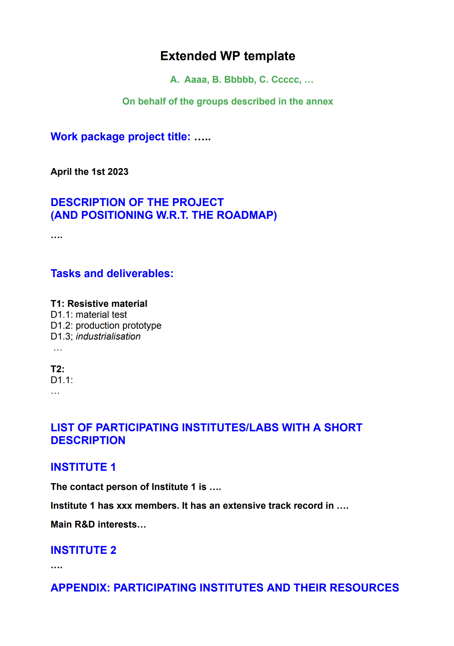
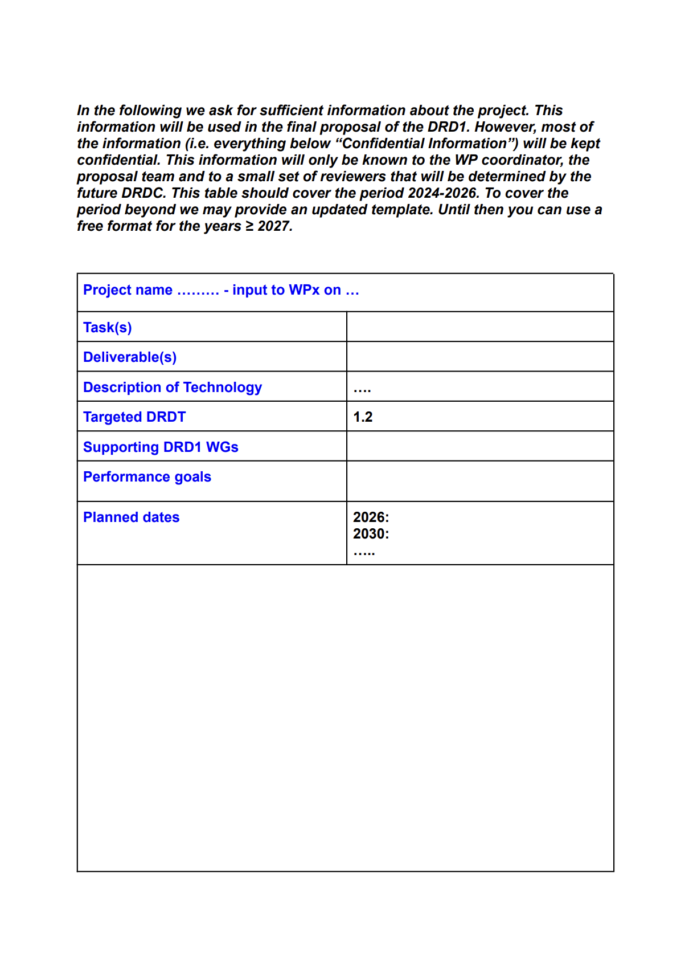
1
2

Slide 41
WP (Project) summary
1
2

Slide 42
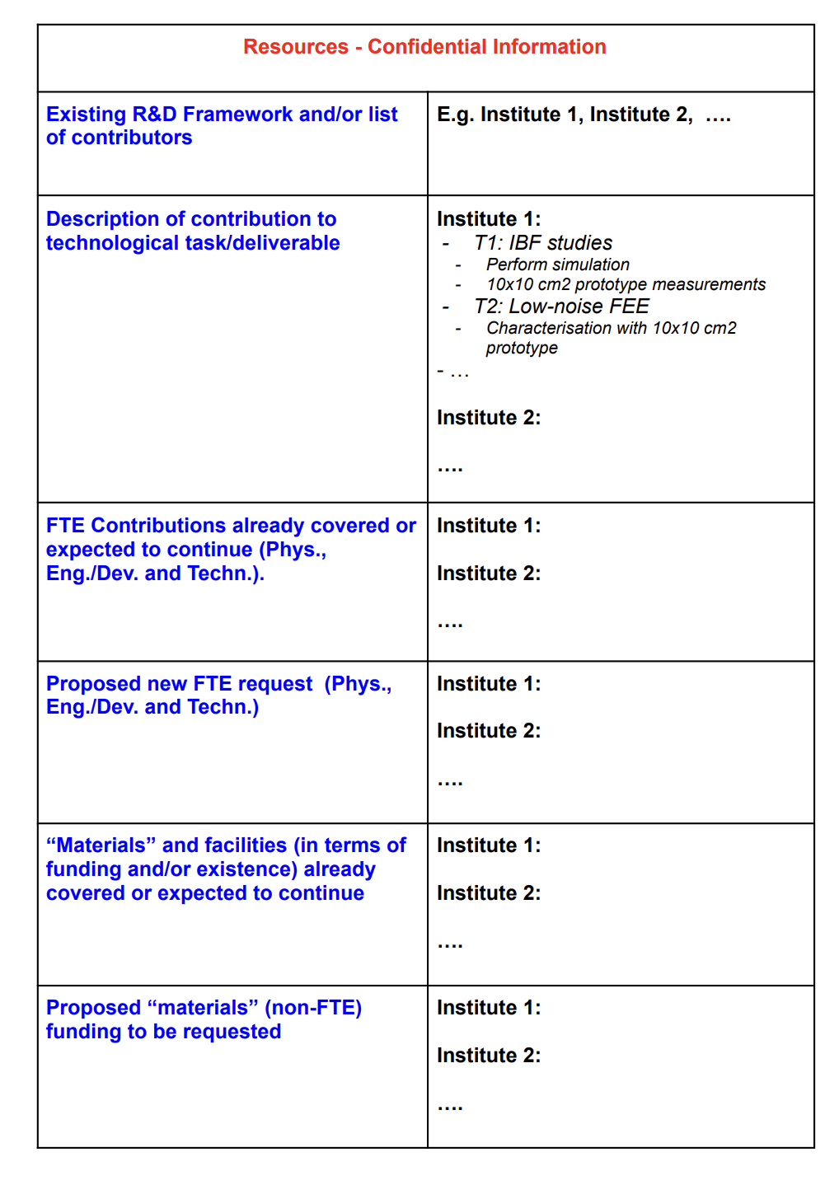
3

Slide 43
Confidential information available to:
WP (Project) members
Cooridnators
DRD1 Management
DRDC
This will not be a part of any public documents, proposals, etc.
Here we can be more detailed
  Resources needed to accomplish the goals/deliverables
    FTE available per year for 2024-2027(9) and later
    Non-FTE available per year for 2024-2027(9) and later
    FTE and non-FTE requested per year for 2024-2027(9) and later
3

Slide 44
Let’s organise
Today and in the following days we should choose our approaches which may differ for different WPs, different cases
WP Coordinators will contact ALL institutes which shared their interest in given WP topics in the survey and/or community feedback
  Ongoing process – you can add/remove your names at any time. Contact WG2 conveners and/or WP coordinators
  We will contact the “contact persons” from your institutes. The list is based on the survey, and institute’s feedback we received so far
Contacts by mail + dedicated meetings;
During the afternoon session, we will discuss whether some particular approach can be associated with given WPs.
But it may also be, that we will decide (together) at a later stage. Maybe an additional WP survey is needed within the interested institutes
Template will be circulated (pre-filled with WP Project proposals or naked)

Slide 45
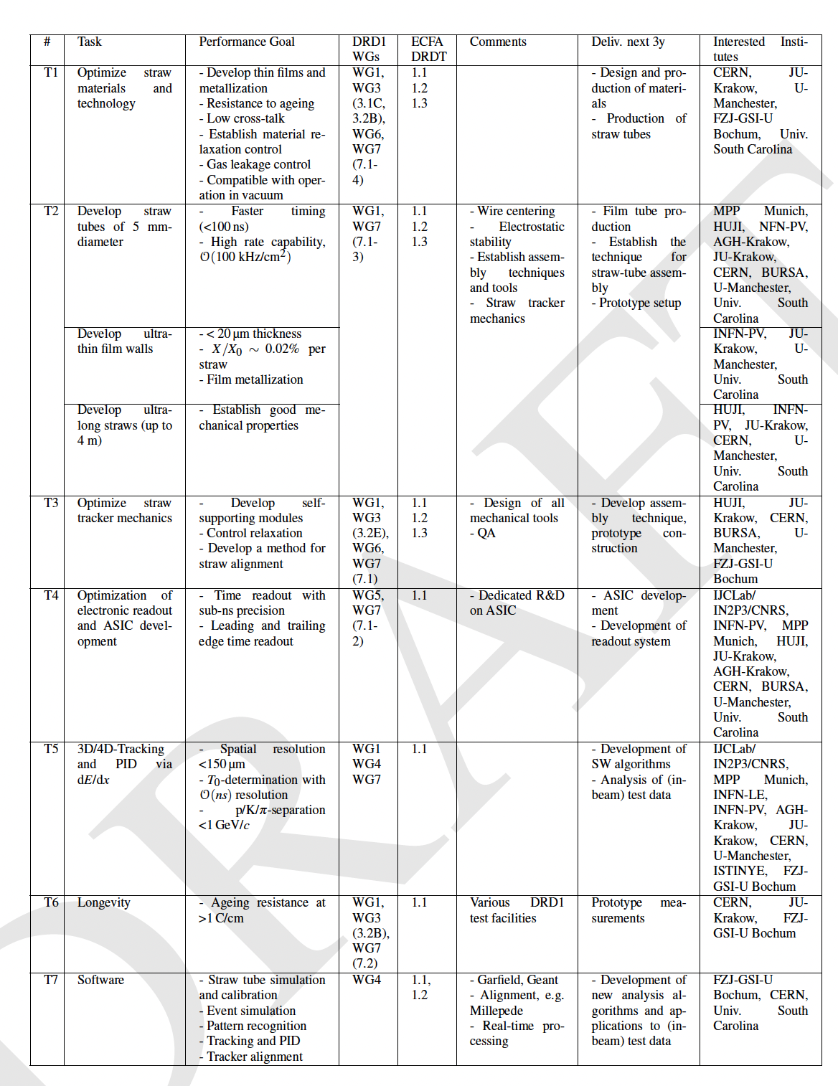
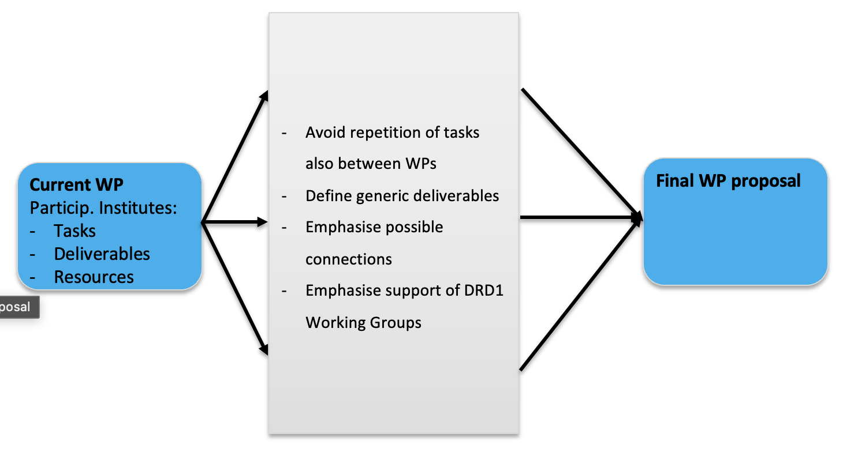
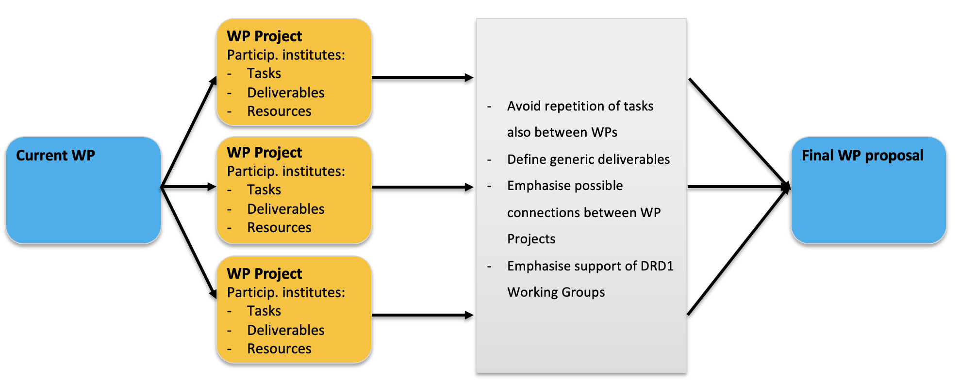
Summary tables for the DRD1 proposal
  Depending on our approach (WP Projects, Generic WP tables) we can creat any kind of tables
  Depending on DRDC, with available input, we can create any kind of tables
2024
2025
2026
>2027
FTE
nFTE
Deliv.

Slide 46
BACKUP

Slide 47
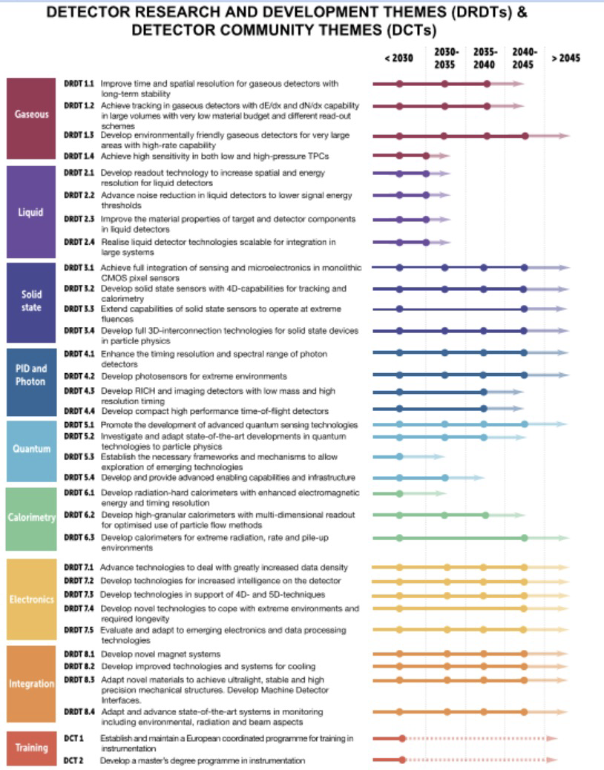
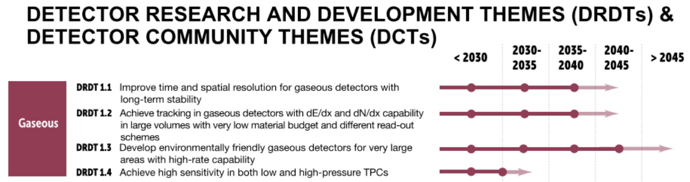
DRD Themes

Slide 48
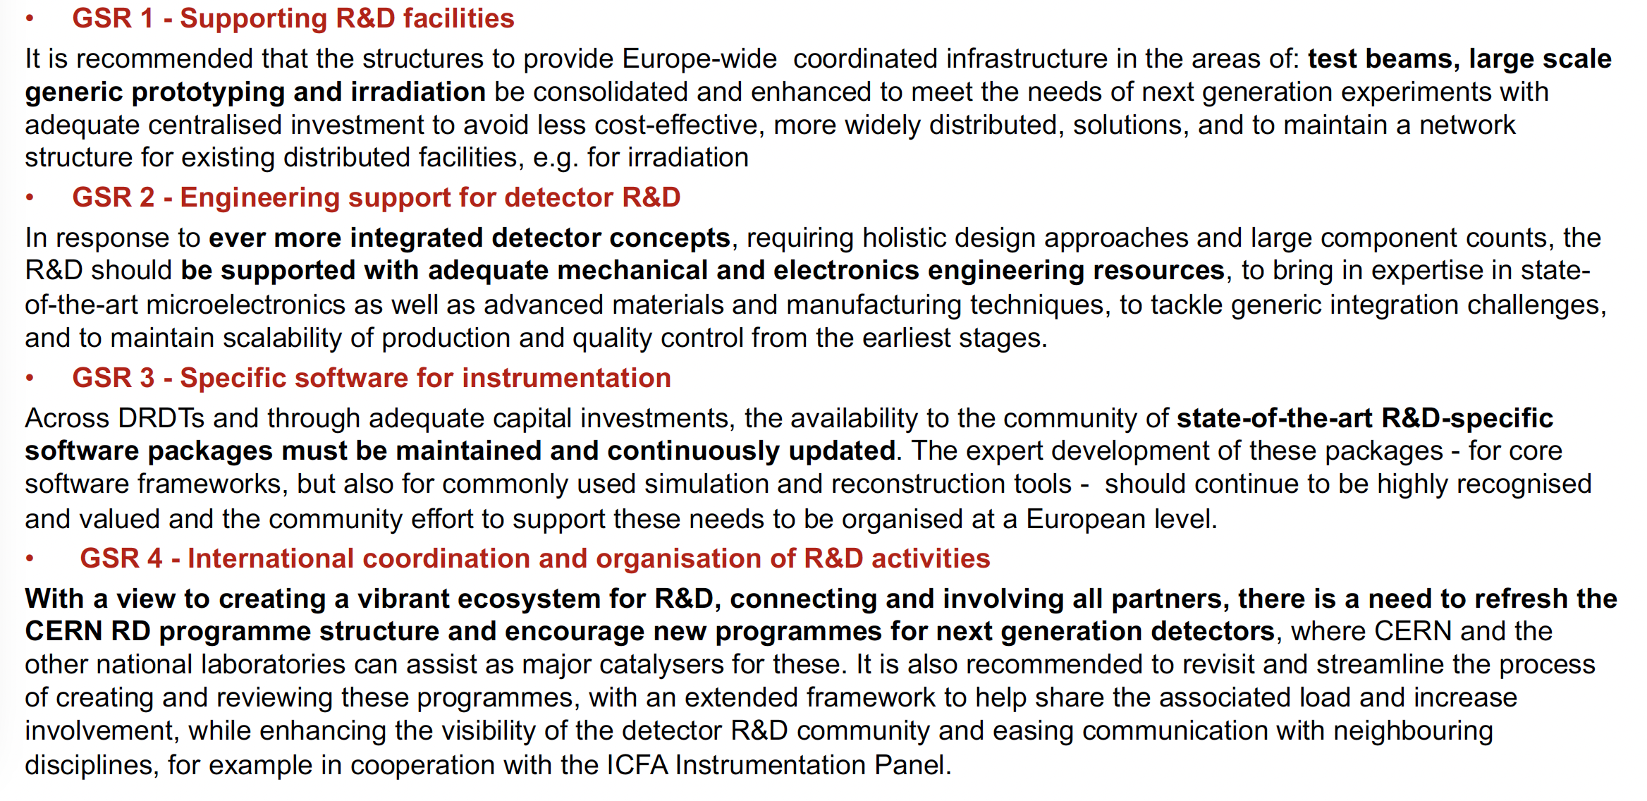
General Strategic Recommendations

Slide 49
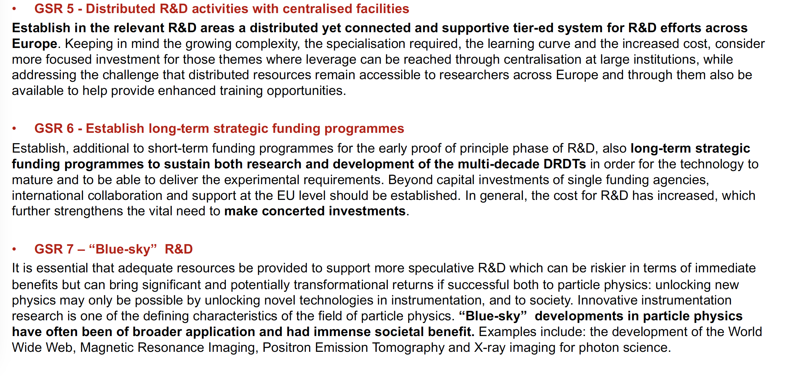
General Strategic Recommendations

Slide 50
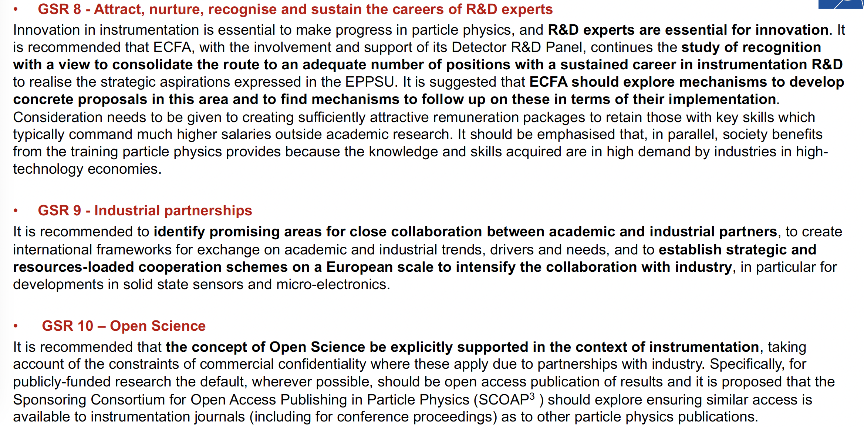
General Strategic Recommendations

