Slide 1


Status and challenges of interaction region magnets for HL-LHC, with focus on Nb₃Sn triplet
E. Todesco, TE-MSC, CERN
LASA, Milano, March 2024

Slide 2
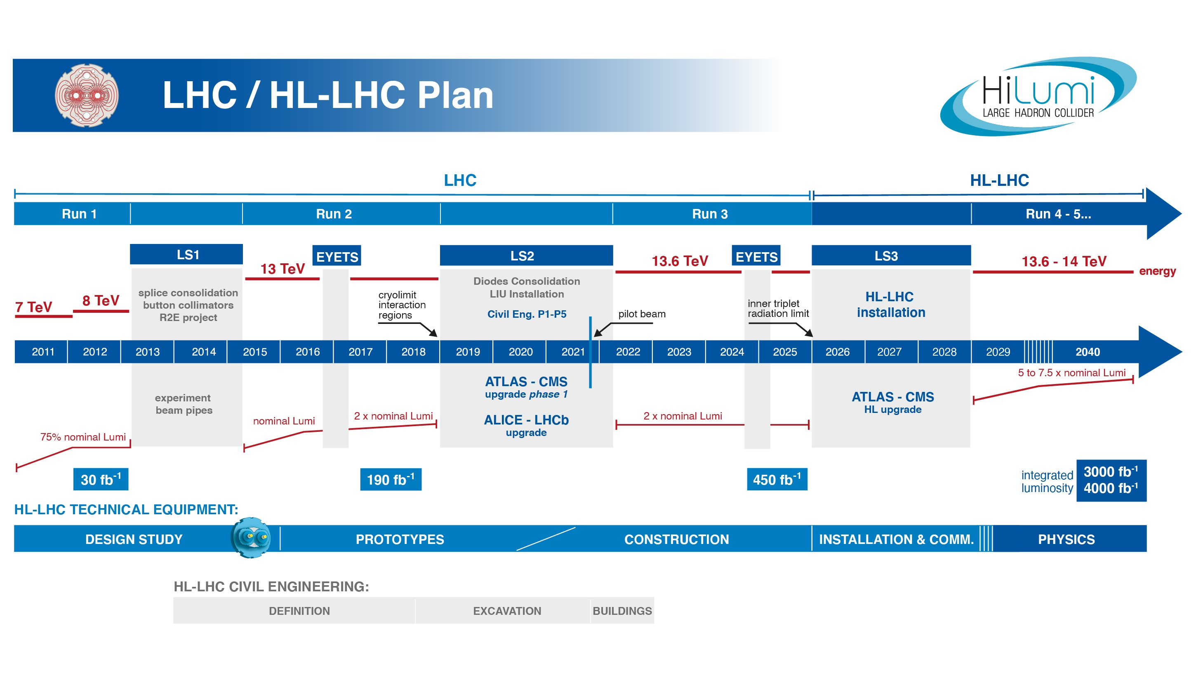
The HL-LHC project
Luminosity upgrade of LHC
  Studies since 2000
  Investment of DOE on Nb₃Sn
  and on crab cavities (LARP)
  HiLumi design studies in 2012-2014
  Project started in 2015, led by L. Rossi
  Installation in 2026-28
  Larger aperture triplet and crab cavities are the enabling technologies
IR magnets: replacing magnets in the 160 m left and right of ATLAS and CMS with larger (double) aperture magnets
  220 MCHF budget (w/o personnel), including 8 collaborations/in kind contributions
  www.cern.ch/hilumi/wp3

Slide 3
List of WP3 contributors (from East to West)
KEK: T. Nakamoto, M. Sugano, K. Suzuki, N. Kimura et al.
IHEP: Q. Xu, Y. Wang, D. Ni, W. Wu, L. Li, Q. Peng, et al.
FREIA: K. Pepitone, R. Ruber, et al.
INFN-LASA: M. Statera, M. Sorbi, M. Prioli, S. Mariotto, et al.
INFN-Genova: P. Fabbricatore, S. Farinon, B. Caiffi, A. Bersani, R. Cereseto, et al.
CERN: S. Izquierdo Bermudez, E. Gautheron, G. Kirby, A. Foussat, J. Carlos Perez, F. Rodriguez Mateos, N- Lusa, E. Ravaioli, M. Bednarek, J. Ferradas Troitino, F. Mangiarotti, M. Bajko, L. Bottura, A. Devred, H. Felice, G .Willering, S. Ferradas Troitino, M. Duda, H. Prin, A Milanese, J. Ferradas Troitino, E. Takala, R. Principe, A. Ballarino, D. Tommasini, B. Bordini, J. Fleiter, V. Parma, F. Savary, D. Duarte Ramos, Y. Leclercq, M. Struik, L. Fiscarelli, S. Russenschuck, C. Petrone, G. de Rijk, L. Rossi, P. Fessia, S. Riebe, H. Garcia Gavela, G. Vandoni, L. Quain Solis, A. Dallocchio, D. Perini, P. Moyret, S. Sgobba, A. Moros, M. Crouvizier, B. Bulat, M. Guinchard and its team, et al.
CEA: H. Felice, D. Simon, et al.,
CIEMAT: F. Toral, C. Martins Jardim, J. Garcia Matos, et al.
AUP: G. Ambrosio, S. Feher, R. Carcagno, G. Apollinari, B. Ahia, P. Joshi, K. Amm, M. Yu, A. Nobrega, J. Schmalzle, M. Anarella, A Vouris, G. Chlachidze, S. Stoynev, R. Bossert, M. Baldini, P. Ferracin, D. Cheng, S. Prestemon, G. L. Sabbi, L. Cooley, V. Lombardo et al.,
In red: management at CERN and in collaborations

Slide 4
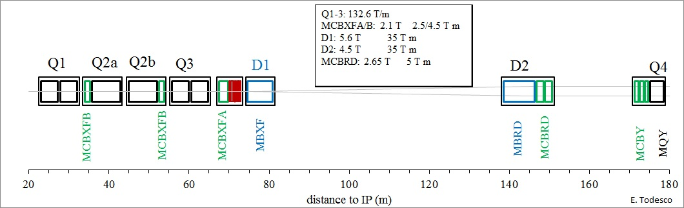
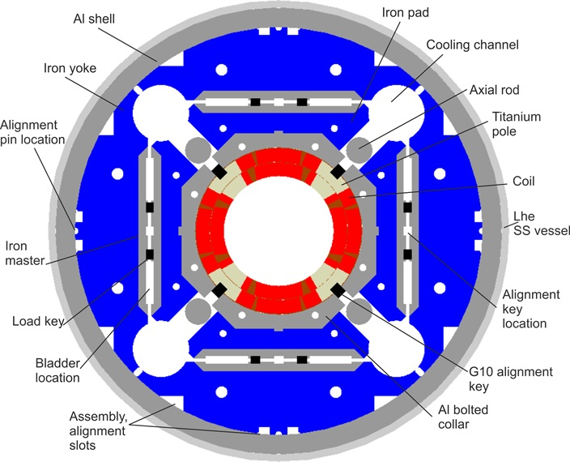
Focus on the triplet
MQXF Nb₃Sn quadrupoles: US manufactures 20, 4.2-m-long MQXFA (Q1/Q3)
CERN manufactures 10 7.2-m-long MQXFB (Q2a and Q2b)
Longest Nb₃Sn accelerator magnet so far (4.2 m for Q1/3, 7.2 m for Q2)
  Previous record was 4-m-long LQ done by LARP
  First use of Al rings structure and b&k for magnets to be installed
  S. Caspi, et al. IEEE TAS 11 (2001)
  First use of CLIQ as protection system Ravaioli, Kirby, et al IEEE TAS 24 (2014)
MQXF cross-section
(P. Ferracin, G. Ambrosio, et al.)

Slide 5
Contents
MQXF design in a nutshell
The short model program (MQXFS)
The US 4.2 m-long magnet (MQXFA)
The CERN 7.15 m-long magnet (MQXFB)
Some lessons learnt in the view of Nb₃Sn dipoles for FCC-hh

Slide 6
MQXF design in a nutshell
Large aperture: 150 mm diameter
Operational parameters (at 7 TeV)
  132 T/m gradient, 462 A/mm² overall j
  11.3 T peak field in the coil
  5 K of temperature margin
    Present LHC triplet has ≈2 K
  110 MPa of accumulation of stress in the midplane due to e.m. forces
  Operates at 77% on the loadline
    Present LHC triplet is at 82%-78%
Conductor: 40 strand cable, 0.85 mm strand
  High j_{c} Nb₃Sn strand RRP, 1280 A/mm² at 15 T, 4.22 K (10% more systematically achieved)
  Production of more than 3000 km of 0.85 mm diameter strand, with UL of 500 and 800 m
MQXF cross-section
(P. Ferracin, G. Ambrosio, et al.)

Slide 7
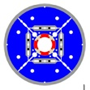
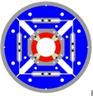
MQXF design in a nutshell
MQXF is the third generation of LHC IR quadrupoles of LARP
  First target was 200 T/m in 90 mm aperture (TQ), 2003
    Two versions: TQS based on Al shell, and TQC, based on collars
  Then in 2007 target moved to 170 T/m in 120 mm aperture (HQ), including also alignment features
    Based on Al shell structure, considered to be more efffective
    Three models built
  Then in 2013 final aperture of 150 mm was selected
Aperture increase was associated to larger coil width and lower operational current densities
  Note that TQ was not compatible with protection contraints
TQS
HQ
 | MQXF | HQ | TQ
Gradient (T/m) | 132 | 170 | 200
Peak field (T) | 11.4 | 12.1 | 10.0
Coil width (mm) | 36 | 29.5 | 18.6
Aperture (mm) | 150 | 120 | 90
Overall j (A/mm²) | 462 | 593 | 739
Stress at r (MPa) | 86 | 91 | 75
MQXF

Slide 8
Contents
MQXF design in a nutshell
The short model program (MQXFS)
The US 4.2 m-long magnet (MQXFA)
The CERN 7.15 m-long magnet (MQXFB)
Some lessons learnt in the view of Nb₃Sn dipoles for FCC-hh

Slide 9
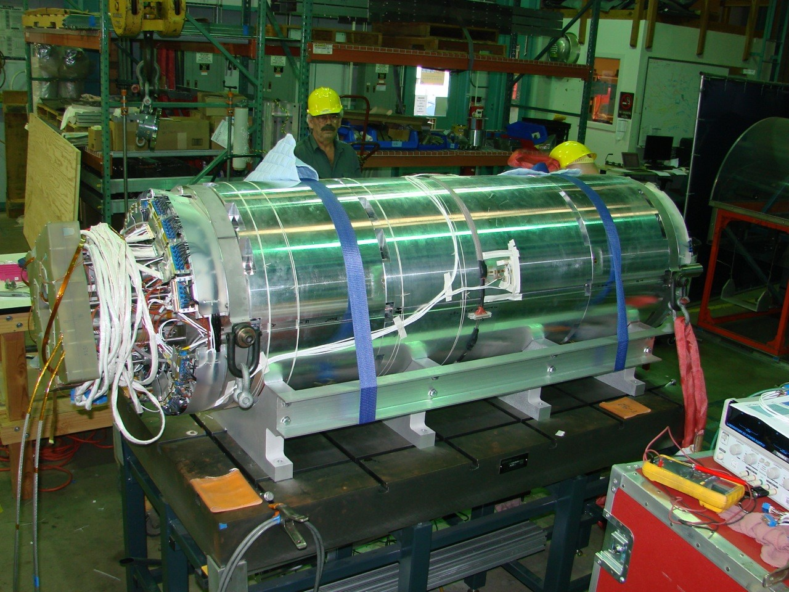
MQXF short model synoptic
7 short models built, 6 conform
MQXFS1: ≥12.9 T
11.6 T peak field corresponds
to the gradient requirement
for 7 TeV operation
(also called nominal)
MQXFS3: ~10.6 T
MQXFS5: ≥12.7 T
MQXFS4: ≥13.1 T
T₀: aperture and cable selection
MQXFS6: ≥13.4 T
MQXFS7: ≥13.2 T
MQXFS8: ≥13.1 T
2013
2014
2015
2016
2017
2018
2019
2020
2021
2022
2023
2024
2025
2026
2027
T₀+3

Slide 10
MQXF short model timeline
29 coils manufactured, with few variants
  3 at FNAL (RRP), 14 (RRP) + 12 (PIT) at CERN
Assembled in 7 models
  Structures were totally reused
  Mixing CERN and FNAL coils, mixing RRP and PIT
  Successive assemblies varying preload (0.1 mm difference in key giving 20 MPa)
Main results
  Absence of retraining after thermal cycle to nominal current (and above)
  Margin in temperature: reaching nominal current at 4.5 K (>2.6 K margin demonstrated)
  Endurance tests on two magnets, 100s of quenches, 10 thermal cycles
  Margin in field (and forces): systematic ability of reaching coil peak fields above 13 T (25% more e.m. forces and stresses)
  Reaching systematically >90% short sample at 1.9 K and at 4.5 K
  Reproducibility: only one magnet not reaching nominal current out of seven

Slide 11
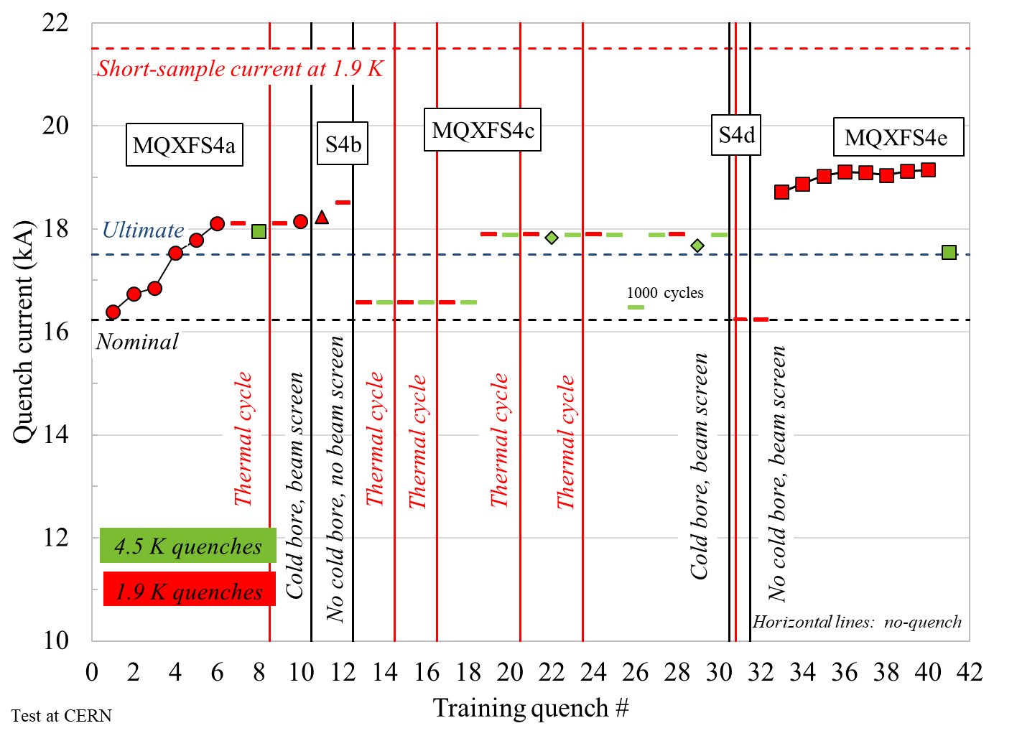
MQXF short model results
Typical pattern of training of a short model
  The MQXFS short model program is a good paradigm of what should be achieved by a magnet in the short version before scaling up the length – see last part of these slides
13.2 T peak field
7.5 TeV
7 TeV
11.3 T peak field
MQXFS4 training and endurance (S. Izquierdo Bermudez, F. Mangiarotti, et al.)

Slide 12
Contents
MQXF design in a nutshell
The short model program (MQXFS)
The US 4.2 m-long magnet (MQXFA)
The CERN 7.15 m-long magnet (MQXFB)
Some lessons learnt in the view of Nb₃Sn dipoles

Slide 13


MQXFA synoptic
Green is conform : ≥11.6 T
Red is non conform
Cold mass 1
Magnets 07 and 08
succesfully went through
coil replacement
11.6 T: requirement
for 7 TeV (nominal)
plus 300 A margin
MQXFAP1: ≥11.6 T, but electrical short
MQXFA10
MQXFAP2: ~10 T, broken structure
MQXFA11
MQXFA03
MQXFA08b
T₀+4
MQXFA04
MQXFA13: ~10.7 T
T₀: aperture and cable selection
MQXFA05
MQXFA14
Program
Project
MQXFA06
MQXFA07b
DOE approval
MQXFA07: ~10.7 T
MQXFA15
MQXFA08: ~9.5 T
2013
2014
2015
2016
2017
2018
2019
2020
2021
2022
2023
2024
2025
2026
2027
11 magnet tested, 10 more new magnets to test (9,12,16-23), plus MQXFA13 reassembly

Slide 14
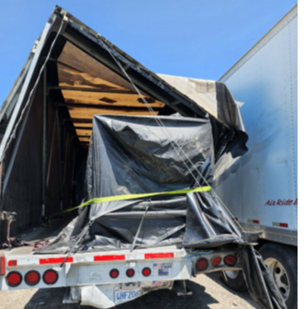

MQXFA conform magnets
MQXFA program confirms
  Ability to operation at nominal current plus 300 A, both at 1.9 K and 4.5 K
  Perfect memory, i.e. no retraining, and some robustness
Powering test of first six conform MQXFA magnets
(J. Muratore, B. Ahia, S. Feher et al.)
Non conform MQXFA11 transport

Slide 15
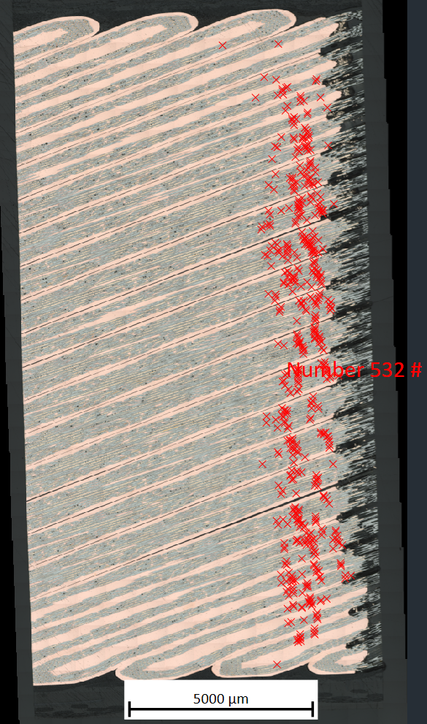
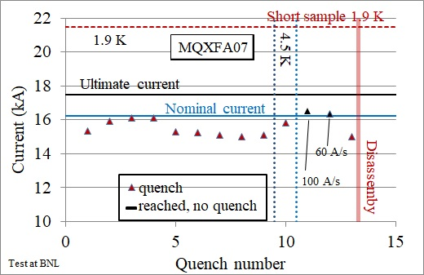
MQXFA performance limitations
MQXFA07 and 08 showed performance limitations with reverse behaviour
  Issue identified in an asymmetry in the assembly, at the transition straight part-end
  MQXFA07 limiting coil has been inspected via tomography/mterialography at CERN: large number of longitudinal cracks in the filaments in that region
Power test of MQXFA07 (J. Muratore, S. Feher, G. Ambrosio et al.)
Presence of cracks (red crosses) in coil 214 (M. Crouvizier, A. Moros, S. Sgobba)

Slide 16
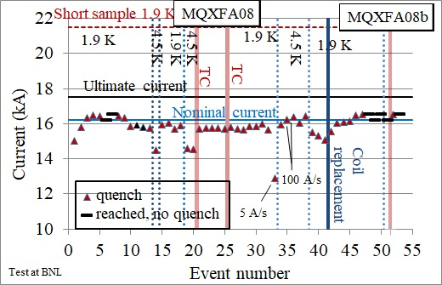
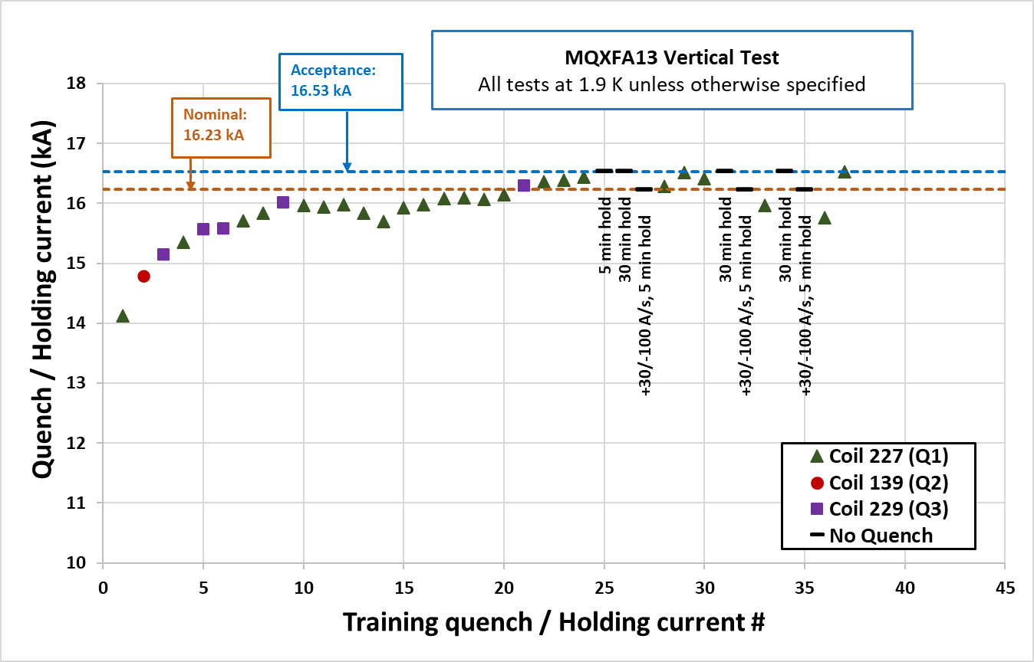
Overcoming performance limitations
Both 07 and 08 went through a coil replacement and then reached performance
  Iteration on assembly parameters, alingment key (see last part)
MQXFA13 also showed performance issues, coil replacement is ongoing
  Performance: out of 11 built, 8 conform 3 non-conform (excluding prototypes)
    Two out of these three non-conform magnets were reassembled and now ok
Power test of MQXFA08 (A. Ben Yahia, S. Feher, G. Ambrosio et al.)
Power test of MQXFA13 (A. Ben Yahia, S. Feher, G. Ambrosio et al.)

Slide 17
Contents
MQXF design in a nutshell
The short model program (MQXFS)
The US 4.2 m-long magnet (MQXFA)
The CERN 7.15 m-long magnet (MQXFB)
Some lessons learnt in the view of Nb₃Sn dipoles for FCC-hh

Slide 18
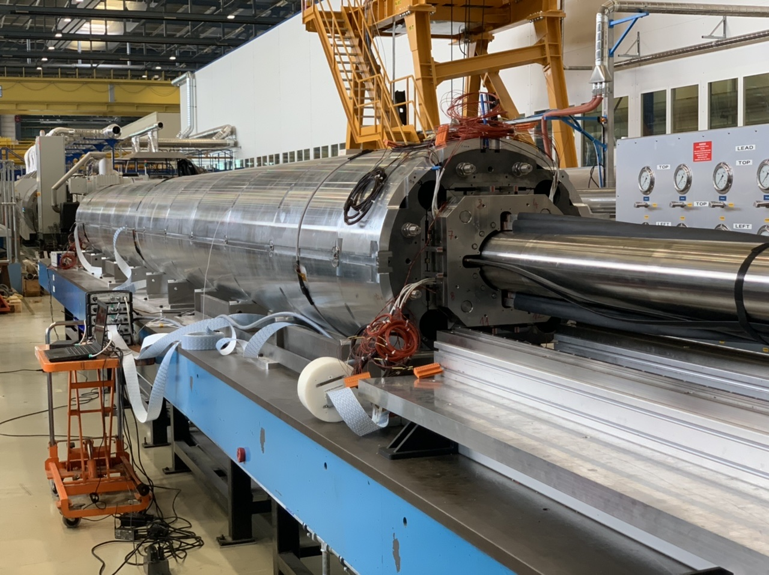
MQXFB synoptic
Green: conform ≥ 11.6 T
Red: non conform
Grey: to come
MQXFBP1: ~10.5 T
MQXFBP2: ~11.2 T
MQXFBP3
MQXFB02*
T₀: aperture and cable selection
MQXFB03
MQXFB04
MQXFB05
2013
2014
2015
2016
2017
2018
2019
2020
2021
2022
2023
2024
2025
2026
2027
T₀+7
7 to 9 more magnets to test
* NC HV test, to be disassembled

Slide 19
MQXFB performance limitations
MQXFBP1 and MQXFBP2 were limited just below nominal current
  Contrary to MQXFA, no reverse behaviour, i.e., 4.5 K performance consistent with 1.9 K (70% and 74% of short sample) – quenches in straight part
  MQXFBP1 was disassembled, and longitudinally broken filaments were found in the limiting coil, in agreement with quench antenna and voltage tap locations
MQXFB prototype performance
(F. Mangiarotti, S. Izquierdo Bermudez, et al.)
Broken filaments in coil 108, limiting MQXFBP1
(M. Crouvizier, A. Moros, S. Sgobba, et al.)

Slide 20
MQXFB performance limitations
MQXFBP3 reached nominal current plus 300 A
  But at 4.5 K the limitation is still visible, corresponding to 80% of short sample
  No degradation after thermal cycles
  A three bullet plan was defined to address possible causes: (i) integration in LHe vessel (addressed in MQXFBP3), (ii) assembly, (iii) coil manufacturing
MQXFB prototype performance
(F. Mangiarotti, S. Izquierdo Bermudez, et al.)
Comparison of performance of MQXFB prototypes
(S. Izquierdo Bermudez)

Slide 21
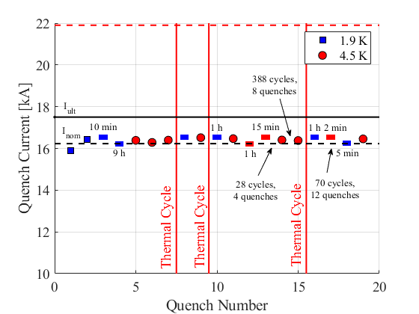
MQXFB performance limitations
MQXFB02 reached nominal current plus 300 A
  But at 4.5 K the limitation barely visible, corresponding to 82% of short sample and 2.6 K temperature margin - No degradation after thermal cycles
  A three bullet plan was defined to address possible causes: (i) integration in LHe vessel (addressed in MQXFBP3), (ii) assembly (MQXFB02), (iii) coil manufacturing
MQXFB02 performance
(F. Mangiarotti, S. Izquierdo Bermudez, et al.)
Comparison of performance of MQXFB prototypes
(S. Izquierdo Bermudez)

Slide 22
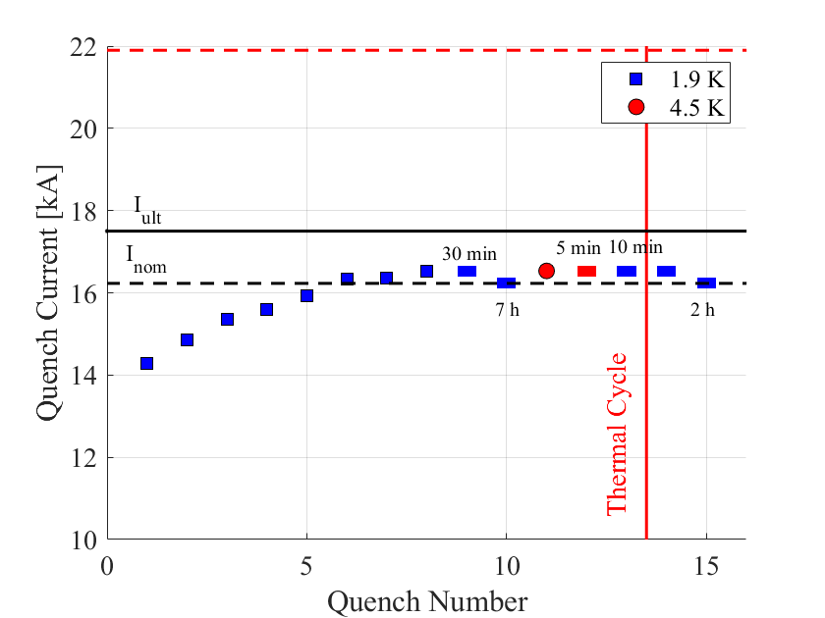
MQXFB performance limitations
MQXFB03 reached nominal current plus 300 A, and showed to limitations at 4.5 K
  This magnet implemented modification of coil fabrication (removal of the binder from the outer layer, curing an oversize in the coil azimuthal length and other indicators)
  Note that US magnets did not have these indicators (neither limitations in performance, and therefore kept the binder
MQXFB03 performance
(F. Mangiarotti, S. Izquierdo Bermudez, et al.)
Ramp rate comparison of prototypes
(S. Izquierdo Bermudez)

Slide 23
Contents
MQXF design in a nutshell
The short model program (MQXFS)
The US 4.2 m-long magnet (MQXFA)
The CERN 7.15 m-long magnet (MQXFB)
Some lessons learnt in the view of Nb₃Sn dipoles

Slide 24
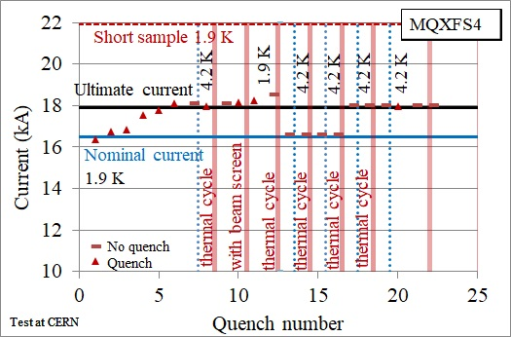
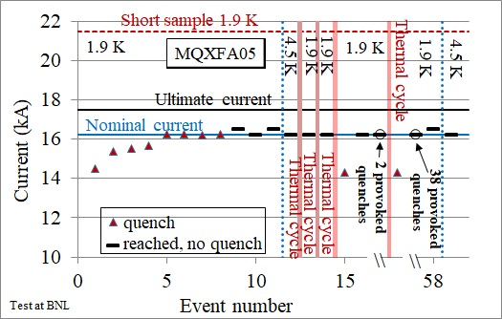
About long term stability
Degradation of Nb₃Sn magnets after thermal cycle has become a major concern in the community after the results in 2018-2020 of the 11 T long magnets
  Three short models succesfully went through endurance tests: MQXFS1, MQXFS4, MQXFS6
  One full-length MQXFA magnet (without integration in the LHe vessel) succesfully went through endurance tests – no degradation observed after thermal cycles and quenches
Short magnet endurance test
(P. Ferracin, F. Mangiarotti , et al.)
Long magnet endurance test
(B. Ahia, S. Feher, G. Ambrosio, et al.)

Slide 25
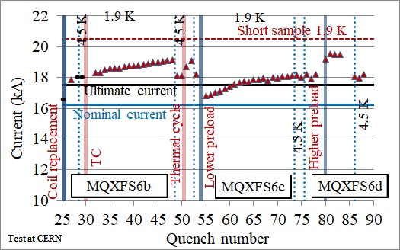
About low preload
The structure based on Al shells aims at full preload just below nominal current
  Very low preload has also been tested, corresponding to preload at 70% of nominal current: magnet was tsill able to operate at nominal current, but nearly 2 kA of maximum reachable current were lost
  (S. I. Bermudez, et al., IEEE TAS 32 (2022) 4007106)
Power tests
Coil unloading during powering
Preload experiment on MQXFS6 (S. Izquierdo Bermudez, F. Mangiarotti, et al.)

Slide 26
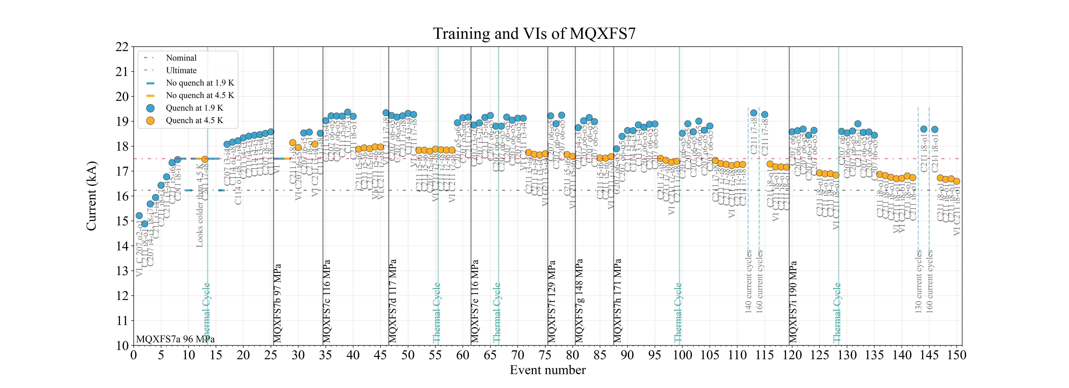
About high preload
Similar to what done in TQ magnet, higher preload were explored (up to 200 MPa)
  Test is ongoing, at 200 MPa nominal performance is still reachable, but signs of performance degradation in the range above 90% of short sample limit – we are now going back to 120 MPa
90% s.s.
at 1.9 K
171 MPa
190 MPa
7 TeV
80% s.s.
at 1.9 K
96 MPa
117 MPa
148 MPa
129 MPa
Preload experiment on MQXFS6 (S. Izquierdo Bermudez, F. Mangiarotti, et al.)

Slide 27
About training: a red haring ?
A lot of emphasis has been put in the community on training of Nb₃Sn
  Typical statement: «Training in Nb₃Sn magnets is slow, and this is not acceptable for a machine made of 4000 magnets as FCC-hh »
  This mainly comes from the experience on LHC, were operation at 6.8 TeV (83.5% of short sample) requires about 600 retraining quenches
MQXF shows a long virgin training, especially above 80% of short sample – more significant than Nb-Ti LHC dipoles
On the other hand, training after thermal cycle appears absent in MQXF up to nominal (but this is 77% of short sample – not directly comparable to LHC dipoles)
One should not forget that there are two types of training: virgin training and training after thermal cycle
  Virgin training is part of magnet construction and test: even though one trains in the test station for two weeks, the magnet construction takes one year … so virgin training is probably not a driving factor
We are gathering a lot of statistics, and at the end of the MQXF production, we will be able to better assess the « issue » of training in Nb₃Sn

Slide 28
About mechanical design
The principle of the TQ structure is open gap, i.e. there are no stoppers preventing the force from the Al shell to go on the coils
  This structure has the advantage of simplicity, as the cool-down effect is not related to tolerances of the stoppers and is fully reproducible …
  … and having measurements of strain at cryogenic temperature in absolute is very tricky
In MQXF, alignment features were introduced (alignment keys)
After some iterations the interference between
alignement key and collars has been removed
  Even with this lack of interference, field quality is very good:
  It corresponds to a coil positioning of 20 μm
Different structures can do the same work …
… for MQXF we decided to reuse all concepts validated in LARP
This was a risk minimization

Slide 29
About mechanical observables
There is a wide range of assembly parameters for preload
  Note that the « exact » state of stress in the coil is an ill defined quantity, as the coil is a composite structure and it cannot be measured directly
  It is not a surprise that experiments on different settings can vary up to a factor two (i.e. degradation is in the 100-200 MPa range)
  Another point is how much degradation we can accept ?
    Working at 80%, we can survive 50% of degradation …
    … but should be stable in time ! Tricky point
A fundamental point is to have reliable observables
  Coil size, shimming size and keys size
  Strain gauges in the coil and in the shell, used
  at room temperature during assembly
  Seeing the coil unloading during powering is an essential
  tool to validate the control of the mechanical aspects

Slide 30

Targets for FCC-hh Nb₃Sn magnets
Based on the HL-LHC experience, one can set the targets for FCC-hh dipole
  This is needed to clarify the ambiguities between 16 T, 14+ T, margins, requirements, etc
  We set 14 T operational field, at 80% on the loadline (20% margin)
    This gives 5 K temperature margin, and according to HL-LHC experience should guarantee the possibility of operating 14 T also at 4.5 K (proving tht half of the theoretical temperature margin is there)
    4.5 K is an interesting option for energy saving – it implies having most of the correctors and other main magnets in Nb₃Sn (with Nb-Ti at 4.5 K you lose a lot)
A 14 T dipole with the FCC 91 km tunnel can give 90 TeV c.o.m. collision energy
For the short model magnets, one should prove more
  Before scaling in length one should have consistent margins in the design!
Targets for short models
  They should reach systematically 90% of short sample at 4.5 and at 1.9 K
  This means able to reach 15.8 T at 1.9 K
  This proves the margin in the mechanics for 25 % larger forces and stresses
  And, obviously, reproducibility of performance

Slide 31
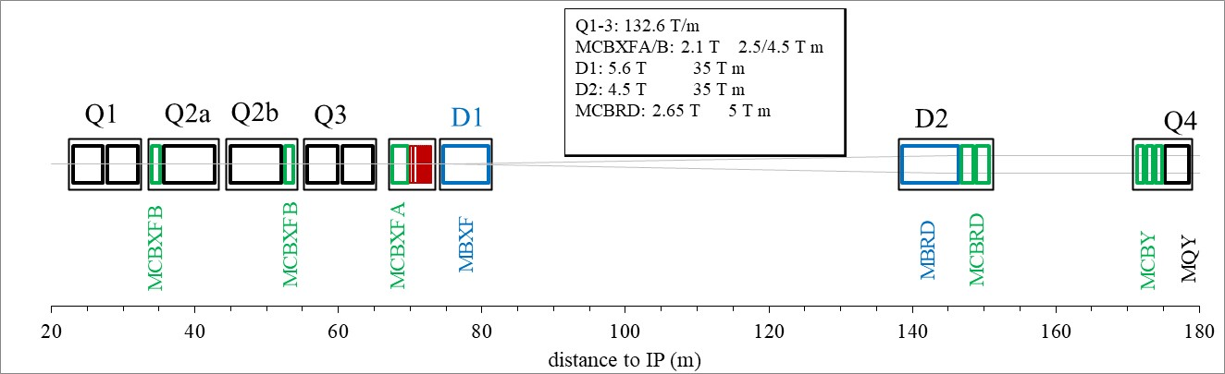
2013 status
SCHEDULE
In summer 2013 we defined the HL-LHC baseline, based on preparatory work by LARP, S-LHC, Phase-I and Phase-II upgrade, HL-LHC design study
E. Todesco, H. Allain, G. Ambrosio, G. Arduini, F. Cerutti, R. De Maria, L. Esposito, S. Fartoukh, P. Ferracin, H. Felice, R. Gupta, R. Kersevan, N. Mokhov, T. Nakamoto, I. Rakno, J. M. Rifflet, L. Rossi, G. L. Sabbi, M. Segreti, F. Toral, Q. Xu, P. Wanderer, and R. van Weelderen: "A first baseline for the magnets in the high luminosity LHC insertion regions" IEEE Trans. Appl. Supercond. 24 (2014) 4003305 (presented in ASC 2013, published on 2014)

Slide 32
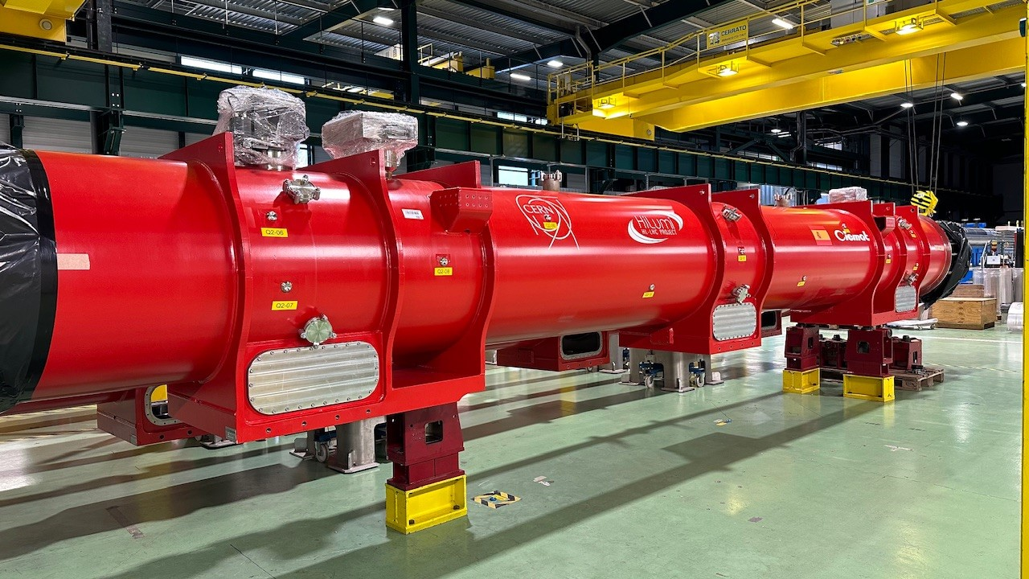
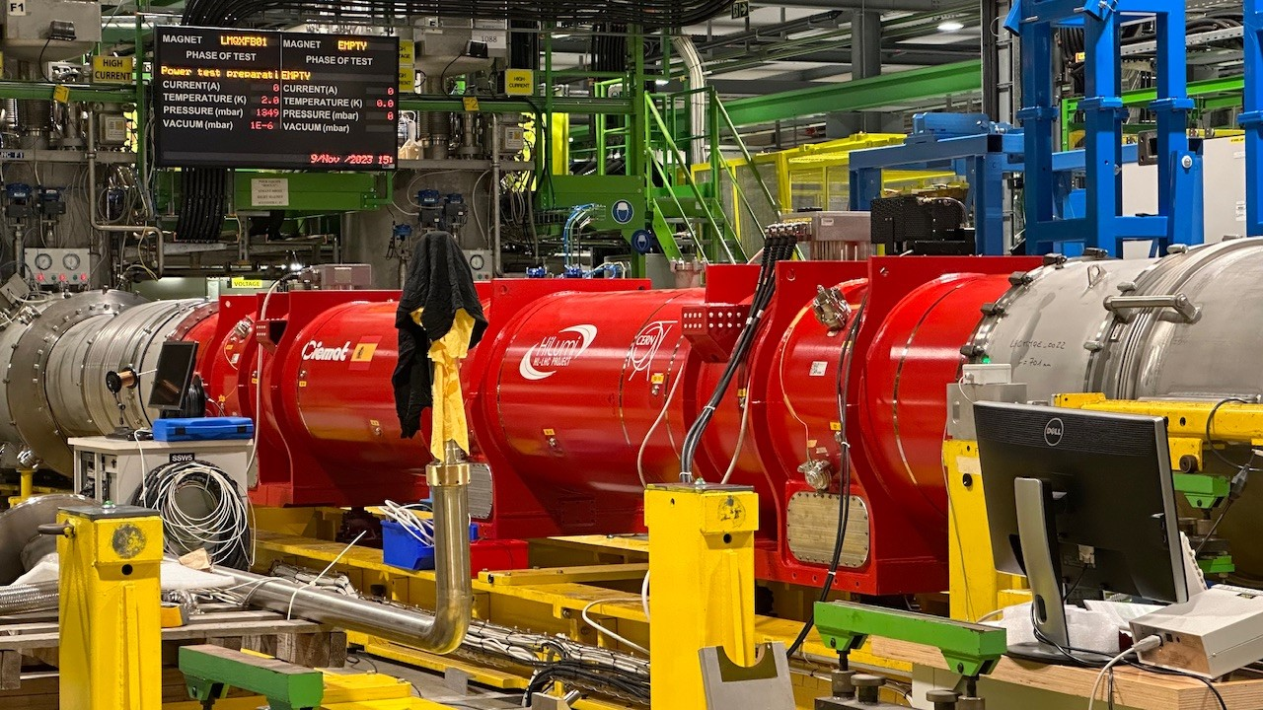

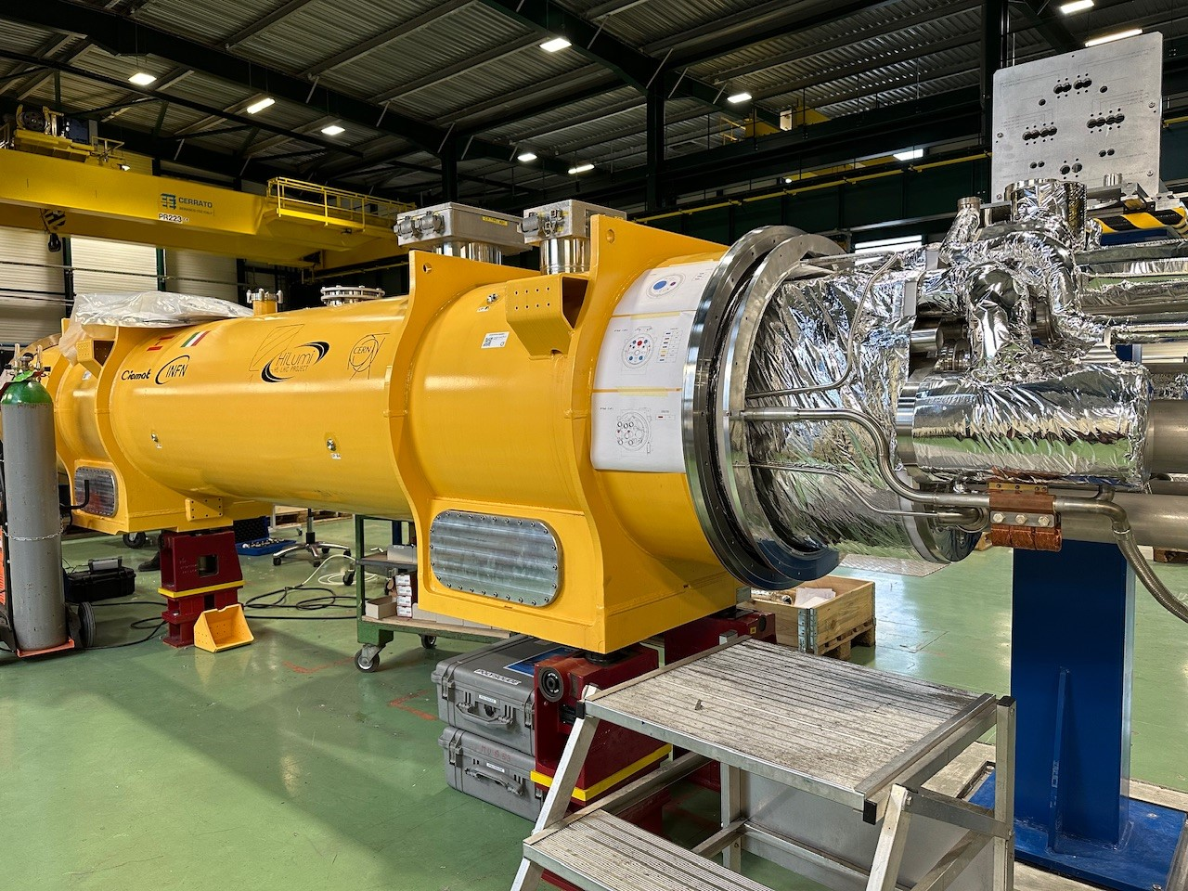
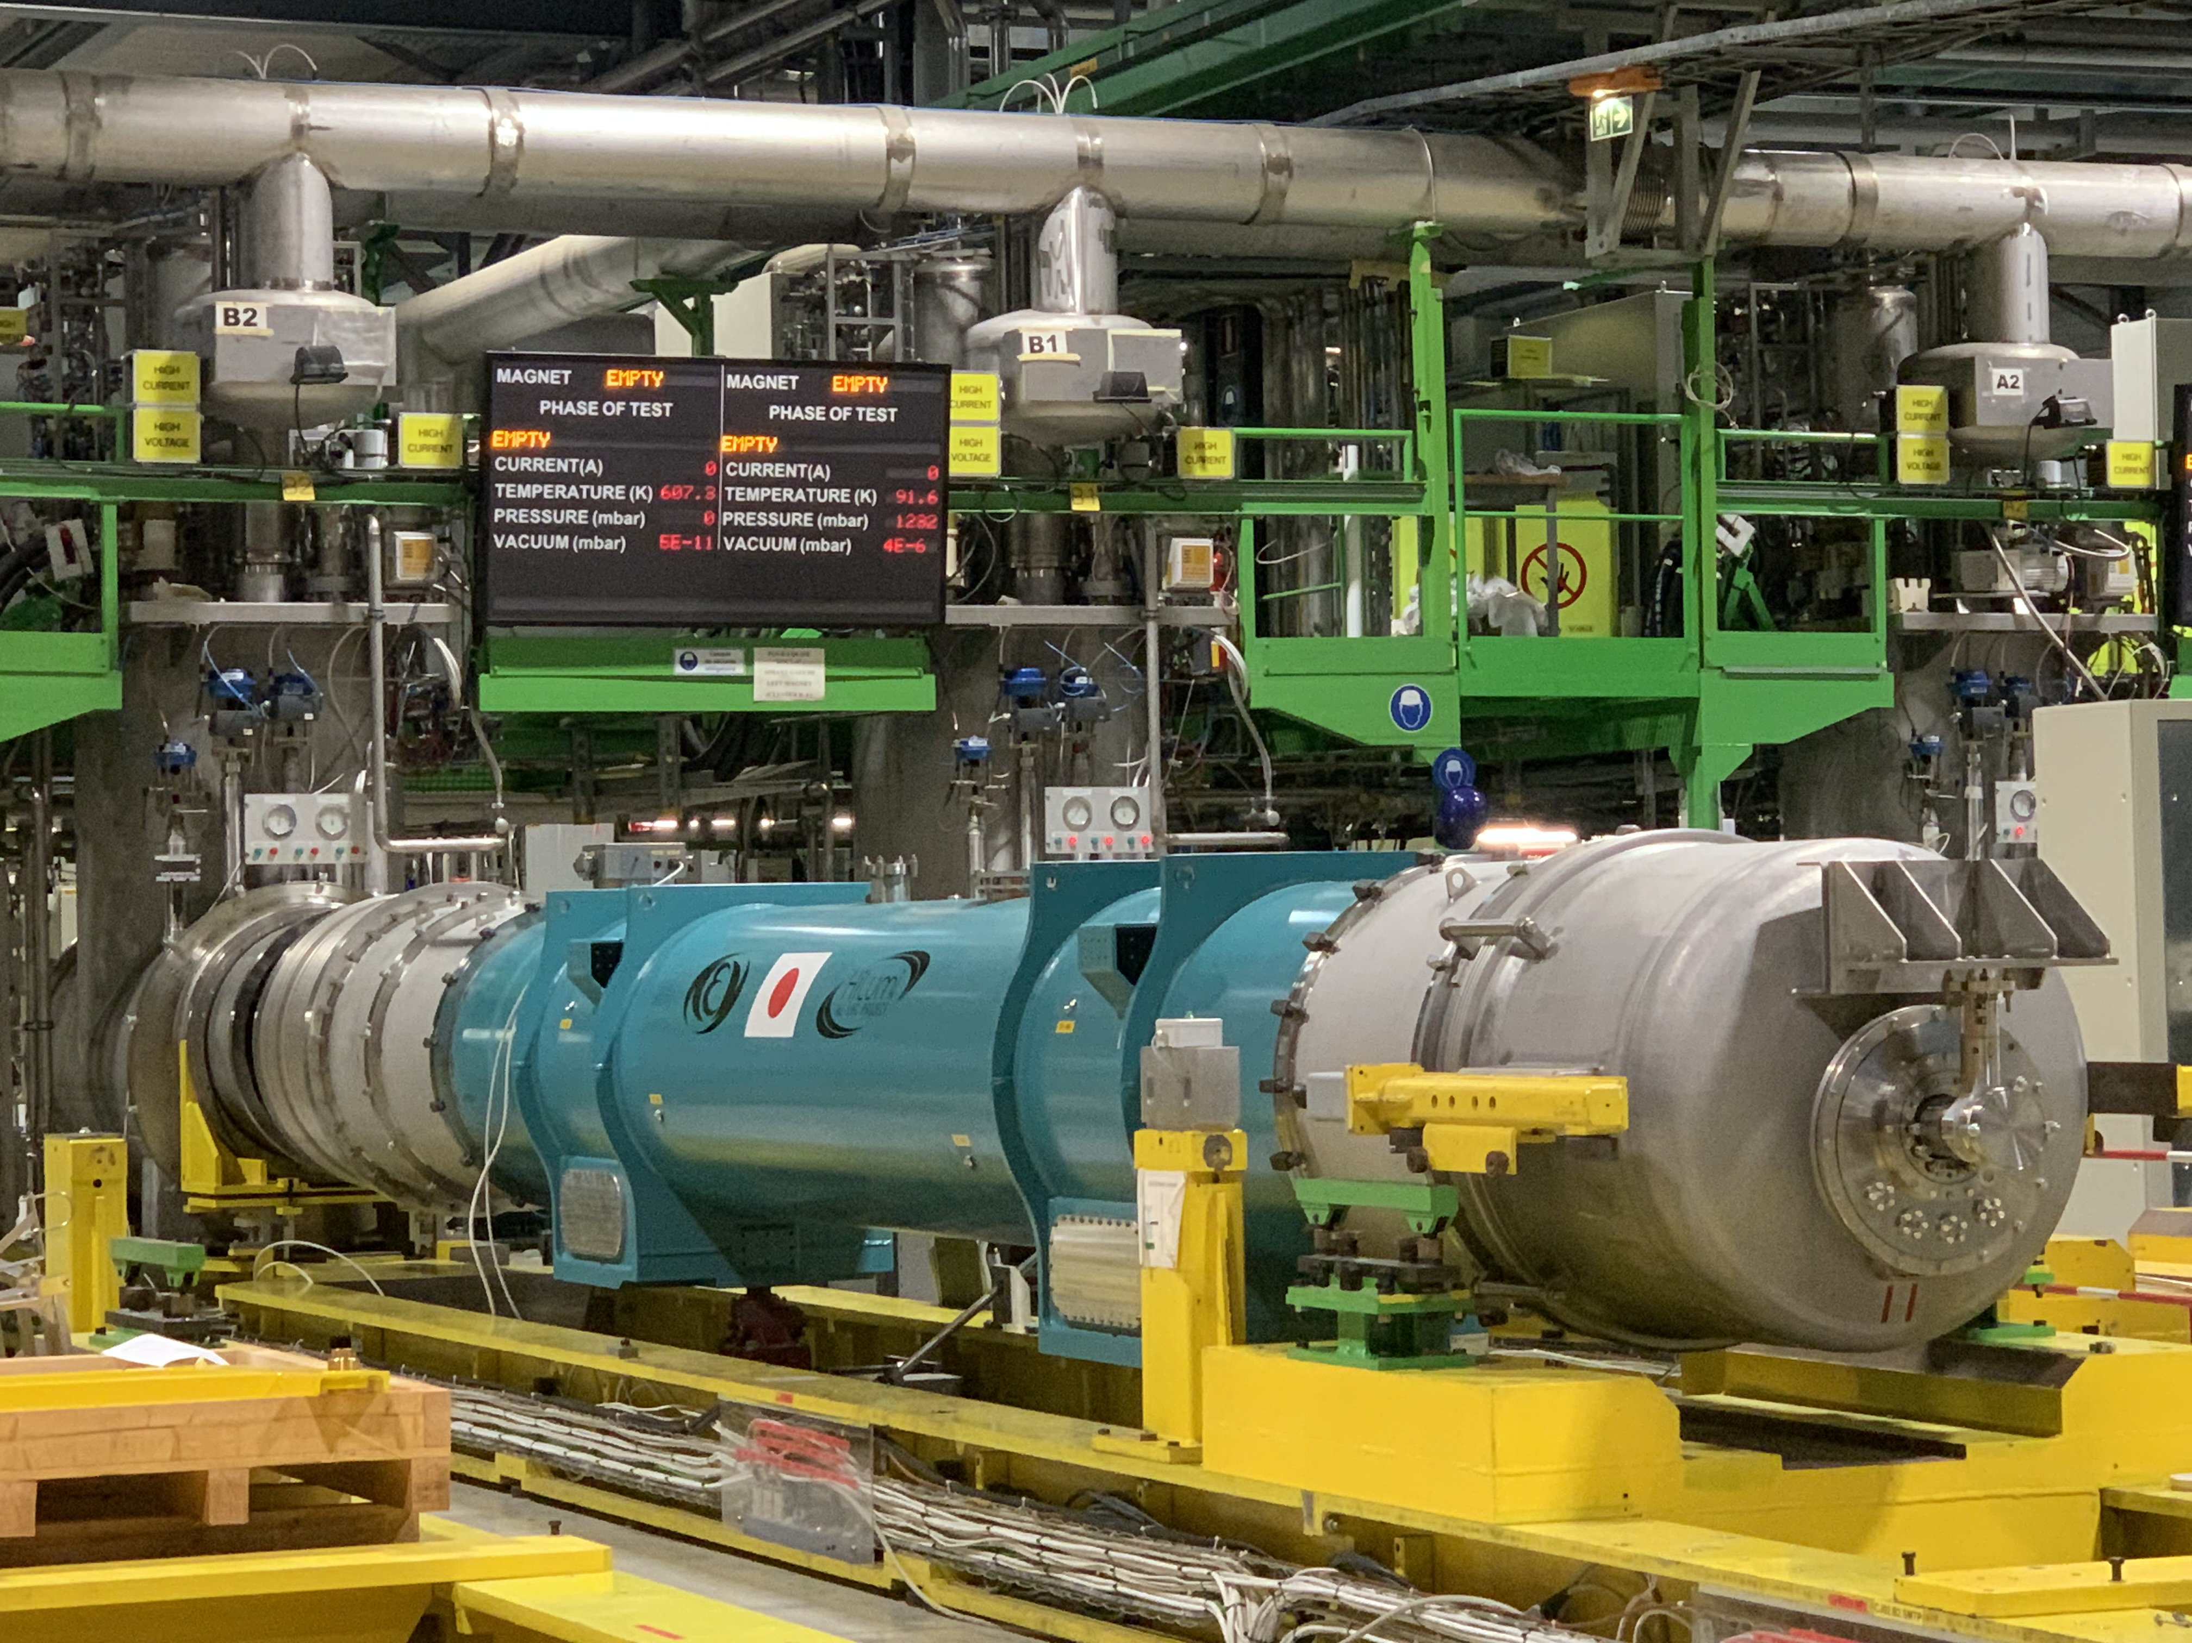
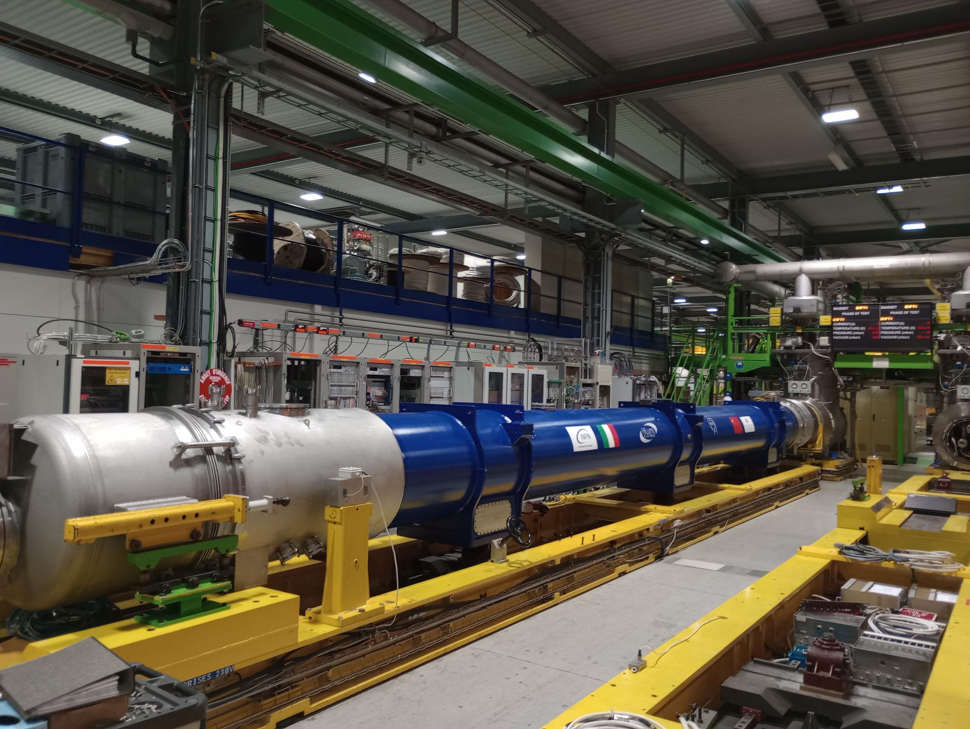
Ten years later …
SCHEDULE

