Slide 1
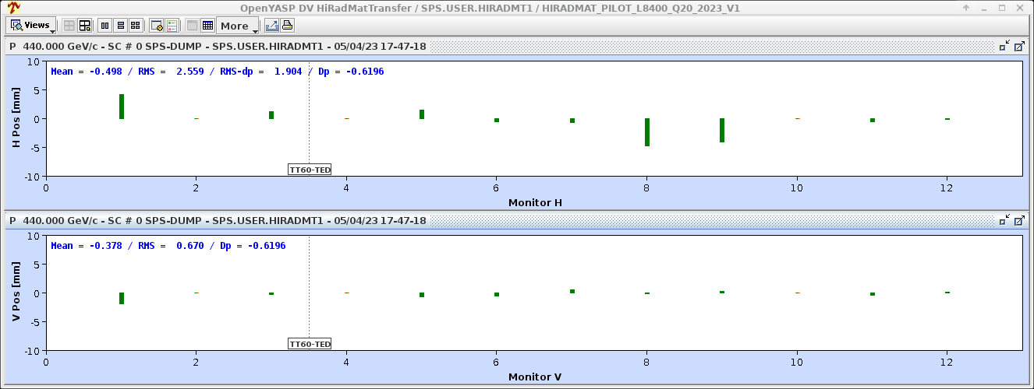
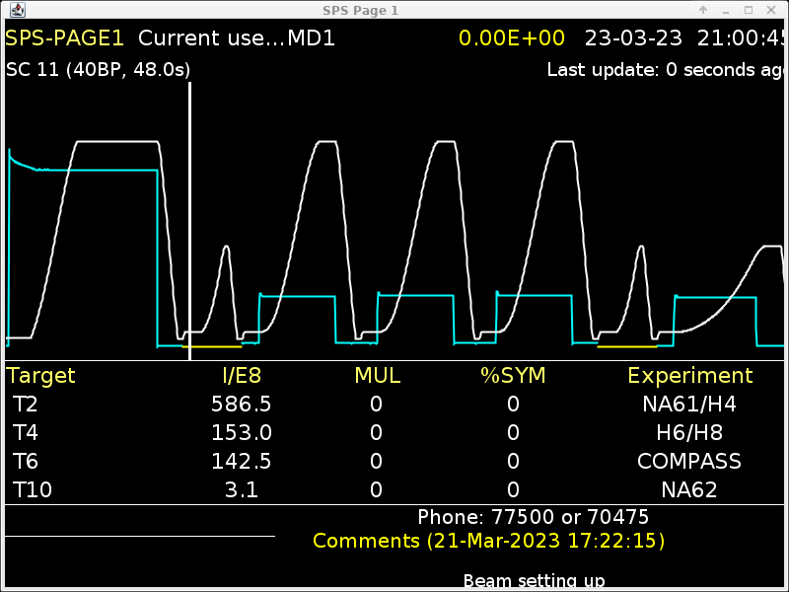
SPS report – week 14
SFTPRO extracted to TT20 TEDs – core & core + islands @ 5e12ppb
  Alignment girder and ZS already done
  Noise suppression being studied the coming weeks → first results look promising
HiRadMat ready on long and short cycles using LHCINDIVs
  HiRadMat1 extracted to HiRadMat dump yesterday
  HiRadMat1 bunch rotation setting up started
AWAKE bunch rotation setting up still needed
  AWAKE beams set up with INDIVs
Plan to send NA beam to targets probably in the course of next week

Slide 3
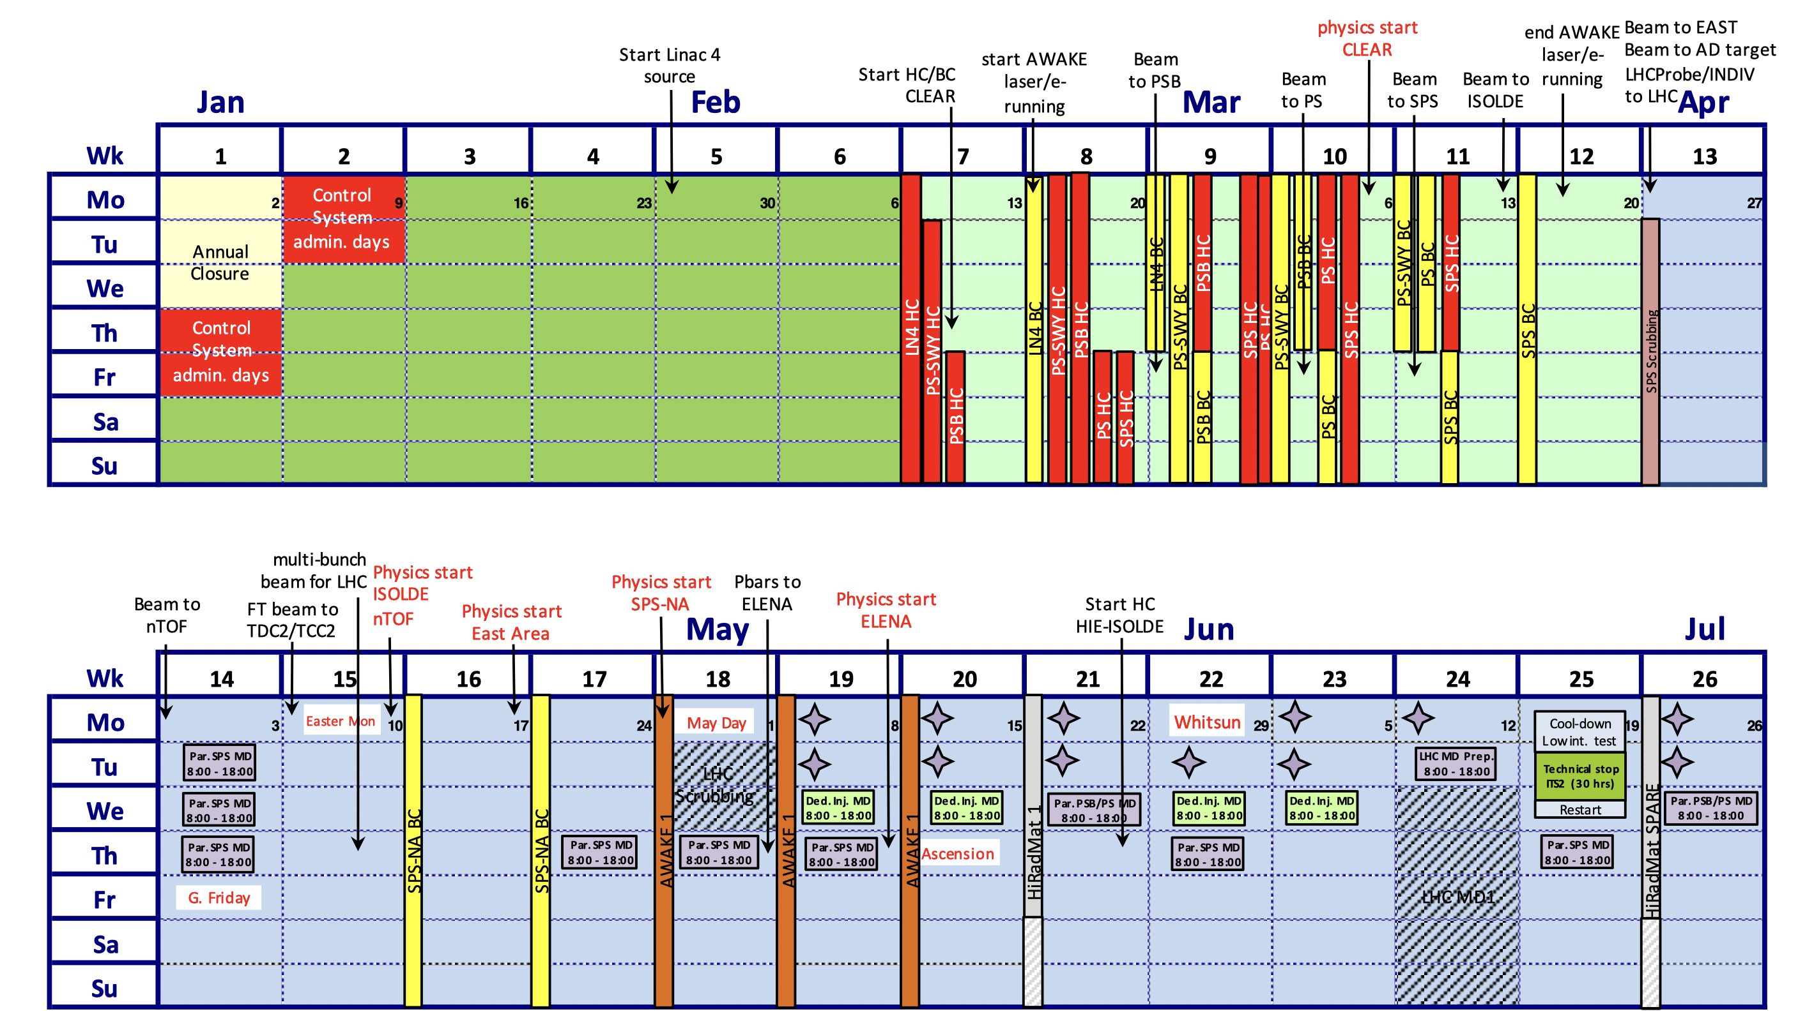
SPS beam commissioning – beams desiderata
Week 11/12:
  MTE core at 5e11
  LHCINDIV at 1.2e11 ppb
  Add special beam for RF voltage calibration
  Multi-bunch LHC beams towards end of week – standard 72, BCMS 36 & 48, up to 2.1e11 ppb
Week 13+:
  Multi-bunch beams for LIU studies – 72 standard, BCMS, 8b4e, up to 2.6e11 ppb
  MTE core + island up to 5e12 ppb per injection – vertical emittance of 4.5 um

Slide 4
SPS beam commissioning – 5 week overview
Week 11/12:
  Threading beam, aperture measurements, acceleration
  BBA
  Fast extraction setting up, beam to TT40/TT60 TEDs, beam to LHC
  Multi-bunch LHC beams setting up
Week 13:
  EPC tests with reduced power for de-gaussing
  Scrubbing with multi-bunch LHC beams
  Kicker waveform scan (MKE-6)
Week 14:
  LHC & LIU beam commissioning with high-intensity beams
  Beam to TT20 TEDs (the latest!)
Week 15:
  Slow extraction setting up
  Steering to targets, parallel scrubbing
Week 15, 16, 17:
  Beam on targets, parallel scrubbing

