Slide 1
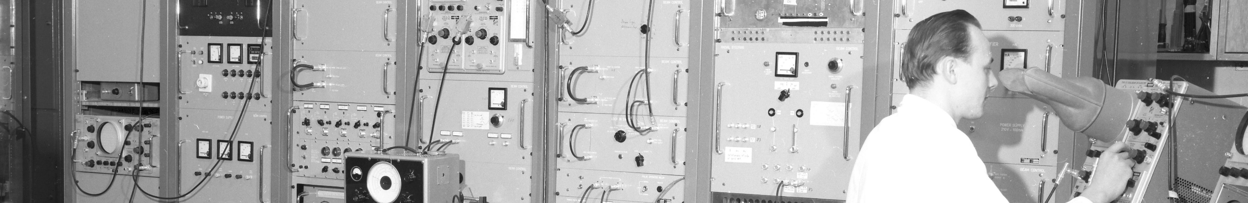
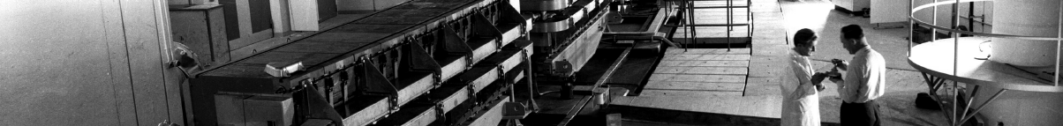
PS Report week 14
Many thanks
to the PS OP and coordination teams as well as all equipment experts and support teams!

Slide 2
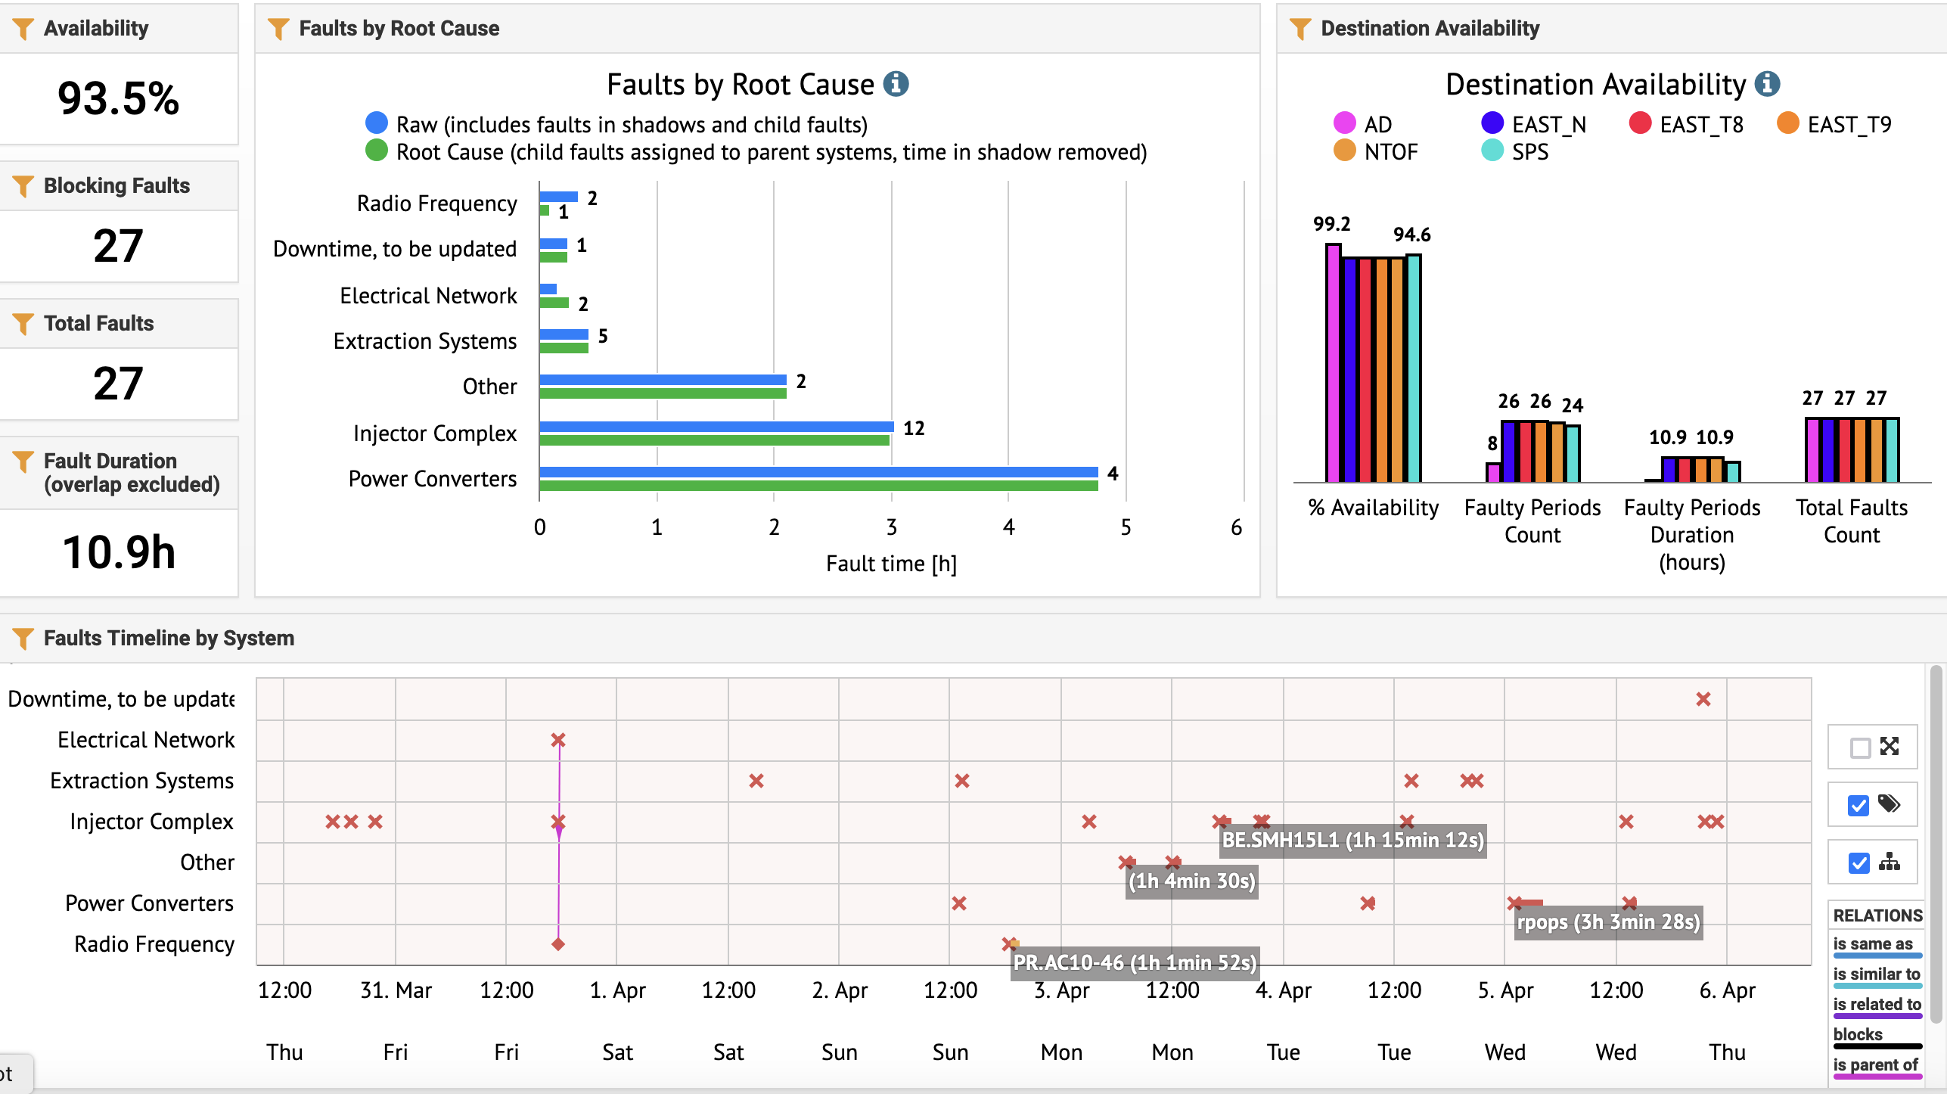
Availability
Main downtime due to accesses on Monday and POPS DC3 communication issue Tuesday night.

Slide 3
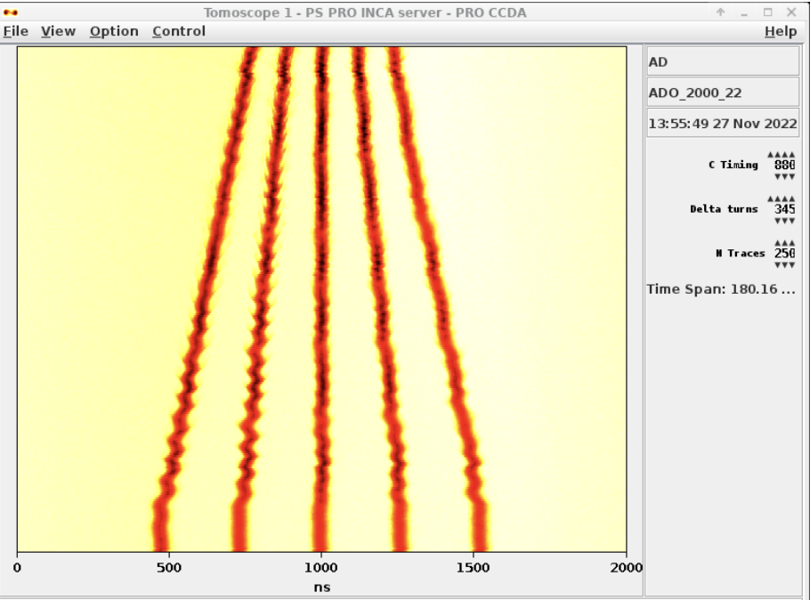
Main Activities
EAST
2 short accesses organized by Federico Ravotti on Monday to install foils for calibration of beam intensity
Extraction and transfer line optimization ongoing (Eliott, Marc)
AD
Beam (5 bunches) set up, ready for FTA line commissioning next week
              Use of 1 bunch only tested (advantage of same emittance wrt. 5 bunches compared to reduction of intensity)
SPS
Delivering different beams for scrubbing, including 8b4e
AWAKE
Beam setup started yesterday
nTOF
FTN line optics commissioning; issue with Semgrid in front of target (H profile measurement bad for higher intensities) → beam stop TODAY 12-14h

Slide 4
Status of operational beams
Fixed target beams | Status | Comment
SFTPRO (core only) | Fine adjustments | Sent to SPS at 50 ∙ 10¹⁰ p/p
SFTPRO (5 turn extraction) | Fine adjustments | Available up to 1.5 ∙ 10¹³ p/p
AD | Fine adjustments | Available up to 1.5 ∙ 10¹³ p/p and ready for FTA line commissioning
TOF | Fine adjustments | 850 ∙ 10¹⁰ p/p and 28 ns bunch length at extraction
EAST | Finalising setup | Beam sent on T9, N targets and to IRRAD Fast extraction
LHC-type beams | Status | Comment
LHCPILOT, LHCINDIV | Fine adjustments | Sent to LHC
LHC25 (3bp, 72b) | Fine adjustments | Sent to SPS at 2.3 ∙ 10¹¹ p/b; Pushed up to 2.6 ∙ 10¹¹ p/b
LHC25 (2bp, 12b to 48b) | Fine adjustments | Extracted with splittings and bunch rotation
LHC25 BCMS (48b) | Fine adjustments | OK at 1.4 ∙ 10¹¹ p/b Pushed up to 2.3 ∙ 10¹¹ p/b, tuning necessary to go beyond
LHC25 8b4e (56b) | Fine adjustments | Pushed up to 2.1 ∙ 10¹¹ p/b
AWAKE | Fine adjustments
HiRadMat
ILHC (1b)
ILHC (4b)

Slide 5

PS Coordinator for week 14 – Bettina Mikulec
PS Coordinator for week 15 – Alexander Huschauer
Questions and Comments
9:00 live meeting at the CCC on Tuesday/Wednesday/Thursday/Friday
Zoom link to follow the meeting on remote: https://cern.zoom.us/j/9372114100?pwd=L29BcmlHUENCdFBRSytXYVcrM1B4Zz09
Meeting ID : 937 211 4100
Passcode: 525463

