Slide 1
XTAX endoscopic inspection 2023
S. Girod; Y. Fiammingo

Slide 2
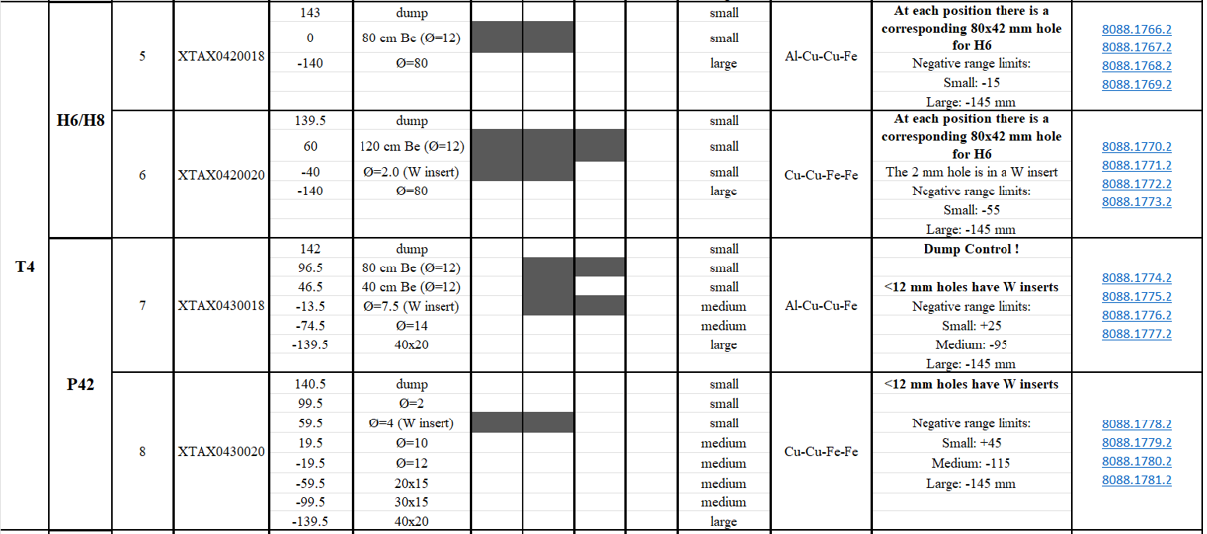
XTAX T4
Tax position +142 mm
3
1
-74.5 mm
4
4
2
1
Tax position -65 mm
+140.5 mm

Slide 3
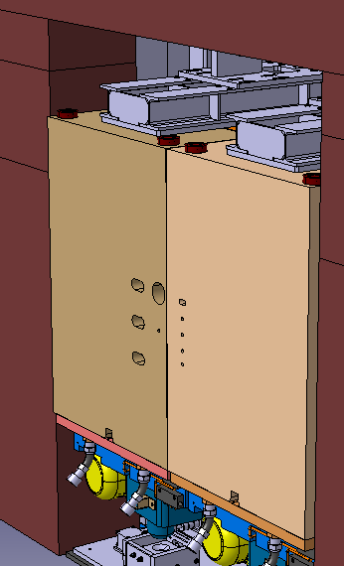
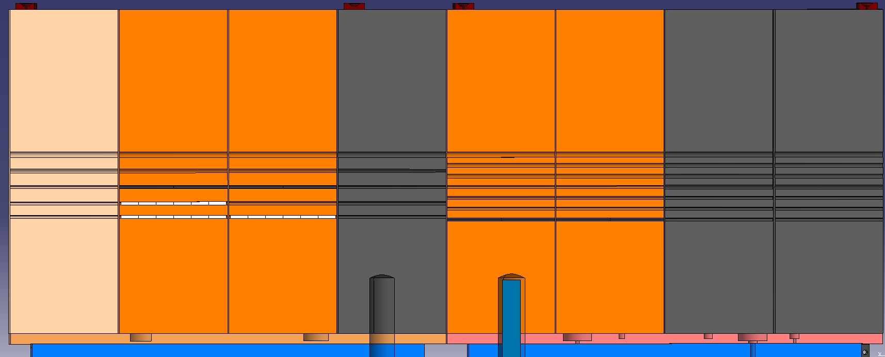
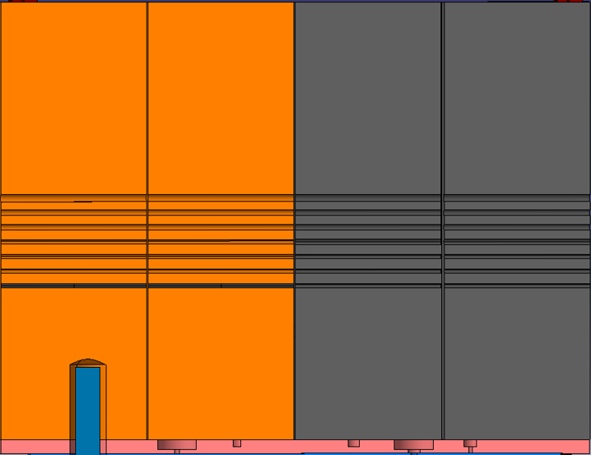
XTAX T4: ST1530759
XTAX.043.018
XTAX.043.020
4
1
3
1
2
T4
4
(dump)

Slide 4
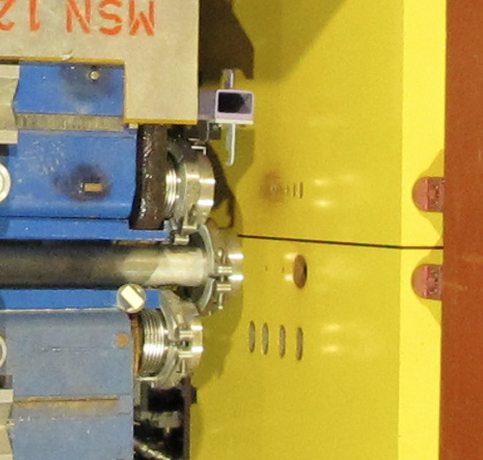
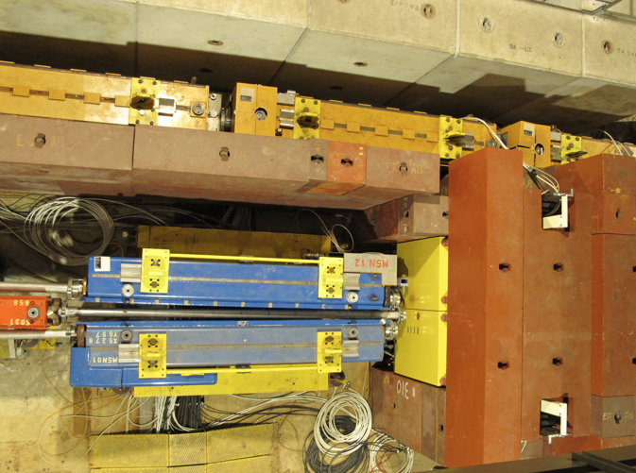
T4 exit https://edms.cern.ch/panoramas/viewer?fov=90.00&id=55923362&lat=-6.84&lon=214.44
Bride fenetre Ø200
Ø12

Slide 5
T4 videos
\\cern.ch\dfs\Departments\SY\Groups\STI\TCD\0020-SPS_Complex\0020-Experimentals_Areas\NORTH_AREA\ECN3_TaskForce\0040_EquipmentPictures\2023_03_27_Endoscope Inspection T4 XTAX
1_T4_043_020_1804110015
2_T4_043_020_1804110016
3_T4_043.018_1804110017_18_19_20
4_T4_043.018_1804110021

Slide 6
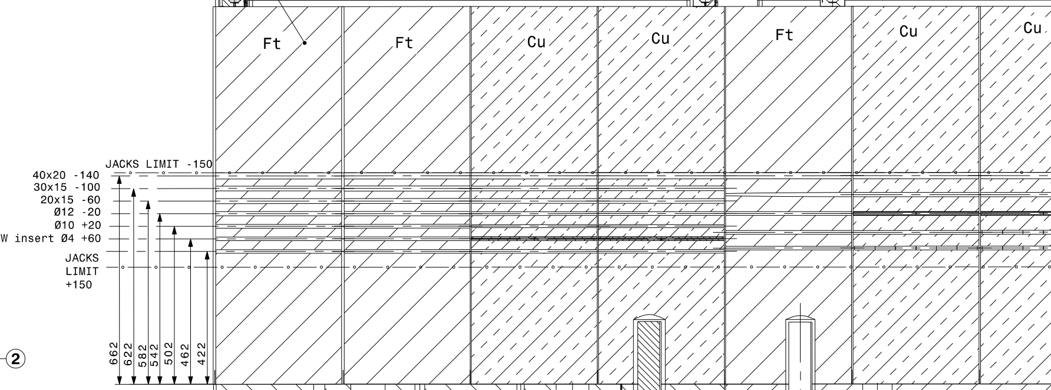
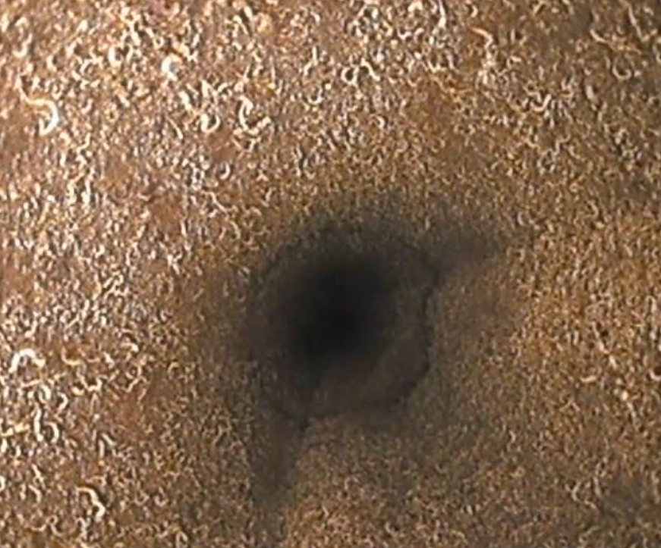
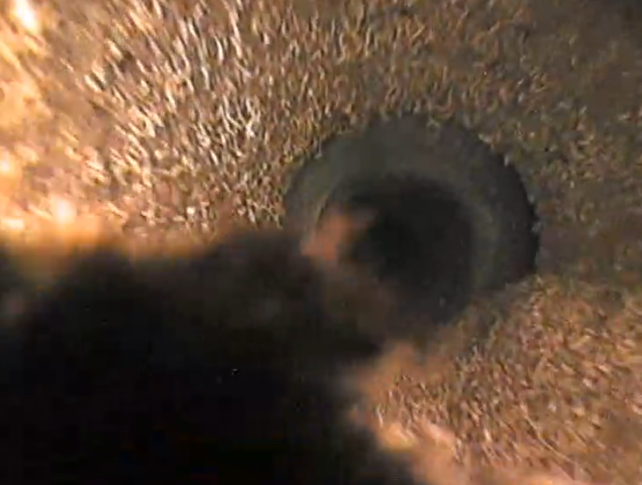
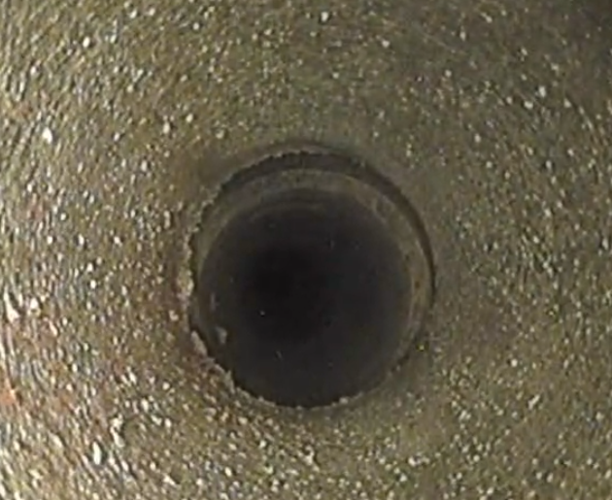
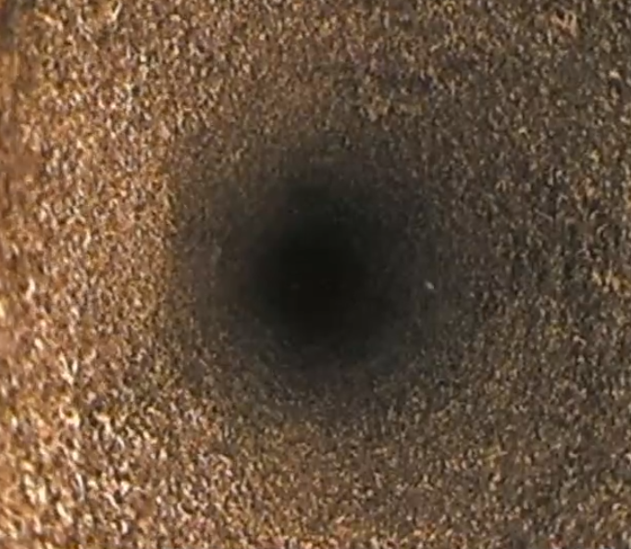
1_T4_043_020_1804110015
XTAX.043.020
XTAX.043.018
T4
1
Beam
0:48
1:16
1:38
4:30
5.52
9.04
9.50

Slide 7
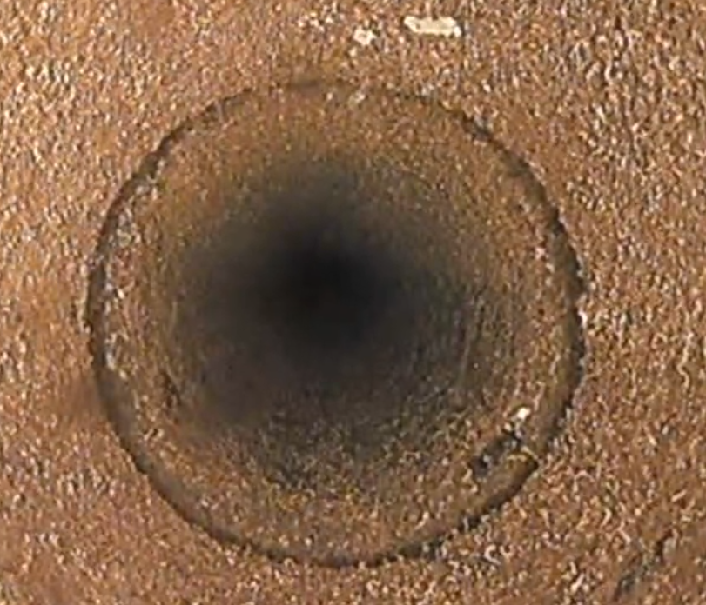
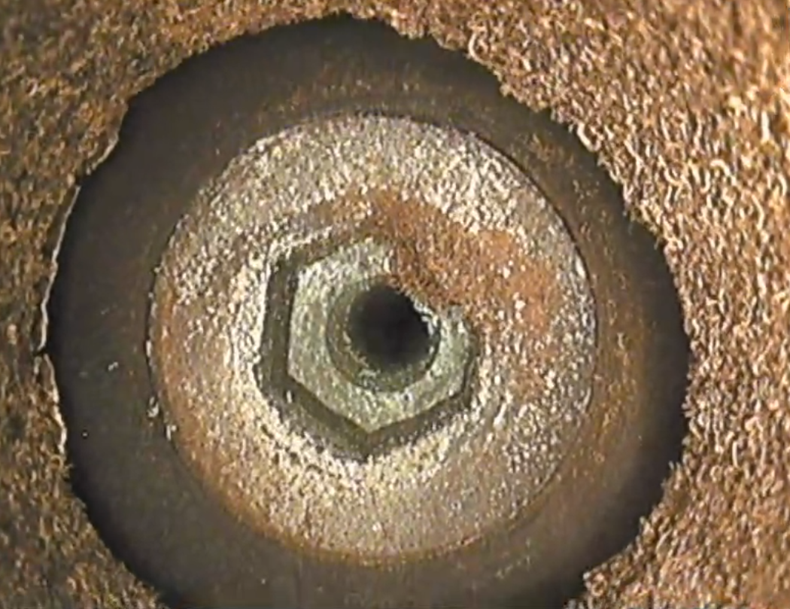
T4
XTAX.043.020
XTAX.043.018
Beam
2
0:36
1:13
W insert Ø4/12
2_T4_043_020_1804110016

Slide 8
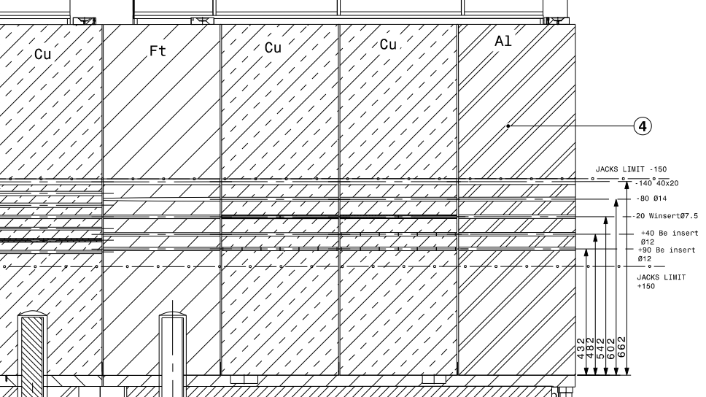
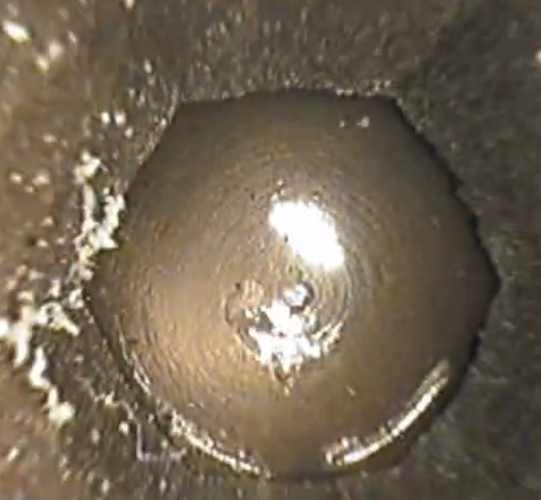
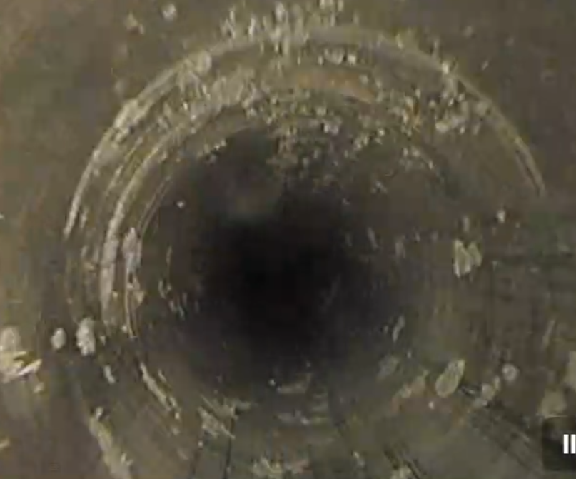
3_T4_043.018_1804110017
XTAX.043.018
T4
Beam
3
1:39
1:36

Slide 9
3_T4_043.018_1804110018
XTAX.043.018
T4
Beam
3
1:39
1:36

Slide 10
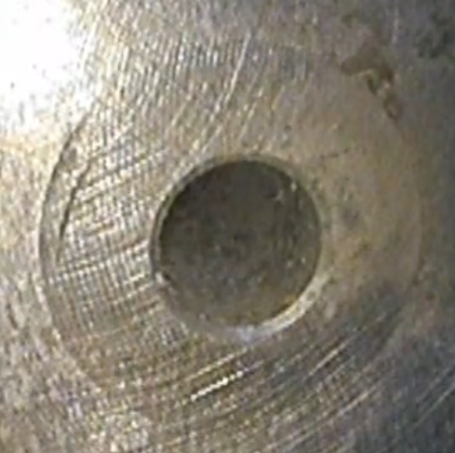
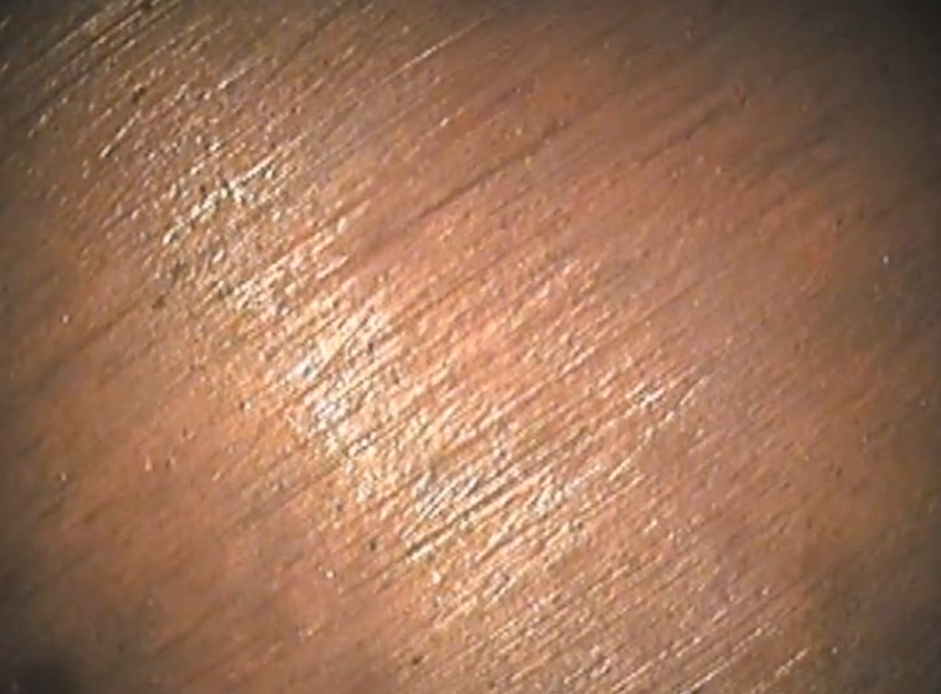
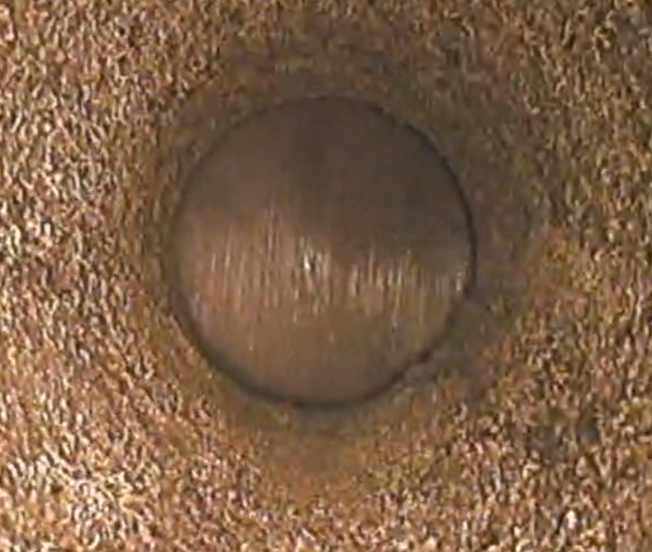
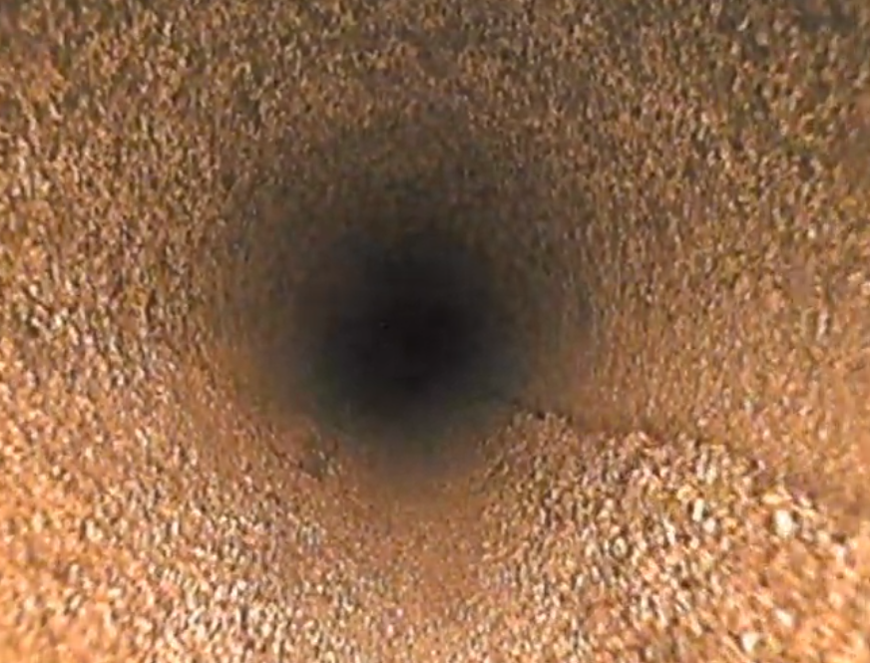
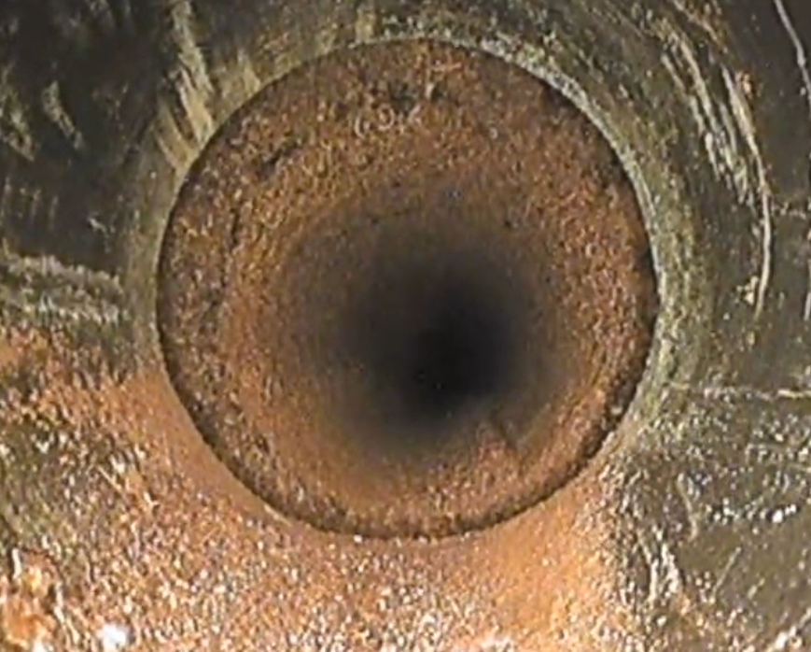
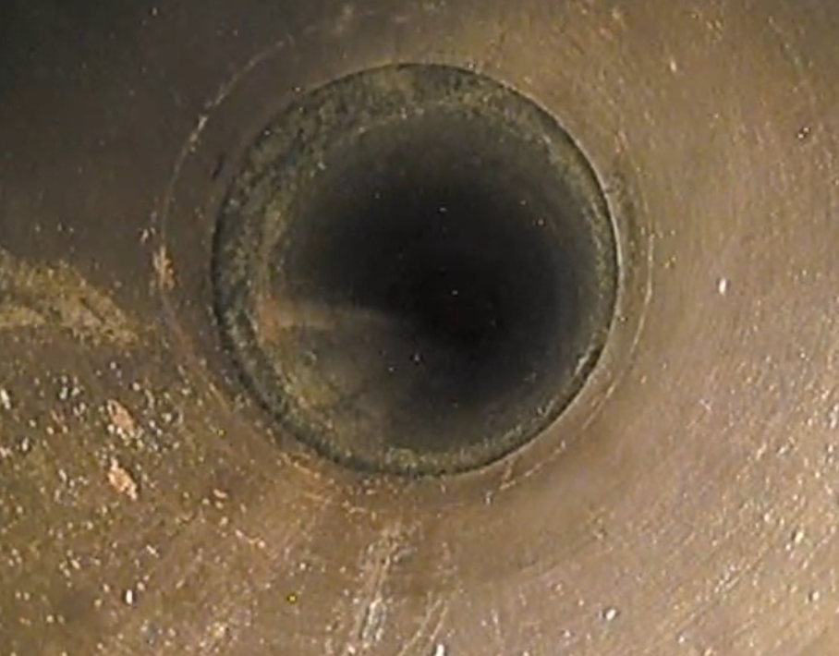
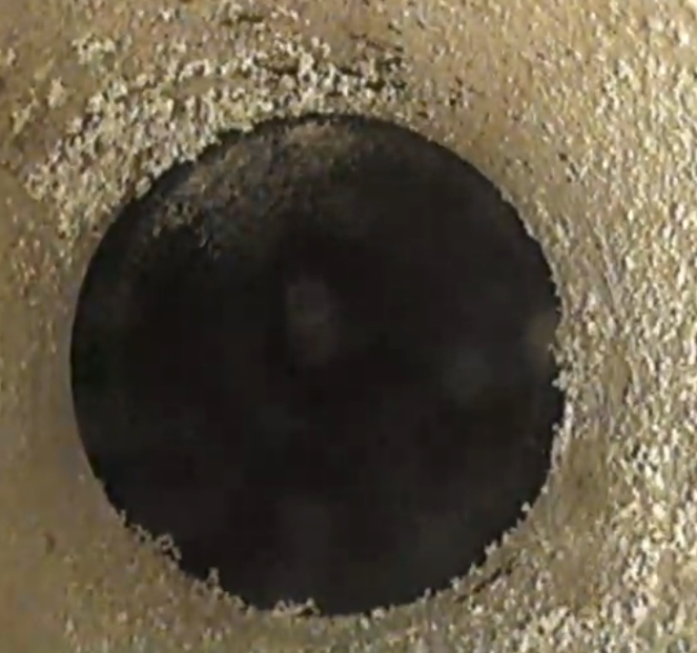
4_T4_043.018_1804110021
XTAX.043.018
0:43
4
Beam
4
1:15
2:05
2:34
3:23
4.36
5.58

Slide 11
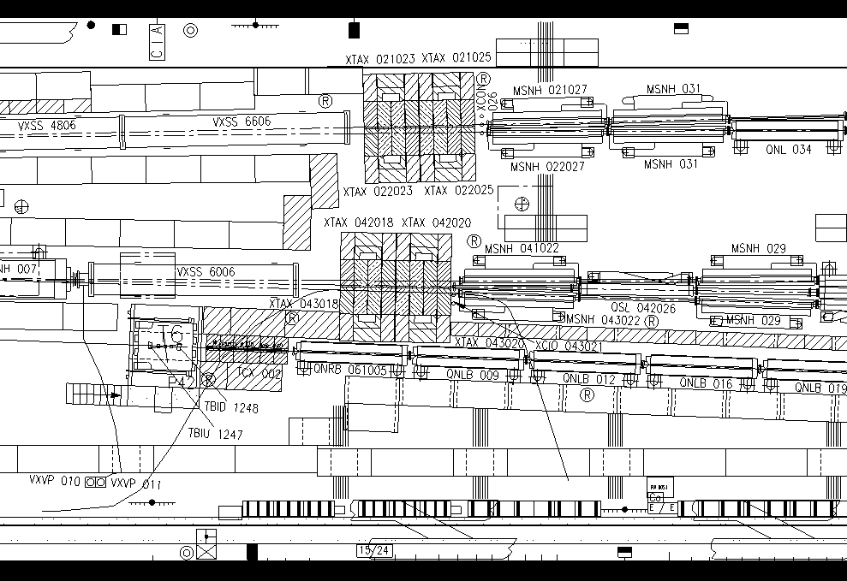
Layout TCC2 T4 working position
E2
E1

Slide 12
Material
Endosope Ø8mm L=15m (EN-STI) with Head lens straight
Guiding tubes PVC 6+6 m
Tripod
Tape, film vinyl
IMPACT: https://impact.cern.ch/impact/secure/?place=editActivity:210082
WDP: https://impact.cern.ch/impact/secure/?place=editWorkDosePlanning:3172:1

Slide 13
Radiation Dose Reports (T4 + T6)
 | Estimated [µSv] | Taken [µSv]
Collective Dose: | 986 | 859
Individual Dose | 350 | 197

