Slide 1

Luminosity at Z: 2 IP vs 4 IP
D. Shatilov
Acknowledgments: K. Oide
166th FCC-ee Optics Design Meeting
CERN, 20 Apr 2023

Slide 2
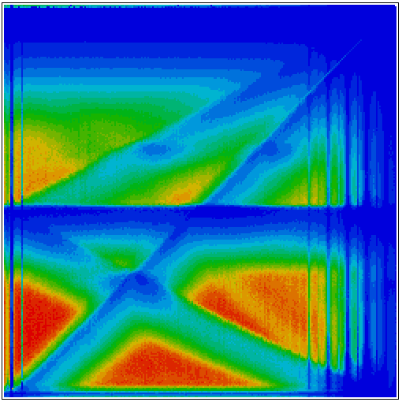
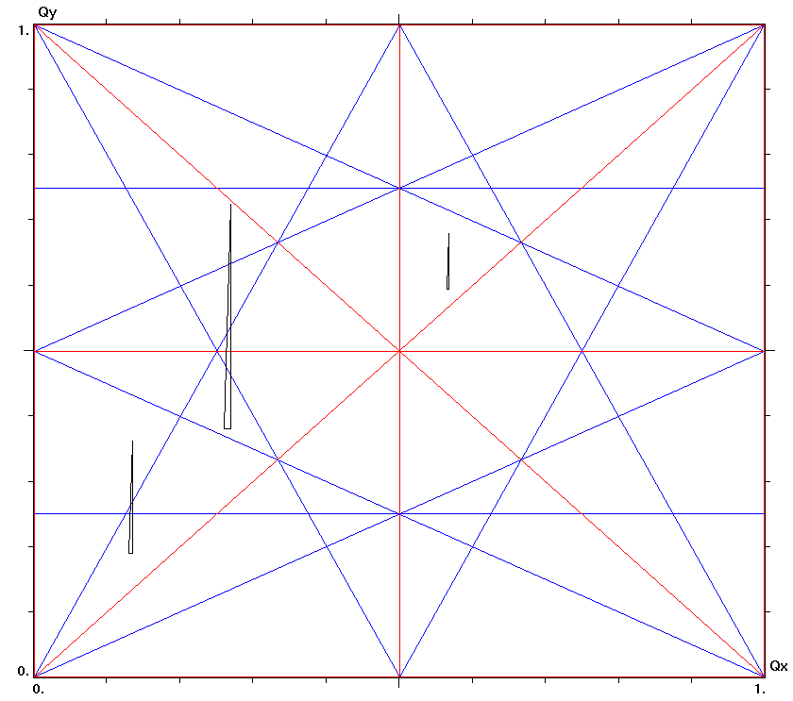
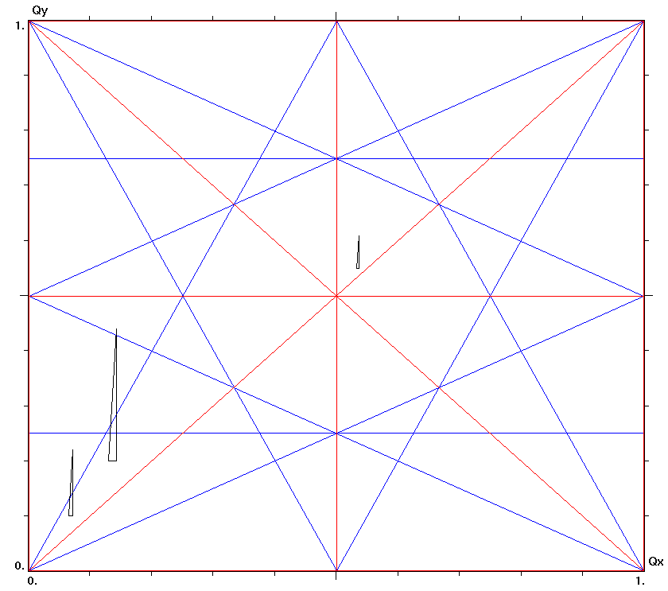
Choice of the Working Point
One IP or perfect symmetry (tunes per superperiod)
1.0
ν_{y}
4 IP
ν_{x} + 2ν_{y} = n
2 IP
4 IP
2 IP
0.5
ν_{x}
0.5
(0.57, 0.61)
1.0
“Old” baseline
As suggested by K. Oide 3 weeks ago
Luminosity vs. betatron tunes, simplified model, weak-strong simulations. Colors from zero (blue) to the maximum (red).
D. Shatilov 166th FCC-ee Optics Design Meeting, CERN 2

Slide 3
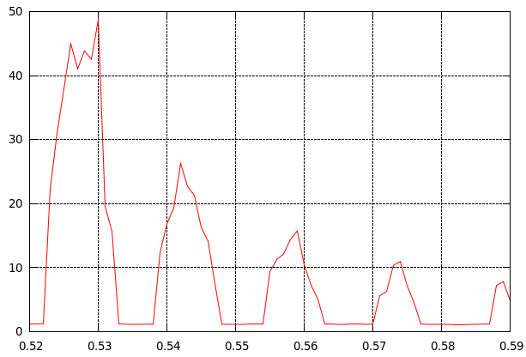
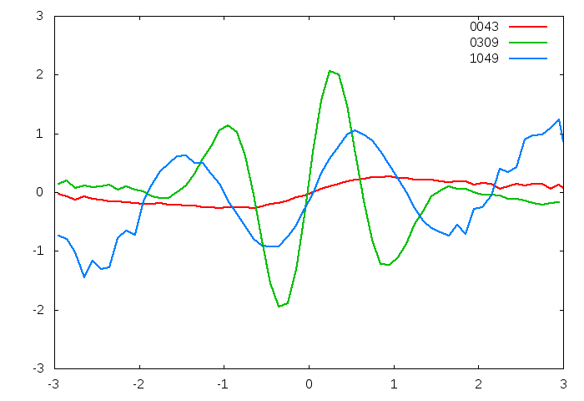
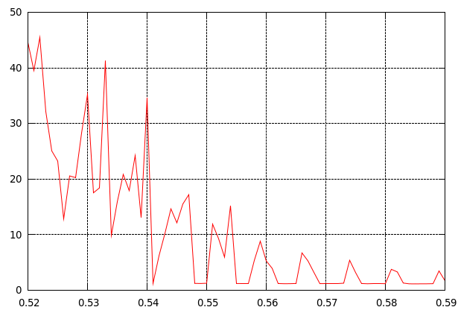
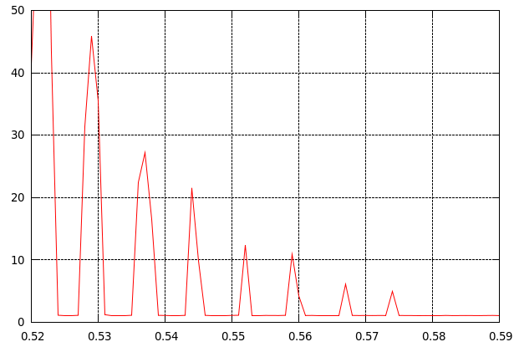
Coherent Beam-Beam Instability
x
Bunch shape at some turns
+
-
e
L_{i}
e
θ
φ ∙σ_{x}
z
x /σ_{x}
2σ_{z}
2σ_{x}
Sketch of collision with large Piwinski angle
So far no impedance !!!
z /σ_{z}
Excited coherent modes are associated with synchrotron satellites of half-integer resonance:
Since the wavelength cannot be less than 2L_{i}, we get the condition:
If φ is not too large, we can solve the problem by choosing
We can decrease ν_{s} by decreasing the RF voltage, but the product φν_{s} will not change. A decrease in N_{p} (bunch population) leads to a decrease in φ, so will also decrease, but only along with the luminosity.
If we double the number of IPs (from 2 to 4), then ν_{s} will be halved, and the increase in φ (due to the strengthening of BS) will be much less. Thus, we reduce and in any case double the order of resonances in the vicinity of a given working point. On the other hand, the ratio ν_{s} /ξ_{x} will decrease, which significantly reduces the area free from instability.
Then, if we want to have a small ν_{x}, needs to be reduced to ∼10 cm. And it will affect the DA.
ε_{x} /ε_{x0}
Here all tunes are per superperiod !
N_{p} = 1.5⋅10¹¹
ν_{x}
D. Shatilov 166th FCC-ee Optics Design Meeting, CERN 3

Slide 4
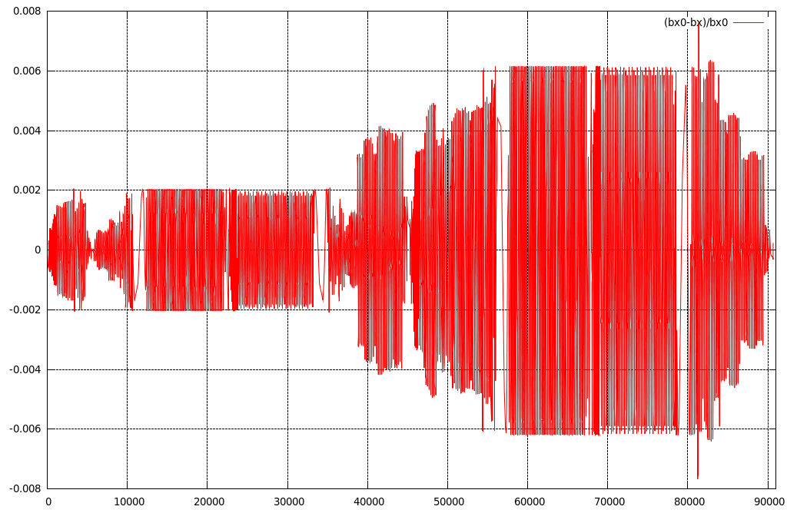
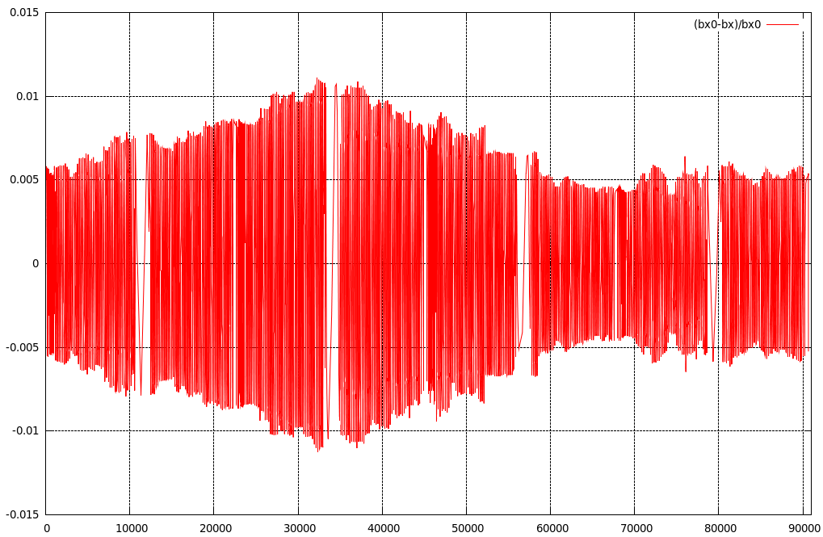
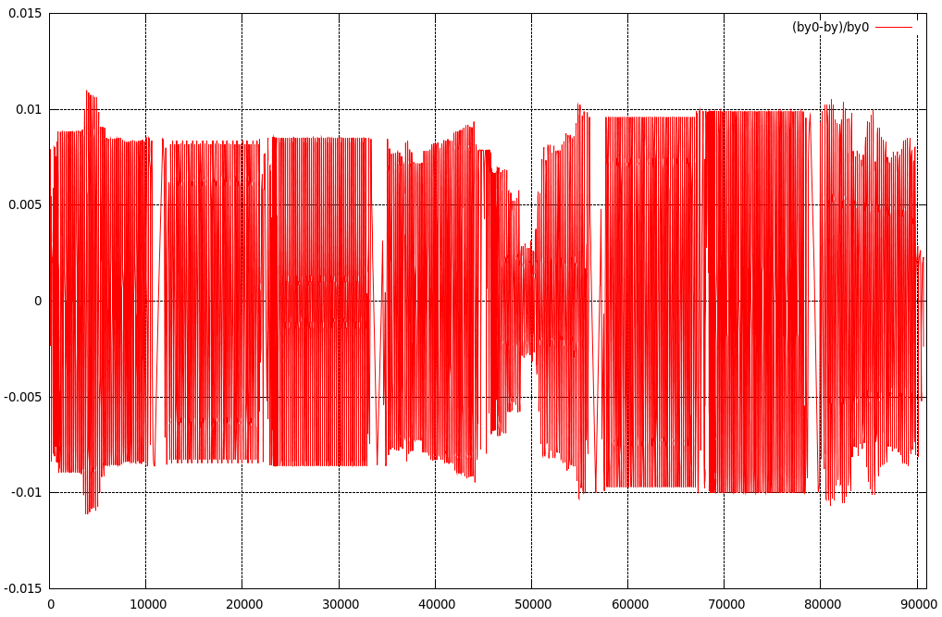
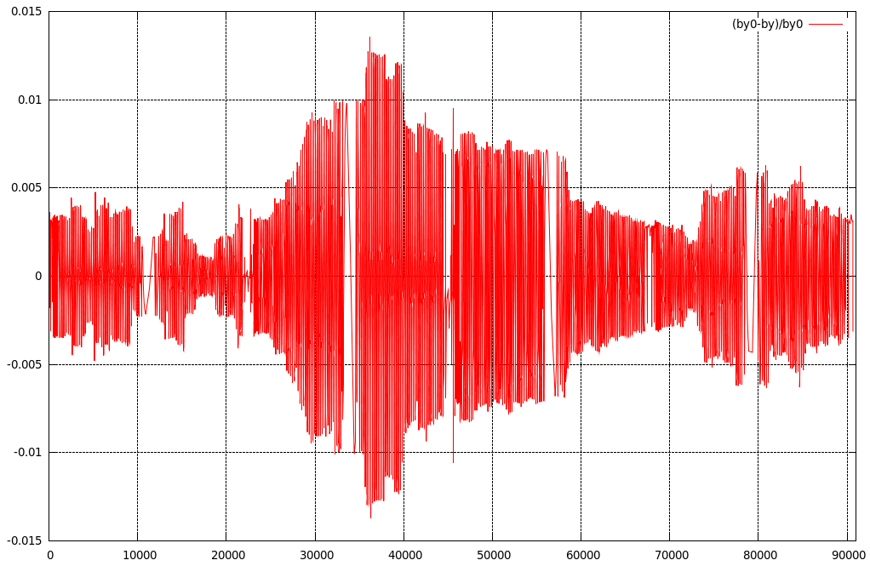
Misalignments of Arc Sextupoles and Beta-Beating
β_{x} beating
σ_{δx} = 7 μm
σ_{δy} = 15 μm
β_{y} beating
D. Shatilov 166th FCC-ee Optics Design Meeting, CERN 4

Slide 5
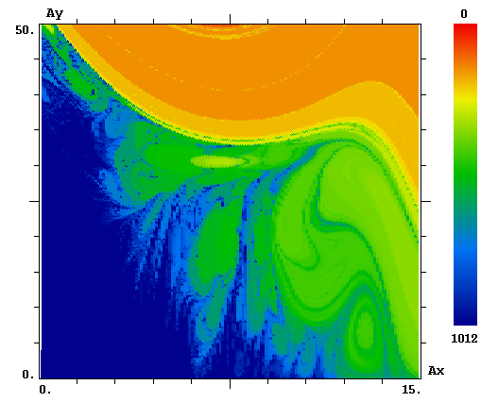
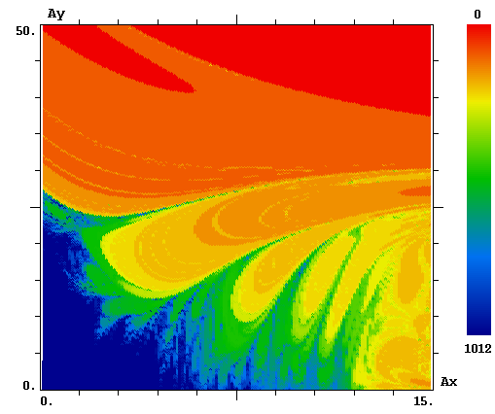
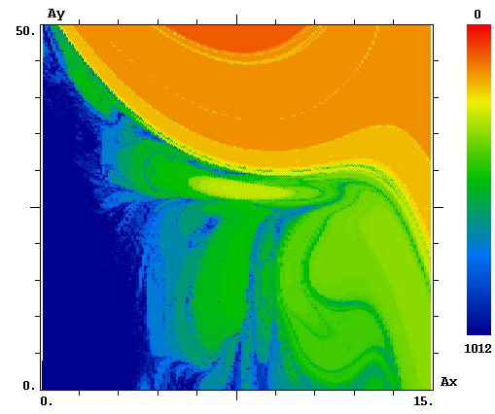
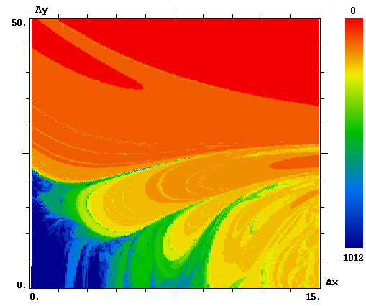
DA and Momentum Acceptance
Ideal lattice
On the left is the number of turns that the particle makes until it dies. Dark blue color for surviving particles after a thousand turns. The amplitude of synchrotron oscillations corresponds to δ_{E} = ±0.5%.
We have long said that for a given energy spread, the luminosity with 4 IP will be higher than with 2. But the problem is that the allowable energy spread becomes much lower with 4 IP.
With misalignments
D. Shatilov 166th FCC-ee Optics Design Meeting, CERN 5

Slide 6
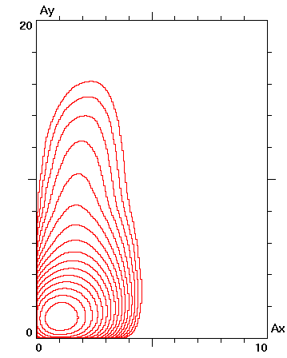
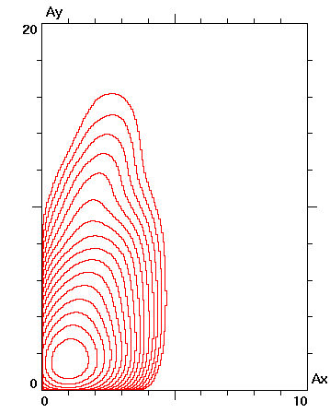
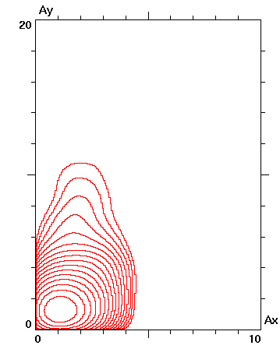
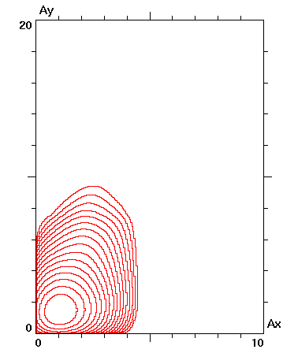
Simulation Results
Lattice and orbit at the IPs have been corrected to perfection.
Number of IPs | 2 | 4 | 2 | 4
Beamstrahlung | ON |  | OFF
N_{p} [10¹¹] | 2 | 1.5 | 0.8 | 0.6
Number of bunches | 12000 | 16000 | ----- | -----
σ_{z} [cm] | 1.3 | 1.35 | 0.54
σ_{δ} | 9.3E-4 | 9.8E-4 | 3.9E-4
L / IP [10³⁶] | 1.45 | 0.8 | 1.55 | 1.0
Lifetime (bb) [min] | 50 | 15 | ----- | -----
Density contour plots
D. Shatilov 166th FCC-ee Optics Design Meeting, CERN 6

Slide 7
Discussion and Next Steps
At the CDR, with 2 IPs, the luminosity per IP was 2.3E+36. And now it is 1.45E+36, why?
  Decrease in perimeter => lower total beam current.
  Increase in momentum compaction factor => larger emittances.
  Errors, misalignments => decrease in the DA and momentum acceptance, violation of superperiodicity.
Next steps:
  Last optics update from K. Oide. Should be checked against impedance and other collective instabilities.
  Optics from Pantaleo (almost ready for tests, but there are small issues).
  …… ????
  Similar studies for higher energies.
D. Shatilov 166th FCC-ee Optics Design Meeting, CERN 7

