Slide 1

In-SiTu Acceptance Determination
For Diphoton events at FCC-ee
FCC Physics Performance meeting
17 April 2023
Patrick Janot, Emmanuel Perez
This project is supported from the European Union’s
Horizon 2020 research and innovation programme
under grant agreement No 951754.
Gratefully acknowledging discussions with Michael Benedikt, Alain Blondel, Mogens Dam and Katsunobu Oide

Slide 2
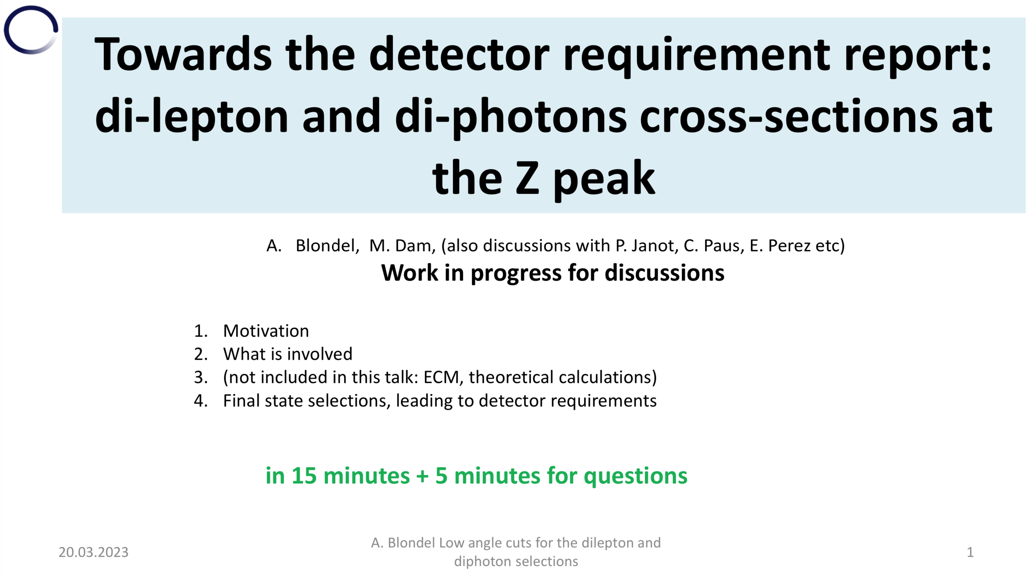
Why this presentation ?
A. Blondel & M. Dam’s presentation on 20 March 2023 was the trigger for this work

Slide 3
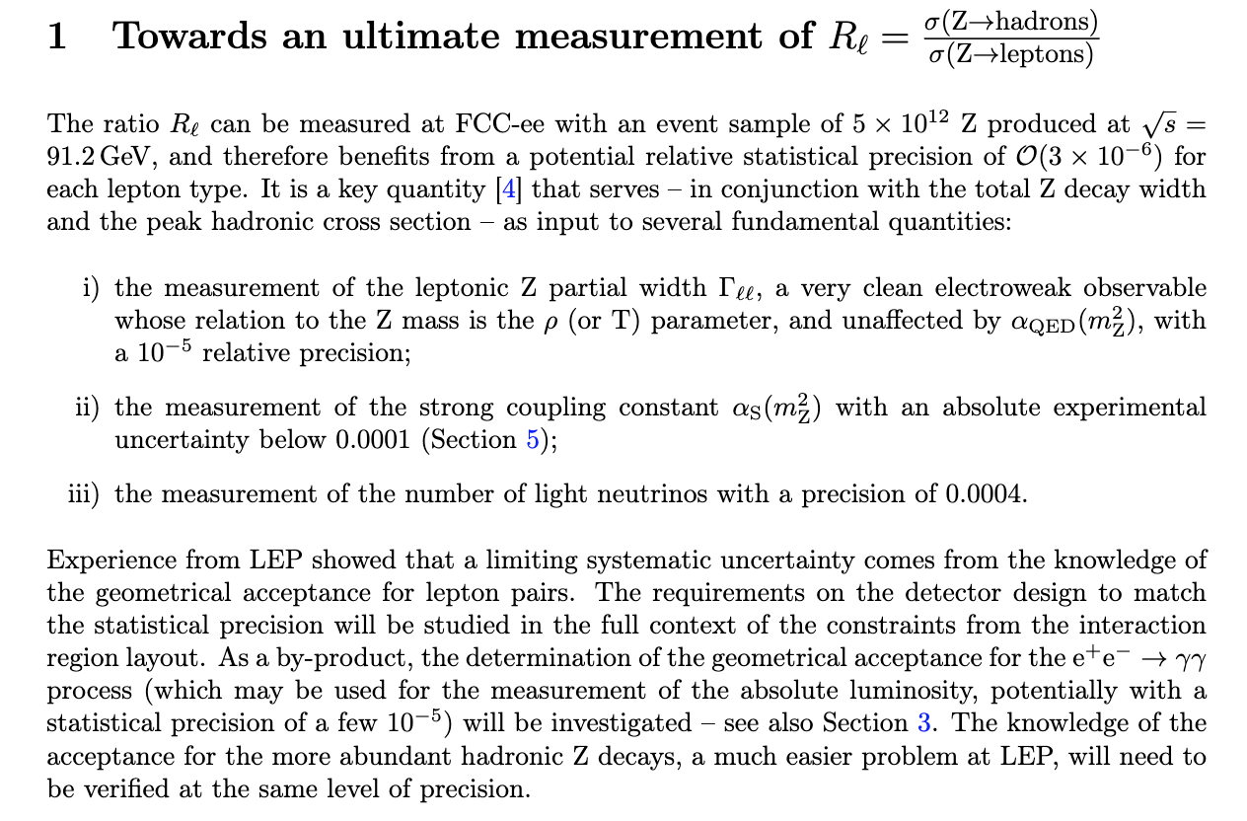
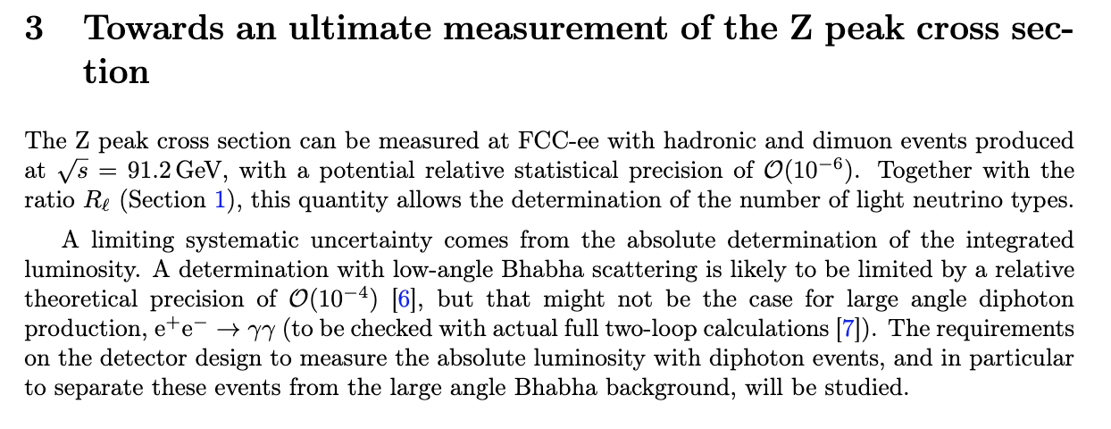
Why this presentation ?
This work is also part of the 1st and 3rd case studies submitted to Snowmass 2021
  A case study is aimed at detector requirements and theory precision constraints
    To match systematic uncertainty to the FCC-ee expected statistical precision
      Just pick your case study !
See https://www.overleaf.com/read/nknybgrqqwbp

Slide 4
Scientific motivation
Precise measurement of the absolute luminosity with e⁺e⁻ ➝ γγ events at the Z pole
  Bhabha scattering cross section, 64-86 mrad: 14 nb, 6 . 10¹¹ events / expt at 91.2 GeV ?
    YES ! But theoretical prediction (projected) precision limited to ~10⁻⁴
      Excellent for point-to-point luminosity determination (e.g., m_{Z}, Γ_{Z}) and continuous monitoring
      Limited for absolute luminosity measurements (e.g., σ⁰, N_{ν} )
  Large angle diphoton cross section: ~60 (40) pb for θ_{min} = 10 (20) degrees ?
    Much better theoretical prospects
      Pure QED process at LO, no hadronic correction up to NNLO
    About 3.10⁹ (2.10⁹) events expected / expt for θ_{min} = 10º (20º) at 91.2 GeV
      Relative statistical uncertainty on the cross section: 1.9 (2.3) 10⁻⁵
    Important systematic uncertainty comes from the absolute knowledge of θ_{min}
      A bias Δθ on θ_{min} results in a cross section bias Δσ/σ = 2.91 (2.17) Δθ
      The absolute value of θ_{min} must be known to 6.5 (10) μrad to match the statistical uncertatinty
    In his presentation, Alain and Mogens translated this constraint to a detector design requirement
      The positions of the calorimeter cells must be known to Δr < 17 (29) μm and Δz < 99 (80) μm @ 2.6m
        On both sides, with respect to … (???) – Alain and Mogens did not say.
      Tighter constraint for dileptons: Δr < 14 (8) μm and Δz < 79 (45) μm
S. Jadach et al., arXiv:2012.11437
C. Calame et al., arXiv:1906,08056
See Alain/Mogens’ presentation (*)
(*) The numbers differ slightly from this presentation
because of a factor 2 in the e⁺e⁻ ➝ γγ cross section value

Slide 5
Meaning of Δr < 17 (29) μm and Δz < 99 (80) μm ?
How do these two numbers translate to a detector design requirement ?
  Underlying assumption: all cells close to the acceptance limit have the same r (or z) bias
    Compensation at play if the design precision δr is randomly distributed over all cells instead
  If the average radius (and z position) can be determined “in situ” with the above precision
    The cell-to-cell design constraints are typically Δr < 0.3 (0.6) mm and Δz < 2.o (1.6) mm
δr
r
More events
Less events
δr_{eff} = δr / √N_{cells}
If Δφ_{cell} ~ 1º : constraints on each cell
are typically 20 times looser

Slide 6
Meaning of Δr < 17 (29) μm and Δz < 99 (80) μm ?
The absolute design precision on the average radius is anyway deceptive
  Any design bias on <r> can be compensated by an identical relative bias on the z position
    OR: any design precision on <r> can be ruined by a poor <z> placement of the ECAL end-capS
  We therefore better have an “in situ” method to determine where the end-caps actually are
    Only r_{min}/z_{min} ( = tan θ_{min}) is relevant – the actual values of r_{min} and z_{min} are not
True position z_{true}
Theoretical
position z_{th}
r
θ_{th}
θ_{measured}
IP x
z
On each side, tanθ = r/z
Δθ = sinθ cosθ (Δr/r – Δz/z)

Slide 7
Meaning of Δr < 16 (28) μm and Δz < 95 (77) μm ?
Also, we have two sides – this further relaxes the constraint
  For a given radius, a displacement z of the two end-caps to the left (or to the right)
    Increases the number of photons selected in the left (right) end-cap
    Decreases by the same amount the number of photons selected in the right (left) end-cap
      Known trick: Events are selected with a tight cut alternatively on each side
    Only a 2nd order effect on the ”averaged” acceptance
  For a given radius, an increase (reduction) of the distance between the two end-caps
    Increases (decreases) the number of photons selected in both end-caps
    Large effect on the “averaged” acceptance
      And therefore on the measured luminosity
  The “in situ” method needs to tell where the end-caps are with respect to each other
    [(Δr_{min}/r_{min}–Δz_{min}/z_{min})₊ + (Δr_{min}/r_{min}–Δz_{min}/z_{min})₋]/2 is mostly relevant for the average acceptance
      i.e., the bias on the average radius and on the distance between the two end-caps at this radius
    The bias on the difference between the radii and on the global z position is less relevant
      But we’ll see that it can be measured in situ anyway with an excellent precision

Slide 8
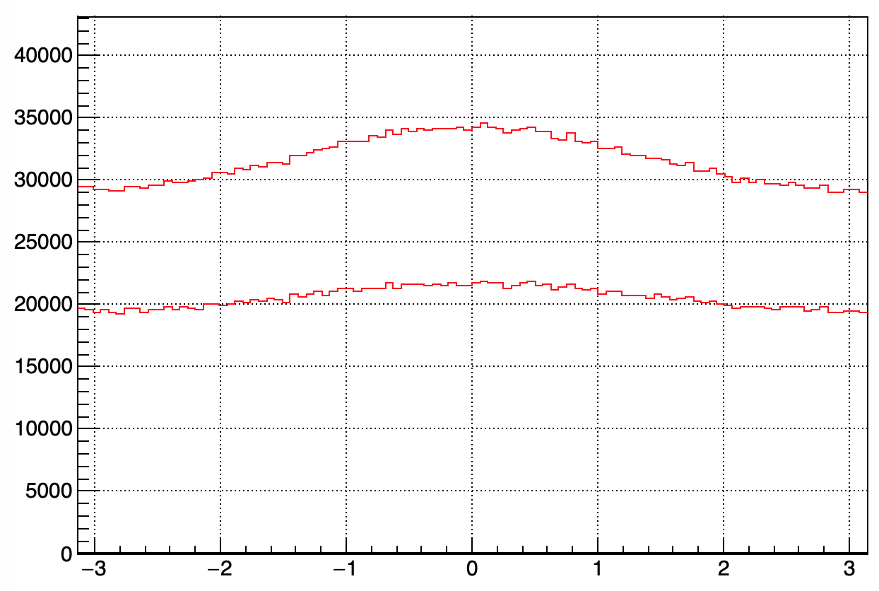
Additional note
The above arguments were developed assuming head-on collisions
  The FCC-ee beams cross with an angle α = 30 mrad in the horizontal plane
  The detector is therefore not in the collision centre-of-mass system
    The two photons of diphoton events are not back-to-back in the detector
    The differential cross section depends on the azimuthal angle φ
      Because events are boosted towards “the right half” of the detector (φ = 0)
φ distribution for e⁺e⁻ ➝ γγ
0.1% of the total statistics at 91.2 GeV
θ_{γ} > θ_{min} = 10 degrees
θ_{γ} > θ_{min} = 20 degrees
A small complication …
But α provides a precious additional constraint
e.g., A_{LR} (θ_{min}) ~ sin(α/2) / sinθ_{min}
Could be used in principle to
determine θ_{min} “in situ” but
statistically not powerful enough
dependent on simulation details
φ (rad)

Slide 9
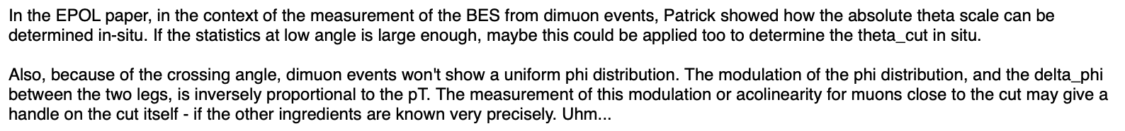
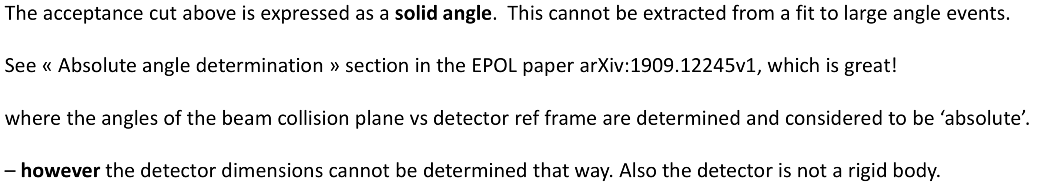
Can we constrain the average acceptance bias in situ ?
No, we can’t – according to Alain and Mogens, following a question from Emmanuel
  This handwaving reply is inaccurate - as will become obvious in the coming slides
    It is certainly important to have the detector designed to the best possible precision, but …
      A design precision of a few μm may be expensive and is difficult to guarantee
      The detector dimensions may change in the experimental cavern (gravity, temperature, B field, …)
        “The detector is not a rigid body” (and other mechanical constraints)
  It is anyway our duty to find large-statistics ancillary measurements using FCC-ee data
    And show the committees that we do not depend on (too?) challenging design constraints
Emmanuel’s
question
Alain & Mogens’ reply
Slide 14

Slide 10
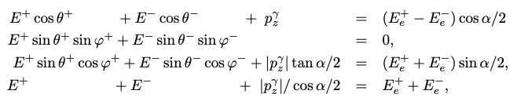
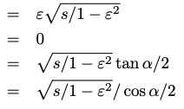
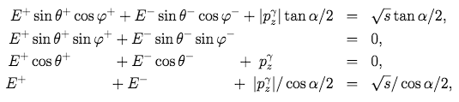

What does arXiv:1909.12245 (Section 8) say?
Total energy-momentum conservation applied to two-body final states (+ one ISR γ)
  For example, dilepton and diphoton events, e⁺e⁻ ➝ e⁺e⁻(γ), μ⁺μ⁻(γ), τ⁺τ⁻(γ), γγ(γ)
    Where E± are the measured energies of the outgoing e±, μ± , τ±, or the forward/backward γ
    Where α is the beam crossing angle (nominal : 30 mrad),
    Where the z axis is the bisector of the e± beam axes (15 mrad away from both axes),
    Where the e± beam axes form the (x,z) plane; the y axis goes upward perpendicular to this plane
    Where θ± are measured with respect to the z axis in this ”FCC-ee” frame,
    Where φ± are measured with respect to the x axis in the plane transverse to the z axis,
    Where √s is the centre-of-mass energy of the collision
    Where p_{z}^{γ} is the ISR γ momentum along z and ε is the asymmetry between e± beam energies
[due to RF asymmetry, energy spread]
$$E_{e}^{±}=E\left(1±ϵ\right), \sqrt{s}=2E \sqrt{1−ε^{2}} cos\frac{α}{2}$$

Slide 11
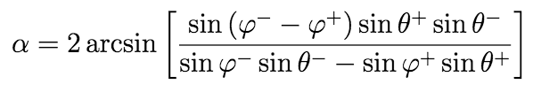


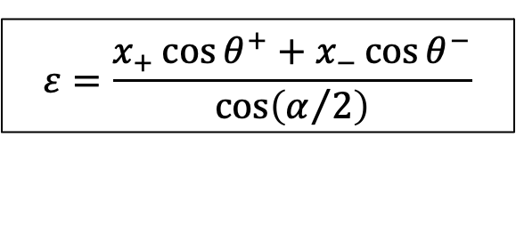
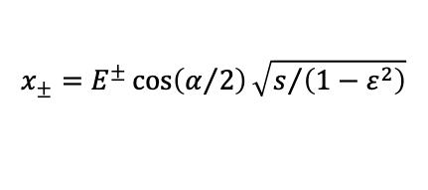
What does arXiv:1909.12245 (Section 8) say?
These four equations can be solved for α and x_{γ} OR for α and ε
  Event by event, and as a function of the sole lepton or photon (measured) angles
    Do it as an exercise, or look at the didactic presentation at the 2nd EPOL Workshop
      Crossing angle
      Longitudinal boost (from ISR γ or from beam energy asymmetry ε)
with
(Reduced lepton or photon energies)
$$ε=\frac{x_{+}\cos{θ^{+}+x_{−}\cos{θ^{−}}}}{\cos\left(α/2\right)}$$
OR
OR
$$x_{±}=E^{±}\cos\left(α/2\right)\sqrt{s/{\left(1−ε^{2}\right)}}$$

Slide 12



Longitudinal boost
With 10⁶ dimuon events (5 minutes at the Z pole, or less, with other dilepton events)
  The x_{γ} (ε) distribution contains ISR + √s spread + RF asymmetry + muon angular resolution
    The mean value of the distribution comes solely from the RF asymmetry (precision 1/√N)
    The spread of the distribution is almost insensitive to the muon angle resolution (here 0.1 mrad)
      Dominated by beam energy spread and ISR
No BS: 0.038%
Nom. BS: 0.132%
ε = 0.1%
ε = 0

Slide 13
Crossing angle
With 10⁶ dimuon events (5 minutes at the Z pole, or less, with other dilepton events)
  The distribution of α contains ISR + √s spread + RF asymmetry + muon angular resolution
    The mean value of the distribution equals the crossing angle itself
    The spread of the distribution is dominated by the muon angular resolution (here 0.1 mrad)
      Totally insensitive to beam energy spread and asymmetry. 2nd order sensitivity to ISR.
No BS: 0.038%
Nom. BS: 0.132%

Slide 14
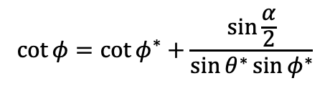
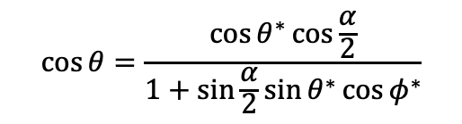
Why does it matter here ?
It matters for two main reasons
  The crossing angle and the (average) boost are identical for all events
    They can be used as constraints when it comes to absolute angle determination
  Their distributions are sensitive to any alteration of measured lepton/photon angles
    Can be used to fit the alteration with the aforementioned constraints
  The FCC-ee crossing angle is finite and substantial
    Angles in the lab frame as a function of CM angles (Lorentz transform, no longitudinal boost)
    Lab angles equal to the CM angles up to a correction proportional to sin(α/2)
      An alteration of the lab angles can be absorbed in this correction
        ⇒ Modification of the average value, spread, and correlation with boost
$$\cos{θ=\frac{\cos{θ^{∗}\cos{\frac{α}{2}}}}{1+\sin{\frac{α}{2}}\sin{θ^{∗}\cos{φ^{∗}}}}}$$
$$\cot{φ}=\cot{φ^{∗}}+\frac{\sin{\frac{α}{2}}}{\sin{θ^{∗}\sin{φ^{∗}}}}$$

Slide 15
First application in arXiv:1909.12245
Determination of the x,y,z axes of the FCC-ee frame with dimuon events
  By minimizing the Voigtian width of the crossing angle distribution
  By minimizing the correlation between the boost and the crossing angle
  Within 1h at 91.2 GeV, fix the corresponding Euler angles to 35 μrad, 18 μrad and 3 μrad
    Today, we’ll understand the reasons for the α spread increase and gain lots of sensitivity !
In these plotz,
a boost of 0.1%
is included
1h at the Z pole
1h at the Z pole
Curves are fit
to a Voigtian

Slide 16
Can we apply a similar strategy for θ∗_{min}?
As Alain and Mogens suggest, this method is not (yet) tailored at determining θ∗_{min}
  Though any angle still require as a 1st step the knowledge of the main IP and the x,y,z axes!
This method uses all dilepton events, irrespective of their polar angle, and aims at
  An independent determination of the beam crossing angle
  An independent determination of the average longitudinal boost (and energy spread)
  A global alignment of the tracker axes in the FCC-ee frame
To tailor the method for θ∗_{min} determination, we will assume in the following that
  The average crossing angle and the average boost are known with excellent precision
    e.g., from the dilepton events measured in the tracker
  The two EM calorimeter/pre-shower endcaps can be aligned in the FCC-ee frame
    See additional material for an optimal alignment with the use of α and ε
      Global rotations or transverse translations have anyway a 2nd order effect on the acceptance
  The relative positions of pre-shower and calorimeter cells are known by design
    With a precision of 0.5 (0.3) mm in radius and 1.5 (1.9) mm in z, at 20 (10) degrees
      Although such a precision can also be obtained “in situ” with the large FCC-ee statistics

Slide 17
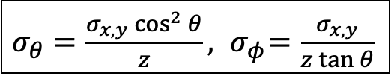
Case study setup: General strategy
Wrote a simple e⁺e⁻ ➝ γγ generator in the centre-of-mass frame, √s = 91.2 GeV
  Polar angle distribution dσ/dcosθ∗ = 2πα/s × (1 + cos²θ∗ ) / (1 − cos²θ∗)
  Azimuthal angle distribution dσ/dφ∗ = uniform
  Simulate ISR and beam energy spread as described in P. Janot’s presentation (01/21)
  Longitudinal RF boost set to 20 MeV (see J. Keintzel’s presentation at FCC Week ’22)
  Transverse boost due to 30 mrad crossing angle
  Apply a global homothety/translation (Δr,Δz) to photons close to the acceptance limit
    Get photon energies E± , θ± and φ± photon angles in the detector frame
  Smear angles according to the photon position resolution in the EMCAL: σ_{x,y}=0.1,0.5,1 mm
    See next slides for examples
Determine the constraining observables
  Compute event-by-event α and ε from the measured (smeared) photon angles
  Determine θ∗± and φ∗± from a boost back to the centre-of-mass frame (and the known α₀)
Fit the translation/homothety from the diphoton events close to the acceptance limit
Here α = 1/137., not 30 mrad :-)
$σ_{θ}=\frac{σ_{x,y}\cos^{2}{θ}}{z}, { σ}_{φ}=$ $\frac{σ_{x,y}}{z\tan{θ}}$

Slide 18
Case study setup: Selection details
Basic (loose) selection of events (in the lab frame)
  E⁺_{γ} + E⁻_{γ} > 80% √s
  θ⁺ > 7º
  θ⁻ < 173º
Followed by a tighter selection (in the collision centre-of-mass frame)
  Boost (x, y, z axes, and α₀ and x_{γ}⁰) obtained from large angle dilepton events
    β_{x} = sin α₀/2
    β_{y} = 0
    β_{z} = ε⁰ cos α₀/2
  Tight cut on one side only, changing side every other event
    θ^{∗+} > θ∗_{min} OR θ^{∗−} < 180^{ο} – θ∗_{min} with θ∗_{min} = 10º or 20º for illustration
      Known trick to reduce sensitivity to the collision vertex position (or global left-right ECAL translation)
Plots made with photon position resolution = 0.5 mm and 0.01% of the total stat / expt
  Plots with 1 mm (worst case) and 0.1 mm (preshower) shown at the end
This angular cut corresponds to 122 mrad away from the z axis
May be too close to the MDI quadrupole magnets
To be tuned to the actual EMCAL size
1h of data taking

Slide 19
Typical photon position resolution at E = 45.6 GeV
CALICE Si/W , see link Fig. 16
  CALICE collaboration
  Cell size 1 cm × 1 cm
  Molière radius 0.9 cm
  Position resolution: 1 mm (test beam)
    Can improve to 0.5 mm with 0.5 cm × 0.5 cm cells (as for the CLD design)
CMS PbWo₄ crystals, see link Fig. 14
  Crystal size 2 cm × 2 cm
  Molière radius 2.2 cm
  Position resolution 0.4 mm (MC)
    Benefits from excellent energy resolution (energy-weighted barycentre)
CMS end-cap preshower, see link Fig.13
  Absorber: Lead
  2-mm-wide Si Strips
    Arranged on two layers (x, y)
  Position resolution 0.3 mm (MC)
    IDEA foresees 0.5-mm-wide strips
      Expected position resolution 75 μm
IDEA dual-readout calorimeter, see link
  Lorenzo Pezzotti’s thesis, Figure 3.34 (MC)
  Chessboard-arranged fibres (1.5mm pitch)
  Molière radius 3 cm
  Angular resolution 0.17 mrad @ 2.50 m
    Position resolution: 0.4 mm
  Improvement expected from Preshower
    Extrapolation from CMS: 0.075 mm

Slide 20
Note: Typical size of an EM Shower
Molière radius = 2 ± 1 cm ➝ EM shower size R = 6 ± 3 cm
  At z = 2.60m, it corresponds to opening angles of
    Δθ = R cos²θ / z ≃ 1.2º ± 0.6⁰ degrees (at θ = 10^{ο} or 20^{ο})
    Δφ = R / (z tanθ) = 3.6º ± 1.8º degrees at θ = 20^{ο}, and 7.4º ± 3.7º degrees at θ = 10^{ο}
  What is important is the angles of the photons, not the positions of the cells.
    Use bins (or sliding windows) of 1º in θ and of 3 -11º in φ to determine the average θ∗_{min}
      The test ring at 10º would therefore look like (in the centre-of-mass frame)
25-100 bins in φ
θ∗ = 10.5º
θ∗ = 9.5º

Slide 21
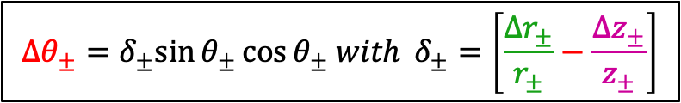



Average (Δr± ,Δz± ) bias around θ∗_{min}
Acceptance bias
In the lab, this modifies θ_{min} on both sides for all cells of the ring
  Does not modify φ (in the lab)
Δr₋
Δr₋
Δθ₊
Δr₊
Δr₊
Δz₊
Δz₋
Δθ₋
5.20m
Δz₋
Δr₋
Δr₋
Δr₊
Δr₊
Δz₊
$$\frac{Δ\sin{θ_{±}}}{\sin{θ_{±}}}={+δ}_{±}\cos^{2}{θ_{±}}$$
$$Δθ_{±}=δ_{±}sin{θ_{±}}\cos{θ_{±} with }δ_{±}=\left[\frac{Δr_{±}}{r_{±}}−\frac{Δz_{±}}{z_{±}}\right]$$
$$\frac{Δ\cos{θ_{±}}}{\cos{θ_{±}}}={−δ}_{±}\sin^{2}{θ_{±}}$$
If r & z change in the same proportions,
the polar angle does not change
and there is nothing to do!
$$Δφ_{±}=0$$

Slide 22
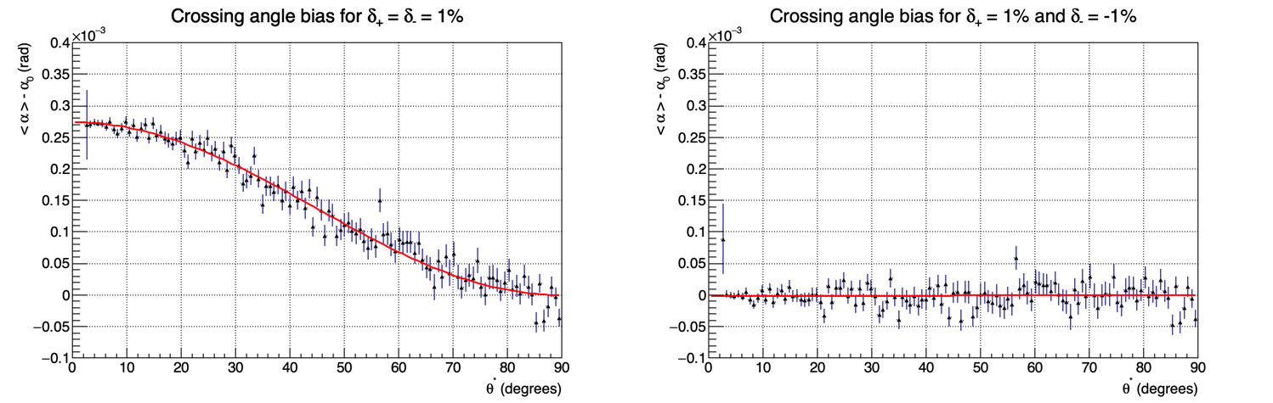
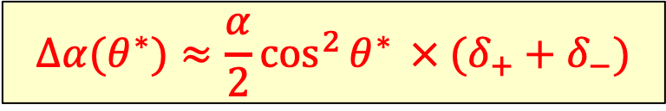
Taylor expansions of α and ε around δ± = 0
Crossing angle α
  Check with simulation (0.01% of the total statistics at 91.2 GeV)
⇒
$$Δα(θ^{∗})≈\frac{α}{2}\cos^{2}{θ^{∗}}{ × (δ_{+}+δ_{−})}$$
1% α
Fit to cos²θ∗
No sensitivity when δ₊ = −δ₋
For a given radius, α constrains
the distance d between the two end-caps
Δd/d = (δ₊+δ₋)/2
(Acceptance very sensitive to it)
Fit δ₊ + δ₋
End-cap limit

Slide 23
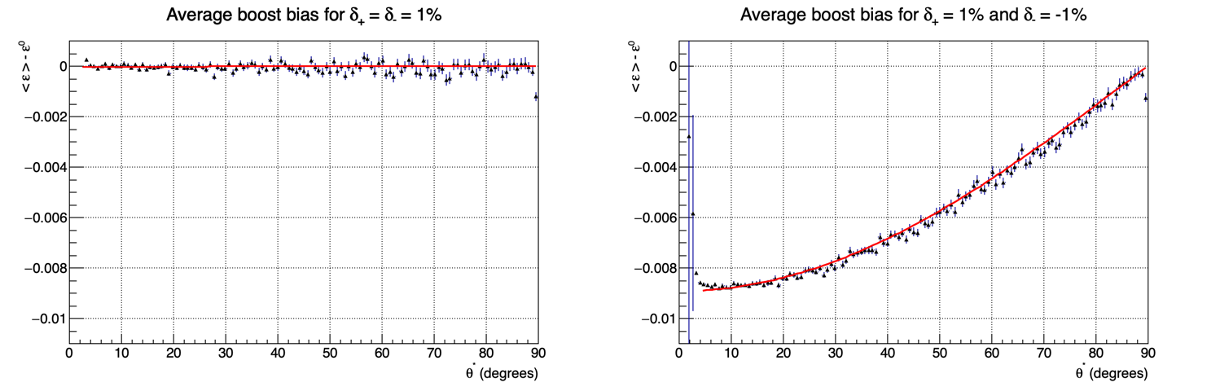
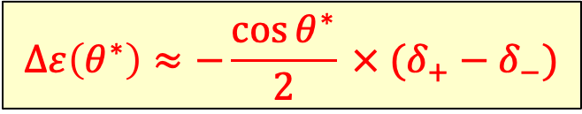
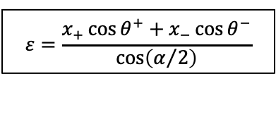
Taylor expansions of α and ε around δ± = 0
Average boost
  Check with simulation (0.01% of the total statistics at 91.2 GeV)
$$ε=\frac{x_{+}\cos{θ^{+}+x_{−}\cos{θ^{−}}}}{\cos\left(α/2\right)}$$
⇒
$$Δε\left(θ^{∗}\right)≈−\frac{\cos{θ^{∗}}}{2}{ × (δ_{+}−δ_{−})}$$
End-cap limit
For a given radius, x_{γ} constrains
the (Left-Right) position of the ECAL
with respect to the IP: Δz/d = (δ₊−δ₋)/2
(Acceptance very mildly sensitive to it)
Fit δ₊ − δ₋
Fit to −cosθ∗
No sensitivity when δ₊ = δ₋
−1%

Slide 24
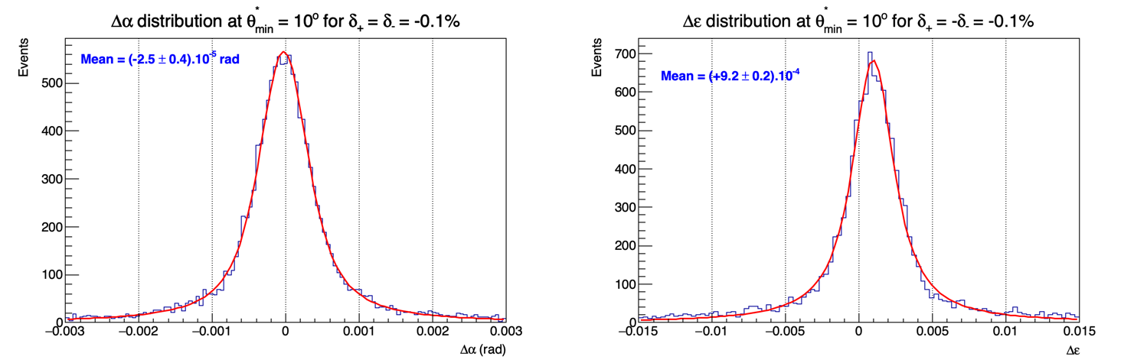
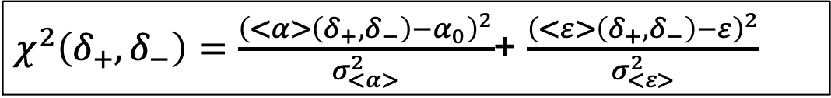
Fit δ± for 0.5 mm photon position resolution
Simple 𝜒² minimization (with respect to δ±) in a 1º-wide ring around θ∗_{min}
  Mean values <Δα> and <Δε> and their precisions σ_{<α>} , σ_{<ε>} obtained from simulation
$χ^{2}\left(δ_{+},δ_{−}\right)=\frac{{\left(<α>\left(δ_{+},δ_{−}\right)−α_{0}\right)}^{2}}{σ_{<α>}^{2}}$+ $\frac{{\left(<ε>\left(δ_{+},δ_{−}\right)−ε\right)}^{2}}{σ_{<ε>}^{2}}$

Slide 25
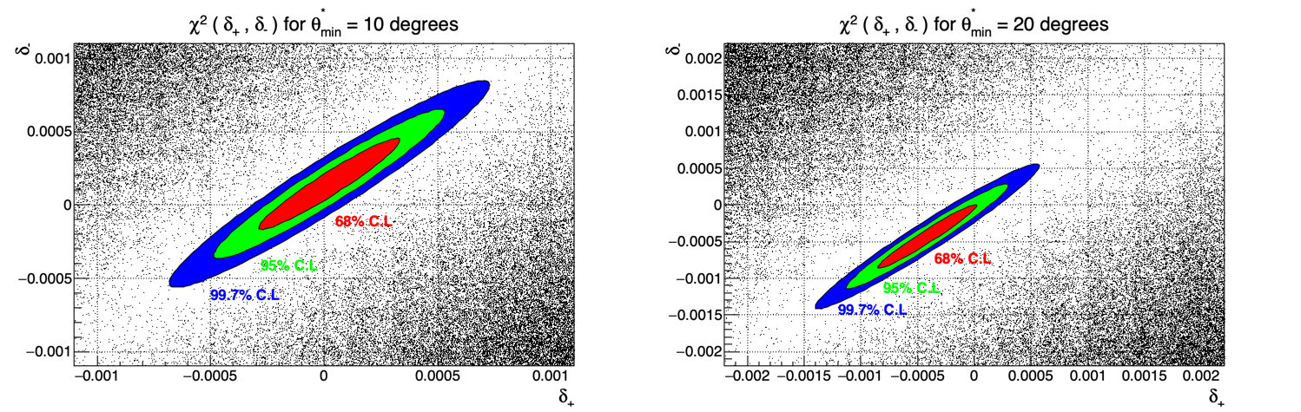
Result of the fit with 0.5mm resolution
With 0.01% of the total statistics at 91.2 GeV
  At 10⁰ (20⁰), the precision on (δ₊+δ₋)/2 amounts to 1.5 10⁻⁴ (2.5 10⁻⁴)
    Precision on average radius: 70 μm (205 μm); Precision on distance d: 800 μm (1120 μm)
  With the full statistics of diphotons, precision improves by a factor 100
    Ultimate precision on average radius: 0.7 μm (2 μm); Precision on distance: 8 μm (11 μm)
      Already 10 times better than needed – another factor of 16 (8) is expected from the dilepton statistics !

Slide 26
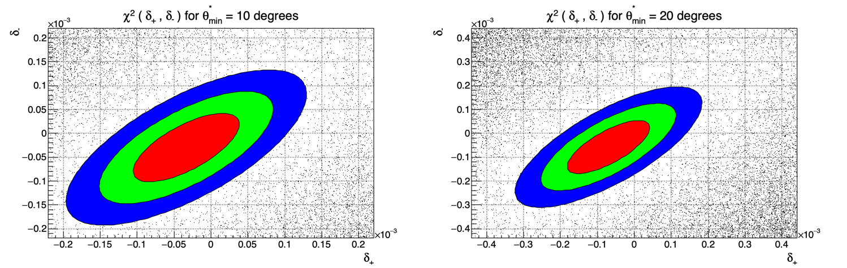
Result of the fit with 0.1mm resolution
With 0.01% of the total statistics at 91.2 GeV
  At 10⁰ (20⁰), the precision on (δ₊+δ₋)/2 amounts to 3 10⁻⁵ (5 10⁻⁵)
    Precision on average radius: 15 μm (50 μm); Precision on distance d: 170 μm (270 μm)
  With 0.1 mm position resolution, the constraints on θ∗_{min} are met with 0.04% of the stat.
    Acceptance monitoring (and cell-to-cell alignment) with the required precision every 4 hours
  Ultimate precision with full statistics: radius 0.15 μm (0.5 μm); distance 2 μm (3 μm)

Slide 27
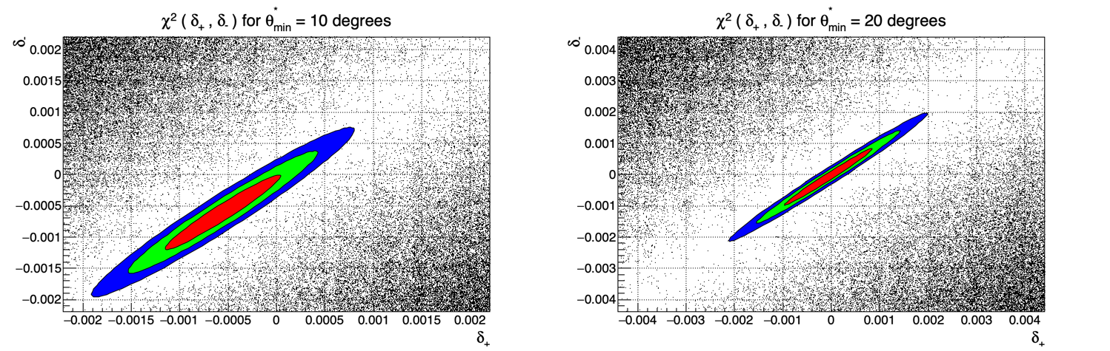
Result of the fit with 1mm resolution
With 0.01% of the total statistics at 91.2 GeV
  At 10⁰ (20⁰), the precision on (δ₊+δ₋)/2 amounts to 3 10⁻⁴ (4.5 10⁻⁴)
    Precision on average radius: 135 μm (430 μm); Precision on distance d: 1.5 mm (2.350 mm)
  Ultimate precision with full statistics still within requirements – monitoring with dileptons?
    Radius 1.3 μm (4 μm); Distance 15 μm (23 μm)

Slide 28
Summary in numbers
Precision on θ∗_{min} at 10 (20) degrees with di-photon events at √s = 91.2 GeV
  Adding φ∗ granularity : 50 (100) bins/sliding windows to account for photon shower size
Position resolution | 1 mm | 0.5 mm | 0.1 mm
With 0.01% of total stat. | 50 (150) μrad | 25 (75) μrad | 5 (15) μrad
With full statistics | 0.5 (1.5) μrad | 0.25 (0.75) μrad | 0.05 (0.15) μrad
Alain & Mogens’ demand | < 6.5 (10) μrad for luminosity measurement with di-photon events
Stat. to meet demand | 0.6 (2) % | 0.15 (0.50) % | 0.007 (0.03) %
Time to meet demand | 2.5 (10) days | 0.5 (2.5) days | 35 mins (2 hours)
With di-electrons | 15 mins (3 hours) | 3 (45) mins | 8 seconds (2 mins)
With 0.01% of total stat. | 350 (1500) μrad | 175 (750) μrad | 35 (150) μrad
With full statistics | 3.5 (15) μrad | 1.75 (7.5) μrad | 0.35 (1.5) μrad
With di-electrons | 0.2 (1.7) μrad | 0.1 (1) μrad | 0.02 (0.1) μrad

Slide 29
Conclusion
The 30 mrad crossing angle α at FCC-ee is a jewel
  Together with the longitudinal boost (also available in head on collisions), it can be used
    To find the absolute positions of the two beam axes, defining the FCC-ee natural frame
    To globally align the sub-detectors (rotation, translation) in the FCC-ee natural frame
      See additional material
    To evaluate the acceptance of angular cuts with better precision than needed
    To determine the absolute angles of photons (and electrons) to a mind-boggling accuracy
  It advantageously complements the (useful) detector design accuracy
A photon position resolution of 1 mm (and below) at 2.6m is adequate for all the above
  If the calorimeter (cell) positions/dimensions are stable over several hours (days)
A precision pre-shower (resolution < 0.1 mm) in front of the ECAL endcaps ?
  Such a device would allow variations in time to be monitored
    Every minute for the diphoton acceptance (with di-electrons)
    Every 10 minutes for the absolute photon angle determination in the (θ, φ) plane
  A much better resolution would be a waste for this purpose (see also next slide)

Slide 30
Caveat (?)
Erratic variations of the boost ε₀ and the crossing angle α₀ might ruin the method
  These variations should be kept below their experimental determination resolution
α₀ variations must be kept below 0.1–1 mrad (for 0.1–1 mm γ position resolution)
  Natural beam divergence causes variations of ±70 (40) μrad in hor. (vert.) plane
  Variations due to top-up injection and beam-beam effects amount to ±2 to 5 μrad
  Relative movements are followed with Beam Position Monitors (BPM’s)
    Expected precision is of the order of ±10 nm at 2.2m (±0.005 μrad) every second for each beam
    Electronics drift / mechanical deformation / tides are expected to be slow and can be monitored
      A variation of 0.1 mrad corresponds to 220 μm at 2.2 m (where the quadrupoles are)
Should ε₀ variations be kept below the beam energy spread (0.132% at 91.2 GeV)?
  These variations would also be called energy spread
  The measurement of δ₊−δ₋ from ε is much better than that of δ₊+δ₋ from α
    Can relax the constraint by a factor 3 – 30 (for 0.1– 1 mm γ position resolution)
  The difference δ₊−δ₋ has only a 2nd order effect on the acceptance anyway
    Can further relax the constraint by one order of magnitude

Slide 31
Caveat (?)
Erratic variations of the boost ε₀ and the crossing angle α₀ might ruin the method
  These variations should be kept below their experimental determination resolution
α₀ variations must be kept below 0.1–1 mrad (for 0.1–1 mm γ position resolution)
  Natural beam divergence causes variations of ±70 (40) μrad in hor. (vert.) plane
  Variations due to top-up injection and beam-beam effects amount to ±2 to 5 μrad
  Relative movements are followed with Beam Position Monitors (BPM’s)
    Expected precision is of the order of ±10 nm at 2.2m (±0.005 μrad) every second for each beam
    Electronics drift / mechanical deformation / tides are expected to be slow and can be monitored
      A variation of 0.1 mrad corresponds to 220 μm at 2.2 m (where the quadrupoles are)
Should ε₀ variations be kept below the beam energy spread (0.132% at 91.2 GeV)?
  These variations would also be called energy spread
  The measurement of δ₊−δ₋ from ε is much better than that of δ₊+δ₋ from α
    Can relax the constraint by a factor 3 – 30 (for 0.1– 1 mm γ position resolution)
  The difference δ₊−δ₋ has only a 2nd order effect on the acceptance anyway
    Can further relax the constraint by one order of magnitude
Seems under control

Slide 32
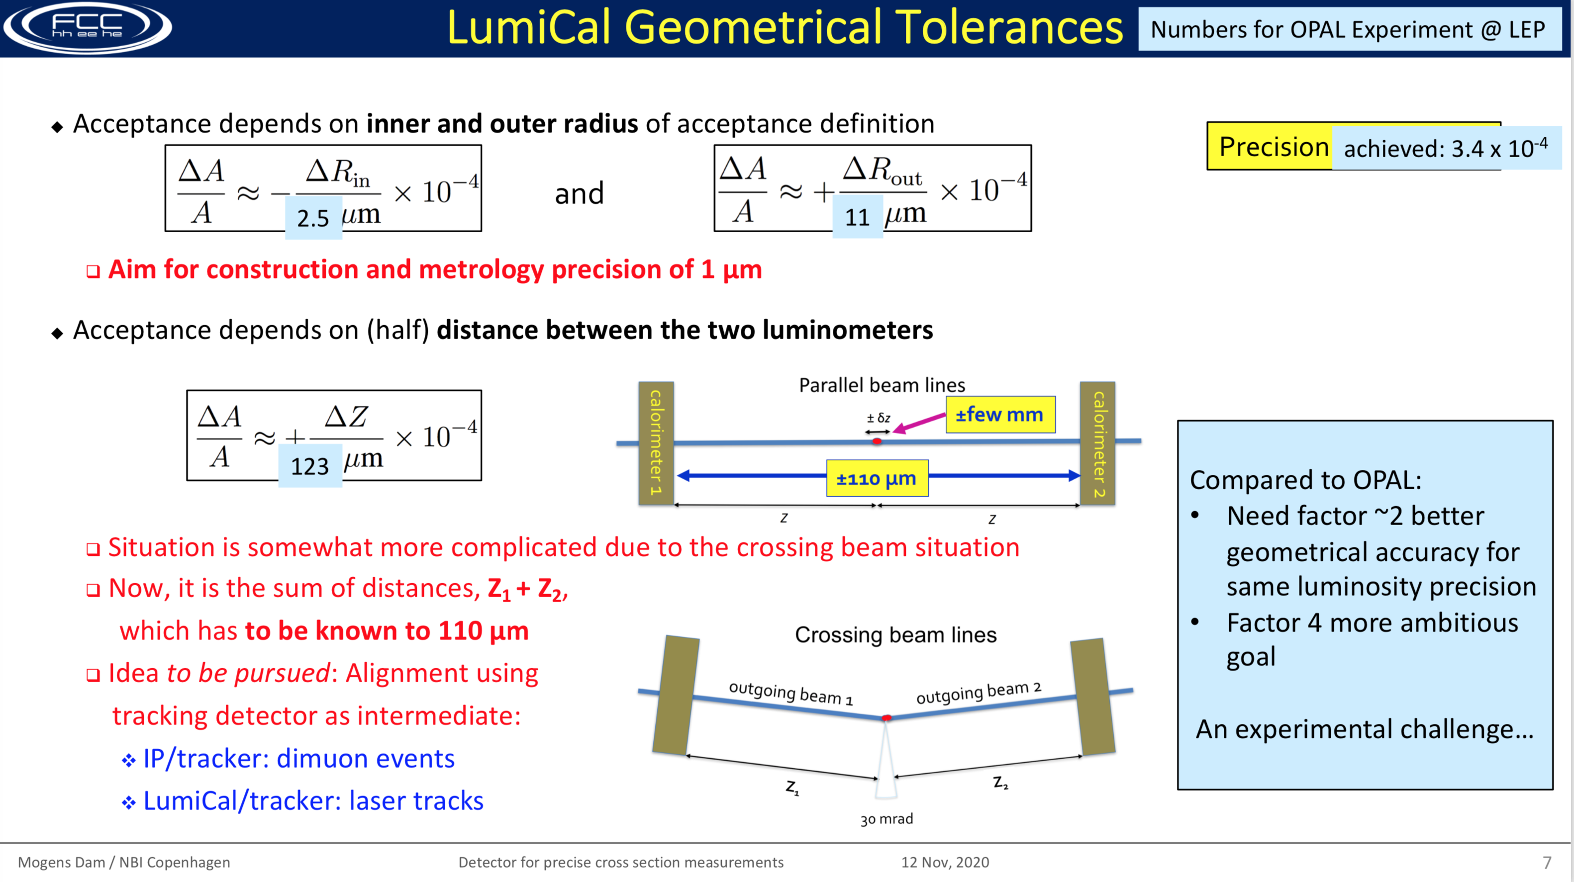
Outlook
Burning question: (to be solved next, hopefully by a younger physicist)
  Can this method be successfully applied to determine the acceptance of the luminometer ?
Pros
  Larger statistics (×10³)
  Max. effect (cos²θ∗)
  Looser constraint (10⁻⁴)
Cons: Lower angles
  Worse φ & α resolution
  Smaller distance (2.5)
Add’l complication (?)
  Different axes at z±
  Axes ≠ z axis
    It’s just maths !
⇒ ×10⁴
From Mogens
1/sinθ ⇒ ×3
⇒ × 10

Slide 33
Additional material
End-cap global rotations around x,y,z axes and translations in x,y directions
  All these transformations have 2nd-order effect on the acceptance
Less events
on this side
y
Δγ₊^{x}
Δθ₊
More events
on this side
z
Δx
x
Δy
x
More events
on that side
Less events
on that side

Slide 34








End-cap global rotations around x, y, z axes
Rotation around z axis by Δγ±^{z}
Rotation around x axis by Δγ±^{x}
Rotation around y axis by Δγ±^{y}
$$Δθ_{±}=0$$
$$Δφ_{±}={Δγ}_{±}^{z}$$
$$\frac{Δr}{r}=\sin{φ}\left(\cos{Δγ}−1\right)≈0$$
y
Δγ₊^{x}
Δθ₊
$$Δθ_{±}={−sin}^{2}{θ_{±}}\sin{φ_{±}}{Δγ}_{±}^{z}$$
$$Δφ_{±}=0$$
z
x
$$\frac{Δz}{z}=−tan{θ\sin{φ}}{Δγ}$$
$$Δθ_{±}={−sin}^{2}{θ_{±}}\cos{φ_{±}}{Δγ}_{±}^{z}$$
$$Δφ_{±}=0$$

Slide 35
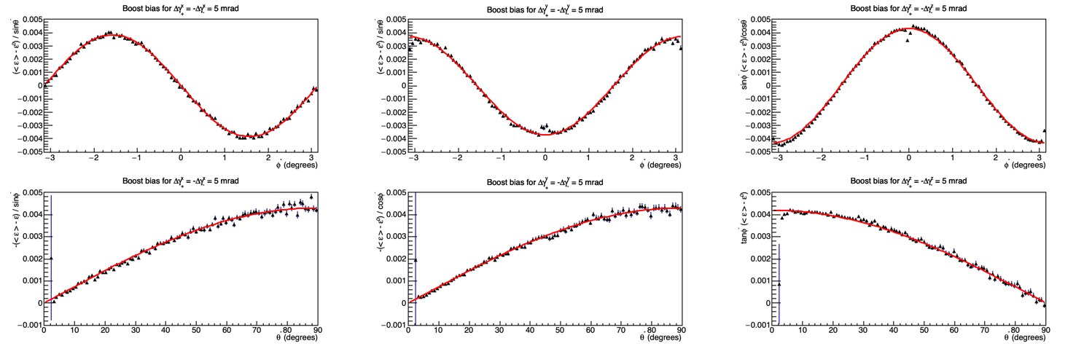



Taylor expansions of ε around δγ±^{x,y,z} = 0
Δγ₊^{x,y,z} = −Δγ₋^{x,y,z} = 5 mrad and check with 0.01% of the total statistics at 91.2 GeV
  Rotation x Rotation y Rotation z
$$Δε\left(θ^{∗},φ^{∗}\right)≈\frac{\sin{θ^{∗}}}{2}{ \sin{φ^{∗}}× ({Δγ}_{+}^{x}−{Δγ}_{−}^{x})}$$
$$Δε\left(θ^{∗},φ^{∗}\right)≈\frac{\sin{θ^{∗}}}{2}{ \cos{φ^{∗}}× ({Δγ}_{+}^{y}−{Δγ}_{−}^{y})}$$
$$Δε\left(θ^{∗},φ^{∗}\right)≈−\frac{\cos{θ^{∗}}}{2}{\frac{\cos{φ^{∗}}}{\sin{φ^{∗}}}× ({Δγ}_{+}^{z}−{Δγ}_{−}^{z})}$$

Slide 36
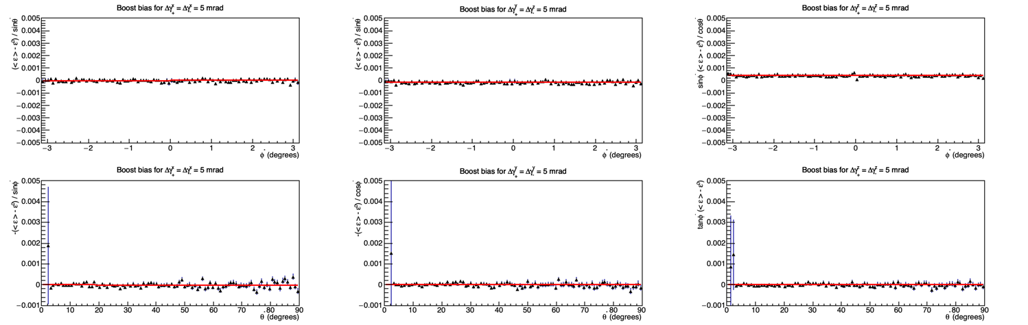
Taylor expansions of ε around δγ±^{x,y,z} = 0
Δγ₊^{x,y,z} = Δγ₋^{x,y,z} = 5 mrad and check with 0.01% of the total statistics at 91.2 GeV
  Rotation x Rotation y Rotation z
    No sensitivity in Δγ₊ + Δγ₋

Slide 37
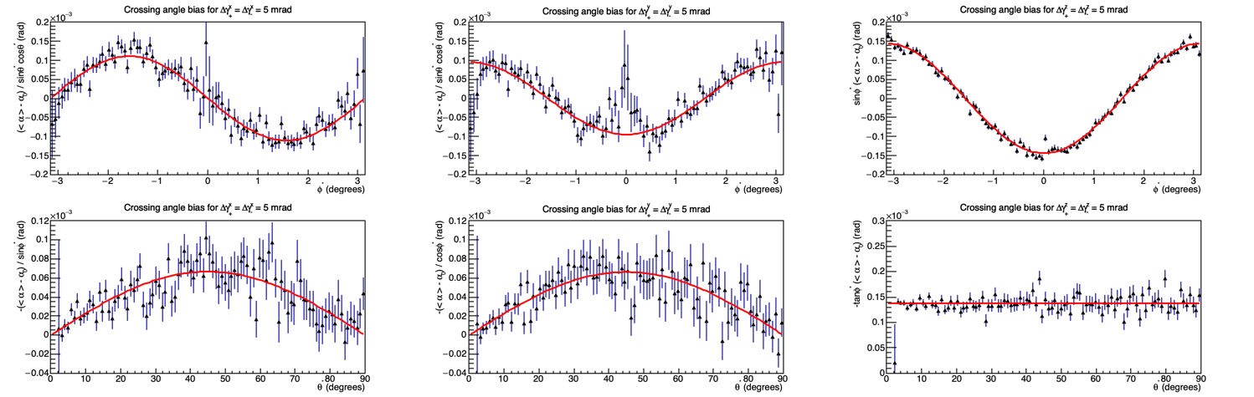


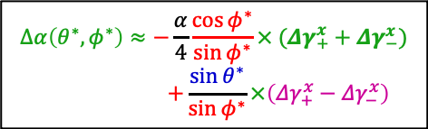
Taylor expansions of α around δγ±^{x,y,z} = 0
Δγ₊^{x,y,z} = Δγ₋^{x,y,z} = 5 mrad and check with 0.01% of the total statistics at 91.2 GeV
  Rotation x Rotation y Rotation z
$$Δα\left(θ^{∗},φ^{∗}\right)≈−\frac{α}{2}\cos{θ^{∗}\sin{θ^{∗}}}{\sin{φ^{∗}}× ({Δγ}_{+}^{x}+{Δγ}_{−}^{x})}$$
$$Δα\left(θ^{∗},φ^{∗}\right)≈−\frac{α}{4}\frac{\cos{φ^{∗}}}{\sin{φ^{∗}}}× ({Δγ}_{+}^{x}+{Δγ}_{−}^{x})$$
$$+\frac{\sin{θ^{∗}}}{\sin{φ^{∗}}}×\left({Δγ}_{+}^{x}−{Δγ}_{−}^{x}\right)$$
$$Δα\left(θ^{∗},φ^{∗}\right)≈−\frac{α}{2}\cos{θ^{∗}\sin{θ^{∗}}}{\cos{φ^{∗}}× ({Δγ}_{+}^{y}+{Δγ}_{−}^{y})}$$

Slide 38
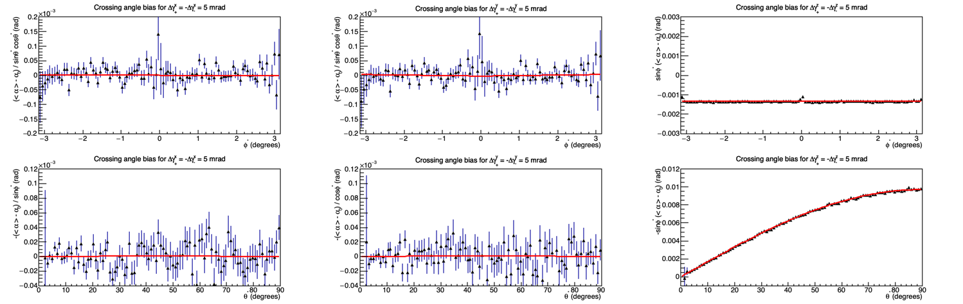
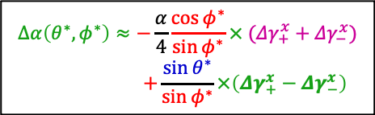
Taylor expansions of α around δγ±^{x,y,z} = 0
Δ₊^{x,y,z} = −Δ₋^{x,y,z} = 5 mrad and check with 0.01% of the total statistics at 91.2 GeV
  Rotation x Rotation y Rotation z
    No sensitivity in Δγ₊ − Δγ₋ for rotations around x and y axes
$$Δα\left(θ^{∗},φ^{∗}\right)≈−\frac{α}{4}\frac{\cos{φ^{∗}}}{\sin{φ^{∗}}}× ({Δγ}_{+}^{x}+{Δγ}_{−}^{x})$$
$$+\frac{\sin{θ^{∗}}}{\sin{φ^{∗}}}×\left({Δγ}_{+}^{x}−{Δγ}_{−}^{x}\right)$$

Slide 39
Result of the “rotation” fits (0.5mm resolution)
Each rotation has a specific dependence in (θ∗ , φ∗)
  Can be fitted “independently” of the other two in a global 𝜒²(Δγ₊^{x,y,z}, Δγ₋^{x,y,z}) minimization
    With 0.01% of the total statistics (1h of data), the following precision are reached
      Rotation around x axis : 80 μrad
      Rotation around y axis : 100 μrad
      Rotation around z axis : 20 μrad
    With the complete diphoton statistics at 91.2 GeV
      Rotation around x axis : 0.8 μrad
      Rotation around y axis : 1 μrad
      Rotation around z axis : 0.2 μrad
    Factor ~10 more precise using dielectrons e⁺e⁻ ➝ e⁺e⁻(γ)
      The improved method is significantly more precise than that presented in the EPOL paper
        Albeit with a twice worse angular resolution (0.5 mm resolution at 2.60m = 0.2 mrad resolution)
        The method uses the full statistical power of α and xγ
    Much better than needed precision, as the bias on the acceptance is a 2nd order effect

Slide 40
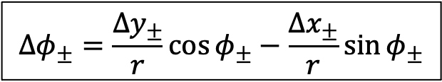
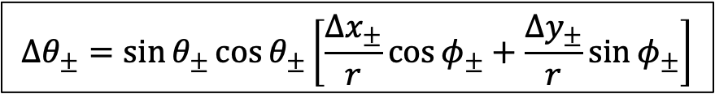
End-cap global translations in x, y directions
y
Translations by Δx± and Δy±
  More tedious to deal with (though not impossible) analytically through α and ε
  Was too lazy to carry out the calculation yet :-) Meanwhile …
    The polar angle modification induces an azimuthal modulation of the number of events
      Especially for cross section with a strong polar angle dependence (e.g., di-photons, di-electrons)
        Less powerful than α and x_{γ} but powerful enough for what we are up to.
More events
on this side
Δx
x
Δy
Less events
on that side
$$Δθ_{±}=\sin{θ_{±}}\cos{θ_{±}}\left[\frac{Δx_{±}}{r}\cos{φ_{±}}+\frac{Δy_{±}}{r}\sin{φ_{±}}\right]$$
$$Δφ_{±}=\frac{Δy_{±}}{r}\cos{φ_{±}}−\frac{Δx_{±}}{r}\sin{φ_{±}}$$

Slide 41
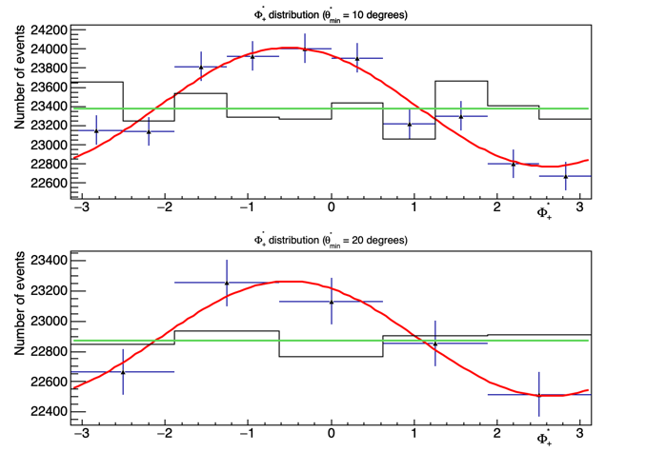
End-cap global translations in x, y directions
Modulation of the φ∗ distribution for a given θ∗_{min}
  Example: translation by r₀ = 1.1 cm (2% at 10º), φ₀ = -π/6 in the lab frame
    Photon position resolution 0.5 mm; Plot with 0.01% of the total statistics
2nd order effect on the luminosity
  Difference in total nb. of events < 5. 10⁻⁴
    Mostly of statistical nature
    5 x smaller than stat. uncertainty
Can be realigned from the φ∗ distribution
  Maximum of the modulation gives φ₀
  Amplitude of the modulation give r₀
⇒ Effect damped by a factor 5-10
  With only 0.01% of the luminosity
    Can be done with any kind of events !
Ultimate precision with γγ at 91.2 GeV
  10 (20) μm for θ∗_{min} = 10º (20º)
    Less than 1 μm with di-electrons
w/ translation
233927 events
w/o translation
233822 events
w/ translation
114425 events
w/o translation
114359 events
Not a concern
π/6

Slide 42
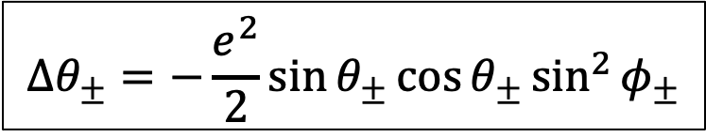

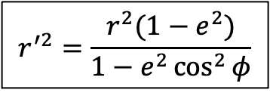
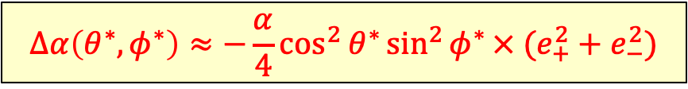

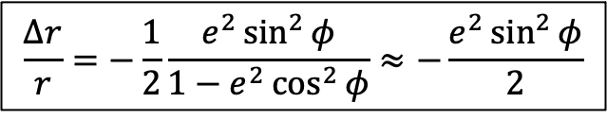
Global compression, e.g., due to gravity (Alain B.)
Such a transformation along the vertical y axis would change the acceptance
  And may not have a large effect on the crossing angle (in the horizontal plane) ?
    Equation of an ellipse in polar coordinates
    And therefore (if deformation e is small)
  Taylor expansion of α and ε around e² = 0
y
-re²
$$r^{′2}=\frac{r^{2}(1−e^{2})}{1−e^{2}\cos^{2}{φ}}$$
⇒
$$\frac{Δr}{r}=−\frac{1}{2}\frac{e^{2}\sin^{2}{φ}}{1−e^{2}\cos^{2}{φ}}≈−\frac{e^{2}\sin^{2}{φ}}{2}$$
x
$$Δθ_{±}=−\frac{e^{2}}{2}{\sin{θ_{±}}}\cos{θ_{±}}\sin^{2}{φ_{±}}$$
$$Δφ_{±}=0$$
$$Δα\left(θ^{∗},φ^{∗}\right)≈−\frac{α}{4}\cos^{2}{θ^{∗}}{\sin^{2}{φ^{∗}}× (e_{+}^{2}+e_{−}^{2})}$$
$Δε\left(θ^{∗},φ^{∗}\right)≈\frac{1}{4}{{\cos{θ^{∗}}sin}^{2}{φ^{∗}}× (e_{+}^{2}−e_{−}^{2}}$)

Slide 43
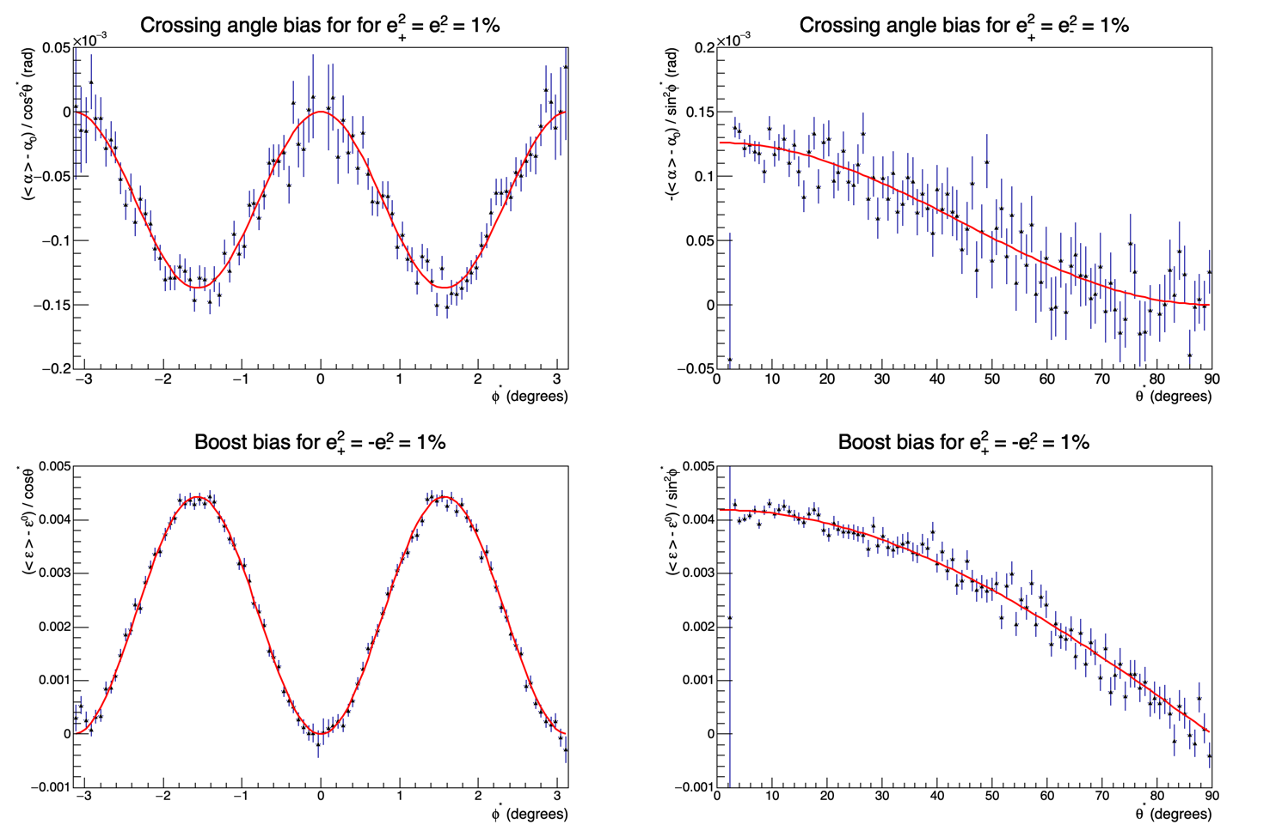


Global compression, e.g., due to gravity (Alain B.)
Check with the simulation with 0.01% of the total statistics (0.5mm position resol.)
    )
$$Δα\left(θ^{∗},φ^{∗}\right)≈−\frac{α}{4}\cos^{2}{θ^{∗}}{\sin^{2}{φ^{∗}}× (e_{+}^{2}+e_{−}^{2})}$$
Expected precision on the acceptance
with 0.01% of the statistics:
<Δθ> = 20 μrad at (10±0.5)º
<Δθ> = 60 μrad at (20±0.5)º
i.e., 0.2 (0.6) μrad with full stat
$Δε\left(θ^{∗},φ^{∗}\right)≈\frac{1}{4}{{\cos{θ^{∗}}sin}^{2}{φ^{∗}}× (e_{+}^{2}−e_{−}^{2}}$)

Slide 44
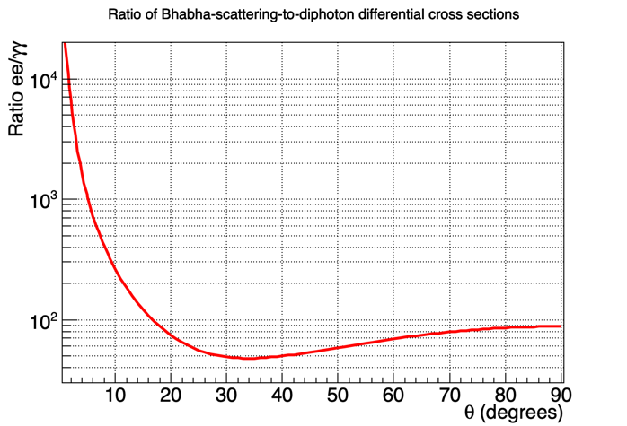
Bhabha scattering
Bhabha scattering e⁺e⁻ ➝ e⁺e⁻ cross section offers larger statistics than e⁺e⁻ ➝ γγ
263 at 10º
75 at 20º

