Slide 1
LHC: Past, Present and Future
Dr. José Miguel JIMENEZ
CERN, European Organization for Nuclear Research
Geneva, Switzerland
Head of the Vacuum, Surfaces and Coatings Group
Technology Department

Slide 2
Who am I?
Engineer degree in 1991
PhD in Surface Science at the Energy Atomic Commission (CEA Saclay, France) in 1994
CERN Staff
  Upgrade of LEP accelerator from 1994 ⇨ 2000
  Vacuum systems of the LHC, its transfer lines and CNGS proton line from 2000 ⇨ 2008
Head of the Vacuum, Surfaces and Coatings Group in the Technology Department, CERN since 2008
  69 Staffs
  ~39 Fellows, Doct, Students and Project Associates

Slide 3
OUTLINE
The LHC in few slides
Proton run in 2010, observations, encountered limitations
First heavy ion run
Perspectives for 2011
Summary and conclusions

Slide 4
OUTLINE
The LHC in few slides
Proton run in 2010, observations, encountered limitations
First heavy ion run
Perspectives for 2011
Summary and conclusions

Slide 5
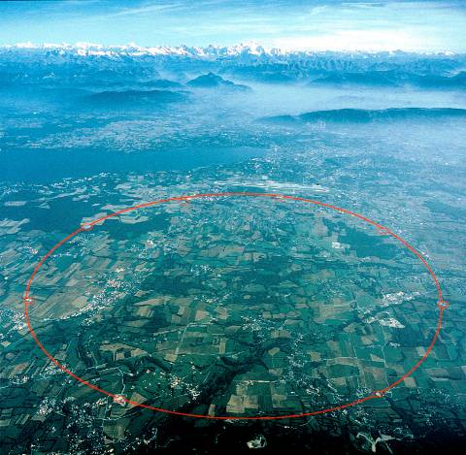
What is LHC (Large Hadron Collider) ?
7 TeV
proton-proton accelerator-collider built in the LEP tunnel
1982 : First studies for the LHC project
1994 : Approval of the LHC by the CERN Council
1996 : Final decision to start the LHC construction
2004 : Start of the LHC installation
2006 : Start of hardware commissioning
2008 : End of hardware commissioning and start of commissioning with beam
2009-2030: physics operation
Beams of LEAD nuclei are also accelerated, smashing together with a collision energy of 1150 TeV

Slide 6
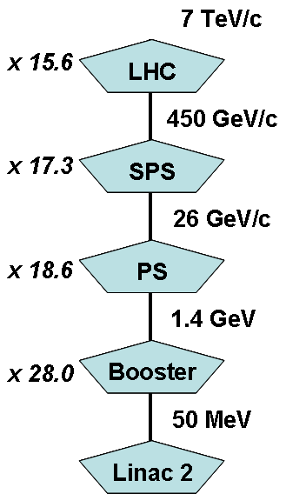
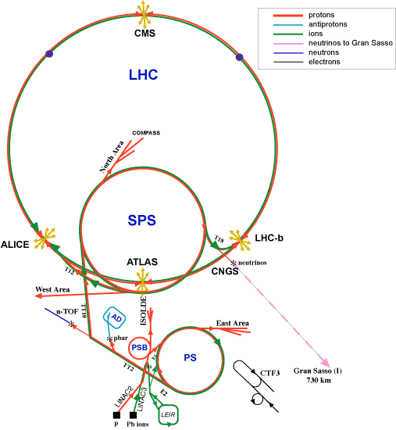
The CERN accelerator network

Slide 7
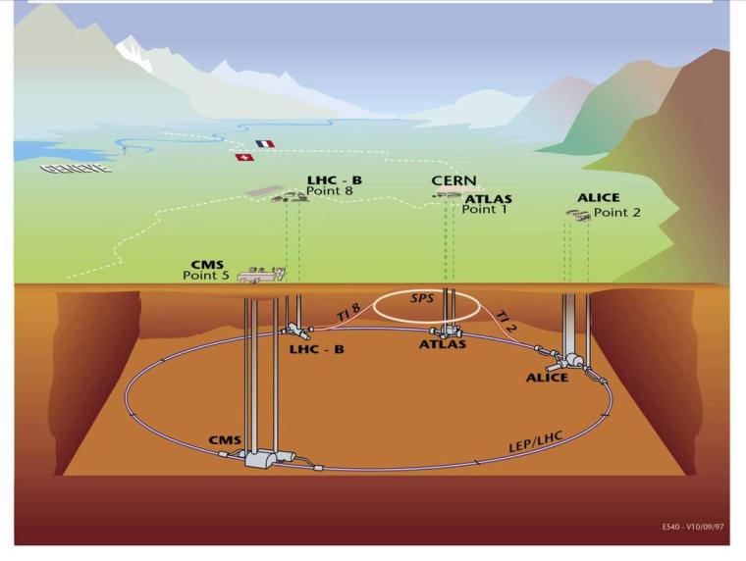
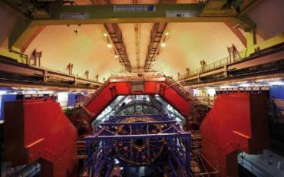
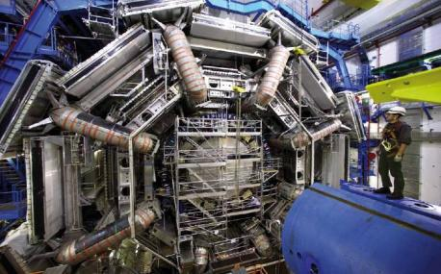
Four large experiments
Overall layout of LHC

Slide 8
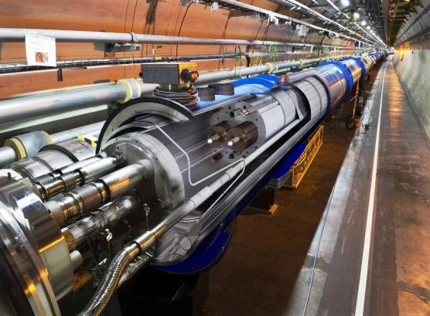
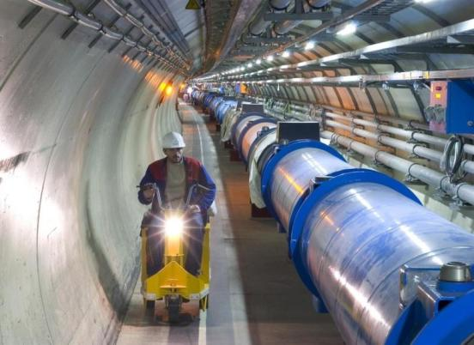
What is special
with LHC ?
The highest field accelerator magnets: 8.3 T (ultimate: 9 T)
Proton-Proton machine : Twin-aperture main magnets
The largest superconducting magnet system (~8000 magnets)
The largest 1.9 K cryogenics installation (superfluid helium)
The highest currents controlled with high precision (up to 13 kA)
The highest precision ever demanded from the power converters, few ppm
A sophisticated and ultra-reliable magnet quench protection system

Slide 9
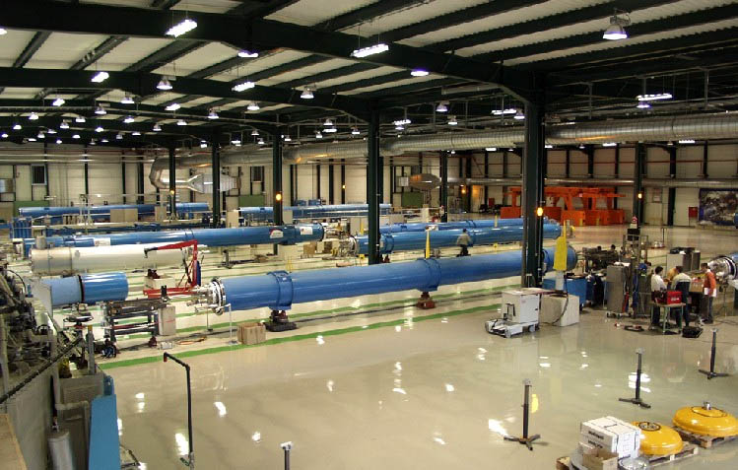
Final assembly of cryomagnets at CERN
One main dipole magnet :
35 tons , 15m, 108 mH
1232 main dipoles
400 main quadrupoles

Slide 10
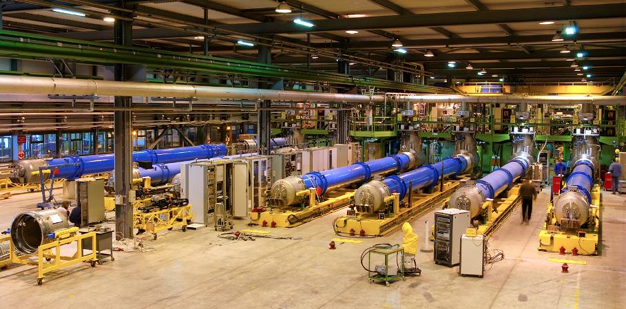
100% cold tests at CERN (up to ultimate field)
1232 dipoles and 400 quadrupoles
Cold magnetic performance measured on 20% of the magnets
(correlation between warm and cold measurements)

Slide 11
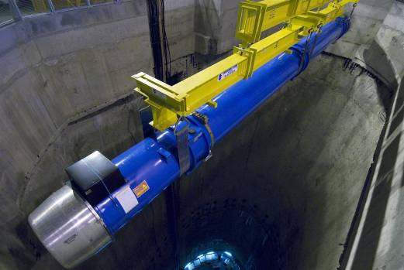
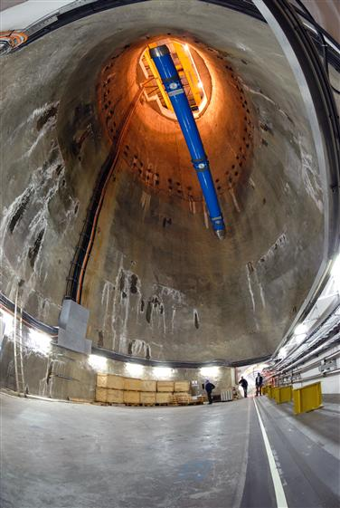

Descent of the last magnet 26-04-2007
30’000 km underground at 2 km/h!
Installed in the tunnel : 50 000 t

Slide 12
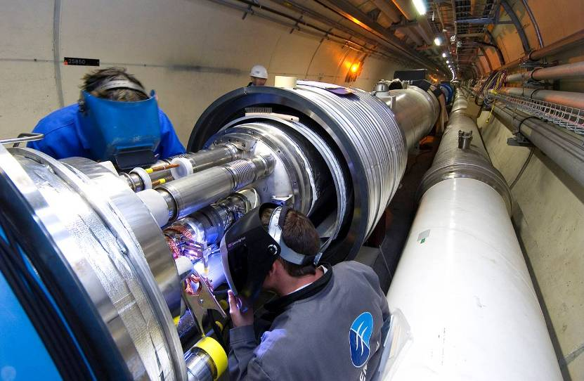
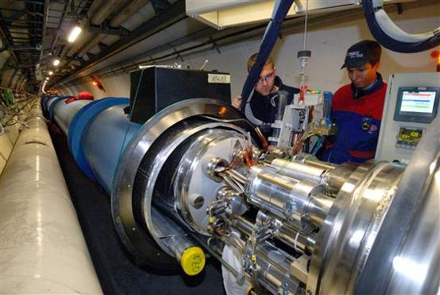
Cryomagnet interconnects challenge
123 000 helium-tight in situ welds

Slide 13
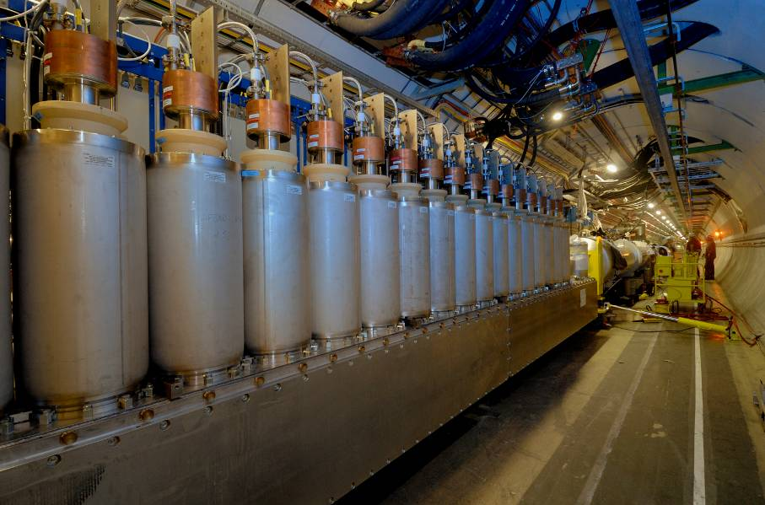
18 of 1’600 current leads
High temperature superconductors 10’000 magnets
1’700 electrical high current circuits precision of 1/1’000’000 (1ppm)

Slide 14
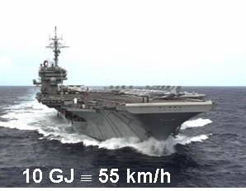

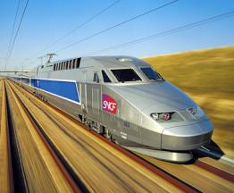
LHC accelerator magnet stored energy
1232 * 108 mH = 133 H ; ½ L . I² ~ 10 GJ
Energy stored in the magnet system: 10 GJoule
Energy stored in one (of 8) dipole circuit: 1.3 GJoule
10 GJoule ≅ flying 700 km/h
The energy stored in the LHC magnets corresponds approximately to 8 such trains running at 300 km/h
Notes:
14
Aircraft carrier

Slide 15
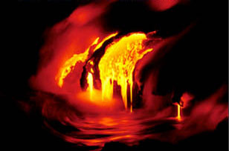

LHC beam stored energy
Momentum at collision 7 TeV (1 eV = 1,6 × 10⁻¹⁹ Joule)
Number of bunches 2808
Protons per bunch 1.15 ⋅ 10¹¹
Total number of protons 6.5 . 10¹⁴ (1 ng of H⁺)
(2 beams)
Energy stored in the two beams: 724 MJoule
Energy to heat and melt one ton of copper: 700 MJoule
700 MJ melt one ton of copper
700 MJoule dissipated in 88 μs
700.10⁶ / 88.10⁶ ≅ 8 TW
World Electrical Installed Capacity ≅ 3.8 TW
90 kg of TNT per beam

Slide 16
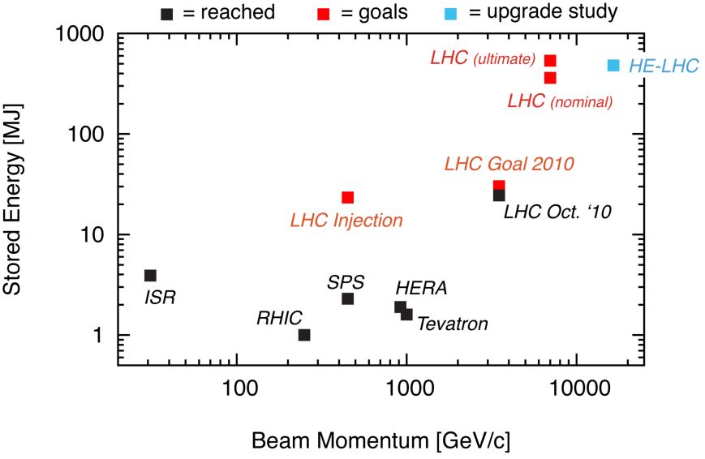
LHC beam stored energy
80 kg TNT

Slide 17
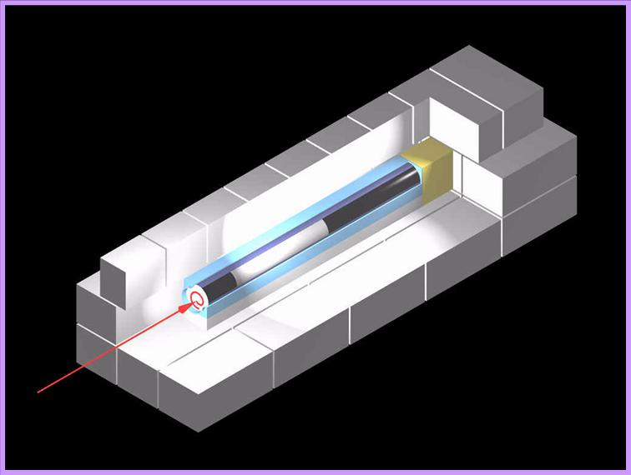
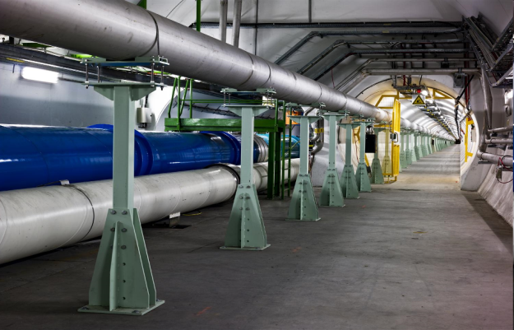
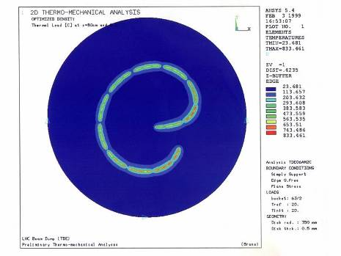
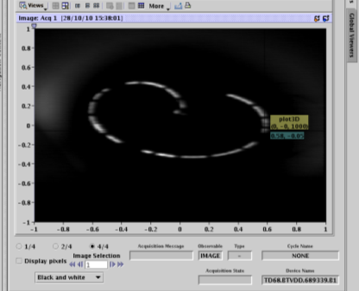
Beam Dump
beam absorber (graphite)
about 8 m
concrete shielding
up to 800 ⁰C
Temperature of beam dump block at 80 cm inside
V. Mertens
B. Goddard

Slide 18

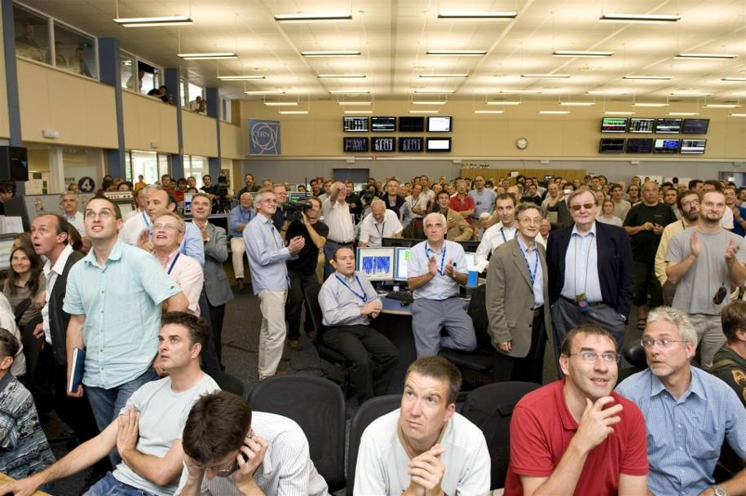
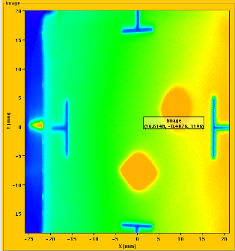
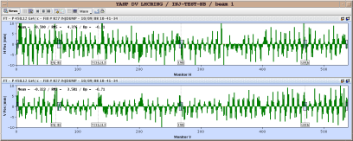
10th September 2008…
First turn !

Slide 19
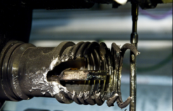
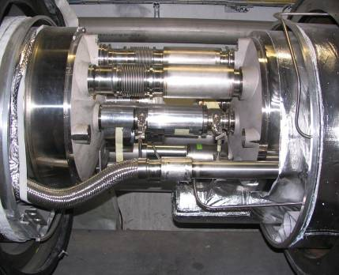
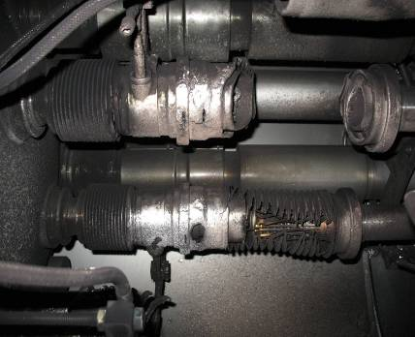
The Sector 3-4 incident (just before the 1st ramp)
19th September 2008 at 11:18.36
last test of the last circuit of the last sector: 7kA (4TeV) towards 9.3 kA (5TeV)
Electrical arc between two magnets at 8.7 kA

Slide 20
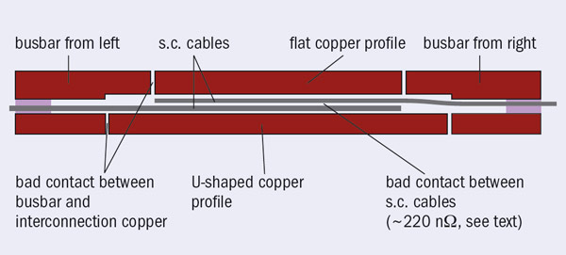
The start ...
From L. Rossi, CERN Courier September 2010

Slide 21
½ machine done

Slide 22
Why do we limit the beam energy to 3.5TeV
All the work done since November 2008 makes certain that a repeat of September 19th 2008 can NEVER happen.
  The offending connector in this incident had an estimated resistance of 220nΩ. We have measured all 10,000 inter-magnet connectors and the maximum resistance we have seen is 2.7nΩ for dipole busbars and 3.3nΩ for dipole busbars

Slide 23
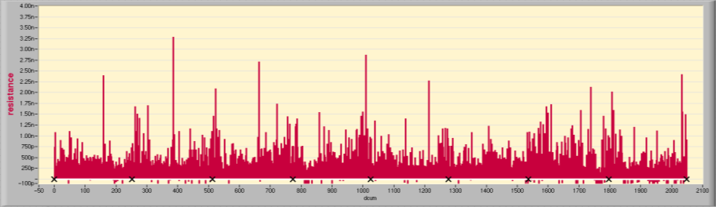
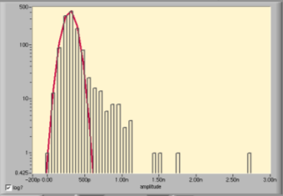
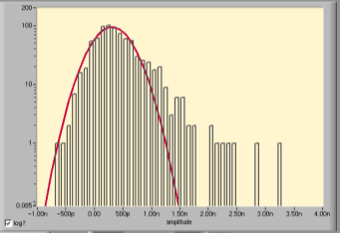
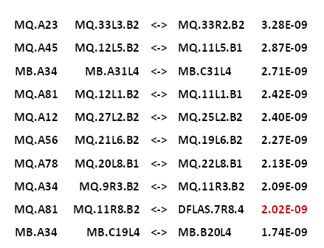
LHC main splices today: busbars SC
Main Dipoles&Quads Bus, sorted by position, 2048 segments
All HWC pyramids and plus ~150 ramps to 3.5TeV analyzed
2nΩ
12 23 34 45 56 67 78 81
Dipole Buses
Quad Buses
Top 10 Splice Resistances
306** ± 313pΩ
301 ± 85pΩ
R_{max} = 3.3nΩ
R_{max} = 2.7nΩ
(**) number of splices in the quads segments corrected, 1.3 added
From Z. Charifoulline

Slide 24
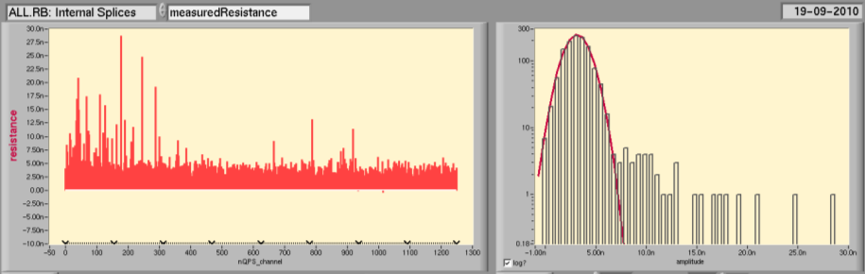
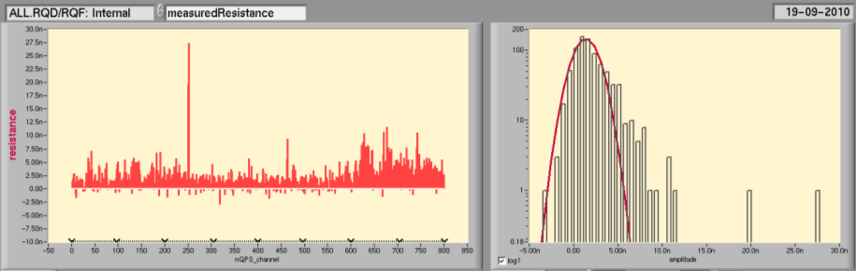
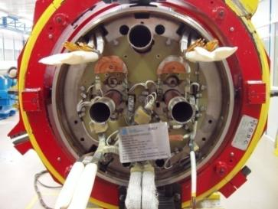
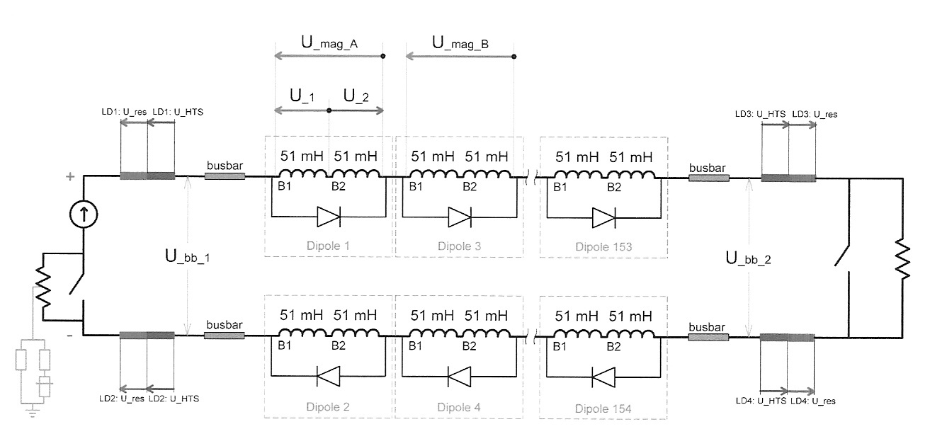
LHC main splices today: magnets SC
Main Dipoles
3.1±1.2nΩ
8 splices
(but not all the same type)
12 23 34 45 56 67 78 81
Main Quads
1.4±1.3nΩ
3 + 2* splices
(* partially)
12 23 34 45 56 67 78 81
From Z. Charifoulline

Slide 25
Why do we limit the beam energy to 3.5TeV
All the work done since November 2008 makes certain that a repeat of September 19th 2008 can NEVER happen.
  The offending connector in this incident had an estimated resistance of 220nΩ. We have measured all 10,000 inter-magnet connectors and the maximum resistance we have seen is 2.7nΩ for dipole busbars and 3.3nΩ for dipole busbars
BUT in April 2009, we have uncovered a different possible failure scenario which could under certain circumstances produce an electric arc in the “copper stabilizers” of the magnet interconnects

Slide 26







Sample pictures
Sample 1 (61 μΩ)
Sample 3A left (26 μΩ)
Sample 2A left (32 μΩ)
Sample 3A right (43 μΩ)
Sample 2A right (43 μΩ)
Sample 3B (21 μΩ)
Sample 2B (42 μΩ)
Pictures by J.-M. Dalin

Slide 27
OUTLINE
The LHC in few slides
Proton run in 2010, observations, encountered limitations
First heavy ion run
Perspectives for 2011
Summary and conclusions

Slide 28
Summary of LHC Commissioning in 2009
November 20th 2009
  First beams around again
November 29th 2009
  Both beams accelerated to 1.18 TeV simultaneously
December 8th 2009
  2x2 accelerated to 1.18 TeV
  First collisions at 2.36 TeV cm!
December 14th 2009
  Stable 2x2 at 1.18 TeV
  Collisions in all four experiments
LHC - highest energy collider
Limited to 2 kA in main circuits (1.18 TeV) during deployment and testing of new Quench Protection System

Slide 29
Decided Scenario 2010-2011
Following the technical discussions in Chamonix (Jan 2010),
CERN management and the LHC experiments decided
  Run at 3.5 TeV/beam with a goal of an integrated luminosity of around 1fb⁻¹ by end 2011
      Implies reaching a peak luminosity of 10³² in 2010
  Then consolidate the whole machine for
  6.5 – 7 TeV/beam (during a shutdown in 2012)
  From 2013 onwards LHC will be capable of maximum energies and luminosities
Primary Goal for 2010

Slide 30
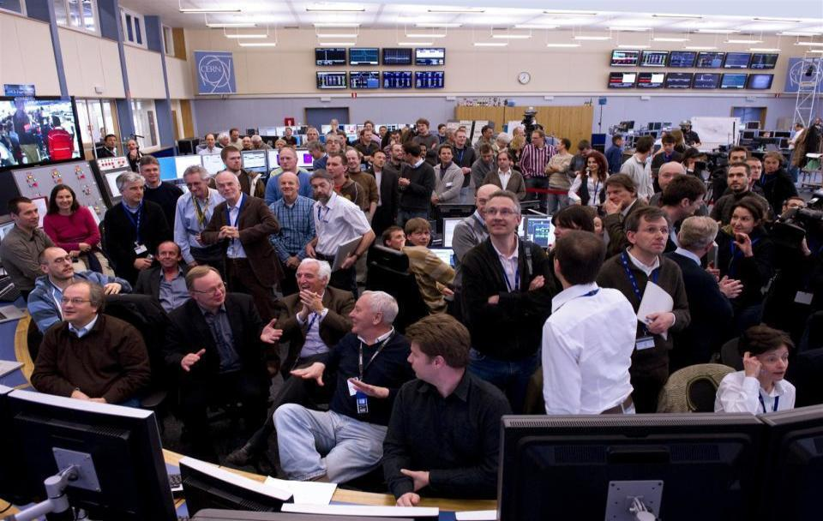
30th March 2010: first collisions at 7 TeV (2 x 3.5 TeV)

Slide 31
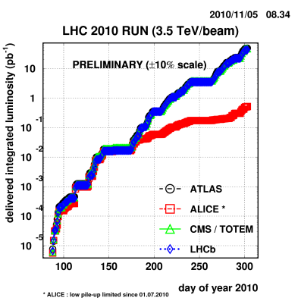
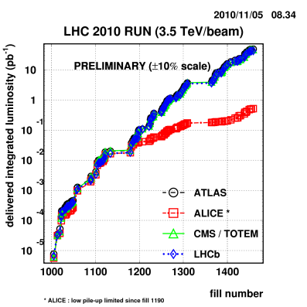
Integrated luminosity (log scale)
45 pb⁻¹
nom. bunches 3.5m
150ns trains

Slide 32
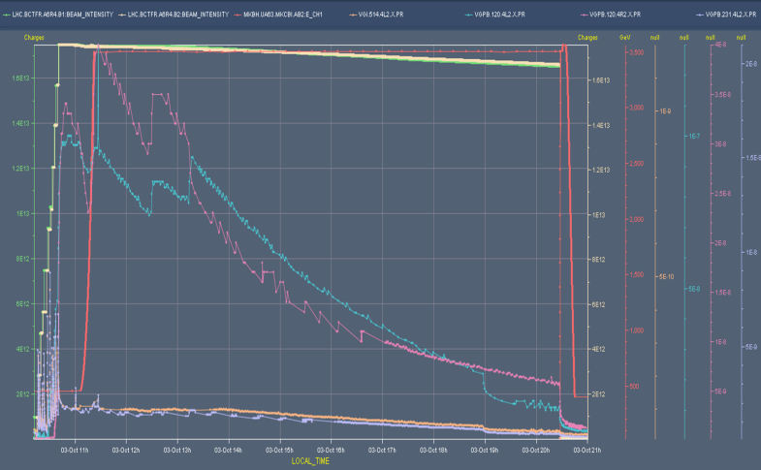
Pressure bumps induced by Electron avalanches
“Electron Clouds”
Squeeze
Ramp
Losses @ inj.

Slide 33
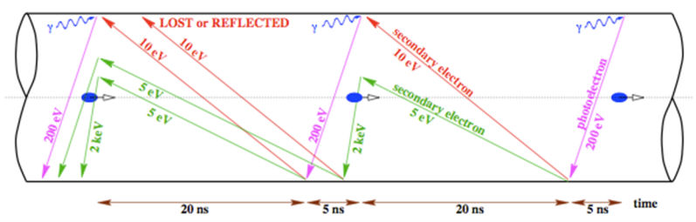
Electron Clouds in the LHC...
As foreseen, the LHC beams have reached a stage where beam-induced vacuum dynamic effects start to be visible …
  Smaller bunch spacing with trains can provoke electron clouds
  Vacuum pressure rise in warm sections
  Additional heat load on the cryogenic system in cold sections
  Electrons in the beam pipe can feed back to affect the beam stability
  Can be eliminated by conditioning the surface - scrubbing
Schematic of e- cloud build up in LHC arc beam pipe,
due to photoemission and secondary emission

Slide 34
Electron cloud: Parameters & Limitations
The electron cloud build-up:
  Is a threshold phenomenon
  Depends highly on the Secondary Electron Yield (SEY) δ
    Is enhanced by the low energy electrons surviving the gaps between bunch trains (reflectivity of low-energy electrons)
  Is attenuated by the spacing between bunches and bunch trains
  Is affected by many other parameters like:
    Size of the beam vacuum pipe
    Magnetic field
    Temperature of the beam pipe walls
bunch population
number of bunches in the train
Linear build-up

Slide 35
Electron cloud: induced limitations
Vacuum pressure rise
  Electron stimulated desorption (ESD) / Multipacting length vs pumping speed
Cryogenic cooling capacity
  Electron flux to the wall (heat deposition) / Limitation by the available cooling capacity (capillaries / cryoplants)
Beam instability
  Electron density / Limiting factor for the scrubbing run (emittance blow-up and losses)
Beam-gas scattering induced radiation to cables and electronics
  Dynamic vacuum in the beampipe (total/partial pressures of gas species)
    Radiation to cables and electronics / Single events / Quench limit
Background to Detectors
  Beam-gas scattering / Dynamic pressure in the beampipe / Length of the pressure bumps

Slide 36
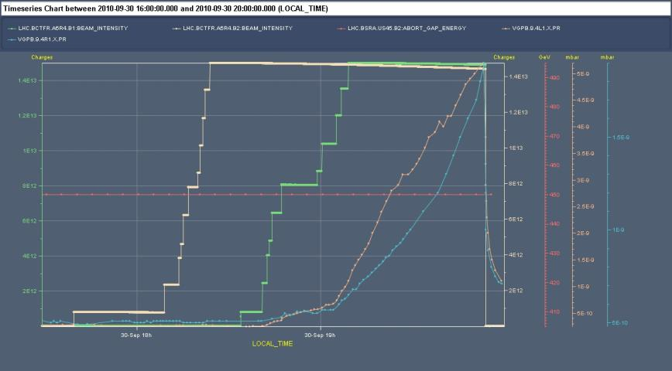
Review of Results:
150 ns Bunch Spacing
Beam 1
Beam 2
No pressure Increase
Pressure Increase
450 GeV
Electron cloud only visible in recombination areas WITH 2 beams circulating
NOTHING visible in the arcs (Cryogenic systems)

Slide 37
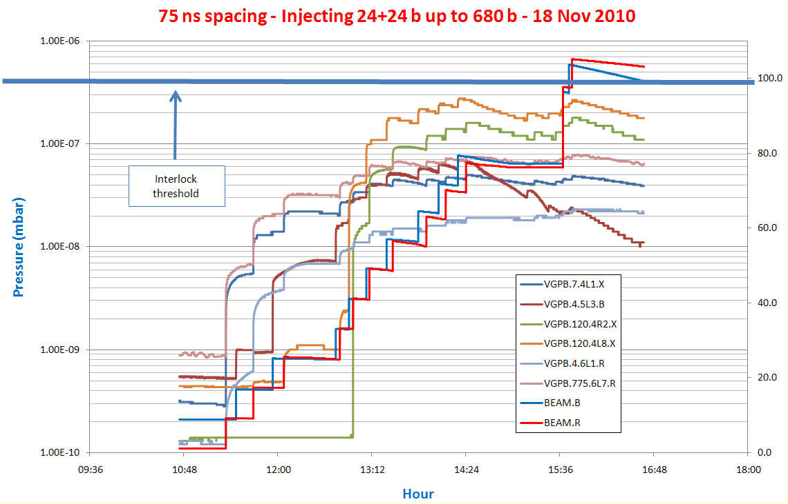
Review of Results:
75 ns Bunch Spacing

Slide 38
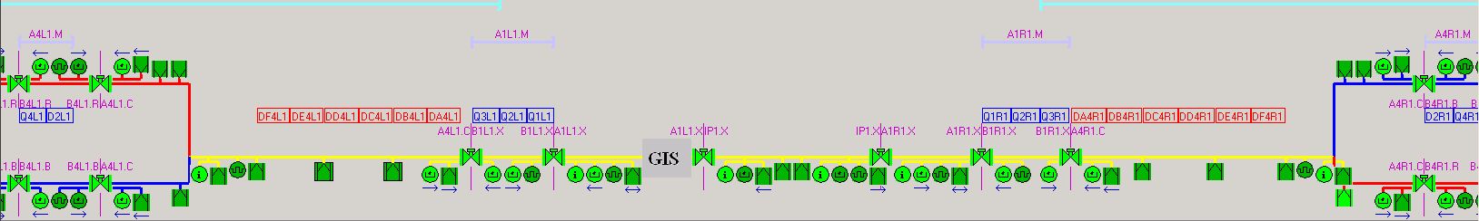
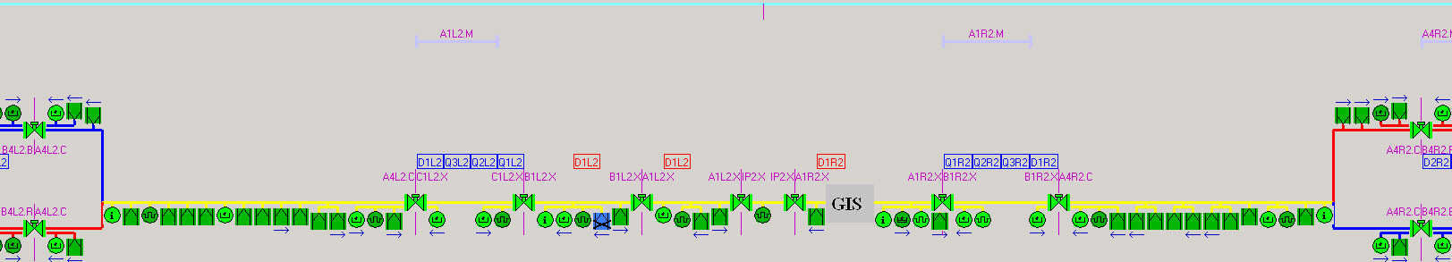
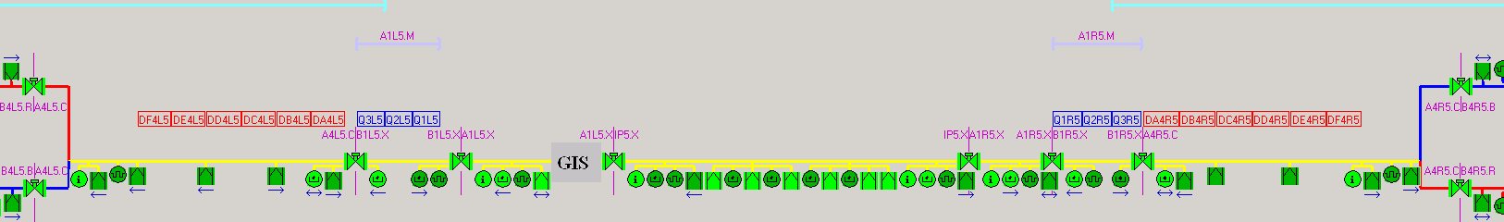
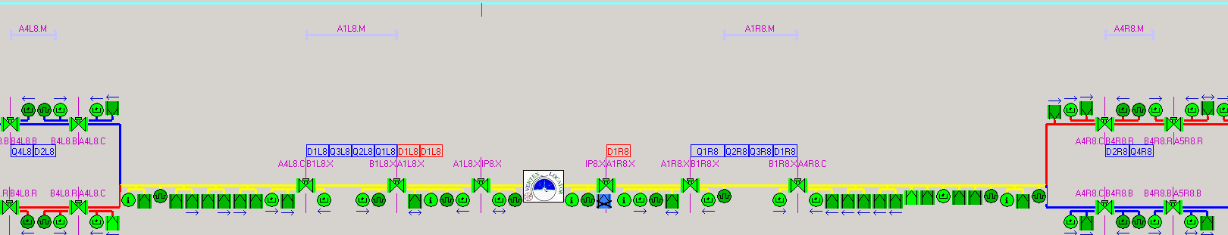
Review of Results
75 ns Bunch Spacing
2 beams crossing at these points (22.5 m and 45 m)
2 beams crossing at these points (22.5 m and 45 m)
ATLAS
Exp. Area
Triplets
Triplets
Summary with 75 ns at 450 GeV:
In the LSS
  Pressure rises in the pipes with 1 circulating beam explained by SR and electron
  cloud; ΔP results from the multipacting length vs pumping speed configurations.
  Pressure rises in the pipes with 2 circulating beams is enhanced in particular in the
  Cold/Warm transition of the Inner triplets on Q3/DFBX side for ATLAS, ALICE and
  LHCb.
In the arcs: Nothing observed (Cryogenics resolution: 5 mW/m)
Triplets
Alice
Exp. Area
Triplets
Magnetic field from CMS ≥ 10 Gauss
Magnetic field from CMS ≥ 10 Gauss
CMS
Exp. Area
Triplets
Triplets
LHCb
Exp. Area
Triplets
Triplets

Slide 39
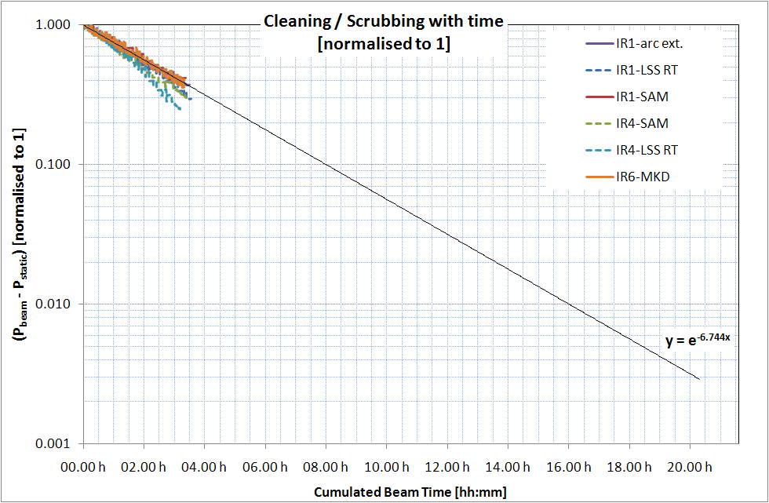

Review of Results:
Cleaning + Scrubbing (1/2)
Cleaning/Scrubbing ONLY if running with electron cloud!
Valid for a given bunch intensity and filling pattern
Linear scale

Slide 40
Review of Results:
Cleaning and Scrubbing (2/2)
Before scrubbing (30/10)
Heat load ~20 mW/m/beam
After scrubbing (19/11)
Heat load <10 mW/m/beam (Only B2)
Same filling pattern 50ns_109b_91_12_90_12bpi10inj and bunch population (~10¹¹ p).
L. Tavian
Scrubbing at 450 GeV effective also
for 3.5 TeV in the arcs.

Slide 41
Operation in 2011:
Expected decrease η and δ (calculations)
Dose [in e⁻/cm²] depends on magnetic field conditions
  Field free: homogeneous bombardment of the beampipe surface
  Dipole field: electrons are confined in two vertical strips
  15 times more dose expected in LHC arcs compared to LSS
Recall:
Vacuum Cleaning
  Is a dose effect characterized the reduction of the desorption yields (η)
  η = Number of gas molecules desorbed from the surface/bulk by a primary electron, photon, ion.
Beam Scrubbing
  Is a dose effect characterized the reduction of the secondary electron yield (δ)
  δ = Number of secondary electrons generated by a primary electron.
Pressure decrease results from the combined effect of vacuum cleaning and beam scrubbing

Slide 42

Operation in 2011:
Expected decrease η and δ (calculations)
Assumptions: 1 mA/m of e⁻ flux bombarding the beampipe (or 1.6 10¹⁶ e⁻/s.m)
FF: 5.1 10¹² e⁻/s.cm²
DF: 8.0 10¹³ e⁻/s.cm²
~8 h of scrubbing in 2010
Scrubbing
Cleaning
FF [scrubbing’11]
DF [scrubbing’11]
8 h of scrubbing
in 2010
Field free: 200 s 33 min 5 h 54 h 1 w 23 d
Dipole field: 13 s 125 s 21 min 3 h 35 h

Slide 43


Electron Cloud Mitigation...
Solenoid A4L1 - ON
Solenoid A4L1
Solenoid A4R1 - ON

Slide 44




Scrubbing... 824 bunches (> 8.10¹³ protons)
New record of intensity injected in the LHC
8 + 14 * (24 +24 ) = 680 bunches
at 1.1 10¹¹ p/b, 75 ns bunch spacing@450 GeV
25 % of the nominal LHC intensity!
Beam optimisation ongoing
33 %
Beam 1
Beam 2
824 bunches
8 +[ (2*24) * 14] = 680
8b
24b
24b

Slide 45

Fast local beam losses
Sudden local losses
No quench, but preventive beam dump
Rise time on the ms scale
Working explanation: dust particles falling into beam creating scatter losses and showers propagating downstream
Solved by increasing the threshold of the BLM
Not limiting at 3.5 TeV

Slide 46
OUTLINE
The LHC in few slides
Proton run in 2010, observations, encountered limitations
First heavy ion run
Perspectives for 2011
Summary and conclusions

Slide 47

Long preparation from injector chain

Slide 48

Ion Commissioning: First 24h from Nov 4th !
Beam 1 Inj., Circ.
& Capture
Beam 2 Inj., Circ.
& Capture
Optics Checks
BI Checks
Collimation Checks
First Ramp
Collimation Checks
Squeeze

Slide 49




First stable beams (2 bunches per beam)
8th Nov. 2010

Slide 50

First stable beams (2 bunches per beam)

Slide 51


Heavy Ion Run 2010 - luminosity
pp
Prediction !

Slide 52
Heavy Ion Issues - Single Event Upset
Primary ion beam losses are intercepted at the collimators
Several features contribute to more severe ion loss
  Ion dissociation and fragmentation reduce cleaning efficiency by factor ~100 when compared to protons.
    Collimation upgrade (DS collimators) will solve this.
  Ion beam lifetimes factor ~3-6 lower than for proton beams
    Not yet understood
Effects are clearly seen in Radmon monitors
and in the equipment!
  QPS and PC

Slide 53
OUTLINE
The LHC in few slides
Proton run in 2010, observations, encountered limitations
First heavy ion run
Perspectives for 2011
Summary and conclusions

Slide 54


2011 LHC Schedule
Approved by the Research Board, Dec’10
Version 1.2

Slide 55
Decisions taken following Chamonix and LMAC Meetings
Do physics in 2011@3.5 TeV AND 2012
BUT study
  Maintenance and repairs needs for such a long running period
  Make a new 10 year plan including all shutdowns and technical stops (LMC + experiments)
  Try to keep to a minimum the duration of the shutdown
Learn about:
  Electron cloud: heat load, vacuum, scrubbing, monitoring
  Fast beam losses
  Radiation to electronics
  Beam-beam – pushing the limits

Slide 56

Why staying at 3.5 TeV?
Probability per Year of burning an interconnect
Going to 4TeV, 50s implies a significant increase in the risk of burning an interconnect
Optimum choice

Slide 57
Design & assembly procedure
MB bus bars
Isostatic assembly
Mirror symmetry across H and V planes (assembly facilitate and cost saving)
Allowed misalignment default V±5 mm, H±3 mm
Second insulation skin
Pre-stress adjusted with accurate tooling (5kg)
Helium ducts in order to give good cooling for the bus bars (no thermal barrier)
Shunt soldering in position
Central insulation piece introduction between the bus bars
Lateral insulation pieces introduction
Kapton foil wrapping around insulation pieces
316L collars tie clamping around

Slide 58
OUTLINE
The LHC in few slides
Proton run in 2010, observations, encountered limitations
First heavy ion run
Perspectives for 2011
Summary and conclusions

Slide 59
Summary and conclusions
LHC is magnetically very reproducible on a month to month time scale
High precision of the powering system (8 independent sectors !)
High availability of the cryogenics and hardware system
Head on beam-beam limit higher than foreseen
Aperture better than foreseen
Not a single magnet quench due to beam
Careful increase of the number of bunches OK
Electron cloud and vacuum
Machine protection
  Set up is long
  Quench levels for fast and slow losses needs optimized
  Fast beam losses to be understood

Slide 60


In 2009, Beam was back !
In 2011, THE year of Physicists?

Slide 61

...what else? Thanks you for your attention.
Cryogenics
Vacuum
Survey
Machine protection
DG
Operation with Beams

Slide 62
Acknowledgements
This talk sketched some aspects of the work of many people, over many years.
Particular thanks for material to:
  F. Bordry and A. Siemko.

Slide 63
Reserve...

Slide 64
Evolution of target energy during commissioning
When
Why
7 TeV
2002-2007
Design
12 kA
5 TeV
Summer 2008
Symmetric quench
9 kA
Late 2008
Splice problem
3.5 TeV
3.5 TeV
Summer 2009
Stabilizers
6 kA
Fix nQPS
Test 6kA
Winter
2010
1.18 TeV
October 2009
nQPS
2 kA
450 GeV

Slide 65
LHC Systems: Faults downtime distribution
Equipment type | Faults | Qty. | Availability^{[1]} [%] | MTBF [hours]
Quench heater power supplies | 26 | 6076 | 99.998 | 1145760
Quench detection systems | 19 | 10438 | 99.999 | 3362135
DAQ caused by radiation (SEU) | 12 | 1624 | 99.997 | 828240
DAQ other causes than radiation | 8 | 2532 | 99.999 | 1936980
DAQ all faults combined | 20 | 2532 | 99.997 | 774792
EE600 | 6 | 202 | 99.988 | 206040
EE13 kA | 5 | 32 | 99.939 | 39168
R. Denz
QPS wins in 2010 by a neck…

Slide 66
Busbar Joins Failure modes (for I<9 kA)
Spurious trips/heater firings, ….
Training
Beam losses
Cable/bus movement
Resistive losses in the splice
P>0
P→0
P>0
P→0
P→0
P=0
P_{B}>0
Thermal prop.
through the
bus (1 joint)
Prompt quench
of a joint
Quench of a magnet
Delayed quench
of a joint
P_{J}>0
Thermal prop.
through GHe
(3 joints)
Burn-out of the joint
P_{G}>0

Slide 67


Luminosity evolution
5 orders of magnitude in ~200 days
~50 pb⁻¹ delivered, half of it in the last week !
10³⁰ cm⁻² s⁻¹
Bunch train commissioning

Slide 68

UFOs - Worrying trend through the summer

Slide 69
Milestones reached during 2010
Early beam operations - physics running with low intensity widely spaced bunches
Date | Day | Achieved
Feb 28 | 1 | Restart with beam
Mar 12 | 13 | Ramp to 1.18 TeV
Mar 19 | 20 | Ramp to 3.5 TeV
Mar 30 | 31 | First collisions at 7 TeV centre of mass | Luminosity ~ 2×10²⁷ cm⁻² s⁻¹
Apr 01 | 33 | Start squeeze commissioning | Regular physics runs 2 on 2 bunches of 10¹⁰ Un-squeezed 1 colliding pairs per experiment Rates around 100Hz
Apr 07 | 39 | Squeeze to 2 m in points 1 and 5
Apr 09 | 41 | Single nominal bunch of 1.1×1011 stable at 450GeV
Apr 13 | 45 | Squeeze to 2 m in point 8
Apr 16 | 48 | Squeeze to 2m in point 2
April 24 | 54 | First stable beams at 7 TeV, 3 on 3, squeeze to 2m | Luminosity ~ 2×10²⁸ cm⁻² s⁻¹
May |  | Increase bunch intensity to 2×10¹⁰ ,Increase k_{b} | Regular physics runs
May 24 |  | 13 on 13, 2m, 8 colliding pairs per experiment | Luminosity ~ 3×10²⁹ cm⁻² s⁻¹
Physics running with low intensity widely spaced bunches

Slide 70
Milestones reached during 2010
Physics running with nominal intensity widely spaced bunches
Physics running with nominal intensity 150ns bunch trains
Date | Day | Achieved
June |  | Increase bunch intensity to nominal, squeeze to 3.5m | No physics for 3 weeks!
June 25 |  | First stable beams at 7 TeV, 3 on 3 nominal bunch | Luminosity ~ 5×10²⁹ cm⁻² s⁻¹
July 15 |  | 13 on 13, 8 colliding pairs per experiment, 9 10¹⁰ / bunch | Luminosity ~ 1.5×10³⁰ cm⁻² s⁻¹
July 30 |  | 25 on 25, 16 colliding pairs per experiment, 9 10¹⁰ / bunch | Luminosity ~ 3×10³⁰ cm⁻² s⁻¹
Early Aug |  | Stable running period to consolidate operation and MP | ~1.3 MJ per beam
Aug 19 |  | 48 on 48, 36 colliding pairs 1 5 and 8 (< in 2), 9 10¹⁰ / bunch | Luminosity ~ 6×10³⁰ cm⁻² s⁻¹
Aug 24 |  | 50 on 50, 35 colliding pairs 1 5 and 8 (< in 2), 10¹¹ / bunch, lower ε | Luminosity ~ 10³¹ cm⁻² s⁻¹
Sept |  | Setting up bunch trains on crossing angles | No physics for 3 weeks!
Sept 22 |  | First stable beams at 7 TeV with bunch trains, 24/16 nominal bunches | Luminosity ~ 4×10³⁰ cm⁻² s⁻¹
 |  | Increase number of trains, 10¹¹ / bunch
Oct 08 |  | 248 on 248, 150ns bunch trains, 233 colliding pairs in 1, 5 and 8 | Luminosity ~ 9×10³¹ cm⁻² s⁻¹
Nov 08 |  | 368 on 368, 150ns bunch trains, 348 colliding pairs in 1, 5 and 8 | Luminosity ~ 2×10³² cm⁻² s⁻¹
Physics running with nominal intensity widely spaced bunches
Physics running with nominal intensity 150ns bunch trains

Slide 71
The operational cycle
Squeeze
Collisions
Ramp
Rampdown
Injection
Injection | Ramp | Squeeze | Collisions | Rampdown
Many schemes Injection channel | Dynamic effects Feedbacks | Optics Collimators | Beam steering Beam-beam | Ramp rates Reproducibility
← All through the cycle →
Beam dump Collimations system Protection devices

Slide 72



LHC nominal performance
Nominal settings
Beam energy (TeV) | 7.0
Number of particles per bunch | 1.15 10¹¹
Number of bunches per beam | 2808
Crossing angle (μrad) | 285
Norm transverse emittance (μm rad) | 3.75
Bunch length (cm) | 7.55
Beta function at IP 1, 2, 5, 8 (m) | 0.55,10,0.55,10
Derived parameters
Luminosity in IP 1 & 5 (cm⁻² s⁻¹) | 10³⁴
Luminosity in IP 2 & 8 (cm⁻² s⁻¹)* | ~5 10³²
Transverse beam size at IP 1 & 5 (μm) | 16.7
Transverse beam size at IP 2 & 8 (μm) | 70.9
Stored energy per beam (MJ) | 362
* Luminosity in IP 2 and 8 optimized as needed

Slide 73

2010 Proton Run - Performance Highlights

Slide 74
Mitigated by change of BLM threshold
UFO dump rate has gone down significantly since we increased the thresholds at SC elements (except triplets) by a factor 3.
  12 UFOs before change of threshold.
  But there are still coming at a steady rate.
  No quench with UFOs.
2 UFOs since threshold change:
  UFO near LHCb leading to dump by LHCb – not the LHC BLMs.
  Ultra-fast and somehow non-standard UFO at BSRT.
Even though the UFO rate seems to be under control now, UFOs will become a problem if we ever increase the energy since the quench and BLM thresholds will come down again (factor 2-3 !).
To be looked at and understood
  UFO mechanism
  Possible cleaning by beam
  Actions for 2012 stop

Slide 75
“To burn or not to burn” depends on:
Failure probability calculations depends on:
Current (Ampl and t)
Defect size (represented by R_{addit})
RRR of the bus, the diode lead, and the cable
Geometry “Dipole-Bus-Diode”
Heating up of the magnet coil.
Heating up of the diode
Heat transfer to helium (bus, diode lead, joint area)
GHe propagation time
Resistance of the ‘half moons’
Conclusion:
A worst case approach for all parameters would give an unrealistic result.
Therefore, all parameters will be fixed to best known (default) values (realistic, but somewhat conservative), and the burn-out current is calculated as a function of the (single sided) defect size for energy levels of 3.5, 4, and 4.5 TeV.

Slide 76


Shunt
4 shunts for each dipole connection, 2 pairs on each side fully redundant,
plus the basic connection
2 shunts for each quadrupole connection, 1 on each side , plus the basic connection

