Slide 1

The search for neutrino-less double beta decay using the nEXO experiment: Simulation needs and challenges
David Gallacher
PhD Candidate – Brunner Neutrino Lab - McGill University
VIEWS24 – Vienna Workshop on Simulations 2024
Notes:
Notes from practice:
Cut one slide from intro, try to get down to 5 minutes
Maybe remove MPA slide?
Ask people about biasing for simulation studies
Collect info for summary presentation afterwards
Introduction of CHROMA and light simulations was kind of awkward, try reworking the order of information

Slide 2
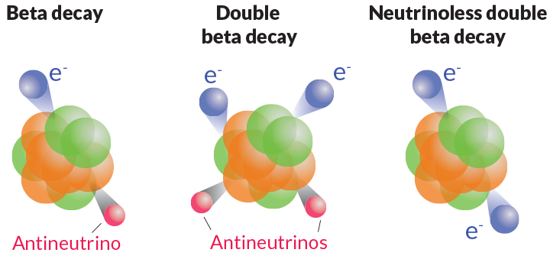


Neutrino-less Double Beta Decay
Neutrino-less Double Beta Decay (0νββ) is a hypothetical rare form of nuclear decay
Enabled by non-zero neutrino mass
Is a lepton number violating process
  Majorana Fermions are a new class of particles
Provides insight into the fundamental nature of neutrinos and the origin of their mass
0L -> 1L + 1$\overline{L}$ = 0 L
0L -> 2L + 2$\overline{L}$ = 0 L
0L -> 2L = 2L
Matter creation!

Slide 3

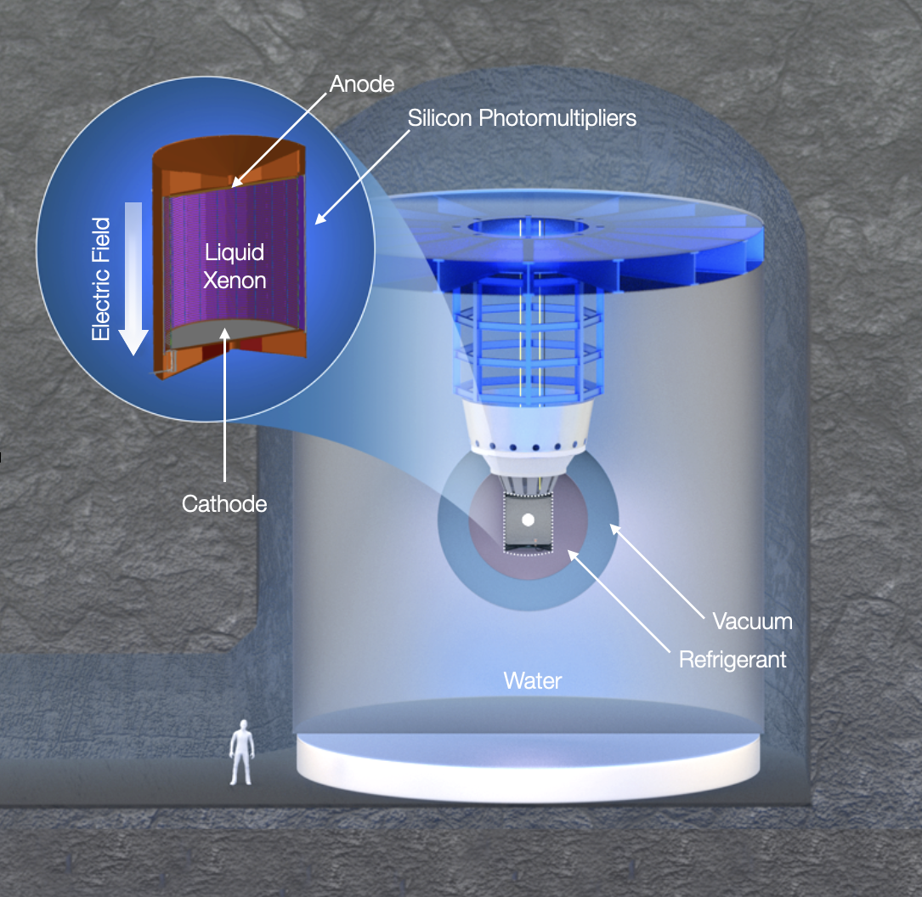
- Searching for 0vBB
nEXO is a proposed 5-tonne single-phase liquid xenon time projection chamber (LXe TPC)
LXe is 90% enriched in 2νββ isotope ¹³⁶Xe
  Q_{BB} ~2.46 MeV
Extensive radio-assay program for background mitigation
  Ultra-low background technique based on success of EXO-200 program
nEXO projected sensitivity to 0νββ half-life is 1.35x10²⁸ years at 90% CL after 10 years [1]
  Current experimental limits in ¹³⁶Xe: >2.6x10²⁶ yrs (KamLAND-Zen)

Slide 4
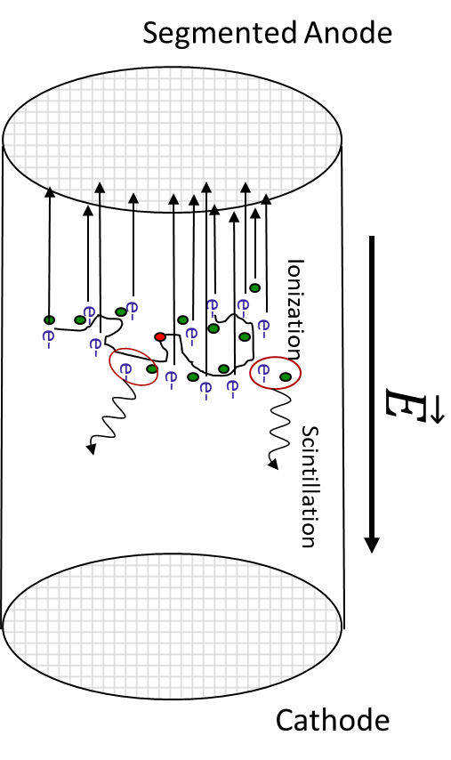
Detecting 0νββ
Radiation in LXe produces ionization electrons + scintillation light
TPC configuration is optimized to measure both charge and light signals
  Drift charge to Charge Collection Anode
    ~3800 Channels in 120x10cm tiles
  Collect light along barrel with Silicon Photomultipliers (SiPMs)
    24 “Staves” with 20 tiles of 16x6cm² Sub-arrays -> 7680 channels over 4.6m²
  Combine both for <1% energy resolution at Q_{BB}
3D Position Reconstruction based on charge (XY) and charge delay time (Z)

Slide 5
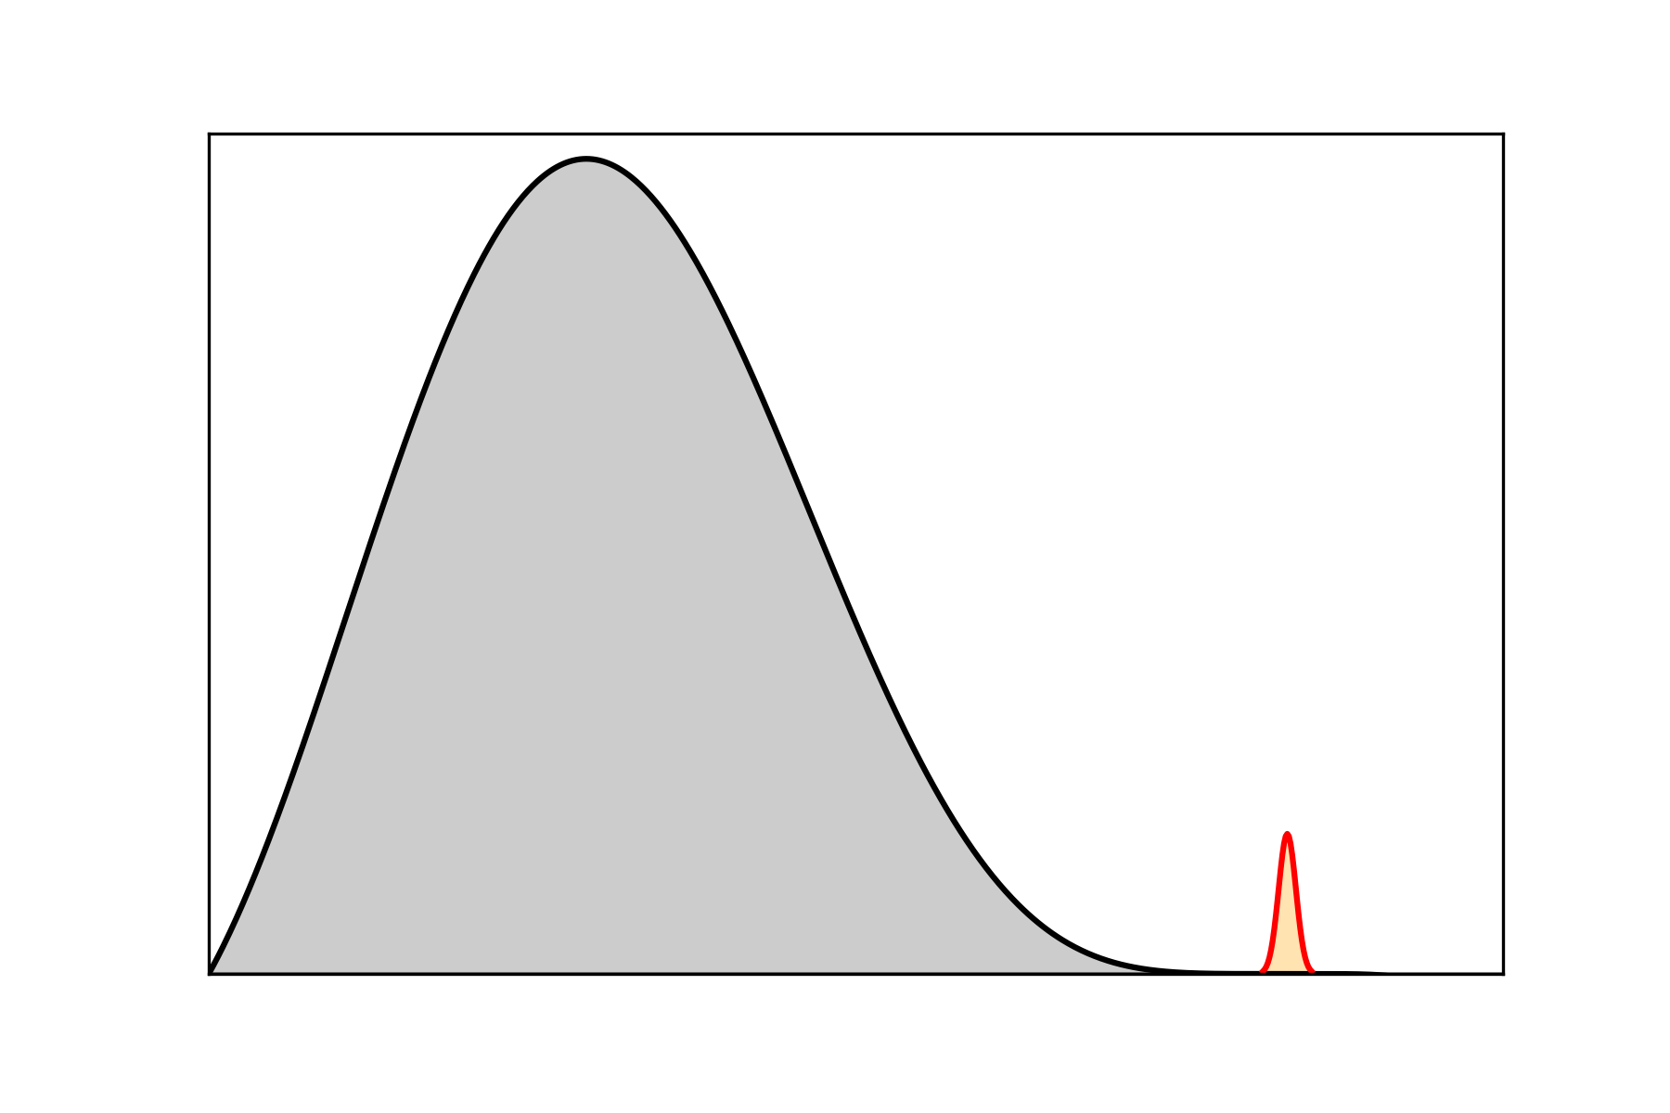
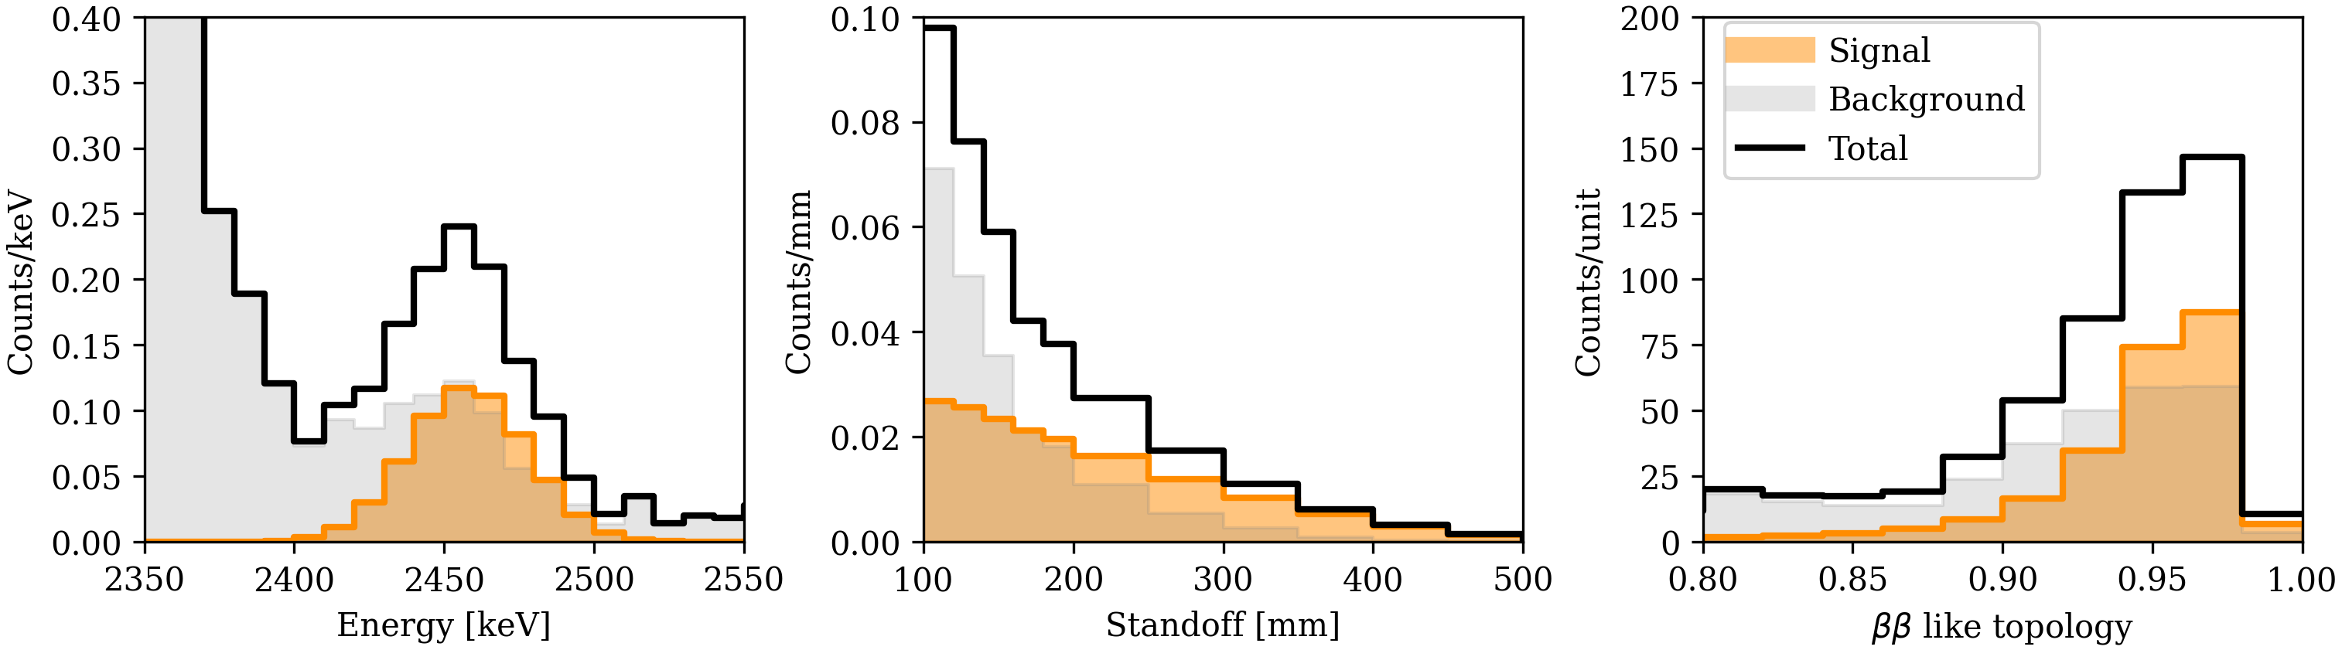

TPC Multiparameter Analysis
Signal like
Energy:
Standoff:
Topology:
Bkg. like
Bkg. like
Signal like
Distance from nearest detector surface
Signal like
Bkg. like
~3 mm
1D projections of simulated nEXO signal and backgrounds:
T_{1/2} = 7.4 x 10²⁷ yr
nEXO (3$σ$)

Slide 6
nEXO Simulations
Time to get technical

Slide 7

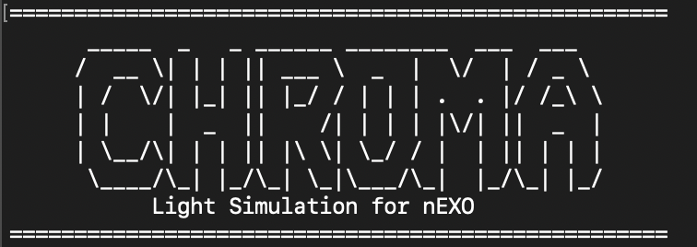

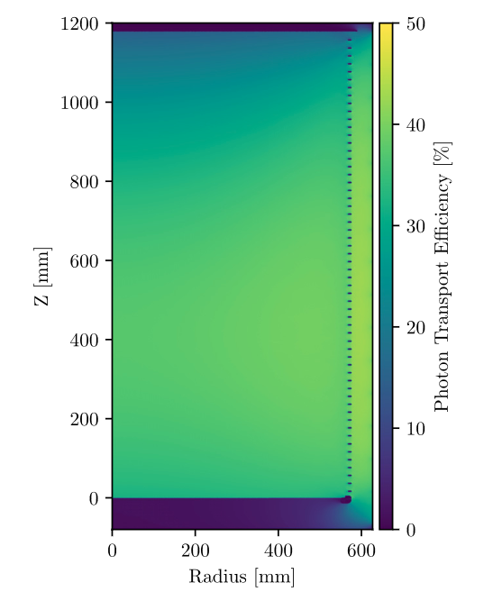
nEXO Simulations Framework
Stand-alone GPU
Modular CPU using SNiPER
Primary Particle Transport
Detailed Light Simulation
Charge Simulation
Diffusion + Transport + Attn.
LXe Energy Deposit Response
Charge Waveform + Noise
Ionization Electrons
Scintillation Photons
Light Map
Detector Response
Light Map + Efficiency
Notes:
This is for nominal simulations, detailed simulations in light and charge channels are possible as stand-alone simulations

Slide 8
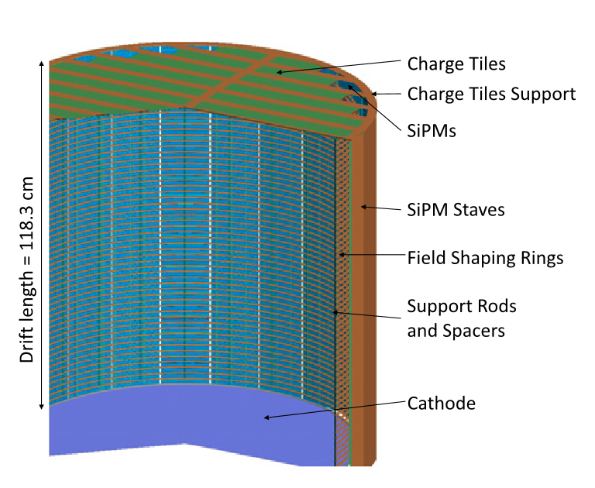
GEANT4 for nEXO
We all know what GEANT4 is
nEXO Runs GEANT4 in SNiPER Framework
  Integrated modular analysis and secondary detector response simulations
It’s essential to run full GEANT4 simulations for all background sources
  Integrated online assay and radiopurity data-base used for cataloguing, version control and background contribution estimation
  Check out our Radiopurity DB Paper [3] for more details!
See Li T, et al. Parallelized JUNO simulation software based on SNiPER [3],for more info on SNiPER
Notes:
All detector components have radiopurity assay information
Produce a PDF of acceptance vs energy for each source and component

Slide 9
Charge Response Simulation
LXe Energy Deposit Response
nEXO has developed a detailed charge response simulation
  Option to run fully detailed or “fast” with an effective model
Ionization Electrons are produced by the Noble Element Scintillation Toolkit (NEST)
  Microphysics MC for noble element detectors
Standalone SNiPER Algorithm service handles charge simulation
Reconstruction algorithm handles detector response and reconstruction
Ionization Electrons
Diffusion + Transport + Attn.
Detector Response
Charge Waveform + Noise
See Li Z, et al., Simulation of charge readout with segmented tiles in nEXO [4], for full details!

Slide 10

CHROMA – GPU Accelerated Photon Transport
Using the Chroma Framework from https://github.com/BenLand100/chroma
  Chroma has recent renewed support and is being developed under https://github.com/pennneutrinos/chroma
  We will fast-forward to the stable development branch soon!
Chroma + GPU libraries are kept in a singularity container
  Works with NVIDIA GPUs
  Compatible with HPC cluster GPUs
Geometry is defined by STLs
  No need for simplifying assumptions, export the whole detector CAD as STL files and configure optical properties in data tables
GPU-based photon transport simulation
Surface-based triangular mesh geometry
Development in Python (core simulation in CUDA-C)
Does:
  Optical Photon Transport
  Wavelength Shifting
  Photon Detection
Up to 200x faster for optical photon tracking in Chroma vs GEANT4

Slide 11
CHROMA Integration
Currently CHROMA is used in two modes
Stand-alone high photon # simulation to produce accurate light-map as input for GEANT4 simulations
Detailed Light-only studies of light transport to for individual photons
  Light-only studies used to understand requirements for key optical elements inside of nEXO
  Exploration of background rejection techniques in light channel
  Used to design and characterize response of water-Cherenkov detector for muon veto
Current work is focusing on integrating GEANT4 output into Chroma indirectly using upROOT + nestpy for event-by-event analysis in detailed light simulation
Investigating CHROMA integration into SNiPER with nEXO GEANT4
  Cons: Significant work required, need not demonstrated
  Pros: Fast accurate detailed light transport with only one-geometry to maintain, opens new possibilities for light-only analyses. Full correlations maintained!

Slide 12
Light Response Simulation
Stand-alone high statistics (O(10¹²) photons) GPU Simulation of light transport in CHROMA aka Light Map
Light map used to determine photon transport efficiency (PTE) for each energy deposit location from GEANT4 simulation
NEST calculates # of photons
PTE and SiPM efficiency, correlated noise and fluctuations included to determine # of detected PE for each event

Slide 13
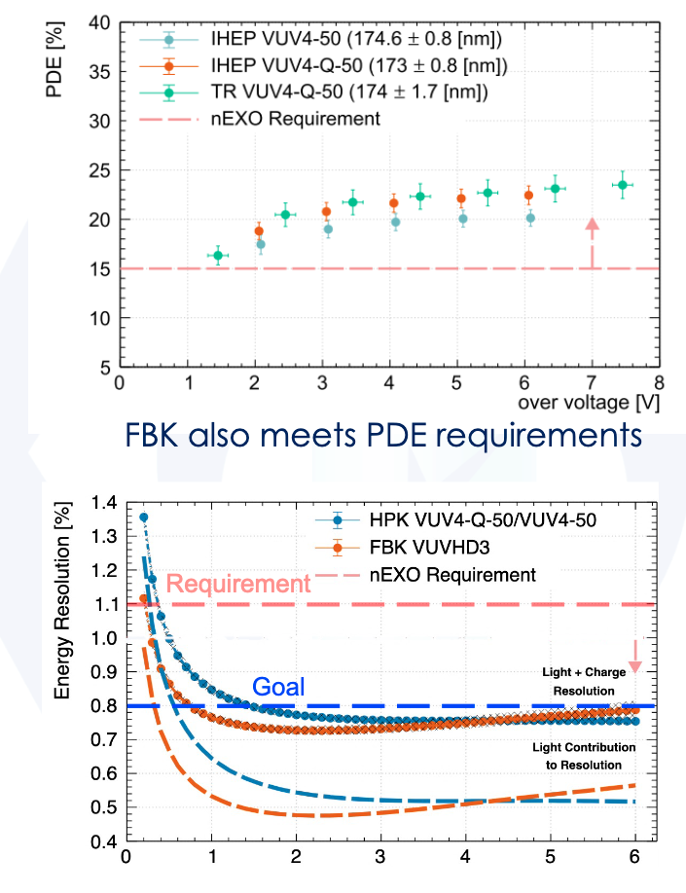
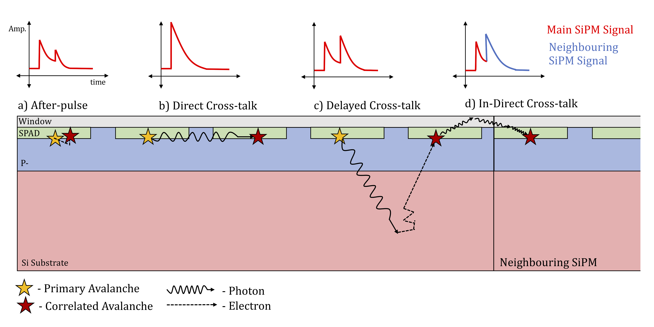
Modelling SiPM Response
For a complete simulation, we must accurately model SiPM correlated noise, PDE, and detector readout response!
A full SiPM response simulation library in development, in early stages currently
External cross-talk
overvoltage [v]
Figures from: Gallina G. et. al, Performance of novel VUV-sensitive Silicon Photo-Multipliers for nEXO [5]

Slide 14

Modelling SiPM Response
For a complete simulation, we must accurately model SiPM correlated noise, PDE, and detector readout response!
A full SiPM response simulation library in development, in early stages currently
External cross-talk
overvoltage [v]
Figures from: Gallina G. et. al, Performance of novel VUV-sensitive Silicon Photo-Multipliers for nEXO [5]

Slide 15


SiPM Response Model
Goals:
  Easily configurable and customizable response (Yaml Inputs)
  Integration directly into SNiPER analysis pipeline for nEXO
  Integration directly into Chroma simulation
  Stand-alone capabilities for testing and noise studies
Assumption:
  Designed for “Photon counting” applications, assumption of low-occupancy (no saturation model for now)
Includes:
  Full (WL and θ dep.) and Simplified photon detection efficiency (PDE) models
  Toy MC for all correlated and uncorrelated noise – Parameters read in through data files
    OV dependent
    Includes timing and gain dependence
    Values from detailed characterization work in [5]
  External crosstalk response model
    Based on validated simulations and measurements from nEXO R&D groups
    Requires full detector simulations for input (Chroma)

Slide 16
SiPM Response Model
PDE Response
Photon Times
None:
Return times as hits
np.array
Simple:
Uniform Efficiency
Return array of ”detected” photons (hits)
Generate Dark Noise
PDE Model
Full:
np.array of dataclasses
WL Dep Efficiency
AOI Correction to Eff.
Return array of ”detected” photons (hits)
Simulation Loop
Noise Types
Yes
All hits have noise generated?
No
Generate Noise Hits
diOCT:
Summarize Results
OV-dep Prob.
deOCT:
np.array of dataclasses
OV-dep Prob.
Exponential Delay Time
Return Hits
Simulate Each Noise Source Independently
AP
OV-dep Prob.
Exponential Delay Time
Time-Gain Relationship
Add Noise Hits to Hit array
eXT
OV-dep Yield
Simulation Generated Transport time
Channel Specific Prob

Slide 17
Outlook and Future Plans
nEXO is a next generation 0νββ search experiment, sensitive to half-lives beyond 10²⁸ years
nEXO has a robust simulation frame-work for background mitigation, building on the demonstrated success of the EXO-200 program
Detailed charge and light simulations are in-place using modern frameworks to compliment GEANT4 simulations
  Work is in progress on the last stages of the full light response simulation
Exploring new optimizations for light simulations with GPU integration for photon transport
Exciting future ahead for 0νββ searches!

Slide 18
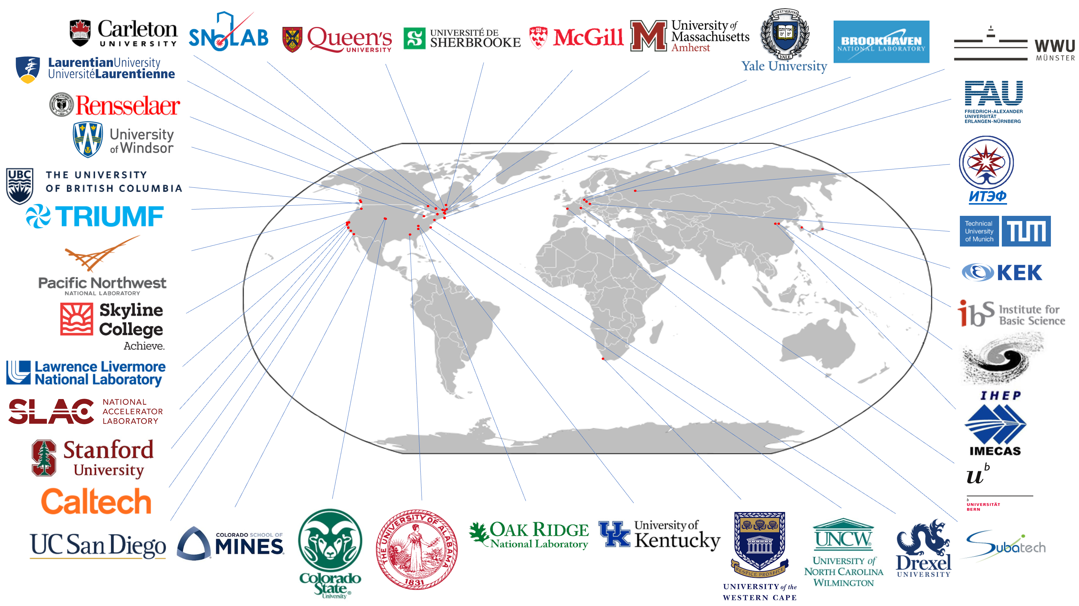
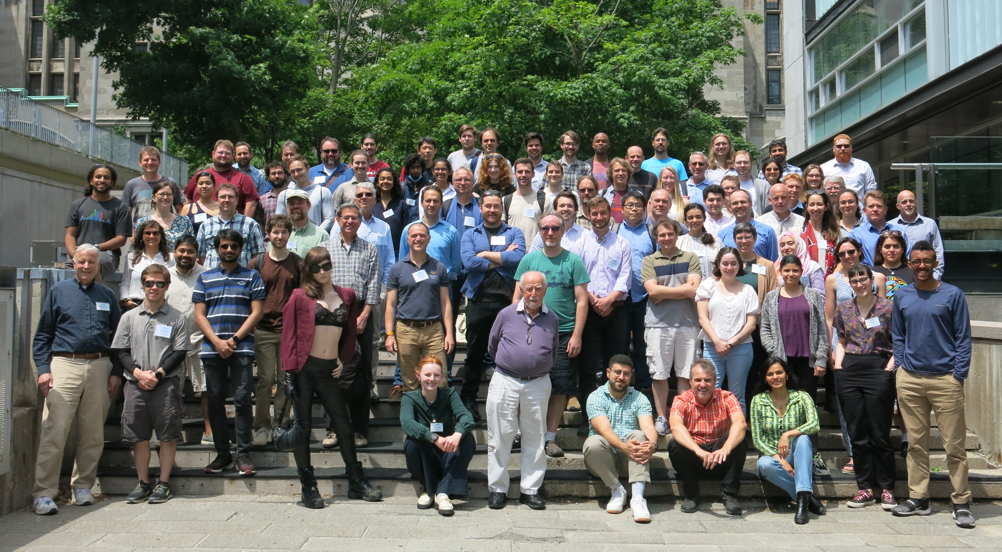
Thank you!

Slide 19
References
Adhikari, G., Al Kharusi, S., Angelico, E., Anton, G., Arnquist, I. J., Badhrees, I., … Ziegler, T. (2021). nEXO: neutrinoless double beta decay search beyond 10^28 year half-life sensitivity. Journal of Physics G: Nuclear and Particle Physics, 49(1), 015104. doi:10.1088/1361-6471/ac3631
Tsang, R. H. M., Piepke, A., Kharusi, S. A., Angelico, E., Arnquist, I. J., Atencio, A., … Ziegler, T. (2023). An integrated online radioassay data storage and analytics tool for nEXO. arXiv [Physics.Ins-Det]. Retrieved from http://arxiv.org/abs/2304.06180
Lin, T., Zou, J. H., Li, W. D., Deng, Z. Y., Cao, G. F., Huang, X. T., & You, Z. Y. (2018). Parallelized JUNO simulation software based on SNiPER. Journal of Physics: Conference Series, 1085, 032048. doi:10.1088/1742-6596/1085/3/032048
Li, Z., Cen, W. R., Robinson, A., Moore, D. C., Wen, L. J., Odian, A., … Ziegler, T. (2019). Simulation of charge readout with segmented tiles in nEXO. Journal of Instrumentation, 14(09), P09020–P09020. doi:10.1088/1748-0221/14/09/p09020
Gallina, G., Guan, Y., Retiere, F., Cao, G., Bolotnikov, A., Kotov, I., … Ziegler, T. (2022). Performance of novel VUV-sensitive Silicon Photo-Multipliers for nEXO. The European Physical Journal C, 82(12). doi:10.1140/epjc/s10052-022-11072-8

Slide 20
Backup

Slide 21
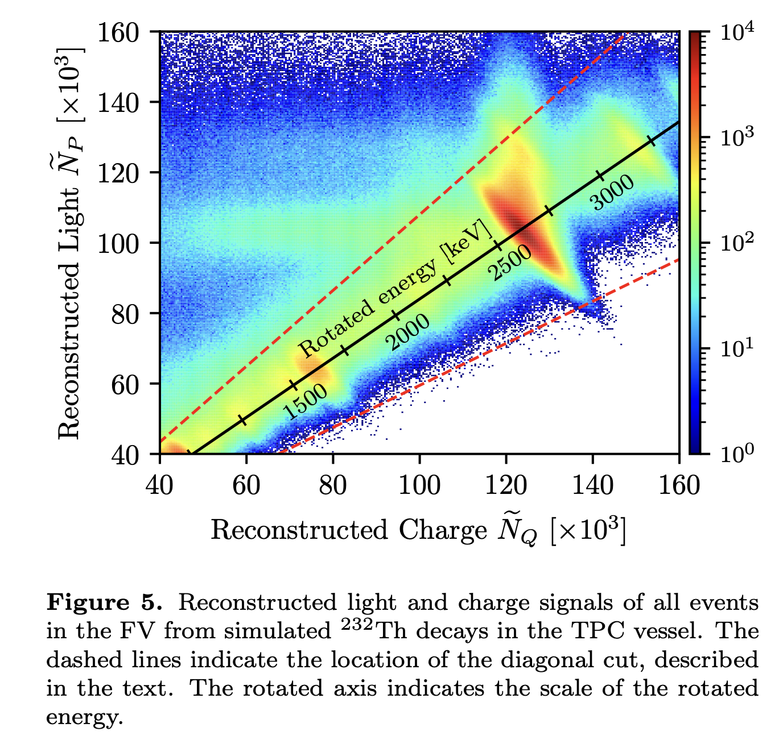
TPC: Rotated Energy
Light and charge are anti-correlated in a LXe TPC
A linear combination of light and charge for ER events gives “Rotated Energy”
Discriminates alphas due to different charge/light ratios

Slide 22
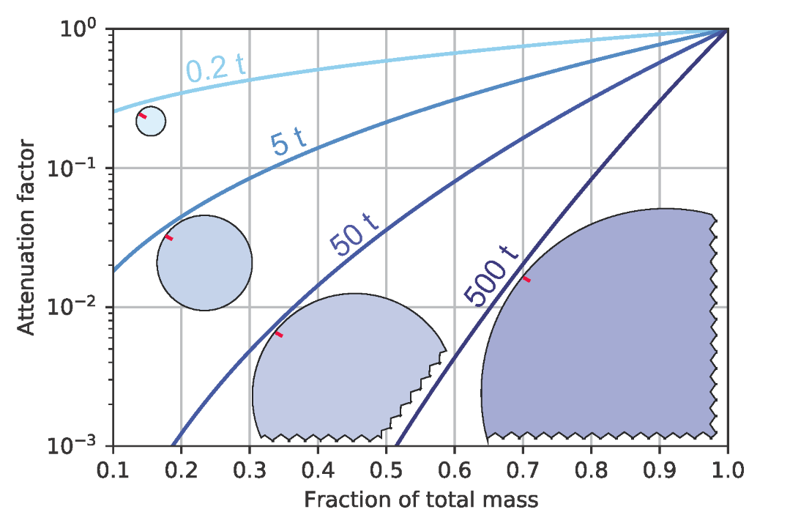
Beneficial Features of a LXe TPC
Large scale monolithic homogenous detector
  Scalability
  Online purification
  Self-shielding from dominant background – External 𝛾’s
3D position reconstruction
Multiparameter analysis
Ability to capture and tag daughter isotope
  Rejects all non-ββ backgrounds
Option to perform a control run
With 5 t of LXe, centre of nEXO is at least ~7 attenuation lengths from the external detector components

Slide 23
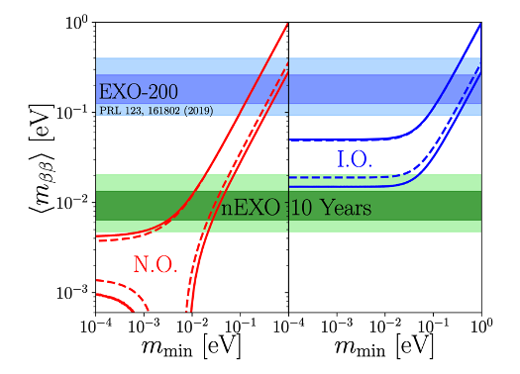
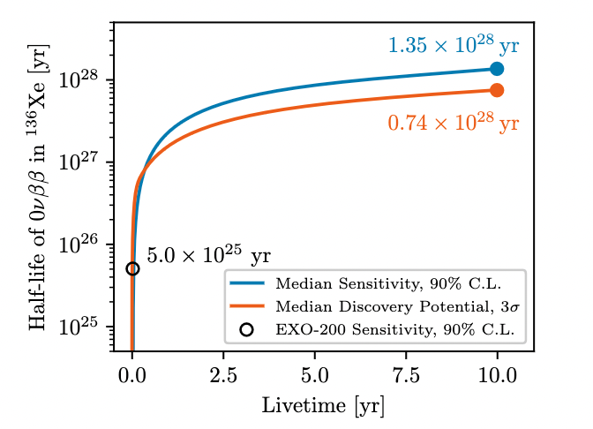
nEXO Sensitivity

Slide 24
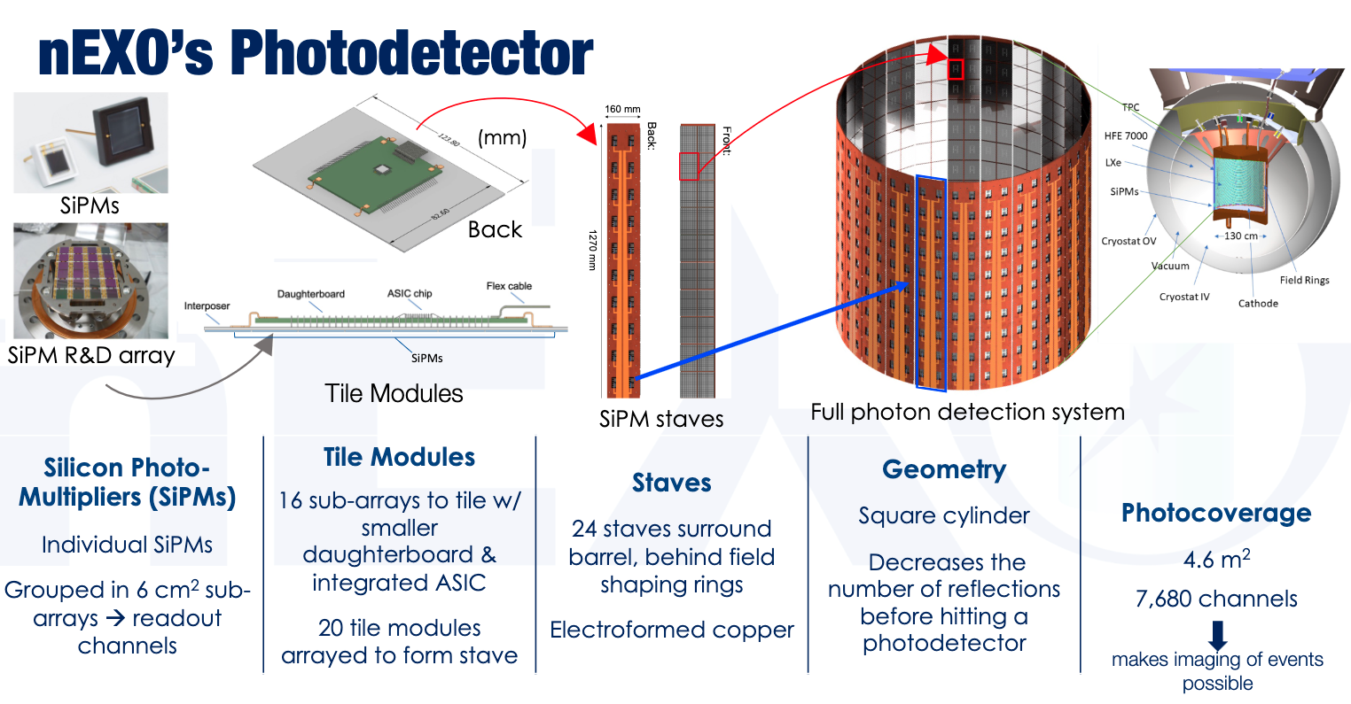
Borrowed from Sierra Wilde APS Talk

Slide 25
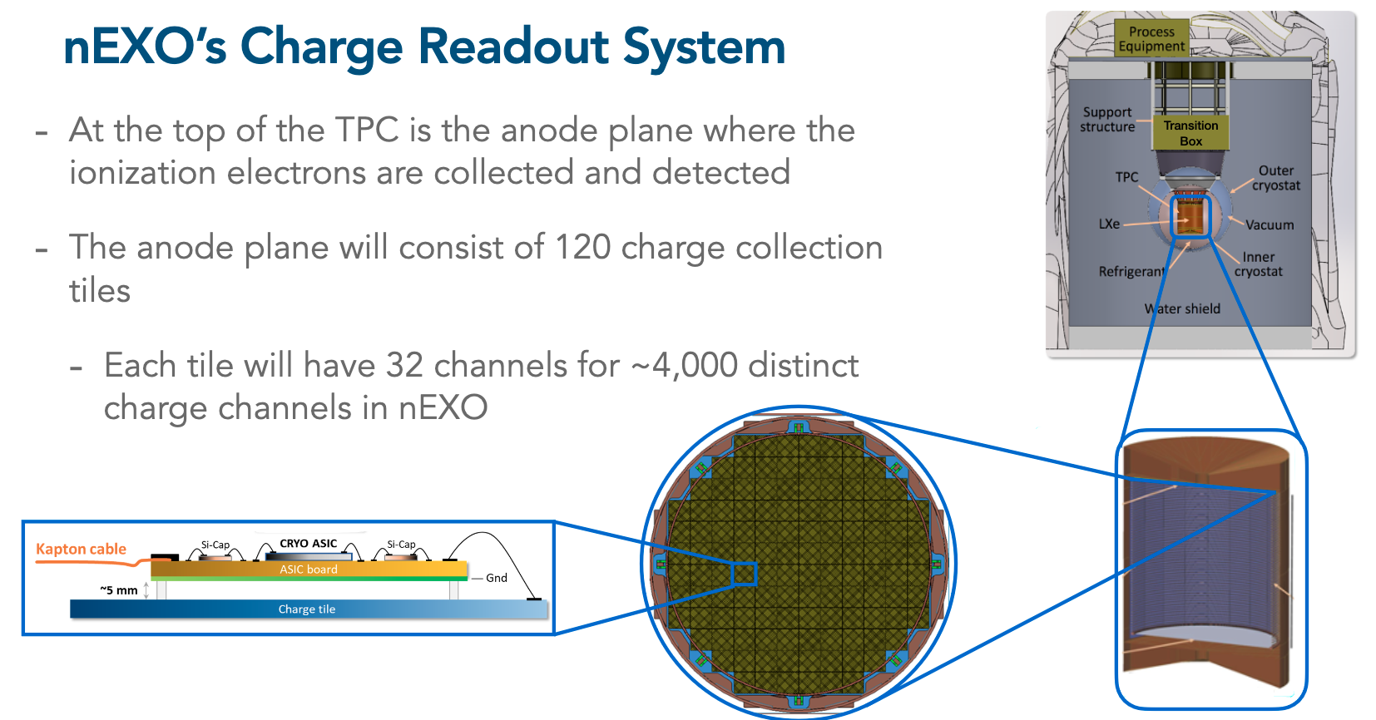
Borrowed from Glenn Richardson APS Talk

Slide 26
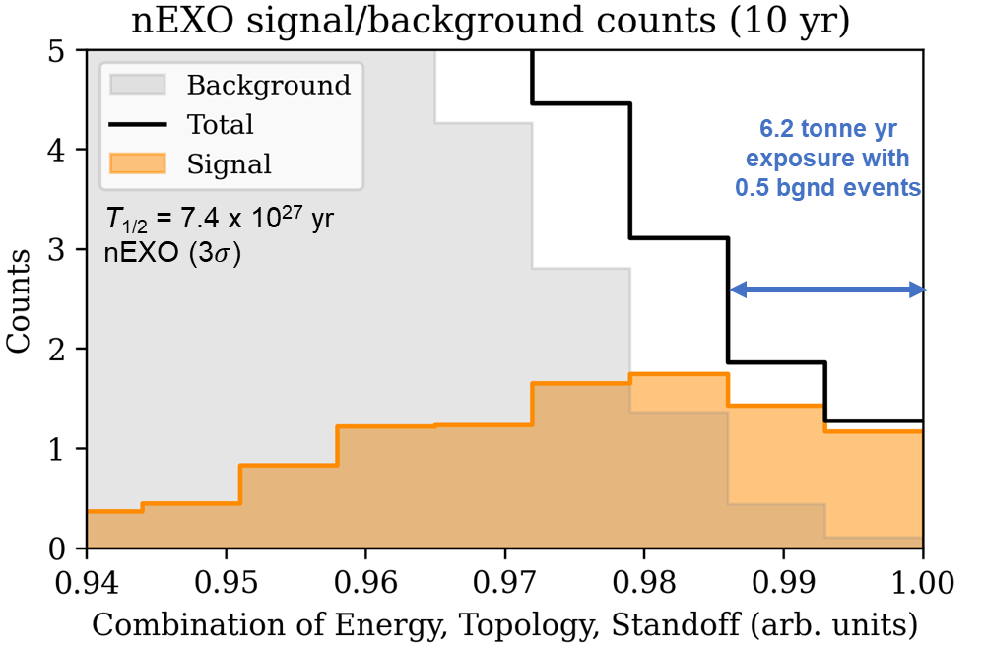
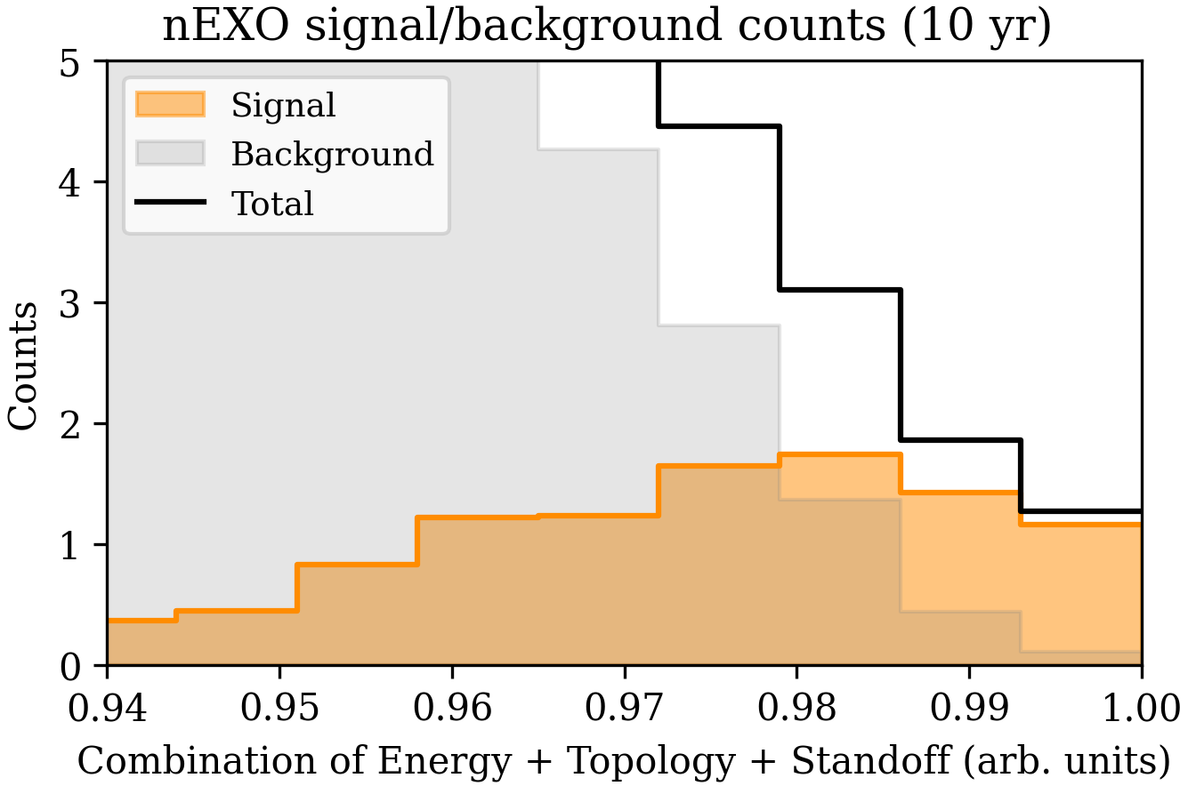

1D Projection: Pseudo-Background Free
Likelihood fit allows optimal weighting between signal and background combining energy, topology, and standoff over full 3D parameter space
Arranging the 3D bins into 1D, ordered by signal-to-background ratio, to help visualize the signal and background separation in nEXO
T_{1/2} = 7.4 x 10²⁷ yr
nEXO (3$σ$)
6.2 tonne yr,
0.5 bkg. events
Combine energy, topology, and standoff (preserving correlations)
0 ← Background-like
Signal-like → 1

