Slide 1
Status of Accelerator Studies
Ring-Ring Design Linac-Ring Design
Appleby Robert , Bernard Nathan [UCLA], Adolphsen, Chris [SLAC]
Burkhardt Helmut, Fitterer Miriam, Bogacz Alex [Jefferson Lab]
Holzer Bernhard, Jowett John, Litvinenko Vladimir [BNL],
Wienands Uli (SLAC), Desmond Barber [DESY] Schulte Daniel, Tomas Rogelio,
Thompson Luke [Manchester] Zimmermann Frank
General Studies
Bracco Chiara (Injection-Dump) Mess Karl-Hubert (Integration)
Calaga Rama (RF – Crab cavities) Osborne John (Civil Engineering)
Ciapala Ed, Tückmantel Joachim (RF) Pieloni Tatiana (B-B)
Goddard Brennan (Injection-Dump) Rinolfi Louis (Sources)
Haug Friedrich (Cryo) Russenschuck Stephan (SC Magnets)
Herr Werner (B-B) Tiesen Hugues (PO)
Jimenez Miguel (VAC) Tommasini Davide (NC Magnets)

Slide 2

Two Options
Ring-Ring
Power Limit of 100 MW wall plug
“ultimate” LHC proton beam
60 GeV e± beam
L = 2 10³³ cm⁻²s⁻¹ → O(100) fb⁻¹
LINAC Ring
Pulsed, 60 GeV: ~10³²
High luminosity:
Energy recovery: P=P₀/(1-η)
β*=0.1m
[5 times smaller than LHC by
reduced l*, only one p squeezed
and IR quads as for HL-LHC]
L = 10³³ cm⁻²s⁻¹ → O(100) fb⁻¹
Synchronous ep and pp operation (small ep tuneshifts)
The LHC p beams provide 100 times HERA’s luminosity

Slide 3
2. Ring
Luminosity 10³³cm⁻²s⁻¹ ‘straight forward’ to achieve
Electrons and Positrons possible
Energy limited by synchrotron radiation
Polarisation perhaps 40%
Magnets, Cryosystem no major R+D, just D
Fully on CERN territory
Injector using ILC or ESS type cavities (scaled down ELFE or ER test)
Interference with the proton machine
Bypasses for LHC experiments (~3km tunnel)
Cost still needs to be estimated
…

Slide 4
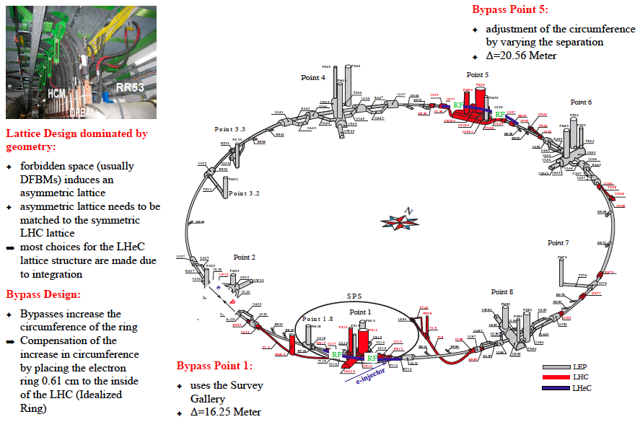
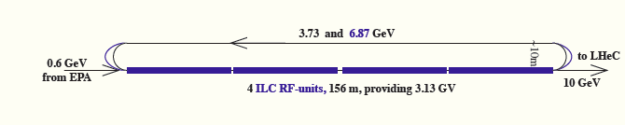
A 60 GeV Ring with 10 GeV LINAC Injector
5min filling time

Slide 5
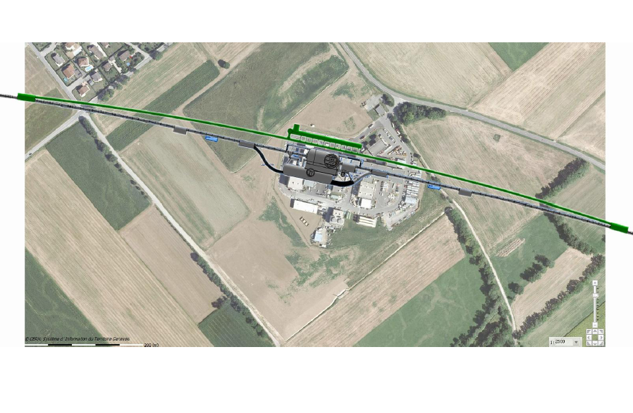
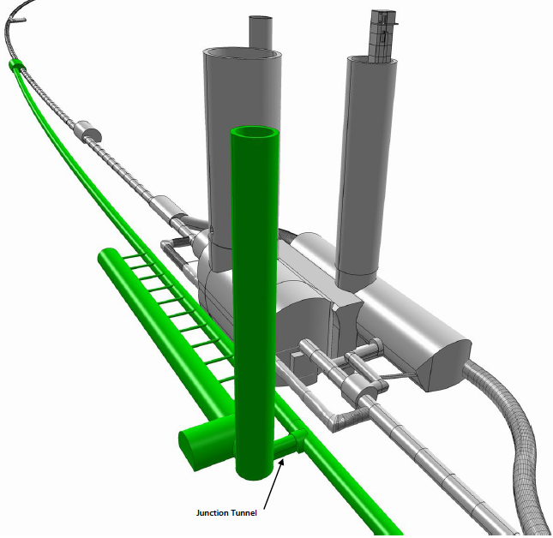
Bypassing CMS
GS-SE - Civil Engineering

Slide 6
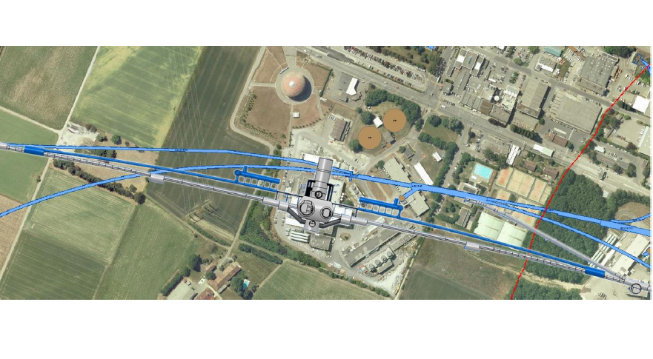
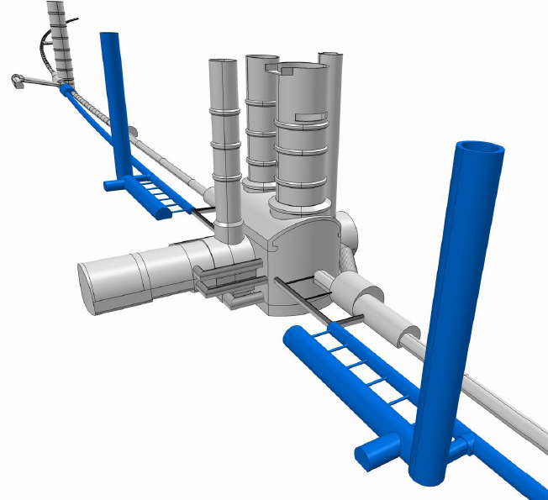
Bypassing ATLAS
GS-SE - Civil Engineering
For the CDR the bypass concepts
were decided to be confined to
ATLAS and CMS which is no
statement about LHCB or ALICE

Slide 7
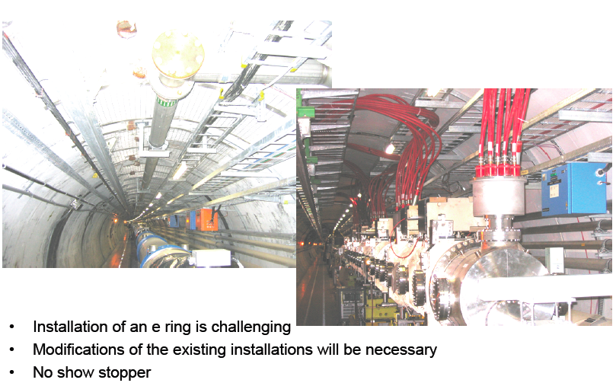
Ring Installation Study
This is the big question for the ring option (interference, activation,..)

Slide 8
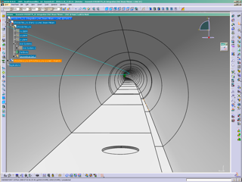
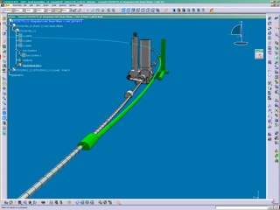
Ring Installation Study: Preparation for 3-d Integration
GS-SE - Civil Engineering

Slide 9
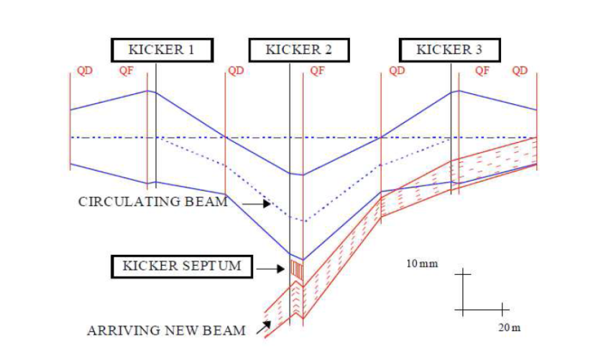
Ring-Ring Injection
Transfer line connecting 10 GeV recirculating Linac (on surface or underground) to LHeC
Purely horizontal injection in the bypass around ATLAS, in a dispersion free region
Bunch-to bucket injection is planned and two options are considered:
  Simple septum and kicker where single bunch or short trains are injected directly onto the closed orbit ➔ fast kickers: rise-fall time of ~ 23 ns
  Mismatched injection where bunches are
  injected with either a betatron or dispersion
  offset (dispersion ≠ 0 is needed for this last case).
  Three kickers are used to generate a closed orbit
  bump that brings the circulating beam close to the
  injected beam. The bump has to be switched off before
  the next circulating bunch arrives ➔ slow kickers:
  rise-fall time ~ 80 μs.
  A damping wiggler is needed to reduce the damping
  time from 3 s to 0.2 s (period between injections).
Injection transfer line: 97.5 deg phase advance FODO cell, 4 QUADs and 2 RBEND for matching (Max Dx = -2.3 m)

Slide 10

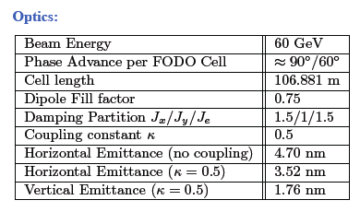
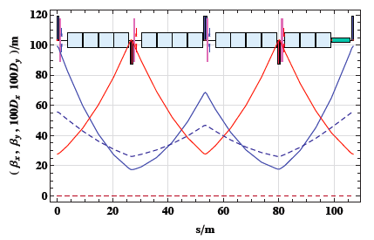
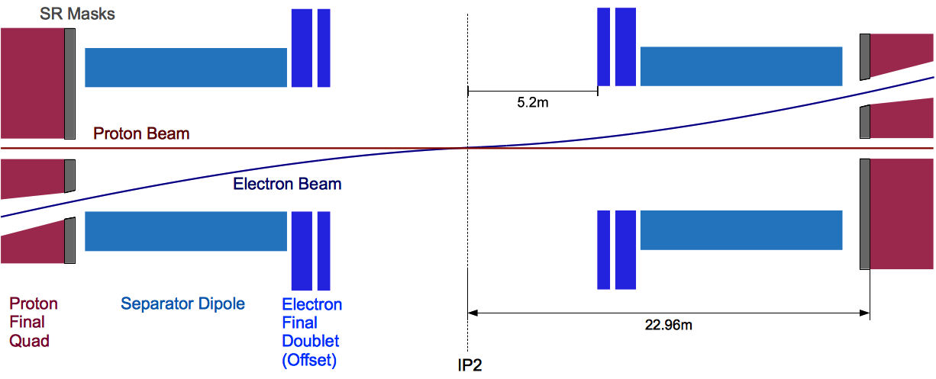
Ring - Arc Optics and matched IR

Slide 11
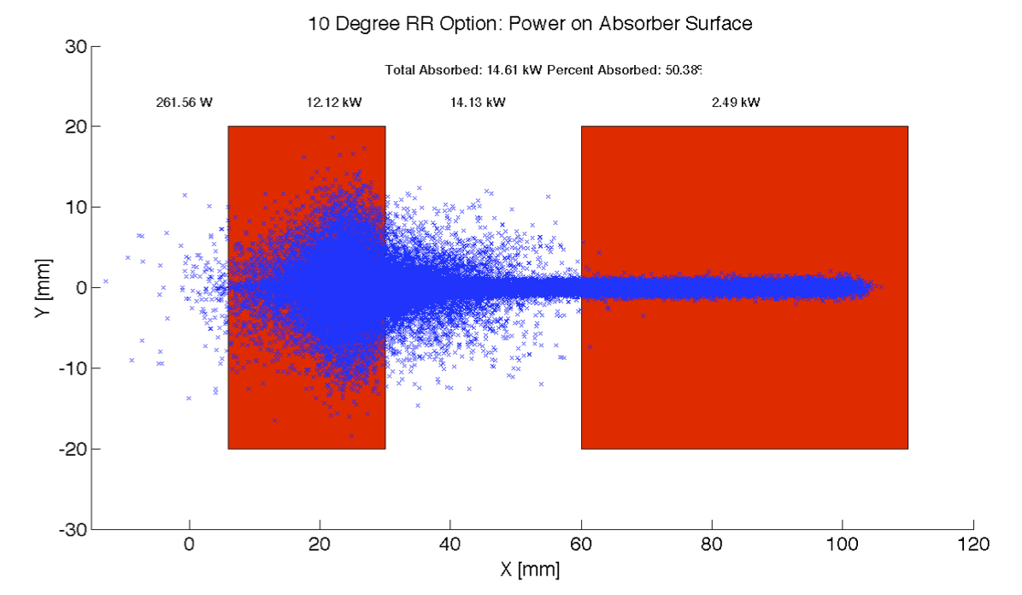
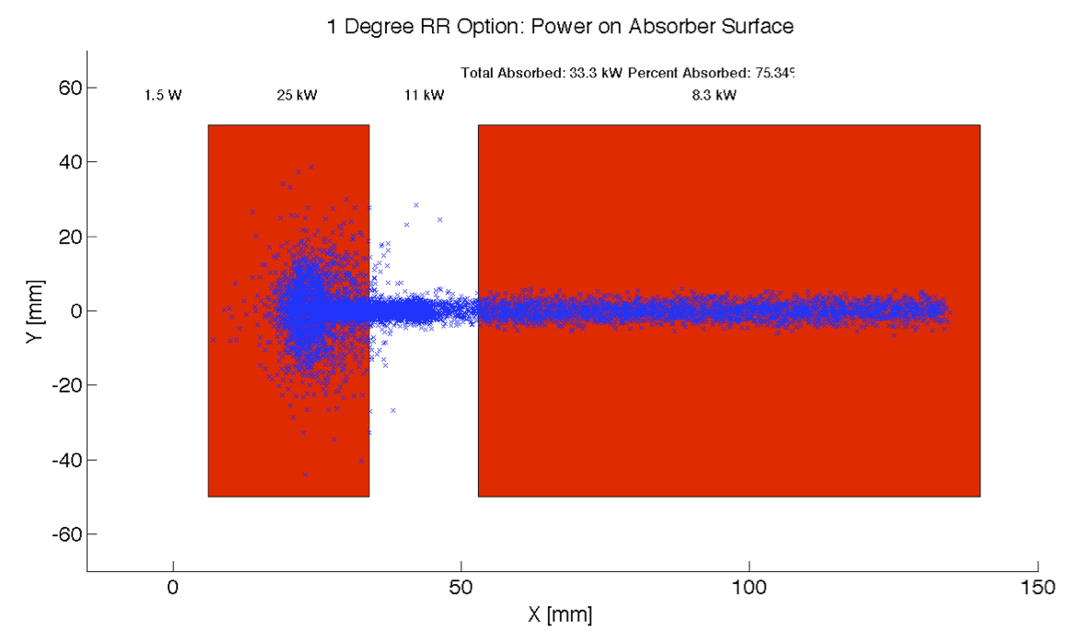
IR Design: Synchrotron Light Absorber

Slide 12
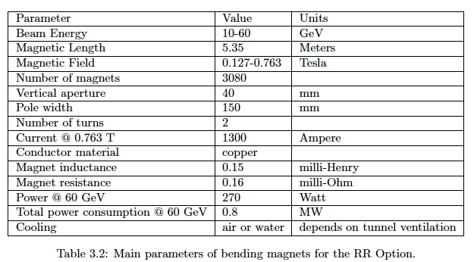
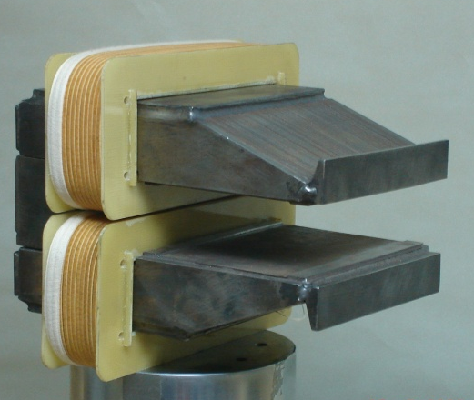
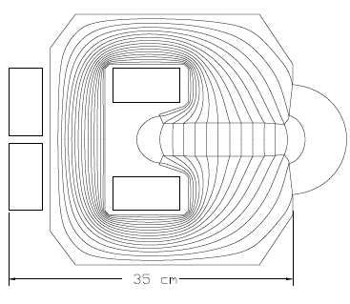
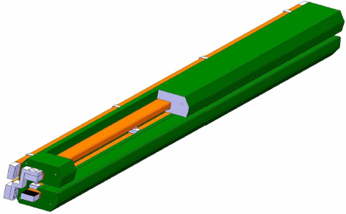
Ring Dipole Magnets
BINP &
CERN
prototypes
5m long
(35 cm)²
slim + light
for installation

Slide 13
e-Ring RF system at 721.4 MHz 60 GeV 100 mA
Synchrotron losses 44 MW => 50 MW pk rated RF system (RF Feedback margin)
Take efficiency (wall-plug to RF) ~45 % => < 100 MW mains power.
Use SPL like 700 MHz cavity, but at harmonic that allows 25 ns bunch spacing (40 MHz multiple)
= > Synergy with ongoing SPL cavity prototyping work. Here limitation is not gradient but input power !
Assume 225 kW per coupler, 2 couplers per cavity, => 112 cavities (Reasonable)
Synchrotron losses 437 MeV/turn, 500 MV gives quantum lifetime of > 500 hrs
Take peak RF voltage of 560 MV, gives 60 MV margin (can survive several klystrons trip – see below)
5 MV/cavity only needed, i.e. use 2 cell cavity (SPL cavity is 25 MV/m in 5 cells length 1.06 m)
=> 8 double cell cavities in 14 10m cryomodules, Total RF Length 140 m, + Quads, Vacuum, BI eqpt.
Two cavities per one 1 MW Klystron - ( “Only” 56 klystrons...)
Install all cavities in the IR bypass sections
208 m available (124 + 2 *42)
8 at CMS bypass = 80m RF cryomodules
2 x 3 at ATLAS bypass = 2 * 30m RF RF cryomodules
RF Power System underground
Need 100m2 per 8 cavity module in adjacent RF gallery, i.e. 7-8 m wide over the module length
Surface: Need one HV Power Converter rated 6-8 MVA per 4 klystrons on surface.. (14 i.e. 8 at CMS, 6 at ATLAS)

Slide 14
3. Ring-Ring: Open Questions
Injector complex -> ERL test facility?
Synchrotron radiation masks for IR
RF : 18 waveguides at CMS, 6+6 at ATLAS.
3km bypass tunnels
RF caverns with 7m shielding required between cavity and Klystron
Escape galleries at ATLAS and CMS still missing
Ring Ring Injector to be added :
  approx. 400m length injection from SM18 surface or underground
installation?
Vacuum installation with kW/m Synchrotron radiation heat deposition
Spin Rotators
Beam-Beam

Slide 15
3. LINAC
Luminosity 10³³cm⁻²s⁻¹ possible to achieve for e⁻
Positrons require E recovery AND recycling, L+ < L-
Energy limited by synchrotron radiation in racetrack mode
Energy Recovery option for high energy option
Polarization possible for e⁻ (~90%), challenging for e⁺ (7 mA!)
Cavities: Synergy with SPL, ESS, XFEL, ILC
Cryo: comparable to LHC cryo system (cavity Q values!)
Energy Recovery (CI, Cornell, BINP, ..) to be developed for LHeC
Small interference with the proton machine
Bypass of own IP
Extended dipole in detector
Real-estate for surface installations?
(~9km tunnel below St Genis for IP2?)
Cost still to be estimated
Need to redo ERL layout to avoid using existing TI2 tunnel

Slide 16
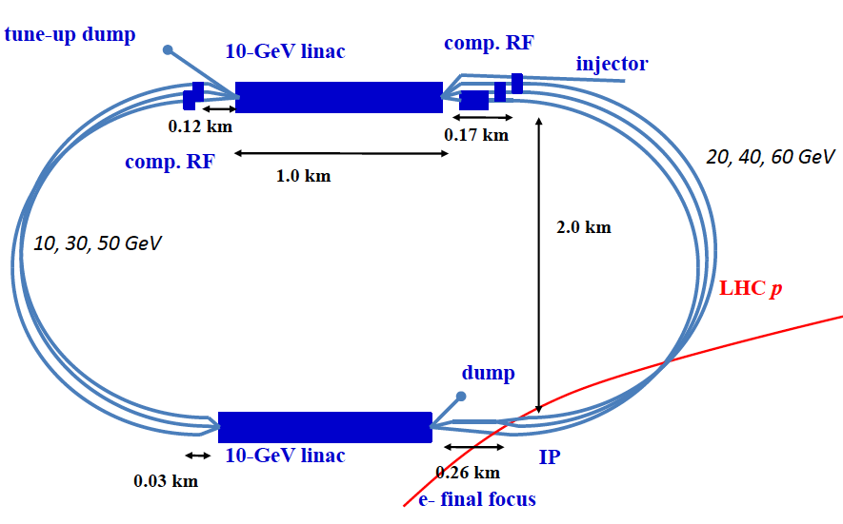
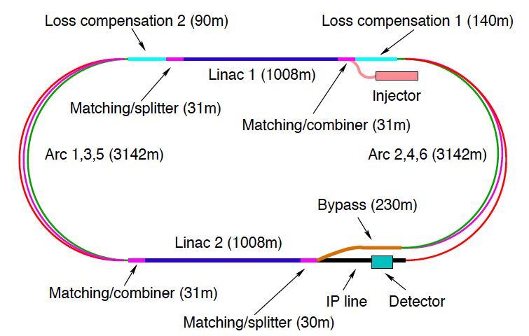
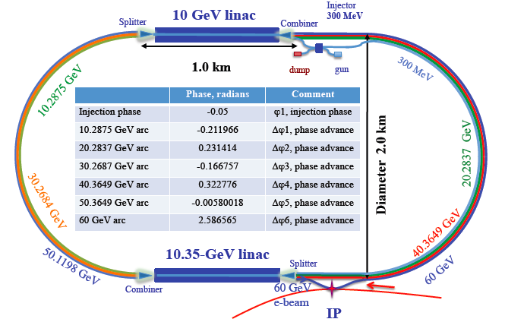
LINACs
CERN 1
CERN 2
Jlab
BNL
Two 10 GeV Linacs, 3 returns, ERL, 720 MHz cavities, rf, cryo, magnets, injectors, sources, dumps…

Slide 17
3 – Pass ERL RF system at 721 MHz
Energy = 3 * 20 GeV, 2 x 10 GeV Linacs, 6.6 mA, Take 721 MHz, to allow 25 ns bunches
Option of Taking SPL type cavity @18 MV/m (Close to BNL design - eRHIC)
1.06 m/cavity => 19.1 MV/cav => 1056 cavities total (=132 x 8)
Take 8 cavities in a 14 m cryomodule (cf SPL) => 66 cryo modules/linac
Total length = 924 m/linac + margin ~10%
Power loss in arcs = 9.5 MW, 9 kW/cavity, Take P_{rf} = 20 kW/cavity with overhead
for feedbacks, total installed RF 21 MW.
No challenge for power couplers, power sources – could be solid state
However, still need adjacent gallery to house RF equipment
(high gradient = radiation !) 4-5 m diameter sufficient
Energy reach limited by Synchrotron radiation losses in arcs
Future: hardware prototyping on SC cavities, - good synergy with SPL Proton Driver study which is well underway. ➔ Possibility for testing of ERL concept at CERN.

Slide 18
Linac 1 − multi-pass + ER Optics
800
0.5
BETA_X&Y[m]
DISP_X&Y[m]
0
-0.5
0
BETA_X
BETA_Y
DISP_X
DISP_Y
1008
800
0.5
BETA_X&Y[m]
DISP_X&Y[m]
0
-0.5
0
BETA_X
BETA_Y
DISP_X
DISP_Y
1008
800
0.5
BETA_X&Y[m]
DISP_X&Y[m]
0
-0.5
0
BETA_X
BETA_Y
DISP_X
DISP_Y
1008

Slide 19
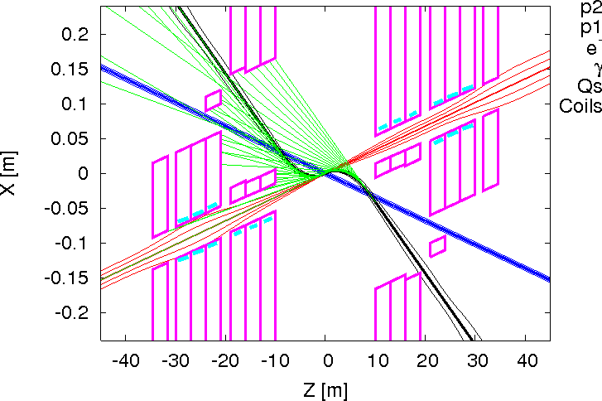
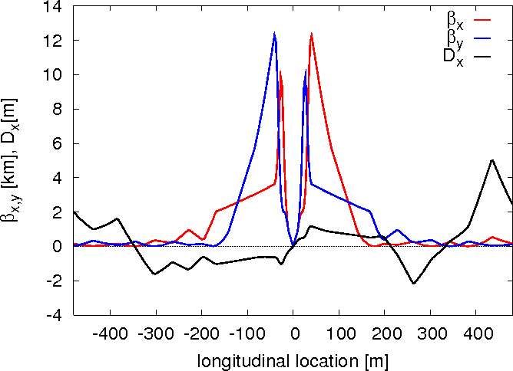
Linac-Ring FF layout and p optics
Rogelio Tomas

Slide 20
3. LINAC: Beam Dynamic Issues
Relative energy spread at interaction point
  Synchrotron radiation in arcs 3.3x10⁻⁴
  Single bunch wakefields in linacs <2x10⁻⁴
Emittance growth
  Synchrotron radiation in arcs
    7μm from injection to IP
    26μm from injection to dump
  From static imperfections in linacs (e.g. misalignment)
    Expected to be very small (emittance in LHeC is 10³ times larger than in ILC)
Wakefield induced beam break-up
  Simulations are performed taking into account all six turns
  Beam-beam effect is neglected, arcs are replaced by transfer matrix
  Amplification of incoming beam jitter is studied
    Single bunch effect in linac is OK
    Multi-bunch transverse is OK (tested with a new code)

Slide 21
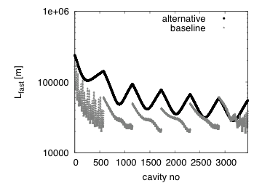
3. LINAC: Beam Dynamics Open Issues
Has been studied for the linacs only
  Arcs need to be included
  Only analytics estimates used
Continuous beam would trap ions in the linacs
  This would lead to unstable beam
One 10μs long gap in beam prevents long-term tracking
  Rise time of instability during the train between gaps seems to be acceptable (10 turns)
Full study needed
  Arcs will make instability worse
  Ions are not completely lost during one passage of the gap
  But the frequency of the induced instability varies along the machine, which helps

Slide 22
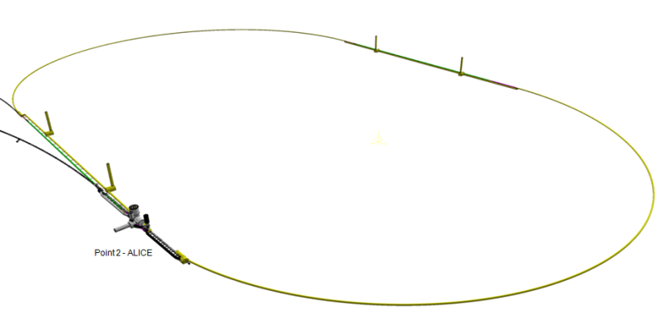
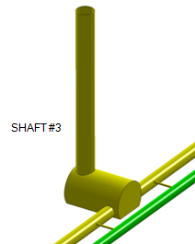
Linac-Ring Cryogenics
Cryo supply
ERL
Sector 250 m
Picture not to scale
1 km
string of cryomodules
CW operation, 18 MV/m
2 K thermal load: 37 W/m (for active length)
2 K total therma l load: 42 kW @ 2 K
Electric power: 30 MW
(with a COP of 700)
2 Cryoplant units
Compressor s
On surface
Cooling requirements dominated by dynamic losses at 2 K
(other loads neglected here for simplicity)
Split cold boxes (see LEP2, LHC)
Lay-out is based on LHC cryogenic principles with split cold boxes (surface cold box and underground cold box with cold compressors).
Refrigerator units of approx. 5 kW @ 2 K assumed. To be designed. Technology and experience: LHC, CEBAF (JLAB).
Underground cavern
Distribution
Cryo supply

Slide 23
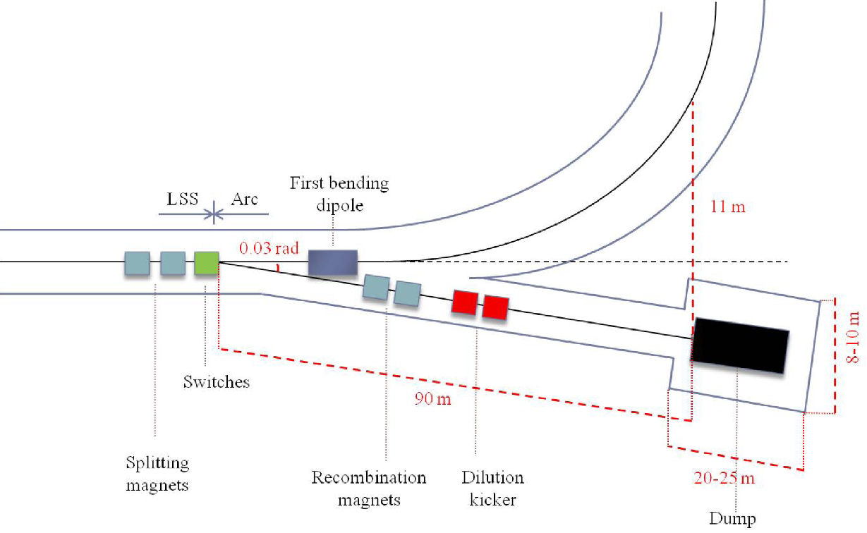
Linac-Ring 60 GeV Dump
Nominal dump: 0.5 GeV ➔ 3 MW
Same design as for 140 GeV Dump:
  Volume: 3 m³ of water
  0.5 m diameter, 8 m length with 3 m × 3 m ×10 m long shielding
Beam dump line

Slide 24
3. LINAC: Beam Physics Future Work
Lattices
  Full integrated lattice remains to be done
Fast beam-ion instability needs to be studied in more detail
More detailed integrated performance studies should be carried out
  Including beam-beam effect
  Full lattices and imperfections
Beam-Beam
Spin tracking

Slide 25
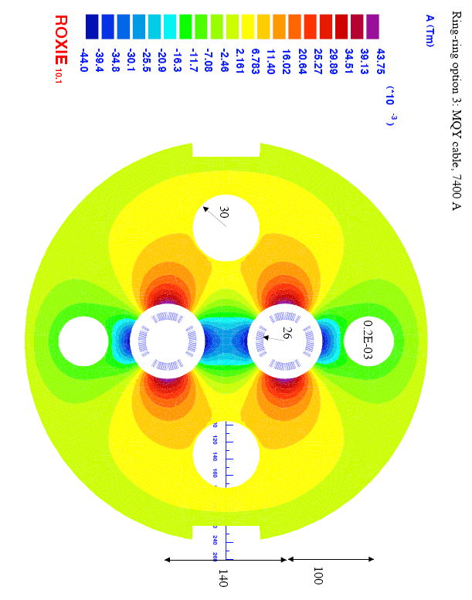
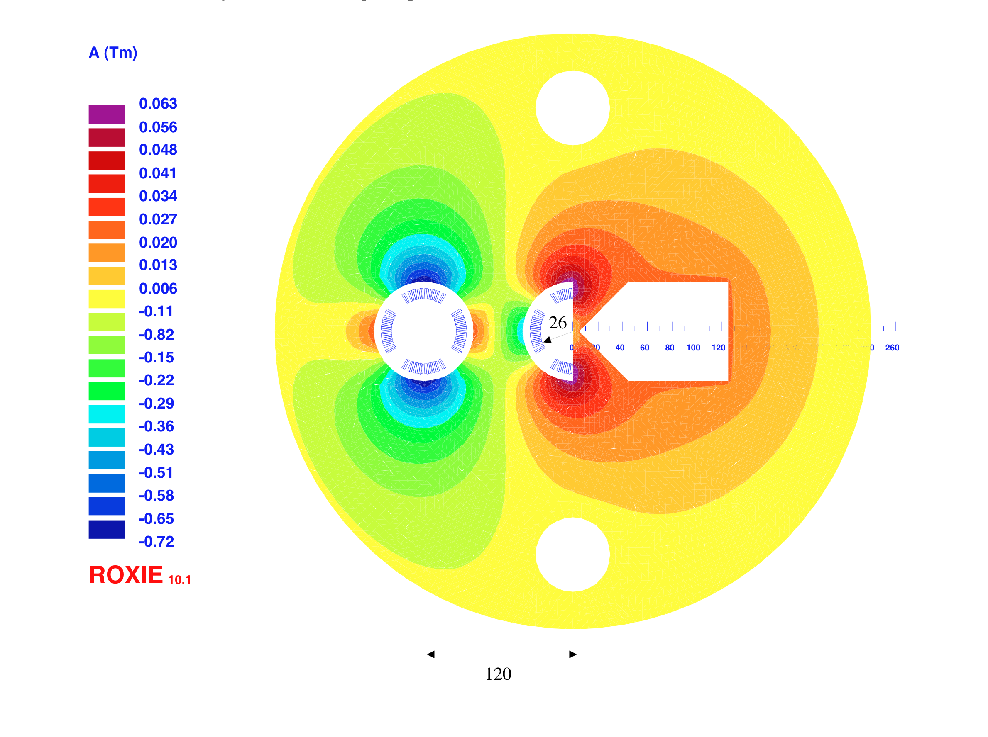
Interaction Region(s)
RR -Small crossing angle ~1mrad (25ns) to avoid first parasitic crossing (L x 0.77)
LR – Head on collisions, dipole in detector to separate beams
Synchrotron radiation –direct and back, absorption simulated (GEANT4) ..
[July 2010]
1st sc half quad (focus and deflect)
separation 5cm, g=127T/m, MQY cables, 4600 A
2nd quad: 3 beams in horizontal plane
separation 8.5cm, MQY cables, 7600 A

Slide 26
Design Parameters
electron beam | RR | LR | LR
e- energy at IP[GeV] | 60 | 60 | 140
luminosity [10³² cm⁻²s⁻¹] | 17 | 10 | 0.44
polarization [%] | 40 | 90 | 90
bunch population [10⁹] | 26 | 2.0 | 1.6
e- bunch length [mm] | 10 | 0.3 | 0.3
bunch interval [ns] | 25 | 50 | 50
transv. emit. γε_{x,y} [mm] | 0.58, 0.29 | 0.05 | 0.1
rms IP beam size σ_{x,y} [μm] | 30, 16 | 7 | 7
e- IP beta funct. β*_{x,y} [m] | 0.18, 0.10 | 0.12 | 0.14
full crossing angle [mrad] | 0.93 | 0 | 0
geometric reduction H_{hg} | 0.77 | 0.91 | 0.94
repetition rate [Hz] | N/A | N/A | 10
beam pulse length [ms] | N/A | N/A | 5
ER efficiency | N/A | 94% | N/A
average current [mA] | 131 | 6.6 | 5.4
tot. wall plug power[MW] | 100 | 100 | 100
proton beam | RR | LR
bunch pop. [10¹¹] | 1.7 | 1.7
tr.emit.γε_{x,y} [μm] | 3.75 | 3.75
spot size σ_{x,y} [μm] | 30, 16 | 7
β*_{x,y} [m] | 1.8,0.5 | 0.1
bunch spacing [ns] | 25 | 25
“ultimate p beam”
1.7 probably conservative
Design also for deuterons
(new) and lead (exists)
RR= Ring – Ring
LR =Linac –Ring
Parameters from 8.7.2010
New: Ring: use 1º as baseline : L/2
Linac: clearing gap: L*2/3

Slide 27
Summary
-Two options on the table with parameter sets that could satisfy physics needs
-Each option has it’s own distinct advantages and challenges:
Ring-Ring: integration positron operation
bypasses (R2E) straightforward trading between L and E
injector
polarization
Linac-Ring: positron operation integration
RF technology (Q!!) polarization (sources require R&D: e⁻ source – e⁺ source)
cryogenics potential for other future projects (e.g. ELFE)
beam stability
interference with local communes
-Common challenges and open issues:
Superconducting magnet design and R&D
Superconducting RF design (synergy with SPL and ESS)
Synchrotron light absorption in the detector region and protection of SC magnets
Both options require significant civil engineering (ca. 8km for LR and ca 3km for RR)
Production of large number of components (ca. 4000 warm magnets & 1000 structure
[2*80 modules of 6 700 MHz 5 cell structures])

Slide 28
LHeC Future Planning?
LHeC installation should be compatible with 5-10 years operation:
assume LHC end of lifetime reached in 2030-2035 (radiation damage)
LHeC operation start required by 2025 (at latest)
start production of key components (magnets & RF) by 2015
prototype development (magnets & RF) launched by 2013±1
LHeC installation time:
Magnet installation for Ring-Ring option only possible during long
LHC shutdown ➔ 2016, 2020, (2025?)
LEP installation into empty tunnel took ca. 1 year!
Only one scheduled long shutdown if LHeC can not profit from 2016
shutdown
Civil engineering might require substantial lead time
(e.g. negotiation with communes)
3rd CERN-ECFA-NuPECC workshop on the LHeC , 12-13 November 2010
28

Slide 29
LHeC DRAFT Timeline
Based on LHC constraints, ep/A programme, series production, civil engineering etc
Year | 2012 | 2013 | 2014 | 2015 | 2016 | 2017 | 2018 | 2019 | 2020 | 2021 | 2022
 | Prototyping- testing
 |  |  |  | Production main components
 |  |  | Civil engineering
 |  |  |  |  |  |  |  | Installation
 |  |  |  |  |  |  |  |  |  | Operation
Variations on timeline:
production of main components can overlap with civil engineering
Installation can overlap with civil engineering
Additional constraints from LHC operation not considered here
in any variation, a start by 2020 requires launch of prototyping of
key components by 2012
[shown to ECFA 11/2010: mandate to 2012]

Slide 30
Additional Transparencies

Slide 31
LHeC Sources
Ring-Ring option
e⁻ and e⁺ :
1) No need of polarized beams (polarization obtained in the ring)
2) Former and existing machines have already demonstrated the requested performance
3) Detailed design would improve the results.
Linac-Ring option
Polarized e⁻ beam:
The source, with expected performance, is feasible but requires R&D.
Unpolarized e⁺ beam
A preliminary design is proposed (for p-140 GeV). It is challenging and needs further studies with an important R&D.
Polarized e⁺ beam
The design is extremely demanding and requires studies with a very strong R&D.

Slide 32
Key points for the LHeC e⁺ source
Unpolarized e⁺ for (p-140 GeV)
1) RF deflectors to split e⁻ beam and recombine e⁺ beams with 10 lines in parallel
2) Ten e⁺ target stations in parallel (radiation issues, shielding, etc…):
3) Pre-Injector Linacs ( 200 MeV):
- Bunch length (20 to 100 ps) => bunch compressor
- Normalized rms emittances ( 6000 to 10000 mm.mrad) => Damping Ring
Polarized e⁺ for (p-60 GeV)
Compton Linac could be one approach with many issues to be studied.

Slide 33
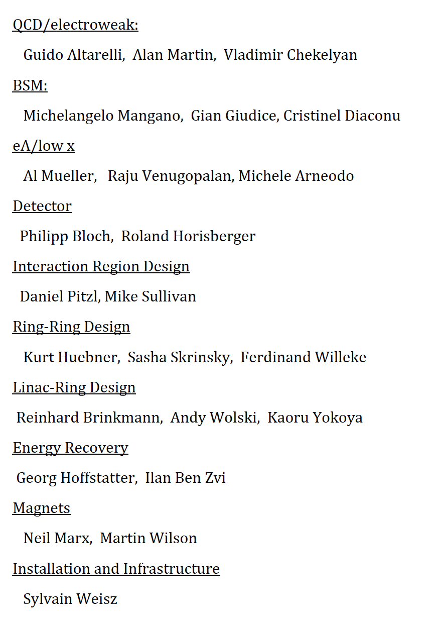
Organization + Status for the CDR
Accelerator Design [RR and LR]
Oliver Bruening (CERN),
John Dainton (CI/Liverpool)
Interaction Region and Fwd/Bwd
Bernhard Holzer (DESY),
Uwe Schneeekloth (DESY),
Pierre van Mechelen (Antwerpen)
Detector Design
Peter Kostka (DESY),
Rainer Wallny (U Zurich),
Alessandro Polini (Bologna)
New Physics at Large Scales
George Azuelos (Montreal)
Emmanuelle Perez (CERN),
Georg Weiglein (Durham)
Precision QCD and Electroweak
Olaf Behnke (DESY),
Paolo Gambino (Torino),
Thomas Gehrmann (Zuerich)
Claire Gwenlan (Oxford)
Physics at High Parton Densities
Nestor Armesto (Santiago),
Brian Cole (Columbia),
Paul Newman (Birmingham),
Anna Stasto (MSU)
Today: writing … for the
Referees of CERN
Scientific Advisory Committee
Guido Altarelli (Rome)
Sergio Bertolucci (CERN)
Stan Brodsky (SLAC)
Allen Caldwell -chair (MPI Munich)
Swapan Chattopadhyay (Cockcroft)
John Dainton (Liverpool)
John Ellis (CERN)
Jos Engelen (CERN)
Joel Feltesse (Saclay)
Lev Lipatov (St.Petersburg)
Roland Garoby (CERN)
Roland Horisberger (PSI)
Young-Kee Kim (Fermilab)
Aharon Levy (Tel Aviv)
Karlheinz Meier (Heidelberg)
Richard Milner (Bates)
Joachim Mnich (DESY)
Steven Myers, (CERN)
Tatsuya Nakada (Lausanne, ECFA)
Guenther Rosner (Glasgow, NuPECC)
Alexander Skrinsky (Novosibirsk)
Anthony Thomas (Jlab)
Steven Vigdor (BNL)
Frank Wilczek (MIT)
Ferdinand Willeke (BNL)
Steering Committee
Oliver Bruening (CERN)
John Dainton (Cockcroft)
Albert DeRoeck (CERN)
Stefano Forte (Milano)
Max Klein - chair (Liverpool)
Paul Laycock (secretary) (L’pool)
Paul Newman (Birmingham)
Emmanuelle Perez (CERN)
Wesley Smith (Wisconsin)
Bernd Surrow (MIT)
Katsuo Tokushuku (KEK)
Urs Wiedemann (CERN))
Frank Zimmermann (CERN)
Expect CDR in spring 2011
Working Group Conveners

Slide 34
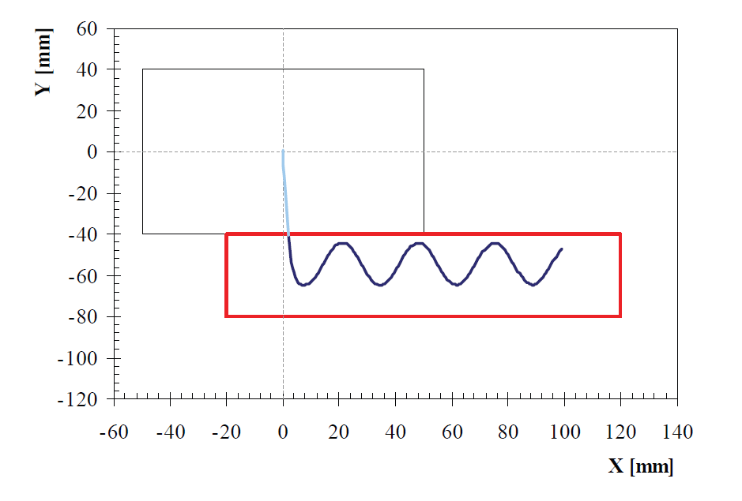
Ring-Ring Dump
Internal dump LEP-like:
  Bunch intensity ×20 lower than LEP
  Beam size ×2 higher than LEP
  Lower energy (60 GeV)
  More bunches: 2808
Combination of horizontal and
vertical kicker magnets used as
an active dilution system to paint
the beam on the absorbing block
and increase the effective sweep length
Carbon-composite used for absorbing block
Kickers + absorbing block installed in the bypass around CMS in a dispersion free region
Vacuum containment, shielding and water cooling have to be incorporated.
Beam profile monitor in front of absorber to observe correct functioning of the system

Slide 35
Linac-Ring 140 GeV Dump
A post collision line has to be designed taking care of minimising losses and irradiation.
“EcoDump” – power recovery and reuse should be investigate (50 MW = average energy consumption of 69’000 Europeans)
ILC-like water dump:
  Volume: 36 m³ of water
  Max ΔT in water: 90º
  Max T in water: 215º ➔ higher pressure needed: ~ 35 bar (to keep 25º margin from boiling point) .
  Size (including shielding): 36 m longitudinally, 21 m transversely
  Thin titanium alloy window to minimise energy deposition
Challenges:
  Pressure wave formation and propagation into the water vessel
  Remotely operable window exchange
  Handling of tritium gas and tritiated water

