Slide 1
Screen Testing for Beam Instrumentation at CERN
S.Burger – CERN / 20th of June 2023
Workshop: Low Density Materials for Beam Instrumentation Workshop
https://indico.cern.ch/event/1275649/

Slide 2
Content
BTV Instrument Principle
Screen Light Emission Processes
Testing of Nanotube Material (not exhaustive)
  BNNT (CLEAR + HiRadMat)
  CNT (HiRadMat)
Conclusion

Slide 3
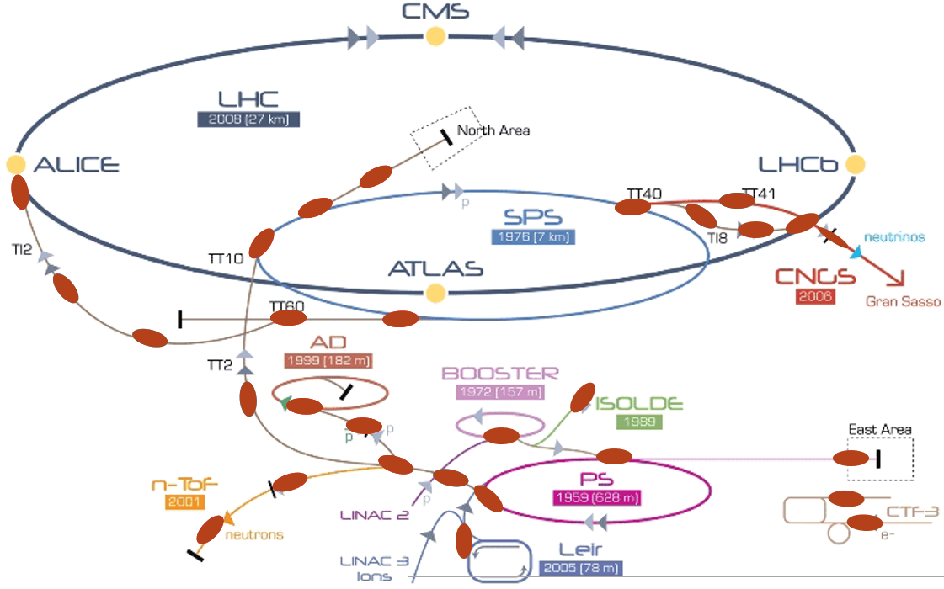
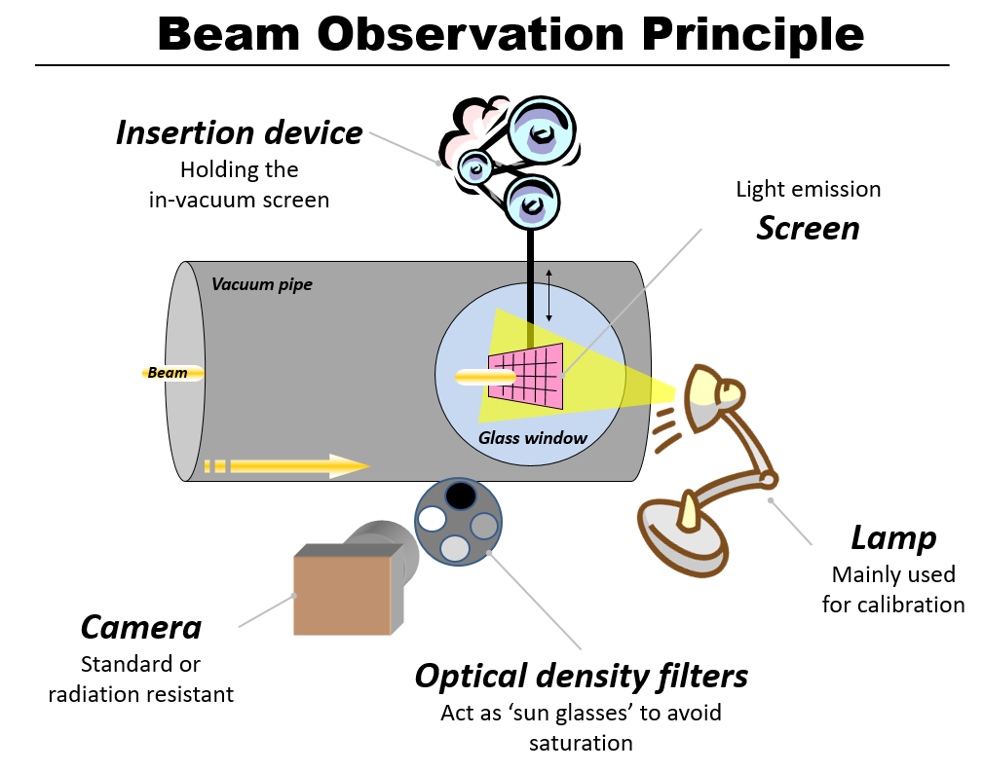
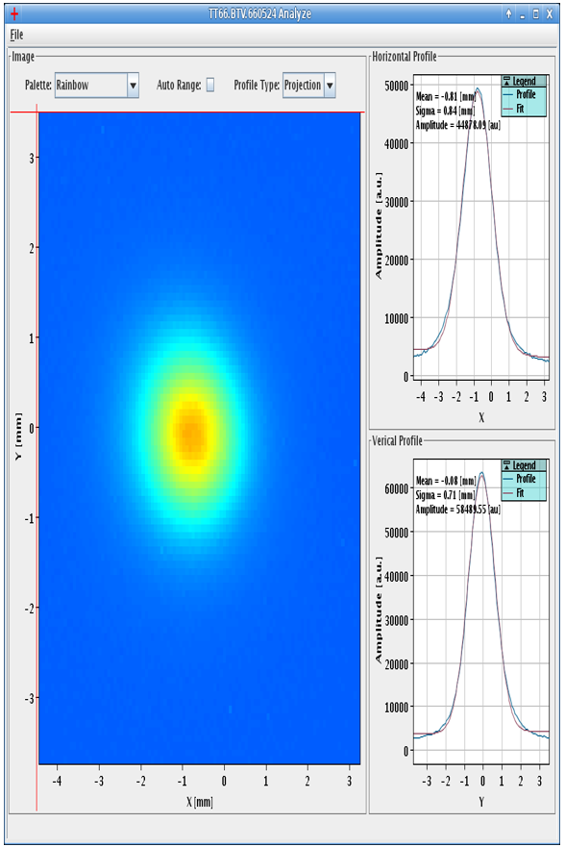
Beam Observation Principle: BTV Instrument
→ Beam Profile / Size
→ Beam Position
Screen based instruments are at any trajectory change – injection & extraction lines but also in spectro / target / dump and transfer lines
Location of BTV instruments
CERN accelerator chain map
→ ~200 devices installed

Slide 4
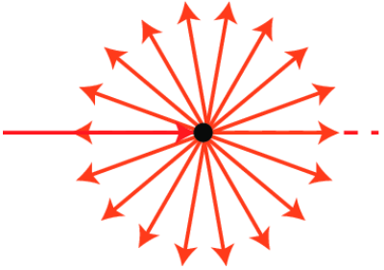
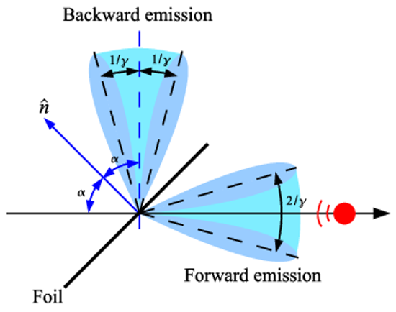
Screen Types → 2 main light emission processes
Scintillation screen:
    Photons of a characteristic spectrum are emitted following the absorption of radiation (== interacting with energized particles). Scintillation is an inherent molecular property in () molecules and arises from their electronic structures (Wikipedia). Isotropic emission.
    Material example:
      Ceramic Alumina, Al2O3:CrO2
      Powder P43, P47 (on substrate)
      & Plastic, Quartz, YAG, LAG, etc…
Optical Transition Radiation (OTR) screen:
    Is a form of electromagnetic radiation emitted when a charged particle passes through inhomogeneous media, such as a boundary between two different media (Wikipedia). This process emits photons in the visible and is proportional to the reflective index of the material. Specific angular emission.
    Material example:
      Ti, Al, Graphite, SiC, GlassyC, etc…
Low intensity → use of scintillation
High intensity → use of OTR
Efficiency Scintillation vs OTR ~ few 1e3

Slide 5
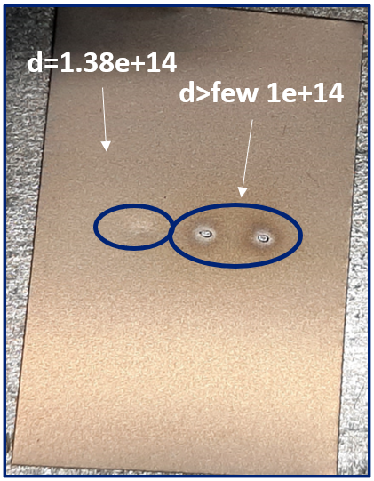
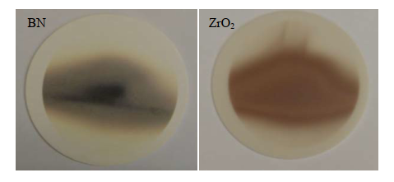
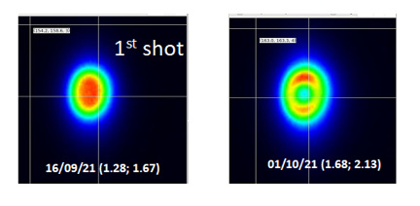
Screen Thermal and Mechanical Damage Examples
26Gev Proton Beam
~7e12p/cm2 in air
High density
440GeV
Proton Beam
Low Energy Ion Beam
Chromox
Screen testing (2005) on 4.2MeV/u lead ions, 100μA, 600μs beam every 1.2s
Ti

Slide 6

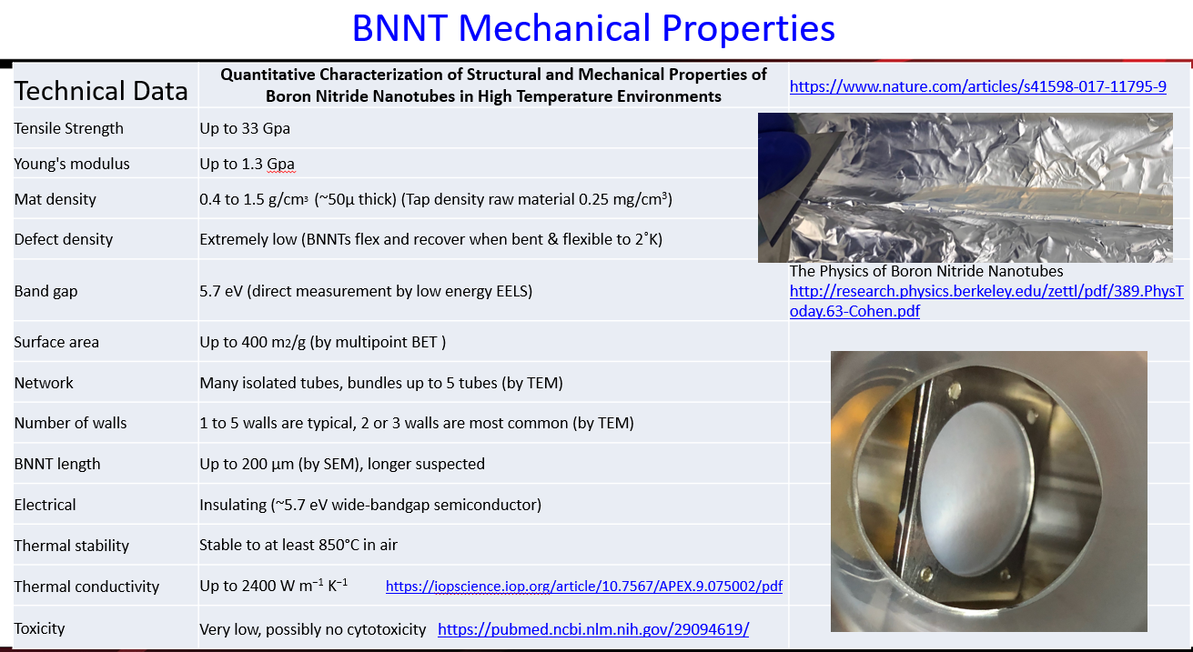
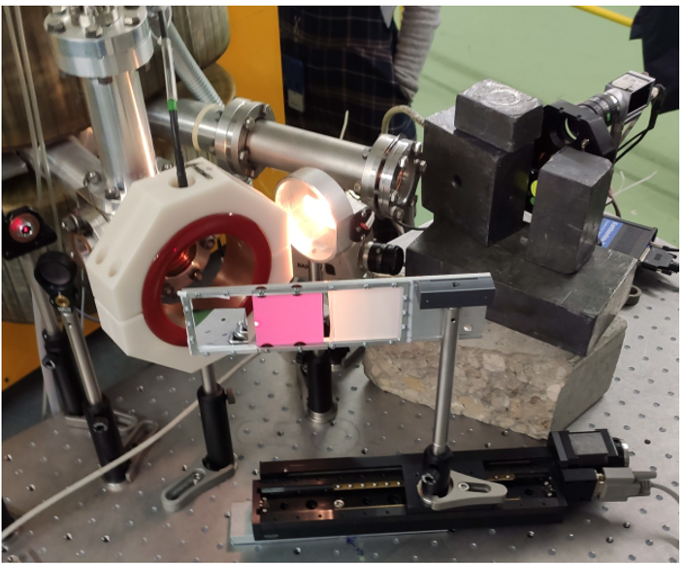
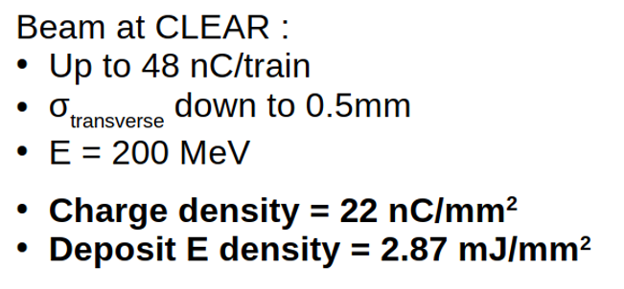
BNNT Material tested in CLEAR (1)
Reference: Aries Materials Workshop, June 22, 2021 Kevin Jordan, Boron-based nano-tubes as scintillators and further applications
YAG Chromox BNNT
2022/02
e- in air

Slide 7
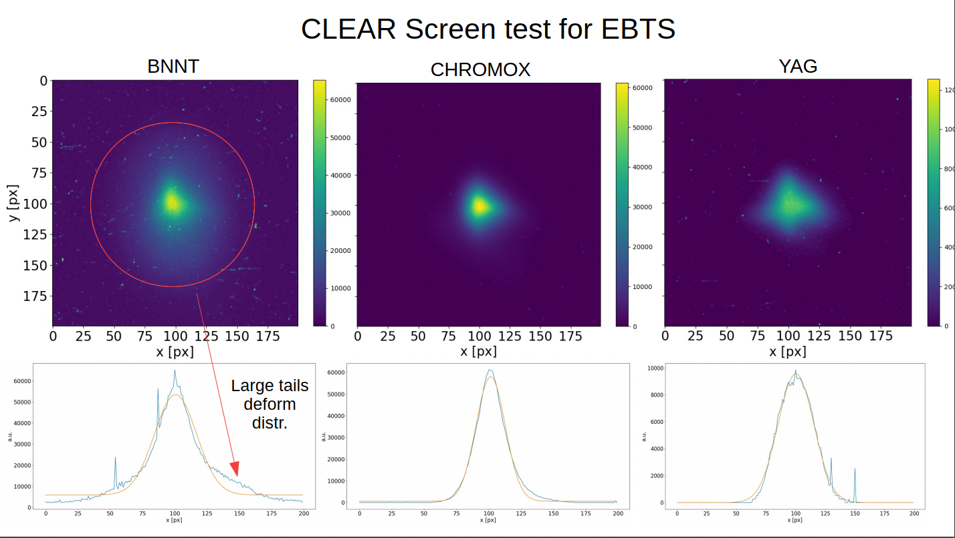
BNNT Material tested in CLEAR (1)
Light yield (normalized to Chromox):
Chromox 1 (IT 3ms)
YAG 5 (IT 3ms → >> 70 ns decay time)
BNNT 0.025 (IT 34us → >> few ns decay time)
Beam size:
Chromox and YAG have similar profiles
BNNT seems to have tails → in air, parasitic light (luminescence) of the same amplitude order as the signal !
5e4
2e6
1e7

Slide 8
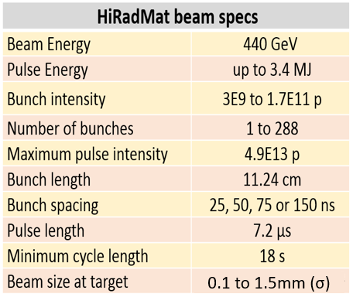
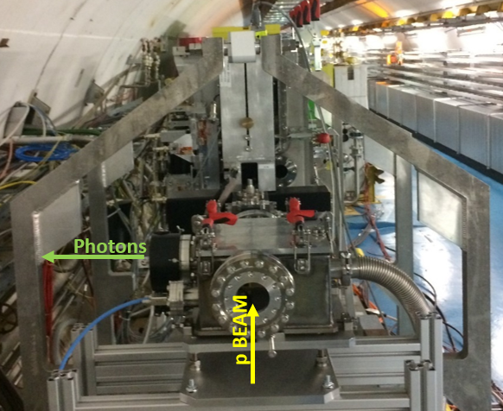
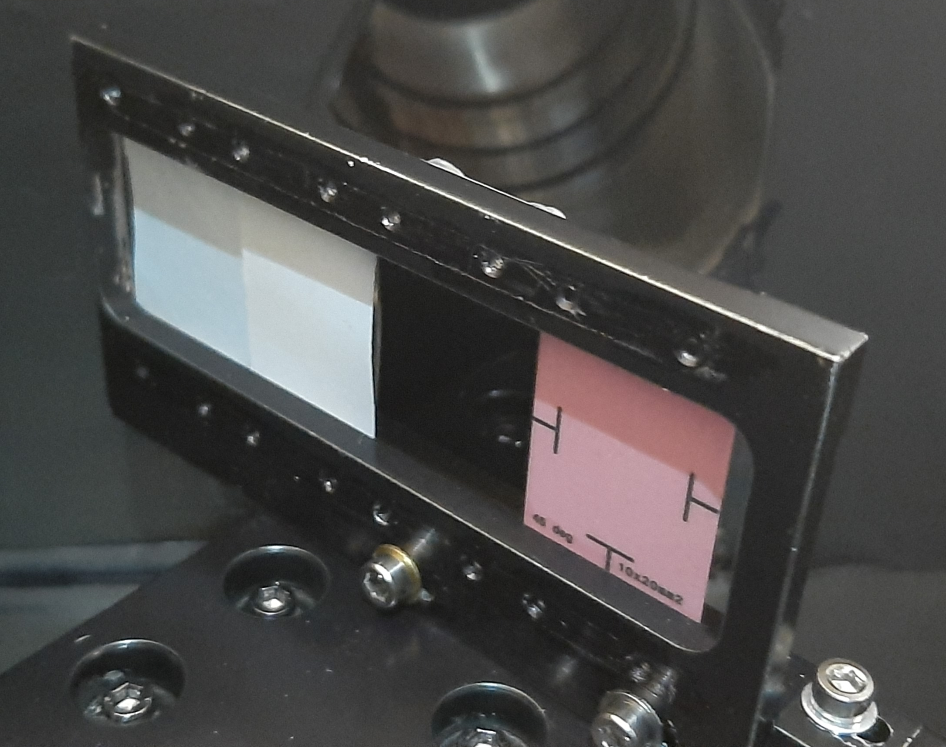
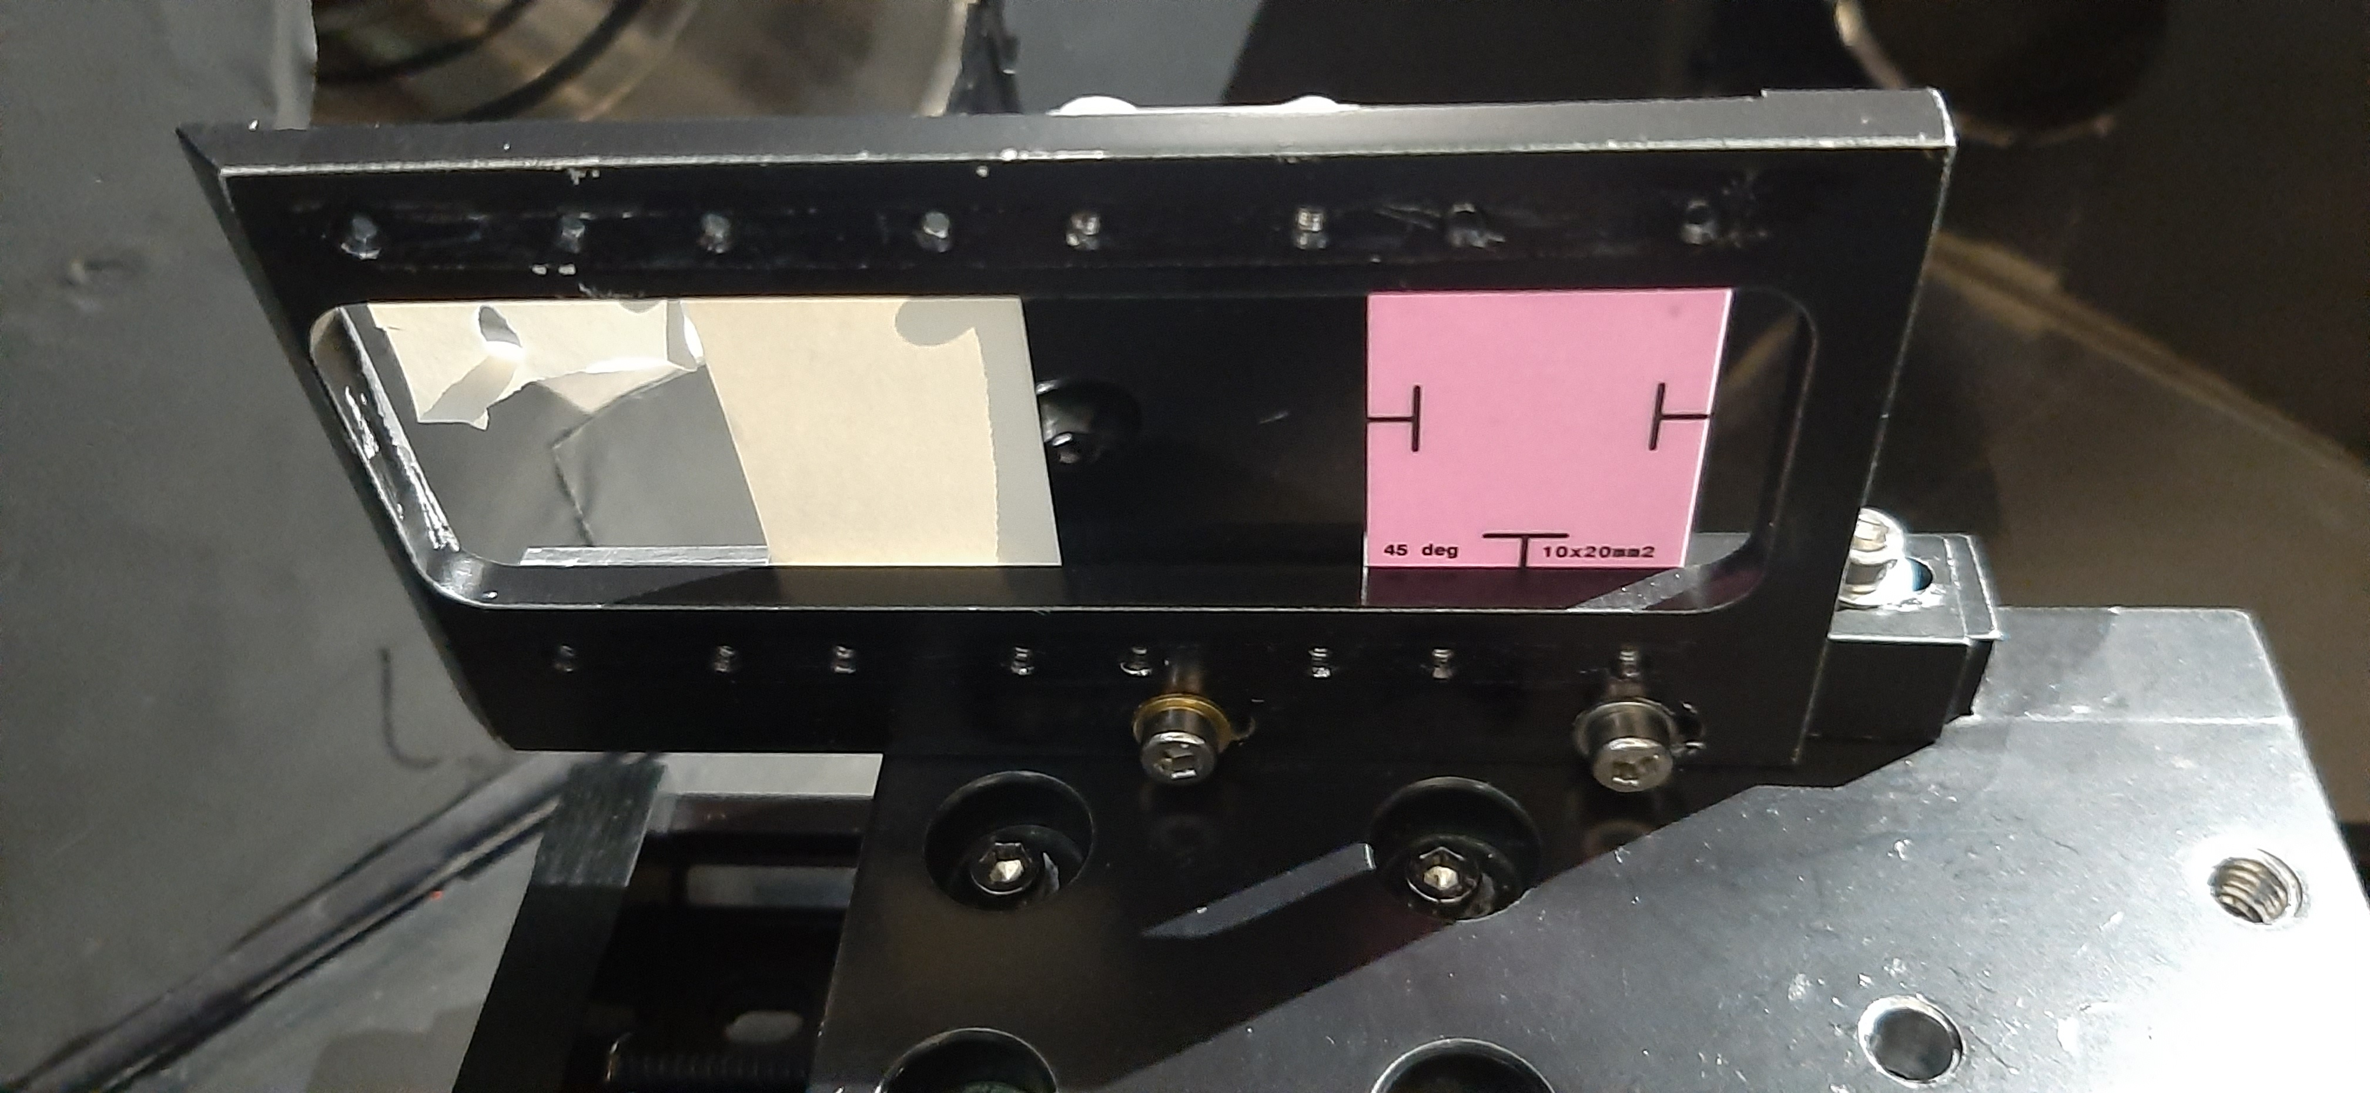
BNNT screen tests in HiRadMat (1)
May 2022
In vacuum system to mitigate parasitic light
Beam density range :
Minimum <1.2e11 p/mm2
Maximum 5.52e14 p/mm2
BNNT 1mg/cm2
BNNT 2mg/cm2
Glassy C
Chromox
In vacuum HiRadMat BTV
Screens as installed before pumping down
Screens as discovered after pumping down and back to atmospheric pressure

Slide 9
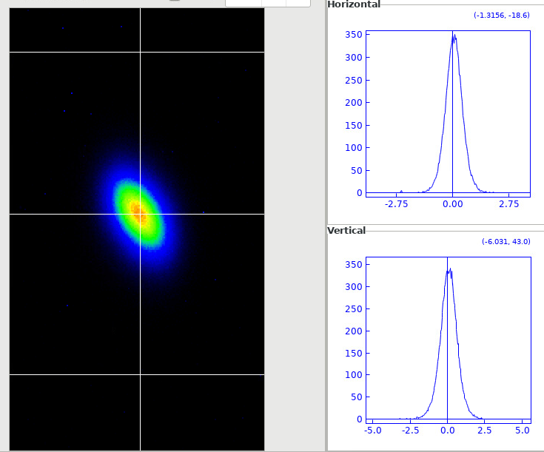
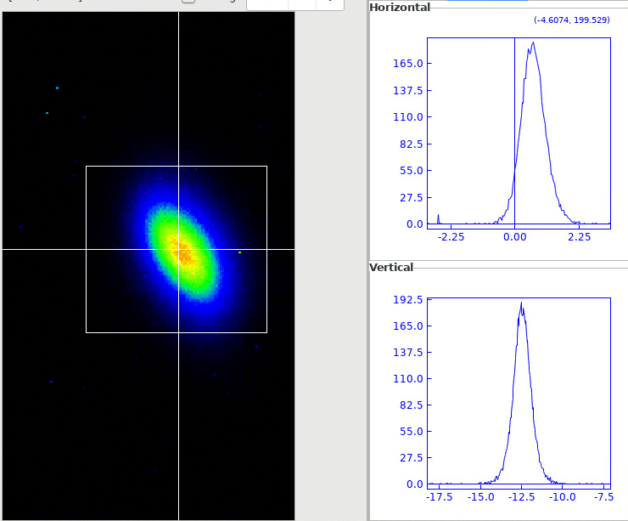
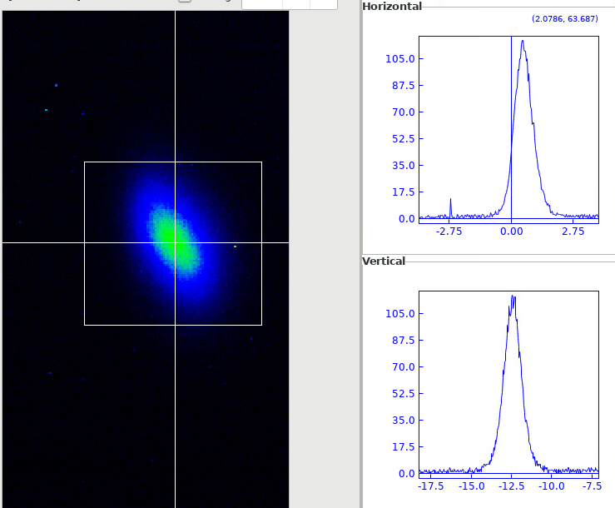
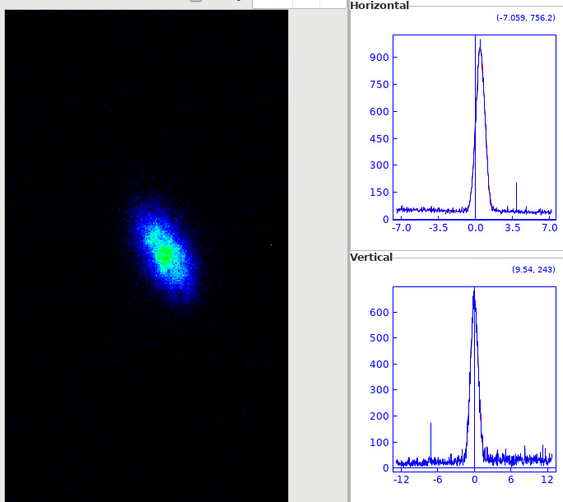
BNNT screen tests in HiRadMat (2)
May 2022
Single bunch _~9e10ppp_ Optics 0.5mm2
Chromox 250um
OD 3
GlassyC
OD 1
BN-NT
OD 0
Ti
OD 0
Beam Size
0.46 x 0.61 | 0.47 x 0.60 | 0.47 x 0.63 | 0.5 x 0.63
Normalized Amplitude
200 | 1 | 0.05 | x
→ Very good behavior
Viewer digital gain 18
Viewer digital gain 22

Slide 10
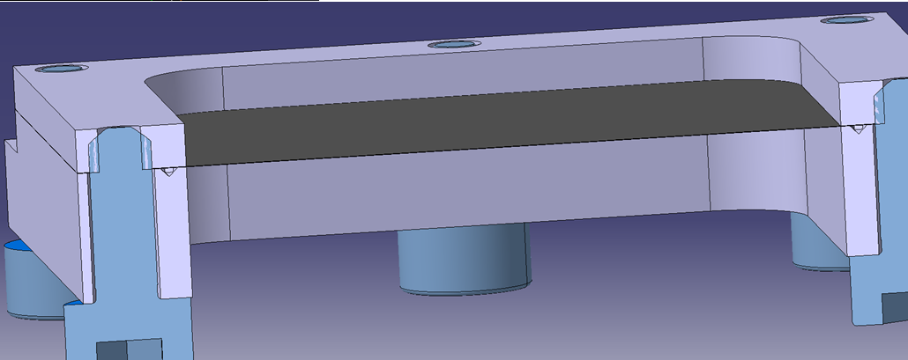
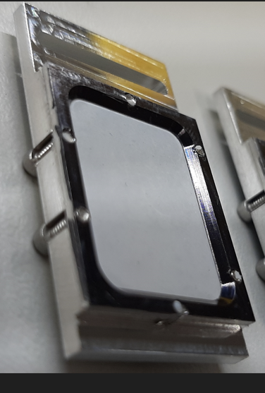
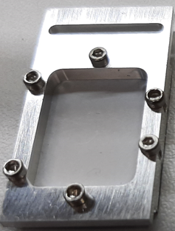
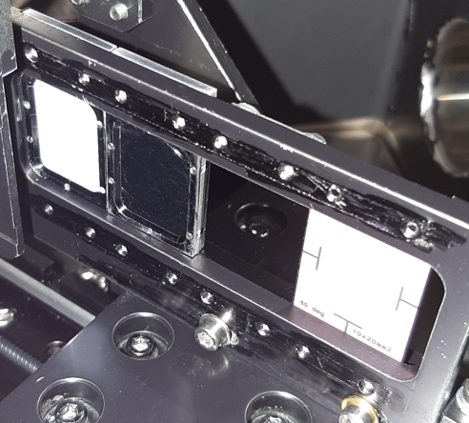
BNNT screen tests in HiRadMat (3)
October 2022
New support to better stretch the material and ensure a flat surface.

Slide 11
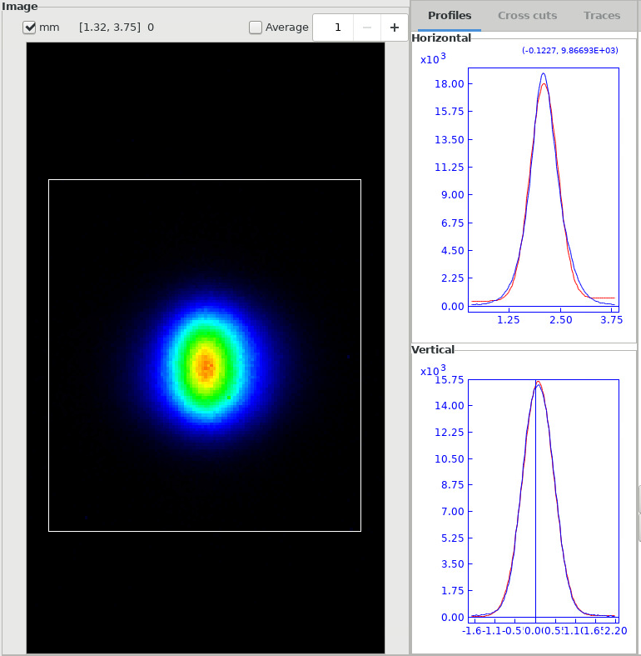
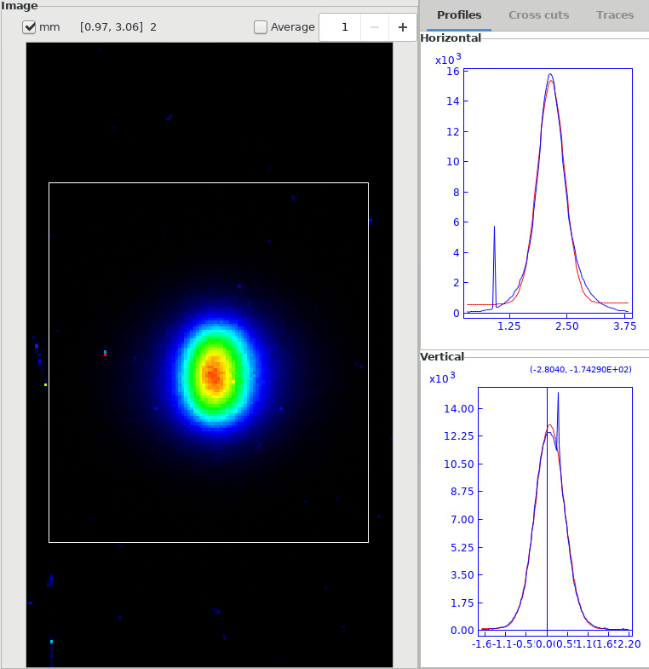
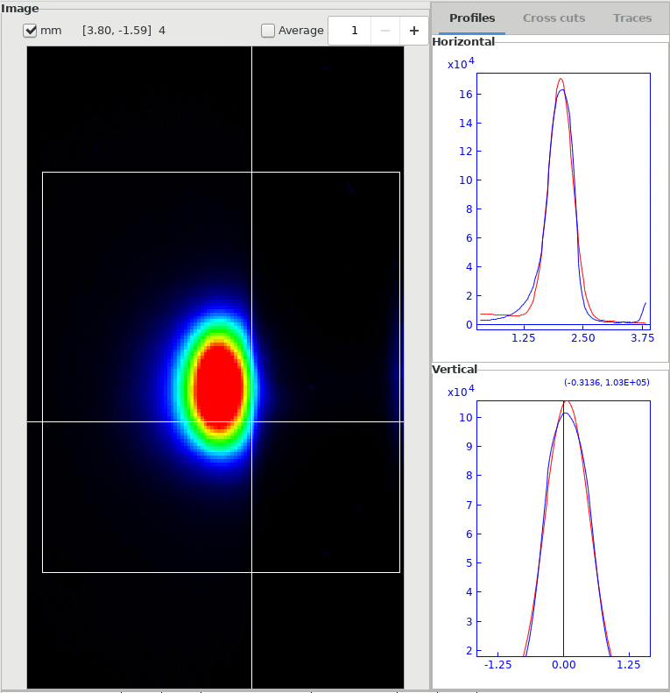
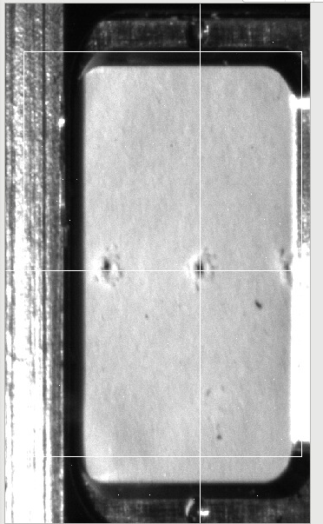
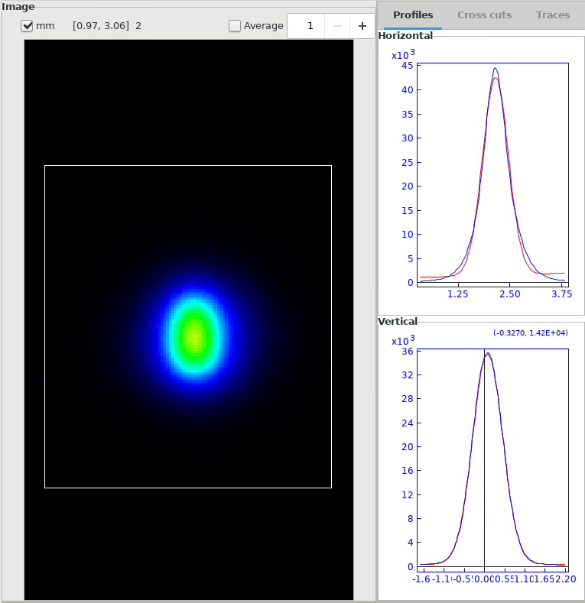
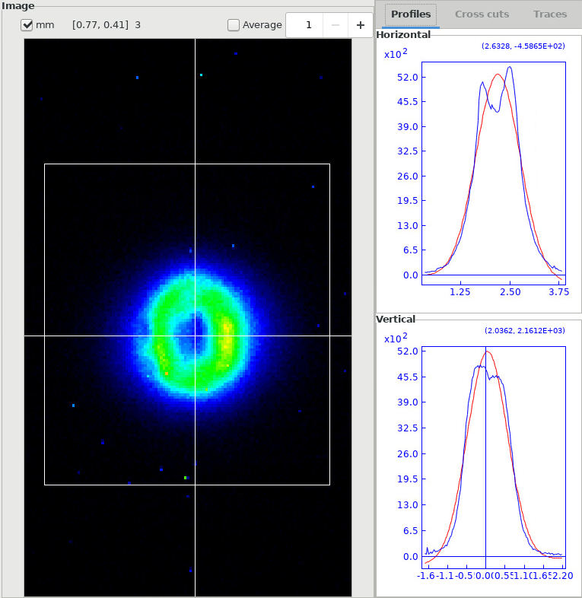

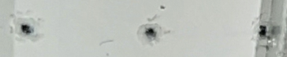
BNNT screen tests in HiRadMat (4)
October 2022 Optics is 0.25mm2
Measurement OK
Measurement seems OK but screen seems to be burnt by this beam impact !
288b / NF
Step + 4000
25b / NF
216b / NF
→ Confirms that damage is seen on the next extracted beam measurement
Image of the screen after the high intensity beam extraction test
0.33x0.42
0.29x0.39
Saturated
BNNT 288b / OD1
Step -4000
BNNT 60b / NF
2nd BNNT 216b / NF
0.31x0.40

Slide 12
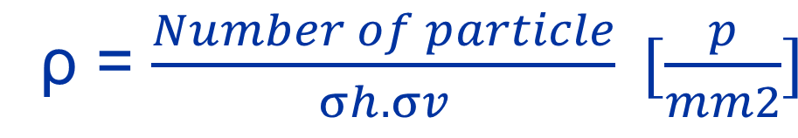
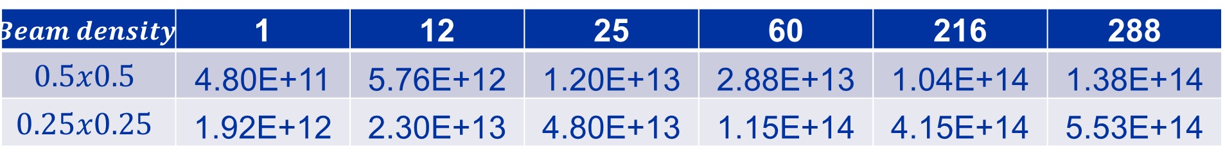
BNNT screen tests in HiRadMat (5)
October 2022
Beam density
ρ = $\frac{Number of particle}{σh.σv} [\frac{p}{mm2}]$
$$Beam density$$ | 1 | 12 | 25 | 60 | 216 | 288
$$0.5x0.5$$ | 4.80E+11 | 5.76E+12 | 1.20E+13 | 2.88E+13 | 1.04E+14 | 1.38E+14
$$0.25x0.25$$ | 1.92E+12 | 2.30E+13 | 4.80E+13 | 1.15E+14 | 4.15E+14 | 5.53E+14
BNNT gets damage

Slide 13

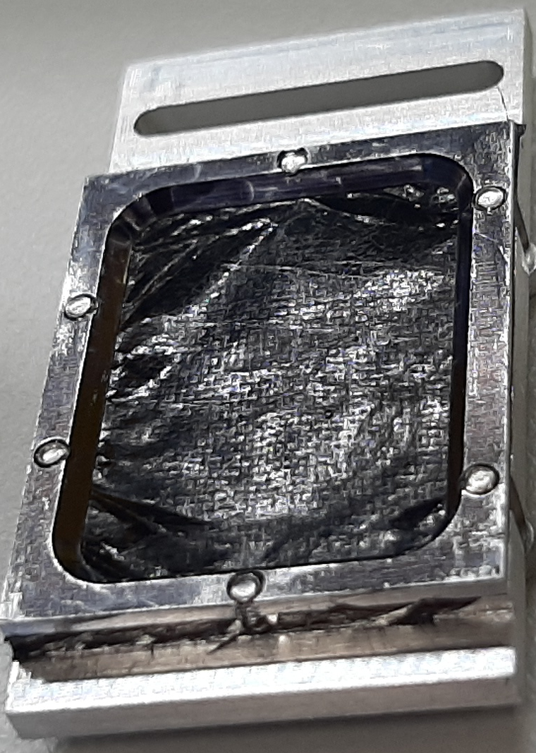
CNT screen tests in HiRadMat (1)
October 2022
Thanks to Anastasia Mikhalchan and Juan-Jose Vilatela
2 types of CNT: ‘standard’ & high purity
Very difficult to install the screen even on the new support made for stretching of the screen.
The screen can not be ‘drilled’ by hand. When screwed, the material is pulled inside its support

Slide 14
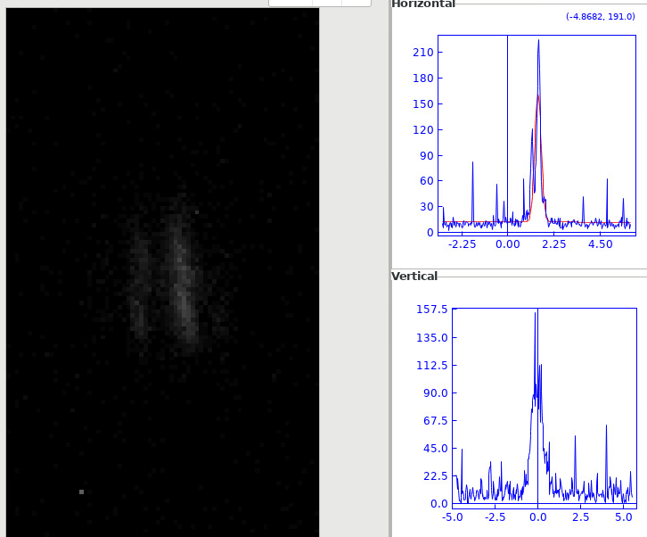
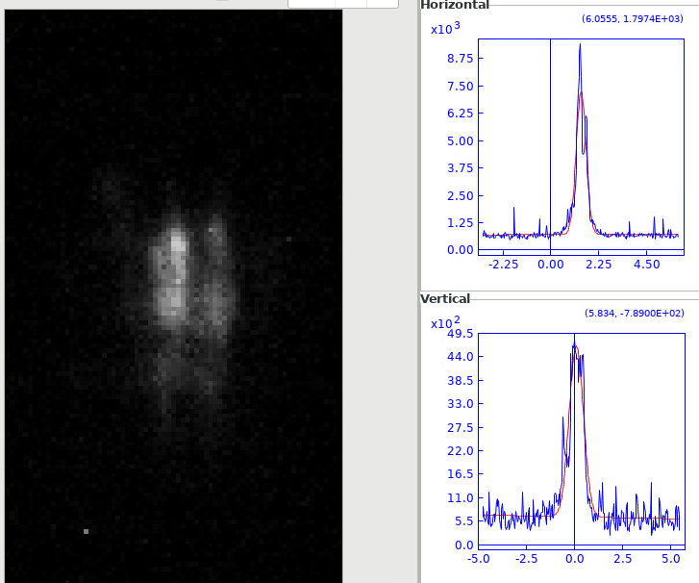
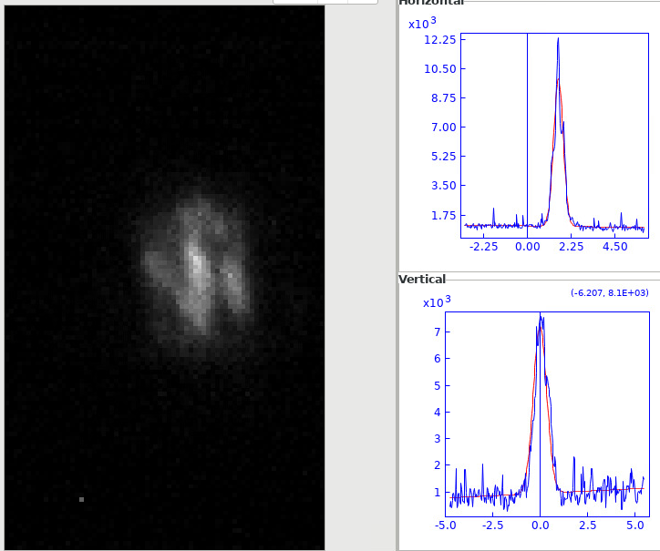
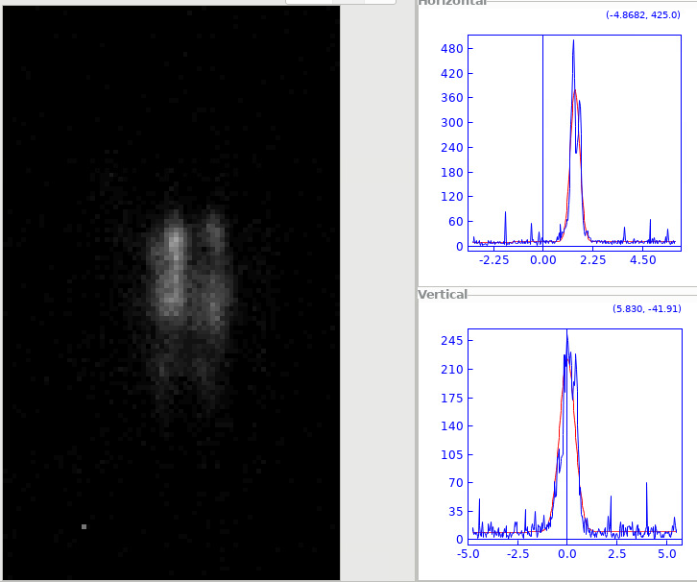
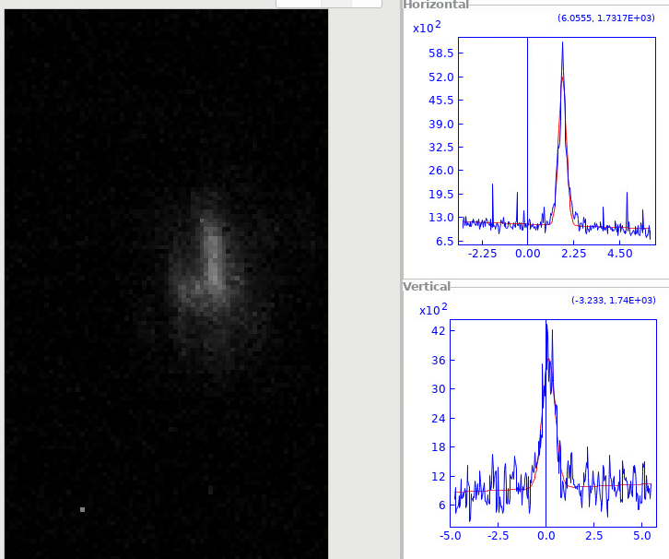
CNT Measurements (1)
2022_10_26
CNT Single bunch - 0.25mm
14:10:29
14:11:48
14:13:07
Screen not stretched
Amplitude is varying
Screen movements !?
14:11:09
14:12:28

Slide 15
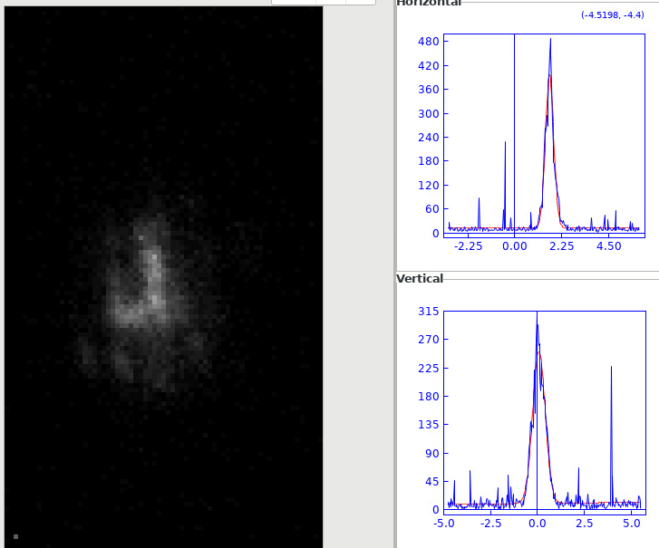
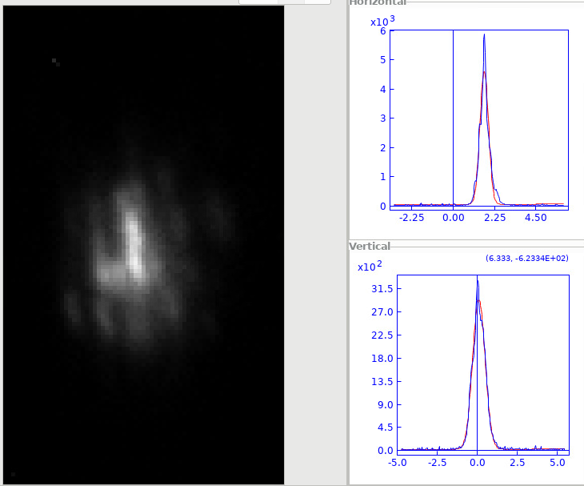
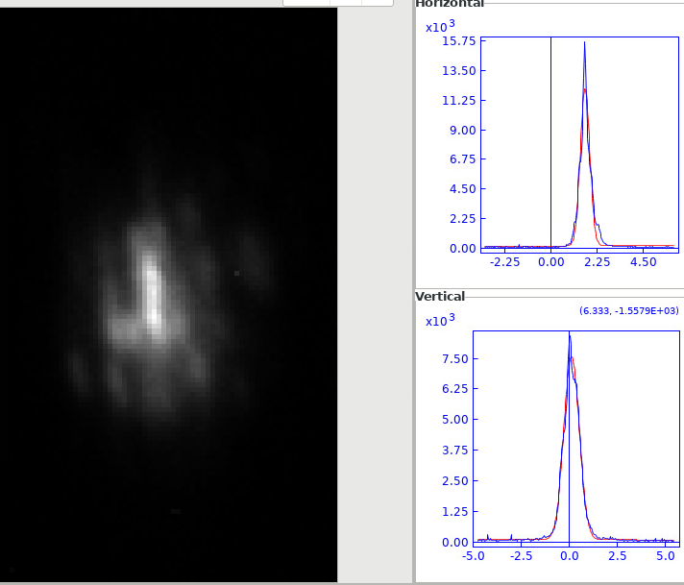
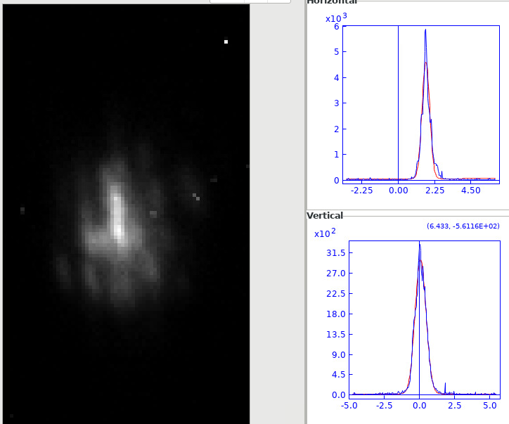
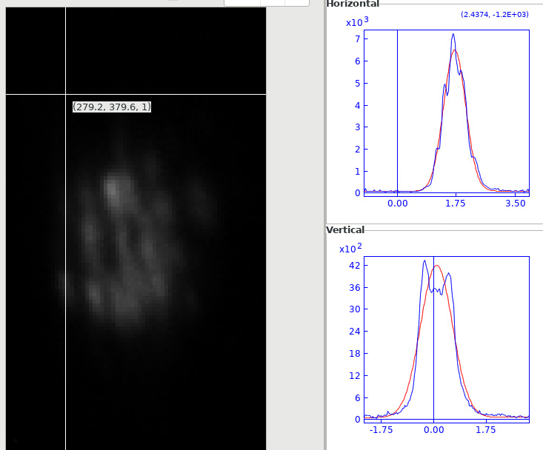
CNT Measurements (2)
2022_10_26
CNT 25 bunches - 0.25mm
2022_10_26
CNT 60 bunches - 0.25mm
300
with OD1
3150
7500
15:04:41
15:05:58
15:37:58
Screen not stretched
Amplitude is varying
Screen movements !?
Degradation visible ??
3150
Screen not stretched
Amplitude is varying
Seems more stable ??
4200
15:05:19
15:38:36

Slide 16
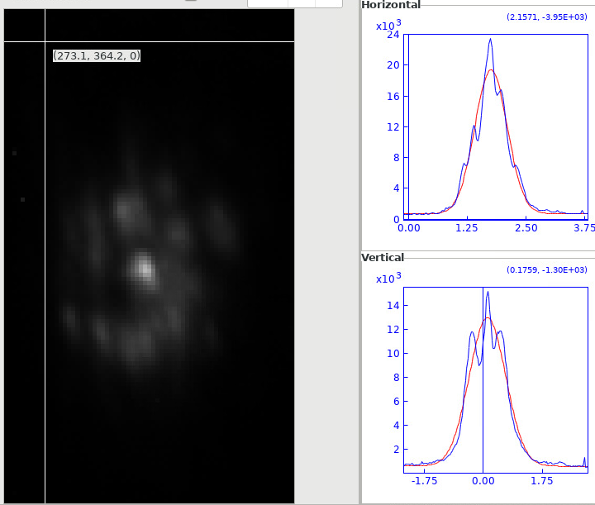
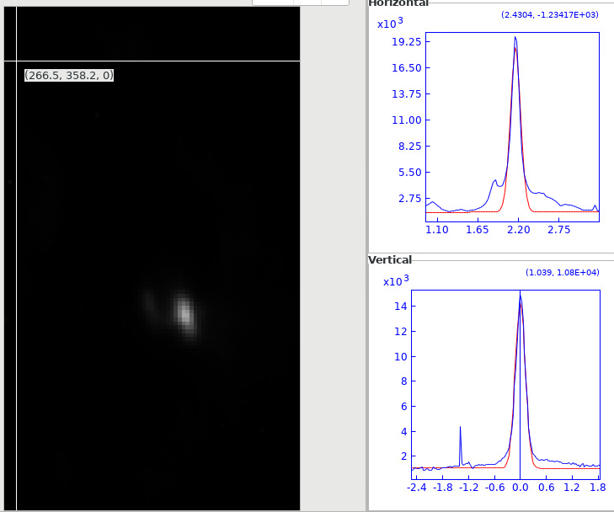
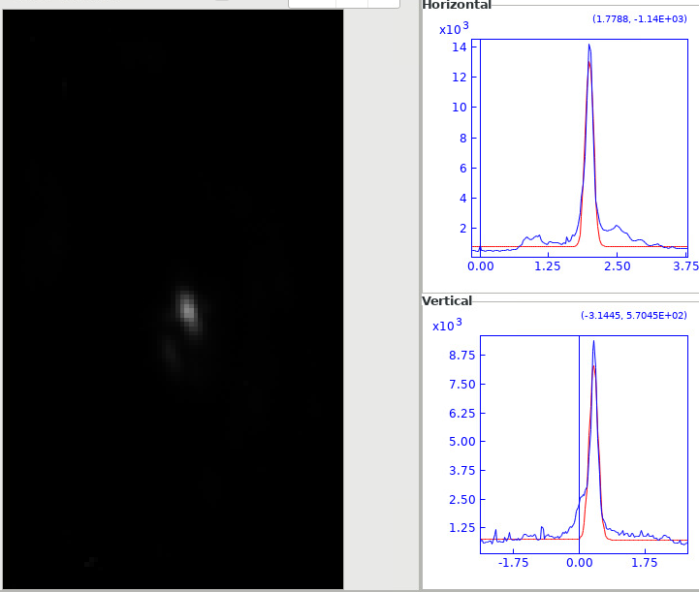
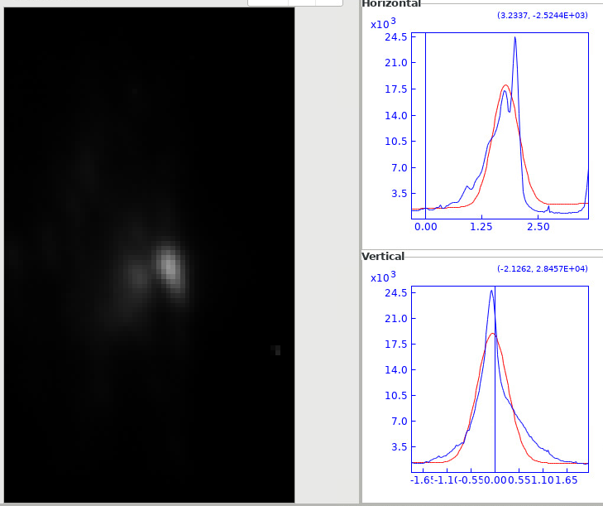
CNT Measurements (3)
2022_10_26
CNT 216 bunches - 0.25mm
2022_10_26
CNT 288 bunches - 0.25mm
Target damaged area
15000
14500
16:22:07
17:09:17
Target ‘virgin’ area
Screen not stretched
Amplitude is varying
Screen movements !?
Degradation visible ??
9000
24500
16:22:46
17:09:17

Slide 17
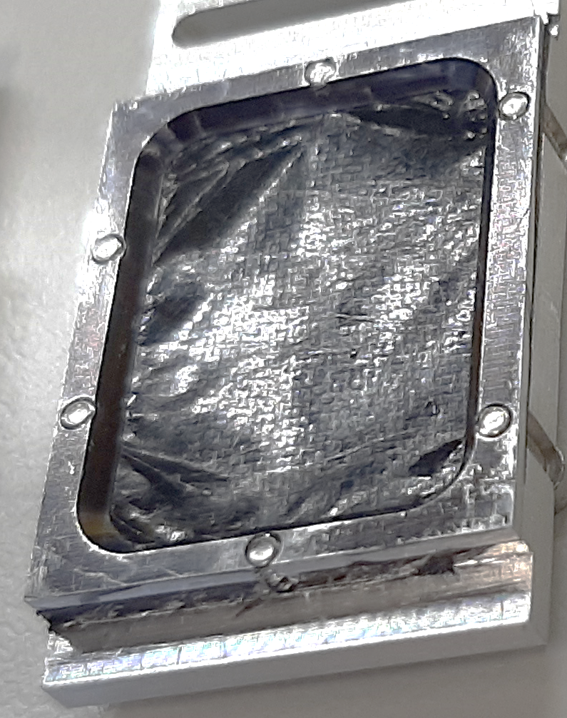
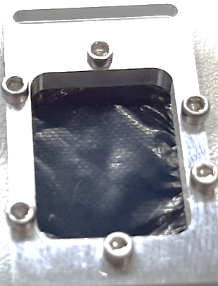




CNT Measurements (3)
Looks like stretched : due to heating ??
Difficult to estimate the beam density which starts damaging the material and the one that destroys it…
Before
irradiation
Limit for CNT damage ??
After
irradiation
→ Clear impacts seen on the material

Slide 18



CNT beam test, Next step
Laser cut for holes clearance
Laser cut of the hole for easier clamping of the screen
Installation of the 2 types of screen ready for beam test
High purity and ‘standard’ CNT type installed ready for beam
New setup for 2023

Slide 19
Conclusion
BNNT and CNT material were tested on different beams (CLEAR and /or HiRadMat)
BNNT gives results in very good agreement with the well known Chromox or GlassyC screens
Due to its low yield, probably not adapted to low intensity beam.
Can not sustain full power of HiRadMat but looks ok up to a few 1e14p/mm2
→ good performance for a scintillation screen type
CNT could not be tested correctly as the screen could not be installed flat or stretched enough for OTR measurement (angular dependent)
Nevertheless, light is observed (~same level as other OTR screens)
Can not sustain full power of HiRadMat but looks ok up to 1e14p/mm2
→ Test to be redone soon with new setup and high purity material
Main advantages of NanoTube material as screens is the very little amount of material that sees the beam compared to standard screens which limits the radiation impact around the device
With 200 BTVs installed, we constantly look at new ideas or material to improve the performance of our instrumentation → all ideas, new material to be tested is more than welcome !!
New setup for 2023

Slide 20
Thanks For Your Attention !

Slide 21





TL LHC BTV
SPS BTV
LHC BTV
Most of the time in vacuum system
ADT BTV
CPS BTV

Slide 22

Screen examples
14mm
60cm

Slide 23






Beam Measurement Examples Using Screens

Slide 24



Screen testing at HiRadMat in 2016
Screen materials installed for testing with a 440GeV/c p beam in air.
Testing yield and resolution, not specifically robustness…

