Slide 1

Thermal simulations for carbon nanotube and carbon fibre as wire scanners targets
Manon Boucard :: Master student of EPFL-LPAP :: Paul Scherrer Institute
Low Density Materials for Beam Instrumentation Workshop 20/06/23 – 21/06/23

Slide 2
Introduction
Wire scanners are instruments used to measure transverse beam profile, using thin wire of tungsten, molybdenum or carbon fibre because of their good thermal, mechanical, and electrical properties.
Low-density materials, such as carbon nanotube, can offer advantages.
Focus on the thermal behavior of the wire:
  Thermal modeling: PyTT (Python Thin Target) simulation code from A.Navarro and M.Sapinski
    Physical model
    Benchmarking
  Comparison of the thermal behavior of carbon fibre (CF) and carbon nanotube (CNT) wires:
    2 different sets of beam parameters :
      PSI Main ring cyclotron beam
      HL-LHC beam

Slide 3
I) PyTT code
II) Wire signal benchmarking
III) Comparison of thermal simulation between carbon fibre and carbon nanotube wire scanners for PSI and HL-LHC beam parameters

Slide 4
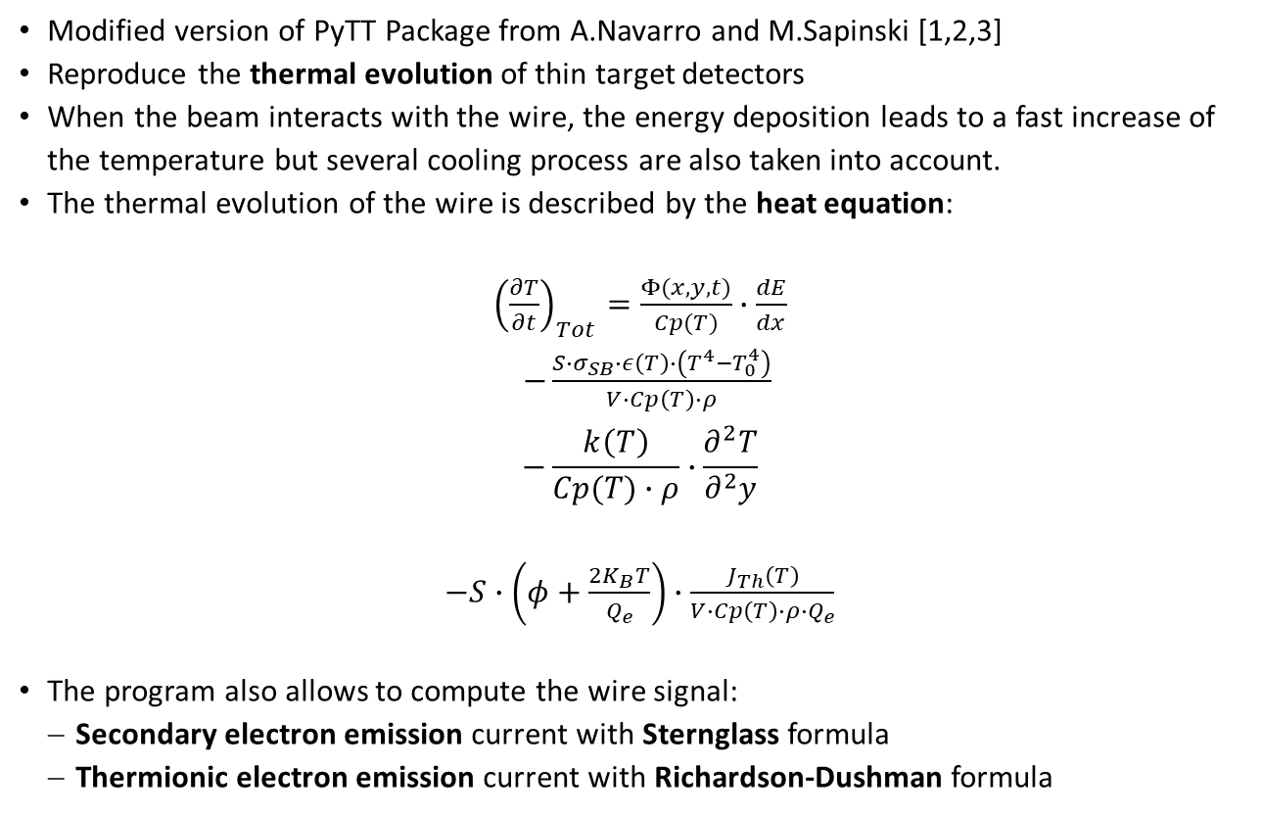
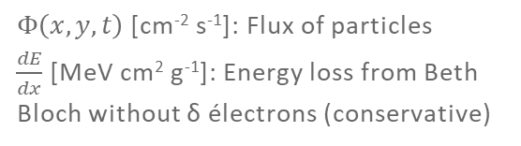
Thermal modeling: PyTT simulation program
Modified version of PyTT Package from A.Navarro and M.Sapinski [1,2,3]
Reproduce the thermal evolution of thin target detectors
When the beam interacts with the wire, the energy deposition leads to a fast increase of the temperature but several cooling process are also taken into account.
The thermal evolution of the wire is described by the heat equation:
${\left(\frac{∂T}{∂t}\right)}_{Tot}=\frac{Φ(x,y,t)}{Cp(T)}∙\frac{dE}{dx}$
$−\frac{S∙σ_{SB}∙ε\left(T\right)∙\left(T^{4}−T_{0}^{4}\right)}{V∙Cp\left(T\right)∙ρ}$
$$−\frac{k\left(T\right)}{Cp(T)∙ρ}∙\frac{∂^{2}T}{∂^{2}y}$$
$−S∙\left(φ+\frac{2K_{B}T}{Q_{e}}\right)∙\frac{J_{Th}\left(T\right)}{V∙Cp\left(T\right)∙ρ∙Q_{e}}$
The program also allows to compute the wire signal:
  Secondary electron emission current with Sternglass formula
  Thermionic electron emission current with Richardson-Dushman formula
← Beam heating
Radiative cooling →
$Φ\left(x,y,t\right)$[cm⁻² s⁻¹]: Flux of particles
$\frac{dE}{dx}$ [MeV cm² g⁻¹]: Energy loss from Beth Bloch without δ électrons (conservative)
Conductive cooling →
(neglected because it is weak)
Thermionic cooling →
[1]: A. Navarro, Understanding Secondary Emission Processes and Beam Matter interactions for Optimization of Diagnostic Wire Grid System in Particle Accelerators, PhD Thesis, 2022
[2]: M. Sapinski, Model of Carbon Wire Heating in Accelerator Beam, CERN-AB-2008-030 BI, 2008
[3]: A. Navarro, PyTT GitHub, URL: https://github.com/navarrof/PyTT
Notes:
The energy deposited depends on the beam energy, the type of particle, the wire material and geometry

Slide 5
I) PyTT code
II) Wire signal benchmarking
III) Comparison of thermal simulation between carbon fibre and carbon nanotube wire scanners for PSI and HL-LHC beam parameters

Slide 6
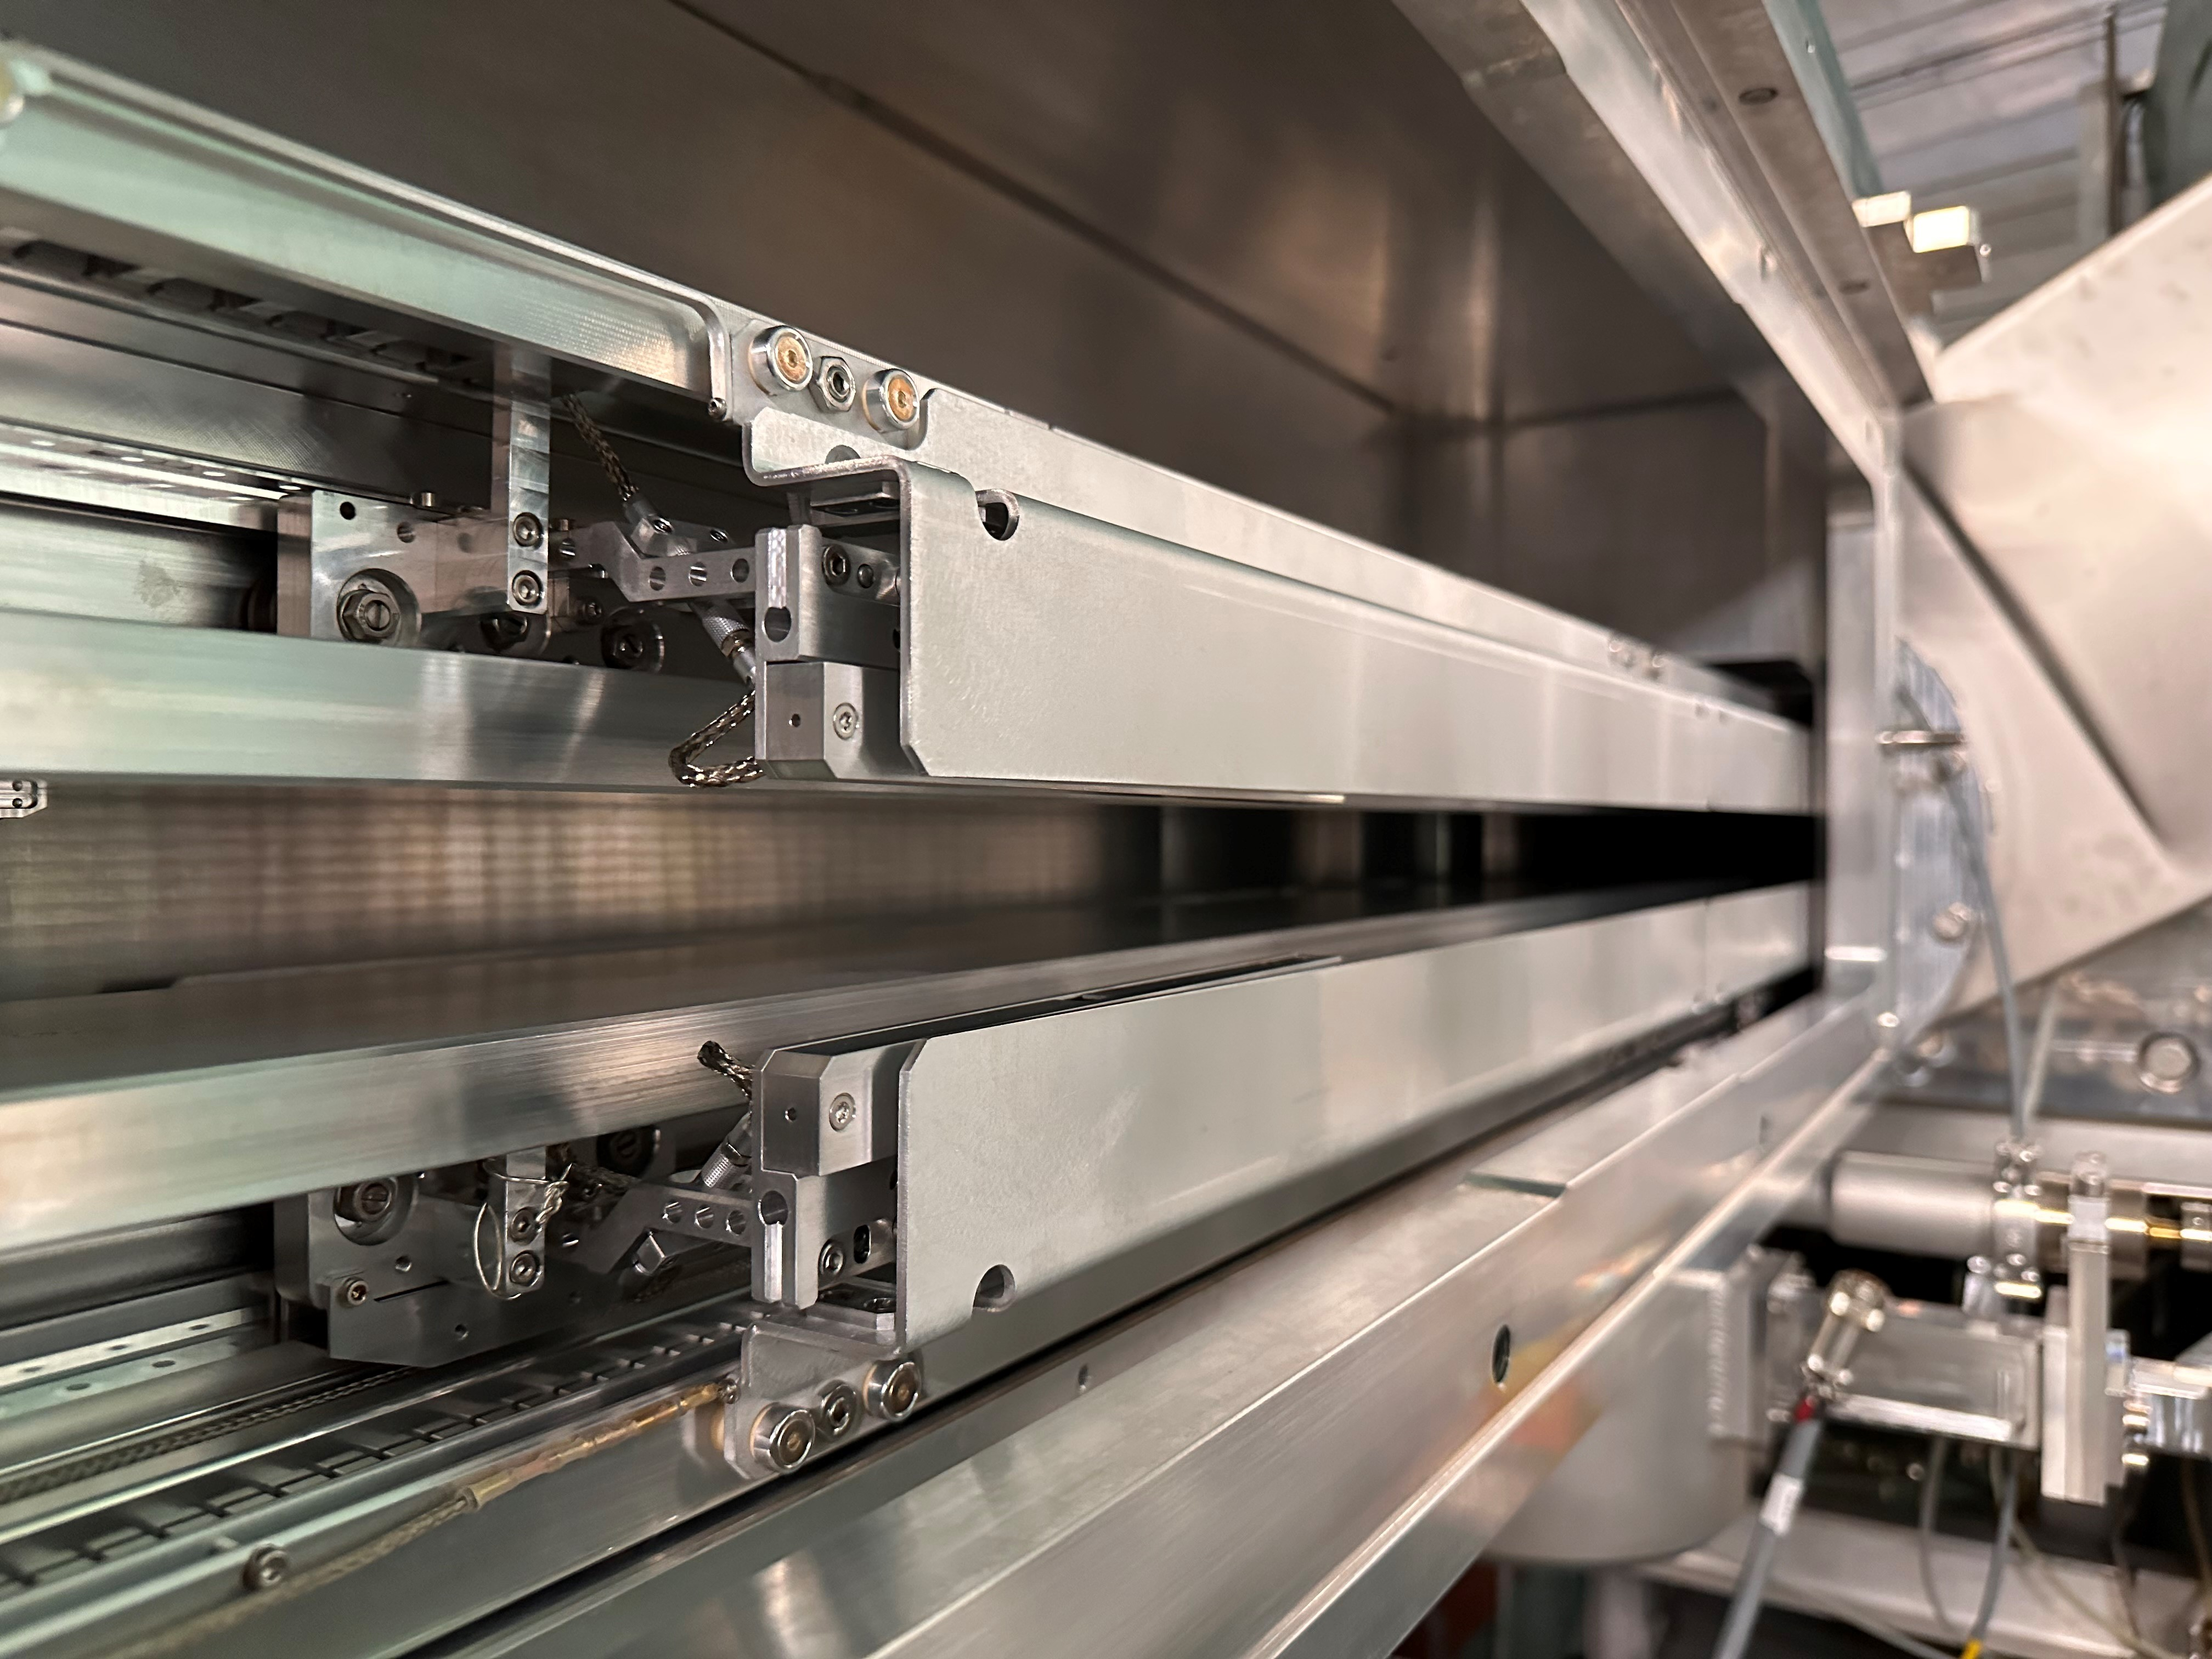
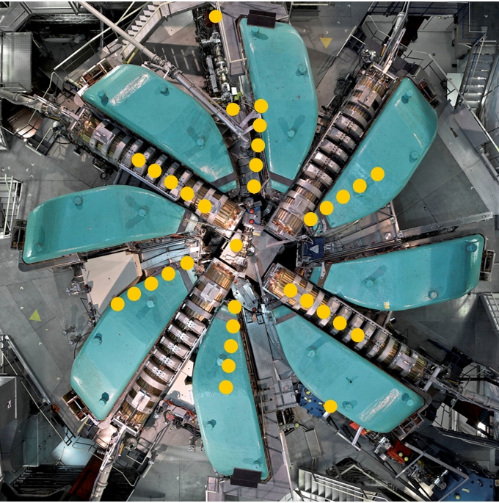
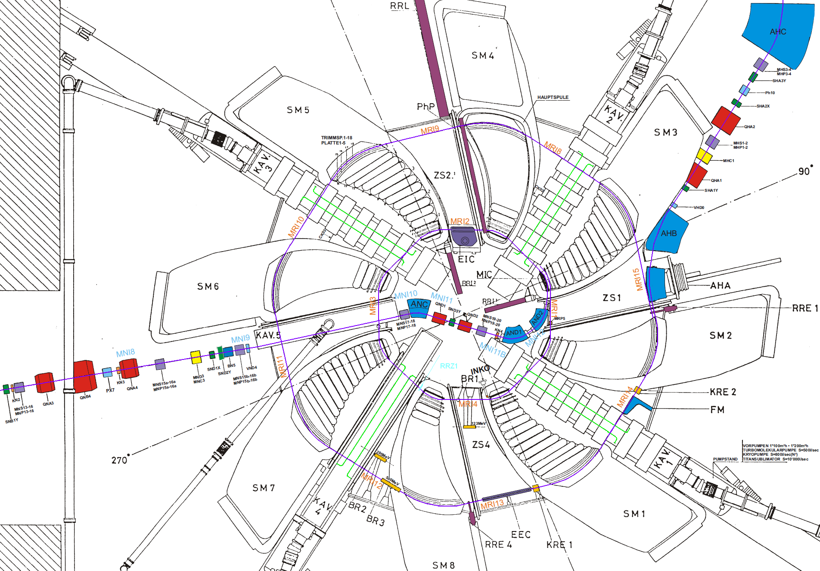
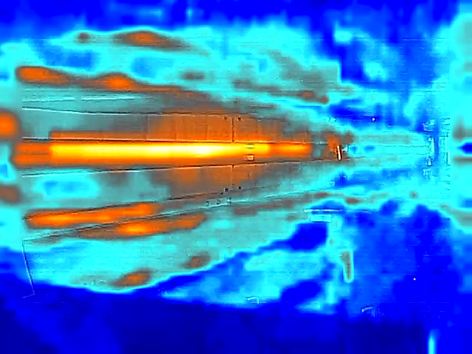
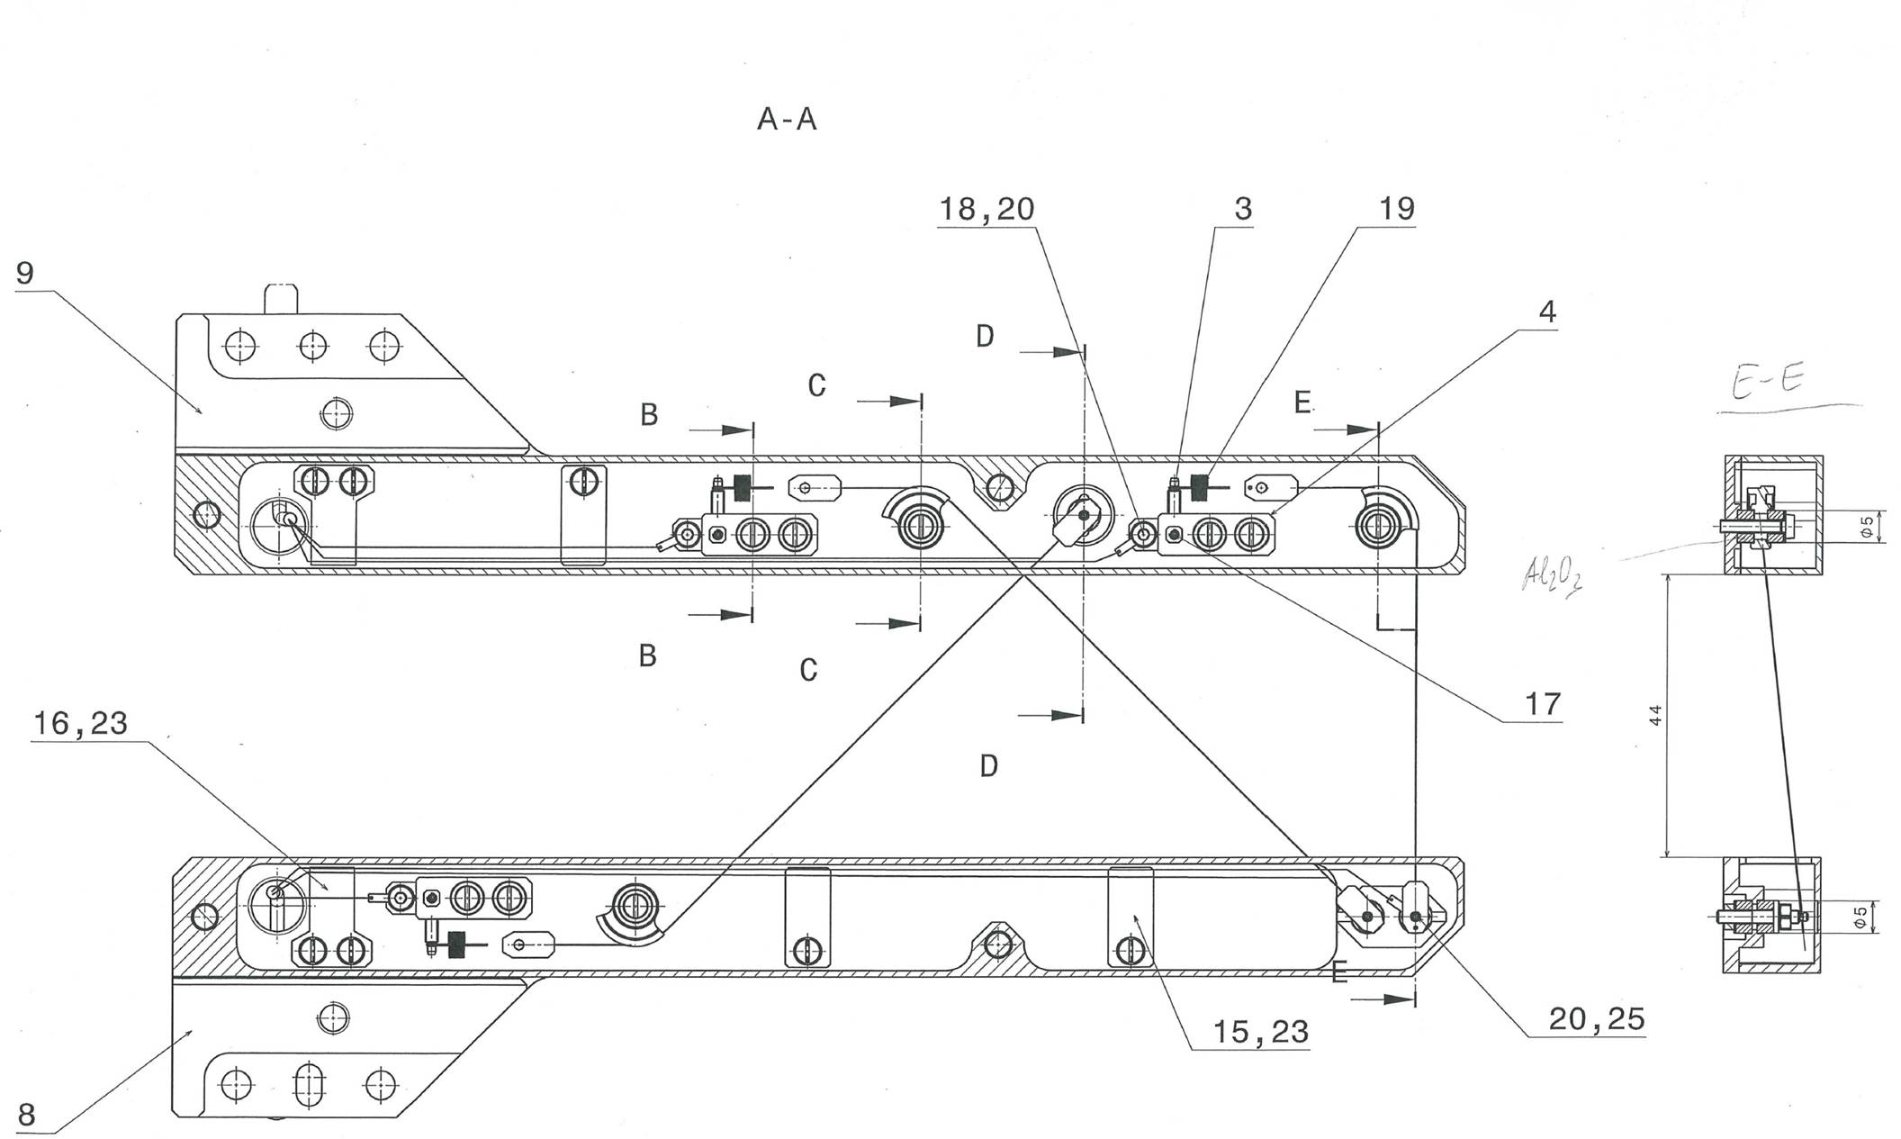
PSI’s Main Ring Cyclotron Radial Probe (RRL)
PSI’s Main Ring Cyclotron Radial Probe (RRL): wire scanner which is able to scan all the orbits along the cyclotron radius (2.5m) by measuring secondary emission current
RRL position
Wire 3
3 wires made of carbon fibre with 2.1 g/cm3 density, 34 μm diameter and 3 cm/s speed
Wire 2
Wire 1

Slide 7
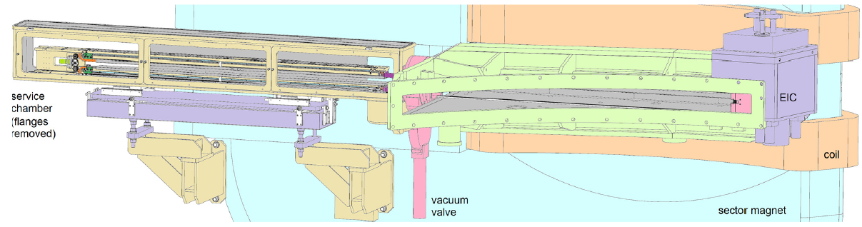
PSI’s Main Ring Cyclotron Radial Probe (RRL)

Slide 8
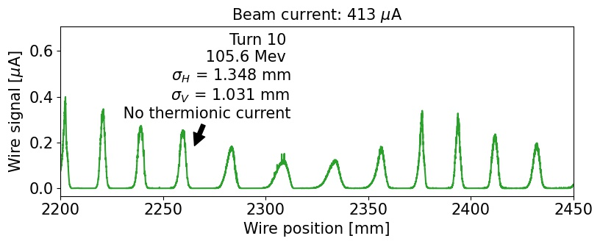
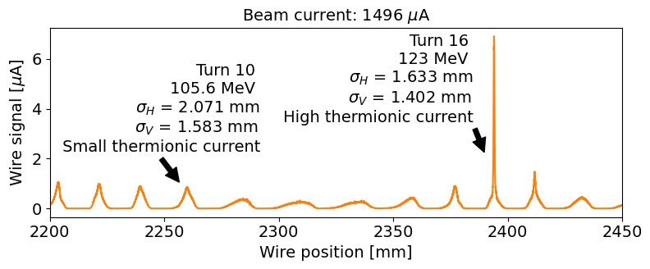
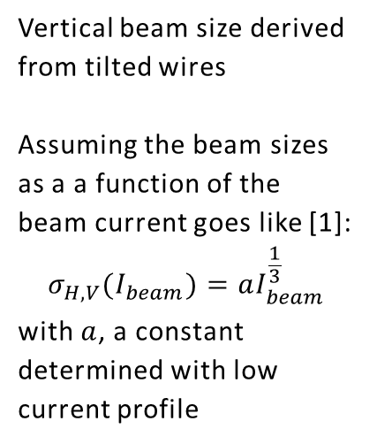
RRL’s Measurements
3 cases are studied for wire 1 with different thermionic current:
Comparison of RRL’s measurements with simulations
Benchmark of the wire signal because it is very difficult to benchmark the temperature
Vertical beam size derived from tilted wires
Assuming the beam sizes as a a function of the beam current goes like [1]:
$$σ_{H,V}(I_{beam})=aI_{beam}^{\frac{1}{3}}$$
with $a$, a constant determined with low current profile
[1] C. Baumgarten, H. Zhang, priv. comm

Slide 9
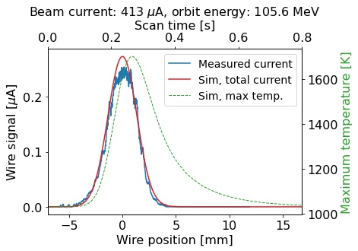
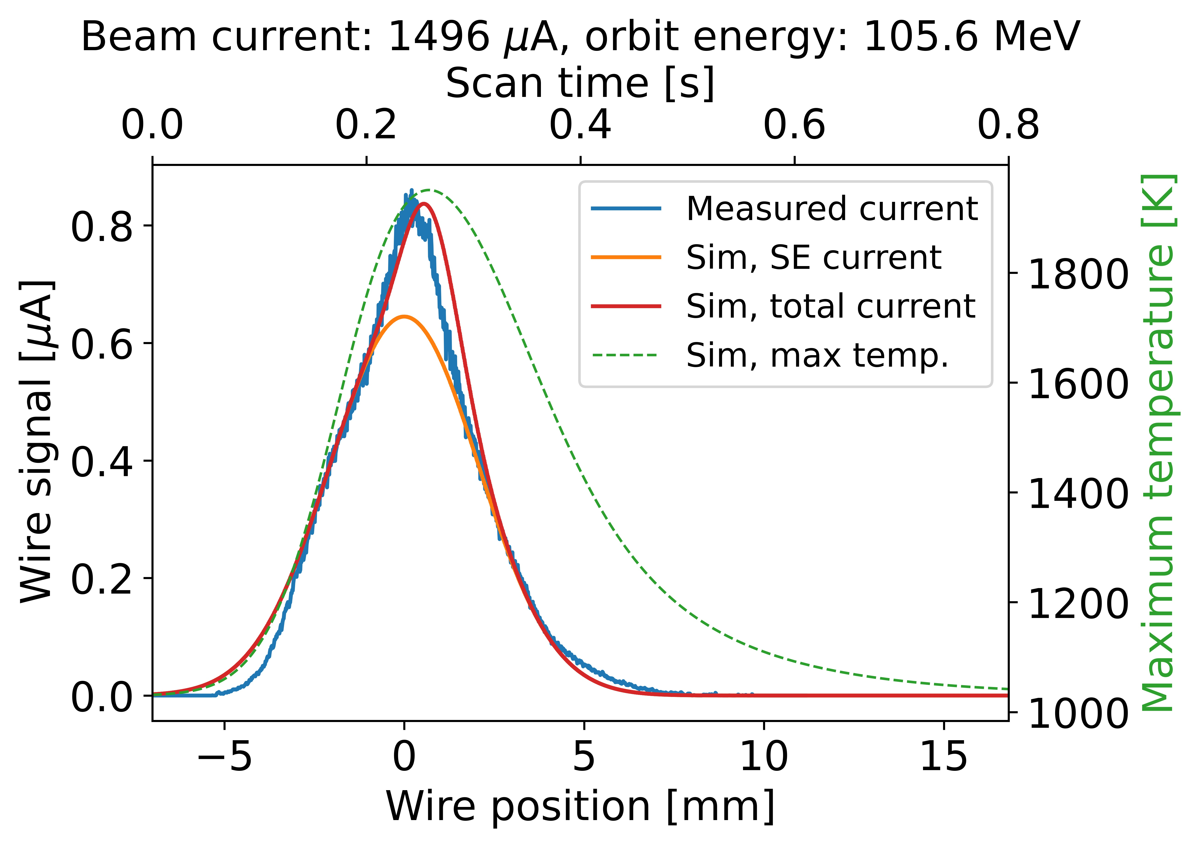
Benchmarking of the wire signal
No thermionic current: wire signal well reproduced (slightly higher in simulation)
Small thermionic current: accurately reproduced
More detailed study:
M. Sapinski, M. Boucard, Dealing with Thermionic Emission in Wire Scanners based on Secondary Electron Emission, THPL150, in Proc. of International Particle Accelerator Conference (IPAC23), Venice, Italy, May 2023

Slide 10
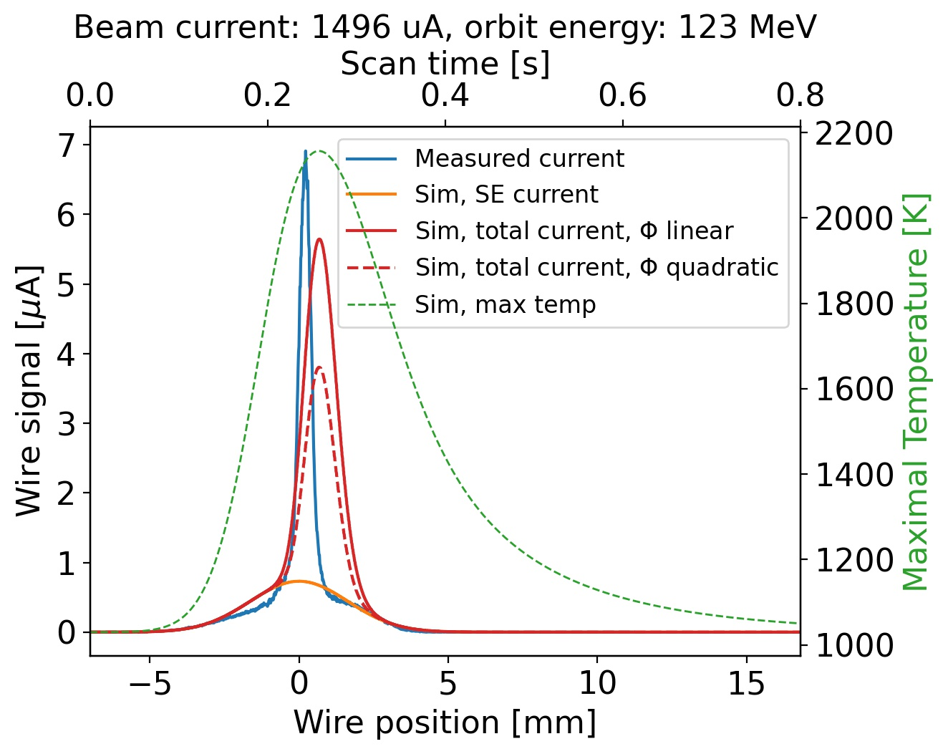
Benchmarking of the wire signal
Higher thermionic current: discrepancy between simulation and measurements which can come from:
- Sensitivity to parameters like emissivity and work function for which the temperature dependency is poorly known
- Other phenomena that are not taken into account by PyTT like build-up of space charge and increase of the electron reflection coefficient
Previous benchmarking has been done in Navarro’s thesis [1](see slides in Annexes) for SEM grid but it is more speculative (what is observed could be an effect other than the thermionic current)
More detailed study:
M. Sapinski, M. Boucard, Dealing with Thermionic Emission in Wire Scanners based on Secondary Electron Emission, THPL150, in Proc. of International Particle Accelerator Conference (IPAC23), Venice, Italy, May 2023
[1] A. Navarro, Understanding Secondary Emission Processes and Beam Matter interactions for Optimization of Diagnostic Wire Grid System in Particle Accelerators, PhD Thesis, Universitat Politècnica De Catalunya and CERN, 2022

Slide 11
I) PyTT code
II) Wire signal benchmarking
III) Comparison of thermal simulation between carbon fibre and carbon nanotube wire scanners for PSI and HL-LHC beam parameters

Slide 12
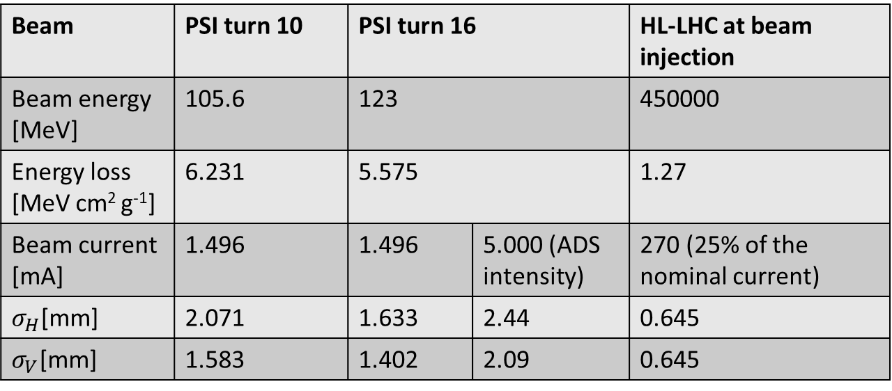
PSI Main Ring Cyclotron and HL-LHC beams parameters
Beam | PSI turn 10 | PSI turn 16 |  | HL-LHC at beam injection
Beam energy [MeV] | 105.6 | 123 |  | 450000
Energy loss [MeV cm² g⁻¹] | 6.231 | 5.575 |  | 1.27
Beam current [mA] | 1.496 | 1.496 | 5.000 (ADS intensity) | 270 (25% of the nominal current)
$σ_{H}$[mm] | 2.071 | 1.633 | 2.44 | 0.645
$σ_{V}$[mm] | 1.583 | 1.402 | 2.09 | 0.645
PSI plans to reach 3.0 mA.
ADS [1]: proton accelerator → high-intensity neutron beam by spallation → transmutes Thorium into Uranium isotopes → release energy
Only short-living nuclear wastes are produced
[1] Accelerator-Driven Nuclear Energy, URL: https://world-nuclear.org/information-library/current-and-future-generation/accelerator-driven-nuclear-energy.aspx World Nuclear Association Website

Slide 13
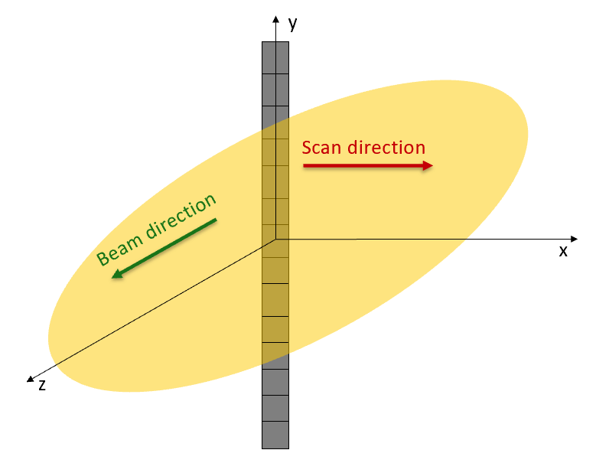
Wire parameters for thermal simulation
Simulation parameters:
  Wire:
    2 cm long
    At PSI main ring cyclotron: 3 cm/s speed
    At HL-LHC: 1 m/s speed
    34 μm diameter
    Materials: carbon fibers or carbon nanotubes wire
  Resolution of slices:
    PSI: 0.25 mm
    HL-LHC: 0.10 mm
  Number of steps: 10000
Crucial parameters in thermal simulations for CF and CNT:
  Density
  Work function
  Emissivity
  Specific heat
Slice

Slide 14
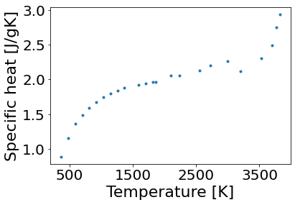
Density and specific heat
Touloukian, Y. S.
Buyco, E. H.
Density:
  Carbon fibers: 2.1 g/cm³
  Carbon Nanotubes:
    1.0 g/cm³ (experiment at CERN [1])
    0.2 g/cm³ (anticipated)
Specific heat:
  Should be the same for CF and CNT
  Depends on the temperature
  Values are taken from: Thermophysical Properties of Matter - the TPRC Data Series. Volume 5. Specific Heat - Nonmetallic Solids, Touloukian, Y. S. Buyco, E. H., 1970
[1] Alexandre Mariet, Study of the effects of copper-coating and proton irradiation at 440 GeV on the mechanical properties of carbon nanotube wires for particle beam instrumentation at CERN, PhD thesis, Université de Franche-Comté and femto-st, Besançon, May 2023

Slide 15
Emissivity and work function
Emissivity
  Similar for CF and CNT: around 1
  Surface of CNT not really smooth → can lower the emissivity
  Lower emissivity → lower radiative cooling
Work function
  Similar for CF and CNT: around 5 eV
  The lack of smoothness of the surface can lower the work function of the CNT
  Lower work function → stronger thermionic current
  Literature suggests that the work function decreases with the temperature [1,2]→ stronger thermionic cooling for high temperature
[1]H. Zhu, C. Masarapu, J. Wei, K. Wang, D. Wu, B. Wei, Temperature dependence of field emission of single-walled carbon nanotube thin films, Physica E: Low-dimensional Systems and Nanostructures, Volume 41, Issue 7, 2009, Pages 1277-1280
[2]R. Rahemi, D. Li, Variation in electron work function with temperature and its effect on the Young’s modulus of metals, Scripta Materialia 99, 2015, Pages 41-44
Notes:
Decrease in work function required to explain the observed thermionic emission → suggests that a decrease of emissivity could also play a role

Slide 16
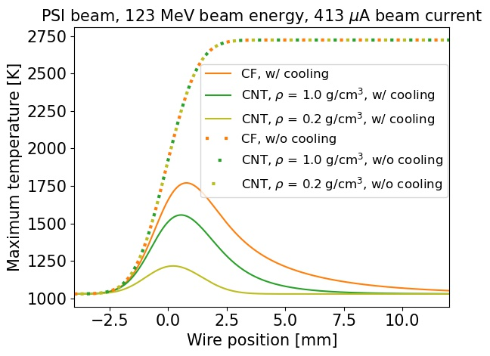
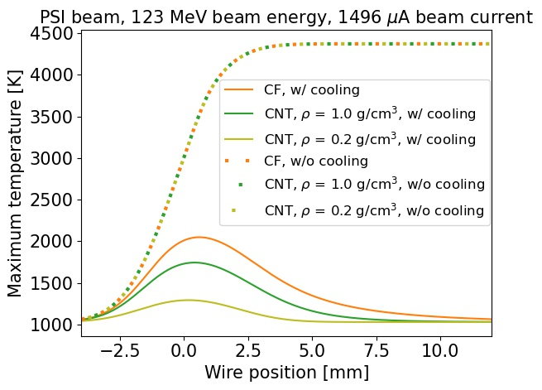
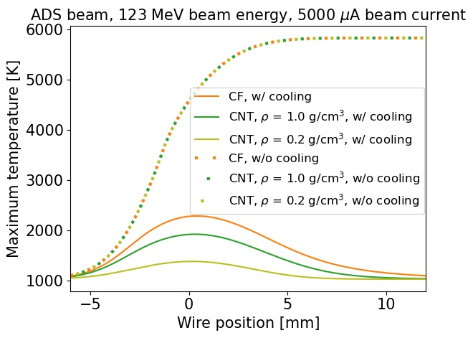
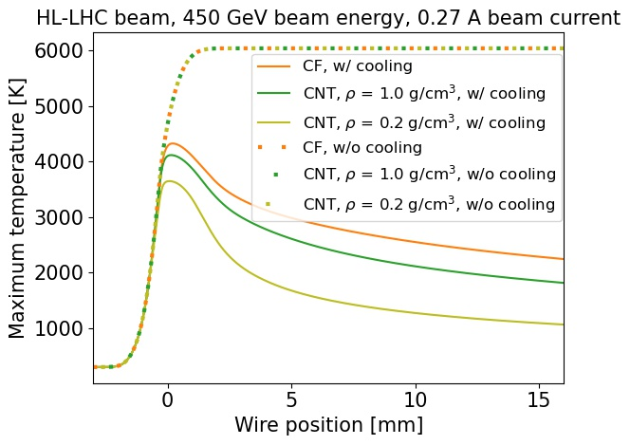
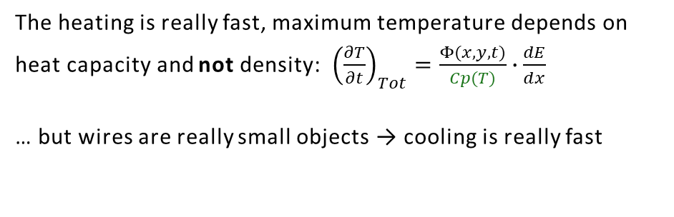
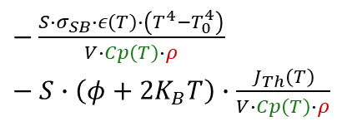
With and without cooling thermal behaviour
PSI
HL-LHC
The heating is really fast, maximum temperature depends on heat capacity and not density: ${\left(\frac{∂T}{∂t}\right)}_{Tot}=\frac{Φ(x,y,t)}{Cp(T)}∙\frac{dE}{dx}$
… but wires are really small objects → cooling is really fast
ΔT≈700 K
[MeV cm² g⁻¹]
Temperature rises are the same for CF and CNT but the cooling is faster for CF because of the smaller amount of material
Less materials → cool faster (like when you take a spoonful of hot tea in a cup to cool it down more quickly)
$−\frac{S∙σ_{SB}∙ε\left(T\right)∙\left(T^{4}−T_{0}^{4}\right)}{V∙Cp\left(T\right)∙ρ} −−S∙\left(φ+2K_{B}T\right)∙\frac{J_{Th}\left(T\right)}{V∙Cp\left(T\right)∙ρ}$
Radiative cooling
Thermionic cooling
Notes:
In the first approximation

Slide 17
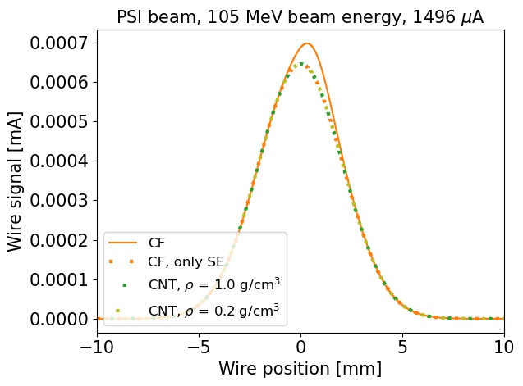
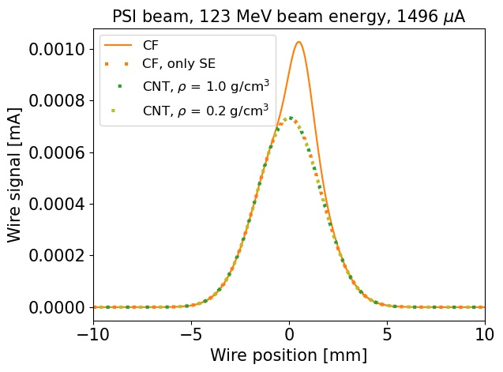
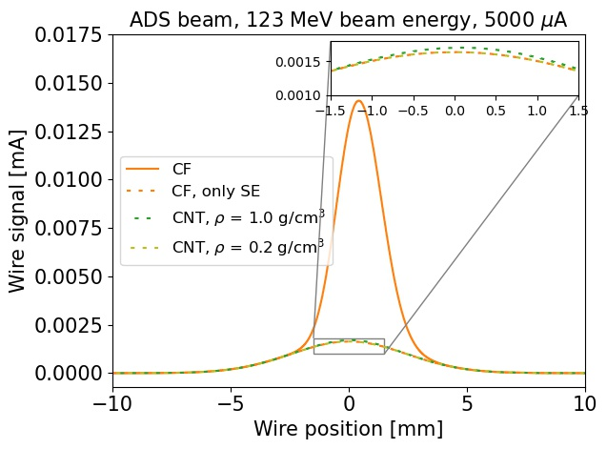
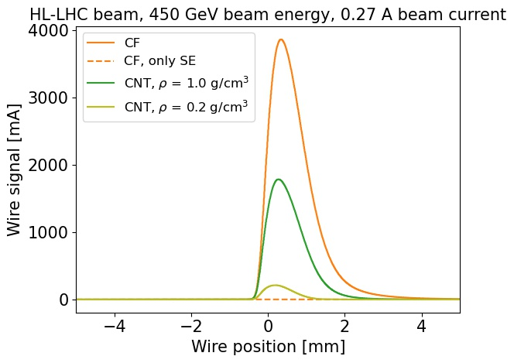
PSI and HL-LHC wire signal
PSI
No thermionic emission (or really small) for CNTs with PSI beam parameters.
HL-LHC
Huge thermionic peak for HL-LHC beam → unexploitable measurements → reasons why the SE current is not used for high-energy beams.
Other phenomena like space charge can occur and are not considered by PyTT.

Slide 18
Conclusion
PyTT is a tool for estimating the thermal behavior of thin targets
Benchmarking using secondary and thermionic emission is positive
Discrepancy observed for high thermionic current probably due to space charge from generated electrons
Simulations show high sensitivity on materials parameters:
  Temperature dependence of work function and emissivity
Due to low-density materials, the cooling processes are faster → temperatures reached by CNT wires are lower than those reached by CF wires
Complete suppression of thermionic emission current for PSI beams

Slide 19
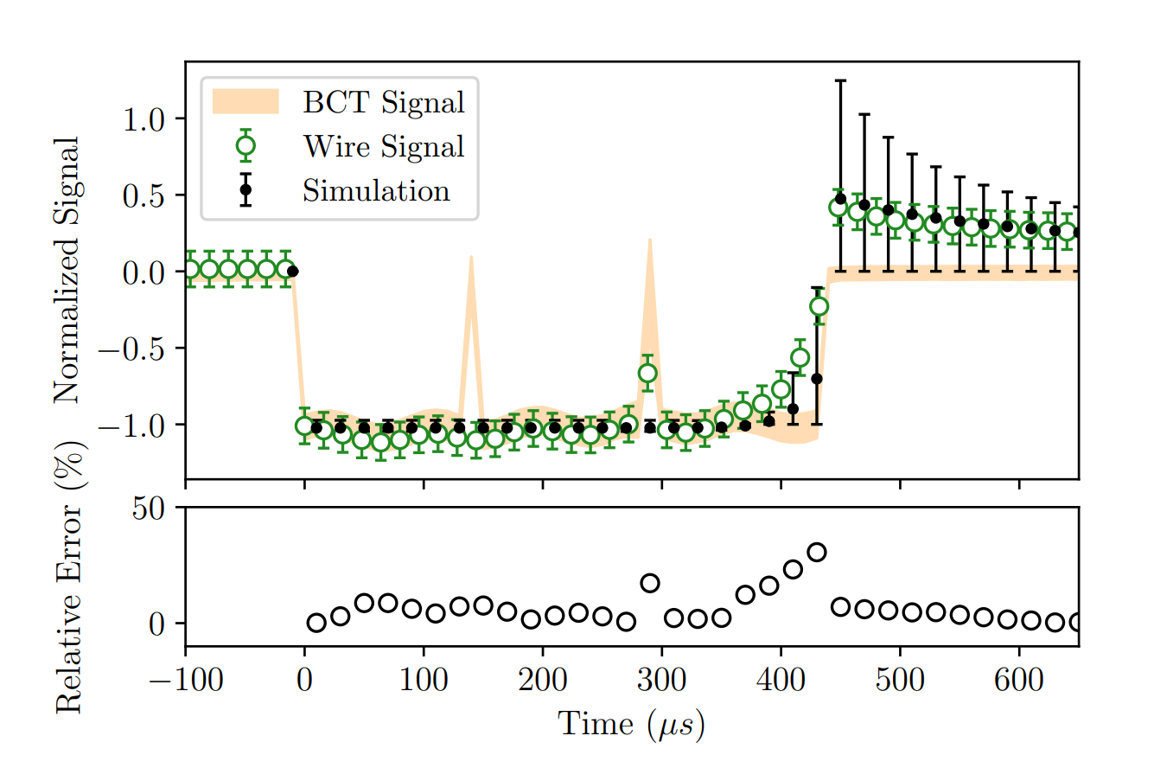
Annexes: Previous benchmarking [1]
The current measured by the detector at that time does not come from the beam: thermionic current
Simulations and measurements in good agreement
[1] A. Navarro, Understanding Secondary Emission Processes and Beam Matter interactions for Optimization of Diagnostic Wire Grid System in particle Accelerators, PhD Thesis, Universitat Politècnica De Catalunya and CERN, 2022

Slide 20
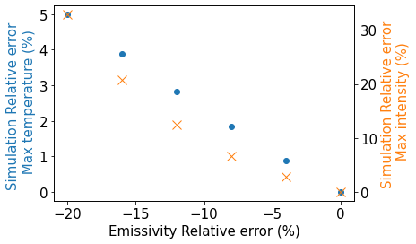
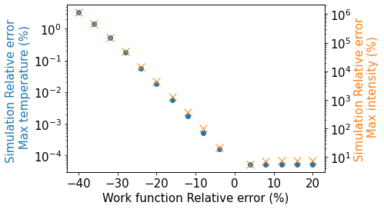
Annexes: Simulation uncertainities
PSI main ring cyclotron beam, 105.6 Mev beam energy, 1496 μA beam current.
Initial work function : 5 eV
Initial emissivity : 1
For emissivity and work function, relative errors are bigger for intensity than for temperature
The simulated intensity is high-sensitive to emissivity and work function change, especially for work function for which the relative error grows exponentially (due to the exponential term of thermionic current).

Slide 21
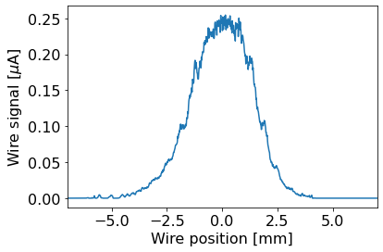
Annexes: RRL measurements uncertainties
Electronic noise
Not Gaussian beam
The response function of MESON acquisition card

Slide 22
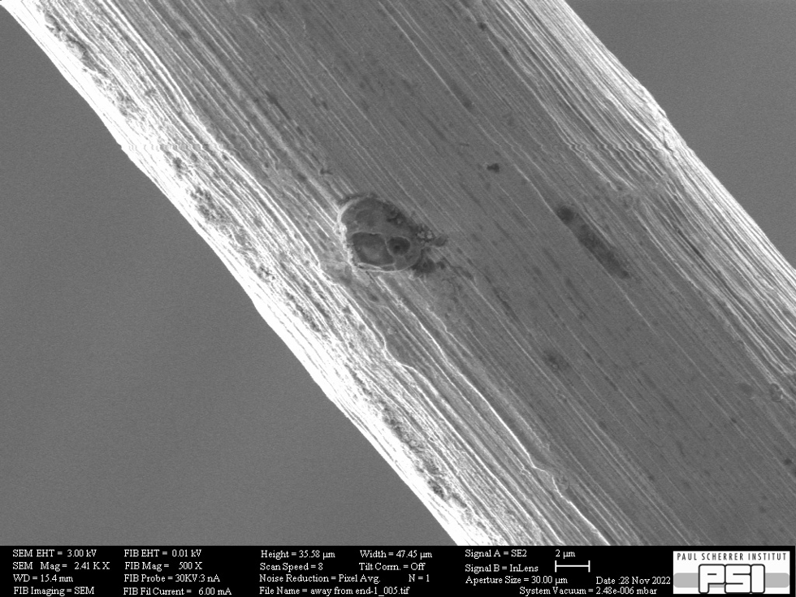
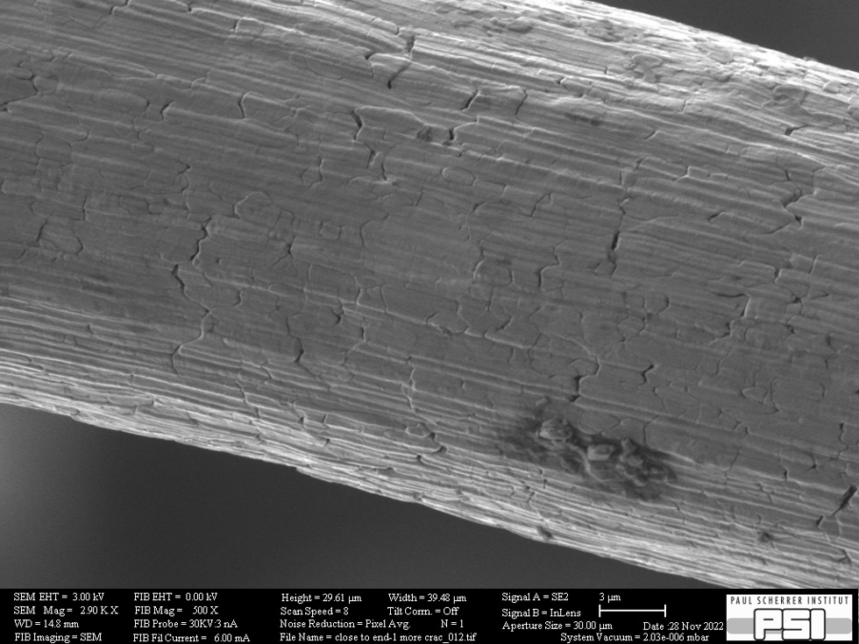
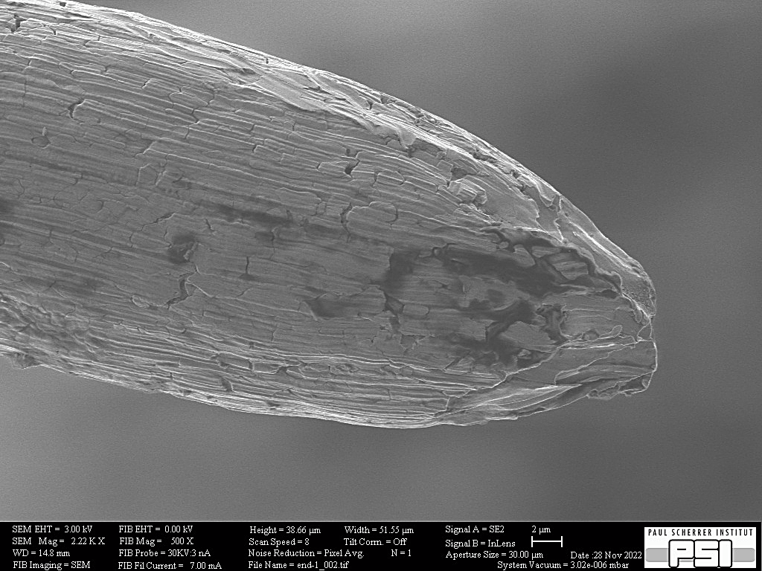
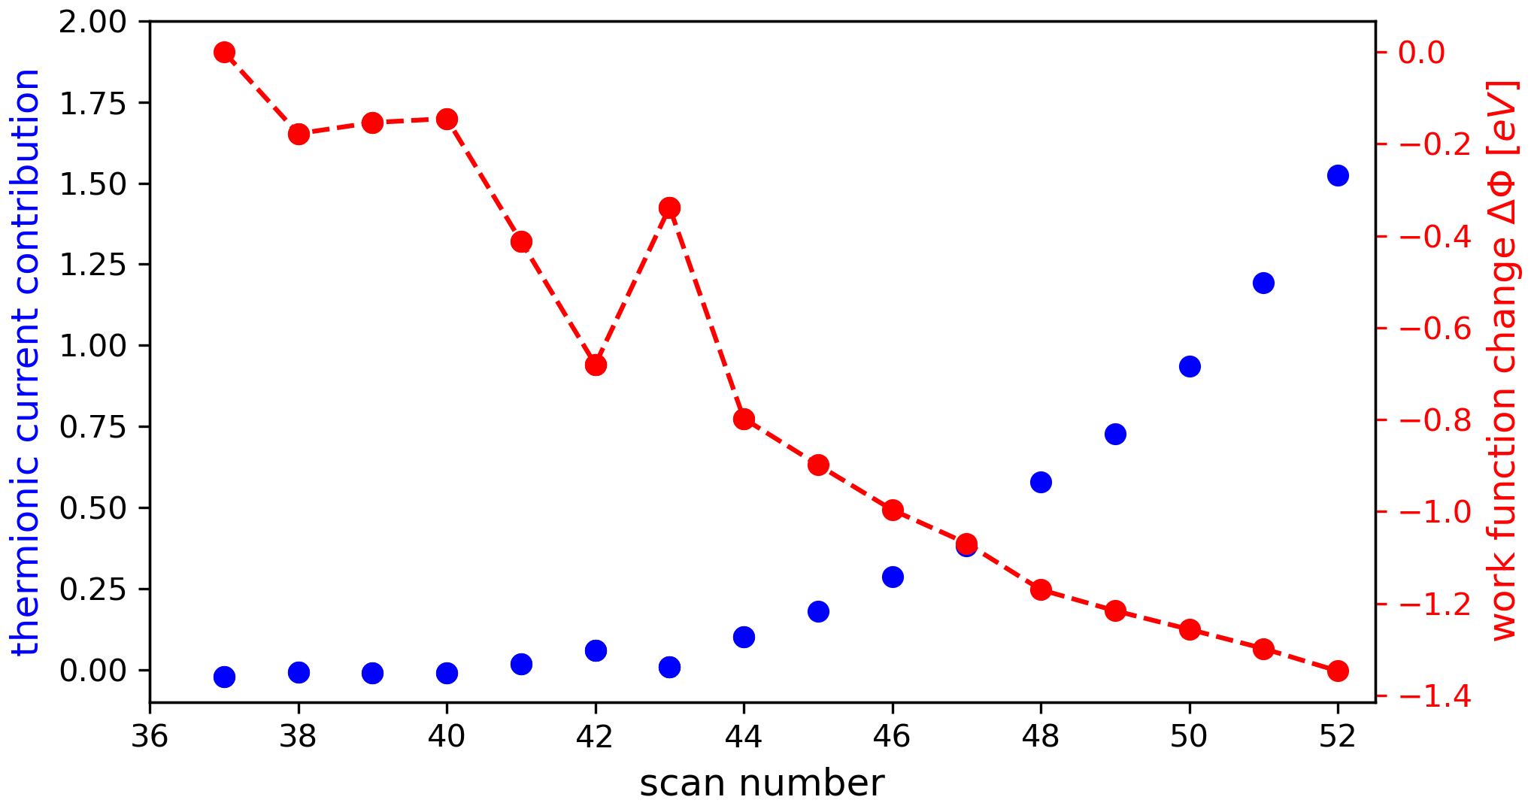
Annexes: Influence of the material surface on work function
Ductile damage of a Molybdenum wire due to multiple scans [1]
End of a broken wire
Passages through the beam damage the wire, the smoothness of the wire decreases → increase of the thermionic emission → explained by a decrease in the work function.
[1] M.Sapinski, About the Damage Mechanisms of Thin Targets Exposed to High-power Particles Beams, THPL151, in Proc. of International Particle Accelerator Conference (IPAC23), Venice, Italy, May 2023

Slide 23
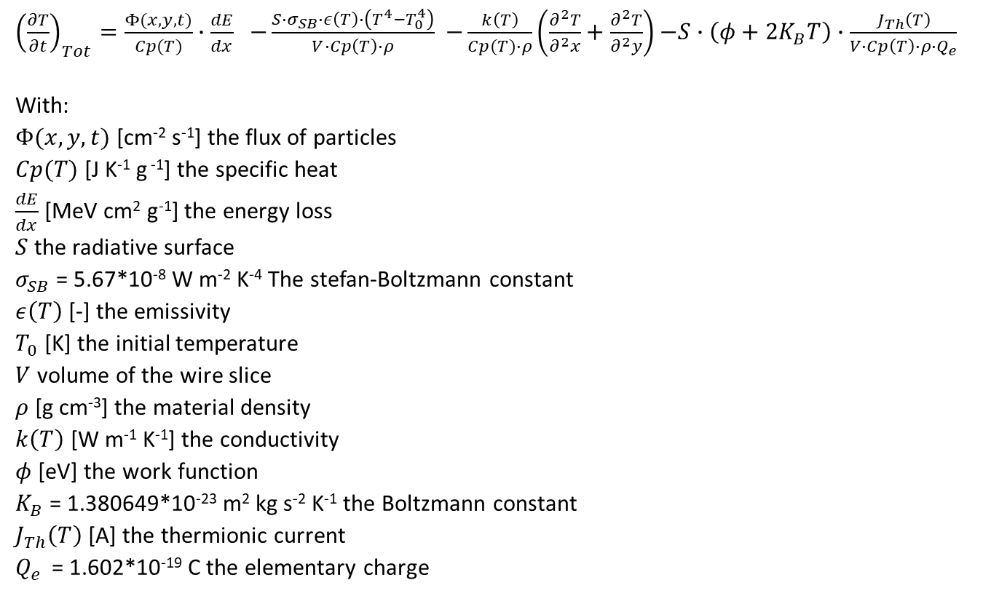
Annexes: The heat equation
${\left(\frac{∂T}{∂t}\right)}_{Tot}=\frac{Φ(x,y,t)}{Cp(T)}∙\frac{dE}{dx}$ $−\frac{S∙σ_{SB}∙ε\left(T\right)∙\left(T^{4}−T_{0}^{4}\right)}{V∙Cp\left(T\right)∙ρ}$ $−\frac{k\left(T\right)}{Cp(T)∙ρ}\left(\frac{∂^{2}T}{∂^{2}x}+\frac{∂^{2}T}{∂^{2}y}\right)$ $−S∙\left(φ+2K_{B}T\right)∙\frac{J_{Th}\left(T\right)}{V∙Cp\left(T\right)∙ρ∙Q_{e}}$
With:
$Φ(x,y,t)$ [cm⁻² s⁻¹] the flux of particles
$Cp(T)$ [J K⁻¹ g ⁻¹] the specific heat
$\frac{dE}{dx}$ [MeV cm² g⁻¹] the energy loss
$S$ the radiative surface
$σ_{SB}$ = 5.67*10⁻⁸ W m⁻² K⁻⁴ The stefan-Boltzmann constant
$ε\left(T\right)$ [-] the emissivity
$T_{0}$ [K] the initial temperature
$V$ volume of the wire slice
$ρ$ [g cm⁻³] the material density
$k\left(T\right)$ [W m⁻¹ K⁻¹] the conductivity
$φ$ [eV] the work function
$K_{B}$ = 1.380649*10⁻²³ m² kg s⁻² K⁻¹ the Boltzmann constant
$J_{Th}\left(T\right)$ [A] the thermionic current
$Q_{e }$ = 1.602*10⁻¹⁹ C the elementary charge

