Slide 1
How high-power accelerators damage thin wires?
Mariusz Sapinski :: Paul Scherrer Institut
Low Density Materials for Beam Instrumentation, CERN, June 20th, 2023

Slide 2
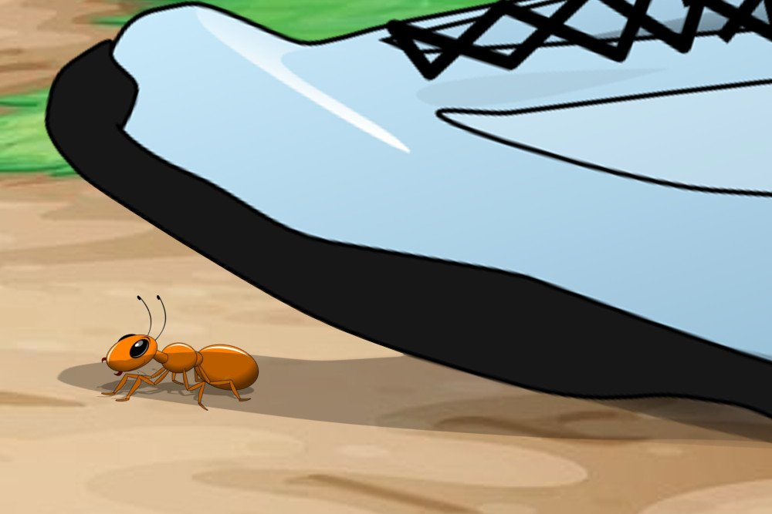
Remarks and Outlook
Presentation:
Focuses on experience from CERN and PSI/HIPA wire scanners (not exhaustive)
Signals some open questions
Is not about carbon nanotubes
Outlook:
Breakage tests at CERN SPS – carbon fiber sublimation, ion beam mystery
Quench test at LHC – precise sublimation of carbon fiber, impact on profile reconstruction
Long history of RF-damages (carbon) – mystery of skin effect
Ductile damage of Molybdenum wire – importance of surface quality
Other cases (not discussed):
Gold layer melting in LINAC4 SEM grids
Tungsten wire corrosion due to electric discharges
Carbon fiber breakage by possible thermal shock
(SLAC)
see: C. Field et al., “Wire Breakage in SLC Wire Profile Monitors”, BIW98
1.4 MW or
320 MJ beam or
4 MW of RF power in cavities
100 µg wire
image from sacompassion.net

Slide 3
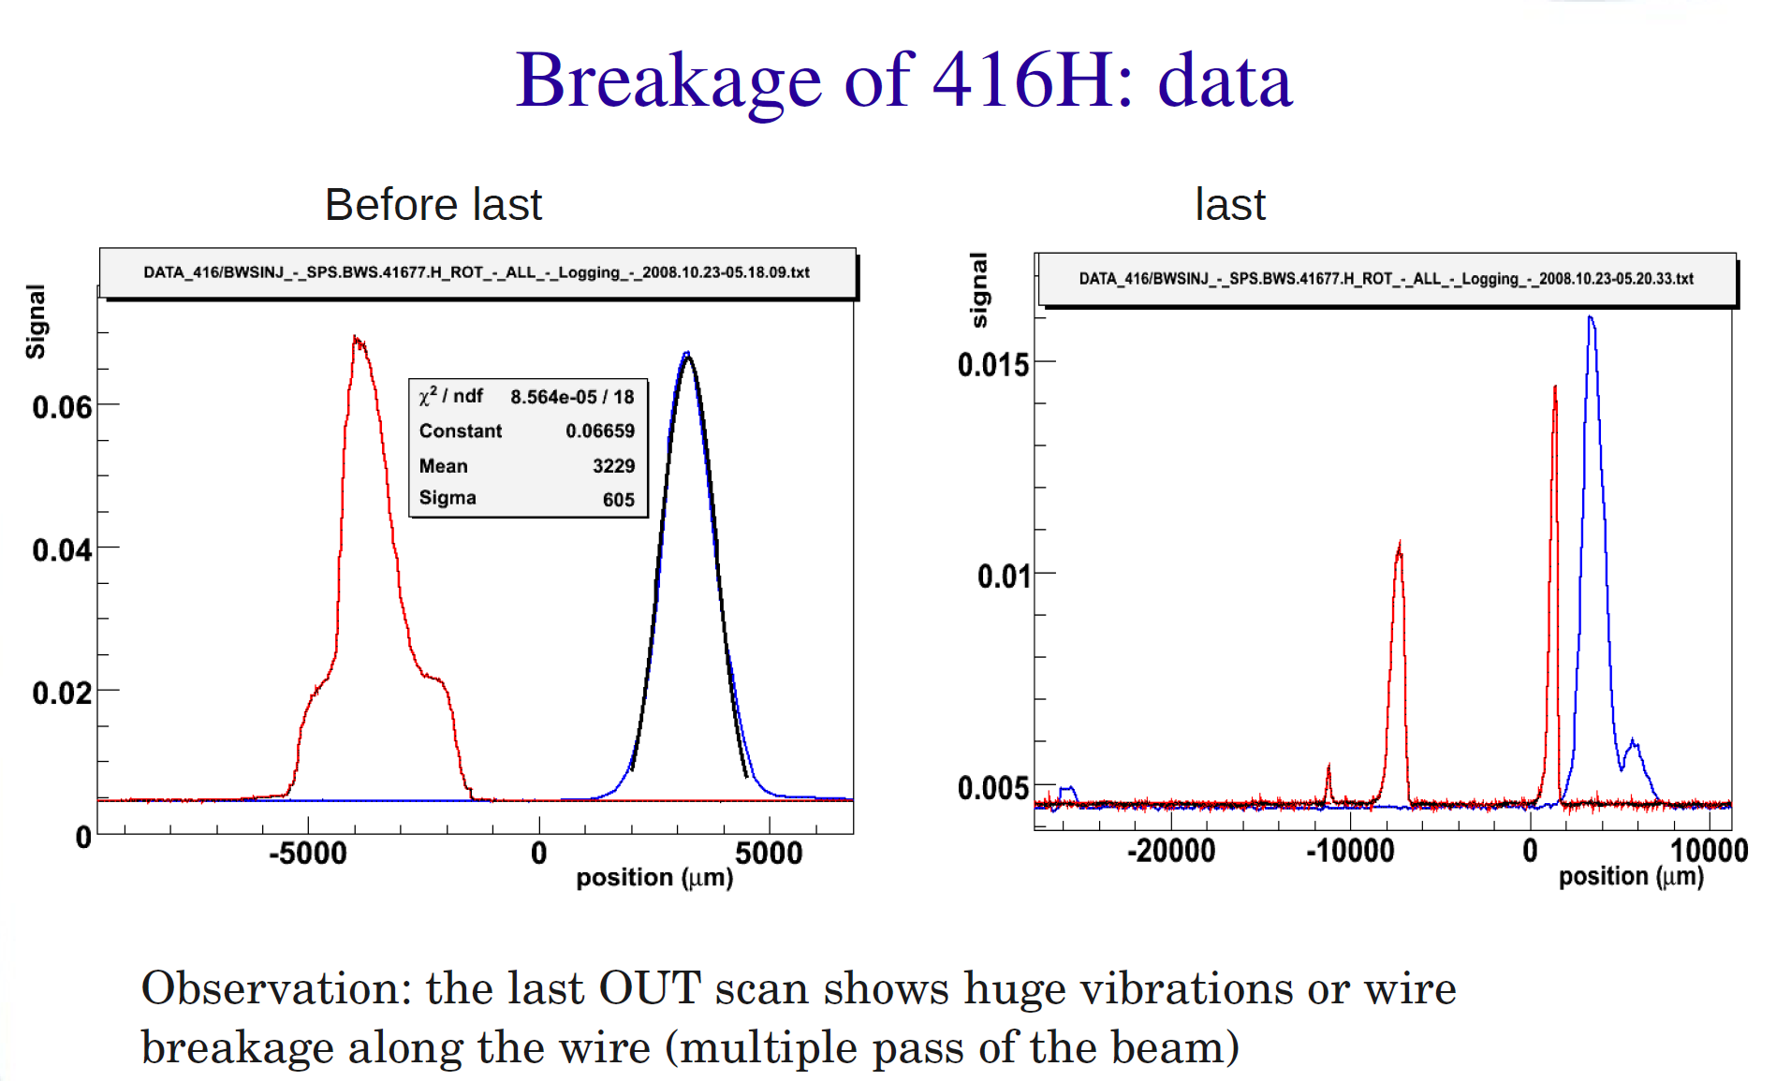
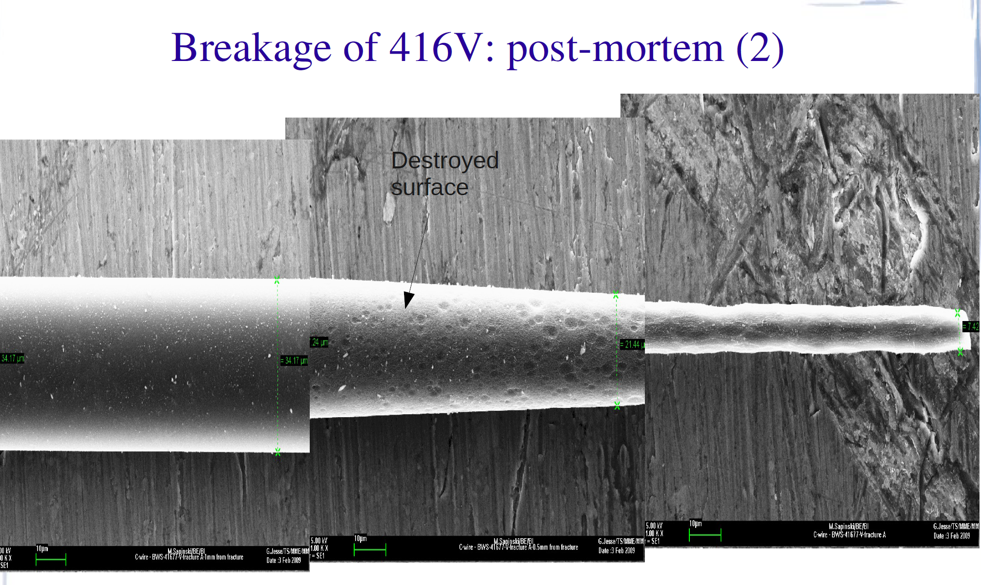
SPS experiment, 2008
Scanners used: 416V, 416H
450 GeV proton beam, coasting (reduce RF)
Breakage at 50-70 cm/s (nominal 6 m/s)
Scans before breakage suggest strong
wire deformation and/or vibrations
Electron microscope analysis shows
significant sublimation, from 34 µm
diameter down to about 6 µm
Model predicts temperature ~3500 K
95% of material sublimated before the
wire breakage,
carbon fiber is truly a strong material
Sublimation increases surface-to-volume ratio,
leading to better thermal behaviour
As a result of these experiments the limits
for LHC scanners were established
see: "Carbon Fiber Damage in Accelerator Beam", proceedings of DIPAC 2009, CERN-BE-2009-028

Slide 4
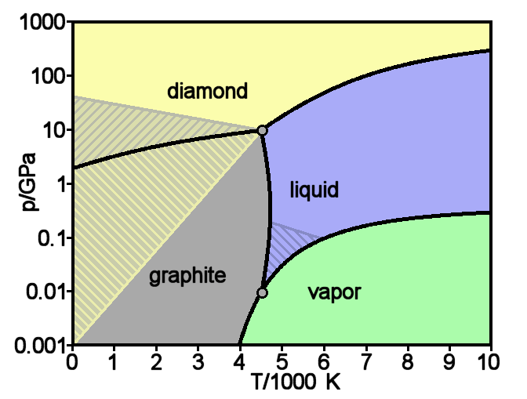
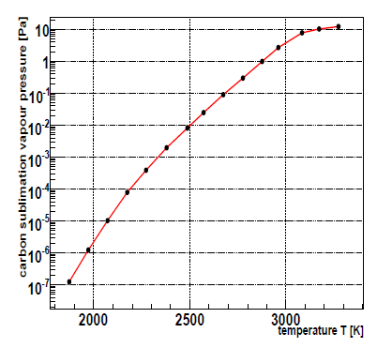
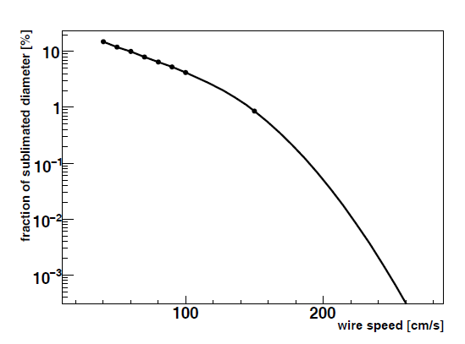

Sublimation calculation
In vacuum graphite does not melt, it sublimates
Sublimation rate can be calculated using simplified
model assuming steady-state conditions:
$dD/dt$ = ½ v_{vap}(T) $\frac{ρ_{vap}}{ρC}$,
vapour density computed from vapour pressure
Measurements: 2 times more material sublimated than
foreseen by the model, what is large error but not
completely crazy result
Simplified carbon phase diagram
see: “Carbon Fiber Damage in Particle Beam", 46th ICFA Advanced Beam Dynamics Workshop on High- Intensity and High-Brightness Hadron Beams, Morschach, MOPD61

Slide 5
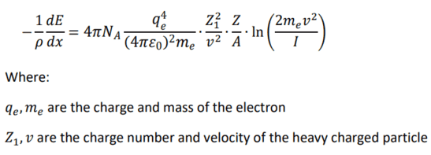
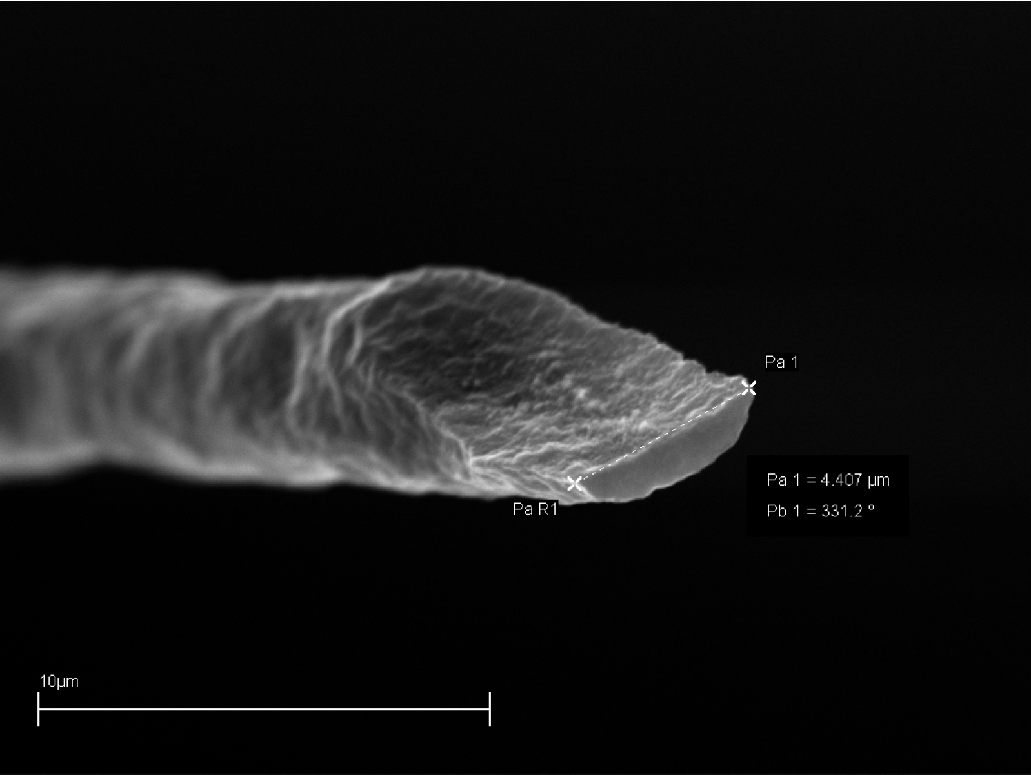
SPS experiment with Pb⁸²⁺, 2011
Goal: test wires with ion beam
Ion energy deposition Z² higher than protons
(this is why GSI do not have wire scanners)
SPS scanner used: linear horizontal
450 ZGeV Pb⁸²⁺ beam
Wire never broke with the beam, even at the
smallest registered velocity of 2 cm/s
It broke during the process of removal
Electron microscope shows sublimation down to
7.7 µm
Reason why wire did not break remains a mystery
  z² law does not apply to thin targets?
  δ-electron cooling is much stronger than
  for protons?
If confirmed, this could open the possibility to use wire scanners in heavy ion machines…

Slide 6
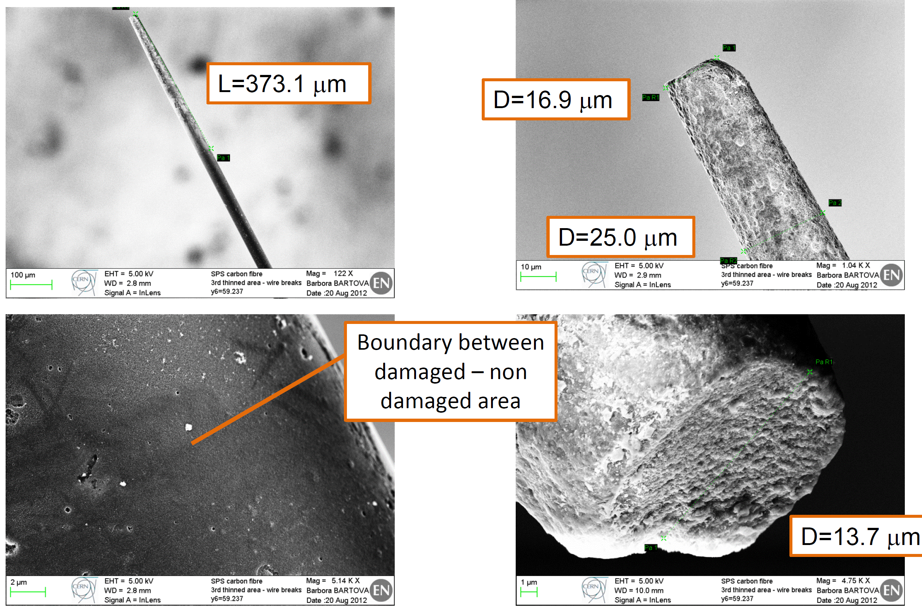
SPS breakages (protons, 2012)
Experiment in which wire was irradiated in 3 places with increasing intensities
Surface damage already at relatively low intensities, sublimation damage consistent with previous observations

Slide 7
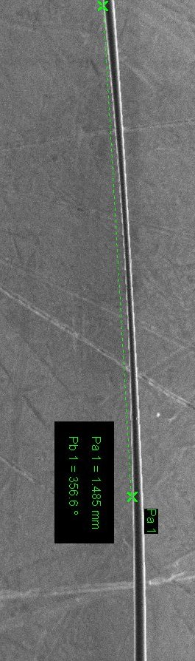
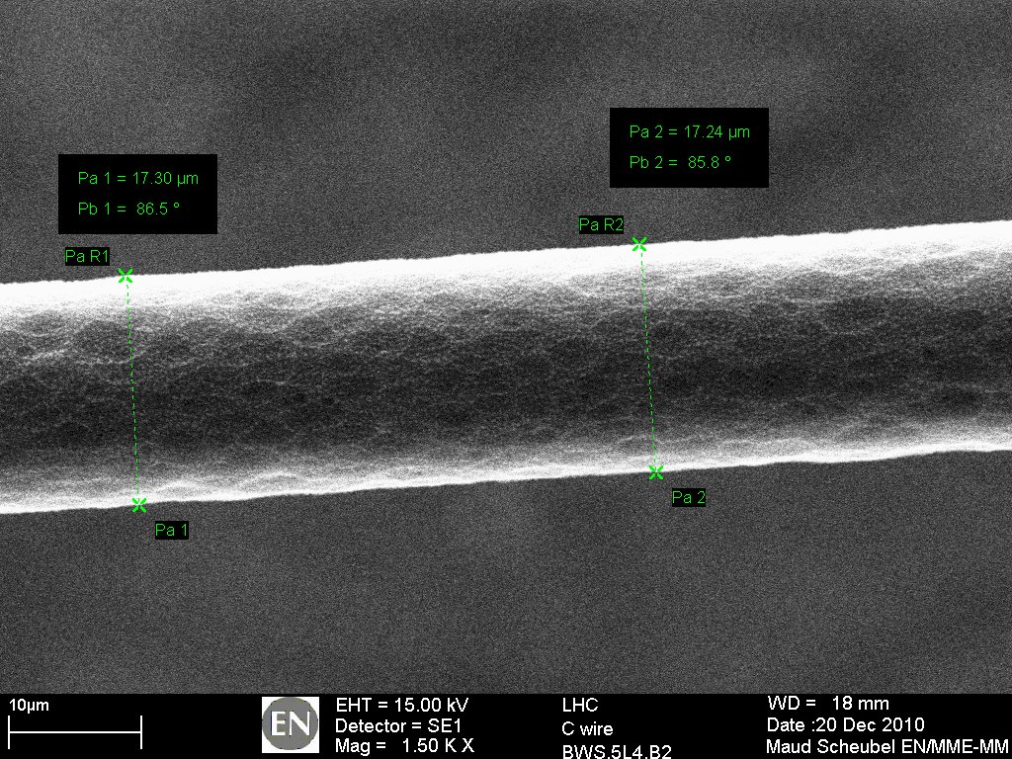
LHC quench test (protons, 2010)
3.5 TeV proton beam
Goal: to quench the superconducting magnet NOT to damage the wire
Wire recovered in one piece
Analysis with electron microscope: familiar sublimation images
see: “LHC magnet quench test with beam loss generated by wire scan” , in Proceedings of IPAC11,
WEPC173, CERN-ATS-2011-062

Slide 8
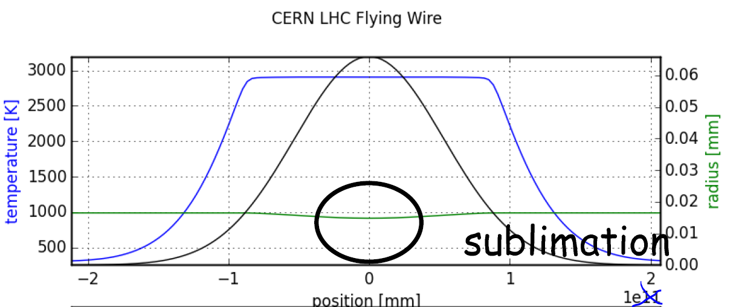
Pitfalls of sublimation
One may think that controlled sublimation is a legitimate wire scanner operational mode but:
Thinner wire = less signal from the beam center → potential measured profile deformation
Fortunately, because of “stabilizing effect” of thermionic emission on temperature, effect is not as strong as one could think, but still “controlled sublimation” operation is not recommended
It could be a nice subject for a summer student
Notes:
Scanning is in the «other» oplane, so wire diameter nonuniformity should not affect the measurement of the sigma, at least for gaussian beams – how to express it?

Slide 9
RF damage
RF can be generated by beam or can leak from RF cavities
Metal or semimetal (graphite) wire is a good antenna, therefore there is a rich record
of wire damage due to coupling to RF
RF can break wire without the beam (in parking position)
Countermeasures:
  Damping RF using ferrites
  Changing tank geometry
  RF shields
RF heating is typically at the ends of the wire (no overlap with beam)
In CERN case the ends are copper-plated; different thermal expansion coefficients
In PSI case the breakage occurs at the glue surface
SPS
CERN-AB-2003-067 BI

Slide 10
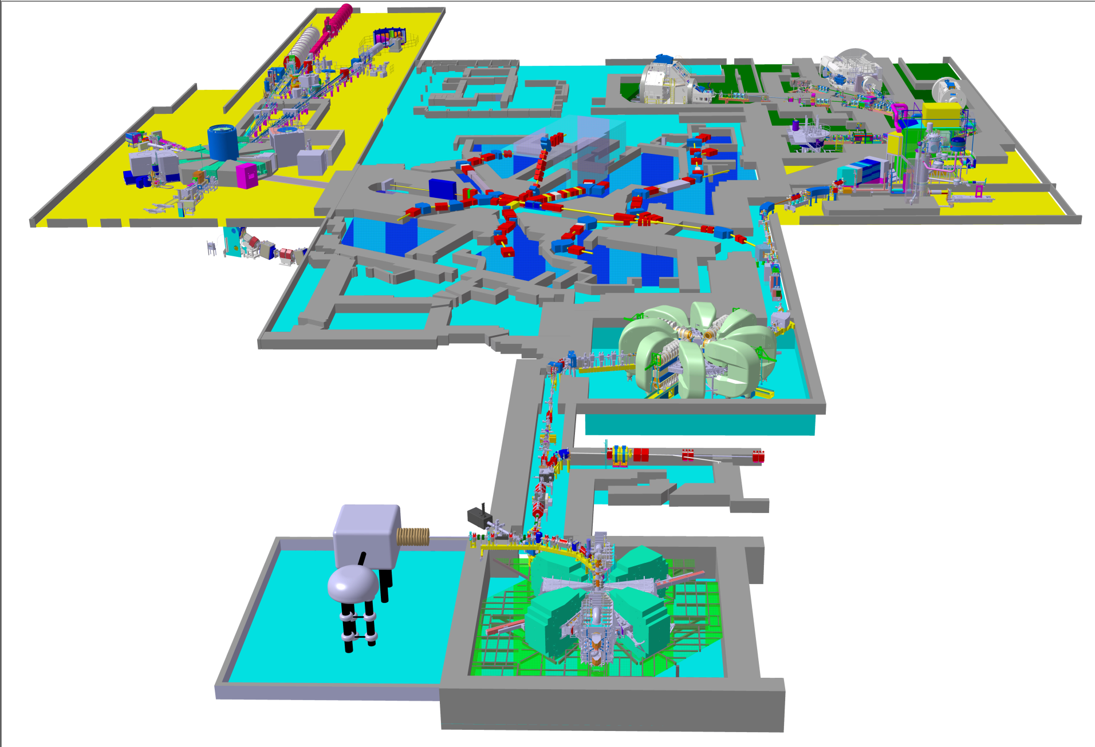
High Intensity Proton Accelerator Facility
PROSCAN
Gantry 3
Gantry 2
Gantry 1
COMET-Cyclotron
250 MeV, 1 μA
Meson
Facilities
Spallation Neutron Source
SINQ
Ultra Cold Neutron Source
Ring Cyclotron
590 MeV, 2.4 mA
1.4 MW CW beam
Cockcroft-Walton
870 keV, 30 mA
Isotope Production
Injektor 2-Cyclotron
72 MeV, 2.7 mA

Slide 11
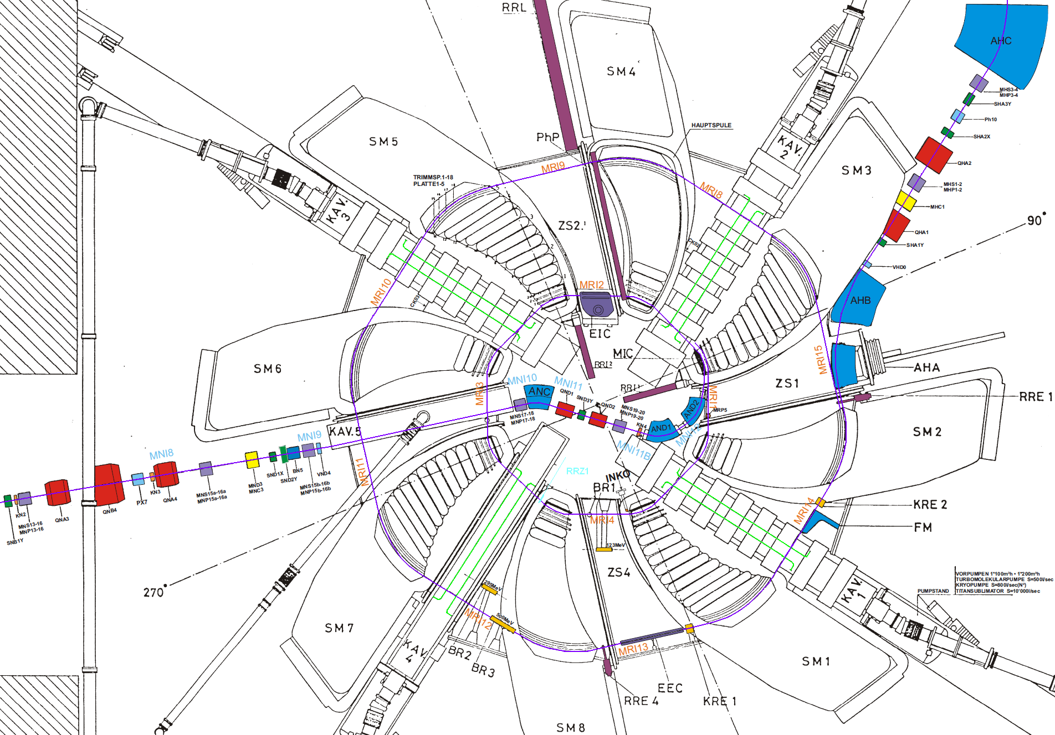
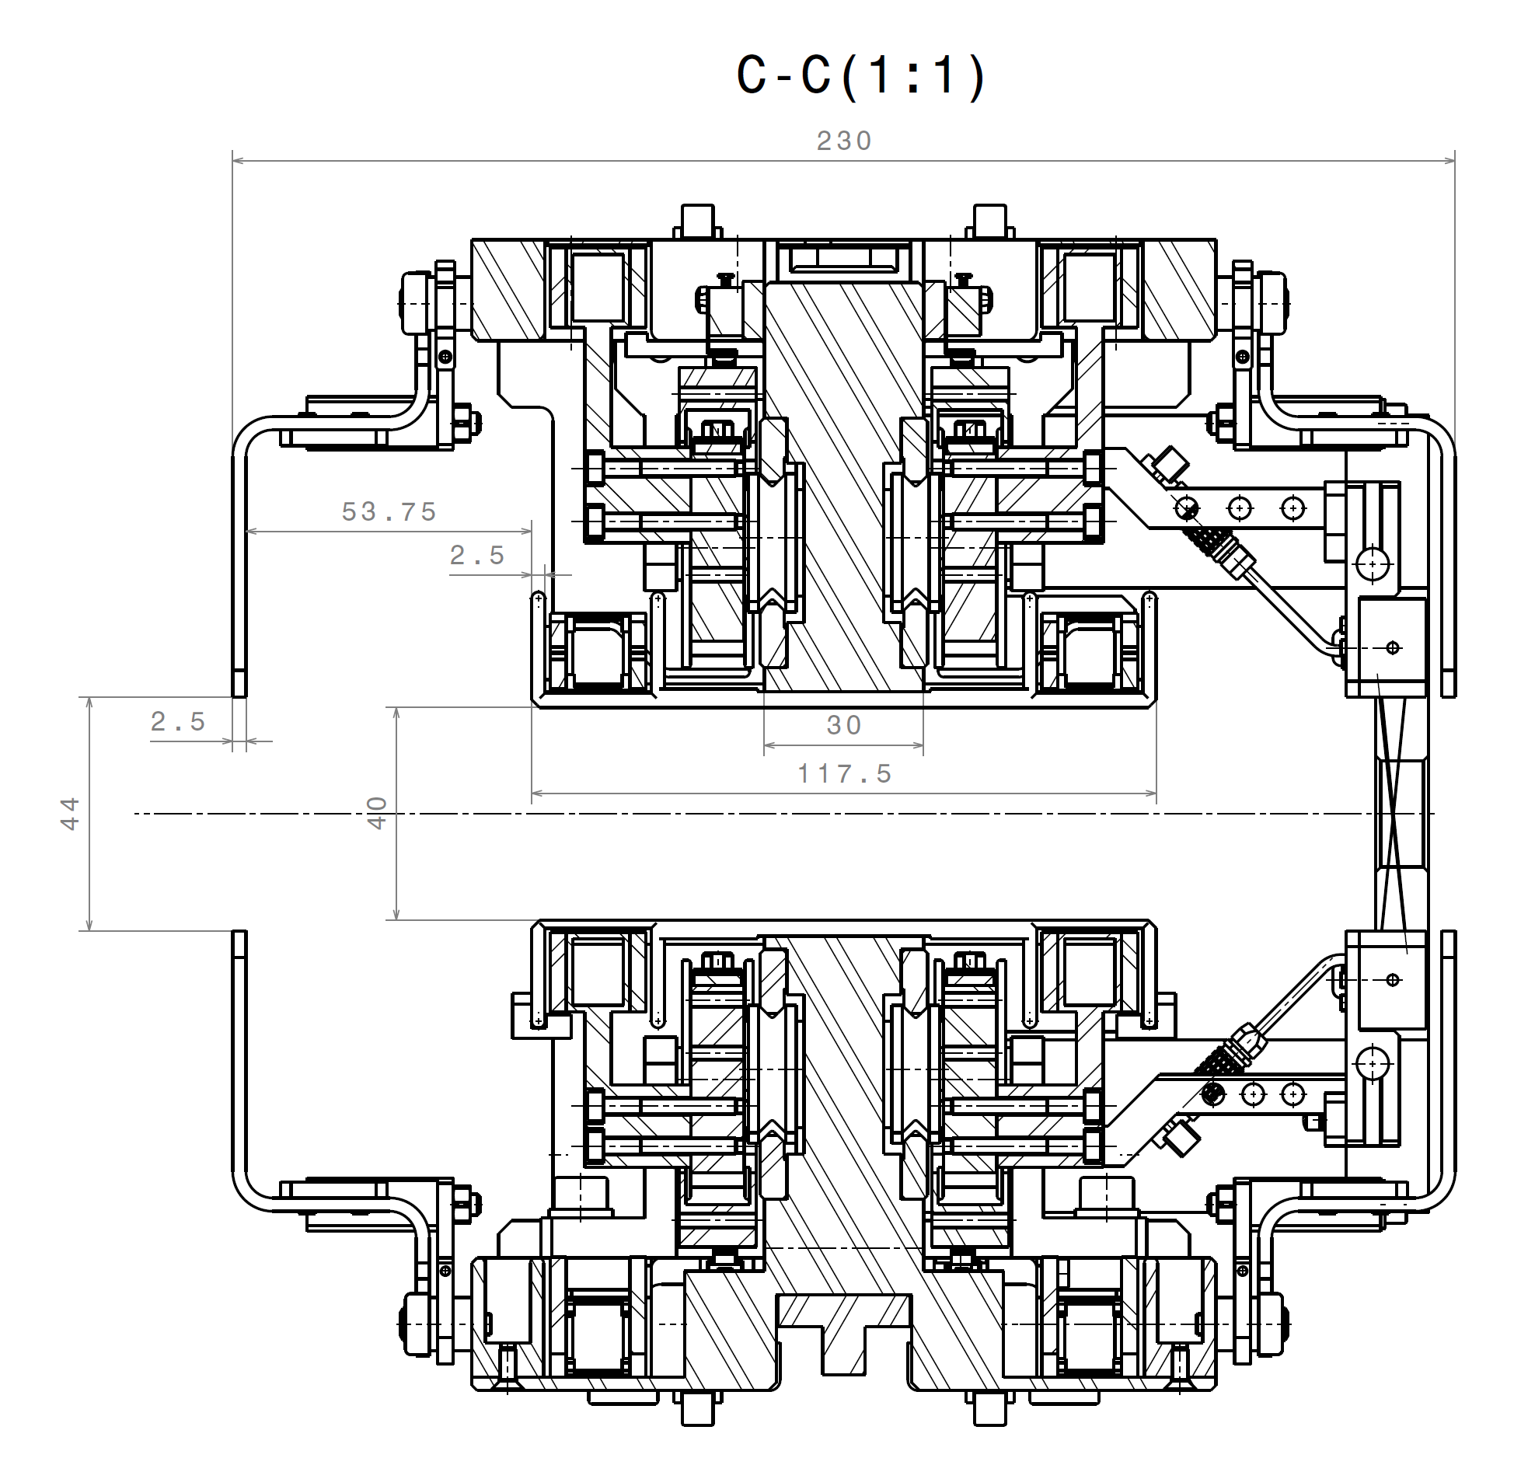
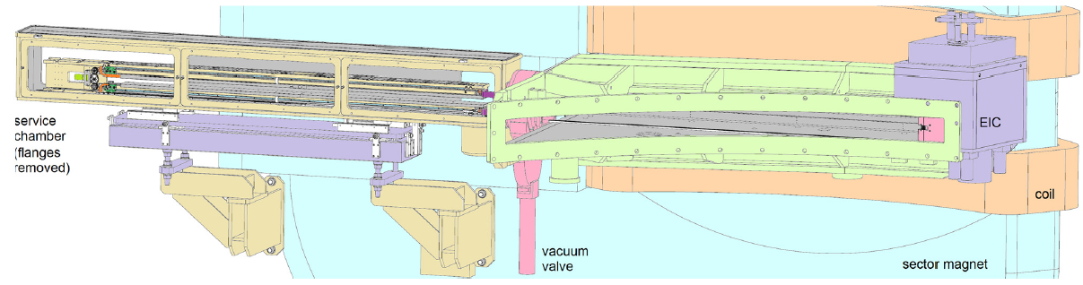
RF damage in cyclotron
Sector cyclotrons are filled with cavities
Long radial probe is a special, very long (2.5 m)
wire scanner designed to scan all turns (180) of
a cyclotron
RF shields in
anticipation
of problems
100 µg
2.5 m
1 MW, 50 MHz
1 MW, 50 MHz
1 MW, 50 MHz
1 MW, 50 MHz

Slide 12
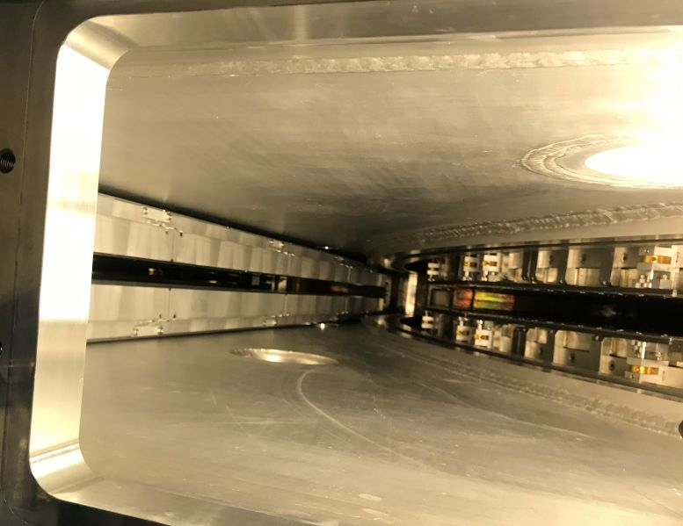
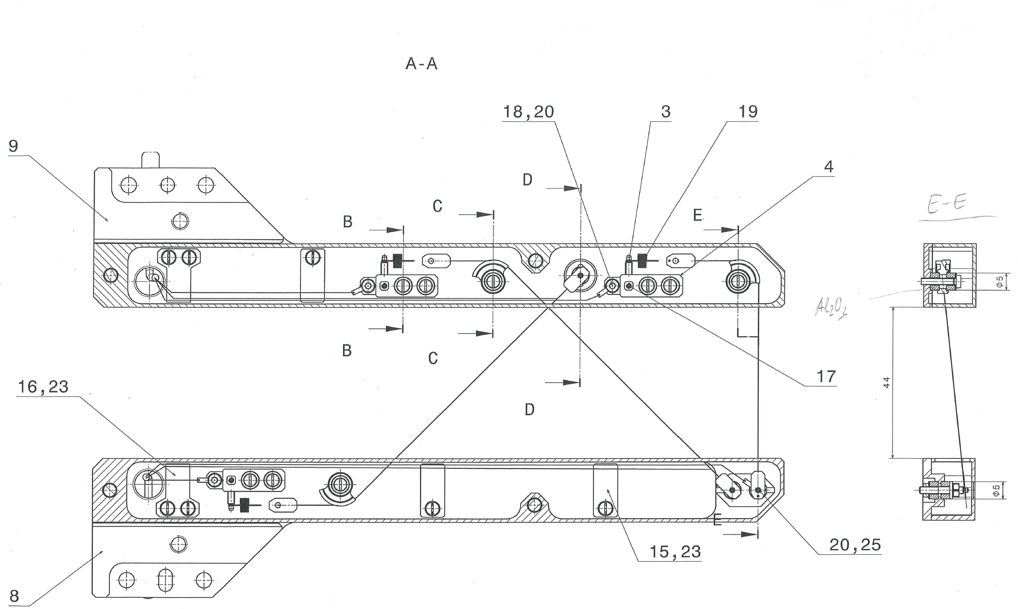
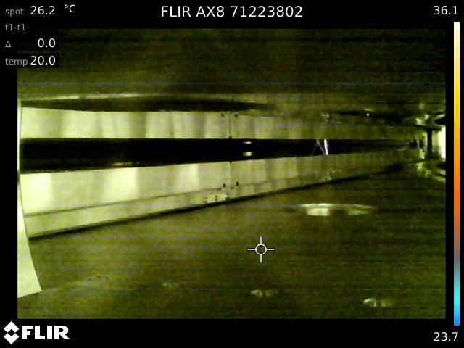
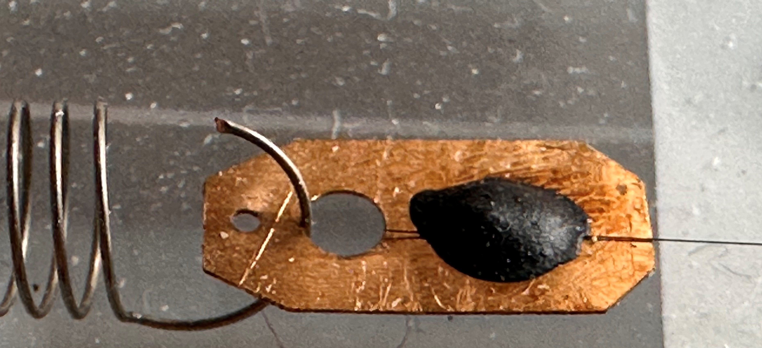
RF damage in cyclotron - observations
Wire getting hotter towards the center of the cyclotron
Breakage usually at wire bending or wire-glue interface
Breakage when neighboring cavities are powered
asymmetrically (eg. one on and one off)

Slide 13
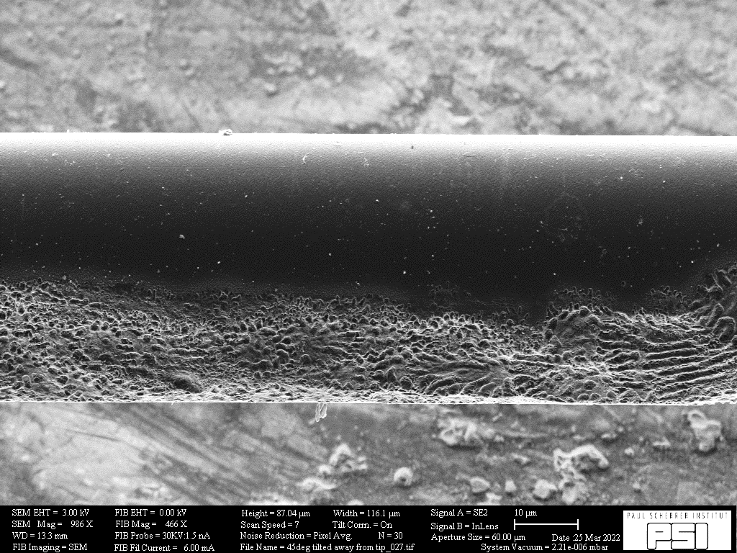

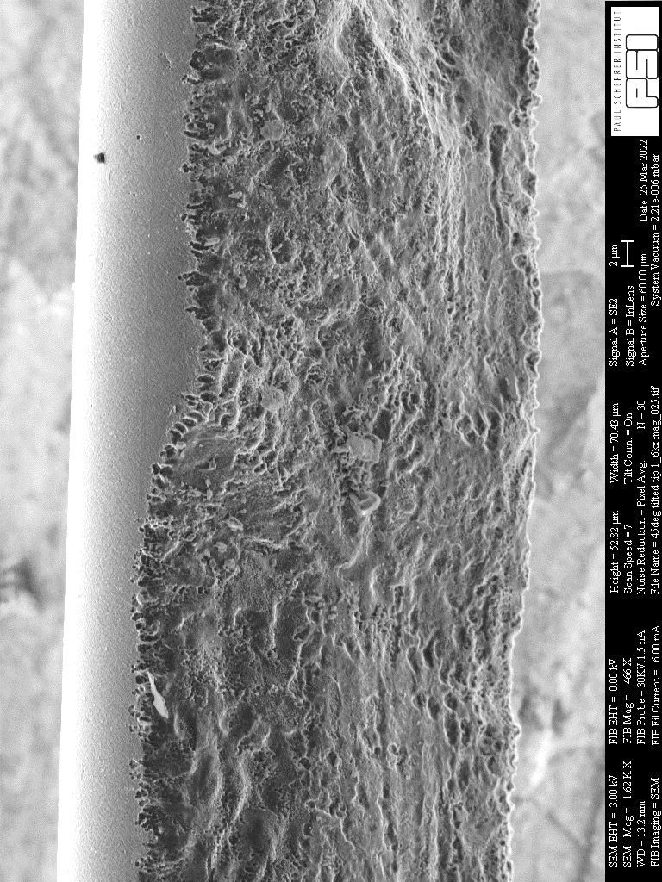
RF damage in cyclotron - observations
RF imbalance leads to imminent breakage
Skin effect? Let’s check:
ρ=8∙10⁻⁶ [Ωm] – at room temperature
µ=1.26∙10⁻⁴ [H/m]
ω = 2 π 50 [rad*MHz]
→ δ = 19 µm – close enough!
It is possible that RF leaking from opposite cavities undergo destructive interference in the location of the wire saving it from damage

Slide 14
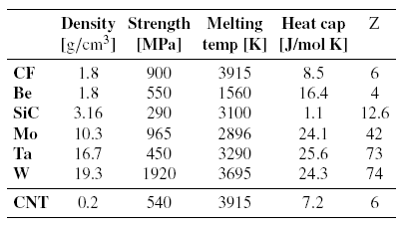
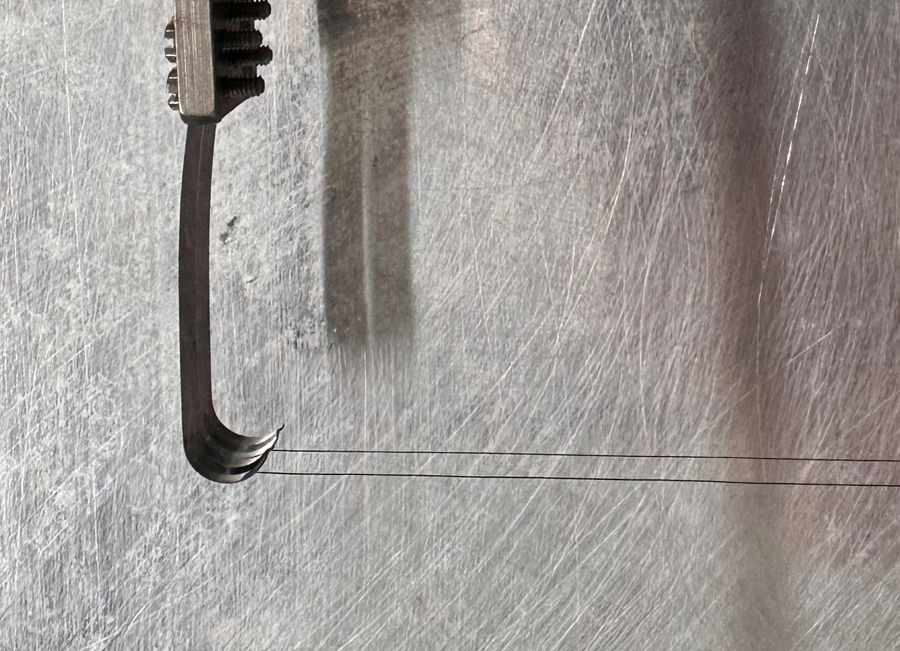
Metal wires
Metal wires are easier to mount and less fragile to transverse bending forces
We use 24-µm Molybdenum wires in less critical areas
Wires must be tensioned (pre-stressed) to keep their shape
The pre-stress is much below the proportional limit
at room temperature
spring mechanism
400 MPa

Slide 15
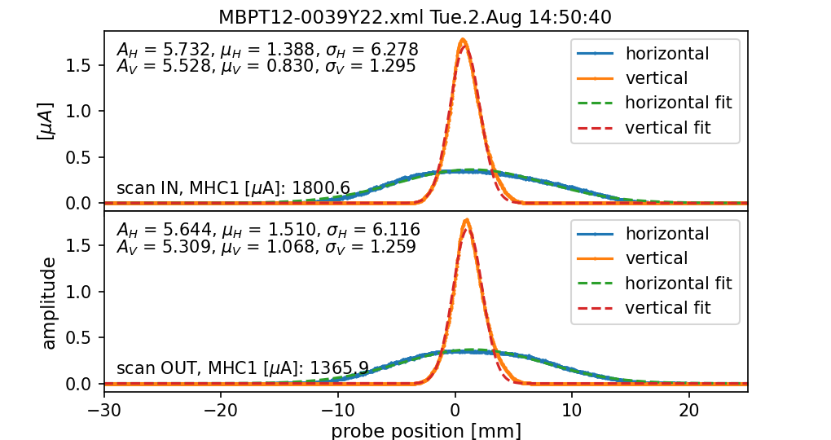
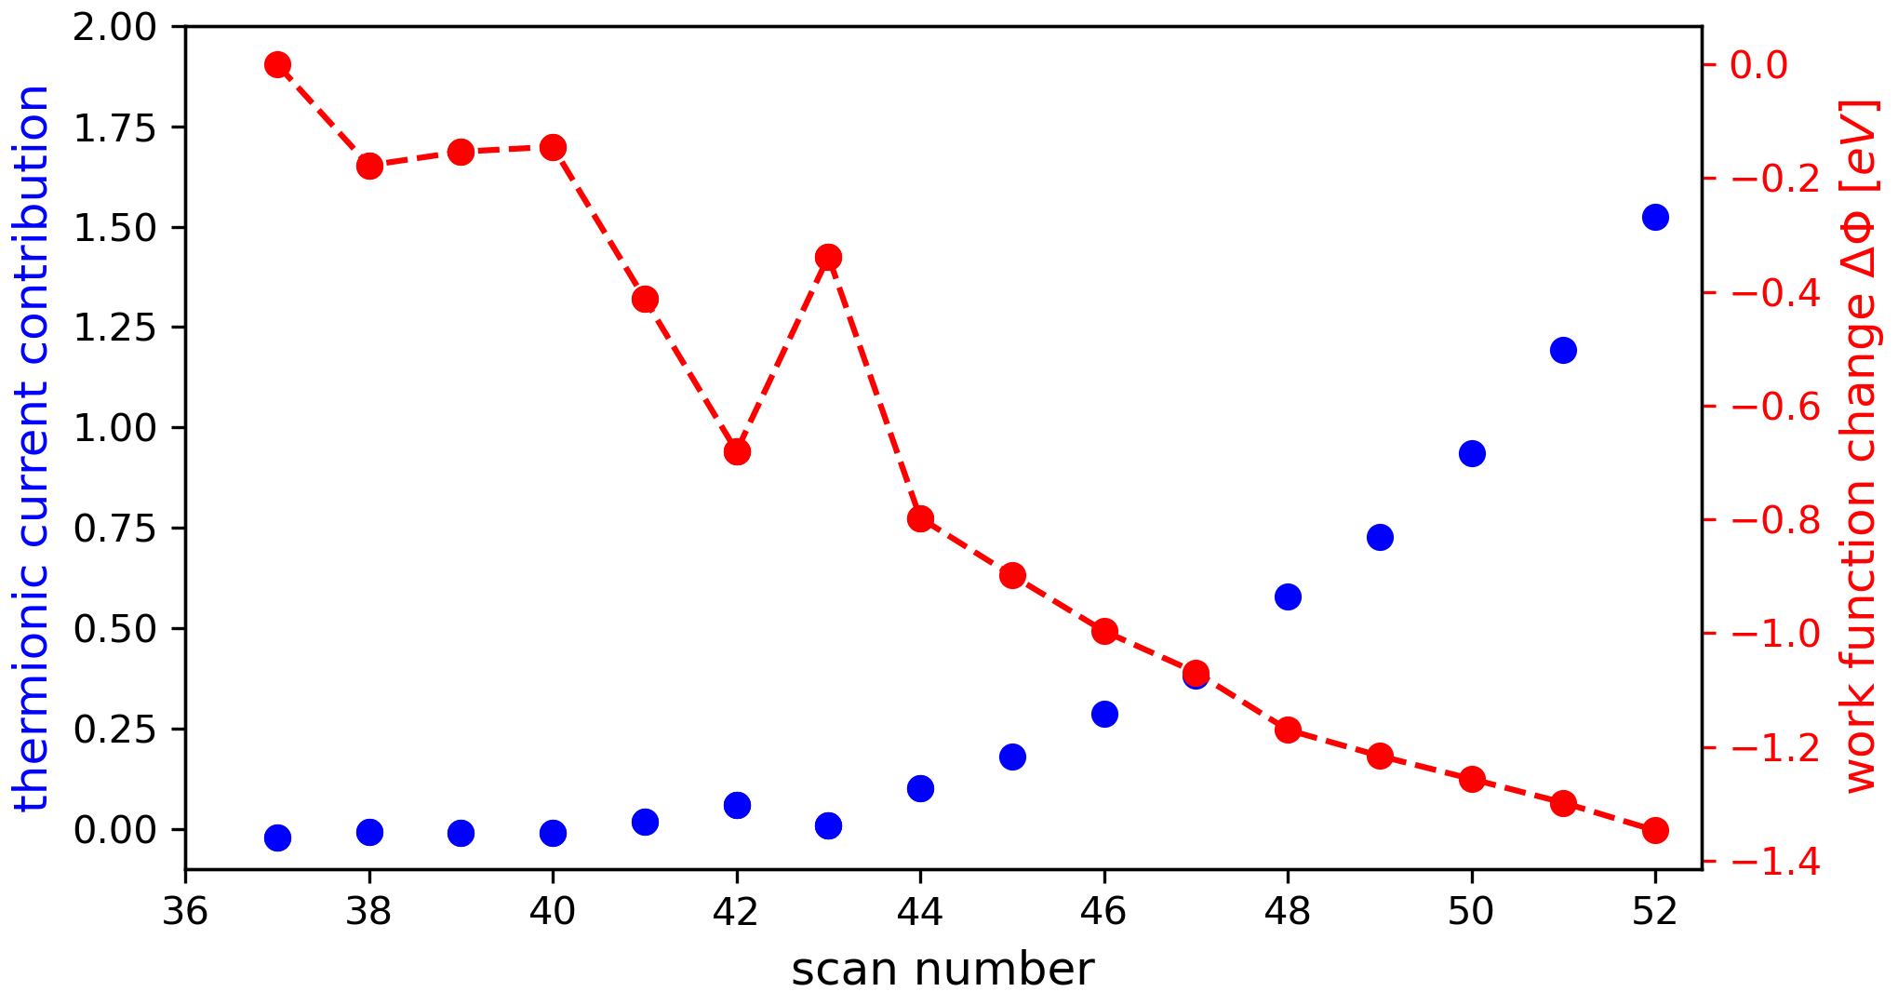
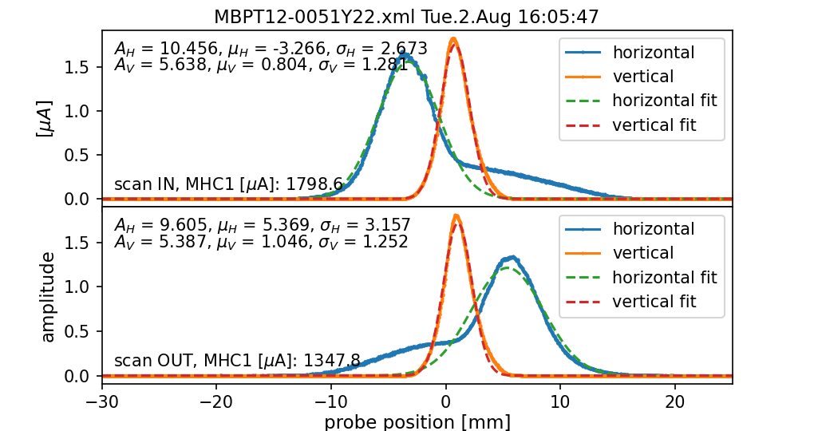
Damage event
In 2022 a brand new wire in a wire scanner on Ultra Cold Neutron beamline broke after ~20 scans
For each scan the beam conditions were always the same:
  Beam current 1.8 mA
  Beam energy 590 MeV
  Beam size: σ_{H} = 6.2 mm, σ_{v} = 1.3 mm (very asymmetric)
  Wire speed 60 mm/s
During the consecutive scans thermionic emission appeared and steadily increased

Slide 16
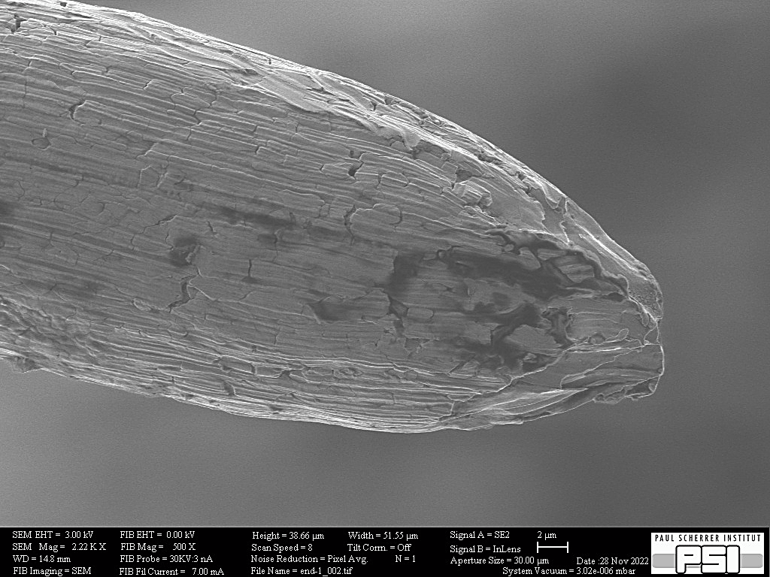
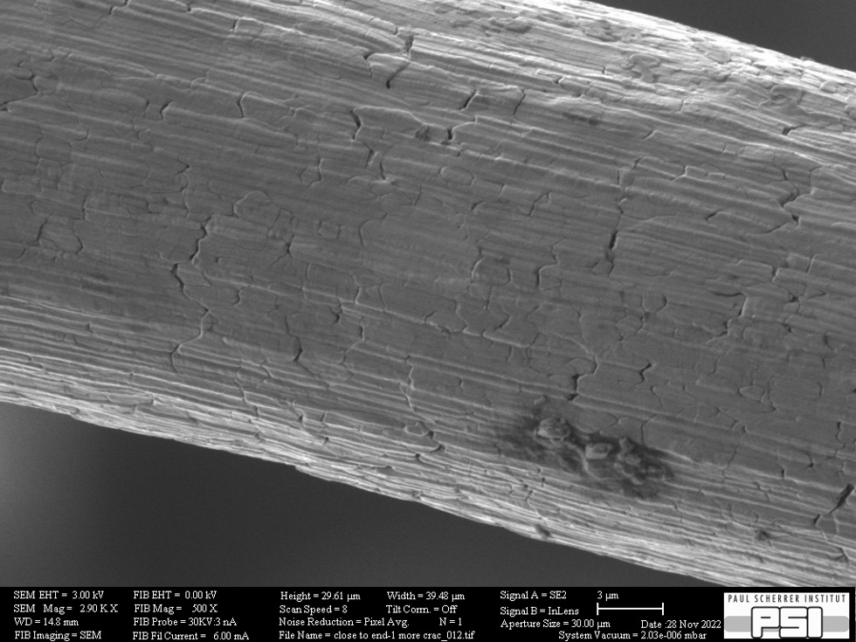
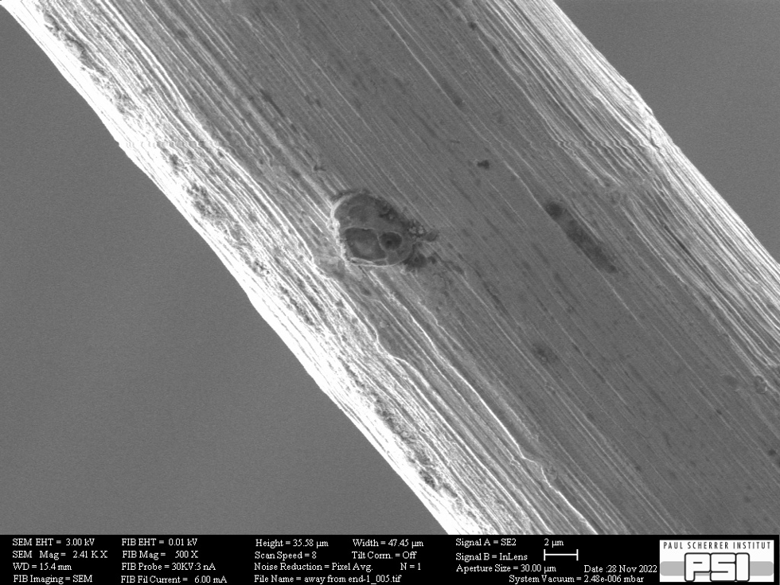
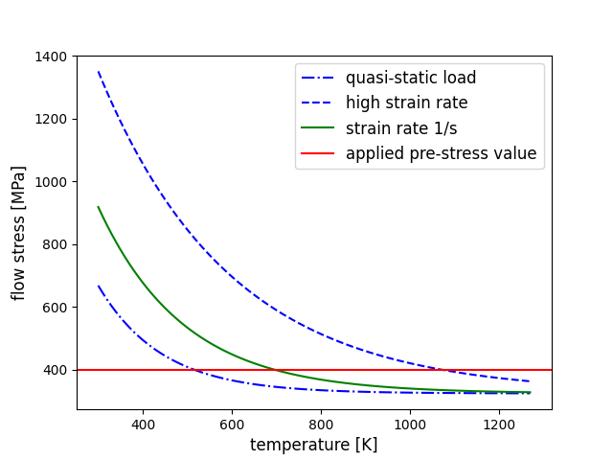
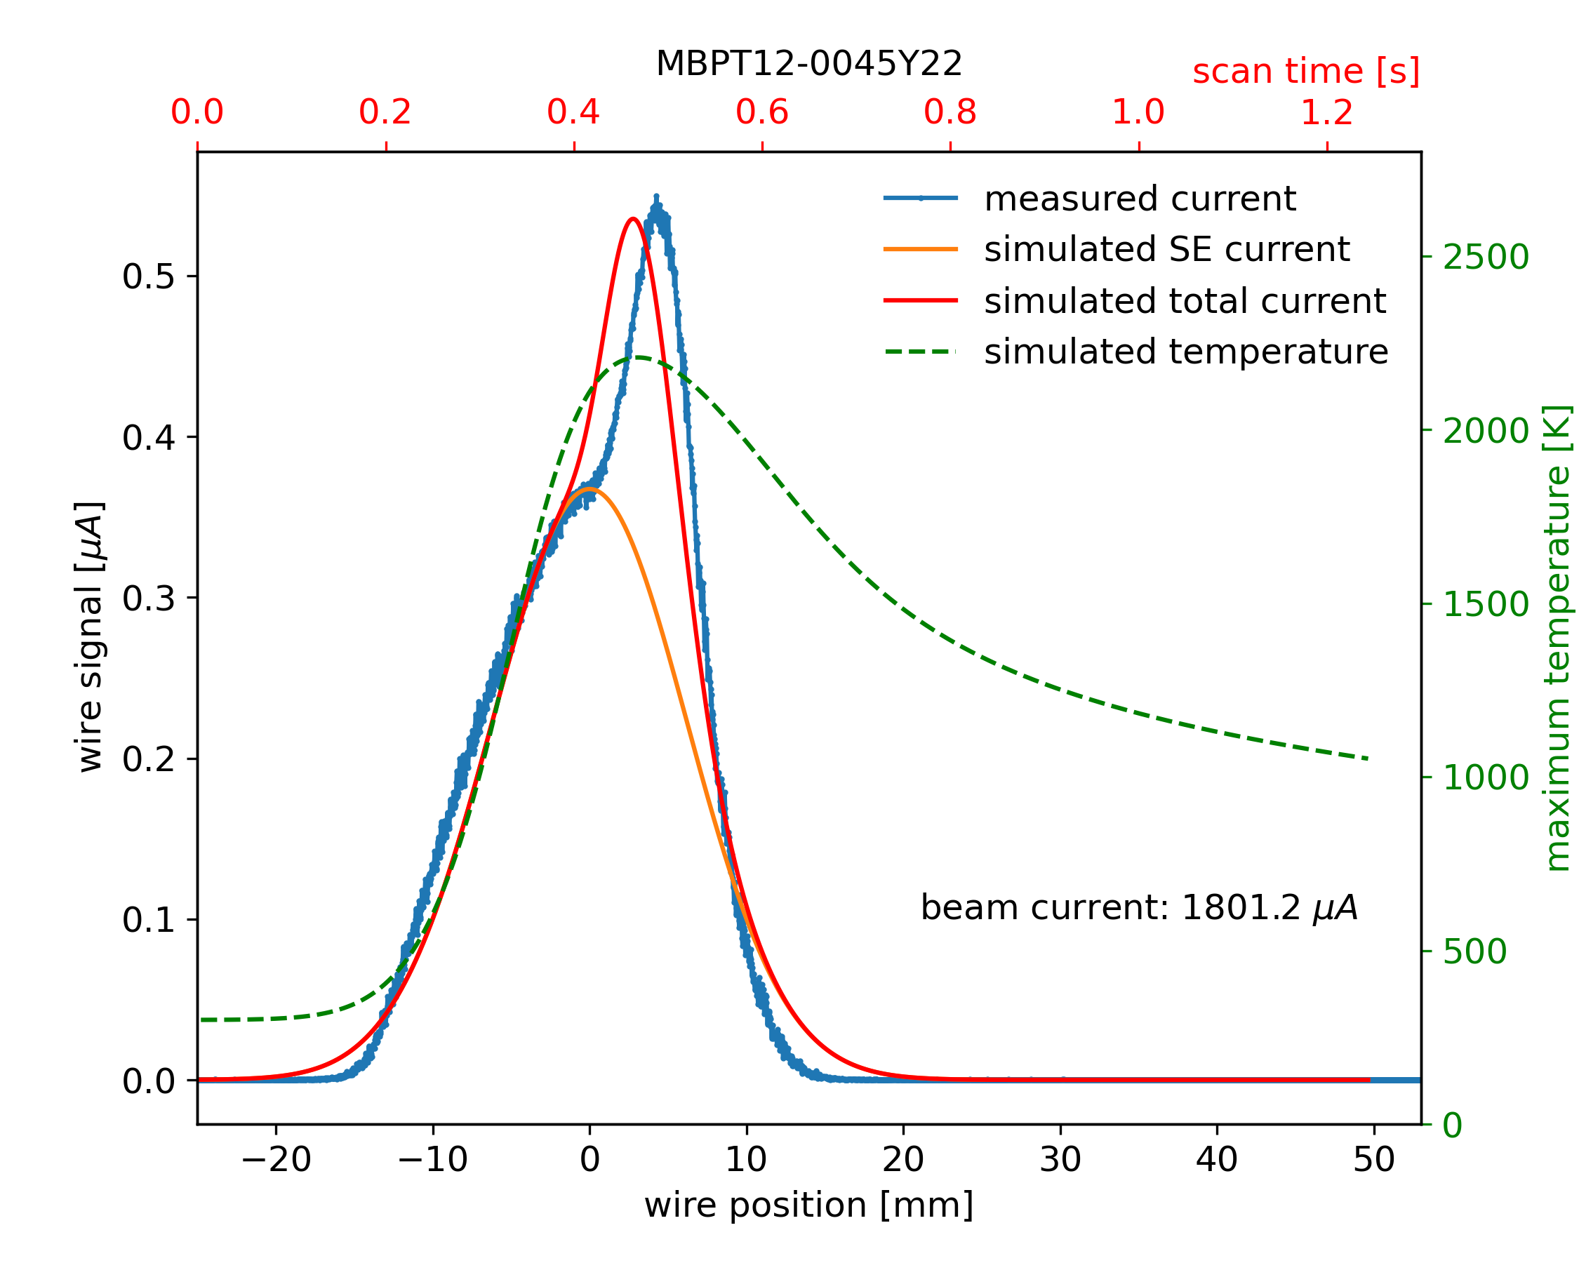

Ductile damage
Electron microscope analysis revealed characteristics of ductile damage
Thermal simulation show temperatures far from melting, but easily exceeding the flow stress value at higher temperatures
The increase of the thermionic emission could be due the cracking of the wire surface which
lead to decrease of work function
Some prior observations of similar effects exist
necking surface cracks pristine
THPL151

Slide 17
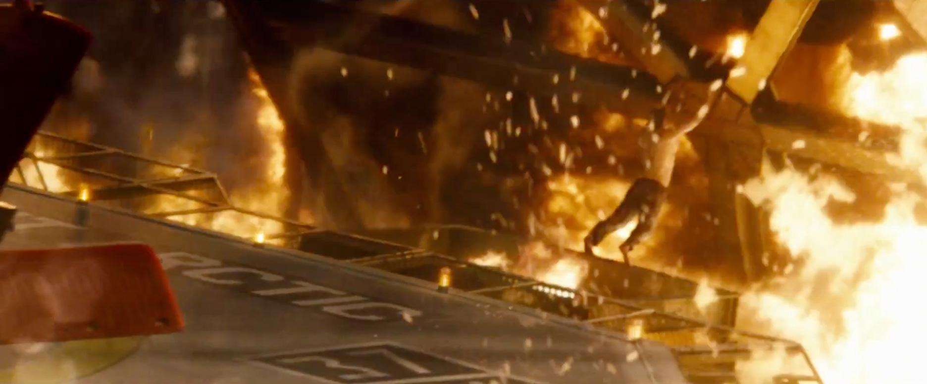
Sumary and conclusions
Sublimation is the main damage mechanism for carbon fibers in high-power beams
Sublimating material is a “negative feedback” phenomena:
increased Surface-to-Volume ratio leads to lower temperatures
But wire with varying diameter affects beam profile measurement (is it negligible?)
RF coupling is a major issue at PSI and CERN, but for very different reasons
In case of metal wires the damage could be due to decrease of proportionality limit with increasing temperature
Open points:
  Unexpected resistance to ion beam
  Impact of wire nonuniformity on measured profile
  Is RF skin effect really visible on carbon fiber?
  Can surface cracks explain increase of thermionic emission?
Superman (Clark Kent), 1978

