Slide 1
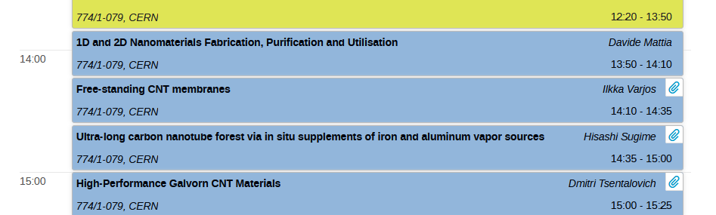
What I hope will come out of this workshop
Research institutes, universities and industrial partners will describe the state-of-the-art in material production around the world along with trends and future expectations [Session chair: Stefano]

Slide 2
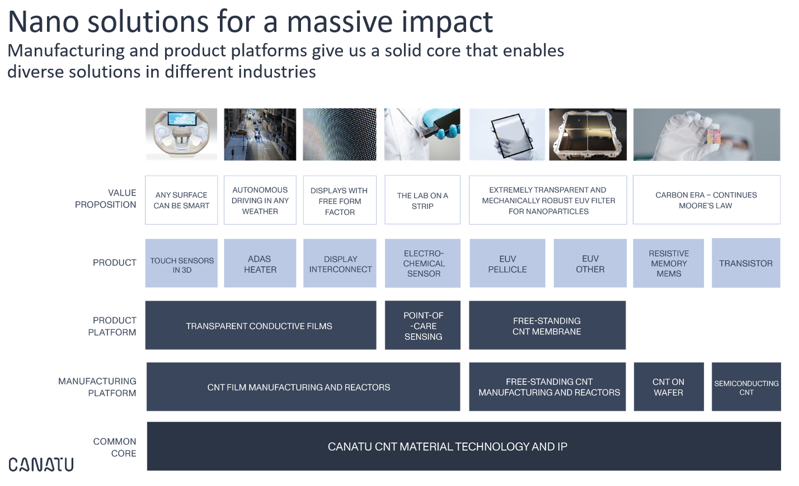
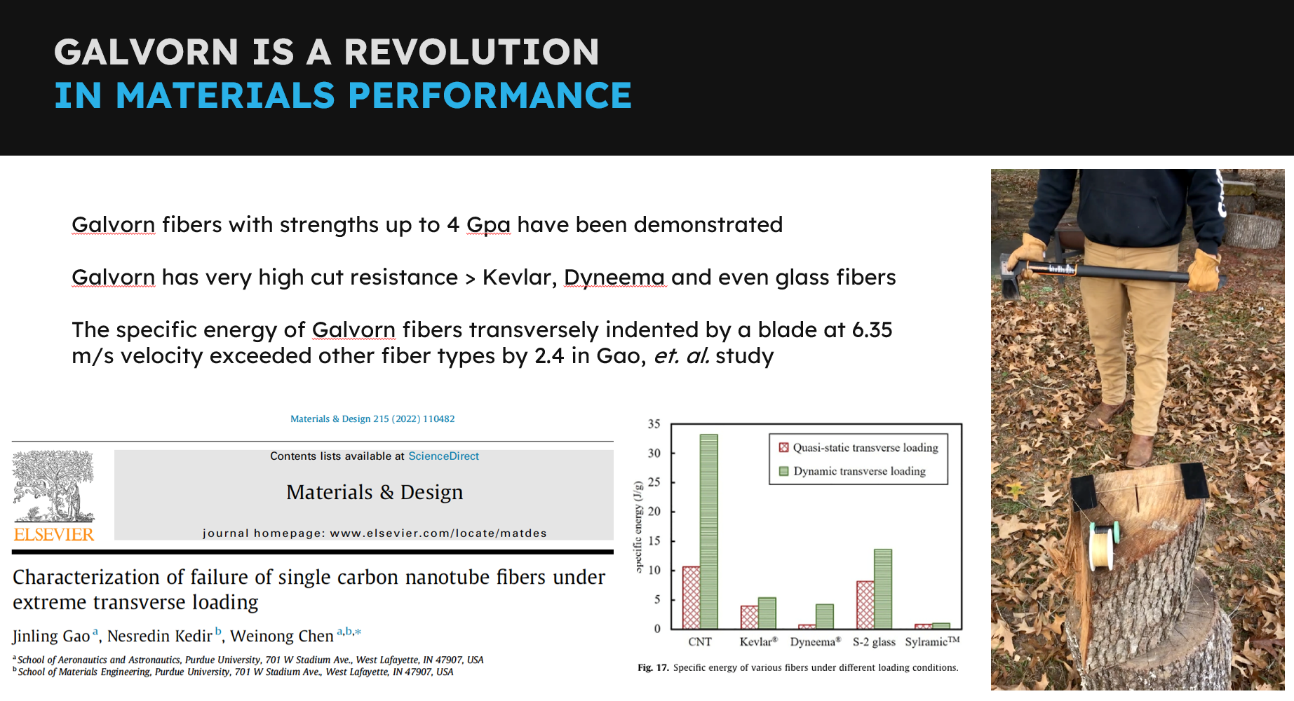
What I hope will come out of this workshop
State-of-the-art in material production around the world
  Understanding of the process (post-processing to improve conductivity, crystallinity, etc.)
  Industrial nano-solutions (Canatu, Galvon CNT materials)
  Not only CNT based materials (SiC, Polymer, Glassy C… NT)
  Not only wires, but fabrics and potentially wider use as structural materials
  Processing limitations (joining?)
  High strength achievable: reproducibility, reliability, dispersion of properties? (from 40 MPa to 4 GPa) → depends on product, location in the product

Slide 3
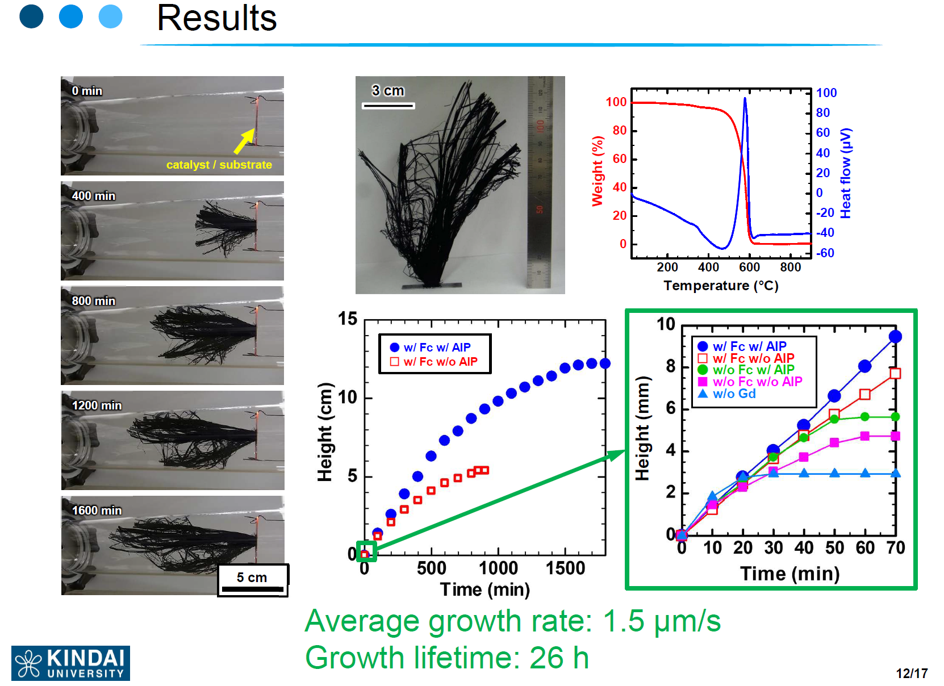
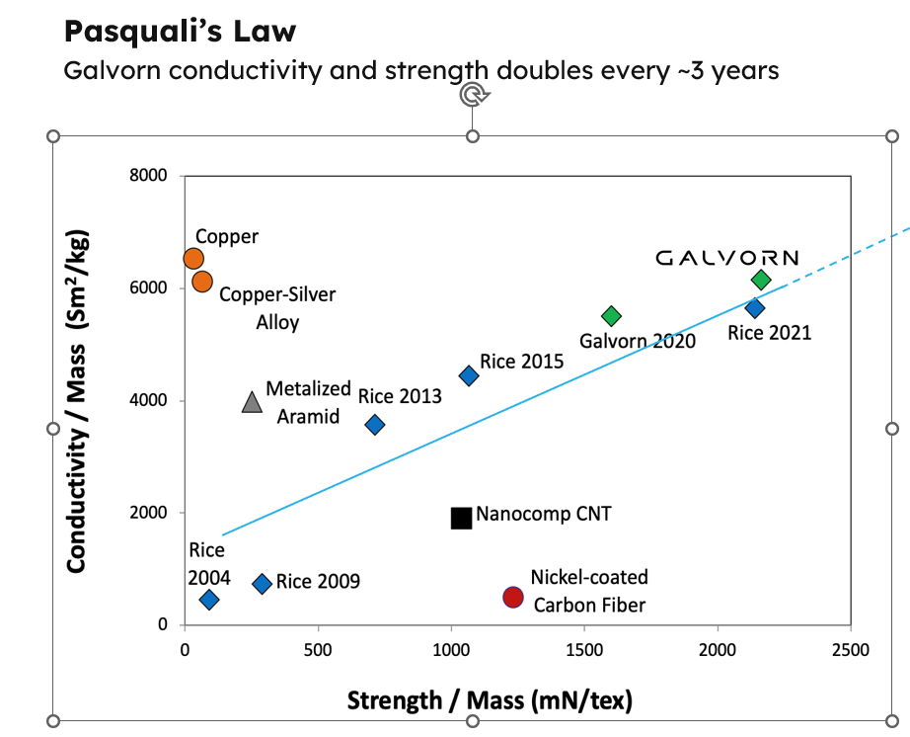
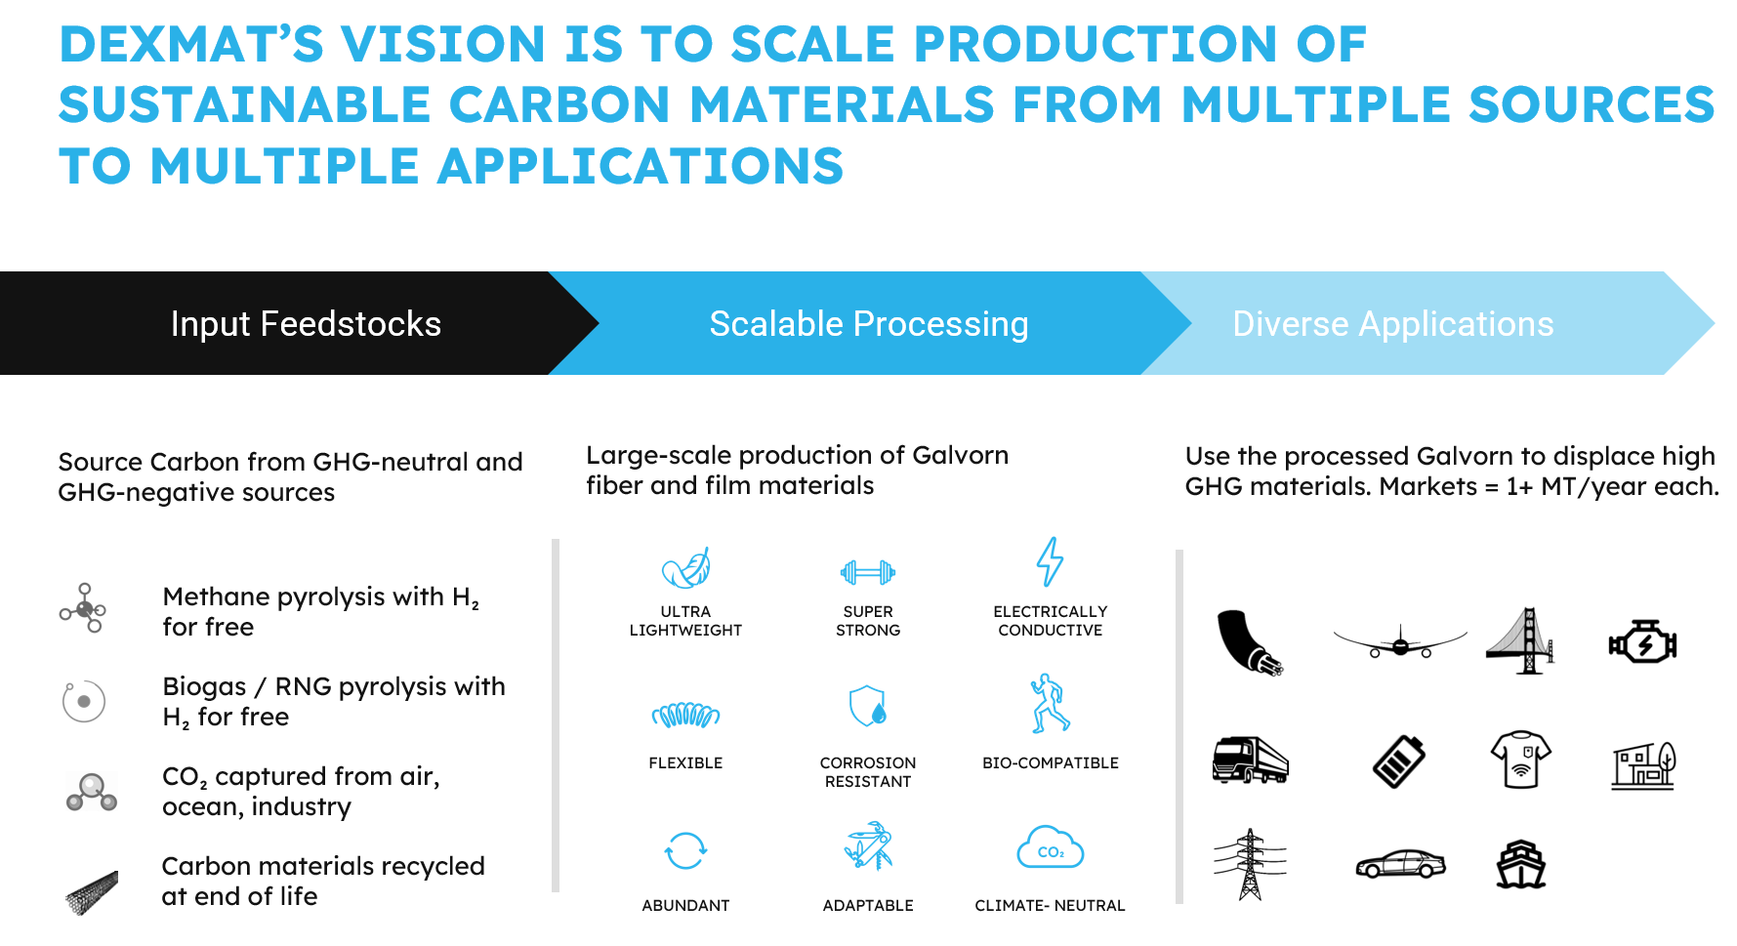
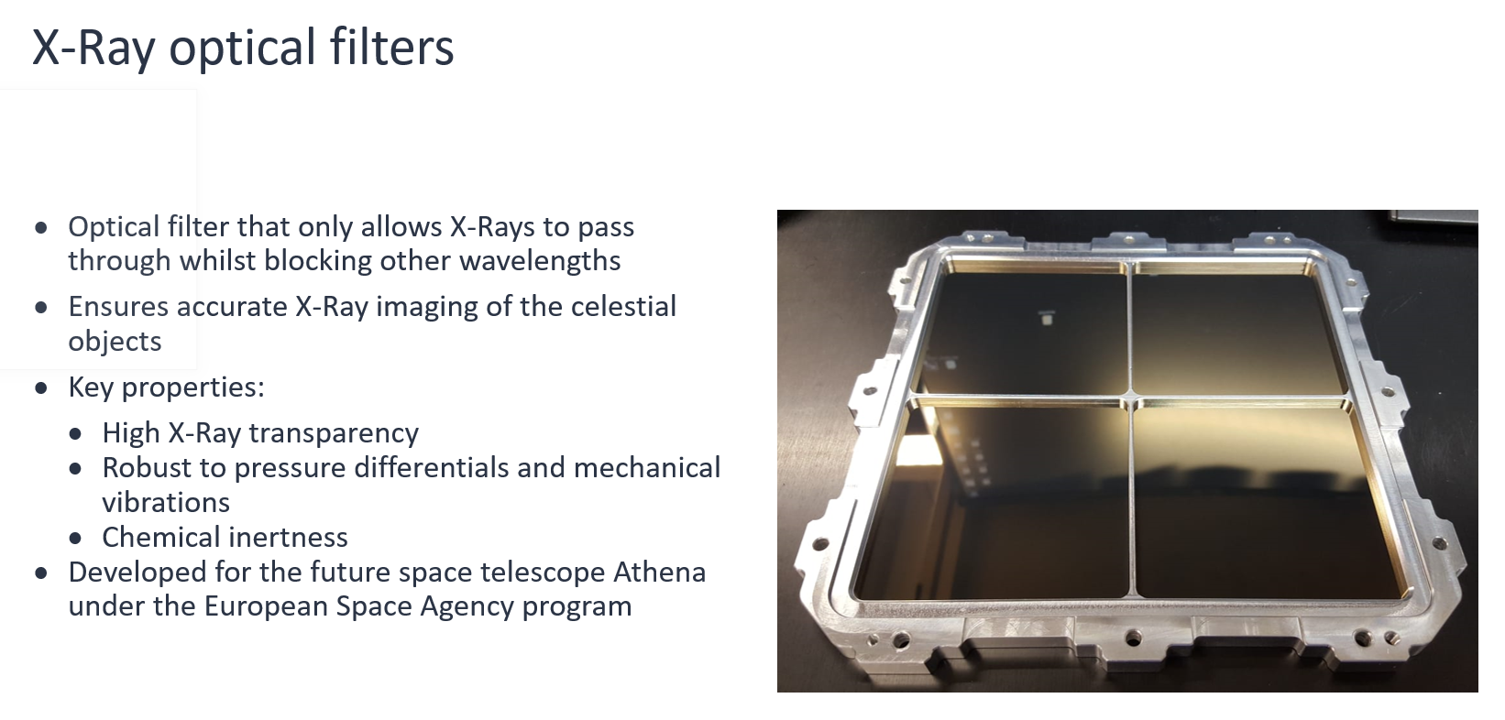
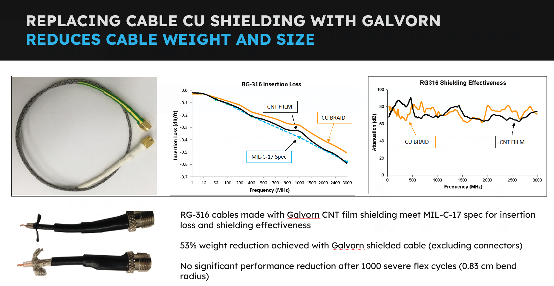
What I hope will come out of this workshop
Along with trends and future expectations
  A breakthrough method for growing a 14-cm-long CNT forest with an average growth rate of 1.5 μm s⁻¹ and a growth lifetime of 26 h was developed
  Electrical applications
  X-ray optical filters
  Continuous improvement
  of the specific strength

Slide 4
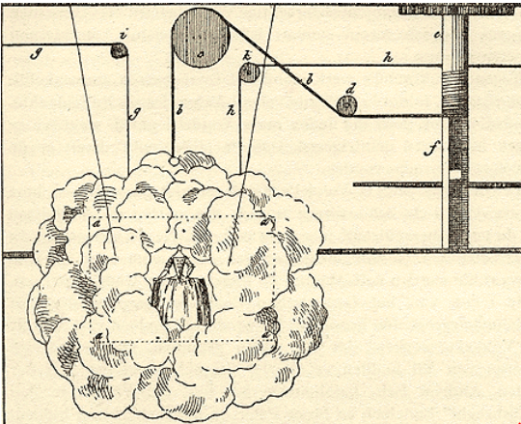

What I hope will come out of this workshop
  Deus ex machina?
  Free in exchange of feedback…

