Slide 1
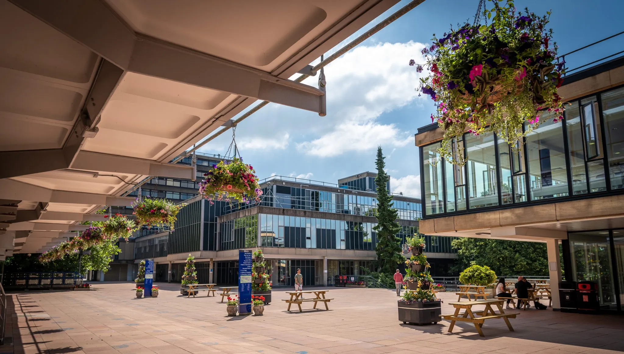
Mechanical characterisation of braided carbon nanotubes for wire scanners
Dr Alexander J G Lunt (ajgl20@bath.ac.uk) - @LuntAlexander

Slide 2
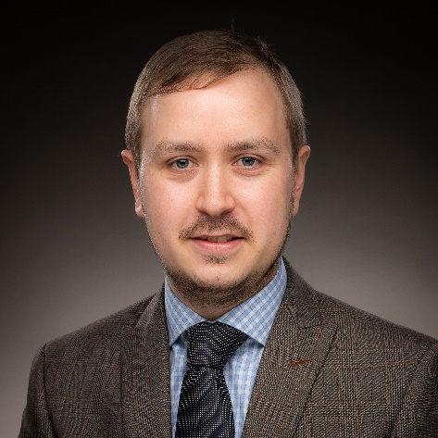
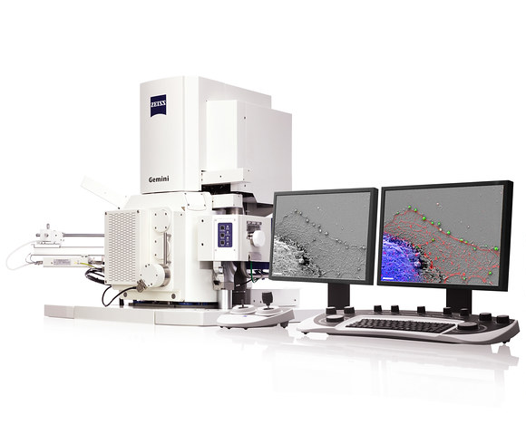
Introduction to the presenter
Dr Alexander J G Lunt
Senior Lecturer in Mechanical Engineering
Co-director of Integrated Materials, Processing and Structures Research Centre
Micromechanics – 11 PhD’s
  Non-destructive techniques: synchrotron, X-ray, neutron, CT
  Microscopy methods: SEM, FIB, TEM, AFM, Nanoindentation
Broad applications
  Metallurgy, composites, AM, biomaterials, batteries…
Strong industrial collaboration
  GKN, Carpenter Technology, Dowty, AVL, Rolls Royce…
Composites lead for Materials & Design
Notes:
Dr Alexander Lunt is a Senior Lecturer in Mechanical Engineering at University of Bath. He is a trailblazer in the world of materials engineering (70+ publications, £7m+ income) and leads a team of 11 PhD students working on topics ranging from carbon nanotubes to novel detector cooling joining methodologies, and from carbon fibre structural batteries to advanced additive manufacture design. Much of Dr Lunt’s research is collaborative, and industry linked and accordingly he has a strong international network of academic and commercial partners in world leading organisations. Dr Lunt is the University’s CMS affiliation lead, is composites editor for Elsevier’s Materials & Design (IF = 9.4) and sits on numerous governmental advisory panels. He makes widespread use of large research facilities such as Diamond Light Source and has been widely decorated for his research/teaching methods.

Slide 3
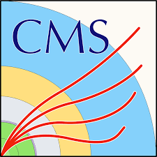


CERN Collaboration and CMS Affiliation
CERN Senior Fellow 2016-2019
  EN-MME
Signed as affiliate members in Feb 2019
  CMS Affiliation lead
Collaborative projects
  PhDs
    Mechanical characterisation of thin-walled cooling pipe connections
    Computational fluid dynamics of 2 phase CO₂ in microchannels
  MEng
    Mechanical testing of braided CNTs
    New extendable gantry system for CMS cavern access
    Load bearing composite structures for CMS detectors
  Lots of undergraduate projects
  Bursaries + placement students – large numbers of applicants to CERN!
  Visits from technicians

Slide 4
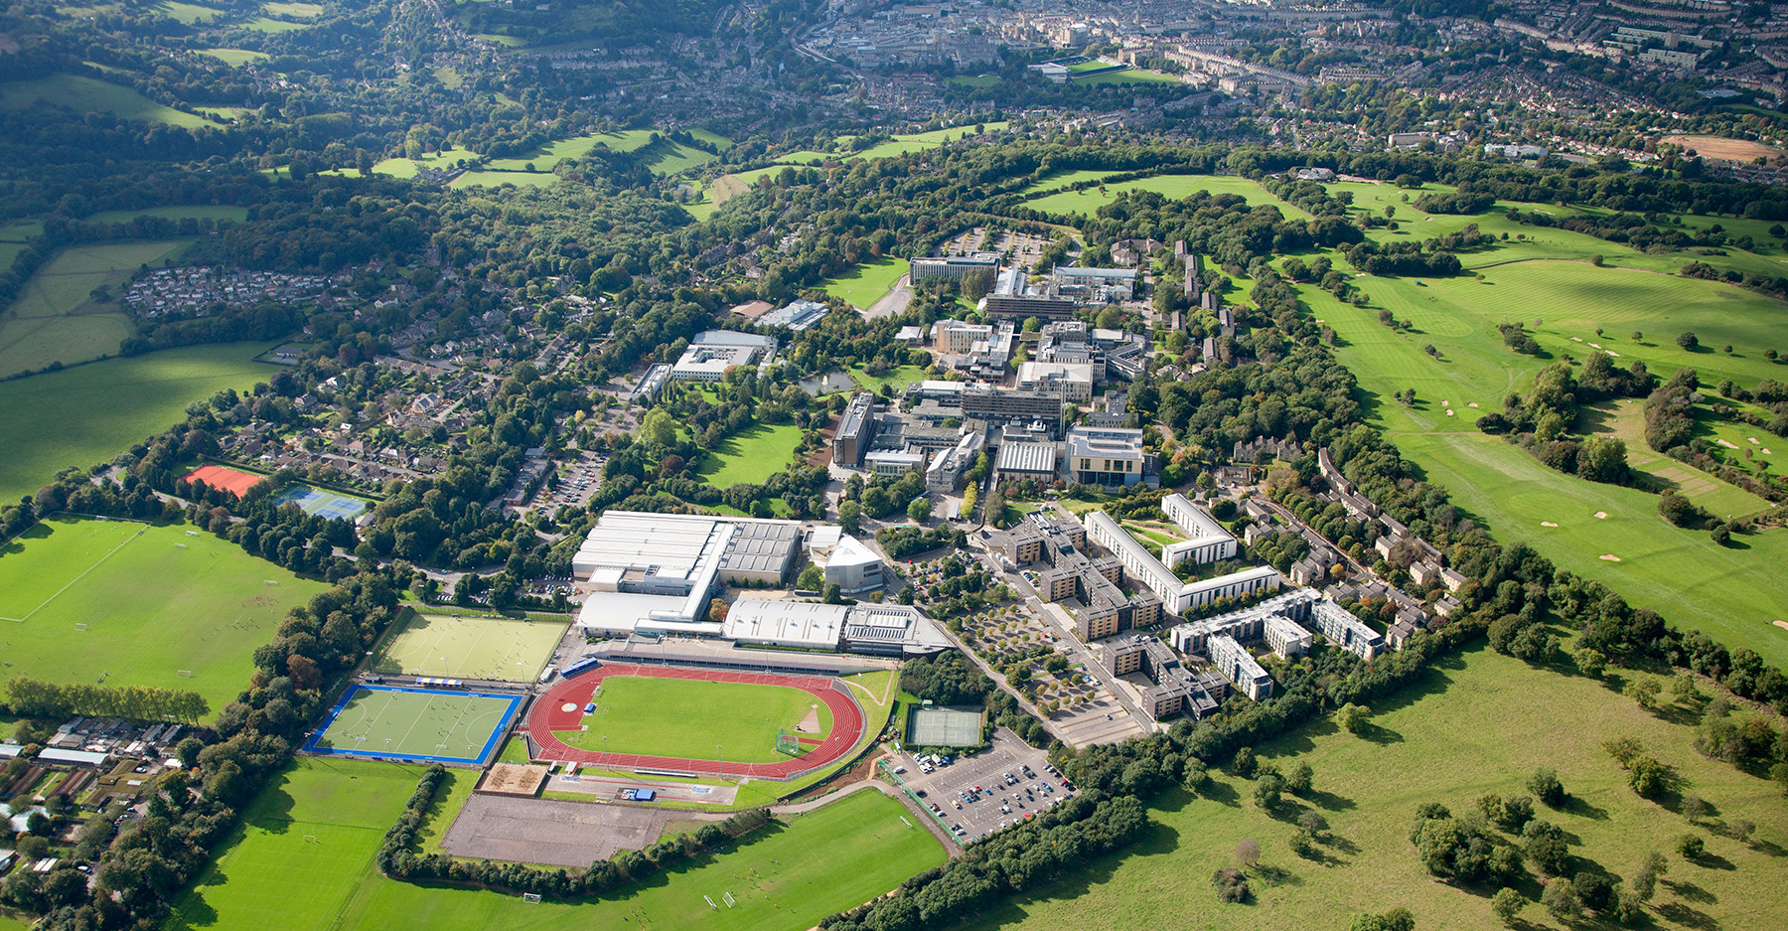


The University of Bath
Established in 1954
Campus-based on hill above city
Times University of the year 2023
Science / technology focus
92% of research ranked ‘world leading’
20,000 students
Extensive research facilities
  Last year £450m new facilities opened
Sport focus – 19 medals at Tokyo 2020
UNESCO World Heritage city

Slide 5
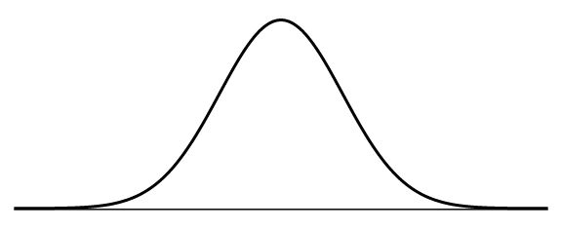
Project Background: The wire scanner problem
Number of scattered particles
Wire Position
Notes:
The increased luminosity generated in future particle accelerator systems will require improvements to existing beam instrumentation techniques and materials. A promising route for future beam-profile wire scanners is the use of braided carbon nanotubes which have an exceptional combination of mechanical properties and thermal characteristics. Accordingly, a bespoke braiding system has been developed to produce the braids required, however optimisation of the braiding parameters is required to maximise the potential of this new technology. This study outlines initial investigations into the effects of key parameters on mechanical performance and potential routes to reliably model these systems. The resulting insights will help refine braiding geometries for the HL-LHC, but also have important implications for alternative uses of these high specific stiffness wire

Slide 6
Project Background: The wire scanner problem
Future particle accelerator systems have increased luminosity
More flux (protons) per second
Smaller beams at higher beam energies
  Leading to increasing beam density
Current instrumentation and materials require improvements
Notes:
The increased luminosity generated in future particle accelerator systems will require improvements to existing beam instrumentation techniques and materials. A promising route for future beam-profile wire scanners is the use of braided carbon nanotubes which have an exceptional combination of mechanical properties and thermal characteristics. Accordingly, a bespoke braiding system has been developed to produce the braids required, however optimisation of the braiding parameters is required to maximise the potential of this new technology. This study outlines initial investigations into the effects of key parameters on mechanical performance and potential routes to reliably model these systems. The resulting insights will help refine braiding geometries for the HL-LHC, but also have important implications for alternative uses of these high specific stiffness wire

Slide 7
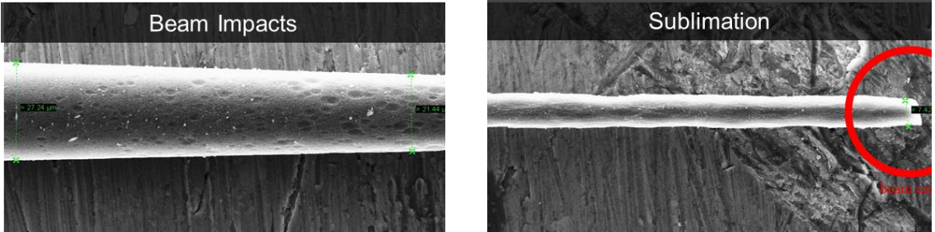
Project Background: The wire scanner problem
Wire ageing is becoming a problem
Requirements:
  High strength
  Low density
  High thermal conductivity
  Resistant to radioactive environments
  Compatible with vacuum
Notes:
The increased luminosity generated in future particle accelerator systems will require improvements to existing beam instrumentation techniques and materials.
Sapinski M, Dehning B, Guerrero A, Koopman J, Metral E. Carbon Fiber Damage in Accelerator Beam. 2009.

Slide 8
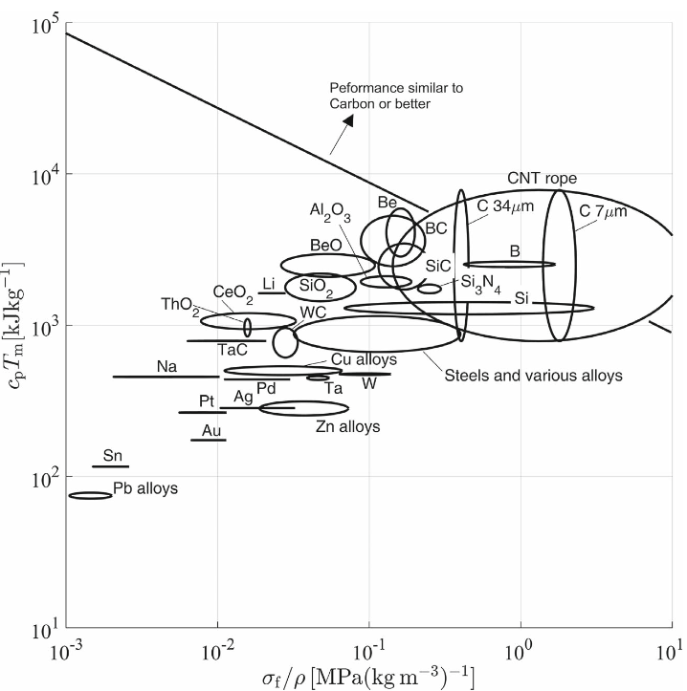
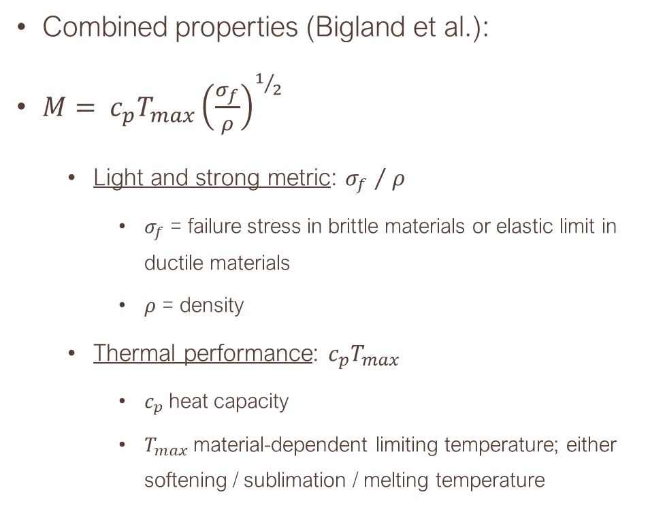
Material selection
Combined properties (Bigland et al.):
$M= c_{p}T_{max}{\left(\frac{σ_{f}}{ρ}\right)}^{1/2}$
  Light and strong metric: ${σ_{f} }/{ ρ}$
    $σ_{f}$ = failure stress in brittle materials or elastic limit in ductile materials
    $ρ$ = density
  Thermal performance: $c_{p}T_{max}$
    $c_{p}$heat capacity
    $T_{max}$material-dependent limiting temperature; either softening / sublimation / melting temperature
Notes:
Bigland, H., Huber, J.E., Veness, R. and Cocks, A.C.F., 2020. Wire Materials for Scanners in the Large Hadron Collider: An Unusual Materials Selection Problem. Advanced Engineering Materials [Online], 22(3), p.1900927. Available from: https://doi.org/10.1002/adem.201900927.

Slide 9
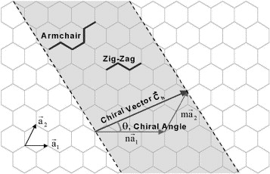
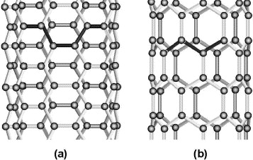
Project Background: Carbon nanotubes
One solution to this problem is the use of braided carbon nanotubes
Notes:
A promising route for future beam-profile wire scanners is the use of braided carbon nanotubes which have an exceptional combination of mechanical properties and thermal characteristics. Accordingly, a bespoke braiding system has been developed to produce the braids required, however optimisation of the braiding parameters is required to maximise the potential of this new technology. This study outlines initial investigations into the effects of key parameters on mechanical performance and potential routes to reliably model these systems. The resulting insights will help refine braiding geometries for the HL-LHC, but also have important implications for alternative uses of these high specific stiffness wire

Slide 10
Project Background: Carbon nanotubes
One solution to this problem is the use of braided carbon nanotubes
Notes:
A promising route for future beam-profile wire scanners is the use of braided carbon nanotubes which have an exceptional combination of mechanical properties and thermal characteristics. Accordingly, a bespoke braiding system has been developed to produce the braids required, however optimisation of the braiding parameters is required to maximise the potential of this new technology. This study outlines initial investigations into the effects of key parameters on mechanical performance and potential routes to reliably model these systems. The resulting insights will help refine braiding geometries for the HL-LHC, but also have important implications for alternative uses of these high specific stiffness wire

Slide 11
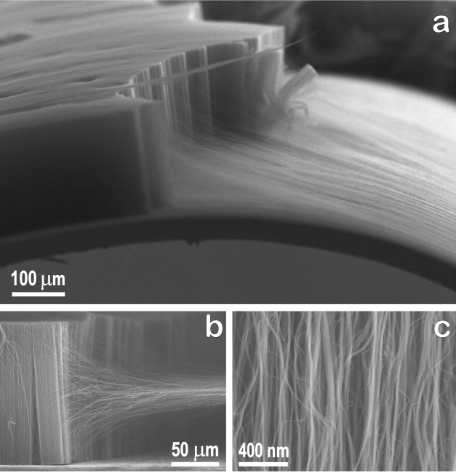
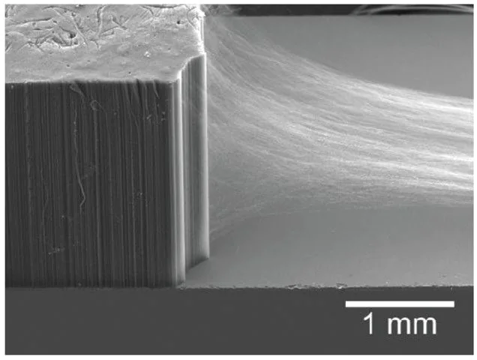
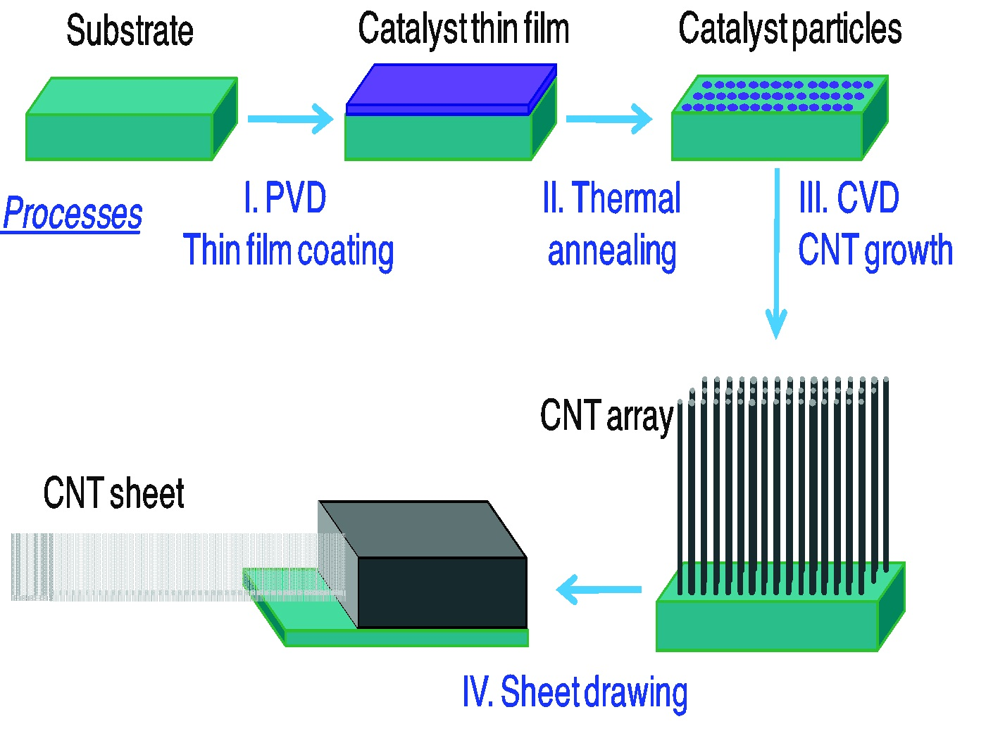
Manufacturing CNTs
Notes:
CNT Forests
Drawing of fibres
Re-do the process diagram?
Image on side also nice? Pick which one

Slide 12
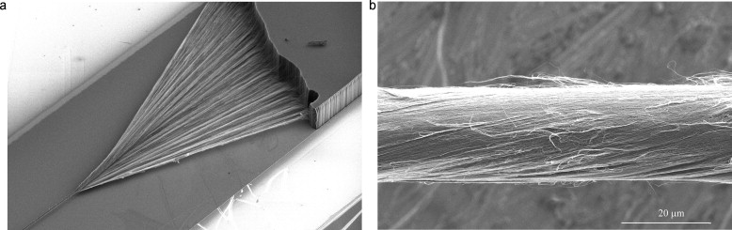
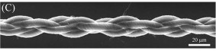
Why braid?
Enables use of smaller diameter fibres
  More control over fibre diameter
Increased optimisation capabilities:
  Braiding style (twisted or braided)
  Braiding characteristics
Failure modes
  Single fibre failure not catastrophic

Slide 13
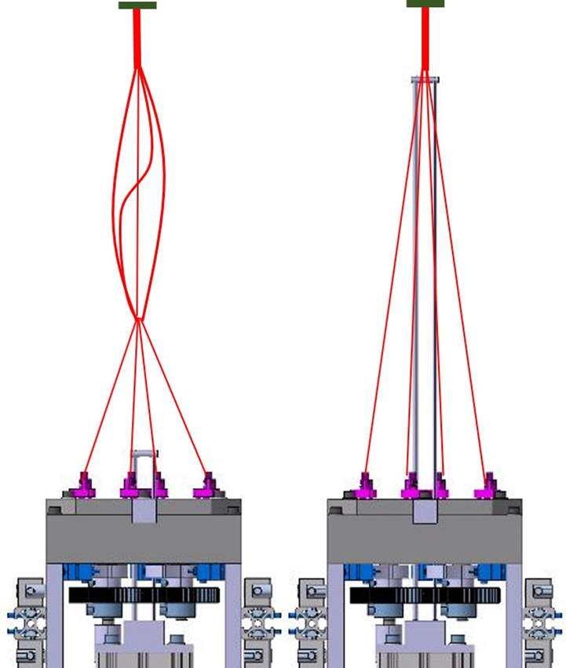
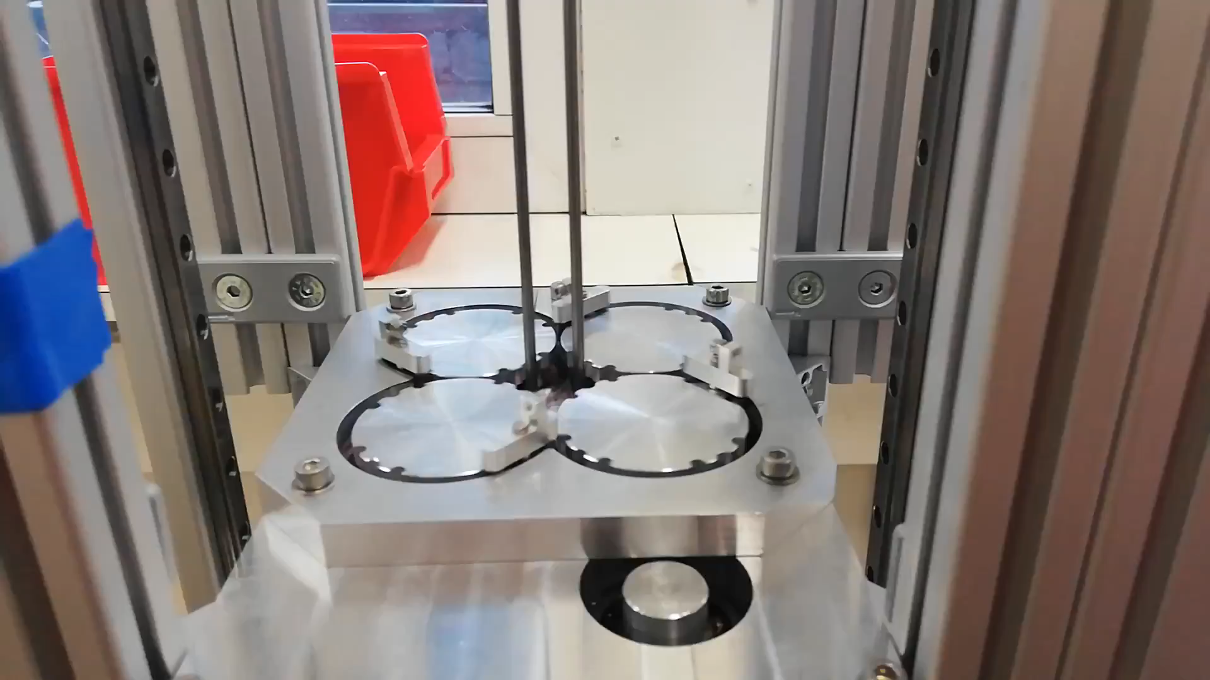
Project Background: Braided CNT’s
Bespoke microwire braiding machine designed at CERN
Notes:
a bespoke braiding system has been developed to produce the braids required, however optimisation of the braiding parameters is required to maximise the potential of this new technology

Slide 14
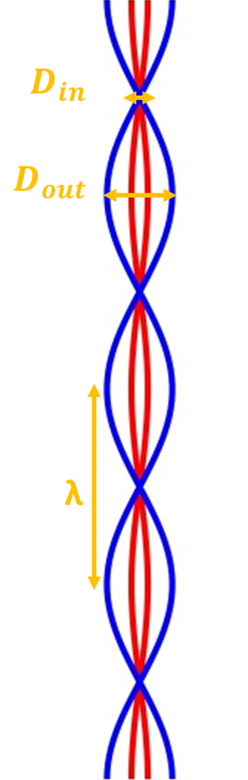
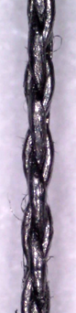
Project Background: Braided CNT’s
Parameters to investigate:
Material: SS304, Nylon, carbon fibres, CNT
Braid type: Braided vs. unbraided
Wavelength (mm): 0.75, 1.00, 1.25, 1.50
Wire Thickness
Wire pre-tension: Key for FEA
Notes:
a bespoke braiding system has been developed to produce the braids required, however optimisation of the braiding parameters is required to maximise the potential of this new technology

Slide 15
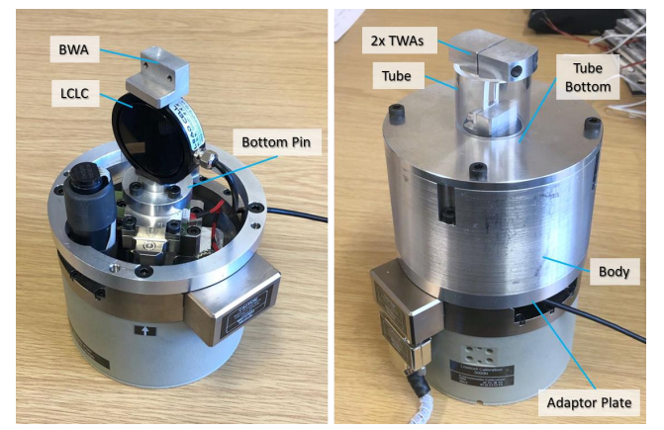
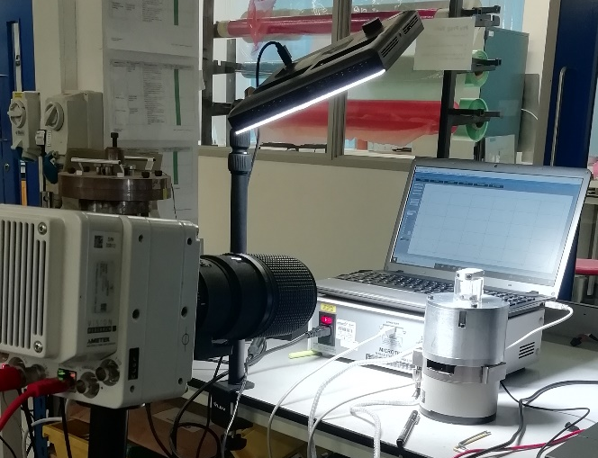
Experimental methods
All tests carried out on the Deben CT5000:
Low-capacity load cell (50N)
Casing redesign to cater for card stock method grips and new load cell
High speed imaging performed to observe failure

Slide 16
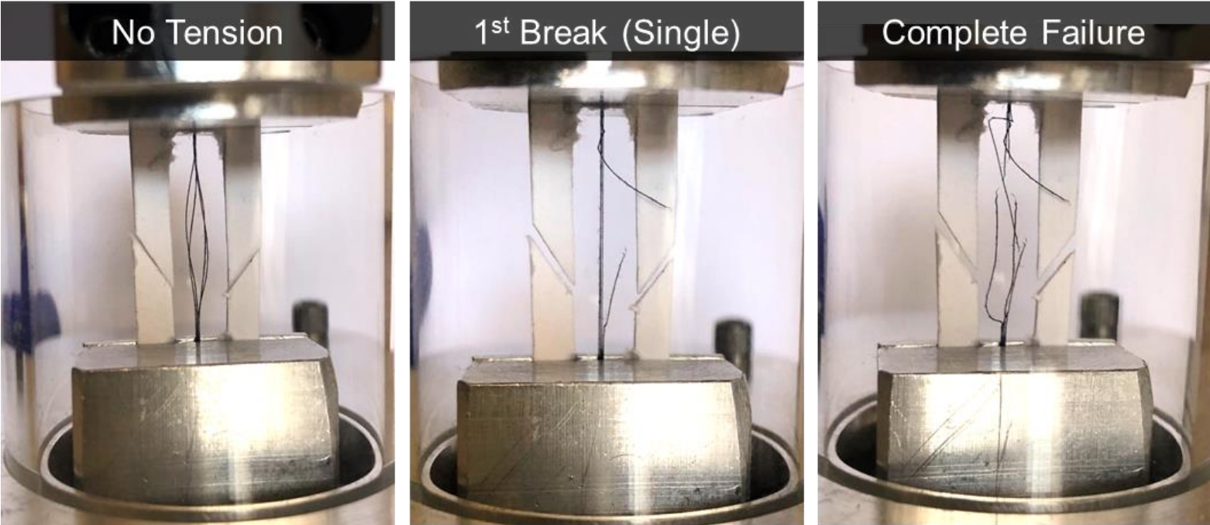
Experimental methods: Single fibre failure

Slide 17
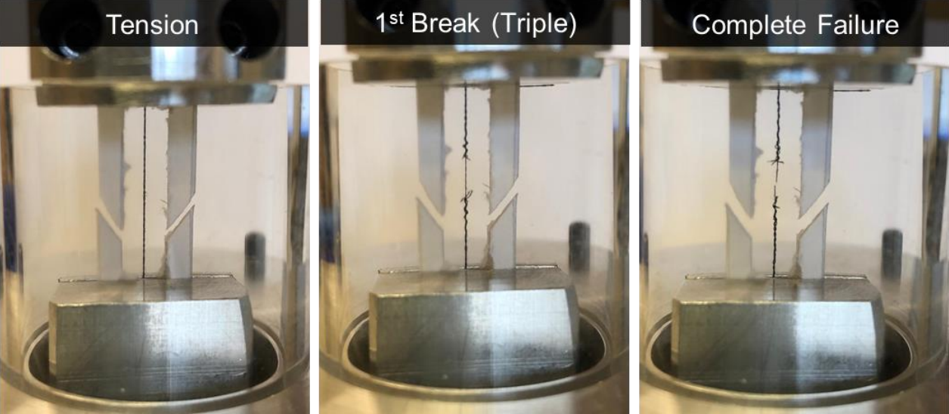
Experimental methods: Multiple fibre failure

Slide 18
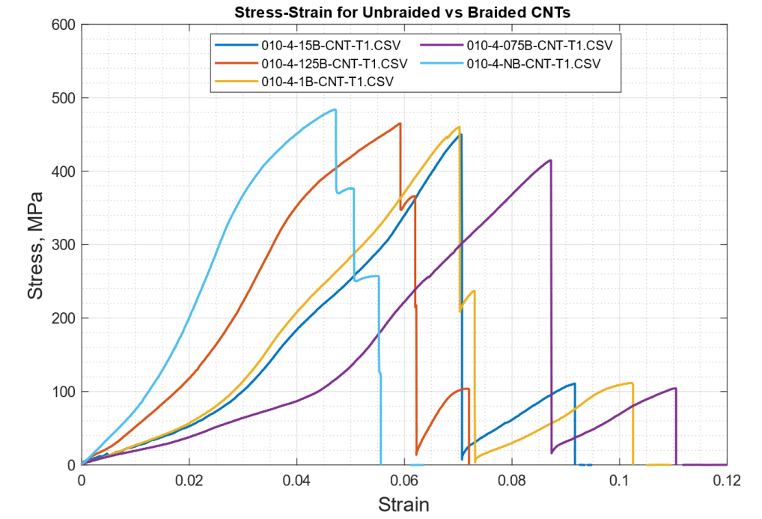
Results
Increasing wavelength
Increased wavelength leads to:
Decreased strain to failure
Increased stiffness
Increased failure loads
Notes:
Wavelength is xxxB in naming convention here

Slide 19
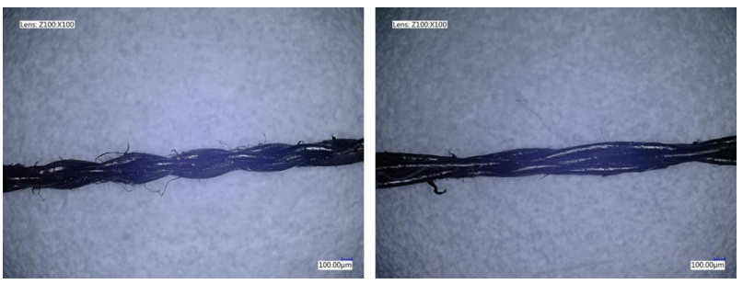
Results: Braiding regularity
Uniformity of the wavelengths seems to be relatively poor
Average normalised standard deviation of ~10% for manual measurements
See below for same 1.5mm wire sample

Slide 20
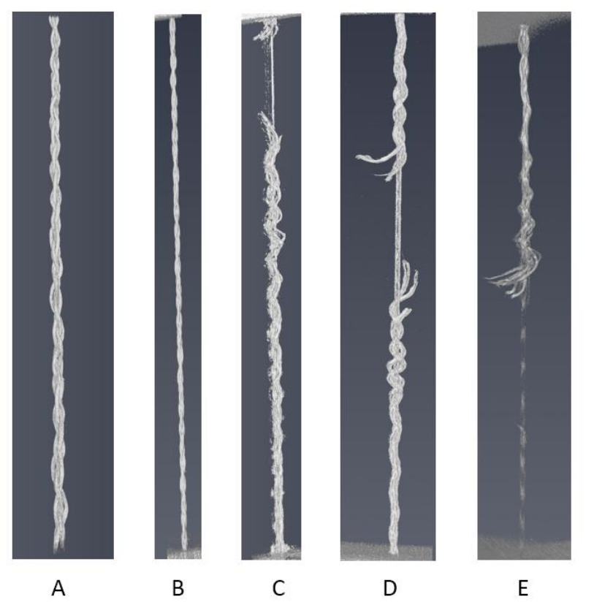
Results: CT
A: Unloaded
B: Under load
C: Multiple fibre failure
D: Multiple fibre failure
E: Multiple fibre failure

Slide 21
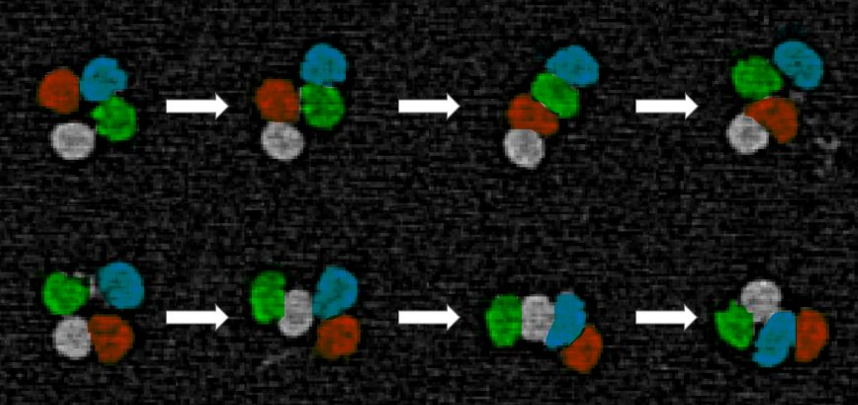
Results: CT
Notes:
I can't find a better quality image. Shall I delete this slide?
Check with Flo maybe?

Slide 22
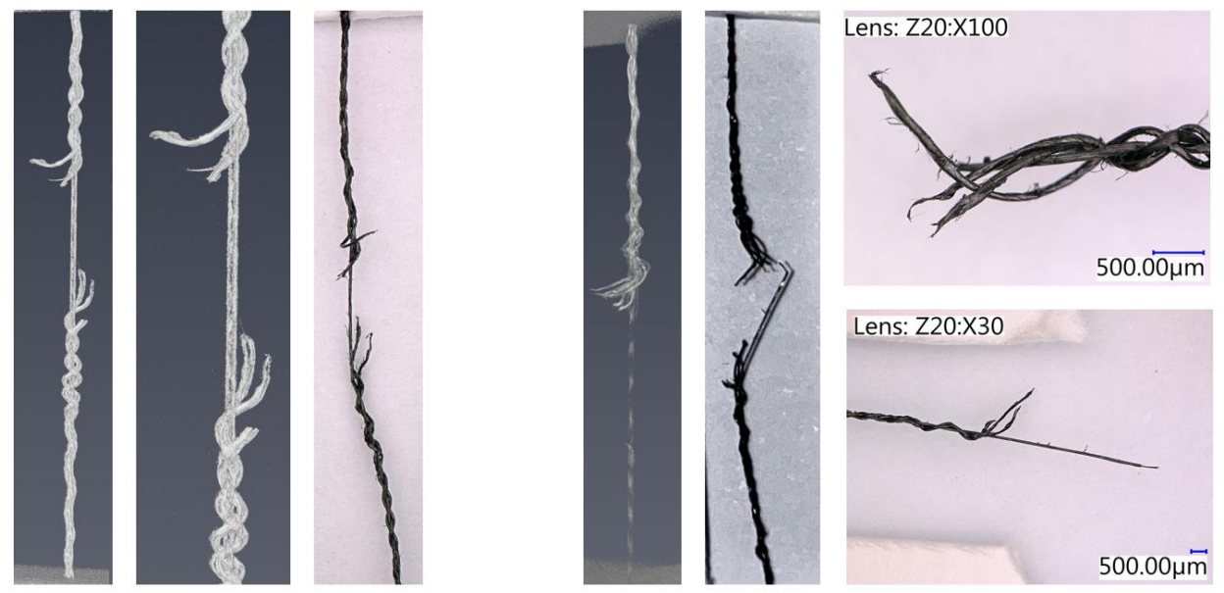
Results: CT and digital microscope correlation

Slide 23
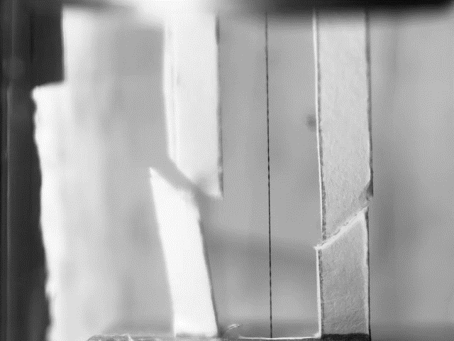
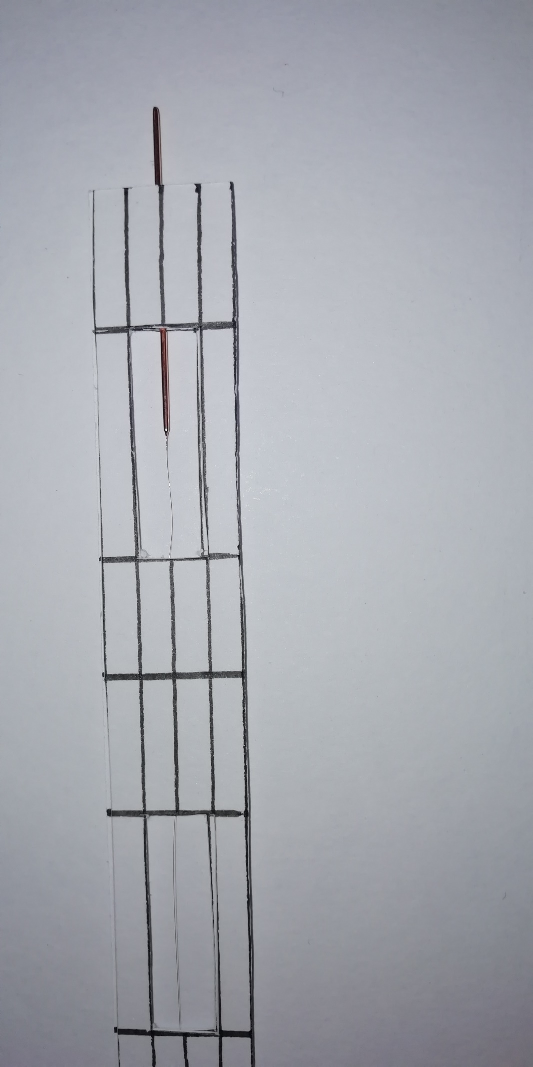
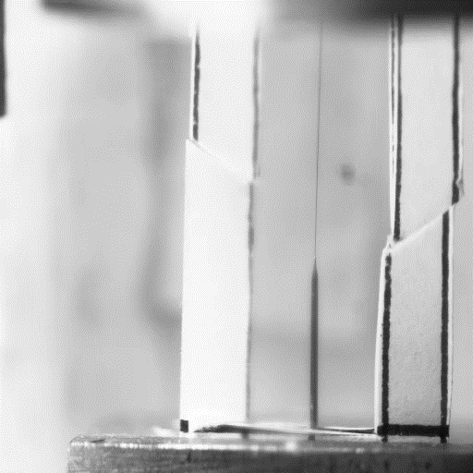
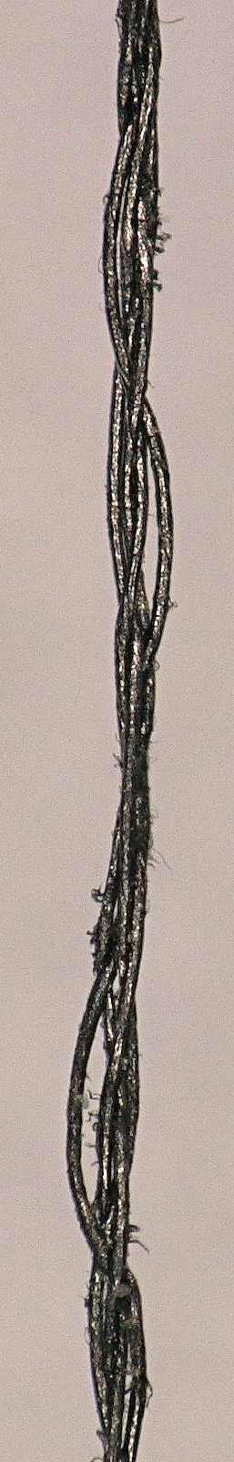
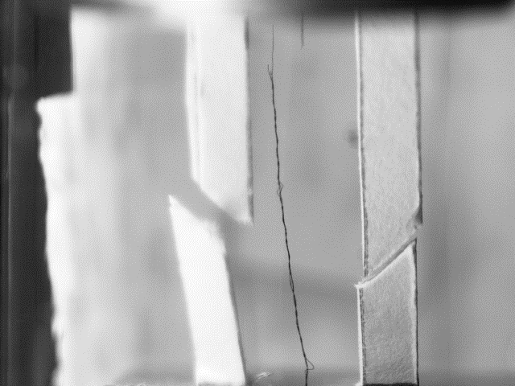
Results: High speed imaging
First Break
Fig.2: Failure of wire embedded in Cu at 200 fps. Brittle fracture and debris falling within Perspex tubing.
Final Break
Fig.1: Progressive failure of the irregular braided CNT sample under tension.

Slide 24
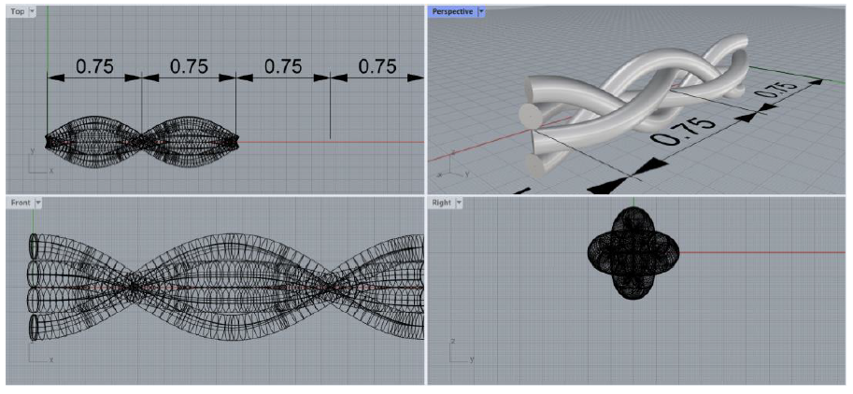
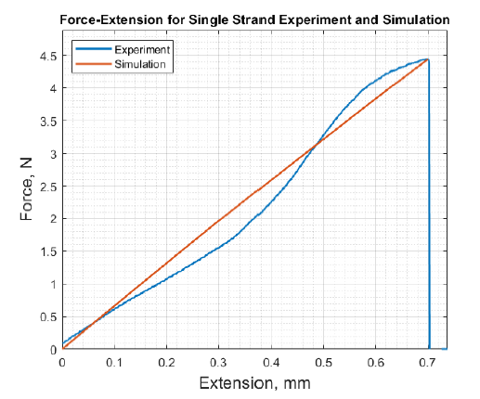
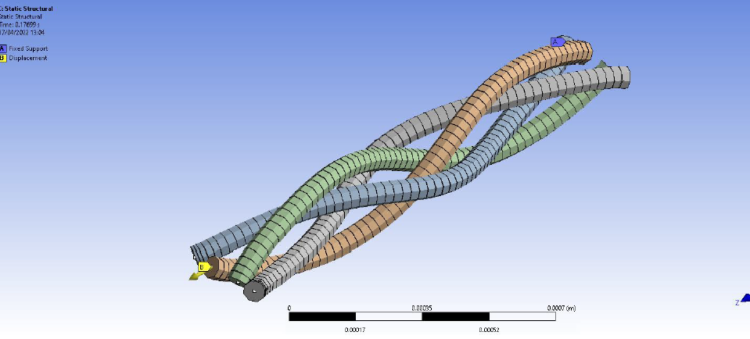
Finite Element Simulations
Notes:
These are only temporary images! I will update these by Monday!

Slide 25
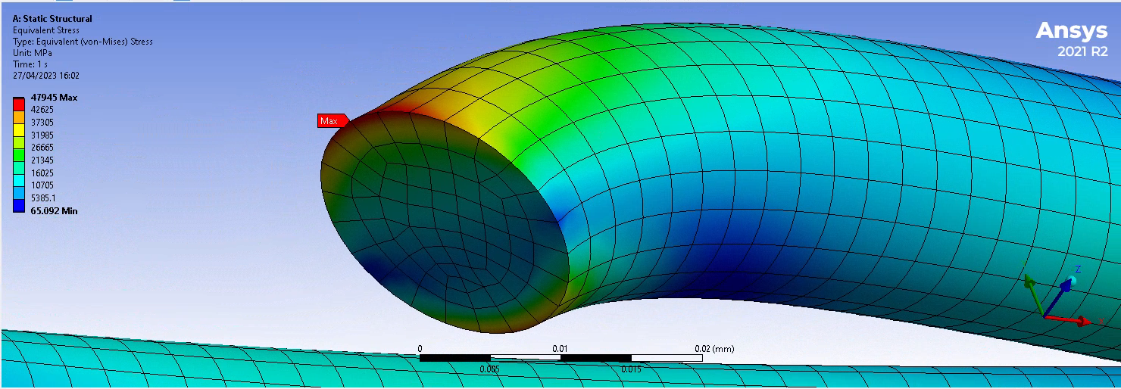
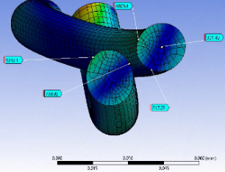
FEA Results
increasing COF
Fig.1: Mesh convergence study showing a stress-singularity was present in the model at the fixed boundary condition.
Fig.2: Stress-strain curve showing as friction was applied to the model, the stress experienced by the strands in the braid decreased.

Slide 26
PhD Student Selected – Gerard Aliana Cervera
Development and characterisation of Carbon Nano-Tube (CNT)-based wires for accelerator beam diagnostic applications at CERN
University of Bath Supervisors: Prof Davide Mattia (Chem Eng) & Dr Alexander Lunt (Mech Eng), CERN supervisor: Dr Raymond Veness (CERN)
Establish a production facility to spin yarns of single-, double- and multi-wall CNTs (SWNTs, DWNTs & MWNTs) via catalytic Chemical Vapour Deposition (CVD). Optimise production in terms of reducing yarn thickness / increasing length while maintaining sufficient tensile strength

Slide 27
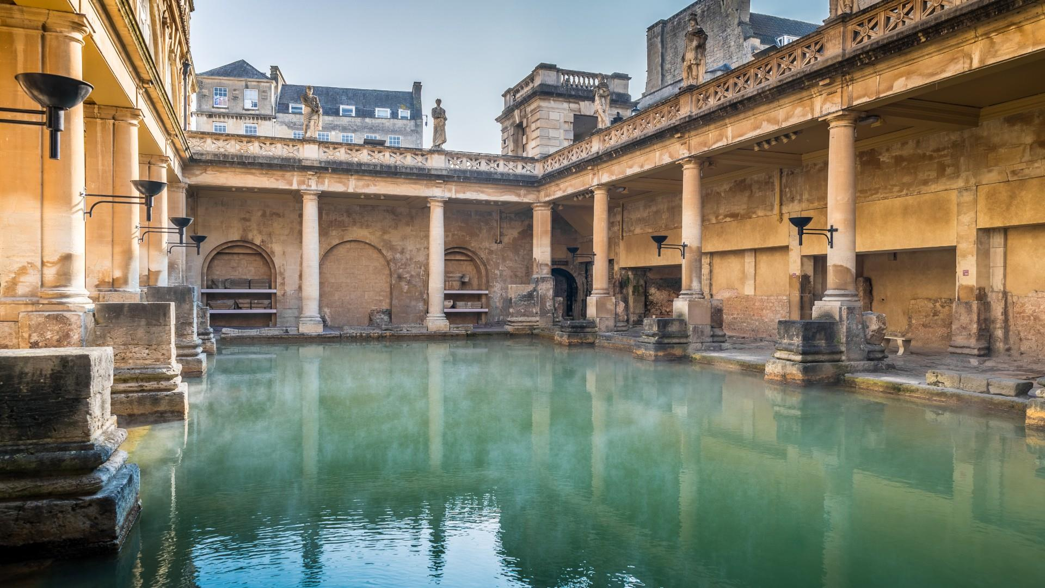
Thank you
Paloma Rodriguez Santana
Raymond Veness
Alexander Mariet
Giannis Papazoglou
Egor Naumov
Pablo Granero Marana
Mohamed Zamdi
Fariha Khan

