Slide 1
Micro-Nanomanipulation
Focus: Understanding the technology and challenges involved in manipulating long nano-fibres for practical use in instrumentation and accelerator devices
Jean-Yves Rauch
Micro Robotex station, manipulation, welding and flexion of CNT, study of flexoelectricity
An overview of the Micro-Robotex nanofactory (SEM/FIB/GIS/RMMs) and current studies on CNTs
Ana Teresa Perez Fontenla
Microscopic Characterization Activity at CERN
Current capabilities at CERN and ongoing work regarding CNTs

Slide 2
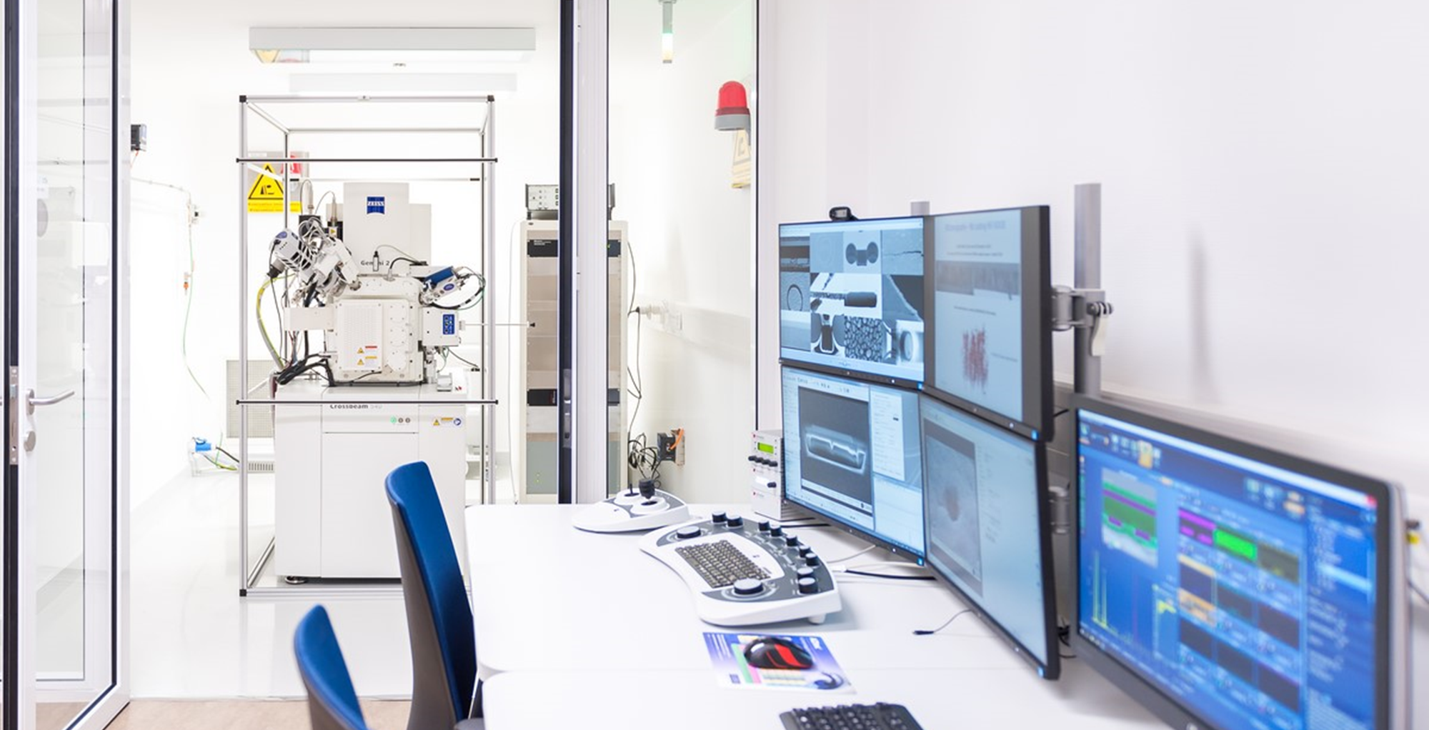
Micro-Nanomanipulation
Where can we focus our energy to give short-term and longer-term benefits?
Key discussion from the session yesterday:
Training requirements (what expertise are we missing?)
  Short term - need to identify and consider how to secure
  Long term - new collaborations / new recruitment / new avenues of exploration
Sample space / potential variables to investigate is huge
  Short term - need to start to think how to narrow this down
  Long term – consider investing into relevant areas to be ready
Sample mounting techniques for micromechanical characterisation
  Short term - suggested new SEM grid style device
  Long term - smaller wires (4 micron) will require a new solution

Slide 3
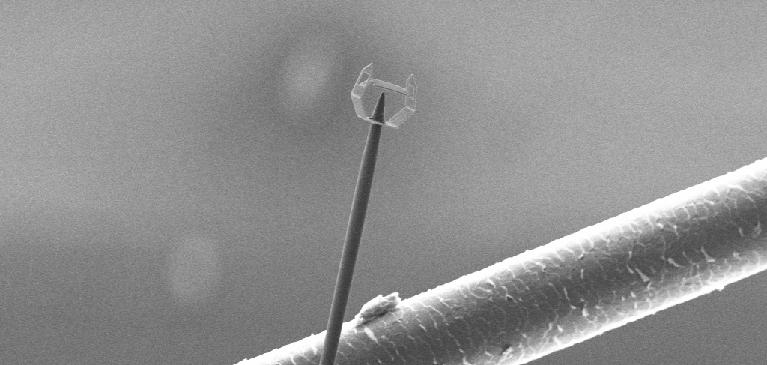
Micro-Nanomanipulation
What new collaborations are needed and where do we need to look for resources?
Key discussion from the session yesterday:
We currently cannot weld carbon nanotubes here at CERN – this would extend our capabilities but we need to be careful of contamination within the weld
  Collaborations – we have some knowledge but extra expertise would be useful
  Where – existing contacts within the network, but also worth reviewing literature
We do not fully understand vacuum compatibility of these materials
  Collaborations – lots of existing expertise within CERN in this area, but people within the research community may have knowledge of this aspect
  Where – existing contacts, but worth considering other applications / use cases for these materials in similar fields

