Slide 1
STI beam request for 2023
L.S. Esposito, SY-STI
H8 Beam Line 2023 Users Meeting

Slide 2
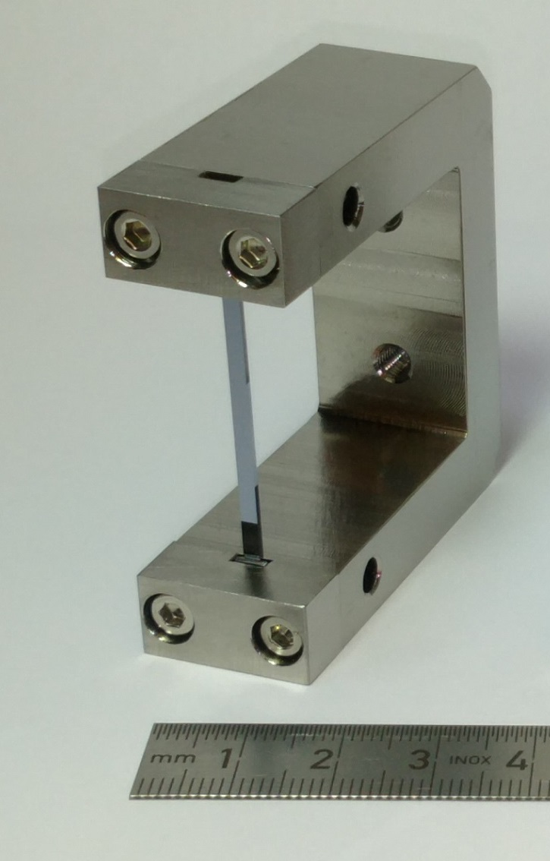
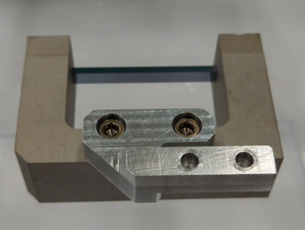
Outline
Motivations for the STI beam request
List of crystal assemblies
Beam requirement
Infrastructure needs
Crystal assemblies
TECS crystal
TCPC crystal

Slide 3
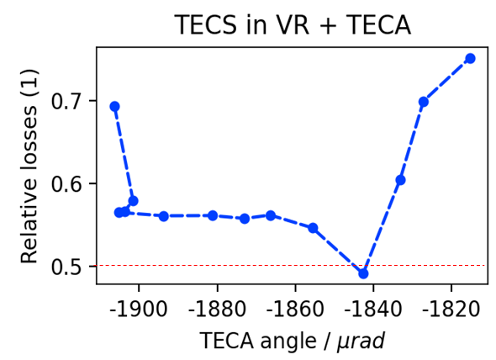
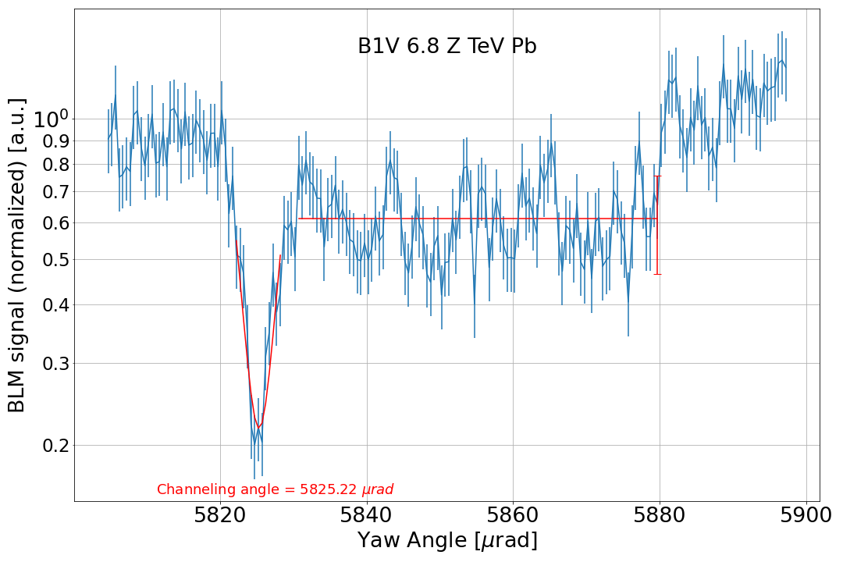
Motivations of the STI beam request – 1
Beam manipulation with bent crystals is mature technology used in several CERN applications:
losses reduction during the slow extraction from SPS (TECS, TECA)
crystal-assisted collimation for the ion runs in LHC (TCPC)
More applications are foreseen in the future:
LHC fixed target experiment (TCCS, TCCP)
Losses reduction at TCSC and splitter magnets in TDC2
F. Velotti
R. Cai

Slide 4
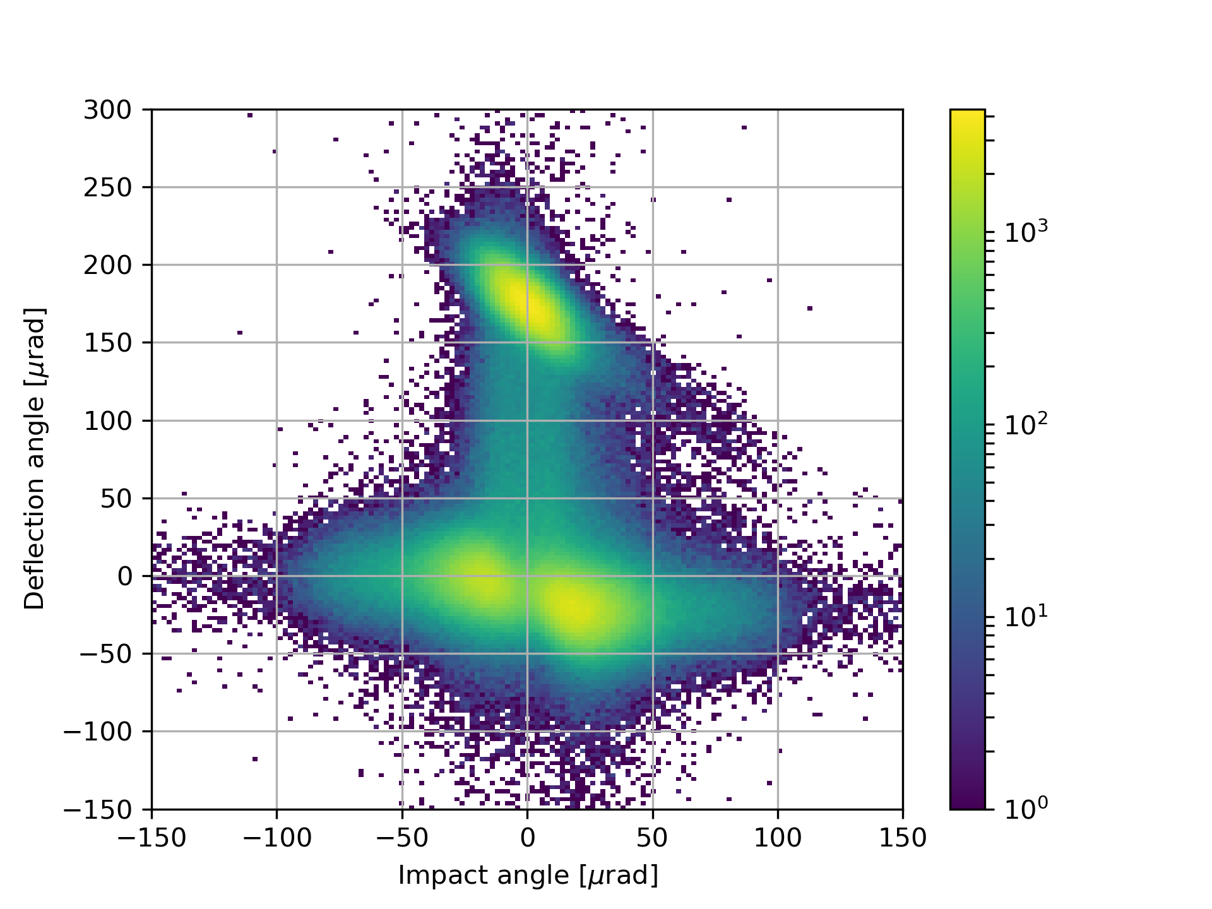
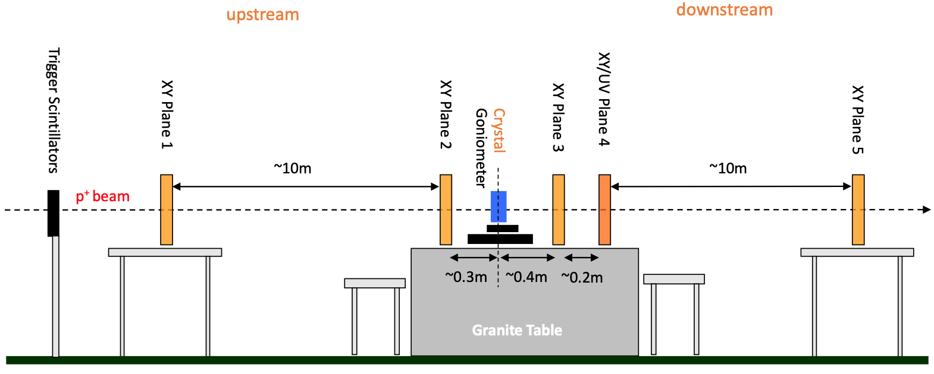
Motivations of the STI beam request – 2
The validation of crystal assemblies with beam is needed for the final CERN hardware qualification before the installation of the crystals in the machines
It is the only methods to measure the crystal channeling efficiency (proportional to in-depth crystal defects), which cannot be measured by the X-ray diffractometer
Typical plot showing the particle regimes in a crystal
Schematic layout of the UA9 telescope installed in PPE128
CH
AM
VR

Slide 5
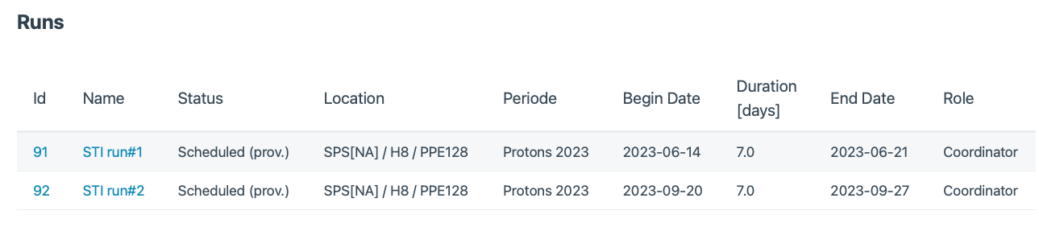
Beam time
UA9 runs are allocated in contiguous slots to optimize resources:
Use of the same instrumentations
No need to mount/dismantle the apparatus several times
Benefit from the same experts’ teams

Slide 6
List of crystals
2 LHC crystals from the last batch production by INFN-Ferrara
4 LHC crystals to be remeasured for stability check
3 crystals assembled at CERN

Slide 7
Beam request
180 GeV secondary beam (routinely used in the last years)
  ~few mm sigma
  ~ 10-20 μrad divergence
  Intensity ~1e6 particles/spill
  Smaller beam spot and divergence would be beneficial

Slide 8
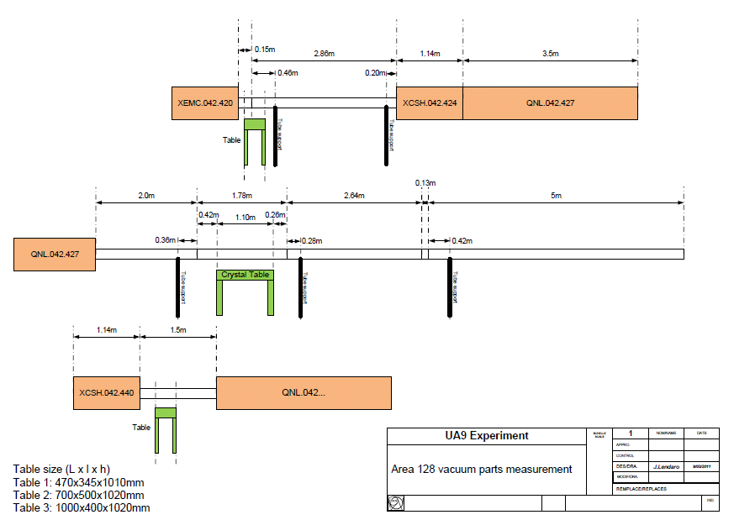
Infrastructure needs in PPE128
Usual setup used in the last years
Vacuum pipes dismounted to allow the install the tracker detectors/goniometer
Quadrupole QNL.042.427 turned off
Standard cables configuration (HV, signal, Ethernet)

