Slide 1


H8 users meeting
M. van Dijk, A. Baratto-Roldán, J. Bernhard
Date: 19.04.2023

Slide 2
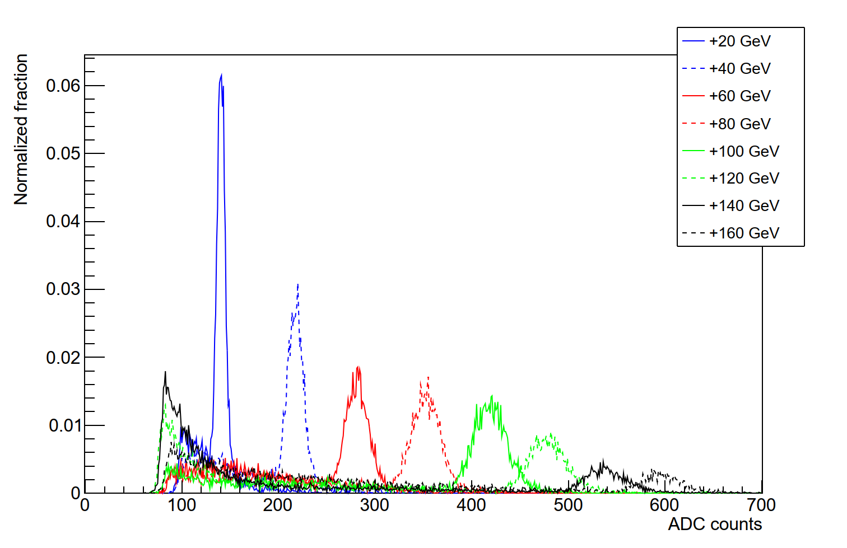
H8 General Information
Beam originates from the T4 target, shared with the H6 and P42 beamlines
  Available momenta: <10-400 GeV/c
  Magnetic spectrometers with maximum δp/p : 0.1 - 1.5% (not for muons)
    Momentum selection, not particle species selection
Many options for beam
  Primary ions (no primary protons)
  Mixed hadrons and electrons (electrons can be filtered out)
    “Normal” for H8 is +180 GeV/c hadrons
    Tertiary beams available (mixed hadron / electrons)
  Tertiary muons (low rate)
Spill duration: flat-top ~4.8s for protons, ~9.0s for ions, 1-2 spills / supercycle (~3000/day)
  Rates at detector are adjustable, from ~hundreds up to 10⁷ per spill (RP and other limitations may apply)
18/04/2023
Tertiary beams with
beamline calorimeter

Slide 3
Contact persons for H8
Beamline physicists
    Main Maarten van Dijk 166972 maarten.van.dijk@cern.ch
    Deputy Johannes Bernhard 164896 johannes.bernhard@cern.ch
    Support Anna Baratto Roldán 160360 anna.baratto.roldan@cern.ch
      Beam composition, intensity, spot-size, vacuum, Cherenkov gases, general layout possibilities, beam tuning
General beamline support (see also later presentation)
    Bastien Rae 167388 bastien.rae@cern.ch
      CESAR training, patrol rights training, beam control, file loading, beam tuning …..
In case we are all away: Dipanwita Banerjee, Nikolaos Charitonidis
Technical support (see also later presentation)
    Michael Lazzaroni 162407 michael.lazzaroni@cern.ch
      “I want help with transport”, “I need a special table”, “my zone has less blocks than last year and I need them”, “something is broken in the zone” …..

Slide 4

After-hours support
Please first call the CCC (24/7 shifts) 77500
  The operators can help you to tune the beam and solve most issues
    Equipment/magnetic element failure, beam got switched OFF due to RP alarms, access to the zone, …
  They will call us if they cannot figure it out
At weekends or nights, we do still check our e-mails and there is a (quite) high probability to pick-up the telephone also
Mattermost is available
  General channels on sps-h8-users (invite link)
  A separate subchannel can be made for your testbeam
  Also available for private messages (@mvandijk)

Slide 5
Beam line & machine limitations
H6, H8 and P42 share the same target
    In general strong coupling between the momenta of H6 and H8
    Standard setting: +180 GeV/c in H8 and +120 GeV/c in H6.
    This is the reason we need to know in advance your schedule and discuss !
    → Not everything will be known in detail today – please get in touch 2-3 weeks before your beamtime!
Moreover :
  SPS machine has its own limitations, MD’s, Q-ripples etc → May have some impact on your beam quality
    Especially for primary beams.
  Proton content and spot size in low momenta (<30 GeV) beams is small (15%) and big (10 cm ) in both planes
    Not many things to be done (physics boundaries).
However : Many times many workarounds can be found, and many possibilities exist. Keep us involved and informed in your experiment !

Slide 6
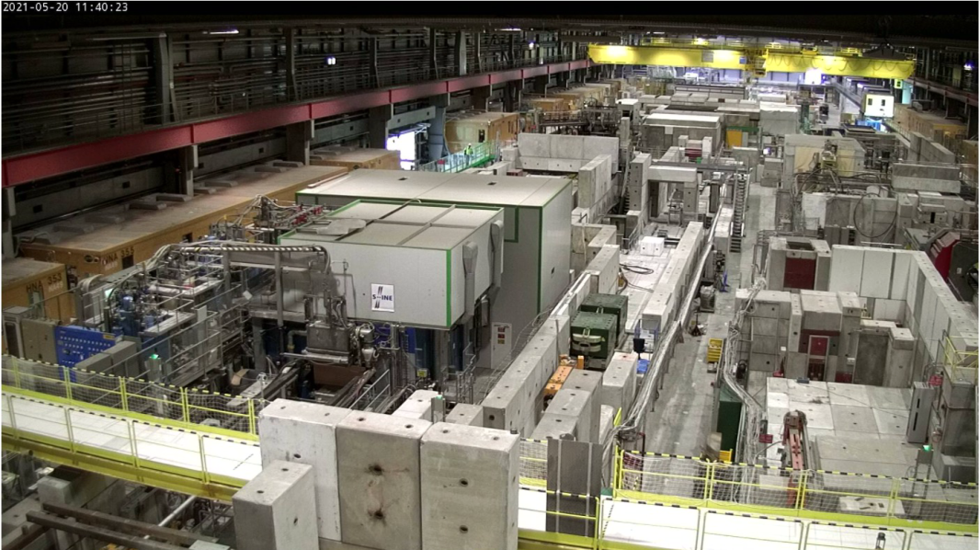
Summary
We look forward to welcoming you in H8!
Communicate with us as early as possible your worries, issues, details so that we can identify and mitigate showstoppers if any

