Slide 1
Organization of the large LHC experimental collaborations and Open Science
Pippa Wells, May 2023

Slide 2
Accelerators & Experiments
CERN Convention stipulates “the operation of particle accelerators and the necessary ancillary apparatus for use in the research programmes”
Since the days of LEP (1980s)
  accelerators funded from the CERN budget (from Member States) and project contributions from non-member states (NMS)
  experiments constructed by (in-kind) contributions from institutes in Members States and non-Member States; may be supplemented by a cash contribution to a Common Fund for the joint procurement of infrastructure
  experiments are operated jointly by the collaborating institutes and supported by a Maintenance and Operations Budget financed by all institutes (through their funding agencies), of which CERN is typically one

Slide 3
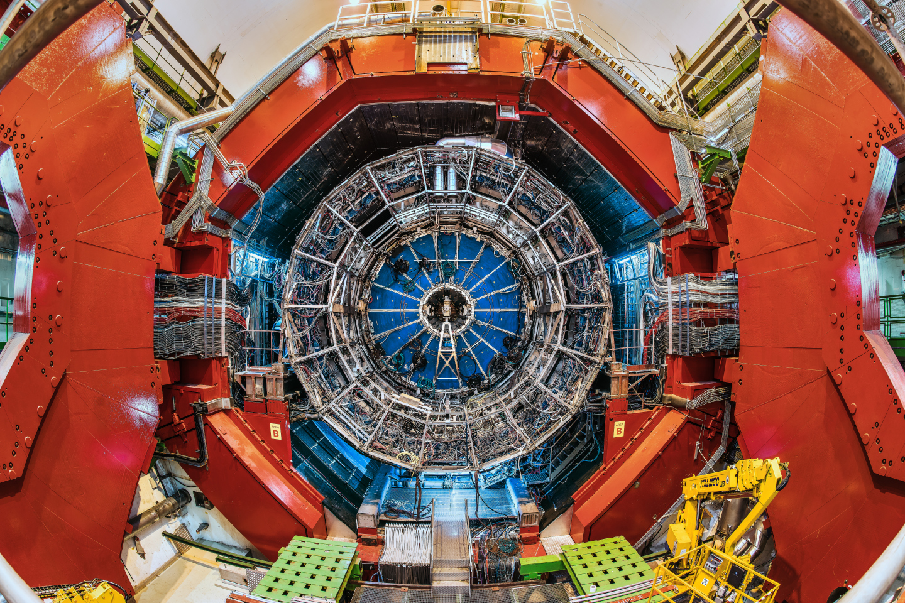
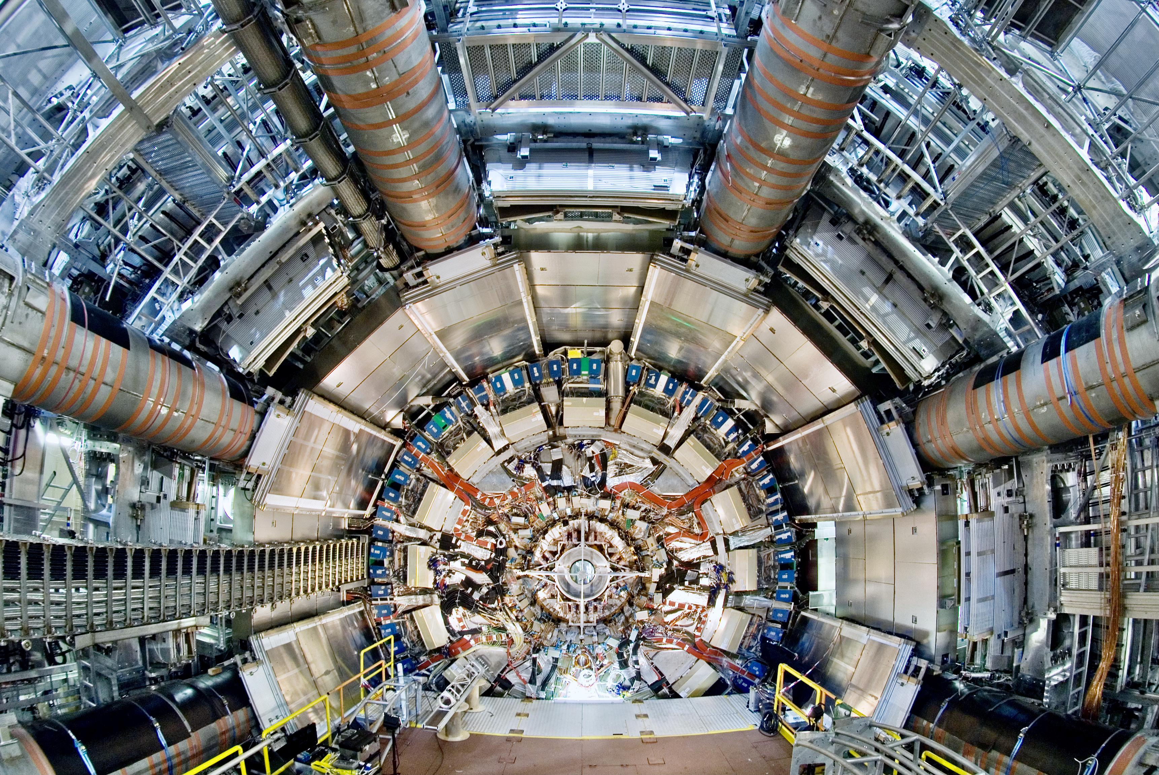
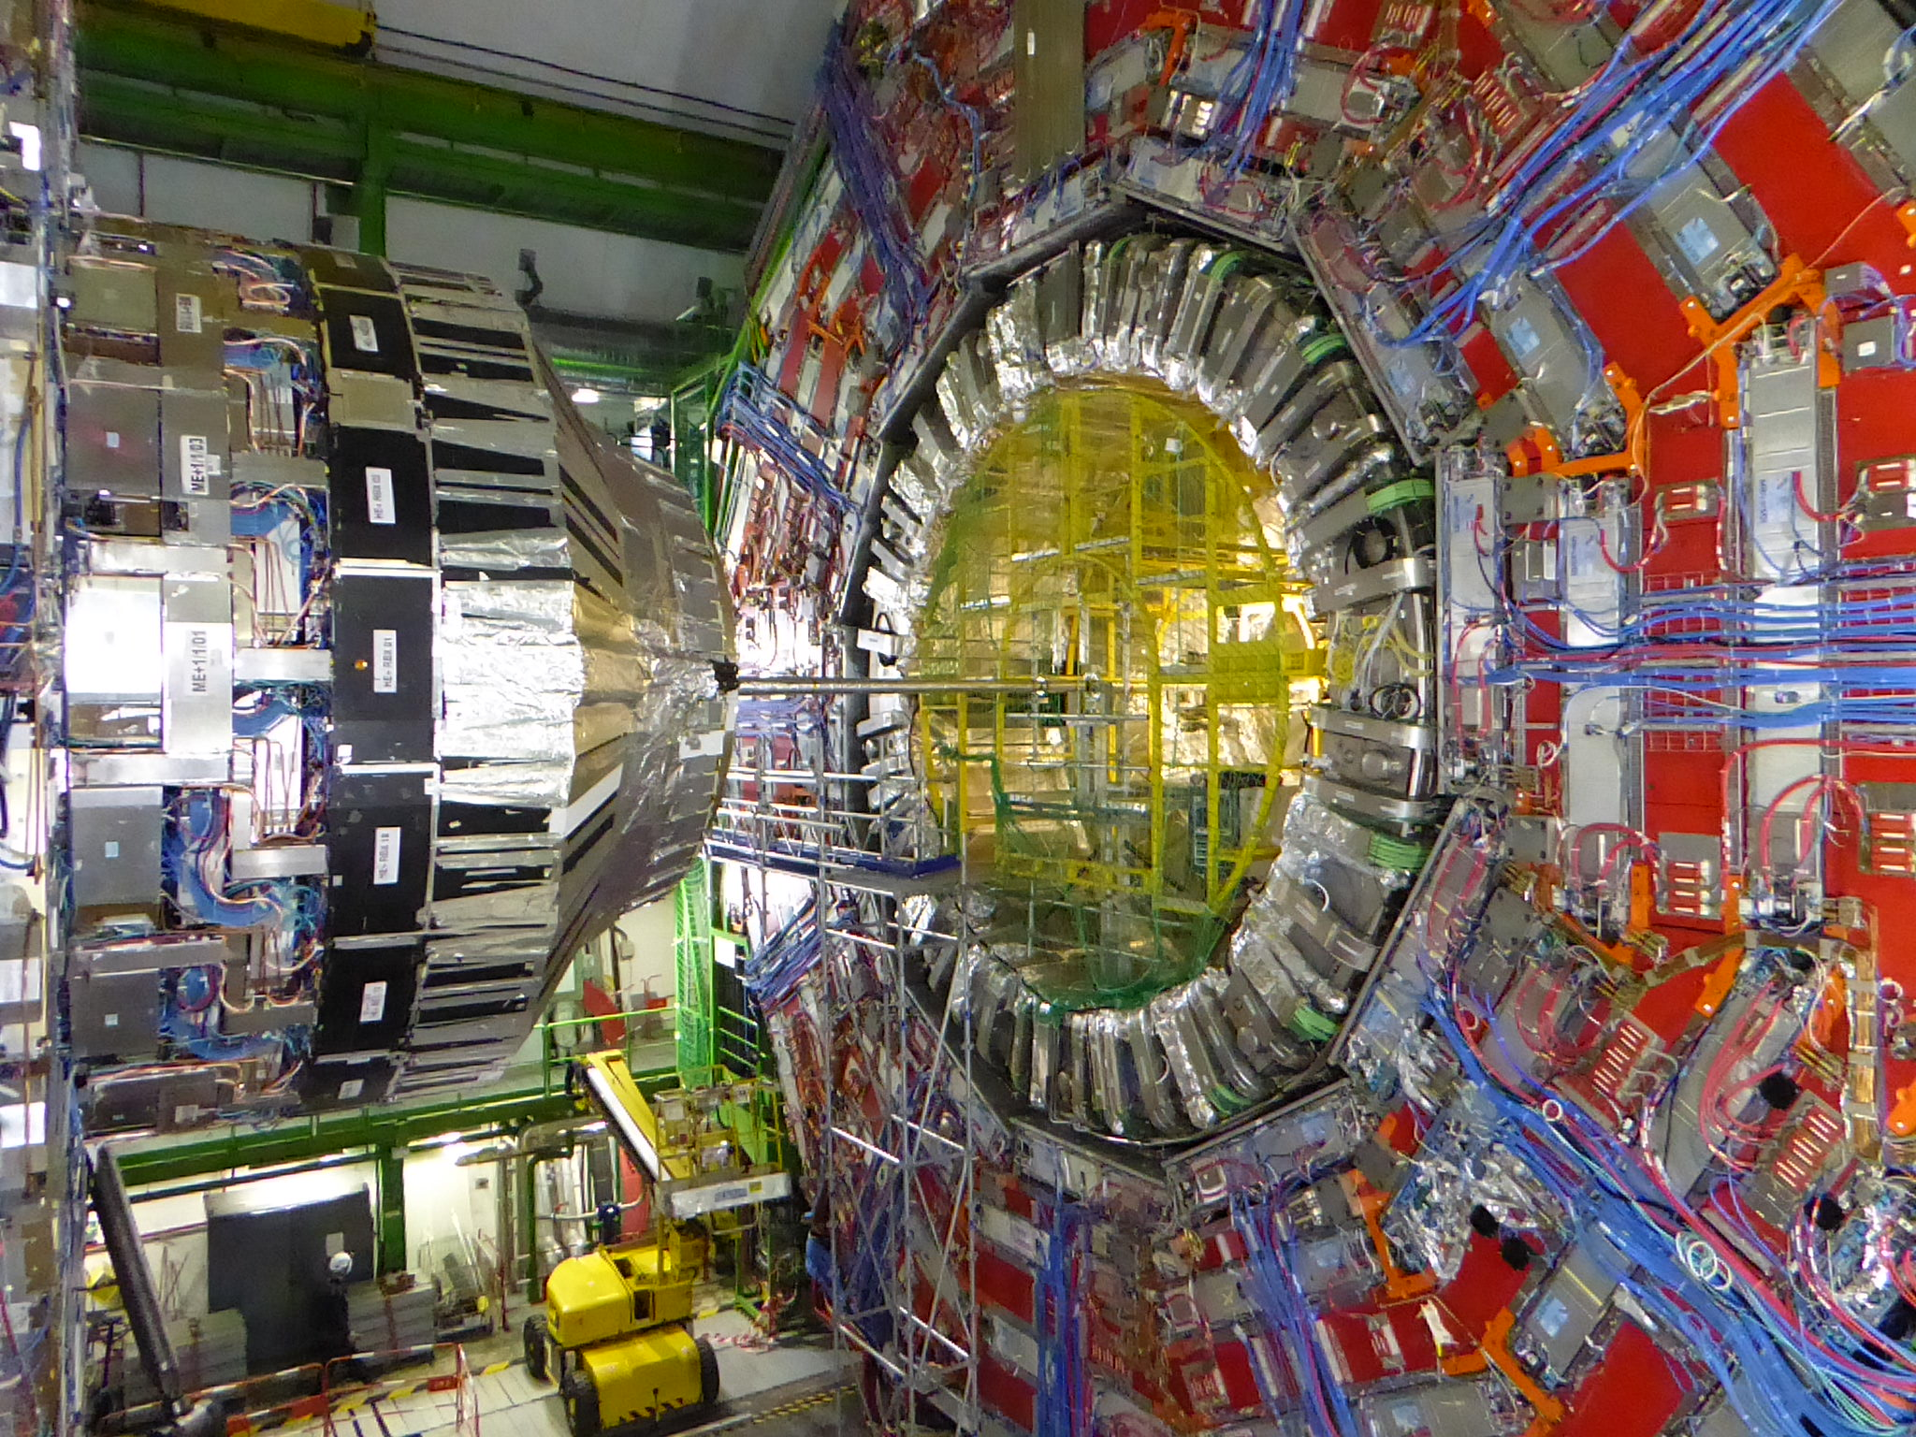
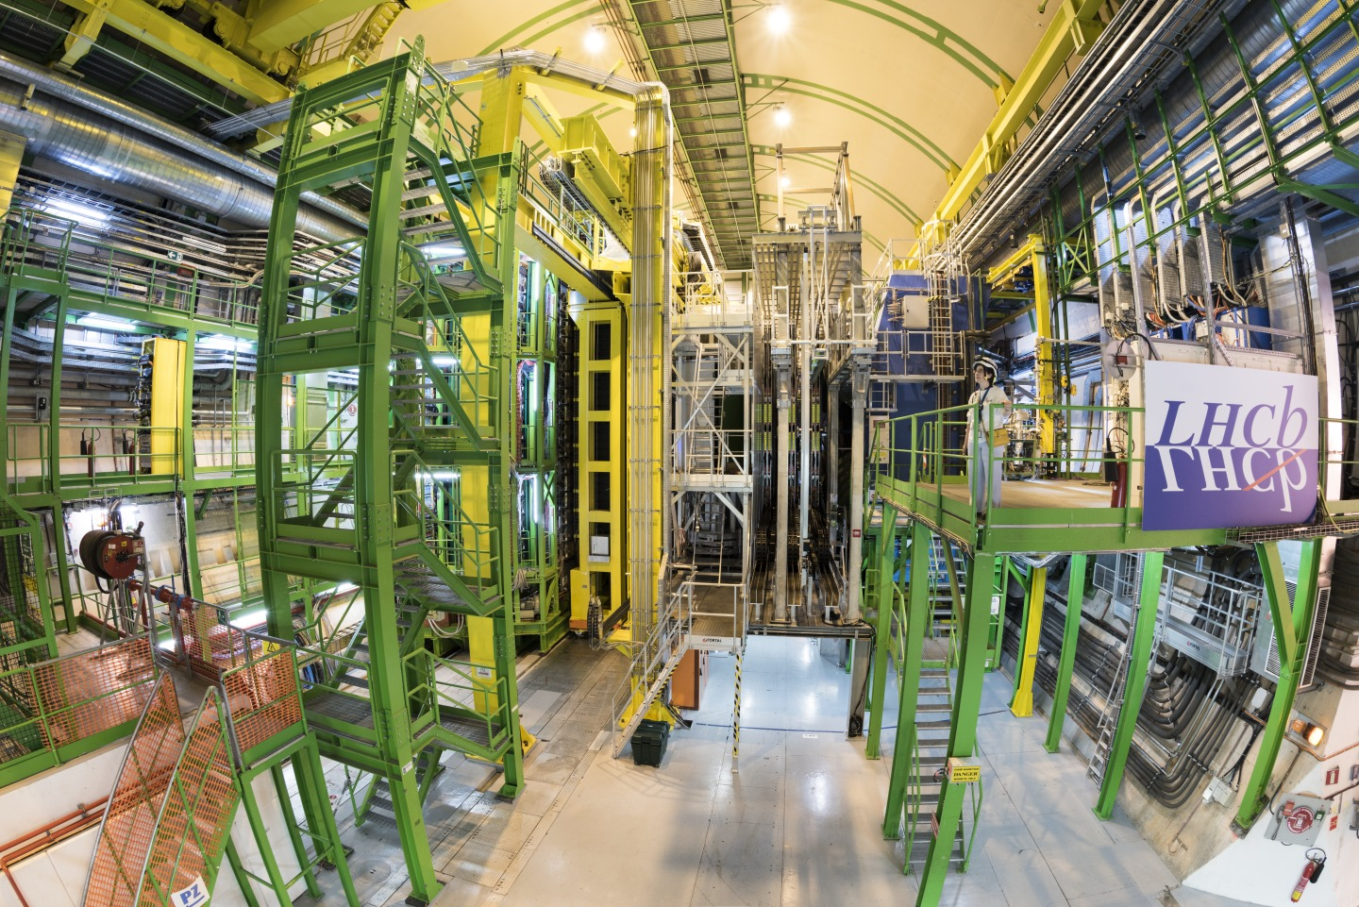
Four large LHC Experiments at CERN
ALICE
~2000 members
ATLAS
>3000 members
CMS
>3000 members
LHCb
>1400 members

Slide 4
Experimental Collaborations
  Interested physicists form a proto-Collaboration and propose an experimental set-up that is deemed capable of carrying out a measurement programme of interest using infrastructure at CERN
  Once approved the physicists constitute a formal Collaboration with the aim to build and operate the apparatus and to analyse and publish the data recorded jointly
    their home institute commits to support their activity
    the results are published under the name of the Collaboration
  Collaborations are open - new institutes may join following a well-defined procedure

Slide 5
Approval and Review by Scientific Committee (LHCC)
  The competent Scientific Committee is called by the Director responsible for research. These committees are constituted by international and independent experts that peer-review the proposals and progress reports
    For the LHC, 4 proposals were received for general purpose detectors. Two merged (1992) to become ATLAS. Another was CMS.
    Expression of Interest → Letter of Intent → Technical Design Reports
  Progress is compared to milestones set at the approval of the experiment
    Now significant upgrades are in progress – similar procedure
  Problems are flagged to the experiments, CERN management and funding agencies to allow for counter measures
  Research Board receives the concise reports of the Committee

Slide 6
Research Board
  Research Board (RB) is chaired by the Director General of CERN and consists of the Directors, the CERN Department Heads and the chairs of the Scientific Committees
  The RB approves the experiment – or not – based on
    scientific recommendations from Scientific Committee
    assessment of the financial situation of the experiment and
    resource implication at CERN (support, services, technical installation, technology requirements). The Department Heads of the relevant technical groups at CERN assess the implications beforehand
  Final decision is taken by Council through the approval of the Medium Term Plan

Slide 7
Participation in Experiments at CERN
General Conditions (GC) are the legally binding basis for participation in a CERN hosted experiment
    GC set out the rules for users and
    describe the host lab responsibilities
Engagement in an experiment is concluded by a Memorandum of Understanding (MoU) between the collaborating institute (funding agency) and CERN, signed by the Director responsible for research
    MoUs describe the responsibilities for the construction of the experiments, the operation of the apparatus and its dismantling
    Funding Agencies have direct oversight of their funds via the Resources Review Board
GC last update Dec 2020:

Slide 8
Memoranda of Understanding
  MoUs describe core contributions (deliverables) of the institutes for the construction of experiments
  Core contribution is the value of components purchased and external labour. Internal (institutional) labour is not included.
    Depending on the salary scale and overheads the full cost may be considerably higher than core cost
  Collaborating institutions are expected to contribute core cost at the level of their share in the experiment, e.g. by authors or other agreed scheme
    (This also defines their fair share contribution to the Common Fund for joint purchases of some infrastructure and to the annual Maintenance and Operation costs)

Slide 9
Sketch on Reporting on LHC experiments
LHCC: LHC Experiments Committee
P2UG: Phase 2 Upgrade Group
RRB: Resource Review Board
SPC: Science Policy Committee
UCG: Upgrade Cost Group
CERN Council
Ex off. SPC Chair
DG
SPC
Ex off: PoC, DG, DRC
LHCC chair
Research Board
Chair: DG,
DRC, ex off: LHCC chair
DRC
RRB
Chair: DRC,
ex off: DG, LHCC chair
LHCC
Ex off: DG, DRC
Information
P2UG ATLAS/CMS
Ex off: LHCC & UCG chairs
UCG
Ex off: LHCC & SG chairs
Scrutiny Group

Slide 10
Experiment Organisation
Example - ATLAS
Broad engagement of the
participating institutes
Groups of institutes build
parts of the apparatus
The data are available to
all physicists for analysis,
organised in dedicated
working groups

Slide 11
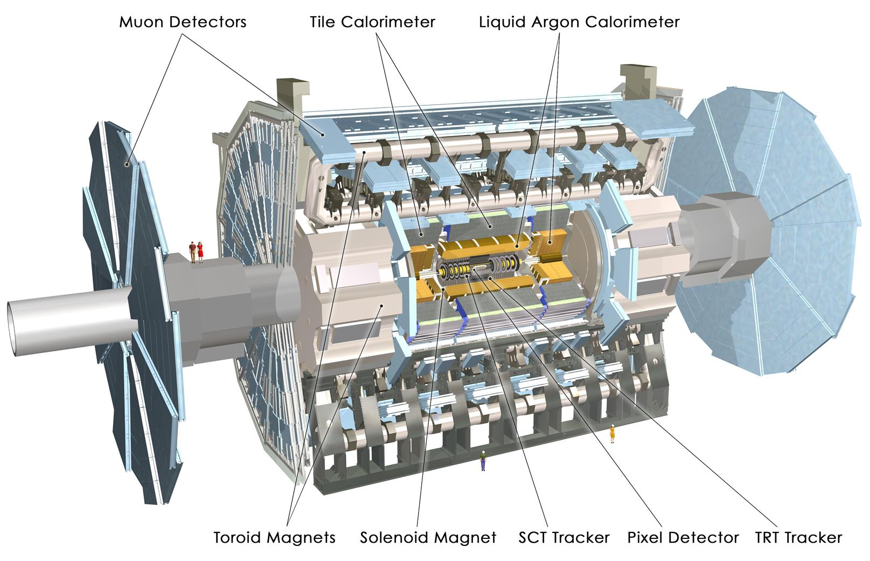
ATLAS detector
25m high, 44m long
Total weight 7000 tonnes
100 million “pixels” per picture.
3000 scientists including 1000 students

Slide 12
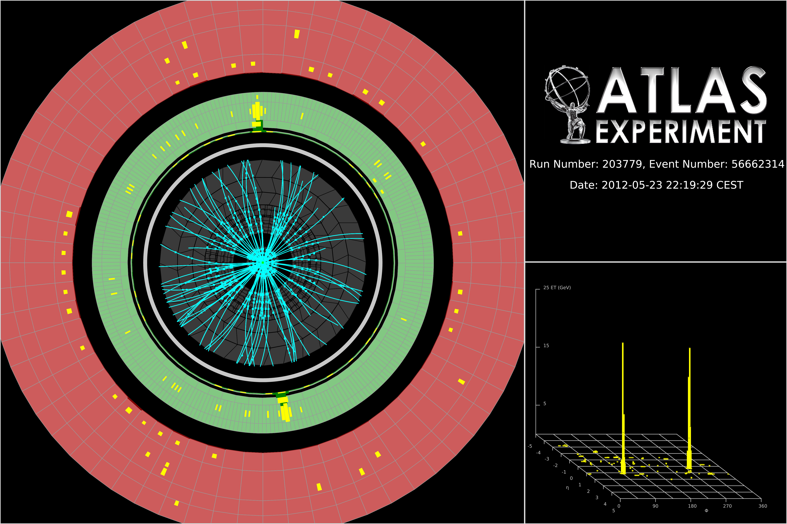
Higgs boson candidate with two photons

Slide 13
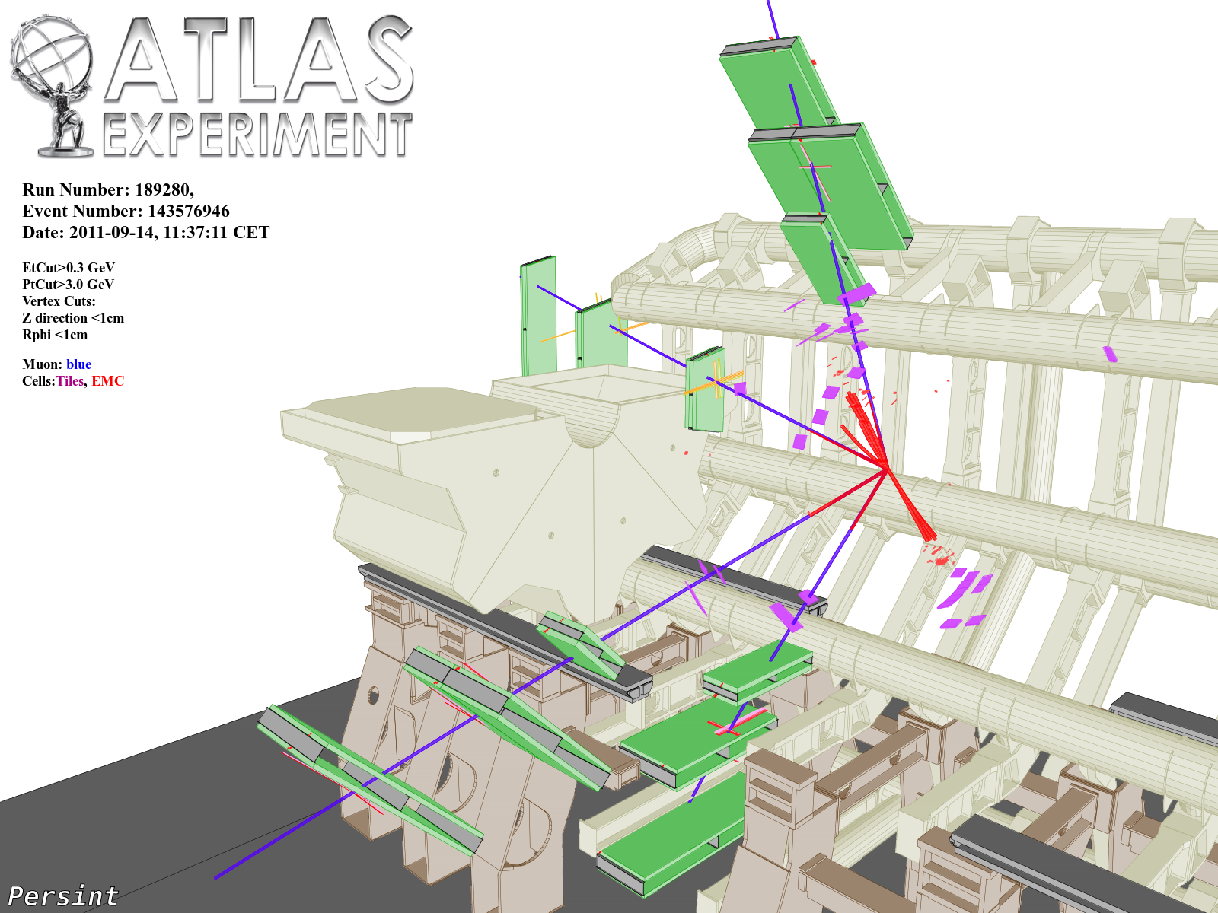
ZZ → μμμμ

Slide 14
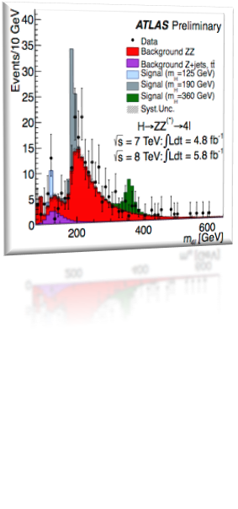
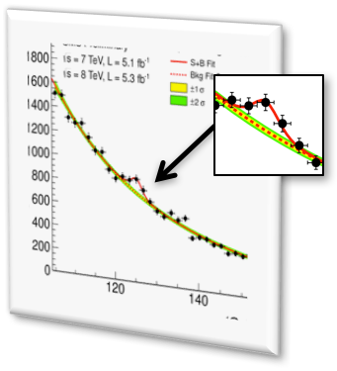
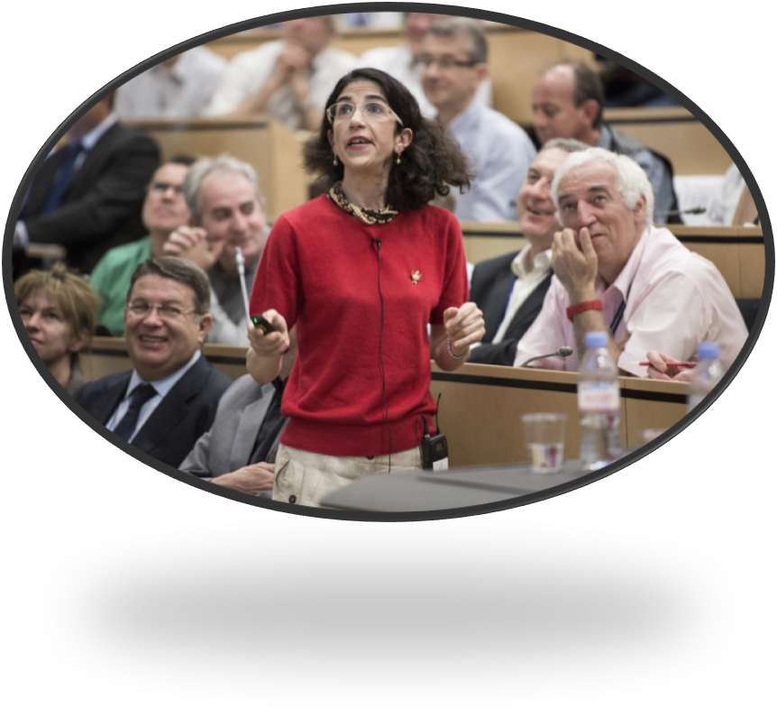

4 July 2012 – “I think we have it”
(Rolf Heuer)
Fabiola Gianotti
Joe Incandela

Slide 15
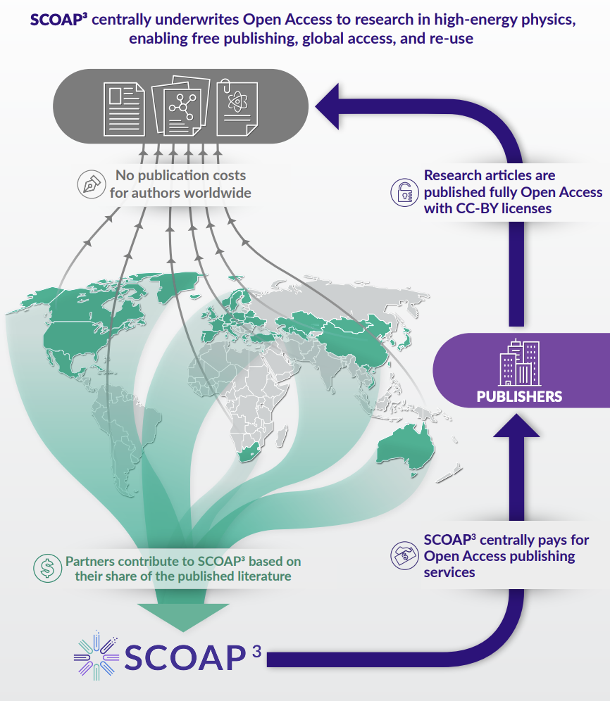
Open Science
Open Access Policy (2014)
  >90% of research produced at CERN published OA
  (CC-BY licenses)
  Sponsoring Consortium for Open Access Publishing in Particle Physics - SCOAP³ (44 countries)
  Inspired major global OA initiatives: PlanS, OA2020, etc.
LHC Open Data Policy (2020)
  LHC experiments committed to release experimental data for diverse scientific and educational uses
  Data released together with associated analysis tools
CERN Open Science Policy (2022)
  Policy broadened to explicitly include open software, hardware, research integrity and assessment, education, training and outreach, citizen science

Slide 16
Summary
  The governance of experiments at CERN has a long and highly successful tradition
    it has grown from small experiments of some ten people in the 1960s to the large collaborations comprising more than 3000 members today
  Built on fair sharing, on a joint (physics) goal and the determination to succeed
  The monitoring of the scientific success and the efficient use of resources involves committees with international experts
  The experiment results and data are available in the spirit of Open Science

