Slide 1
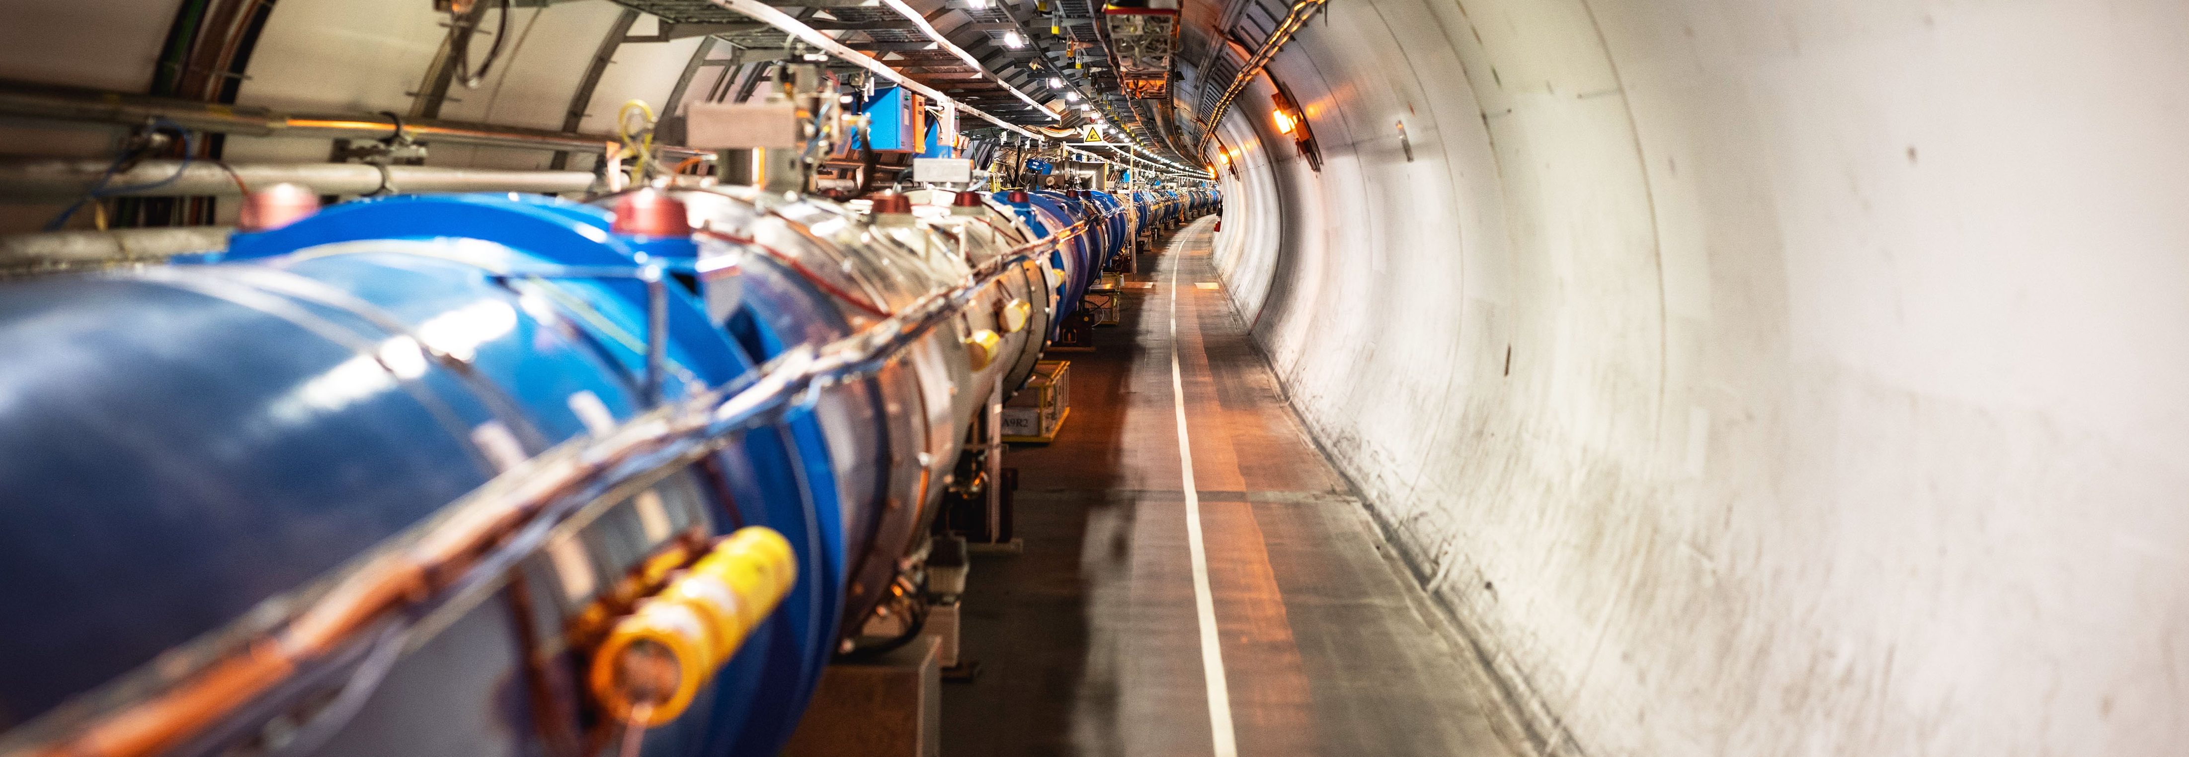
Accelerating Innovation
How CERN Technology Makes its Way into Society
Han Dols, Head of Business Development & Entrepreneurship, CERN

Slide 2
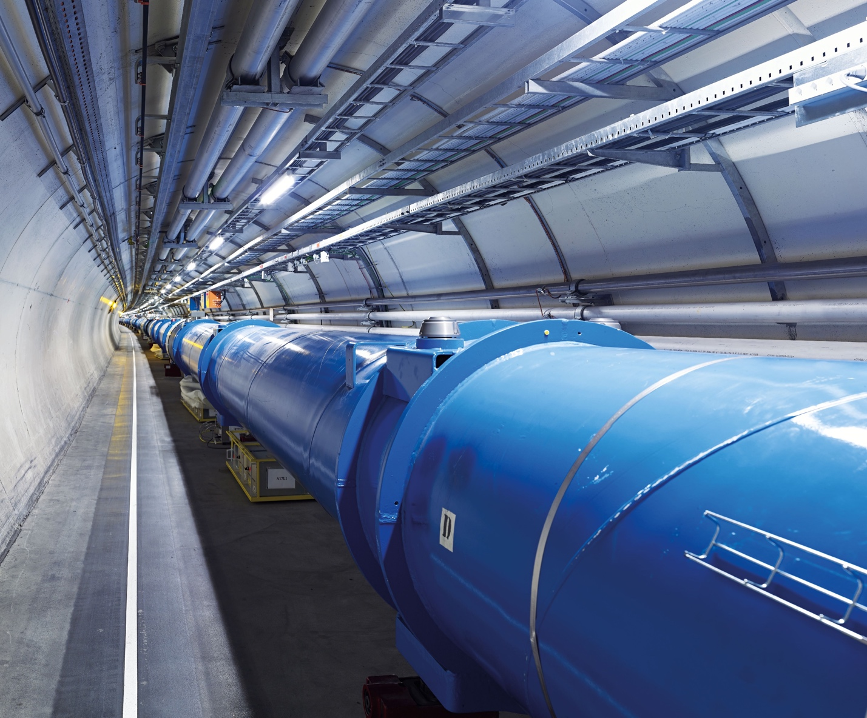
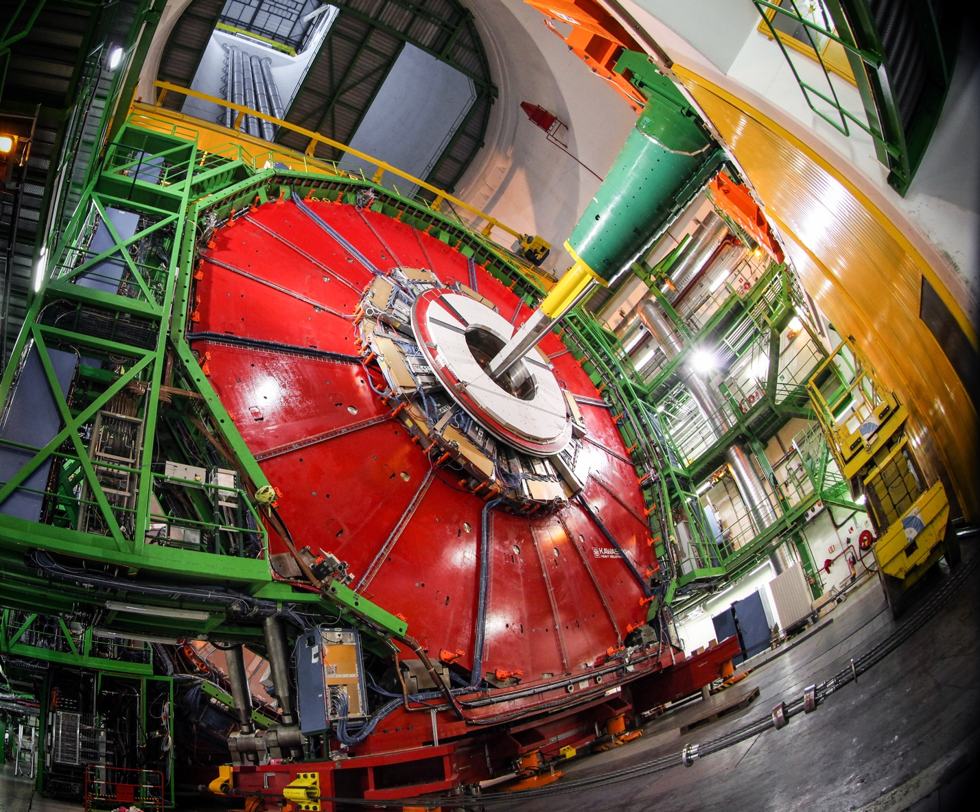
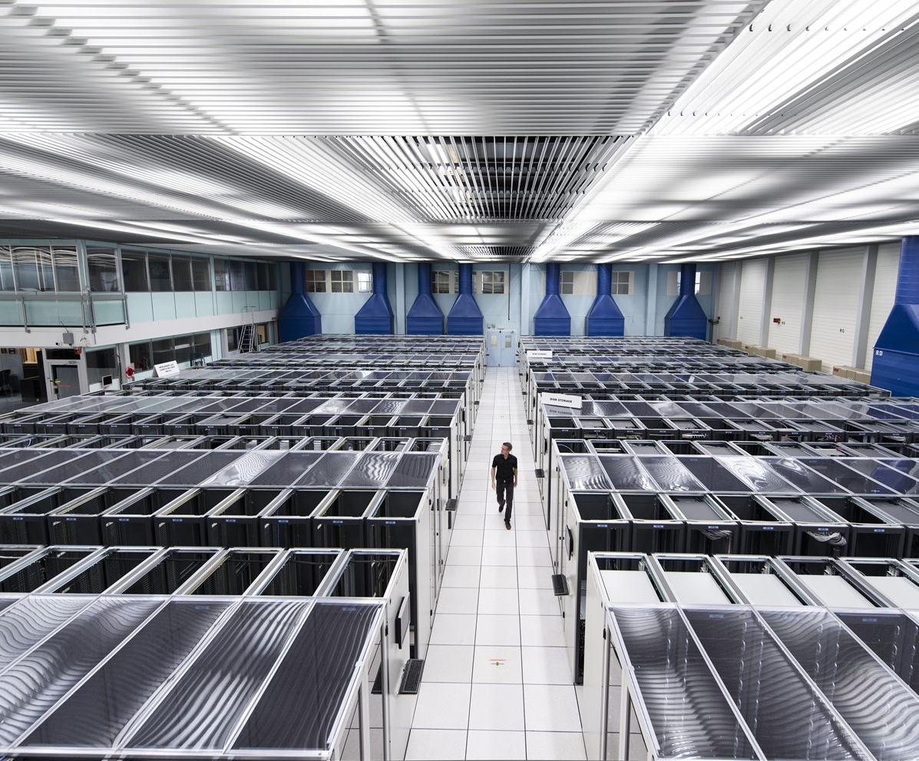
We develop technologies in three key areas
ACCELERATORS
DETECTORS
COMPUTING

Slide 3
Machine Learning and Deep Learning
Industrial Controls and Automation
Metrology
High and Ultra High Vacuum Systems
Data Analytics
Health, Safety and Environment Management
Cryogenics
Optoelectronics and Microelectronics
High Volume Data Management & Storage
Superconducting Magnets
Particle Acceleration and Control
Radiation Protection and Monitoring
Particle Tracking and Calorimetry
Sensors
Material Science
Cooling and Ventilation
Robotics
Collaboration Tools
Radio Frequency Technology
Manufacturing and Mechanical Processes

Slide 4
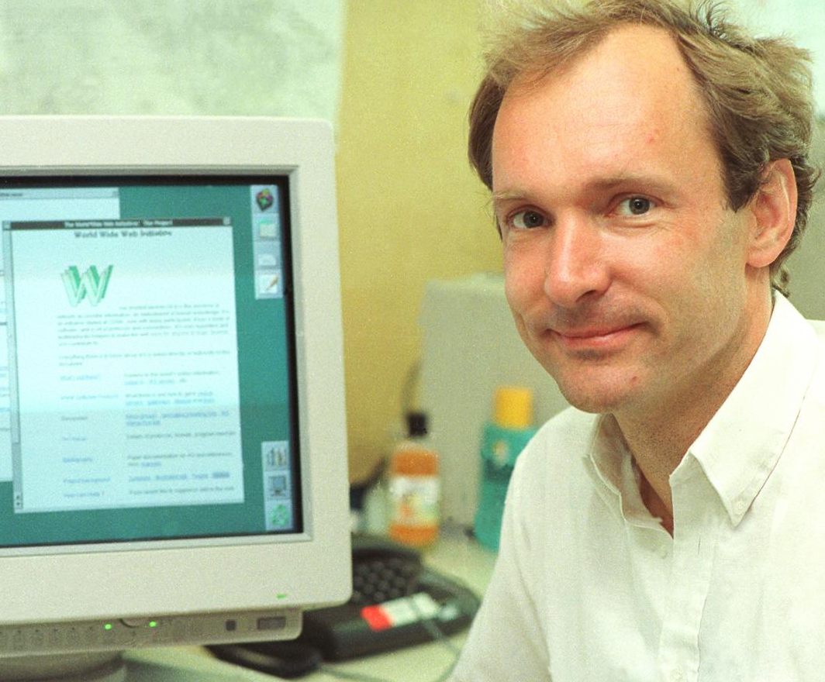
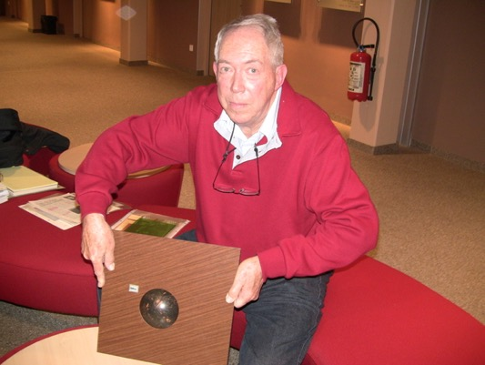
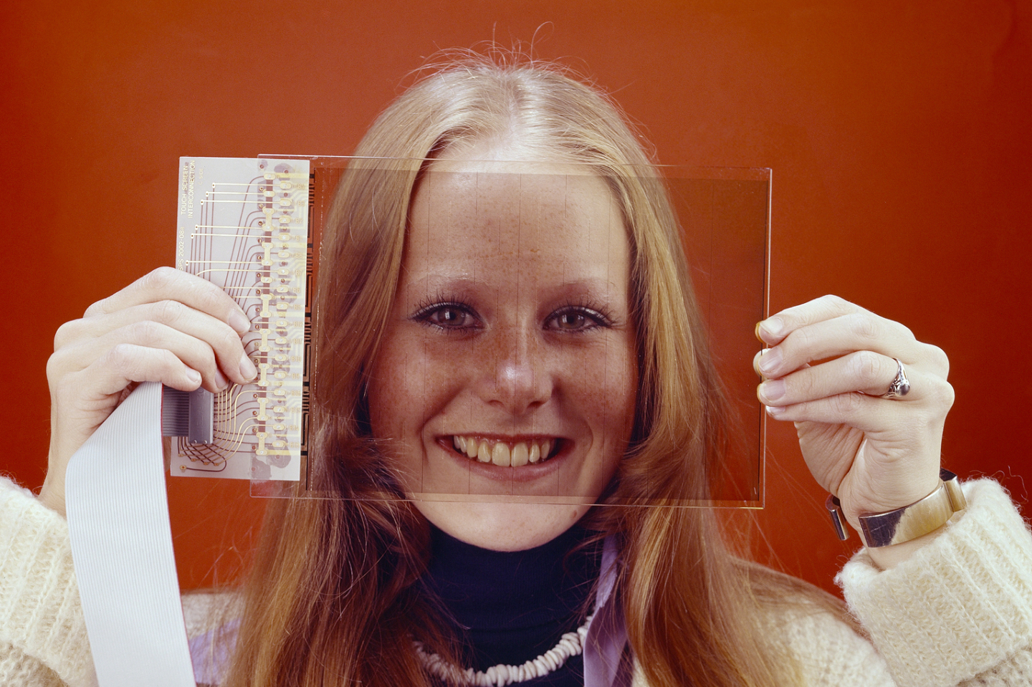
Some historic examples
WWW
TRACKERBALL
TOUCHSCREEN

Slide 5
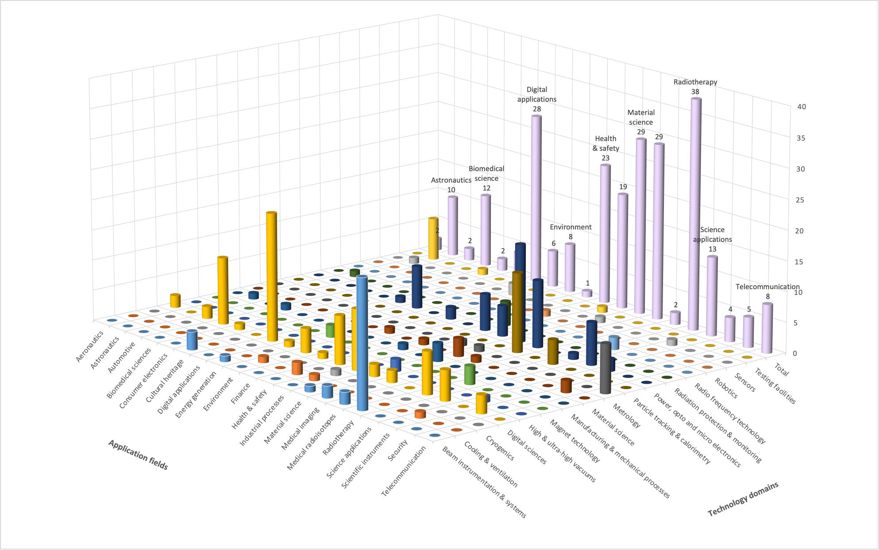

Slide 6
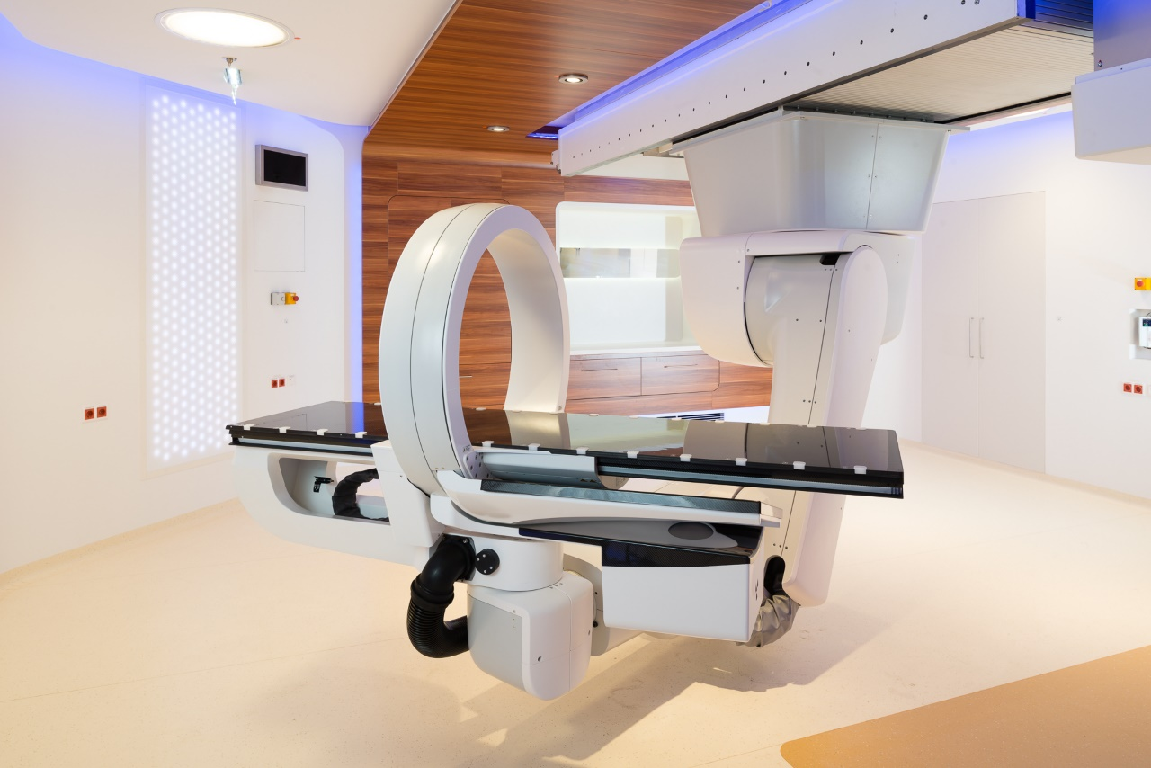
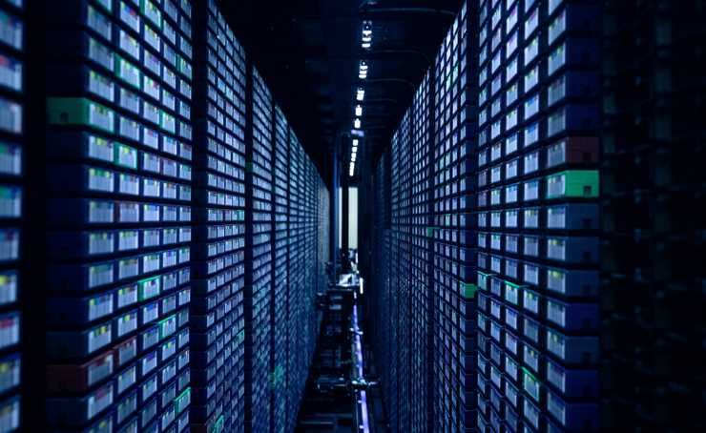
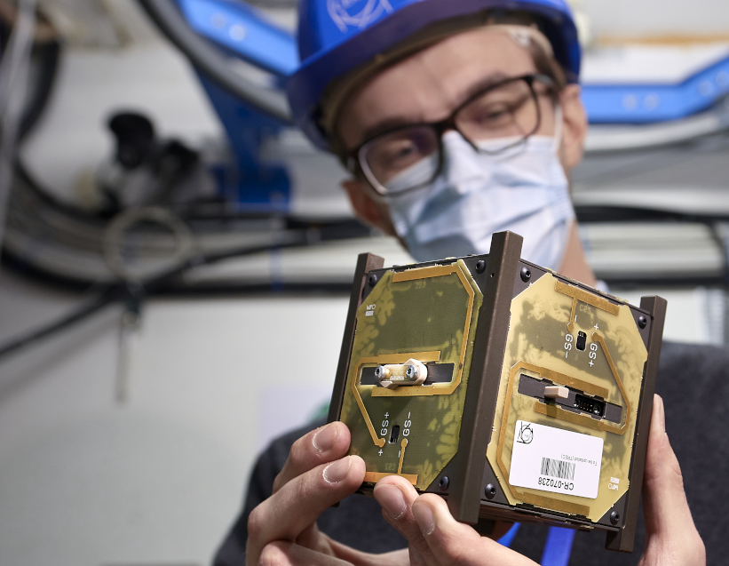
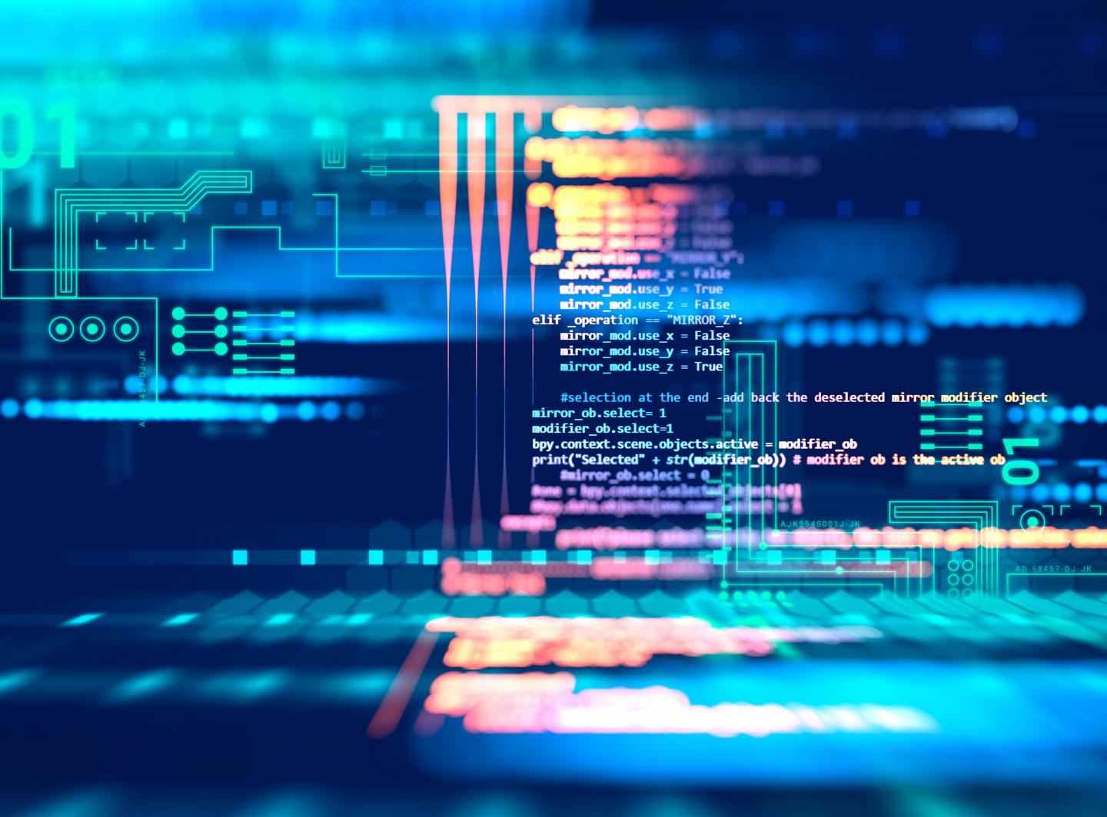
CERN as trusted non-commercial innovation partner
HEALTHCARE
ENVIRONMENT
DIGITAL
AEROSPACE
QUANTUM

Slide 7
Hybrid strategy: tech push & market pull
Scout for tech & knowhow
Search unmet needs
Mobilize tech experts
Mobilize innovation partners
Create tech and IP dossiers
Create value propositions

Slide 8
Shaping innovation partnerships
Discover
Discussion with Innovation / R&D management
Discovery day program at CERN
Shape
Define innovation ambitions and technical needs
Discuss expertise contributed by partners
Execute
Formalize partnership:
- Collaborative R&D
- License
- Consultancy
- Contract Research
Find mutual interest
Timeline, resources, IP

Slide 9
Shaping innovation partnerships
Licence
Access to existing solution
Support to implement
Consultancy/Service
Time of experts
Contract research
Specific solution
Outsource its development to CERN
Collaborative R&D
Time of facilities
Specific issue
General issue
Jointly find solution
Jointly develop solution
Open source access
Open source software
Open source hardware

Slide 10
MedAustron and CNAO offer hadron therapy using CERN technology.
Collaborative R&D

Slide 11
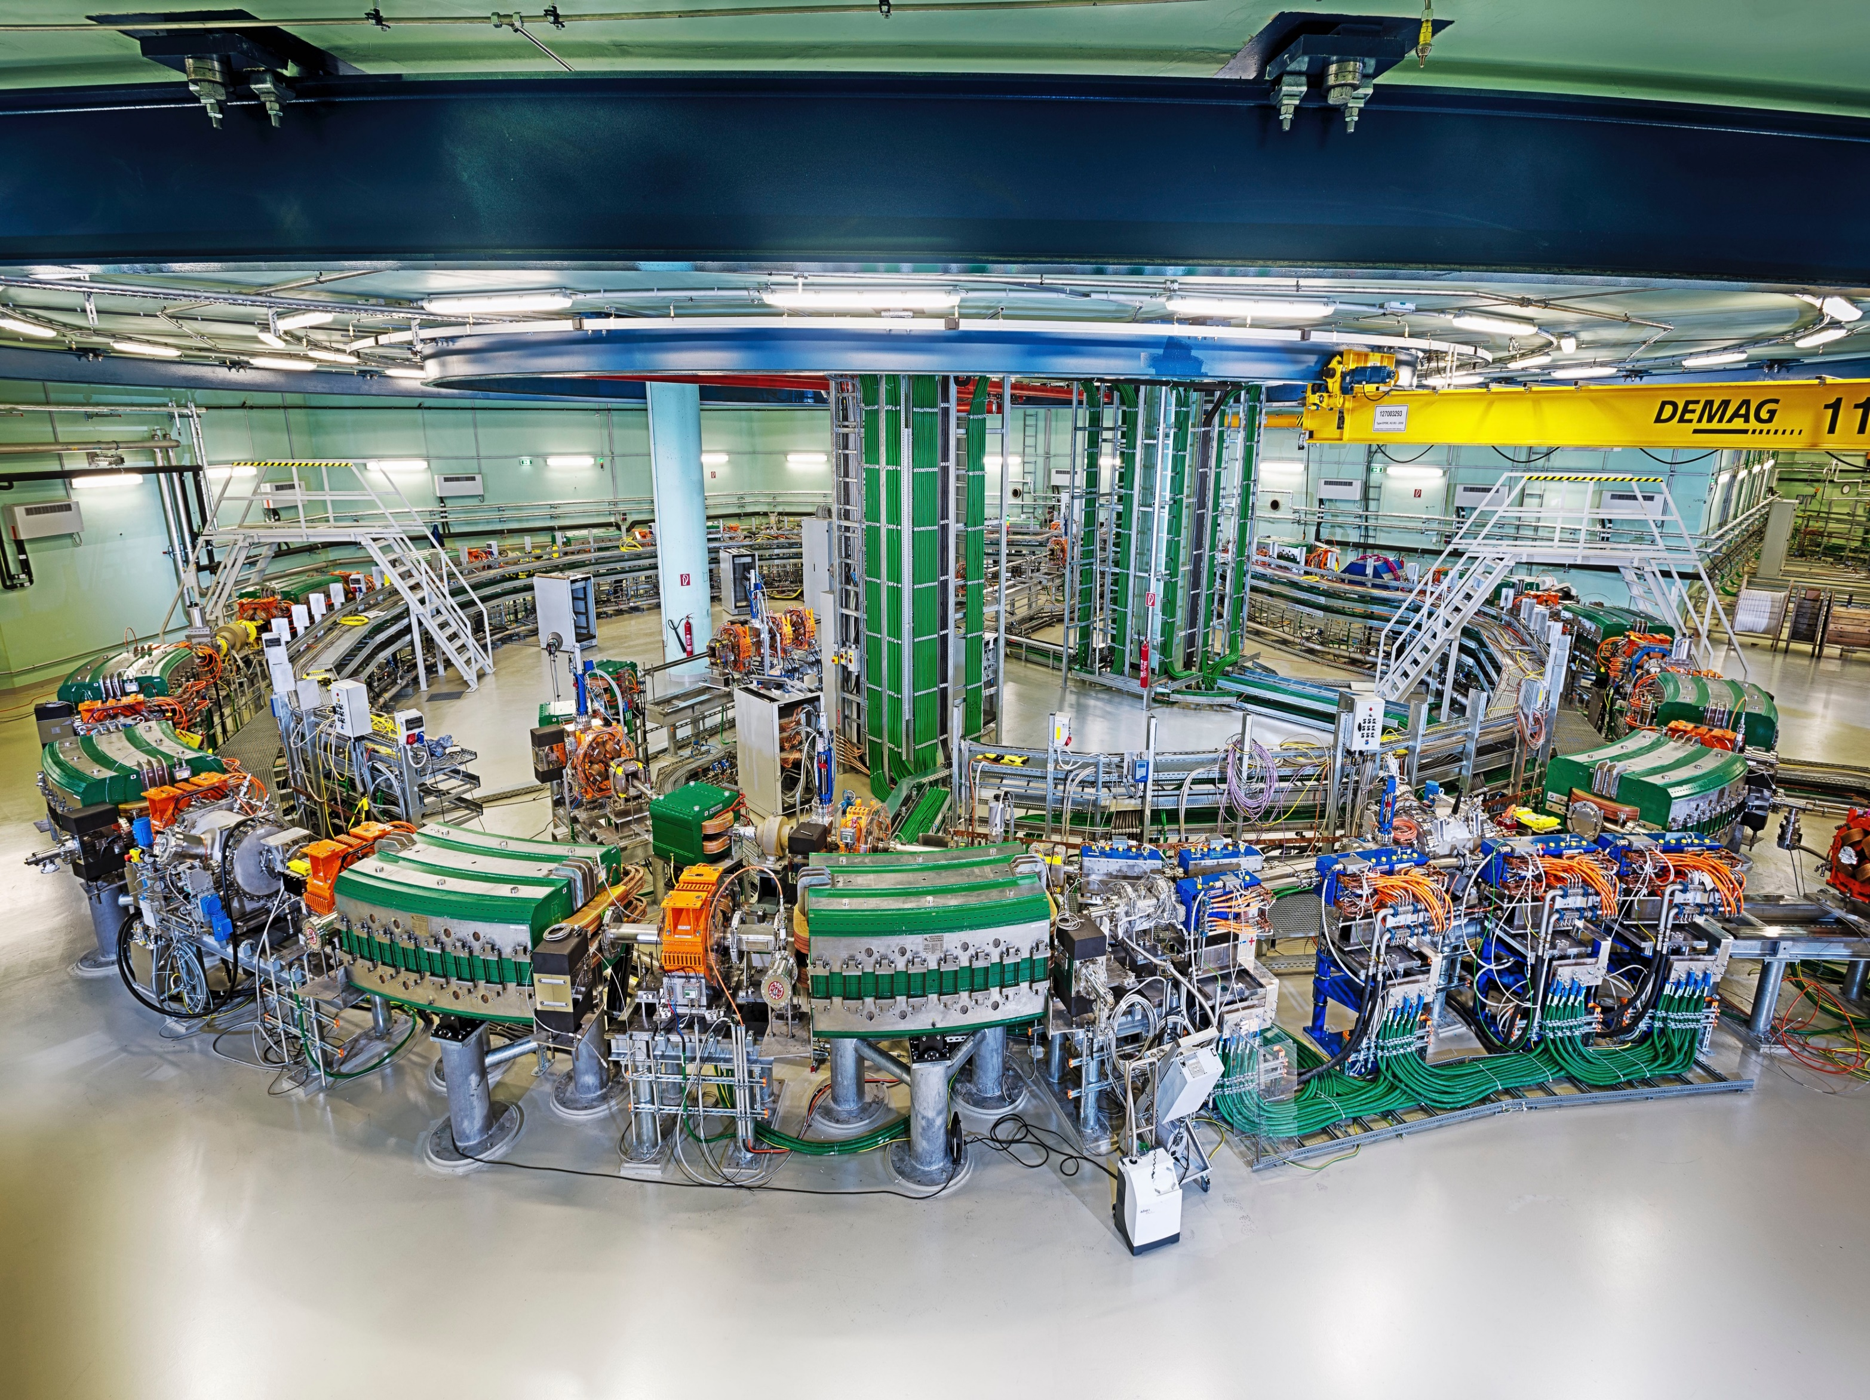
Collaborative R&D
MedAustron and CNAO offer hadron therapy using CERN technology.

Slide 12
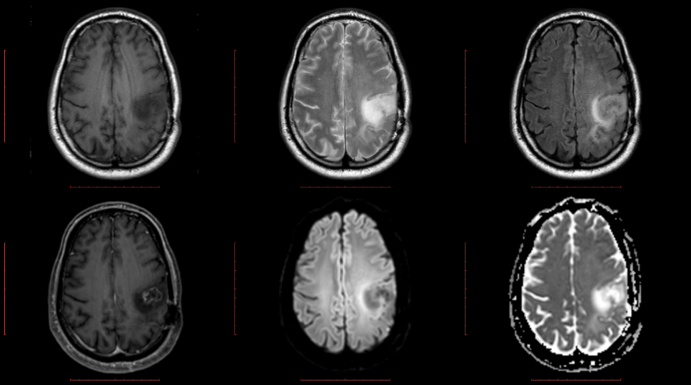
EU Program
Han Dols
Head of Business Development and Entrepreneurship Section at CERN
MSc in Physics at TU Delft, Alumni from IMD (Geneva), Webster University (Leiden) and Haas School of Management, University California (USA)
20 years experience in various functions in industry, leading marketing & business development global scale for innovative technologies in the medical device and material science industry
Companies he worked for include DSM as well as Medtronic, where he was running clinical evaluations of new therapies for heart failure
Han Dols
Head of Business Development and Entrepreneurship Section at CERN
MSc in Physics at TU Delft, Alumni from IMD (Geneva), Webster University (Leiden) and Haas School of Management, University California (USA)
20 years experience in various functions in industry, leading marketing & business development global scale for innovative technologies in the medical device and material science industry
Companies he worked for include DSM as well as Medtronic, where he was running clinical evaluations of new therapies for heart failure
CAFEIN: Federated network platform for the development and deployment of AI based analysis and prediction models.

Slide 13
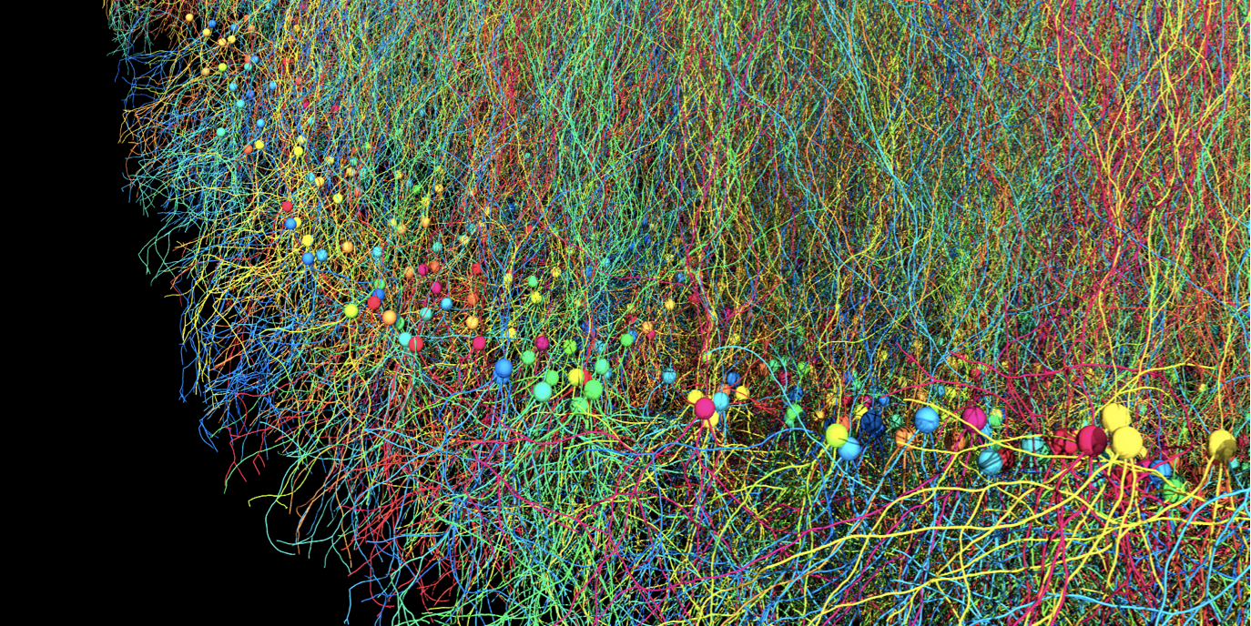
R&D Collaboration
BIODYNAMO
a modular, high-performance, open source
agent-based simulation platform
BioDynaMo: a modular, high-performance, open source
agent-based simulation platform
A. Raimondo, CERN & Society Foundation Board Meeting, 26.04.2022

Slide 14
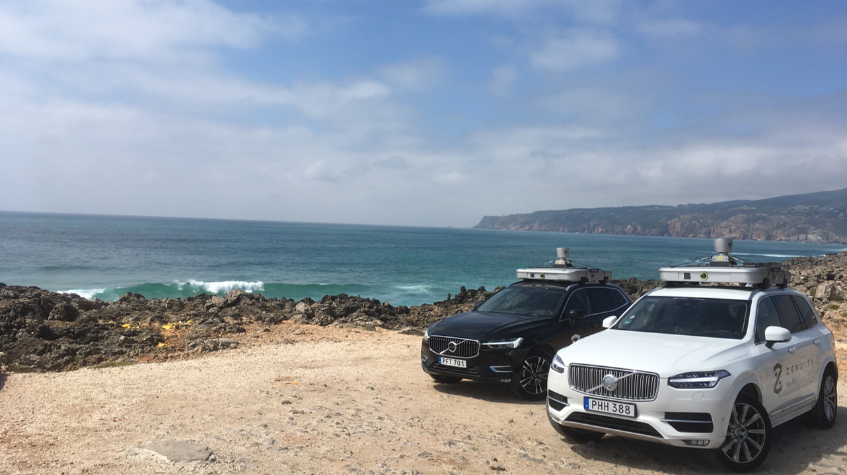
ZENSEACT (Volvo Cars Company) teams up with CERN on extremely fast machine learning using FPGAs.
Collaborative R&D

Slide 15
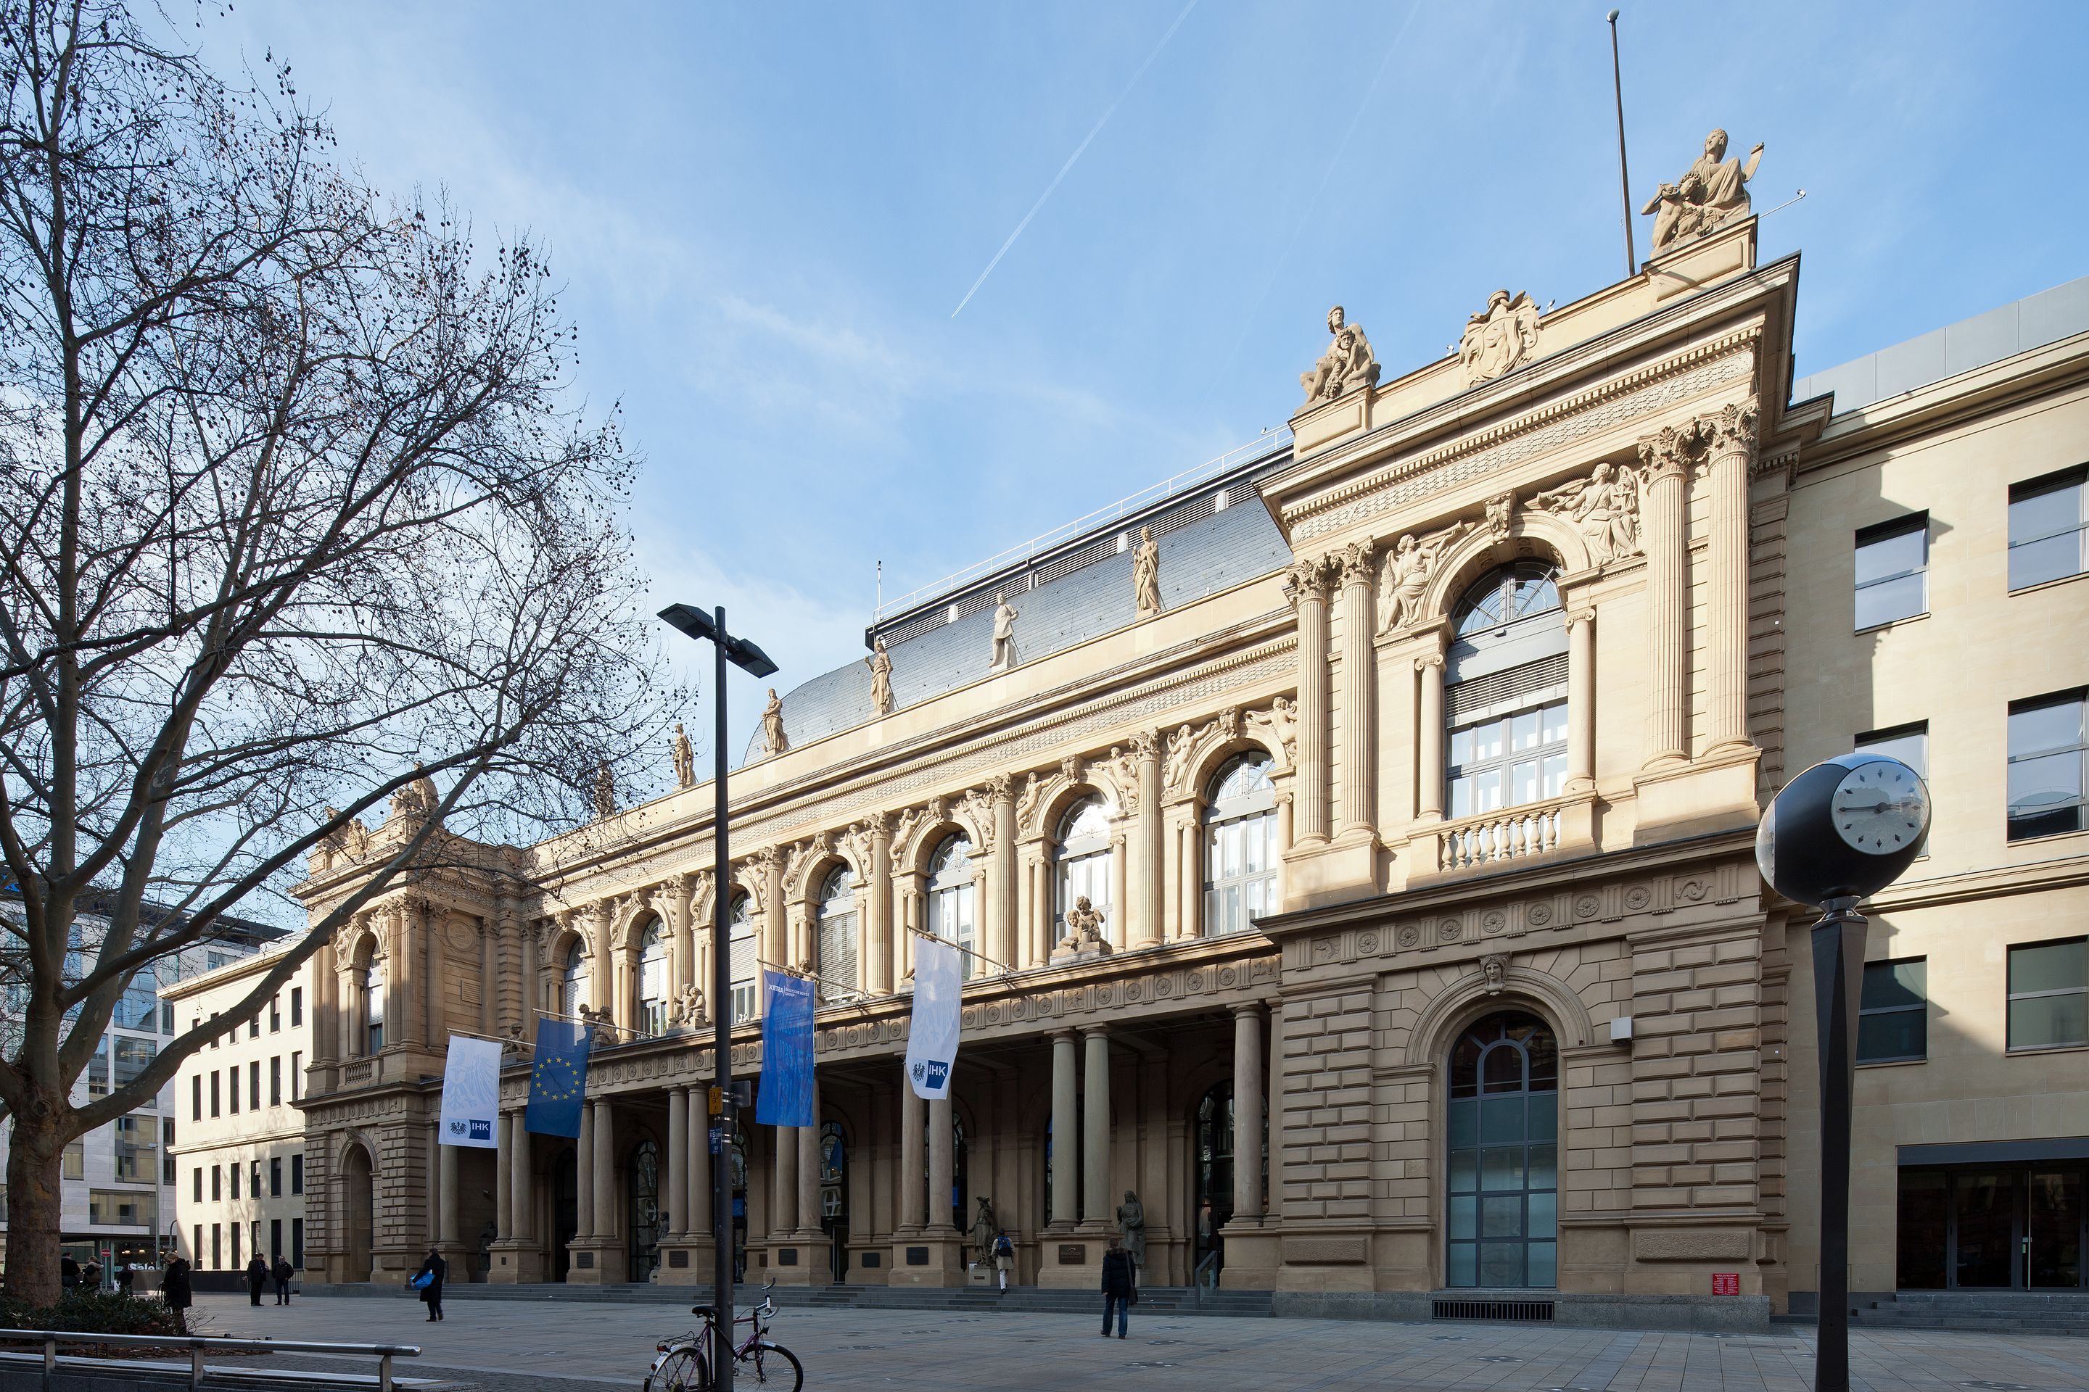
Frankfurt Stock Exchange is using CERN’s White Rabbit technology to synchronize timing in their trading infrastructure to less than a nanosecond.
Open Source

Slide 16



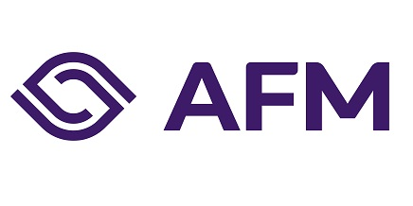
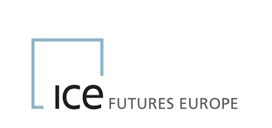
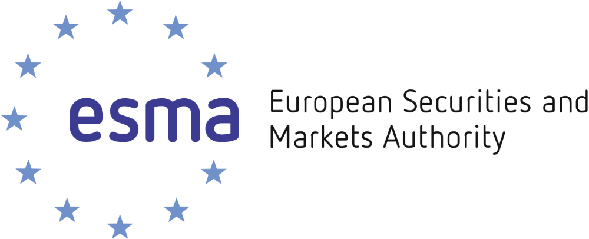

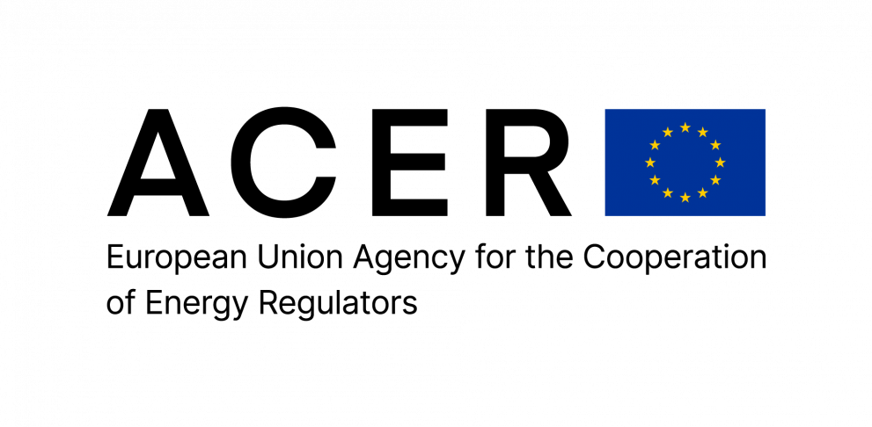




Collaborative R&D
HighLo project explores CERN knowhow and software to support national banks and regulators in detecting fraud in financial and energy markets (CORMEC/WUR). First International Expert Group on Market Surveillance hosted at CERN.

Slide 17
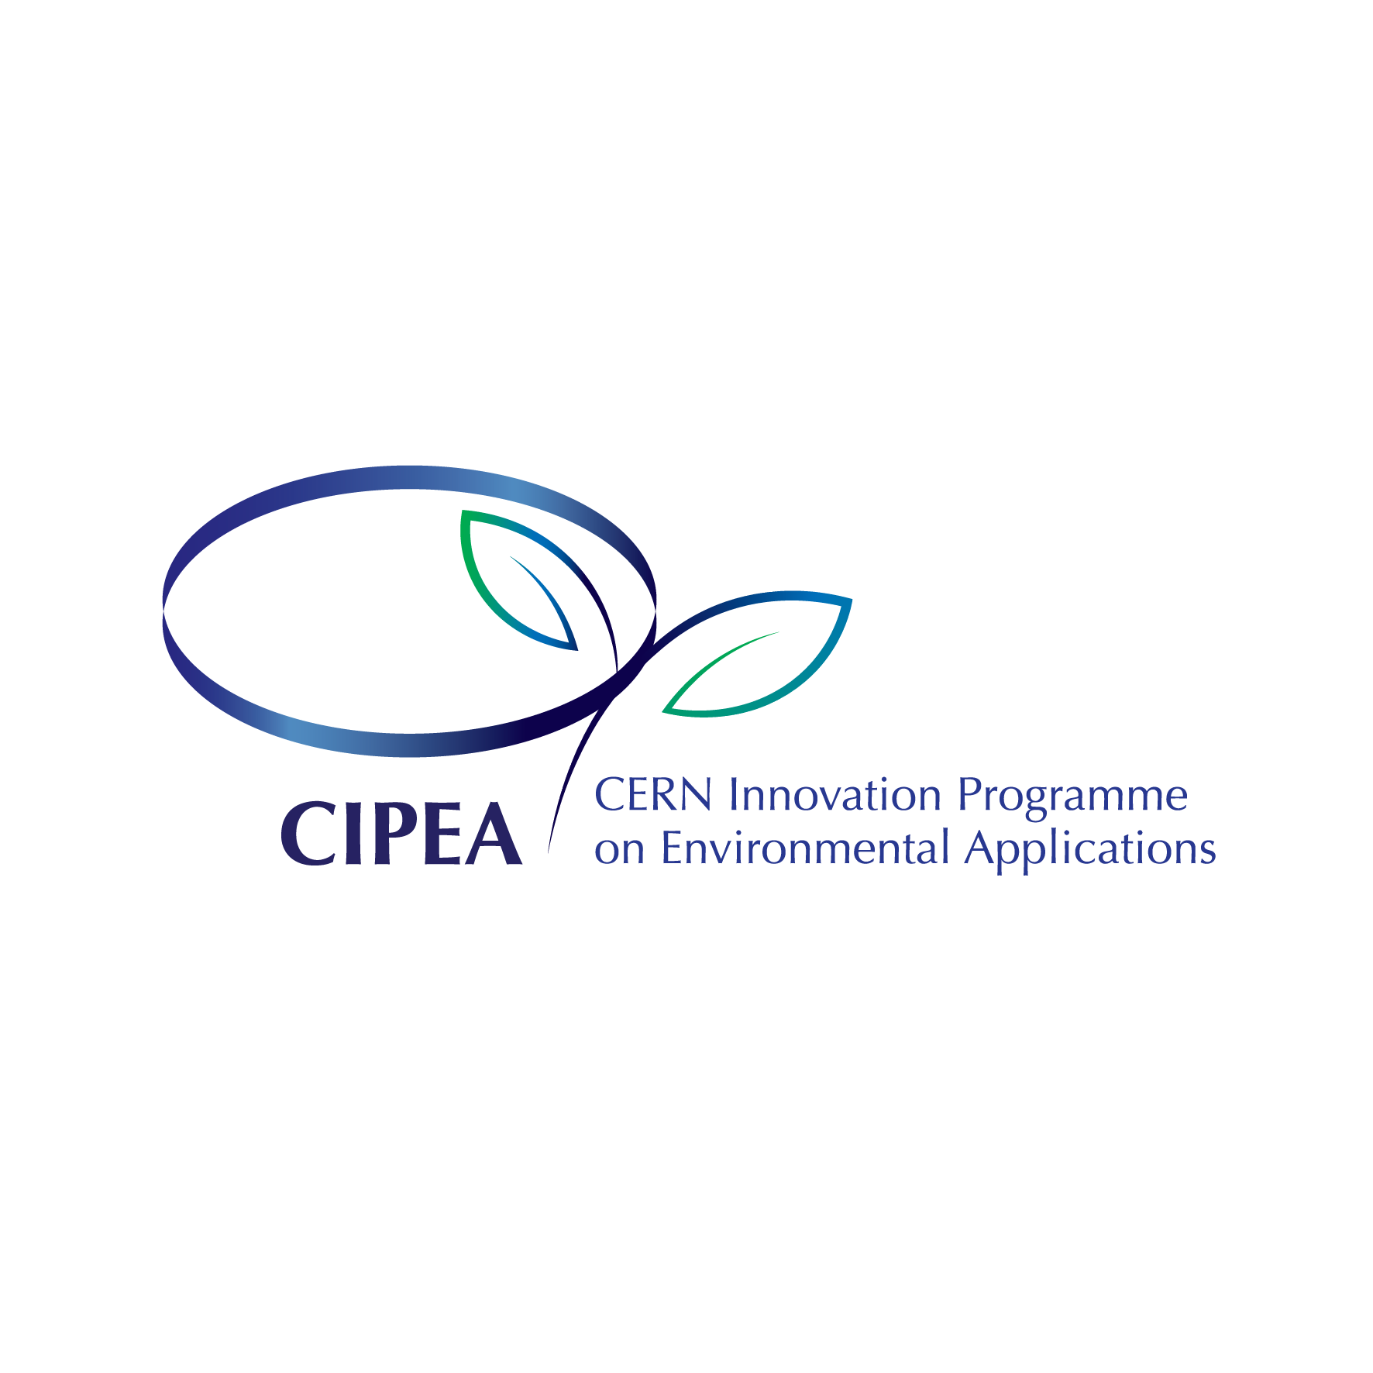

Slide 18
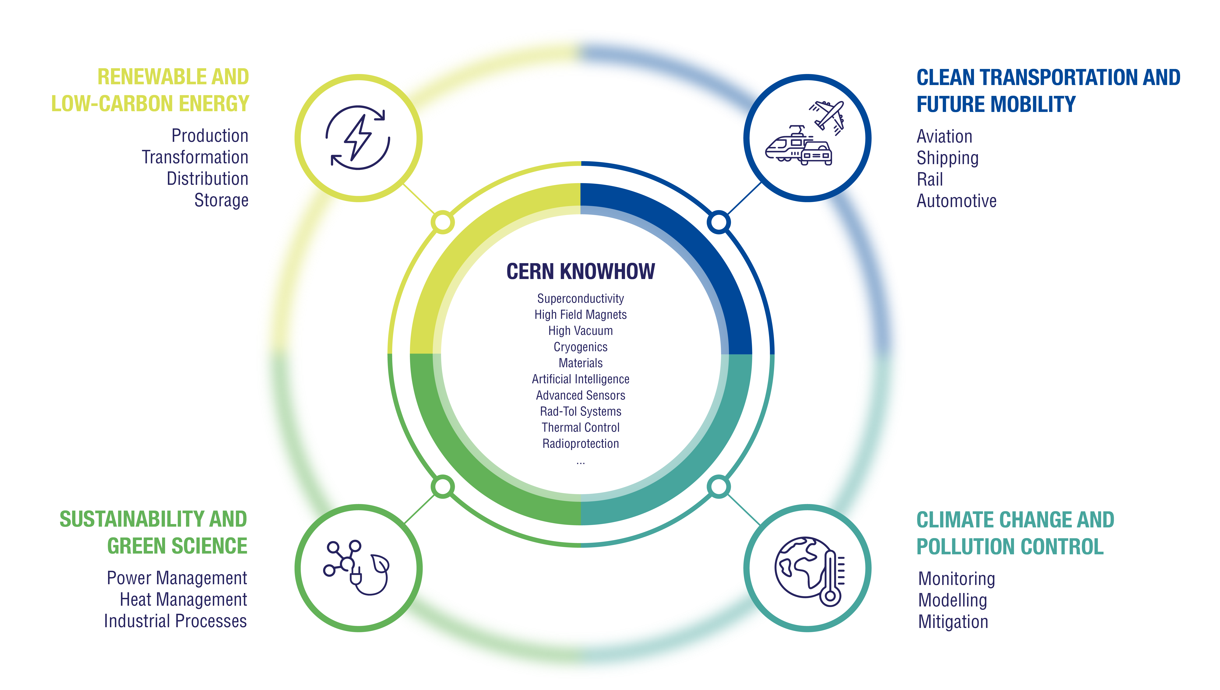

Slide 19
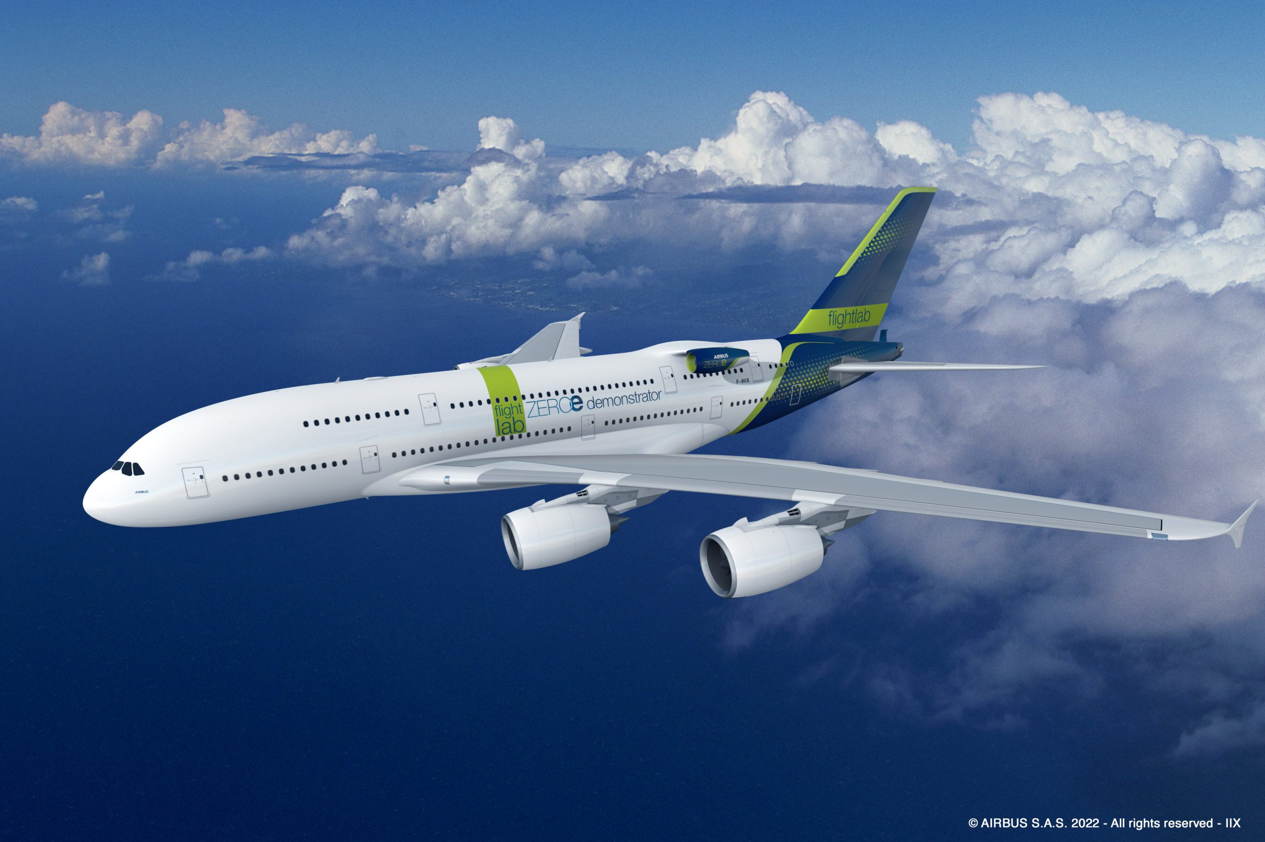
CERN and Airbus collaborate to assess potential of superconducting technologies for future low emission airplanes.
Collaborative R&D

Slide 20
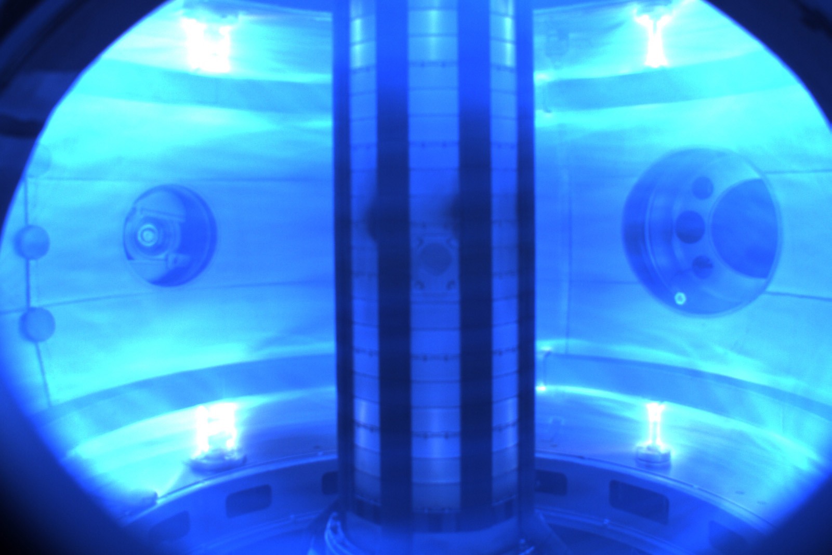
Tokamak Energy (fusion power) taps into expertise of CERN on simulation of currents and magnetic fields.
Consultancy

Slide 21
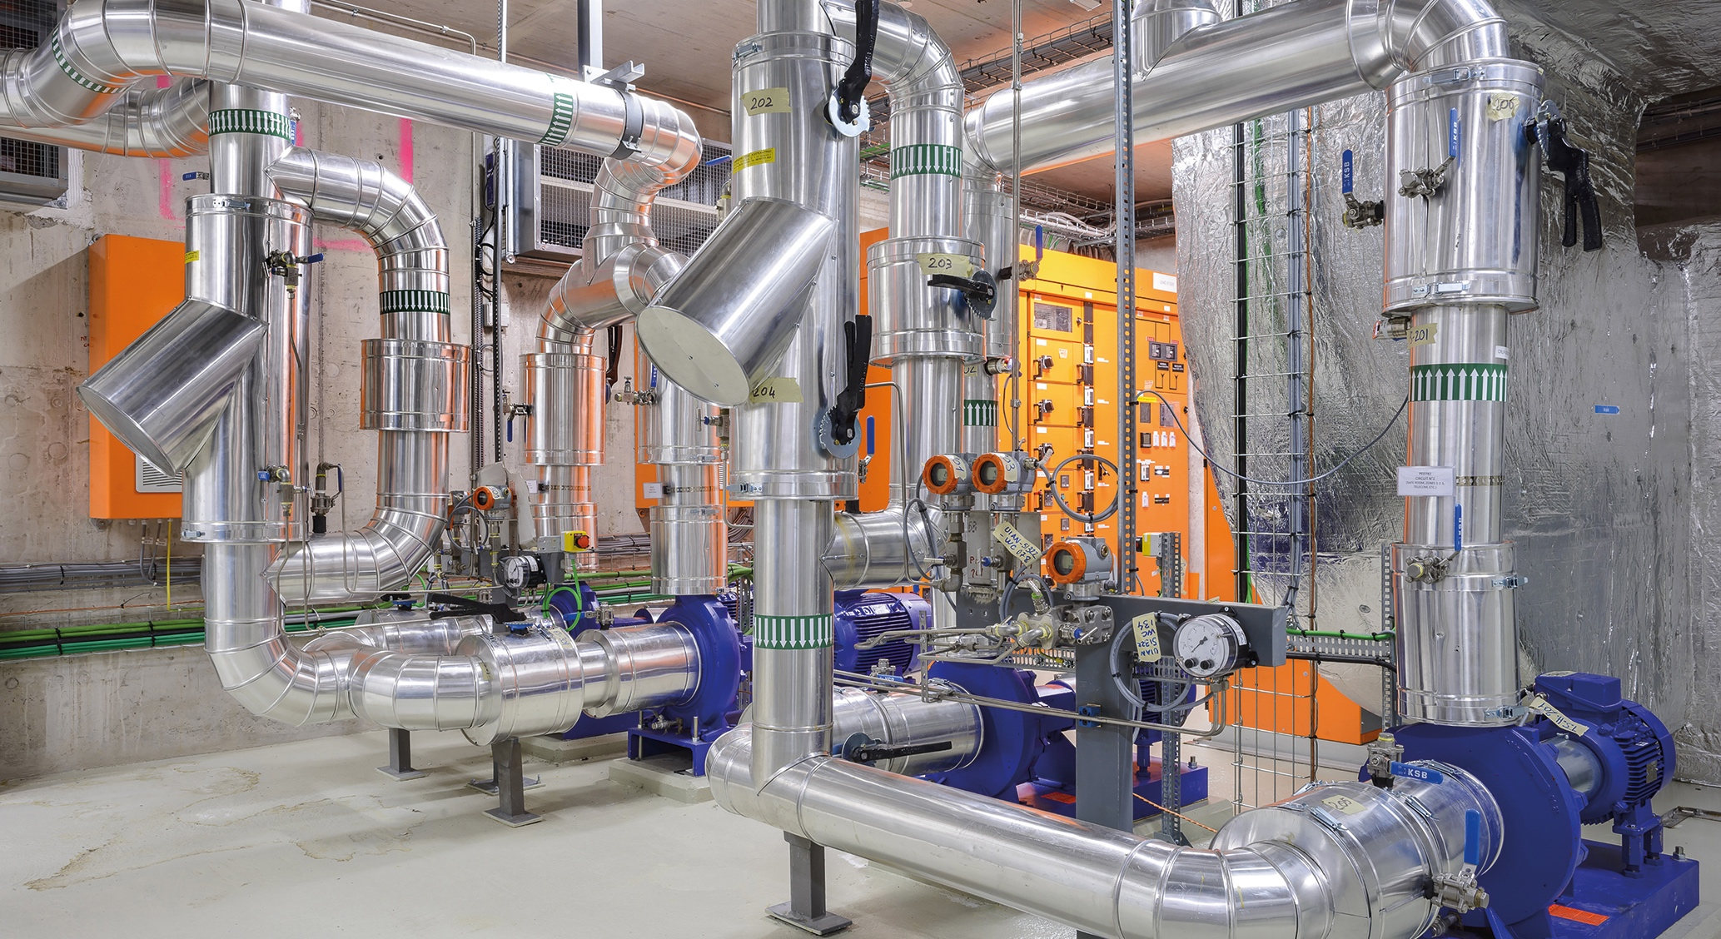
ZENSEACT (Volvo Cars Company) teams up with CERN on fast machine learning using FPGAs.
Collaborative R&D
Collaborative R&D
CERN and ABB team up on reducing electricity in cooling and ventilation.

Slide 22
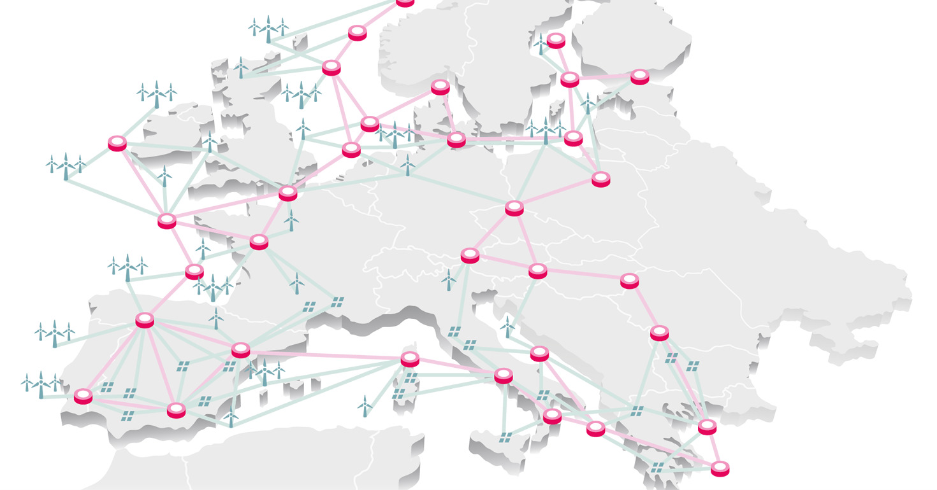

Collaborative R&D
SuperNode and CERN collaborate on new solutions for renewable energy transmission.

Slide 23
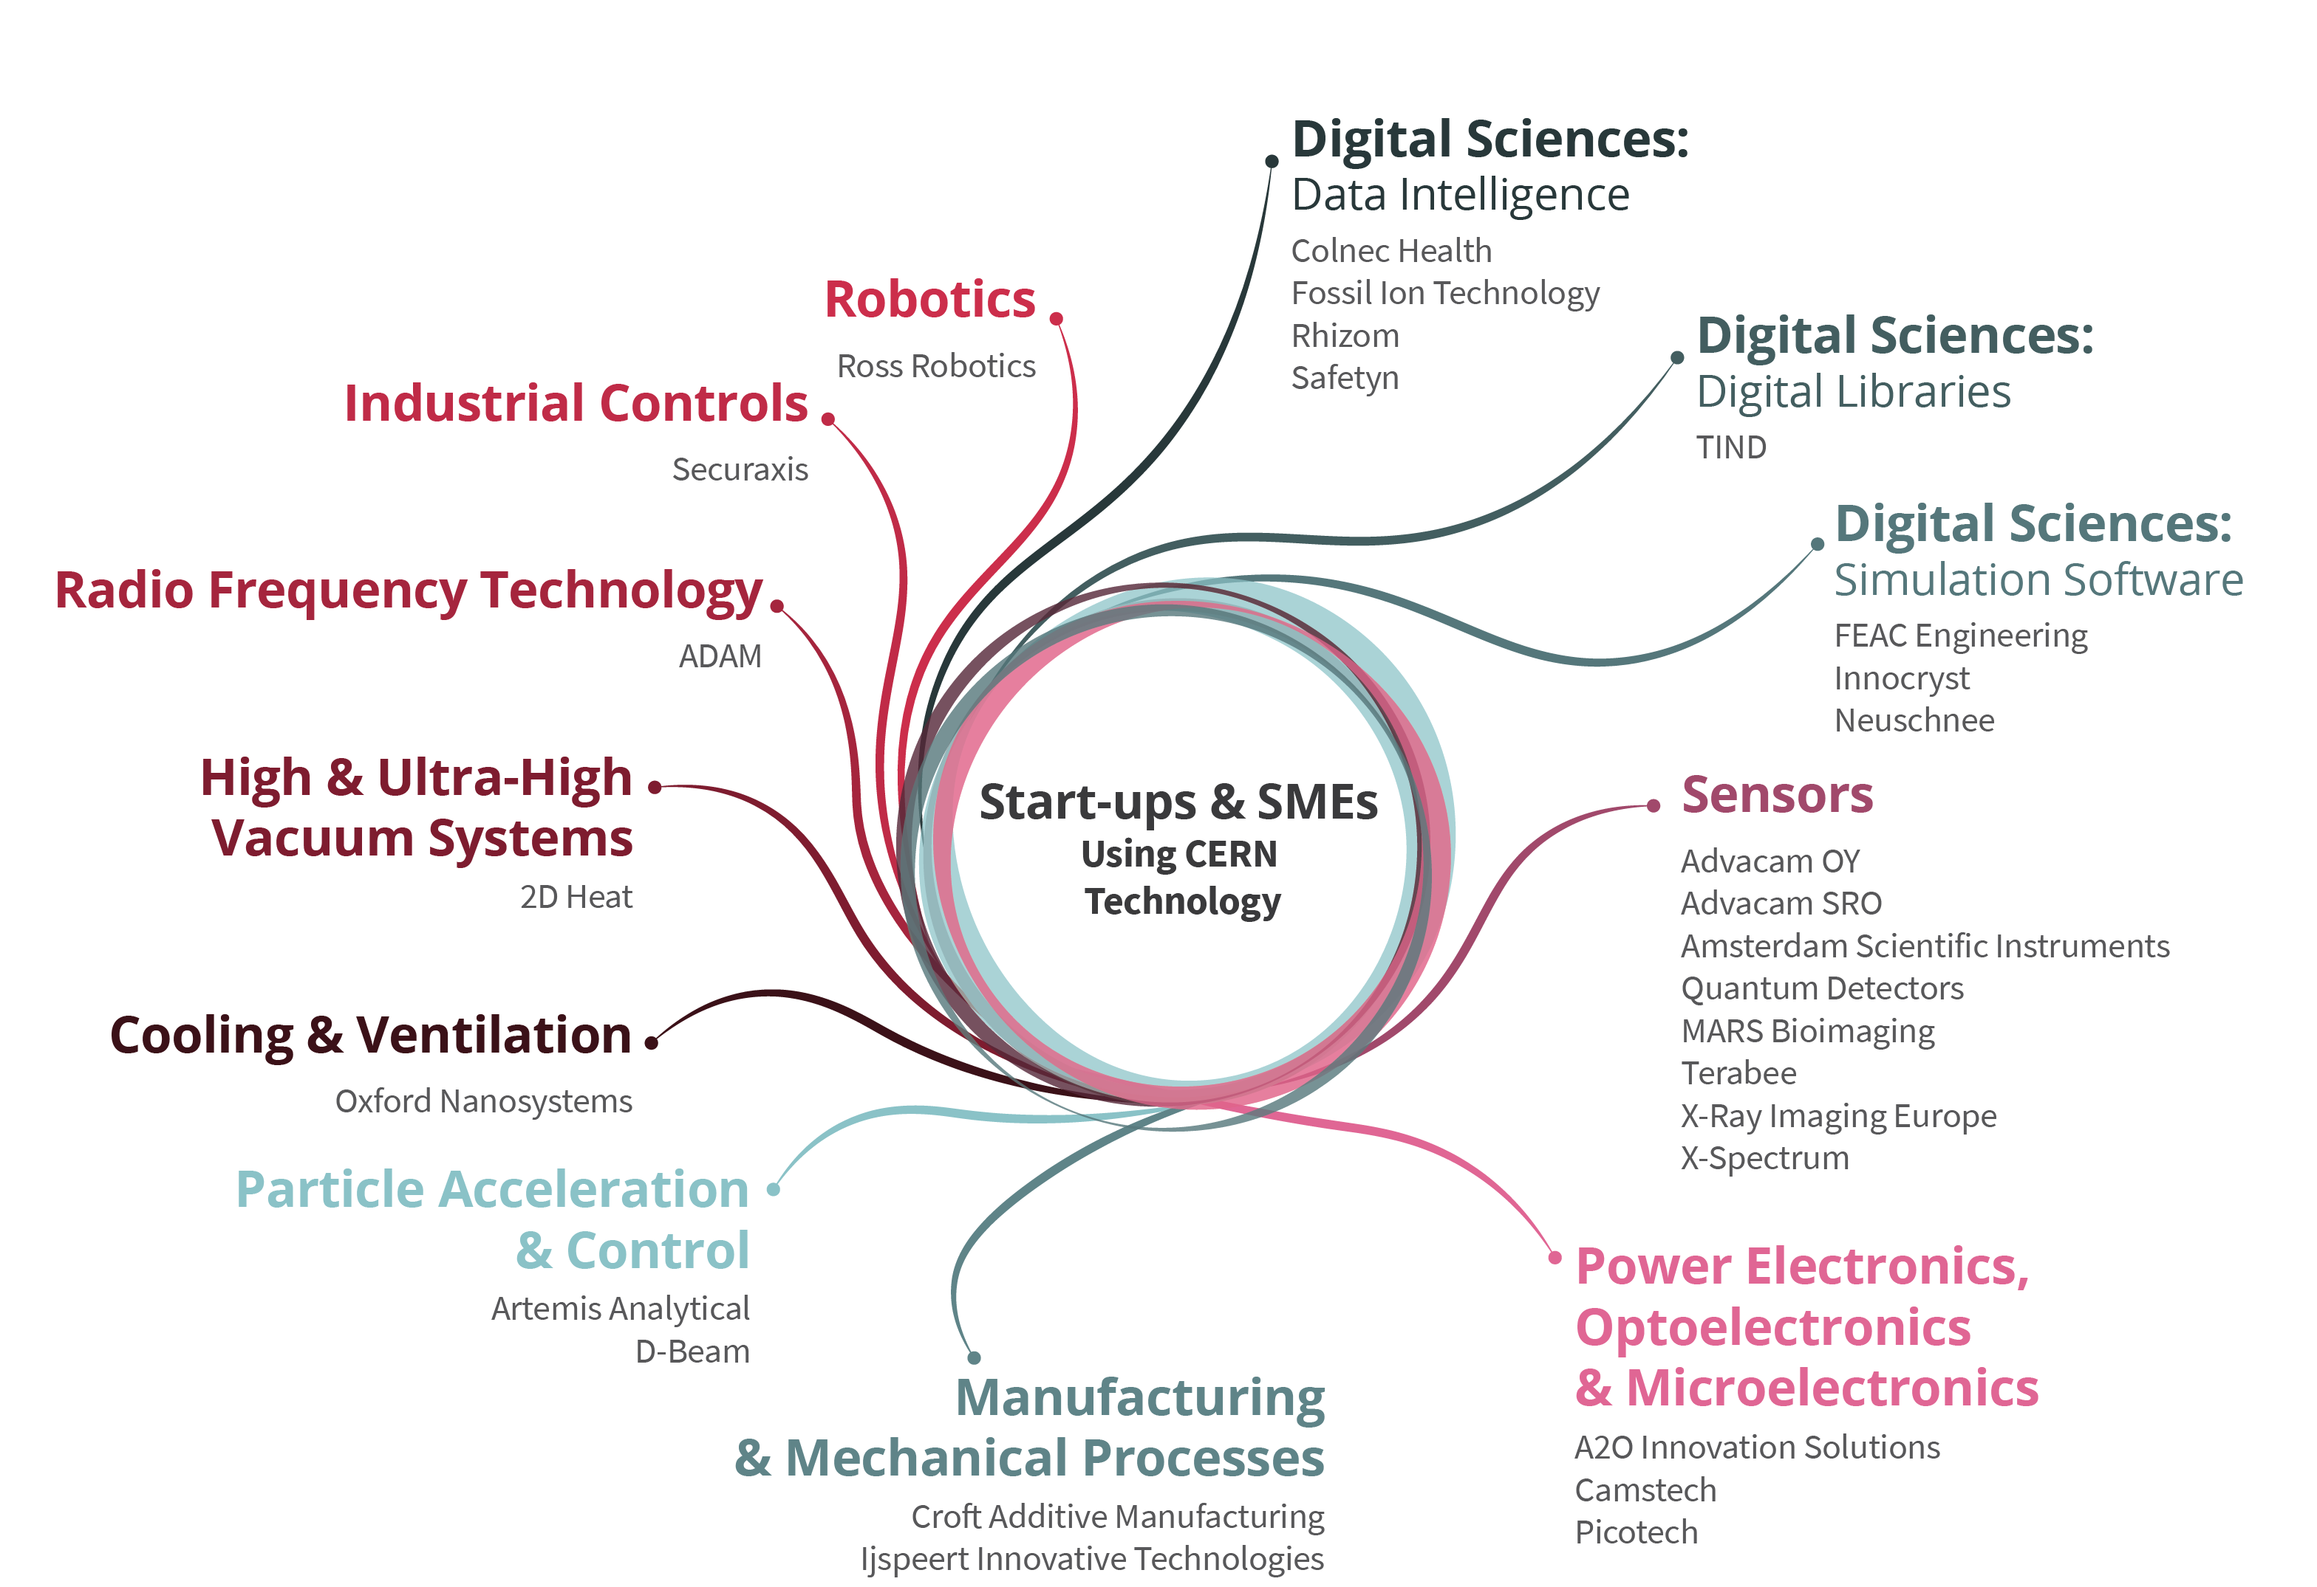
Startups and Spin-offs

Slide 24
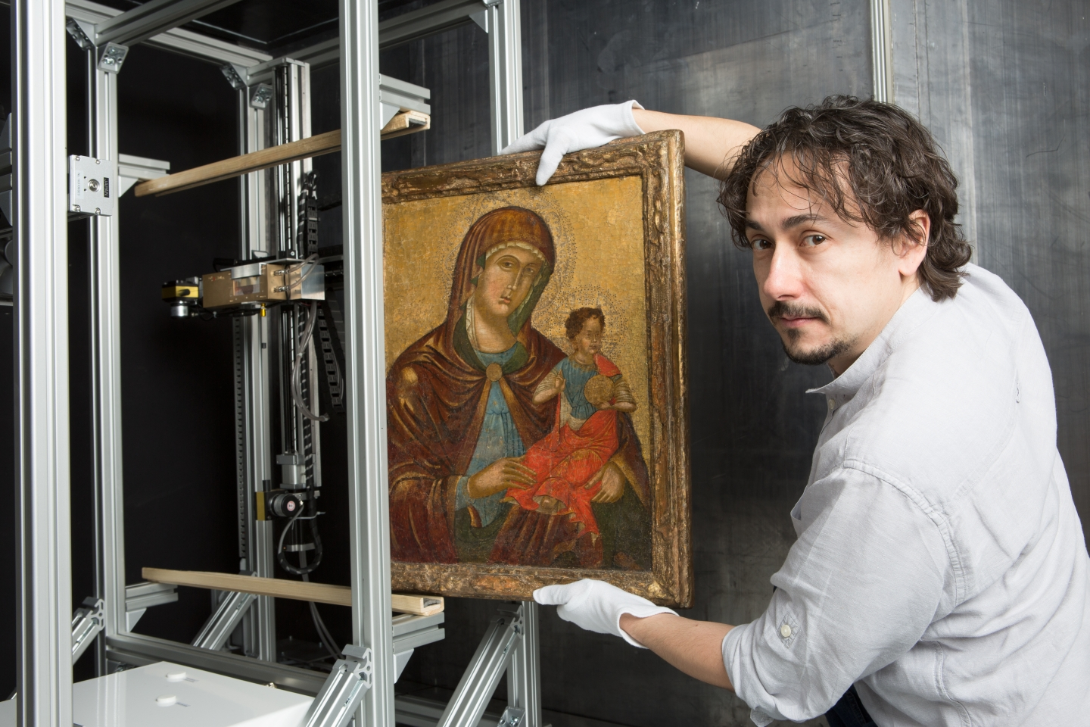
InsightART: Using CERN Medipix detector to analyse art.
License
Notes:
#EuropeForCulture = because 2018 is the European Year for Cultural Heritage.
At CERN, the Medipix collaborations have been developing pixel detector readout chips since the 1990s, enabling high-resolution, high-contrast, noise-free images – making them unique for imaging applications. Medipix2, Medipix3, Timepix and Timepix3 are state-of-the-art particle imaging and detection readout chips. Now they are being used to bring about a revolutionary improvement in the field of art authentication and restoration. A new start-up company based in Prague, InsightArt s.r.o., has adopted the technology to perform spectral X-ray scans of paintings.
Note: Cultural Heritage is defined as: “Cultural heritage takes many forms: from the tangible legacy of monuments, artwork and books, to digital resources, either newly created or used to ensure cultural preservation. The concept also includes intangible (such as language and oral traditions) and natural elements (such as flora and fauna). This heritage may seem remotely connected to CERN's technological advances, yet the opposite is true: in 2018, several projects related to art restoration and digital preservation are using CERN technology.”

Slide 25
Startup TIND: Digital archive, library management and preservation.
License

Slide 26
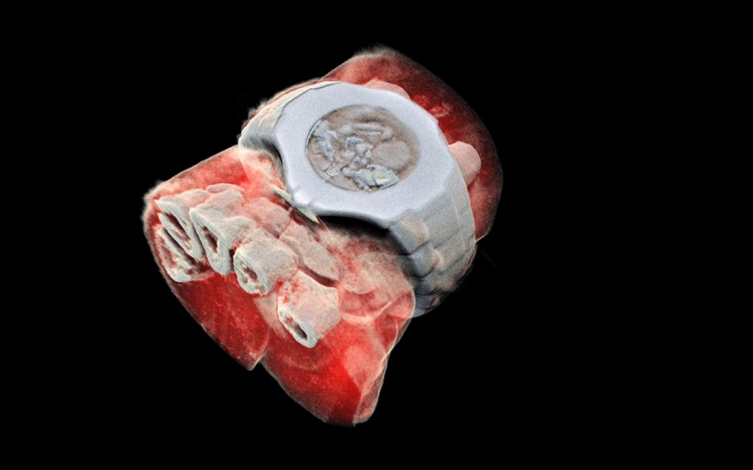
License
MARS Bio Imaging: next generation X ray finally in color using CERN chips

Slide 27
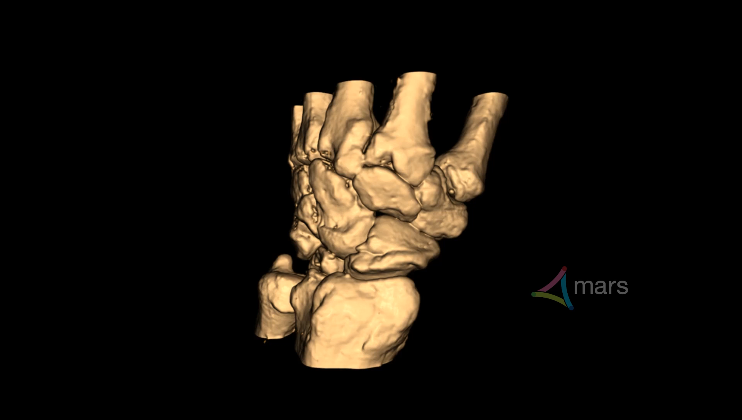
License
MARS Bio Imaging: next generation X ray finally in color using CERN chips

Slide 28
Key lessons learned
  CERN is strong in the ‘extremes’ of the technology scale
  CERN tech is not close to market: funding & industry critical
  Mind the gap – in language, ‘clockspeed’ and culture
  Best projects arise where different disciplines collide
  Start with a project based on a concrete need
  Be aware… magic may happen!

Slide 29
THANK YOU!
han.dols@cern.ch
kt.cern

