Slide 1
Mirror coil structure
Short version

Slide 2
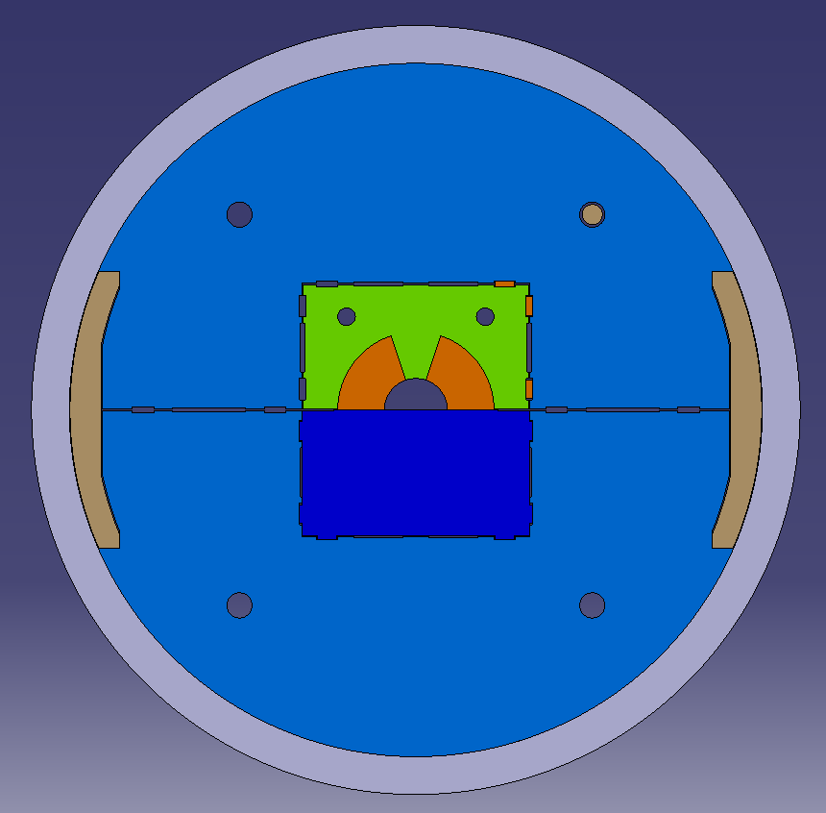
External structure assembled the first time only. Cylinder forced at hot around iron yoke halves and aluminium stoppers. It fits at 250 C so we heat at 400 C to get rid of tolerances.
Iron yoke gap can be tuned via keys.
Vertical or horizontal gap (insert can be turned).
Mirror insert , can be removed and become a single aperture
A block coil (40 mm aperture) can probably fit.
Bladders and keys.
In a long configuration shell welding + domes (or plates) at the extremities. Long bladders (thicker tubes? Welded parts (Nico did something in the past)?).
Drawings from Nikolina Vejnovic (MME)

Slide 3
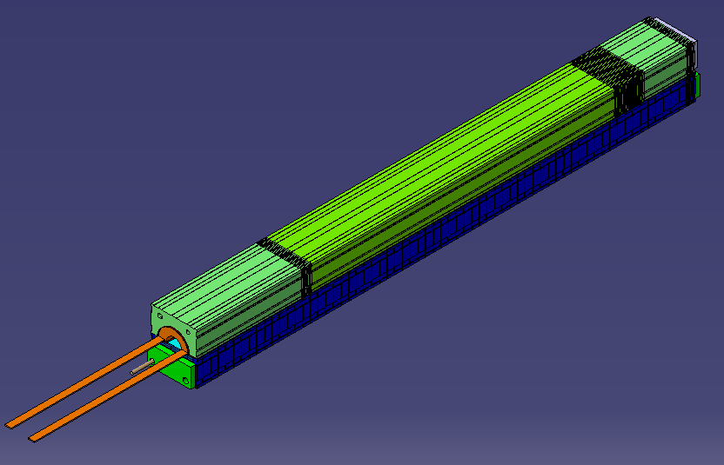

Slide 4
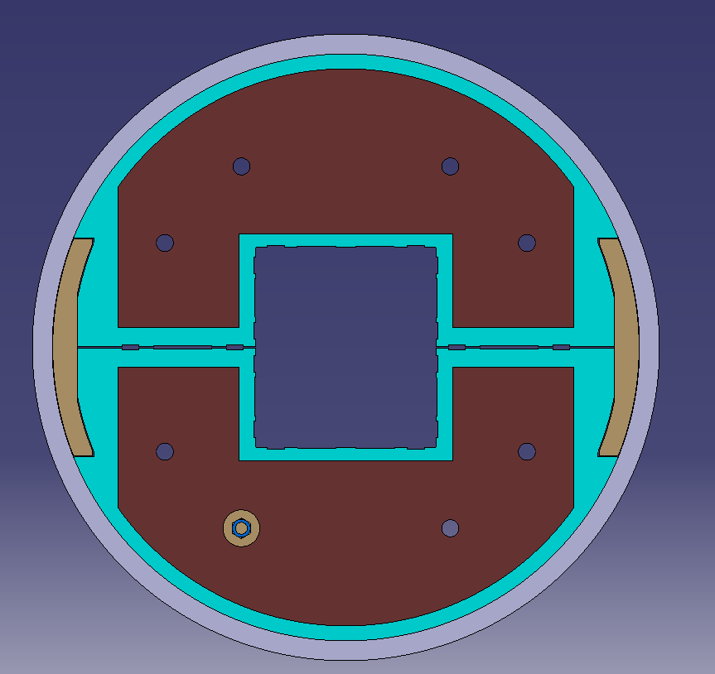
11 T coils can fit. Test of the structure with a known coil?
Optimized around 12 T cosθ coils but other ‘things’ could fit.
Up to 2-m long coils.

Slide 5
