Slide 1
PARTICLE PHYSICS AND COSMOLOGY
in the 20th century
Rolf Landua
CERN

Slide 2
DISCLAIMER
This is a lecture about particle physics and cosmology.
It covers about 100 years of ideas, theories and experiments.
More than 50 Nobel prize winners on particle physics
Very difficult to be comprehensive, exact or in-depth
This is a broad overview about the main discoveries.

Slide 3
All that remains to do in physics is to fill in
the sixth decimal place
(Albert Michelson, 1894)

Slide 4

Kinetic theory,
Thermodynamics
Boltzmann
Maxwell
Newton
Particles
Fields
Universe
Technologies
1895
Electromagnetic
Weak
Strong
Detector
Accelerator
1900
e⁻
Brownian motion
Photon
Radio-activity
1905
Atom
Special relativity
1910
Nucleus
Geiger
Quantum mechanics
Wave / particle
Fermions / Bosons
Cosmic rays
General relativity
1920
p⁺
Cloud
1930
e⁺
n
Spin Antimatter
Fermi Beta-Decay
Galaxies; expanding universe
Cyclotron
Yukawa
π exchange
1940
μ ⁻
Dark Matter
Nuclear fusion
π
Synchrotron
1950
Particle zoo
QED
P, C, CP violation
Big Bang
Nucleosynthesis
τ⁻
Bubble Chamber
p⁻
1960
νe
W bosons
Cosmic Microwave Background
e⁺e⁻ collider
Higgs
Wire chamber
νμ
u
d
s
EW unification
Beam cooling
1970
GUT
QCD
Colour
c
SUSY
Online computers
1975
τ⁻
STANDARD MODEL
1980
ντ
b
Superstrings
g
Inflation
Modern
detectors
p⁺p⁻ collider
W
Z
1990
CMB Inhomgeneities (COBE, WMAP)
3 generations
WWW
t
2000
Dark Energy (?)
ν mass
GRID
2010

Slide 5
Kinetic theory,
Thermodynamics
Boltzmann
Maxwell
Newton
Particles
Fields
Universe
Technologies
1895
1
Electromagnetic
Weak
Strong
Detector
Accelerator
1900
e⁻
Brownian motion
Photon
Radio-activity
1905
Atom
Special relativity
1910
Nucleus
Geiger
Quantum mechanics
Wave / particle
Fermions / Bosons
Cosmic rays
General relativity
1920
p⁺
Cloud
1930
e⁺
n
Spin Antimatter
Fermi Beta-Decay
Galaxies; expanding universe
Cyclotron
2
Yukawa
π exchange
1940
μ ⁻
Dark Matter
Nuclear fusion
π
Synchrotron
1950
Particle zoo
QED
P, C, CP violation
Big Bang
Nucleosynthesis
τ⁻
Bubble Chamber
p⁻
1960
νe
W bosons
Cosmic Microwave Background
e⁺e⁻ collider
Higgs
Wire chamber
νμ
u
d
s
EW unification
Beam cooling
1970
GUT
QCD
Colour
c
SUSY
Online computers
1975
τ⁻
STANDARD MODEL
1980
ντ
b
Superstrings
g
Inflation
Modern
detectors
p⁺p⁻ collider
W
Z
1990
CMB Inhomgeneities (COBE, WMAP)
3 generations
WWW
t
2000
Dark Energy (?)
ν mass
GRID
2010

Slide 6
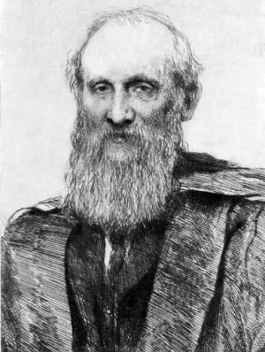
In the early 1900s, most physicists believed that physics was complete, described by classical mechanics, thermodynamics, and the Maxwell theory.
Address to the British Association for the Advancement of Science, 1900
There is nothing new to be discovered in physics now, All that remains is more and more precise measurement.
(Lord Kelvin, 1900)
William Thomson
(Lord Kelvin)
But Lord Kelvin also mentioned two ‘clouds’ on the horizon of physics:
1) Blackbody radiation
2) Michelson-Morley experiment

Slide 7
1900
Universe = solar system and the stars of our galaxy
Nobody knew how the sun produced its energy
Nothing was known the structure of atoms and nuclei
Only two known fields: gravitation, electromagnetism
Nobody anticipated the incredible journey of physics in the next 100 years

Slide 8
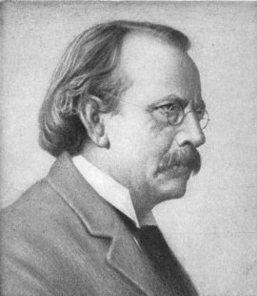
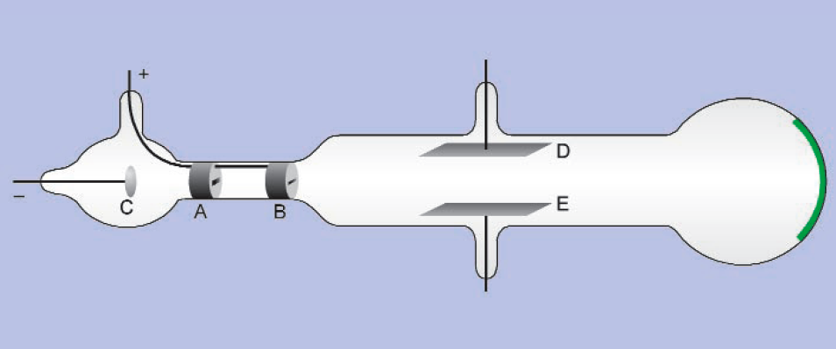
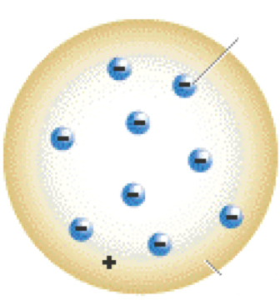
1
1897
e⁻
Electrodes D+E : electric field
External coils: magnetic field
e⁻
J.J. Thomson
Cathode ray experiments (~ TV)
'Rays' are charged corpuscles*
with unique charge/mass ratio
*later called 'electrons'
e⁻
Electrons are sub-atomic particles!
His 'plumpudding' model of the atom (1904)

Slide 9
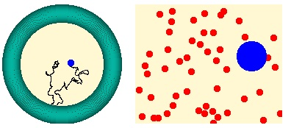
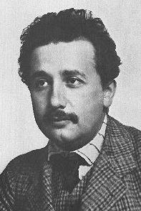

Atom
1905
Robert Brown (1827) observes random walk of
small particles suspended in a fluid
Albert Einstein (1905) explains by kinetic theory that the motion is due to the bombardment by molecules
Francois Perrin (1907) uses Einstein's formula to confirm the theory and measure Avogadro's number
The existence of atoms was proven

Slide 10
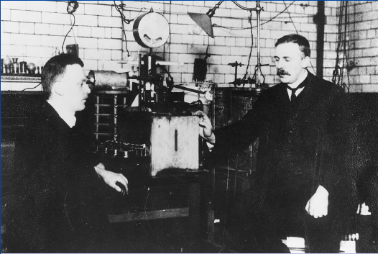
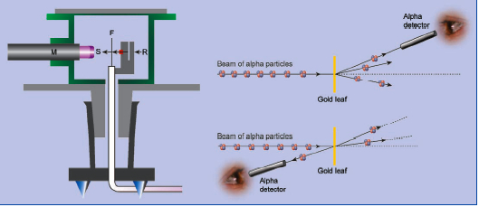
Nucleus
1911
Ernest Rutherford (r) and Hans Geiger (l)
in Manchester
Geiger and Marsden fired alpha particles (He nuclei) on gold foils
1 in 8000 alpha particles were backscattered (> 90 deg)
This could not be explained by the 'plumpudding model'
Rutherford's explanation: all the mass of the atom is concentrated in the nucleus
Size: At minimum distance, Coulomb repulsion = kinetic energy: ~ 27 ×10⁻¹⁵ m (true value: 7.3)
Discovery of the nucleus

Slide 11
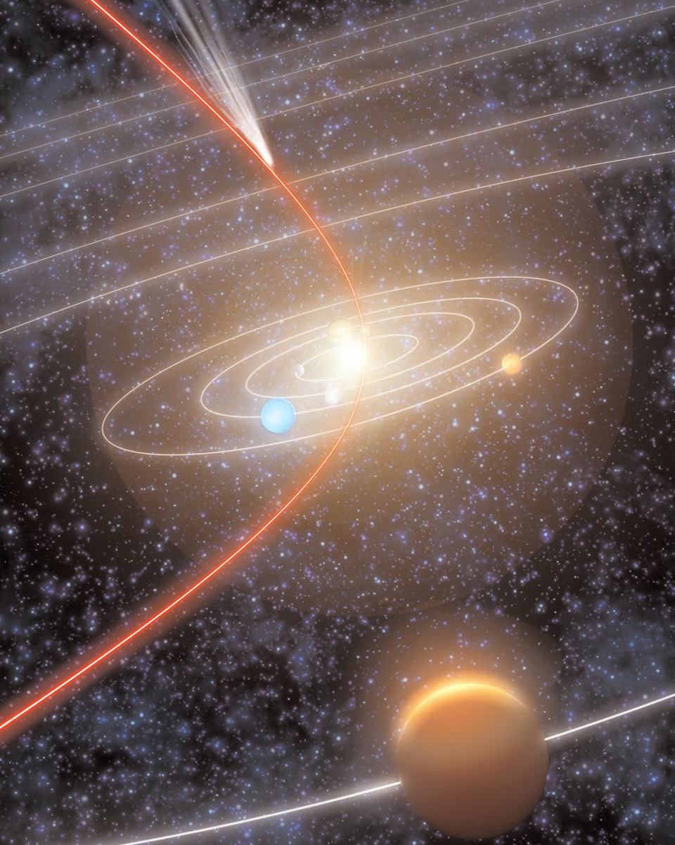
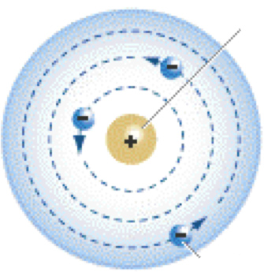
Nucleus
1911
Analogy with solar system:
If the nucleus had the size of the Sun
the electrons would orbit in 1000 x the distance of Sun-Earth
Nucleus
?
How can electrons orbit a nucleus without radiating their energy?
?
What is the nucleus made of ?
Rutherford's model
of the “empty” atom

Slide 12
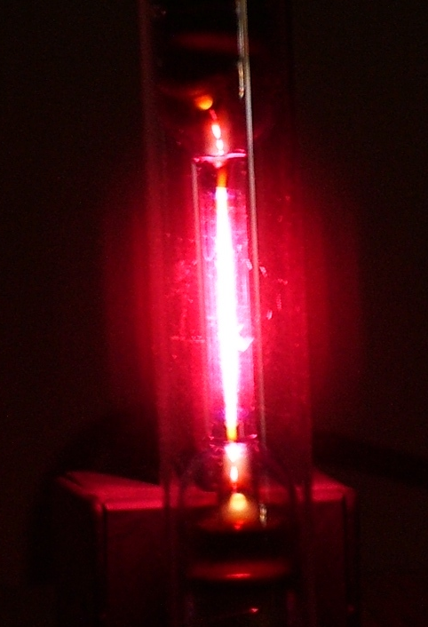


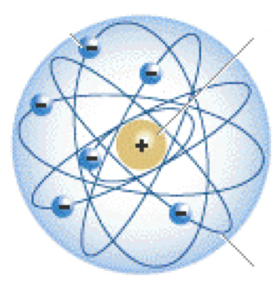


1913
J. J. Balmer (1885) observed the emission spectrum of hydrogen
His empirical formula:
Niels Bohr visited Rutherford in 1913
he was the first to apply quantum ideas to atoms
• Quantization of angular momentum -> energy levels
• Emission of radiation only during transitions
• Energy of photons = difference of energy levels

Slide 13
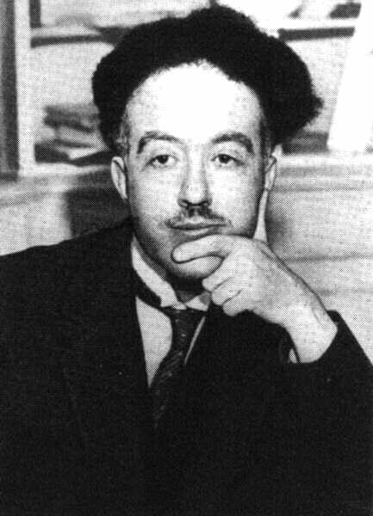

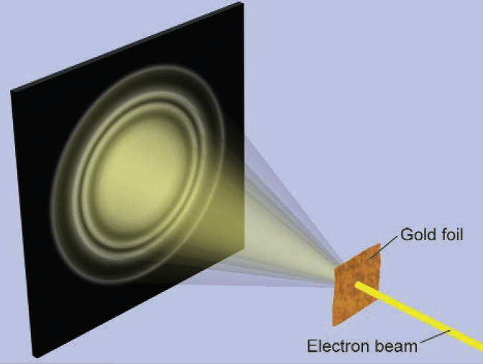
1923-1927
It took 10 more years to understand the mysterious rules governing the atomic world: quantum mechanics.
Particles behave like waves
Louis de Broglie (1924)
*this hypothesis was confirmed in 1927
by electron diffraction (Davisson/Germer)

Slide 14
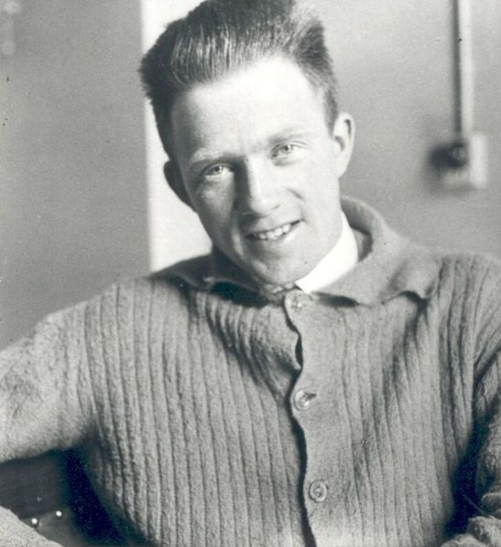

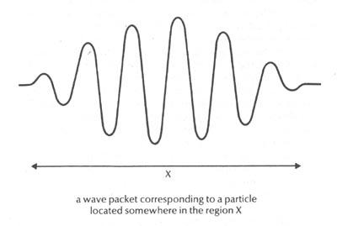
1923-1927
Uncertainty relation
If particles are waves (of finite size), then there must
be a limit to the precision of measurement between:
Position and momentum
Heisenberg (1925)
Analogy:
Measurement time Δt of a signal leads to
uncertainty of frequency (Fourier transform):
Δf Δt ~ 1
Energy and time

Slide 15
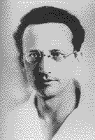
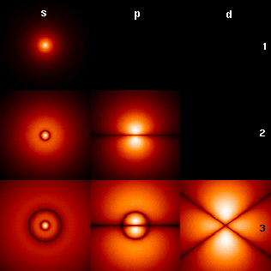
1923-1927
Probability wave function
Excellent description
if v << c
If particles are waves -> describe by a wave equation
Schrödinger 1926
Interference: ψ = complex function
Interpretation (Born, 1927):
ψ = probability amplitude
|ψ|² = probability
Electron wave functions in hydrogen atom
('standing 3-dim waves')

Slide 16
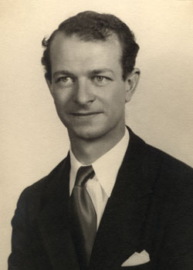
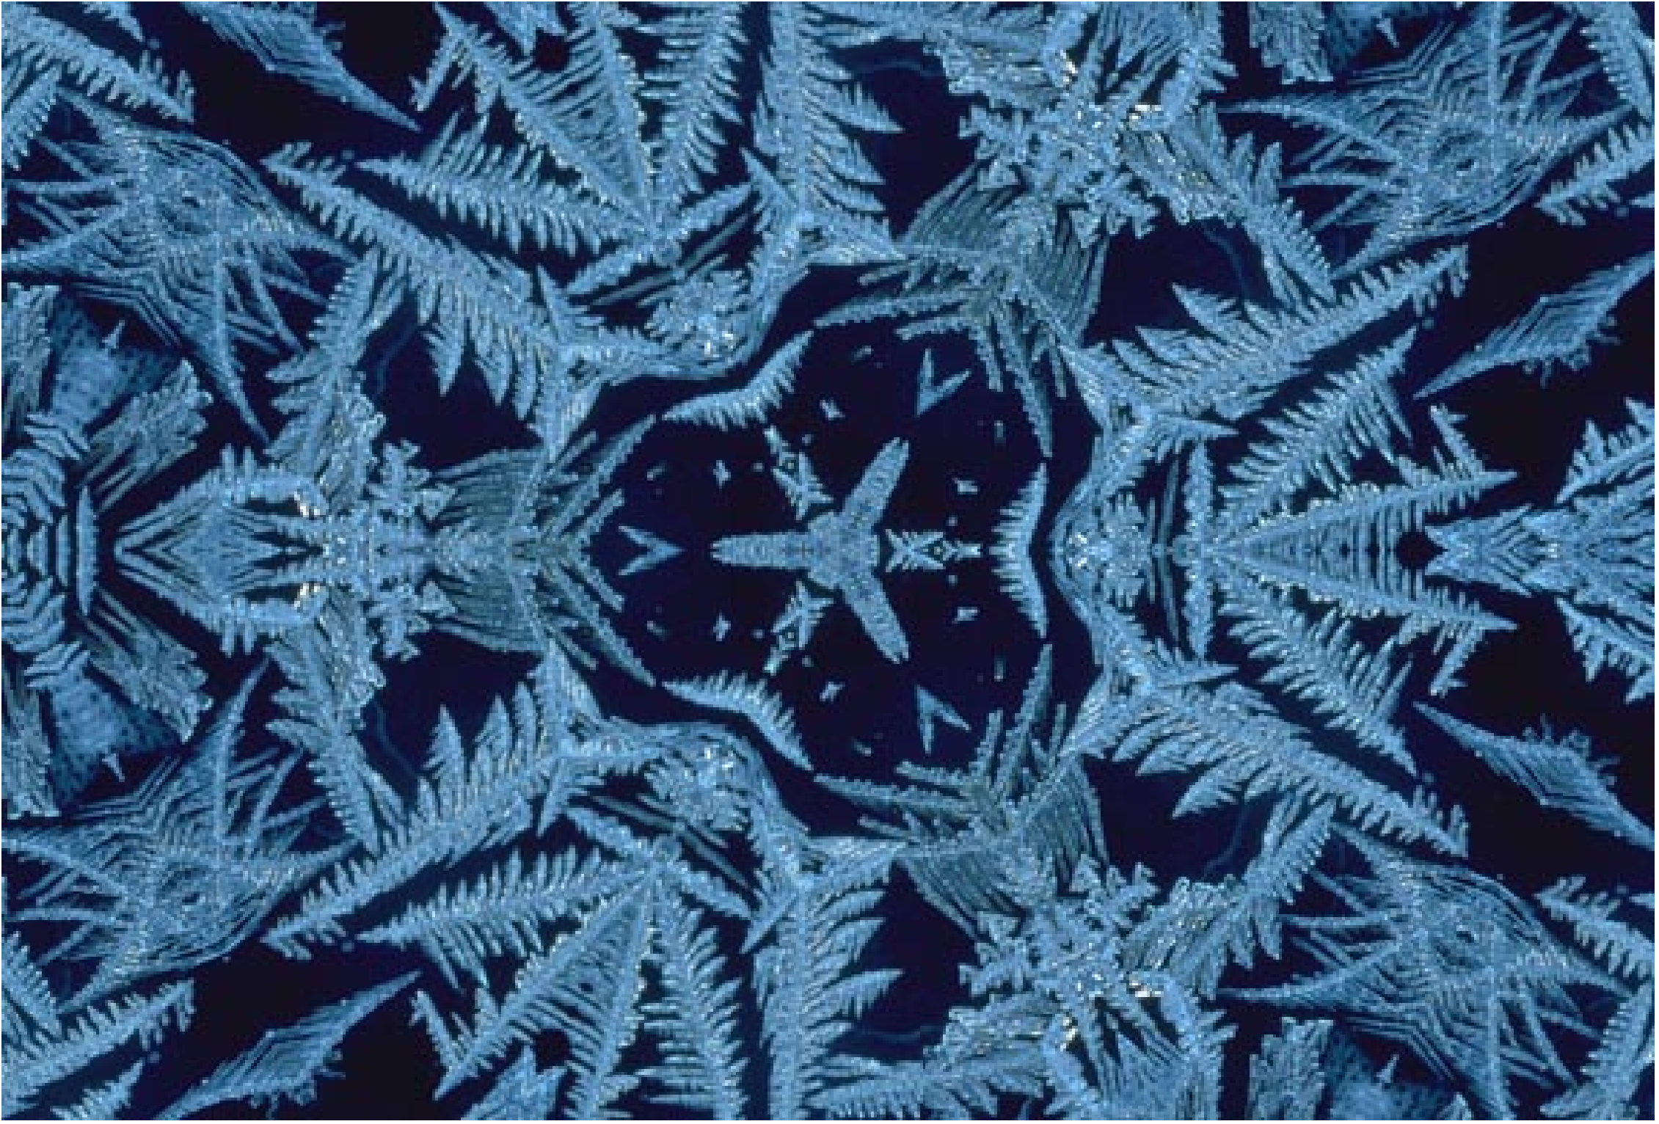
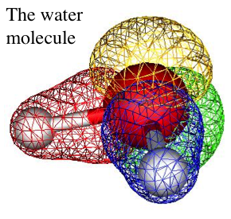
1928
Quantum physics explained the existence of 'structure' in nature
The nature of chemical bonds
Linus Pauling (1928)
Atoms, Molecules and the origin of structure were understood.
And the atomic nucleus? Not much progress between 1911 - 1932.

Slide 17
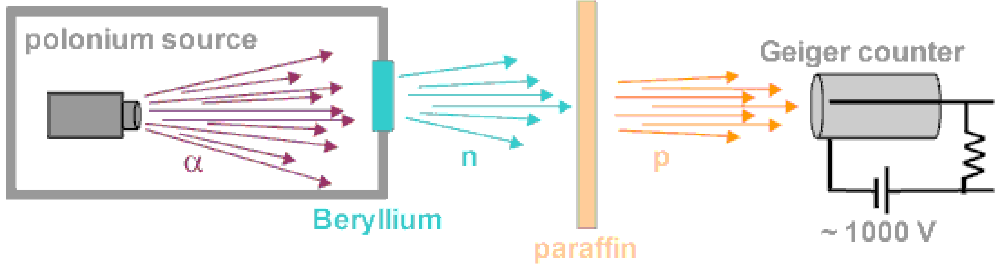
n
1932
What is the nucleus made of ?
For example: He-4 has only Z=2; what are the other two units of mass due to ?
Heisenberg: Protons and electrons (4 protons and 2 electrons)?
Did not work - the uncertainty relation forbids the presence of electrons in the nucleus!
Chadwick (1932): The neutron
From kinematics: Mass of neutron ~ mass of proton
What keeps everything together? Strong short-range interaction?

Slide 18
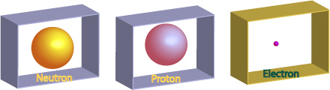
Fundamental particle spectrum (1932)
Simple, easy to remember
Still taught at schools
(usually in chemistry lessons)

Slide 19
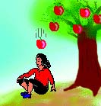
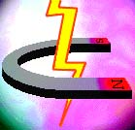

2
Fields
1900
What holds atoms and nuclei together?
1900: two fundamental interactions were known:
Gravitation
Electromagnetism
Similarities: both have inverse square dependence on radius
Differences: the strength of the forces is vastly different (38 orders of magnitude!)

Slide 20
Remember: in 1900, there were two ‘clouds’ on the horizon of physics:
Two clouds:
1) Blackbody radiation
2) Michelson-Morley experiment
Their understanding would lead to
- quantum theory
- relativity
William Thomson
(Lord Kelvin)

Slide 21
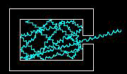
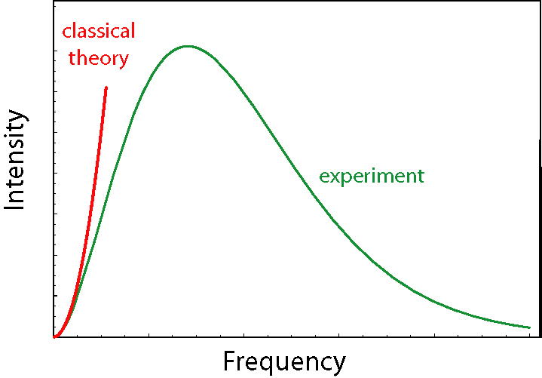
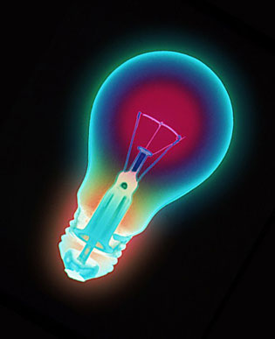
Fields
Photon
‘Electromagnetic’ interaction
Blackbody radiation
“Black body” absorbs all incoming light;
re-emits thermal equilibrium radiation
“Radiation function” = f(T) only
<E>
average energy of oscillators
(proportional to temperature)
Emission spectrum
Ok for ‘low’ temperatures (Jeans law)

Slide 22
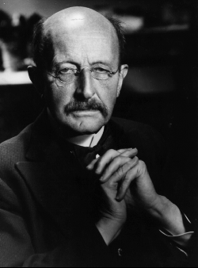


Fields
Photon
‘Electromagnetic’ interaction
An “Act of Desperation”
Oscillators (in the wall of the black body)
emit ‘ finite energy elements ’ ε = h ν
14 December 1900
Higher frequency means bigger chunks, so it is
less likely to find E >> kT
average energy
of oscillators
h = new fundamental constant
Max Planck

Slide 23
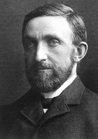

Fields
Photon
‘Electromagnetic’ interaction
The photoelectric effect
1902
Cathode rays (electrons) are produced by shining light on metal surfaces.
Classical expectation: Energy of light proportional to square of its amplitude ~ electron energy
Philipp von Lenard
Energy proportional to
light frequency (slope = “h”)
“The electron energy does not show the
slightest dependence on the light intensity”

Slide 24
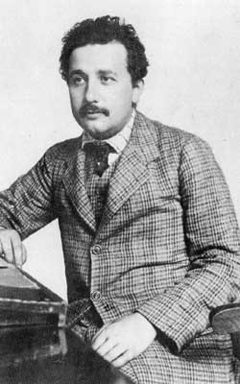
Fields
Photon
‘Electromagnetic’ interaction
“My only revolutionary contribution”
17 March 1905
Light is emitted and absorbed in quanta
Emax = hν - W
“A light quantum gives all its energy to a single electron.”
Photons are particles.
(Compton,1917, proved it)
Albert Einstein

Slide 25
Fields
Special relativity
Special relativity
Einstein had thought about the ‘medium’ for electromagnetic waves
and concluded that there was none.
But how could the speed of light be the same in all inertial frames?
His postulates:
1) Speed of light = constant = c (in vacuum)
2) all inertial frames are equivalent (“relativity principle”)
His conclusions:
Since c = constant and speed = (space interval/time interval) -->
space and time cannot be absolute!

Slide 26
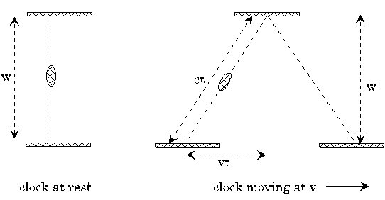
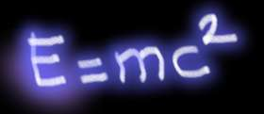

Fields
Special relativity
c²t² = v²t² + w²
t²(c² - v²) = w²
t = time observed for moving frame
τ = time in moving frame (w=c τ)
1) Time dilation, space contraction
2) Modification of Newton’s laws, relativistic mass increase.

Slide 27
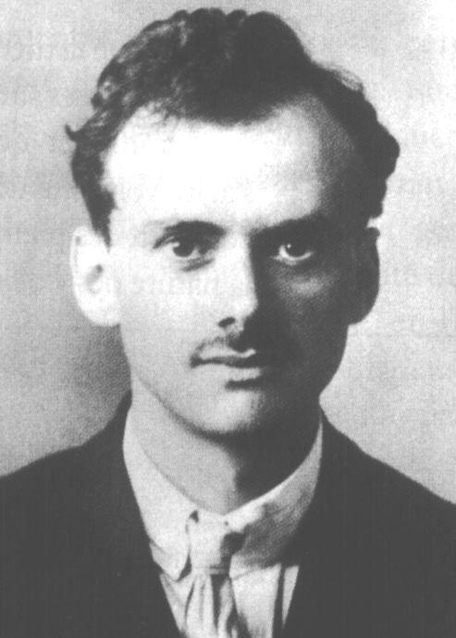
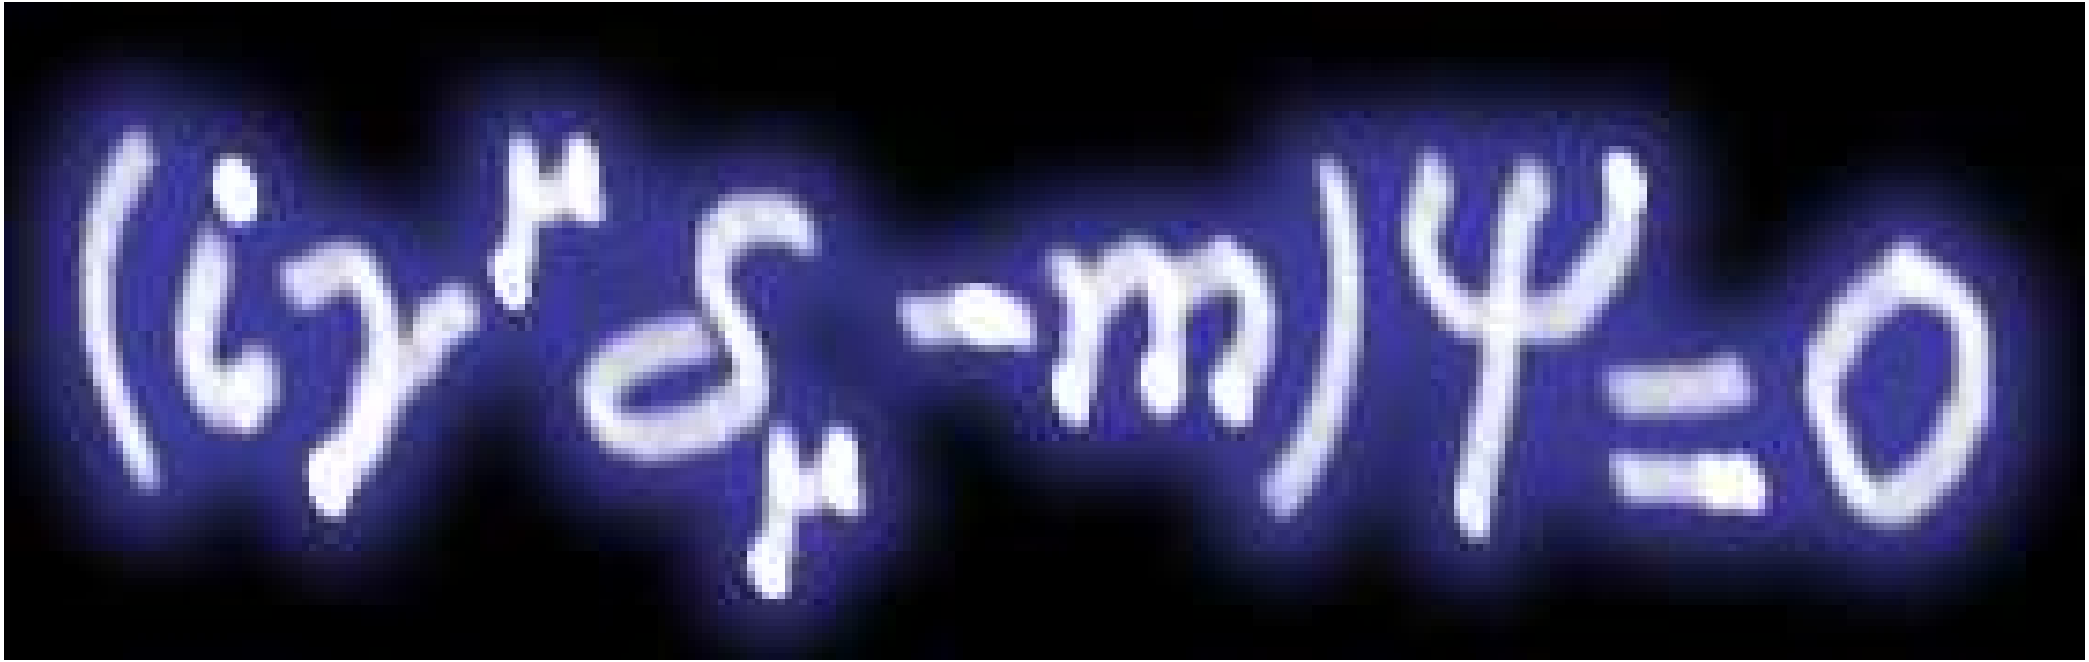
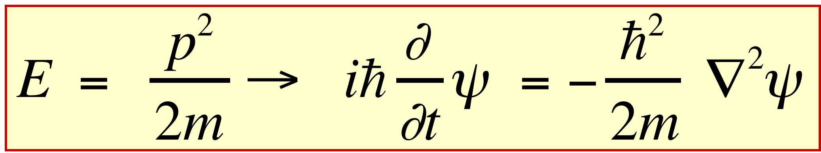
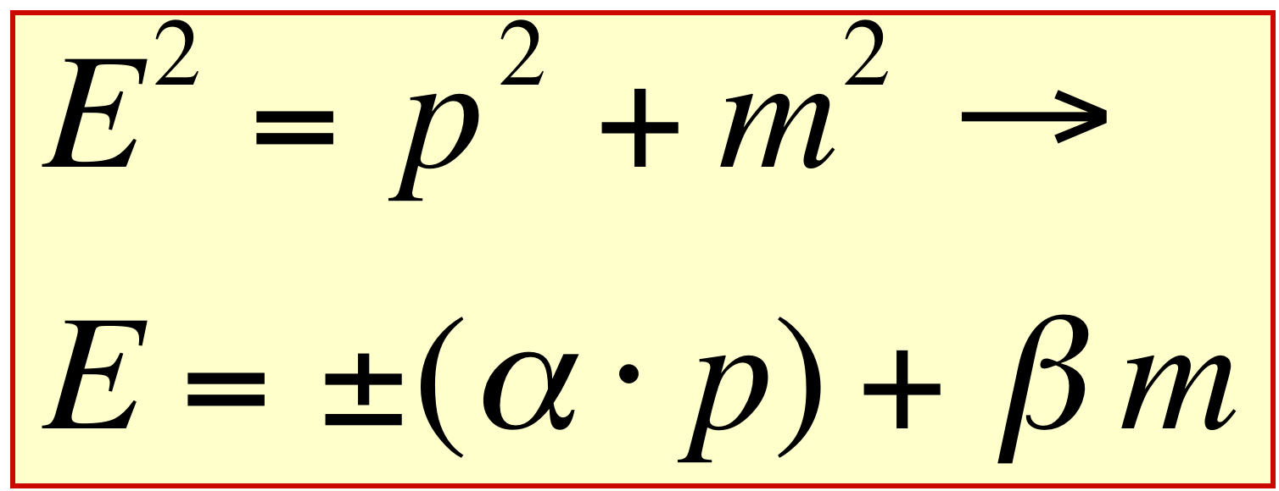
Fields
‘Electromagnetic’ interaction
How could special relativity and quantum physics be united ?
e⁻
Spin
e⁻
Ψ =
e⁺
Antimatter
e⁺
Paul A.M. Dirac
(1928)
Compare with (non-relativistic) Schrödinger equation
CONSEQUENCES:
ELECTRON SPIN EXPLAINED
ANTIPARTICLES MUST EXIST !
ELECTRONS OBEY ‘PAULI PRINCIPLE’ (1940) - FERMIONS

Slide 28
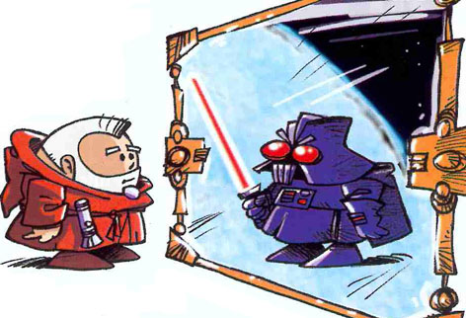
Fields
‘Electromagnetic’ interaction
Two crucial (theoretical) predictions by Dirac
The wave function has 4 components (two spin 1/2 particles)
2 components for particle - and 2 components for antiparticle!
Every particle has an antiparticle !

Slide 29
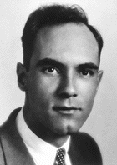
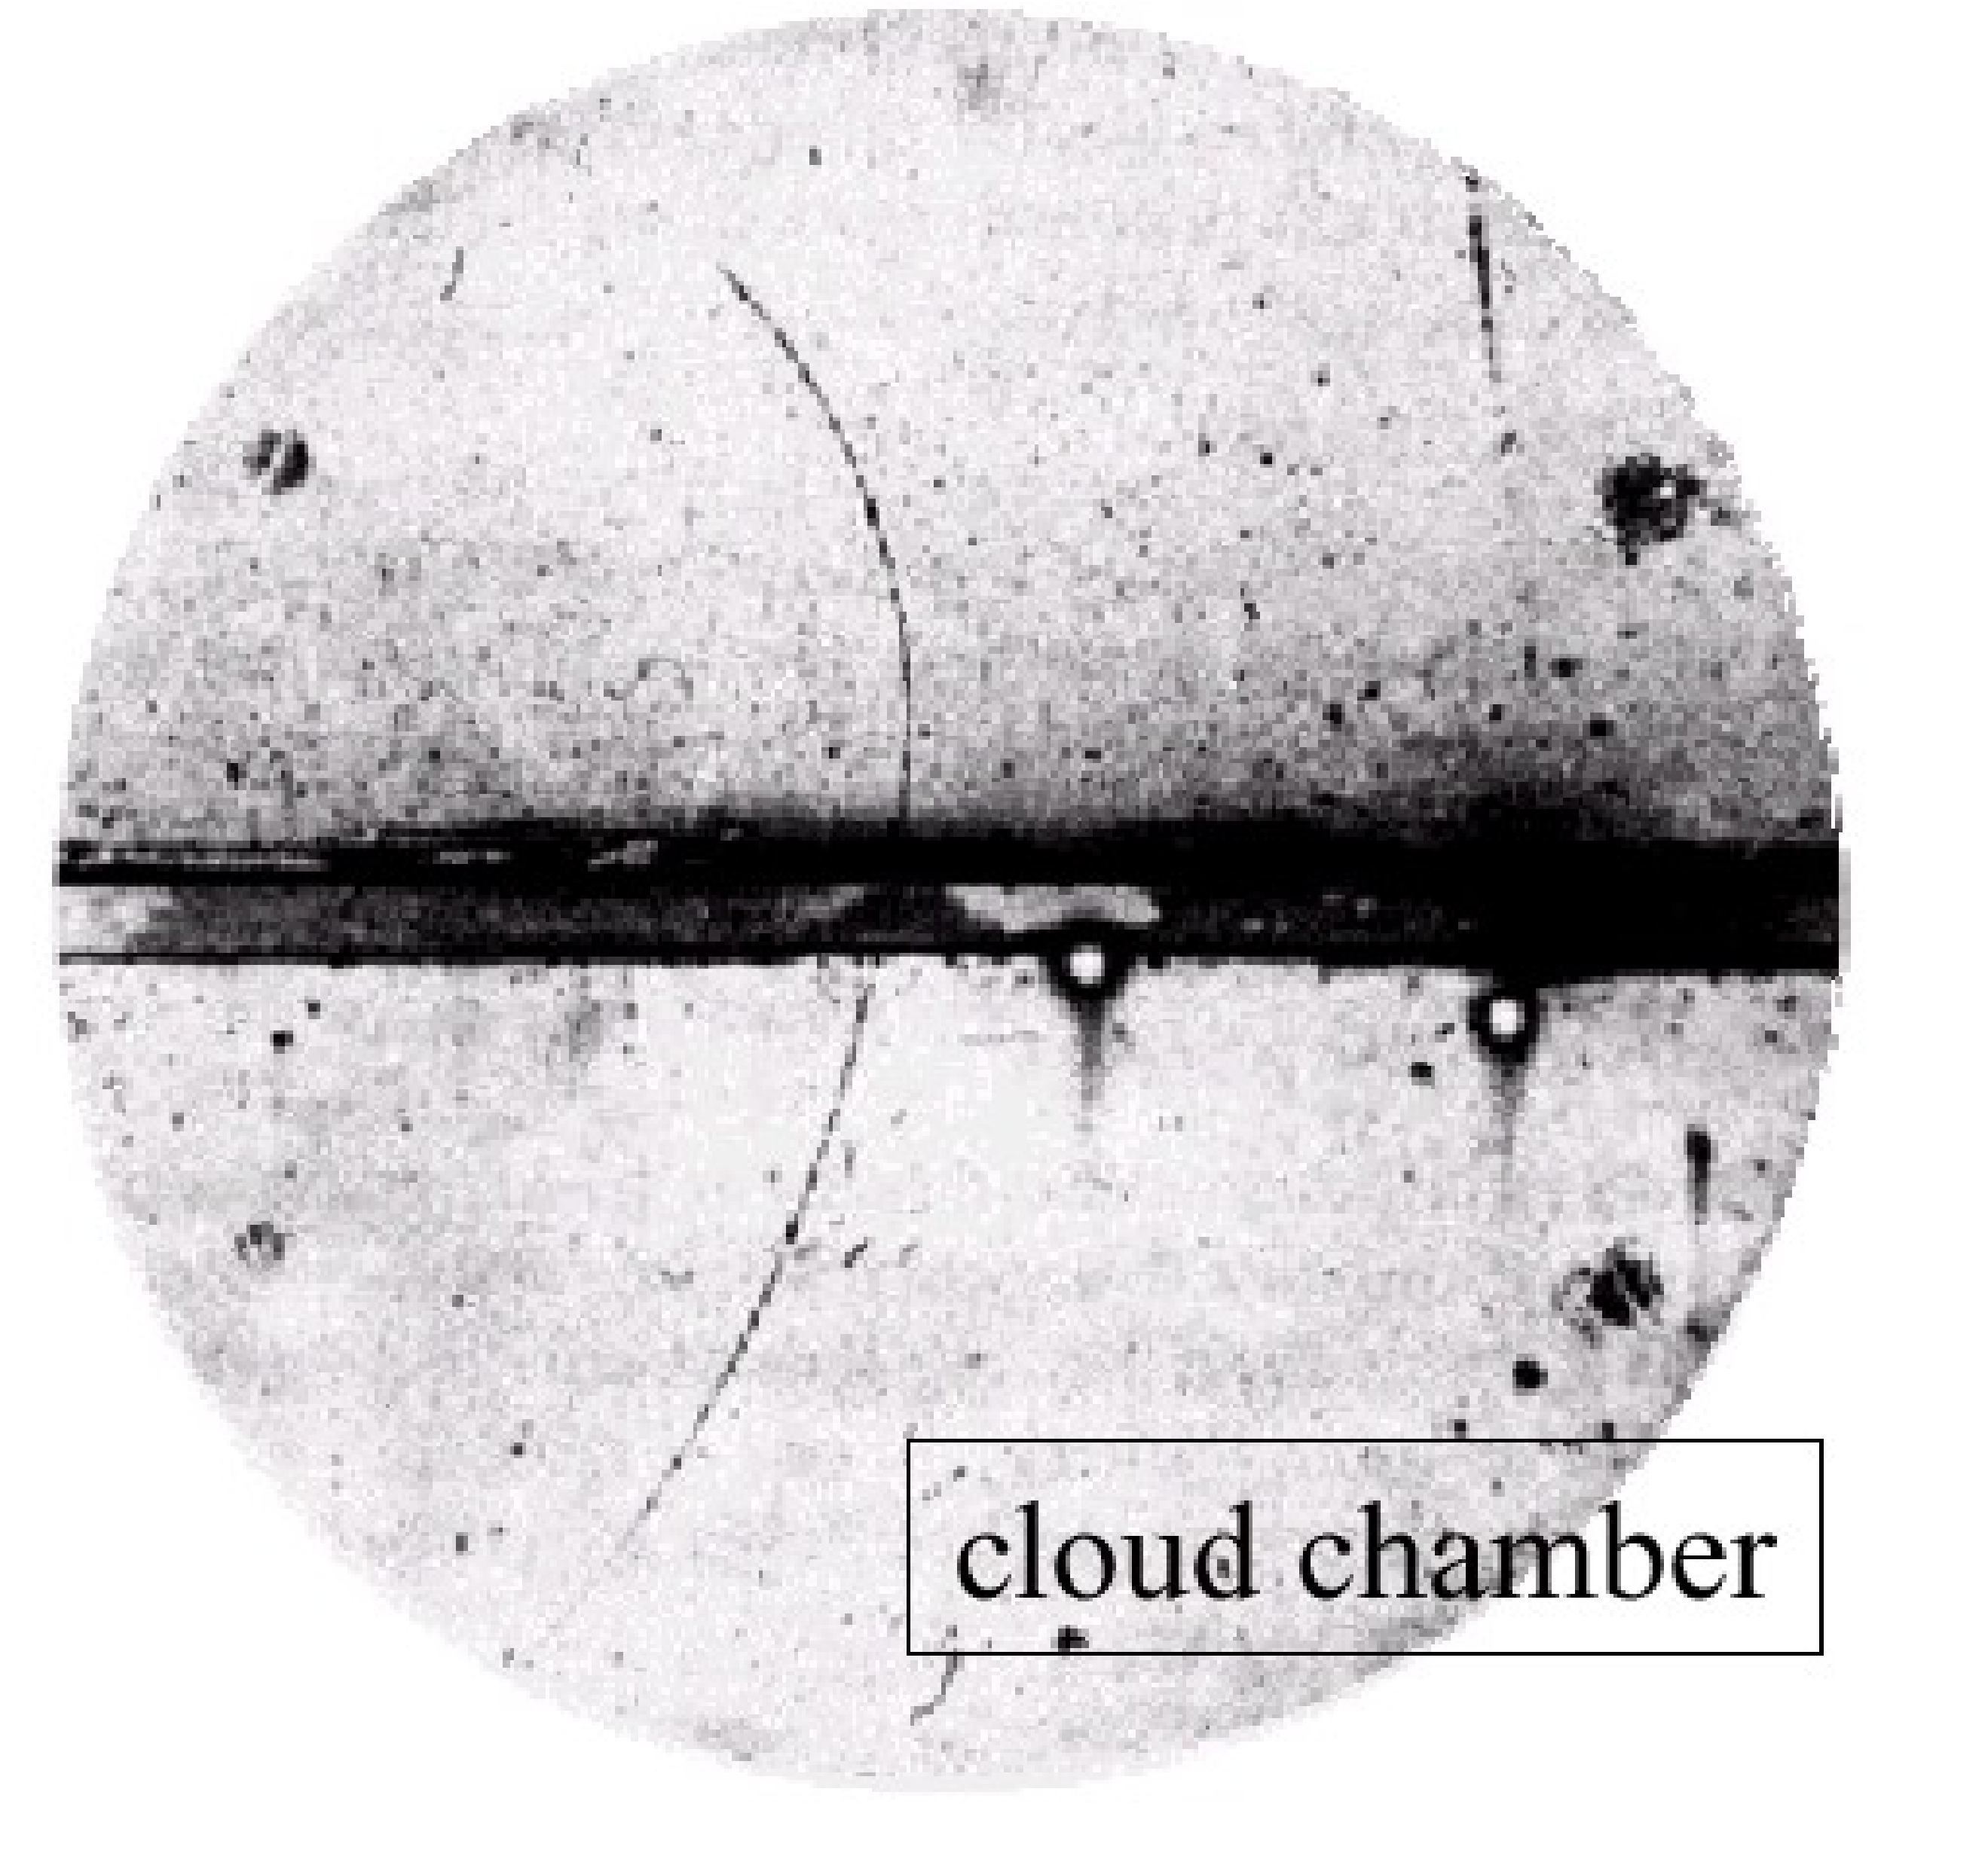
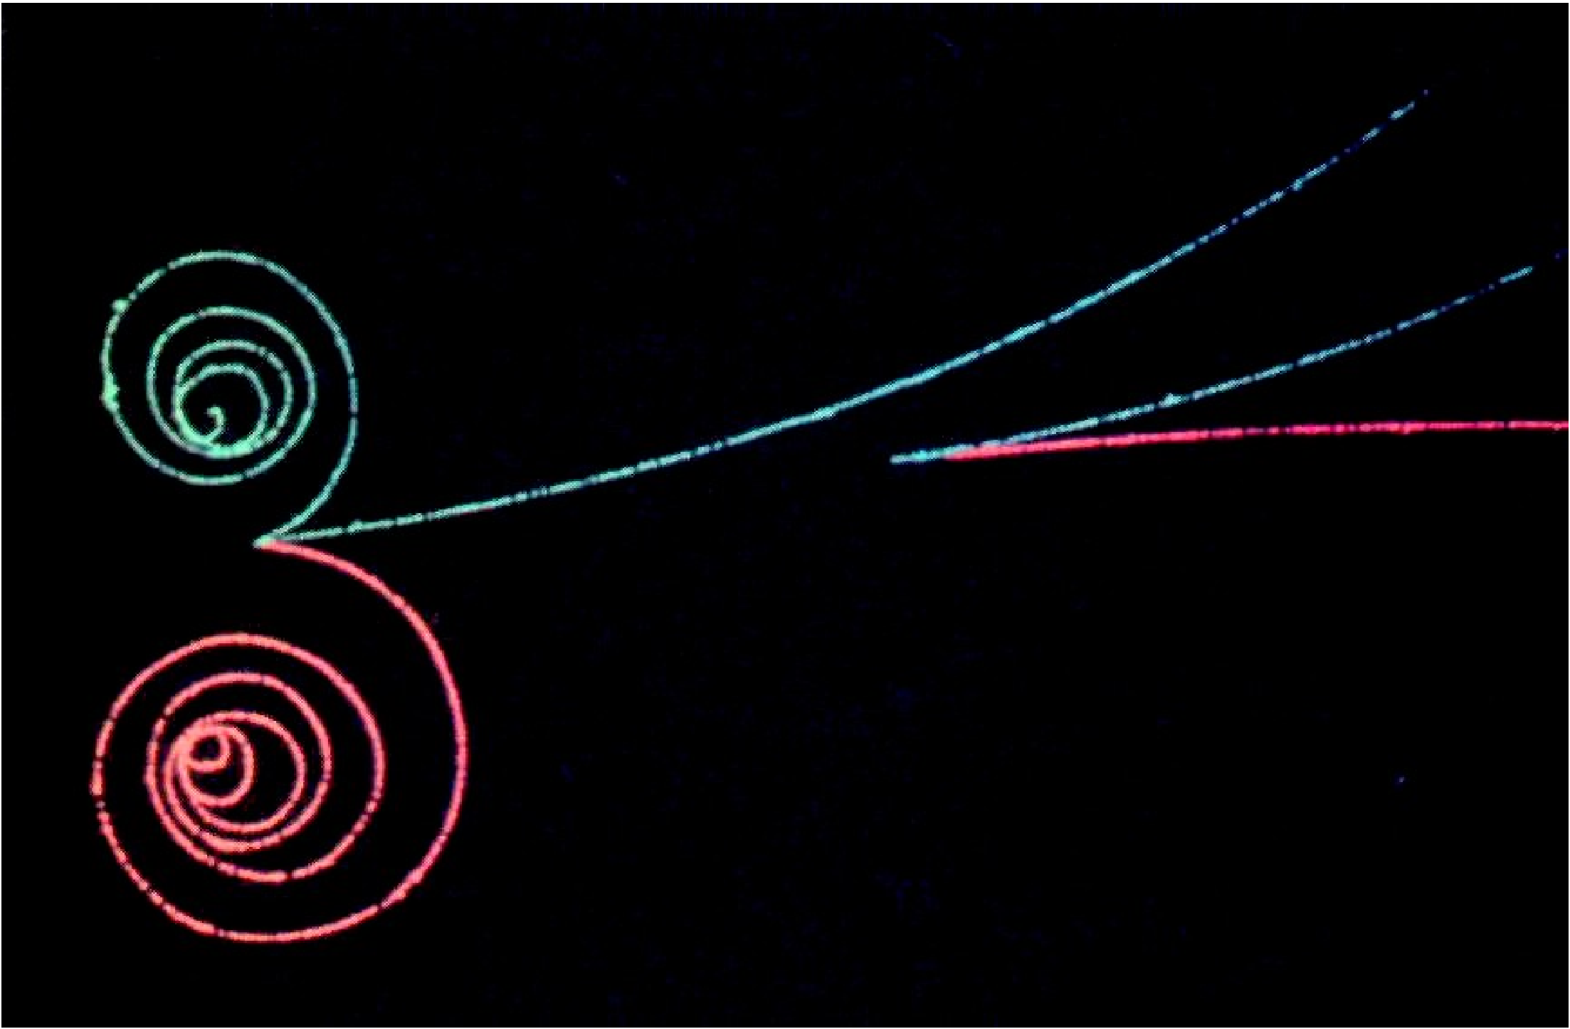
Fields
e⁺
‘Electromagnetic’ interaction
Discovery of the positron
Dirac was right!
Anderson (1932)

Slide 30
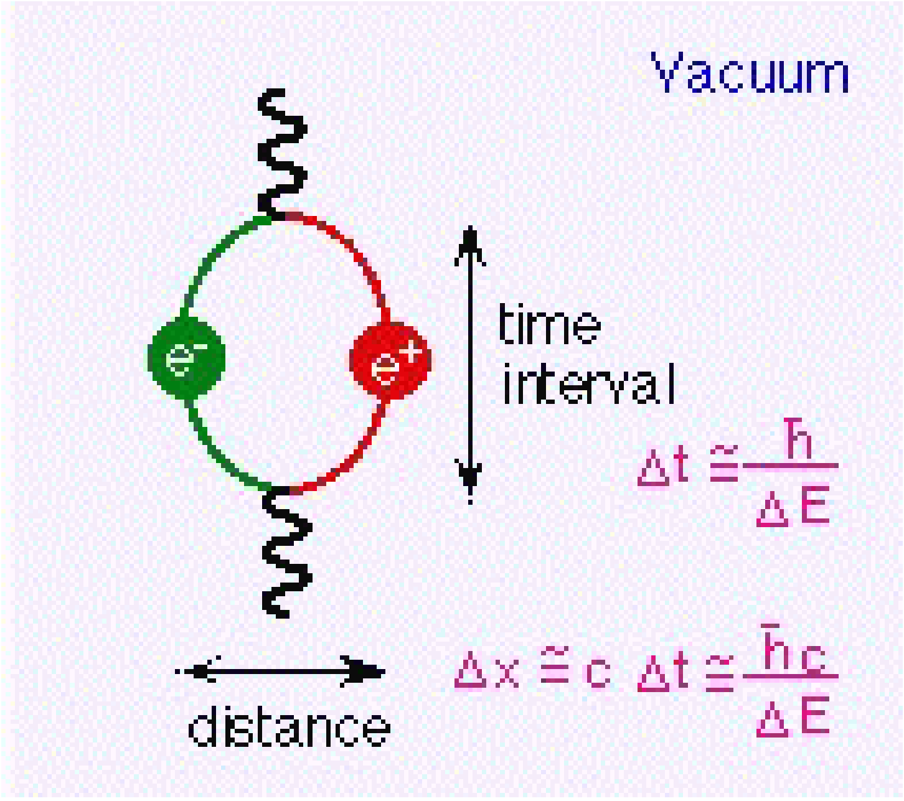
Fields
‘Electromagnetic’ interaction
NOW THE VACUUM HAD BECOME REALLY MESSY
Quantum physics says that ‘oscillators’ (e.g. field quanta) cannot be at absolute rest (uncertainty relation)
The lowest energy states of e.g. electromagnetic fields can produce (virtual) electron-positron pairs: VACUUM FLUCTUATIONS

Slide 31
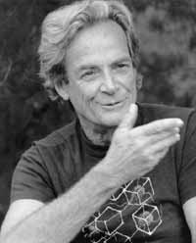
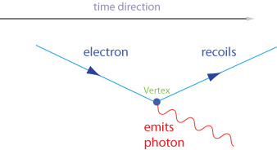
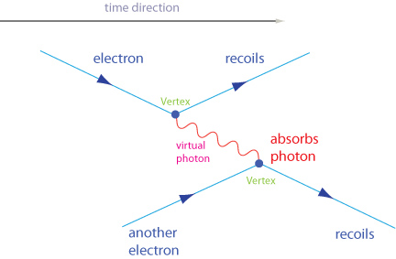
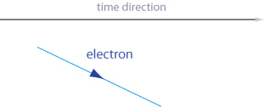
Fields
1934 - 1948
How to calculate the interaction of photons and electrons?
Quantum Electrodynamics
Feynman, Tomonaga, Schwinger

Slide 32
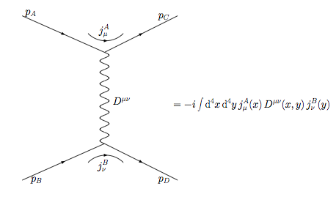
Fields
1934 - 1948
Feynman diagrams
Precise computation rules - in graphical form
R. P. Feynman
Feynman diagrams
later became a graphical way
to represent all kinds of
particle interactions

Slide 33

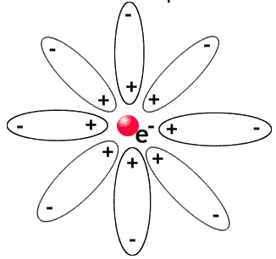
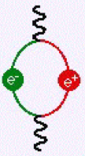
Fields
‘Electromagnetic’ interaction
“Renormalization”
The ‘naked’ electron + vacuum fluctuations = measured electron
(“infinite” - “infinite” = “finite”)
the “dressed” electron:
vacuum fluctuations modify its charge and mass (‘Debye shielding’)

Slide 34
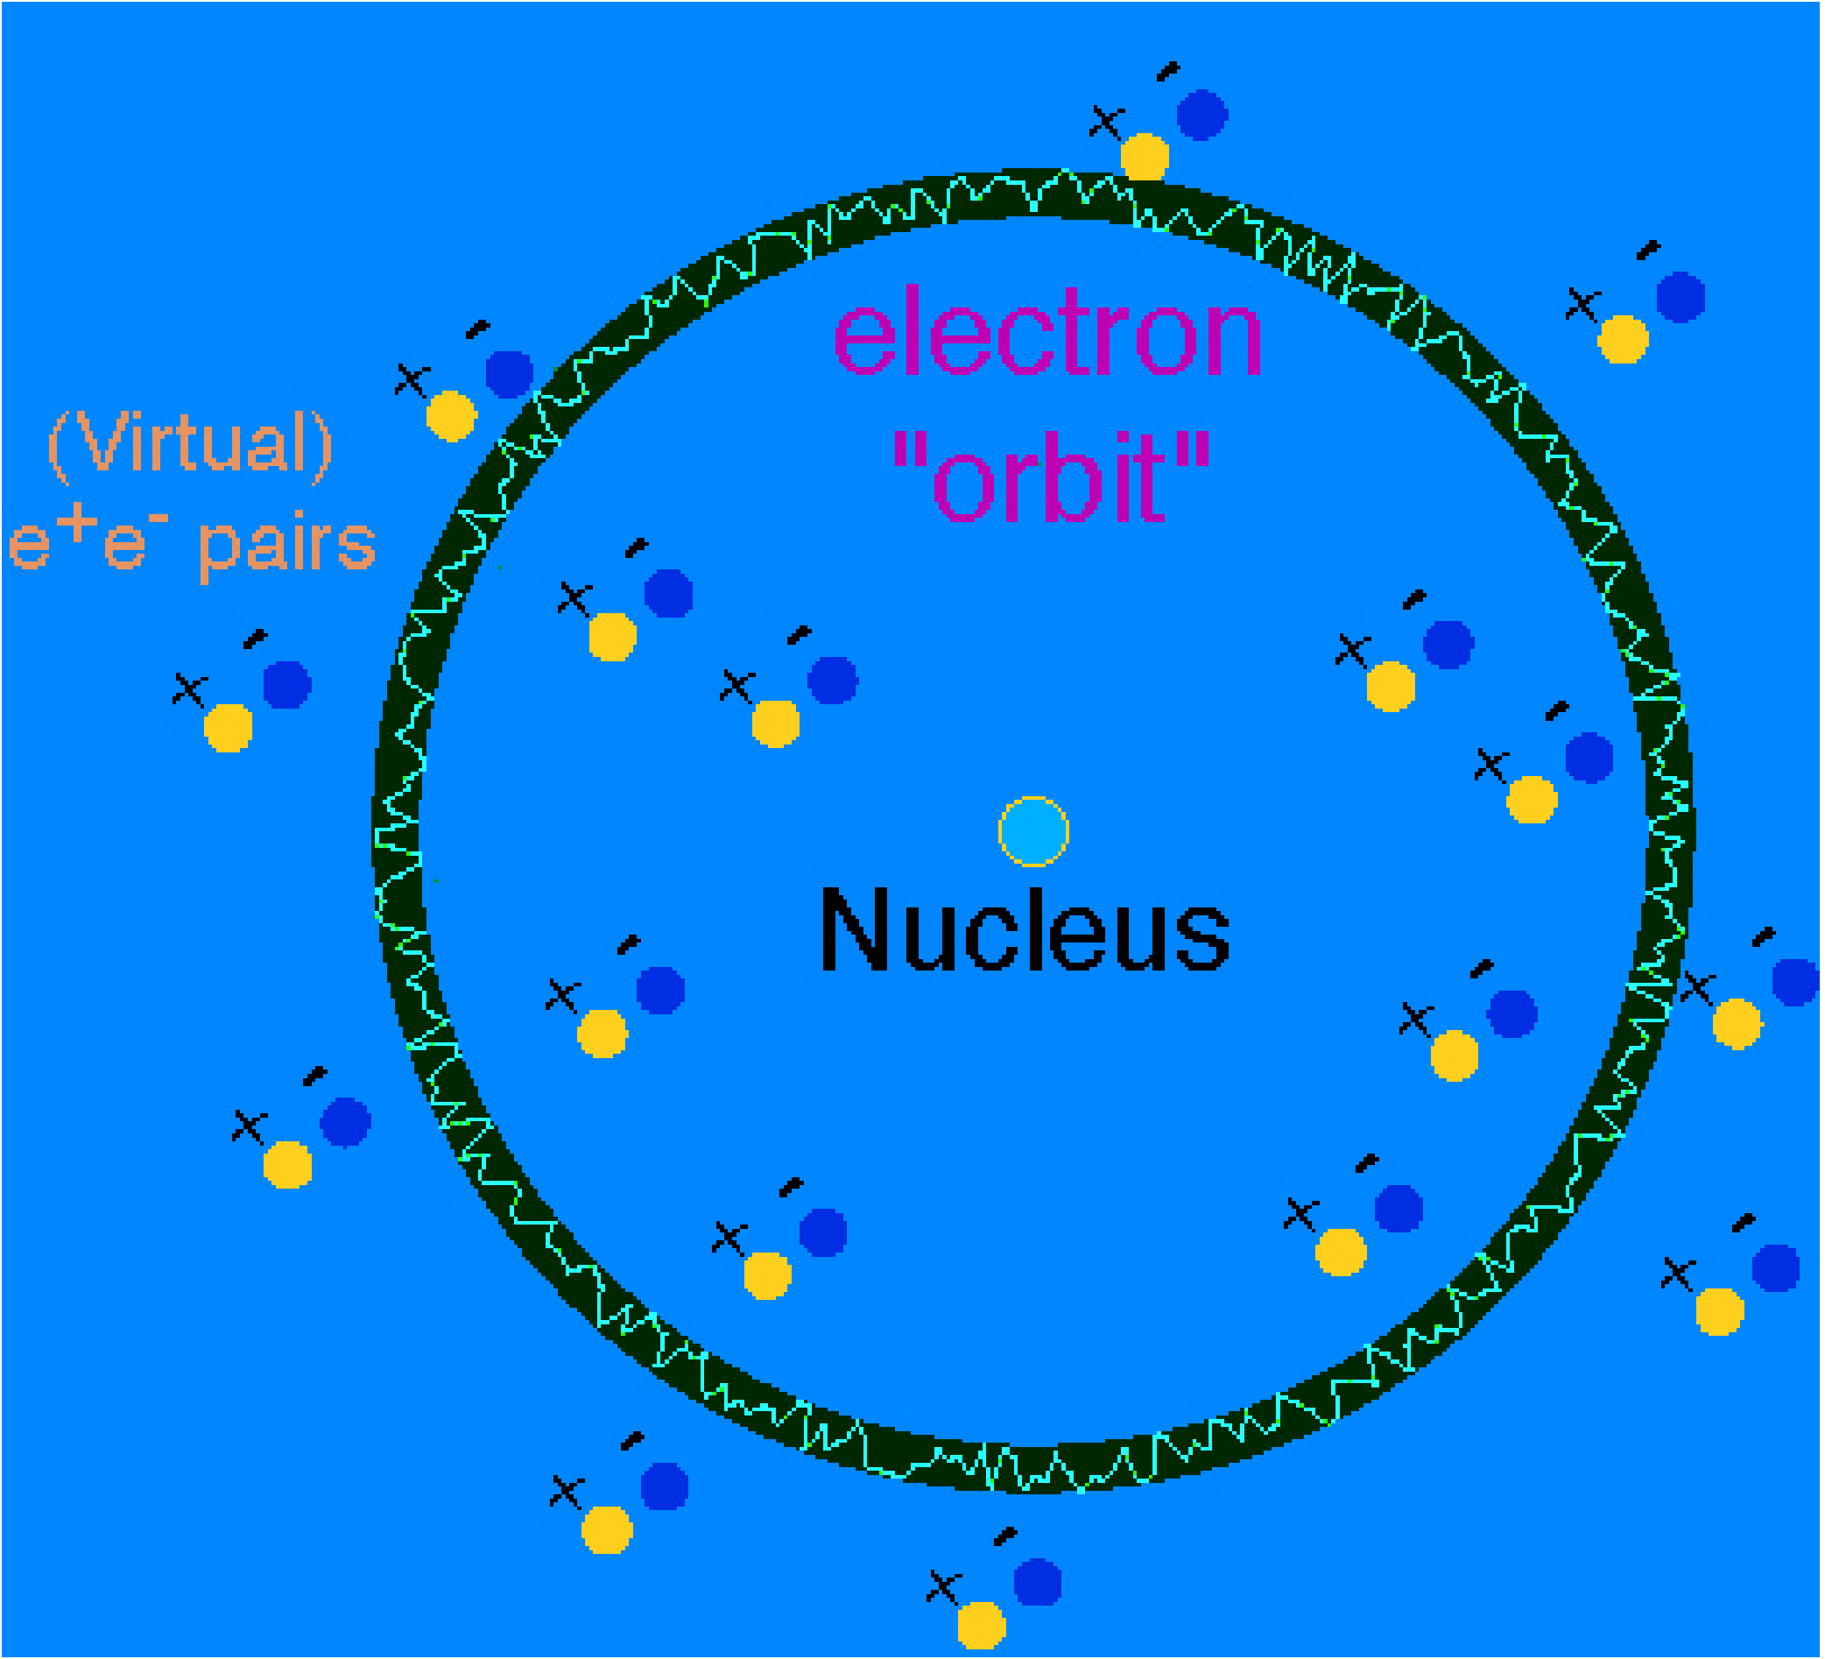



Fields
1948
Vacuum fluctuations have observable effects
... and Quantum Electrodynamics allowed to calculate
them precisely
Electron (anomalous)
magnetic moment
Lamb Shift
(shift of atomic energy levels)
Casimir effect
(force on two uncharged metal plates)

Slide 35


Fields
‘Electromagnetic’ interaction
QED: Charged particles interact by exchanging photons
1) Massless virtual photons are continuously emitted by electric charges
2) The 1/r² law comes from the probability to hit another particle at distance r
(directly connected with the 3 dimensions of space)
1/r² law
Could that become a model for other interactions?

