Slide 2
Working on the CERN Site
Prestations sur le Site du CERN
Pierre Bonnal, Frédéric Chapron or Bertrand Nicquevert
on the behalf of all Services concerned

Slide 3
Agenda
Aim: going through document
“Working on the CERN Site”
Compliance with Laws
Hours, Access, Reception Conditions
Safety and Safety Coordination
Storage Transport and Handling
Utilities and Work Site Services
Miscellaneous…

Slide 4


Purpose
CERN has set up working rules
Contractors and contractors’ personnel
shall comply these rules where applicable
This document “Working on the CERN Site” highlights rules
that may have a cost
for contractors
=
Notes:
4P Suisse

Slide 5

Applicability
This document is subject to change
The latest version applies and is downloadable from:
Documents: Key Reference Documents | Procurement and Industrial Services Group (cern.ch)
The contractor shall regularly consult this link

Slide 6






CERN Instruction on COVID-19
Comply with the CERN specif COVID instructions
Complete self declaration of honor
Respect the physical distancing of 2 meters
Wear mask type 1 EN 14683
Clean your tools, workstation, cars, surface with a virucide product.
Wear a proximeter (given by CERN)
2 m
Notes:
Is this still applicable ? https://hse.cern/fr/covid-19-information . Costs of special covid measures are under contractor’s responsibility.

Slide 7
Section 1
Compliance with Laws

Slide 8

1.1 General Obligation
The contractor shall comply with all applicable laws, i.e. all CERN rules and regulations applicable to the execution of the contract including:
http://cern.ch/hoststates
http://cern.ch/safety-rules
See also presentation related to the “4P” by the Procurement Officer
Notes:
To obtain information about the applicable working conditions of his personnel, the contractor shall contact the Host States authorities competent in matters of labour law

Slide 9

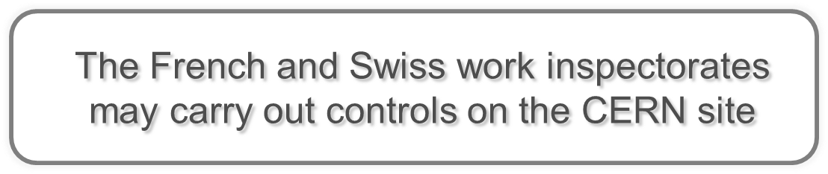
1.2 Competent Authorities

Slide 10

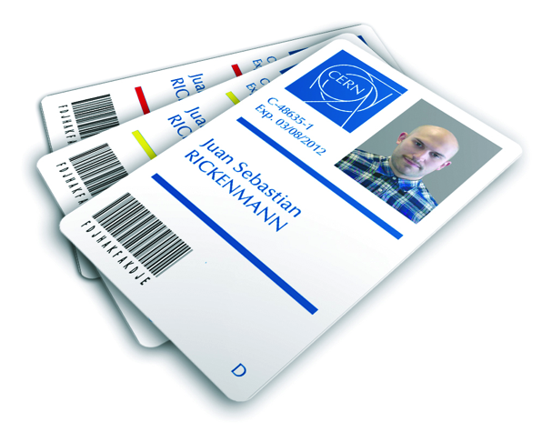
Section 2
Hours, Access and Reception Conditions
on Site

Slide 11


2.1 Working Hours and Days
Official CERN Working Hours
Normal Working Hours
Specific Authorizations (outside Normal Working Hours)
“Authorization to work outside normal working hours and days”
Authorization(s) from Work Inspectorate of the Host State

Slide 12
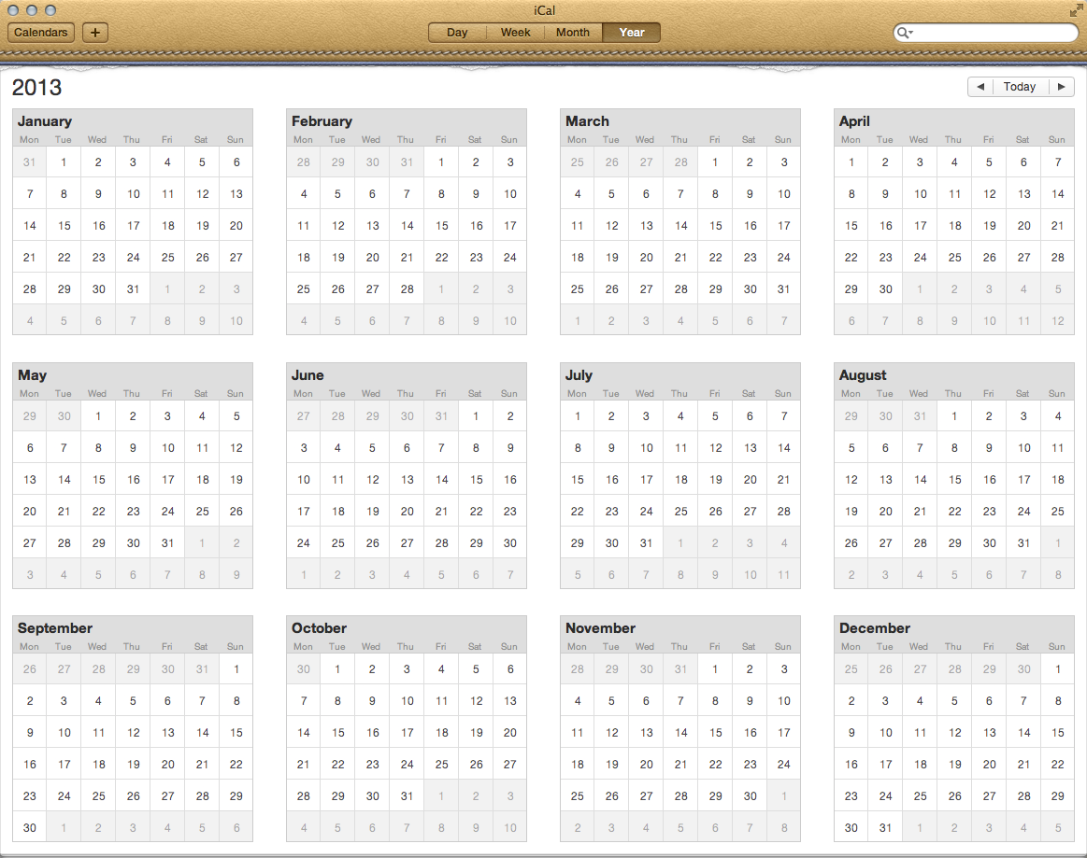
2.1 Working Hours and Days (cont’d)
Working Days
Monday
Tuesday
Wednesday
Thursday
Friday
Public Holidays
CERN closes for two weeks at the end of the year
1st January
Good Friday
Easter Monday
Ascension Thursday
1st May
Whit Monday
The “Jeûne Genevois”
24th December
25th December
31st December
Notes:
Most of the standard CERN services are closed on the CERN public Holidays (restaurants, coffee areas, internal transport services, etc.).

Slide 13

2.2 Access to the CERN Site
Access card
incl. access rights
to specific areas
Safety awareness
and/or training
CERN general Safety course
+ specific to the areas
+
This takes time !!
Notes:
Safety awareness, at cost for contractor.
Plus all specific safety trainings that may be necessary for the contract.

Slide 14

2.3 & 2.4 Access to Facilities
Specific authorizations are required for:
2.3 Surface Technical Installations
2.4 Beam Facilities
    PS Complex *
    SPS Complex *
    LHC Complex *
    * incl. corresponding Experimental Areas
Operation vs. Shutdown periods
Notes:
H0B0 or equivalent to access tunnels.
Anticipate intervention in radiation areas ALARA.
Rescue mask for PS and SPS facilities.

Slide 15
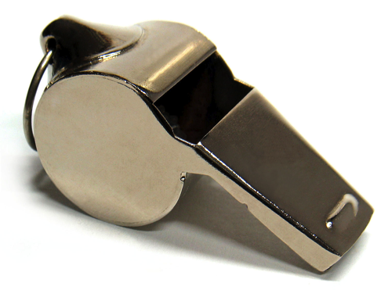
2.6 Access Card Withdrawal
Non-compliance with the rules
applicable on the CERN site can result in
the withdrawal of the access card,
and thus of the access authorization
to the CERN site!

Slide 16
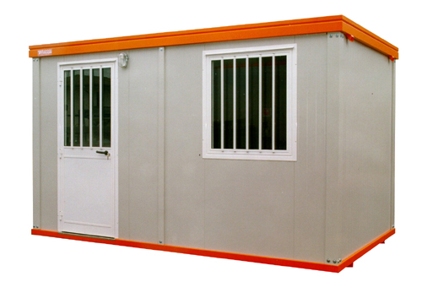


2.7 Portable Cabins and Car Parks
Notes:
Subject to CERN’s prior written authorisation, the contractor may be granted an area on which to install portable cabins, store unprotected material and park vehicles.
Connecting portable cabins to CERN network (power, networks, etc.) is at contractor’s costs. For water and sewerage networks, to discuss with CERN technical contact.

Slide 17

Section 3
Safety and
Safety Coordination

Slide 18
3.1 Work Categories
First Category Works → large-scale operations
WSCP (Work & Safety Coordination Plan) SSHPP (Special Safety & Health Protection Plan) | Drawn up by CERN Drawn up by the contractor
Second Category Works → other operations or services
PP (Prevention Plan) | Prepared jointly by CERN and the contractor (at CERN’s initiative)
Technical Stops → specific operations or services
WSCP (Work & Safety Coordination Plan) Risk assessment(s) | Drawn up by CERN Drawn up by the contractor
Notes:
risks stemming from: environment, Interference between the activities, The activities themselves
VIC before starting works.
IMPACT request

Slide 19
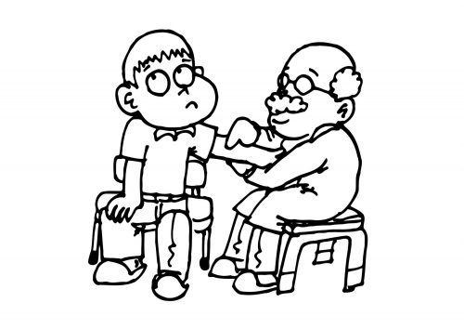
3.2 Monitoring of Health and Fitness to Work
Contractors are responsible for monitoring the health of their personnel in accordance with laws
Special monitoring may be required

Slide 20

3.3 Specific Hazards
Protective and preventive
measures to implement

Slide 21

3.4 Electrical Hazards
Case 1: Non-electrical works
in technical installations and
beam facilities
Prerequisite:
Having followed CERN’s
15-min on-line electrical safety awareness
Then, access authorization delivered by CERN

Slide 22
3.4 Electrical Hazards
Case 2: Electrical works in technical
installations and beam facilities
Prerequisite:
Having followed CERN’s
15-min on-line electrical safety awareness
Having followed the appropriate
electrical safety training ← Contractor
Being in possession of the appropriate
electrical certification ← Contractor
Then, access authorization delivered by CERN

Slide 23

3.5 Fire Hazards
CERN Fire Permit procedure
CERN Fire & Rescue Service
Notes:
Welding, grinding, cutting and any other work involving hot spots must not commence until a CERN fire permit has been obtained, grounding of welding machines, Avoidance of the storage of combustible or flammable materials in underground areas, Keeping workplaces clean at all times, Implementation of the fire prevention measures, Ensuring access to means of intervention (e.g. fire extinguishers) and to means of triggering an alarm (e.g. manual call points and red telephones), as well as to evacuation routes and systems

Slide 24

3.6 Flammable Gases Hazards
Limited to some facilities or equipment
Participation in risk assessments

Slide 25
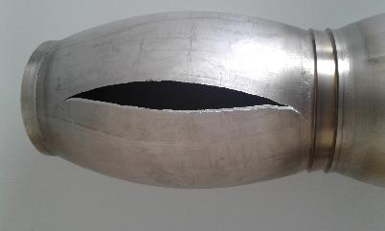
3.7 Rupture Hazards
Limited to some facilities or equipment
Participation in risk assessments

Slide 26



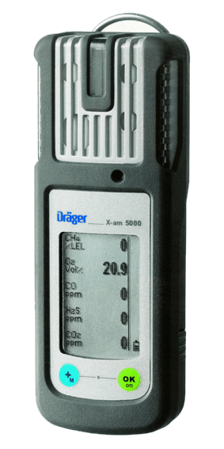
3.8 Cryogenic Hazards
Pressure
Asphyxiation
(O₂ deficiency)
Cold burns
Wearing of a portable ODH detector may be required
+ CERN’s 10-min on-line ODH detector awareness
Notes:
To prevent the risk of asphyxiation and cold burns, installations containing cryogenic equipment have warning panels at their entrances and are equipped with detection systems linked to the evacuation alarms

Slide 27
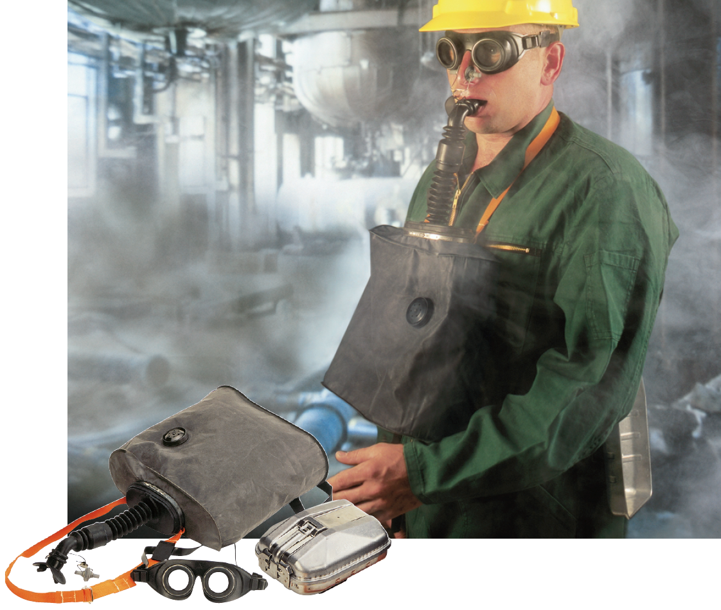
3.9 Self-Rescue Masks
LHC and SPS
underground areas
Self-rescue mask
safety training
(2-hour training,
organized by CERN)
Masks supplied
and maintained
by the contractor
Notes:
All persons who are required to enter the underground areas of the SPS or the LHC must be in possession of a self-rescue maskv and must have followed the “self-rescue mask” safety course.

Slide 28


3.10 Chemical Hazards
3.10.1 Asbestos Hazards
3.10.2 Storage of
Hazardous Materials
3.10.3 Transport of
Hazardous Materials
Limited to some facilities and equipment
Participation in risk assessments

Slide 29

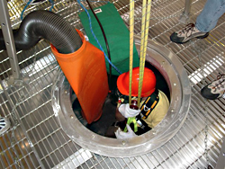
3.11 Working in Confined Space
The presence of a person supervising
outside the area is compulsory
CERN permit to enter procedure
One-day training organized by CERN
Notes:
Areas classified as “Confined Spaces” are generally pits, tanks, vats, clean or waste water systems (including access manholes) and ducts in technical facilities or experimental areas. These areas are identified by appropriate signs

Slide 30
3.13 Ionising Radiation
Works in Radiation Areas:
Authorisations from
competent authorities
Qualified expert
(2013/59/EURATOM 24 Dec. 2013)
Exposed workers:
Appropriate RP training
Dosimetric monitoring
Medical follow-up

Slide 31
3.13 Ionising Radiation
CERN’s 45-min
on-line RP training
One-day
RP training
organised
by CERN

Slide 32
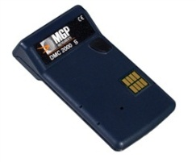
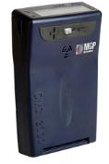
3.14/15/16 Dosimetry, Radiography
In addition to their own dosimeter, CERN provides to exposed workers:
Personal dosimeters (obligatory)
Additional extremity or
operational dosimeters as required
All industrial radiography activities are subject to CERN’s prior written approval
Notes:
x

Slide 33

3.18 Magnetic Field Hazards
Restriction for persons not medically
fit to work in magnetic field environment

Slide 34
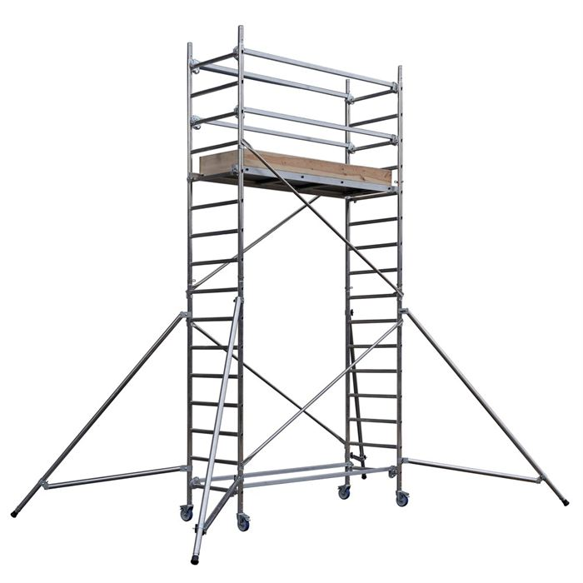
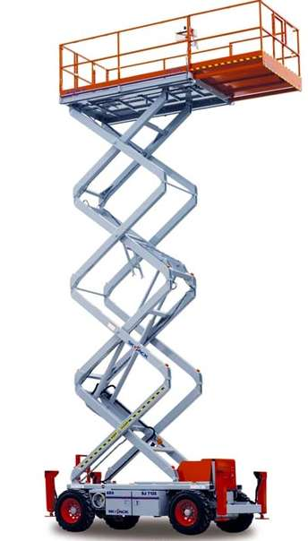

3.20 Working at Height Hazards

Slide 35


3.22 Hazards with Lone Working
Participation in risk assessments
Notes:
To take into account for the corrective maintenance CERN outside working hours.

Slide 36

3.23 Emergency Rescue Organization
Permanent presence of
occupational first-aiders

Slide 37
3.24
Immediate Stoppage of Activities
All persons have the duty to stop an activity
if they judge that it presents
an imminent and serious danger
The competent Host State authorities
and CERN representatives
may also stop the activity with immediate effect

Slide 38
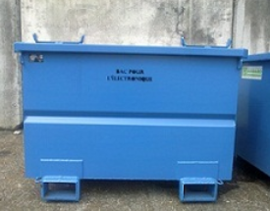

3.25 Environmental Protection
CERN commits itself to respect and protect the environment (air, soil, natural environment, etc.) and to respect the applicable environmental regulations
Xyz
Xyz
Xyz
  Waste shall be temporarily stored in the designated areas and regularly evacuated

Slide 39

Section 4
Storage, Transport
and Handling

Slide 40
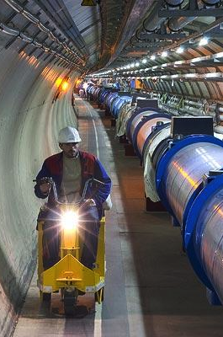
4.1 Storage Areas
Storage space availability
is an issue in underground
areas (SPS and LHC)
Passage areas shall be kept free
Only marked out storage area
Stored equipment/bulk property
clearly identified
Warning signs on both/all sides

Slide 41
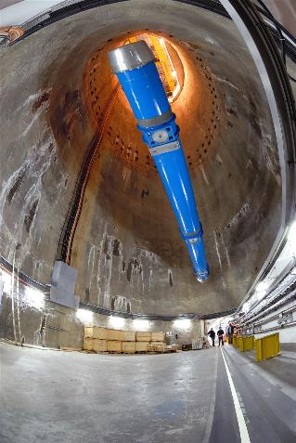
4.2.1 Vertical Handling Operations in the Access Shafts
Handling equipment:
operated
exclusively
by CERN
Requests:
through CERN
technical contact
(5 working days before)
Notes:
Internal transport for large pieces of material may also be done by CERN.

Slide 42
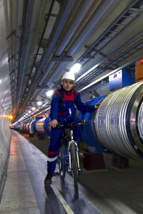
4.2.2 Use of Bicycles in the Underground Structures
The contractor may
use bicycles
Model approved
Parked in compliance with rules

Slide 43

4.3 Customs Formalities
Belonging to CERN or being sent to CERN
by CERN’s Import-Export Service
Belonging to the contractor
contact Custom’s Office or Custom’s Agent

Slide 44


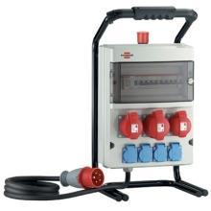
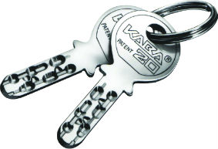
Section 5
Utilities and Work Site Services

Slide 45
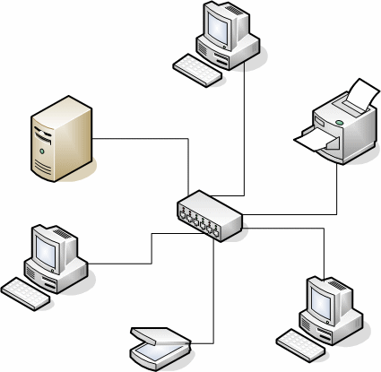






5.1 CERN Computing Resources
In compliance with CERN Op. Circular no. 5
Notes:
CERN account if needed, computer security course,

Slide 46
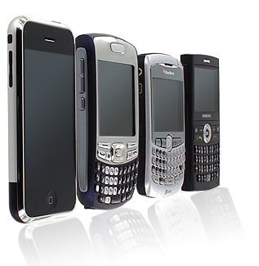
5.2 Communication Networks
CERN internal
telecom network
limited to
6XXXX, 7XXXX, 8XXXX
and 16XXXX
“CERN Mobile Phone”
Contract limited to
6XXXX, 7XXXX, 8XXXX
and 16XXXX
External communications
at contractor’s expense
Note: CERNPhone app

Slide 47
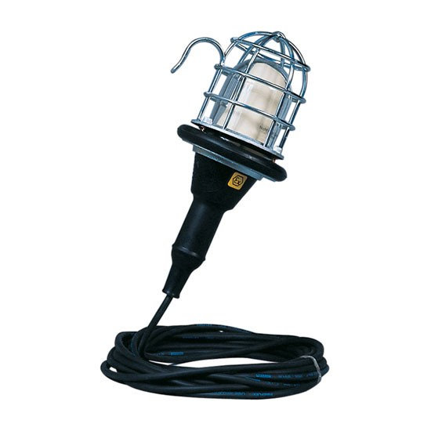
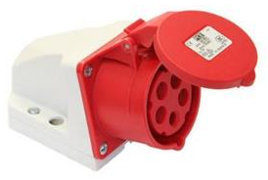
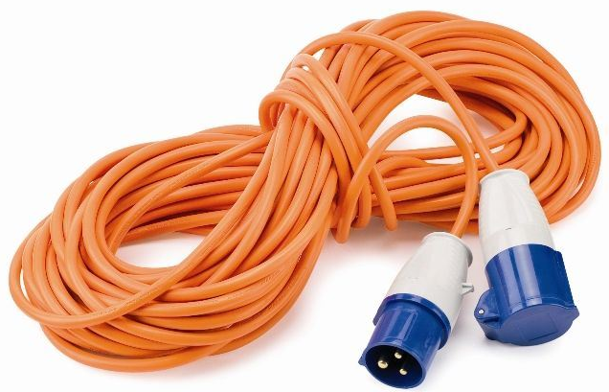

5.3 Electricity and Lighting
400 V, 32 A or 63 A
CE type sockets
Compliance
with CERN
Safety Code C1
230 V, 10 A
Swiss type sockets
even on French side

Slide 48


5.5 Principe of Ventilation of Underground Works
Constant air velocities
in underground works
Ambient temperature ca. 16 ºC
Notes:
CERN ensures the ventilation of the underground facilities but not the ventilation of the service tunnels, Air velocities can hamper certain types of work. The contractor must implement the appropriate protective devices

Slide 49
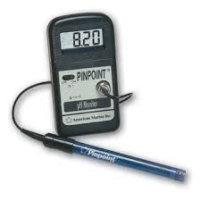
5.6 Water Distribution and Sewage
Water can be supplied to contractor (request shall be made to CERN technical contact)
Water can be drained into the CERN site drainage or sewage water network (request authorization through CERN technical contact)
The discharge of water into drainage/ sewage shall comply with laws where the
water is collected (France or Switzerland)
Notes:
Sewage = eaux usées.

Slide 50
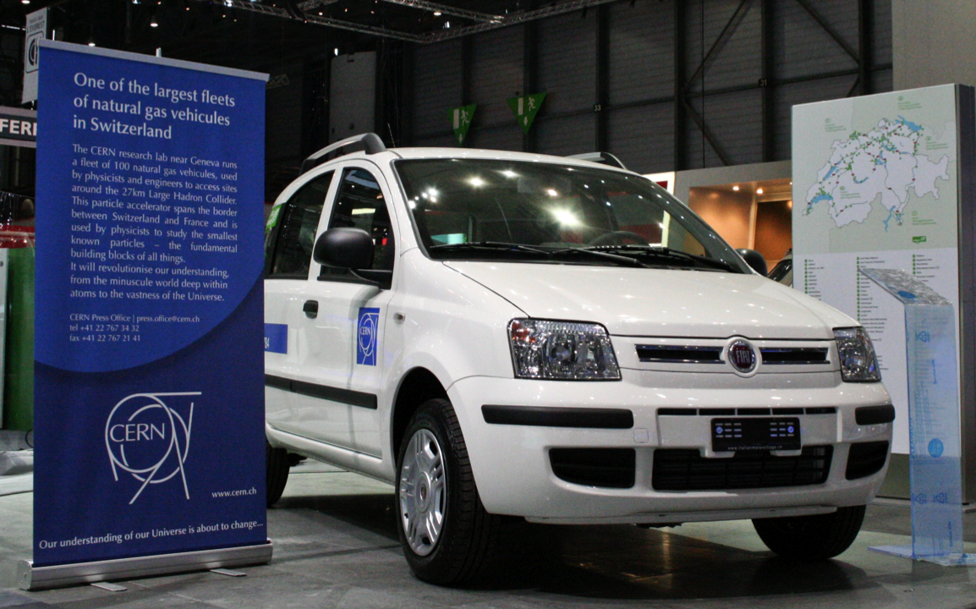
5.8 Use of CERN Vehicles
In compliance with CERN Op. Circular no. 4

Slide 51
5.9 Keys
CERN will provide
the contractor with keys
to access relevant buildings
and rooms, exclusively for the performance
of the contract
The contractor shall return all keys to CERN on the date of termination of the assignment of the personnel concerned

Slide 52
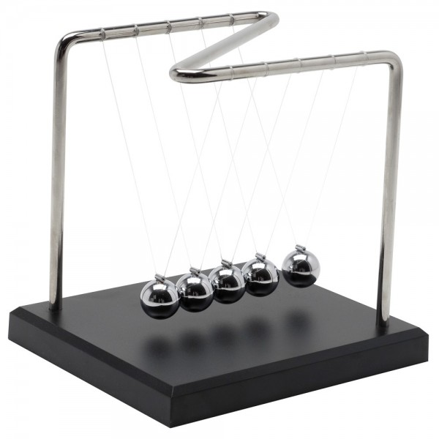
Section 6
Miscellaneous

Slide 53
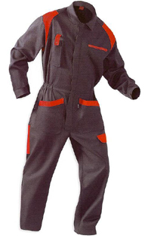
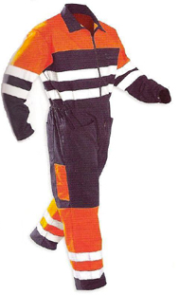
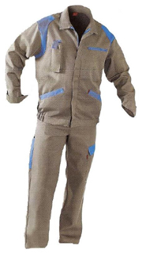
6.1 Visual Identity of the Contractor
Xyz
Xyz
Xyz
With reflecting parts of the suite or a reflecting vest

Slide 54
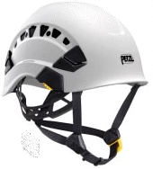
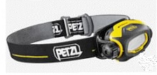
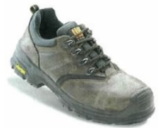
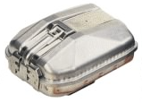
Individuel protection equipment in the LHC underground
Helmet with frontal light
Safety shoes
Self Rescue Mask
Other individuel protection equipment may be needed case-by-case, following risk assessment.

Slide 55

6.2 Liability and Insurance in Case of High Value Exposure
See clause 27.4 of the General Conditions of CERN Contracts
Notes:
Protection des ouvrages mitoyens

Slide 56
6.3 Performance of the Contract
6.3.1 Time Loss by the Contractor
6.3.2 Disappearance, Loss or Theft
of CERN Property
    Specific procedure (CERN/DSU-RH/13100)
    Penalties:

Slide 57

Many thanks to you for submitting a bid

